Slide 1
Closeout from the
6th meeting of CLIC ACE
Alban Mosnier, Pantaleo Raimondi, Nobu Toge,
and Tor Raubenheimer
(Lyn Evans, Markus Huening, Thomas Roser, Vladimir Shiltsev, Tsumoru Shintake)
February 4, 2011

Slide 2
Charge
Committee was been asked to comment on:
  The status and progress of the ongoing CLIC R&D activities
  The R&D program and the correspondent planning for the post CDR phase of the project
  Comment on critical technical systems corresponding to ACE’s specific concerns (Damping Ring) and systems with major investments envisaged in the post CDR phase (Two-Beam modules, CTF3 upgrade and new drive beam facility) will be treated in detail.

Slide 3
Strategy
Develop design covering 500 GeV → 3 TeV cms energy
  Energy range will be determined by LHC
  Agree with development of a staged approach
Feasibility being demonstrated in 2011
  Echo comments from 2010: be clear about ‘feasibility’
  Manage community’s expectations
Development of the cost
  Benefit of TBA: higher energy reach and lower cost but this comes with increased risk
  Need enough engineering to understand cost drivers and justify cost models
  Manage community’s expectations

Slide 4
CDR Plans
Three volumes
Vol 1: The CLIC accelerator and site facilities Dec 2011
    CLIC concept with exploration over multi-TeV energy range up to 3 TeV
    Feasibility study of CLIC parameters optimized at 3 TeV (most demanding)
    Application to 500 GeV as first stage and intermediate energy range
    No cost figures (peer review postponed)
  First draft of text by April !!
Vol 3: CLIC study summary
    Comprehensive summary of vol1 and 2 findings for European Strategy
    Staging scenario up to energy compatible with LHC Physics
    Including cost issues and cost drivers for R&D mitigation in next phase
    Proposing objectives and work plan of post CDR phase
  Complete in March 2012
Agree with strategy but still concerned that the schedule is aggressive

Slide 5
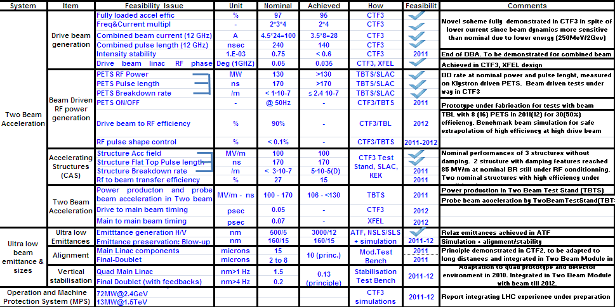
Progress on Feasibility
Excellent progress despite major setbacks

Slide 6
Plans for 2012-2016
Activity | Description | Deliverables (2016) | Total material budget
Cost studies, Civil engineering, Proj, Implementation | Update and improve CLIC cost model & civil engineering studies | Technical Design (TD) and Project Implementation Plan (PIP) of CLIC Zero Improved cost model, feedback to CLIC baseline review | 4 MCHF
Beam physics studies | Beam physics and overall design | Review of the CLIC baseline design Stability and alignment, timing and phasing, stray fields and dynamic vacuum Studies towards CLIC Zero | 3 MCHF
CTF3 + | CTF3 consolidation and upgrade | Consolidation and upgrade (higher energy, stability, reliability) Drive beam phase feed-forward experiments Upgrade and operate TBL as 12 GHz power production facility Operation with beam of a long string of CLIC two-beam modules | 43 MCHF
CLIC Zero | Injector for the CLIC drive beam generation complex | Build and commission 30 MeV Drive Beam injector with nominal CLIC parameters Build and commission a few Drive Beam accelerator nominal modules Participation to Technical Design of full CLIC Zero facility | 42 MCHF (~ 30 MCHF)
RF Structures | design and fabrication of 12 GHz accelerating structures & PETS and associated R&D | Build and test about 120 accelerating structures Build and test about 10 PETS prototype Establish quality control, brazing and assembly procedures for structure fabrication at CERN Precision machining center at CERN | 29 MCHF
RF test infrastructure | Building, commissioning and operation of high-power RF test stands | Four 12 GHz klystron-based RF high-power test stations, for about 8 slots, running before 2016 Continue high-power testing at 11.4 GHz (KEK and SLAC) Contribution to high-power testing in CTF3+ (TBL) | 13 MCHF
Prototypes of critical components | Technical R&D – design, build and test prototypes of CLIC critical components | R&D and prototypes of two-beam modules alignment and stabilization systems Prototype of final focus quadrupole and stabilization system Several nominal CLIC two-beam modules, mechanically tested, possibly beam tested R&D and prototyping of critical beam instrumentation Design and studies of machine protection system DR superconducting wiggler prototypes, test with beam, extraction kickers prototypes Dynamic vacuum assessment Contribution to the CLIC Zero DB RF system and powering | 40 MCHF++

Slide 7
Resource Planning
Available resources will be limited
  Personnel from CERN decreasing
    Collaborations will be very important
  List of topics appears to be growing
    Need to prioritize and be clear about goals
Design effort evolves from research effort towards a development effort (focused enabling research)
  Engineering studies of structures and modules are key
    Will likely need multiple iterations
  CTF3 will be a major part of development effort
    Focus on well defined demonstrations/experiments
  Develop plans for a full CLIC injector
    Don’t demand too much of CTF3

Slide 8
Low Emittance Beam Generation
Lot of work made in damping ring studies and design
  Addressed all the topics stressed by the committee in the 2010
  Improved (adiabatically) the ring design to ameliorate potential problems (e.g. IBS). It seems that the space for further improvements in the “optics” is small (=>design close to an optimum).
  Further improvements possible with a lot of R&D and engineering (e.g. higher gradients Quads, wigglers etc..). This is foreseen anyway.
  The 2 GHz RF frequency option poses a lot of feasibility issues. RF requirements and collective effects greatly relaxed with the 1GHz RF frequency adoption…
  A delay loop/line has to be added after the DR with a potential degradation of the beam parameters. The impact should be studied and included in the luminosity budget. We feel that this is not a feasibility issue, rather a performances one.

Slide 9
Low Emittance Beam Generation
Damping Ring (Continued…)
  Should give scrutiny to the component-level and system-level performance requirements on the delay loop. Any chances of relaxing the tolerances by reoptimizing the parameters or by introducing FDBK/FDFDs?
  Integrate a sufficient amount of tuning knobs in the delay loop.
  Integrate a sufficient amount of diagnostic tools / systems in the beamline downstream of the DR/delay loop.
  RF System under study and design based on existing systems.
  Several solutions possible and under analysis/comparison
  Sychronous phase spread correction techniques well studied and several options avaliable (frequency mismatch looks attractive, simpler RF System and less RF power needed)

Slide 10
Low Emittance Beam Generation
Damping Ring (Continued…)
  Integration with the DR under way
  Impedance being modeled and included in the budget
  like to see drawings with the RF cavities in the ring (including SR and MPS collimation…)
  Collective effects are being studied and integrated in the modeling.
  Still too early to judge their impact on the overall performances.
  Several solutions are under study to ameliorate some of them but several iterations are needed to decide which one to adopt (e.g. Carbon coating for e-cloud strongly affects the Ring impedance)
  As general comment: from the work presented it looks like the expertise to carry on the DR design effort is present.
  It seems that all the aspects and problems are being addressed, although probably more FTE’s of what is currently available would be needed for the TDR phase.
  Good effort in building international team focused on Low Emittance Storage Rings.

Slide 11
Low Emittance Preservation
Linac and BDS tuning presented in previous ACE’s, comments reminders:
  Extensive simulations but complex problem (and simulations)
  Wakefield effect on beam dynamics is ~10x SMALLER than SLC but emittances are also much smaller → tight tolerances
  Performance relies on high resolution diagnostics whose requirements are not far from existing demonstrations but challenge is frequently in implementation → TDR development
  Some significant cost implications which may need iteration
  Some improvements shown in the BDS tuning performances
  Possible implication in moving QD0 outside the detector (not clear why the bandwidth is not affected) are extremely attractive.
  QD0 stabilization might be much easier to achieve.
  High ξ optics for CLIC could be studied at KEK ATF2

Slide 12
Alignment and Stabilization
Stabilization tolerances are challenging
  1 nm @ >1Hz on main linac quads. A lot of progress made and now it seems achievable (in the LAB).
  Implementation in the Linac Modules to be (under) studied
  Good progress on feedback studies =>
  Probably it will reduce the requirements on the stabilization tolerances
  Good model under development on how the machine evolves in time and what is needed to maintain the performance as long as possible. More work is foreseen.
Alignment
- Several alignment techniques studied with good redundancy between them. The required tolerances seem achievable.
  Need to think about cost thresholds

Slide 13
CAS - Feasibility Issues (grad. Performance)
Critical feasibility issues
  Demonstrate nominal CLIC stuc with damping features at the design gradient (100MV/m), pulse length (240ns) and BDR (3E-7/m/pulse).
Observation
  T18 satisfied the feasibility goals.
  Struc fab/assy and testing work is progressing, as stated in the previous ACE.
  New results with TD18 and T24. → Design improvement with TD24, and
  TD24 (2 units) to be tested soon.
Remark
  Commend the hard work and progress (as usual!)
Recommendation
  Make every effort to ensure that studies with TD24 proceed as scheduled.
  Develop plans to go beyond 2011.
    Accumulate more statistics
    Accumulate more manufacturing & test experiences at CERN
    Important to increase number of test stations at CERN
    Assess the relative merits of klys-based vs CTF-based facilities for further high-power testing acc struc; decide the actions to take; start soon.

Slide 14
CAS – Additional Design + Demo Issues
Important additional issues are
  HOM damping material and its integration in the assy procedure
  Design + manufacturing of fully-equipped acc struc packages
  Integration of the acc struc packages in the module design
  Beam operation – effects of BDs, alignment (optical survey vs BB), tuning…
Observation
  Systematic and impressive engineering work on track
  CERN group rapidly catching up with (and going beyond) what the previous engineering effort has reached at NLC/GLC.
  Many of the related engineering efforts are (partially) an integral part of CTF3 efforts and elsewhere, wherever applicable.
Recommendation
  An expert review could be useful for re-assessing the details of manufacturing + assy procedures (sequence + order of brazing etc).
  Establish first the design and manufacturing procedure that result in an acc structure package that works. Then a cost reduction effort follows.
  Map out the plans on which aspects of beam operation issues be addressed where, when and how; identify requirements on the needed facilities.

Slide 15
PETS - Feasibility Issues
Critical feasibility issues are to
  Demonstrate nominal PETS with damping features at the design power (136MW) with design pulse length (240ns) with BDR (< 1E-7/m/pulse) with ON/OFF feature (<20ms) and DB → RF eff of 90%.
Observation
  Feasibility issues in the power, pulse length and BDR met in various creative test setups, despite limitations in CTF3.
  ON/OFF scheme in prototyping for testing w. beam.
  TBL w. 8 PETS in 2011 for 30% and 16 PETS in 2012 for 50% eff will be performed
Remark
  Commend the hard work and progress (as usual!)
Recommendation
  Make every effort to ensure that the studies with ON/OFF proceed as scheduled.
  The same goes for the TBL test on “deceleration” in 2011 and 2012.
  Cross examinations of results from Klys-based vs beam-based test benches would be a “plus”, whenever possible.

Slide 16
2Beam Acc Modules
Observation
  Basic implementation scheme for the 2-beam modules has been updated / defined.
  Engineering work associated with the latest scheme of the 2-beam module (1st generation) has begun.
  Impressive progress in integration of a comprehensive set of analysis + thoughts on: beam dynamics, RF, cooling, alignment and installation.
Remark
  Commend the hard + well-integrated work by all who are involved.
  Powerful 3D CAD is fully taken advantage of.
  ACE would like to better understand cost benefit of implementing wire-alignment scheme.
Recommendation
  Should focus on demo’ing the 1st generation hardware system that nominally works and try to remove “rough edges” first.
  Prepare and schedule an extensive internal review when the 1st gen. system is completed. Allocate a sufficient amount of time for it.
  Be prepared for 2 or 3 iterations before going to many module production and be careful not to commit to a major scale manufacturing effort, before feeling comfortable with the design. More useful to develop step-wise evolutionary scenario.

Slide 17
CTF3 and Beyond - quick comments
Observation
  CTF3 is
    the unique test bench for feasibility-demos driving beam generation and two-beam acceleration.
    an important test bench for benchmarking performance of PETS and CAS.
  CTF3 is limited in terms of available beam energy / current / pulse length and system availability, and cannot easily be a facility for testing the full-CLIC-spec beams (DB / MB) for an extended period.
  ACE commends a large and almost heroic amount of concerted efforts by all despite some limitations.
Recommendation
  Sort out the performance problems at CTF3 into
    near-fundamental limitations vs
    relatively straightforward, “a reasonable budget/FTEs can fix this” types.
  Map out which type of CTF3 performance probs are the limiting factors in addressing the remaining CLIC feasibility issues, design optimization issues, etc.
    Develop a structured description
  Develop a proposal with associated cost to go beyond 2013.

Slide 18
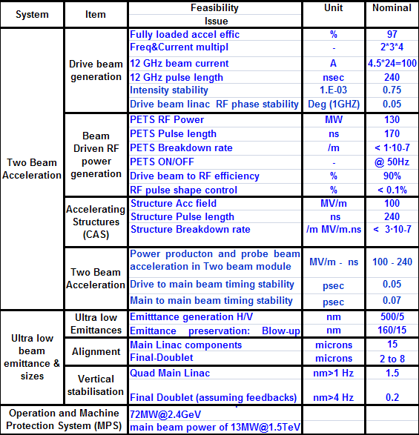
Drive Beam feasibility issues
Principles have been demonstrated in CTF3
despite lower current and lower energy

Slide 19
Drive Beam Generation
Demonstrated in CTF3
Efficiency of fully loaded linac
Combined beam current
To be improved
Injector: substitute thermoionic (needs multiple SHB and generates satellites) by photoinjector
Run in a reliable way and assess lifetime
Stability: selected improvement after identification of jitter sources and operational experience

Slide 20
PETS
Demonstrated PETS on klystron driven test stands
Measured BDR and pulse length
Fabrication & assembly: find the best procedure to get performance but compare different solutions (ex. clean room really needed ?)
Still to be tested at CTF3
ON/OFF device to be tested with beam in 2011
Deceleration of beam in TBL with 8 structures (4 PETS to be installed, 8 PETS for summer 2011 but w/o ON/OFF)
TBL deceleration is an important feasibility demonstration

Slide 21
Drive Beam Rf Power Sources
Significant cost drivers
  Highly efficient sources have multiple benefits
Design exists for drive beam accelerator structures
  CTF3 structures provide feasibility demonstration
Plan being developed to engage EU research community and industry in developing next generation sources
  Excellent program with broad benefits
Different technologies should be compared
  Optimize modulator/klystron/structure system
Rf phase jitter → tight modulator stability but detailed values need further understanding

Slide 22
Experimental Demonstrations
Primary issue is Two Beam Acceleration
→focus on CTF3 goals:
  Drive beam generation
  Two beam acceleration
  Power generation/drive beam deceleration
Many options for module testing at CTF3
  Limit number of modules to allow multiple iterations of design
  Focus on one scenario (maybe 14A, 280 ns)
Use CTF3 to demonstrate Two Beam Acceleration concepts and technology
  Concerned that it will take large effort to use CTF3 for routine processing/operation → focus on dedicated experiments

Slide 23
Final Comments
CLIC team has resources to complete CDR
  Major technical issues have well developed plan of attack
  Present design seems stable; CDR schedule has no float
Making progress in costing
  Some cost information will be required to understand benefits
  Will likely need to iterate on designs in next phase
  Understand cost for achievement of tolerance thresholds
Working on plan for next phase
  TDR must address systems-level feasibility and operation
  Advise focusing CTF3 on dedicated experiments
  Develop plans for CLIC0 as a production facility
Should think about how to engage community

