Slide 1

TBA modules in CTF3
From one module to a long string
6th CLIC Advisory Committee
February 3, 2011
Erik Adli, Department of Physics, University of Oslo, Norway

Slide 2
Outline
Two-Beam Test Stand (2008 ->)
  History
  Current status
  Activities still in progress
One CLIC Module (2012)
  What will it show?
  What will be more difficult to measure?
Three CLIC modules (2013?)
  What will they show?
  Challenges
Many CLIC modules (201?)
  How?
  How many?
  Challenges

Slide 3
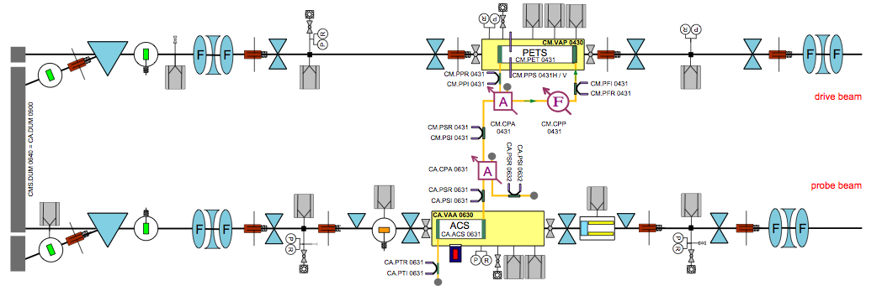
Two-Beam Test Stand
TBTS: designed to test and analyze key concepts of Two-Beam Acceleration
Optimized for experiments; double set of kickers, BPM on each side, triplets on each side (not meant to resemble CLIC module)
PETS with recirculation (not meant to resemble CLIC module)

Slide 4
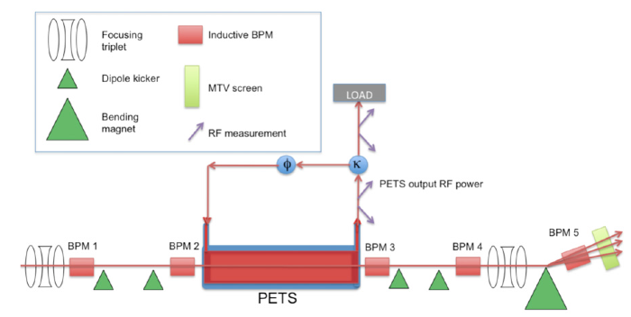
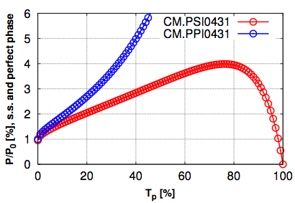
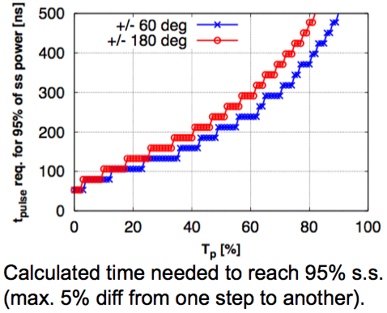
PETS recirculation
TBTS PETS: designed as CLIC PETS, but x ~4 longer to compensate for x ~4 lower drive beam current in CTF3.
In addition: recirculation loop to allow increased power production for commissioning drive beam current.
Disadvantage:
100-200 ns of pulse before steady state conditions are reached (flat top)
Advantage :
Approx. x 4 increase in power feasible.

Slide 5
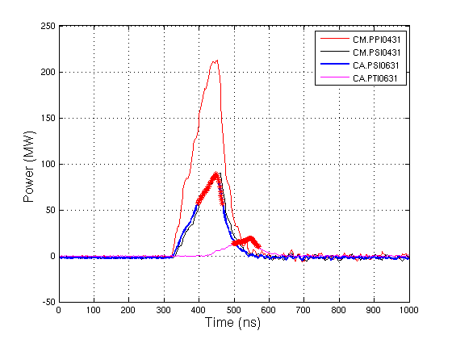
TBTS drive beam and PETS commissioning
Commissioning of beam line (2008 ->)
  Beam line commissioned to ensure full transport (2008)
  PETS with recirculation commissioned and PETS conditioned to routinely operate at > 200 MW in loop with break down rate not visible by “eye”. Break down rate estimations still to be performed (2009-2010)
  Detailed optics verification still to be completed (2011)
  Dispersion control in CLEX drive beam to be improved
2010: routinely 200 MW in PETS recirculation loop with low break down rate.
(note the non-flat pulse, mostly due to steady-state of feedback not reached)
(this rf pulse is representative for the input power for the 106 MV/m gradient achieved in 2010)

Slide 6
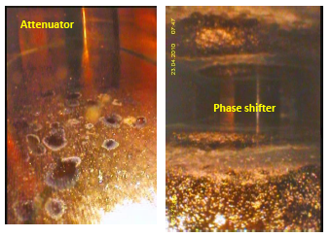
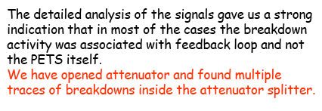
PETS commissioning: not without problems
PETS conditioning in 2009 impeded by break down activity in recirculation system. When reaching high power (~100 MW), activity and damage in recirculation system occurred :
The problem was likely due to fabrication problems, especially on cleaning procedures. A new power splitter, produced with an improved procedure, was installed in 2010 and showed a fast RF conditioning with few breakdowns.
However the PETS recirculation loop not trivial to operate and to analyze -> many new parameters introduced (in particular: losses, reflections, exact settings of power split and phase shift). System has to be fully understood to fully characterize the two-beam acceleration.
The PETS recirculation increased significantly commissioning time; compare TBTS PETS commissioning versus TBL PETS commissioning: o.m. more effort.
(I. Syratchev)

Slide 7
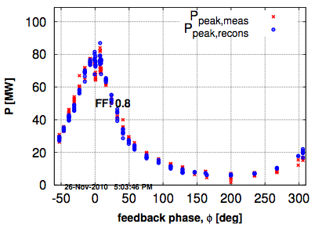
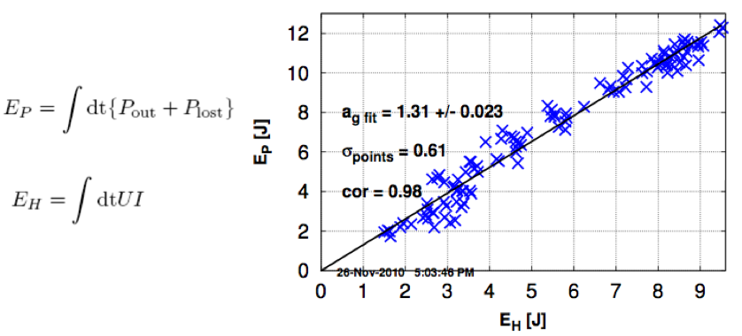
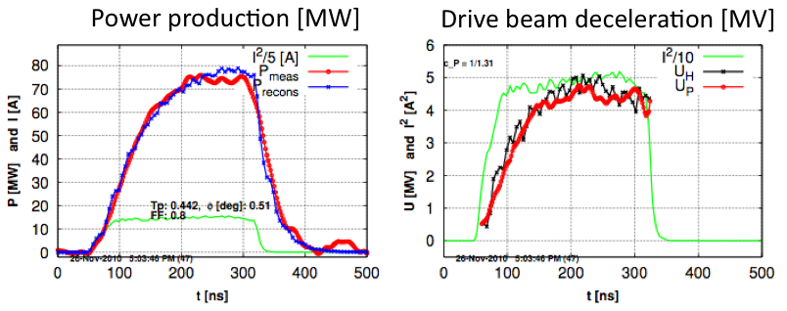
TBTS: experiments
  Analysis of power production and deceleration performed (2010)
    Coupler drive beam and PETS with recirculation to a large degree characterized (EA et al.) but on going efforts to improve models (AC, IS et al.)
Measured and modeled rf power
Power lost versus deceleration
(E. Adli, University of Oslo)

Slide 8
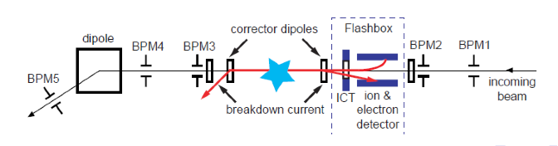
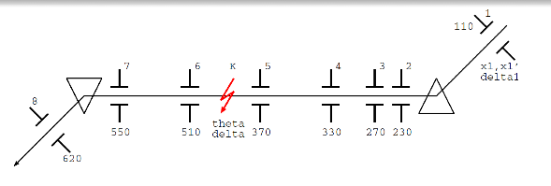
TBTS: experiments
  Break down measurements, including direct kick measurements correlated with flash-box (electron and ion measurements) in progress
  Direct kick measurements of transverse wake effects also feasible with TBTS, to complement HOM antenna measurements, in progress
  Both these measurements require better measurements conditions
    Better drive beam stability
    Improved optics model (to allow for detailed PETS and ACC kick measurements)
(R. Ruber, A. Palaia, Uppsala University)

Slide 9
TBTS: experiments
Other TBTS experiments still in progress:
  Detailed power and energy budget for full system drive beam and probe beam
  Detailed study of transverse effects on drive beam and probe beam
  PETS on/off
  Fine-tuning drive beam and probe beam timing
  Investigation of cross talk drive beam and probe beam
  Drive beam versus probe beam loss monitoring
See R. Ruber, :Two-Beam Test Stand Experimental Program”
Compability with installation of CLIC module?

Slide 10
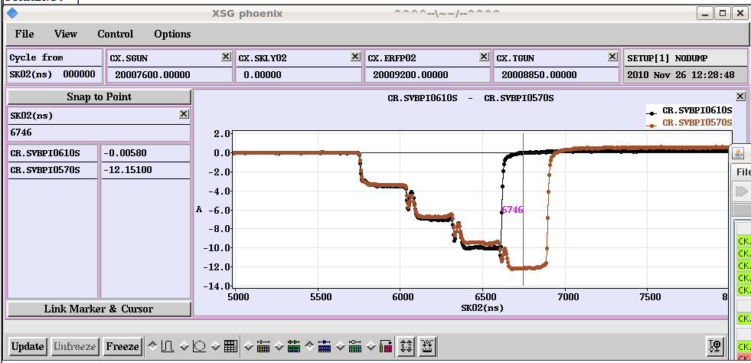
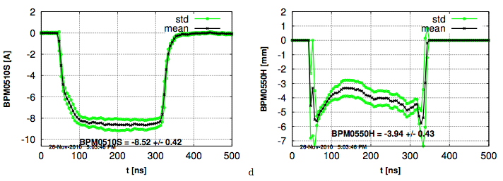
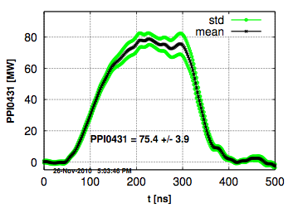
TBTS: example of drive beam stability
Example of TBTS signal pulse to pulse jitter, and along the pulse signals
Taken from measurements day for characterization of power and deceleration (machine optimized for stability, x 4 combination)
My opinion: beam transport and stability this day good day quite good with respect to year (but cannot say whether it was one of the best)
(Nov 26, 2010)
Shown: 1) current just after PETS, 2) H position just before spectrometer, 3) power in PETS loop :
- quite nice and flat current top of over > 200 ns
many % pulse to pulse jitter
dispersion not under control
significant losses from ring to TBTS

Slide 11
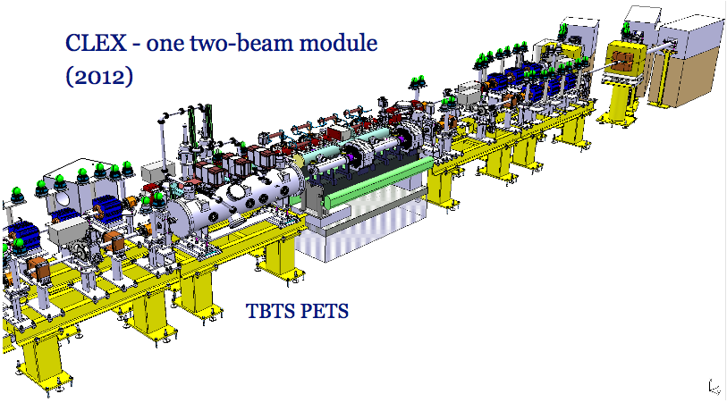
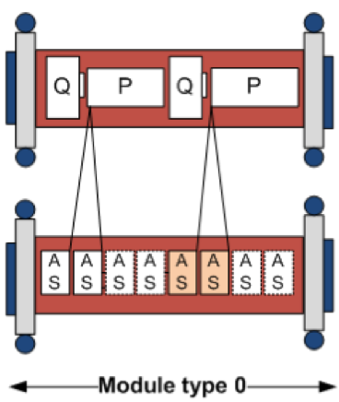
Upgrade: TBTS + 1 module
First upgrade of CTF3 two-beam acceleration test: adding one full CLIC-type module, in addition to TBTS.
Clear goal: realistic beam tests of a module with all relevant components in CLEX.
Notable differences from CLIC module; most prominent: two PETS of ~0.5 m instead of 4 PETS of 0.21 m, to increase power production (later slide)
However, verification of break down effects from a single structure may be impeded; three PETS in a row and several ACCs in a row will make it difficult to isolate activity in a single structure.

Slide 12
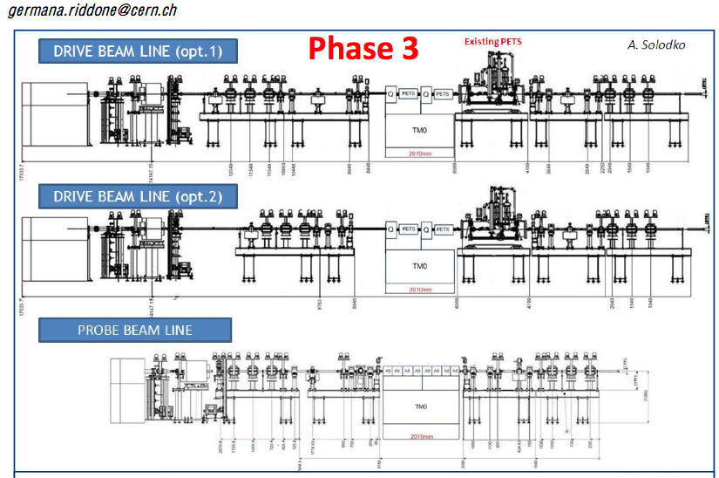
TBTS + 1 module: optics
For one module: optics flexibility should still ok (adds quads and BPMs with respect to current beam line).
Except: current baseline is to remove current ACC tank. Might be of interest to keep old ACC if studies are still on-going (will take time to commissioning new ACCs in module). In this case, objects must be moved and optics limitations re-checked (but, should not be show-stopper).

Slide 13
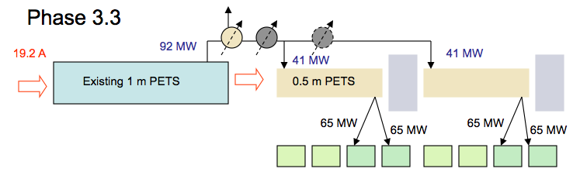
TBTS + 1 module: power
The x 2 PETS length cannot compensate the CTF3 drive beam reduction; at best P_{CTF3MOD} ~ (25/100)^2 x (0.5/0.21)^2 x P_{CLICMOD}~ ¼ P_{CLICMOD}
Possible work-around is feed forward PETS field from TBTS PETS in order to produce enough power to feed two accelerating structures
Adds commissioning time and adds significant complexity to two-beam acceleration analysis (power and energy budgets)
(I. Syratchev, CERN)

Slide 14
Some conclusions: TBTS + 1 module
Installing 1 CLIC module allows for testing of all aspects of the module (not discussed in this presentation)
Detailed understanding of the two-beam acceleration aspects for a full CLIC module (power and energy budget) is fundamental
Kick measurements and fundamental break down studies may be difficult when adding module (may miss opportunity of doing fundamental physics)
Personal opinion: spend enough time to finish major TBTS studies in the current TBTS configuration, before installing the module. Many parts of the program requires :
  Improved calibration of RF signals
  improved optics knowledge (completion of optics commissioning)
  better drive beam stability
To consider: keep TBTS ACC structure if performance is good (not in baseline) -> work out layout and optics solution for this

Slide 15
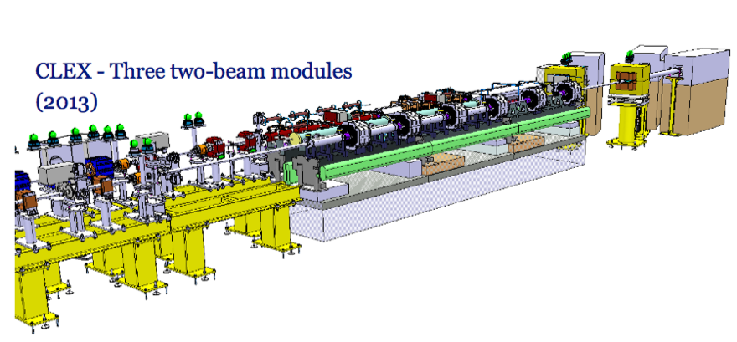
3 modules
Second upgrade of CTF3 two-beam acceleration tests: adding two more CLIC-type modules
Clear goal: realistic beam tests of different modules (type 0 and type 1) + interconnections.
Optics: aperture limitations now start to become more challenging
Power: drive beam limitations, (25/100)^2 ~ 1/16 is still a challenge

Slide 16
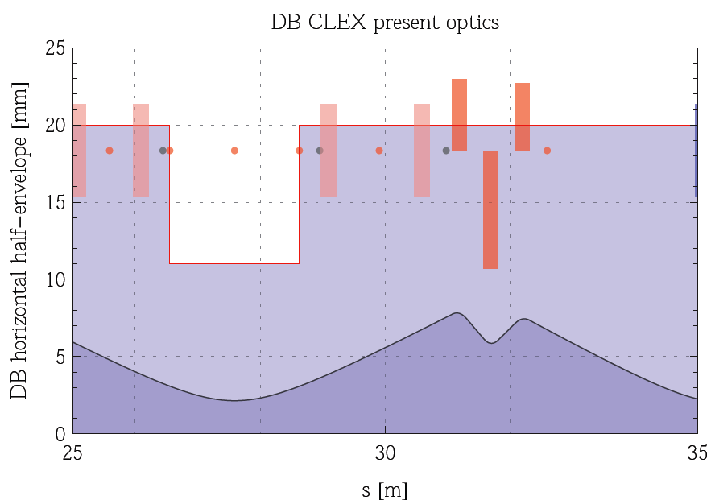
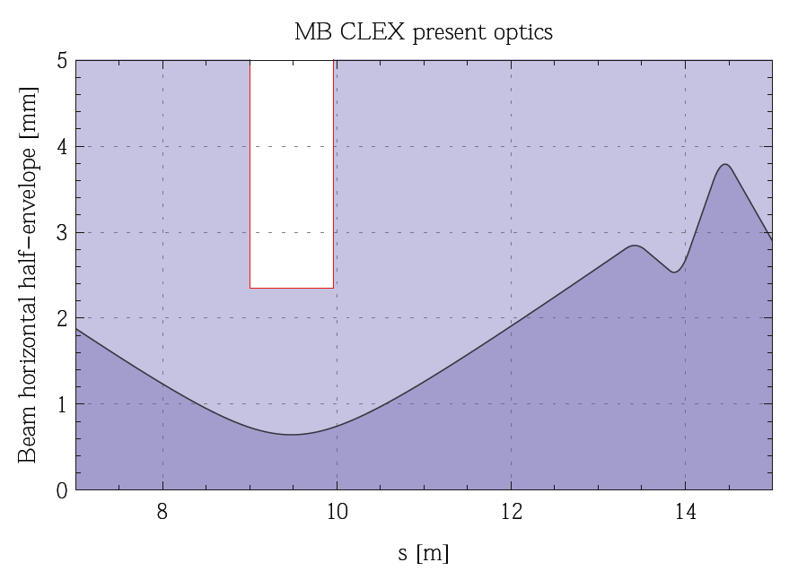
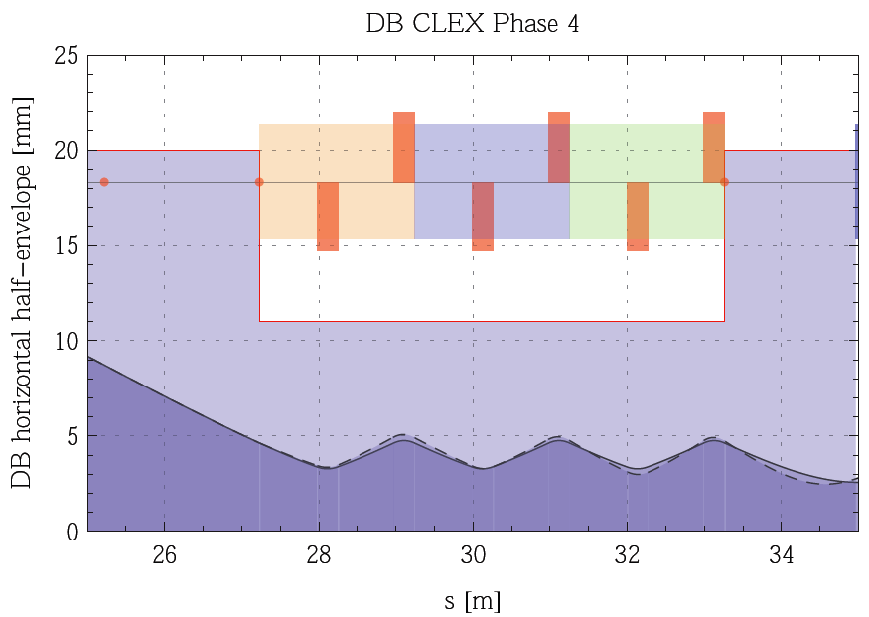
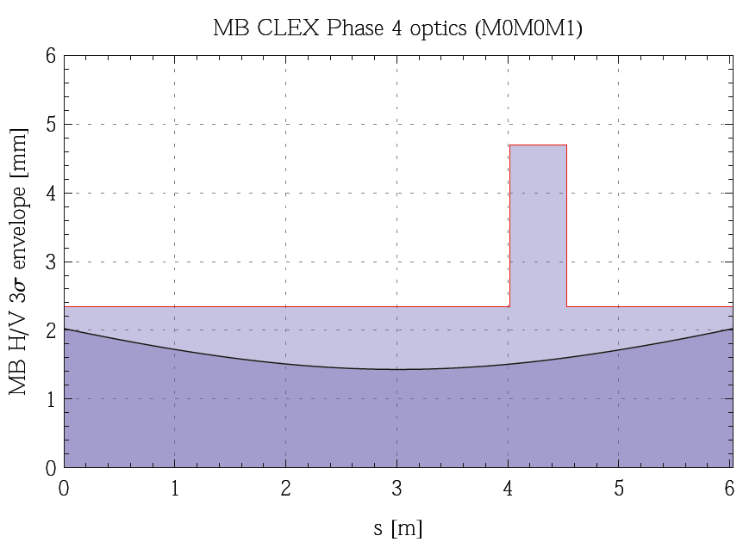
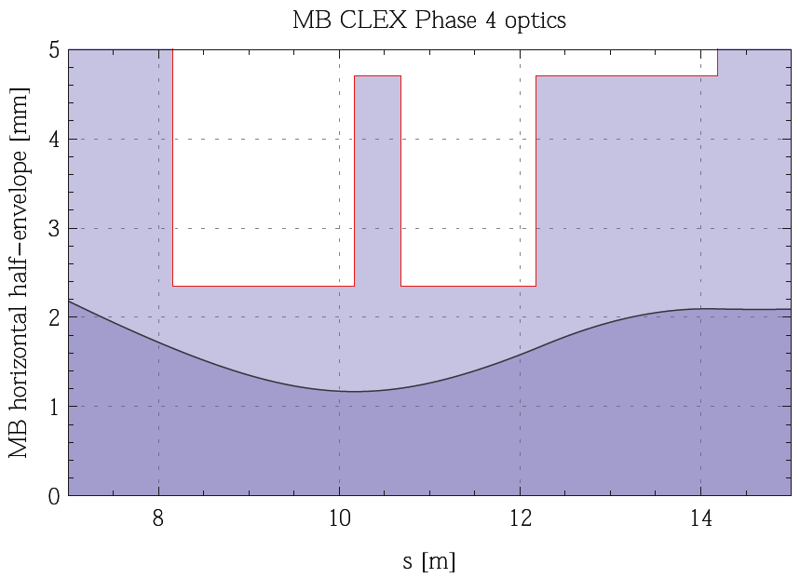
3 modules: optics
With three-module optics: DB acceptance as good as present optics (~6σ) while MB acceptance degrades from ~10σ to ~4σ (optics does not take into account PETS and ACC focusing).
Present optics :
(DB 6σ and MB 10σ)
3 σ envelope, perfect machine
3 modules optics :
(DB 6σ and MB 4σ)
(this graph assuming all ACC installed)
(G. Sterbini, CERN)

Slide 17
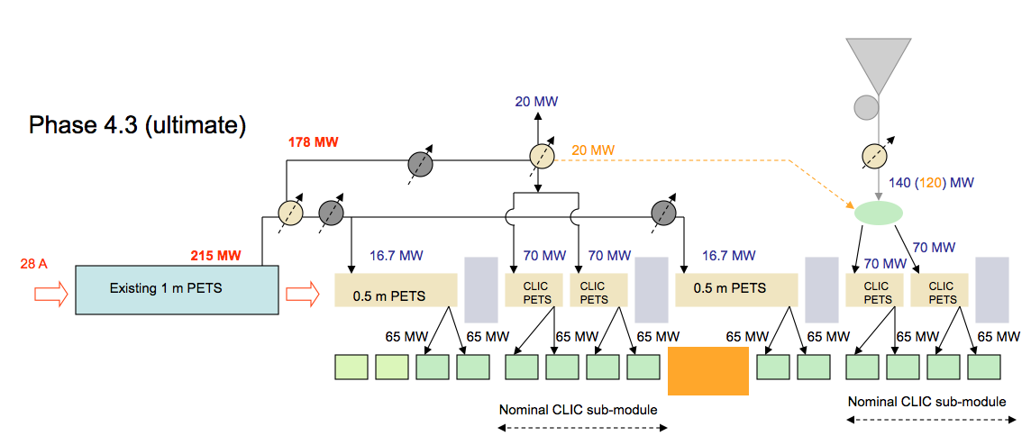
3 modules: power
Nominal CLIC power in PETS and filling of a large fraction of the structures can only be fulfilled with complex feed-forward solutions and additional X-band klystron (eventually, only Klystrons, at added cost).
What is required to test fully the CLIC-type modules?
  Do we need to feed a large fraction of structures?
  Do we need to produce nominal CLIC power in PETS?
(I. Syratchev, CERN)

Slide 18
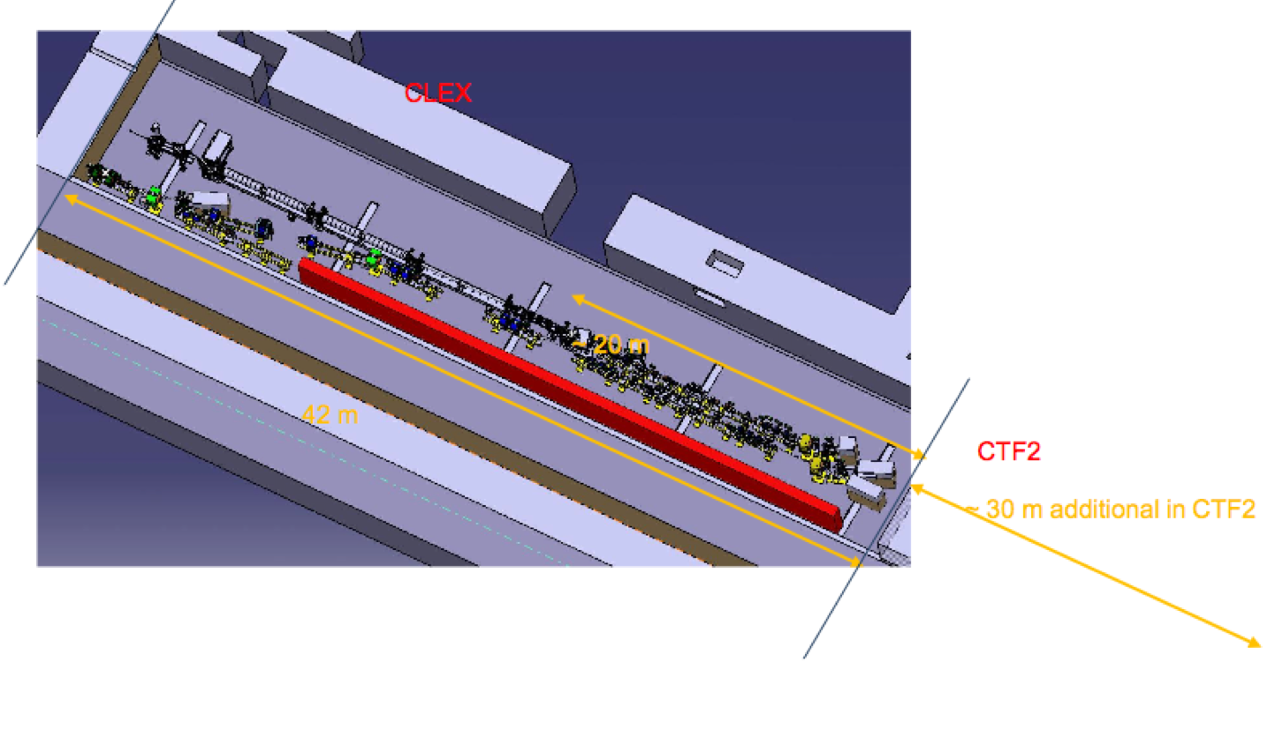
N modules
There is room to install up to 20-25 modules in total, in existing building masses.
How many is "optimal" ?

Slide 19
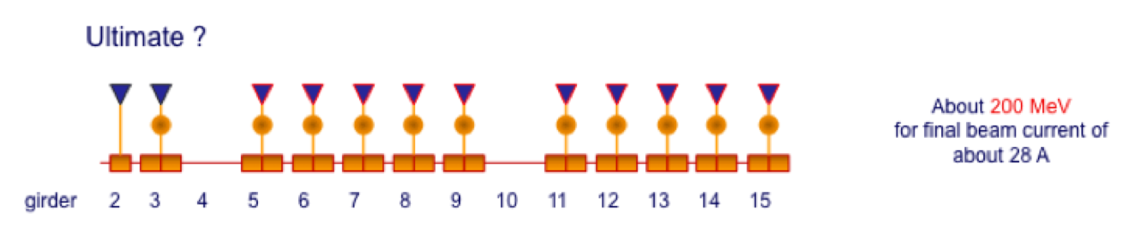
N modules: deceleration limits
For N modules, deceleration starts to become an limiting factor.
Depends on initial energy and number of ACC powered. Consider TBL the limit (studied in detail); E₀ = 150 MeV (design CTF3) 16 PETS, equivalent to 32 ACCs, yields final energy of ~60 MeV.
Possibilities to increase CTF3 E₀ :
E₀ = 200 MeV allows for max. ~50 ACCs to reach final energy of ~60 MeV.
Two more klystrons (assuming none burns) and two more structures; E₀ ~200 MeV
(R. Corsini)

Slide 20
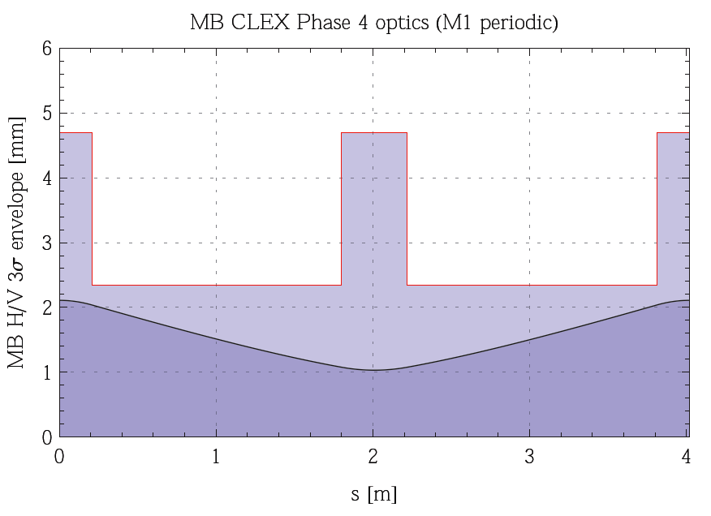
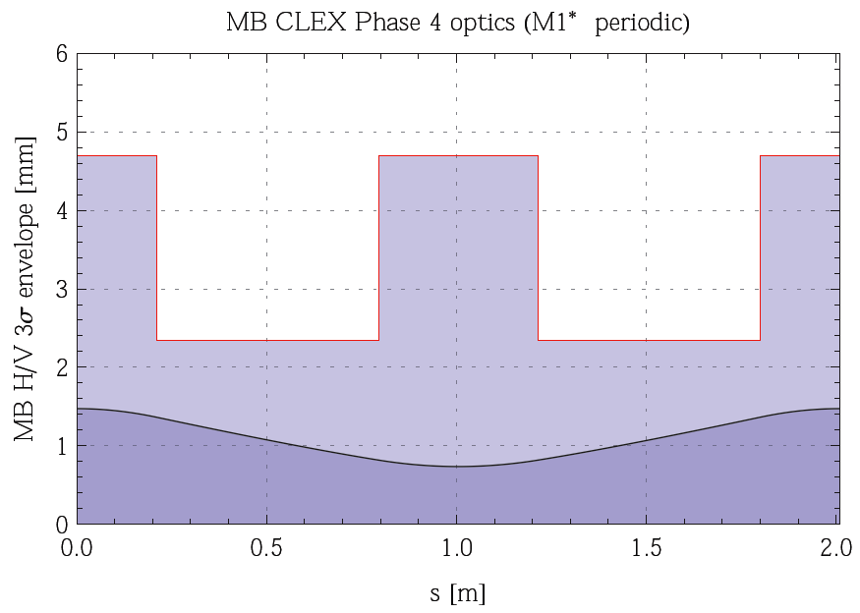
N modules: optics
Drive beam: suggested optics for 3 modules were already periodic solution, with ~6 σ acceptance (ok). In addition comes effect of adiabatic undamping, 50 MeV final energy gives ~4 σ (ideal machine) – tight :
Main beam: periodic solution with module type 1 (quad + 6 acc), only ~3 σ acceptance! (tight). Adiabatic damping not included :
ε_{N} = 20 um
3 σ envelope,
perfect machine
Therefore, for main beam: might need to consider extra quadrupoles every meter. Resulting in ~5 σ acceptance :
(G. Sterbini, CERN)

Slide 21
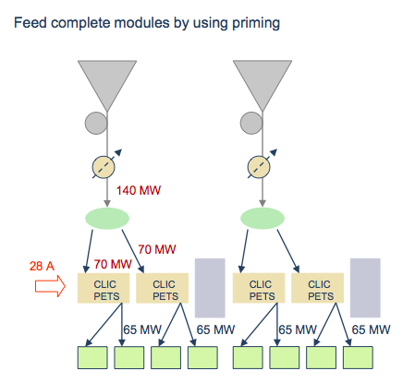
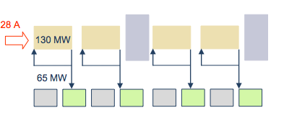
N modules: power
N modules: should to be as CLIC-like as possible (?) (reuse) -> PETS length should be CLIC nominal (up to 4 PETS of 0.21 m per module).
With ~28 A drive beam, without ”tricks”, we get only ~1/16 of CLIC PETS power. Need recirculation, forwarding or klystron priming of rf power (but this is not CLIC-like neither ?) .
Recirculation: can fill every second ACC, however only 140 ns pulse length, and hardly any flat rf power top. Is it important to have a long flat top?
Priming: can fill all ACCs, main beam can reach ~ 2.5 GeV, but expensive.
(I. Syratchev, R. Corsini)

Slide 22
Summary
TBTS: currently achieved good results, but many important experiments still in progress; some of these (in particular break down studies) require substantial improvement in commissioning of both incoming drive beam, dispersion control and beam line optic
Installation of 1 CLIC module with feed-forward rf power to module may complicate analysis for the above -> argument to finish major part of TBTS experiments before installing the module
  How long can/should we wait?
3 modules: optics acceptance for probe beam will be tighter than the present set-up. Nominal power production requires f.f., recirculation and/or priming
N modules
  Limit in deceleration due to initial energy. Do we need to show deceleration? I.e. push towards max. acceptable deceleration? We already have TBL for this purpose.
  Limit in acceleration due to low power production due to CTF3 nominal drive beam current. How much acceleration do we need to show? Is it worth investing in e.g. up to 10 X-band klystrons for priming, to achieve an acceleration of ~2.5 GeV?
General challenge: how to combine fast schedule with need to do detailed studies (e.g. precision measurements of relevant beam and rf parameters) and basic research (e.g. break down studies) ?

