Slide 1
Two-beam Module: Engineering design, System integration and R&D program
G. Riddone in collaboration with N. Gazis, D. Gudkov,
A. Samoshkin and A. Solodko
Acknowledgements to all members of the CLIC Module WG
3 February 2011
OUTLINE
Introduction: method and general layout
CLIC two beam module design: status and main issues
R&D program: status and future steps
6th Advisory CLIC Committee, 2-4 Feb 2011

Slide 2
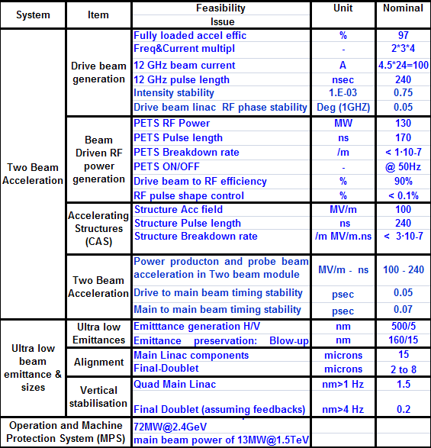
CLIC feasibility issues
Demonstration of novel scheme of two beam acceleration and extension of the basic tests to compact modules integrating all technical systems for RF production, beam measurement and acceleration including alignment, stabilisation and vacuum at their nominal parameters.
➔ performance/cost driver
§ IPAC 10- JP. Delahaye invited paper

Slide 3
Steps towards two-beam module design
Several interfaces and several issues have to be addressed
Filling factor should be as high as possible ➔ very compact design
Design should also take into account assembly, transport and maintenance
➔ BASELINE design for CDR
Beam requirements
Technical system requirements
(design)
Sub-UNITS
design
Two-beam module design, including numerical simulation

Slide 4
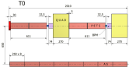
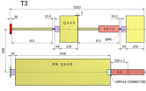
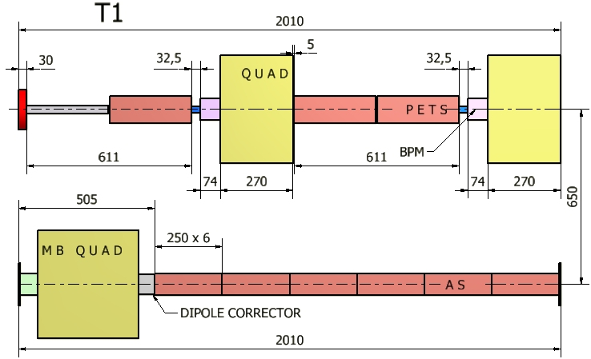
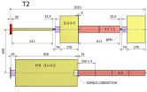
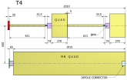
Two-beam module types
Standard Module
8374 per Linac
Module Type 3
477 per Linac
Module Type 2
634 per Linac
Module Type 4
731 per Linac
+ special modules (end-sector region, modules with instrumentation and/or vacuum equipment) to be studied in TDR phase
CLIC Module Type1
154 per Linac

Slide 5
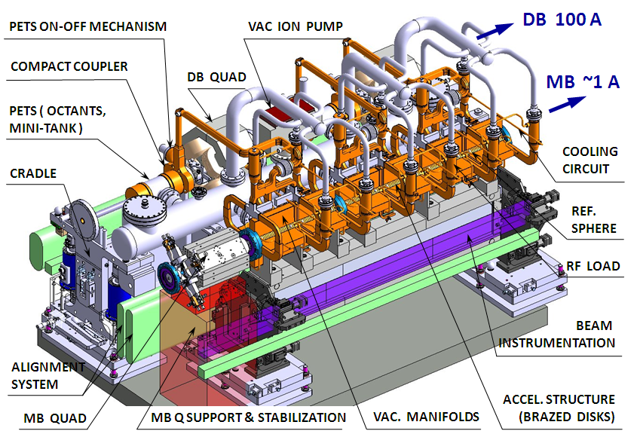
CLIC two-beam module (T1)
A. Samoshkin
CLIC at 500 GeV (4248 modules)
26312 Accelerating structures
13156 PETS
~ 70000 RF components
CLIC at 3 TeV (20924 modules)
142812 Accelerating structures
71406 PETS
~ 400000 RF components
Many issues appear during the integrated design

Slide 6
CLIC two-beam module sub-units
SUB-UNITS
It is impossible to separate the components and consider them as an independent
PETS – RF network – Acc. structures – Vacuum-Cooling
R F
MAGNET & POWERING
BPM – DBQ - PETS interconnection
VACUUM
PRE-ALIGNMENT & STABILIZATION
TWO-BEAM
MODULE
INSTRUMENTATION
Interconnections – BPM – MBQ –Dipole Corr. - interconnections
COOLING
SUPPORTING
ASSEMBLY, TRANSPORT, INSTALLATION
Girders – positioning and stabilisation components

Slide 7
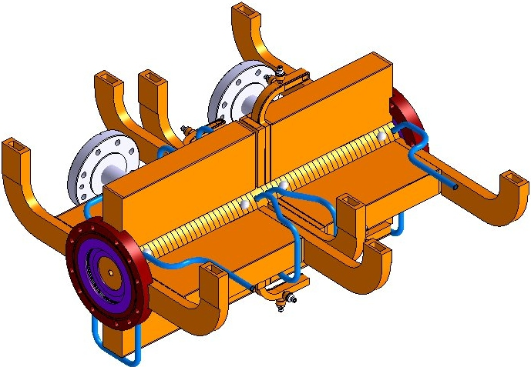
Accelerating structures (1)
- Shape accuracy ±2.5 µm - assembly accuracy is ±5 µm
Integration of damping loads, WFM (1 per Super-AS), vacuum manifolds, cooling circuits, supports + interconnection to adjacent components and inter-beam waveguides
SUPERSTRUCTURE
VACUUM MANIFOLD
VAC. FLANGE
TO LOADS
REF. SPHERE
FROM PETS
WFM
COOLING CIRCUITS
INTRAMODULE INTERCONNECTION

Slide 8

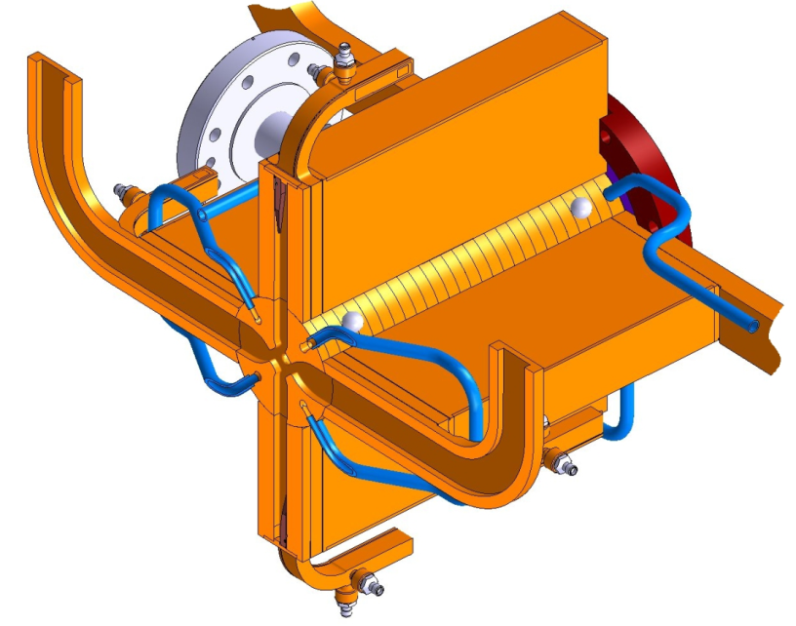
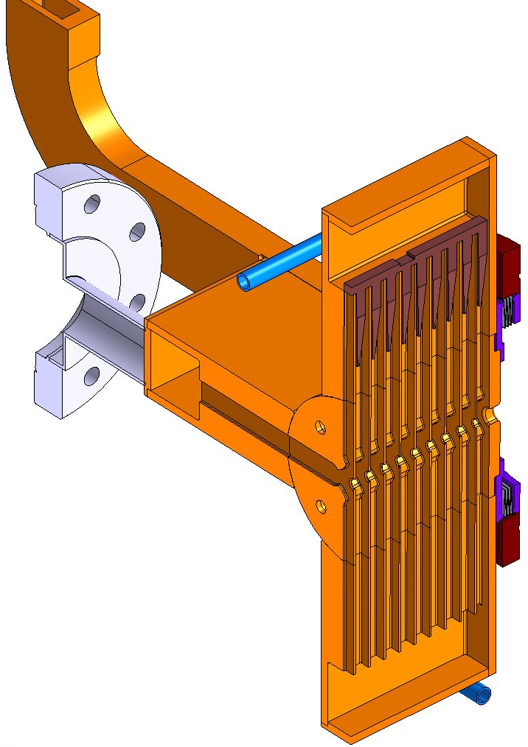
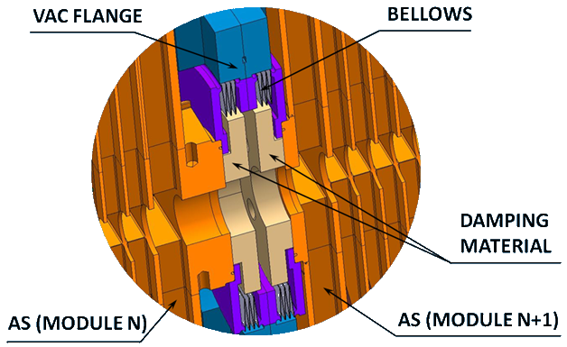
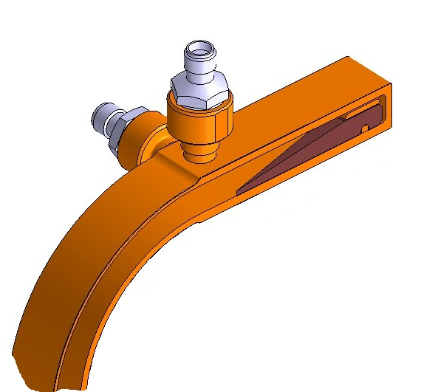
Accelerating structures (2)
FROM
PETS
TO
COMPACT
LOAD
VACUUM MANIFOLD COVER
AS with WFM →Validation in CLEX (2011)- CEA-Saclay
TO MAIN VACUUM RESERVOIR
TM-LIKE MODE PICK UP
TE-LIKE
MODE
PICK UP
DAMPING MATERIAL
HOM ABSORBER
AS (BONDED DISKS)
AS – AS VACUUM
INTERCONNECTION
WFM WAVEGUIDE

Slide 9
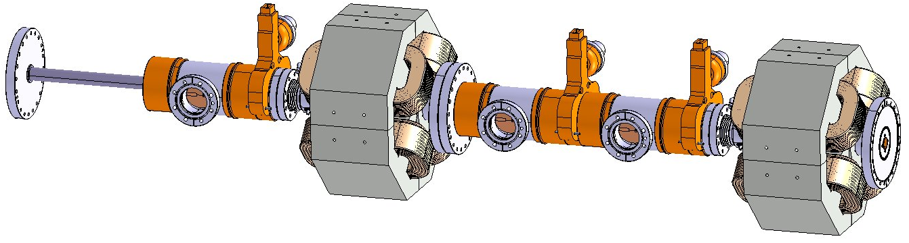
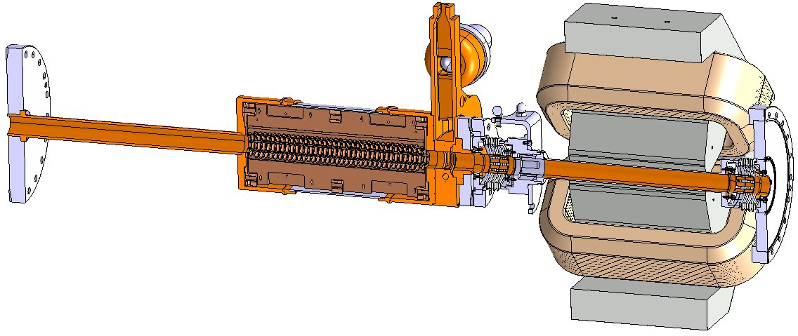
Drive Beam Components (T1)
DB
REF. SPHERES
DRIFTING TUBE
ON-OFF MECHANISM
VAC. FLANGE
PETS
BPM
DB QUAD

Slide 10
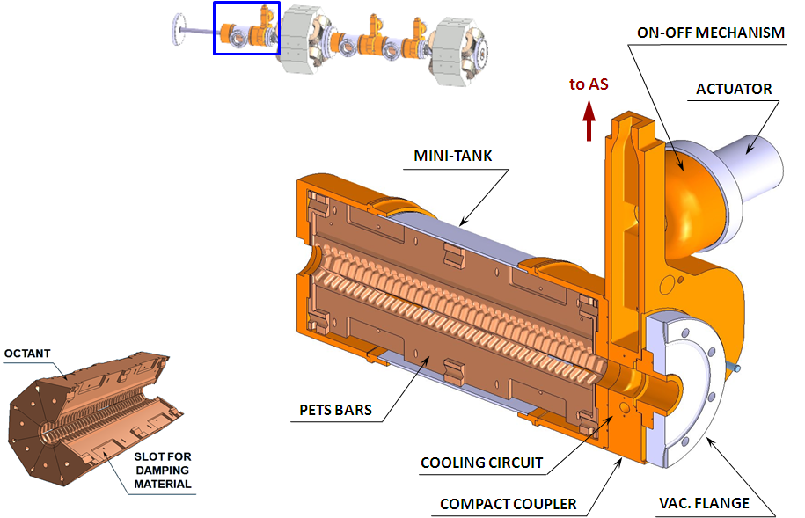
PETS
- Shape accuracy ±7.5 µm - assembly accuracy is ±7.5 µm
Integration of on-off mechanism, damping loads, vacuum connections, cooling circuits, supports + interconnection to adjacent components and inter-beam waveguides

Slide 11
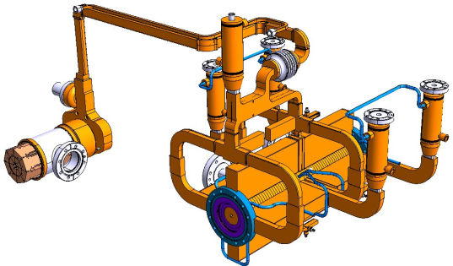
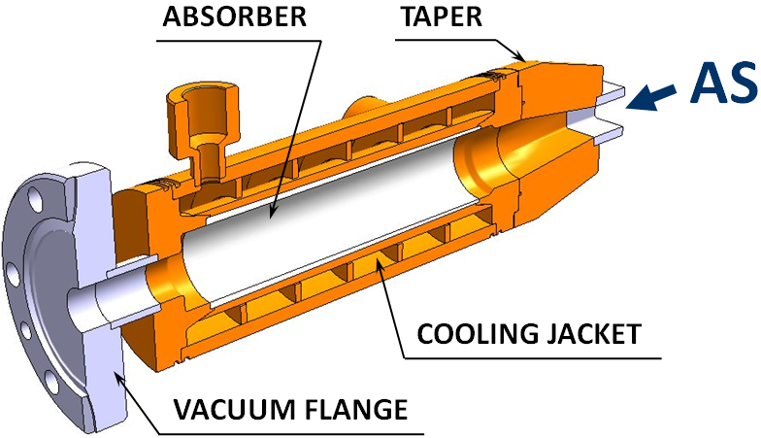
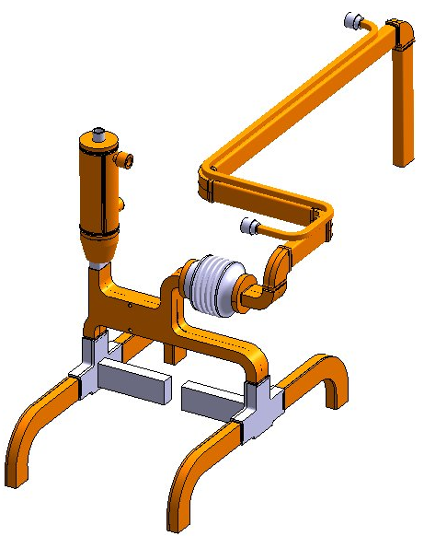
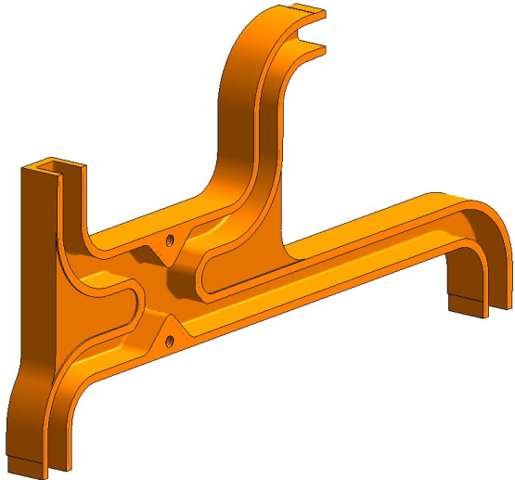
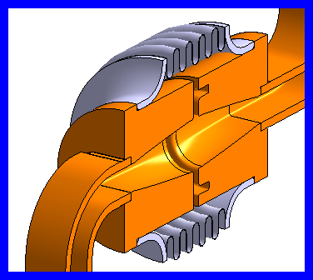
RF Network layout
X-band rectangular waveguides;
the power transmission without electrical contact between two beams, and also MB and DB independent alignment is getting possible with CMF;
Hybrid, RF loads, splitters
COOLING CHANNEL
WAVEGUIDE
LOAD
CMF
PETS
HYBRID
CMF Requirements:
X – shift: ± 0.25 mm,
Y ± 0.5 mm,
Z ± 0.5 mm,
Twist: < 5°
Load
PETS
HO MAGIC T
AS 2
AS 1
AS 1
AS 2

Slide 12

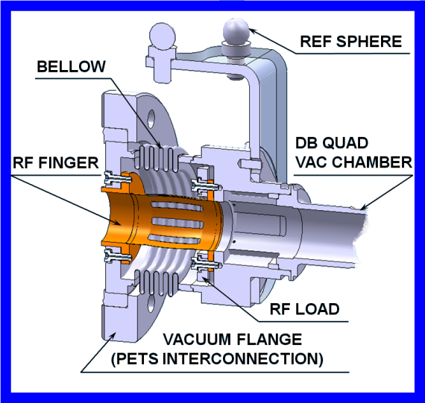
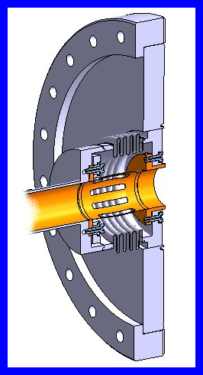
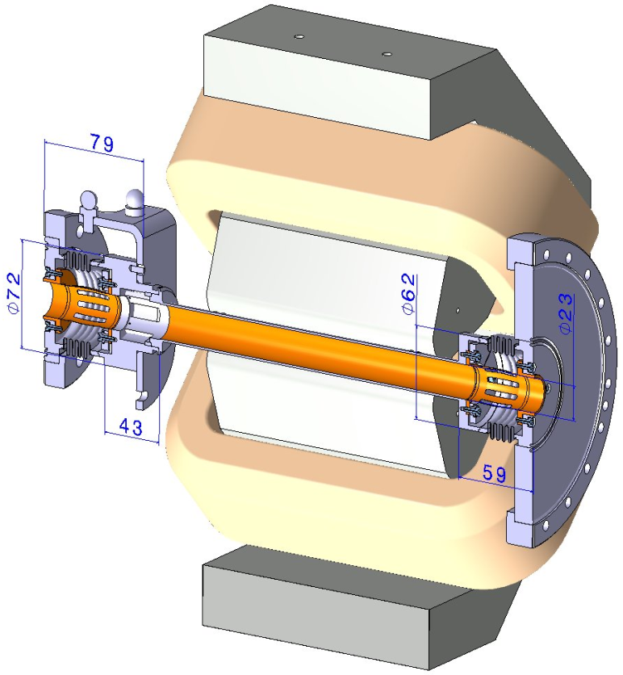
Interconnection – BPM – Vacuum Chamber – Interconnection
DB: The active length specified is 150 mm. The total number of quads required for both linacs is ~42000. In current module design the DB Quad vertical size drives the beam height.
DB
DB Quadrupole working gradient: 81.2-8.12 T/m, current density: 4.8 A/mm² , magnet aperture: Ø23mm
DB tuneable permanent magnet solution is under investigation (Cockcroft Institute)
BPM
Q-PETS INTERCONNECTION

Slide 13
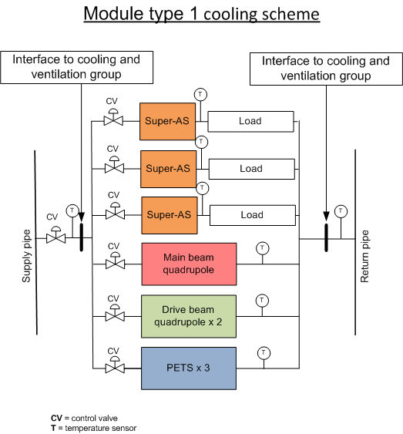
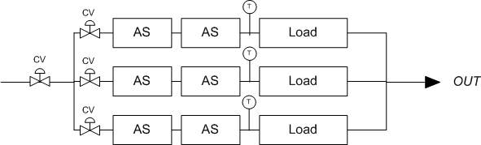
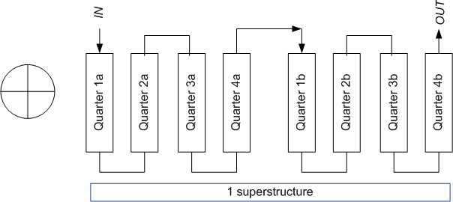
Module cooling scheme
One inlet/outlet access point close to IP
35 ˚C
25 ˚C
45 ˚C
25 ˚C
45 ˚C
Twater_in = 25 ˚C [± 2 ˚C]
Re = 5800 (d = 7 mm)
h = 3750 W/m²/K
V= 70 l/h [per AC. STR.]
V = ~350 l/h [per MODULE]
V = 3500 m/h [per LINAC]
6139 W per Type 1 module

Slide 14
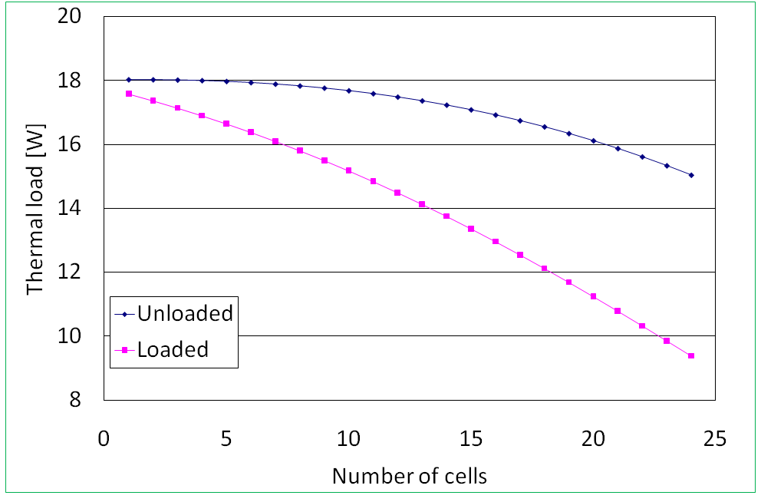
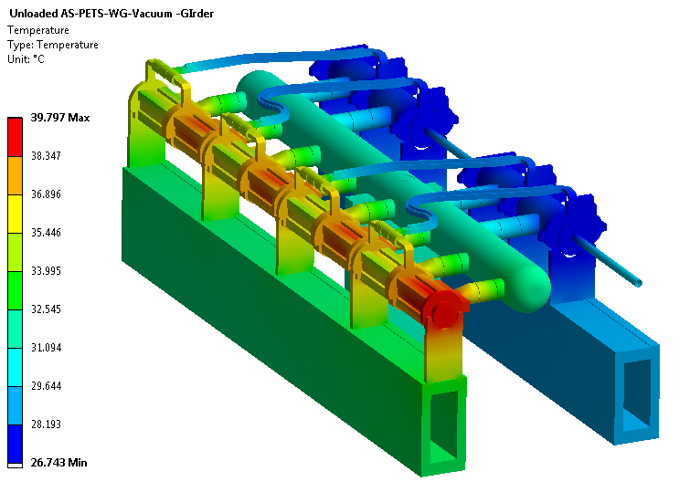
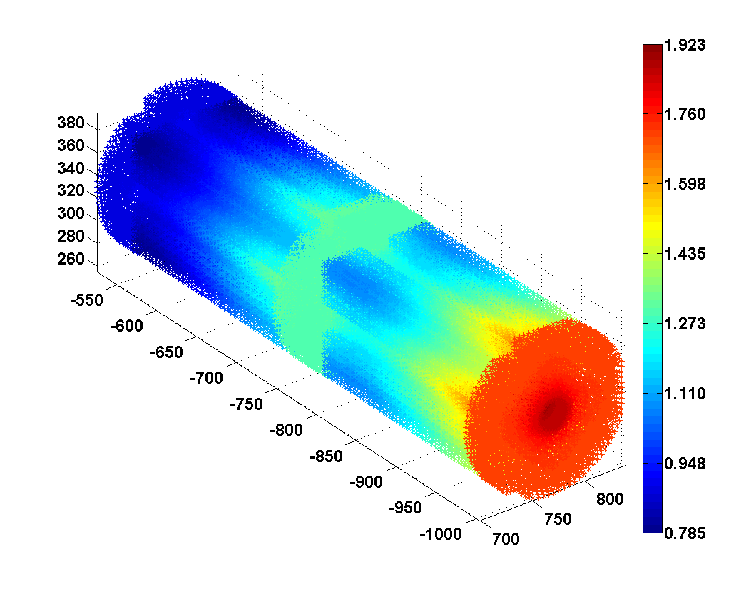
Thermal analysis
Cell-to-cell heat dissipation
Unloaded 821W
Average dissipated power for a super-structure
Loaded 672 W
Temperature difference
Unloaded to Loaded
Unloaded case
1.9 K
0.8 K

Slide 15
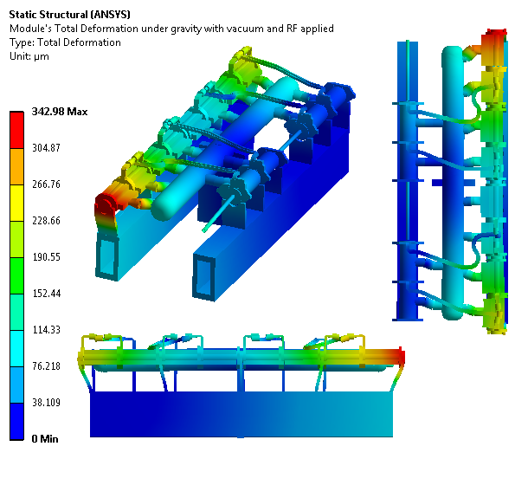
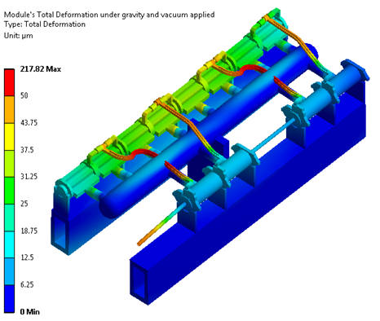
Structural analysis
THERMO-MECHANICAL MODEL
R. NOUSIAINEN (input from technical experts)
Gravity + Vacuum + RF (unloaded)
Gravity + Vacuum
Based on previous module design ➔ 8 accelerating structures as 1 UNIT

Slide 16
Actions following thermo-structural analysis
To limit longitudinal deformation, for the CLIC two beam modules, decoupling of accelerating structure: from 8 as one unit to 2 as one unit (now < 80 um)
  Although for the first prototype modules the most critical configuration was chosen (8 as one unit)
New RF network layout with additional RF components (new analysis under way)
  To be validated with the prototype module program
  Impact on RF/beam to be determined
  Fallback solution under study: mini-pumps fixed directly on each structure. No lateral stress on RF structures (study in 2011)
The module evolution justifies a new TMM from March (technical students from HIP, CEA and from ACAS):
  New model with also magnets and RF components

Slide 17
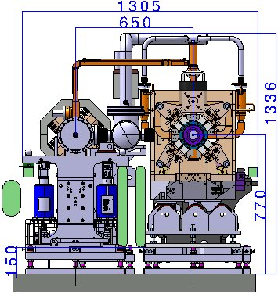
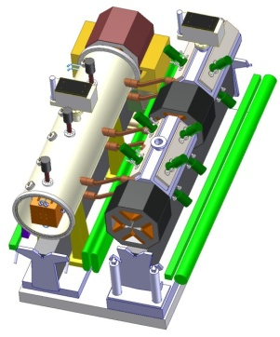
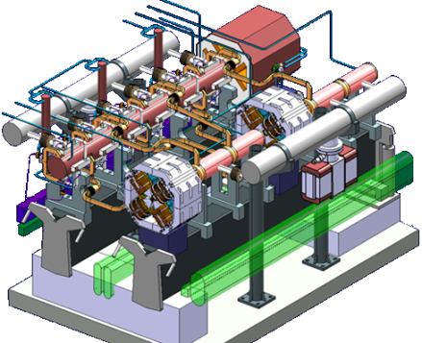
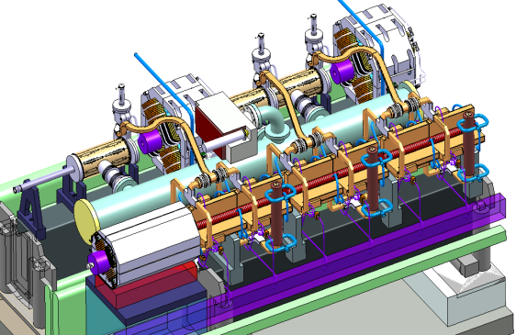
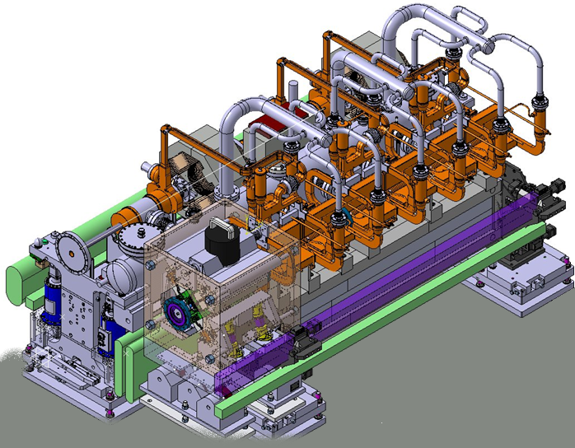
Two-beam module evolution
Integration steps and model design evolutions
  2007
  2008
  2009
  2010
  2011 – 2013 +
Prototype module program

Slide 18
Steps towards two-beam acceleration modules
2009-2011
Two-beam test stand (PETS and ac. structures)
Demonstration of the two-beam acceleration with one PETS and one accelerating structure at nominal parameters in CLEX
2010-2013
Demonstration of the two-beam module design
This implies the assembly and integration of all components and technical systems, such as RF, magnet, vacuum, alignment and stabilization, in the very compact 2-m long two-beam module
Prototype modules in LAB [x4]
Demonstration of the two-beam acceleration with two-beam modules in CLEX
Address other feasibility issues in an integrated approach
  Industrialization and mass production study
Prototype modules in CLEX [x3+1]

Slide 19
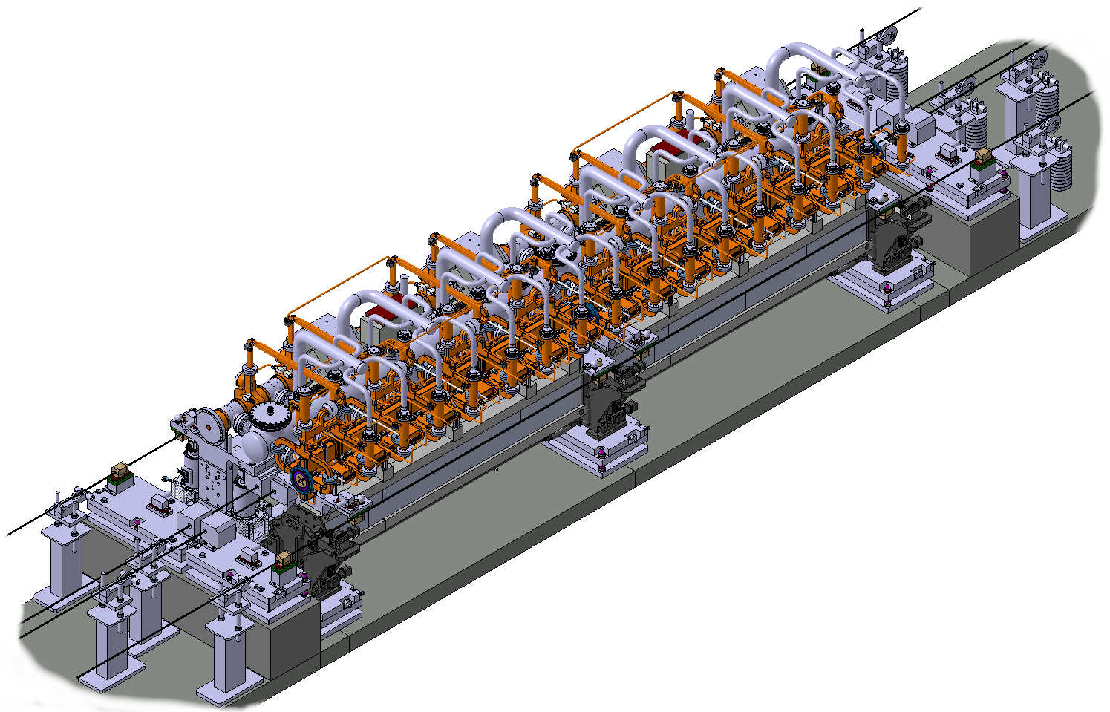
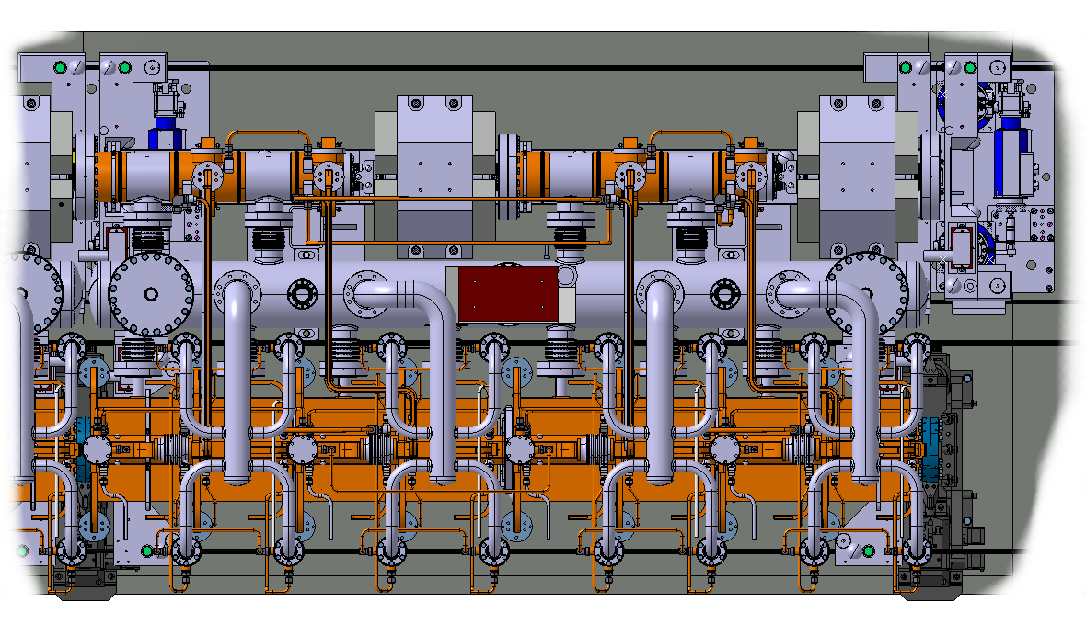
Prototype modules in the lab
D. Gudkov
4 modules representative of all CLIC module types
First two modules under procurement/assembly/testing
T0
T0
T1
T4
Beam

Slide 20
Prototype modules in the lab - Purpose
1. Validation of different types of girder
3. Assembly of RF structures and quadrupoles
6. Integration of all tech. systems
2.Validation of positioning system
3. Pre alignment of components
7. Vacuum system test
4. Validation of interconnections
8. Measurements of thermal transients
5. Stabilization of MBQ in the module environment
9. Transport of the module
Metrology
Measurement of resonant frequencies
Vibration study

Slide 21
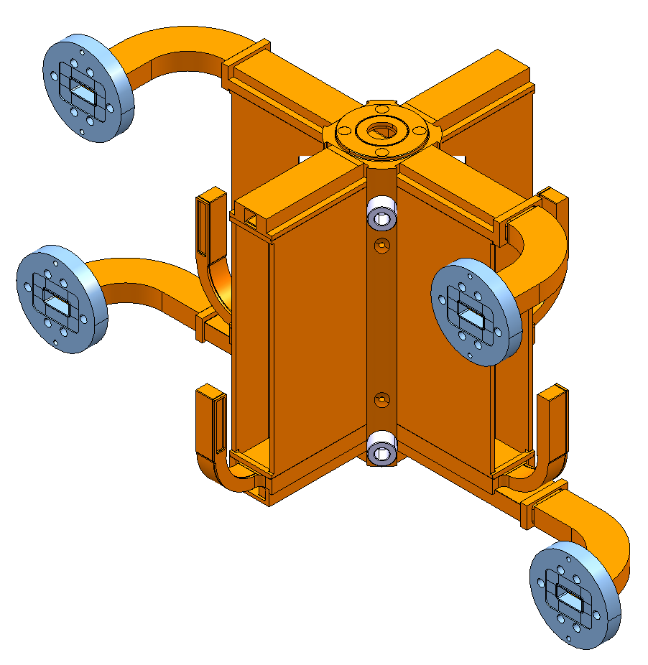
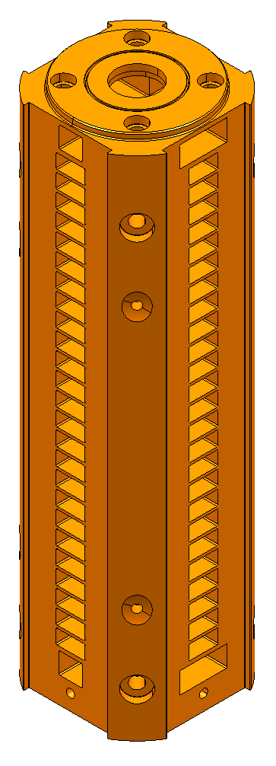
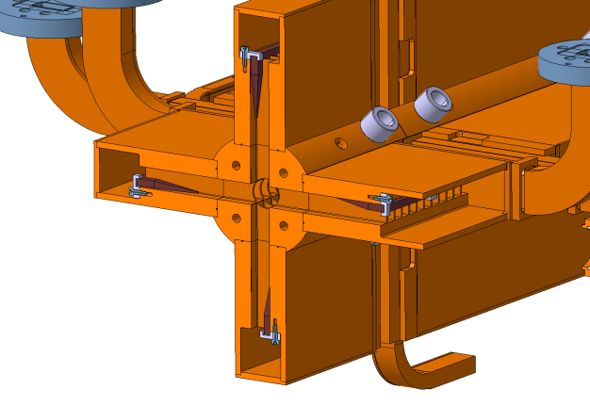
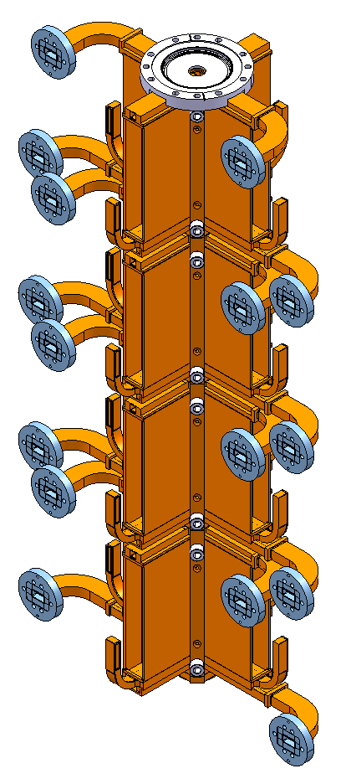
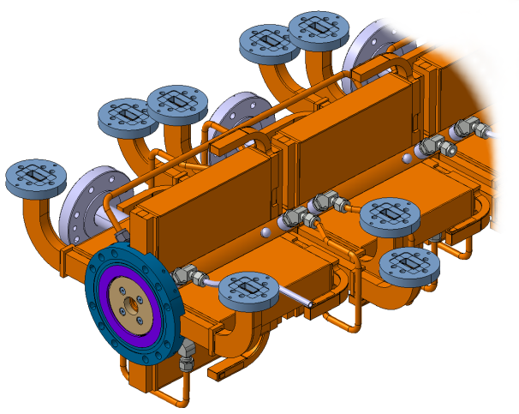
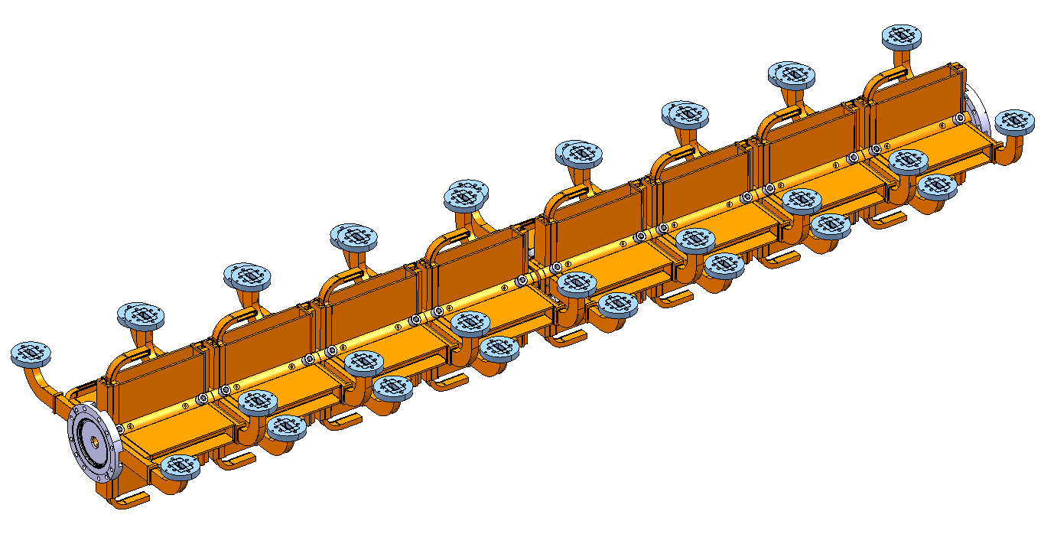
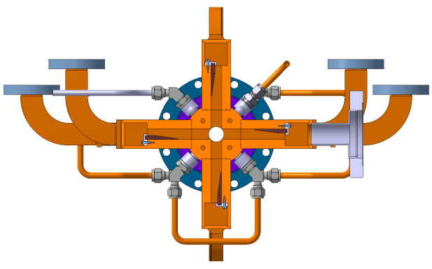
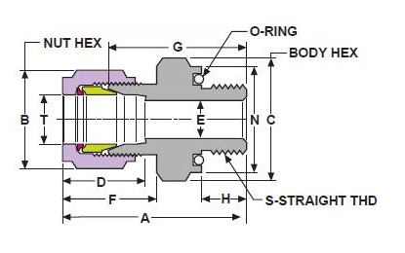
Accelerating structure mock-ups
TEST Module T0 AS mock-up
1. Brazing of manifolds; interface WGs; cooling adapters;
2. Brazing of 2 stacks 1005
mm long each:
Includes:
4 AS with manifolds;
Interconnection MB-MB;
3. Installation of the damping material,
welding of covers:
Damping
material
4. Welding (EBW) of two stacks together:
Cooling system
AS Interfaces
EBW
RFN
RFN
Load
Load
Copper tubes
Standard fittings:
CVT

Slide 22
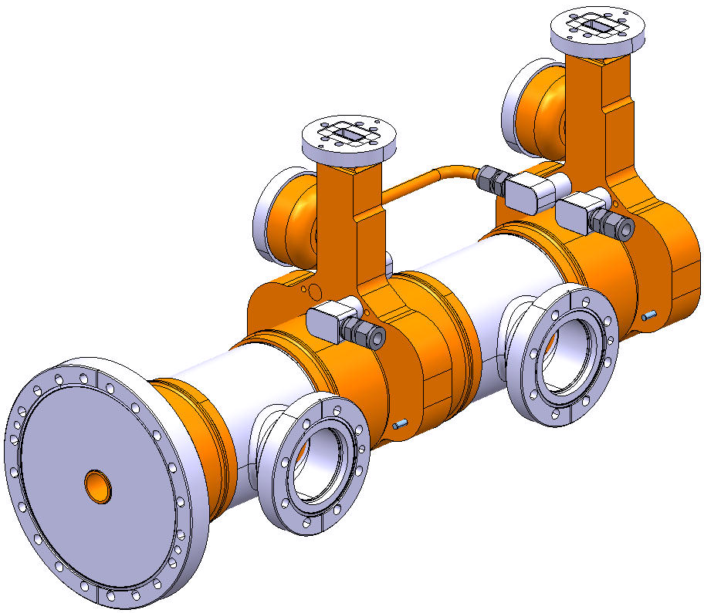
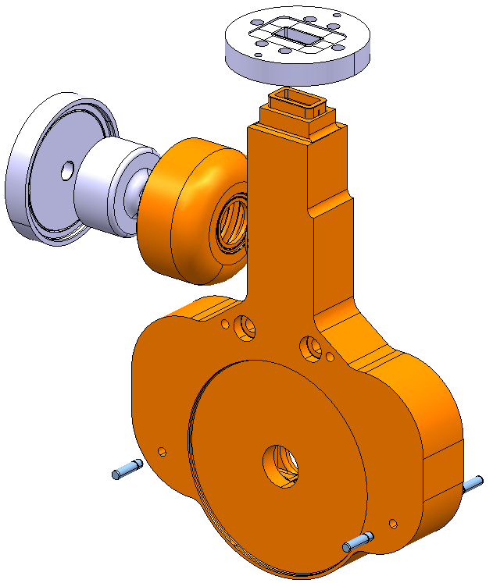
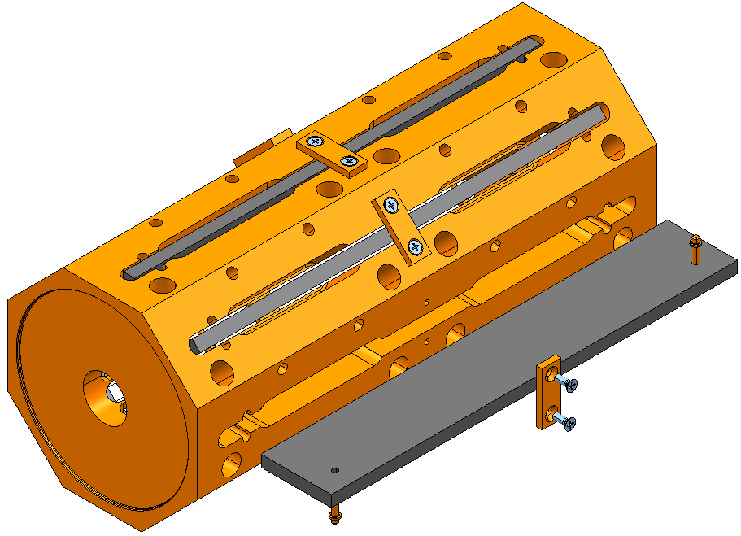
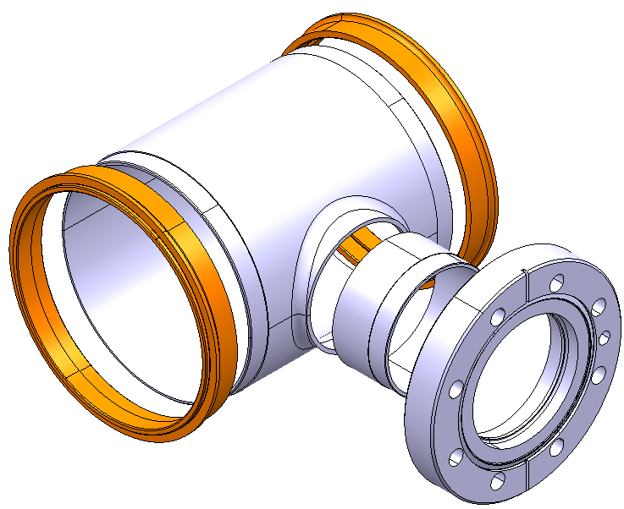




PETS mock-ups
TEST Module T0 PETS mock-up
1
2
3
PETS mock-up. Screwing.
Minitank. Brazing & Welding.
Compact coupler. Brazing.
4
5
General assembly. EB welding.
CC subassemblies. Brazing.

Slide 23


DB Quad + DB BPM + Vacuum chamber
DBQ Mock-up Subassembly
DBQ mock-up upper half
DB BPM-vacuum chamber mock-up
DB BPM support angle
DBQ mock-up lower half
DBQ supporting plate

Slide 24



Vacuum Tank Installation
Vacuum network interfaces
AS/PETS Interfaces
Pumps
Support interfaces
Mobile pumps interfaces

Slide 25




RF-Network Installation
CMF
Cooling interfaces
Compact load
Hybrid
Splitter
AS interfaces
PETS interface

Slide 26





Vacuum Network Installation
Type 1
Type 2

Slide 27




Cooling System Installation
Standard fittings are used to avoid brazing or welding operations:
Insert tube
Tighten the nut

Slide 28
Girders – Procurement strategy
Prototype girders
N. Gazis
Boostec
Epucret
 | Type 0 | Type 0 | Type 1 | Type 4
DB
MB
Measured max. deformation
12-15 μm
Measured max. deformation
19-20 μm
Measured max. deformation
7-9 μm
Micro-Controle
3 companies with three different strategies:
Boostec: 2 SiC girders with V-shaped supports [Nov 2010]
Microcontrole: 2 SiC girders with V-shapes supports, and positioning system [Dec 2010] [pre-stressed]
Epucret: 2 Mineral cast girders [Nov 2010]
Modal Analyses for all CLIC Two-Beam Module Girder prototype configurations: Eigenfrequencies (f) ≥ 35 Hz

Slide 29







Micro-Controle Girders (Type 0)
Visit for on site inspection and preliminary dimensional control (Lazer Tracker)
Delivery at CERN
CMM control at CERN
Actuators & cradle installation
Base plates installation
Loaded Girder alignment measurements
Girder installation

Slide 30





Girders - Final Assembly
Visit on Thu 3 February

Slide 31

Prototype modules in the lab - Schedule
PRTOTOTYPE modules – LAB: schedule
Under tendering: vacuum system, beam instrumentation and RF system for the first two T0 modules and supporting system for T1 module
Most probably tests will continue in 2013

Slide 32


Prototype modules to be tested in CLEX
A. Solodko
3 modules to be tested with beam and RF
T0
T0
T1
Beam
Double length PETS feeding two
accelerating structures each
Fully equipped accelerating structures
First module to be ready by 2012

Slide 33
Prototype modules in CLEX- Purpose
Module engineering, and assembly
Beam-based alignment
Transport, installation and maintenance
RF waveguide network
Vacuum system performance
Full system RF breakdown
Cooling system performance
Stabilization of main beam quadrupole
Metrology
Measurement of resonant frequencies
Vibration study

Slide 34

Prototype module in CLEX- Schedule
PRTOTOTYPE modules – CLEX: schedule
Availability of components depends on the feedback from the modules in the lab. and high power test of RF structures

Slide 35
Main conclusions
Two-beam module is an important part of the CLIC program. At present about 15 collaborators are actively involved
CLIC module design is very challenging: many requirements, limited space (as compact as possible) –> design is available for CDR
At the end of 2009 the prototype module project has been approved: 7 modules → we will learn a lot about the module behavior under different load conditions → input for new design
Comprehensive validation of type 0 girders under way
  First measurements are very promising
Next months will be very busy with the assembly of the components (mainly RF structures) – aim complete validation of type 0 modules by end of 2011
Feed back from first modules in the lab is needed before launching the procurement for modules in CLEX (2nd half of 2011)

Slide 36
EXTRA SLIDES

Slide 37
Main requirements
The module design and integration has to cope with challenging requirements
SYSTEM | REQUIREMENT/S
R F | AS shape tolerance ± 2.5 µm
INSTRUMENTATION | BPM resolution: MB - 50 nm, DB – 2 µm, temporal - 10 ns (MB & DB),
SUPPORTING | Max. vertical & lateral deformation of the girders in loaded condition 10μm
COOLING | ~400 W per AS, alignment preservation
MAGNET & POWERING | DB 81.2-8.12 T/m, current density: 4.8 A/mm2, MB 200 T/m
PRE-ALIGNMENT & STABILIZATION | active pre-alignment ± 10 µm at 1σ, MB Q stabilization 1 nm >1Hz
VACUUM | 10⁻⁹ mbar
ASSEMBLY, TRANSPORT, INSTALLATION | same transverse interconnection plane for DB & MB
A baseline solution for CDR was defined for each technical system

Slide 38


Alternative DB magnet
ALTERNATIVE:
DB tuneable permanent magnet solution is under investigation (Cockcroft Institute)
DB

Slide 39




MB: BPM – Vac. Chamber – Dipole corr.
MB
The beam pipe is attached to the magnet and must be aligned to the magnetic centre of the Quad with an accuracy better than 30 μm; transverse tolerance for pre-alignment 17 µm at 1σ; stabilization: 1 nm >1Hz in vertical & 5 nm >1Hz in horizontal direction at 1σ.
DIPOLE CORRECTOR
MB QUADRUPOLE
REF SPHERE
RF PICK UP
VACUUM CHAMBER
DIPOLE CORRECTOR
MB BPM
BPM
INTERMODULE INTERCONNECTION
Q-AS INTERCONNECTION
Longitudinal space constraints - Still an issue!

Slide 40



Girders and positioning system
  BASELINE:
  - interconnected girders form a “snake system”
  - MB girders are not of the same length
  - MB Q support interrupts the MB girder
  - MB Q beam pipe and AS are connected by bellows
  requirement :
  yellow ref. surfaces precision - 2 μm
  Max. vertical & lateral deformation of the girders in loaded condition - 10μm
  Lab test setup. B162/R-011
  The main components of both beams are supported
  on girders linked to one chain all along the linac.

Slide 41

AS – AS Vacuum Interconnection
A low pressure level (10⁻⁹ mbar) is needed for keeping the good beam quality. The interconnections between main components should sustain the vacuum forces, provide an adequate electrical continuity with low impedance and remain flexible not to restrict the alignment.

Slide 42


Vacuum layout
ALTERNATIVE SOLUTION
Mini-Pumps fixed directly on each structure. No lateral stress on RF structures. (study → 2011)

Slide 43

Vacuum system in the module
C. Garion, ILWS10

Slide 44

Vacuum chamber for the MB quadrupoles
C. Garion, ILWS10

Slide 45



Slide 46



CLIC module vs CLEX module
From CLIC module to CLEX module
CLIC module type 0
(1PETS feeding 2 AS)
CLEX module type 0
Double length PETS
PETS
PETS
(1PETS feeding 2 AS)

Slide 47

Prototype Module - CLEX: Phase 3
Phase 3 foresees the installation and testing of 1 module type 0: AS equipped with WFM (5 um accuracy / few WFM in the 1st powered AS)
3.1 / Nominal power and pulse length for 1 PETS and 2 AS
Recirculation
12 A and 240 ns
3.2 / No modifications on the module type 0 HW
No Recirculation
Current increase from 12 A to 19.2 A
Pulse length reduced from 240 ns to 140 ns

Slide 48

Prototype Module - CLEX: Phase 4
No modifications on the module type 0
Addition of new modules - type 1 and 4
Increase of current from 19.2 A to 22 A
Modification on the module type 1
(2 CLIC PETS)
Needed klystrons and PC

Slide 49


Prototype Modules - installation in CLEX
Phase 3
Phase 3:
Existing PETS (currently under test) will be reused
It will be moved to allow for Type 0 module installation
Phase 4
Phase 4:
Instrumentation downstream the type 0 module will be removed
Installation of type 1 and 4 without displacing type 0

Slide 50







Girders - structural and modal analysis
Prototype girders - ANALYSIS
N. Gazis
Modal Analyses for all CLIC Two-Beam Module Girder prototype configurations: Eigenfrequencies (f) ≥ 35 Hz
Static Analyses of loaded CLIC Two-Beam Module Girder prototype configurations: 80 μm ≥ Deformations (ε) ≥ 10 μm
Modal Analysis
Pre-stressed girders, according to the simulated RF component loads, with precision machining after the integration of the V-shaped supports.
Pre-stressed solution
50

Slide 51



Girders
Design
Firm | Boostec |  | Micro-Controle |  | Epucret
Girder identification | B3069 | B3079 | Poutre 1 | Poutre 2 | DB01E | DB02E
Alignment Measurement | V-supports axis alignment |  | V-supports axis alignment |  | Top Reference Surface planarity
Value | 15 μm | 12 μm | 7 μm | 9 μm | 19 μm | 20 μm

Slide 52






Boostec Girders (Type 0)
Visit for on site inspection and preliminary dimensional control (Lazer Tracker)
Delivery and dimensional control (Lazer Tracker) at CERN
Base plates installation
CMM control at CERN
(finished on 24 Jan 2011)
Girder installation

Slide 53




Epucret Girders
Visit for on site inspection and preliminary dimensional control (Lazer Tracker)
CMM control at CERN
Installation at CERN
Delivery and dimensional control (Lazer Tracker) at CERN

Slide 54

Type 0 girders
Nick Gazis, CERN-BE/RF & NTU-Athens
54

Slide 55

Module power dissipation

