Slide 1




R&D on Stabilization
MBQ: from CDR to technical implementation phase
K. Artoos, C. Collette**, P. Fernandez Carmona, M. Guinchard, C. Hauviller, S. Janssens*, A. Kuzmin, R. Leuxe, M. Esposito.
* PhD student ULB-CERN
* * Associate ULB
The research leading to these results has received funding from the European Commission under the FP7 Research Infrastructures project EuCARD

Slide 2





Collaboration
CERN is collaborating on the stabilization of accelerator components with the following institutes:
Active Structures Laboratory
Department of Mechanical Engineering and Robotics
Université Libre de Bruxelles (ULB), Belgium
Institut de Recherche sur les lois Fondamentales de l'Univers
CEA (Commissariat à l'énergy atomique) Saclay, France
Laboratories in Annecy (France) working on VIbration STAbilisation

Slide 3
Outline
Requirements (reminder)
Strategy stabilisation MBQ
Status and results for feasibility demonstration CDR
Strategy after CDR + some first results!

Slide 4
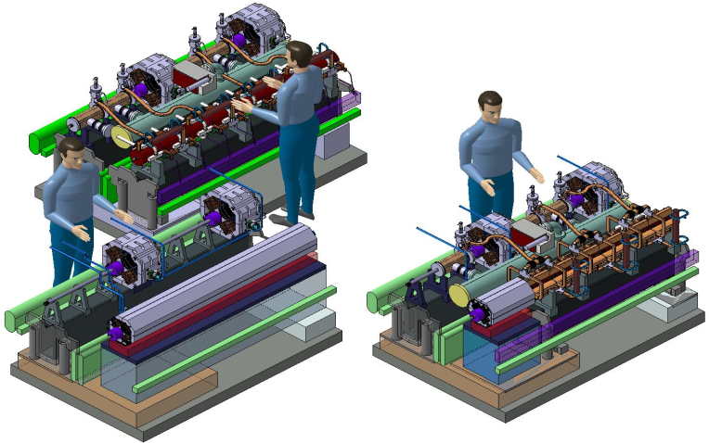
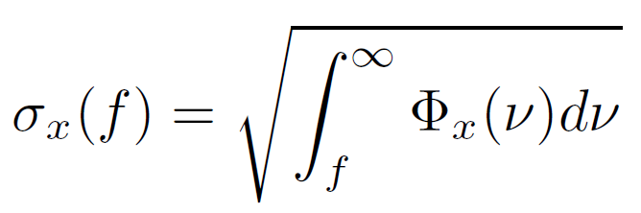
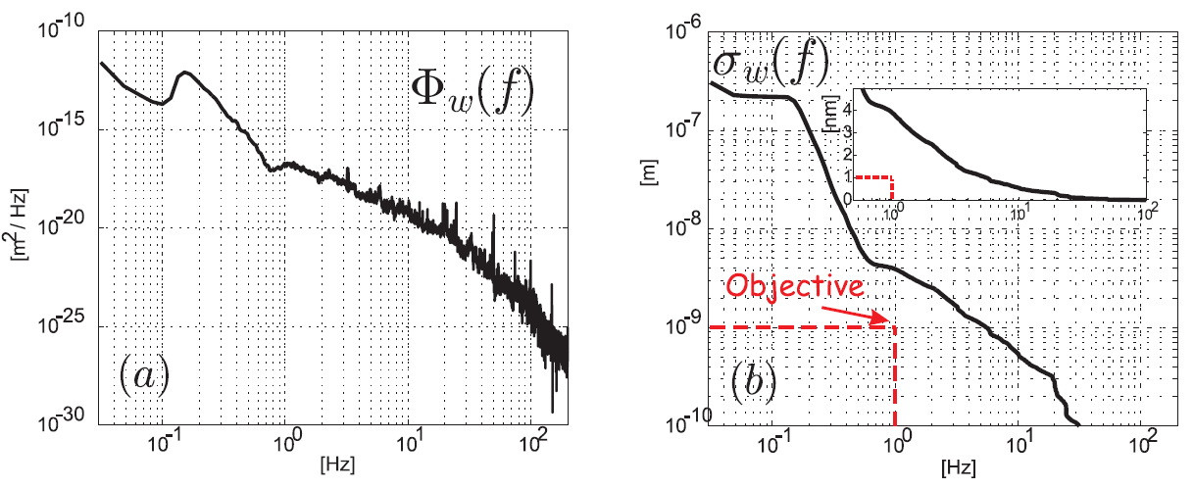
Requirements
3992 CLIC Main Beam Quadrupoles:
Four types :
Mass: ~ 100 to 400 kg
Length: 500 to 2000 mm
A. Samoshkin
Nano-positioning
Stability (magnetic axis):
Type 4: 2m, 400 kg
Type 1: 0.5 m, 100 kg
 | FF | MBQ
Vert. | 0.2 nm > 4Hz | 1.5 nm > 1 Hz
Lat. | 5 nm > 4 Hz | 5 nm >1 Hz

Slide 5
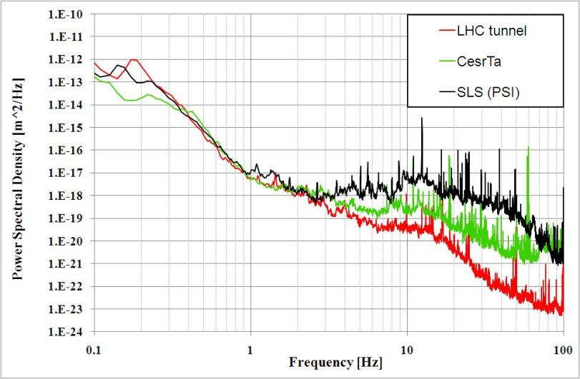
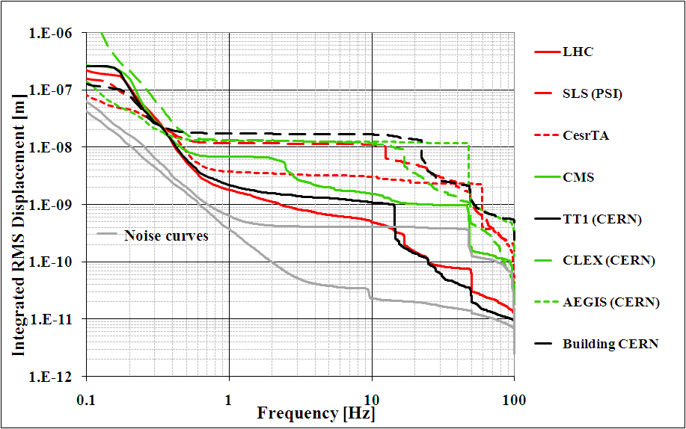
Characterisation vibration sources
vertical
vertical
Running accelerator in deep tunnel comparable to LHC:
- Between 2 and 5 nm ground vertical integrated R.M.S. Displacement
- Amplitude to be reduced by factor 4-5 in frequency range 1-20 Hz
Above 20 Hz contribution to integrated RMS is small
Environment should be part of strategy

Slide 6
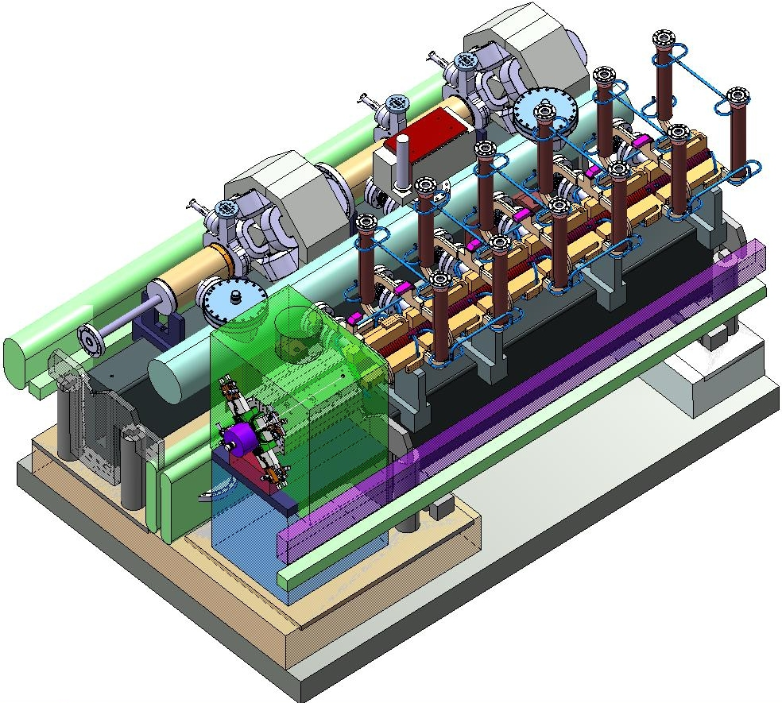
Other requirements
Stiffness-Robustness
Applied forces (water cooling, vacuum pipes,…
Compatibility alignment
Uncertainty
Transportability
Available space
Integration in two beam module
620 mm beam height, width~470 mm
Accelerator environment
- High radiation
- Stray magnetic field
A. Samoshkin

Slide 7
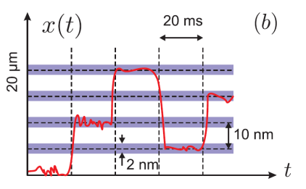
Additional objectives MBQ
« Nano-positioning» proposal
Modify position quadrupole in between pulses (~ 5 ms)
Range ± 5 μm, increments 10 to 50 nm, precision ± 1nm
In addition/ alternative dipole correctors
Might increases time to next realignment with cams

Slide 8

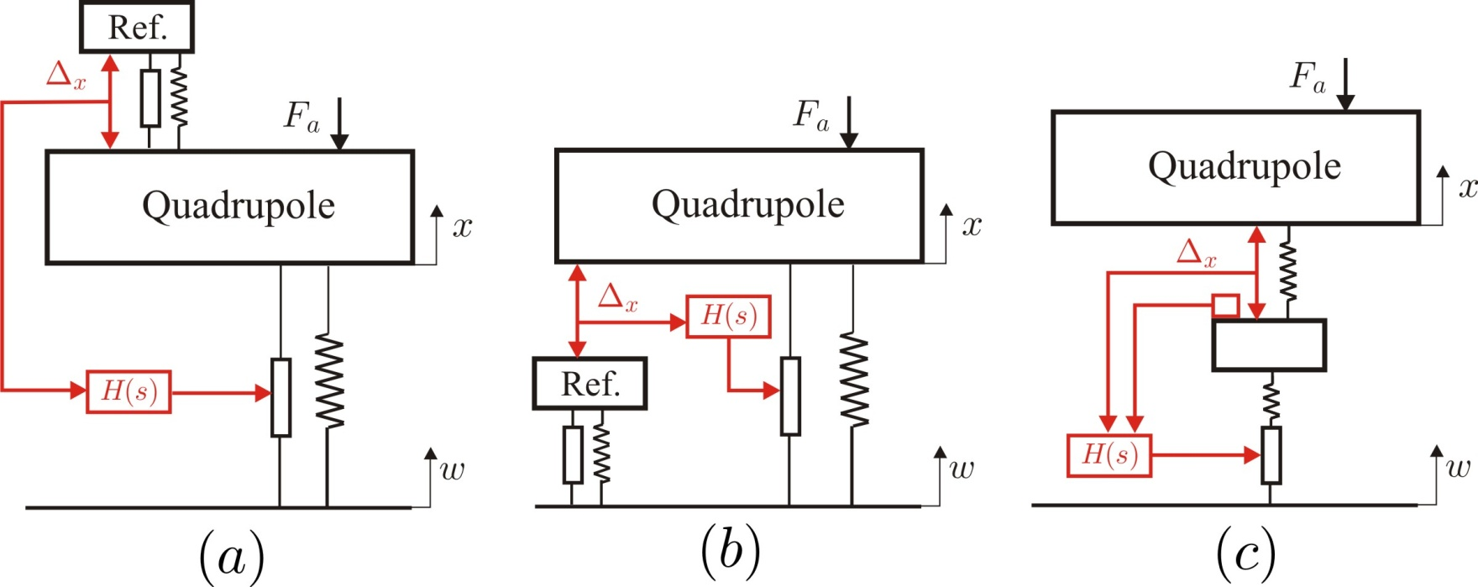
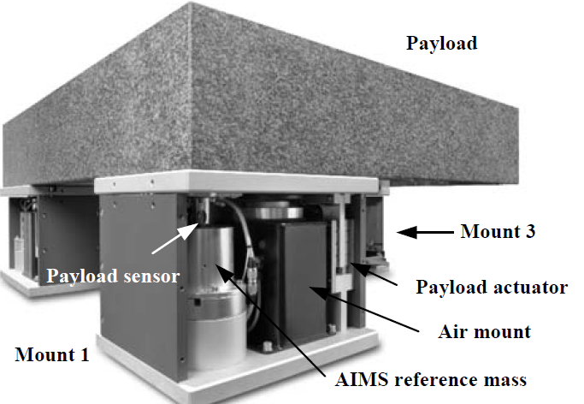
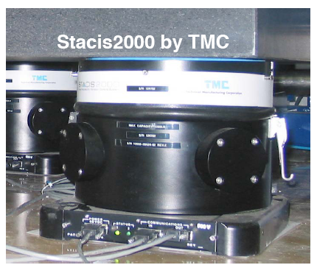
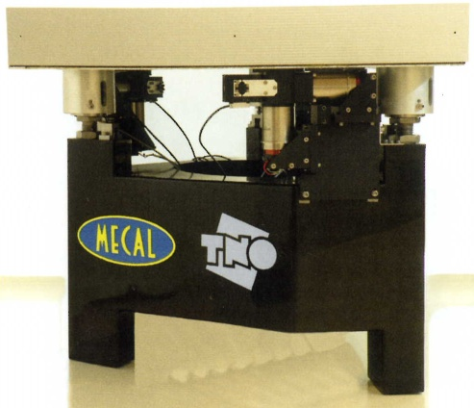
Comparison existing s.o.a. active stabilisation strategies
C. Collette
S. Janssens
IR on payload
IR on the ground
Two stages
k~0.01 N/µm
k~1 N/µm
k~0.01 N/µm
2009: Lithography
WO 084,966 A1
2007: US 2007/003,5074 A1
1994: Proc. SPIE vol. 2264

Slide 9

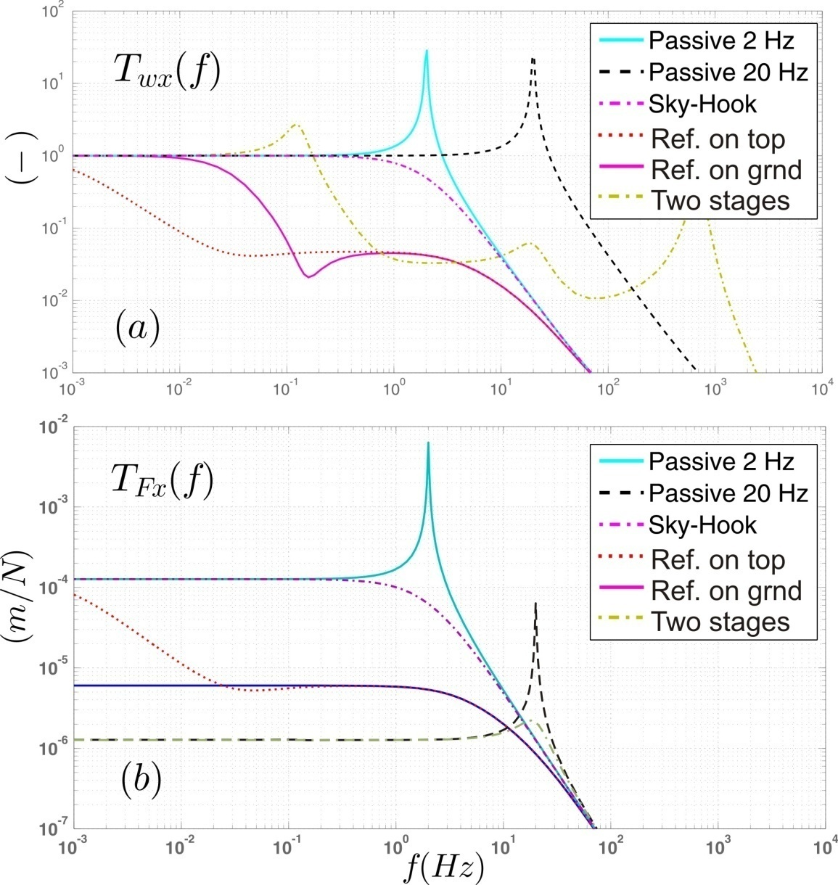
Comparison existing S.O.A. stabilisation strategies
C. Collette
S. Janssens
(Without noise curves)

Slide 10
Comparison Active Isolation
Very Soft (1 Hz)
Soft (20 Hz)
Stiff (200 Hz)
Pneumatic actuator
Hydraulic actuator
+ Broadband isolation
Stiffness too low
Noisy
Electromagnetic in parallel with a spring
Piezo actuator in series with soft element (rubber)
+ Passive isolation at high freq.
+ Stable
Low dynamic stiffness
Low compatibility with alignment and AE
Piezoelectric actuator in series with stiff element (flexible joint)
+ Extremely robust to forces
+ Fully compatible with AE
+ Comply with requirements
Noise transmission
Strong coupling
TNO+AIMS
k~0.01 N/µm
TMC k~1 N/µm
Piezo k~100-500 N/µm
COMPARISON
C. Collette

Slide 11
4 steps toward demonstration stiff stabilisation support
  2010 : 4 steps toward demonstration on MBQ type 4 (+ type 1):
  1. Stabilisation 1 d.o.f. with small weight (“membrane”)
  2. Stabilisation 1 d.o.f. with type 1 weight (“tripod”)
  3. Stabilisation 2 d.o.f. with type 1 weight (“quadruped”)
  4. Stabilisation of type 4 (and type 1)CLIC MB quadrupole proto type

Slide 12
4 steps toward demonstration stiff stabilisation support
  2010 : 4 steps toward demonstration on MBQ type 4 (+ type 1):
  1. Stabilisation 1 d.o.f. with small weight (“membrane”)
  2. Stabilisation 1 d.o.f. with type 1 weight (“tripod”)
  3. Stabilisation 2 d.o.f. with type 1 weight (“quadruped”)
  4. Stabilisation of type 4 (and type 1)CLIC MB quadrupole proto type

Slide 13
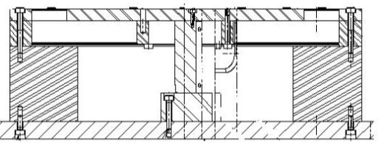
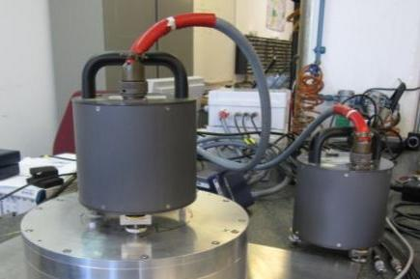
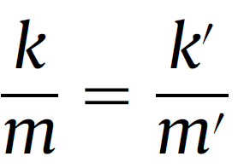
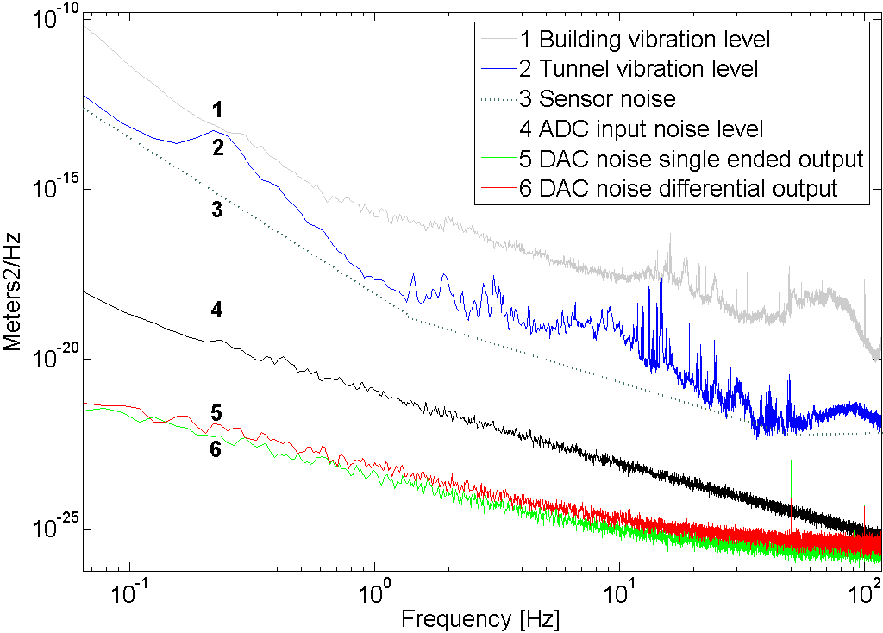
Step 1: One d.o.f. scaled set-up
Since last ACE :
System (sensor) modelled and fully understood
Controller improved
Real time behaviour improved
Improved cabling and power supply
have decreased the noise level
Noise study P. Fernandez Carmona

Slide 14
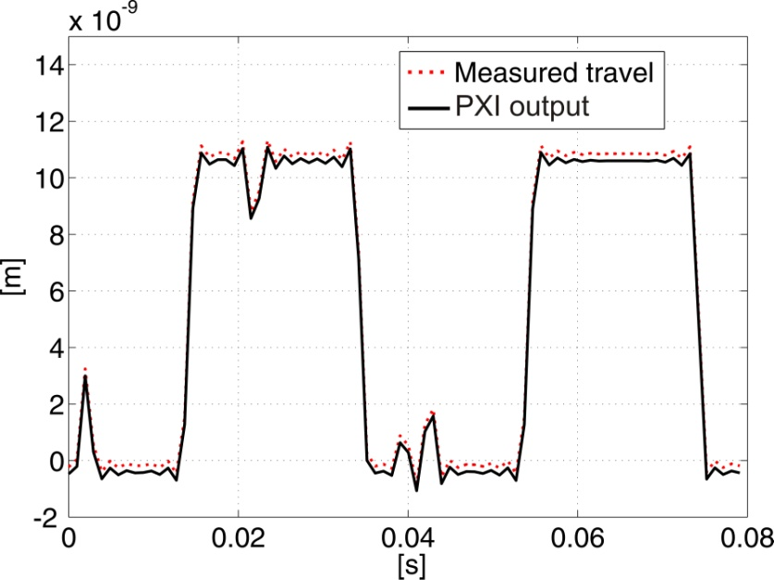
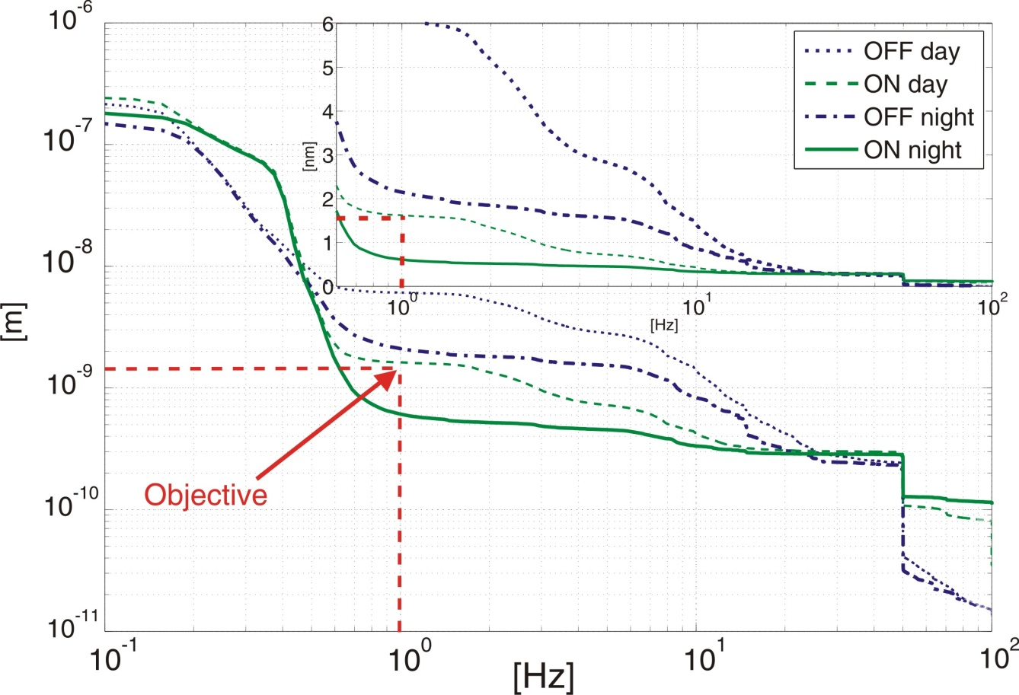
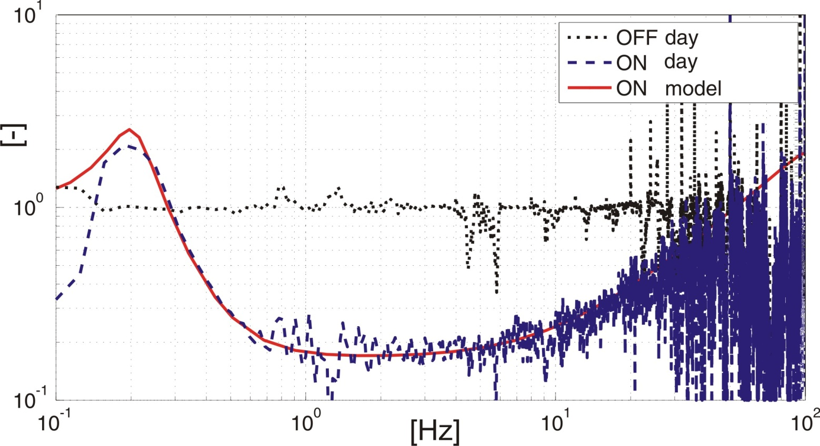
Experimental results
Objectives reached
Result: 0.6 nm at 1 Hz from 2.2 nm
day: 1.6 nm from 6.4 nm
0.44 nm at 4 Hz

Slide 15
4 steps toward demonstration stiff stabilisation support
  2010 : 4 steps toward demonstration on MBQ type 4 (+ type 1):
  1. Stabilisation 1 d.o.f. with small weight (“membrane”)
  2. Stabilisation 1 d.o.f. with type 1 weight (“tripod”)
  3. Stabilisation 2 d.o.f. with type 1 weight (“Quadruped”)
  4. Stabilisation of type 4 (and type 1)CLIC MB quadrupole proto type

Slide 16
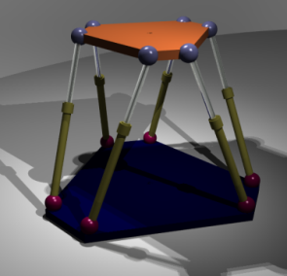
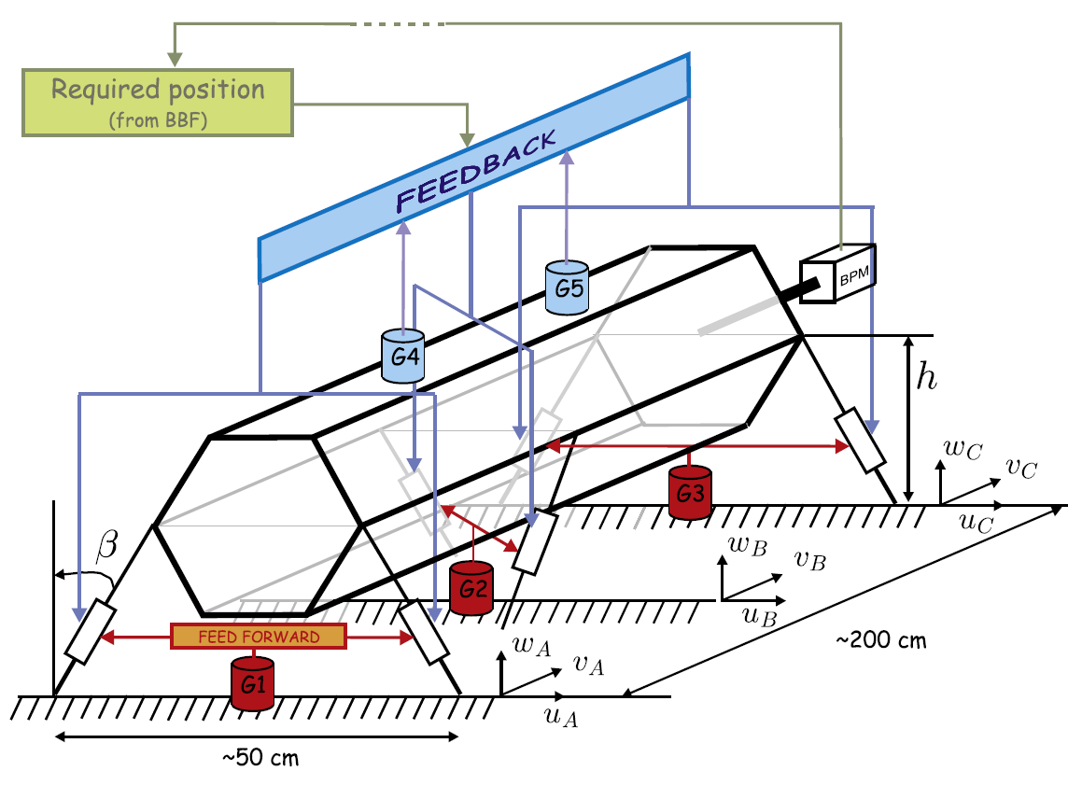
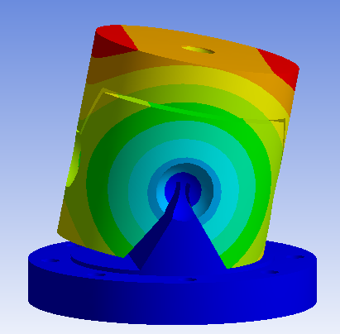
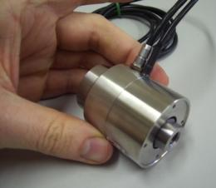
Strategy Support
Stiff structure
At least four d.o.f.
Precise motion
Repeatability
0.1 nm resolution vertically
Parallel structure
Stiff piezo actuators
Flexural hinges
Sensors : Seismometers “to get started”

Slide 17
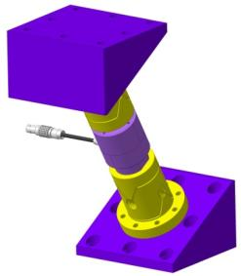
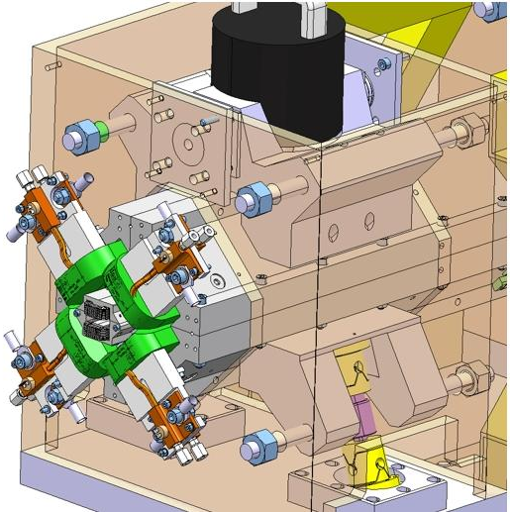
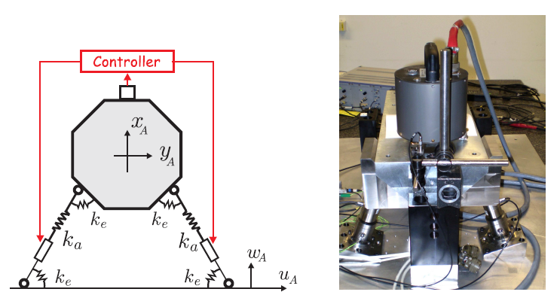
Strategy Support
Structural stiffness
Induced stresses in piezo
Inclination
Resolution, structure stiffness, forces
Number
# D.O.F. , COST
Resonant frequency
Solution 4 types
Block longitudinal
Block roll
X-Y flexural guide

Slide 18
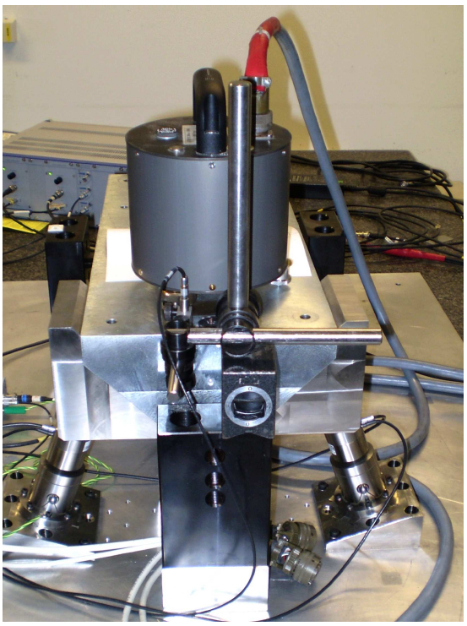
Step 3: 2 d.o.f. with type 1 mass
Objectives:
Validate the strategy and
controller in 2 d.o.f. Type 1
Validate flexural hinge design
Validate Mounting and assembly issues
Validate nano positioning in 2 d.o.f.
Notes:
Block of 100 Kg similar to type 1

Slide 19
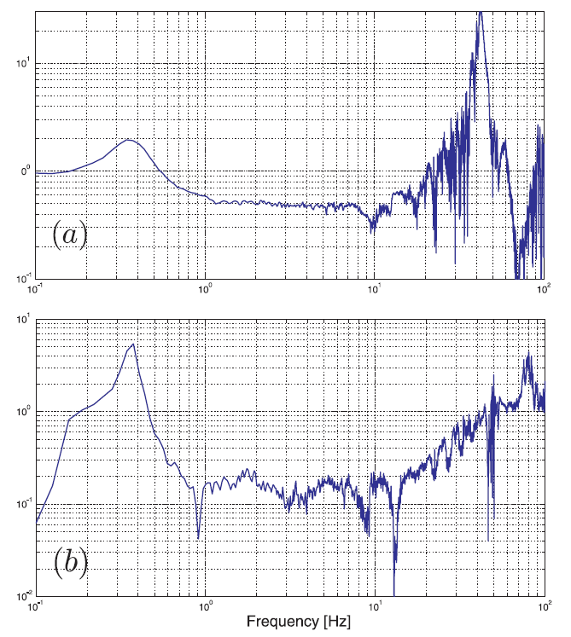
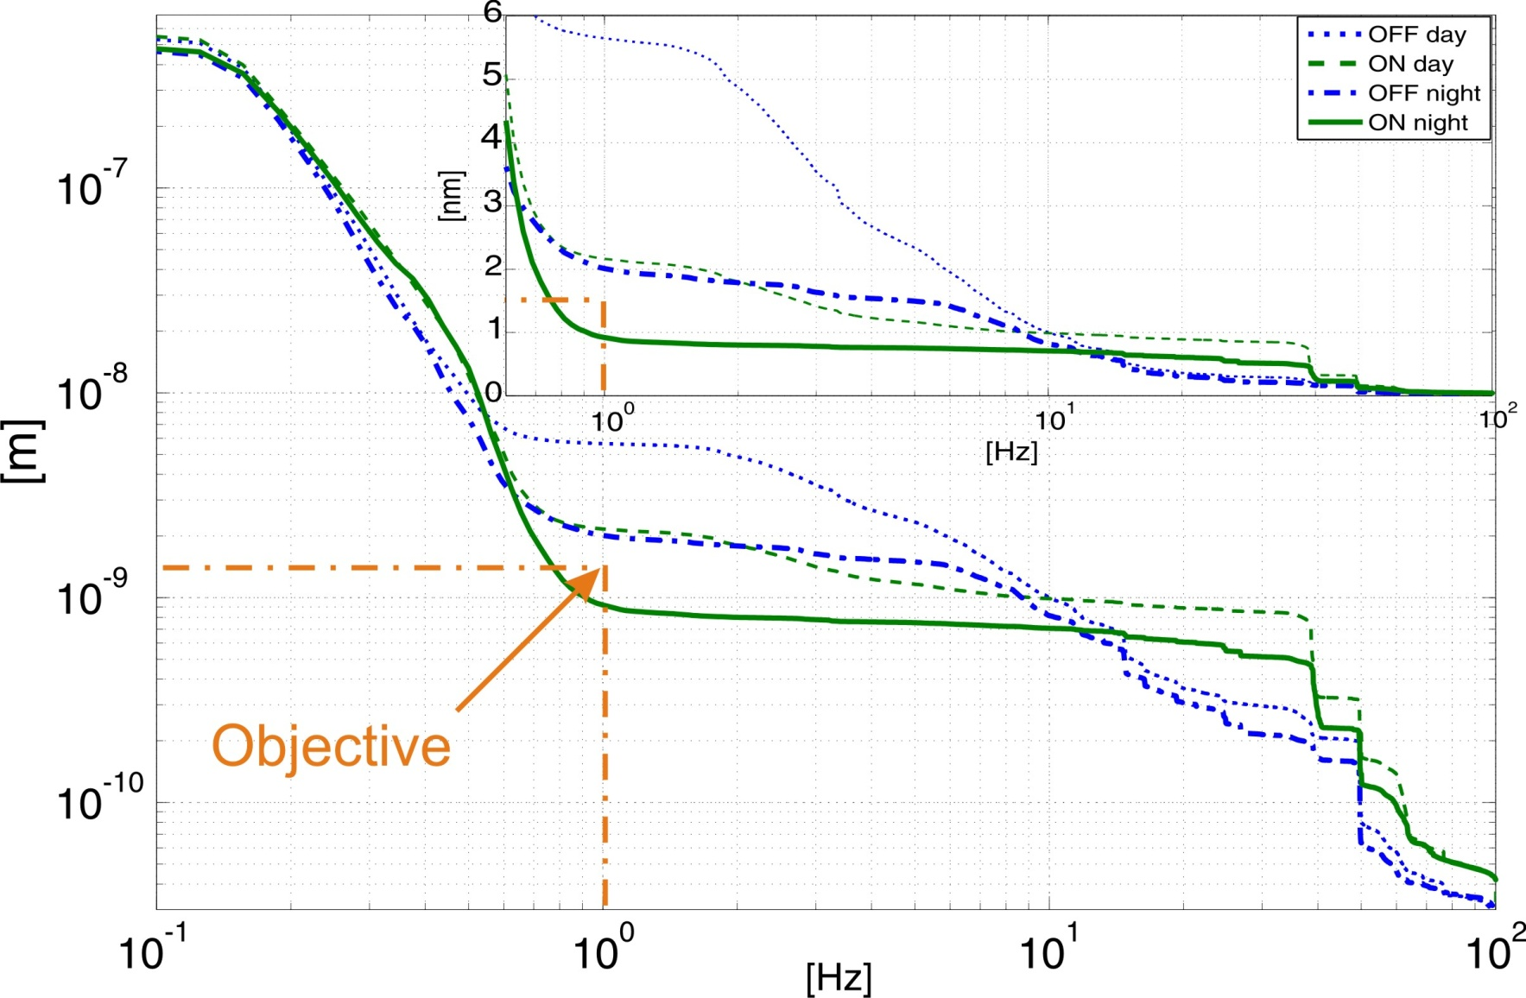
Stabilization in 2 d.o.f.
Will be improved with guide
m
Lateral
stabilization
Vertical
stabilization
0.9 nm at 1 Hz
Can be improved still.

Slide 20
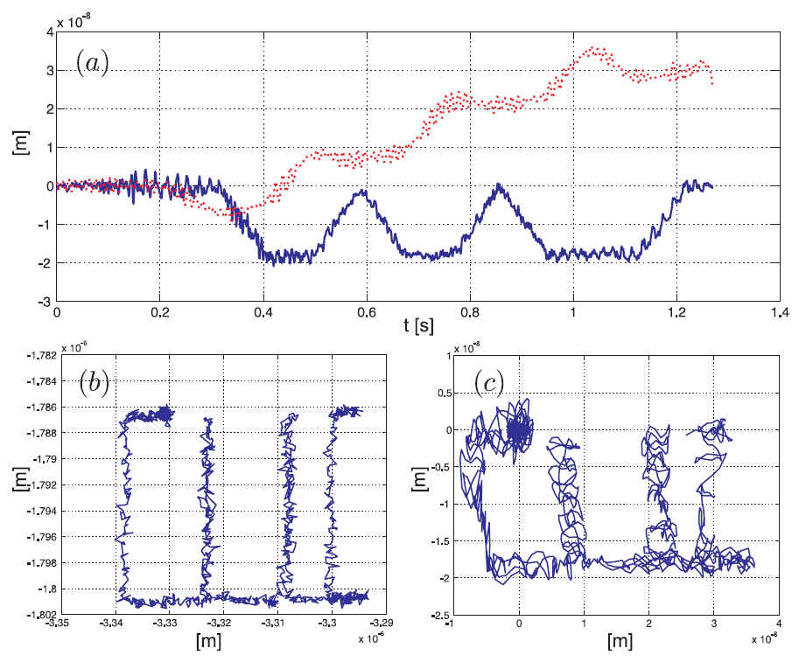
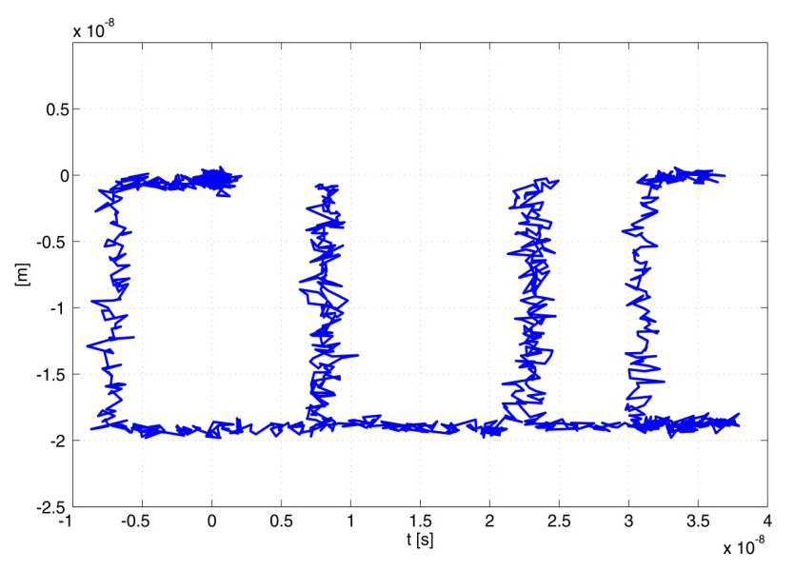
Positioning in 2 d.o.f.
Horizontal motion
Vertical motion
Measured x-y capacitive
Measured in legs
10 nm

Slide 21
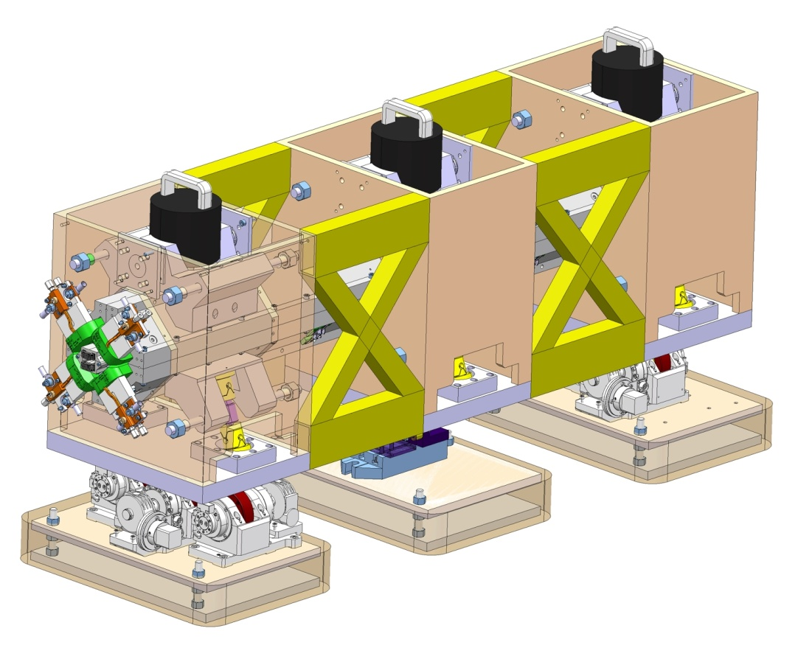

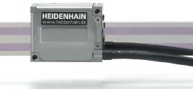
Concept drawing
Type 4
Stiff intermediate girder between alignment and stabilisation
Lockable in longitudinal direction (transport)
Introduce x-y nanometrology
Optical encoders would allow a hardware zero position
R. Leuxe
Alignment stage: H. Mainaud Durand

Slide 22
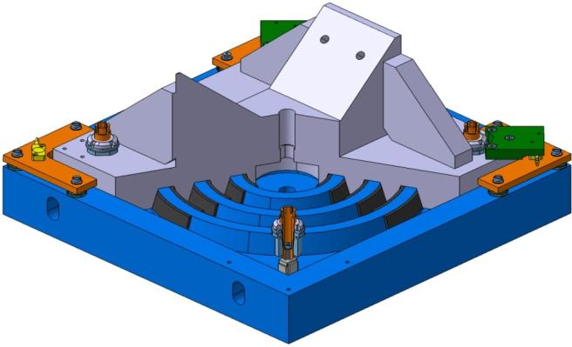
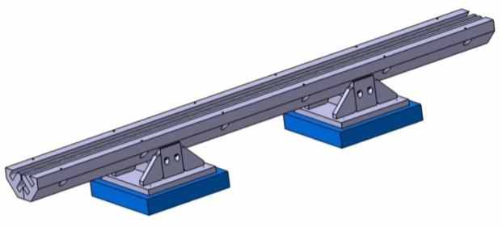
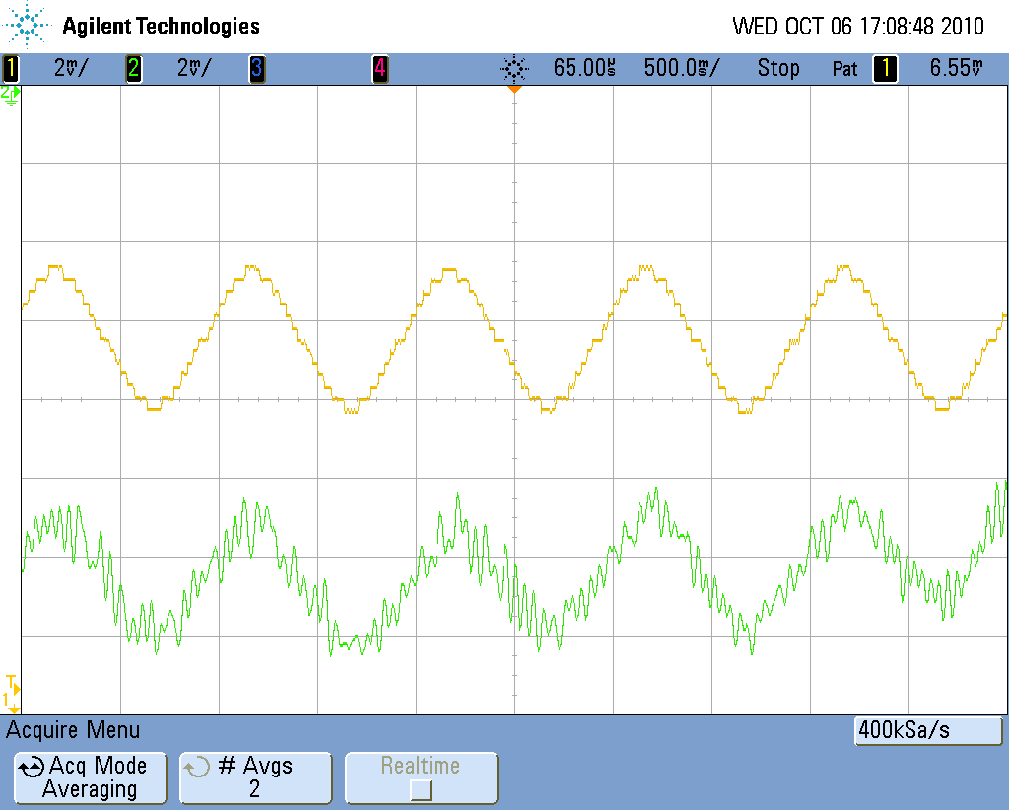
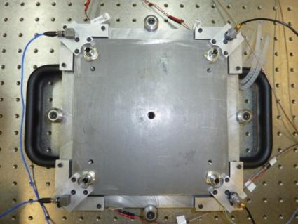
Lavista development Status: changed to stiff support option
Lower electrode of the capacitive sensor
V-support for the magnet
Elastomeric strips for guidance
Mid-lower magnet
240mm
1355mm
Fine adjustments for capacitive sensor (tilt and distance)
Piezoelectric actuator below its micrometric screw
2mV=0.1nm
Next step: add feedback

Slide 23
Conclusions CDR for MBQ
With STRATEGY STIFF stabilisation support based on
parallel piezo actuator structure:
We DEMONSTRATED in a model and on test benches
the technical feasibility to stabilise better than the required level at 1Hz in two d.o.f., from levels that were characterised in a running accelerator in a deep tunnel (LHC). This with commercially available components.
We demonstrated nano positioning in two d.o.f.
We have a concept design of the stabilisation support based on the validated actuator pair with flexural hinges.
Compatible with module requirements and alignment and robust against external forces
We did not yet demonstrate this in an accelerator environment
We did not yet demonstrate this with a complete system (magnet, alignment,...)

Slide 24
Deliverables and R&D
Main deliverables (Eucard):
Continued R&D:
Type 4 mock-up 09/2011
Type 1 and 4 Test modules/
CLEX 2012
Implementation CDR baseline
Increased performance: Interaction with BBF, stability and ratio increase RMS displacement, sensor development
COST reduction: e.g. Electronics, number of actuators, x-y sensors
Compatibility components accelerator environment: sensor development, research + qualification
5 points summary:
Overall system analysis:, sensitivity to change of requirements, again interaction with integrated luminosity simulations, characterisation components and vibrations sources, compliance
Pre-Industrialised, operational system: Reliability, distributed control system, series production
Mature technology

Slide 25
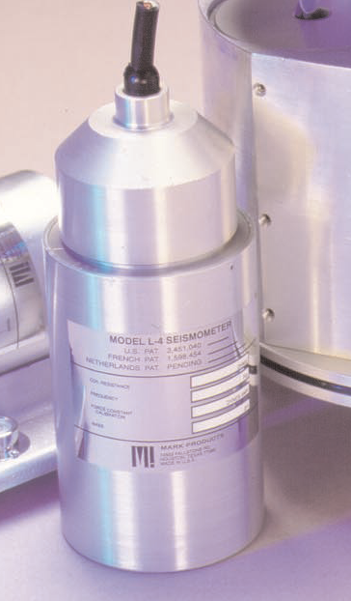
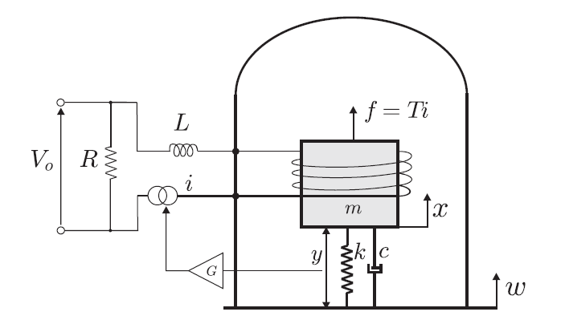

Sensor R&D
Increase performance
Increase RMS ratio
Increase resolution
Adapt to Daniel’s “Favorite Transfer Function”
Decrease Costs
Make compatible with
Accelerator environment
Modify Standard seismometer
  Use mechanics
  Implemented other displacement sensors
Development of a new sensor
Investigate Eentec Electro chemical seismometer

Slide 26
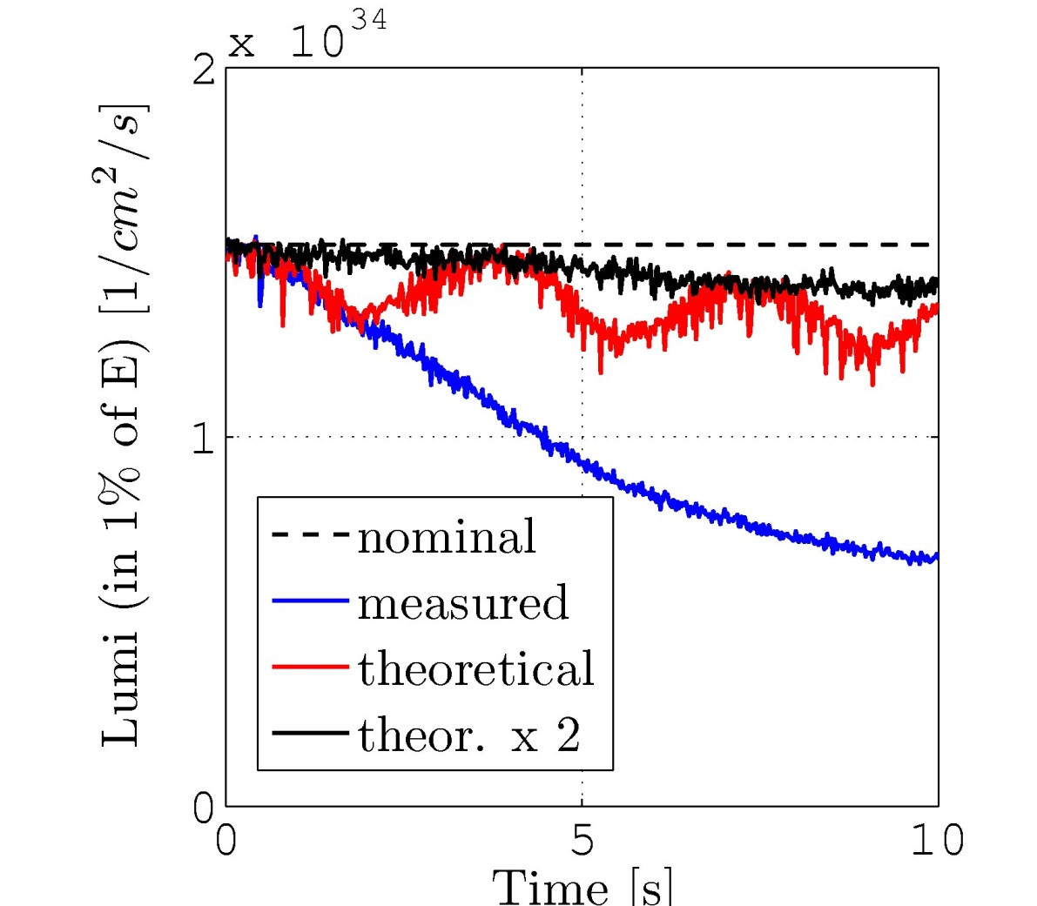
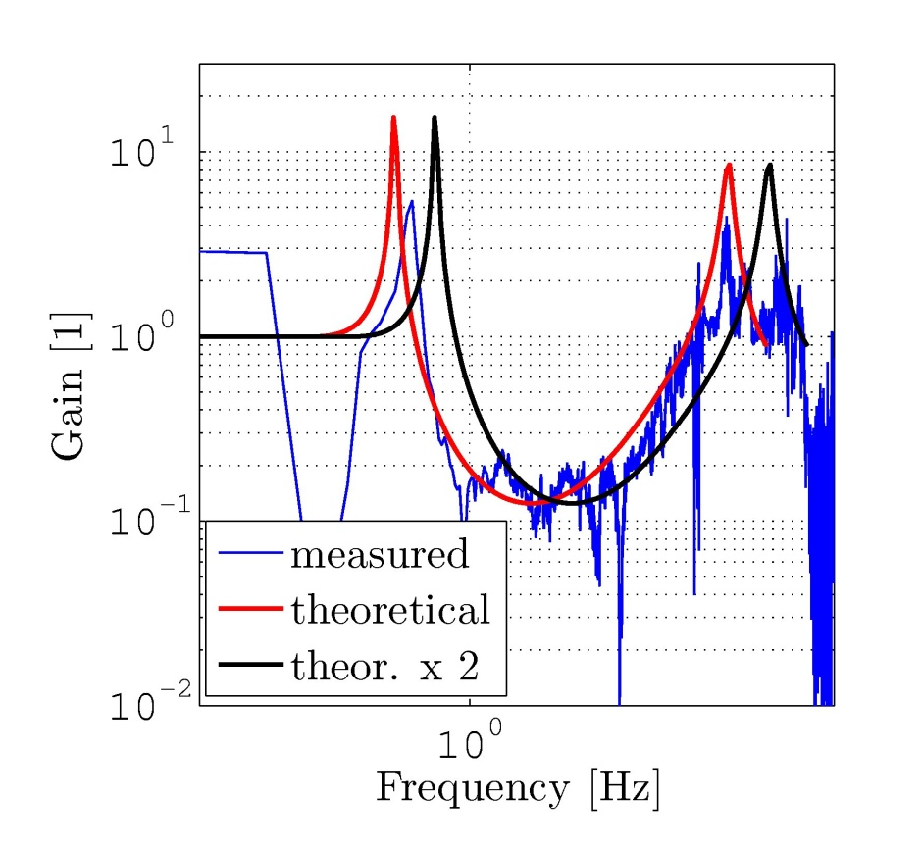
Interaction with BBF team
Guidelines for stabilization team:
  No amplification at the micro seismic peak
  Amplification around 75 Hz has to be kept small
Slide courtesy of J. Pfingstner and J. Snuverink
Beam physics meeting 12-01-2011

Slide 27
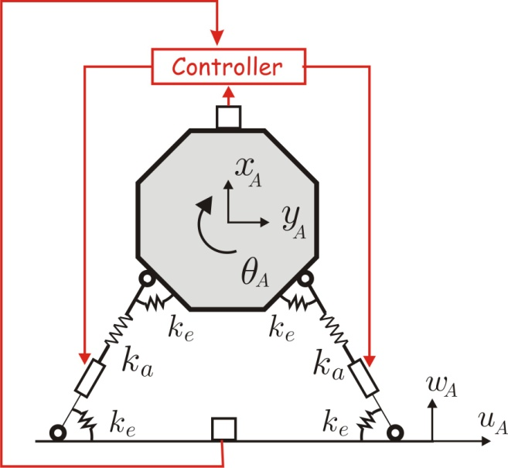
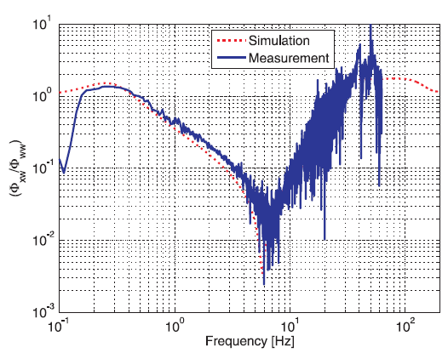
Feedforward Feedback
Reduced peak at low frequency
Reduced peak at high frequency
Tested by J. Snuverink and J. Pfingstner
Request to increase stabilization to higher frequency
S. Janssens

Slide 28
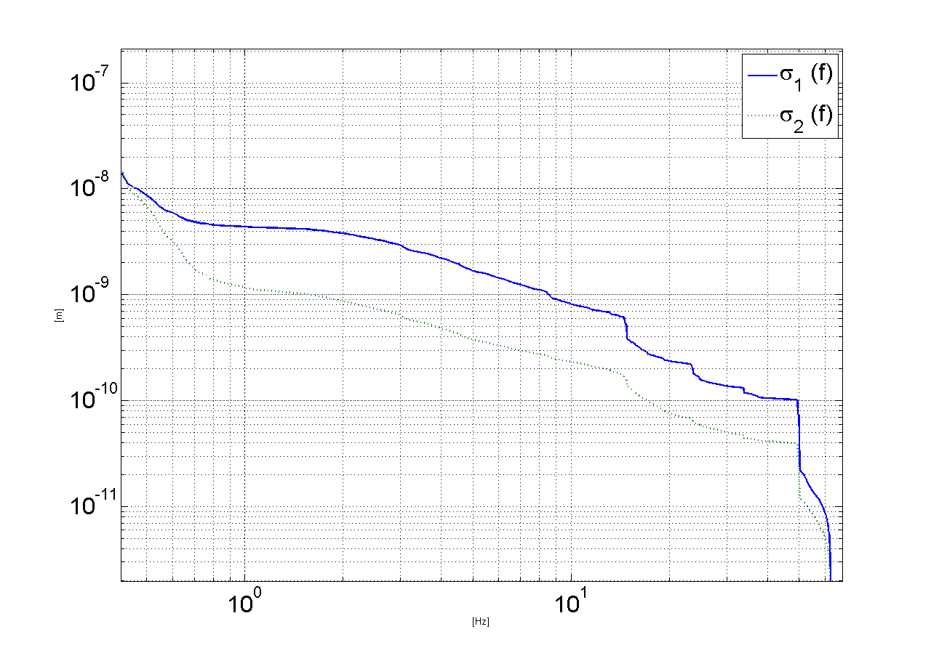
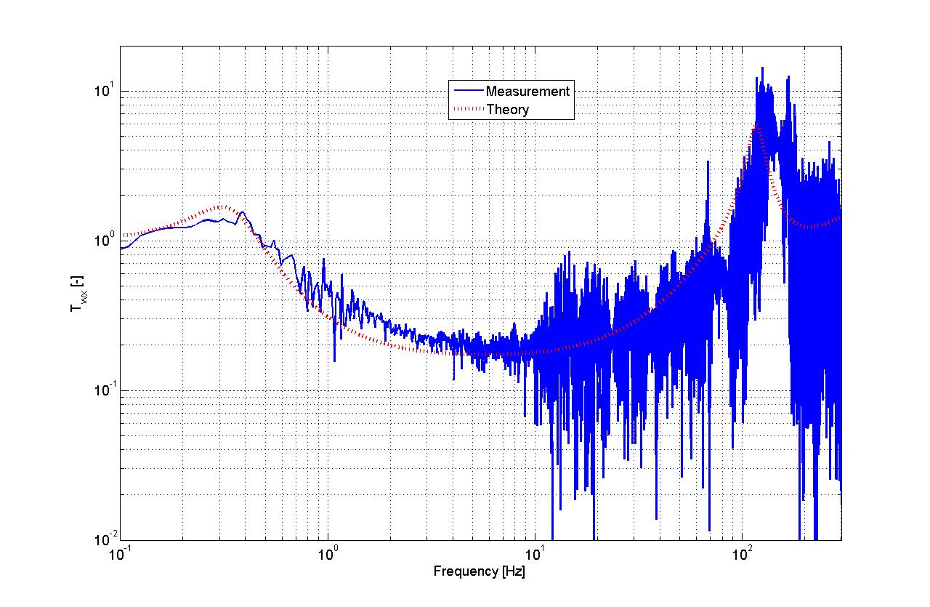
Analog control research
[m]
Membrane
4,5 nm
1,17 nm
P. Fernandez-Carmona
[Hz]
RMS@ 1Hz Measurement in ISR
Measured Transfer function
+ Low noise
+ Low cost
+ Small volume
+ Lower phase delay
+ Less sensitive to single events
+ Low power consumption
- Limited flexibility
P. Fernandez-Carmona

Slide 29
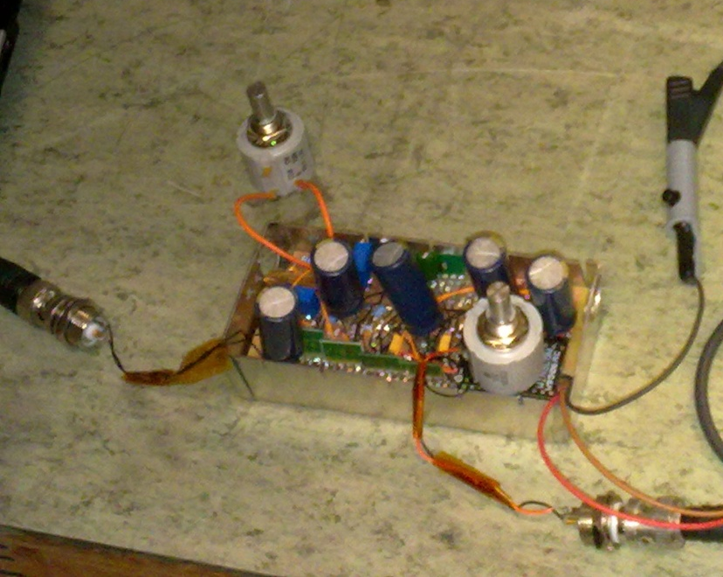
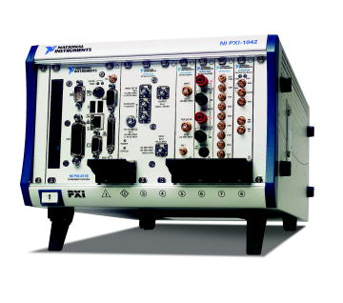
Analog control research
P. Fernandez-Carmona
Power ≈20mW
Cost ≈100CHF
Volume ≈0.15 l
Power ≈80W
Cost ≈15000CHF
Volume ≈13 l

Slide 30
Conclusions technical implementation
Short term deliverables are defined in EUCARD.
Medium term R&D strategy summarized in 5 points.
Technical implementation after CDR has already started with regularly new results.
Integration with BBF and Luminosity simulations is now systematic.

Slide 31
Publications
COLLETTE C., ARTOOS K., KUZMIN A., JANSSENS S., SYLTE M., GUINCHARD M. and HAUVILLER C., Active quadrupole stabilization for future linear particle colliders, Nuclear instruments and methods in physics research section A, vol.621 (1-3) pp.71-78 (2010).
COLLETTE C., ARTOOS K., GUINCHARD M. and HAUVILLER C., Seismic response of linear accelerators, Physical reviews special topics – accelerators and beams vol.13 pp. 072801 (2010).
FERNANDEZ-CARMONA P., COLLETTE C., JANSSENS S., ARTOOS K., GUINCHARD M., KUZMIN A., SLAATHAUG A., HAUVILLER C., Study of the electronics architecture for the mechanical stabilization of the quadrupoles of the CLIC linear accelerator, Journal of Physics : Conference series (Published 2010).
ARTOOS K., COLLETTE C., FERNANDEZ-CARMONA P., GUINCHARD M., HAUVILLER C., JANSSENS S. KUZMIN A., LACKNER F., LEUXE R. and SLAATHAUG A., Stabilization and fine positioning to the nanometre level of the CLIC Main beam quadrupoles, accepted in Physical reviews special topics – accelerators and beams (submitted in 2010).
In preparation: COLLETTE C., FERNANDEZ-CARMONA P., JANSSENS S., ARTOOS K., GUINCHARD M., HAUVILLER C., Inertial sensors for low frequency seismic vibration measurement, Bulletin of the Seismological Society of America
submitted in 2011: COLLETTE C., FERNANDEZ-CARMONA P., JANSSENS S., ARTOOS K., GUINCHARD M., HAUVILLER C., Nano-Motion Control of Heavy Quadrupoles for Future Particle Colliders: An Experimental Validation, Nuclear instruments and methods in physics research section A

Slide 32
Publications
ARTOOS K., COLLETTE C., GUINCHARD M., JANSSENS S., KUZMIN A. and HAUVILLER C., Compatibility and integration of a CLIC quadrupole nano-stabilization and positioning system in a large accelerator environment, IEEE International Particle Accelerator Conference IPAC10, 23-25 May 2010 (Kyoto, Japan).
ARTOOS K., COLLETTE C., GUINCHARD M., JANSSENS S., LACKNER F. and HAUVILLER C., Stabilisation and fine positioning to the nanometer level of the CLIC Main beam quadrupoles, IEEE International Particle Accelerator Conference IPAC10, 23-25 May 2010 (Kyoto, Japan).
COLLETTE C., ARTOOS K., JANSSENS S. and HAUVILLER C., Hard mounts for quadrupole nano-positioning in a linear collider, 12th International Conference on New Actuators ACTUATOR2010, 14-16 May 2010 (Bremen, Germany).
COLLETTE C., JANSSENS S., ARTOOS K. and HAUVILLER C., Active vibration isolation of high precision machine (keynote lecture), 6th International Conference on Mechanical Engineering Design of Synchrotron Radiation Equipment and Instrumentation (MEDSI 2010), 14 July 2010 (Oxford, United Kingdom).
COLLETTE C., JANSSENS S., ARTOOS K., GUINCHARD M. and HAUVILLER C., CLIC quadrupole stabilization and nano-positioning, International Conference on Noise and Vibration Engineering (ISMA2010), 20-22 September 2010 (Leuven, Belgique).

Slide 33
Publications
COLLETTE C., JANSSENS S., ARTOOS K. and HAUVILLER C., Active vibration isolation of high precision machine (keynote lecture), 6th International Conference on Mechanical Engineering Design of Synchrotron Radiation Equipment and Instrumentation (MEDSI 2010), 14 July 2010 (Oxford, United Kingdom).
COLLETTE C., JANSSENS S., ARTOOS K., GUINCHARD M. and HAUVILLER C., CLIC quadrupole stabilization and nano-positioning, International Conference on Noise and Vibration Engineering (ISMA2010), 20-22 September 2010 (Leuven, Belgique).
JANSSENS S., COLLETTE C., ARTOOS K., GUINCHARD M. and HAUVILLER C., A sensitiviy analysis for the stabilization of the CLIC main beam quadrupoles, Conference on Uncertainty in Structural Dynamics, 20-22 September 2010 (Leuven, Belgique).
FERNANDEZ-CARMONA P., COLLETTE C., JANSSENS S., ARTOOS K., GUINCHARD M., KUZMIN A., SLAATHAUG A., HAUVILLER C., Study of the electronics architecture for the mechanical stabilization of the quadrupoles of the CLIC linear accelerator, Topical Workshop on Electronics for Particle Physics TWEPP 2010, 20-24 September 2010 (Aachen, Germany).

Slide 34
Spares

Slide 35
Deliverables
2009 -2010 | R&D Stabilisation CLIC CDR Feasibility demonstration CLIC MBQ stabilisation Stabilisation Working Group
APRIL 2009-2013 | EUCARD WP 9.3.1 and 9.3.2
2009-2010 | Contribution exceptionelle de la France au CERN (EDMS 1009438) WP 4.7 and 4.8 LAPP (calculs et analyse vibratoire)+ CEA (interferometre) Evaluation performances 2011
~ DONE!
T1 concept drawing Module CDR
1. Mock-up type 4 (9/2011)
2. Characterisation of noise/vibration sources in an accelerator (03/’11)
3. Test module Type 1(10/’11) + 4. type 4 (05/’12)
5. CLEX: Type 1 + 6. Type 4 (12/’12)
Final EUCARD reports 03/2013
Experiment at CEBAF (2013)

Slide 36
Deliverables (conditions)
7. Further increase performance: stability and ratio reduction RMS displacement.
8. Compatibility components (sensor/actuator/ electronics) with accelerator environment: research + qualification
9. Compatibility with Alignment + external forces
Calibrate + characterise sensors by comparison + independent measurement method
Demonstrate stability with independent method
11. For operation in test modules and CLEX: a controller with external communication
10
12. State of the art report on sensor development and performances (updated yearly basis)
13. State of the art report on actuator development and performances (updated yearly basis)
14. Overal system analysis: stability, bandwidth, sensitivity to change of specifications,
interaction with BBF
15. Integration in the module design
16. Faults analysis and tolerance of technical system, machine protection
Remark: CDR is the baseline during technical implementation... but with some flexibility without dispersing our activities

Slide 37
2011
Q1
Q2
Q3
Q4
X-y guide prototype
X-y relative displ. measurements
Seismic reference mass/ seismometer improvement
Construction T4 mock-up
Testing T4 mock-up
T1 & T4 assembly, testing, water cooling
Construction T1 Test module
T4 vibration analysis
T1 vibration analysis
T0 vibration analysis
Lavista development
Characterisation vibration sources and propagation

Slide 38
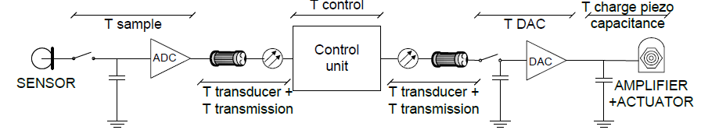
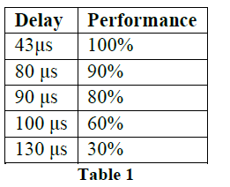
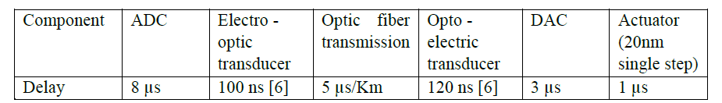
Latency Research
Latency research for stabilization (Digital system)
Goal: “Evaluate the impact of the latency on stabilization
performance”
Controller: Experimental validation with NI PXI 8106 RT + M series acquisition
with a 2D controller
“Study of the electronics architecture for the mechanical stabilisation of the quadrupoles of the CLIC linear accelerator” P. Fernandez 2010_JINST_5_C11014
P. Fernandez-Carmona
Reduction in performance due to latency in feedback system
  Long cables = latency problem => Localized control

Slide 39
Additional objectives
NANOMETROLOGY and introduction REFERENCE position
Measurement of the x-y displacement with respect to intermediate platform (fiducials):
Nanometre resolution
Instrumentation in actuator legs
Capacitive gauges in x-y guide
Optical linear encoders with gratings in x-y guide (Introduction hardware reference position)

Slide 40



Passive Isolation Strategies
Effect of support stiffness
[m/N]
Soft support :
(i) Improves the isolation
(ii) Make the payload more sensitive to external forces Fa

Slide 41



Active Isolation Strategies
Feedback control principle
Add virtual mass
(e.g. space applications)

Slide 42
Active Isolation Strategies
Feedback control principle
Sky-hook damper
(D.C. Karnopp, 1969)

Slide 43
Active Isolation Strategies
Feedback control principle
Position feedback would be great !
➔ How to measure it ?

Slide 44

Passive vs Active vibration isolation
Only active isolation can provide both:
Isolation in a broad frequency range between 1Hz and 20 Hz
Dynamic stiffness for robustness to disturbances and compatibility with alignment
Conditions:
- Measure the vibrations
Process the signal in real time
Apply small dynamic forces

Slide 45


Error budgeting
No significant difference in the noise transmission
Noise reduction

Slide 46




Strong coupling
Stability
Performances
Objective

Slide 47



Stability of slender quadrupoles
C. Collette et al, Nucl. Instr. meth. in phys. Res. A, vol.621 (1-3) pp.71-78 (2010).
C. Collette
Complete matlab program:
- Simulate vibration isolation
Simulate positioning
Simulate mechanics (x-y guide)

