Slide 1

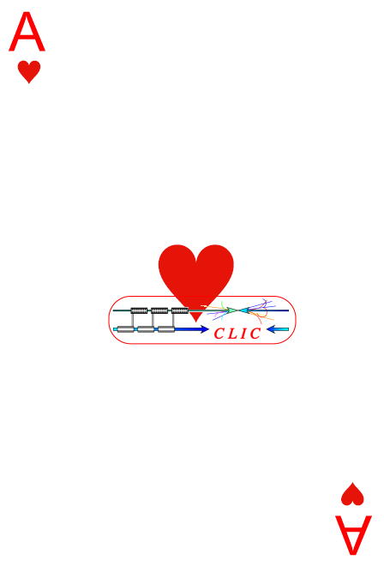


Introduction to the
6th CLIC Advisory Committee
meeting (02-04/02/11)
CLIC Advisory CommitteE
(ACE)
CLIC progress and perspectives
Follow-up from last ACE meeting
J.P.Delahaye/CERN
for the CLIC Study team and CLIC Collaboration

Slide 2
Organisation
This room reserved for the Committee up to Friday pm
Coffee breaks here (Committee and Speakers)
Lunches in CERN Main Cafeteria (tickets provided to Committee)
Dinner to-morrow in Glass Box (Main Cafeteria): (Committee and Speakers)
Report on ACE’s findings and recommendations by ACE chairman to: CLIC team on Friday pm Feb 04
Report on ACE’s findings and recommendations by ACE chairman to: Collaboration Board on Monday am Feb 07
Any organisational or administrative issues: Alexia (161220)

Slide 3
Specific to this ACE meeting
The 6th ACE meeting will focus on:
The status and progress of the ongoing CLIC R&D activities on technical subjects whose final results are expected beyond 2011. 2) The R&D program and the correspondent planning for the post CDR phase of the project.
  In particular, a few critical technical systems corresponding to ACE’s specific concerns (Damping Ring) and systems with major investments envisaged in the post CDR phase (Two-Beam modules, CTF3 upgrade and new drive beam facility) will be treated in detail.
The ACE is asked to provide comments on:
1) Relevance of the R&D issues.
2) Validity of the program to address such issues.

Slide 4
ACE6 agenda
(organised by R.Corsini)
http://indico.cern.ch/conferenceDisplay.py?confId=115921
This morning: Follow-up of ACE5, specially damping ring issues (Yannis) and feasibility status towards CDR
Next CLIC phase: Steinar (LC study leader)
This pm: Two Beam Module issues
  Visit of two beam module test stand to-morrow lunch
To-morrow am: CTF3 and +
To-morrow pm: CLIC Drive Beam injector issues
Friday am: additional info on request

Slide 5
5th ACE meeting (02-04/02/10)
The 5th ACE meeting will focus on the technical progress towards the CDR design and the status of the R&D program needed to demonstrate CLIC feasibility in support of the CDR.
The ACE is asked to comment on:
i) the layout and schedule for the CDR
ii) the schedule of the CLIC feasibility demonstrations and timing of the CDR
the technical and/or design status of the following subjects drawn from the “list of CLIC critical issues”:
ACE report: Recommendations to CLIC team:
http://indico.cern.ch/conferenceDisplay.py?confId=81094
Presentation Tor to CLIC/CTF3 collaboration Board:
  http://indico.cern.ch/conferenceDisplay.py?confId=82576

Slide 6
ACE5 recommendations on Feasibility issues
Clarify the context of “technical feasibility of CLIC concept” upfront, in CDR i.e. what it is, and what it is not.
CLIC group should quantify and qualify -
    What has been demonstrated wrt what is needed at CLIC.
    What is planned to do at the TDR stage with goals, deliverable, milestones and budget for all significant parts of it.
    (How the outcome from activities during the TD stage would relate to the launch of the project. )
CLIC group should offer the explanations in reasonable details for the above sub-bullets in the CDR, besides the design description of CLIC which is already planned in the outline for CDR.
JPD
This presentation
S.Stapnes
02/02 am

Slide 7
ACE5 recommendations on Main Beam Accelerator Structures
Should go full steam ahead with RF testing of the acc structures in pipeline, with emphasis on TD24.
    Take advantage of any chances for further schedule optimization.
    Try to make some statement on the struc life time on the basis of available data.
Besides the ongoing work toward CDR,
    Testing of more accelerator structures highly recommended in the future to enhance confidence in the statistical and technical sense.
    Clarify implications of difference in the current testing environment (i.e. absence of beam, beam-loading) wrt actual CLIC operational conditions, to pre-avoid confusion in the community.
    Address lifetime issues.
    Validated HOM damping performance.
CERN efforts on its own infrastructure (fab + testing) strongly encouraged.
R.Corsini
02/02 am
W.Wuensch
02/02 pm

Slide 8
ACE5 recommendations on Drive Beam Decelerator Structure
Toward completion of CDR
    ON/OFF operation has to be demonstrated (with the new scheme; integrated reflector)
    HOM will not be immediately measured and remains to be an outstanding concern.
    Ditto for damage and lifetime aspects in a recirculator-aided setting.
Ultimate goal has to be remembered:
  DB-driven test all features with a 100 A beam .
JPD for I.Syratchev
R.Corsini
E.Jensen
S.Doebert
03/02 am

Slide 9
ACE5 concerns on Damping Ring
  Space charge tune shift (0.2) very large,
  2GHz RF system seems very hard. No detailed calc or sim seem available.
  Beam pipe diameter very small (10mm).
  Bunch length very short (1mm).
  HOM power studies not available.
  Large gap in the ring might cause a lot of difficulties for the RF system and RF and beam stability requirements.
  Synchronous phase spread due to the gap transient is missing.
  No studies made on single and multi bunch instabilities.
  Feedback requirements missing.
  Longitudinal dynamics (with RF cavities) has to be checked.
Committee feels that not enough data presented to judge the DR feasibility.
  DR is one of the major performance drivers for any LCs.
Y.Papaphilippou
02/02 am

Slide 10
ACE5 Global Recommendations for / beyond CDR
Highly desirable to make concentrated efforts on the CTF3-TBL demo test
  With the goal of showing the probe beam acceleration
  Before the CERN council meeting (June 2011)
For sake of CDR presentation
  Understand the audience (Council, Community around CERN, Community in the world, Community outside HEP)
  Do not be shy about the progress and accomplishment.
  Yet, be open and forthcoming about remaining issues.
  Be quantitative, whenever possible.
  Also, use tables to compare the specs, goals, achievements, projections, whenever possible.
The feasibility of many of the critical components for CLIC has been demonstrated in the sense of an existence proof
    What is less well developed is the feasibility of systems and the systems-integration
    These issues must be addressed in TDR-phase
S.Doebert
03/02 am
H.Schmickler
to authors
S.Stapnes
03/02 am

Slide 11
ACE5 Recommendations on next phase
Develop a plan for the TDR phase that is focused on laying the groundwork for approval of CLIC construction
  The committee supports including prototype development and testing as well as significant R&D items, in particular, realistic testing of the two-beam acceleration structures with 100 Amps and 240 ns.
Construction of the full drive beam linac (2 GeV) could be part of “CLIC-Zero” as a first phase of CLIC construction.
    CLIC-Zero would be only opportunity for the many systems-level demonstration of the CLIC concept.
  Important to think of a possible physics justifications for CLIC-zero.
S.Stapnes
02/02 am
Discussionintroduced& moderatedR.Corsini
03/02 pm

Slide 12

























World-wide CLIC&CTF3 Collaboration
http://clic-meeting.web.cern.ch/clic-meeting/CTF3_Coordination_Mtg/Table_MoU.htm
CLIC multi-lateral collaboration
41 Institutes from 21 countries
Chairman:K.Peach, Spokesperson:RCorsini
New member
from ACE5
ACAS (Australia)
Aarhus University (Denmark)
Ankara University (Turkey)
Argonne National Laboratory (USA)
Athens University (Greece)
BINP (Russia)
CERN
CIEMAT (Spain)
Cockcroft Institute (UK)
ETHZurich (Switzerland)
FNAL (USA)
Gazi Universities (Turkey)
John Adams Institute/RHUL (UK)
JINR (Russia)
Karlsruhe University (Germany)
KEK (Japan)
LAL / Orsay (France)
LAPP / ESIA (France)
NIKHEF/Amsterdam (Netherland)
NCP (Pakistan)
North-West. Univ. Illinois (USA)
Patras University (Greece)
Polytech. University of Catalonia (Spain)
PSI (Switzerland)
RAL (UK)
RRCAT / Indore (India)
SLAC (USA)
Thrace University (Greece)
Tsinghua University (China)
University of Oslo (Norway)
Uppsala University (Sweden)
UCSC SCIPP (USA)
Helsinki Institute of Physics (Finland)
IAP (Russia)
IAP NASU (Ukraine)
IHEP (China)
INFN / LNF (Italy)
Instituto de Fisica Corpuscular (Spain)
IRFU / Saclay (France)
Jefferson Lab (USA)
John Adams Institute/Oxford (UK)
Notes:
12

Slide 13
Extending CLIC /ILC Collaboration http://clic-study.web.cern.ch/CLIC-Study/CLIC_ILC_Collab_Mtg/Index.htm
Common working groups on technical subjects with strong synergy between CLIC & ILC (co-chaired):
  Physics & Detectors, Beam Delivery System (BDS) & Machine Detector Interface (MDI), Civil Engineering & Conventional Facilities, Positron Generation, Damping Rings, Beam Dynamics, Cost & Schedule
Joint Working Groups on Linear Collider General Issues (Accelerator & Detectors)
  reporting to ILCSC and CLIC Collaboration Board
  Final report end 2012, preliminary report by PL to CB on 07/02/11
IWLC2010 workshop (18-22/10/2010 @ CERN)
Joint CLIC & ILC (Accelerator and Detectors)
https://espace.cern.ch/LC2010/default.aspx
500 participants
9 Accelerator WG + 13 Physics@Detectors WG

Slide 14
CLIC design update
Baseline review
  Proposals of WGs in December 2009
  Presented to ACE by G.Geschonke in Feb 2010
  Recommendations of dedicated teams for critical proposals
  Approved by CASC after final review in March 2010:
  https://edms.cern.ch/document/1115567/1
Lots of detailed studies in preparation of CDR
  in the framework of the various WGs reporting to oversight committees:
  http://clic-study.org/structure/CLIC-organisation.htm

Slide 15
CLIC main parameters
http://cdsweb.cern.ch/record/1132079?ln=fr http://clic-meeting.web.cern.ch/clic-meeting/clictable2007.html
Center-of-mass energy | CLIC 500 GeV |  | CLIC 3 TeV
Beam parameters | Relaxed | Nominal | Relaxed | Nominal
Accelerating structure | 502 |  | G
Total (Peak 1%) luminosity | 8.8(5.8)·10³³ | 2.3(1.4)·10³⁴ | 7.3(3.5)·10³³ | 5.9(2.0)·10³⁴
Repetition rate (Hz) | 50
Loaded accel. gradient MV/m | 80 |  | 100
Main linac RF frequency GHz | 12
Bunch charge10⁹ | 6.8 |  | 3.72
Bunch separation (ns) | 0.5
Beam pulse duration (ns) | 177 |  | 156
Beam power/beam MWatts | 4.9 |  | 14
Hor./vert. norm. emitt(10⁻⁶/10⁻⁹) | 7.5/40 | 4.8/25 | 7.5/40 | 0.66/20
Hor/Vert FF focusing (mm) | 4/0.4 | 4 / 0.1 4/0.4 |  | 4 / 0.1
Hor./vert. IP beam size (nm) | 248 / 5.7 | 202 / 2.3 | 101/3.3 | 40 / 1
Hadronic events/crossing at IP | 0.07 | 0.19 | 0.28 | 2.7
Coherent pairs at IP | 10 | 100 | 2.5 10⁷ | 3.8 10⁸
BDS length (km) | 1.87 |  | 2.75
Total site length km | 13.0 |  | 48.3
Wall plug to beam transfert eff | 7.5% |  | 6.8%
Total power consumption MW | 129.4 241 |  | 415 568

Slide 16
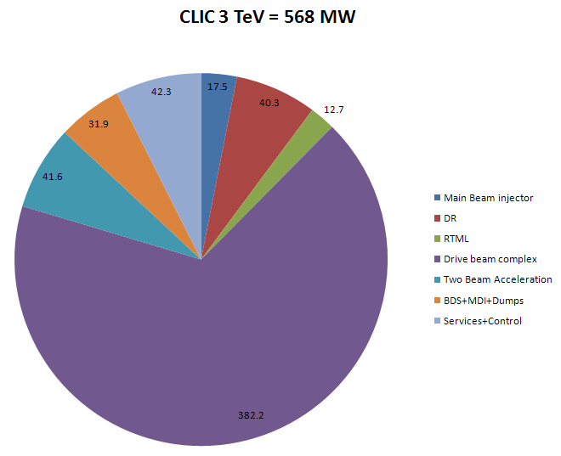
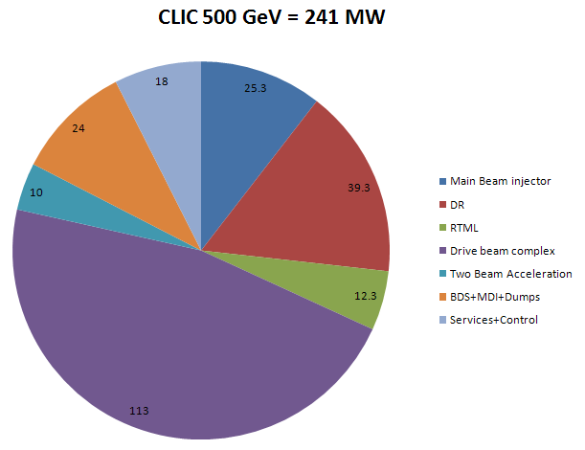
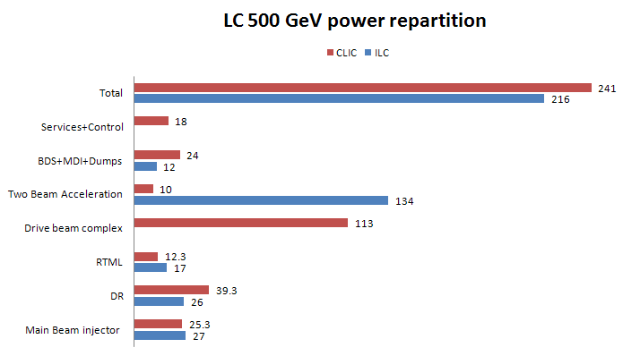
CLIC power
JB.Jeanneret
Preliminary

Slide 17
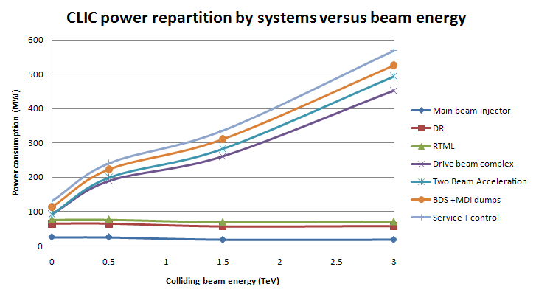
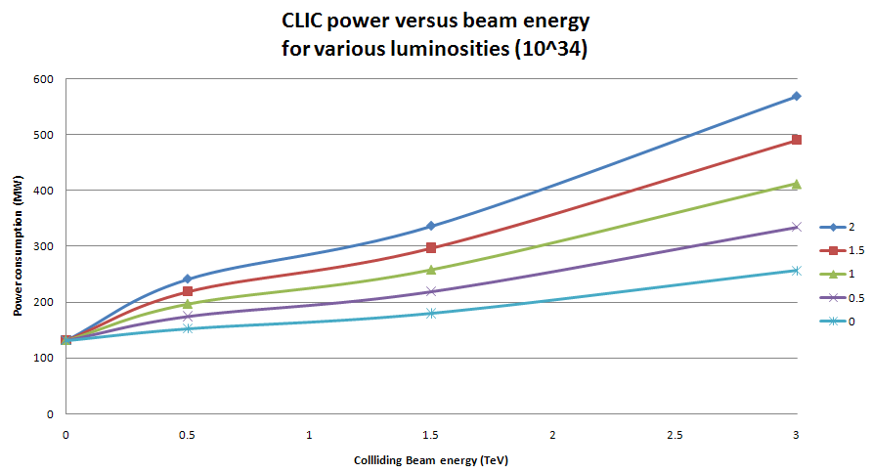
JB.Jeanneret
Preliminary

Slide 18
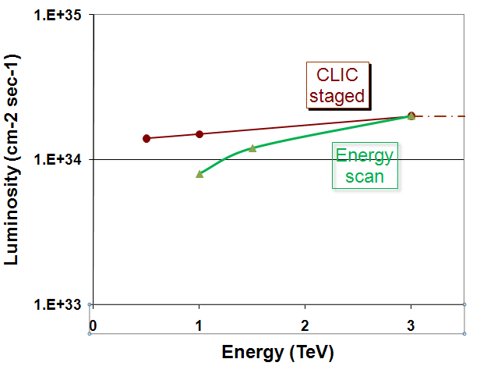
CLIC performances and energy scan

Slide 19
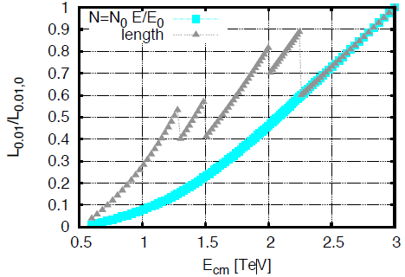
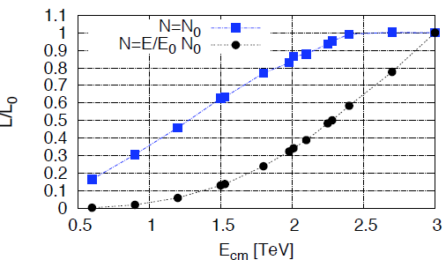
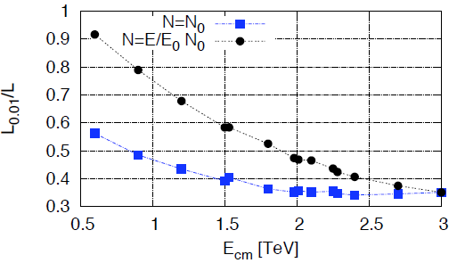
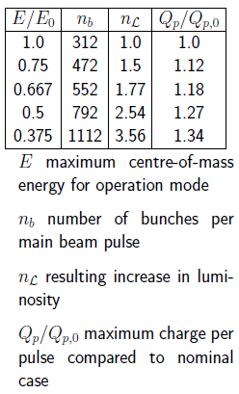
Energy scan strategy and performance
D.Schulte
Beam collision energy (E) adjustment by accelerating gradient (G) tuning
  Charge per bunch N proportional to gradient G for beam stability
Luminosity recovery by longer beam pulse compatible with reduced gradient in RF structures at lower Energy
specified
Longer pulse
Luminosity reduction
Constant pulse
Better energy spectrum

Slide 20
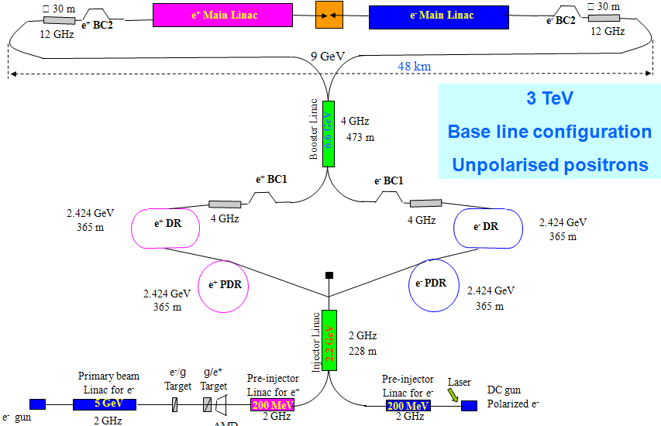
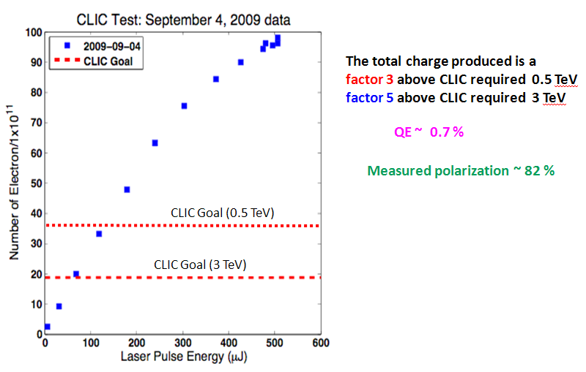
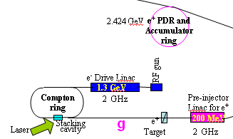
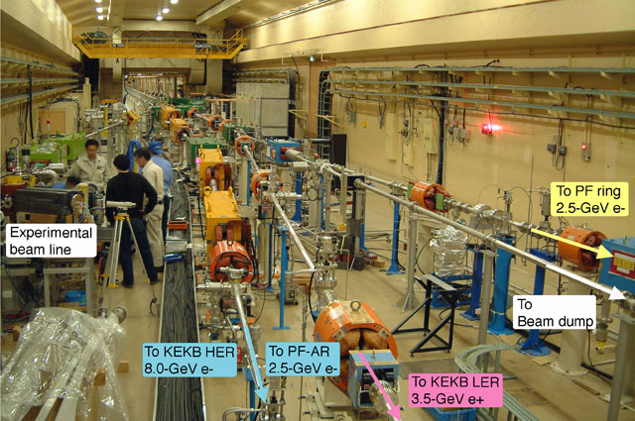
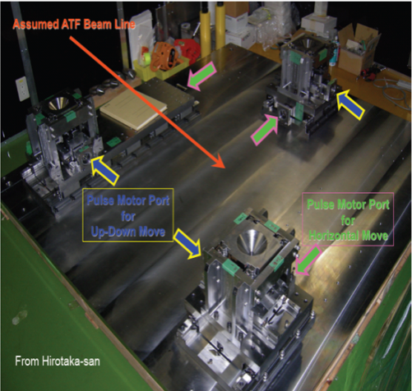
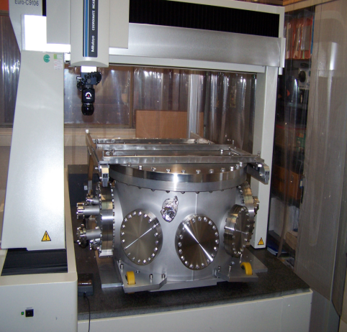
Progress on Main Beam Injector Sources
L.Rinolfi
3 TeV
Laser Compton ring
Polarised positrons
Tests @ SLAC of polarised electrons
Tests @ KEK of unpolarised positrons from hybrid target
Tests @ KEK of Optical cavity using Compton backscattering for ILC and CLIC polarized e⁺
(Collaboration CERN/LAL/KEK)

Slide 21
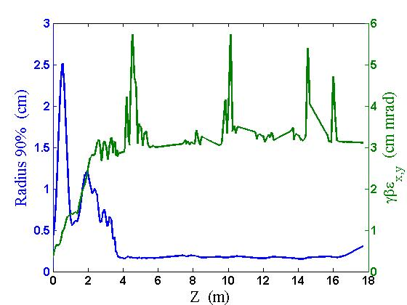
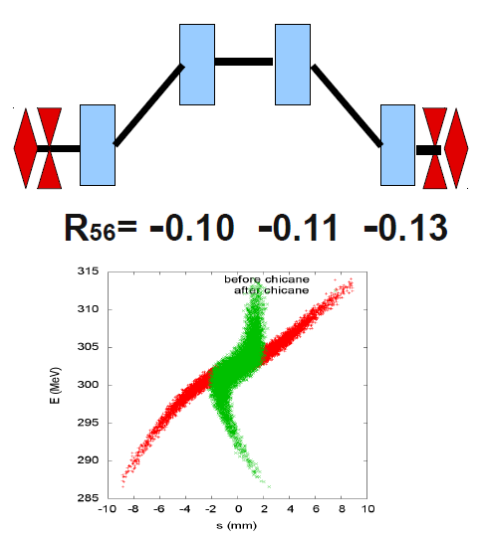
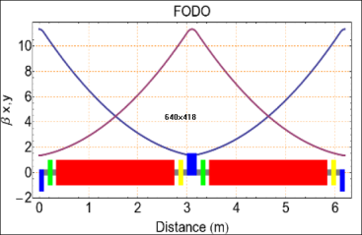
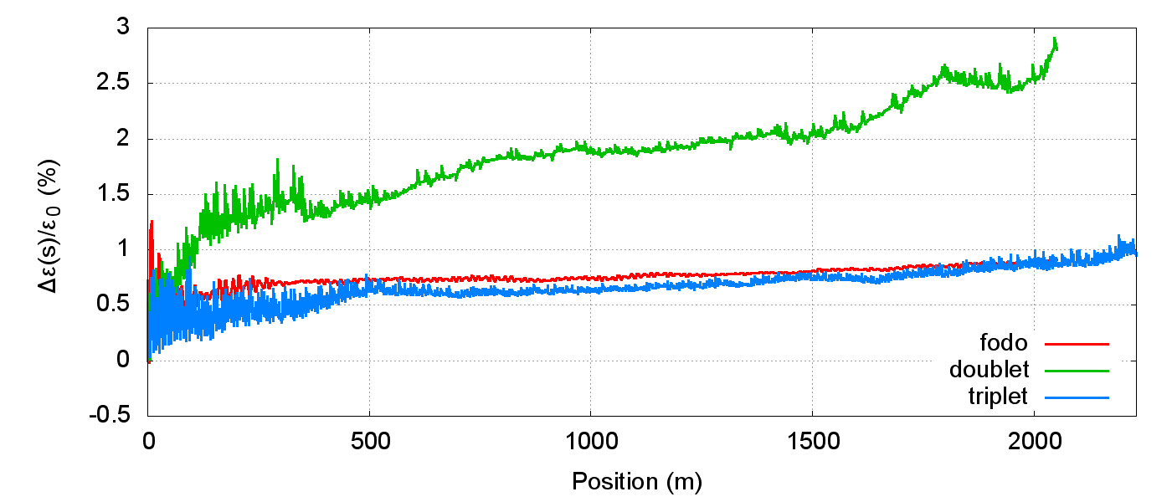
Progress in Drive Beam Complex design
Drive beam injector design
A.Vivoli
S.Bettoni
Conceptual design, beam dynamics simulations
Beam performances well within specs
Drive Beam linac design & simulations – including compressors
Lattice, beam dynamics, transverse and longitudinal stability studies
Stability ensured, tolerances defined for phase and energy errors
A. Aksoy

Slide 22
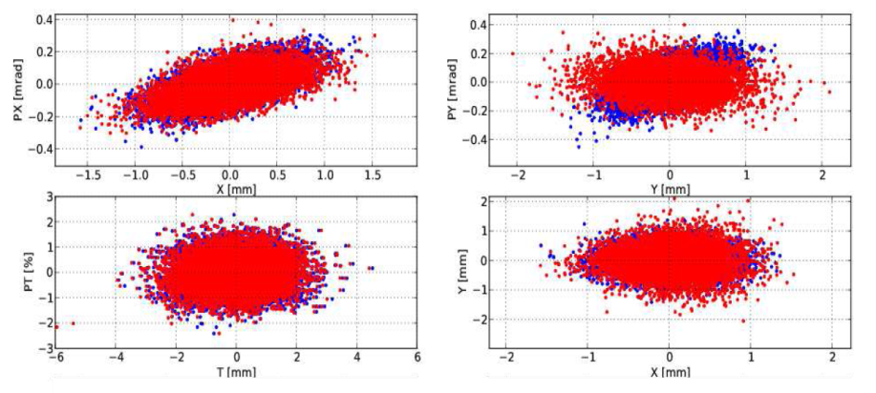
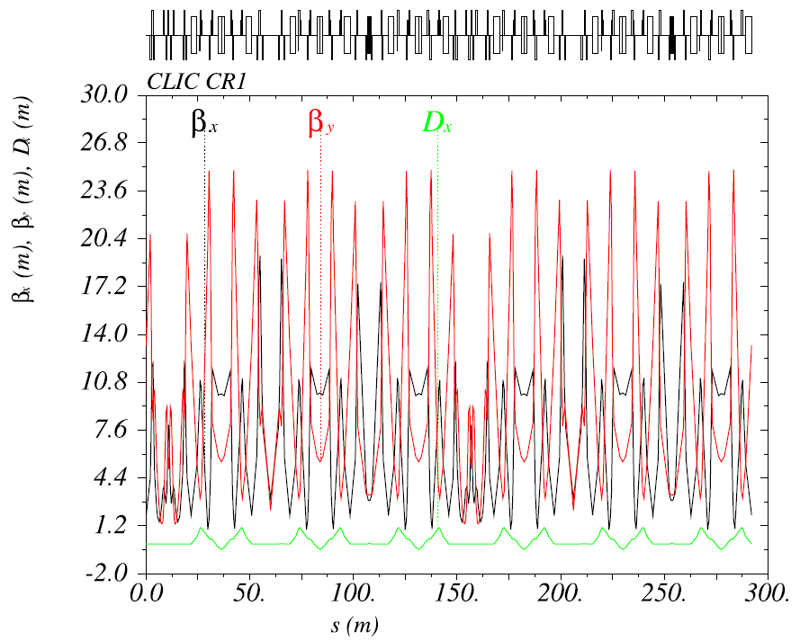
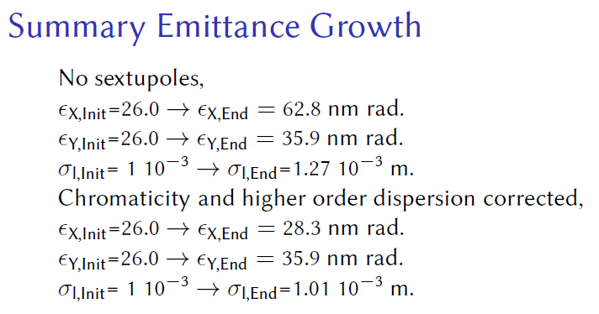
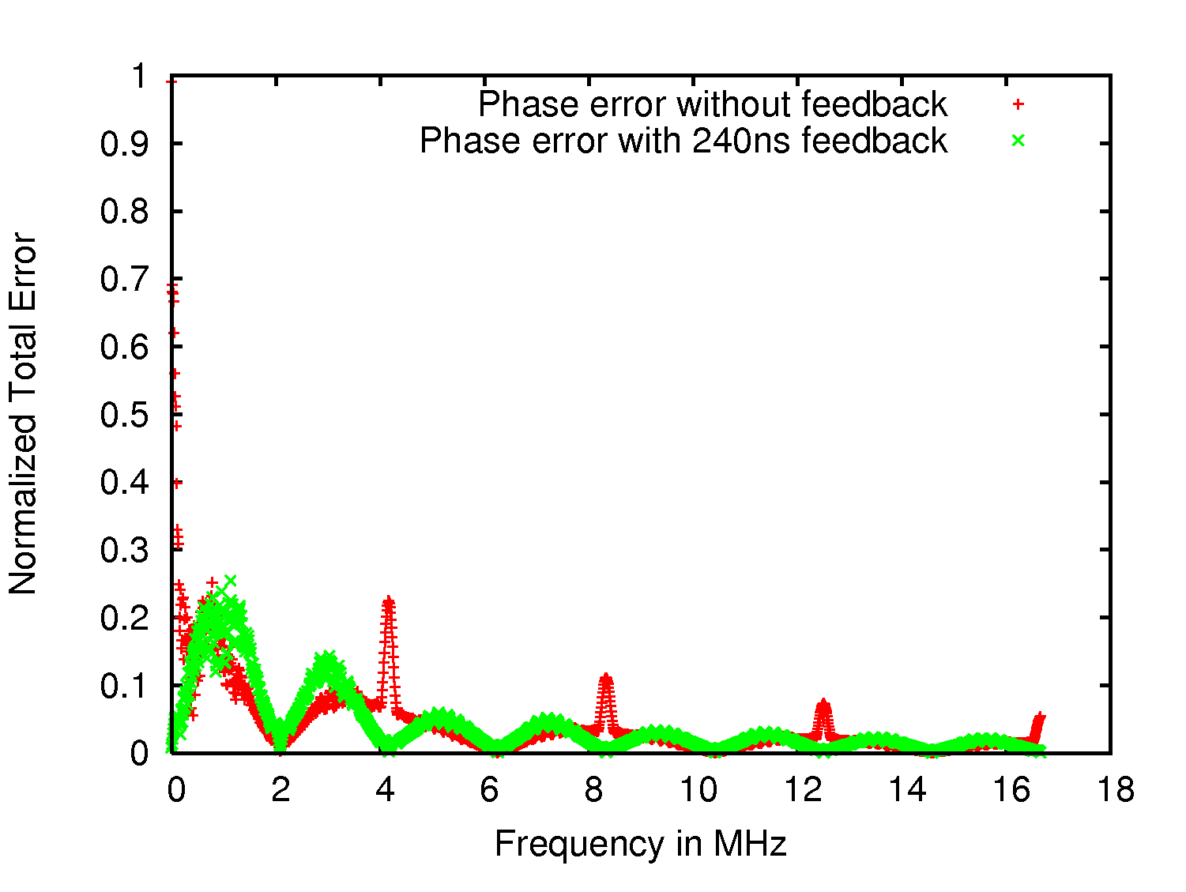
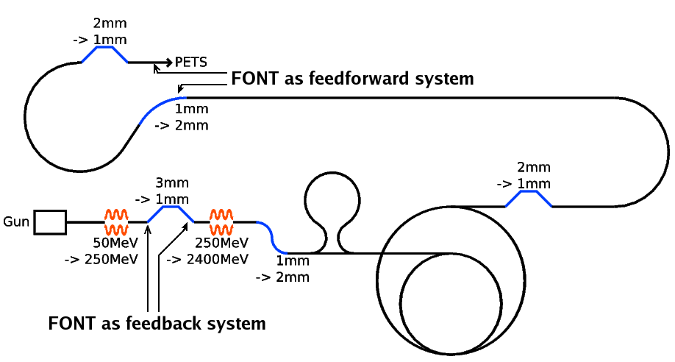
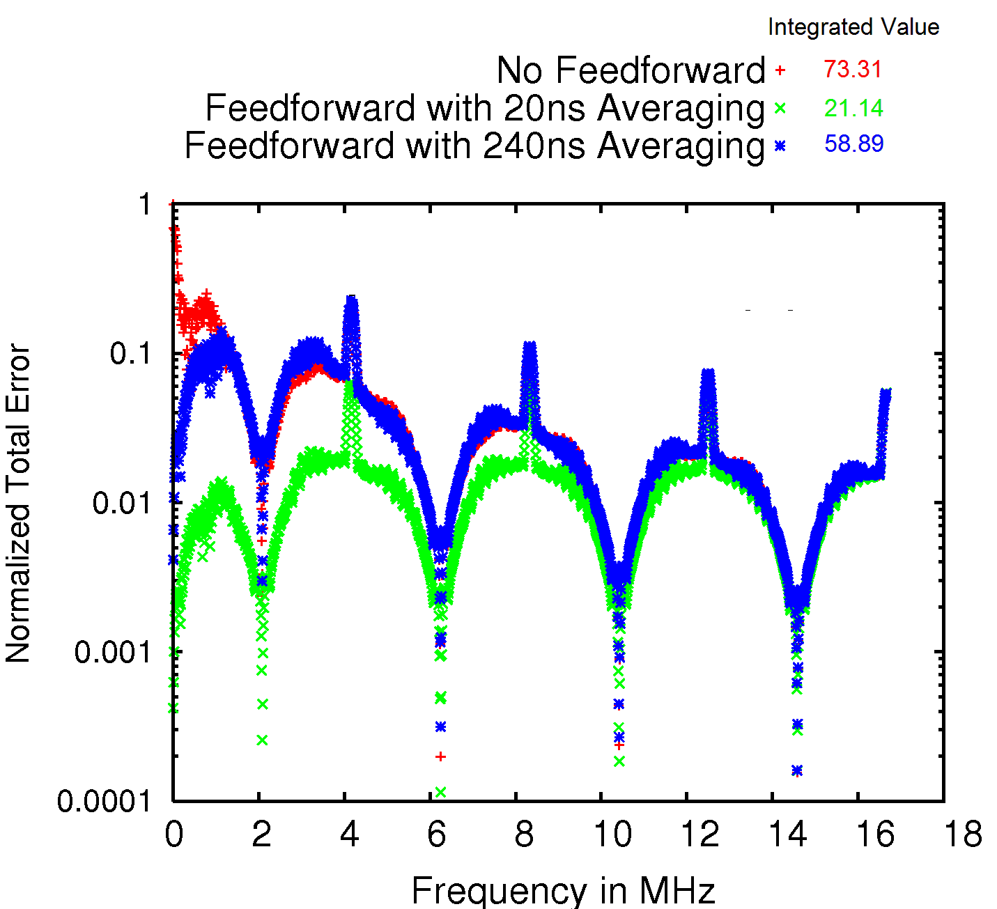
Progress in Drive Beam Complex design, cont’d
Drive beam Combiner Rings
Layout, optics, beam dynamics simulations
Chromatic corrections, control of emittance growth
P. Skowronski, J. Barranco, C.Biscari
Drive beam charge and phase jitter control, feedbacks and feed-forward
A. Gerbershagen
Analysis of charge error propagation, feedback & feed-forward simulation
Good performance with 240ns feedback, residual errors corrected with high-bandwidth feed-forward
A. Gerbershagen

Slide 23
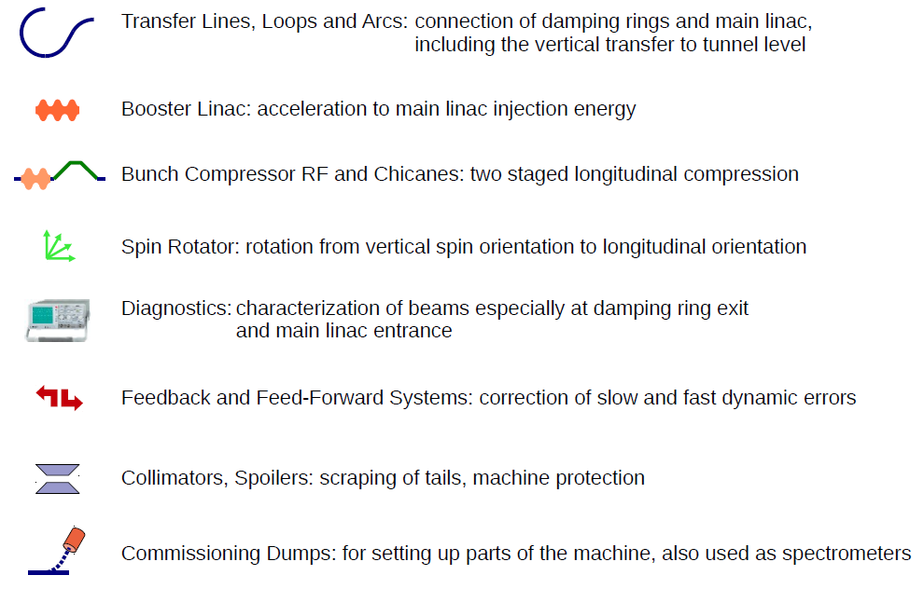
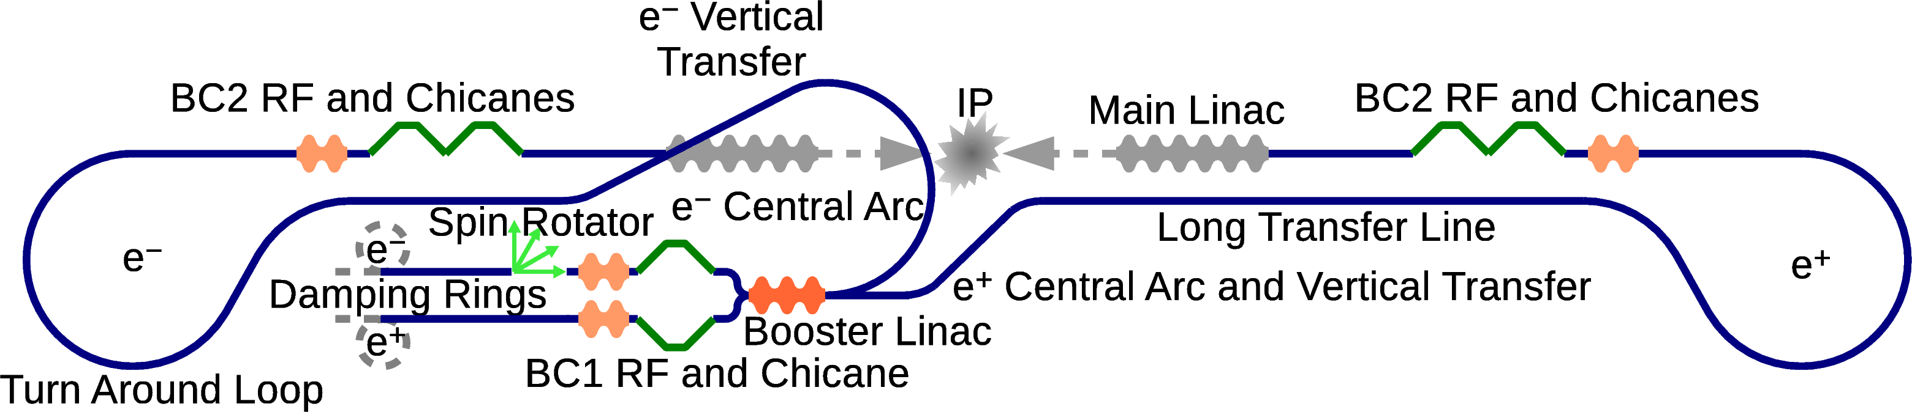
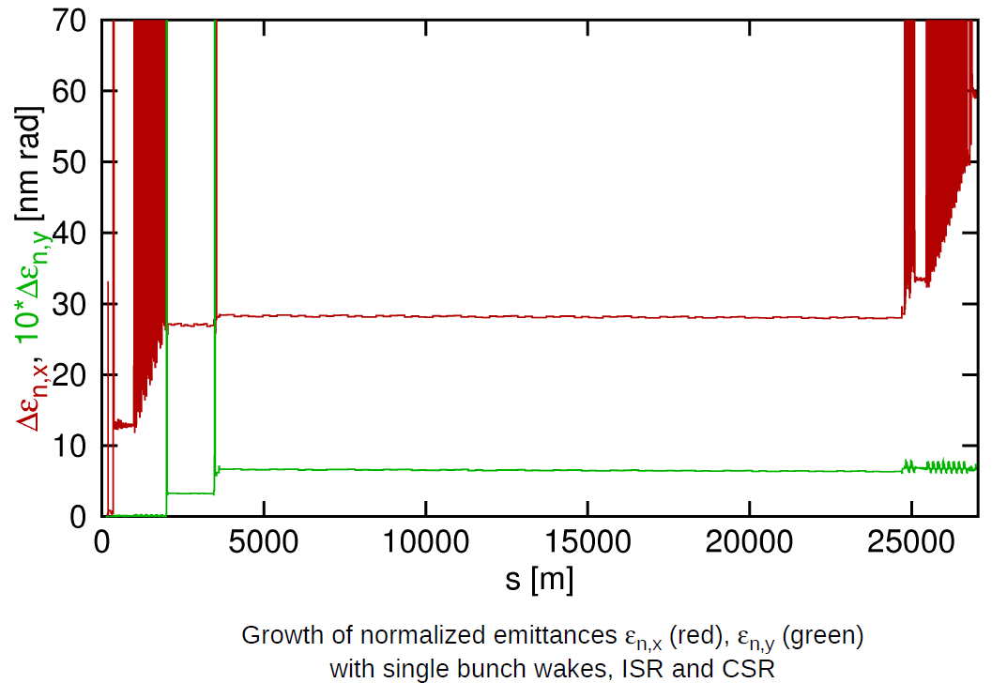
Progress in CLIC RTML design
F.Stulle
Lattices are complete including the e- spin rotator.
Good performance including incoherent synchrotron radiation, coherent synchrotron radiation and single bunch wakes.
Static misalignment along RTML (Booster linac, turn around loops with specifications ~1 µm range for 1-to-1 steering and in the ~100 µm range for dispersion free steering.
Ground motion not really be an issue.
Dynamic magnetic stray for the long transfer line with specification below 10 nT (~0.1 nT for periodic stray fields at betatron wavelength).
Tolerances for incoming beam properties, RF phases and amplitudes : partially tight but not too far from what has already been shown in accelerators, e.g. 0.08 deg @ 2 GHz BC1 RF phase stability.
The RTML studies are considered sufficient for the CDR.

Slide 24
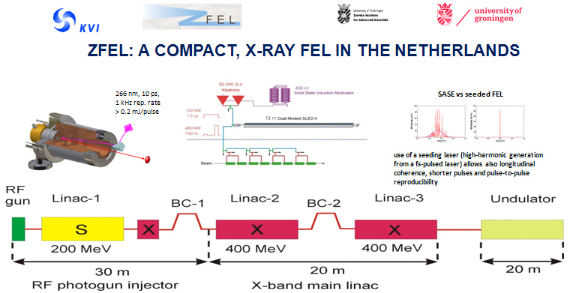
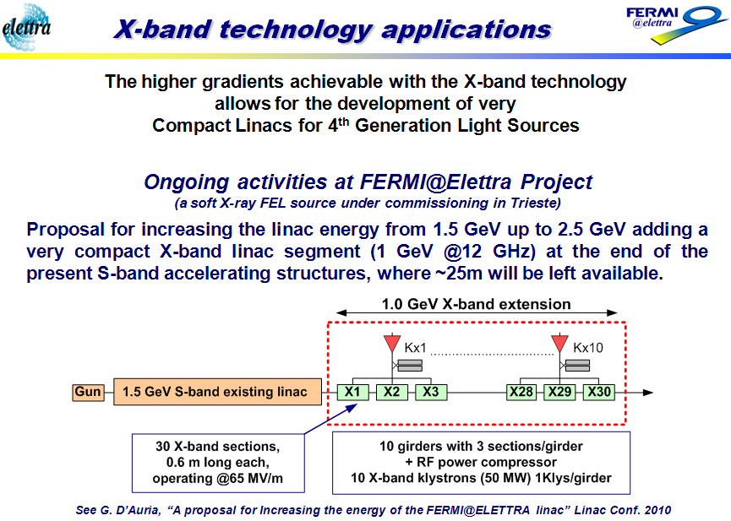
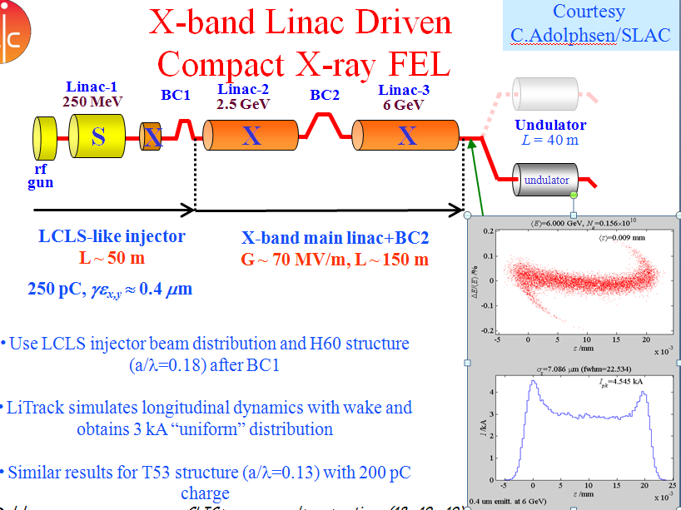
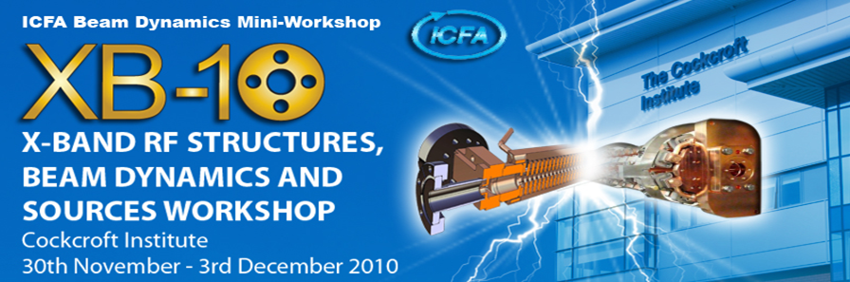
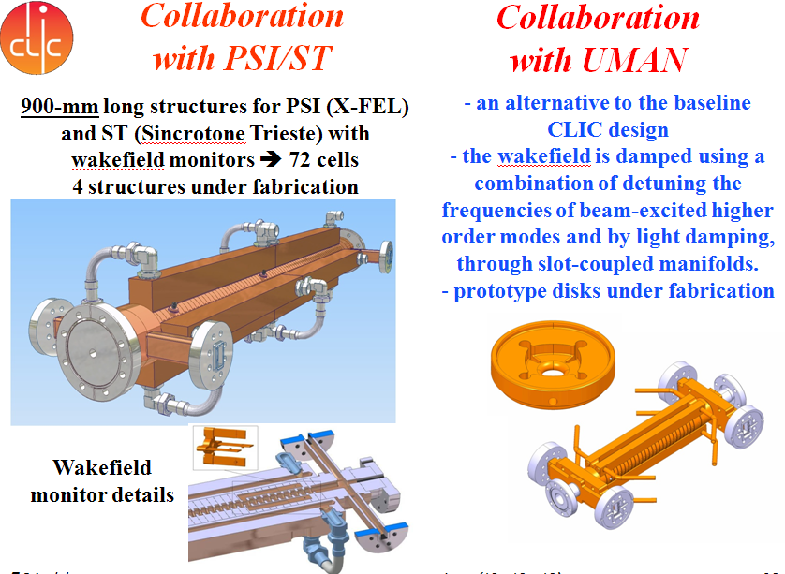
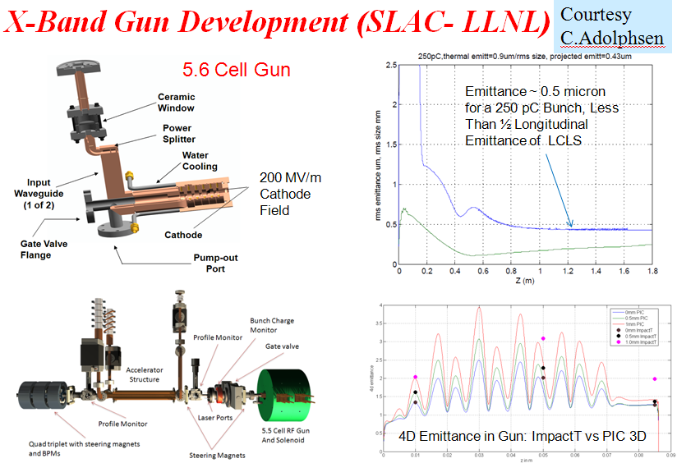
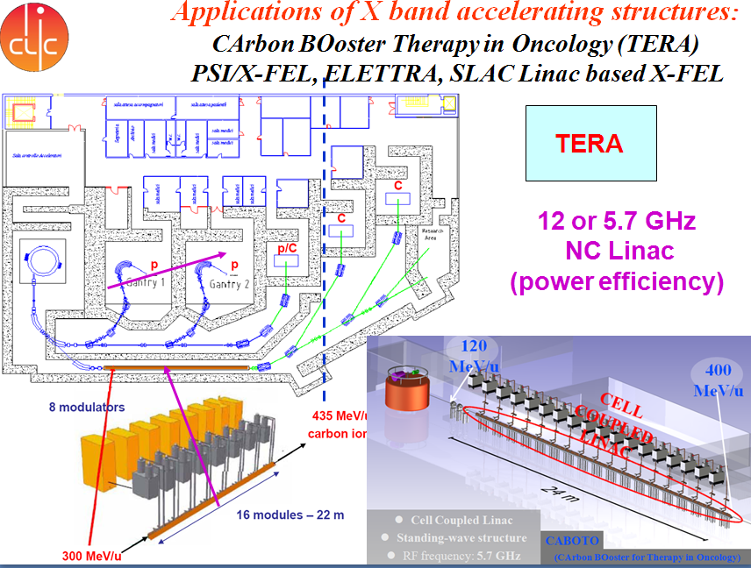
Increasing applications of high field X band structures
Courtesy
C.Adophsen
Courtesy
H.Beijers
Courtesy
G.D’auria
Courtesy
G.Riddone
Courtesy
C.Adophsen
TERA
Courtesy
U.Amaldi
http://www.cockcroft.ac.uk/events/XB10/index.html

Slide 25
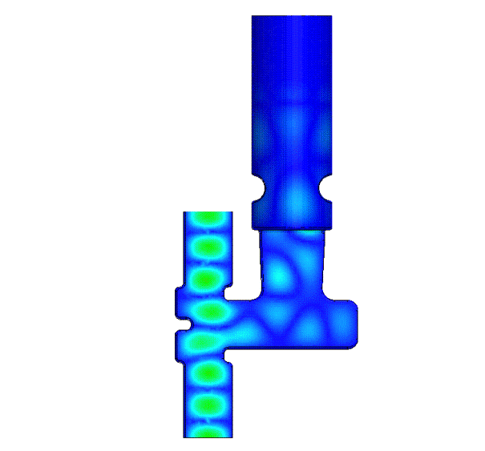
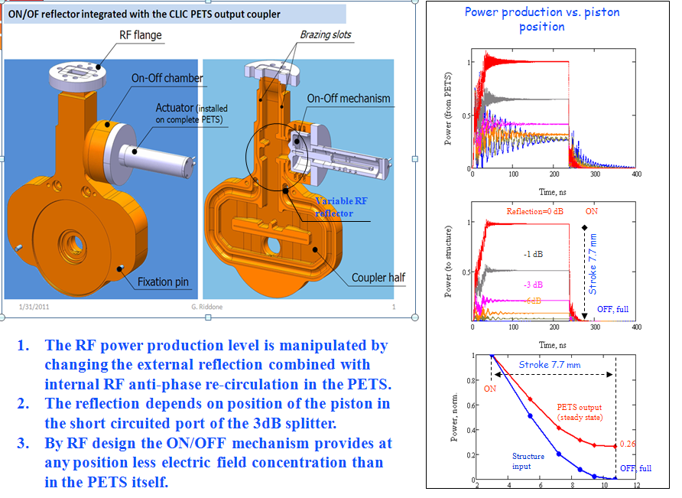
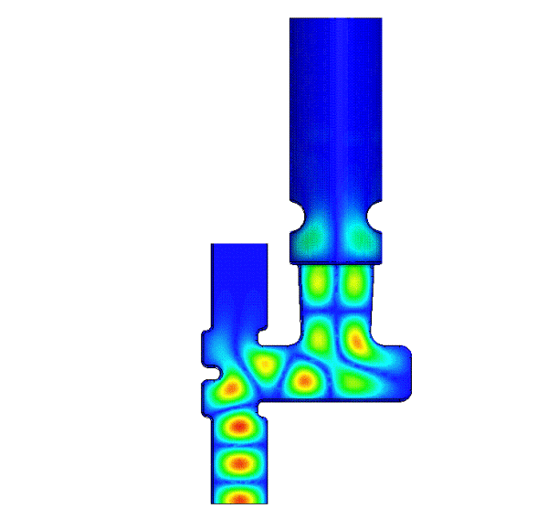
PETS ON/OFF CONCEPT WITH
EXTERNAL COMMUTATION
AND INTERNAL RECIRCULATION
Tunable reflector
ON
OFF
PETS power
PETS ON
0.25
Ramped pulse for beam loading compensation.
PETS power
Recirculation in anti-phase
0.25
PETS OFF
Time [s]

Slide 26
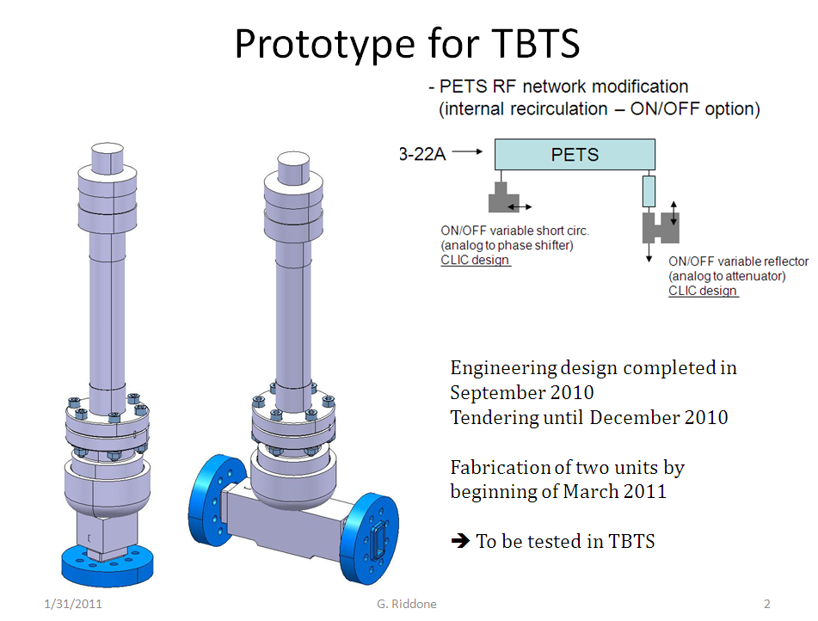
Prototypes for TBTS PETS
ON/OFF mechanism testing program
Present layout of the PETS with external recirculation
PETS
Drive beam
attenuator
phase shifter
“Slow” linear actuator
Modified layout of the PETS with internal recirculation
PETS
Drive beam
Variable RF short circuit
(phase shifter)
Variable RF short circuit
Variable RF reflector
Variable RF reflector
(attenuator)
During summer shout down 2011, the PETS external recirculation loop will be replaced by the CLIC type variable reflector and operate with internal re-circulation. To demonstrate termination of the CLIC nominal RF power production CTF3 should provide high (25 A) current.
The new layout will allow operation in amplification mode (low current), similar to the operation with external re-circulation.
Installation on TBTS during summer for tests with beam

Slide 27
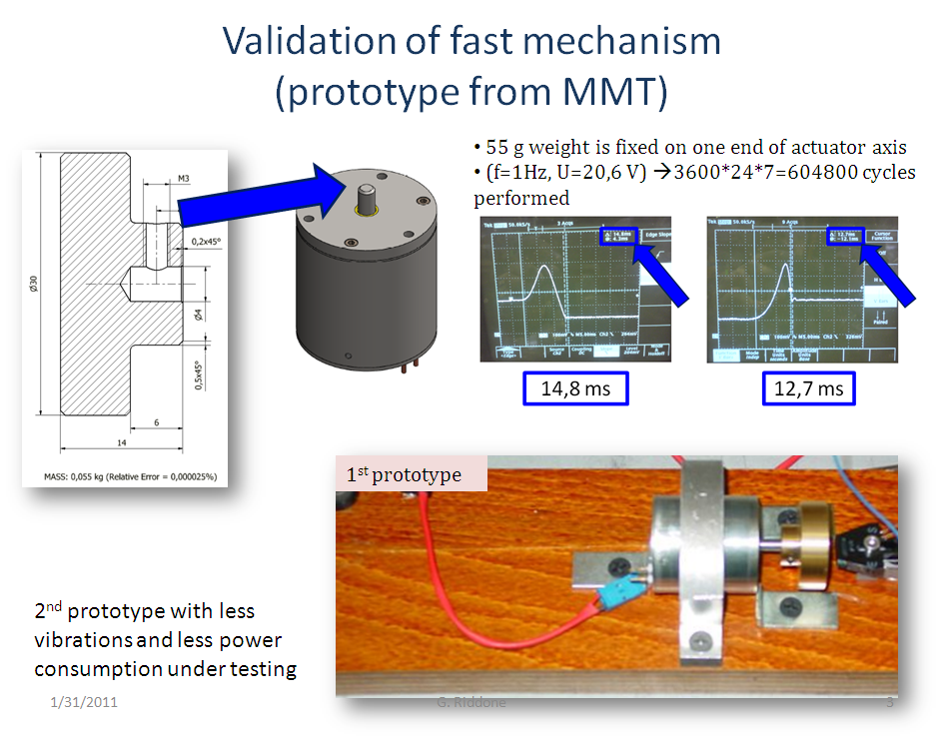
Development and validation of the fast (20 msec) linear
actuator (10 mm linear stroke). Prototype from MMT

Slide 28
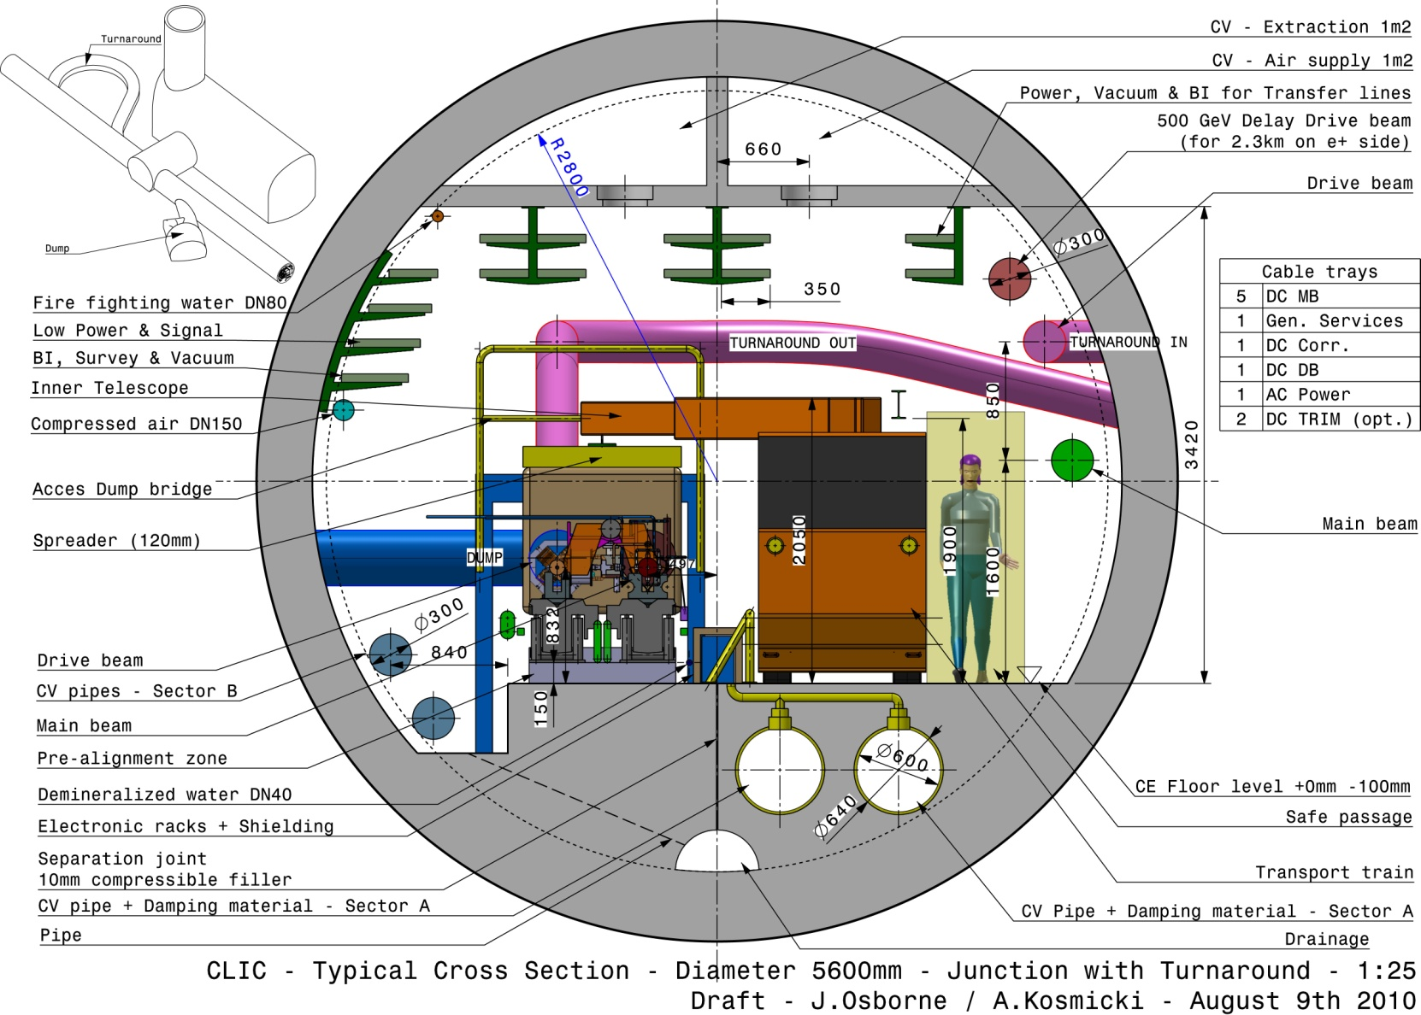
Standard tunnel
with modules
Tunnel integration &“Conventional Facilities”
Typical tunnel diameter increased
from 4.5m to 5.6m internal diameter
‘standard’ metro diameter in Europe
More space needed for power converters and other services = bigger tunnel
CV pipes now isolated via compressible filler
Transversal ventilation adopted for CDR
DB turn-around
DB dump
UTRA
cavern
J.Osborne
28

Slide 29
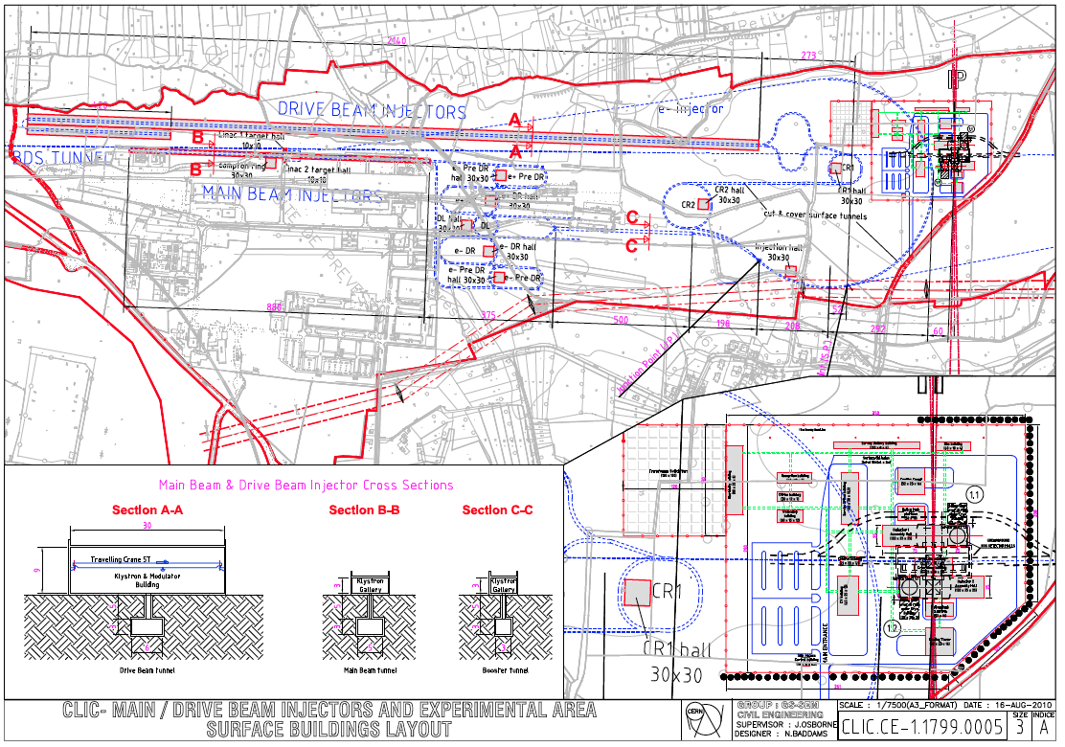
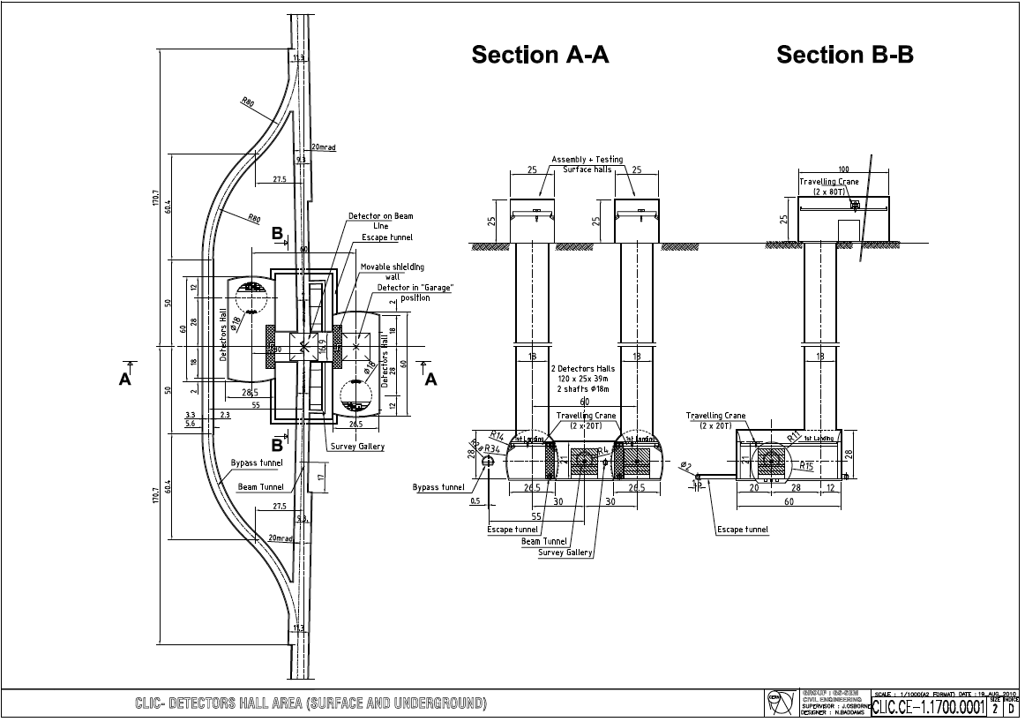
Tunnel implementation (laser straight)
Central Injector complex
Central MDI & Interaction Region

Slide 30
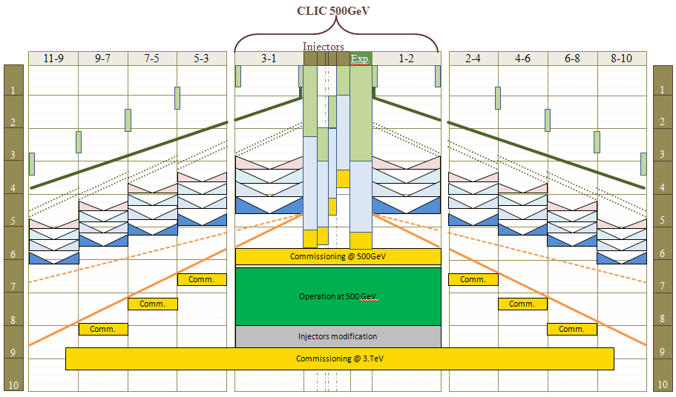
General Construction and installation Schedule derived from LHC experience
K.Foraz
Time

Slide 31
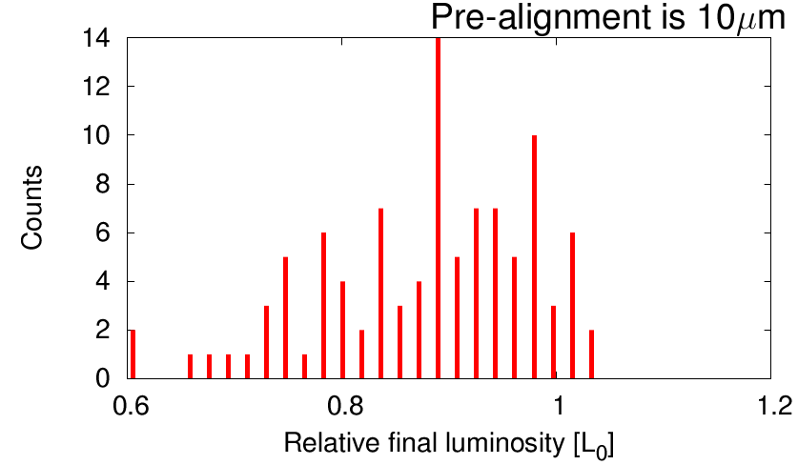
Progress on the CLIC BDS
R.Tomas
Write-up of the CDR: BDS CDR chapter
Consolidation of the 500 GeV BDS
Consolidation of the L*=6m 3 TeV FFS
Consolidation of the collimation system:
          CLIC note on collimation
Tuning of the FFS
Commissioning of ATF2 (BBA & tuning)
Status of tuning in 2010 with l* = 3.5m
80% probability to reach 80% of the luminosity
In 18000 iterations (design lumi=1.3L0)

Slide 32
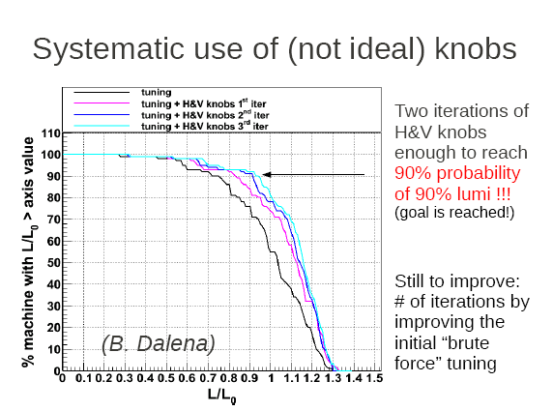
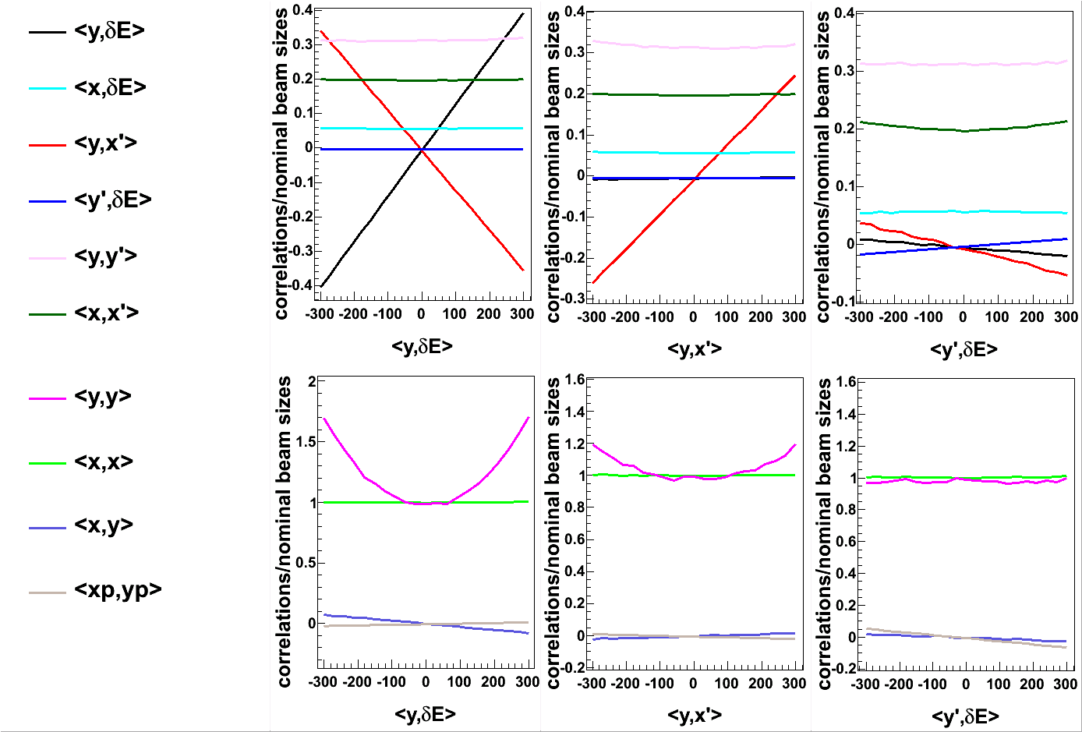
Designing knobs
Progress on tuning FFS with l*=3.5m
E.Marin
Knobs are combinations of the FFS sextupole H&V transverse displacements
They are built to target relevant aberrations in an orthogonal way
We have not managed to build orthogonal knobs yet but still we use them!
Vertical disp
Coupling
Vertical dispersion knob

Slide 33
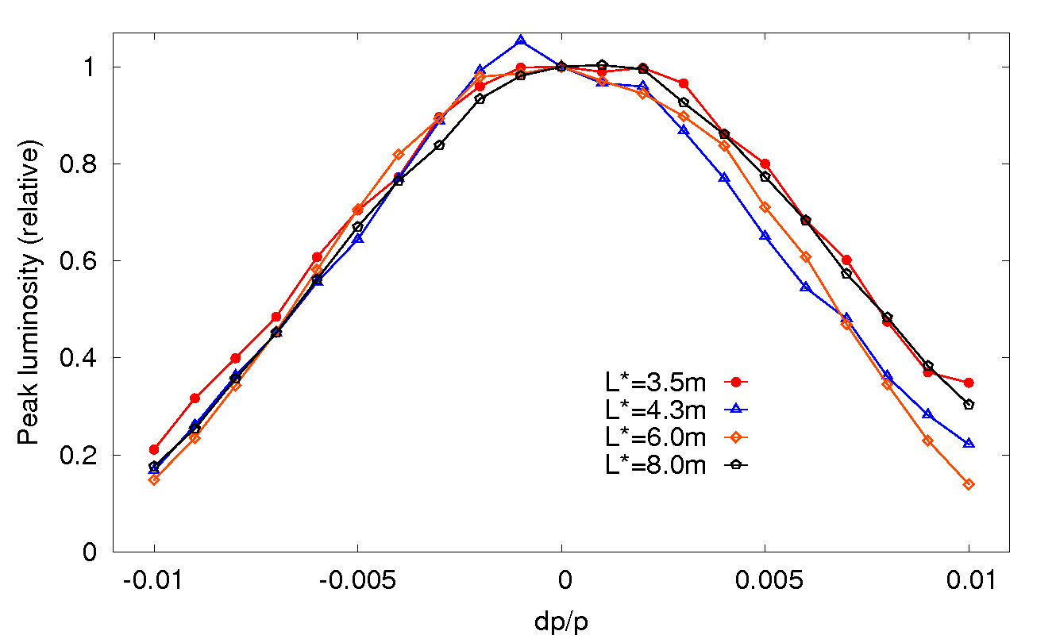
The L*=6m FFS
G.Zamudio
E bandwidths of all CLIC FFS
Lumi=1.1L0 (larger than design but lower than for L*=3.5m)
Bandwidth is similar
Tuning 8μm prealign.: 80% prob. to reach 90% of L0 (without knobs!)
The L*=6m FFS performance is close to the current L*=3.5m. With a bit more effort we might be able to move QD0 out of the detector!

Slide 34





Fruitful collaboration with ATF/KEK
ATF2 commissioning - Dec 2010
ATF2 & ATF2 ultra-low β* successes are critical for CLIC
CERN contributes 2 “commissioners”:
E. Marin & Y. Renier
Dec. run: 300nm were reached with a MAPCLASS-optimized lattice
Simulations set good expectations for next run
Generation of ultra
low emittances at ATF
Experimental data
<xy> coupling
Simulations
CLIC Damping Ring

Slide 35

Machine Detector Interface
Improved Final Doublet Support (stabilisation 0.15 nm)
Integration into detector (Push pull mode)
Intra-beam feedback
Lumical
BPM
Spent beam
L.Gatignon, A.Herve
N.Siegrist, H.Gerwig
Beamcal
Kicker
QD0

Slide 36






Final doublet integration & stabilisation
Hybrid QD0 permanent magnet stabilised
with coils mounted independent of yoke
M.Modena
Concrete mass of ~ 80 tons mounted on calibrated springs.
Eigenfrequency ~ 1 Hz.
Designed to reduce vibrations by a factor of ~ 30.

Slide 37




QD0 support tube and QF1 supported by cantilever from pre-isolator in tunnel
Final doublet stabilisation
Hybrid QD0 permanent magnet stabilised with coils mounted independent of yoke
Beam
feedback
Mechanical
feedback
M.Modena
Feed forward
CLIC
target
Concrete mass of ~ 80 tons mounted on calibrated springs.
Eigenfrequency ~ 1 Hz.
Designed to reduce vibrations by a factor of ~ 30.

Slide 38
CLIC issues as discussed at ACE5
Critical issues?
  Every parameters or system above the present state of the art
  Overall list of critical issues (Risk Register) under:
  https://edms.cern.ch/nav/CERN-0000060014/AB-003093
Critical Issues classified in three categories:
  CLIC design and technology feasibility
    Not feasible or never done before
    Feasible with parameters leading to a dramatic (?) consequences on performance reduction or cost increase
  Performance
    Feasible with parameters leading to a substantial (?) reduction of CLIC performance
  Cost & Power
    Feasible with parameters leading to a substantial (?) increase of CLIC cost or power consumption
Dramatic: order of magnitude ? Substantial: a few?

Slide 39
CLIC strategy
Address feasibility issues during CDR phase (2004-11)
  For each feasibility issue build and test (at least one) equipment or system and demonstrate parameters close enough to nominal
  such that:
    It is shown to be feasible
    The nominal performance is not reduced by a large factor
    The cost or power are not increased by a large a large factor
    If factor is still substantial, feasibility issue classified in performance or cost or power issue
Address performance, cost & power issues during post CDR phase (2012-2016):
  For each performance and cost issue build and test a large enough number of equipments or systems for long enough time and demonstrate parameters close enough to nominal and a yield large enough such that:
    The nominal performance is not reduced (negligeable)
    The cost and the power are not increased (negligeable)
    longevity is long enough
  Provide margin for solid and flexible design

Slide 40



CLIC Accelerator Feasibility Issues @ ACE6
Delay of critical studies by CTF3 fire
R.Corsini
Exp. results
S.Doebert
W.Wuensch
F.Tecker
D.Schulte
H.Mainaud
K.Artoos

Slide 41


Operation & Machine Protection System
Issues: Main beam: 2*14 MW @ 1.5 TeV (50Hz)
        Drive Beams: 2*70 MW @ 2.4 GeV (50Hz)
Protection strategy: Static protection by construction (2 ms)
  Next cycle permit system (from LHC)
  Post cycle analysis
M.Jonker
Taking advantage of LHC experience !
Great synergy with ILC main beam (11MW @ 500GeV)
Common reflection on reliability & availability

Slide 42
Conceptual Design Report:
New strategy towards European Strategy for HEP
3 volumes:
  Vol 1: The CLIC accelerator and site facilities (H.Schmickler)
    CLIC concept with exploration over multi-TeV energy range up to 3 TeV
    Feasibility study of CLIC parameters optimized at 3 TeV (most demanding)
    Application to 500 GeV as first stage and intermediate energy range
    No cost figures (peer review postponed)
  Vol 2: The CLIC physics and detectors (L.Linssen)
  Vol 3: CLIC study summary
    Comprehensive summary of vol1 and 2 findings for European Strategy
    Staging scenario up to energy compatible with LHC Physics
    Including cost issues and cost drivers for R&D mitigation in next phase
    Proposing objectives and work plan of post CDR phase
Schedule:
  Mid April 2011: Vol1, Contributions by individual Authors
  mid July 2011: Vol1, Reviewed for consistency by Editorial Board
  mid Sept 2011: Vol1, Completed and Processed
  Dec 2011: Vol 1 presented @ SPC for comments
  March 2012: Final Vol 1 and 2 + Vol3 to European Strategy

Slide 43
Layout of Volume 1 on Accelerator
1) Overview of the CLIC concept; Details on CLIC feasibility demonstration
2) Accelerator Physics description of the Main Beam Complex
3) Accelerator Physics description of the Drive Beam Complex
4) Preliminary design of a 500 GeV and intermediate energy stages
5) Detailed description of the accelerator components
6) Civil Engineering and Services
7) CLIC technologies demonstrated in CTF3
8) Construction and Operational Scenarios
9) Energy Scanning
3TeV
Specifications
CDR website with skeleton and present contributions:
  http://project-clic-cdr.web.cern.ch/project-CLIC-CDR/

Slide 44
Contribution/Authors by CLIC collaborators
International. editorial board:
N.Phinney (SLAC), N.Toge (KEK), P.Lebrun(CERN), H.Schmickler(CERN)
Processing (Latex):
M.Draper(CERN), D.Manglunki (CERN), H.Schmickler (CERN)
Author-list management:
A.Augier(CERN), M.Draper (CERN)
authors:
i) responsible author: responsible for submission in time
ii) contributing author: active contribution to write-up
iii) supporting author: “signing-up” through a web-portal as CDR author

Slide 45
CLIC Tentative Schedule
Delay of CDR (fire in CTF3 Klystron gallery)
Post CDR phase reviewed following Medium Term Plan
Final CLIC CDR and
proposal next phase
@ European Strategy
European Strategy
for Particle Physics
@ CERN Council
CTF3 Modulator (before-after fire)
Draft Conceptual
Design Report(CDR)
(Acc.&Det.) to SPC
Project Implementation
Plan (PIP) and
proposal for next phase

Slide 46
Conclusion
2011 critical and transition year!
CLIC concept and Feasibility studies described in CDR towards European Strategy by the end of 2011 …and early 2012.
Exploration of multi-TeV energy range up to 3 TeV
Design optimized at 3 TeV (most demanding) and R&D focused on corresponding feasibility issues
  Findings on performances and limitations by technology risks, power and cost
  Staging scenario with parameters range compatible with LHC Physics and affordable power
Strong R&D on risk, performance, power and cost issues required during post CDR phase
Linear Colliders (including CLIC) in excellent hands (Steinar and CLIC team) for the future.

