Slide 1
Luminosity Stability and Stabilisation Hardware
D. Schulte for the CLIC team
Special thanks to J. Pfingstner and J. Snuverink

Slide 2
Strategy
Show that luminosity is stable with the baseline solution
  Developing a model of the imperfections
    Ground motion, element jitter, mechanical stabilisation, …
  Develop mitigation methods
    Feedback, system design, …
  Integrate into code and perform fully integrated simulations with PLACET and GUINEA-PIG
  This proves that a given solution is valid
Understand the luminosity performance
  Find simplified models to understand the effects
  Ensure that full simulation results are understood
  Point toward improvements for performance or cost

Slide 3
Model

Slide 4
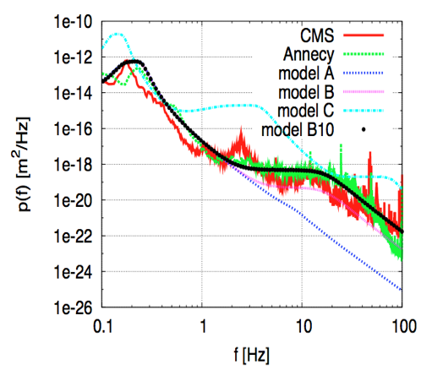
Ground Motion
Important source of luminosity loss
  Level of ground motion at final site is not known
  Technical noise transmitted via the ground is not known
Use two models
  Short time scales (< 100 s)
    A. Seryi models: P(ω,k)
  Long time scales
    ATL law: <(Δy)²> = A*t*L
Model A corresponds to LEP tunnel with no technical noise
Model B10 is made to fit measurements at Annecy and the CMS hall
  Ad hoc correlation based on model B
For ATL model we use A= 0.5 nm²/(ms)
Micro-seismic peak

Slide 5
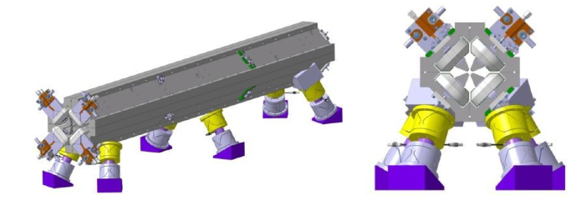
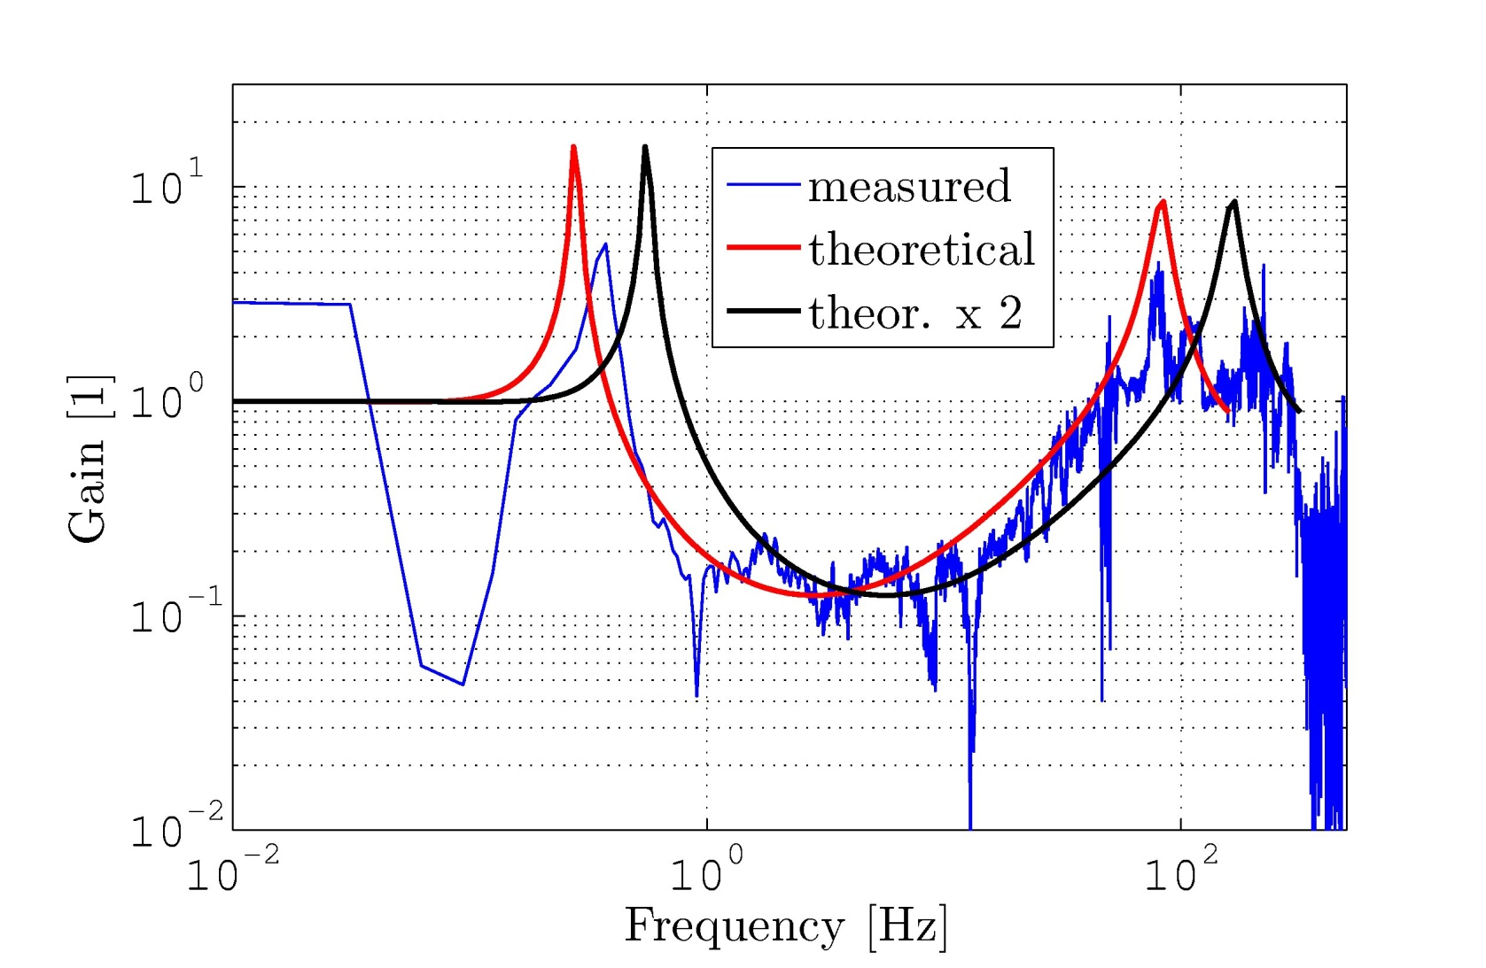
Main Linac Quadrupole Stabilisation
System reduces quad movements above 1 Hz (int. RMS 1 nm)
Reduces emittance growth and beam jitter for high frequencies
Implemented transfer function into beam dynamics code
  For the moment all elements are moved with transfer function
  But magnets completely dominate the luminosity loss
Taken from CERN stabilisation group

Slide 6
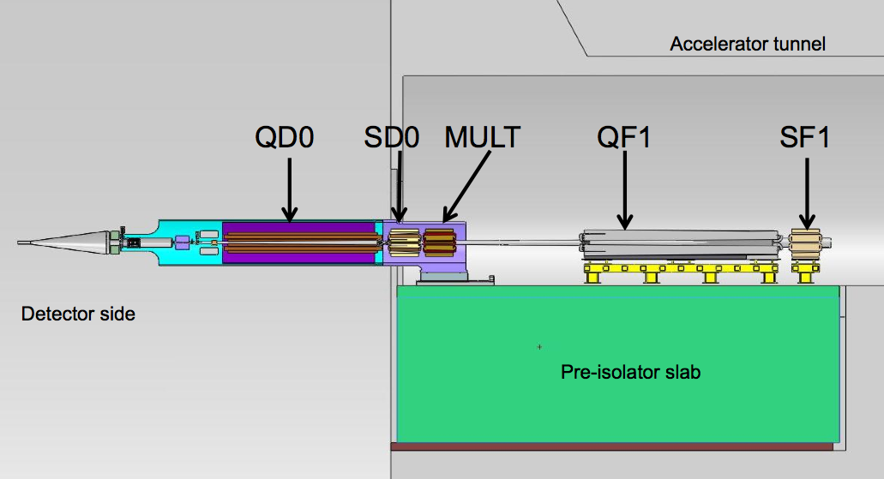
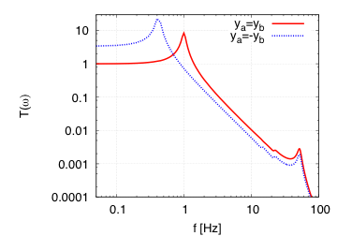
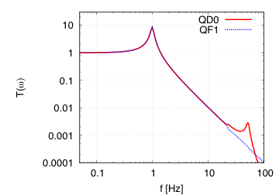
Pre-Isolator Transfer Function
Transfer function is complex
Modified ground motion generator to correctly model this
In reality will have also active stabilisation
Transfer for coherent motion
A. Gaddi et al.
Transfer to QD0
a
b

Slide 7
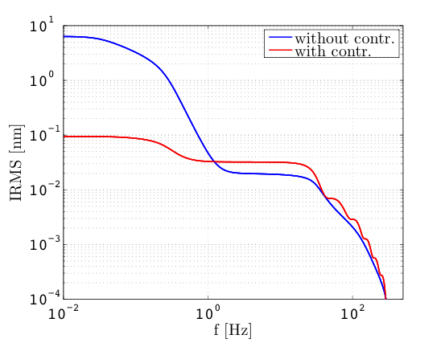
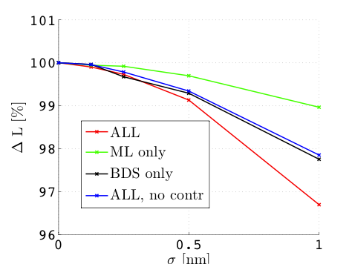
Hardware Noise
Active stabilisation will
induce noise
Received a spectrum
last Friday
Simple model weights
noise with feedback
transfer function
About 0.1nm effective jitter
<0.1% luminosity loss
Consider not to implement
this for final CDR results
Will be considered later

Slide 8
Feedback Design

Slide 9
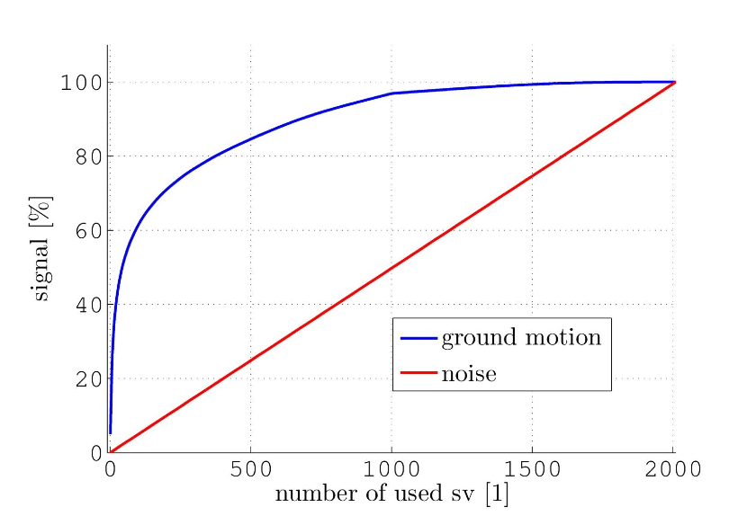
Feedback Design
Every magnet is equipped with a BPM
  We use information from all BPMs
Each quadrupole is equipped with a corrector
  Dipole magnet and mover from stabilisation system
Correct the orbit globally
  In matrix inversion only the most important singular values are used
  Currently 16 singular values are used at full gain
  300 singular values are used at gain of 0.05
Some singular values are important for luminosity but not yet well measured
  Room for improvement
Orbit feedback and IP feedback are independent

Slide 10
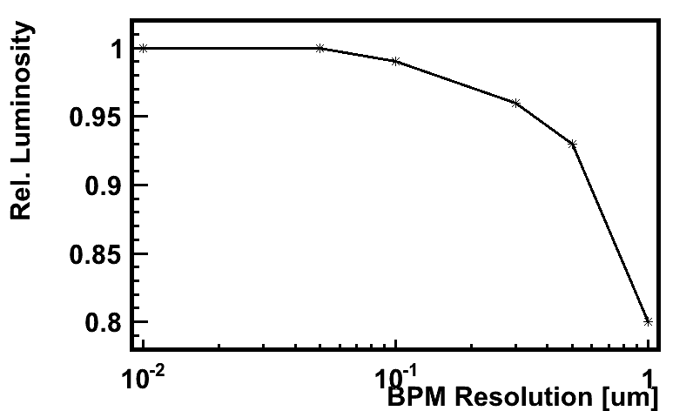
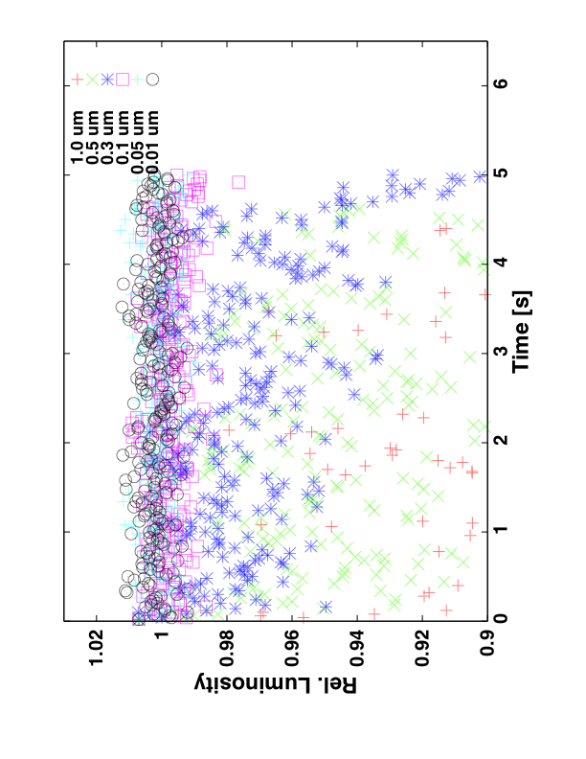
Required BPM Resolution
Let the feedback run at full speed
  No ground motion, only BPM errors
Baseline BPM resolution of 50 nm leads to less than ΔL/L<<1%
  Value chosen to resolve 0.1σ beam jitter in the main linac
  Significantly improved result due to noise-robust beam based feedback
    Previous requirement had been 20nm for ΔL/L=1%

Slide 11
Results

Slide 12
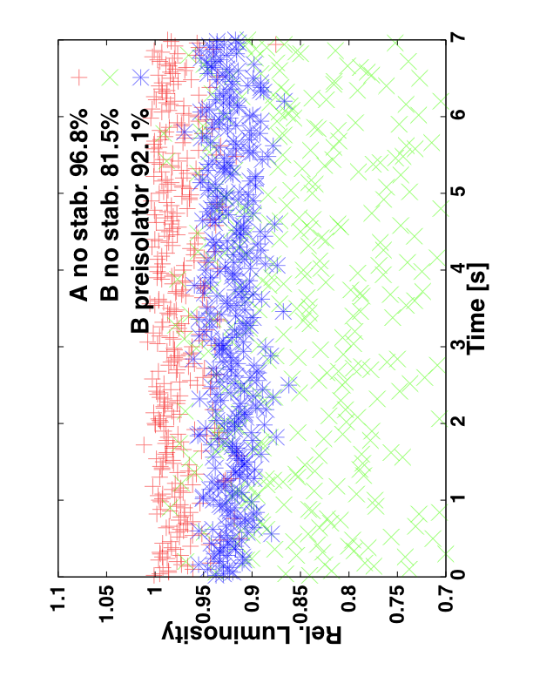
Luminosity with Beam-based Feedback
No stabilisation used, vertical plane only
Results:
Model A
  ΔL/L=3.2%
  does not need any stabilisation hardware
For model B
  ΔL/L=18.5%
With final doublet stabilisation
  ΔL/L=7.9%
B10 and C are not acceptable

Slide 13
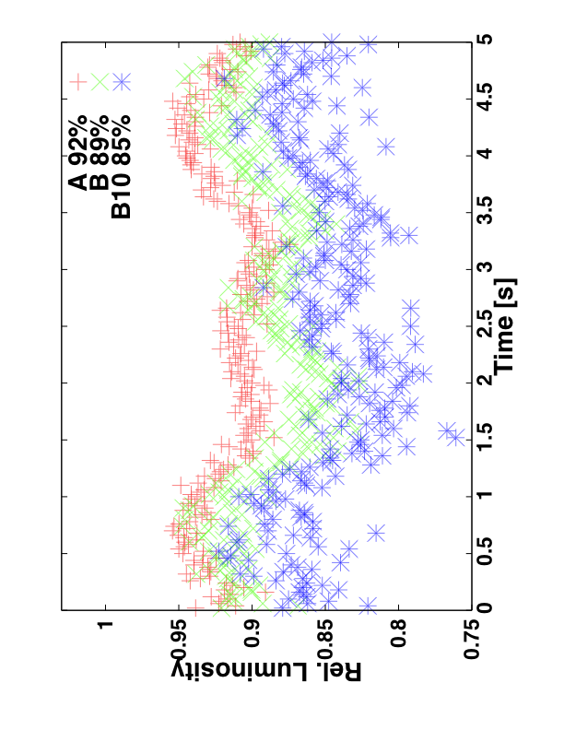
Adding Magnet Stabilisation
Use the main linac transfer function for all magnets, except final doublet
  Conservative approach, might be able to do better in BDS
Model A is worse
  ΔL/L=8%
Model B is slightly worse than with pre-isolator alone
  ΔL/L=11%
Model B10 now about acceptable
  ΔL/L=15%
  Are still optimising controller

Slide 14
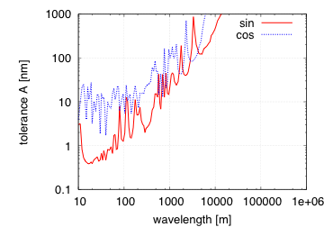
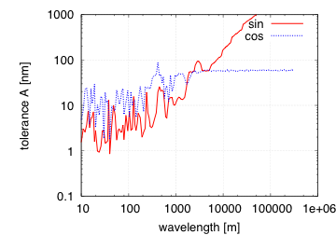
Note: Simplified Calculation
Simplified calculation allows to determine impact of each ground motion mode as function of
  Wavelength
  Frequency
Tolerance shown
  ΔL/L=10%
  sinus/cosinus with respect to IP
Upper plot has no stabilisation
Lower plot has air hook final doublet stabilisation

Slide 15
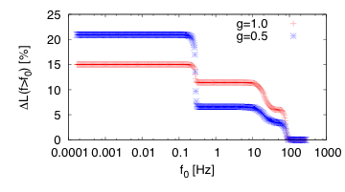
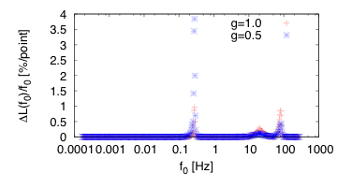
Consequences for Stabilisation Equipment
Estiamate luminosity loss for each ground motion mode (B10)
Estimated luminosity loss is 15%
final doublet is assumed perfectly stable
reasonable agreement with simulations
Luminosity loss is due to
amplification close to micro-seismic peak
amplification below 100Hz
residual effects between 10 and 50Hz
Should tailor hardware transfer function to these findings

Slide 16
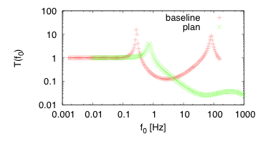
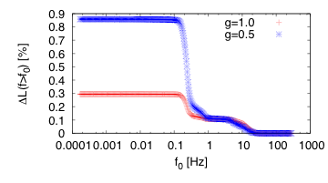
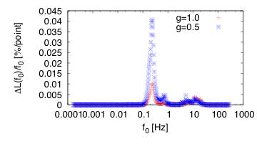
Improved Transfer Function
Modify baseline transfer function
to shift resonance away from micro-seismic peak
avoid second resonance
Significant improvement in the two resonances expected

Slide 17
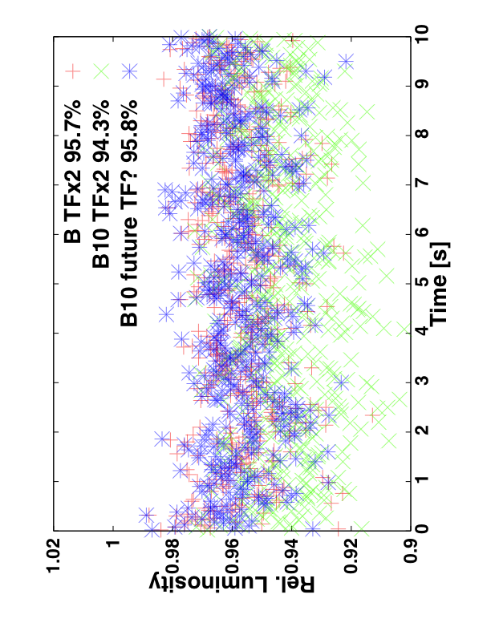
Result for Optimised System
Full simulation of vertical only
Performance would be satisfactory
  ΔL/L=4.2%
Residual loss should be largely due to final doublet
  currently simulations with PID are running
Concept for hardware exists
But hardware needs to be developed

Slide 18
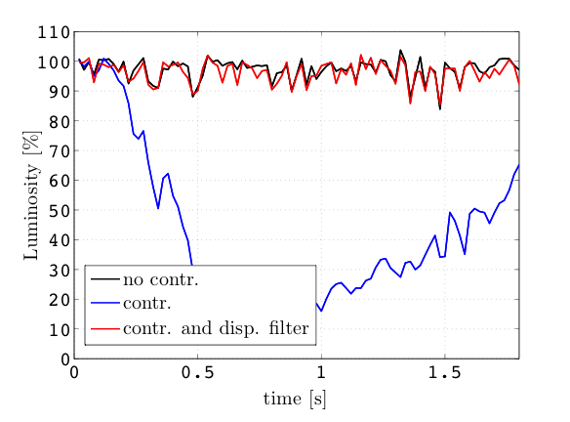
Impact of RF Jitter
RF jitter leads to luminosity loss
  Limited BDS bandwidth
  Residual dispersion
Can interact with orbit feedback
  Non-zero horizontal target dispersion in BDS fakes orbit jitter
Performed simulation of baseline machine with RF jitter and running feedback
Not a problem in the vertical plane
Filtering the dispersion signal and reducing horizontal gain reduces additional effect
  RF jitter 2.6% loss
  RF jitter and feedback 3.8%
  Impact on orbit feedback is negligible Δ(ΔL/L)=O(0.1%)
Further optimisation should be possible
Need to re-run final simulations with dispersion filter

Slide 19
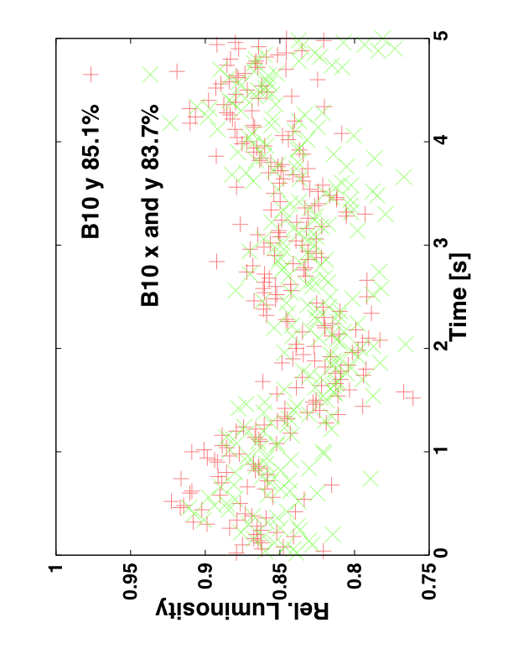
Horizontal Motion
Would expect more margin in horizontal plane
  Larger emittance
But some additional complications
  Transfer function is different in x
  Have to use lower gain because of horizontal dispersion
The additional luminosity loss is 1.4%
Need to repeat some simulations with horizontal feedback

Slide 20
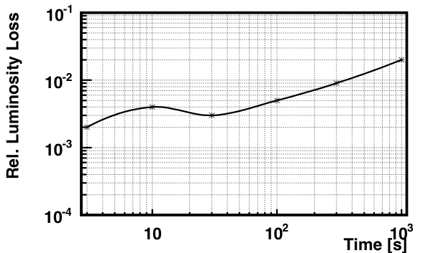
Long Term Luminosity Stability
Beam-based orbit feedback can only maintain luminosity for limited time
Simulation of long term ground motion
  Apply long term motion using model B/B10
    Feedback is not active during this period
  Run the feedback until it converges
    Running during the ground motion could yield better results
Can probably be improved by optimizing beam-based feedback
Can use tuning knobs to further improve

Slide 21
Future
Finish studies for CDR
Improve the controller
  Better algorithms
  Better layout
Guide improvement of hardware
  Interaction with beam-based feedback
  Cross talk between different systems
  Ground motion sensor based feed-forward on the beam
Further improvement of modelling
  Technical noise, ground motion, RF jitter, stray fields
Cost reduction
Integrated tests
  E.g. pulse-to-pulse beam vs. ground motion in ATF2/ATF3

Slide 22
Improved Controller
Non-linear controller at IP is being tested in Annecy (B. Caron)
  Will be integrated when tests are successful

Slide 23
Intra-pulse Interaction-point Feedback
Intra-pulse feedback is being
developed at Oxford
  Is currently kept as a reserve
  Can yield up to factor 4 reduction of luminosity loss
  i.e. factor 2 in tolerances
  Can have secondary beneficial effects

Slide 24
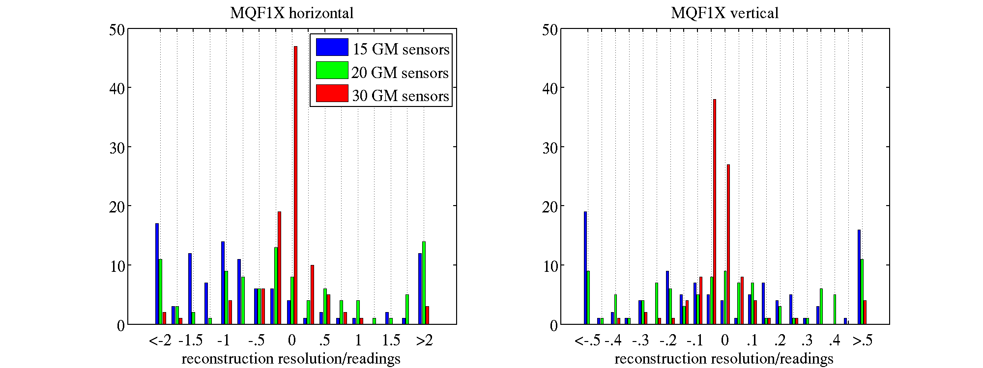
Experiments
Good opportunity could be ATF2/ATF3
Ground motion-based feed-forward
  Measure the motion of quadrupole pulse-to-pulse
  Predict the beam motion in BPMs for each pulse
  Compare to measured beam motion pulse to pulse
Simulation seem promising
  ATF2 ground motion
  Sensor sensitivity
Thanks to Y. Renier

Slide 25
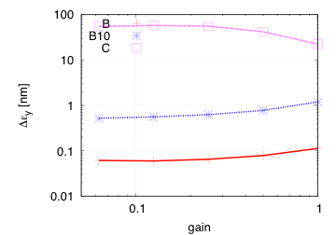
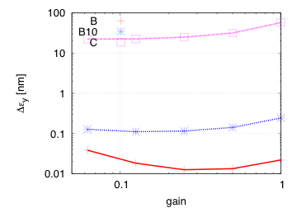
Note: Main Linac Estimate
Ground motion only
  Multi-pulse emittance used
  Δε_{y}= 0.4nm ≅ ΔL/L=1%
Model B yields
  No stab.: ΔL/L=0.15-0.3%
  Stab.: ΔL/L=0.03-0.06%
  Stabilisation not required for ground motion only
Model B10
  No stab.: ΔL/L=1.5-3%
  Stab.: ΔL/L=0.3-0.6%
  Stabilisation marginally required
Model C does not work
  Also with stabilisation
No stabilisation
With baseline stabilisation

Slide 26
Conclusion
The current model for the stabilisation hardware is implemented in our simulations
  The noise induced by the hardware is not yet included, but appears acceptable
We have chosen ground motion model B10 as our benchmark point
  But will adapt to real motion once known
Horizontal ground motion and interaction with RF jitter seems OK
Luminosity loss with current baseline hardware would be 16% for B10
  But further hardware development will improve this; 4.2% (no noise, y only)
Further optimisation of the beam-based controller and feedback is ongoing
The use of tuning knobs to reduce the long-term luminosity loss is under investigation
We plan to gain experience in ATF2/ATF3

