Slide 1
Module related RF structures R&D (high gradient next steps and RF aspects of TBA module)
+
Presentations should follow, whenever possible, the following scheme:
Status of activity, compared to required CLIC performances.
Short term program, expected results by end 2012.
R&D planning for the next phase (2011-2016).
+
20+10 min
W. Wuensch
CLIC ACE
2-2-2011

Slide 2
Recent test and hardware results:
Results from recent PETS high-power test in ASTA (Roberto)
High-power accelerating structure tests and analysis
Two-beam tests in TBTS (Roberto)
Micron precision machining and assembly
rf components
Design, simulations, developments and next steps:
Fully featured accelerating structures – compact couplers and integrating loads
Accelerating structure design directions – evolution and alternatives
On/off/ramp system progress and definition of operational scenarios
Wakefield validation and coupled drive-to-main linac wakes
Wakefield monitors and accelerating structure alignment
BDR with beam – calculation and measurement
Dynamic vacuum
Cooling system
High-power rf phenomena
Alternative designs
Cost and many, many more subjects
Testing infrastructure:
Status of high-power testing capability

Slide 3
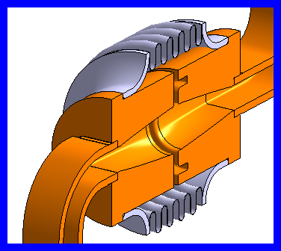
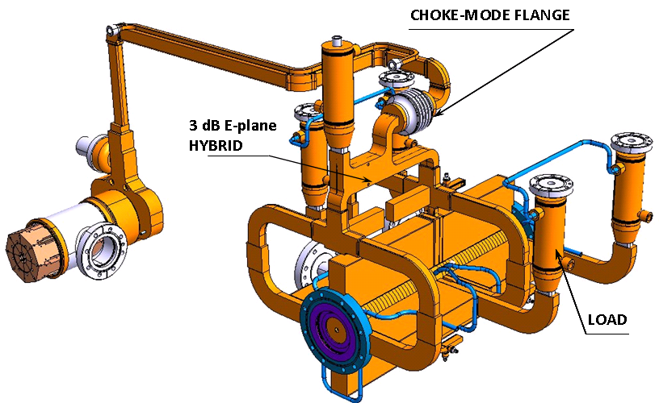
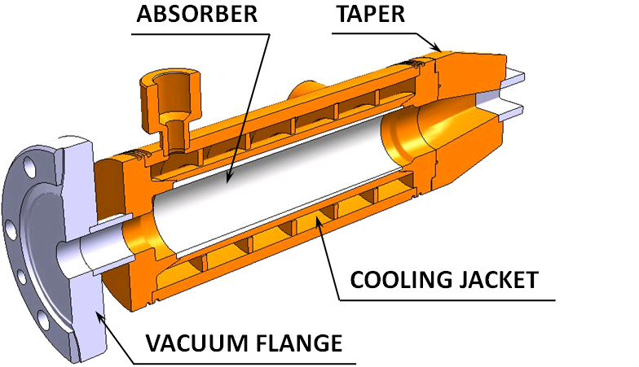
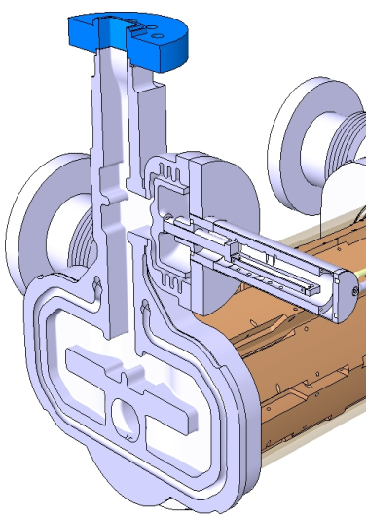
CLIC main linac rf network
PETS
high-power
as short as possible
low longitudinal and transverse impedance
Waveguide network
high power
precise phase length
Choke mode flange
independent alignment of main and drive beam
ON/OFF mechanism
On/ramp/off
necessary (?) to react to breakdown and/or failure
Accelerating structure
high-gradient
as long as possible
micron precision
transverse wakefield suppression

Slide 4
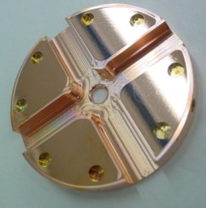
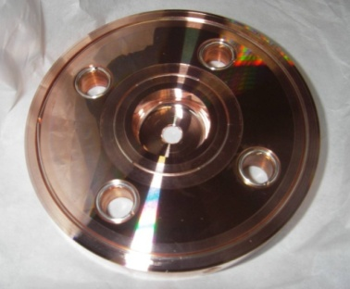
Breakdown rate at 100 MV/m (unloaded) accelerating gradient
and scaled to 180 ns pulse length
New
TD24
T18 – strong tapering
T18 – strong tapering
T24 – Higher efficiency
T18 – strong tapering
T24 – Higher efficiency
TD18 – waveguide damping
T18 (CERN) – strong tapering
TD18 – waveguide damping
log(BDR/m)
CLIC BDR specification
TD24 – CLIC nominal being tested with beam in CTF3 two-beam test stand. Processing just started.

Slide 5
Unloaded gradient at CLIC 4*10⁻⁷ BDR and 180 ns pulse length
T18 – strong tapering
1400
T18 – strong tapering
3900
T18 – strong tapering (continuation with recirculation)
280
T18 – strong tapering (CERN built)
550
TD18 – waveguide damping
1300
TD18 – waveguide damping
3200
T24 – high efficiency
600
T24 – high efficiency
650
MV/m
conditioning
time [hr]

Slide 6
Accelerating structure development core program
Adopt NLC/JLC technology
Two successful tests, third underway, have shown that 100 MV/m, 240 ns, 10⁻⁶ to 10⁻⁷ range is feasible.
Structure for 100 MV/m using high-power scaling laws – T18
Successful start of one test already shows damping features do not significantly affect performance. Damped structures at 100 MV/m are feasible.
Add damping features – TD18
CLIC nominal structure with better rf design for higher efficiency – TD24 (and T24 to be systematic)
Predicted equivalent performance from high-power limits but more efficient. Needs verification, tests in spring.
Verification of features such as SiC loads, compact coupler, wakefield monitor
Mechanical design underway (tricky).
Fine tuning of design, optimization of process, medium series production and testing
ACE 2-2-2010

Slide 7
RF Process Results T24_SLAC_Disk1
Started at Sept/21/2010
1e-3(1/pulse/m) = 51.8/hour at 60 Hz for 0.24 m
Currently BDR at 98 MV/m@230ns is 7.4e-5/pulse/m (~3.8BKD/hr)

Slide 8
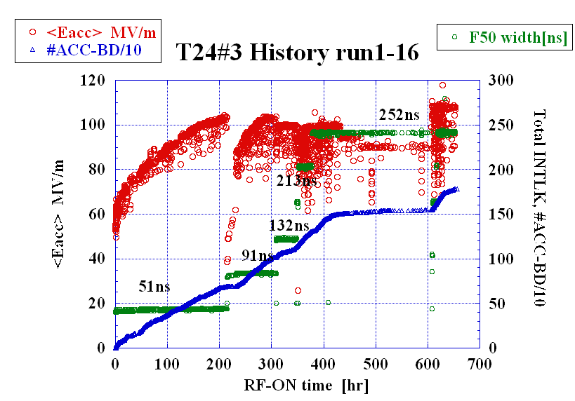
T24 at KEK
slope is typically a few 10⁻⁵

Slide 9
Pushing structure to longer pulse width with constant gradient (110 MV/m)
T18 which is now in resonant ring

Slide 10
ASTA: Test of T18 in Resonant Ring Status (31 January 2011)
Structure processed with ~100 ns input pulse (no flat part) up to ~60 MW peak power at the input of the structure (106 MV/m).
Pulse shape changed to ~100 ns charging time and ~100 ns flat part. The structure run at ~52 MW at the input of the structure (~100 MV/m). System limited not by rf breakdowns in the structure but by outgassing in transport line (A waveguide section will be replaced soon).
V. Dolgashev et. al

Slide 11
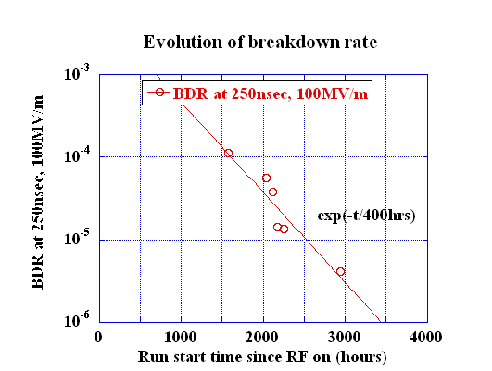
Steady reduction of breakdown rate
This data is from a TD18. In seven structures the breakdown rate decreased similarly during extended running while one T18 developed a hot cell and breakdown rate went up. Structure performance statistics is a priority for future tests.

Slide 12
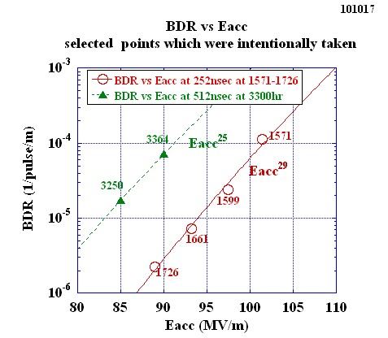
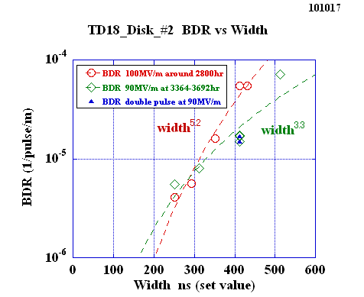
Crucial dependencies: E²⁹τ⁵/BDR =const
Data taken at KEK on TD18

Slide 13
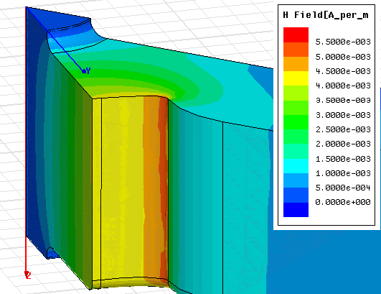
Difference between T and TD18 explained?
Damping waveguide
Points of enhanced breakdown rate in TD18 tested at SLAC probably identified.
Location is point of maximum surface current.
Inner cell
Origin of problem thought to be current carrying capacity of bond joint.
TD24 has lower surface current and joint is receiving renewed scrutiny.

Slide 14
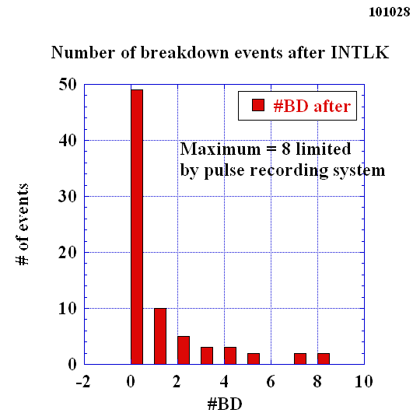
Breakdown sequence statistics
Both sets of measurements were made on TD18s
SLAC
KEK
This kind of data is essential for determining rf hardware – on/off/ramp? – and establishing credible operational scenarios.

Slide 15
18 series breakdown rate distributions
T18
SLAC
TD18

Slide 16
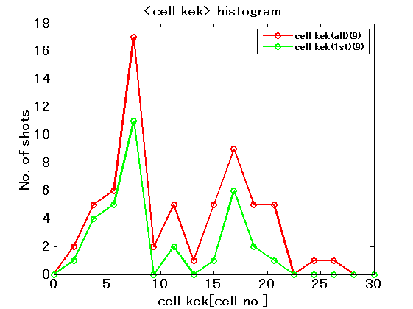
T24 breakdown location distributions
SLAC

Slide 17
Experiments to determine effect of beam on BDR
CTF2 – Intentional beam loss in PETS did not directly induce breakdown.
TBTS – Two-beam configuration is correct for measuring beam-loaded breakdown rate but limited sensitivity due to low, order of one Hz, repetition rate and low, < 0.5 A, main beam current.
Accelerating structure in drive-beam linac “30 GHz dog-leg” fed by klystron – New idea, has only been discussed among a very small group of people, so not received full scrutiny yet. But sufficiently exciting to present here. 1-2 A trivial for drive beam linac, transport easier than 1.5 m long 30 GHz PETS, and 25 Hz accessible. All magnets, beam instrumentation, dump etc. in place. Over-moded power line from CTF2 to CTF3 drive beam linac in place too. Only needs replacement of mode converters and new bend. With around 4 A (and we used to run 30 GHz at around 5 A) we generate full accelerating structure power so could use recirculation for more testing capacity or install a T18 or, even better a PSI/Trieste H75 based structure, backwards and feed the CTF2 test area…

Slide 18
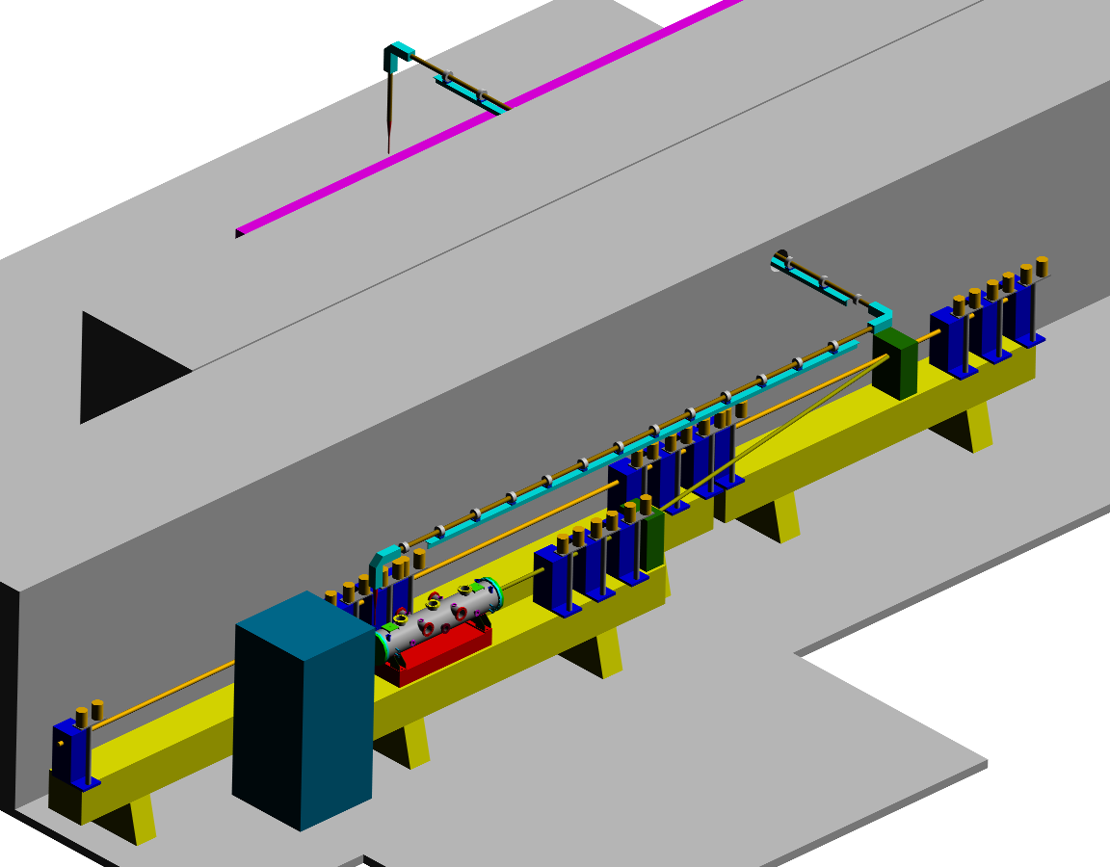
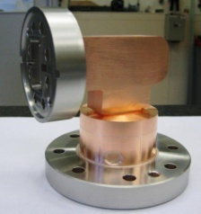
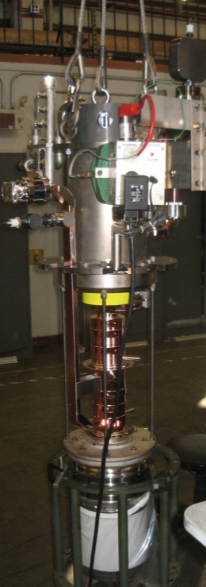
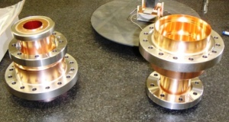
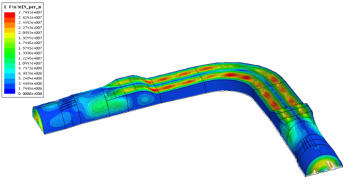
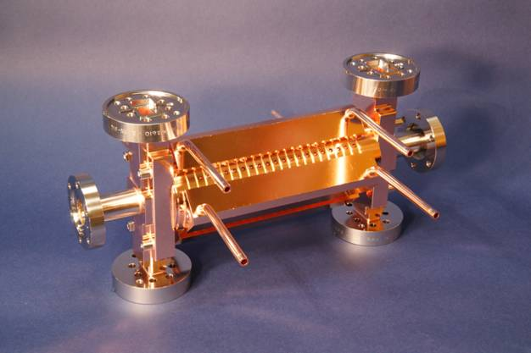
High-gradient test
stand, CTF2
Two-beam 30 GHz power
production in CTF3
High-power
transfer line
CTF3
linac
PETs branch

Slide 19
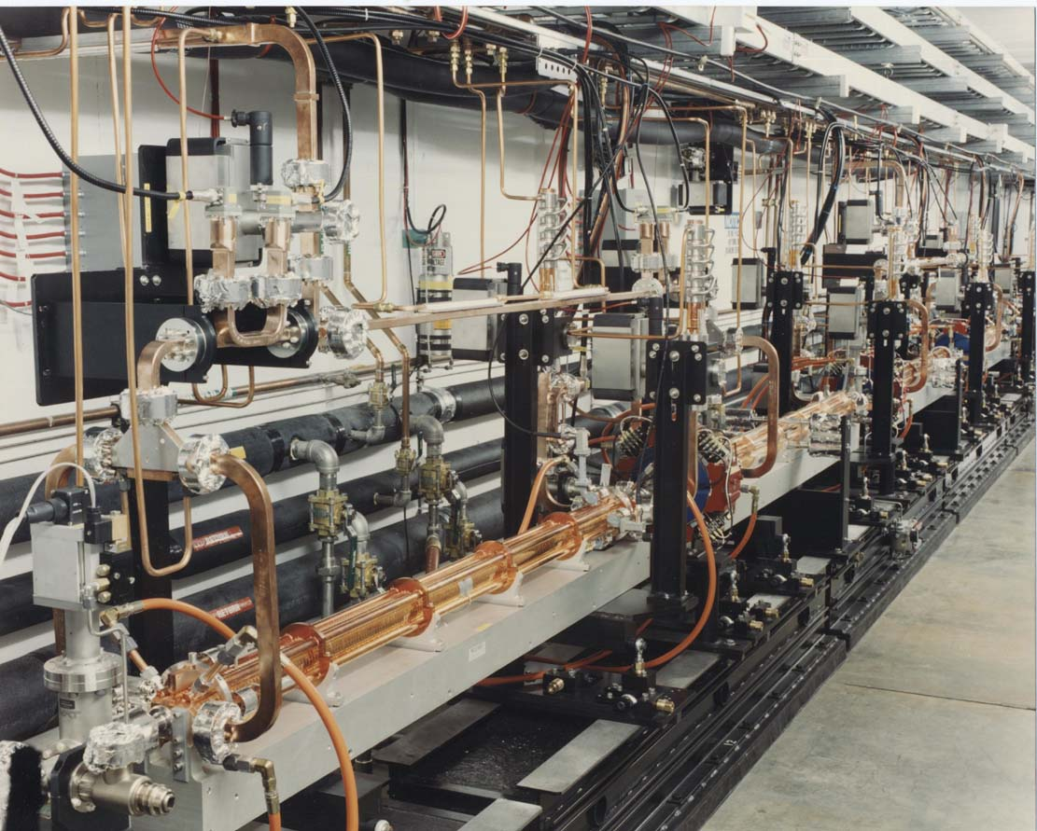
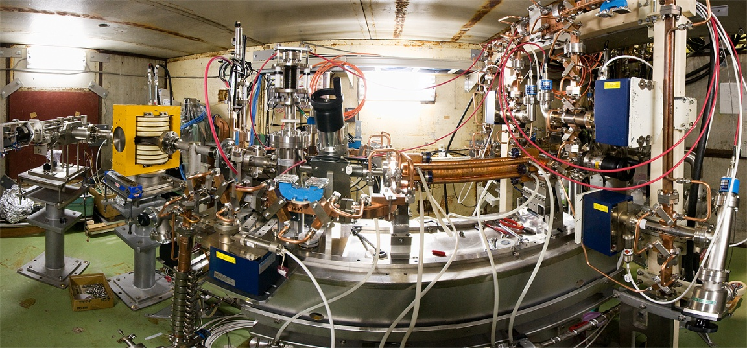
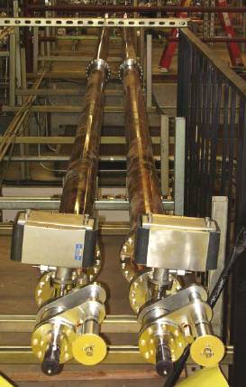
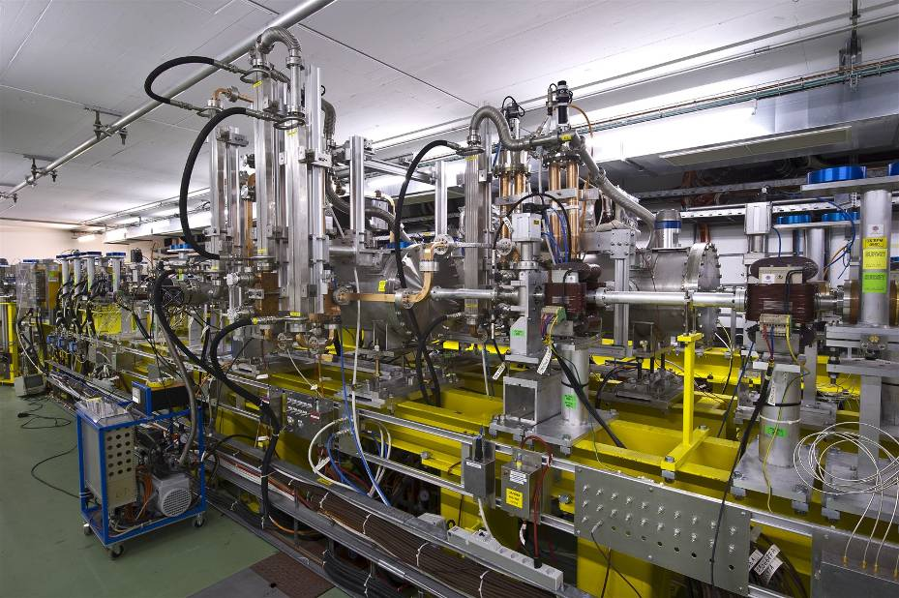
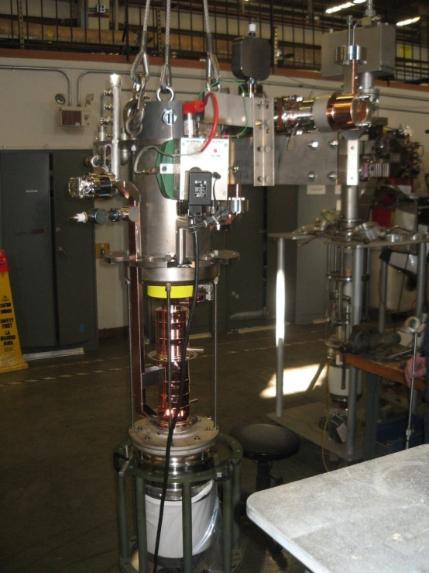
Prototype accelerating structure test areas
Nextef at KEK
NLCTA at SLAC
ASTA at SLAC
Two-beam test stand at CERN
New klystron at CERN

Slide 20
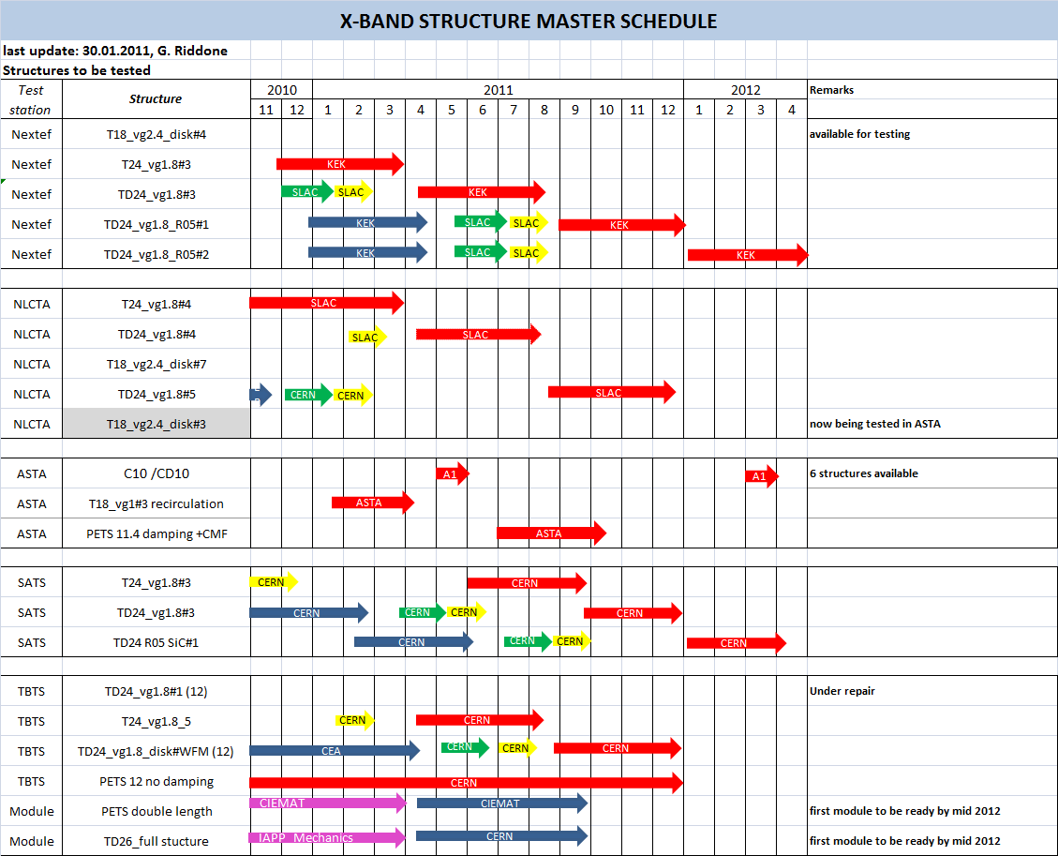
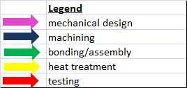
TD24s now under bonding/heat treatment

Slide 21
Testing schedule simplified
ACE 2-2-2010
21.1.2010 |  | 2010
 |  | Jan | Feb | Mar | Apr | May | Jun | Jul | Aug | Sept | Oct | Nov | Dez
Facility | Structure
SLAC Station 1 | TD18_vg2.4_disk[3]
11.4 GHz | T24vg1.7_disk [3]
 | TD24vg1.7_disk [3]
SLAC Station 2 | T18_vg2.4_disk[3]
 | T18_vg2.4_disk[6]_CERN
 | CERN structure
SLAC ASTA | PETS 11.4 GHz
 | C10vg0.7[1]
 | PETS 11.4 GHz_ SiC
KEK NEXTEF
 | TD18_vg2.4_disk[2]
 | T24vg1.7_disk [4]
 | TD24vg1.7_disk [4]
CERN Test Stand | T24_vg1.7_disk [2]
12 GHz | TD24_vg1.7_disk [2]
CLEX 12 GHz
 | Pets 12 GHz
 | TD24_vg1.7_disk [1]
 | PETS ON/OFF

Slide 22
Current effective testing capability for CLIC-related structures
Facility | Available testing slots
Nextef | 1
NLCTA | 0.5
ASTA | 0.25
CERN klystron | 0
TBTS | unique capabilities – will not be used for low BDR tests
Total | <2
Personal view – highlighting availability is not a criticism but an attempt to honestly evaluate our situation.

Slide 23
Introduction to dynamic vacuum
Main beam linac requirements : total p≤10⁻⁹ Torr (from G. Rumolo https://edms.cern.ch/document/992778/2), assuming CO, N₂ and/or H₂O. H2 is not harmful.
Three separate issues:
  Static vacuum
  Dynamic vacuum due to breakdowns
  Dynamic vacuum due to field emission / dark currents
Static vacuum and dynamic vacuum due to breakdowns are not covered here. However for the design repetition rate they are not a limiting issue and can be simulated on the basis of known data. See C. Garion https://edms.cern.ch/document/1109052/1 and https://edms.cern.ch/document/1095288/1

Slide 24
Dark currents induced dynamic vacuum I
Progress since last year's ACE
  Necessary information: Electron Stimulated Desorption (ESD) coefficients of unbaked copper, processed according to manufacturing sequence of RF structures, at high energy
  A new laboratory test system has been prepared and is operational, for testing copper samples up to e⁻ energy of 35 keV (safe limit for lab equipment). Test of samples from a large matrix of [surface treatments]•[thermal treatments] has started (Chiara Pasquino thesis)
  Necessary information: accurate dark current simulations, calibrated with actual dark currents measured in faraday cups, in order to obtain the # of molecules degassed at each pulse.
  Collaboration with SLAC / ACD on using ACE3D for the purpose has started. Kyrre N. Sjøbæk from CERN/Oslo U. Is working on this.
  The two elements above will be combined to produce dynamic pressure profiles (simulation tools are available)

Slide 25
Dark currents induced dynamic vacuum II
Progress since last year's ACE
  Necessary information: Real experimental data for dynamic vacuum.
  Several efforts started:
    Collaboration with Helsinki U. / HIP for direct measurement with a multipass laser system. PhD work is starting (CERN will provide test structure to implement the measuring hardware)
    Stand alone 12 GHz CERN test stand: is being instrumented .
    KEK 11 GHz test stand: data is collected and correlated with dark current. Vacuum improvements of the test stand are foreseen (now limited by baseline vacuum)
    SLAC 11 GHz test stand. Old data will be revaluated and analysed

Slide 26
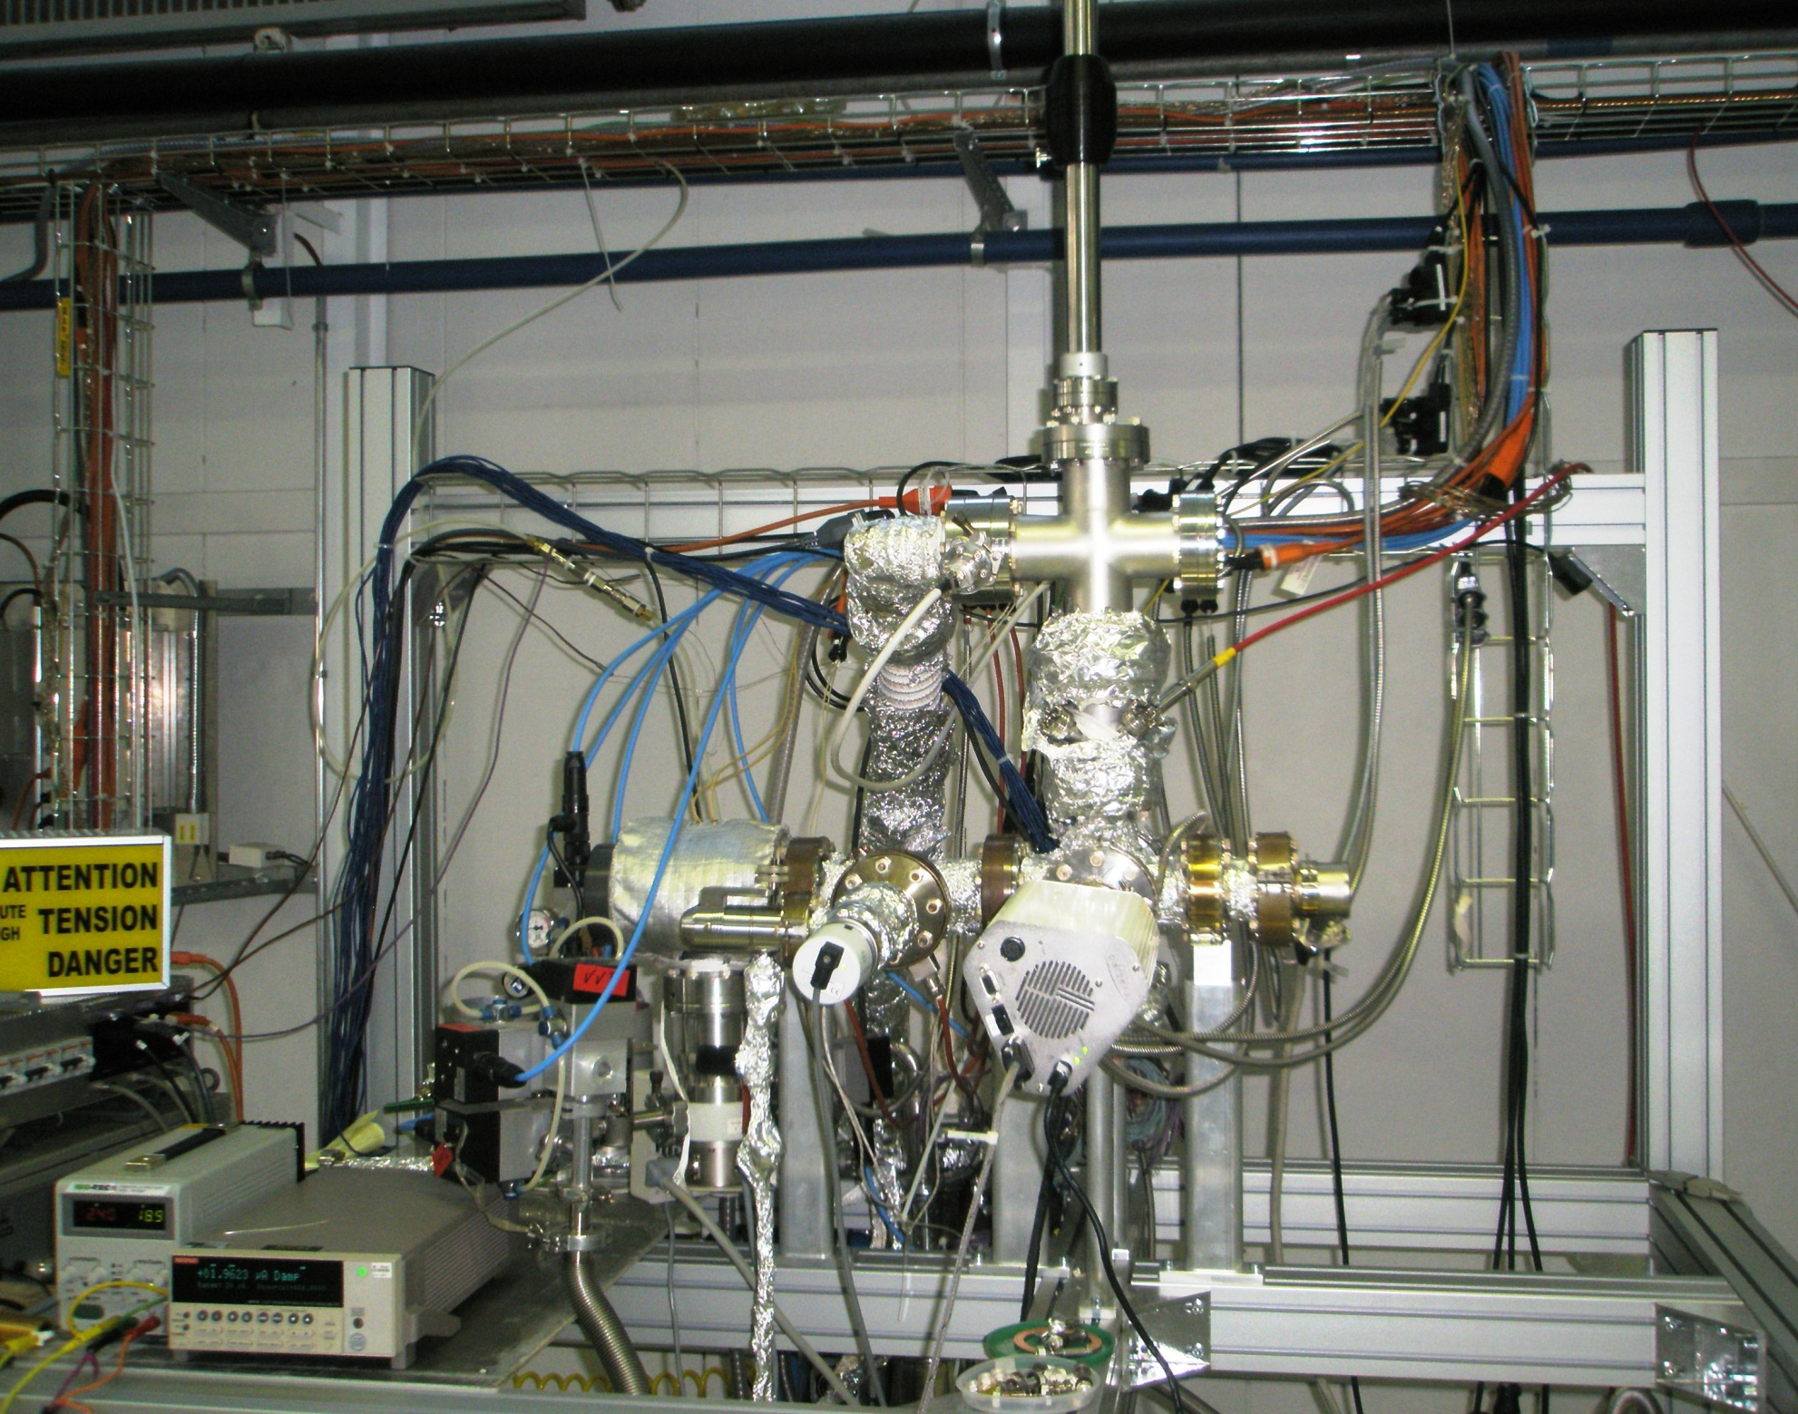
ESD @ 10 keV

Slide 27
Prototype development overview
Test structures include all feasibility-level features/issues:
Correct iris aperture range
Damping waveguides
Completeness, cost and performance features/issues are next:
Compact coupler. We now use a “mode-launcher” coupler which works fine but is too long. There are many options for compact couplers, and at least a few should work, but it could take a number of high-power tests to work it all out.
SiC loads. Loads can be pulled back to arbitrarily low fields, although this would result in a more expensive structure. Field emitted electron bombardment, and resulting dynamic vacuum issue are the main known unknown. However the CTF3 drive beam accelerator has thousands of loads, PETS with SiC in ASTA worked fine and there are lots of high-power C-band loads with SiC in them.
We now have the basic high gradient data, better understanding of breakdown and (soon) a cost model to make a significantly better optimization.
New structures for different energy machines e.g. 500 GeV.

Slide 28
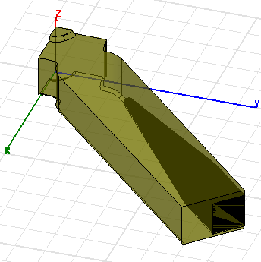
Design of the HOM Damping Load
Will be used for CLIC module prototype and for a structure prototype for high power testing with damping load inside (TD24_vg1.8_R05_SiC)
SiC properties from M.Luong, 1999
Tip size 1x1 mm
Tip length 20 mm or 30 mm
Base size 5.6 x 5 or 5.5 mm
Base length 10 mm
Waveguide width
awd = 10.1 mm or 11 mm
thick line: awg = 11mm,
thin line: awg = 10.1 mm

Slide 29
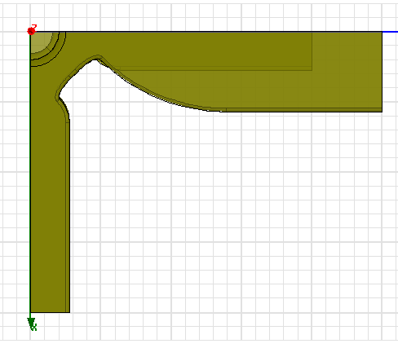
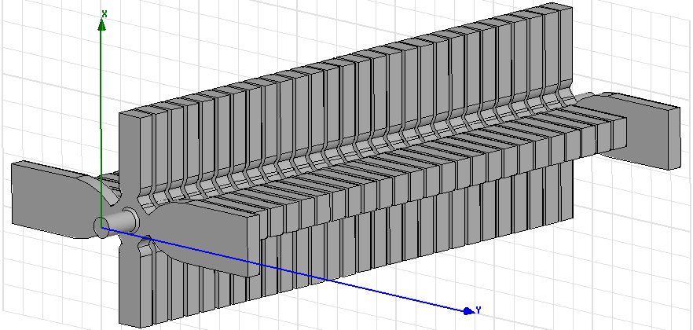
Design of the damped compact coupler
Will be used for CLIC module prototype and for a structure prototype for high power testing with damped compact coupler (TD26_vg1.8_R05_CC)

Slide 30
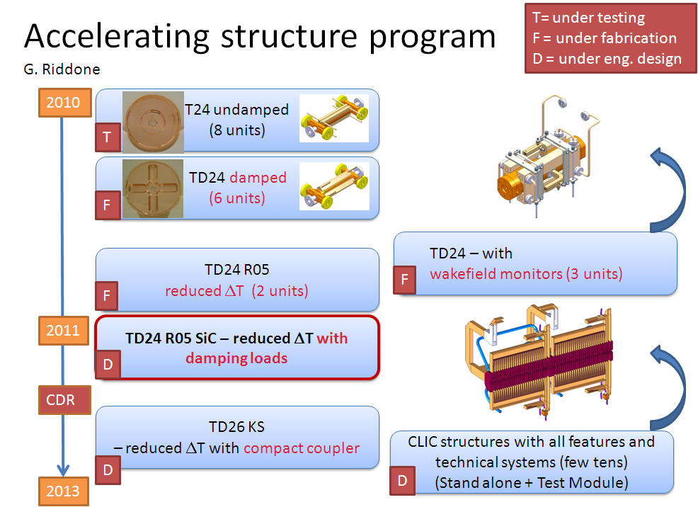

Slide 31
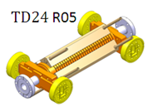
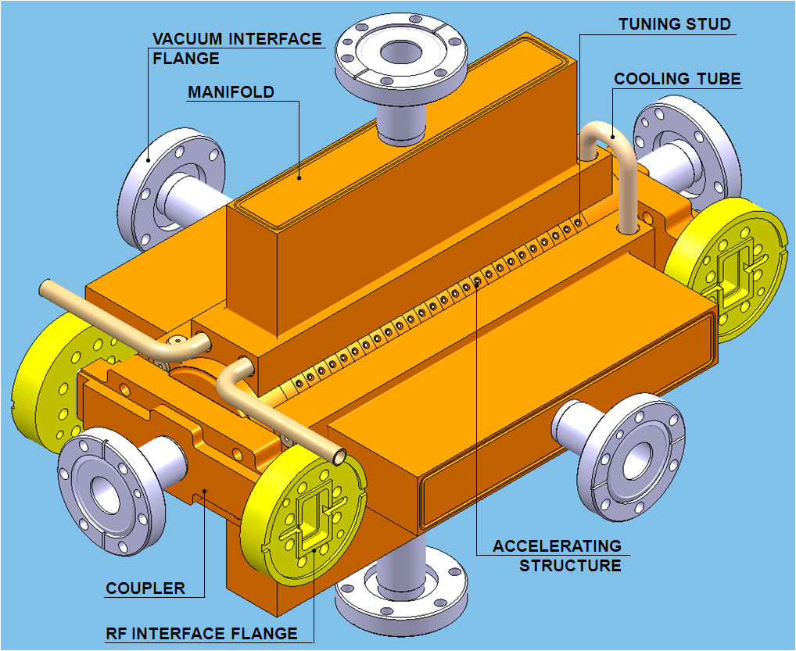
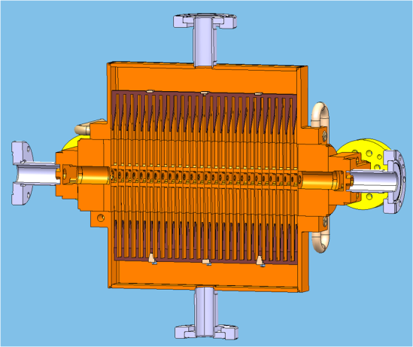
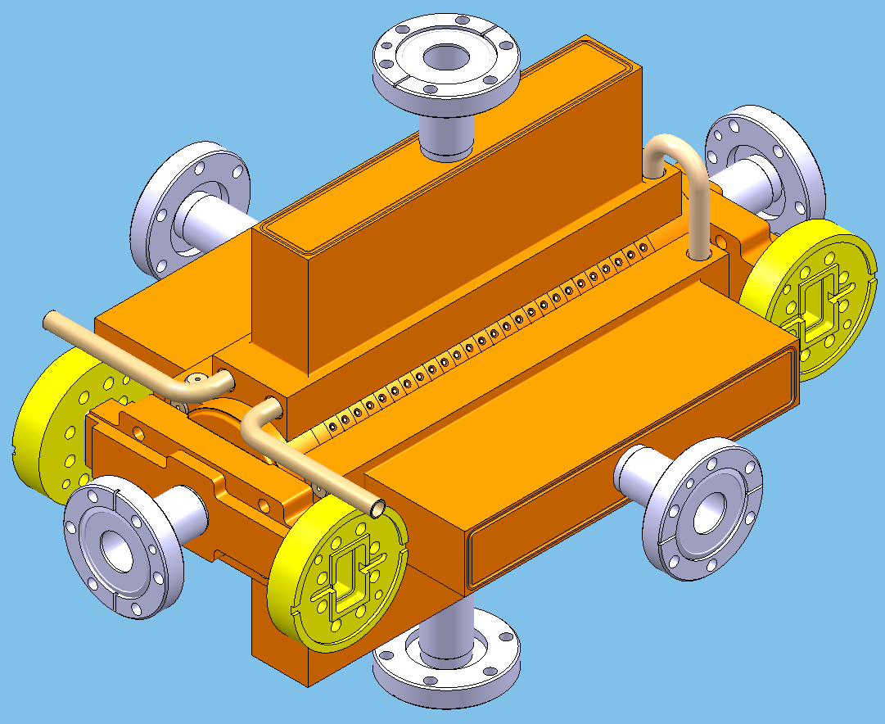
TD24 R05 SiC
New features: (from TD24 R05)
damping loads (numerical simulation performed)
brazing of vacuum manifolds (test under way to validate assembly procedure) ➔ preservation of alignment!
optimization of cooling circuit design
TUNING STUD
VACUUM INTERFACE
FLANGE
COOLING TUBE
MANIFOLD
ACCELERATING
STRUCTURE
COUPLER
RF INTERFACE FLANGE

Slide 32
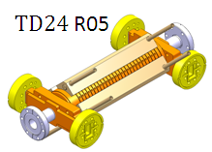
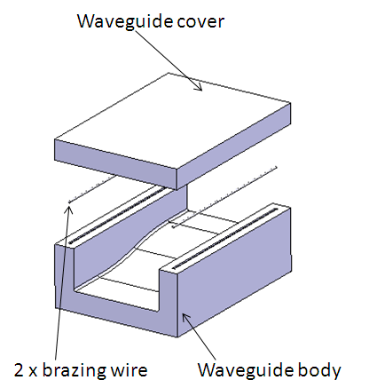
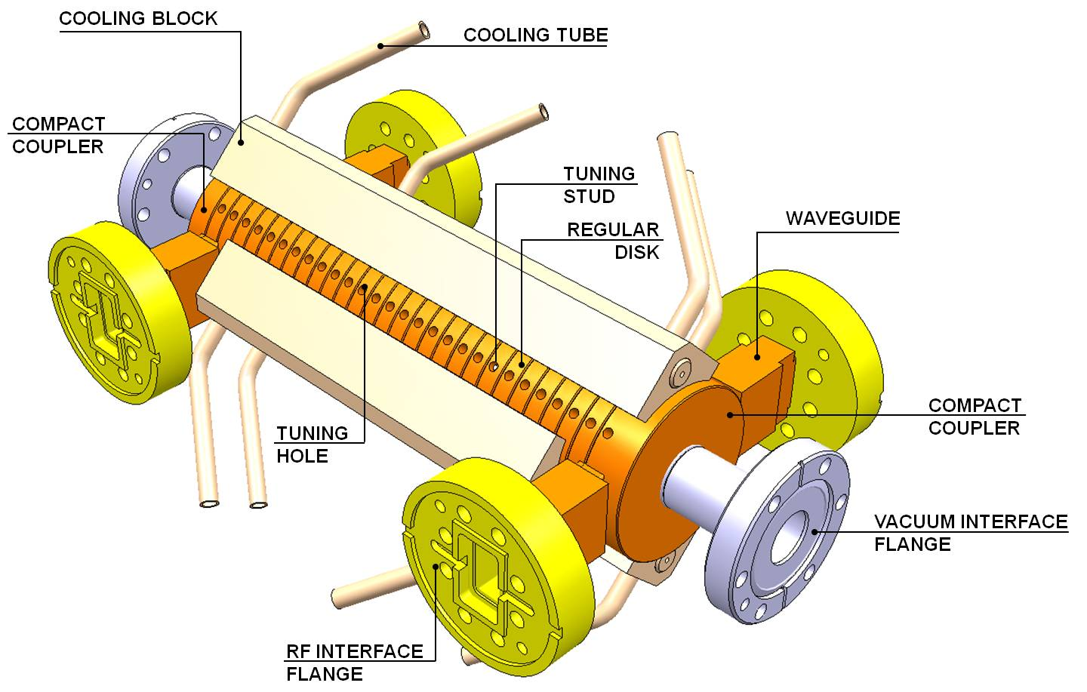
TD26 Compact coupler
New features (from TD24 R05):
compact coupler
new design of waveguides
additional brazing steps (procedure validated)
TUNING STUD
VACUUM INTERFACE
FLANGE
COOLING TUBE
MANIFOLD
ACCELERATING
STRUCTURE
COUPLER
RF INTERFACE FLANGE

Slide 33
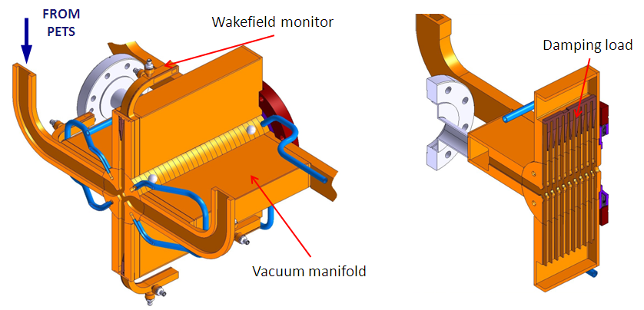
TD26 CC SiC (towards CLIC structures)
All features integrated:
compact coupler (as TD26 CC)
  new design of waveguides
  additional brazing steps (procedure validated)
damping material and vacuum manifolds (as TD24 R05)
WFM (as TD24 WFM from CEA)
interconnection to adjacent structures/modules
- Many brazing/bonding/EBW steps (validation on mock-ups from March 2011)
- Compactness and tolerance preservation are the main issues

Slide 34
Summary of a few key points
Fundamental performance
PETS in very good shape.
Scaling laws for high-gradient, P/λC and S_{c}, and understanding of breakdown have produced PETS and 100 MV/m-range accelerating structures.
All CLIC-series accelerating structures made using the baseline fabrication technique, 1050 °C bond in hydrogen, have reached above 100 MV/m.
T18’s meet specification (unloaded). T24 tests are going well.
Reduced gradient from T18 to TD18 observed. Weakness identified in disk-to-disk joint at highest surface-current point. TD24s scheduled to be tested from March.
We need to start getting statistics not just results on individual structures.
Testing capability is a weak point.
Two-beam units
Getting back on line with two-beam acceleration, now at X-band, and going well. Full program ahead.
Engineering and integration in module
Advancing well.

Slide 35
Extra slides

Slide 36
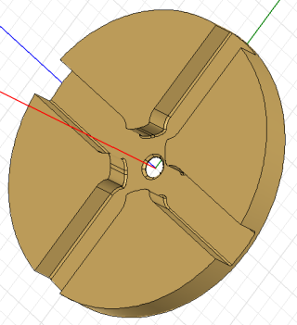

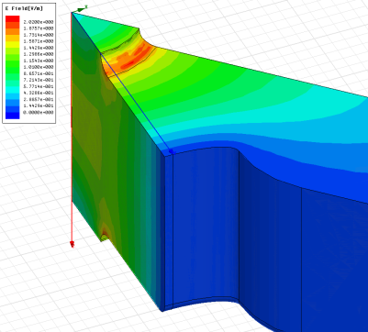
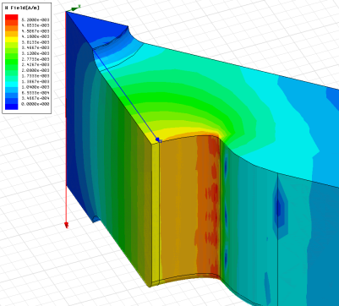
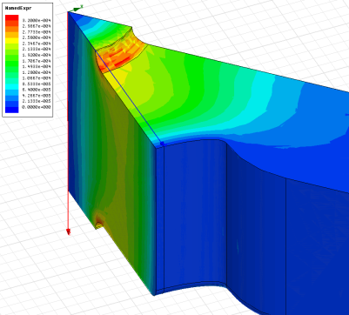
Cell features
E_{s}/E_{a}
H_{s}/E_{a}
S_{c}/E_{a}²

Slide 37
Pulse and whole structure features
S_{c}^{½} [MW/mm²]
E_{s} max [MV/m]
E_{acc} [MV/m]
ΔT [°C]
dashed – unloaded
solid – loaded
CLIC_G
(TD24)

Slide 38
CLIC_G Parameters
Average loaded accelerating gradient | 100 MV/m
Frequency | 12 GHz
RF phase advance per cell | 2π/3 rad.
Average iris radius to wavelength ratio | 0.11
Input, Output iris radii | 3.15, 2.35 mm
Input, Output iris thickness | 1.67, 1.00 mm
Input, Output group velocity | 1.65, 0.83 % of c
First and last cell Q-factor (Cu) | 5536, 5738
First and last cell shunt impedance | 81, 103 MΩ/m
Number of regular cells | 26
Structure length including couplers | 230 mm (active)
Bunch spacing | 0.5 ns
Bunch population | 3.7×10⁹
Number of bunches in the train | 312
Filling time, rise time | 66.7 ns, 21 ns
Total pulse length | 243.7 ns
Peak input power | 61.3 MW
RF-to-beam efficiency | 27.7 %
Maximum surface electric field | 230 MV/m
Maximum pulsed surface heating temperature rise | 47 K

Slide 39
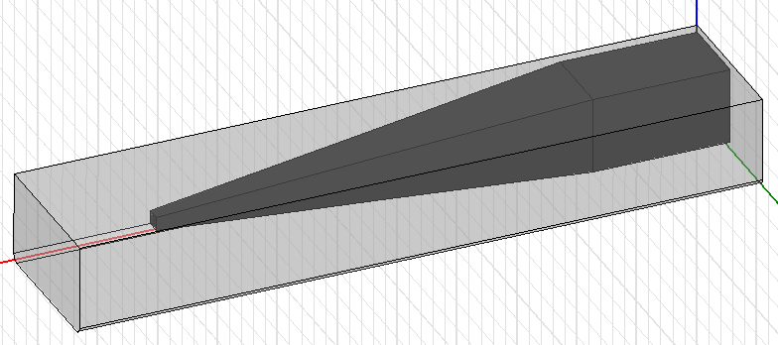
Higher-order mode damping
Cell | First | Middle | Last
Q-factor | 11.1 | 8.7 | 7.1
Amplitude [V/pC/mm/m] | 125 | 156 | 182
Frequency [GHz] | 16.91 | 17.35 | 17.80

Slide 40
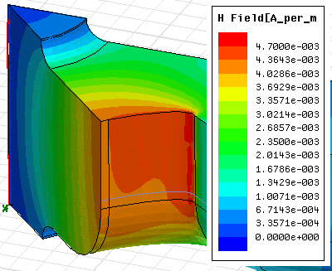
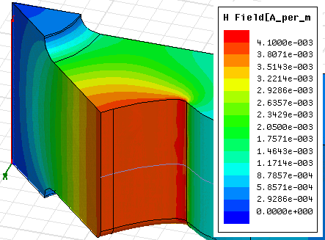
Geometry difference between
TD24_vg1.8_disk
TD24_vg1.8_R05

Slide 41
Now I will spend a few moments on some analysis of some important high gradient experiments which illustrate the status of our understanding of high-power behavior.
Why is this not just an academic exercise?
We now almost have the minimum set of high-gradient data to necessary to further optimize the 3 TeV baseline structure. We’re talking about 5-10% effects at least. This means also incorporating updated cost models.
Machines at energies other than 3 TeV are being discussed. We will soon be making optimizations at new energies and coming up with new structures.
Our ideas will directly influence these designs and optimizations.

Slide 42
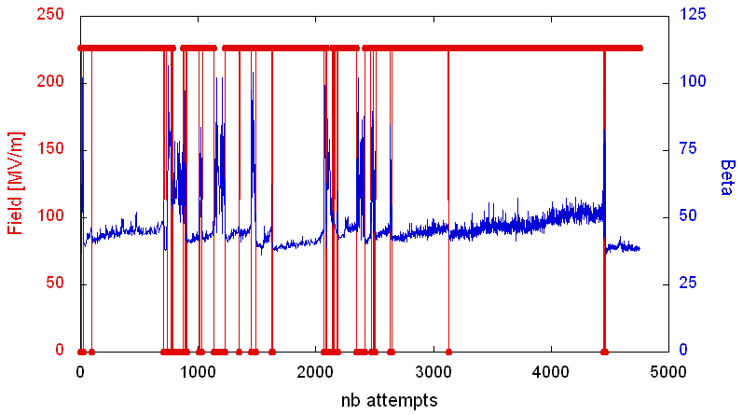
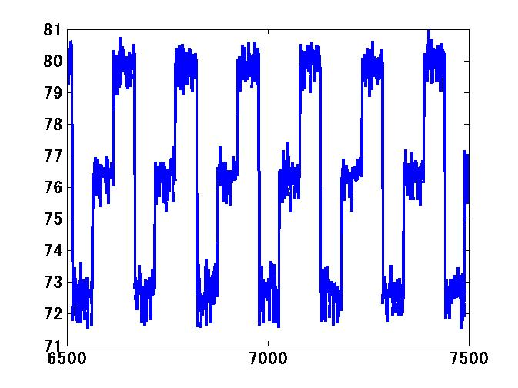
Investigation of the statistical nature of breakdown
Same breakdown rate for interleaved (solid dots) and not indicates random trigger, rather than evolving surface. Test on TD18 at KEK.
Steady increase of β indicates evolving surface in dc spark system, rather than random trigger.
β·E = 10.8 GV/m
Input power (MW)
RF pulse counts

Slide 43
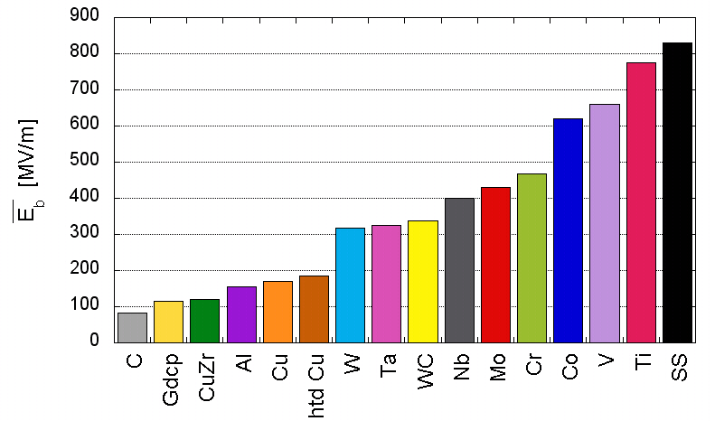
Hints for origin of breakdown rate
hcp
fcc : face-centered cubic
bcc : body-centered cubic
hcp : hexagonal closest packing
hcp
bcc
bcc
bcc
bcc
bcc
bcc
fcc
fcc
High gradient behavior of various materials measured in CERN dc spark system

Slide 44
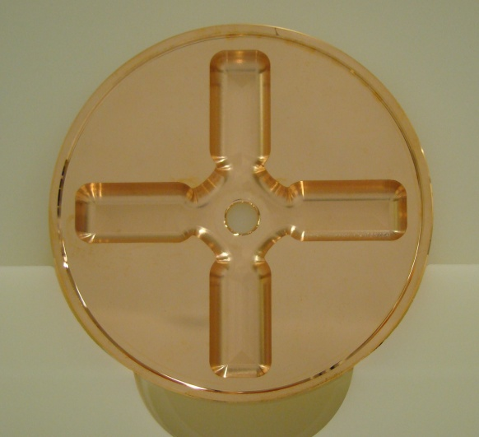





detuned DAMped disk from VDL (TD24)
Zeiss CMM, free state measurement
Shape accuracy 5 µm
2.6 µm achieved
Roughness Ra 0.025
Iris region achieved Ra 0.016

Slide 45





A new level of care for CERN-built structures
Individual inspection
Boxes under N2
Sealed bag under N2
Operation done under laminar flow
RF measurement

Slide 46




Accelerating structures – manufacture
TD18#3 at SLAC
TD18#2 at KEK
Stacking disks
Structures ready for test
Temperature treatment for high-gradient

Slide 47








Status and Prospects
for the CLIC DDS
Roger M. Jones
Cockcroft Institute and
The University of Manchester
International Workshop on Linear Colliders (IWLC), 18-22 Oct 2010, CERN, Geneva

Slide 48



Design of CD-10-Choke
CD10-Choke for demonstration
  RF Design for Gap 1mm, 1.5mm, 2mm
  Mechanical Design finished for 1mm-gap
  Qualification disks and bonding test
To the production pipeline and High Power testing
120 Degree

Slide 49



Damping simulation with Gdfidl/HFSS
Good damping for
first dipole
Mode reflected by the choke, to be studied…
Gap 1mm 2mm
Impedance and wakefield simulated in Gdfidl
E field, fundamental mode
(Model in HFSS)
E field of a dipole mode that is reflected by the choke

Slide 50
Letter of Intent for Experiments at FACET
R. Jones, D. Schulte, R. Tomas, W. Wuensch for the CLIC team
Thanks to
Juergen Pfingster, Alexej Grudiev, A. Latina, G. Sterbini, D Angal-Kalinin, J. Barranco, L. Fernandez, C. Hast, R. Jones, S. Jamison, J. Resta, G. Rumolo, A. Seryi, N. Watson

Slide 51




150 cells/structure, 15 GHz
Higher-order mode damping demonstration in ASSET
Then
Now
Double band circuit model
24 cells/structure, 12 GHz
(loads not implemented yet)
An Asset Test of the CLIC Accelerating Structure, PAC2000

Slide 52

Full length TDS results comparison

Slide 53

Option two: HOMagic-T
First arm of HOMagic-T is for main power
Second arm of HOMagic-T is for wake field damping.
From the symmetry main power will not couple.
Moreover, dimensions are close to that of the call damping waveguides so it is below cutoff for 12 GHz.
Vertical offset
Horizontal offset
load
Signals are coupled out in symmetrical way using directional couplers into a waveguides which are above cutoff for the relevant frequency in order to avoid cross talk between the polarizations.

Slide 54
Impedance of the dipole modes
5μm offset => 125 μW
-10 : -20 dB coupling => 12.5 -- 1.25 μW

Slide 55




TE-like modes in single bunch
GdfidL results, beam offset δx = 1 mm
2nd port mode
Y₊
24 GHz
Y₊
X₊
Y₊
X₋
X₊
X₊
Y₋
Highest amplitude at 24 GHz
Intrinsic resolution ~ 5 µm
Linearity OK
Peak power from 1 µW to 100 W

Slide 56

Accelerating structure with WFM: Mechanical design
Longitudinal cut
SiC RF load
Coaxial pick-up
Cooling blocks
90° waveguide bend
Accelerating Structure
Beam pipe
RF cable
Support
A. Solodko (CERN)

Slide 57

Integration in the two beam test stand vacuum tank
Vacuum RF feedthroughs on CF flange
Accelerating Structure n°1
Accelerating Structure n°2
Beam Trajectory
Input RF power
Vacuum tank not shown

Slide 58
Cost estimate of RF structures
G. Riddone
CERN estimate
Identification of the manufacturing steps
Prototype cost available
For each manufacturing step, application of the learning curve and sum of each contribution
Cost studies with industries
3 studies were launched with industries/institutes in Q4/2009
  VDL, NL (manufacturing of several RF structures, experience with milling and turning, experience with series production)
  KERN, DE (manufacturing of TBL PETS, machine constructors, mainly experience with milling, experience with series production)
  VTT(HIP) FI (research organization, manufacturing of qualification pieces, contact with several Finnish companies, mainly experience in milling)
The cost estimate study incorporated the whole fabrication process (including machining, quality control, assembly and RF checks): conventional machining and H2 diffusion bonding according to the baseline
3 production lines
total production over 5 years
Parametric study launched with VDL and KERN to understand how shape accuracy and roughness affects the machining cost

Slide 59

RF system cost breakdown
G. Riddone

