Slide 1

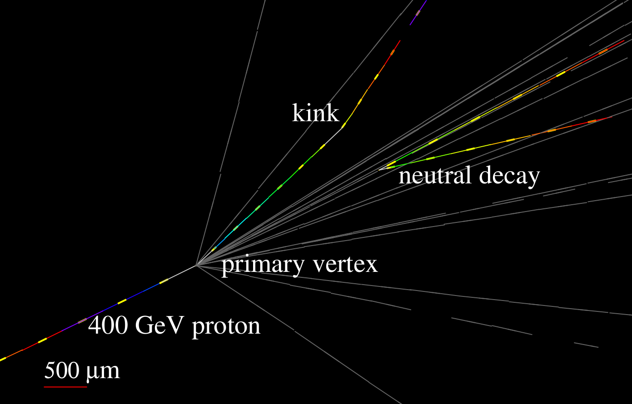
NA65/DsTau experiment, status and plans
Akitaka Ariga (Spokesperson)
University of Bern / Chiba University
On behalf of the DsTau Collaboration
SPSC Open session June 2022
DsTau paper: 10.1007/JHEP01(2020)033
DsTau web site:
https://na65.web.cern.ch/
Notes:
ノートを消したものをuploadする

Slide 2
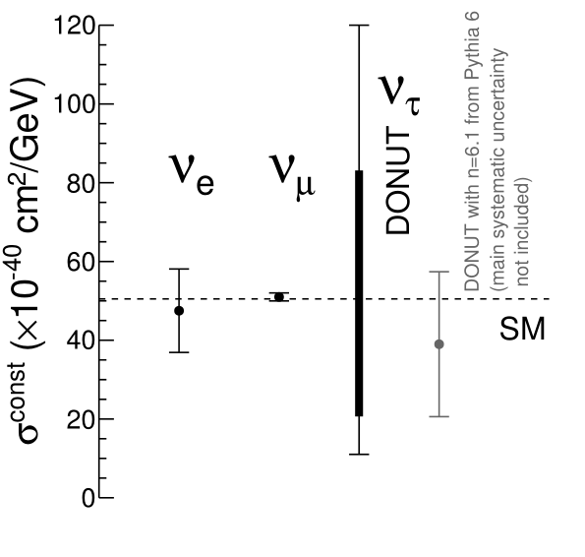
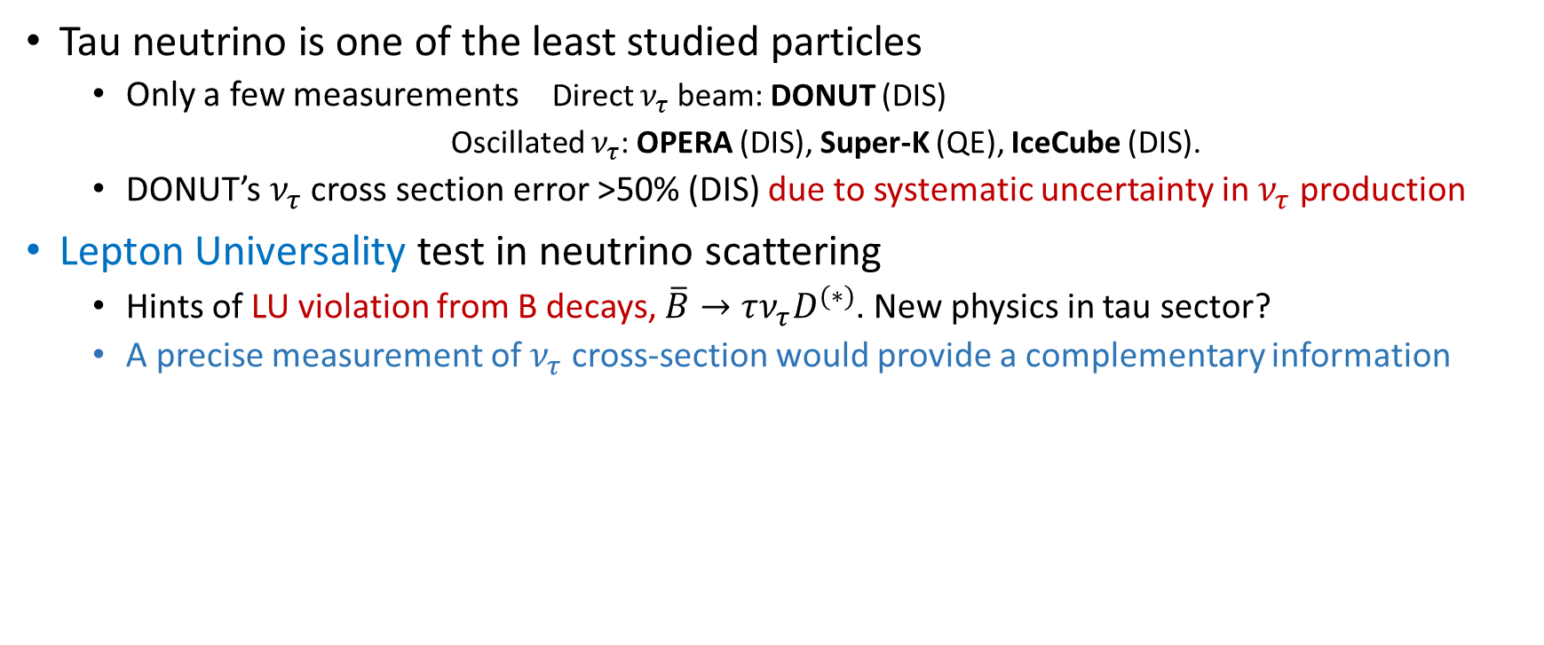

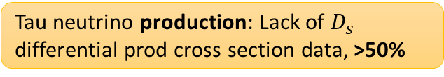
Motivation to tau neutrinos
Tau neutrino is one of the least studied particles
  Only a few measurements Direct $ν_{τ}$ beam: DONUT (DIS)
  Oscillated $ν_{τ}$: OPERA (DIS), Super-K (QE), IceCube (DIS).
  DONUT’s $ν_{τ}$ cross section error >50% (DIS) due to systematic uncertainty in $ν_{τ}$ production
Lepton Universality test in neutrino scattering
  Hints of LU violation from B decays, $\overline{B}→τν_{τ}D^{(∗)}$. New physics in tau sector?
  A precise measurement of $ν_{τ}$ cross-section would provide a complementary information
Tau neutrino cross-section uncertainties in DONUT
Tau neutrino detection statistics of 9 events, 33%
SHiP, FASER$ν$ etc
Tau neutrino production: Lack of $D_{s}$ differential prod cross section data, >50%
DsTau
Tau neutrino production : Others, 33%
Need to improve both $ν_{τ}$ statistics and $ν_{τ}$ production

Slide 3
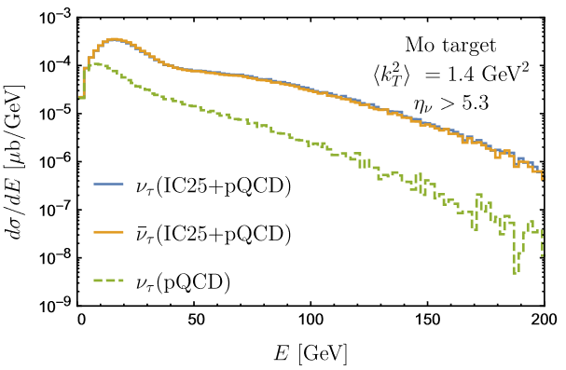
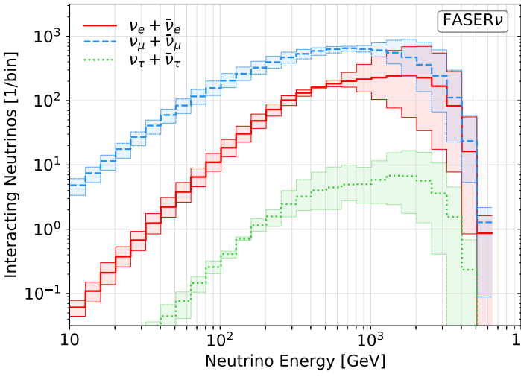
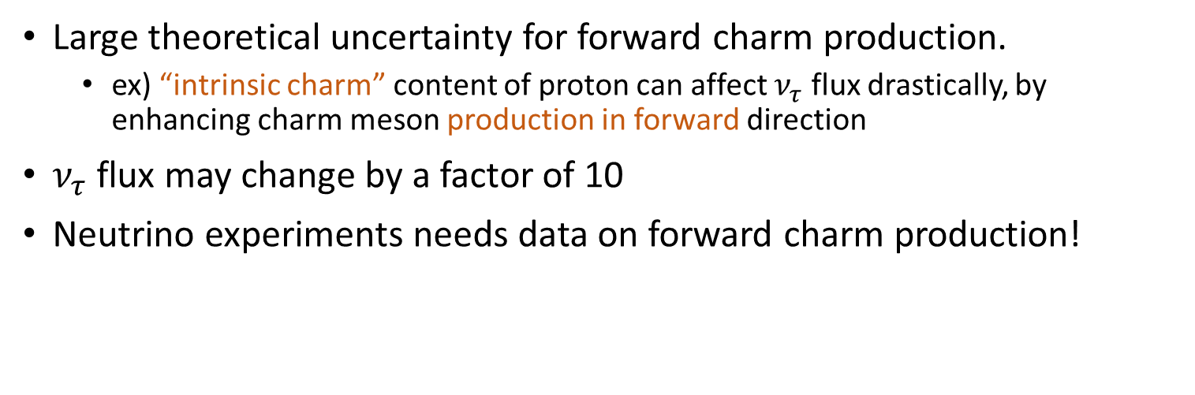
Forward charm production
Large theoretical uncertainty for forward charm production.
  ex) “intrinsic charm” content of proton can affect $ν_{τ}$ flux drastically, by enhancing charm meson production in forward direction
$ν_{τ}$ flux may change by a factor of 10
Neutrino experiments needs data on forward charm production!
SHiP case (400 GeV p-N) interaction
FASER case (7-7 TeV)
Due to large uncertainties of forward charm production among different hadron generators
(Pythia, Sibyll, DPMJet)
arXiv:2105.08270
JHEP02(2019)077

Slide 4










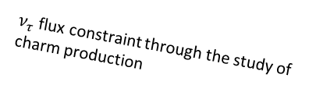



The NA65/DsTau experiment at the CERN SPS
Study of ν_{τ} production for future tau neutrino experiments.
  $D_{s}$ double differential production cross section measurements
  Reduce $ν_{τ}$ flux uncertainty from >50% to 10% → Fundamental input for future ν_{τ} experiment: SHiP, and indirectly FASER
Forward charm physics, charm/gluon PDF
Principle of the experiment
  Detection of “double-kink + charm decay” topology within 10 mm.
  $4.6×{10}^{9}$ protons, $2.3×{10}^{8}$ proton interactions in target, ${10}^{5}$ charm pairs, $1000 D_{s}→τ→X$ detected events.
$ν$ oscillation experiments
DONuT
Re-evaluation of $ν_{τ}$ cross-section (2020)
-2008
Small kink at D_{s} → τ
400 GeV
proton
ν_{τ}
Ds
Tau
$ν_{τ}$ flux estimation
D_{s}
X
Precise $ν_{τ}$ cross section
New physics searches in neutrino scattering
τ
202x?
D⁺
ν_{τ}
$ν_{τ}$ flux constraint through the study of charm production
X'
Astrophysical $ν_{τ}$ observations
~5 mm
2022-
Notes:
1 mrad = 0.057 deg

Slide 5

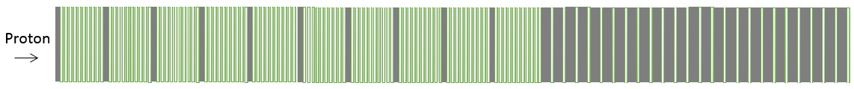

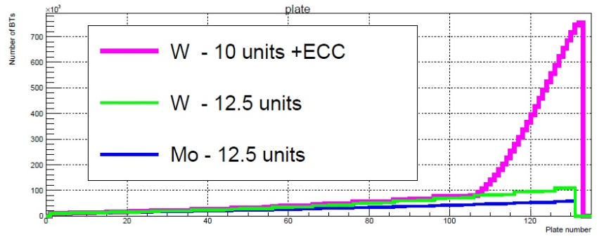
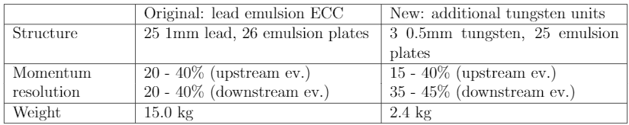
Change of structure for momentum measurement
ECC for momentum measurement
(26 emulsion films interleaved with
1 mm thick lead plates)
-2018
10 units
(total 100 emulsion films)
Original structure had more material → too high track density
  Dedicated scanning is required
Reduce material, but sufficient performance
Making data taking procedure simple
Proton
Momentum analyzer for events at downmost tungsten plates :
3 tungsten plates and 25 emulsion plates
10 units
(total 100 emulsion films)
New 2021-
Proton
Original
New

Slide 6
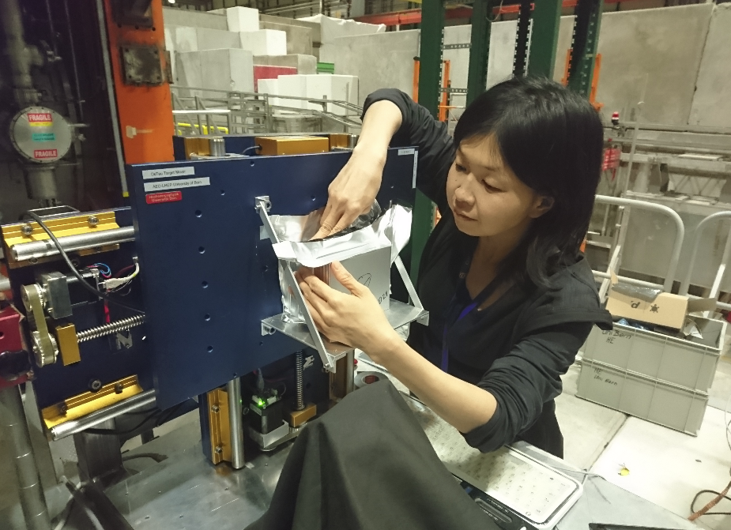

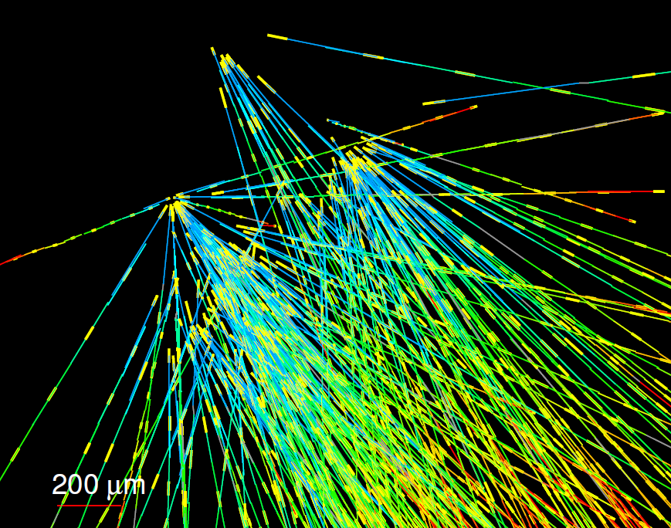
DsTau milestones
Test beam 2016
Test beam 2017
Test of detector structure
Improved detector structure
Refine exposure scheme
Pilot run 2018
1/10 of the full-scale experiment with tungsten target
Physics run 2021-2022 (2023)
Full scale experiment with tungsten and molybdenum targets
Aiming at 1000 $D_{s}→τ→X$ events
Aiming at 1000 𝐷_𝑠→𝜏→𝑋 events
10 % uncertainty on $ν_{τ}$ flux
10 % uncertainty on 𝜈_𝜏 flux
30 modules, 50 m²
LOI in 2016
TP in 2017
Approved as NA65 in June 2019

Slide 7
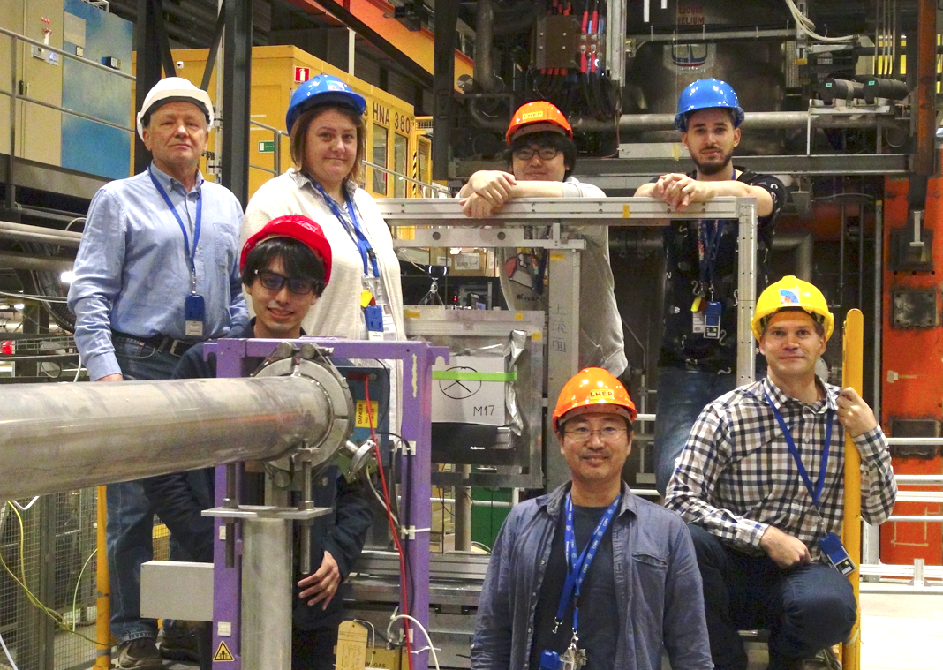
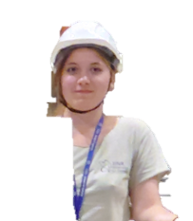
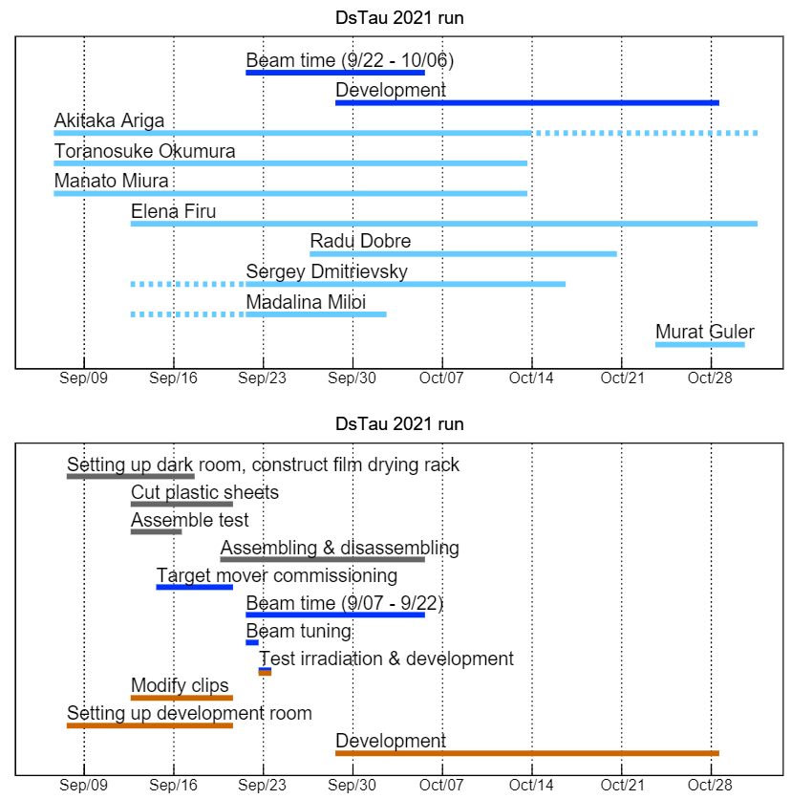
DsTau 2021 run
Originally, we planned to use a total area of emulsion films of >200 m^2 → reduced to 110 m2 due to COVID19
Several new:
  Film size
  Target mover
  Development facility

Slide 8
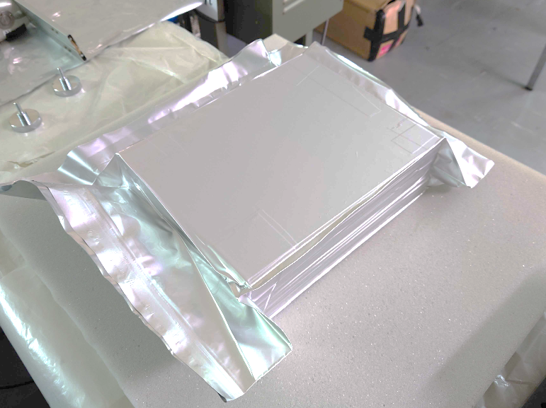
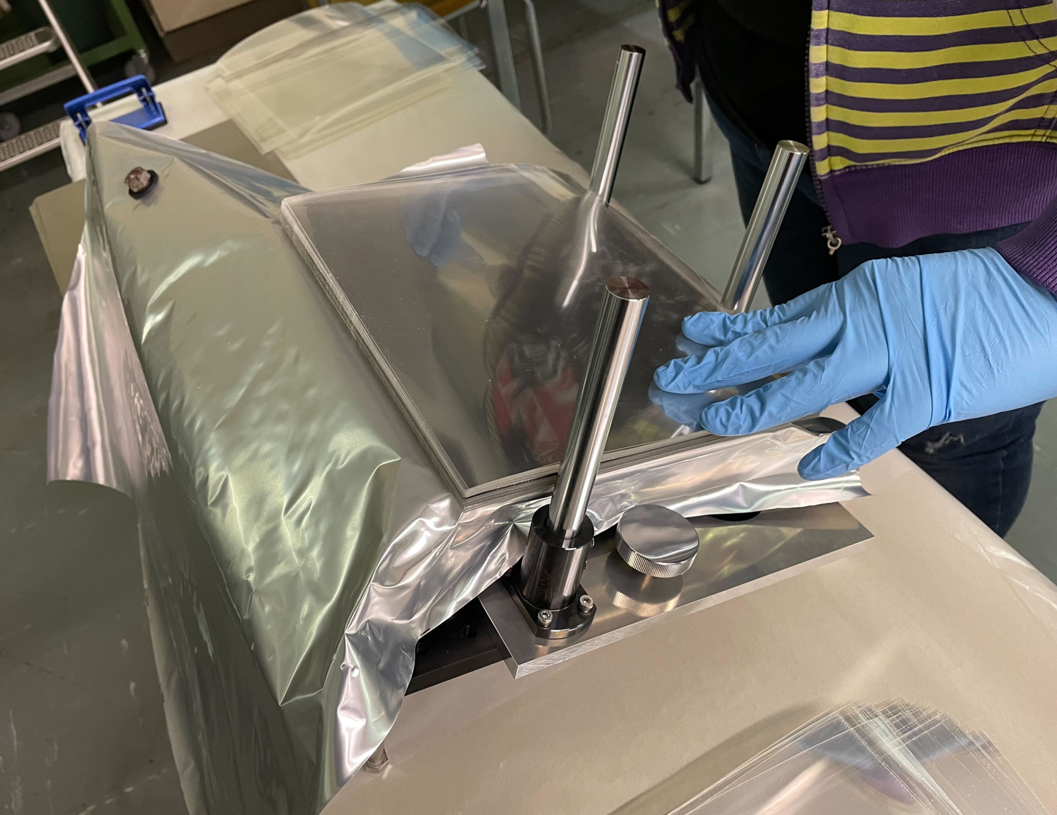
2021 run: Module assembling
Vacuum packed to keep sub-micron alignment
New assembling table
  Films size from 12.5 cm x 10 cm → 25 cm x 20 cm
  A total of 259 components/module
20 cm
25 cm
A total of 17 modules were produced

Slide 9
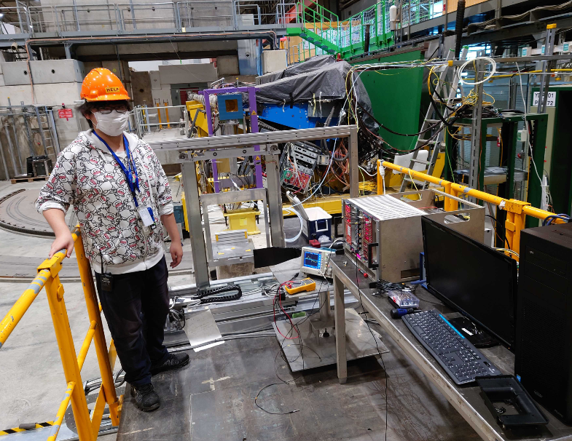
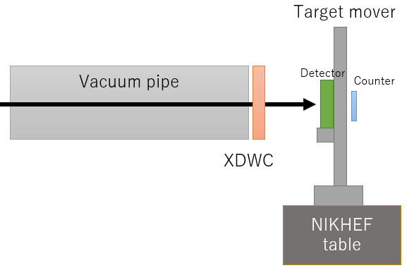
Setup in H2
XWDC
Target mover
PMT
New target mover
XDWC for beam profile monitor
Scintillator(s) to feedback beam intensity in real-time

Slide 10
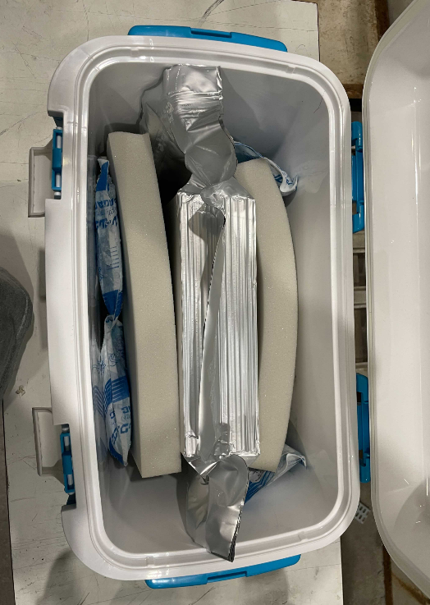
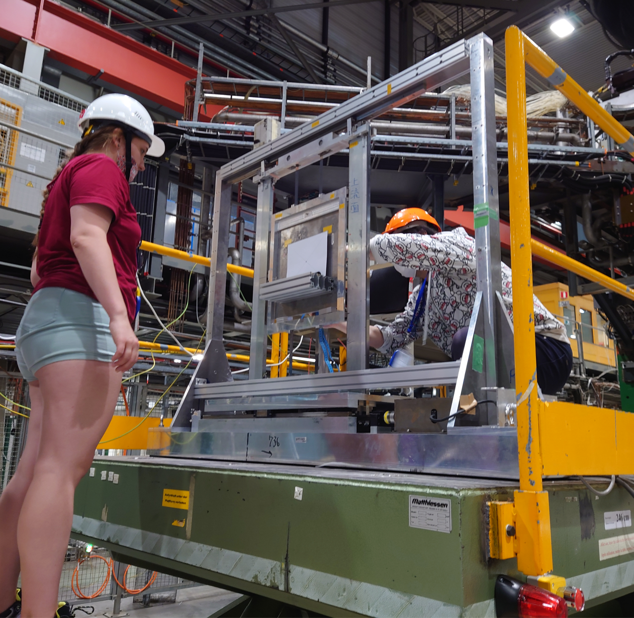
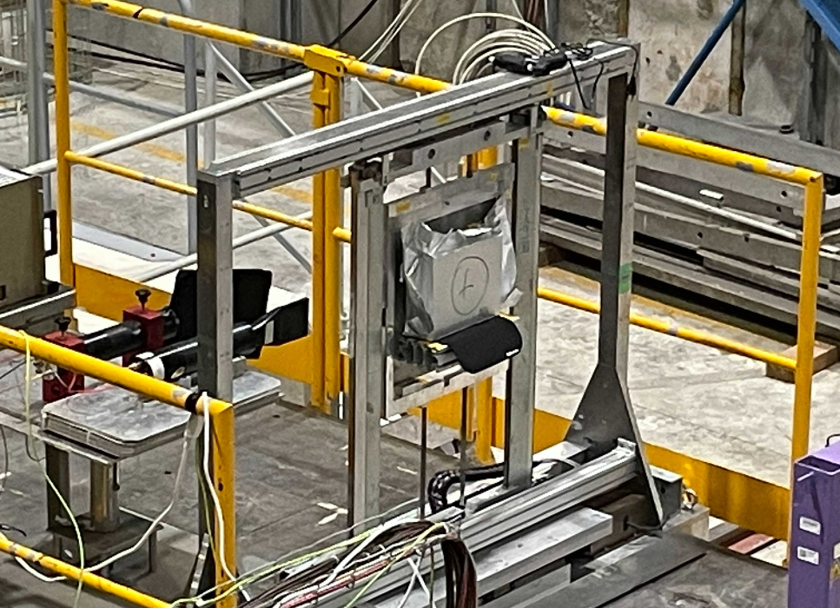
Exposure process
Set a module on the target mover
Exposure
Remove the exposed module
20 min
1 hour ~ 4 hours
20 min
Nighttime
2 spills/SC
Daytime
1 spills/SC

Slide 11
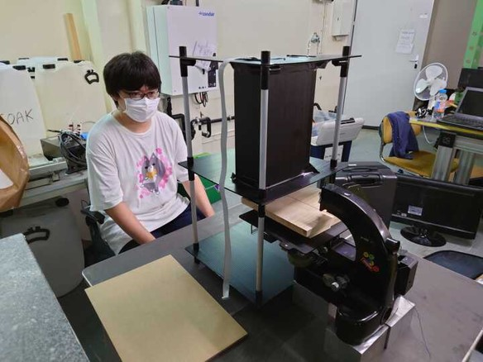
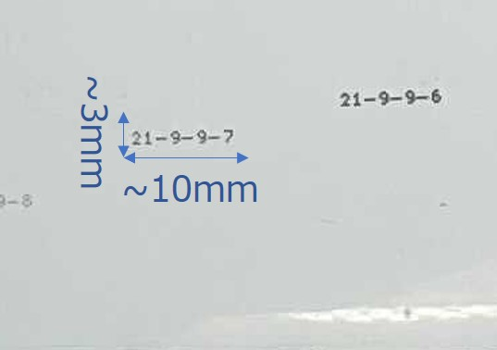
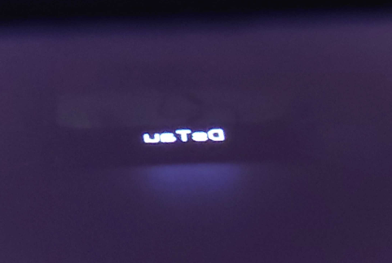
Film labeling
Emulsion films are labeled by an optical label printer
Raspberry pi -> LED dot matrix -> lens -> emulsion
A trouble during operation (a fraction of films doesn’t have a readable pattern), but recoverable.
Labels after development
Light pattern on emulsion film
10 mm

Slide 12
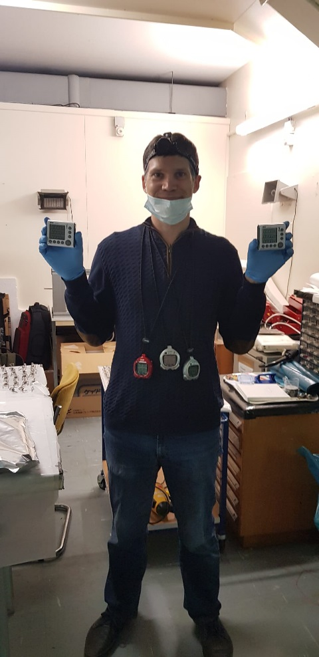
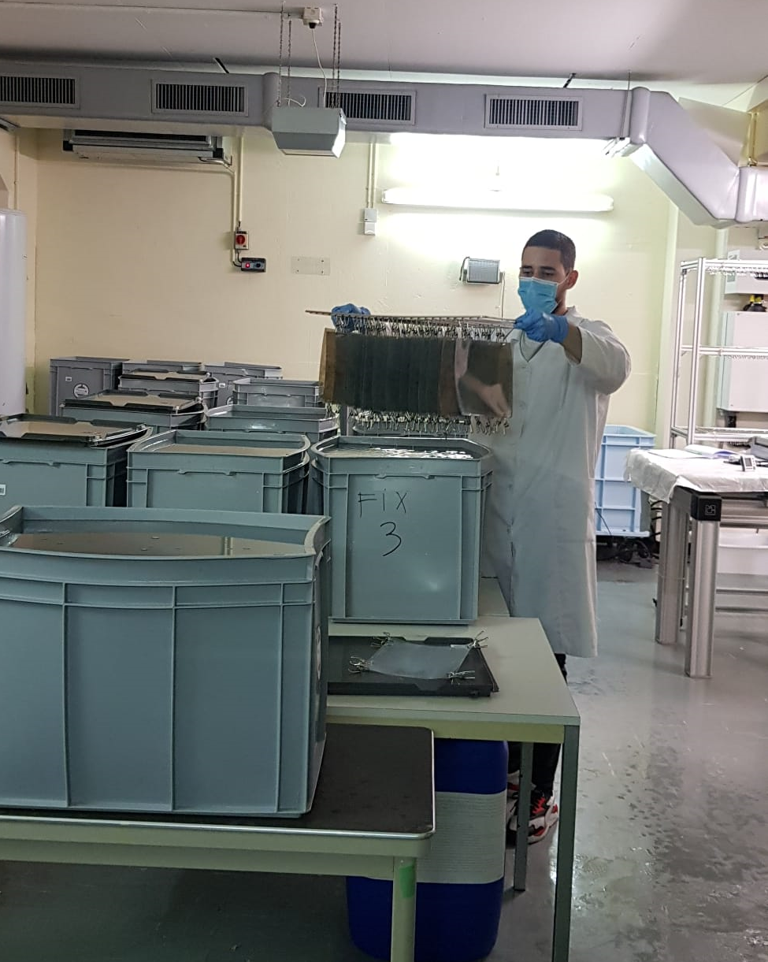
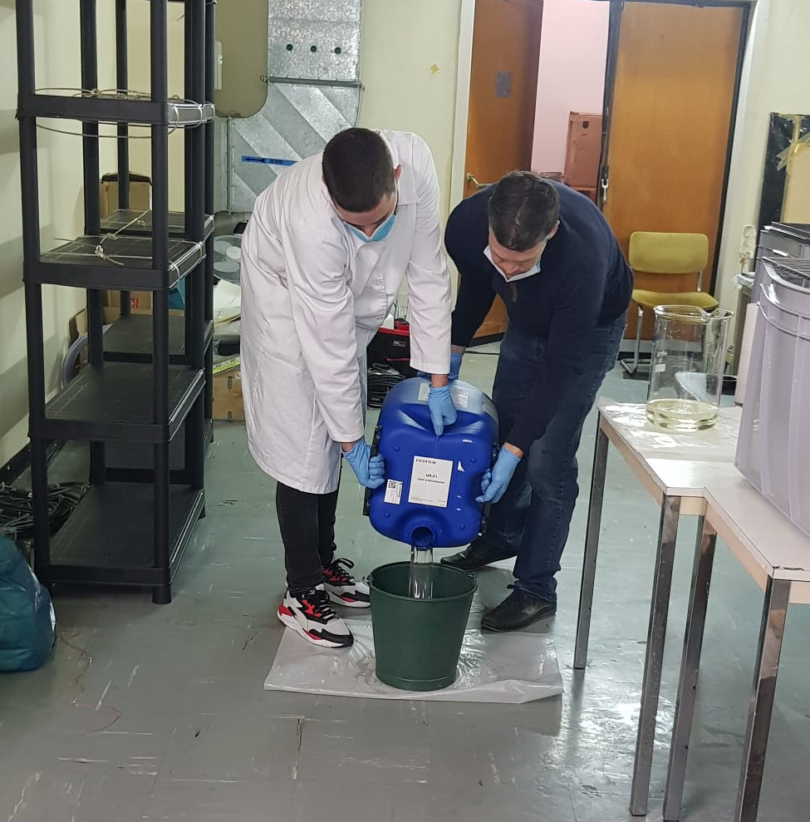
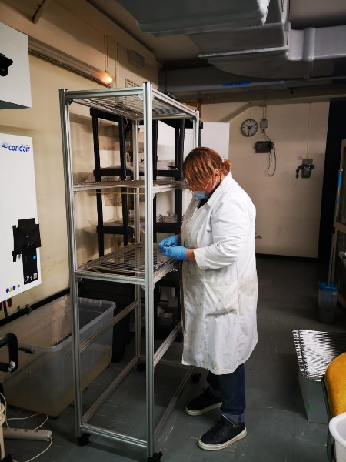
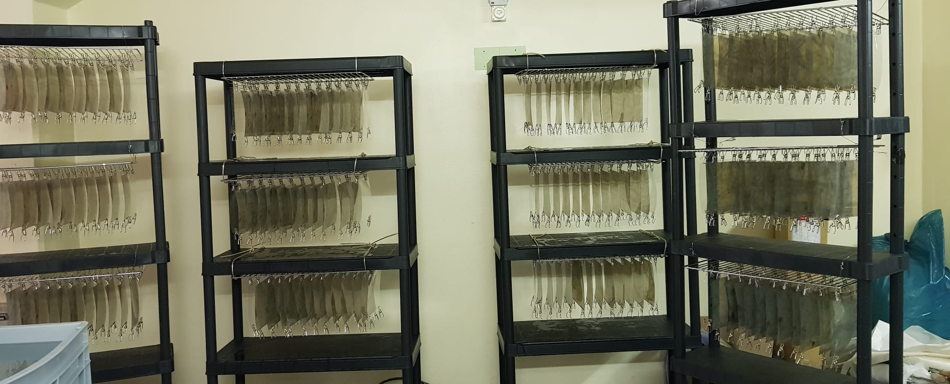
Development
putting clips
after development
preparation of fixer
the man with the clocks - didn't miss a second
Drying films
This was the first large scale development after CHORUS in 90s!
~2200 films were developed in 3 weeks

Slide 13
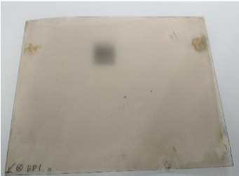
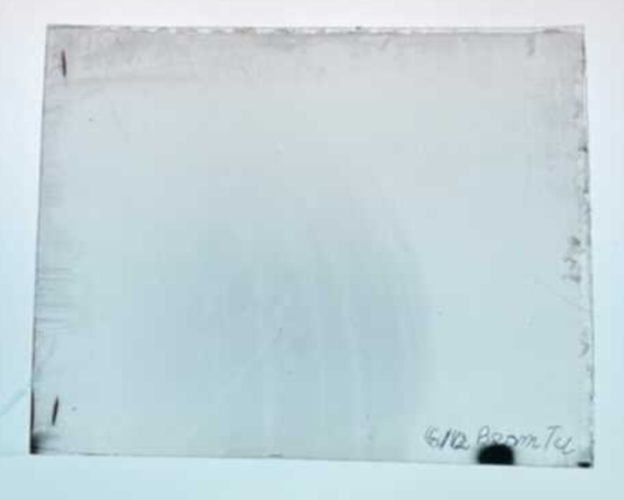
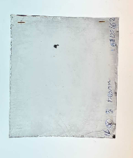
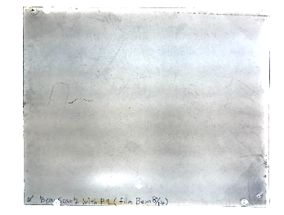
Comparing beam size with 2018 and 2021
2018 2021
Single spot irradiation
12.5 cm
Bad example from the 2018 run
2021 run
Irradiation with scanning by target mover

Slide 14
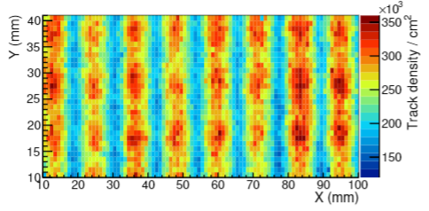
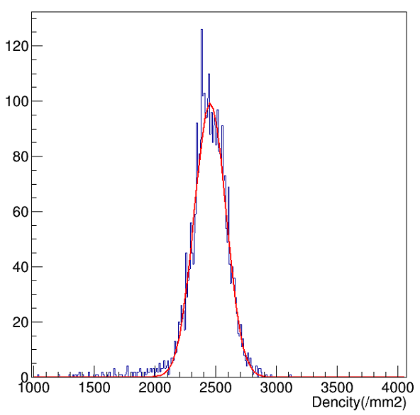
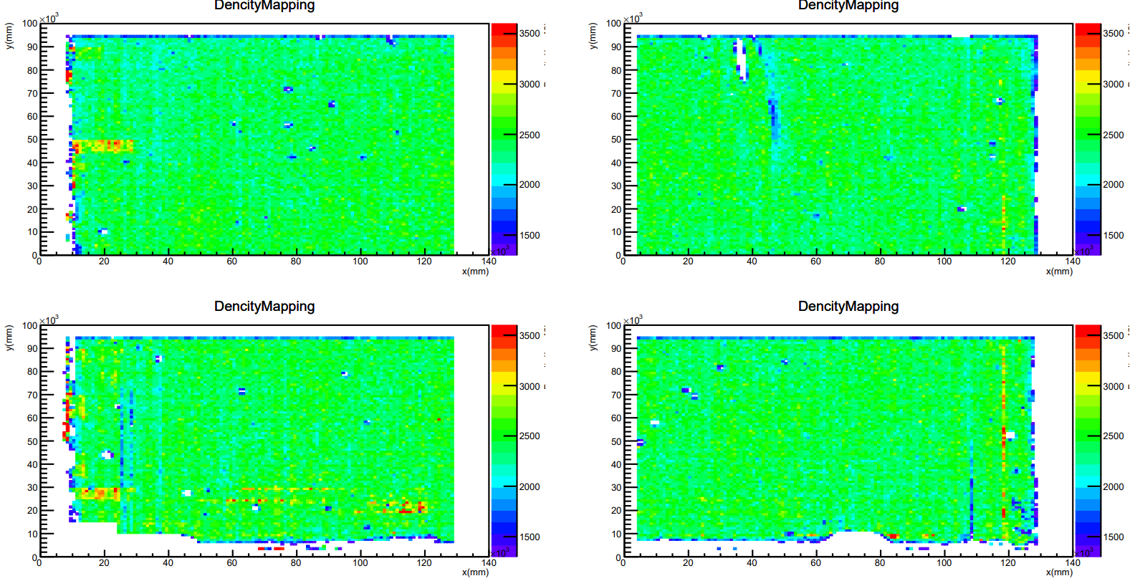
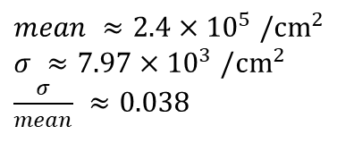
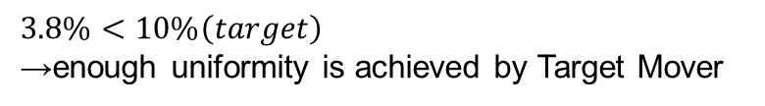
Evaluation of track density uniformity
2016 TB
Distribution of density, fitted by Gauss function
2021 run
Entries
20cm
25cm

Slide 15
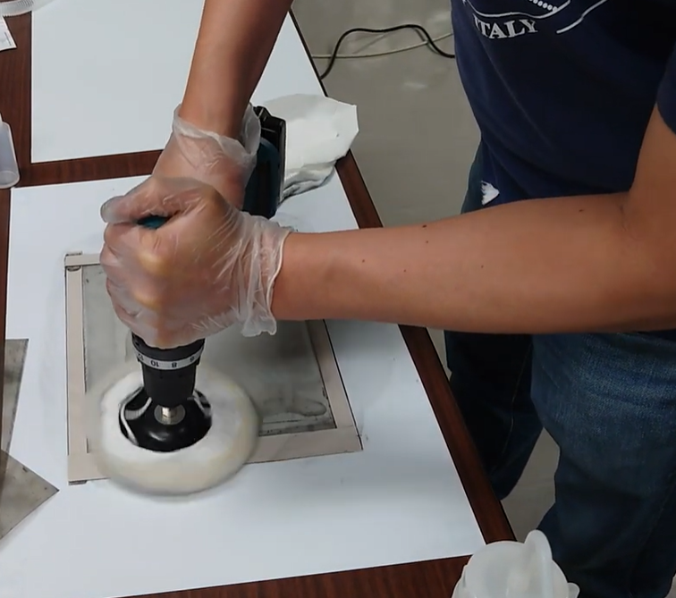
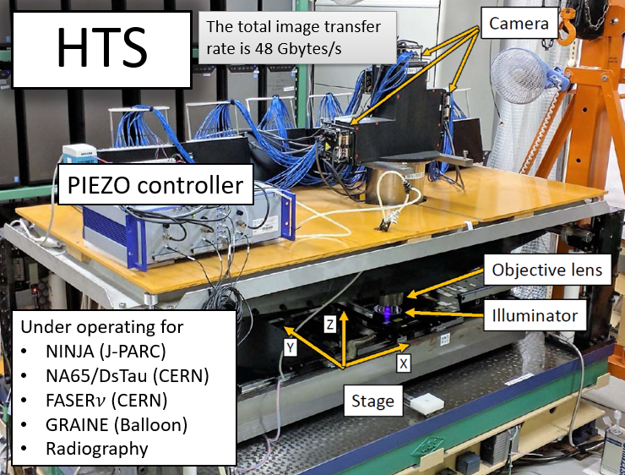
Summary the DsTau 2021 run
17 modules were exposed
  12 tungsten and 5 molybdenum targets
  → about 30% of total (incl. 2018 run)
All films were developed within 3 weeks
Currently
  Silver removal is being done
  Swelling and scanning is ongoing

Slide 16
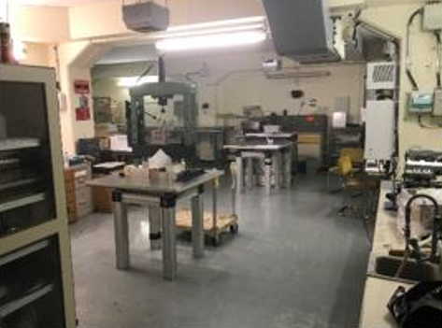
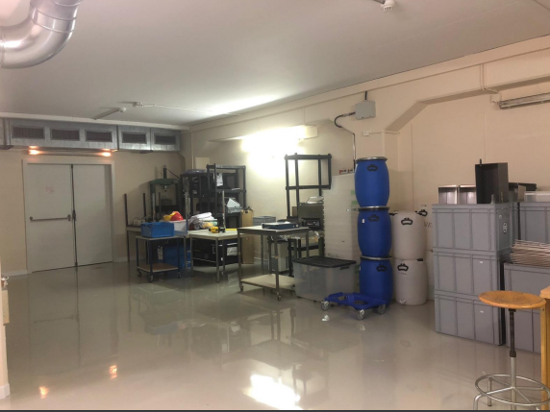
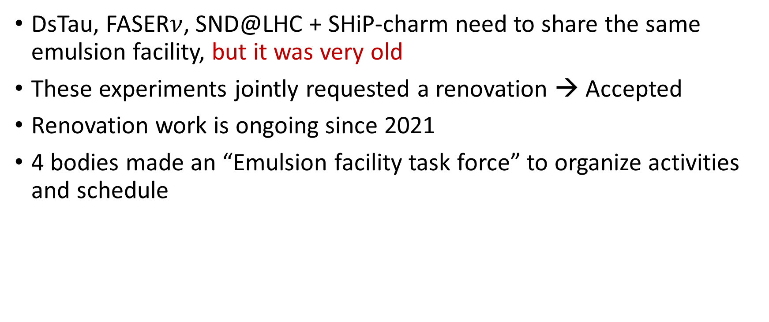
Emulsion facility at Meyrin (B169)
DsTau, FASER$ν$, SND@LHC + SHiP-charm need to share the same emulsion facility, but it was very old
These experiments jointly requested a renovation → Accepted
Renovation work is ongoing since 2021
4 bodies made an “Emulsion facility task force” to organize activities and schedule

Slide 17
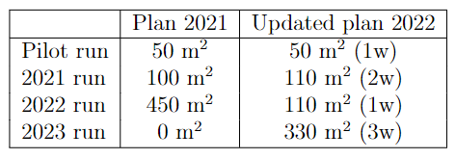
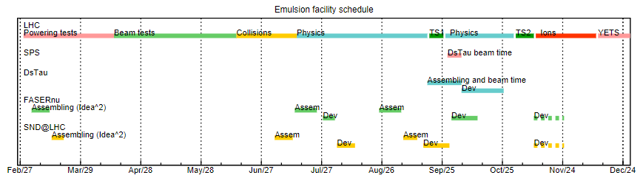
Plan for 2022, 2023 runs
Still, no foreign shifters can contribute to emulsion film production in Japan due to Covid.
→ Limited amount of emulsion, ~100 m2
  Shortened beam time (1 week) was requested
Need an additional data taking in 2023
2022 run is scheduled 28 Sep – 5 Oct, for now
  Crash with other LHC experiments (FASER, SND@LHC) in the use of emulsion facility. Hoping to delay the beam time ~2 weeks later.

Slide 18
Data processing
• Film to film alignment and track reconstruction procedures require powerful processing servers with CPU/GPU and high memory (~128-256~GB of RAM) and disk space (~10~TB for each data module) resources.
• Distributed data processing is being done gradually. Up to now, 25 out of 30 modules in 2018 run have been fully processed (track reconstruction).
Japan (Nagoya/Kyushu):
2 processing servers
CPU, GPU, 256 GB of RAM
Storage capacity: ~150 TB
(+2 in Chiba in near future)
Turkey (METU):
TRUBA computing center resources
CPU, GPU, 128 GB of RAM
Storage capacity: 100+ TB
CERN
EOS
Russia (JINR):
2 processing servers
CPU, GPU, 256 GB of RAM
Storage capacity : ~150 TB
Romania (ISS):
1 processing server
CPU, GPU, 128 GB of RAM
Storage capacity : ~40 TB
400 TB (data)
20 TB (MC)
Batch system of the CERN computing center is also going to be used to process the 2021 physics run data.

Slide 19

Study of Proton interaction with tungsten
Proton interaction vertices location by fine alinement on the material boundaries.
Secondary tracks multiplicity distribution by each detector components.
The results will be summarized into a paper soon.
Old reconstruction
Sharper vertex Z reconstruction

Slide 20


Momentum reconstruction
Charm decay? or Coulomb scattering?
  Kinematical information (= momentum, decay Pt) is important to discriminate charm decays from BG
Algorithm has been implemented and tested
Systematic application still needs a reorganization of data access over different data sets and alignment between them → Work in progress
Signal $D_{s}→τ→X$
BG
MCS of low P particle
Alignment and tracking are closed in a data set of 30 films

Slide 21



MC studies with different generators
Now FLUKA/G4 frameworks are available
Different hadron interaction generators (G4, Pythia, EPOS) can be tested.
Pythia8 as an external decayer for charm.
Comprehensive study is still to be done.
Pythia8 as external decayer for charm

Slide 22



Original plan
Standard readout
(high speed)
High-precision readout
Efficiencies are floating due to
  Difference in generator: Since G4’s charm flight length distributions are shorter than Pythia, efficiencies will be higher for events from the other simulations. (Can be fitted with DsTau data).
  Analysis strategy: Efficiency will be increased by applying the high-precision readout.
  Reconstruction effects: Position resolutions implemented in the simulations seem larger than that of the data. MC reconstruction might be revised.

Slide 23
Summary
DsTau 2021 data taking campaign was successfully finished
  30% of planned exposure was done
We are progressing in data readout, reconstruction and analysis
MC studies are under revisited
2022 run will be again rescaled due to COVID19
  Consequently we need 2023 run
  Hoping to optimize the beam time

Slide 24


Slide 25
Tracking improvement
Miss reconstruction study
Since the track density is bit high than other emulsion experiment application, sometimes tracks are connected to different track at track-reconstruction process.
The track miss-reconstruction spoil decay hunting efficiency and MCS momentum measurement accuracy
MC study
A set of MC data were used to estimate wrongly connecting miss-reconstruction rate ~4%.

Slide 26


Estimated exposure time
Usually (intensity: 5.0e05, daytime of weekday) it takes about 3 ~ 4 hours to finish exposing 1 module.
On weekends or night (maybe after 7:00 p.m.) it takes shorter (about 1 ~ 2 hours).
↑ CERN Visters SPS Page1, weekday night (left) and daytime (right).

Slide 27

QCD with accelerators

