Slide 1
Status and plans of the CLOUD experiment
09 June 2022
Joachim Curtius
Institute for Atmospheric and Environmental Sciences
Goethe University Frankfurt

Slide 2

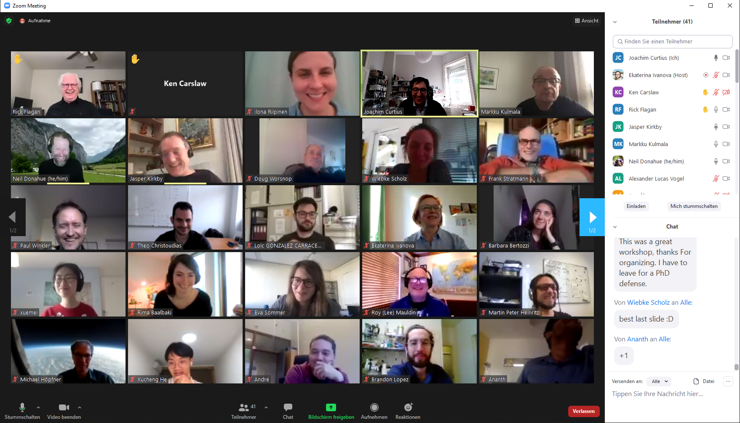
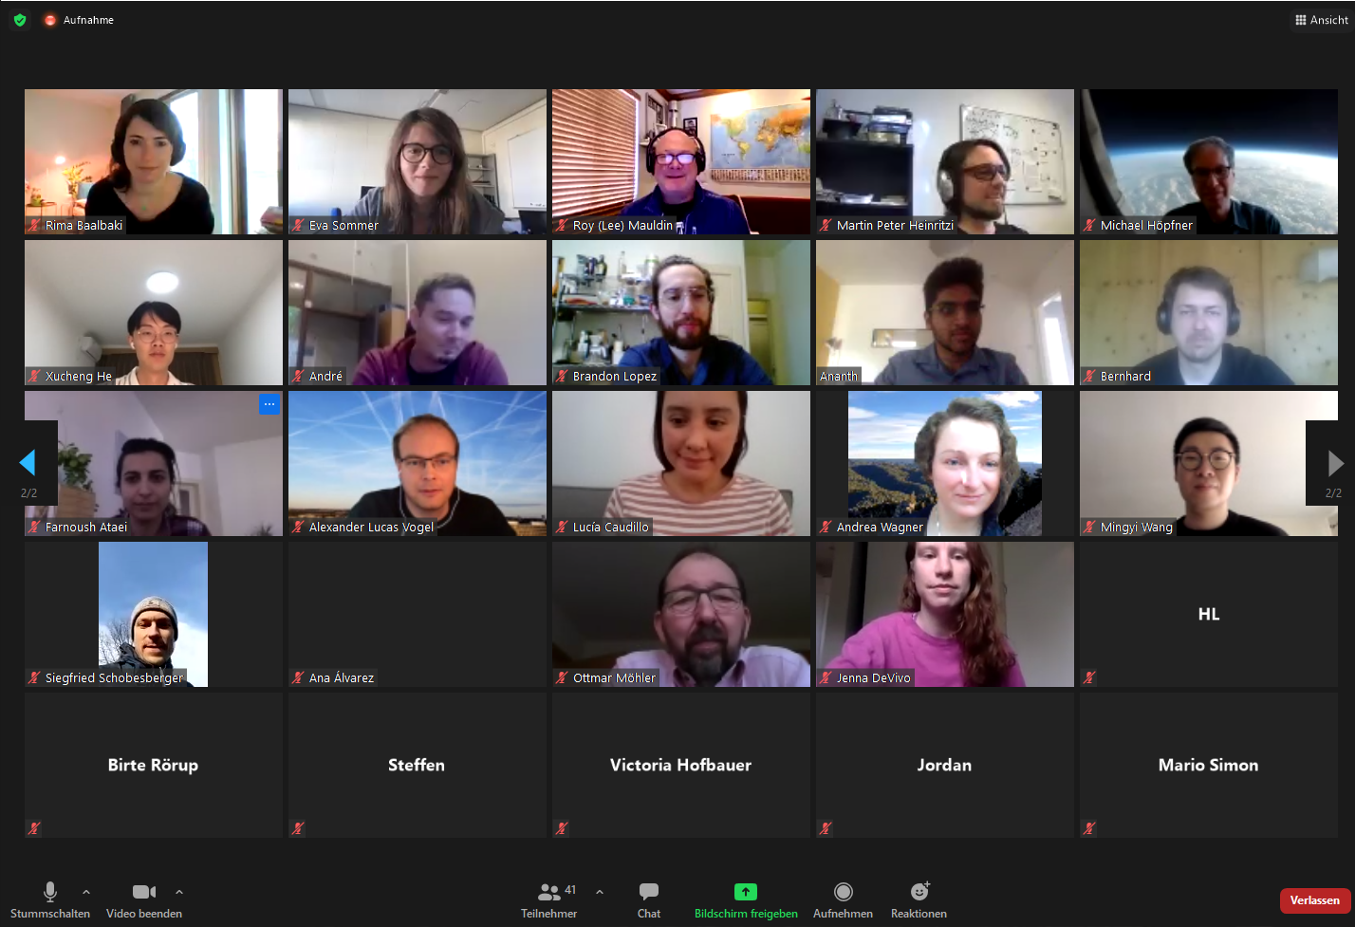
On behalf of the CLOUD collaboration:
Austria: University of Innsbruck
University of Vienna
Cyprus: Cyprus Institute
Estonia: Univ. of Estonia, Tartu
Finland: Finnish Meteorological Institute
University of Helsinki, INAR
University of Eastern Finland
Germany: Goethe University Frankfurt
Karlsruhe Institute of Technology
Leibniz Institute for Tropospheric Res.
Max Planck Institute for Chemistry
Portugal: University of Beira Interior
University of Lisbon
Russia: Lebedev Physical Institute
Sweden: University of Stockholm
Switzerland: CERN
Paul Scherrer Institute
Tofwerk
UK: University of Leeds
USA: Aerodyne Research Inc.
California Institute of Technology
Carnegie Mellon University
Univ. of Colorado Boulder
CLOUD-MOTION, final conference, online, April 2021

Slide 3
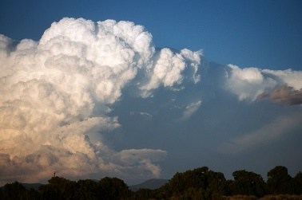
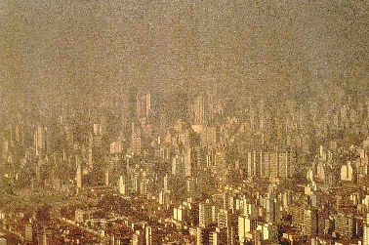
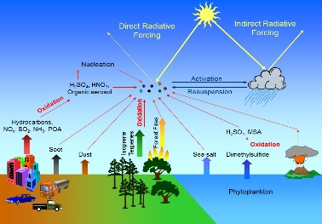
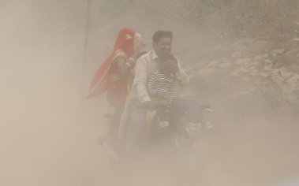
Relevance of atmospheric aerosol
Cloud formation
(CCN & INP, Dusek et al., Science, 2007;
Froyd et al., Nature Geosci., 2022)
Visibility
(e.g., v. Marle et al., Nature, 2022)
Climate
(IPCC AR6 2021; Bellouin et al., Rev. Geophys. 2019)
Health effects
(7 Mio premature deaths)
(WHO report; Lelieveld et al., Cardiovasc. Res, 2020)
Heterogeneous reactions
(e.g., on PSCs; Peter, Ann. Rev. Phys. Chem., 1997)

Slide 6
CLOUD studies the formation of new aerosol particles from precursor gases
Several gases were discovered to play a role for atmospheric new particle formation

Slide 7
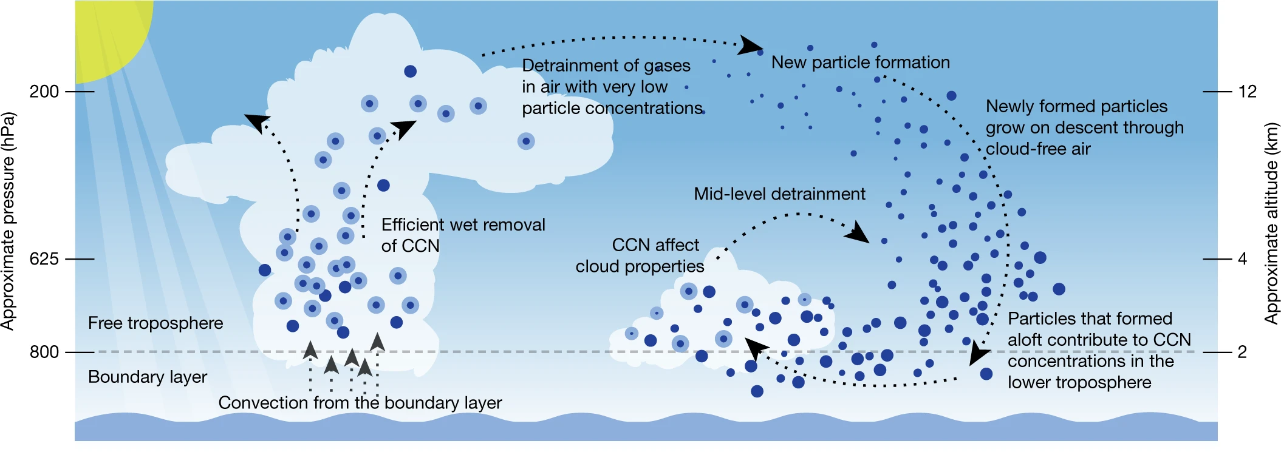
Recent measurements in the tropical upper troposphere
show occurence of high levels of aerosol nucleation
Nucleation precursor gases?
Nucleation processes?
Quantification of nucleation
and growth rates?
→ CLOUD
Williamson et al., Nature, 2019
Notes:
Recent measurements in the atmosphere highlight the role of aerosol formation
in the tropical upper troposphere as a source region for cloud condensation nuclei (CCN)
that are required for the formation of clouds in the tropics.
This aerosol formation mechanism could be the source for most of the CCN in the entire tropics.
CLOUD is recreating the exact conditions for these new particle formation events in the CLOUD experimental chamber at CERN (air, trace gases, temperature, humidity, GCRs, etc.).
We are then able to study the processes that occur in the atmosphere under well-controlled lab conditions.
For each chemical system of relevance, the exact nucleation and growth conditions can be quantified.

Slide 8
Recent measurements in the tropical upper troposphere
show frequent occurence of high levels of aerosol nucleation
But:
Nucleation precursor gases?
Nucleation processes?
Quantification of nucleation rates
and growth rates?
→ CLOUD
Pacific
Williamson et al., Nature, 2019
Notes:
Recent measurements in the atmosphere highlight the role of aerosol formation
in the tropical upper troposphere as a source region for cloud condensation nuclei (CCN)
that are required for the formation of clouds in the tropics.
This aerosol formation mechanism could be the source for most of the CCN in the entire tropics.
CLOUD is recreating the exact conditions for these new particle formation events in the CLOUD experimental chamber at CERN (air, trace gases, temperature, humidity, GCRs, etc.).
We are then able to study the processes that occur in the atmosphere under well-controlled lab conditions.
For each chemical system of relevance, the exact nucleation and growth conditions can be quantified.

Slide 9
T11 beam area with CLOUD Experiment
after East Hall Renovation during CLOUD15T run in spring 2022
Improved space and infrastructure
New control room, new chemical room
Rebuilt gas system & IT network
New T11 beamline magnets and power supplies

Slide 10
CLOUD 2022
New experimental facility
FLOTUS (FLOw TUbe System)
set up for preparation
of pre-aged aerosol particles
Intense UV exposure to simulate
Several days of oxidative
exposure.
Greatly extends science
reach of CLOUD.

Slide 11
Extension of experimental capabilities
through HORUS instrument from MPI-Chemistry:
Allows direct measurement of OH and HO₂ radicals
OH is the most important reactive chemical in the troposphere
Highly challenging measurement: OH concentrations around 0.1 pptv
and OH lifetime below 1 s

Slide 12
Results
Study of nucleation for iodic acid HIO₃:
Detailed mechanism for charged and neutral nucleation identified:
He et al., Science, 2021: Importance for Arctic marine and coastal nucleation.
3-fold increase of atmospheric iodine due to sea ice thinning

Slide 13
Results
Study of nucleation for iodic acid HIO₃:
Determination of nucleation rates (A) and growth rates (B);
HIO₃ identified as potent nucleator
Strong enhancement of particle formation rate at +10C from GCR ions (up to x100)
He et al., Science, 2021

Slide 14





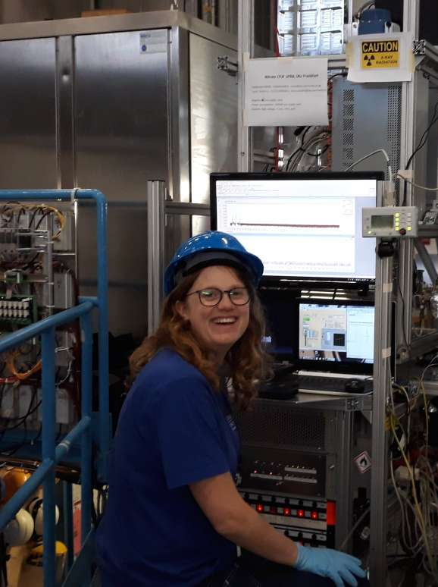


CLOUD Experiments
Can we replicate atmospheric
conditions for deep convective
lifting of precursors
in East Asian monsoon?
Neutral
GCR
Beam
UV
T
Ionization
Instrumentation:
particle counters
size spectrometers
mass spectrometers
gas monitors etc.
H₂SO₄
The
CLOUD
chamber
NO₂ + OH → HNO₃
NH₃

Slide 15
Results
Study of nucleation for nitric acid - ammonia - sulfuric acid system:
Determination of nucleation rates at upper troposphere conditions
Wang et al., Nature, 2022: highly efficient aerosol nucleation
in the outflow of East Asian monsoon.
Ammonium nitrate particles also efficient INP for cirrus

Slide 16
CLOUD-DOC
EU Marie Skłodowska Curie Action - Doctoral Network “CLOUD-DOC“ awarded:
Sep 2022 – Aug 2026, 12 PhD students, 2.7 Mio Euro
Research plan: Focus on four scientific areas
Arctic
Upper Troposphere in the monsoon outflow over
Asian megacities and agricultural regions
Upper troposphere above pristine tropical rain forests
Southern Ocean/Antarctic

Slide 17
CLOUD15 experiment in fall 2022
Science goals: Cold conditions.
Pure biogenic nucleation with aged organics
Use FLOTUS to age mixtures of biogenic vapours and inject these aged vapours
into the CLOUD chamber. Study the chemistry of aged organic vapours
and their ability to form and grow new particles
Carbon closure
Explain quantitatively the fate of all carbon molecules injected into FLOTUS/CLOUD.
Track the oxidative evolution of organic carbon over its entire atmospheric lifetime.
Marine nucleation and growth with methanesulphonic acid (CH₃SO₃H, MSA)
Extend our initial CLOUD15T studies of MSA and ammonia new particle formation
and growth to characteristic of marine and polar regions between
the boundary layer and upper troposphere.
Iodic acid nucleation and growth under upper tropospheric conditions
Study new particle formation and growth involving iodine vapours at upper
tropospheric conditions: low temperatures (-30°C →-50°C), low vapour concentrations
and high ion concentrations.

Slide 18
Beam requests 2022 for CLOUD15 run
CLOUD requests 9 weeks of beam in fall 2022 (Sep-Nov)
for the CLOUD15 run (as in previous years).

Slide 20

Summary
CLOUD is eager to restart science runs after LS2 & Covid shut-down.
Renovation during LS2 lead to greatly improved experimental area.
CLOUD15T technical run took place in spring 2022.
CLOUD15 experiment planned for fall 2022.
Continued achivement scientific results with high impact.
CLOUD-DOC funding secured through EU MSCA-DN.
Ambitious experimental programme for 2022-2026.

Slide 22


Funding
CLOUD-DOC, EU Marie Skłodowska Curie Action - Doctoral Network, Sep 2022 – Aug 2026,
12 PhD students, 2.7 Mio Euro
Regular support by national funding, e.g., by German BMBF, Swiss National Science Foundation, the Academy of Finland Center of Excellence program, other national funding agencies…
Regular meetings of CLOUD Financial Review Committee at CERN.
CERN support is gratefully acknowledged.

Slide 23
Acknowledgements
The CLOUD Collaboration wishes to thank CERN EP-DT and especially the gas and slow control teams, CERN EN-MME, Sebastien Evrard, Davide Jaillet, Ilia Krasin, Robert Kristic, Jose Ramon Rendon Molina, Rene Necca, Aboubakr Ebn Rahmoun, Barbara Holzer (SPS/PS Coordinator) and the CERN PS machine team for their support of CLOUD.

