Slide 1


Moment Unfolding with Deep Learning
Krish Desai
University of California, Berkeley/Lawrence Berkeley National Laboratory
in collaboration with Benjamin Nachman (LBNL) and Jesse Thaler (MIT)
ML4Jets 2022

Slide 2
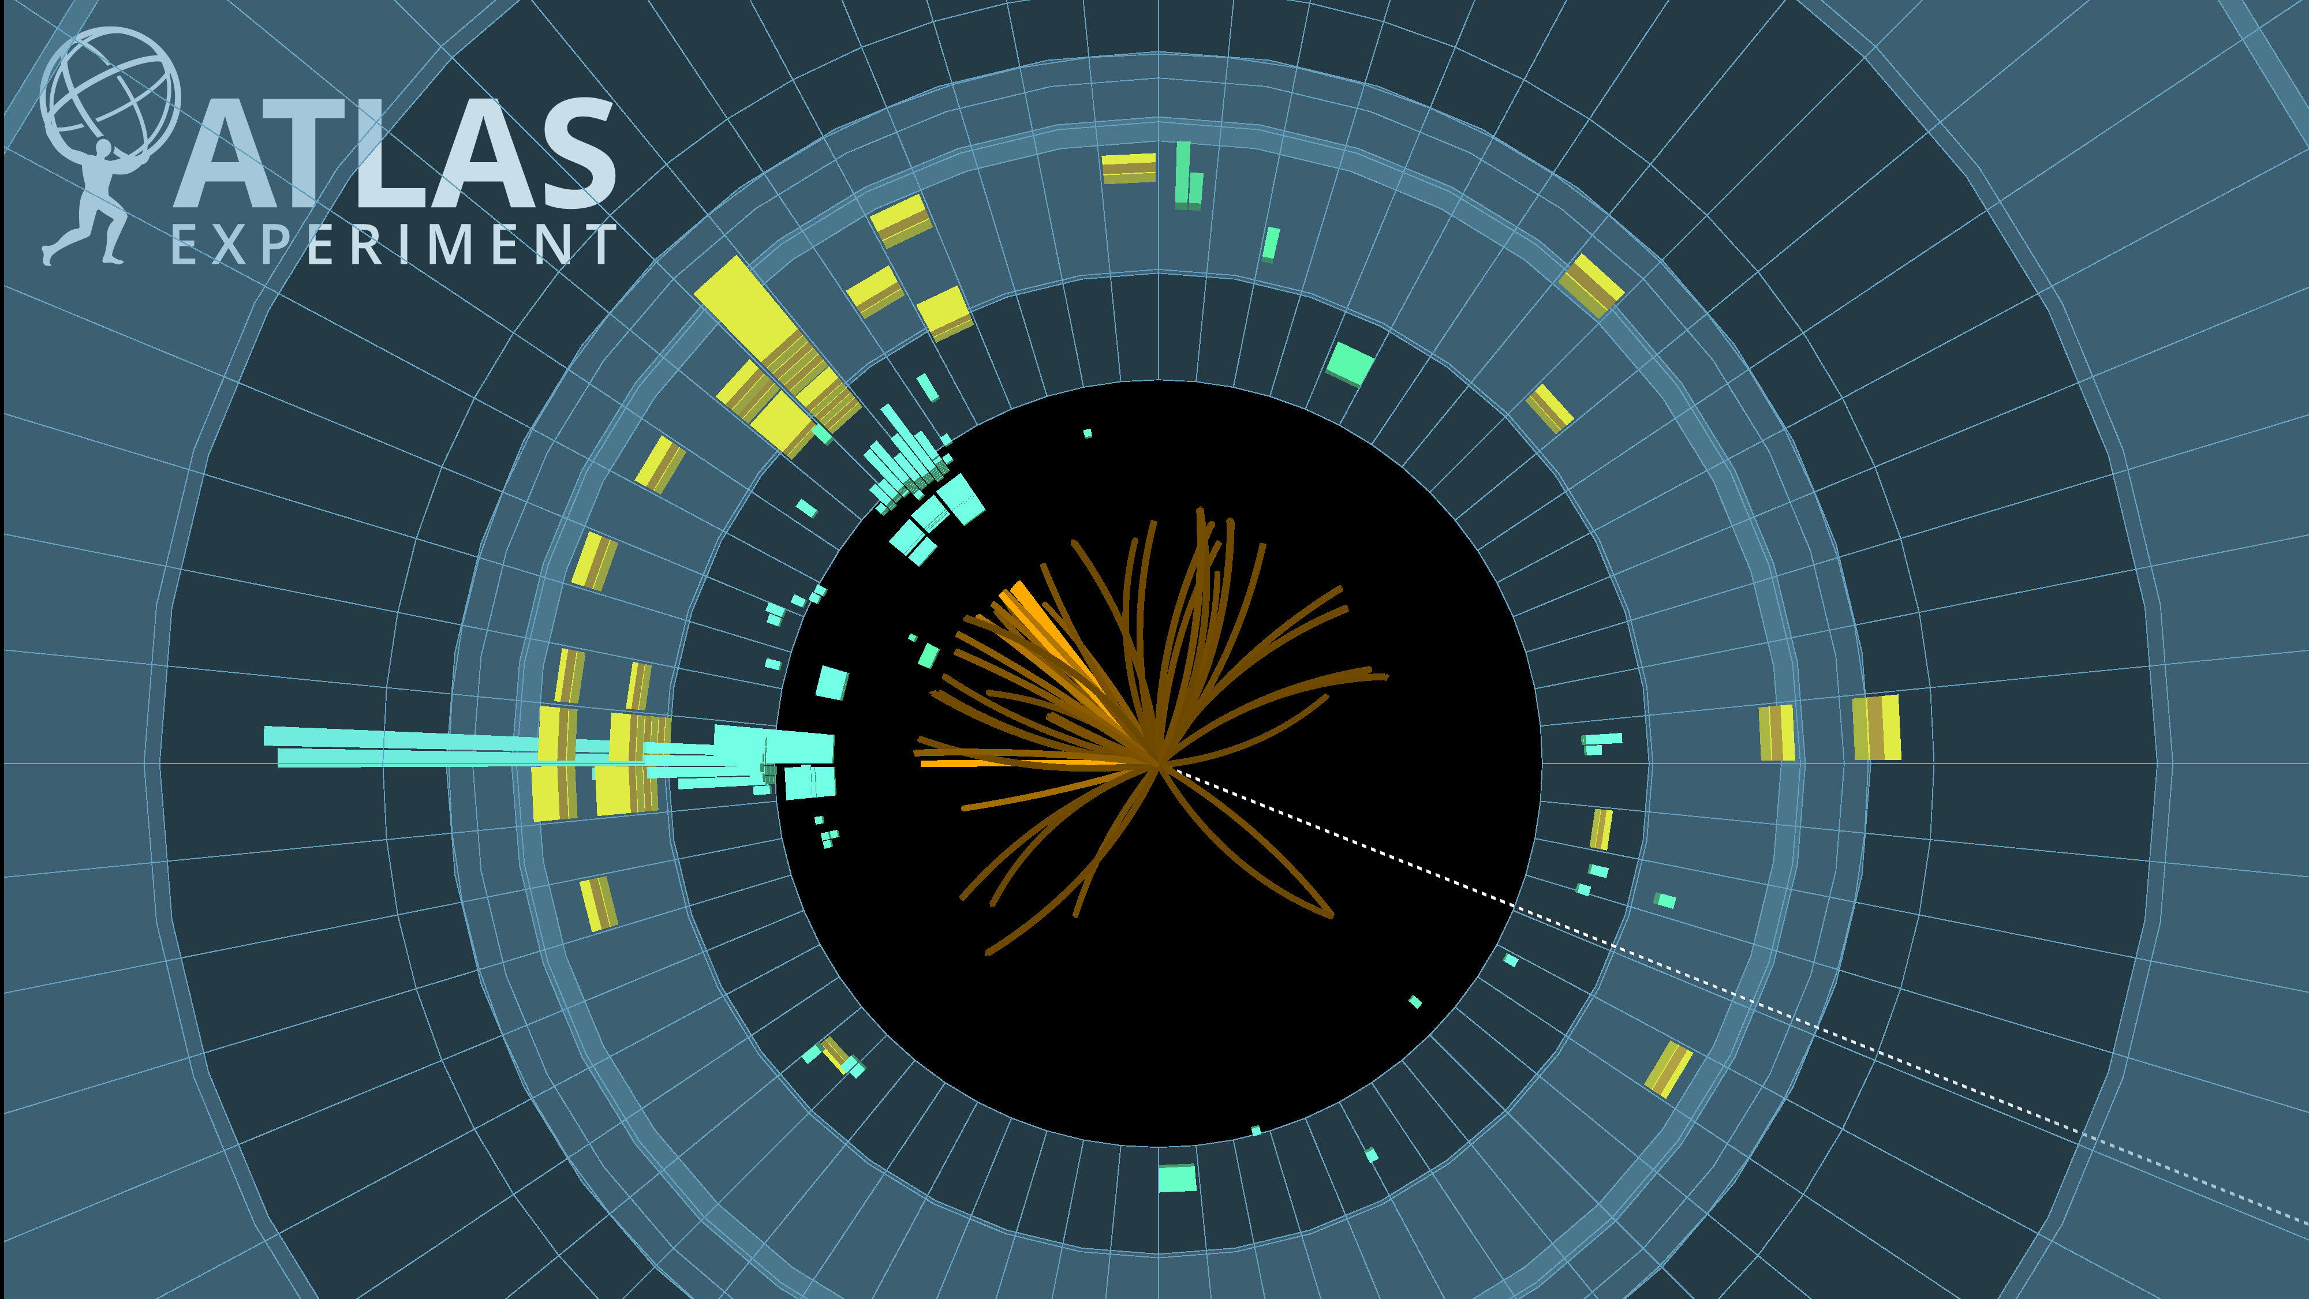

Goal: Unfold Moments – Remove detector distortions from means, variances etc. of observables
Why?
Moments known theoretically more precisely than full distributions.
Existing methods binned–cause artifacts when computing moments
$$n^{th}moment=\left\langle x^{n}\right\rangle =\sum_{i}{p_{i}x_{i}^{n}}$$

Slide 3
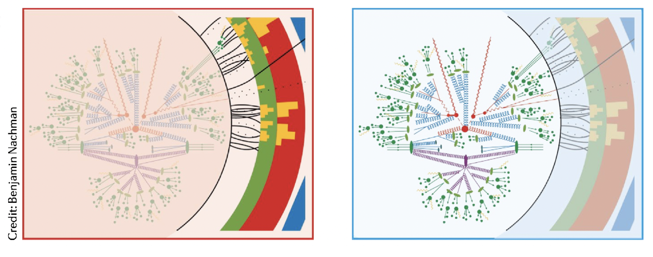
Extant Unfolding Proposals
Binned methods
OmniFold style methods
Normalizing flow based methods

Slide 4


Example: Jet Charge
$Q=\sum_{i}{z^{i}Q^{i}},$ $z^{i}=\frac{p_{T}^{i}}{\sum_{i}{p_{T}^{i}}}$ fraction of jet momentum carried by particle
Calculating the charge of a jet, Wouter J. Waalewijn, Phys. Rev. D 86, 094030
  Hard to compute theoretically beyond the second moment
Entire distribution unnecessary
Want to unfold first few moments accurately w/o binning artefacts
$Q^{i}$ is the charge of the particle

Slide 5
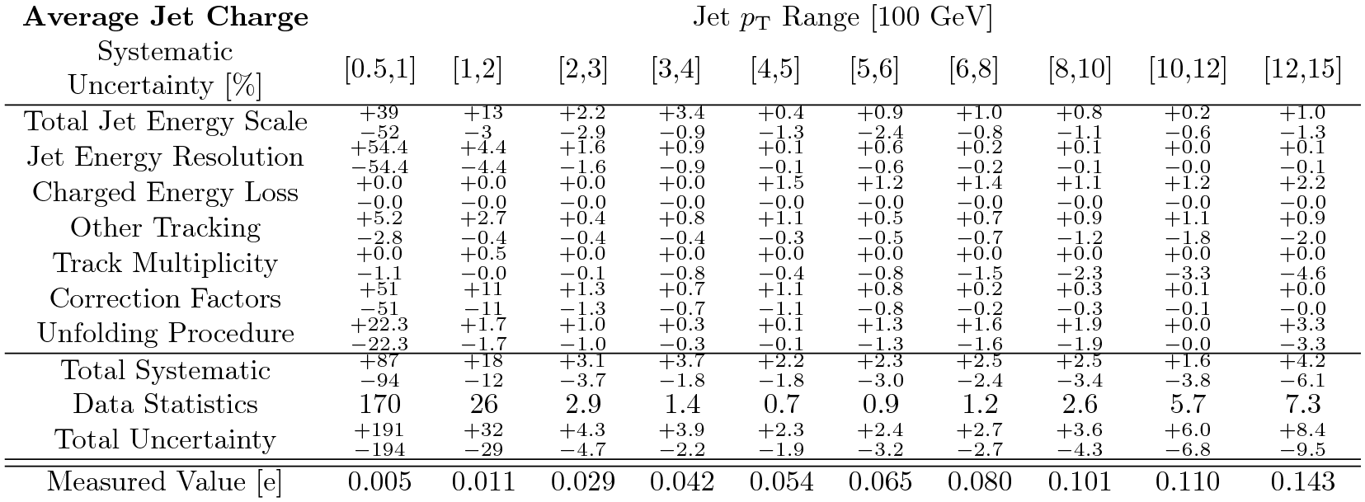
Binning artefacts
Measurement of jet charge in dijet events from √s=8 TeV pp collisions with the ATLAS detector, Phys. Rev. D 93 (2016) 052003
A summary of all the systematic uncertainties and their impact on the jet charge distribution standard deviation for κ=0.3 and the more central jet. Numbers are given in percent.

Slide 6
Moment Unfolding
GAN Like Method developed
Deconvolves moments w/o binning
Circumvents difficulty of computing PDF
Circumvents binning artefacts
Direct comparison with computations

Slide 7
Advantages
Pointwise reweighting based on matching moment by moment
Achieves maximum likelihood estimator
Hence is independent of initial guess

Slide 8
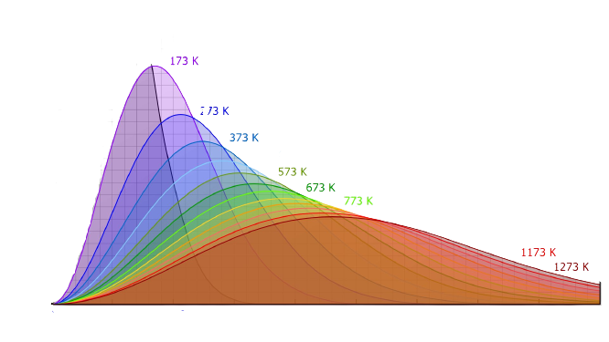


Inspiration
Maxwell–Boltzmann Distribution:
Maximizes entropy holding mean energy constant
Moment Unfolding:
Maximize binary cross entropy loss with simulation
while holding data moments constant
Just like the temperature reweights
the particle energies, the
generator reweights
the simulation
$$p_{i}=\frac{e^{−\frac{E_{i}}{kT}}}{\sum_{i}{e^{−\frac{E_{i}}{kT}}}}$$

Slide 9

Model
GAN Like Model
Generator:
Reweightor function
$$g\left(x\right)=e^{λ_{1}x +…+λ_{n}x^{n}}$$
Way fewer parameters than a traditional GAN

Slide 10
Generator has significantly fewer parameters than most other GANs
Eliminates artifacts introduced by binned unfolding methods
Non iterative in nature, hence distinct from OmniFold
Focusses on high precision measurements of moments rather than broad spectrum prediction of probability density

Slide 11
Truth: N(0, 1), Gen: N(-0.5, 1), Distortions: N(0, 5)
Gaussian Example
Notes:
Lines thicker, label x axis as predicted mu

Slide 12
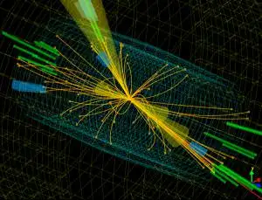
Collider examples
Datasets:
  “Data” – Pythia 8.243
  Simulation – Herwig 7.1.5
Notes:
Say that will focus jet width for illustration, but the approach is general

Slide 13

Detector distortions: Delphes 3.4.2
$$W=\frac{\sum_{i}{ΔR^{i}p_{T}^{i}}}{\sum_{i}{p_{T}^{i}}}$$
$$ΔR^{i}=\sqrt{Δφ_{i}^{2}+Δη_{i}^{2}}$$
Notes:
Mention that red and teal are for one moment at a time
Add formula for jet width

Slide 14
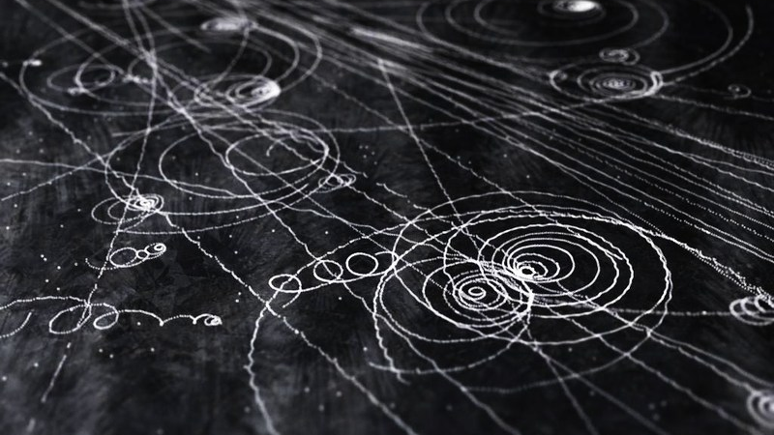
Learning k Moments
Full detector distortions

Slide 15
Jet Width

Slide 16
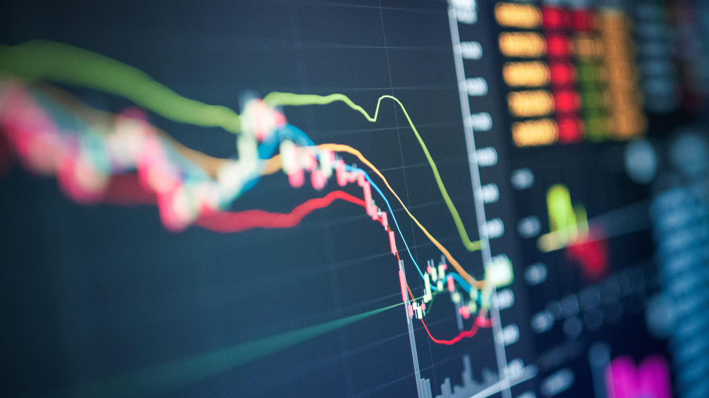
Bonus: Unfold entire distributions?

Slide 17

Infinite Moment Unfolding
$$g\left(x\right)=e^{{λ_{0} + λ}_{1}x +{ λ}_{2}x^{2}+…}=e^{f(x)}$$
Problems:
Renormalization
Poor overlapping support

Slide 18
Conclusion and Outlook
Successfully unfolding k moments in n-dim
Non-overlapping support and W-GANs
Infinite Unfolding and Renormalization
Introduced ML-based approach to unfold moments without binning artifacts.
Notes:
The same methodology can be used to unfold entire distributions and may have advantages over other recent ML proposals

Slide 19
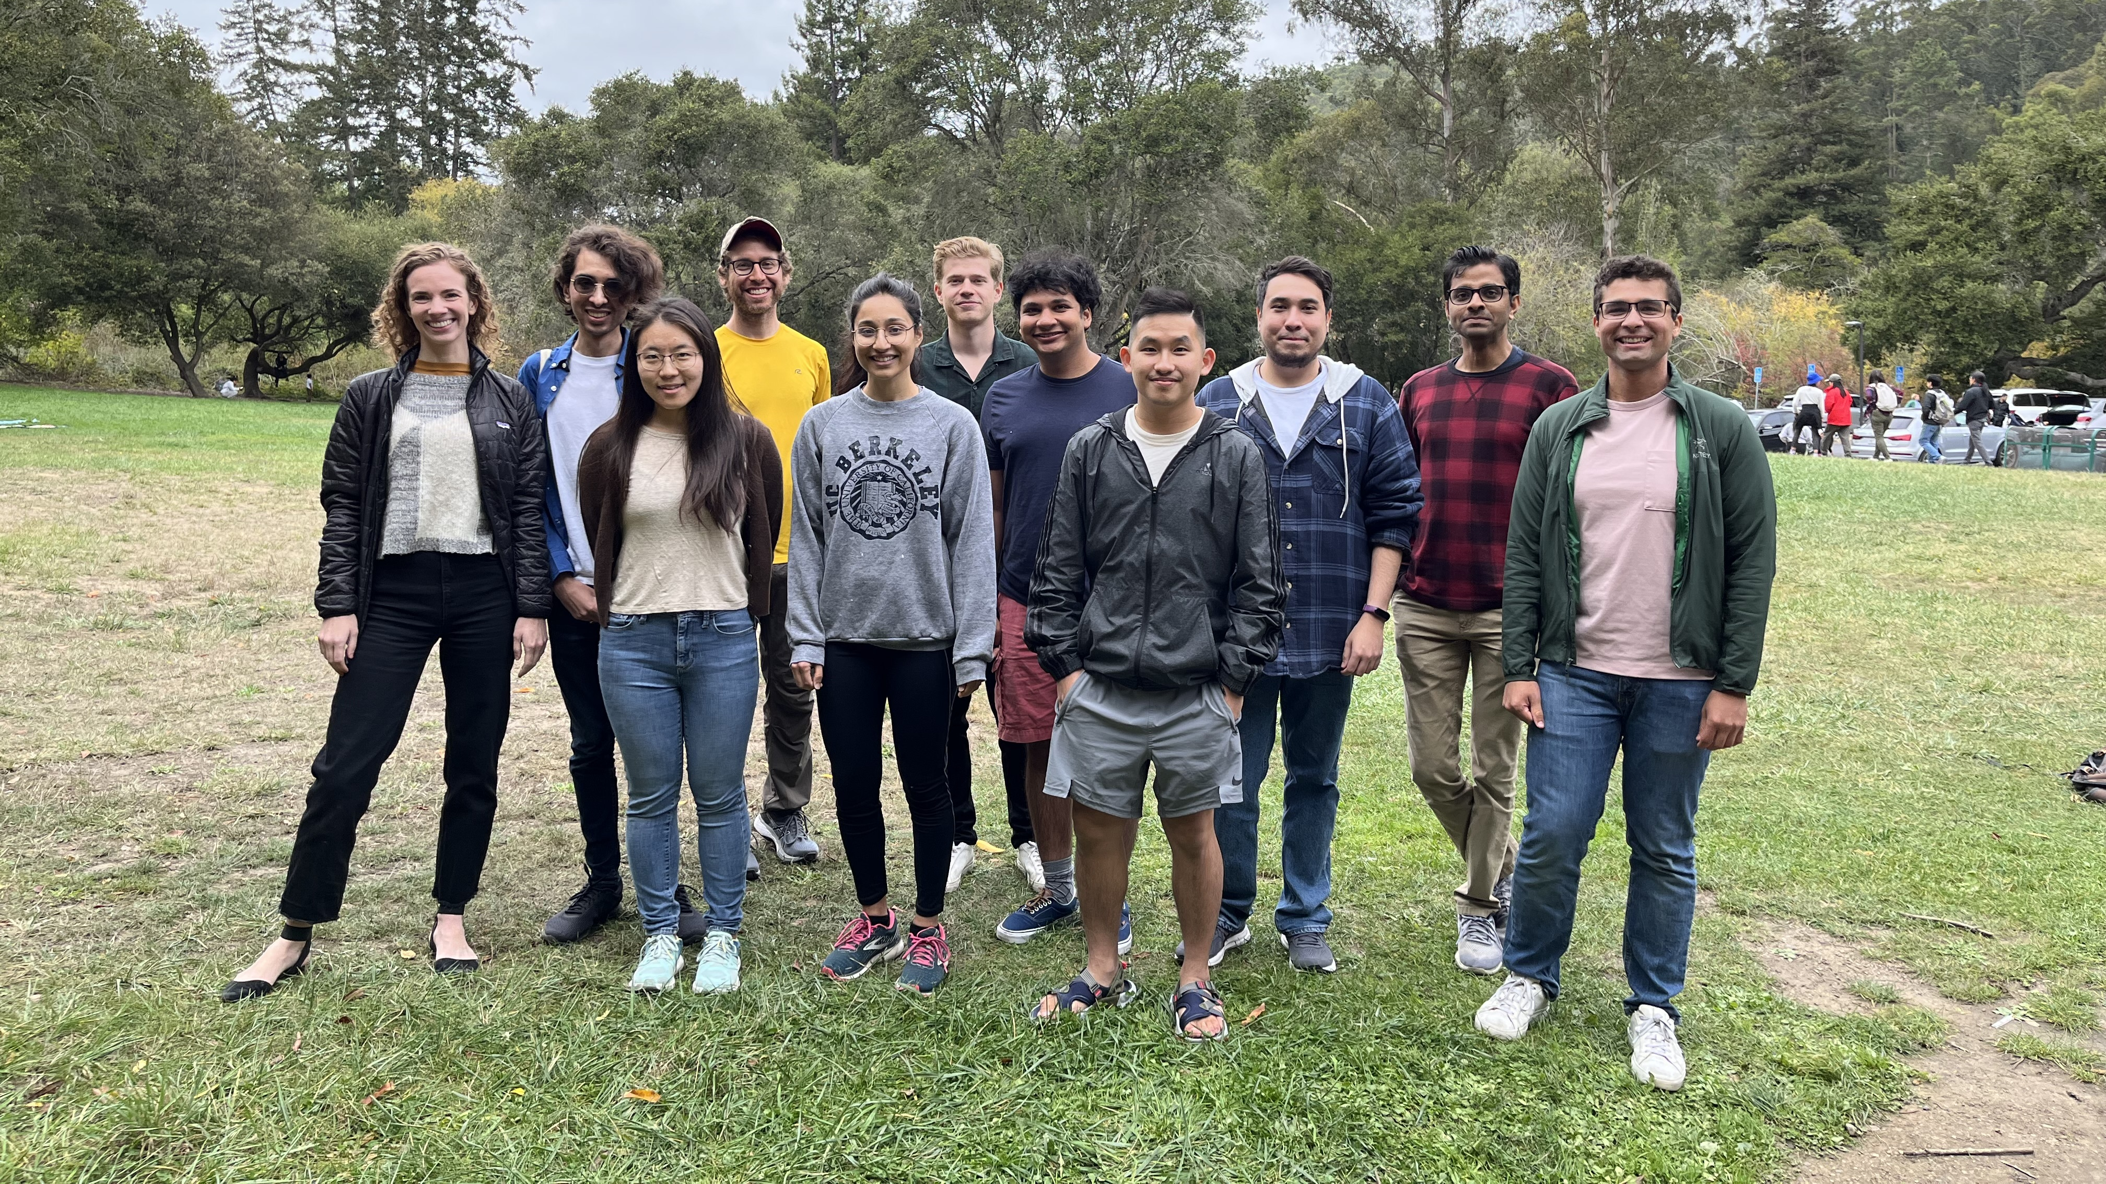
Nachman Machine Learning Group
Questions?

