Slide 1
Testing of Advanced RF Structures
Report from TNA WP12
Final Review Meeting, 15 July 2022
Roger Ruber (Uppsala University)
Walter Wuensch (CERN)

Slide 2
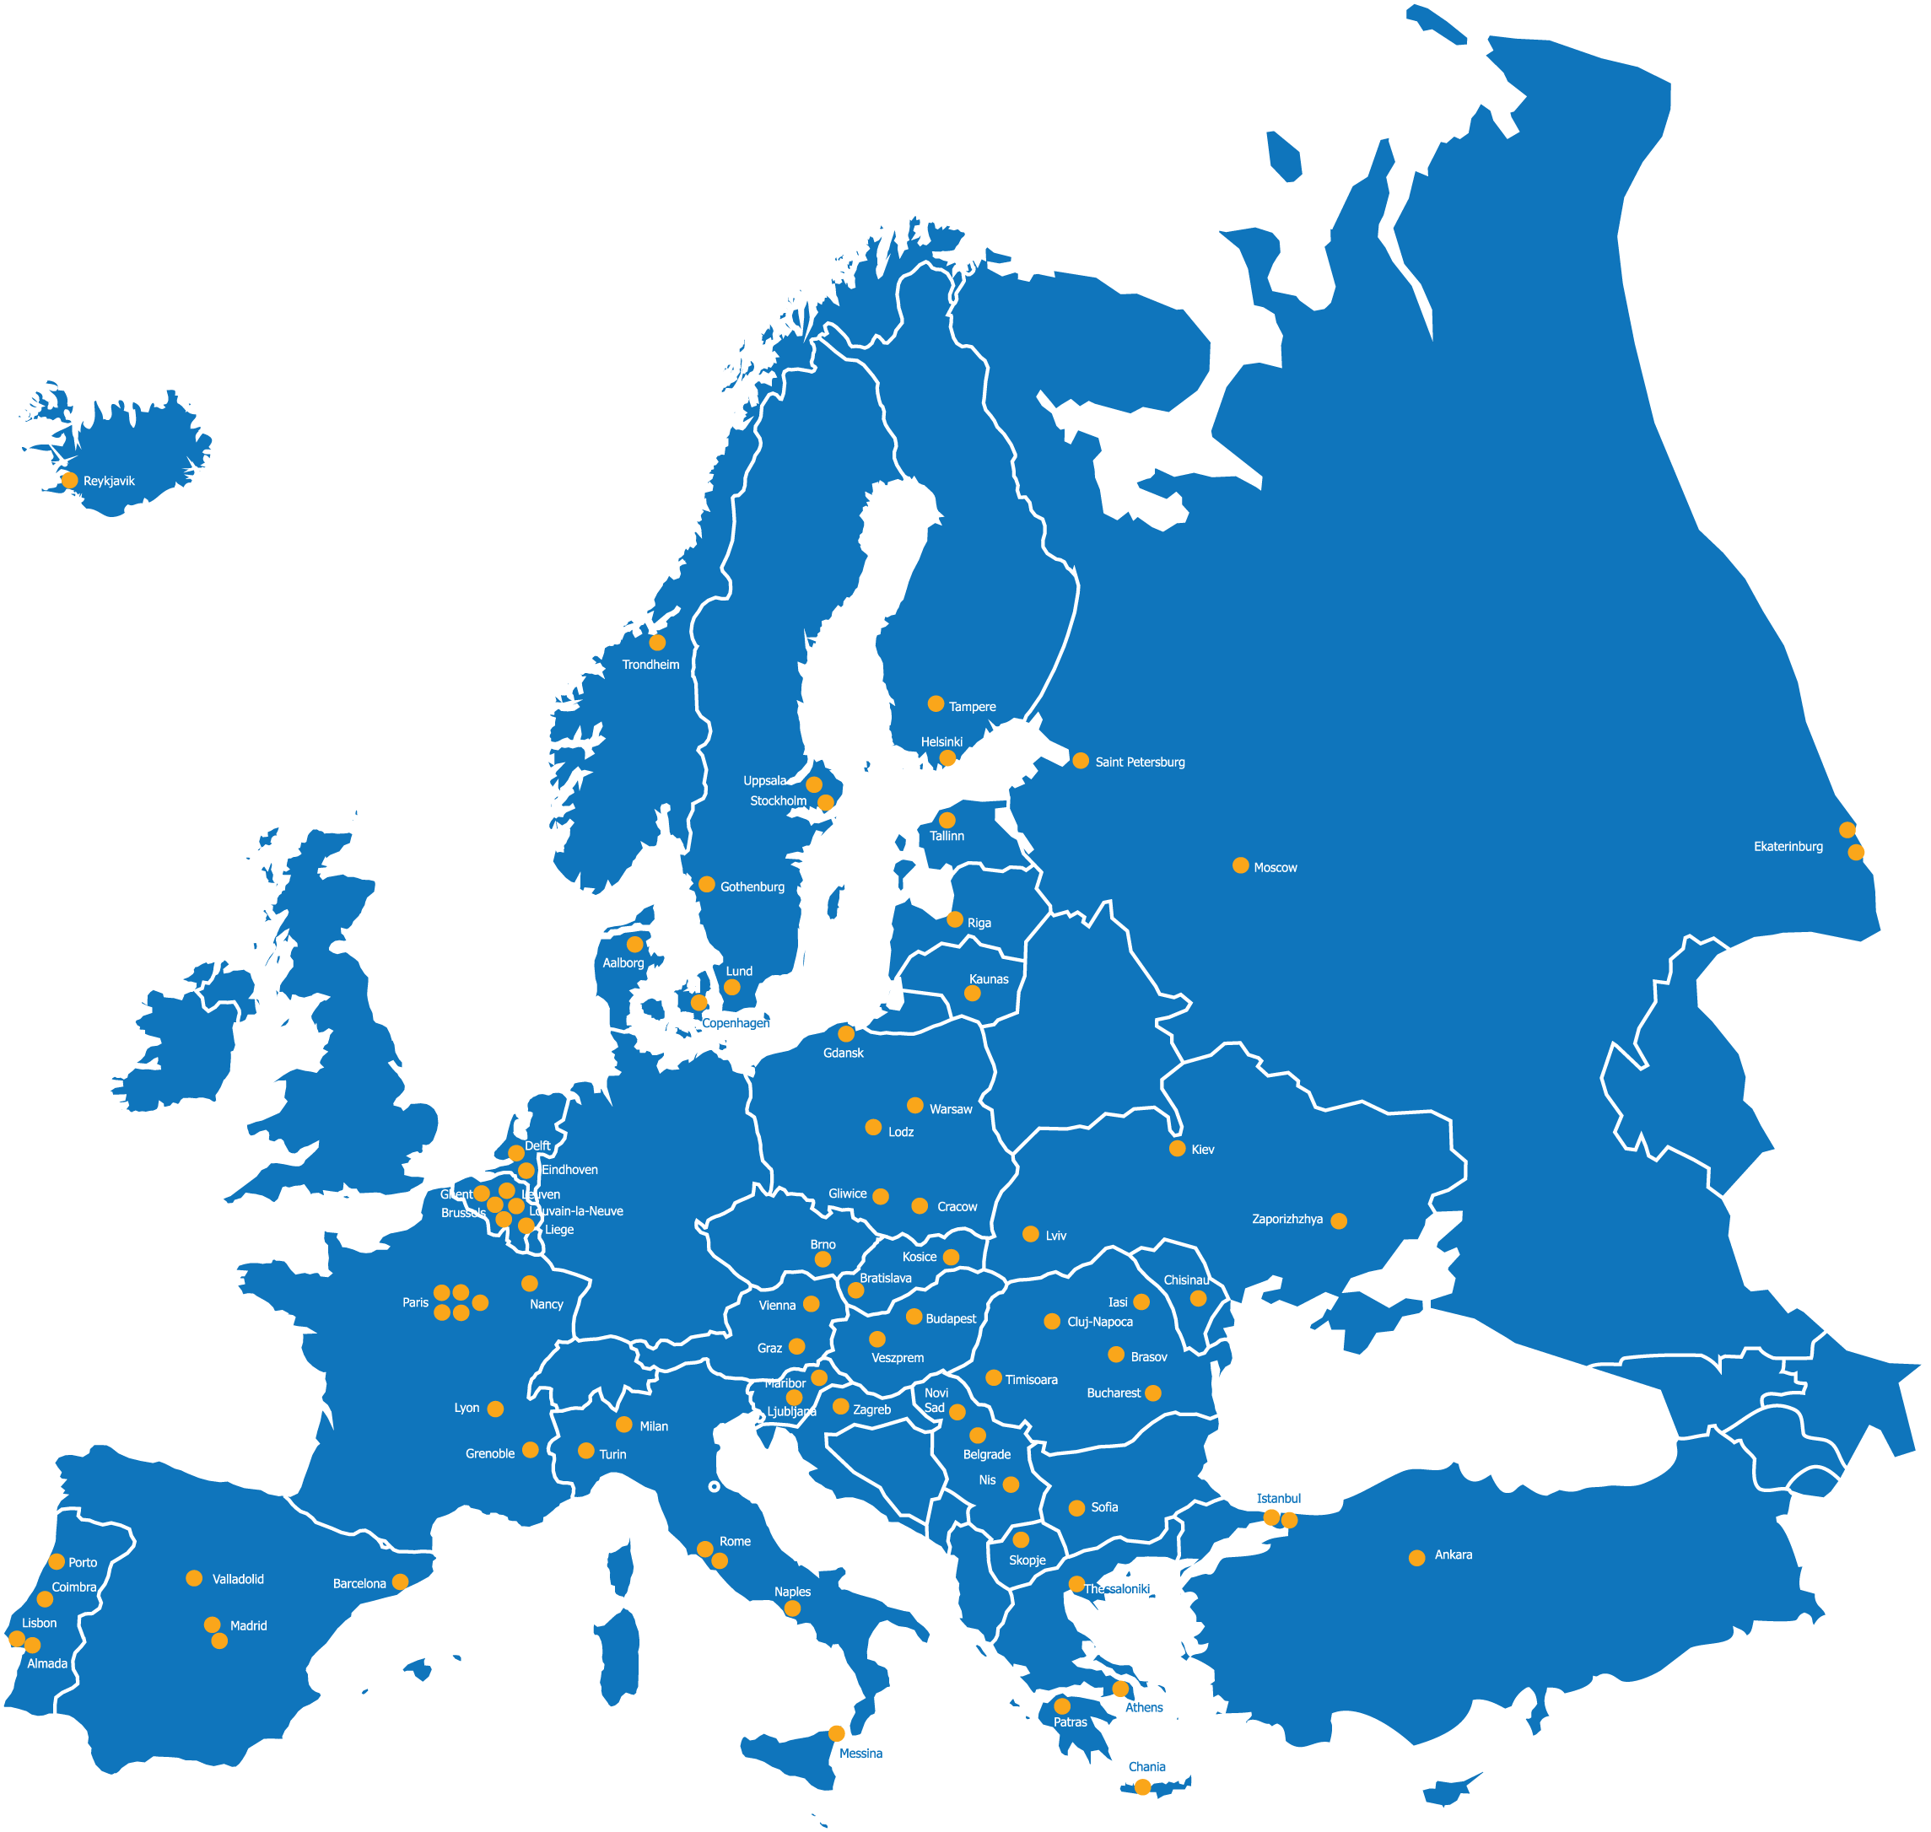

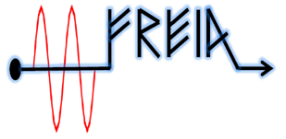

WP12 RF Testing Facilities
HNOSS
Uppsala University
TASK 12.1 HNOSS
XBOX
CERN Geneva
TASK 12.2 XBOX
The TNA within WP12 groups TWO facilities devoted to testing of
superconducting RF cavities and normal conducting RF cavities.

Slide 3
WP12 Overview
Access given per facility
Users by country of institute:
Users total 79,
of which 8 female (10%)
Publications up to now: 18
(articles, conf. poster, open access reports)
Facility | No. of projects |  |  |  |  | No. of users |  |  |  |  | No. of access units
 | P1 | P2 | P3 | Total | Total Annex 1 (amended numbers) | P1 | P2 | P3 | Total | Total Annex 1 (amended numbers) | P1 | P2 | P3 | Total | Total Annex 1 (amended numbers)
HNOSS | 2 | 2 | 0 | 4 | 4 | 18 | 24 | 7 | 49 | 44 | 1,330 | 2,084 | 1,080 | 4,494 | 3,790 | 119%
XBox | 2 | 2 | 0 | 4 | 4 | 13 | 11 | 6 | 30 | 24 | 1,680 | 2,500 | 6,521 | 10,701 | 7,500 | 143%
WP TOTAL | 4 | 4 | 0 | 8 | 8 | 31 | 35 | 13 | 79 | 68 | 3,010 | 4,584 | 7,601 | 15,195 | 11,290 | 135%

Slide 4
WP12 User Selection Panel (USP)
Common USP
  selection based on scientific quality and feasibility,
  3 independent experts:
    Kenneth Österberg (Helsinki Univ., Finland)
    Jiaru Shi (Tsinghua Univ., China)
    Slava Yakovlev (Fermilab, US)
  facility coordinators:
    Roger Ruber (HNOSS, UU)
    Walter Wuensch (XBox, CERN)

Slide 5
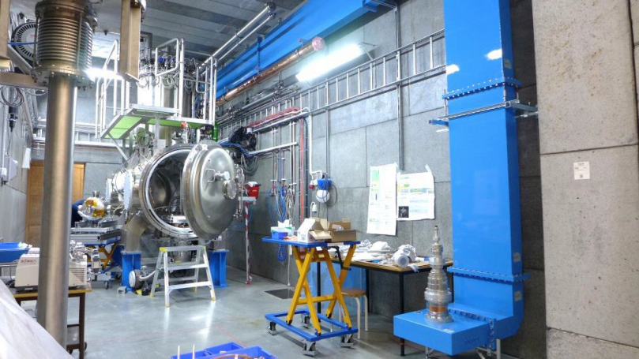
WP12.1 UU/FREIA HNOSS Facility
HNOSS
Uppsala University
TASK 12.1 HNOSS
The HNOSS facility at the FREIA Laboratory, Uppsala University, Sweden, is available for testing of superconducting RF cavities with integrated helium tank.

Slide 6
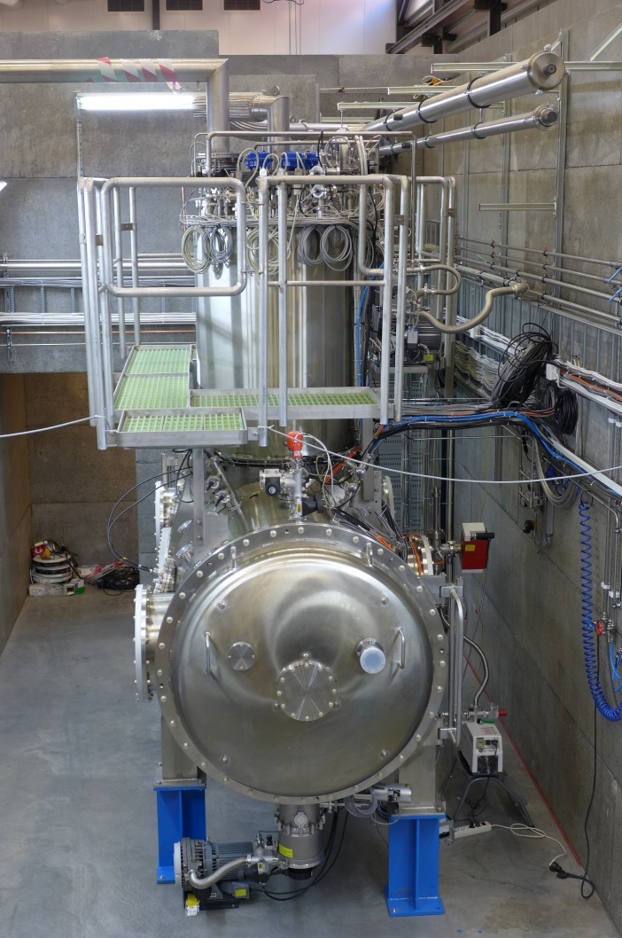
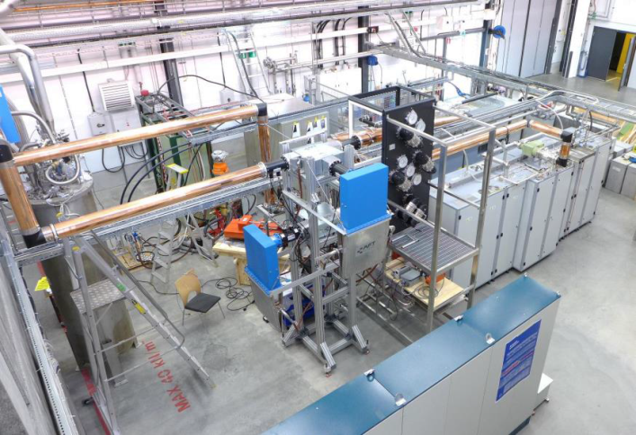
WP12.1 HNOSS at Uppsala University
HNOSS = Horizontal Nugget for Operation of Superconducting Systems
Horizontal cryostat for
superconducting cavities.
  Up to two cavities simultaneously,
  each equipped with helium tank,
  option: fundamental power coupler and
  (cold) tuning system
Low or High power RF testing
Operation in the range 1.8 to 4.5K.

Slide 7
WP12.1 UU/FREIA HNOSS - Overview
In proposal - 4 projects with a total of 2880 3790 access units.
# | Name | Institutes | Status | Access Units | Users
1 | ESS High-beta Elliptical Cavity | CEA Saclay | Completed. Reported and published. | 1330 | 18
2 | Validation of a prototype double spoke cavity cryomodule | IPN Orsay | Completed. Reported and published. | 2048 | 14
3 | RF and piezo actuators study on spoke cavities | Lodz University of Technology | Completed. Reported and published. | 36 | 8
4 | HL-LHC crab cavity cold testing | CERN | Completed. Reported and published. Remote participation due to Covid pandemic. | 1080 | 7
 | TOTAL Achieved |  |  | 4494 (119%) | 47

Slide 8
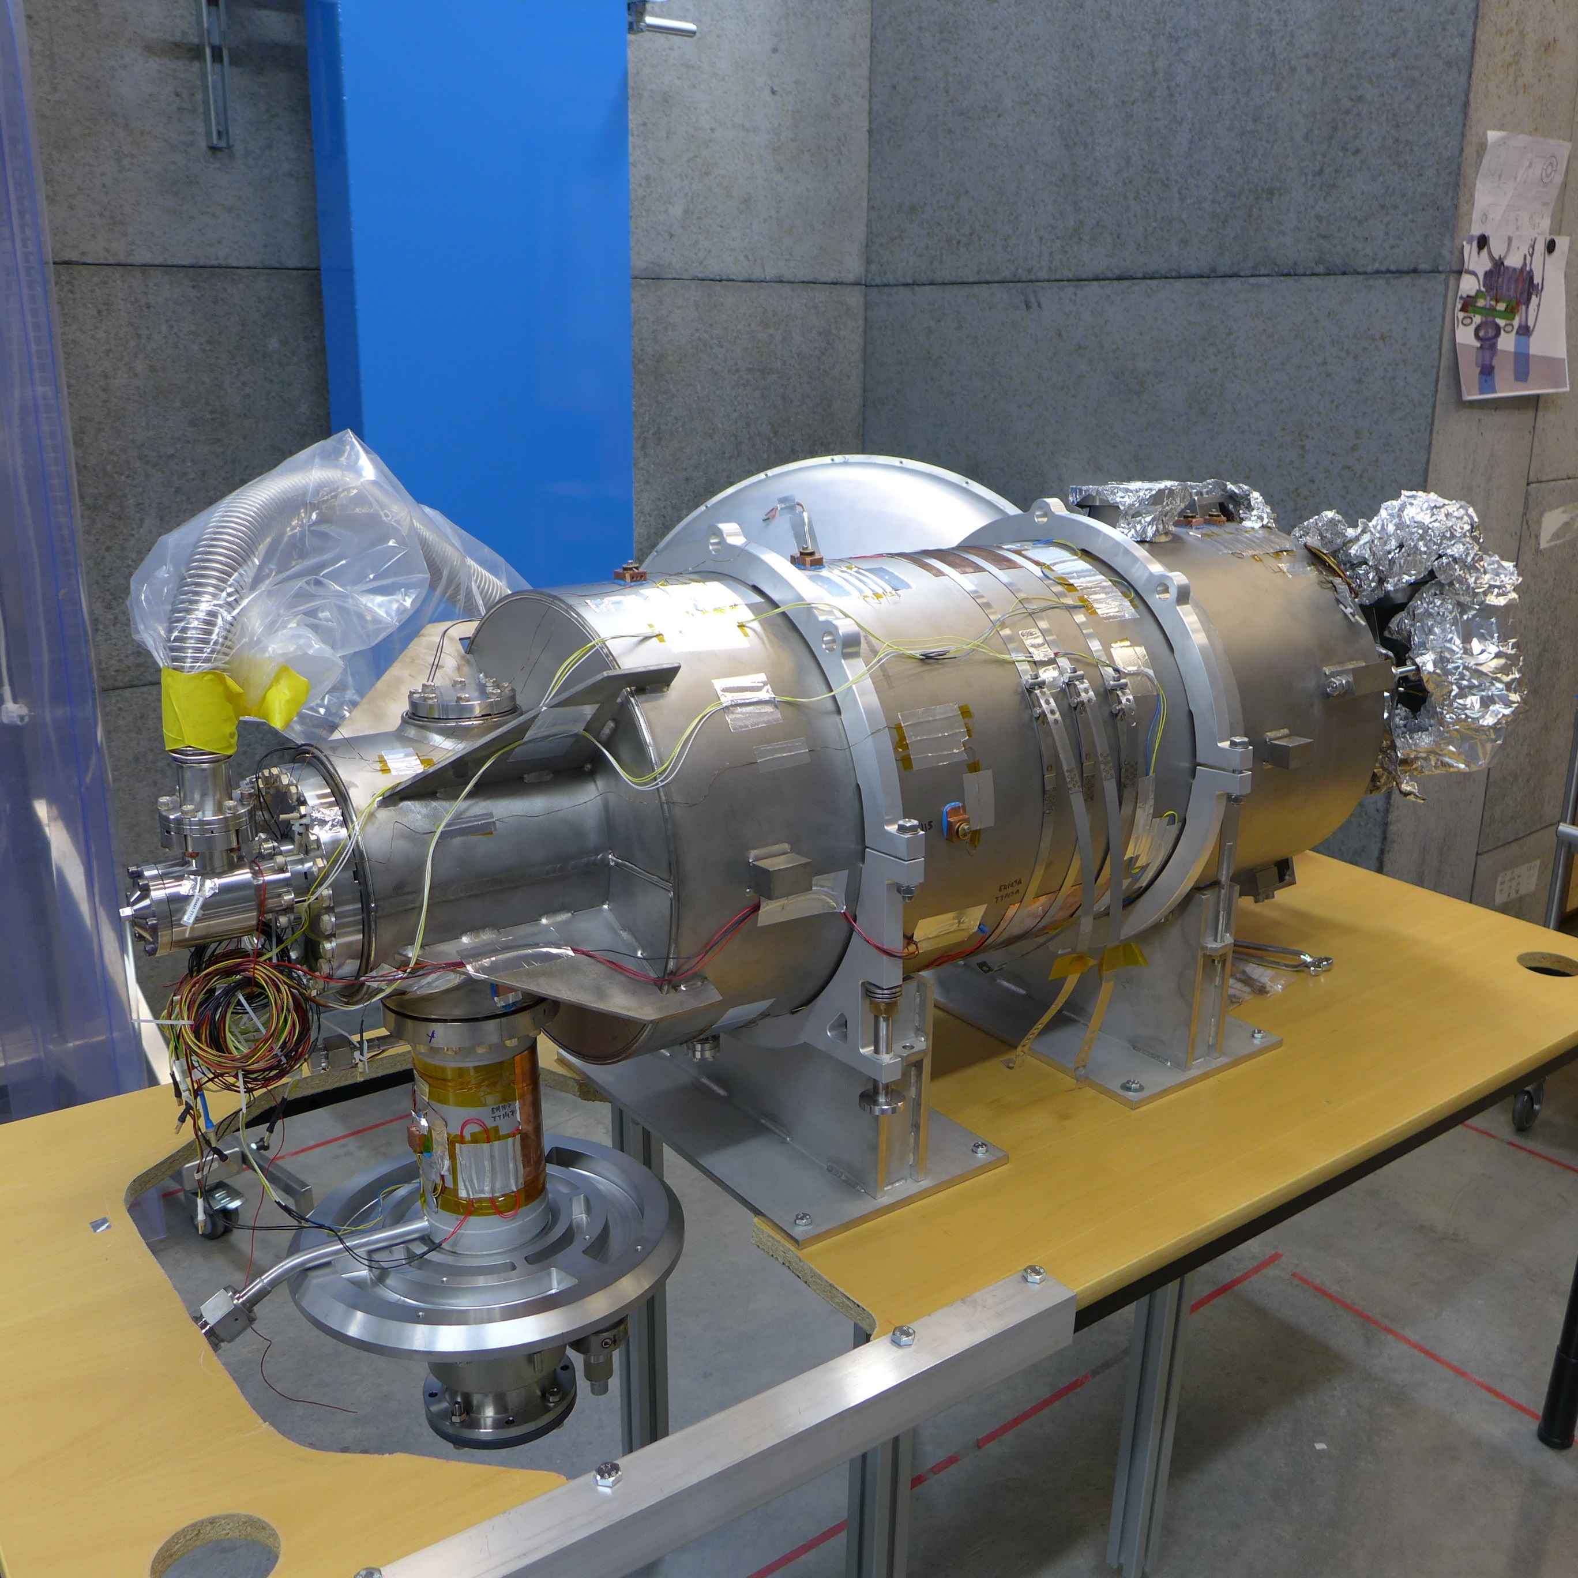
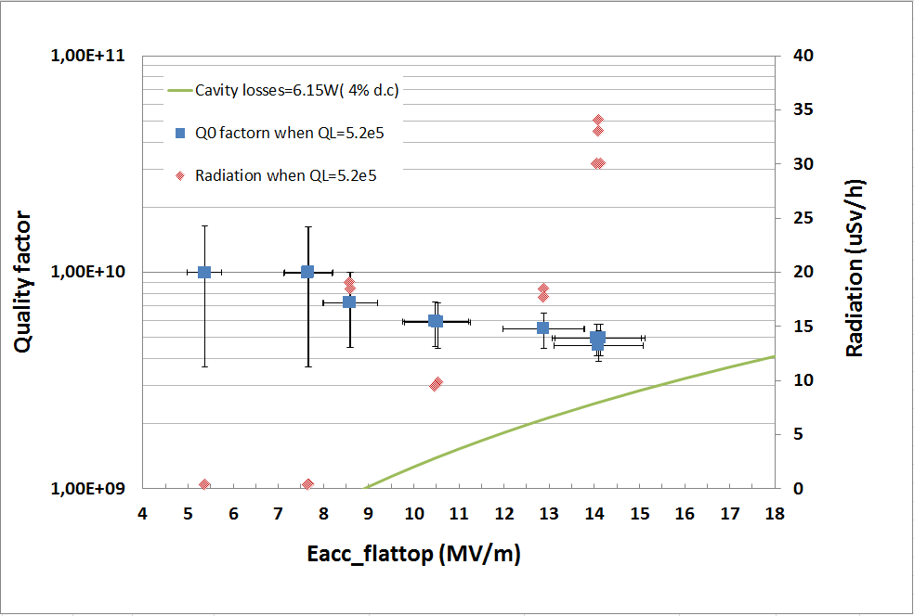
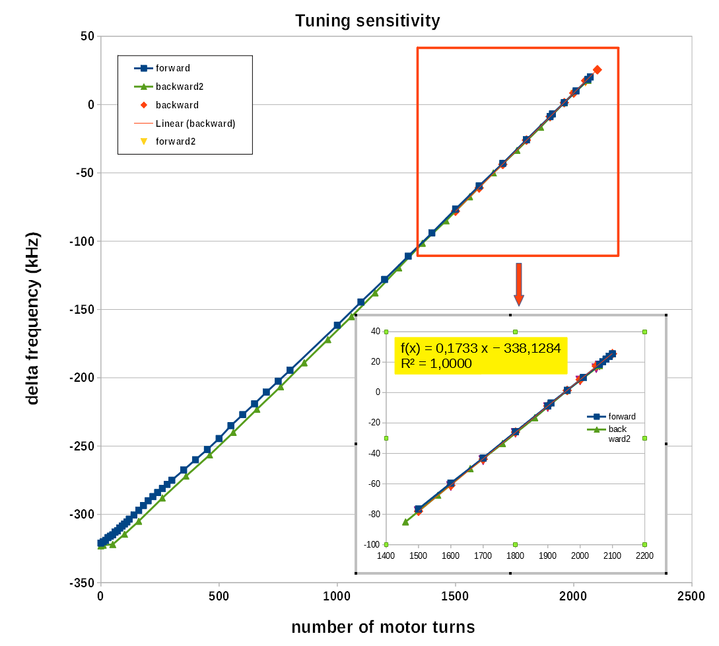
WP12.1 FREIA-HNOSS-2017-01 (#1)
Prototype superconducting
high-beta elliptical cavity for ESS
  experiment run in June and August 2018,
    start-up delay due to technical issues with
    high power klystron and RF-load
  cold tuner problem
    → warm-up and fix
Results
  Q₀ >10⁹
    not much multipacting,
  Lorenz force detuning, cavity tuning sensitivity ok
    lost some motor steps during 1st movement, others ok
    test of new electronics for cold tuner system
Successful validation of cavity package
and new tuning control systems

Slide 9
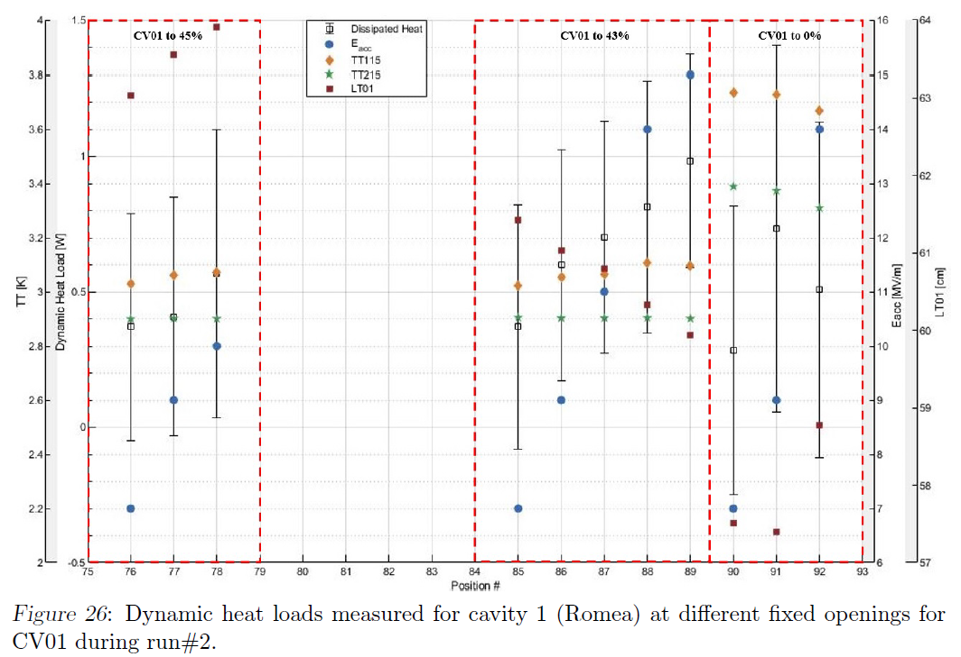
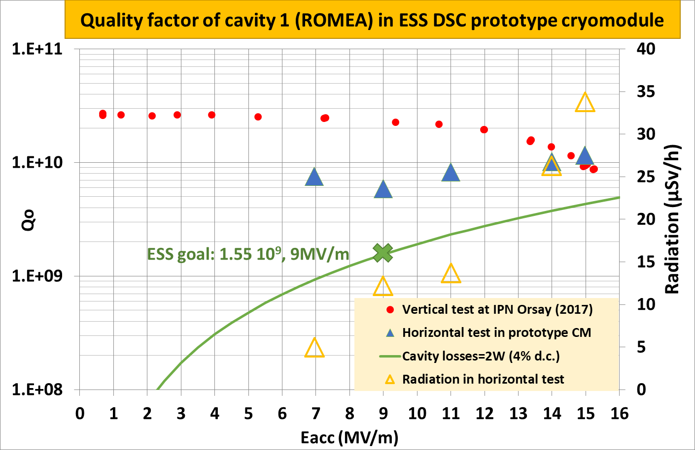
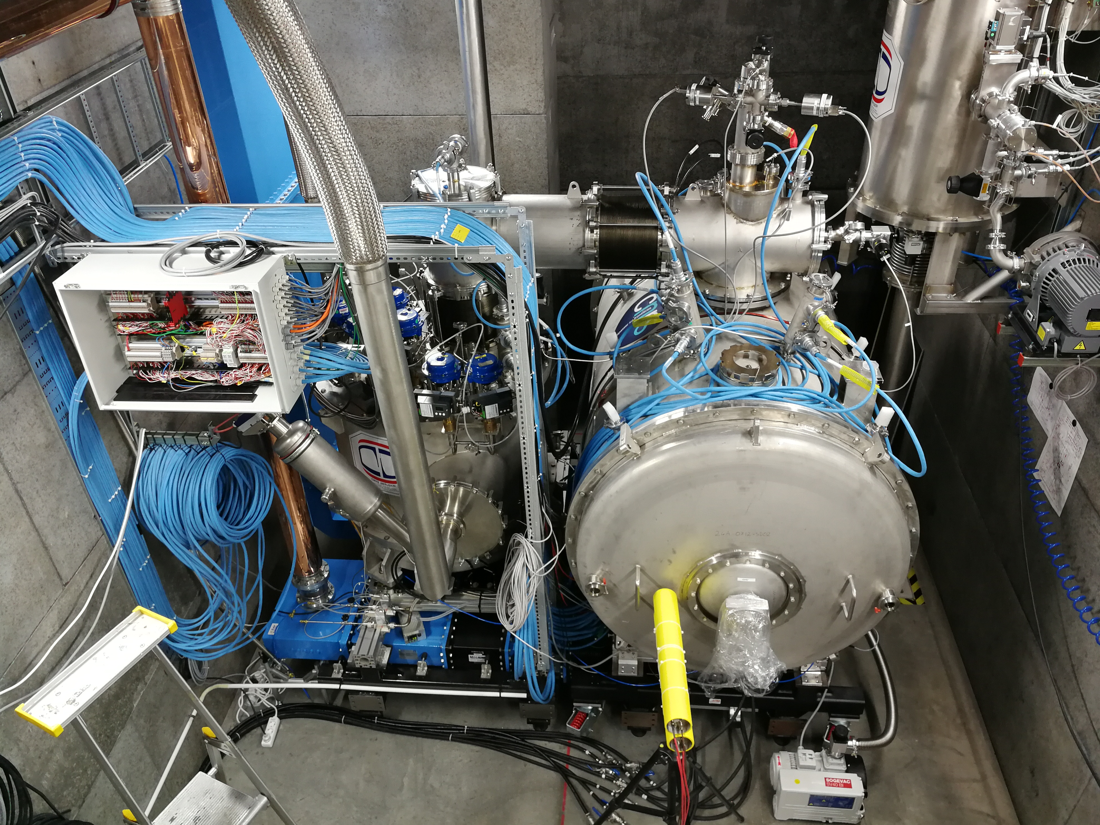
WP12.1 FREIA-HNOSS-2018-01 (#2)
Validation of prototype double spoke cavity
cryomodule
  thermo-acoustic (Taconis) oscillations in
  valve-box → installed RLC circuit
  cryomodule quench → rupture disk replaced
Results
  RF conditioning → several multipacting bands
    revealed problems in RF stations and LLRF synchronization → fixed!
  stable operation at 2K
  measured accelerating gradient, heat load
  → better than target requirements
  studied Lorenz force detuning,
  frequency sensitivity vs. temp., pressure
Cavity 1 dynamic heat load at different filling valve opening

Slide 10
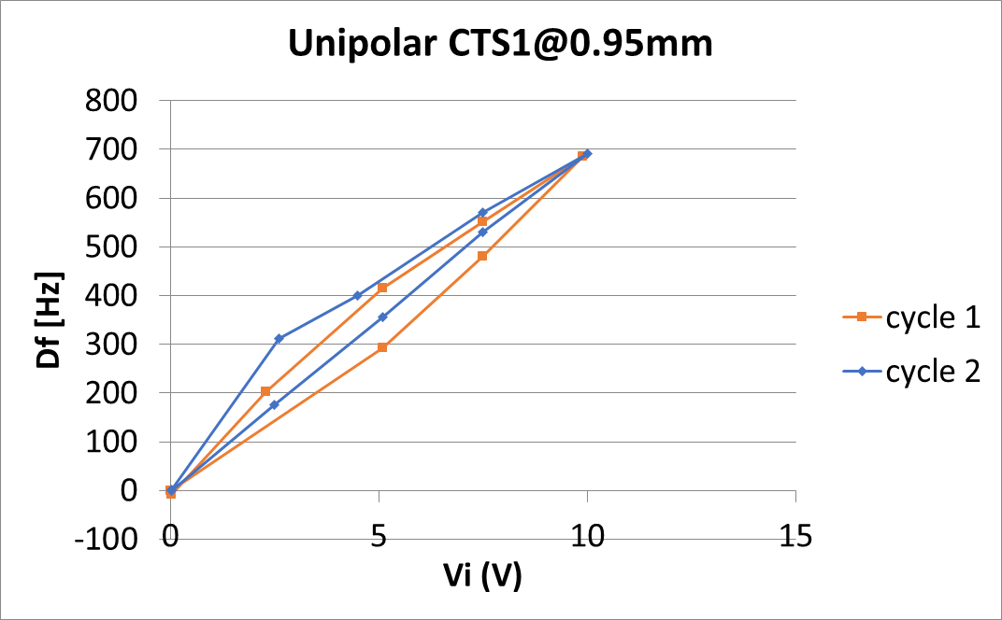
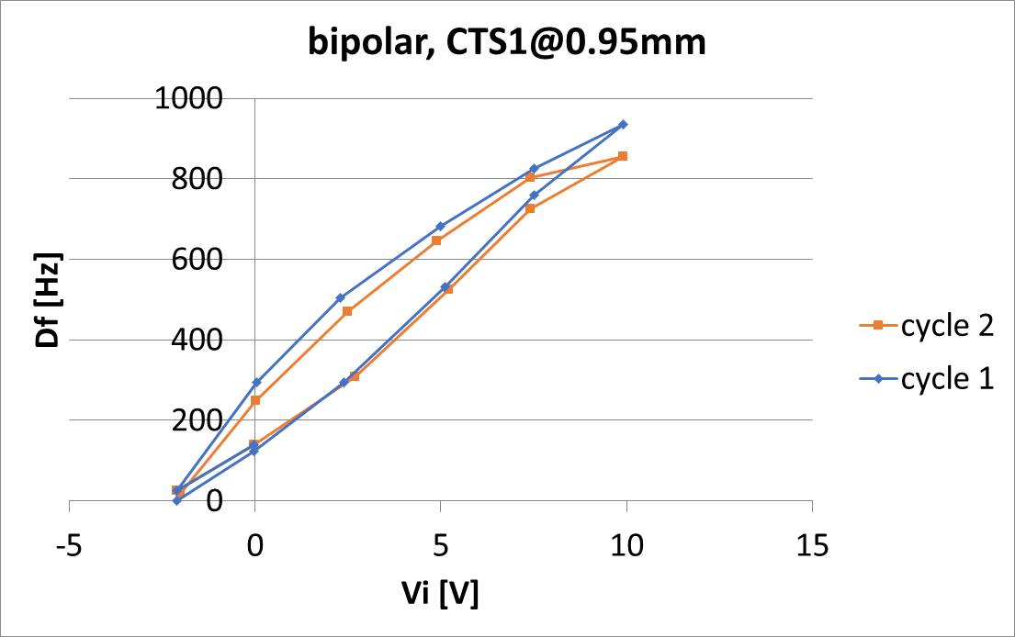
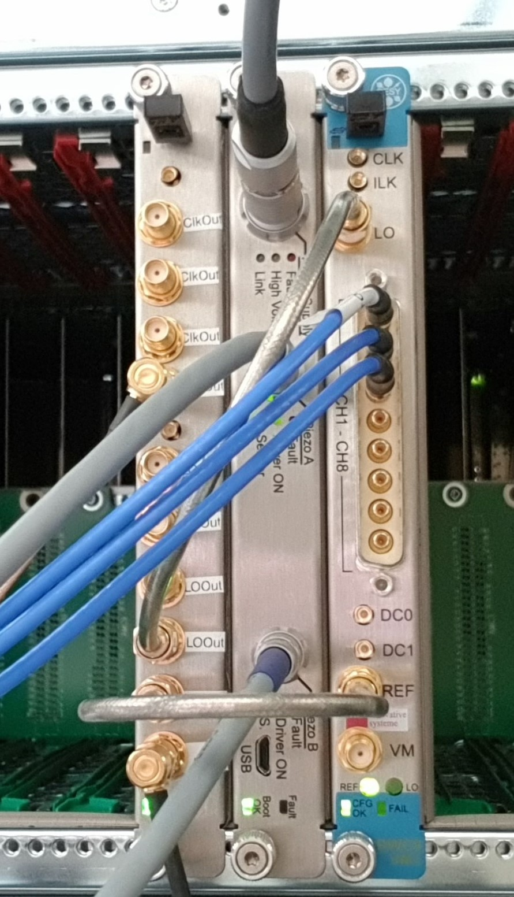
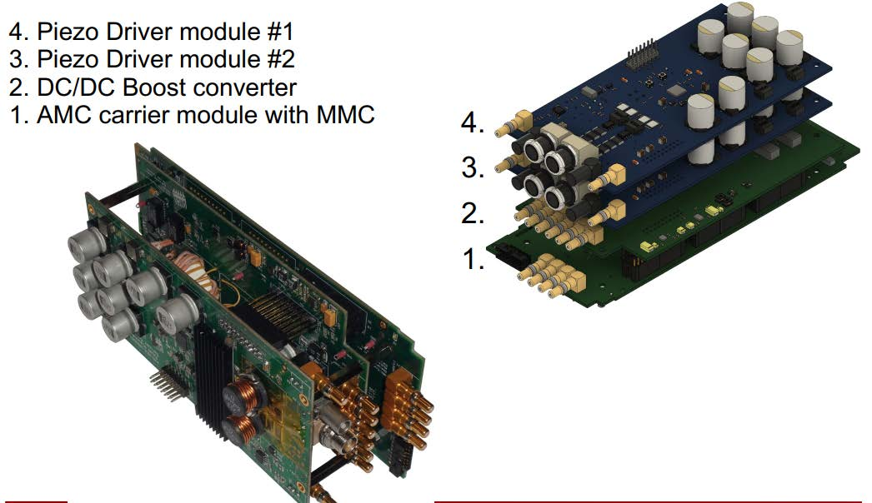
WP12.1 FREIA-HNOSS-2019-01 (#3)
RF and piezo actuators study on spoke cavities
  use cavities from cryomodule project HNOSS-2018-01
Results
  measurement of piezo & cavity operational
  parameters,
    verified and modified specifications
  design verification of control system and
  algorithms.
    main parameters of designed driver modified
    triggered discussion to harmonize piezo driver
    system for ESS spoke and elliptical cavities

Slide 11
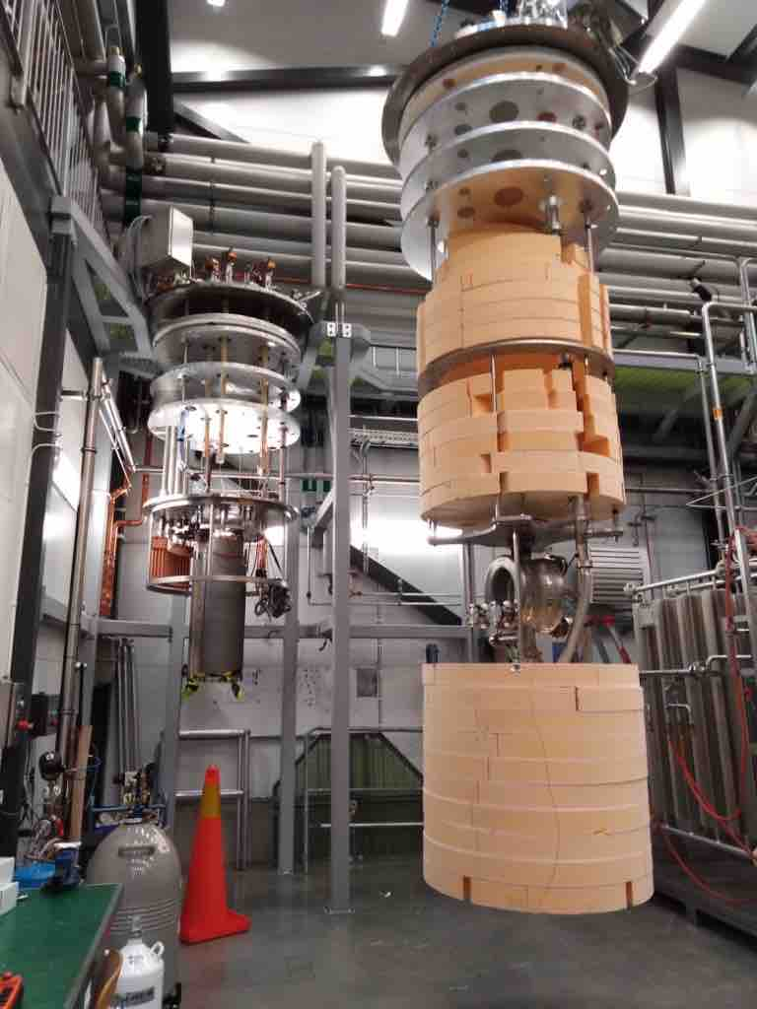
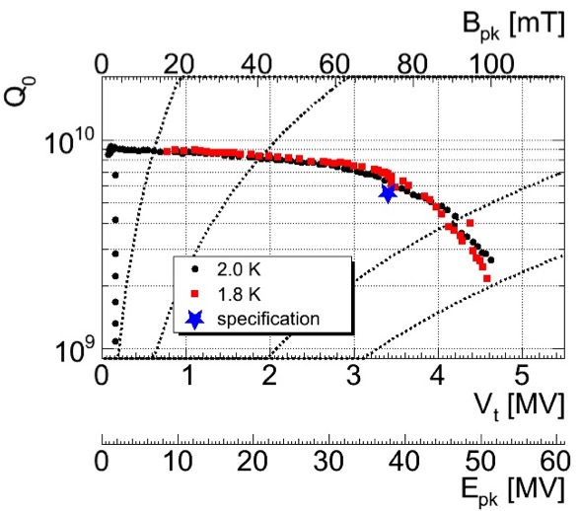
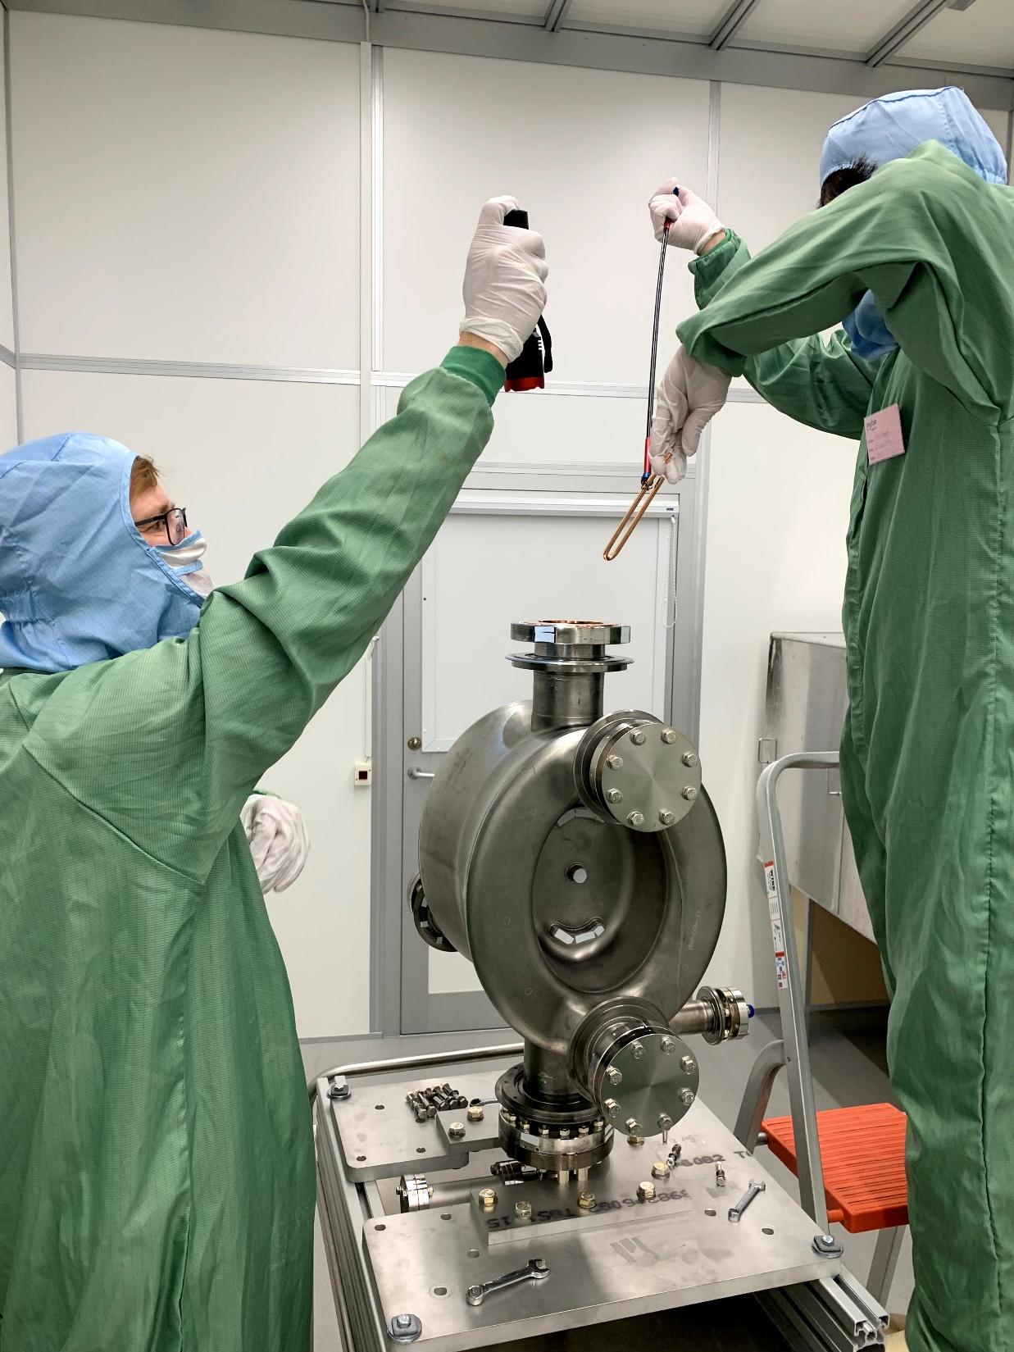
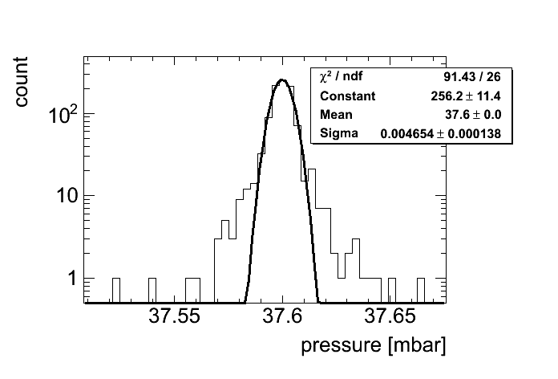
WP12.1 FREIA-HNOSS-2020-01 (#4)
Validation of prototype crab-cavity
  Cavity was without helium vessel, so test in helium bath of vertical cryostat
  A pick-up antenna fallen off during transport
    successfully fixed in the cleanroom
Results
  met project specifications
Class 10 equivalent
Pressure stability at 2K

Slide 12
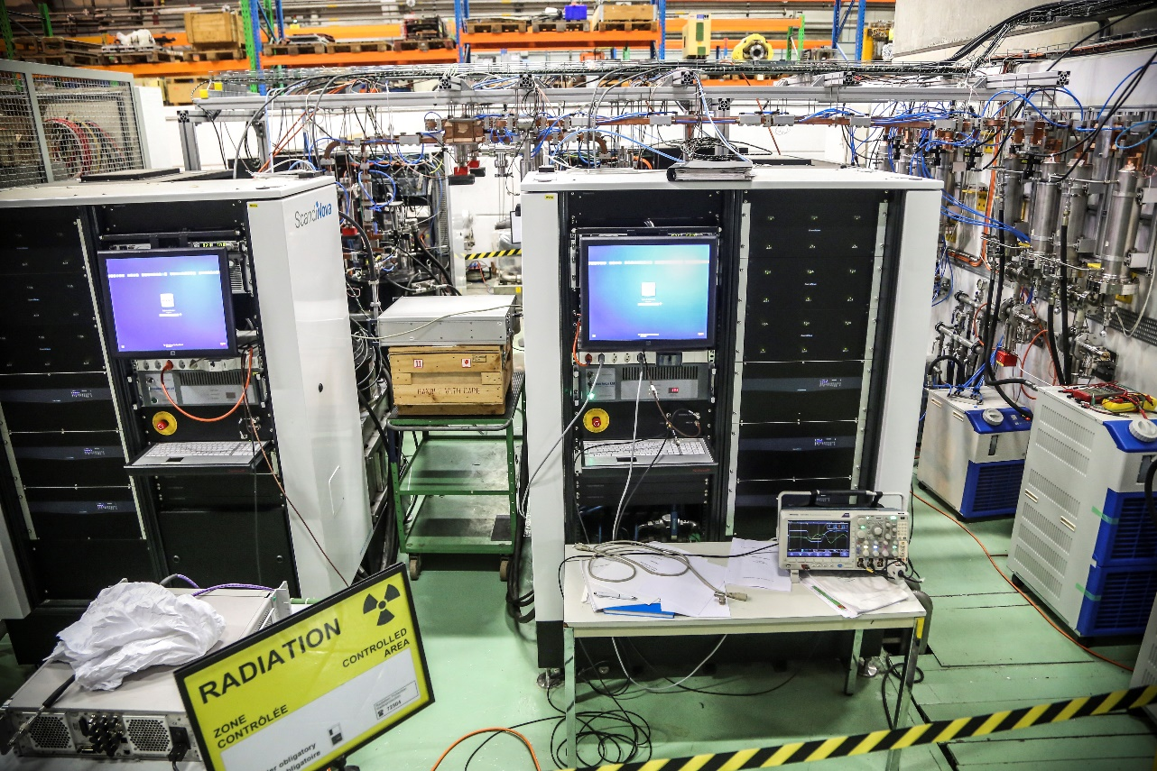
WP12.2 CERN XBox Facility
TASK 12.2 XBOX
XBOX
CERN Geneva
The XBox facility at CERN, Switzerland, is available for testing of
normal conducting RF cavities/structures at X-band frequency.

Slide 13
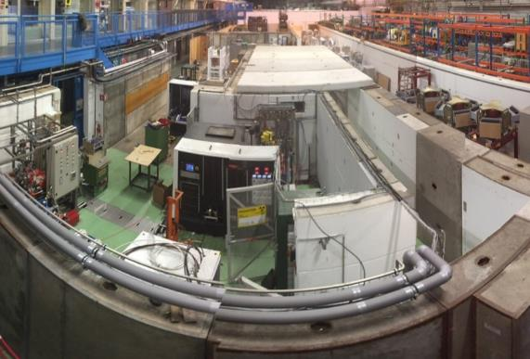
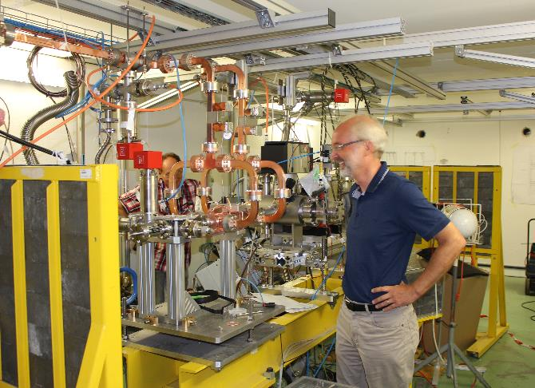
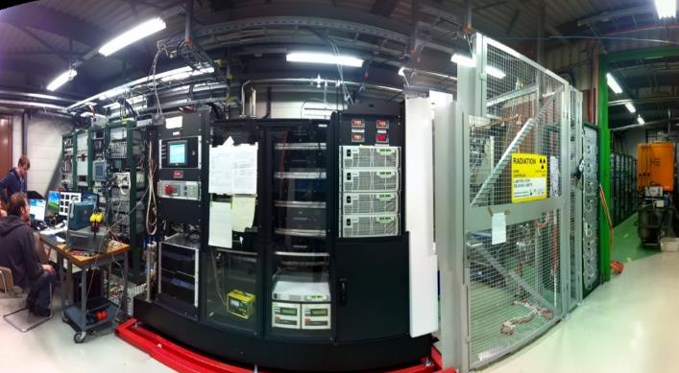
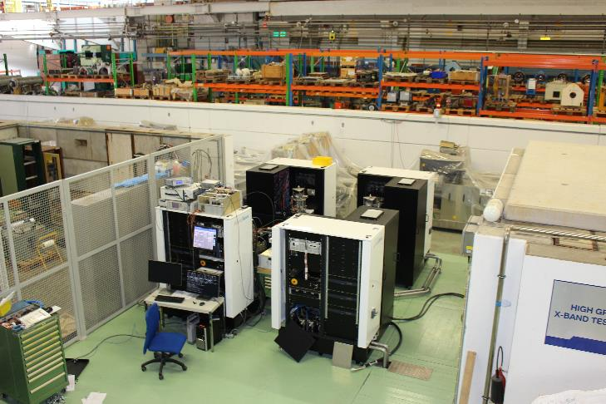
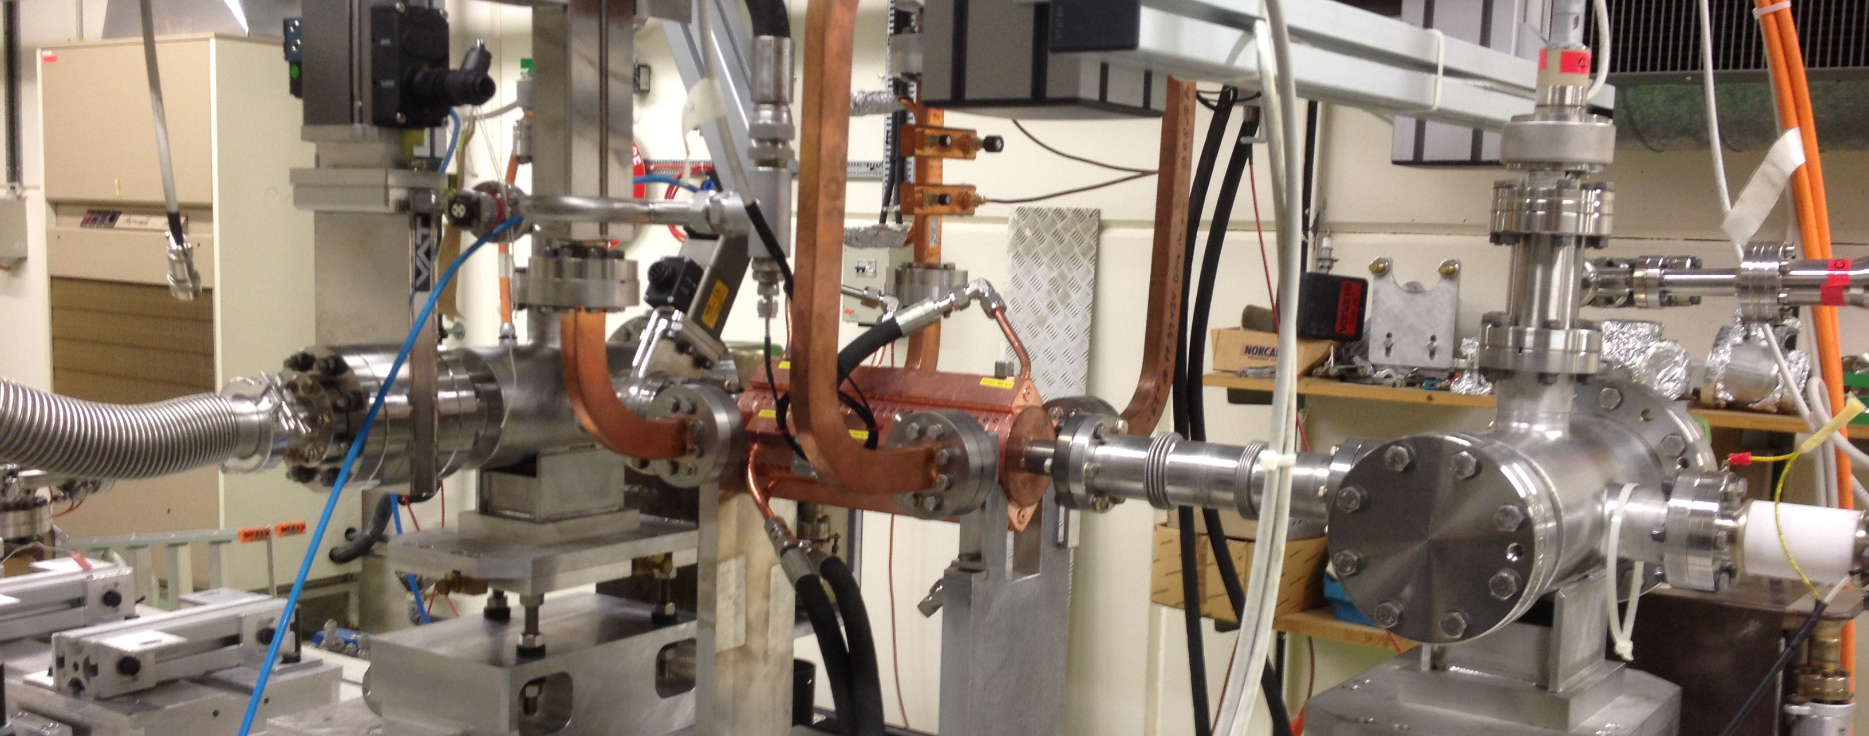
WP12.2 XBox at CERN
State-of-the-art klystron-based X-band (11.994 GHz).
High-gradient structure development
  in the range of 100 MV/m,
  very high peak power >100 MW,
6 Test slots (with pulse compressor)
  XBox 1-2: 50 MW/1.5μs/50 Hz klystron,
  XBox 3: 4 x 6 MW/5 μs/400 Hz klystron,
XBOX 2
XBOX 1
XBOX 3

Slide 14
WP12.2 CERN XBox - Overview
In proposal - 4 projects with a total of 6000 7500 access units.
# | Name | Institutes | Status | Access Units | Users
1 | Dark current and breakdown Spectrometer | Uppsala University | Completed. Reported and published | 1,680 | 6
2 | X-band pulse compression chain | PSI and Tsinghua University | Completed. Reported and published, PRAB. | 4,000 | 7
3 | X-band RF deflecting structure testing | Lancaster University and SARI (Shanghai) | Running. Full remote participation due to Covid pandemic. | 5,021 | 13
4 | Measurement of the Average Power limitation for High Gradient X-band Accelerating Structures for Future Light Sources | Technical University of Eindhoven | Approved. Not carried out due to Covid pandemic. | - | 5
 | TOTAL Achieved Today |  |  | 10,701 (143%) | 19

Slide 15
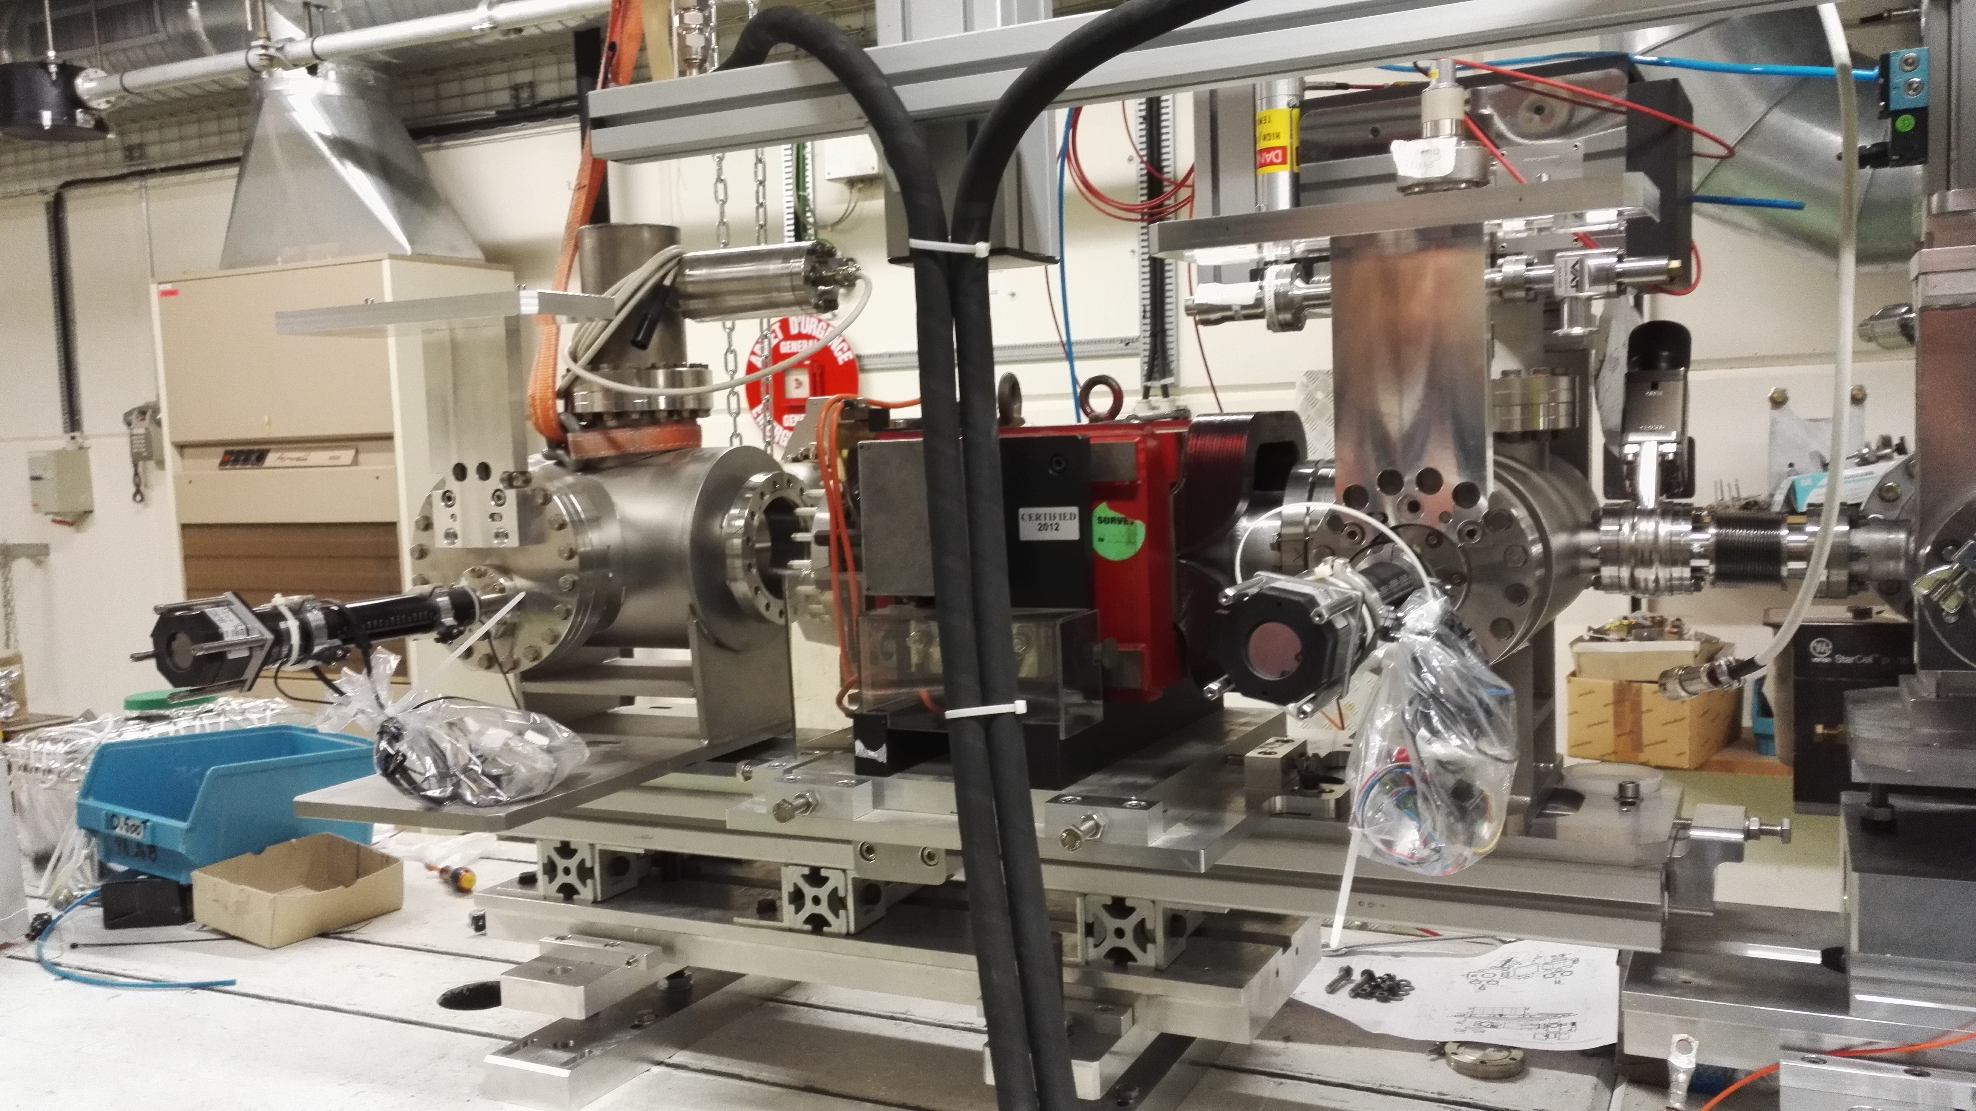
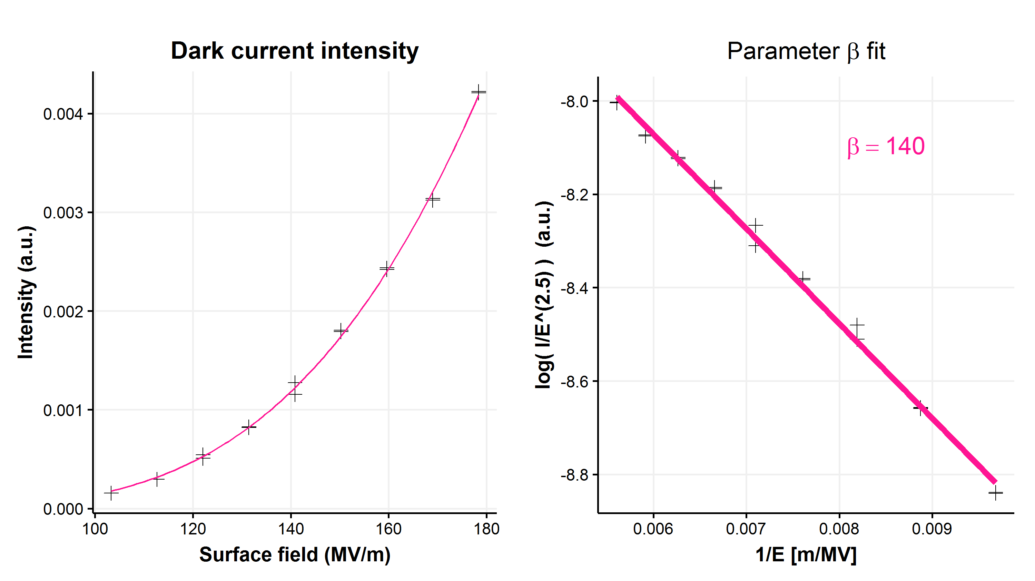
WP12.2 CERN-XBOX-2017-01 (#1)
Dark and breakdown current measurements with spectrometer
Dark current can give information about changes inside the structure during conditioning:
  use the spectrometer to look at the changes, both spatially on the screen and by measuring the energy spectrum
Enhancement factor β accounts for increase in local (microscopic) field
E_{local} from the ideal surface field E
  E_{local} = β * E
Results
  Good agreement with underlying
  theory of field emission
PRELIMINARY
PRELIMINARY

Slide 16
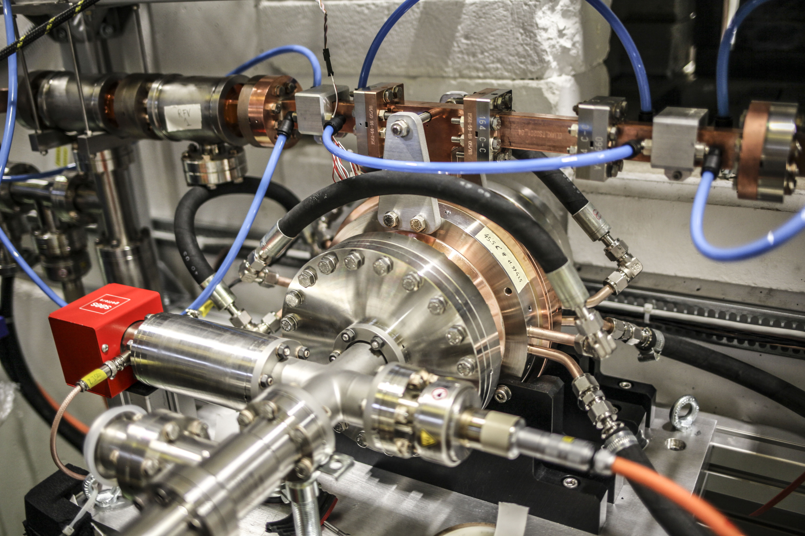
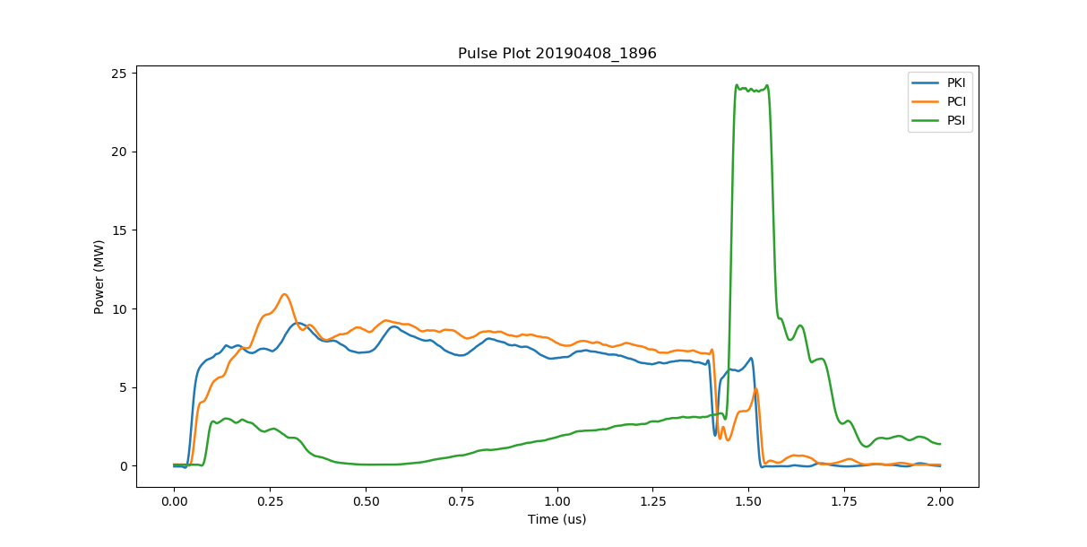
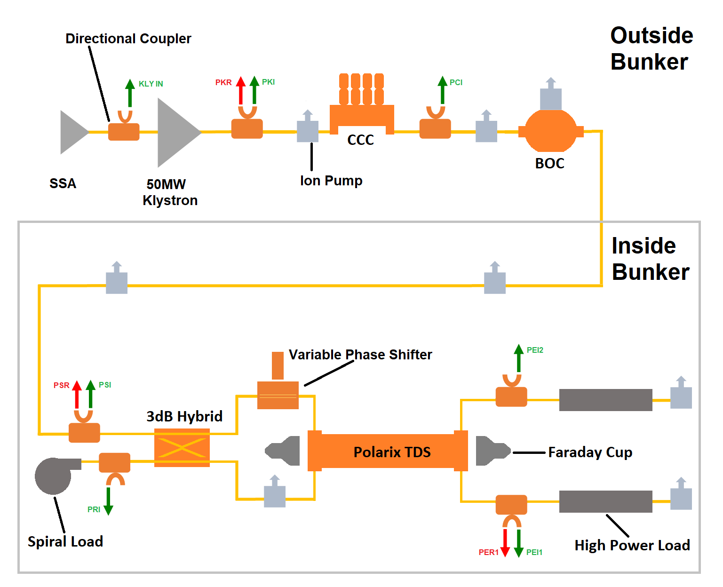
WP12.2 CERN-XBOX-2018-01 (#2)
Validation of the high power performance
of a new pulse compressor cavity (BOC)
and correction cavity chain (CCC)
for X-band operation
BOC output
klystron output
correction cavity output

Slide 17
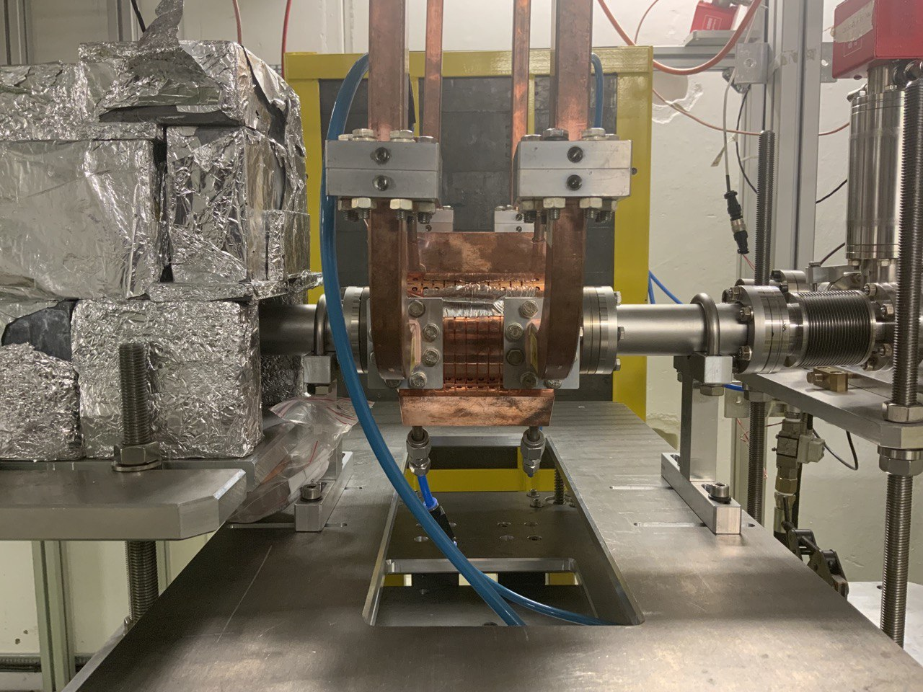
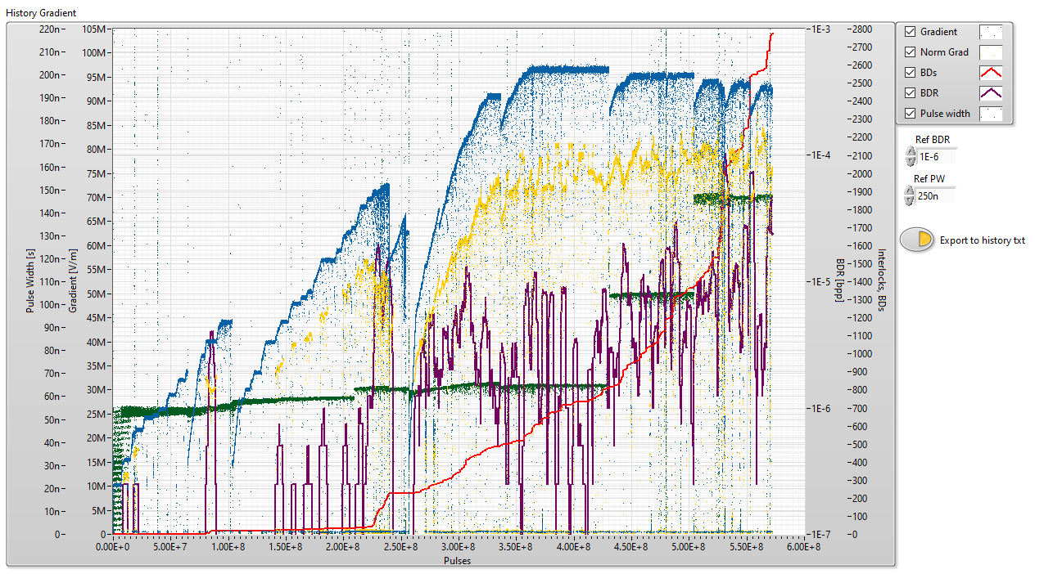
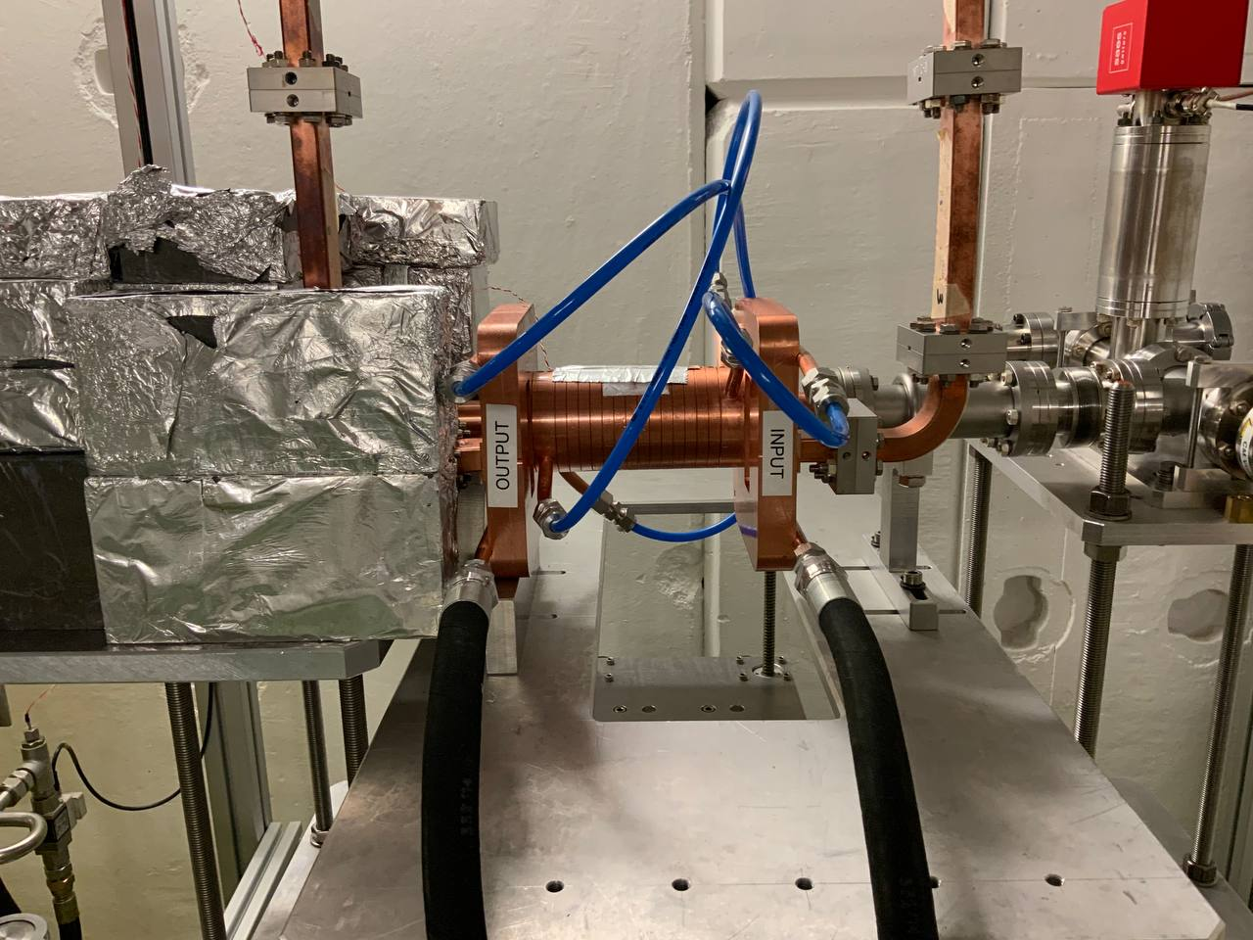
WP12.2 CERN-XBOX-2019-01 (#3)
High-power test of two transverse deflecting cavities
1) prototype crab cavity for the CLIC final focus system
  13 cell structure built by University of Lancaster
2) deflector to measure longitudinal profile of very short bunches in XFEL
  20 cell structure built by SSRF.
Results
  high field conditioned and then operated with input power up to 40 MW
Input power, and corresponding fields, are raised gradually to the operating values, then run at for extended periods at different pulse lengths.

Slide 18
WP12.2 CERN-XBOX-2020-01 (#4)
Measurement of the Average Power limitation for High Gradient X-band Accelerating Structures for Future Light Sources
  aim for better understanding of the average power capabilities of high gradient accelerating structures and their limitations by peak surface electric field and cooling capacity.
Not carried out due to coronavirus restrictions followed by the departure from the proposing university of key staff

Slide 19

WP12 TNA - Summary
A typical User Project is quite complex, often requires some form of approval at the level of the proposing institutes, so lead times are long.
ARIES TNA has become very successful for the facilities and its users!
We could open to new users with exciting projects.
User response has been very positive and overall the users were very pleased to receive these access possibilities.
It was a great experience which we will to continue in...

