Slide 1

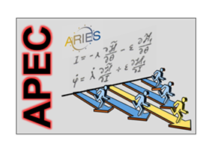

HORIZON 2020
Accelerator Performance and Concepts
report from WP6
http://aries.web.cern.ch/content/wp6
Alessandro Drago / INFN-LNF, Giuliano Franchetti / GSI & GUF, Johannes Gutleber / CERN, Klaus Höppner / HIT, Florian Hug / JGU, Mauro Migliorati / Sapienza, Marco Zanetti / U Padova, and Frank Zimmermann / CERN
ARIES Final Review
Virtual Meeting, Online, 15 July 2022
This project has received funding from the European Union’s Horizon 2020 Research and Innovation programme under Grant Agreement No 730871.

Slide 2
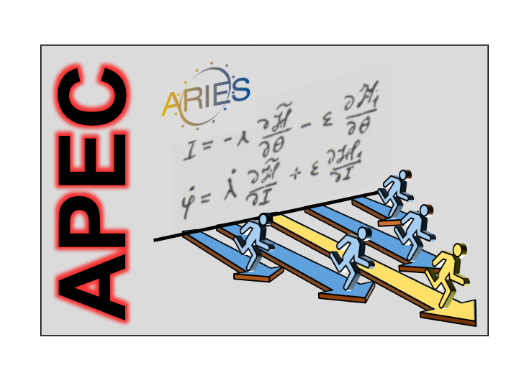
APEC structure – a reminder
Task 6.1 Coordination and communication
Coordinated by Frank Zimmermann (CERN), Giuliano Franchetti (GSI)
Task 6.2 Beam Quality Control in Hadron Storage Rings and Synchrotrons
Coordinated by Giuliano Franchetti (GSI), Frank Zimmermann (CERN)
Task 6.3 Reliability and Availability of Particle Accelerators
Coordinated by Johannes Gutleber (CERN), Klaus Hoeppner (HIT)
Task 6.4 Improved Beam Stabilization
Coordinated by Mauro Migliorati (U. Roma Sapienza), Alessandro Drago (INFN-LNF)
Task 6.5 Beam Quality Control in Linacs and Energy Recovery Linacs
Coordinated by Florian Hug (JGU Mainz)
Task 6.6 Far Future Concepts & Feasibility
Coordinated by Marco Zanetti (INFN & U. Padova), Frank Zimmermann (CERN)

Slide 3
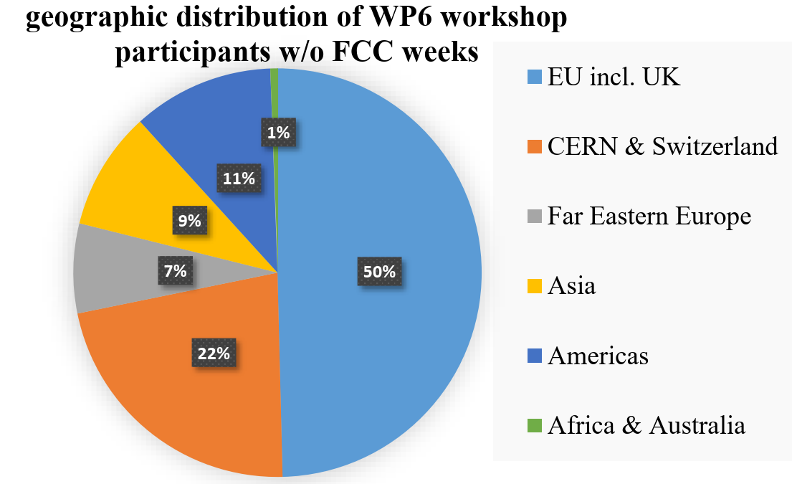
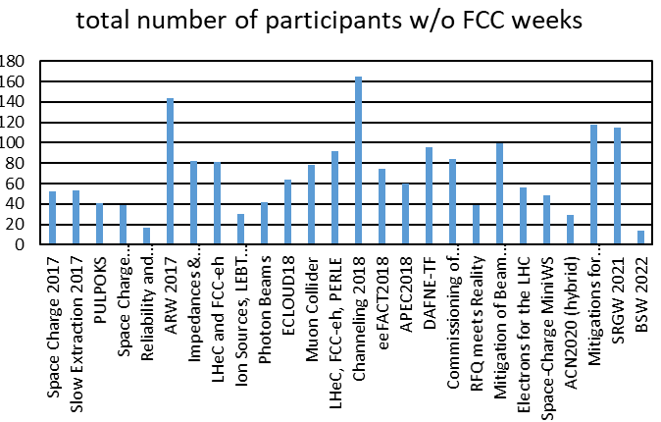
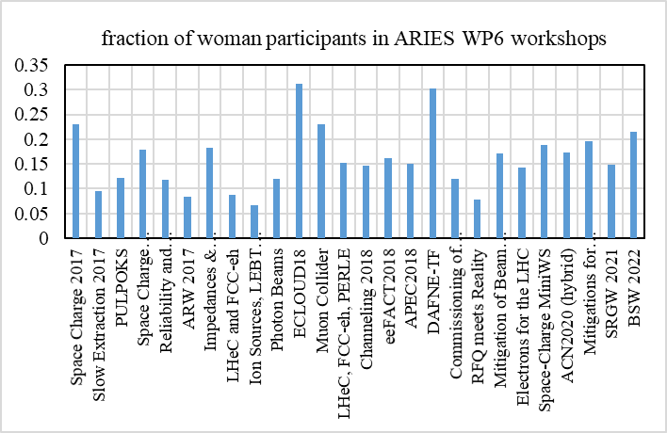
ARIES WP6 workshops
1812 (928) participants with (without) FCC Weeks
fraction of women participants in all WP6 workshops
28 WP6 workshops in total

Slide 4
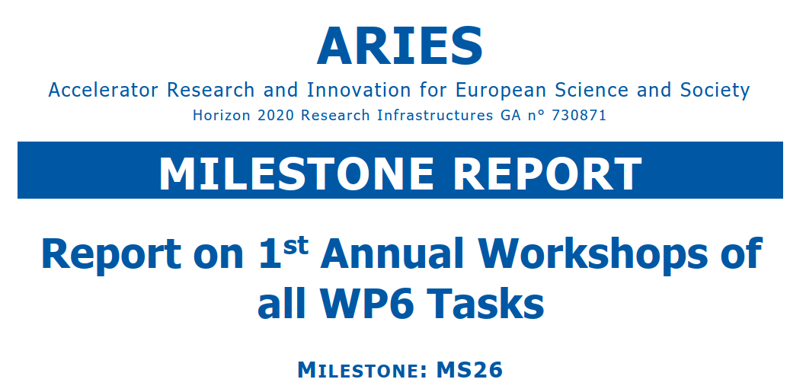
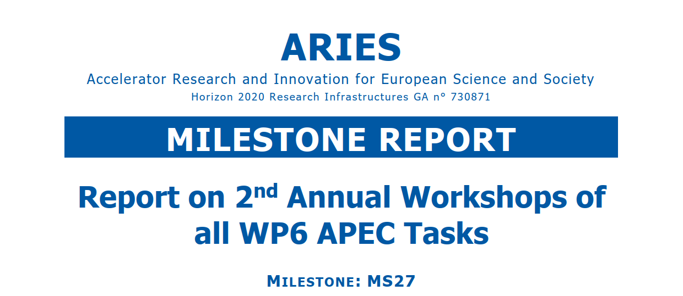
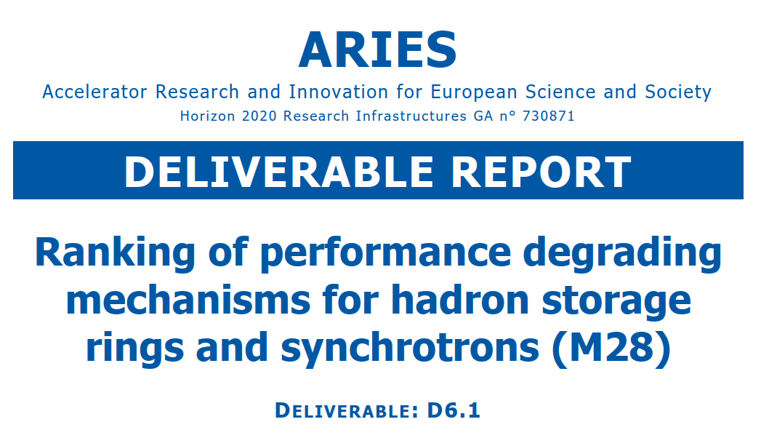
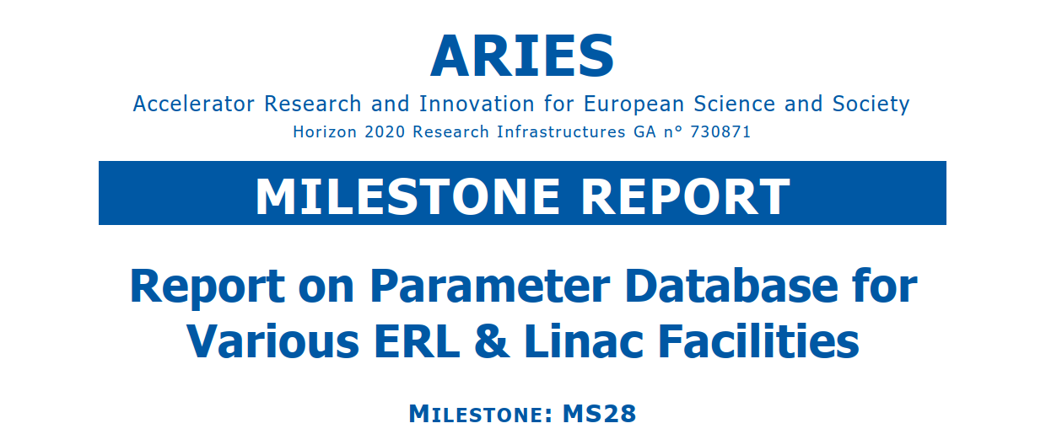
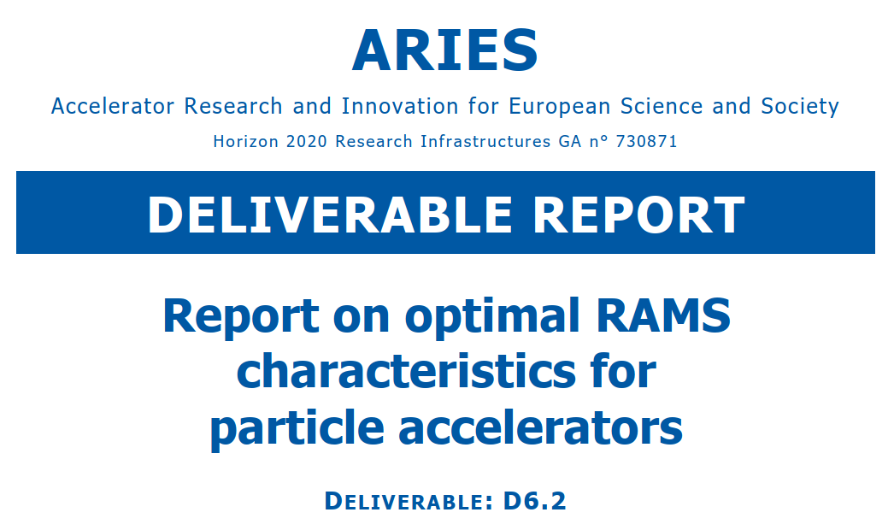
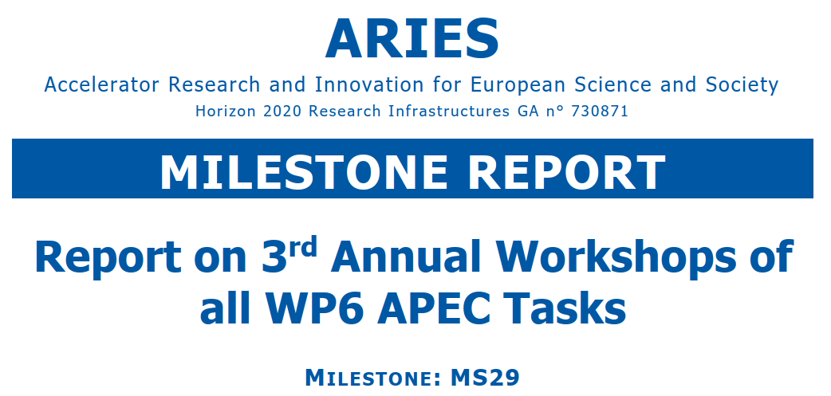
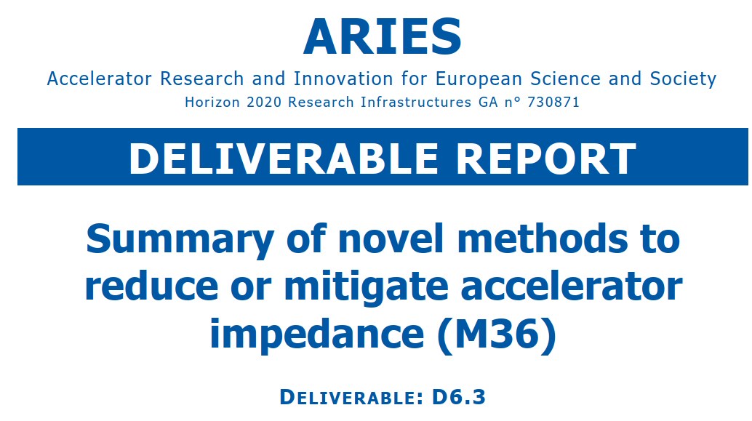
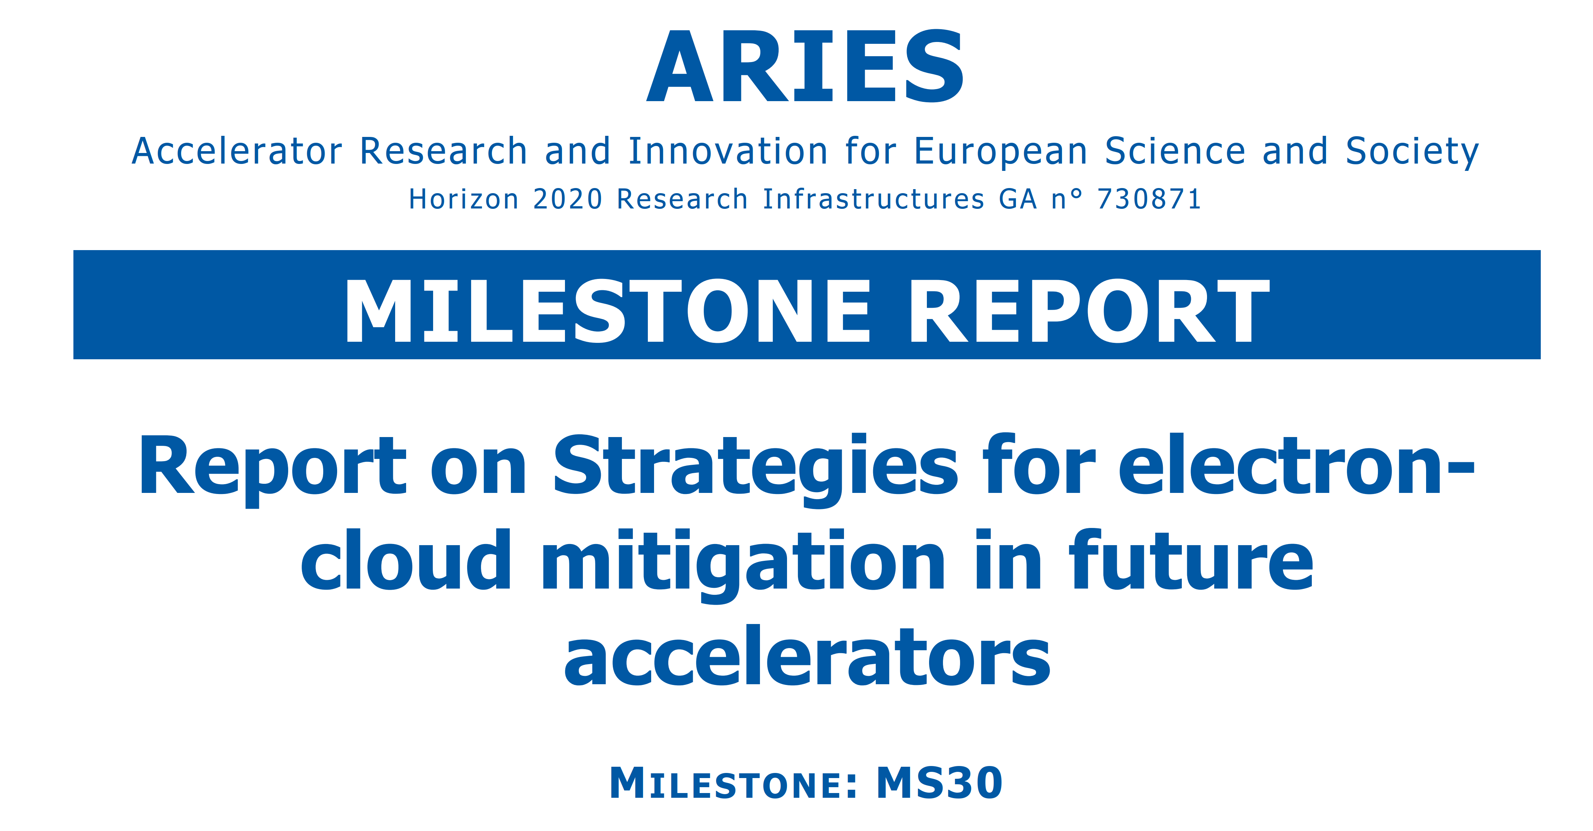
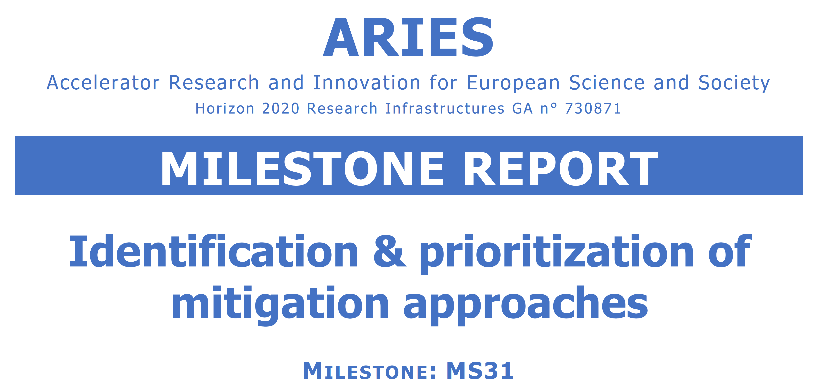
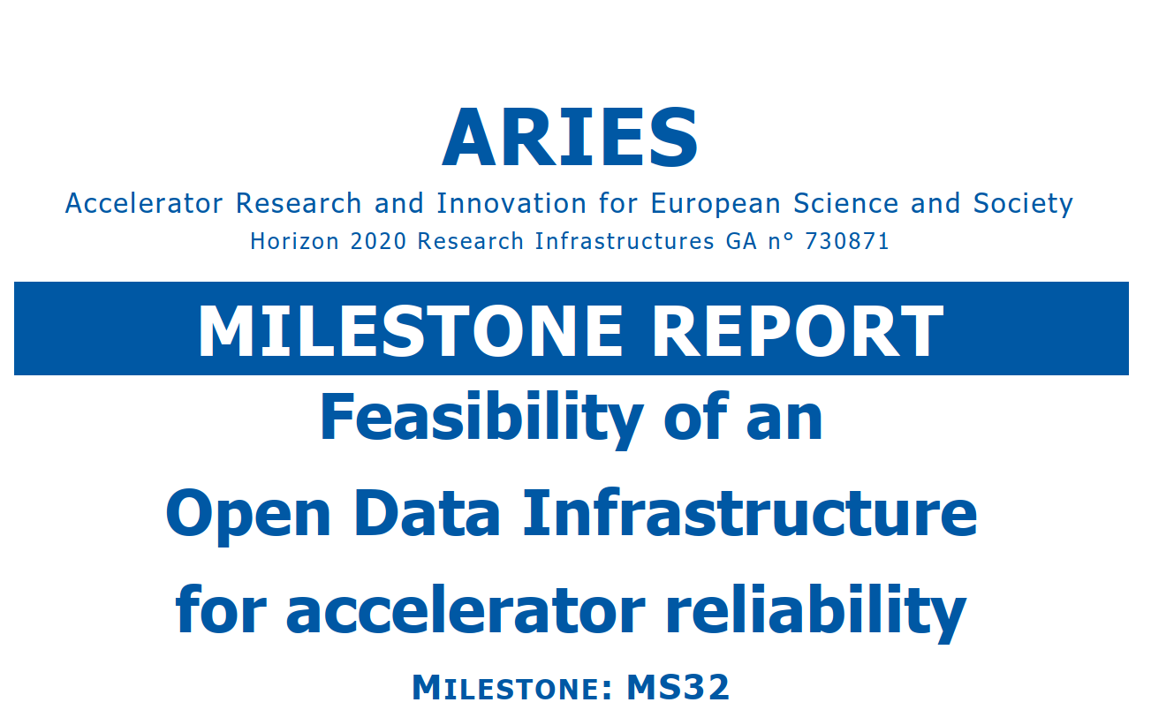
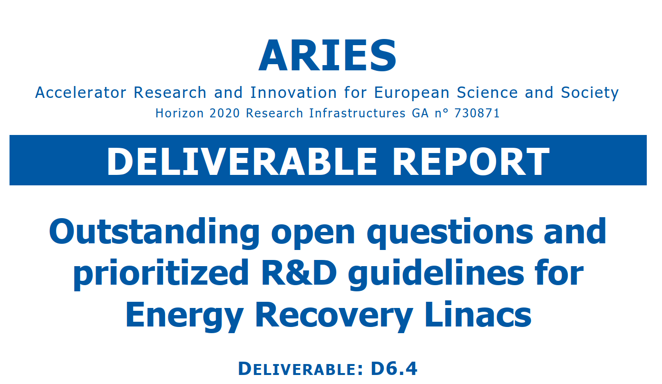
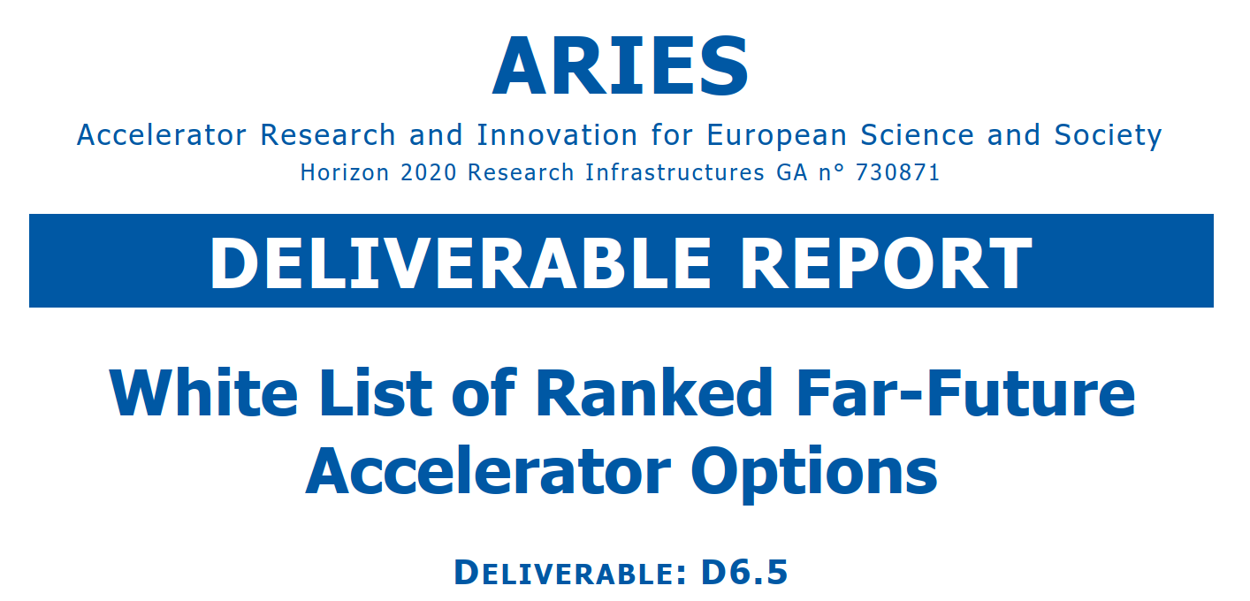
some ARIES WP6 milestones and deliverables
approved
approved
approved
approved
approved
approved
approved
approved
approved
approved
approved
approved
WP6 work plan carried out > 100%, all deliverables completed

Slide 5
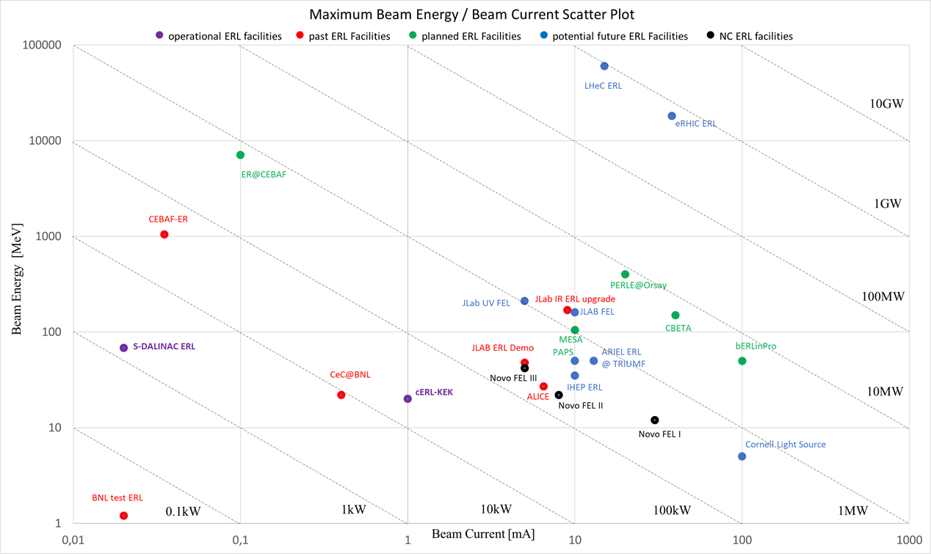
ERL landscape
FCC-ee-ERL
ARIES MS Report 28
LHeC
PERLE
LHeC/FCC-eh Workshop, CERN, Switzerland, 11-13 September 2017
LHeC, FCC-eh, and PERLE Workshop, LAL Orsay, France, 27-29 June, 2018
Electrons for the LHC, Chavannes-de-Bogis, Switzerland, 24-25 October 2019
F. Hug
ARIES MS28

Slide 6
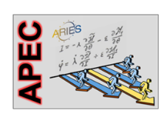
recent HORIZON 2020 ARIES WP6 workshops, a covid circle
Accelerator Applications of Crystals and Nanotubes, EPFL Lausanne & hybrid!, 10-11 March 2020
Mitigation Approaches for Hadron Storage Rings and Synchrotrons (Mitigations2020), safe virtual space, 22 June – 1 July 2020
ARIES Workshop on Storage Rings and Gravitational Waves (SRGW2021), safe virtual space, 2 February -18 March 2021
ARIES WP6 APEC & iFAST WP5.2 PAF joint Brainstorming & Strategy Workshop (BSW22), in-person! Colegio Mayor, Valencia, 30 March -1 April ‘22

Slide 7
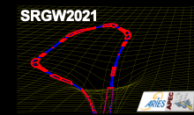
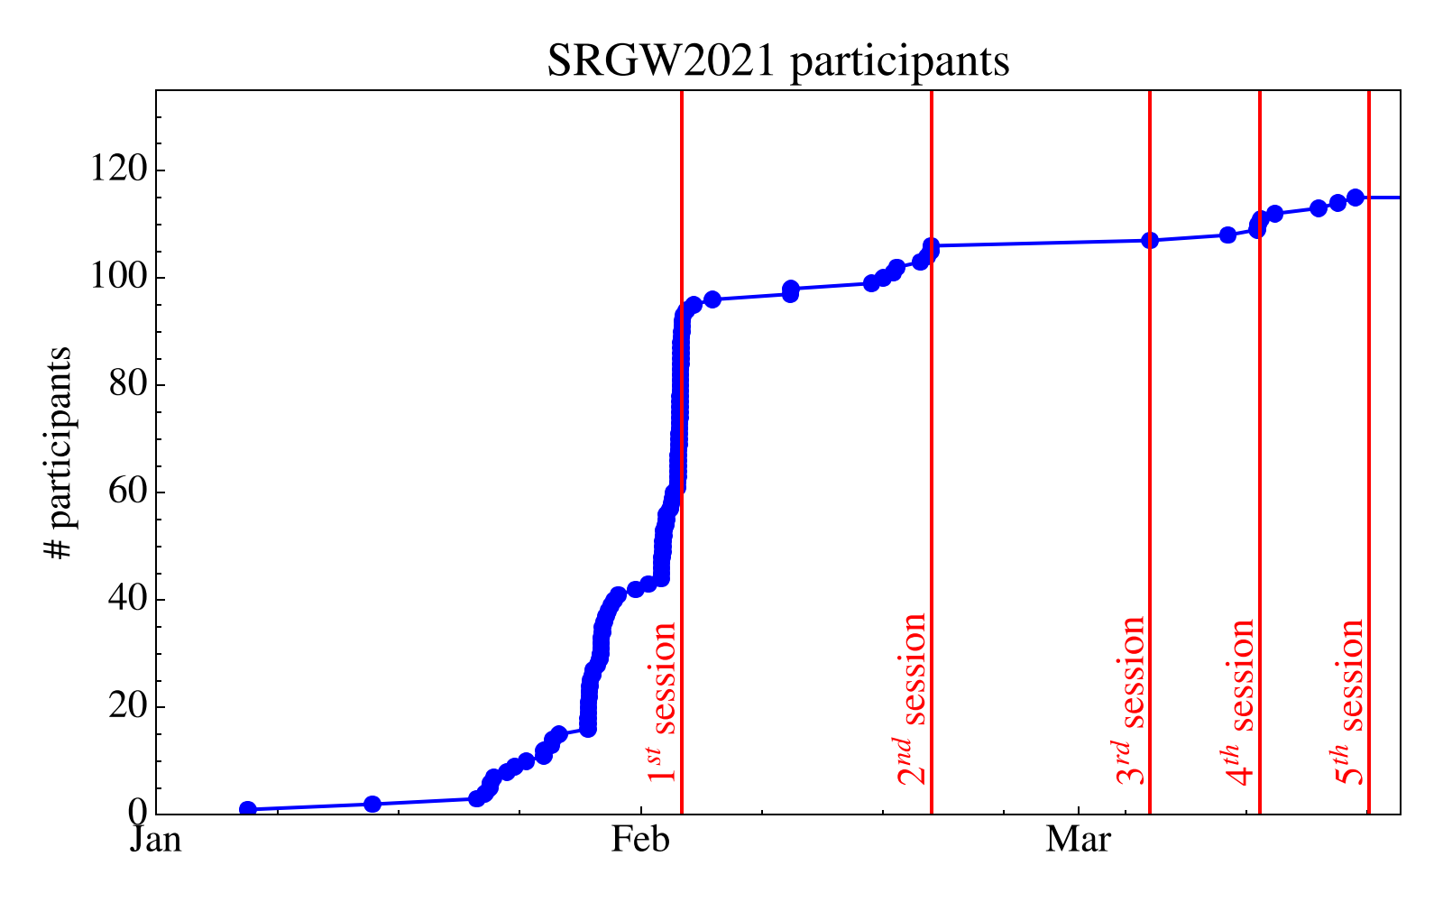
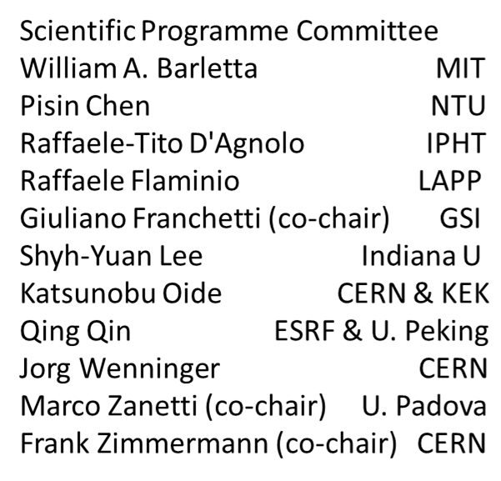
ARIES Workshop on Storage Rings and Gravitational Waves (SRGW2021), virtual space, 2 February -18 March 2021 ; chaired by G. Franchetti, Marco Zanetti, and F. Zimmermann
115 registered participants
main focus: detection and/or generation of gravitational waves or other gravity effects using storage rings & accelerator technologies
Sessions:
2/2/2021, Introduction to Gravitational Waves and their effects, chair: Pisin Chen / NTU Taiwan
18/2/2021, Measurements and sensitivity, chair: Shyh-Yuan Lee / Indiana U
4/3/2021, Proposals and Schemes, chair: Jörg Wenninger / CERN
11/3/2021, Gravitational wave generation and detection, chair: Frank Zimmermann / CERN
18/3/2021, Ground motion and final discussion, chairs: Giuliano Franchetti/GSI; John Ellis/CERN

Slide 8
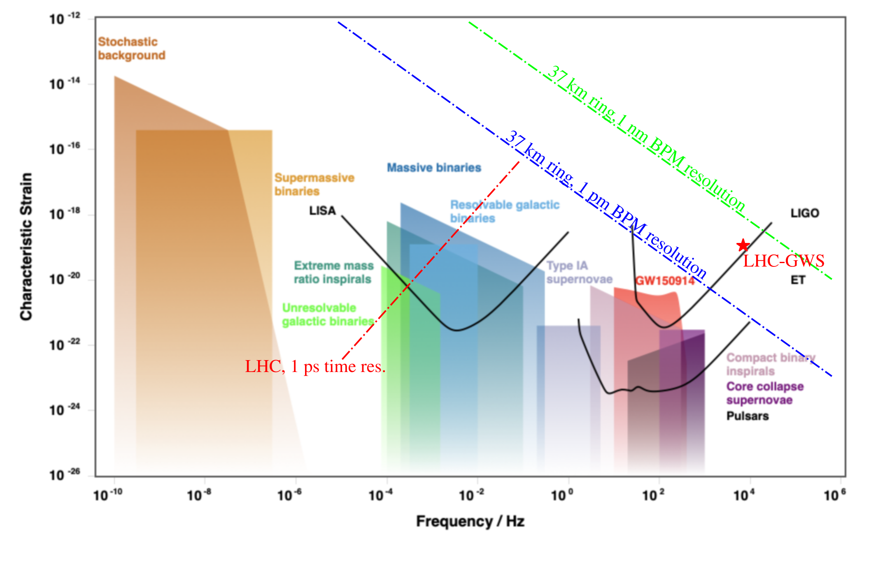
Detection (& Generation) Plot emerging from SRGW2021
Pisin Chen,
NTU
Katsunobu Oide,
KEK + GF + FZ
Suvrat Rao, Hamburg U.
G. Franchetti et al.

Slide 9
Ranking of performance degrading mechanisms for hadron storage rings and synchrotrons
Summary of the accelerator characteristics and main beam features at the laboratories participating in the ARIES ranking effort
Laboratory | Accelerator name | Accelerator Circumference (m) | Initial/final Energy (GeV) | Particles per bunch | Rms bunch length (cm) | Ramp time (s)/ stored time (s)
Fermilab | Booster | 476 | 0.4/8 | 5E10 | 30 | 0.033
BNL | RHIC | 3834 | 25/255 | 2E11 | 0.6 | 300/3600
CERN | SPS | 7000 | 26/450 | 1.1E11 | 15 | 5/20
SLAC/SSRL | SPEAR3 | 234 | 3 | 8.7E9 | 0.6 | NA
J-PARC | Main ring | 1567.5 | 3/30 | 3.3E13 | 1500 | 1.4/0~2
INFN-LNF | DAFNE | 97 | 510 | 1E11 | 1.06 | 0/1200
GSI | ESR | 108 | 0.4/0.004 | 1E8 | 200 | 10/2000
GSI | SIS18/SIS100 | 216/1000 | 0.011/2.7 | 5E11 | 3000 | 0.5
End 2018, APEC2018 workshop
ARIES D6.1

Slide 10
Ranking results on performance degrading mechanisms for hadron storage rings and synchrotrons
ARIES D6.1
R | Intensity limitation | ave | std
1 | Beam loss | 3.12 | 1.16
2 | RF Power | 2.75 | 1.2
3 | Single bunch instability | 2.75 | 0.82
4 | Multi-bunch instability | 2.75 | 1.56
5 | Injector | 2.6 | 1.6
6 | DA | 2.375 | 0.99
7 | Collimation | 2.25 | 1.09
8 | Momentum Acceptance | 2.25 | 1.2
9 | E-Cloud | 2.25 | 1.3
R | Other performance limitation | ave | std
1 | Beam loss | 3.37 | 1.21
2 | Halo development | 2.5 | 1.22
3 | Collimation | 2.37 | 1.21
4 | Dynamic vacuum | 2.37 | 1.4
5 | Peak luminosity | 2.12 | 1.53
6 | Spill. Structure | 2.0 | 1.73
7 | Quenches | 1.37 | 0.69
8 | UFO/dust | 1.12 | 0.33
R | Brightness limitation | ave | std
1 | Nonlinearities | 3.625 | 0.99
2 | Space charge | 3.125 | 1.53
3 | Beta-beating | 2.5 | 1.3
4 | Injector | 2.5 | 1.75
5 | Beam-beam | 2.0 | 1.41
6 | IBS | 1.75 | 1.39
End 2018, APEC2018 workshop

Slide 11
full mitigation ranking by laboratory
For FNAL the Fermilab booster is considered, for BNL the RHIC, for CERN SPS, for SLAC SPEAR III, for KEK the J-PARC Main Ring, for INFN-LNF DAΦNE, and for GSI the ESR, SIS18 and SIS100.
ARIES MS31
APEC2018 and Mitigations 2020 workshops

Slide 12
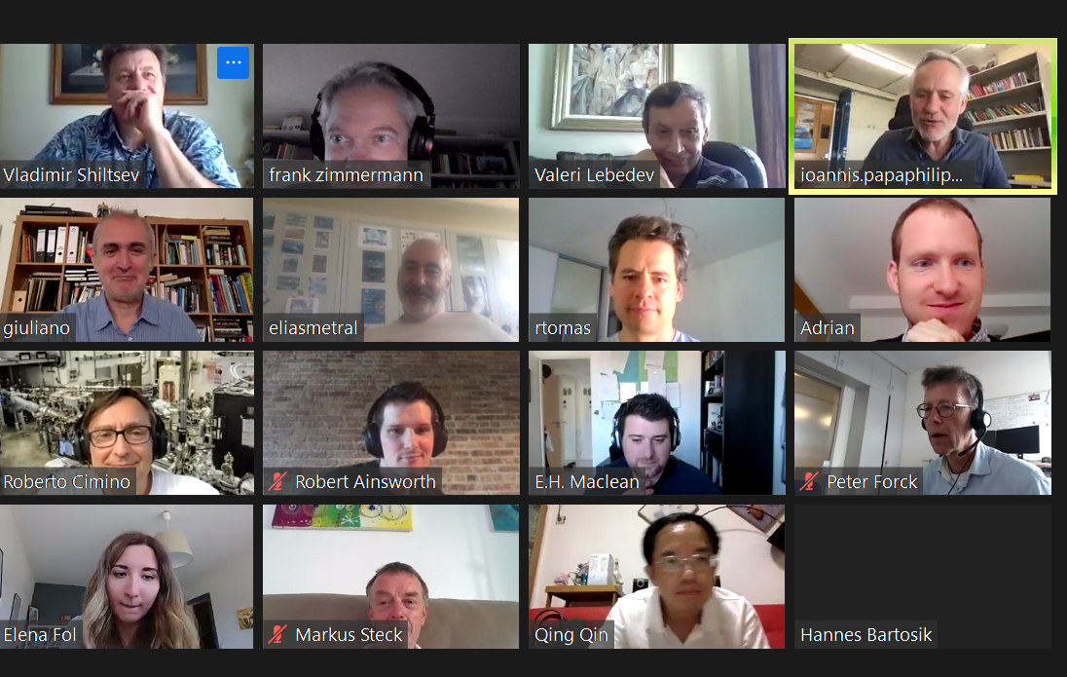
ARIES Mitigations workshop & Ranking for Space Charge Effects
ARIES MS31
Summer 2020
J-PARC Main Ring (MR) Fast Extraction (FX) operation: 1) Injection beam optimization with the Rapid Cycling Synchrotron (RCS) parameters; 2) RF operation with 2nd harmonic and the new feedback system; 3) Correction of the beta modulation and resonances; 4) Transverse instabilities suppressed with chromaticity settings & intra-bunch feedback systems.
CSNS project - main strategies: tune optimization & proper injection scheme. Present limits are pushed through: 1) Installing trim quadrupoles to shape the tune curves; 2) Installing AC sextupoles to control the coherent oscillations; 2) Re-installing injection components to realize the real correlated painting scheme; 3) Re-sorting the dipoles according to the magnetic field measurement in AC mode
FNAL PIP II | Driving forces | Near Term Mitigations | PIP-II Era Mitigations
Emittance growth at injection | Space charge | Resonance (1/2) compens. | Higher inj. energy; Painting inj; Two-stage collimation
Longitudinal losses at inj. | Adiab. Capt. ; Field stability | LLRF Upgr. ; Improved field stab. | Direct bucket injection w. chopping
Loss during transition | Instabilities; Emittance growth at inj. | Damper upgrades | Increased transition rate Reduced leakage
Extraction losses | Vert. Ap. restriction |  | Magnets w. larger aperture in ext. region
GSI: UNILAC upgrade measures: high intensity RFQ, heavy ion stripping, end-to-end optimization, etc.;
SIS18: intensity limitation mechanism: dynamic vacuum, other beam instability mechanisms, etc; mitigation: feedbacks.
Storage rings: precision beam controls.
For RHIC and EIC- some unique techniques: 1) bright sources (high-intensity H-, polarized H-, laser+EBIS); 2) orbit/tune/coupling/ (chromaticity) feedbacks on ramps/in stores, transitions jumps (in AGS, and in RHIC – a slowly ramping SC machine); 3) beam-beam compensation with electron lenses. Importantly, beam cooling fundamentally changes how RHIC is operated. Two cooling systems are operational (stochastic cooling for high-energy ions; electron cooling for low-energy Au), leading to much higher luminosity and cleaner operating conditions. A novel strong hadron beam cooling scheme.

Slide 13
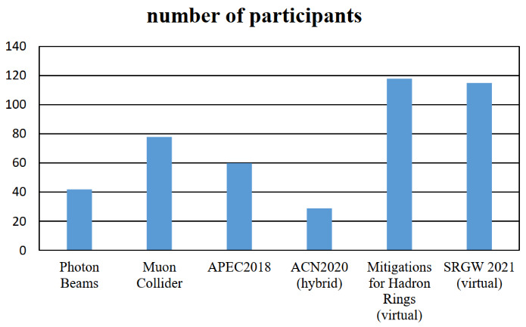
final community survey on (far)-future options
The survey invitation was sent to 388 different participants from six ARIES exploratory workshops. In total 94 experts responded.
(Far-)Future Options for Survey
1. Energy Recovery ( >50 GeV and/or > 50 mA)
2. Plasma Acceleration
3. Photon Collider
4. Gamma Factory
5. Muon Collider, positron based
6. Muon Collider, proton based
7. Crystal/Nanostructure Acceleration
8. Crystal Bending
9. Crystalline Beams
10. Gravitational Wave Detection using Storage Rings
11. Gravitational Wave Generation using Accelerators
12. High Energy Photon Generation using Entanglement and Moessbauer Effect
13. Non-electromagnetic acceleration or focusing mechanisms incl. gravity based schemes
ARIES survey criteria & choices
Feasibility | Importance/ Priority | Risk of Failure | Potential Return to Society | Time scale | Numeric ranking
Easy | Marginal | None | Negative | Next 5 years | 1
Reachable | Relevant | Moderate | Marginal | Next 10 years | 2
Difficult | High | High | Moderate | Next 20 years | 3
Technically hard | Very high | Certain ! | Strong | Next 40 years | 4
Very challenging | Top |  | Game Changer ! | Next 100 years | 5
Impossible |  |  |  |  | 6
April 2021

Slide 14
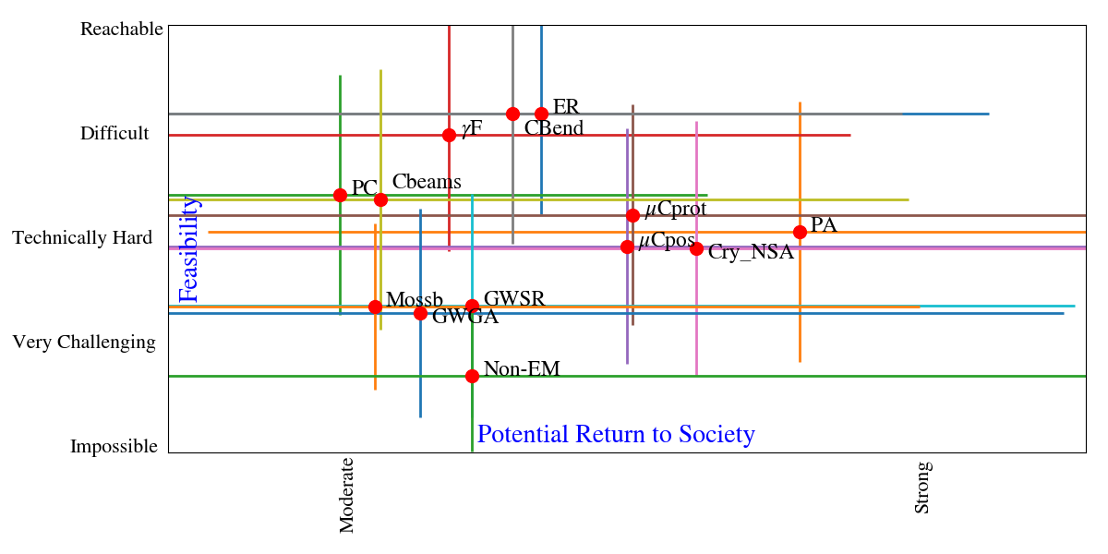
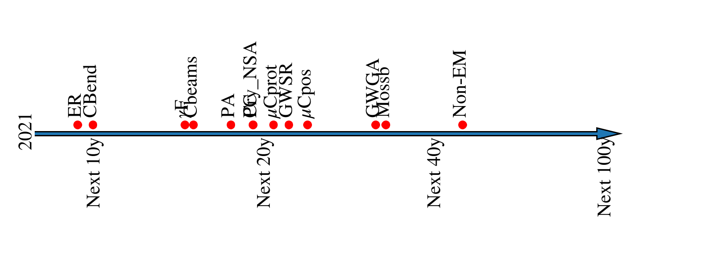
survey results - example
April 2021
Expected realization time scale
ARIES D6.5

Slide 15
White List of Ranked Far-Future Accelerator Options
April 2021
ARIES D6.5
Time scale | Priority and focus
10-15 years | Energy recovery Crystal bending Gamma Factory
15-30 years | Proton based muon collider Plasma acceleration Positron based muon collider Crystal and nanostructure acceleration Gravitational wave detection using storage rings
 | Low or no priority
 | Photon collider Crystalline beams “Moessbauer acceleration” using photon entanglement Gravitational wave generation using accelerators Non-electromagnetic acceleration or focusing mechanisms

Slide 16
key results from WP6 APEC
Reviving and advancing the designs of a muon collider, either proton based or positron based ; this will be pursued in I.FAST, through a dedicated working group and/or European R&D panel, and the US Snowmass process
Launching discussions on using storage rings & accelerator technologies for detection or generation of grav. waves, which may gather significant momentum in the coming years, and already stimulated concrete plans for experiment in LHC access shaft
Cementing the case for energy-recovery based colliders and ERL-based FELs, with input to the ESU19/20 process, & establishment of ERL R&D guidelines [D6.4]. The WP6 results also inform the R&D program for the PERLE test facility at IJClab and other European ERL projects (MESA, BerlinPRO, DIANA,…), and the special LDG ERL R&D Panel.
Design, feasibility demonstration and possible operation modes for proposed Gamma Factory, incl. as driver for subcritical reactor & waste transmutation
Preparing future R&D paths for the application of bent crystals (now in HL-LHC collimation baseline) & for crystal/nanostructure acceleration
Optimal RAMS characteristics for accelerators [D6.2]
availability critical systems and availability model (FCC-ee); measures to improve reliability of key systems, modelling platform (FCC-hh); open data infrastructure for accelerator reliability
Performance limitations in hadron synchrotrons [D6.1] highlighting beam loss, single-bunch instabilities & nonlinearities; review & ranking of mitigations [MS31, D6.3]
Ranking of (far-)future accelerator options [D6.5] priority for (1) ERLs, crystal bending, GF, (2) muon collider(s), plasma & crystal & nanostr. Accel., grav. wave detection
Broad scientific and social impact
WP6 results already widely disseminated –
through articles in scientific journals, CERN Courier, CERN EP Newsletter, Accelerating News, ICFA BD Newsletter / JINST, Zenodo, arXiv, CDS, US Snowmass effort , etc.
inspired new developments and opportunities around the globe (Germany, Italy, Taiwan, US, China,…)

Slide 17
WP6 potential impact on science or society
benefit to science:
defining new directions in accelerator science (muon colliders, crystalline beams, Gamma Factory, ERLs & ERL-based FELs…)
focusing the attention of the community on certain key aspects, which will enable designing future accelerators for new discoveries, while optimizing existing machines; in particular
  - sparked an interest in using storage rings and accelerator technologies for gravitational-wave research
  advanced several studies on the high-precision operation of accelerators and beam diagnostics
  more direct benefit to society:
- controlling beam delivery and rendering accelerator operation more reliable
- emerging methodologies will eventually be transferred to all types of accelerator applications, including for industrial and medical applications

Slide 18
WP6 exploitable foregrounds
Type of exploitation foreground | Description of exploitable foreground ( relevant deliverable) | Purpose (How the foreground might be exploited and by whom) | Potential/expected impact (quantify where possible) | Exploitable product(s) or measure(s) | Sector(s) of application | Timetable, commercial or any other use
GAK, EUP, SIN | Assessment and ranking of far-future accelerator options | Exploited and pursued in I.FAST, and in parallel by the European Accelerator Expert Panels set up by CERN Council and LDG, by the EPS-AG strategy discussions, and by the US Snowmass process | Guidance & prioritization of accelerator R&D over the coming decades. Input to expert panels and the next ESU process. | Published white list of far-future options | Accelerators, particle physics, and nuclear physics, photon sciences, gravitational physics | Medium & long 5-30 years
GAK, EUP, SIN | Improved Reliability and Availability of Particle Accelerators | Exploited, applied and pursued for improving accelerator operation, and in the design of future accelerators; shared use of ARIS system | Enhanced availability and reliability of future colliders, medical accelerators, light sources, and accelerator-driven systems | Report; reliability models, newly cross-linked communities, ARIS PoC | HEP accelerators, ADS, photon sciences, nuclear science, medical accelerators | Short & medium, 0-10 years
GAK, EUP | Revival and advanced designs of muon colliders | Exploited and pursued in I.FAST, and in parallel by the European Accelerator Expert Panels set up by CERN Council and LDG, by the EPS-AG strategy discussions, and by the US Snowmass process | So far: Muon collider R&D supported by ESU 2020; muon collider design study launched; test facilities under discussion; Future: work towards CDR. | Dedicated workshop and deliverable, reports | Particle Physics, HEP Accelerators | Short & medium, CDR in 5 years
GAK, SIN | ERL R&D guidelines | Exploited and pursued in I.FAST, and by the European Accelerator Expert Panels set up by CERN Council and LDG, and, finally, the PERLE project | Realization of test facility PERLE; higher current ERLs | Report and database | Particle Physics, nuclear physics | Short & medium, within 5 years
GAK. EUP | Possibility of detecting gravitational waves at storage rings or using accelerator technologies | Exploited and pursued in I.FAST, and by the AEON/AEDGE collaboration developing an experiment based on the LHC infrastructure | “Accelerator experiments” on novel ways to detect gravitational waves and over extended frequency scales; newly formed collaboratiosn across communities | Reports | Gravitational wave physics, accelerators, particle physics | Short & medium & long, 0-30 years
GAK, EUP, SIN | “Gamma Factory” option | Exploited and pursued by the PBC effort at CERN, with staged beam experiments at the SPS and LHC | Gamma factory based on partially stripped heavy ion beams in the LHC, with numerous applications | Reports | Particle physics, nuclear physics, material sciences, power generation | Medium, 5-10 years
GAK, EUP | Novel options for extremely high-gradient acceleration: crystals and nanostructures | Exploited and pursued in I.FAST, in te US Snowmass process, and by a global collaboration | Ultracompact accelerators with accelerating gradients > 1 TV/m | Reports | All types of accelerator applications, incl. medical accelerators | Long, 15-30 years
WP6 objectives and results highly relevant - WP6 initiated and guided numerous novel science developments of high breakthrough potential

Slide 19
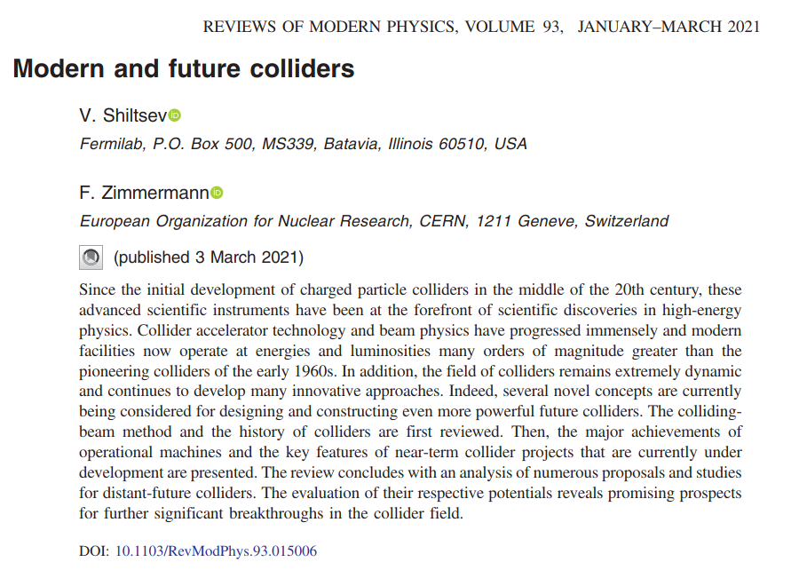
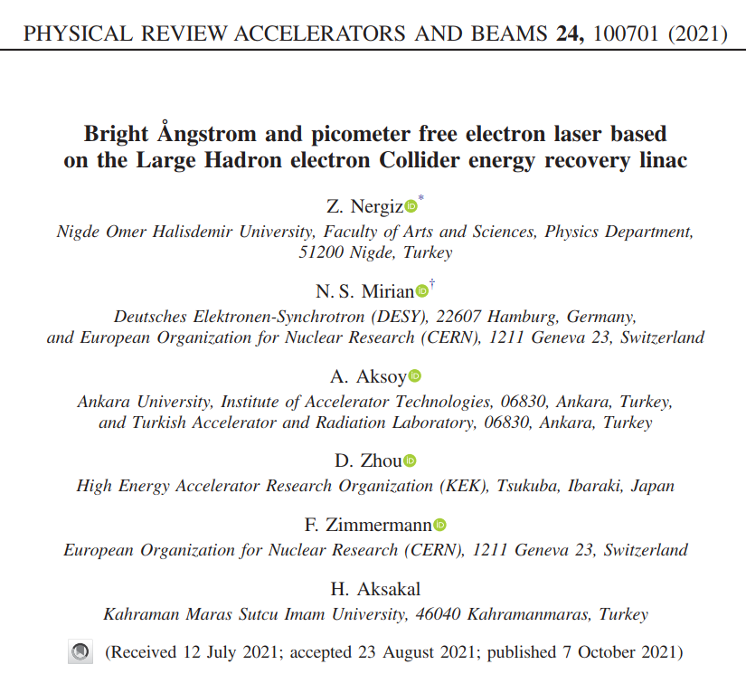
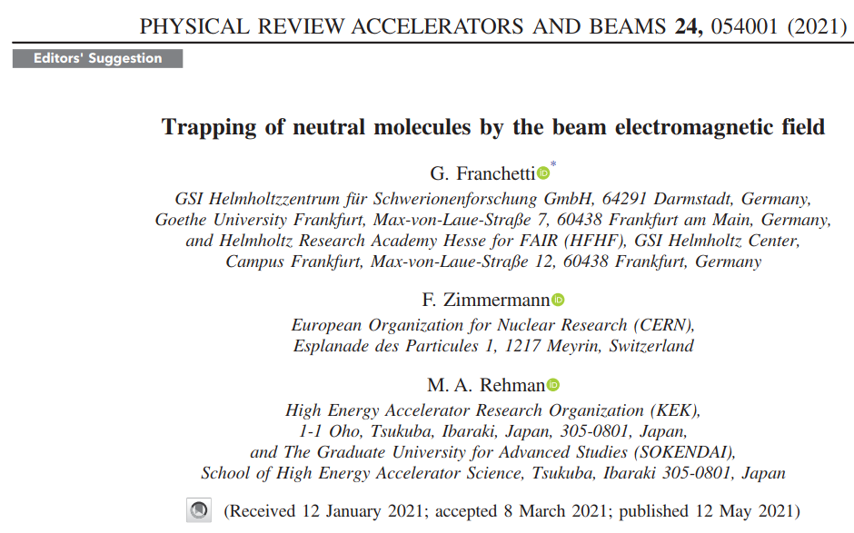
WP6 publications
> 60 articles including, in 2021 (all with ARIES acknowledgement)
*collaboration enabled by ARIES
V. Shiltsev and F. Zimmermann, “ Modern and future colliders,” Rev. Mod. Phys. 93, 015006 (2021) https://journals.aps.org/rmp/abstract/10.1103/RevModPhys.93.015006
G. Franchetti, F. Zimmermann, and M. A. Rehman*, “Trapping of neutral molecules by the beam electromagnetic field,” Phys. Rev. Accel. Beams 24, 054001 https://journals.aps.org/prab/abstract/10.1103/PhysRevAccelBeams.24.054001
Z. Nergiz, N.S. Mirian*, A. Aksoy, D. Zhou, F. Zimmermann, H. Aksakal, “Bright Angstrom and Picometre Free Electron Laser Based on the LHeC Energy Recovery Linac”, Phys. Rev. Accel. Beams 24, 100701 https://journals.aps.org/prab/abstract/10.1103/PhysRevAccelBeams.24.100701

Slide 20











WP6 - thank you !
all beneficiaries & partners of WP6 made important contributions, far exceeding original scope (despite covid-19 pandemic ! ); perfect integration within WP6 activities

