Slide 1
«Students for students»
General introduction

Slide 2
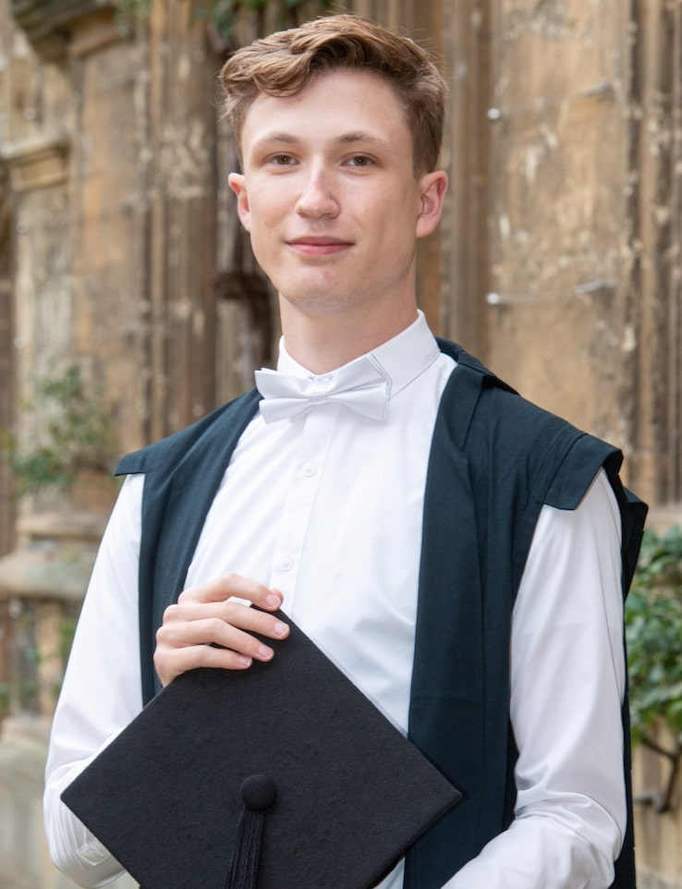
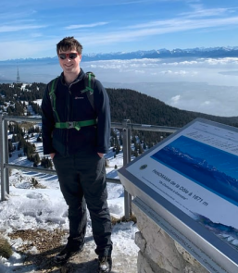
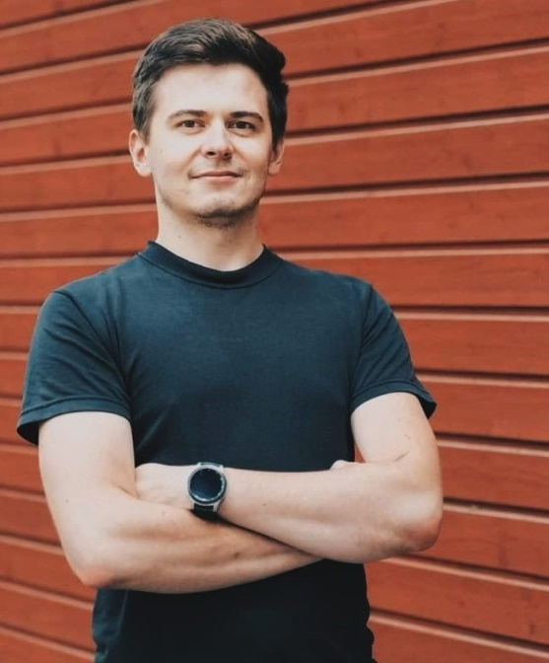
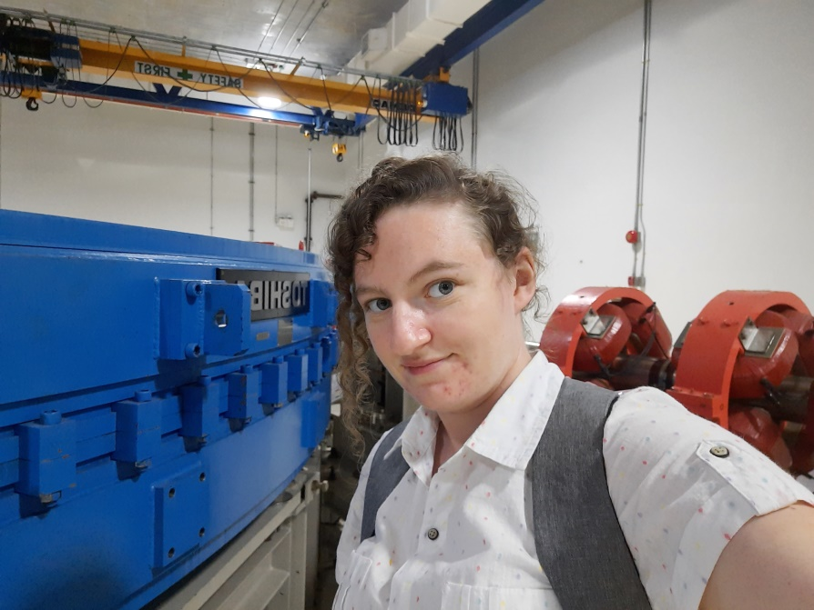
Meet US!
Joseph
CERN,
University of Oxford
Cameron
CERN,
University of Oxford
Kristaps
CERN,
Riga Technical university
Rebecca
CERN,
Imperial College London

Slide 3
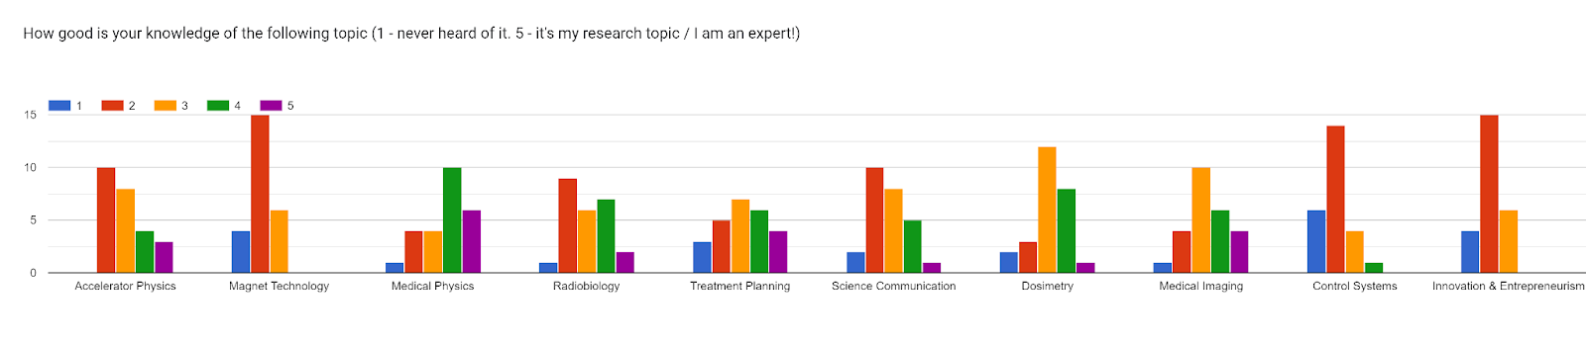
What about YOU?
Accelerator physics
Medical physics and treatment planning
Medical imaging
Radiobiology

Slide 4
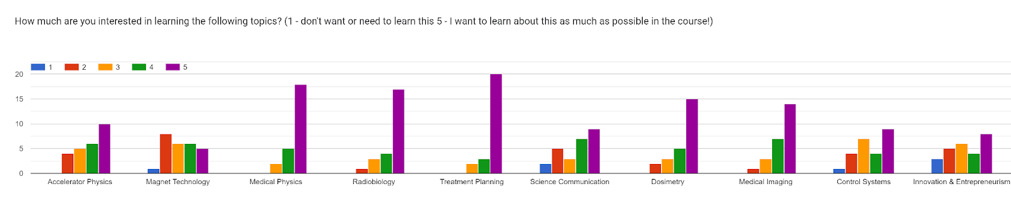
YOUR interests coming into the course
Medical physics and treatment planning
Medical imaging
Radiobiology
Dosimetry

Slide 5


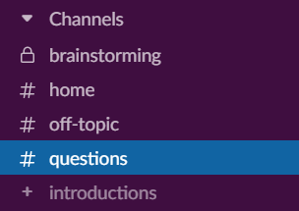
Questions for lecture sessions
I Raise «your hand» and unmute
II Type in the Zoom chat
III Type in Slack #questions

Slide 6
More information on Slack #questions
Reminder!
Link: https://join.slack.com/t/heavyiontherapy/shared_invite/zt-17njxrruf-sQF60JiZBJQMlWFeKVr5LQ
Don’t forget your #introductions ! :)
Information regarding Slack #questions
ASK QUESTIONS WHENEVER:
Question during the lecture?
We will deliver it to the lecturer on Zoom
Came up with a question before the lecture?
Put it in Slack and lecturer will hear it from us
A question came to your mind only after the lecture?
Write it in Slack and lecturer would answer it in Slack
FREELY DISCUSS LECTURES AND QUESTIONS AMONG YOURSELVES
Note!
We have noted your questions in entry Google Forms – they will reach the ears of our lecturers!
And do not forget #off-topic channel for lecture content unrelated discussions and socializing

Slide 7


Zoom culture
BUT
During the lecture
We would appreciate your cameras ON for more interactive lecture environment!
Not obligatory, of course!

Slide 8

What about coffee breaks and lunch breaks?
We wanted to give you an online experience as close to reality as possible!
https://spatial.chat/s/IonTherapyCourse
Every day:
15 minute coffe break at 11 AM
45 minute lunch break ~ 1:15 PM
We will be welcoming you within the informal SpatialChat room!

Slide 9
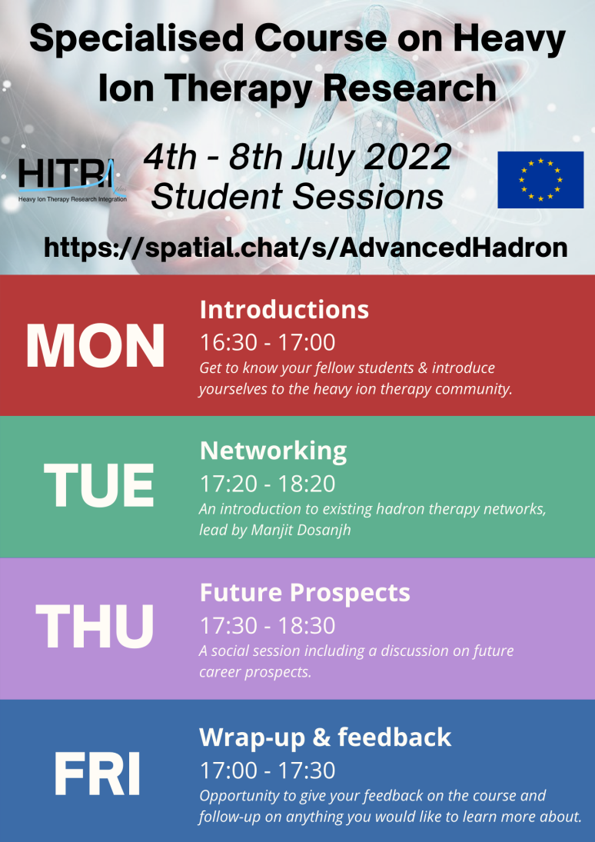
Evening student sessions
Every evening we will be welcoming you, students, in the SpatialChat rooms for dedicated student sessions for networking and discussions on global hadron therapy networks and future opportunities in the field!
And.. SpatialChat is always open for you, if you want to discuss among yourselves!

Slide 10
And one last thing …
As already mentioned in entry Google Forms – we offer you the opportunity to take part in Thursday’s student case study discussion session
«Beams and Dreams»
Tell the others of your research topic!
Share an interesting project you or your group is working on!
Have a novel idea for a future project?
Let us know if you are willing to participate by contacting us in Slack or by e-mail!
WE ARE LIMITED TO A FEW SLOTS!
Policy: Covering as wide range of topics as possible

Slide 11
ENJOY THE LECTURES AND HAVE A WONDERFUL WEEK!

