Slide 1
Passive Piezo-resistive Gauges
for Insulation Vacuum

Slide 2
Overview
The different cases where piezo-resistive gauges are used
Low-radiation areas
High-radiation areas
Current gauge in high-radiation areas
Alternative passive gauges and their tests so far
Summary

Slide 3
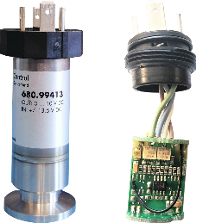
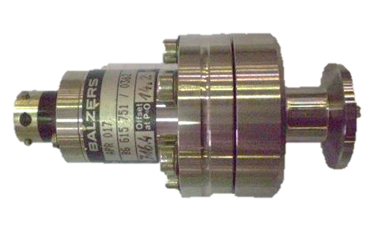
Piezo resistive cases based on LHC location
High-radiation areas
(1MGy HL lifetime)
Only passive gauges
Low-radiation areas
(500Gy HL lifetime)
Active RadTol gauges
LSS
DS
ARC
Balzers APR017
x65 pcs
HUBA 680.99413
x168 pcs

Slide 4
Low-radiation areas

Slide 5
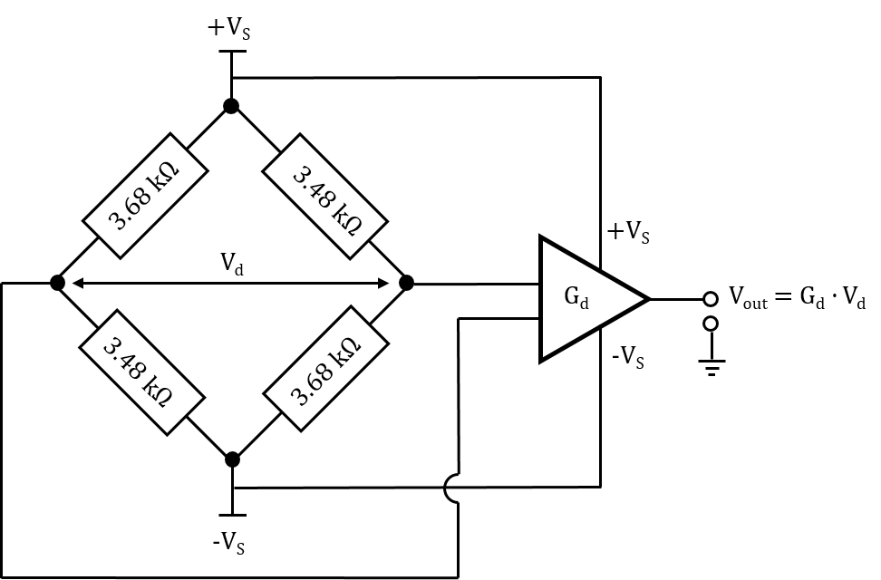

Huba 680.99413
Pressure type | Absolute
Measurement range | 0 - 1.6 bar
Overpressure | 5 bar
Process connection | KF16 DIN 28403
Electrical connection | DIN EN 175301-803- A
Output signal | 0 – 10 V
Bridge excitation | ± 13.5 VDC
Linearity | < ± 0.25 % FS
Temperature range | 0 - 70°C
Seals | ??
168 already installed in low radiation areas
  LHC DS + ARC for IV measurement
Provides 0-10V for 0-1600mbar
  Requires +/-13.5VDC power supplies
Required radiation tolerance of 500Gy
  2.5x higher than expected HL-LHC level in the DS
  10x higher than expected HL-LHC level in the ARC
Only one active component inside
  Differential amplifier MC33178
Tested at:
  CC60 up to 2.4kGy
  CHARM up to 500Gy

Slide 6
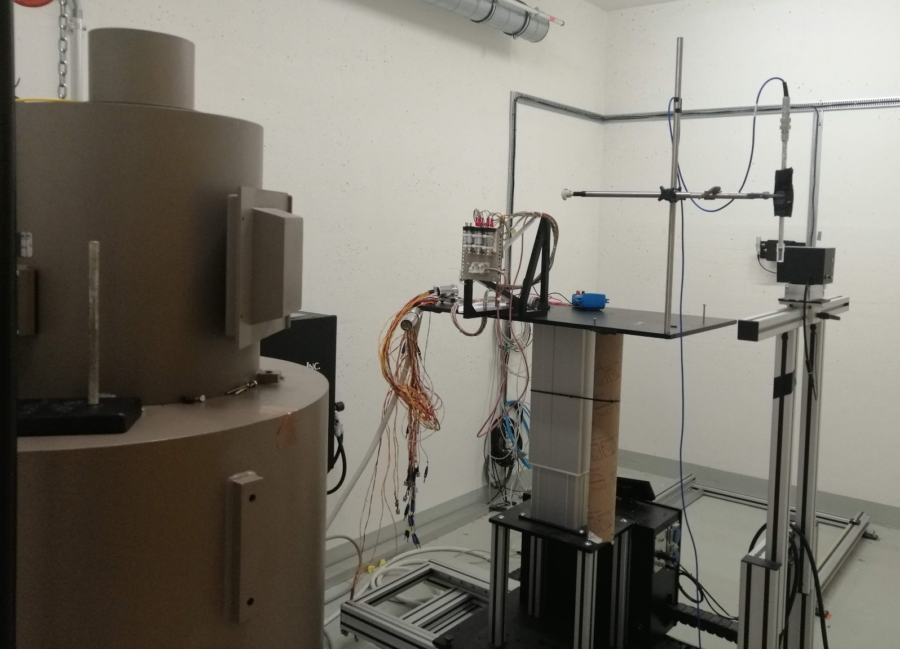
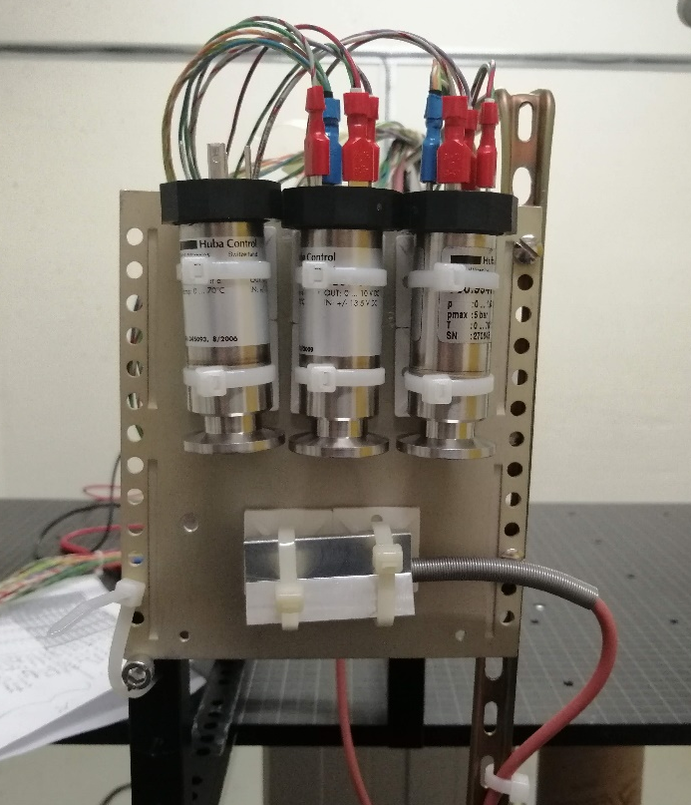
Huba 680.99413 irradiation at CC60

Slide 7
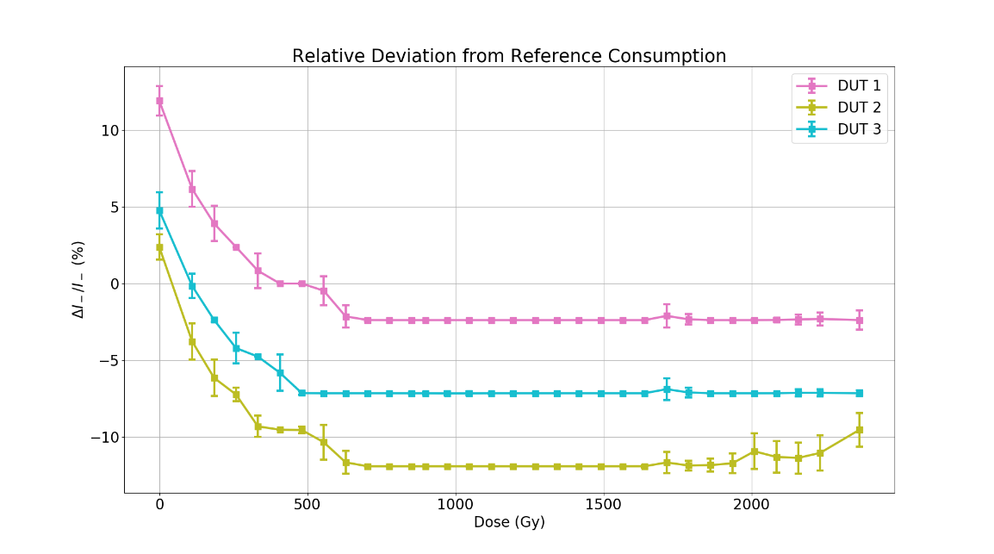
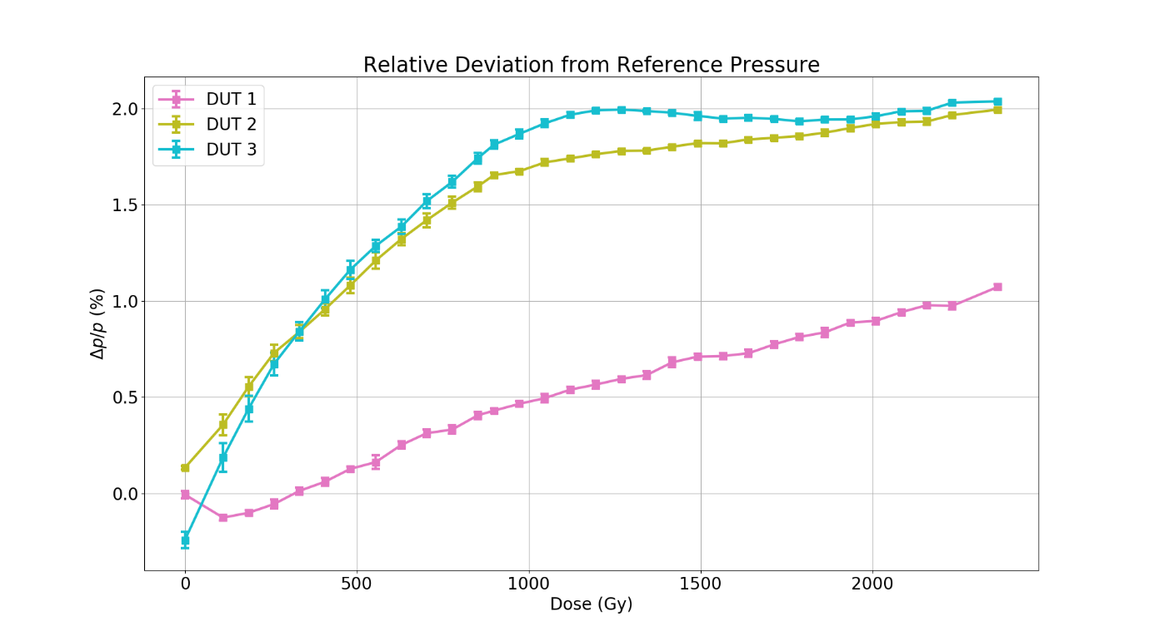
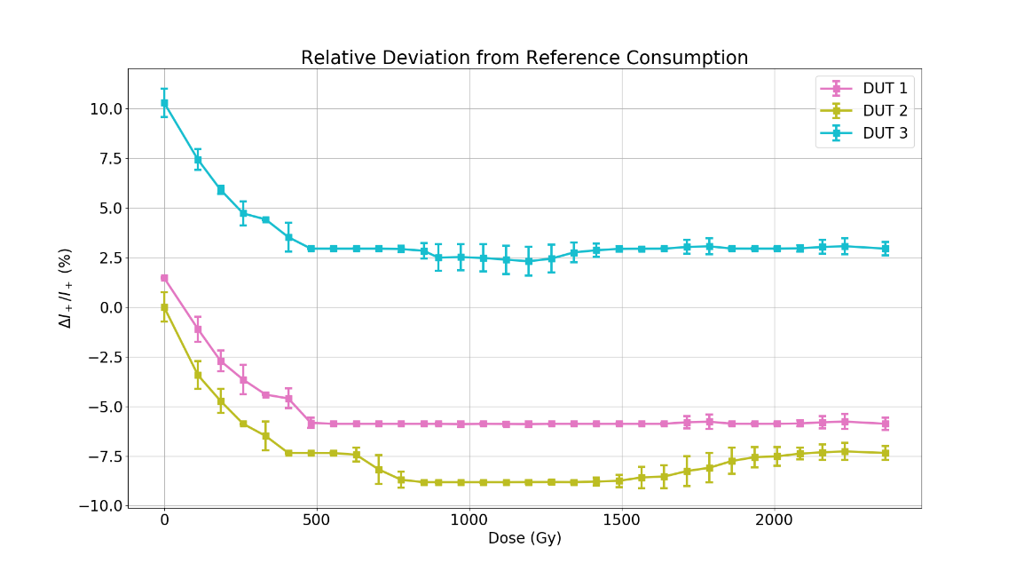
Huba 680.99413 irradiation at CC60
Negative rail
Successfully accumulated 2.4kGy with gamma
<2.5% error at 2.4kGy
<1.5% of error at 500Gy
Active Piezo-Resistive Gauges in the gamma field of CC60 EDMS 2149211
Positive rail

Slide 8
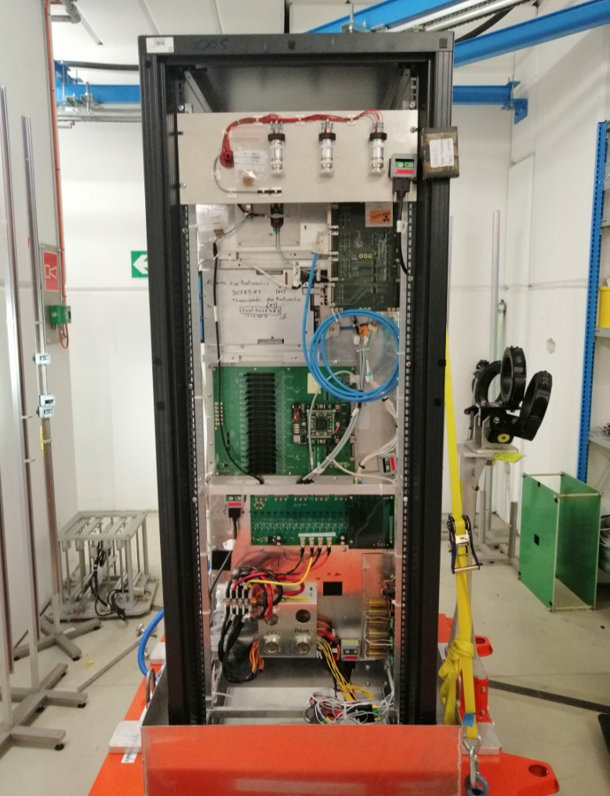
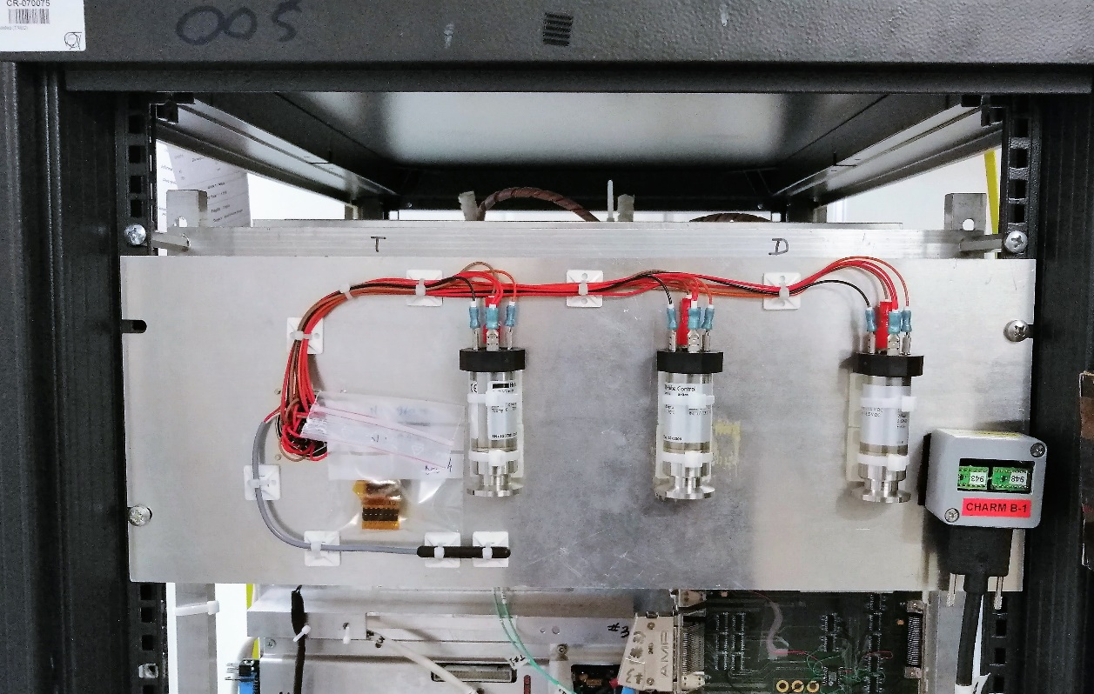
Huba 680.99413 irradiation at CHARM

Slide 9
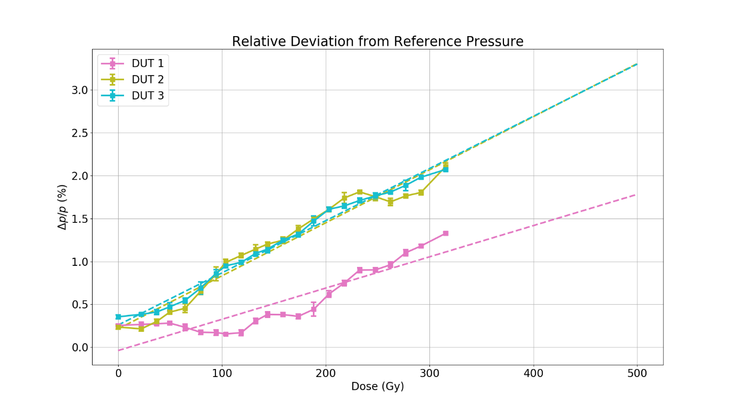
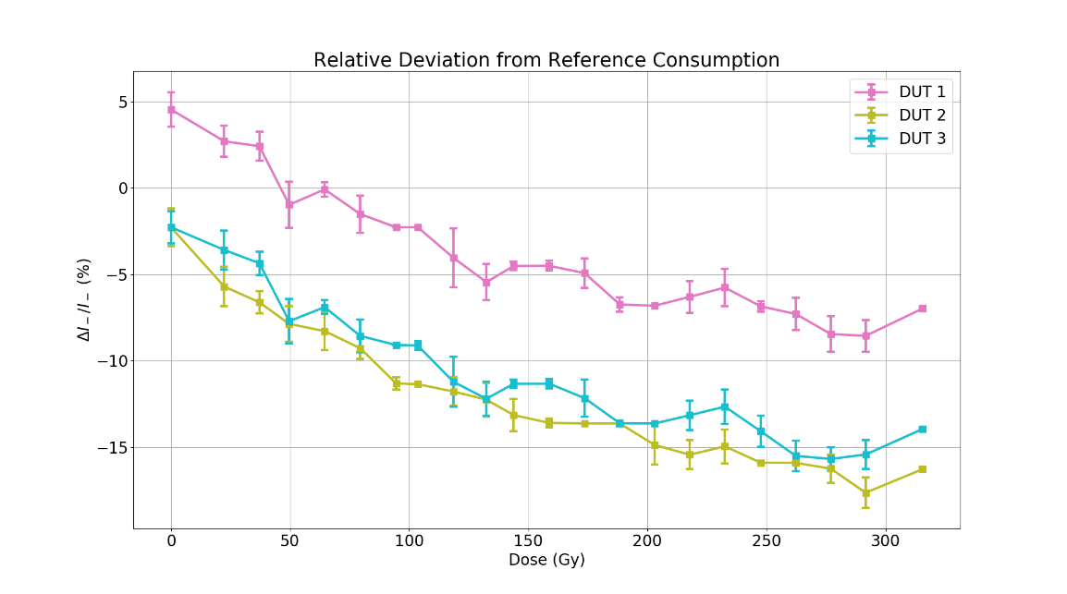
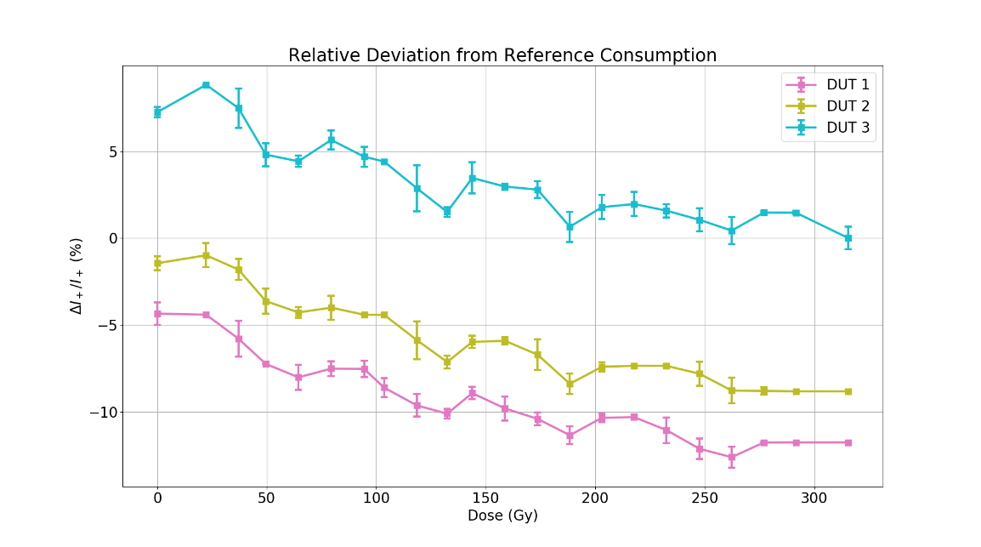
Huba 680.99413 irradiation at CHARM
Negative rail
Successfully accumulated 315Gy with mixed fields
<2.2% of error at 315Gy
<3.5% of error at 500Gy (extrapolation)
Active Piezo-Resistive Gauges in the Mixed Filed of CHARM EDMS 2149211
Positive rail

Slide 10
High-radiation areas

Slide 11
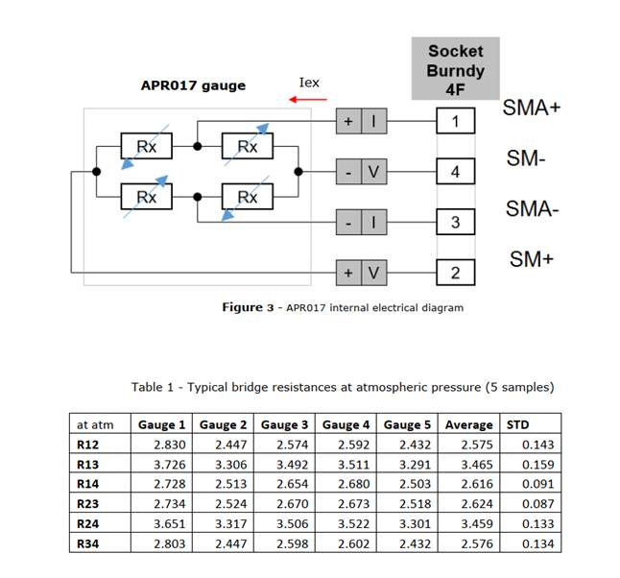
Current gauge in LSS – Balzers APR017
65 already installed in high radiation areas
  LHC LSS for IV measurement
Provides 0-600 mV for 0-2000 mbar
  Requires +4mA current excitation
Required radiation tolerance of max 1MGy
  Never tested (not to our knowledge)
Not manufactured any more:
  Spares for LHC operation
  HL-LHC needs (32 units in addition)

Slide 12
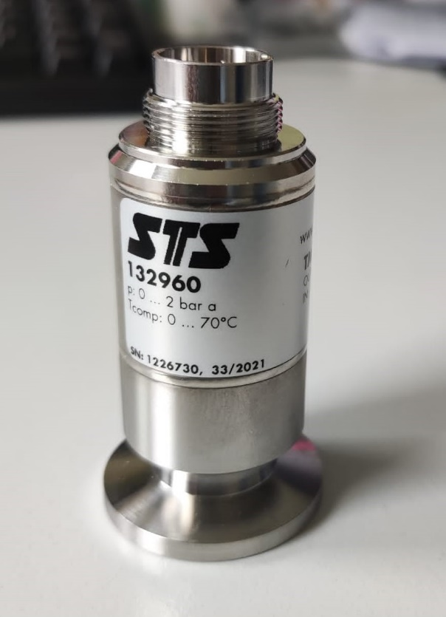
STS TM series to replace Balzers APR017
Pressure type | Absolute
Measurement range | 0-2 bar
Overpressure | 6 bar
Process connection | KF16 DIN 28403
Electrical connection | Binder 723, 5-Pts
Output signal | 0 – 50 mV
Bridge excitation | 10V DC / 1mA DC
Accuracy | <±0.5 % FS
Temperature range | 0 - 70°C
Seals | EPDM

Slide 13
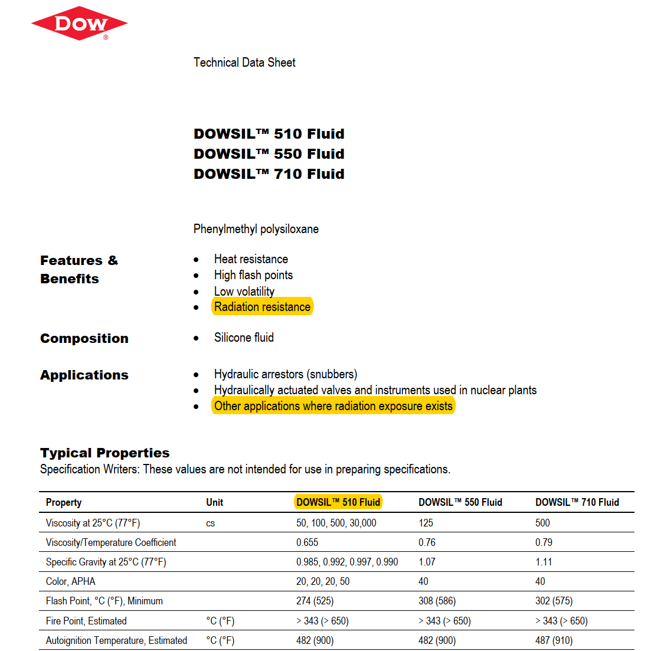
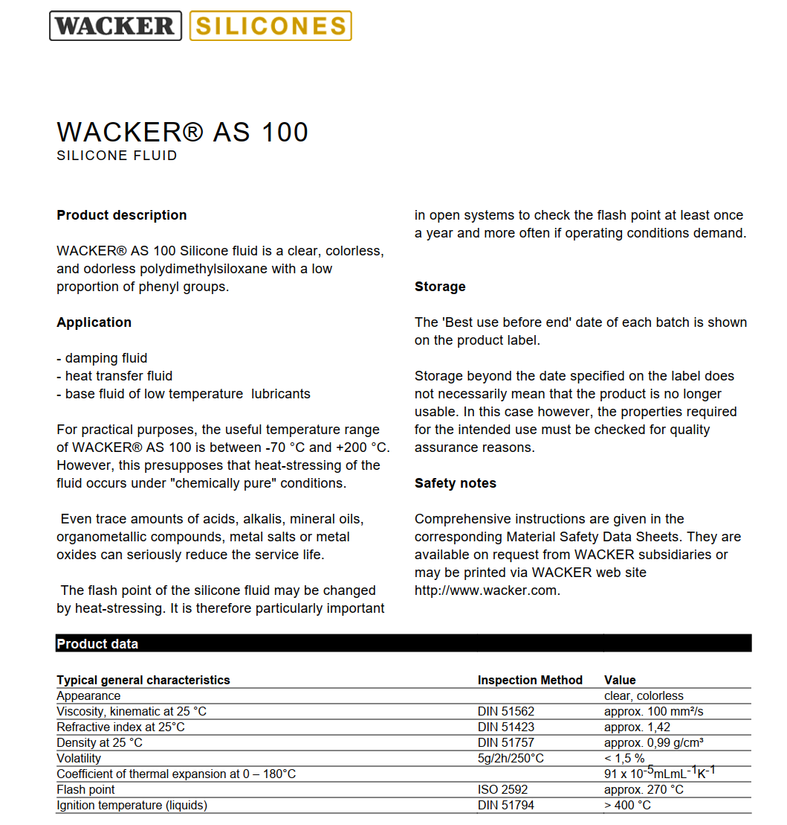
Oil surrounding the STS TM series
Proposal for radiation resistant oil
Tested by ITER (awaiting for the results)
https://www.stssensors.com/blog/2020/06/30/electronic-pressure-measurement-comparison-of-common-measuring-principles/
Standard oil
Increase of unit price by a factor 10!
Unit price 3500 CHF
Unit price 350 CHF

Slide 14
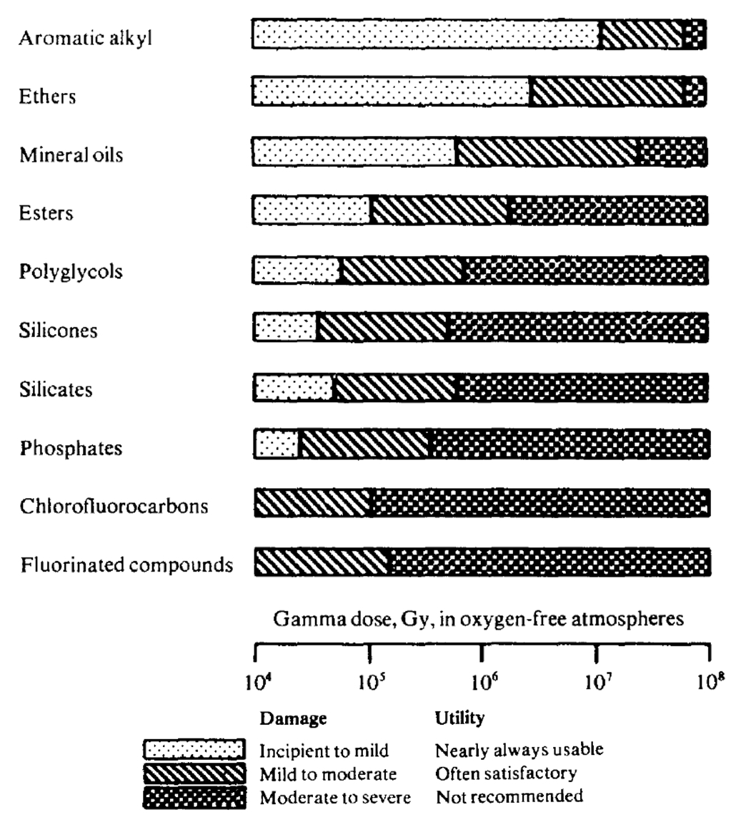

Slide 15
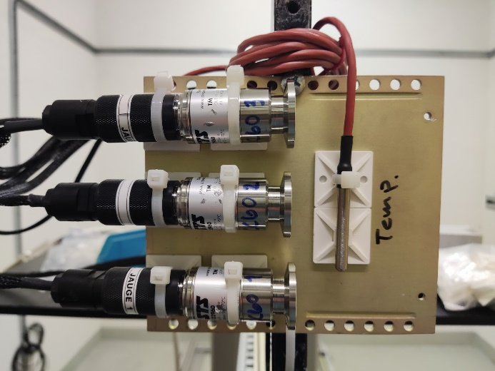
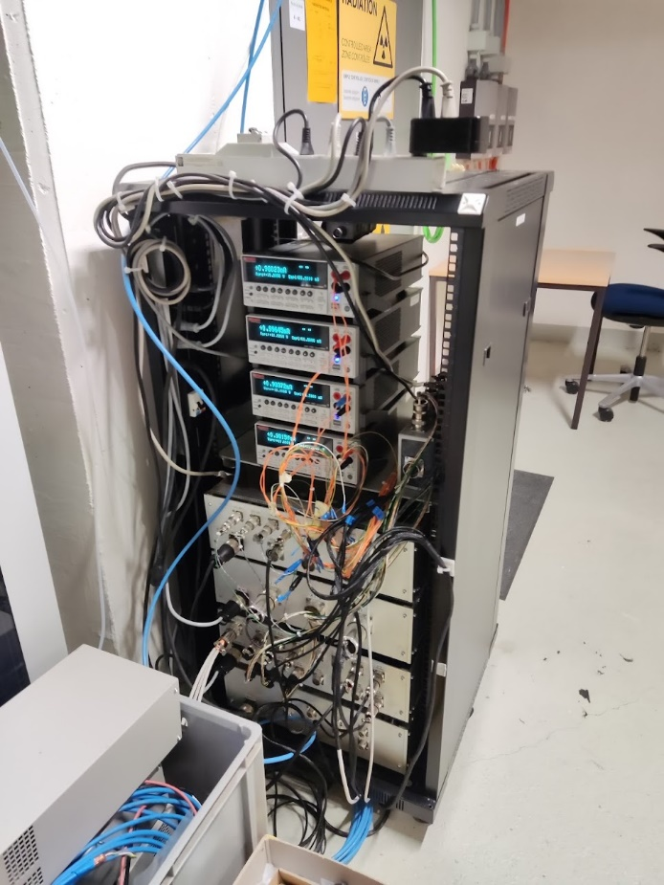
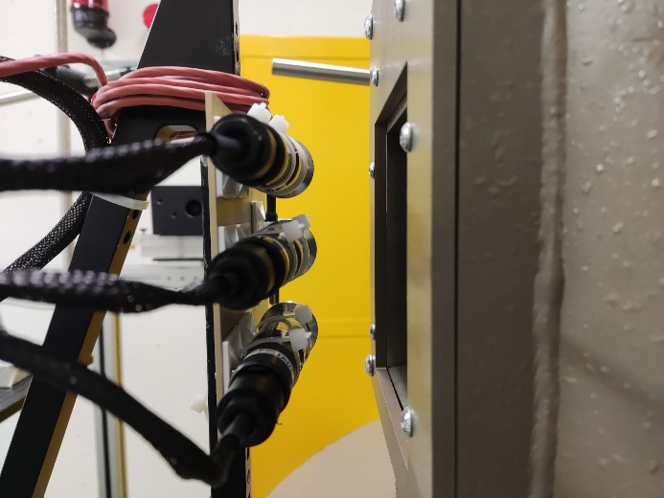
Irradiation at CC60
Potential radiation sensitive elements
  Seals (EPDM)
  Piezo-resistive element
    silicon diaphragm
  Oil surrounding the piezo-resistive element
    silicone-based oil
Active CC60 irradiation
  Pre/Post-irradiation characterization
  Pre/Post-irradiation leak test
  Active irradiation at atmospheric pressure
  1 reference gauge, 3 irradiated samples
2 references tested
  Voltage bridge excitation (STS TM-132960)
    up to 90kGy
  Current bridge excitation (STS TM-133427)
    up to 60kGy

Slide 16
STS TM-132960 (Voltage excitation): Leak detection
Gauges | Pre-irradiation [mbar.l/s] | Post-irradiation [mbar.l/s] | Delta %
V - Reference | 3.2E-8 | 5.4E-8 | +69%
V - Sample 1 | 2.1E-8 | 5.1E-8 | +143%
V - Sample 2 | 1.0E-8 | 1.6E-7 | +1500%
V - Sample 3 | 3.0E-8 | 1.3E-7 | +333%

Slide 17
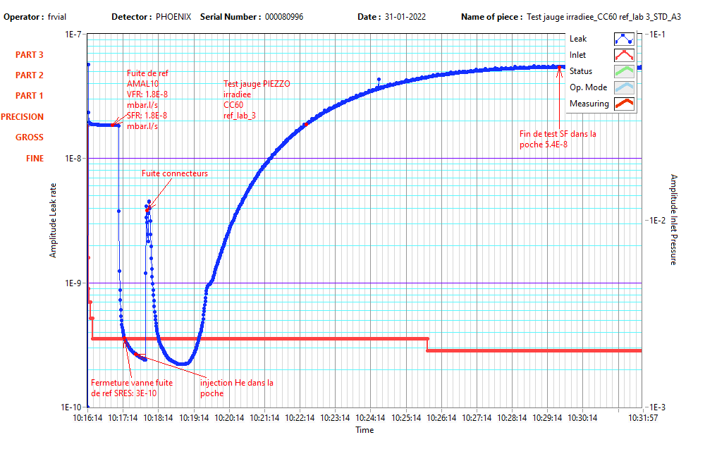
Leak detection clarification

Slide 18
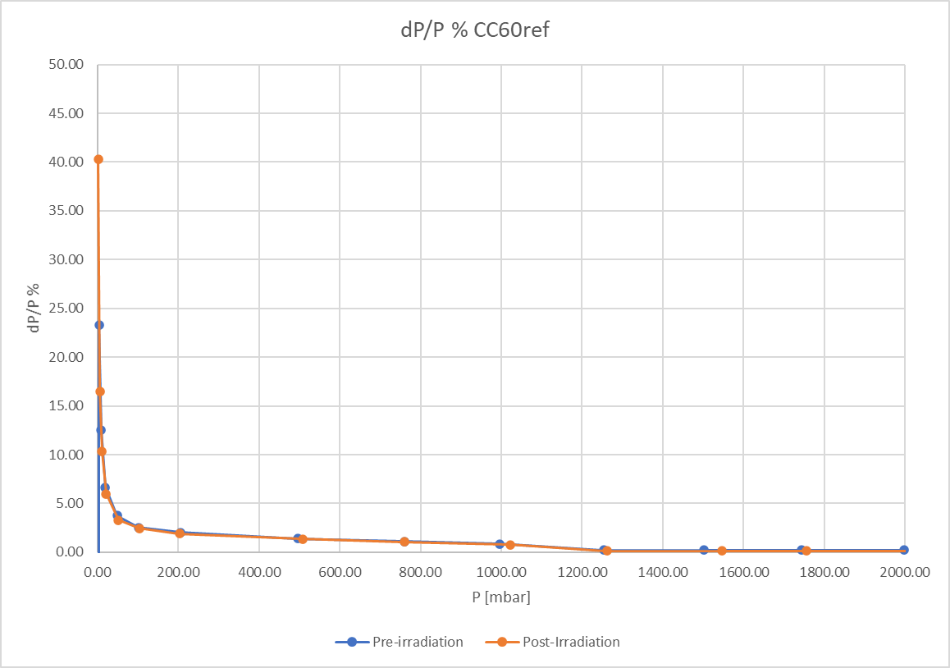
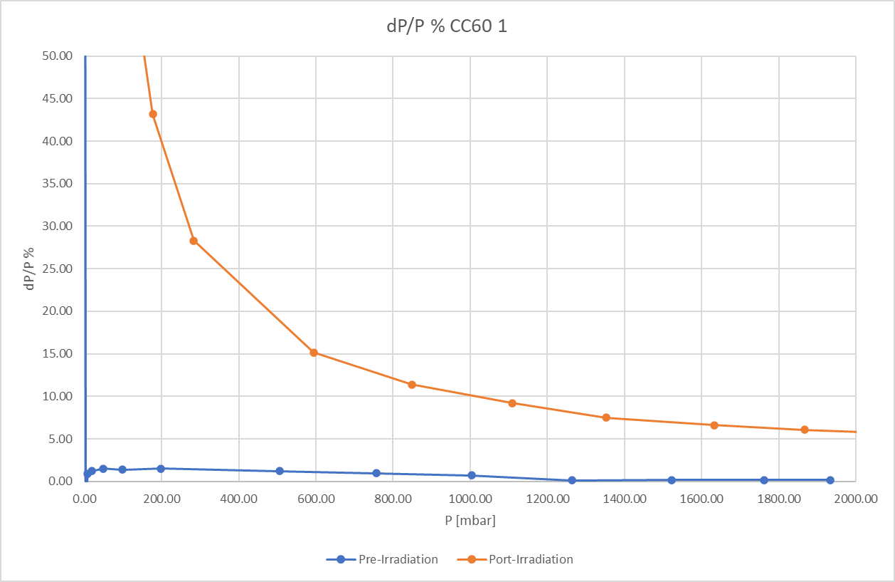
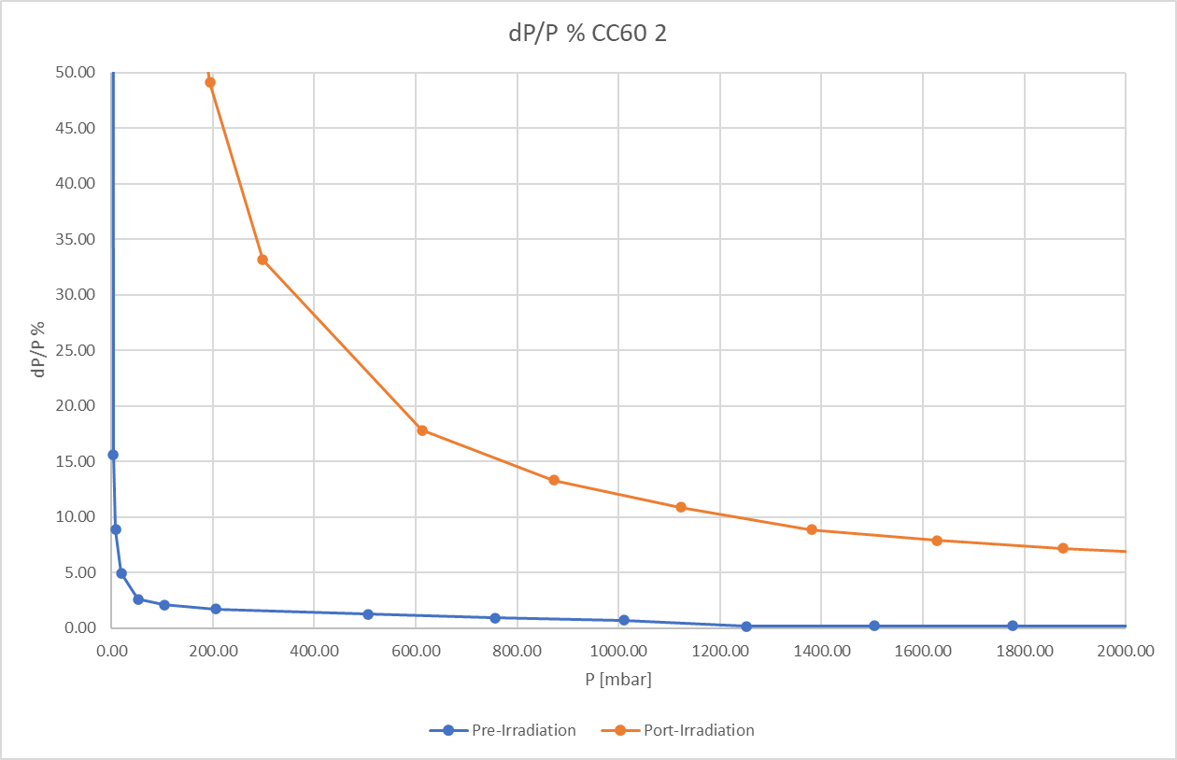
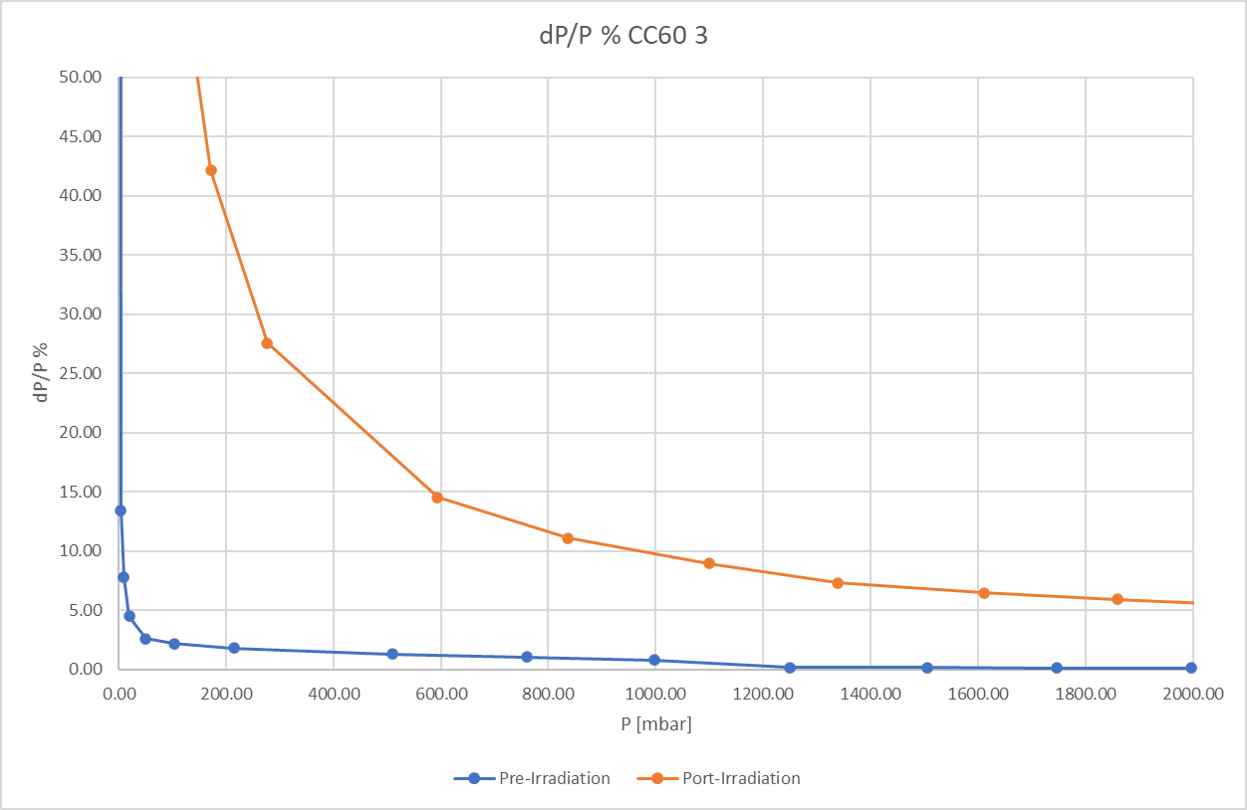
STS TM-132960 (Voltage excitation): Characterization

Slide 19
STS TM-133427 (Current excitation): Leak detection
Gauges | Pre-irradiation [mbar.l/s] | Post-irradiation [mbar.l/s]
C - Reference | 1.3E-7 | ?
C - Sample 1 | 9.2E-8 | ?
C - Sample 2 | 9.4E-8 | ?
C - Sample 3 | 1.2E-7 | ?

Slide 20
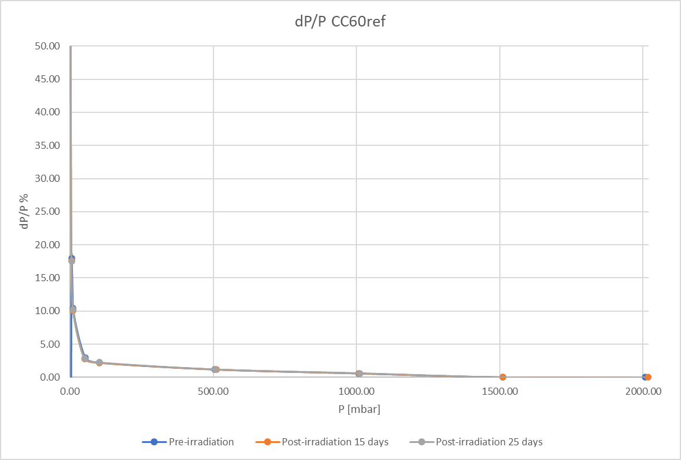
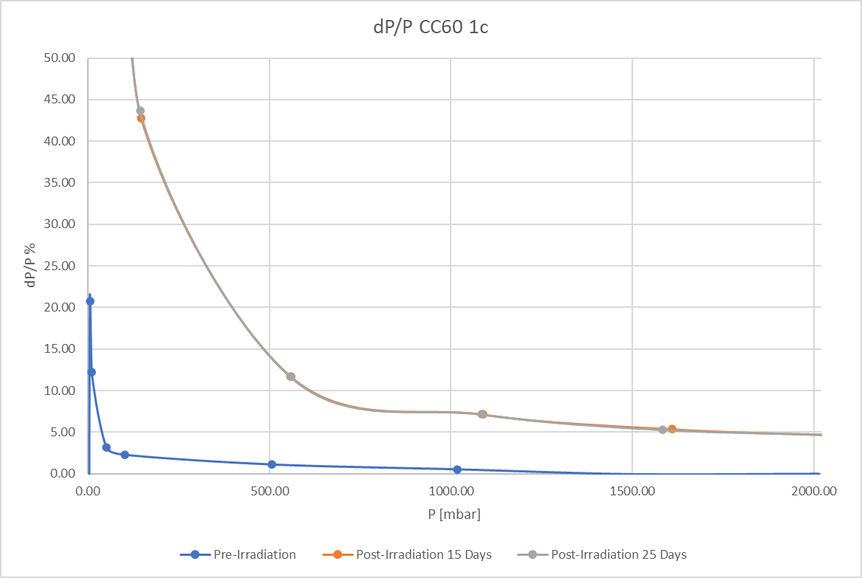
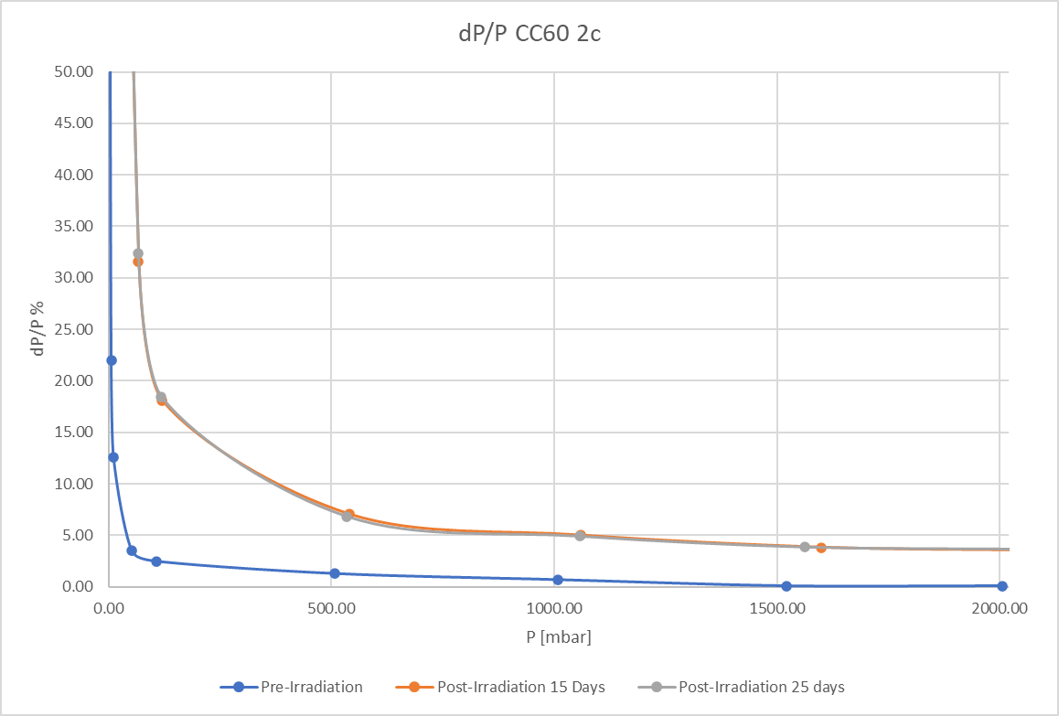
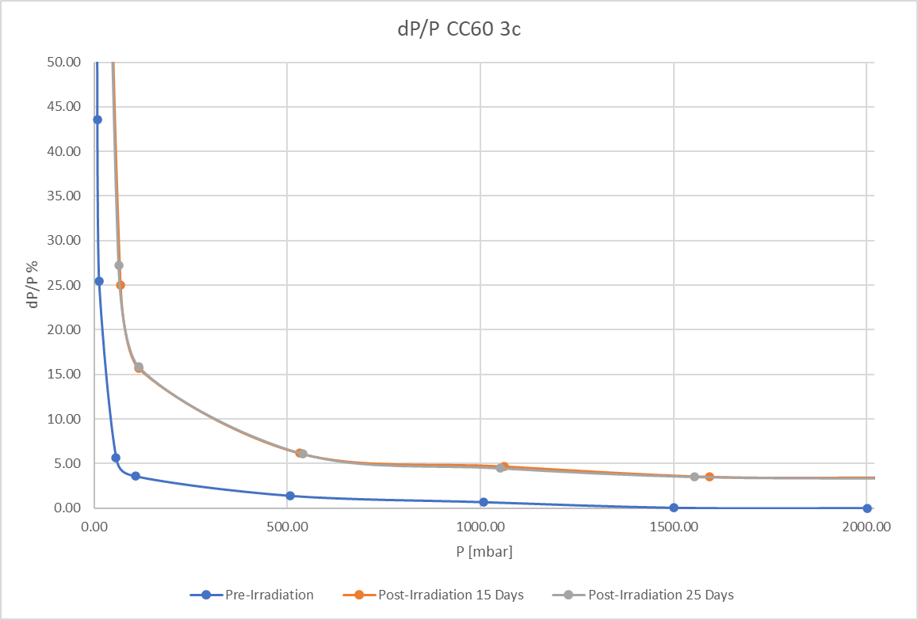
STS TM-133427 (Current excitation): Characterization

Slide 21
Irradiation at external facility – RADTEST company
Passive Gamma irradiation
  Pre/Post-irradiation characterization
  Pre/Post-irradiation leak test
  8 samples sent in total
    2 samples at 50kGy
    2 samples at 100kGy
    2 samples at 500kGy
    2 samples at 1MGy
Awaiting the samples to arrive at CERN
Test specifications EDMS 2621641

Slide 22
Summary
STS gauges seem to be a good candidate to replace APR017
  Preferred solution is with the current excitation (long cables, integration w/ existing electronics)
  Noticeable relative error already from 60kGy
  CC60 campaign data require further analysis (offset, gain linearity, error linearity wrt TID)
  Based on CC60 sample analysis some mitigation actions can be envisaged to maintain errors in tolerable margins
  Awaiting for post radiation leak rate tests of CC60 samples (Q2 2022)
  Awaiting for the post radiation tests from the samples irradiated externally (Q3 2022?)
Not many other options apart from STS
  Pfeiffer APR262 active gauge by removing the internal electronics

