Slide 1


Brazing discs and prototype review
Pedro Morales Sanchez
20/05/2022

Slide 2
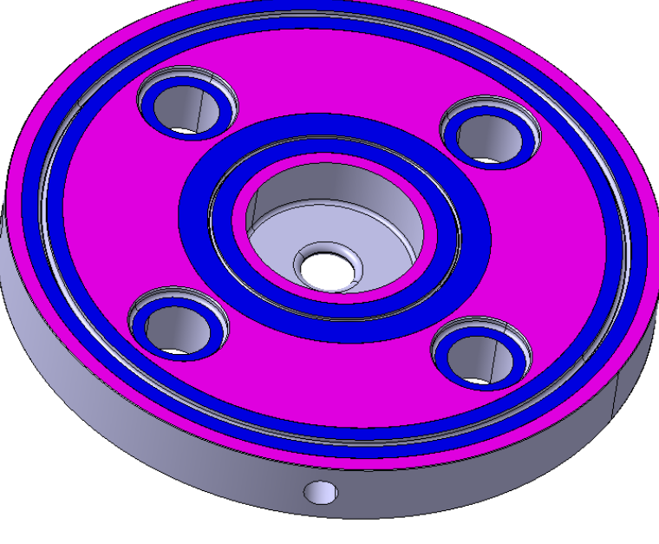
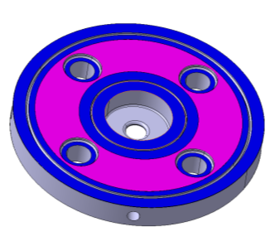
Test
T18VG1-DISK-11WDSDVG1
Ø0.5mm
Ø0.8mm
Gap | Ratio
0.03mm | 4.3/0.96
08/12/2021
Pedro M | Smartcell structure development

Slide 3
Programed tests
Different materials / temperatures / ratios / companies
Thanks to Bodycote and Fritz Motschmann for their collaborative approach to this project.

Slide 4

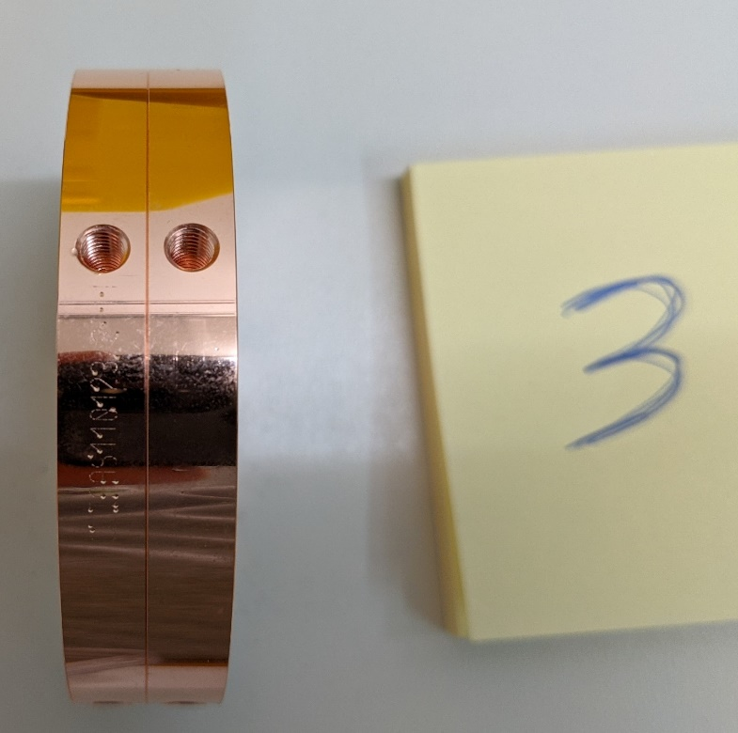
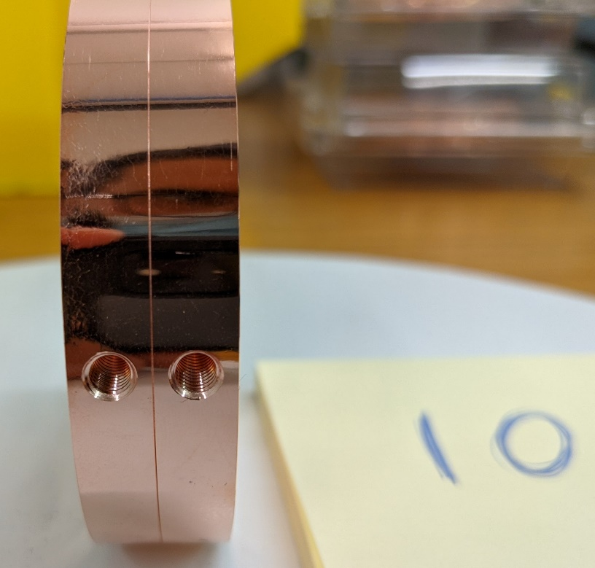
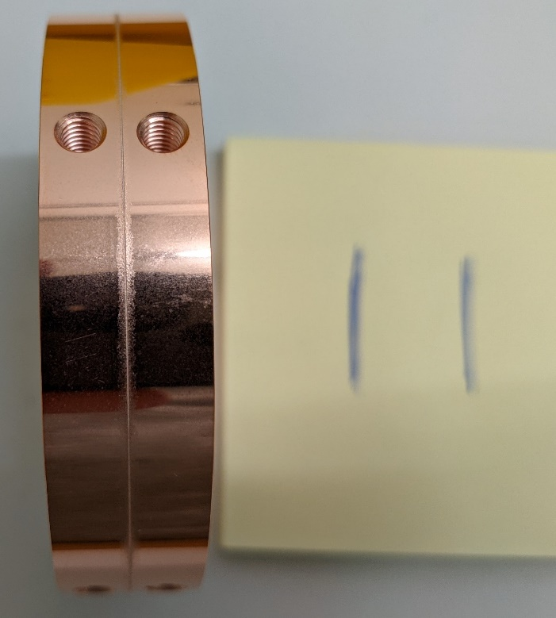
Visual inspection
No overflow
Diffusion
No remarkable problem

Slide 5
Leak test
Leak test OK of all parts after brazing cycle

Slide 6
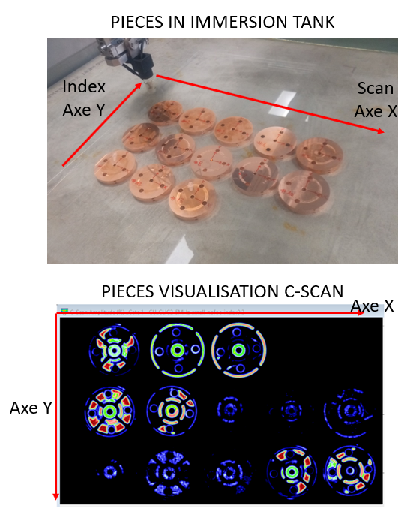
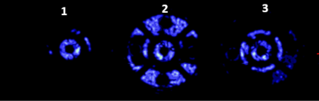
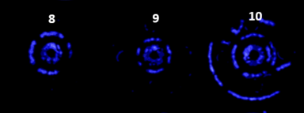
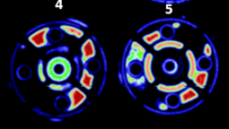
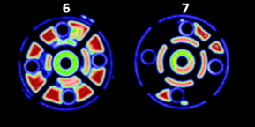
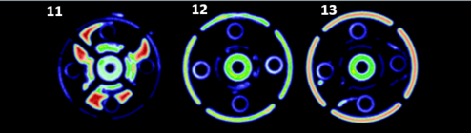
Ultrasounds analysis
H₂ dry/ AuCu50/ Bodycote
H₂ dry / AuCu50/ CERN
Vacuum/ Palcusil-5/ CERN
Vacuum/ Palabraze-840/ CERN
Brazing tests (15 September 2021) · Indico (cern.ch)

Slide 7
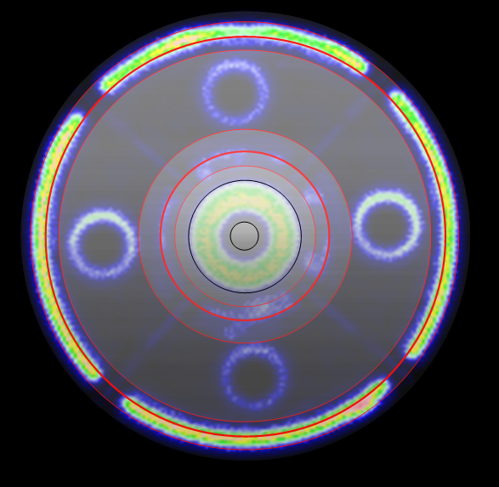
Ultrasounds analysis
H₂ dry/ AuCu50/ Bodycote
H₂ dry / AuCu50/ CERN
Vacuum/ Palcusil-5/ CERN
Vacuum/ Palabraze-840/ CERN
Brazing tests (15 September 2021) · Indico (cern.ch)

Slide 8
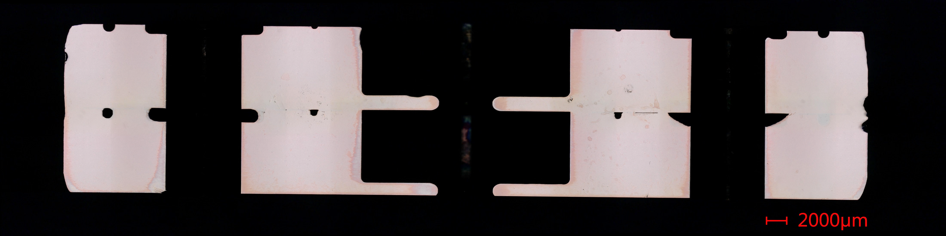
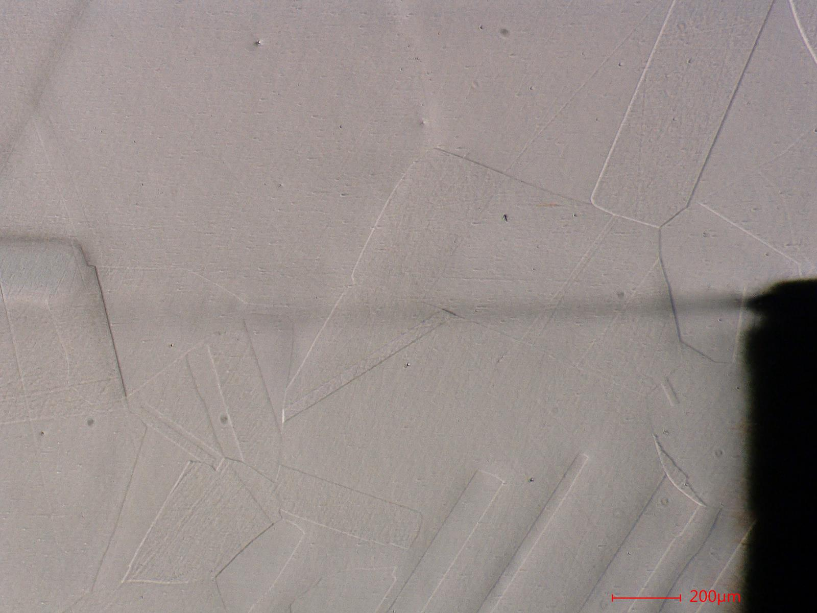
Metallographic evaluation - Gold
#1
1000 deg in the contact area we can see crossing grains. Bonding achieved with low pressure (less 0.05MPa) and very short time cycle
The material stops at the bonding surface
Brazing tests (15 September 2021) · Indico (cern.ch)

Slide 9
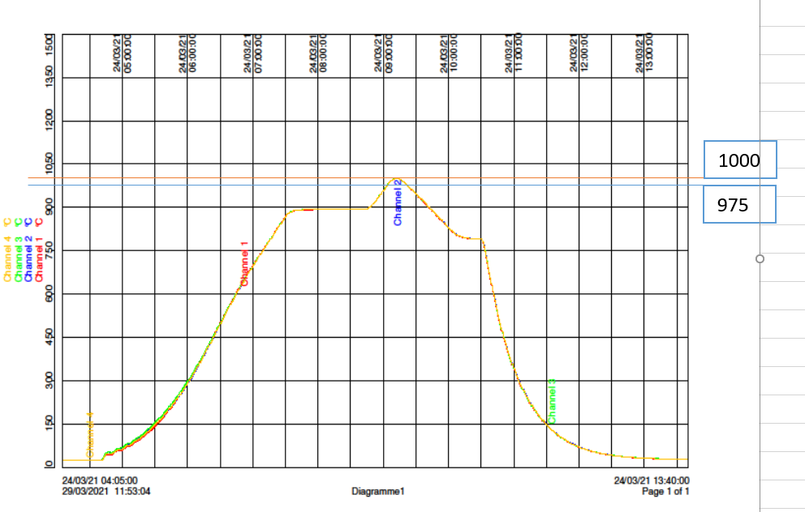
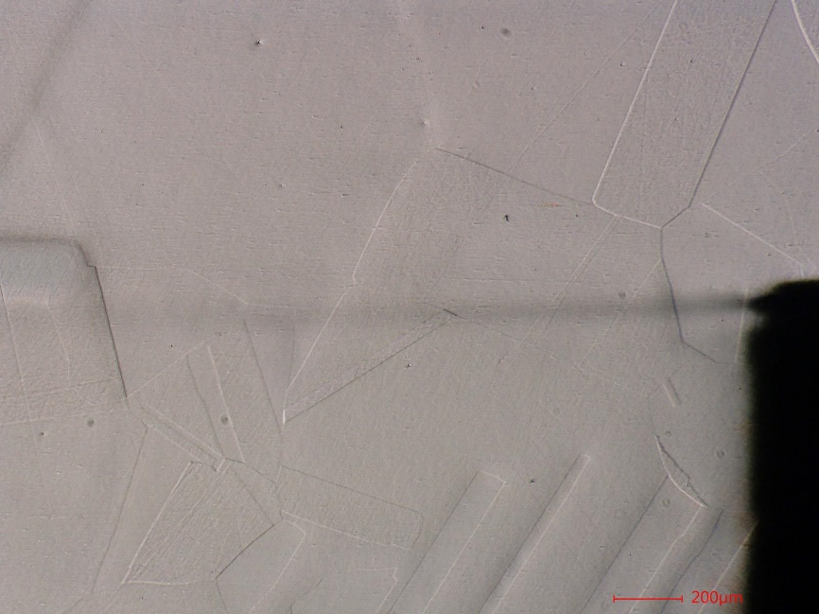
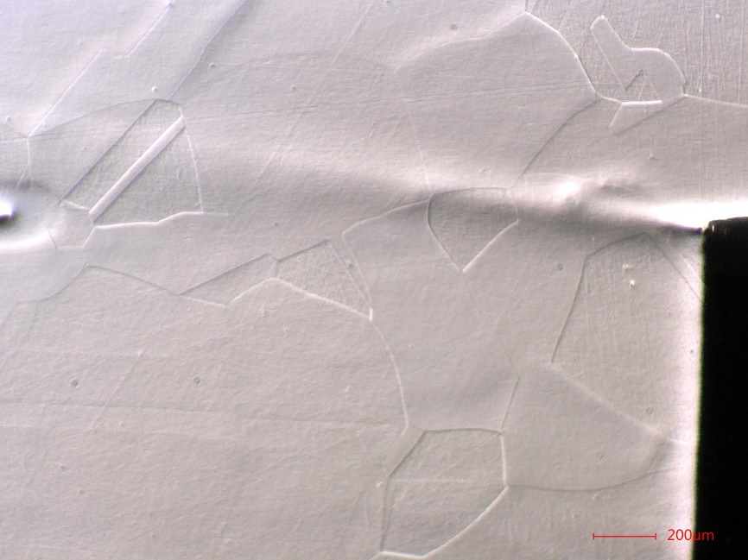
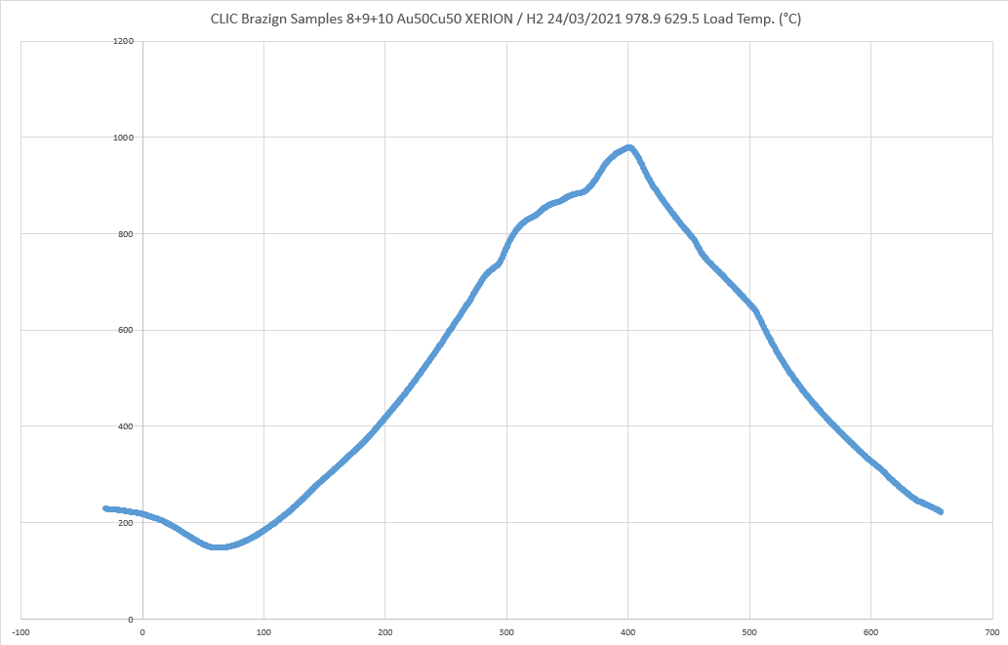
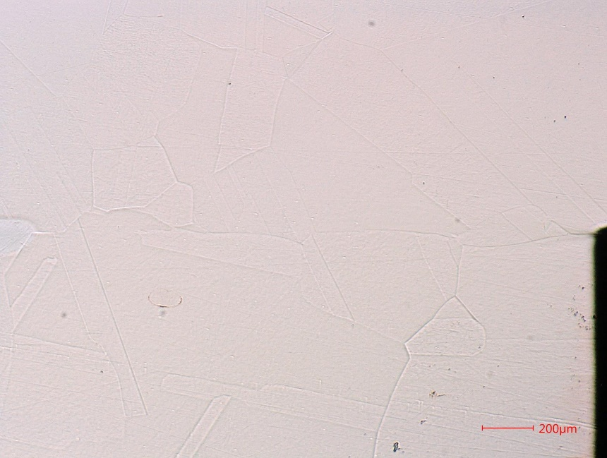
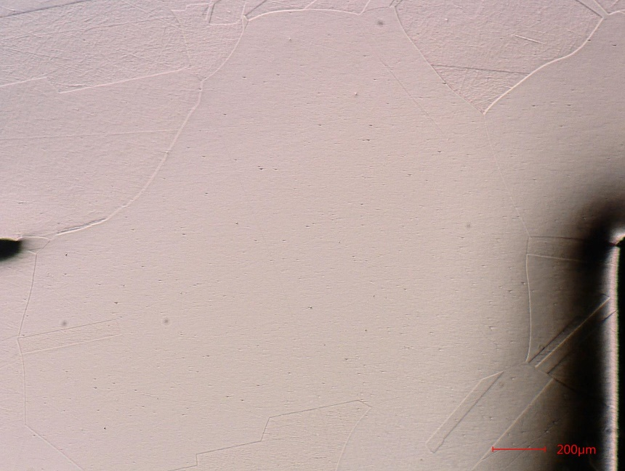
Metallographic evaluation - Gold
#1
#2
#1
Bodycote
Temp: 1000 ºC
Time: 5-10min
#8
#9
CERN
Temp: 978.9 ºC
Time: Time: 5-10min
Brazing tests (15 September 2021) · Indico (cern.ch)

Slide 10
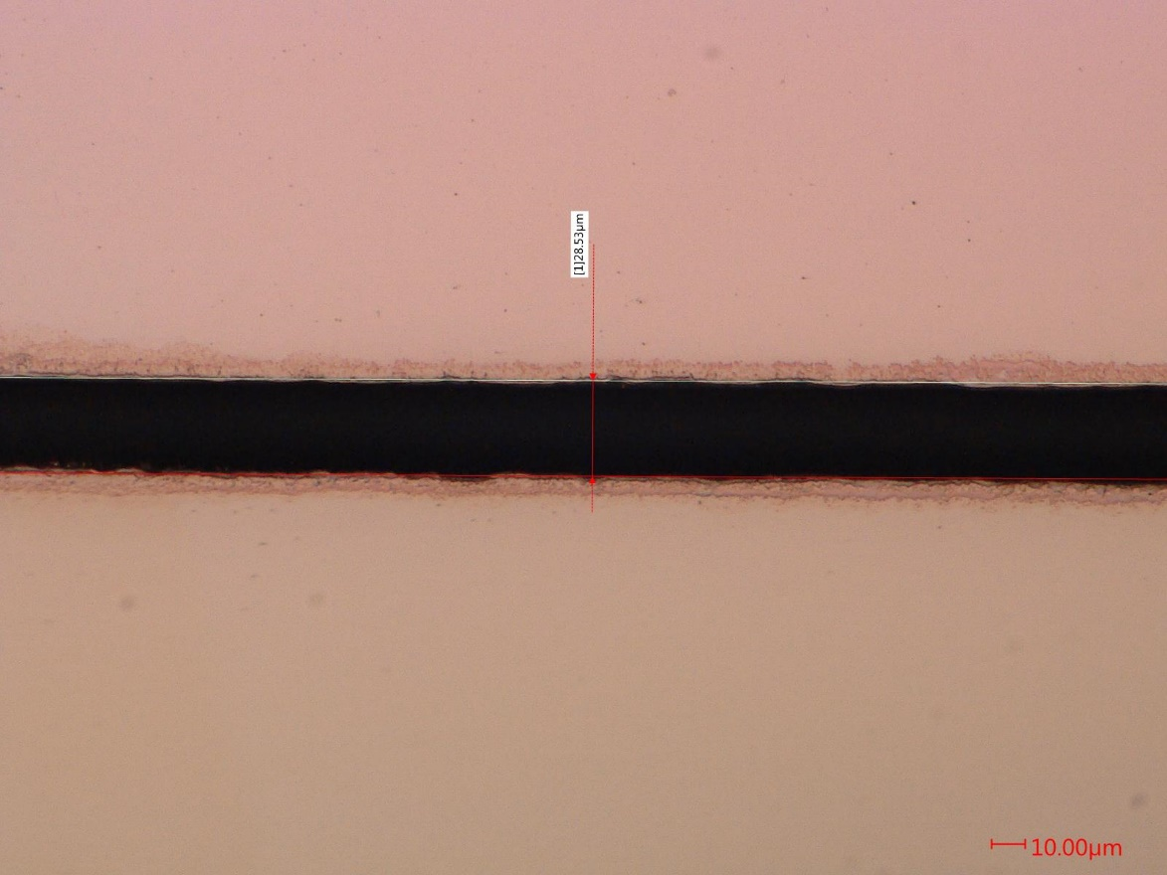
Metallographic evaluation - Gold
#1
Another point we can demonstrate is that when the ratio of BFM in the groves is low it can lead to empty areas
Ratio below 1
Brazing tests (15 September 2021) · Indico (cern.ch)

Slide 11
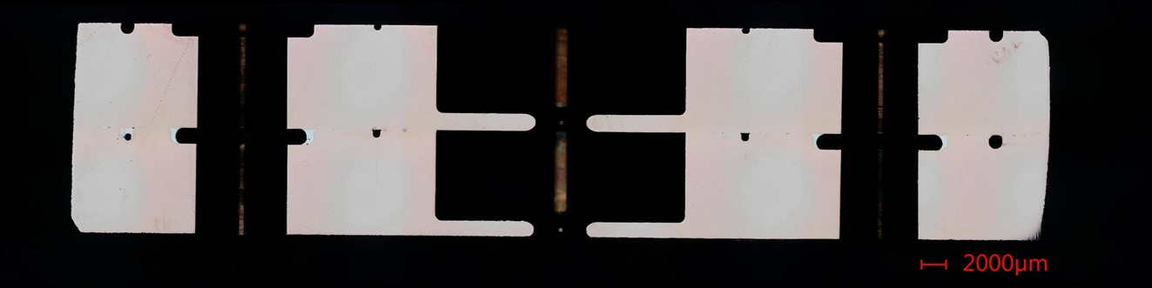
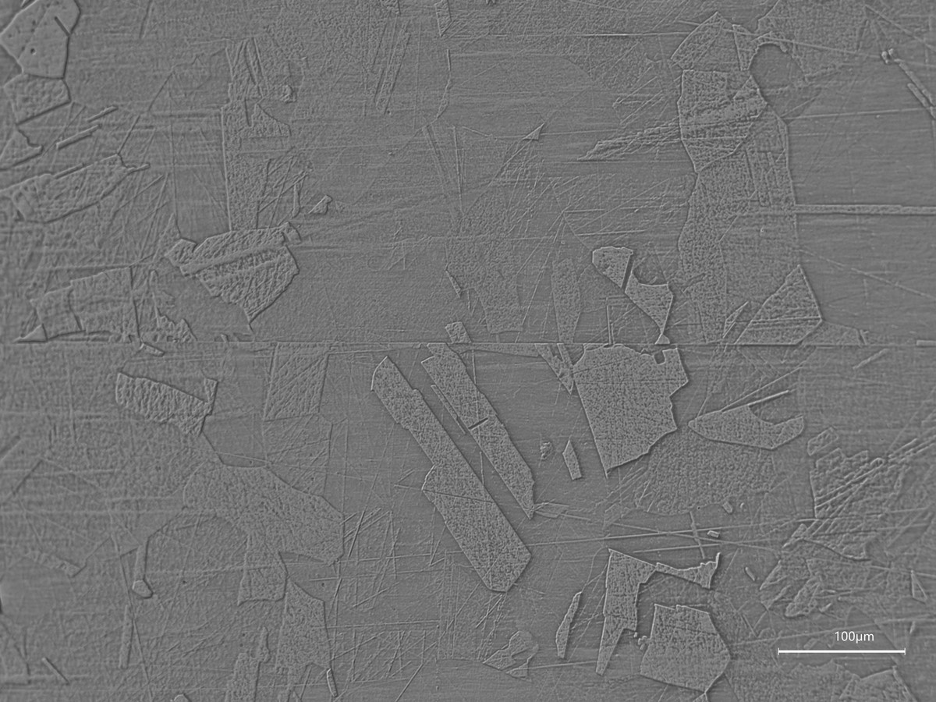
Metallographic evaluation – Palcusil5 (Silver)
#4
That is the lowest temperature reached in the study and still we can observe a good continuity but we cannot see any CG.
Brazing tests (15 September 2021) · Indico (cern.ch)

Slide 12
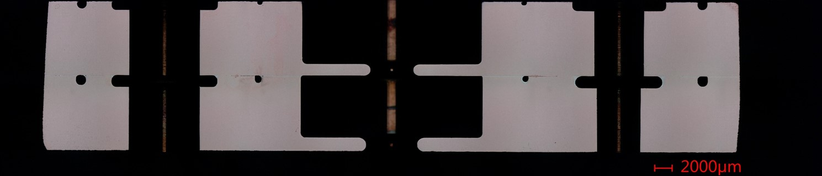
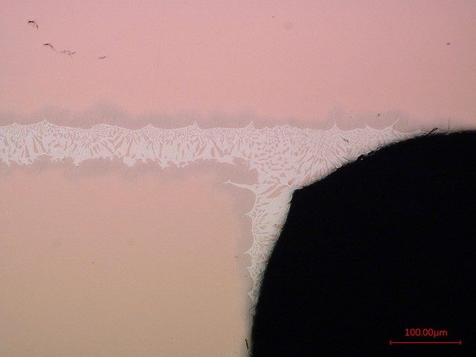
Metallographic evaluation - Palcusil5 (Silver)
#7
Another outcome we can see from this study is that the BFM stops as soon is reaching the end of the channels generating a rounding in the corners and a flat area in the straights surfaces
Brazing tests (15 September 2021) · Indico (cern.ch)

Slide 13
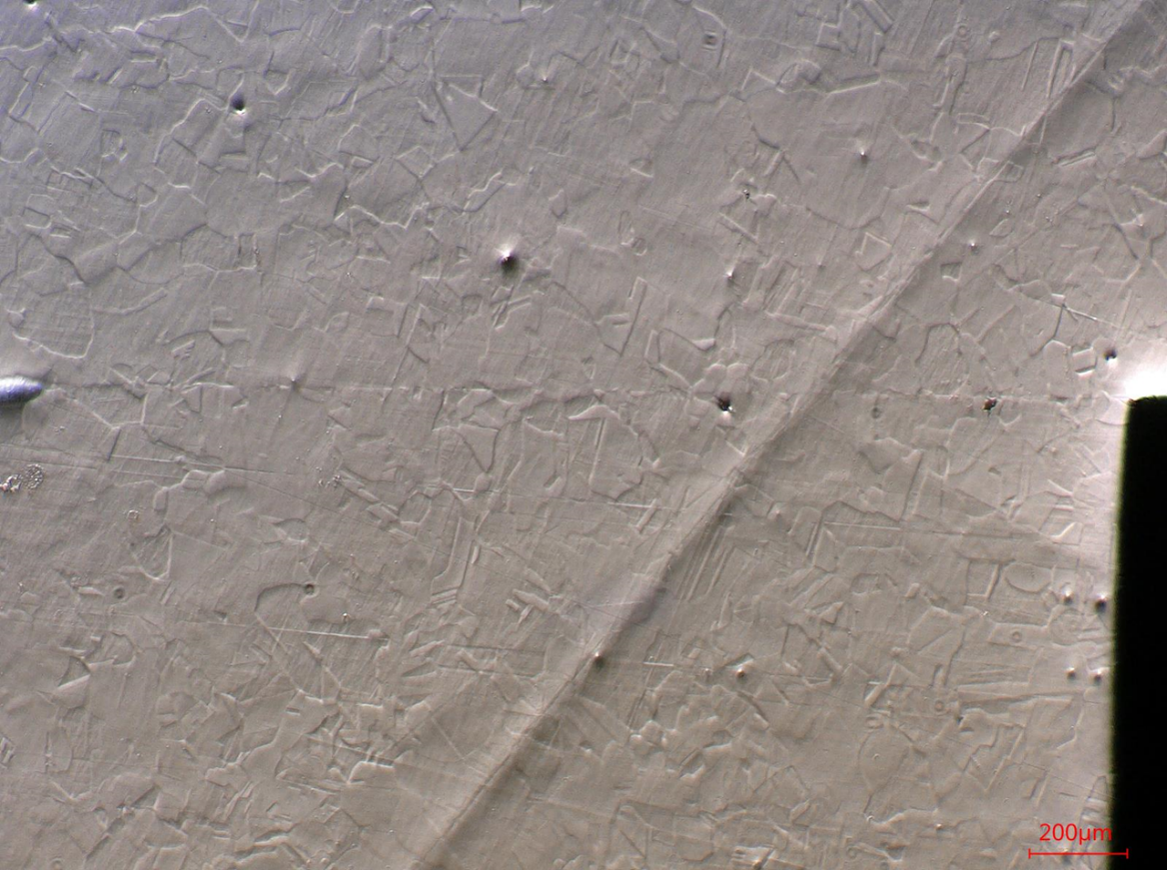
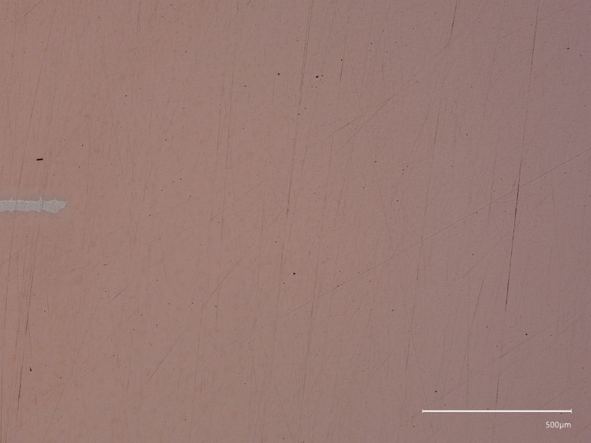
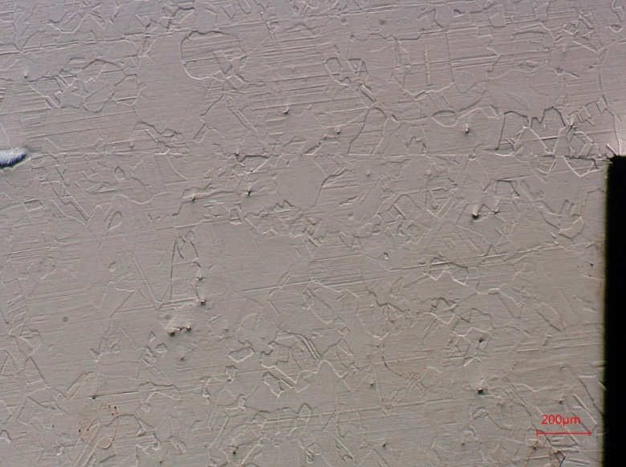
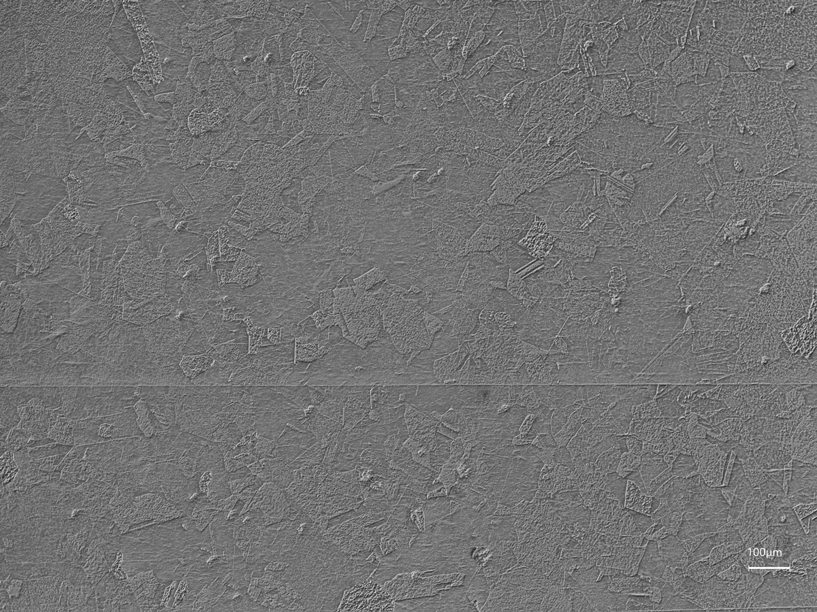
Metallographic evaluation - Palcusil5 (Silver)
#4
#6
At CERN
Temp: 815 ºC
Time: 10-15 min
We can see there is some continuity in all surfaces in contact.
As we can see in the pictures no crossing grains (CG) are observed. The red region in the UT correspond to non CG.
#5
#7

Slide 14
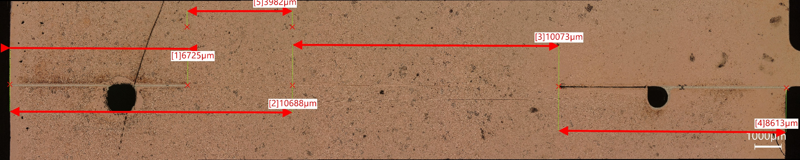
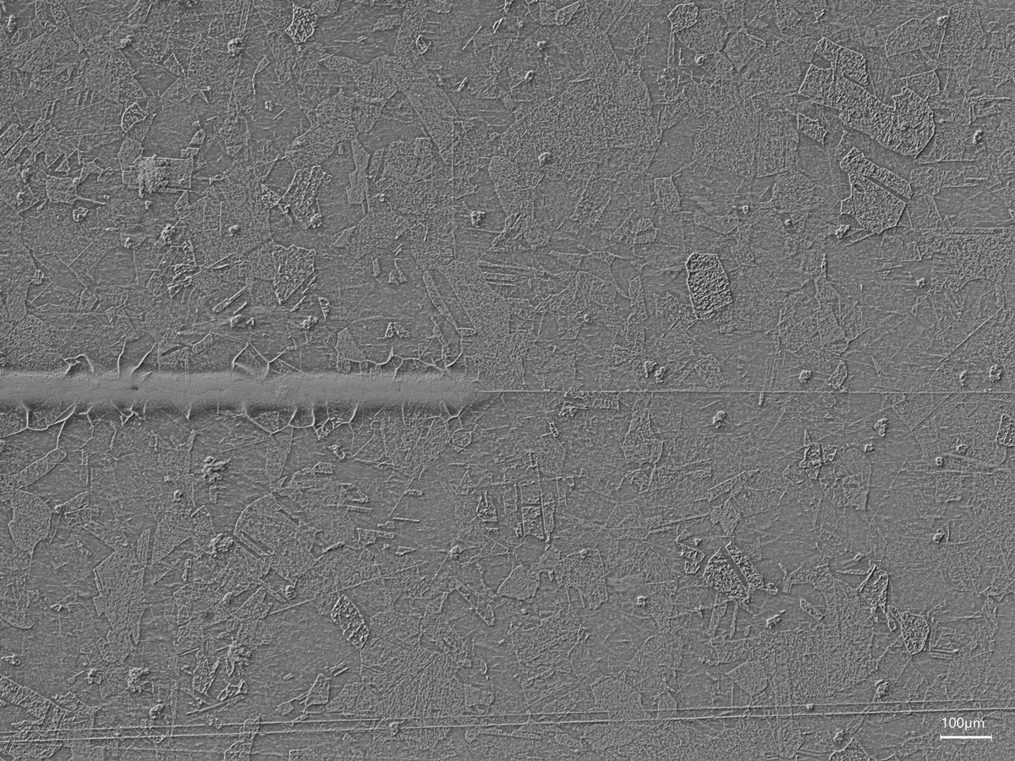
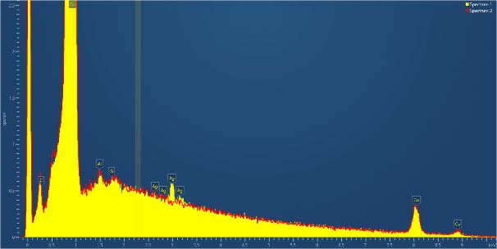
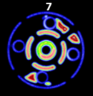
Metallographic evaluation - Palcusil5 (Silver)
#7
SP1
SP2
We see the material stops at the end of the brazing grooves but it generate some diffusion of the Pd or Ag in a range of 2-4mm.

Slide 15
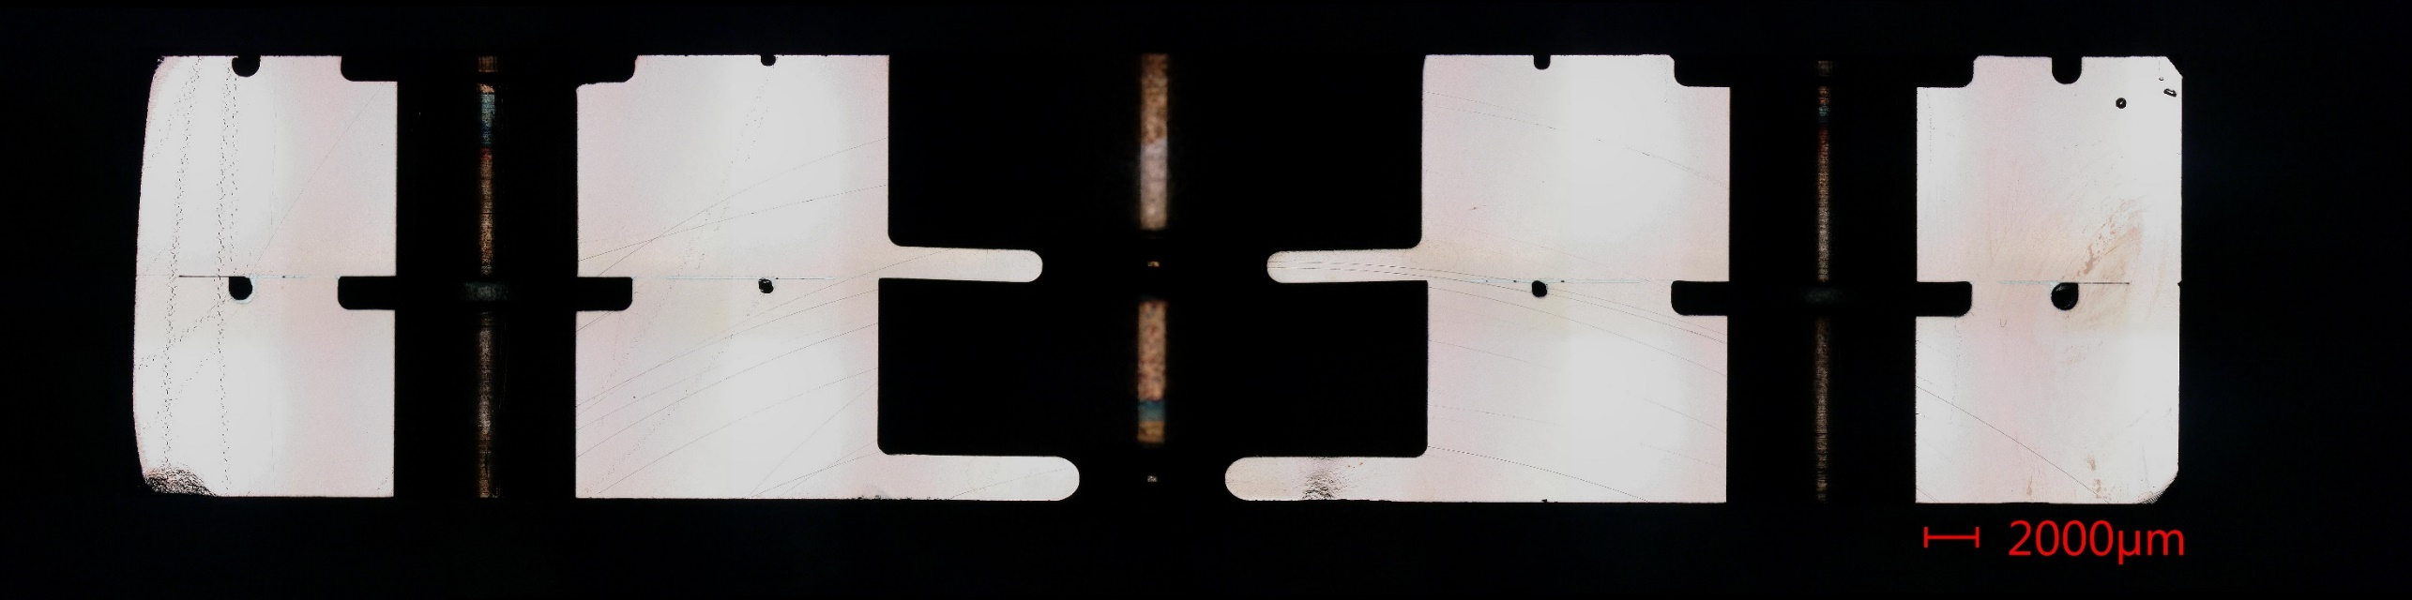
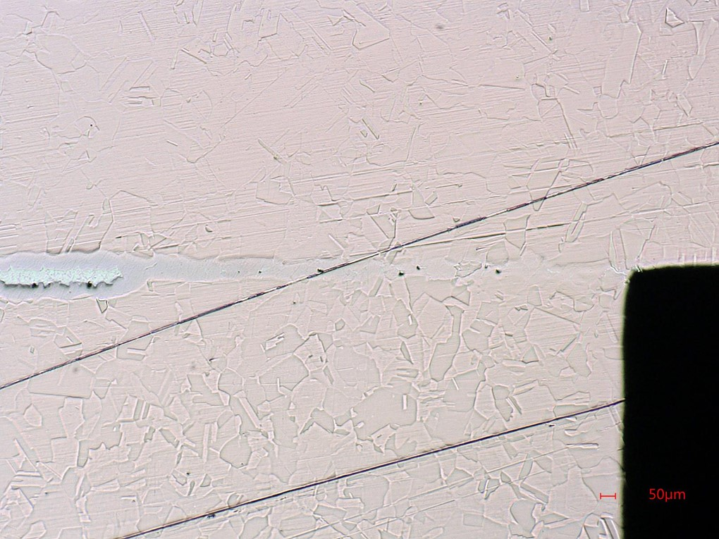
Metallographic evaluation – Pallabraze840 (Silver)
#12
That is a medium temperature (870C) and still we can observe a good continuity.
The curious thing we have observe here is that there is material squeezing in the narrow gap between the discs and reaching the RF area
Brazing tests (15 September 2021) · Indico (cern.ch)

Slide 16
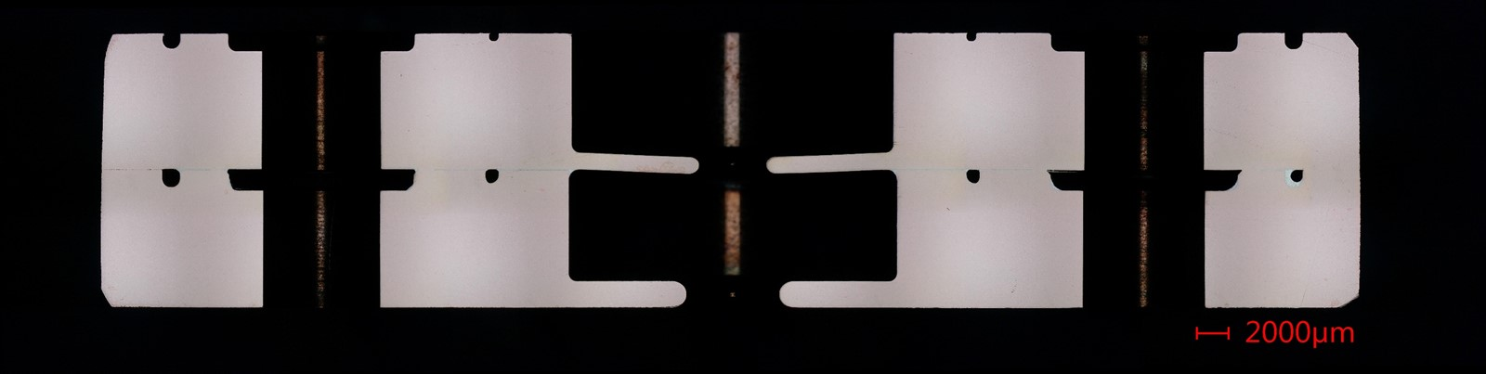
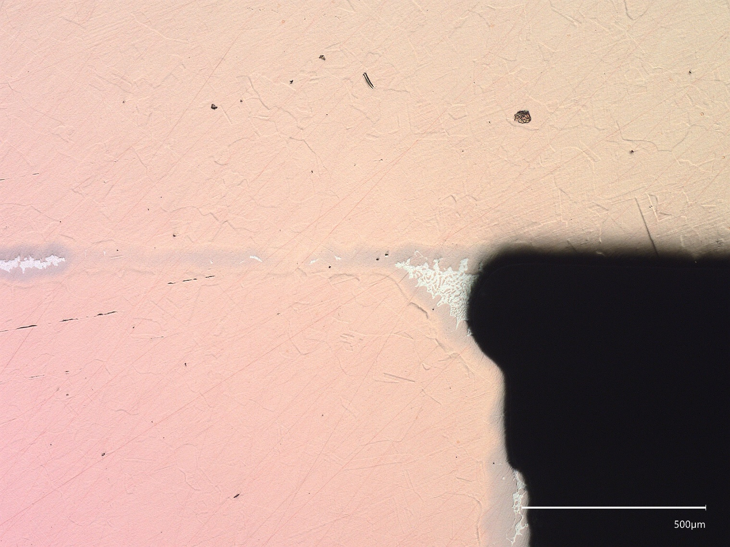
Metallographic evaluation – Pallabraze840 (Silver)
#13
In this picture we can see how the material is going into the gap a in the previous pair.
Here we have a small hint in the middle of one grain that wants to cross but nothing else
Brazing tests (15 September 2021) · Indico (cern.ch)

Slide 17
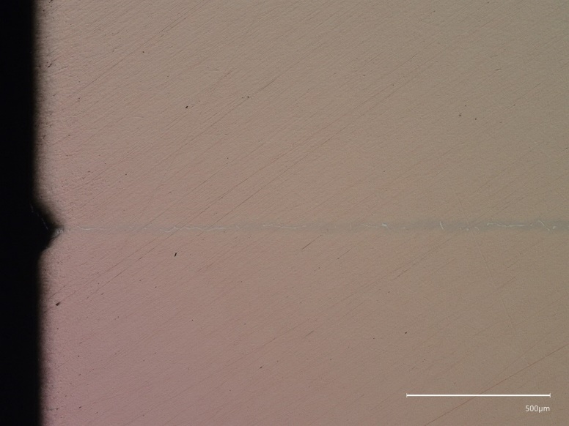

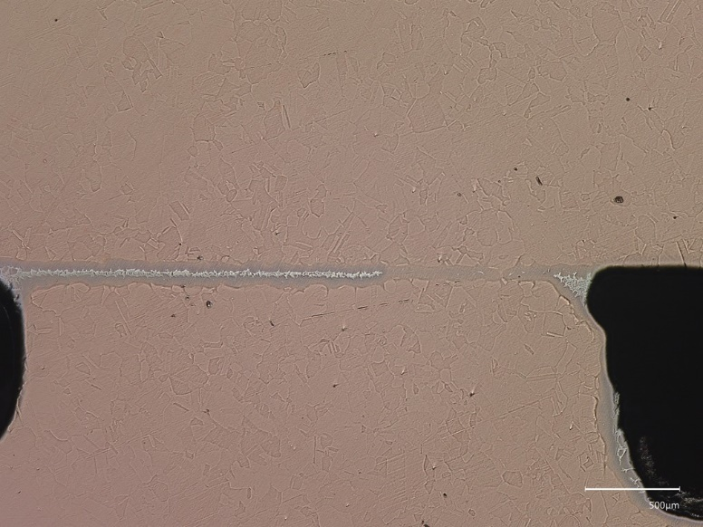
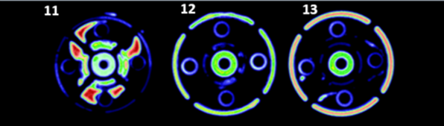
Metallographic evaluation – Pallabraze840 (Silver)
#11
#12
#13
At CERN
Temp: 870 ºC
Time: 15-20 min
We can see that the continuity in UT is almost comparable to the gold bunch BUT here, we see that the material diffusion is enter the interface and cover all possible gaps.

Slide 18
Conclusions
During gold cycles, up to 1000 deg, we observe a good bonding and material remain in the brazing volume.
A sharp edge if very efficient stopping the BFM.
We see that Pallabraze is a safer choice in terms of diffusion because it covers all interface and It allows us to use it in two cycles.
Palcusil5 is a material with a good balance to ensure a good leak despite of having some diffusion in a range of 2-4mm. Only one cycle.
The weight in all tests has not been something influencing the result (<0.05MPa-0.005MPa) or at least we cannot confirm it we the samples we have.

Slide 19
Smartcell prototype
Ordered a prototype for checking we are going in the right direction (or not).
The prototype has been ordered at CERN to be done completely at CERN
The material used for the prototype is Cu OFE laminated, from CERN Store: 44.09.56.210.1 → 8880851 - Material Request
→ Job J3073539 - Smartcell assembly prototype

Slide 20
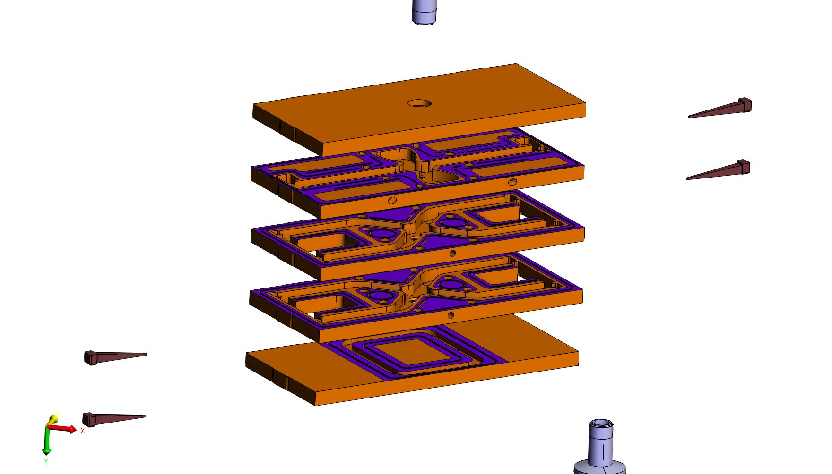
Smartcell prototype

Slide 21
Smartcell prototype
Very sharp edge
Ratios >= 2
Chamfer
Silver Pallabraze is working ok from the perspective of UT analysis, maintaining the temperature very low during the whole process and if we choose it, we have the advantage of having two steps for brazing.

Slide 22
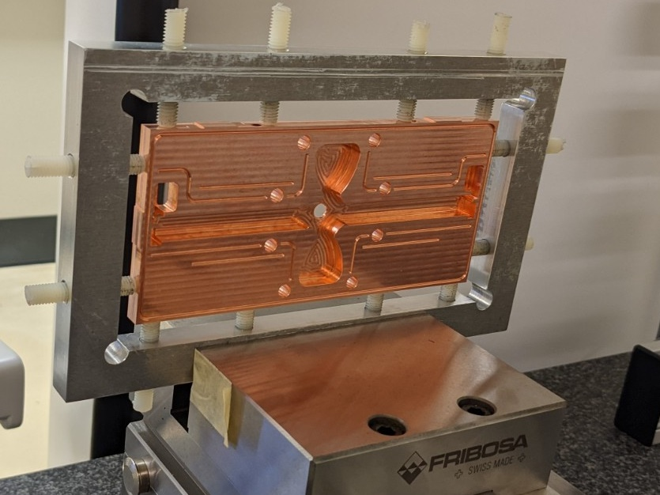
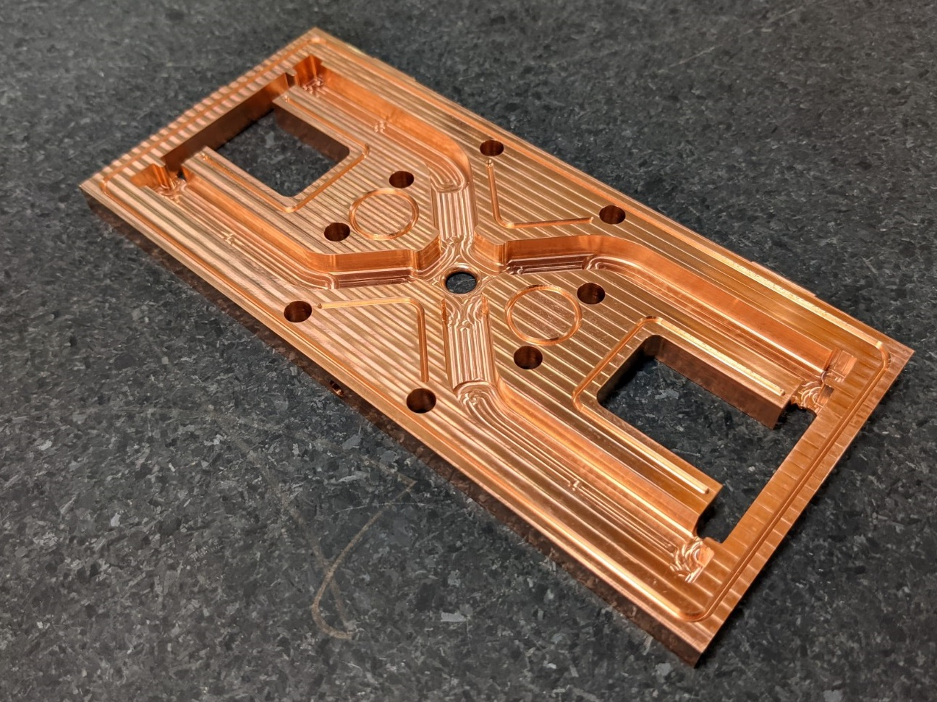
Smartcell prototype
#7
The material used for the prototype is Cu OFE laminated

Slide 23
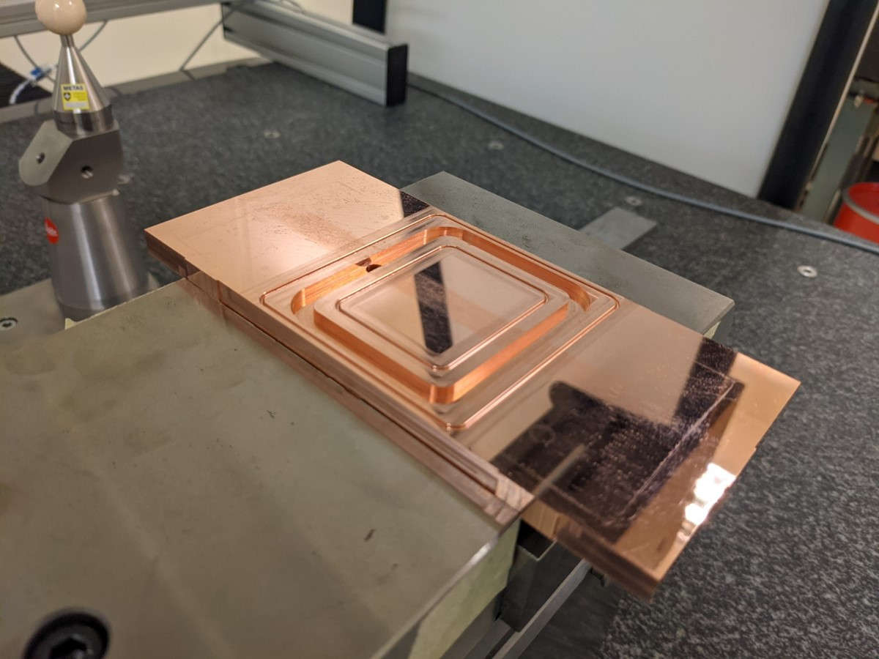
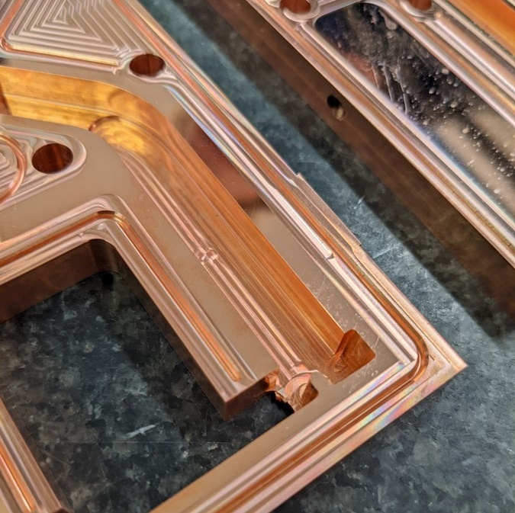
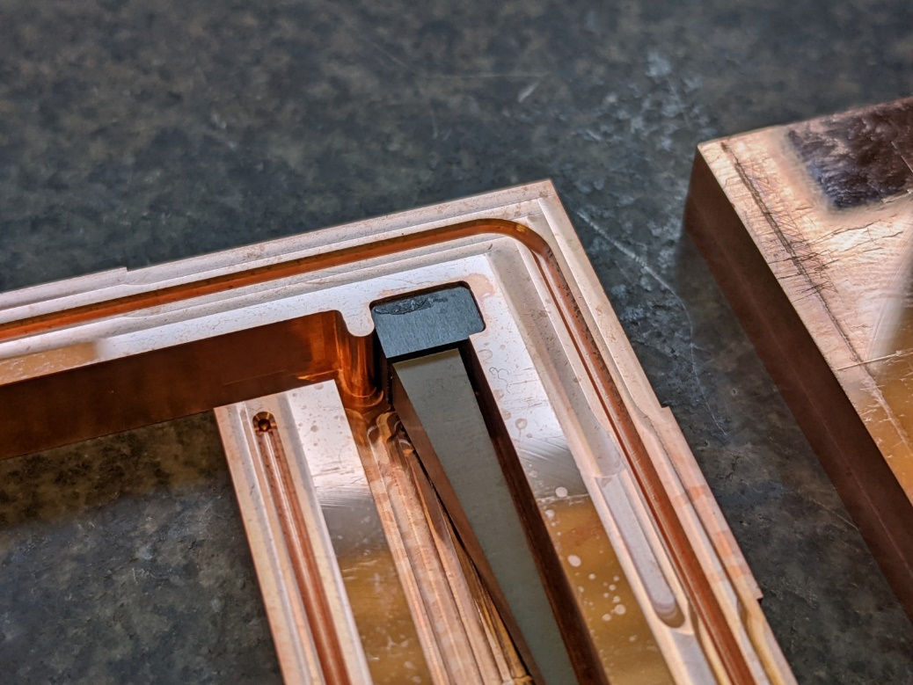
Smartcell prototype
#7

Slide 24
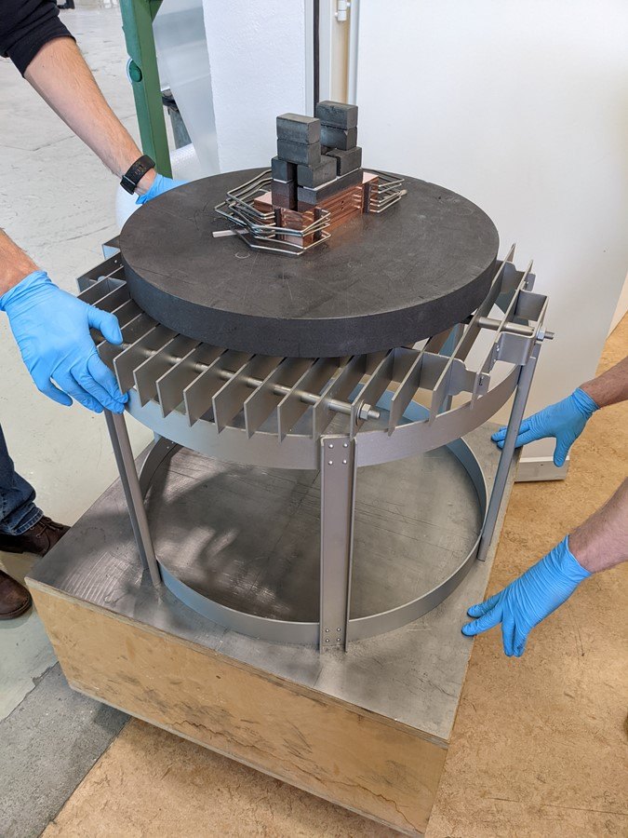
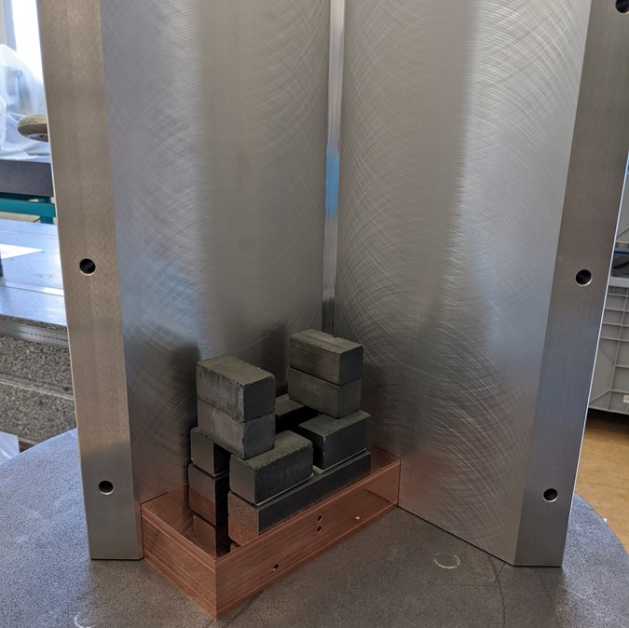
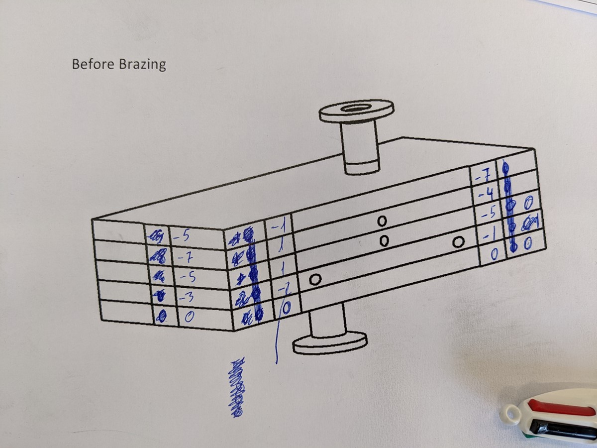
Smartcell prototype
#7

Slide 25
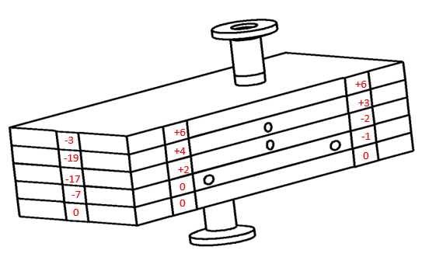

Smartcell prototype
#7
Shift of two cells during the brazing cycle

Slide 26


Smartcell prototype
#7
Worst part is we got a leak in the second interface

Slide 27


Smartcell prototype

Slide 28


Smartcell prototype analysis
#7

Slide 29


Smartcell prototype analysis
#7

Slide 30


#1
#2
#6
#3
#4
#5
#7
#8
#9
#10
#11

Slide 31


Smartcell prototype analysis
#7

Slide 32


#1
#2
#6
#3
#4
#5
#7
0.8mm
#8
#9
#10
0.8mm
0.8mm
0.8mm
#11
1.1mm

Slide 33


Smartcell prototype analysis
#7

Slide 34

Smartcell prototype analysis
#7

Slide 35


Smartcell prototype analysis
#7

Slide 36

Smartcell prototype analysis
Disc test
#7
Smartcell test

Slide 37
Conclusions
The alignment method needs to be improved. New V in granite.
The brackets during brazing do not work properly. More weight.
The BFM silver alloys allow us to use non H2 furnace and lower temperature but on the other hand, they diffuse till the edge (RF region included).
The machining finish is very important to get an homogeneous and good enough continuity between copper parts.

Slide 38
Thanks for your attention.
Questions??
Thanks to Nuria Catalan, Anastasiya Magazinik, Joel Sauza, Fritz Motschmann, Bodycote, Serge Lebet and all participants from materials, especially Anite Pérez and Enrique Rodriguez

