Slide 1
Presentation title is Arial Bold 50pt up to three lines
Presenter Name
Date

Slide 2
Design update

Slide 3
Design update
Vacuum
Cooling
Beam pipe
Beam pipe
4x
WG

Slide 4
Design update

Slide 5
Design update

Slide 6
RF Check
RF reference volume
RF obtained from CAD structure design

Slide 7
Overlap
Is difficult to observe in this picture but this is the red area marked in the previous slide isolated.
As we can see the thickness of the result difference is increasing with the length of the structure.
Is not accurate, just take it as a reference.

Slide 8
Curve checking
To analyse the internal shape which is the main
cause of the deviation in the RF area, we have
Taken the previous design which we know matches 100%
The RF check. From now SK1
Taking the internal sketch we can overlap it with the one we are trying to implement for the new structure. From SK2
With this overlap, from a quick view we can see we are close to match the result BUT lets go closer

Slide 9
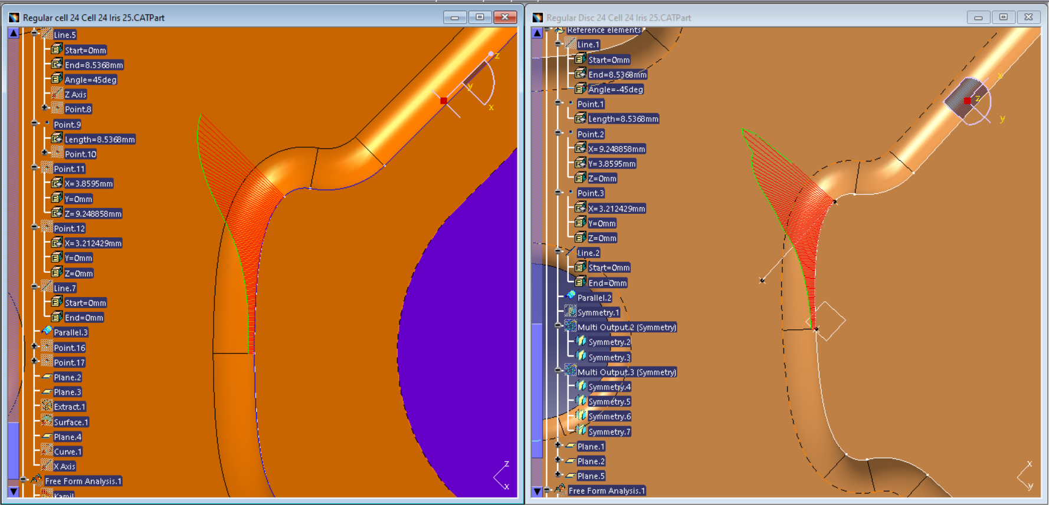
Curve checking
NEW
OLD

Slide 10
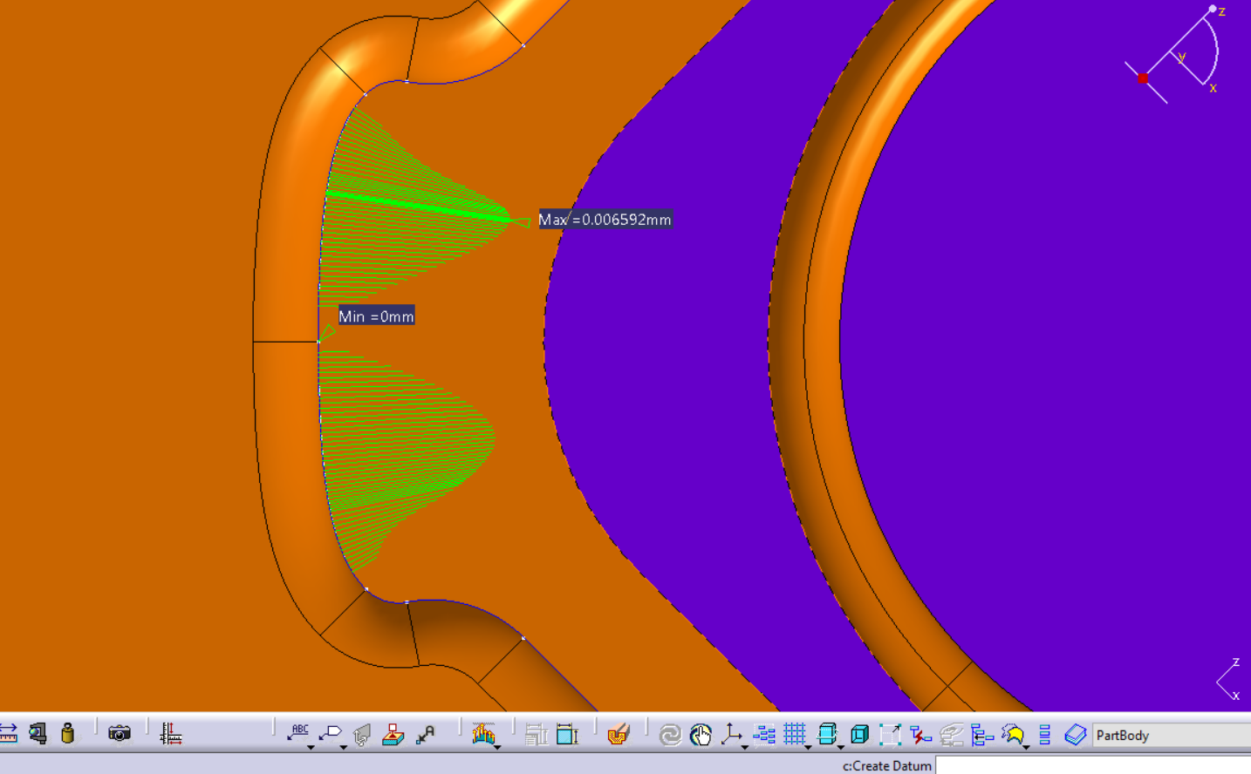
Curve checking
Misalignment found

Slide 11
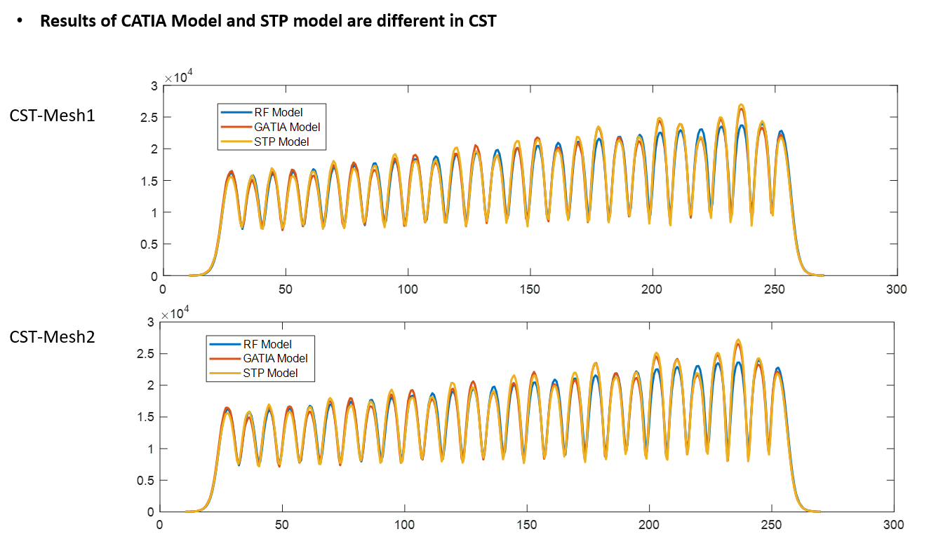
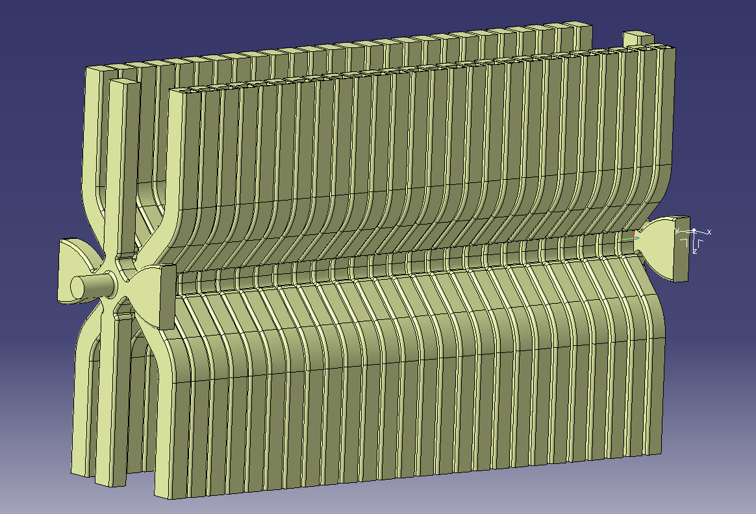
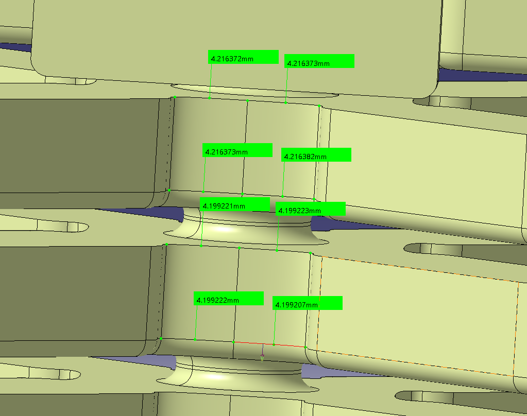
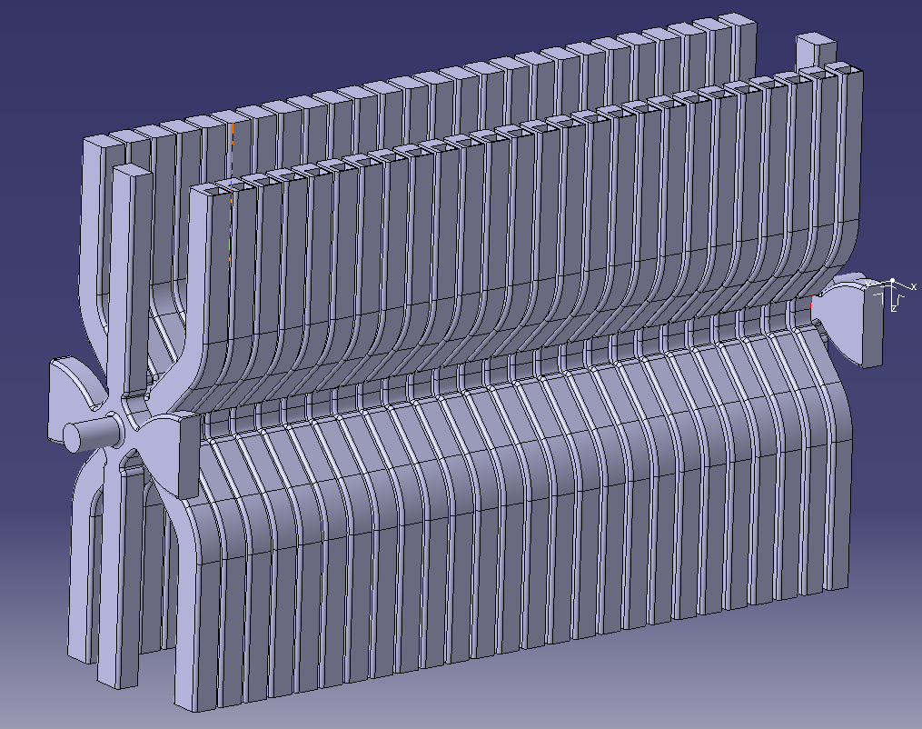
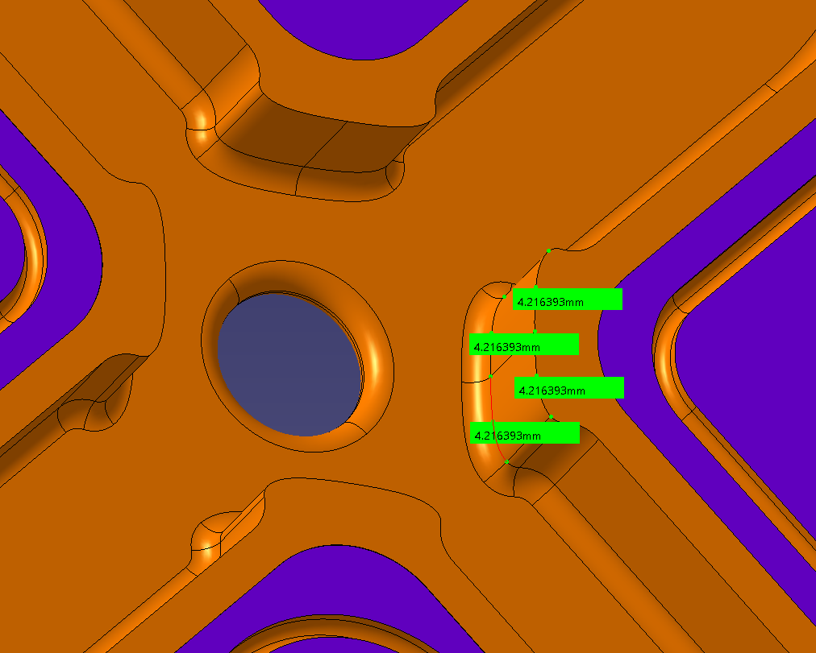
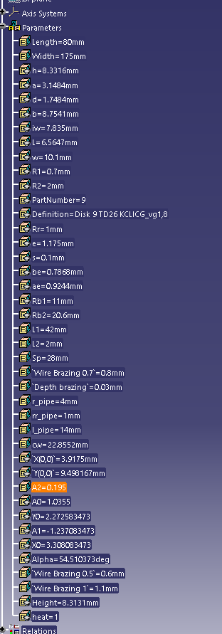
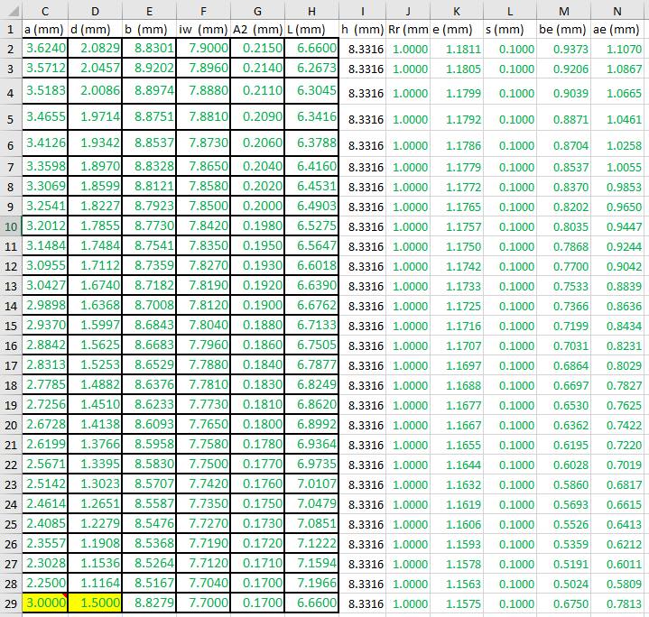
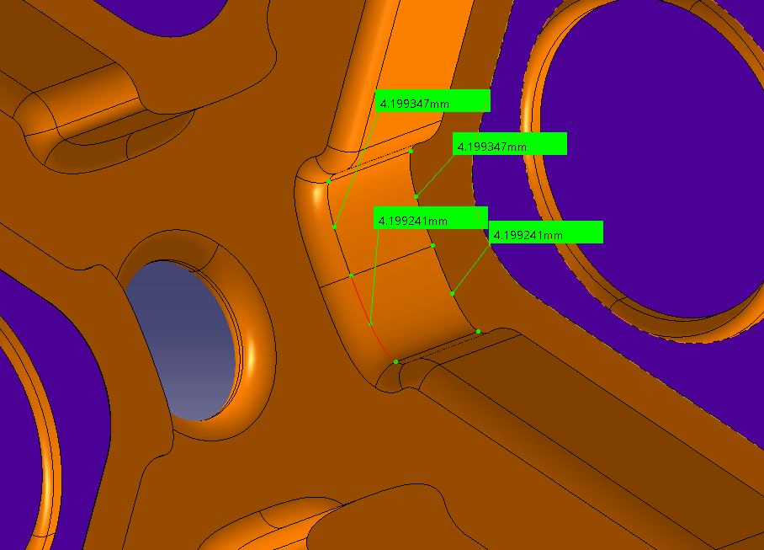
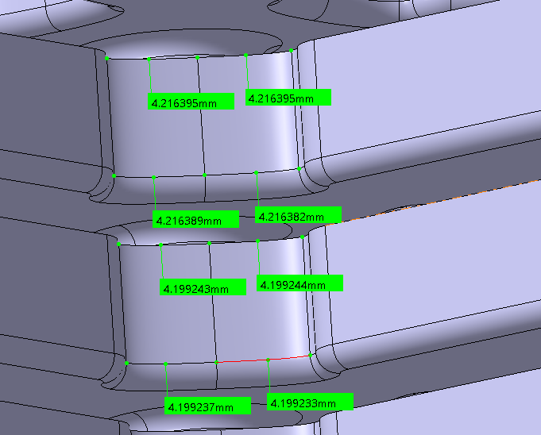
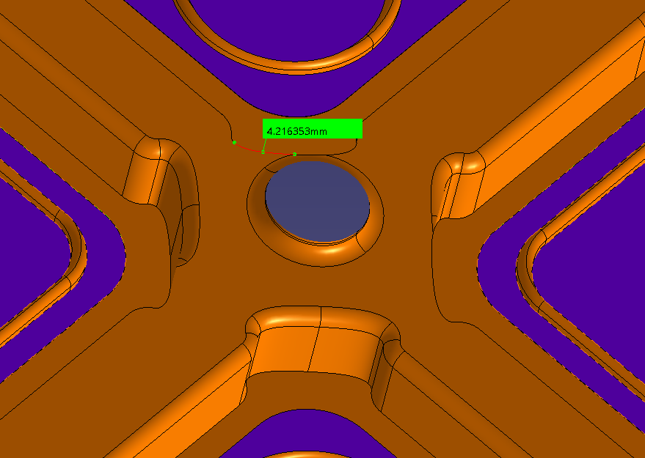
RF Check

Slide 12
RF Check

Slide 13
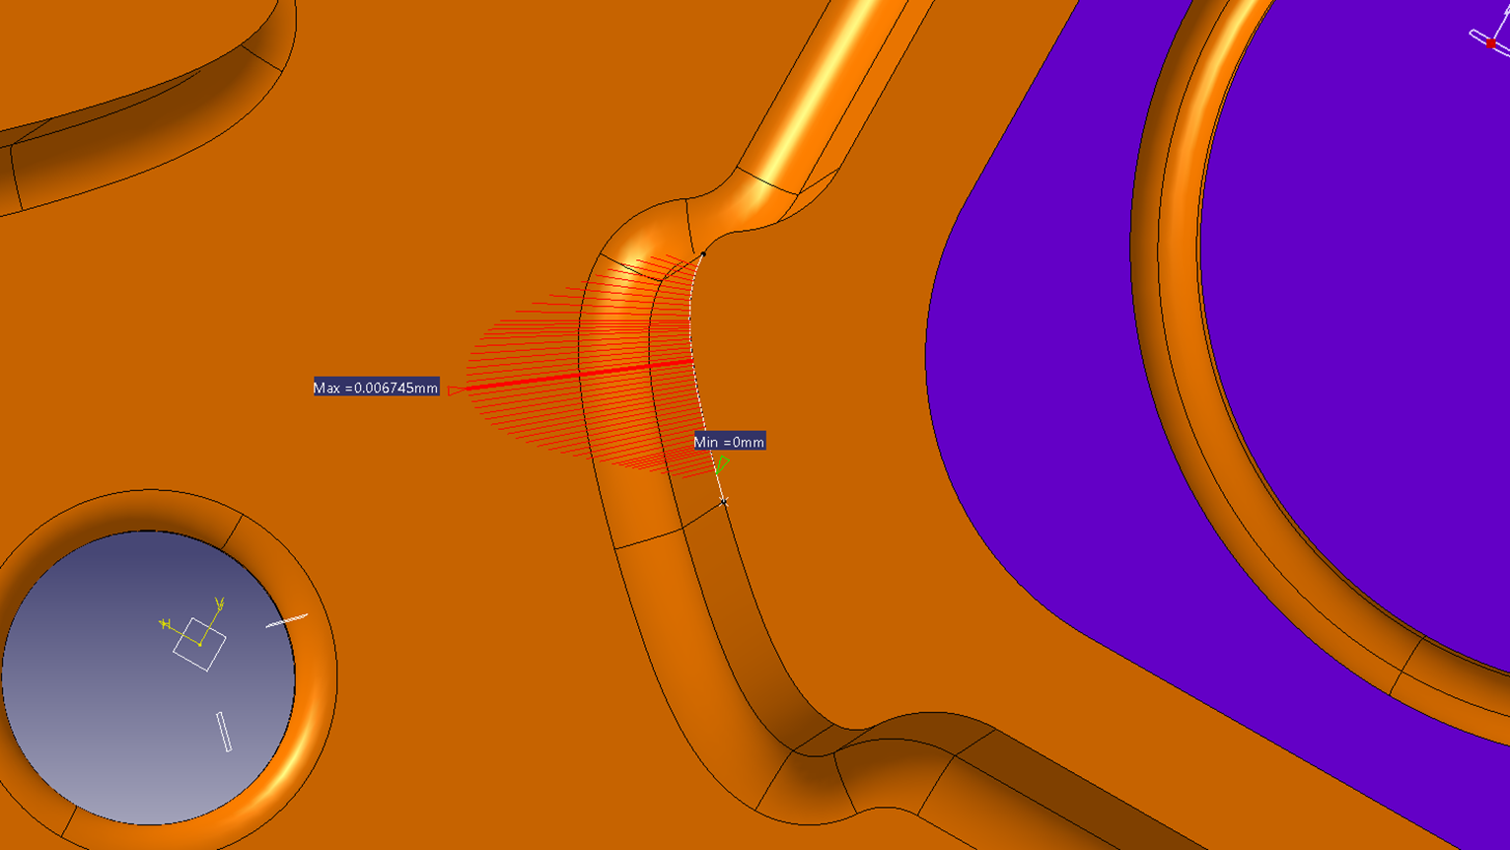
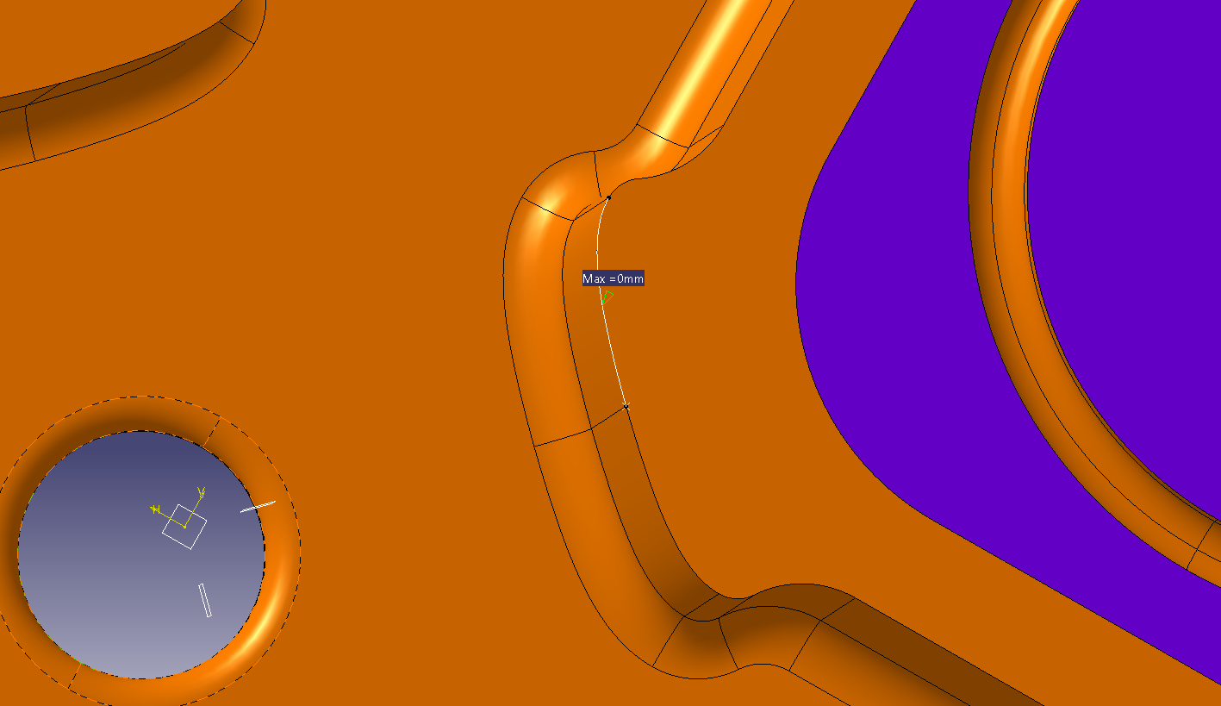
RF Check
From a deviation of 0.006745mm to 0mm

Slide 14
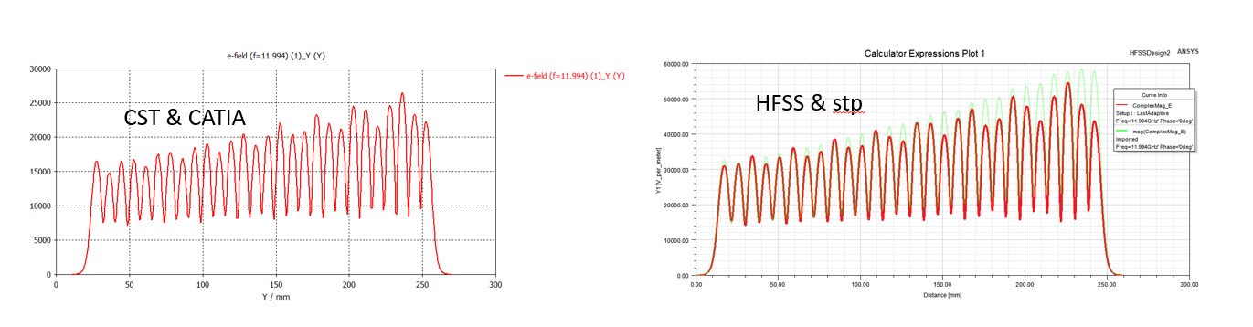
RF Check

Slide 15
RF Check - IGS
They do not match

Slide 16
RF Check - STEP
They do not match

Slide 17
RF Check
They do not match

Slide 18
RF Check
They do not match
4.216395
4.216393
4.216372

Slide 19
Conclusions
In the 3D model, we have advanced quite well not considering the RF area of the iris.
In the RF area we have match the previous results in 3D and we need to keep going to match 100% when exporting to a compatible format.
We need to rethink if the heat factor correction is worth to implement.

