Slide 1


RFD Crab Cavity Contribution from the U.S.
Status, Issues and Delivery Dates
Alessandro Ratti – SLAC
Leonardo Ristori – Fermilab
12th HL-LHC Collaboration Meeting – 19th September 2022

Slide 2
Outline
Scope
Performance of AUP Prototypes
Progress in Bare Cavity Fabrication
Status of Helium Tank Integration
HOM Dampers Fabrication
Plans for Acceptance
Deliveries

Slide 3
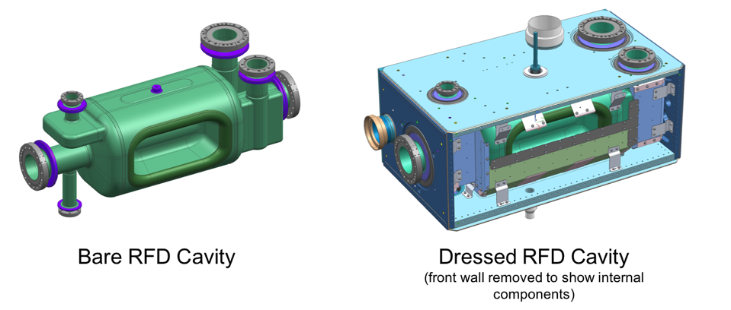
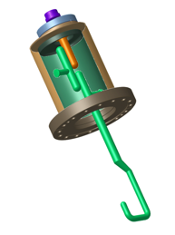
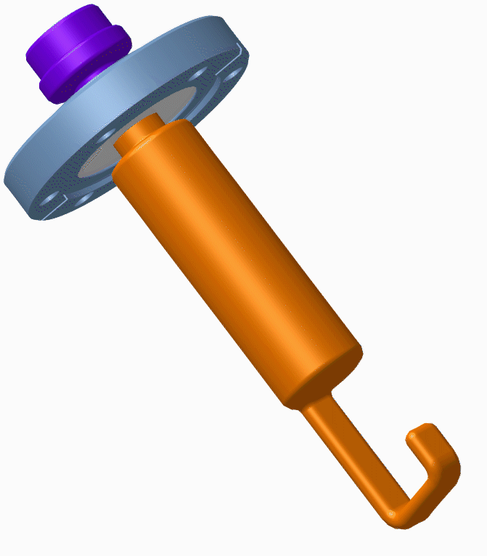
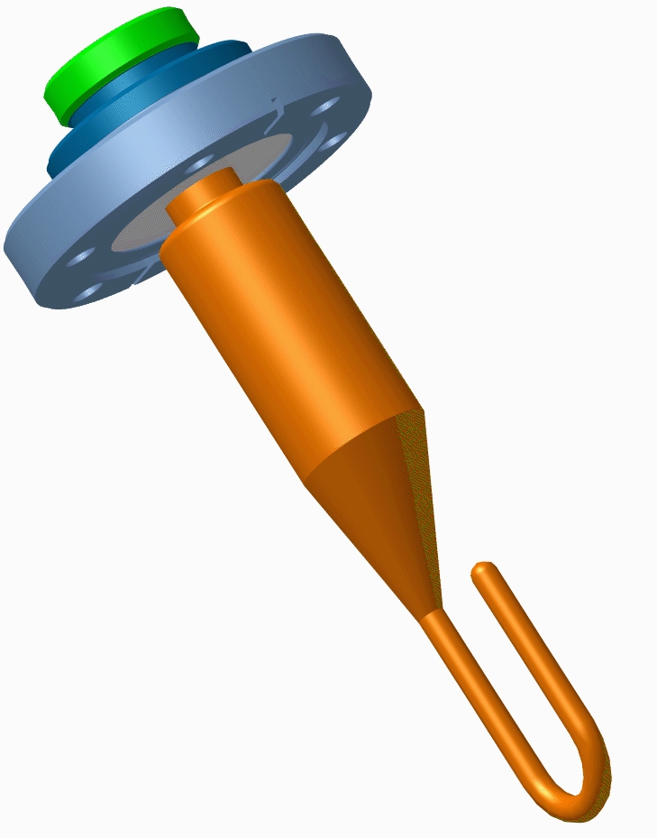
Scope and Deliverables
RF Ancillaries
Project Scope includes 2 Prototypes + 2 Pre-Series + 10 Series
Bare Cavities: Intermediate Qualification at FNAL at 2K
Integration: Bare Cavity + Magnetic Shields + Helium Tank
Dressed Cavities: Final Qualification at FNAL at 2K + RF Ancillaries
Transport to TRIUMF for acceptance by CERN:
  10 qualified dressed cavities (mix of pre-series + series)
  Warm/Cold tests at TRIUMF → formal acceptance by CERN → hand-off

Slide 4
U.S. RFD Team
Participating Institutions in alphabetical order:
Argonne National Laboratory (Brazing and Cavity Processing):
  Mike Kelly, Mark Kedzie, Tom Reid, Bill Toter
Fermilab (RF/Mech Design, Procurements, Cold Tests):
  Paolo Berrutti, Manuele Narduzzi, Alex Melnichuk, Damon Bice
Jefferson Lab (HOM Dampers Fabrication and Cold Tests):
  Naeem Huque, Alex Castilla
Old Dominium University (General Oversight and RF measurements):
  Jean Delayen, Subashini De Silva
SLAC National Accelerator Laboratory (RF Design, Coordination):
  Alessandro Ratti, Zenghai Li

Slide 5
Integration and Coordination Remarks
Requirements unchanged.
Key documents finalized and officially released by CERN allowing AUP to fully transition into production (e.g., Helium Tank specification drawings).
AUP is participating in ~ Bi-monthly WP4 coordination meetings and other technical meetings with WP4 engineers on a ~ weekly basis.
Bi-weekly meetings with CERN RF Group on HOM Dampers allowed fast response to recent issues (cold leaks).
AUP able to continue traveling during COVID although very limited. Now resuming more regular visits to CERN and suppliers.
Cross-participation at CERN and FNAL reviews (e.g., PRRs).

Slide 6
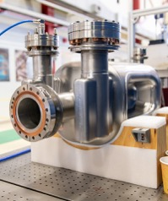
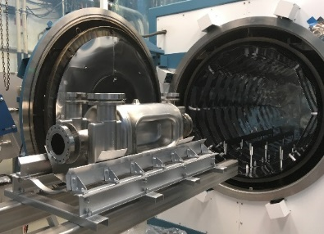
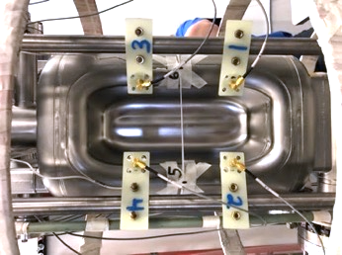
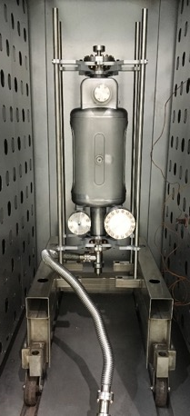
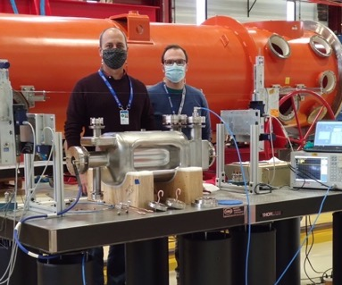
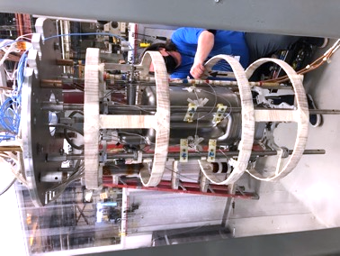
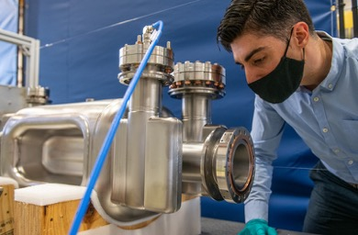

AUP Prototypes at FNAL (2021)
120C Bake
Second Sound Instrumentation
High Temp Treatment
Proto #2
Proto #2 inspections
RF Bead Pull
VTS Preparations
Despite Covid Lock-Downs we were able to receive, process and test 2 AUP prototypes in 2021.
6

Slide 7
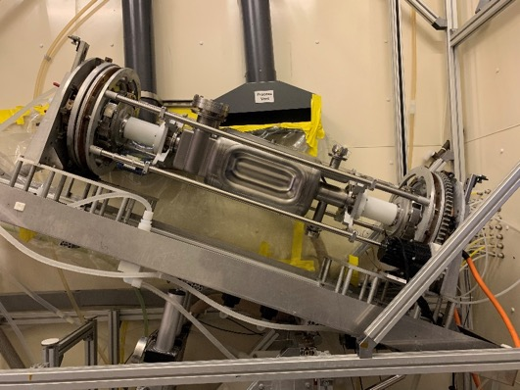
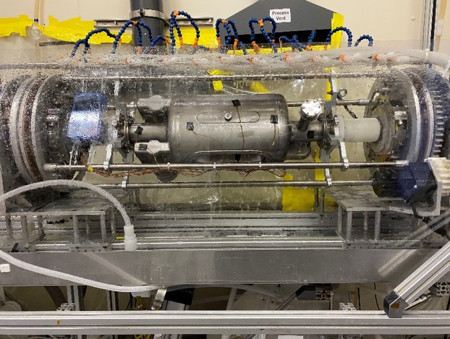
AUP Prototypes at ANL (2021)
Rotational BCP at ANL yielded better results than conventional (static) BCP.
Acid and Nb temperatures were controlled well with sensors on the cavity surface and cooling water sprayed on the exterior Nb surface.
BULK removal: average 130 microns
Light removal: average 40 microns
All US thickness locations match locations used by CERN
Tilting Facilitates Drainage
Location | rotational BCP target 48 μm | conventional BCP target 40 μm
HHOM | 46.1 | 22.5
VHOM | 55.0 | 58.6
FPC | 48.6 | 28.4
BODY | 44.5 | 25.1
POLE (left) | 51.8 | 26.2
POLE (right) | 51.3 | 28.7
MAX | 66 | 213.7
MIN | 25.4 | 8.5
Rotational BCP Tool at ANL

Slide 8
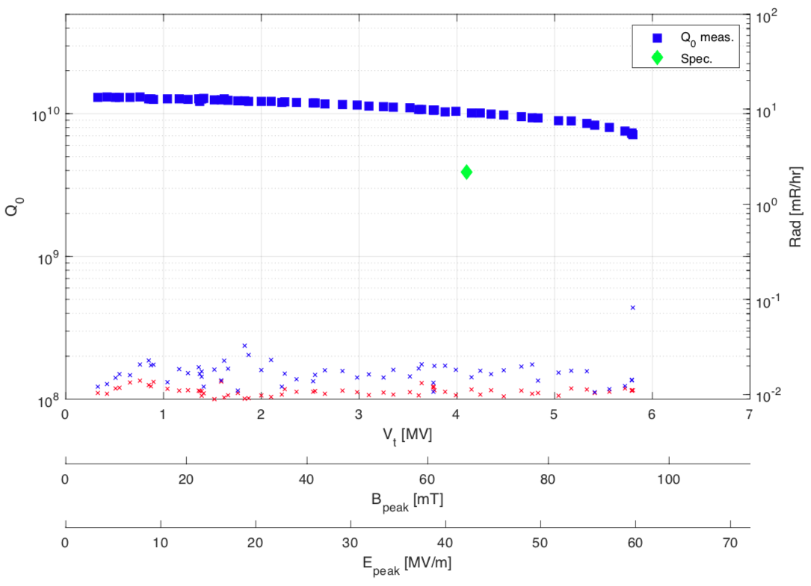
Zanon Prototype #2 + ANL Processing
8/25/21 at FNAL

Slide 9
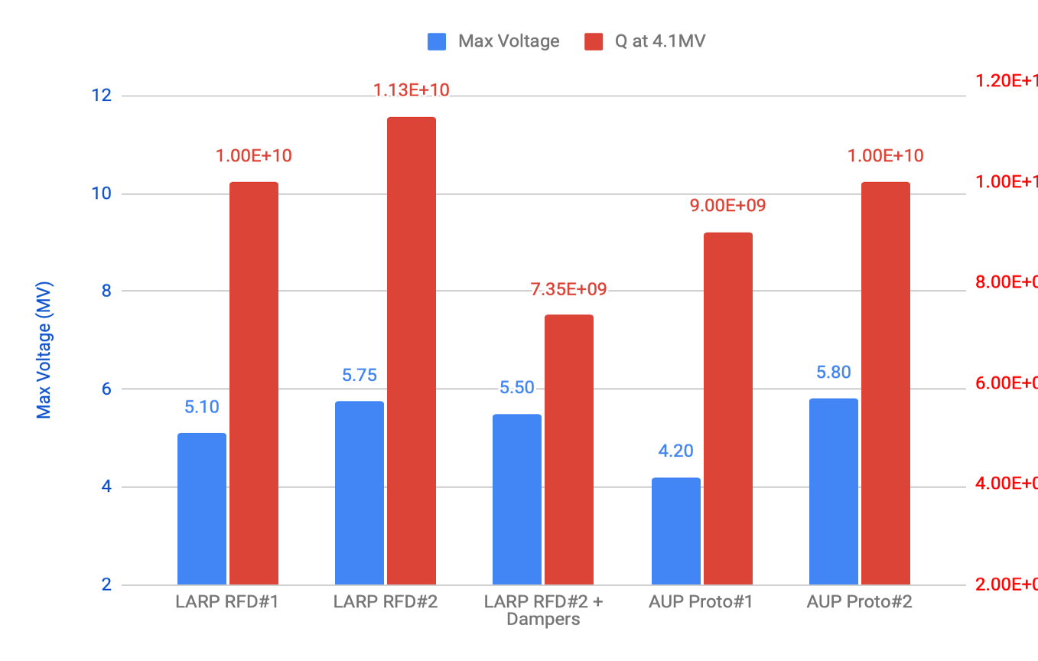
LARP + AUP Cold Test Summary
Acceptance

Slide 10
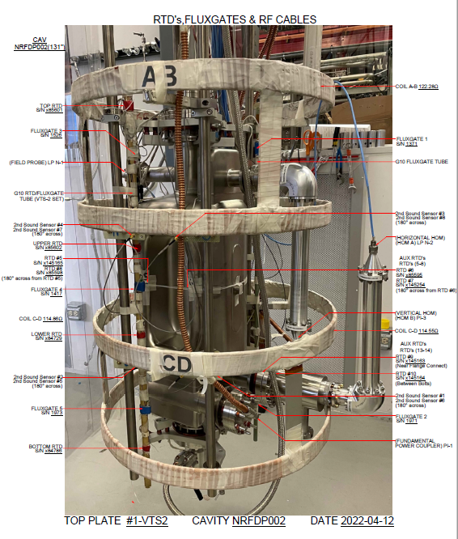
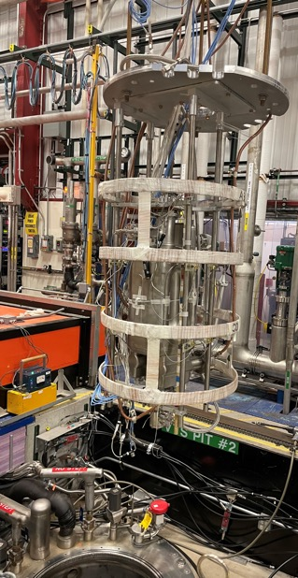
Cavity with HOMs installation at VTS
NRFDP002 was installed on the top plate for vertical cold test after all warm vacuum issues were sorted out: HHOM and VHOM flange gasket leak tight at room temperature, with custom gaskets.
The cavity received usual sensors installation plus additional thermometry on the HHOM-cavity interface to monitor potential temperature increase due to unwanted RF losses.

Slide 11
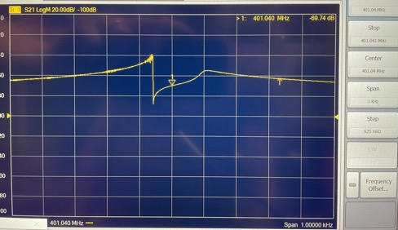
Failed Attempt with Cavity + HOM Dampers
Installed HHOM and VHOM with custom gaskets. Leak check was successful.
When both HOMs were submerged in liquid He (4.2K) the fundamental mode frequency tracking stopped working: RF breakdown at 100 mW of forward power made the test impossible: a screenshot of the NWA is shown below.
Prototype cavity #2 is currently at JLAB where it will be tested with HOMs after complete HPR and assembly in JLAB cleanroom.
More information on prototype HOMs couplers in N. Huque’s talk.
Jlab
V-HOM
CERN Impedance Adapters
Jlab
H-HOM

Slide 12
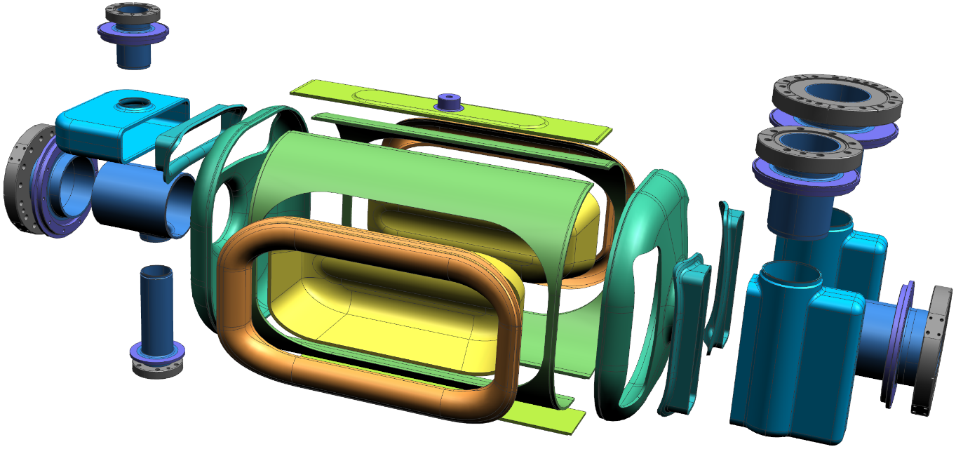
Bare Cavities Fabrication at Zanon: Strategy
Fabrication Details in Manuele’s Talk
Transition
V-HOM
Racetrack
V-HOM
Waveguide
Transition
H-HOM
H-HOM
Waveguide
Beam Axis Extr.
Antenna
Extr.
Corner
Pole
FPC
Waveguide
Half Main Body
End Cap
Transition
FPC
  Adopted CERN specification drawing for Pre-series RFD fabrication
  Extremities tubes machined from Nb seamless pipes (no roll-forming)
  Single design for all the Transitions (machined from a block)
  CNC interfaces and EBW joints handled as ZRI know-how

Slide 13
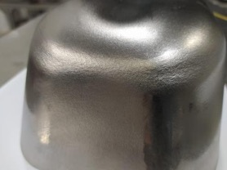
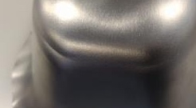
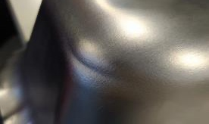
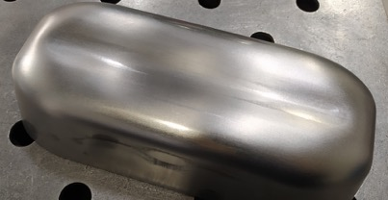
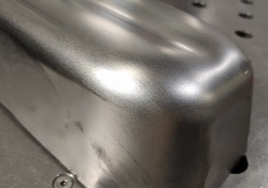
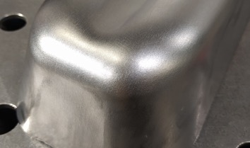
Pole Forming Issues: Now Resolved
First trials with Nb batch for Pre-Series cavities were not ideal. Excessive thinning and orange peel effect was observed in the corners.
Trials with Nb batch for Series produced better results, also thanks to an improved 2-step process developed by Zanon consisting of a partial drawing followed by cutting of the crown and final drawing.

Slide 14
Pole Forming: Process Finally Under Control
Prototypes
Forming Issues
Solution
Limits from Eng. Spec.

Slide 15
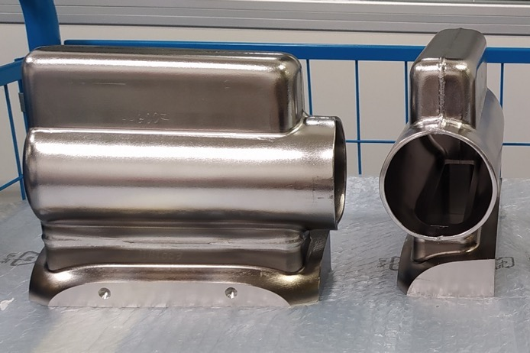
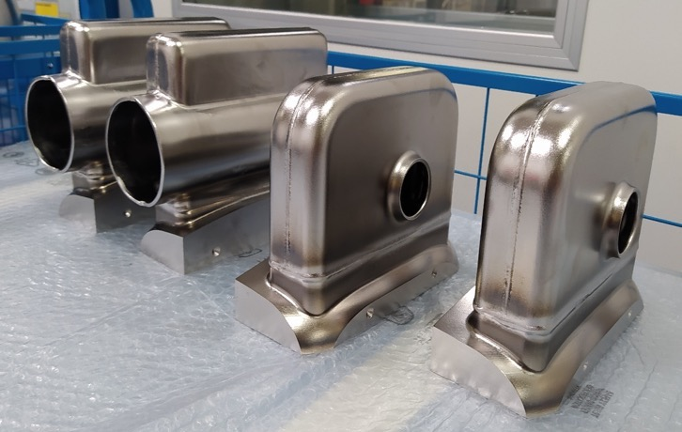
Pre-Series Advancement at Zanon
Components for 2 pre-series cavities in advanced/final stages of manufacturing. Electron-beam welding started with all necessary approvals in place (see pictures).
First Pre-Series bare cavity should be ready for frequency trim-tuning before the end of the year and should be completed in early 2023.
Option to process/prepare at Zanon is being considered.

Slide 16
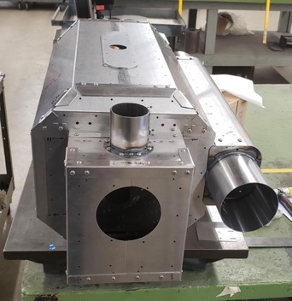
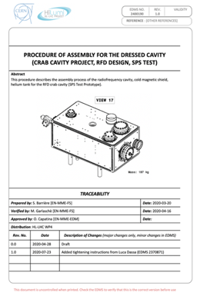
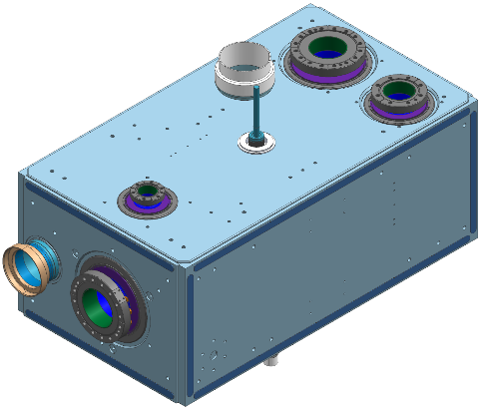
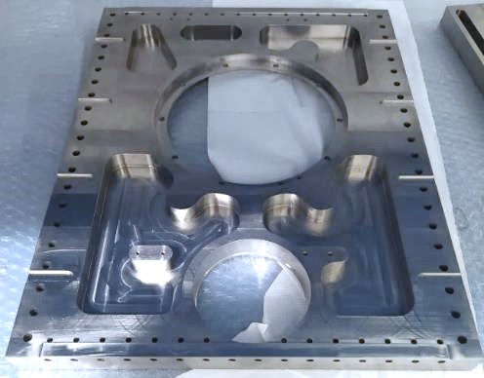
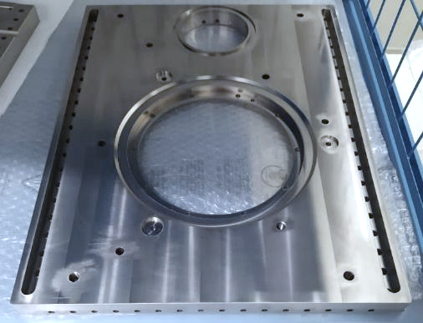
Helium Tank Advancement at Zanon
Contract is in place for 2x He Tanks prototypes fabrication at Zanon.
Most of the Sub-components have been manufactured (see Titanium plates below).
RFD proto#1 and Magnetic Shields (Ad-Vance) are at Zanon for integration.
3 Shield Assemblies are at FNAL (Ad-Vance)

Slide 17
Prototype #1 Plans
Prototype #1 is now at Zanon to receive a full processing cycle in Nov-Jan (Bulk BCP, 600C bake, light BCP).
Subsequently Zanon will proceed with Helium Tank integration on this cavity.
Finally, it will be fully prepared for a cold test by means of HPR, clean room assembly + RF probes, and shipped to FNAL for cold test.
Goal is to validate multiple processes with Prototype #1.
Processing and cold-test preparations at Zanon of pre-series/series cavities is a possibility.
Jacketed Prototype #1 expected at FNAL ~ Spring 2023 for cold test.

Slide 18
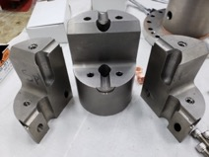
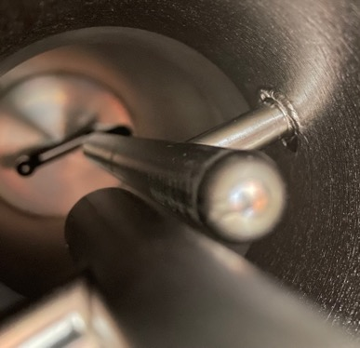
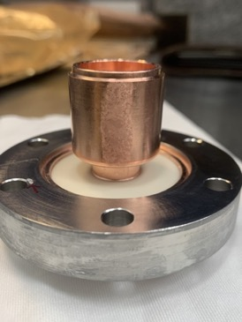
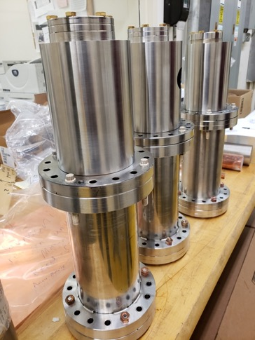
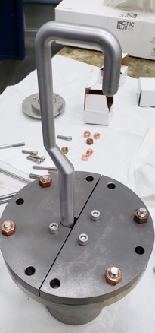
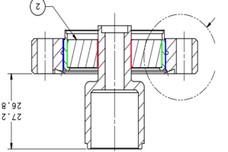
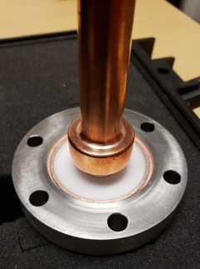
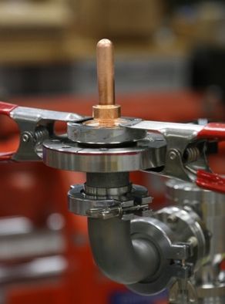
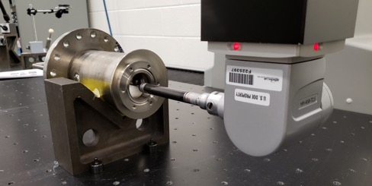
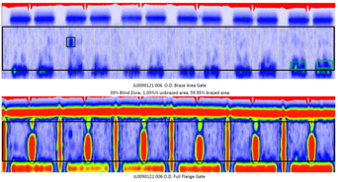
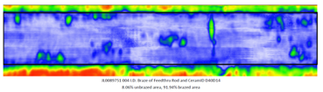
HOM Dampers Prototypes at Jlab
See talk by Naeem Huque
V-HOM Feedthrough Brazing
H-HOM Hook & Tee EBW
H-HOM Fabrication
H-HOM Feedthrough Brazing
H-HOM Metrology

Slide 19
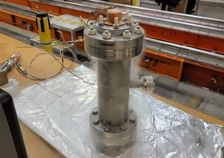
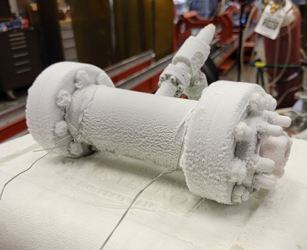
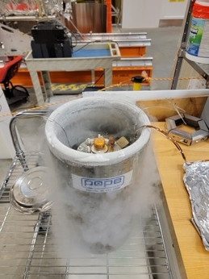
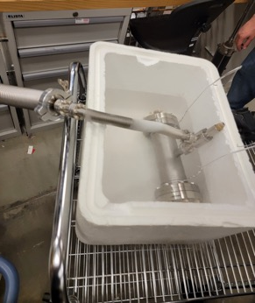
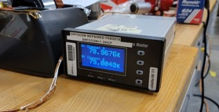
HOM Dampers - Status
Continued troubleshooting prototype ancillaries that caused leaks at FNAL during cold tests.
Achieved leak tightness for 1 set at liquid nitrogen temperature on test bench (see pictures below).
Thanks to Eric for sending test spool piece from CERN (pictured below).
Jlab will be installing this set on Prototype #2 and perform a cold test at Jlab vertical test facility.
Minor interface tooling being finalized to allow the cold test in the next month.
Cold shocks
Cold leak-checks

Slide 20
Transition Plan: Prototypes, Pre-Series, Series
LARP prototypes (2017-2019):
  Validation of cavity design in achieving key performance requirements (e.g. deflecting voltage, quality factor).
  Validation of FNAL/ANL facilities and processes for surface chemical processing, heat-treatments and cold test.
AUP prototypes (2020-2021):
  First development of fabrication process at Zanon.
  First development of QA documentation.
  Practice with CERN system for Manuf. Records & NCRs.
  Confirmation of FNAL/ANL facilities and processes.
  Validate Zanon facilities for processing.
AUP Pre-Series (2021-2022):
  Convergence with CERN on fabrication and QA documentation (DWGs, MIP, welding book, NCRs,..).
  Validate fabrication process, including processing, at Zanon.
AUP Series (2022-2023):
  Repeat process of pre-series, deliver cavities to FNAL ready for VTS.
1 year ago
NOW

Slide 21
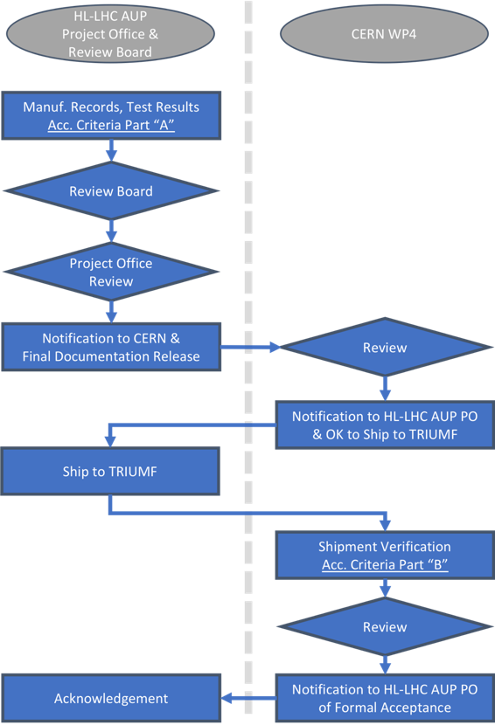
Acceptance of RFD cavities
Acceptance Plan
  US-HiLumi-doc-1744
  Describes the process for acceptance between AUP and CERN, including OK to ship from CERN, and final checks at TRIUMF after receiving
Acceptance Criteria – Part A (at FNAL)
  US-HiLumi-doc-1154
  All requirements from FRS will be verified with a test or a set of measurements during cavity production or during final tests at FNAL.
Acceptance Criteria – Part B (at TRIUMF)
  US-HiLumi-doc-2896
  Series of tests/measurements to be carried out at TRIUMF under AUP supervision to confirm performance of cavities after shipment
Formal acceptance by CERN
  Cavity becomes property of CERN
  TRIUMF begins cryomodule integration

Slide 22
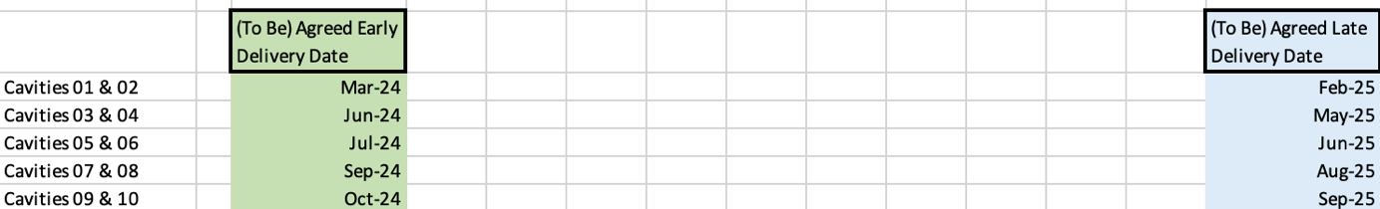
Delivery Dates
First jacketed prototype expected at FNAL early 2023 and possibly ready for shipment to TRIUMF in Spring-Summer of 2023.
Second jacketed prototype has unsure future, currently used to troubleshoot HOM dampers issues at Jlab. Ideally a successful cold test before the end of year and jacketing at Zanon first part of 2023 for a delivery to TRIUMF in Fall of 2023.
Deliveries to TRIUMF of 10 (Deliverable) dressed cavities span March 2024 – Oct 2024 according to working schedule. Will need to be agreed upon with CERN prior to DOE Rebaseline Review in Dec. 2022.
1 cell = 1 month

Slide 23
Summary
Scope and Deliverables have been stable, with key documents recently released by CERN allowing AUP to fully transition into production.
AUP Prototypes exceeded project requirements in 2021.
Pre-Series cavities in advanced stages of fabrication at Zanon also thanks to successful EBW qualification obtained.
Unexpected pole-forming issues were solved leveraging Zanon know-how.
First jacketed and processed prototype expected at FNAL in ~ Spring 2023.
Cold Test with HOM Dampers will be re-attempted before the end of 2022 at Jlab.
Acceptance Plan between CERN and AUP is unchanged, but delivery dates (post-COVID) need to be agreed upon urgently in preparation of DOE Re-baseline review.

