Slide 1

TCC summary and
HL-LHC Baseline evolution
Markus Zerlauth – CERN
On behalf of the HL-LHC project
Uppsala – September 19th to 23rd

Slide 2
Outline
Overview and managerial process of Layout and Baseline evolutions
HL-LHC baseline evolution since Annual Meeting 2021
  Approved/implemented baseline changes
Upcoming baseline changes under preparation
Conclusions

Slide 3
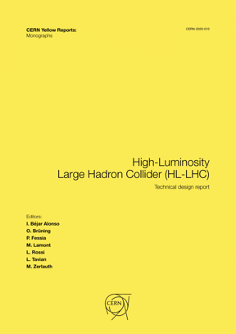
Evolution of Project Baseline (Machine Layout Versions)
Dec 2020: TDR V1.0
Oct 2016: TDR V0.1
CSR’19
CSR’18
CSR’21
CSR’16
CSR’22
V1.4 September 2018
Full remote alignment:
reduction orbit correctors,
new Q4-Q5 position,
MBH, TCLD, MQW, TDIS, TANB
V1.2 November 2015
New triplets lengths and
gradients.
V1.3 November 2016
2CC per IR/side/beam,
Q4 with MQY, 4.5K for Q6,
MQY at 1.9 for IR6
V1.5 November 2019
Small updates from V1.4
Optimization TAXN-D2 area
V1.1 September 2014
2014
2015
2016
2017
2018
2019
2020
2021
2022
V1.6 June 2022
MQXFA/B – Update of Magnetic length and Mechanical-Magnetic offset
CC interchangeability, Space reservation for FP, Change of length TCLMB and TCLMC
Descope MS10, Addition of electrical circuits

Slide 4
Managerial process
Technical Coordination Committee:
Technical assessment and decision on scope changes and consequences on schedule/cost
Baseline EVM:
Implementation of changes in WP’s Cost-to-completion
Baseline EVM
TCC
Engineering Change request:
scope change assessment & approval
Decision Management Report:
Cost/schedule change
Schedule Change Request:
change impacting master schedule of WP/project
ECR/ DMR/SCR
PSM
Project Steering meetings, per WP:
Assessment and decision on budget changes and schedule changes
Courtesy: G. Vandoni
Notes:
Is the definition Extra scope appropriate? Meanwhile, I don’t think so anymore.

Slide 5
Project Organization for Managing the Process
PSM
Project Steering Meetings
TCC
Technical Coordination Committee
Started in 2017
Scope: review of each WP by HLPO with GL & Dep. Head concerned, of: budget, MS & DLV, procurement and production plan
Chaired by HLPL
So far 205 PSMs
  40 in 2017
  38 in 2018
  70 in 2019
  71 in 2020
  48 (+7) In 2021 / not counting C&SR preparation
  4 times :WP3 / WP4 / WP5 / WP6A / WP17
  3 times: WP6A / WP7 / WP8 / WP9 / WP12 / WP13 / WP15 / WP16
  Twice: WP2 / WP10 / WP14 / WP18
Installed in 2016 (merging TC and PLC of HiLumi)
Chaired by DPL
In total 162 meetings (ca. 28/y)
540 presentations
Average attendance of ca. 60 people in remote! Since May this year very successful return to in-presence meetings with similar attendance!
Collaboration Steering Committees
Organized for each Collaboration
Chaired by Collaboration partner and PL
At least once per year per collaboration
In total ca. 42 Meetings so far, 9 in 2021

Slide 6
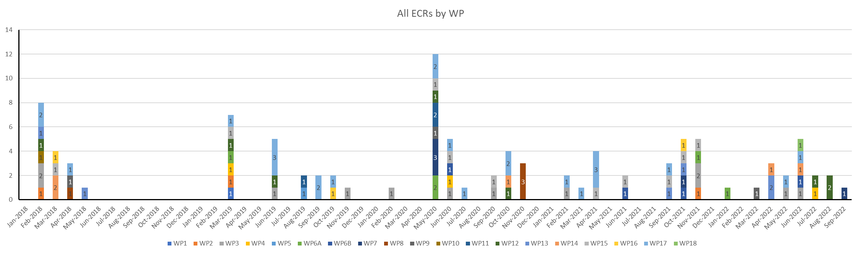
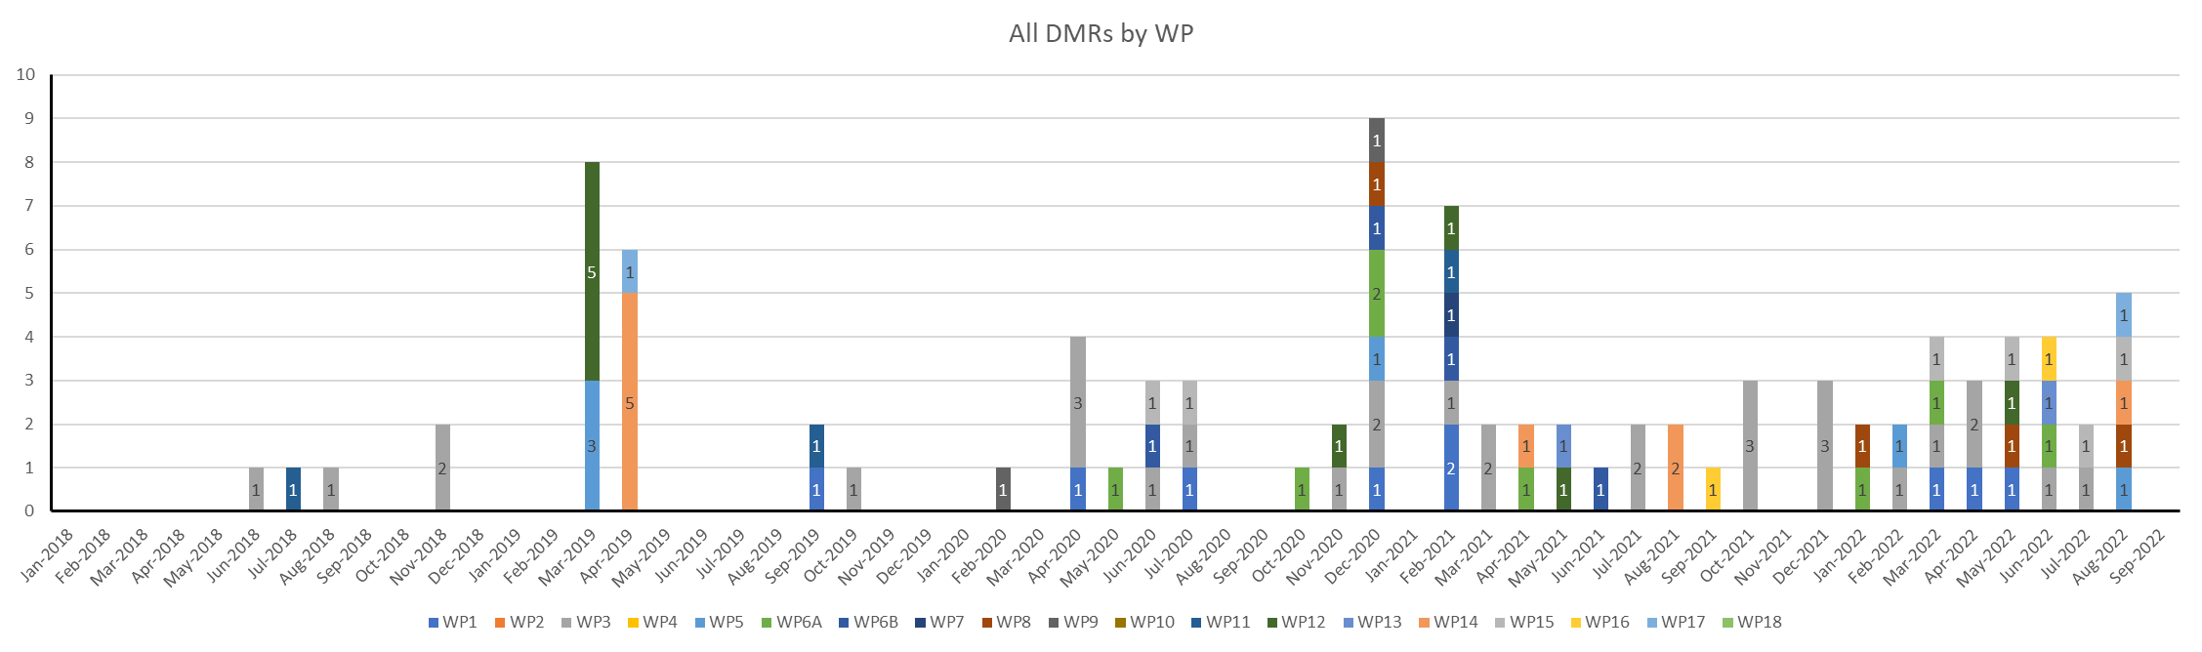
ECRs and DMRs by WPs throughout the project
TOTALS
 | Qty
ECR | 102
DMR | 105
Total | 207
Courtesy: V. Guillen Humbria

Slide 7
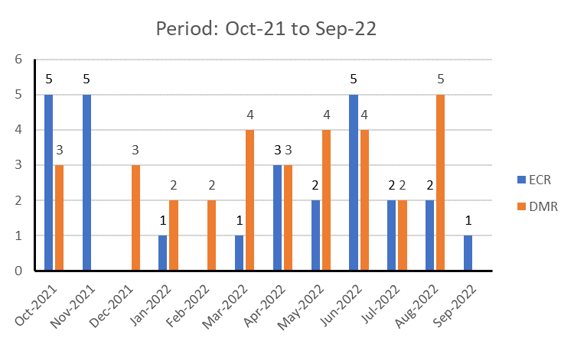
ECRs and DMRs since last Annual Meeting
(27 in past 12 months)
(32 in past 12 months)
Courtesy: V. Guillen Humbria

Slide 8
Reasons for Baseline changes can be varied
  Performance Risk mitigation (design optimisations,..)
  Schedule risk mitigation (in-sourcing of late in-kind contributions)
  Descoping (in-kind, deferrals not necessary for LS3, coating options…)
  Additional scope (managerial decisions, controlled CD/WU, access bridges,...)
  Overcost (tenders in current market situations)
  Missed scope (typically at interfaces)
  Overcost risk mitigation
  Other

Slide 9
HL-LHC Baseline Changes (via ECRs/TCC)
Cable Routing for CP package ad ELQA rack
High-performance variant of the DI/OT platform for the Full Remote Alignment System
Naming conventions for functional position codes for HL-LHC buildings and galleries
FRAS functional software specification
Access bridges over beam line elements
Double QXL and suppression of QUIG
Descoping of dedicated Interlock channels for very fast failure cases
New baseline for IT String Utilities and Measurements
New UR layout and WCC/ACC
Vac equipment support modification
Descoping of BPMQSWZB
Replacement of BPTX by BPTQX
Oct’21 Nov Dec Jan’22 Feb Mar Apr May Jun Jul Aug Sep Oct Nov Dec’22
Updated design of inner layer for MCBXFB
WP6a controlled WU/CD
Crab Cavity Instrumentation (APWL pick-ups)
Energy extraction systems for the HL-LHC RQSX3 circuits
Descoping of a-C coating in the standalone magnets
Update of MQXFA/B length
Controller for FGC3 power converters
Deferral of Installation of Lattice Sextupole in Q10 in Points 1 and 5 to LS4
Installation of DIS readers
Update of magnet delivery plan to IT String
Maintaining option of swapping X-plane for CC in Layout V1.6
BPM specification
Change of conceptual Layout of DFHX/DFHM
High Current DC busbars for the IT and MS magnet strings

Slide 10
HL-LHC Baseline Changes (via ECRs/TCC)
Cable Routing for CP package ad ELQA rack
High-performance variant of the DI/OT platform for the Full Remote Alignment System
Naming conventions for functional position codes for HL-LHC buildings and galleries
FRAS functional software specification
Access bridges over beam line elements
Double QXL and suppression of QUIG
Descoping of dedicated Interlock channels for very fast failure cases
New baseline for IT String Utilities and Measurements
New UR layout and WCC/ACC
Vac equipment support modification
Descoping of BPMQSWZB
Replacement of BPTX by BPTQX
Oct’21 Nov Dec Jan’22 Feb Mar Apr May Jun Jul Aug Sep Oct Nov Dec’22
Updated design of inner layer for MCBXFB
WP6a controlled WU/CD
Crab Cavity Instrumentation (APWL pick-ups)
Energy extraction systems for the HL-LHC RQSX3 circuits
Descoping of a-C coating in the standalone magnets
Update of MQXFA/B length
Controller for FGC3 power converters
Deferral of Installation of Lattice Sextupole in Q10 in Points 1 and 5 to LS4
Installation of DIS readers
Update of magnet delivery plan to IT String
Maintaining option of swapping X-plane for CC in Layout V1.6
BPM specification
Change of conceptual Layout of DFHX/DFHM
High Current DC busbars for the IT and MS magnet strings

Slide 11
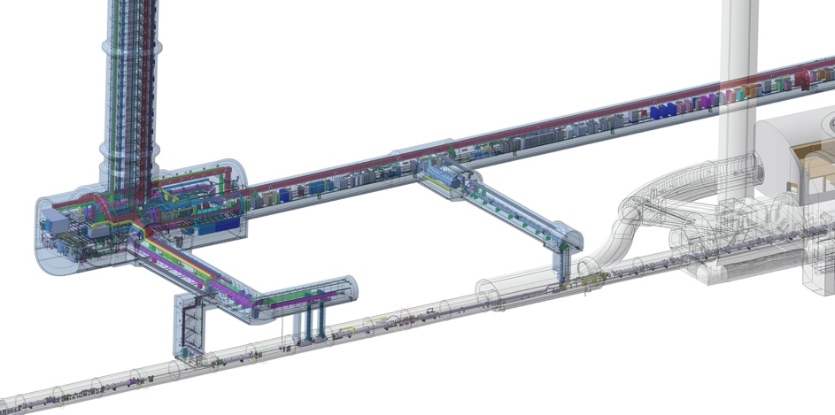
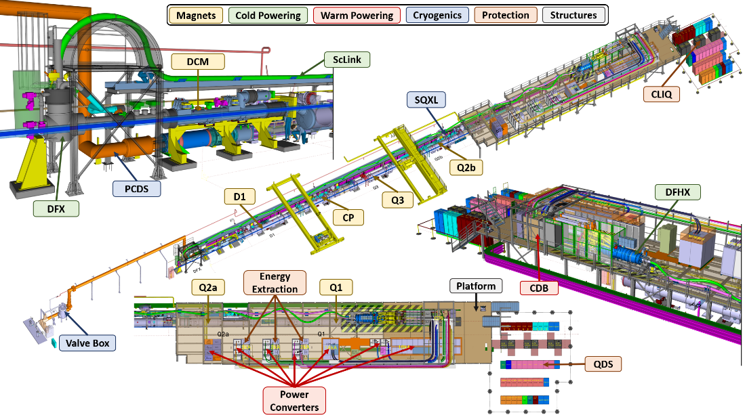
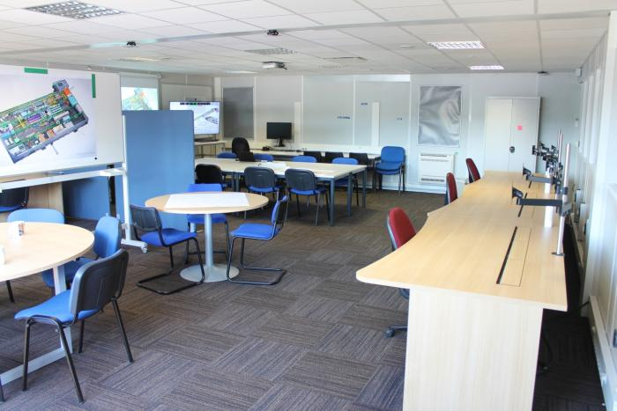
WP16 – IT String
LHC-XMSAH-EC-0001 v.1.0 New Baseline for IT String utilities
Modifications of the IT String utilities to be conform to the integration and the technical design of the HL-LHC inner triplet equipment in the tunnel (AC distribution, WCC and busbars, power converters and integration, signal cabling...). As such, the HL-LHC IT String integration will be preserved to be as close as possible to the installation of the IT zone in the tunnel to validate and solve potential issues that might arise during installation and operation in the final tunnel configuration.
UR
LHC tunnel
IT String control room in SM18
HL-LHC IT String Day II on 15/09
IT String and infrastructure integration in SM18
Notes:
HL-LHC IT String Day II

Slide 12
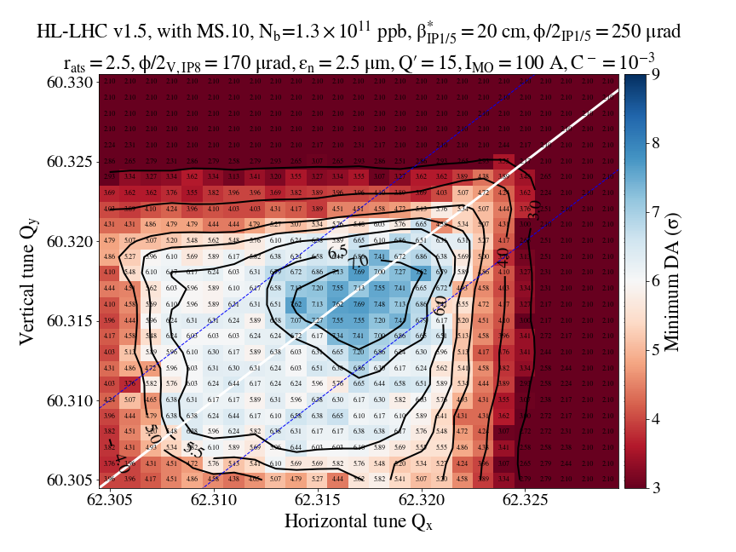
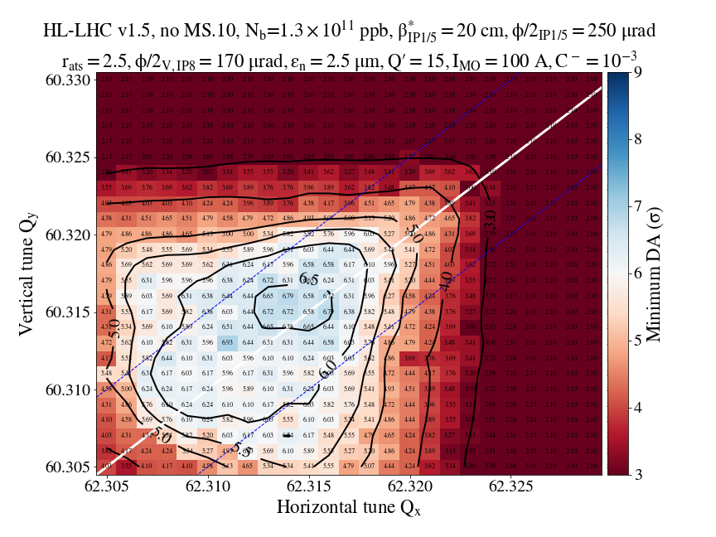
Beam optics and magnet system (WP2/WP3)
LHC-M-EC-0005 v.1.0 Deferred Installation of additional sextupole at Q10 in P1 and P5
Simulations showed that this modification is not absolutely required to meet the performance goals of Run 4 (i.e a beta*=20cm). It was therefore agreed to defer the installation of the MS in Cell 10 in Points 1 and 5 from Long Shutdown 3 (LS3) to LS4 in order to alleviate the workload for de-/installation and magnet refurbishment activities during LS3.
UR
LHC tunnel
Lower beta* represents important performance risk mitigation in view of bunch intensity limitations!
Proposed for re-inclusion in baseline following shift and extension of LS3
Dynamic aperture with (left) and without (right) additional lattice sextupole at Q10

Slide 13
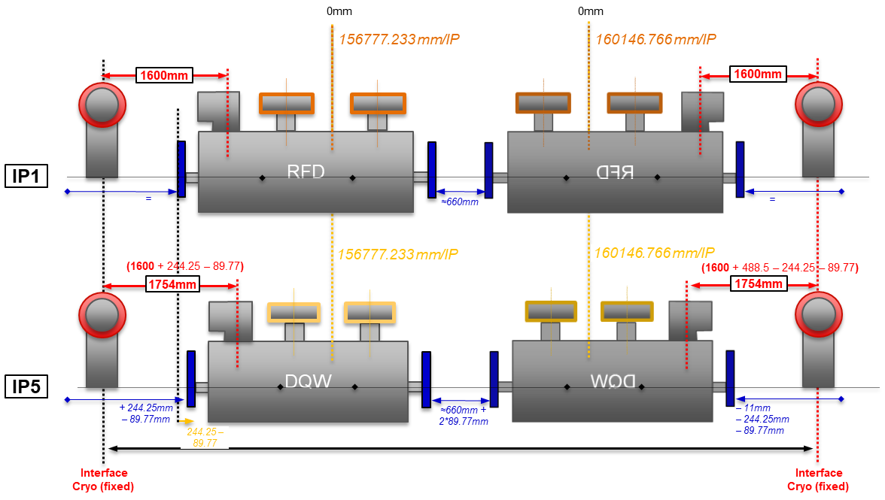
Crab Cavities in optics version 1.6
LHC-ACF_A-EC-0001v.1.0 Crab Cavities in optics version 1.6 – Shift of Civil Engineering cores, adaptation of cryogenic and of vacuum elements
Two types of crab cavities and, therefore, cryomodules are required: the Double Quarter Wave (DQW) in IP5 and the RF Dipole cryomodule (RFD) in IP1 where the crossing angle is implemented in the horizontal plane. To maintain interchangeability of the crab cavities between IP1 and IP5 following a revised cryo-module design, interfaces and integration are updated.

Slide 14
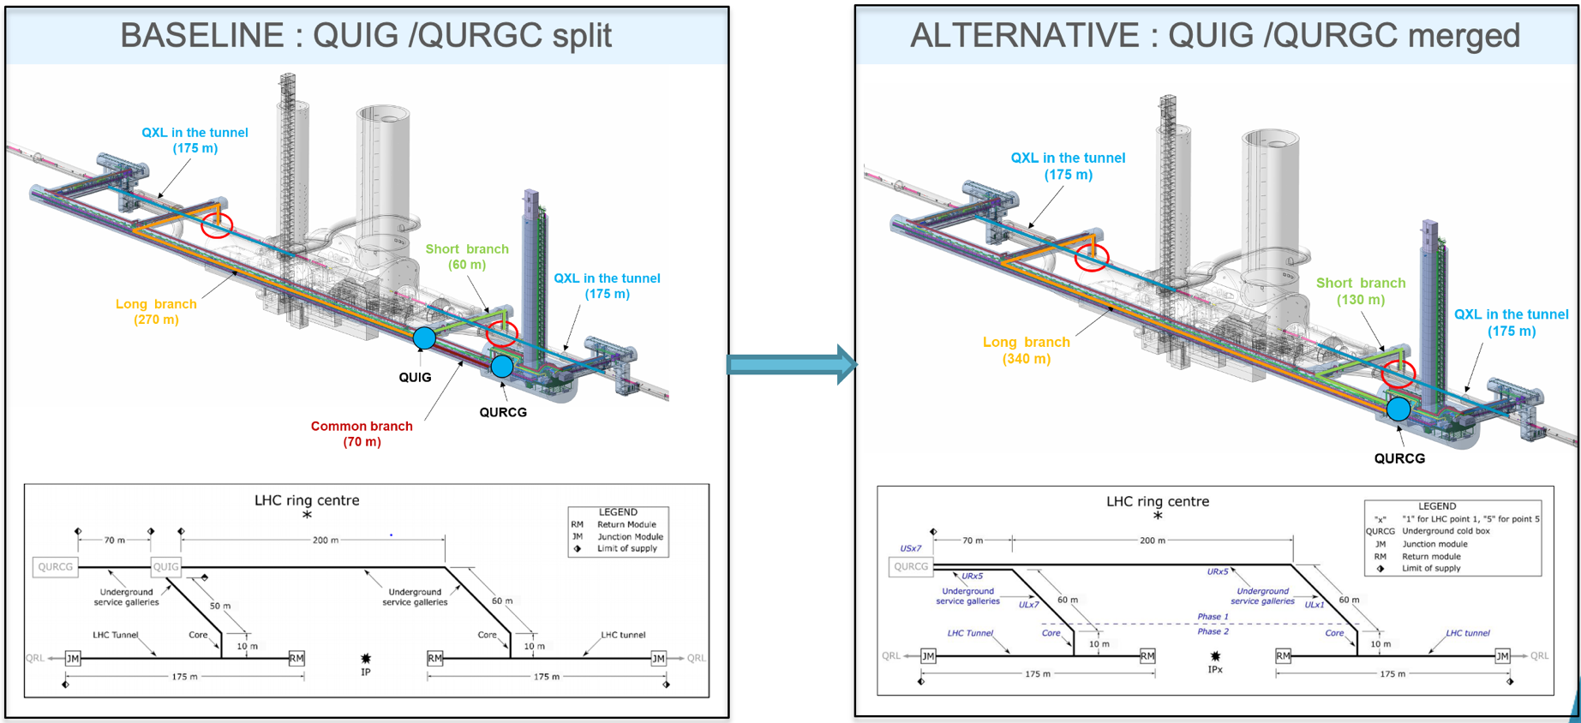
Cryogenics (WP9)
LHC-QUIG-EC-0001v.1.0 Suppression of interconnection box QUIG
Proposed simplification of the cryogenic architecture and suppression of the independent QUIG in the HL-LHC Layout version 1.6.
Functions at the origin of QUIG were studied and attributed to other sub-systems (or simply not retained)
study was started with double QXL directly from US cavern, both for process and integration aspects
UR
LHC tunnel

Slide 15
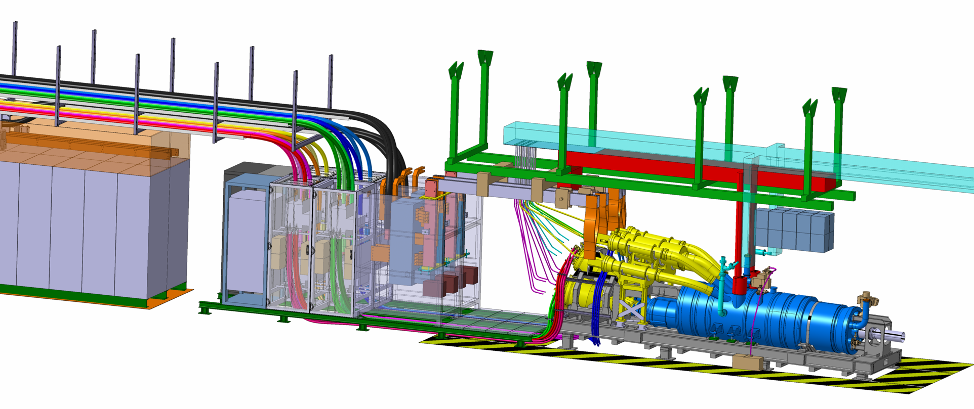
Powering System – UR side (WP6a/b)
Warm Powering system and interface to DFHX/M now fully defined, incl
Adaption to latest UR layout and DFHX/M design
Optimisation and standardisation of DC cables and ventilation needs
Definition of high current DC copper busbars, their cooling system and interfaces with DFHX/M
UR
New UR layout: impact on DC cables and ventilation
LHC-DFH-EC-0006 v.1.0
LHC tunnel
Copper busbars and water cooled plates
LHC-RP-EC-0006
Power converters and
EE systems
Circuit Disconnector Boxes
LHC-RP-EC-0005
Change of Conceptual design of DFHX/M
LHC-DFH-EC-0006 v.1.0

Slide 16
HL-LHC Managerial Decisions (via DMRs)
SM18 Bench-Reconfiguration for testing of WP3 magnets and WP6A SC Links
Software support for cold powering tests of HL-LHC magnets in SM18
Strategy for the procurement of cables for higher radiation tolerance for HL-LHC
Updated EN/EL Manpower Plan for WP17.2 / WP15
Quench Heaters Design for MQXFB
Integration of Minor Civil Engineering works to
HL-LHC activities
Production in-house of HL-LHC HTS Current Leads
Thermal Cycle for the HL-LHC IT String
Re-scheduling of ATLAS JFC3 shieling machining
Decision for descoping of Cu Coating of TAXN Y-chamber
Production of two MCBRD magnets at CERN with IHEP components
Oct’21 Nov Dec Jan’22 Feb Mar Apr May Jun Jul Aug Sep Oct Nov Dec’22
Construction of a fourth D2 corrector prototype at CERN
Manufacturing of one Y-chamber unit
Manufacturing of 4 TCPCs in-house
Strategy for CP cold masses
In-sourcing of HL-LHC BPMs at CERN
In-sourcing of LS3 Collimators and Masks
De-scoping of hollow e-lens
De-scoping of mechanical components of 4 series DFHX from Uppsala University
Strategy for the procurement of transport devices after the opening of IT-4579
Agreement for the extra costs of HOC and spare coils
Strategy for the D2 Series manufacturing
Purchase of additional 100 km of MgB2 wire
De-scoping of additional horizontal dilution kicker magnets
Strategy for the procurement of Vacuum Sector Valves (WP12 & WP4)
Differential longitudinal pressures across the HL-LHC IT Cold Masses

Slide 17
HL-LHC Managerial Decisions (via DMRs)
SM18 Bench-Reconfiguration for testing of WP3 magnets and WP6A SC Links
Software support for cold powering tests of HL-LHC magnets in SM18
Strategy for the procurement of cables for higher radiation tolerance for HL-LHC
Updated EN/EL Manpower Plan for WP17.2 / WP15
Quench Heaters Design for MQXFB
Integration of Minor Civil Engineering works to
HL-LHC activities
Production in-house of HL-LHC HTS Current Leads
Thermal Cycle for the HL-LHC IT String
Re-scheduling of ATLAS JFC3 shieling machining
Decision for descoping of Cu Coating of TAXN Y-chamber
Production of two MCBRD magnets at CERN with IHEP components
Oct’21 Nov Dec Jan’22 Feb Mar Apr May Jun Jul Aug Sep Oct Nov Dec’22
Construction of a fourth D2 corrector prototype at CERN
Manufacturing of one Y-chamber unit
Manufacturing of 4 TCPCs in-house
Strategy for CP cold masses
In-sourcing of HL-LHC BPMs at CERN
In-sourcing of LS3 Collimators and Masks
De-scoping of hollow e-lens
De-scoping of mechanical components of 4 series DFHX from Uppsala University
Strategy for the procurement of transport devices after the opening of IT-4579
Agreement for the extra costs of HOC and spare coils
Strategy for the D2 Series manufacturing
Purchase of additional 100 km of MgB2 wire
De-scoping of additional horizontal dilution kicker magnets
Strategy for the procurement of Vacuum Sector Valves (WP12 & WP4)
Differential longitudinal pressures across the HL-LHC IT Cold Masses

Slide 18
Russian in-kind contributions
Following the non-funding of Russian in-kind contributions, disucssions have been initiated with WPs and groups/departments to assess re-profiling/descoping options, considering performance impact for Run 4 along with their (resource) constraints and over-heads (follow-up, raw material price increase, risk) when in-sourced
Key components have been in-sourced or are being disucssed for alternative in-kind contributions in coherence with the schedule constraints
Additional horizontal dilution kickers and hollow e-lens have been descoped from HL-LHC project (as resource constraints don’t allow for their completion by LS3)
  For hollow e-lens: Engagements with in-kind partners and critical R&D and prototypes of key components will be completed within scope of ‘soft-landing’
  Dilution kicker: Update of design and production documentation supported by project to ensure capturing of know-how and expertise from LHC construction

Slide 19
Russian in-kind contributions
Desoping of hollow e-lens and dilution kickers represents a performance risk for Run4 , which can only be fully assessed/quantified following beam experience with target performance during Run3
  HEL: important feedback to come from beam lifetime and halo population studies with LIU beams / brightnesses (standard operation and dedciated MDs)
  Dilution kicker: Additional consolidation done during LS2 to reduce probability of critical failures; material studies and results from operational LHC dump are encouraging for an HL compatible dump design to be within reach.
Re-integration of items for long-term operation of (HL)-LHC kept as a future possibility, should Run 3 experience confirm their criticality
  Coordinated, project wide technical review proposed for mid-end 2023 to review Run 3 experience/MD results to confirm HL baseline choices and assess expected performance impact of descoping decisions

Slide 20
Russian in-kind contributions – Status of Plan B
WP | Item | Decision by | Comments
WP5 | Crystal collimators | Done | In-house production already done, descope double jaw version
WP6A | HTS current leads | Done | MME already produced 1/3 of series items as risk mitigation, now extended to complete series production taking place in-house. Procurement of raw materials ongoing. Estimated to remain within CORE value.
WP13 | BPM bodies | Done | MME successfully produced prototypes and to produce as well series.
WP5 | Collimators | Done | Production with member state industry under CERN lead. Procurement of raw materials and MS for assembly ongoing. Overhead in manpower for design and production (currently being assessed in detail).
WP14 | Beam dump kickers | Done | Defer (promising beam experiments and results from operational LHC dump indicating reliable HL-design)
WP8 | TAXN, TAXS | Ongoing | Y chamber prototype being built in industry and options for series being explored, either fully in industry or by MME. New in-kind being explored for purchase of raw material and machining of passive absorbers.
WP13 | BLMs | Done | Built to print as LHC design, in-sourcing plan defined.
WP4 | Solid state amplifiers | Ongoing | Decision to remain with IOTs as by baseline. New in-kind being explored, market survey in European industry in parallel
WP14 | Beam dumps | Ongoing | Studies ongoing, core material to be decided following outcome of recent (promising) HighRadMat test and needs for reliable long-term operation.
WP4 | RF transmission chain | Ongoing | RF power distribution lines, circulators and loads – New in-kind being explored, market survey in European industry in parallel
WP5 | Hollow electron lenses | Done | Defer (installation after LS3 if need confirmed by Run3 experience), as not compatible with current resources in MSC. Options for installation during Run4 being assessed.

Slide 21
Upcoming baseline changes (being formalised)
WP6b Descoping of radiation tolerant DCCTs for 60A converters
WP5 Descoping of hollow e-lens from HL-LHC project
WP7 Descoping of dedicated additional (BIS) interlock channels for fast failures
WP8 Descoping of Cu Coating of TAXN Y-chamber
WP14 Descoping of additional horizontal dilution kickers from HL-LHC project
WP15/WP17 Radiation tolerant fibres in HL scope

Slide 22
Conclusions
Technical baseline continues to evolve, albeit at an increasing level of granularity and detail
  27 Engineerig Change Requests (ECRs) + 32 Decision Management Reports (DMRs) approved over the past 12 months
New Layout V1.6 approved in July 2022
Confirmation and further scrutiny of HL baseline to continue in 2023 based on Run 3 experience

Slide 23
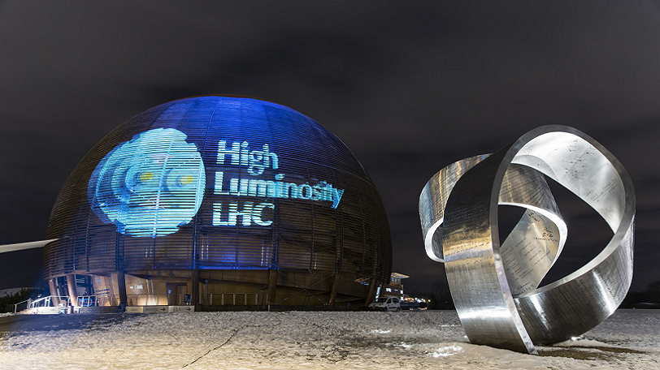

Thank you for your attention!
Questions?

Slide 24
HL-LHC Managerial Decisions (via DMRs)
EDMS | Description | Date | WP
2631530 | Construction of a fourth D2 corrector prototype at CERN | Oct-21 | WP3
2646046 | Quench Heaters Design for MQXFB | Nov-21 | WP3
2604419 | Agreement for the extra costs of HOC and spare coils | Dec-21 | WP3
2669588 | De-scoping of some mechanical components of 4 series DFHX from Uppsala University | Jan-22 | WP6A
2637180 | SM18 Bench-Reconfiguration for testing of WP3 magnets and WP6A SC Links | Feb-22 | WP1 WP3 WP6A
2688784 | Production two MCBRD magnets at CERN with components provided by IHEP | Feb-22 | WP3
2645981 | Manufacturing of 4 TCPCs in-house | Mar-22 | WP5
2595741 | Production in-house of HL-LHC HTS Current Leads | Mar-22 | WP6A
2724922 | Software support for cold powering tests of HL-LHC magnets in SM18 | Mar-22 | WP1 WP3
2675955 | Differential longitudinal pressures across the HL-LHC IT Cold Masses | Mar-22 | WP3
2717815 | Thermal Cycle for the HL-LHC IT String | Apr-22 | WP16
2694690 | Strategy for the procurement of transport devices after the opening of IT-4579 | Apr-22 | WP15
EDMS | Description | Date | WP
2685798 | Strategy for the procurement of cables for higher radiation tolerance for HL-LHC | May-22 | WP1 WP15
2721956 | Strategy for D2 series manufacturing | Jun-22 | WP3
2742239 | Integration of Minor Civil Engineering works to HL-LHC activities | Jun-22 | WP15
2736828 | Strategy for the procurement of Vacuum Sector Valves | Jun-22 | WP4 WP12
2726806 | In-sourcing of HL-LHC BPMs at CERN | Jun-22 | WP13
2740080 | Re-scheduling of ATLAS JFC3 shieling machining | Jul-22 | WP8
2737787 | Updated EN/EL Manpower Plan for WP17.2/WP15 | Jul-22 | WP15 WP17
2740267 | Purchase of additional 100 km of MgB2 wire | Jul-22 | WP6A
2771582 | Decision for Cu Coating of TAXN Y-chamber | Aug-22 | WP8
2771585 | In-sourcing of LS3 Collimators and Masks | Sep-22 | WP5
TBC | De-scoping of HELs and Dilution Kickers | Sep-22 | WP1

Slide 25
HL-LHC Managerial Decisions (via ECRs/TCC)
EDMS | Description | Date | WP
2612566 | Updated design of inner layer for MCBXFB | Oct-21 | WP3
2645150 | Maintaining option of swapping X-plane for CC | Oct-21 | WP15
2640455 | Access bridges over beam line elements | Oct-21 | WP15
2709180 | Access conditions to HL-LHC LSS and sectors as a function of cryogenics and powering | Dec-21 | WP1
2499201 | Crab Cavity Instrumentation | Feb-22 | WP13
2709180 | Double QXL | Mar-22 | WP9
2589302 | FRAS functional software specification | Mar-22 | WP15
2387369 | BPM specification | Mar-22 | WP2
2728908 | Update of MQXFA/B length | Apr-22 | WP3
2445632 | High-performance variant of the DI/OT platform for the Full Remote Alignment System | May-22 | WP15
2386350 | New UR layout and WCC/ACC | May-22 | WP17
2453935 | High Current DC busbars for the IT and MS magnet strings | Jun-22 | WP6b
2721195 | Energy extraction systems for the HL-LHC RQSX3 circuits | Jun-22 | WP7
2740898 | Update of magnet delivery plan to IT String | Jun-22 | WP7
2349917 | Naming conventions for functional position codes for HL-LHC buildings and galleries | Jul-22 | WP1
2755105 (tbc) | Descoping of dedicated Interlock channels for very fast failure cases | Sep-22 | WP7
2755103 (tbc) | Descoping of a-C coating in the standalone magnets | Sep-22 | WP12

Slide 26
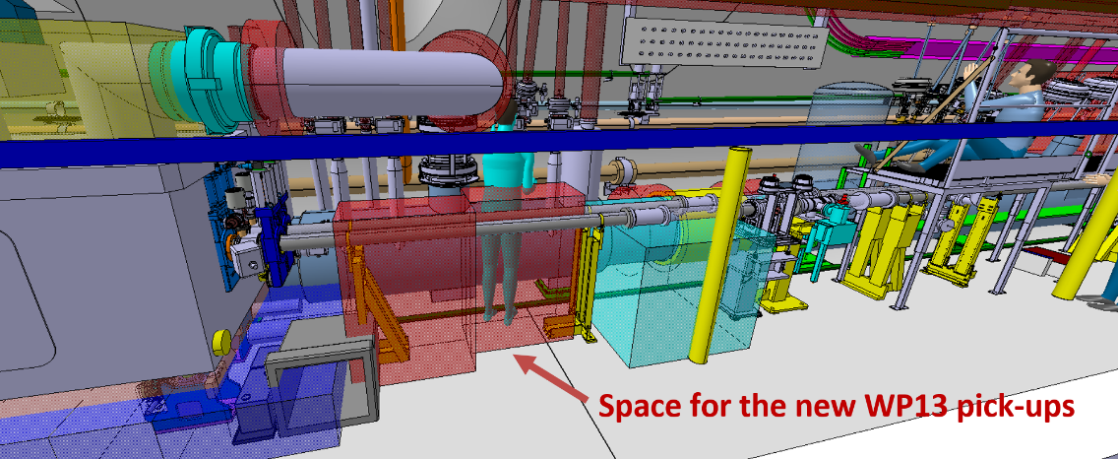
Crab Cavities in optics version 1.6
LHC-ACF_A-EC-0001v.1.0 Crab Cavities in optics version 1.6 – Shift of Civil Engineering cores, adaptation of cryogenic and of vacuum elements
Two types of crab cavities and, therefore, cryomodules are required: the Double Quarter Wave (DQW) in IP5 and the RF Dipole cryomodule (RFD) in IP1 where the crossing angle is implemented in the horizontal plane. To maintain interchangeability of the crab cavities between IP1 and IP5 following a revised cryo-module design, interfaces and integration are updated.
LHC-BPMQ-EC-0001v.1.0 Replacement of APWL pick-ups by a new pick-up designed by WP13
APWL wall current monitors were tentatively foreseen to provide diagnostics needed to safely and efficiently operate the CCs. Now proposed to be replaced by (combination of) new pick-ups managed by WP13. Awaiting final specs, working baseline changed to
  button electrodes for phasing the CC
  button electrodes for filtering the CC antenna direct beam coupling
  stripline electrodes for CC amplitude and noise feedback

Slide 27
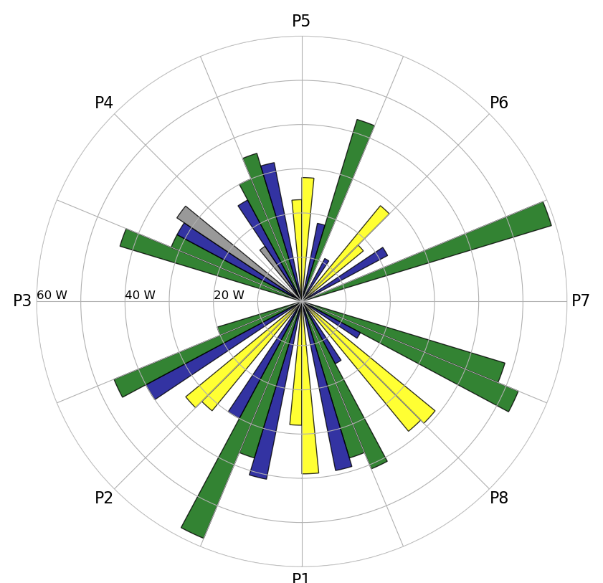
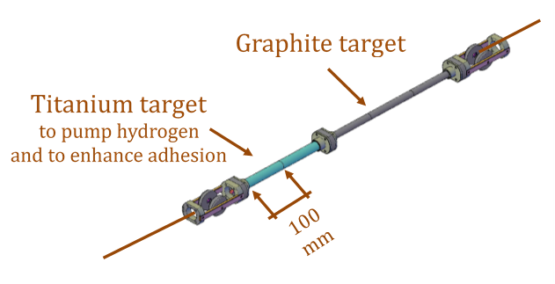
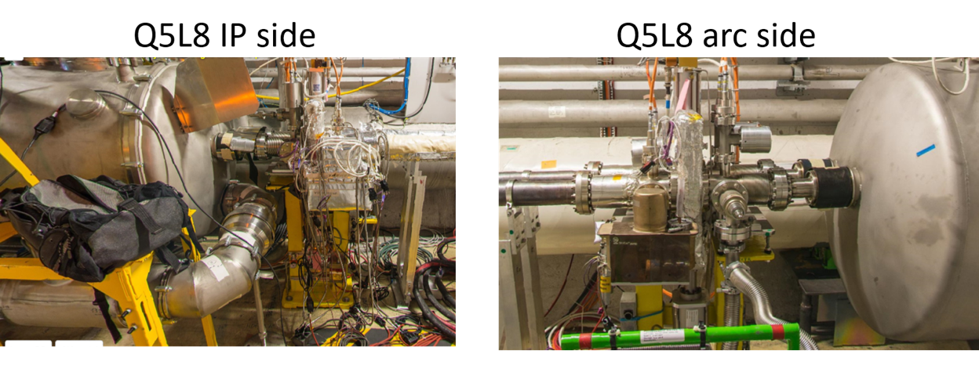
Descoping of aC coating in SAM
LHC-VS-EC-0002v.1.0 Descoping of amorphous carbon coating in the Q5R2, Q6R2, Q6L8 standalone magnets
A first in-situ coating campaign on shorter magnets was desirable to demonstrate during RUN 3 the efficiency of the surface treatment as well as to allow for an early validation of the procedure, tooling and activity duration. Additional margin in the refrigeration power for the sectors 23 and 78, re-aligning the heat load in these sectors to others was also beneficial. For these reasons, the in-situ coating of Q5L8, Q6L8, Q5R2 and Q6R2 was added during Run 2 in the HL-LHC base line. Due to presence of cryosorbers, only Q5L8 could be successfully coated during LS2.
Weak sector
Weak sector

Slide 28
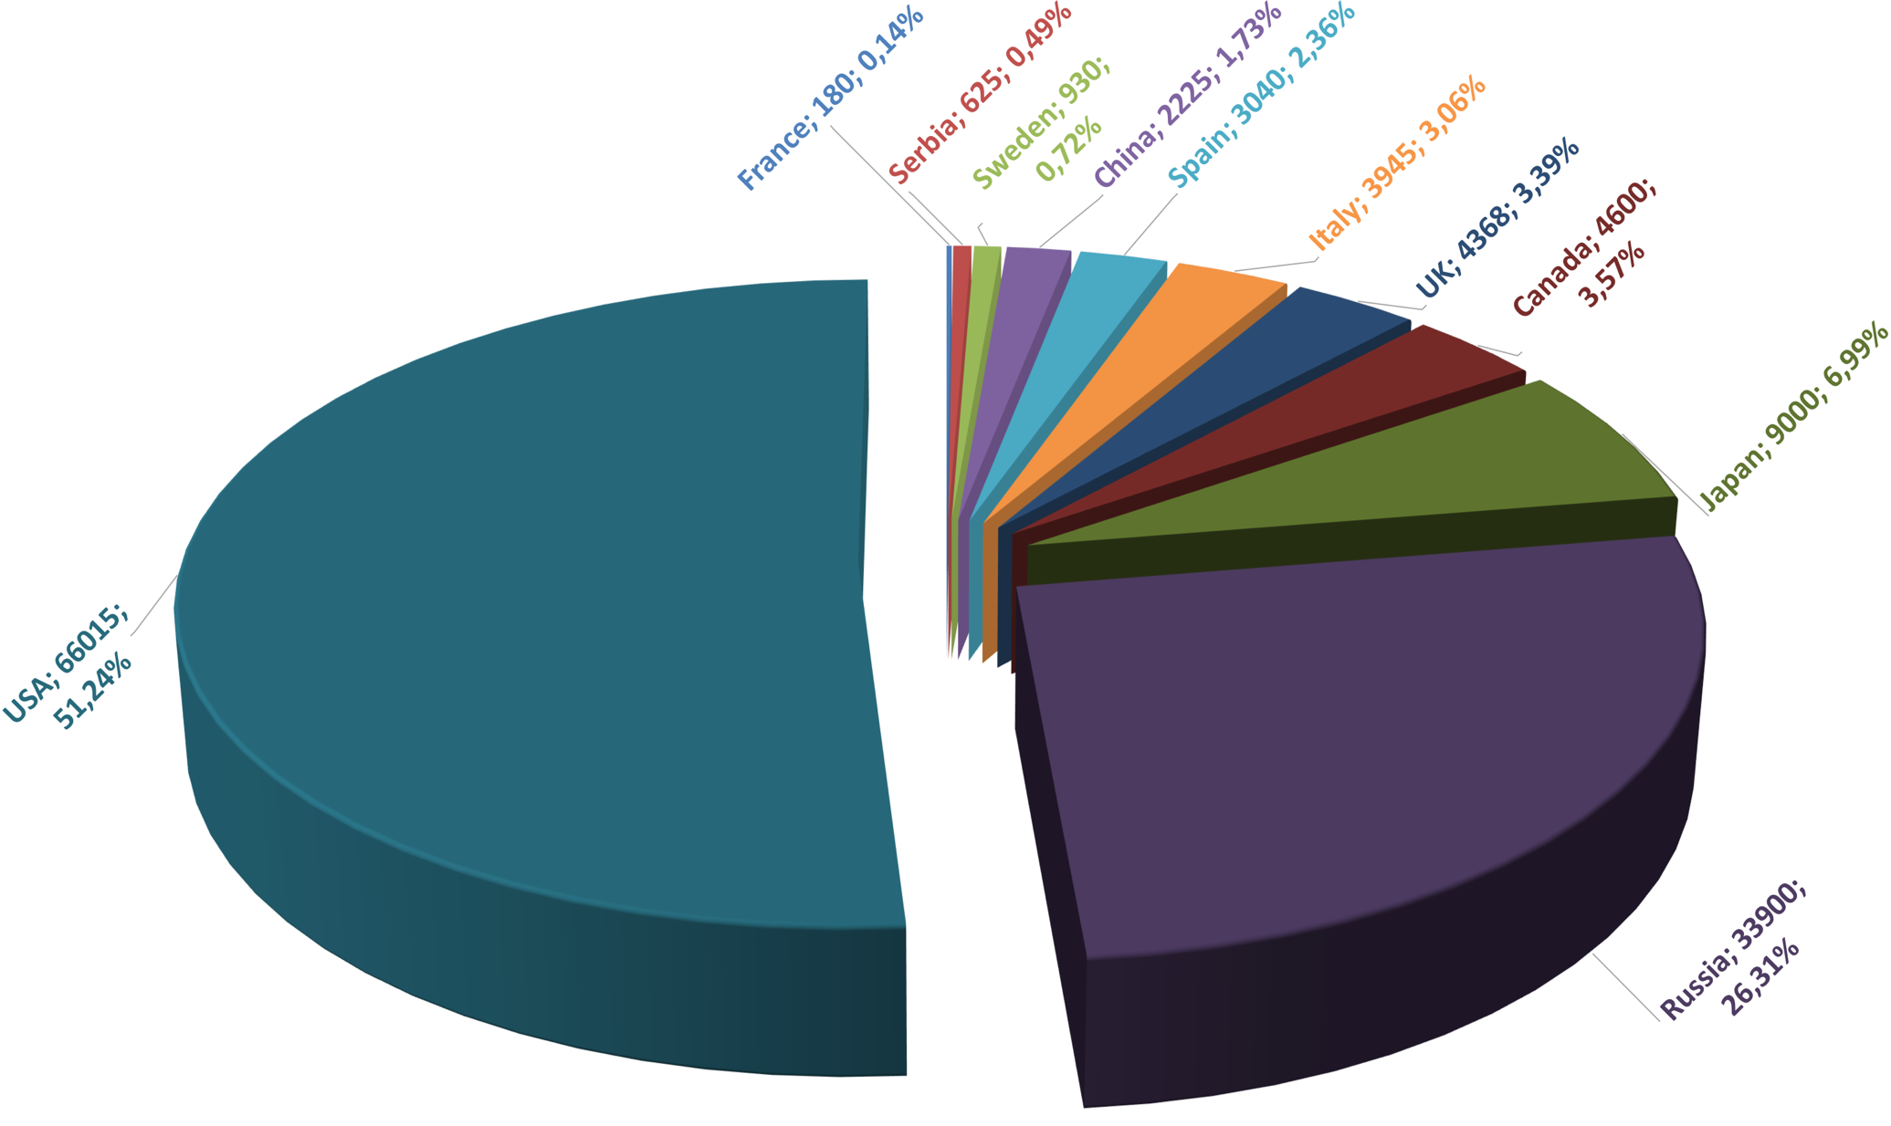
Graphical summary of the in-kind contributions as by CSR’21
Country; (kCHF); %

