Slide 1
MKI Cool
Miguel Diaz Zumel
Acknowledgements:
M.J. Barnes, C. Bracco, W. Bartmann, O. Bjorkqvist, L. Ducimetière, B. Goddard, T. Kramer, T. Maurin, V. Namora, A. Porret, T. Stadlbauer, P. Trubacova, L. Vega Cid, V. Vlachodimitropoulos, W. Weterings
Uppsala – September 19th to 22nd 2022

Slide 2
Outline
Context
  MKI purpose and design
  Cr₂O₃ coating
  Damping element and MKI cool
Issues – now solved
  HV breakdowns
  Unsuccessful conditioning
Issue – understood
  Mis-manufactured alumina tubes
  Present work
Status of first MKI cool to be installed in LHC
Conclusions

Slide 3
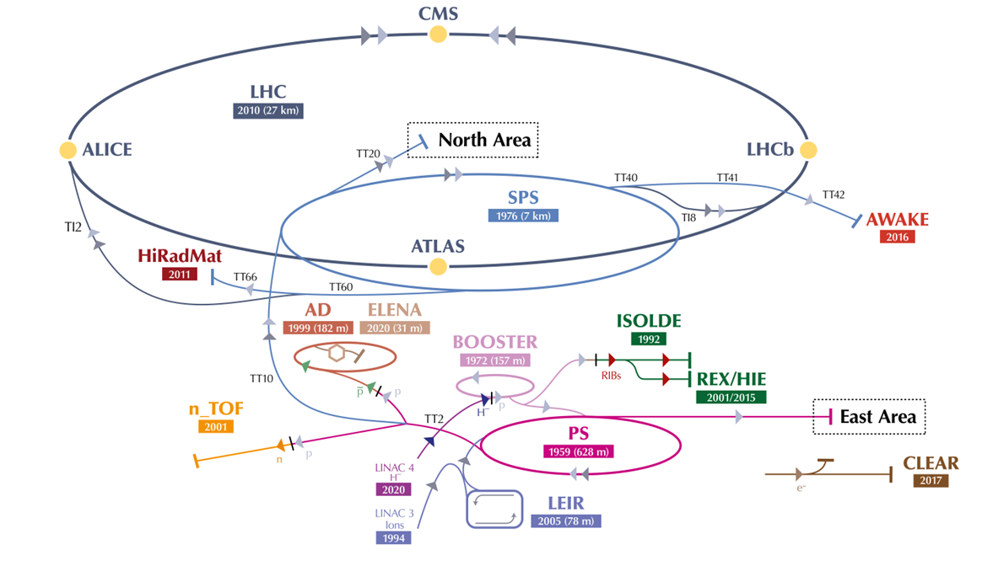
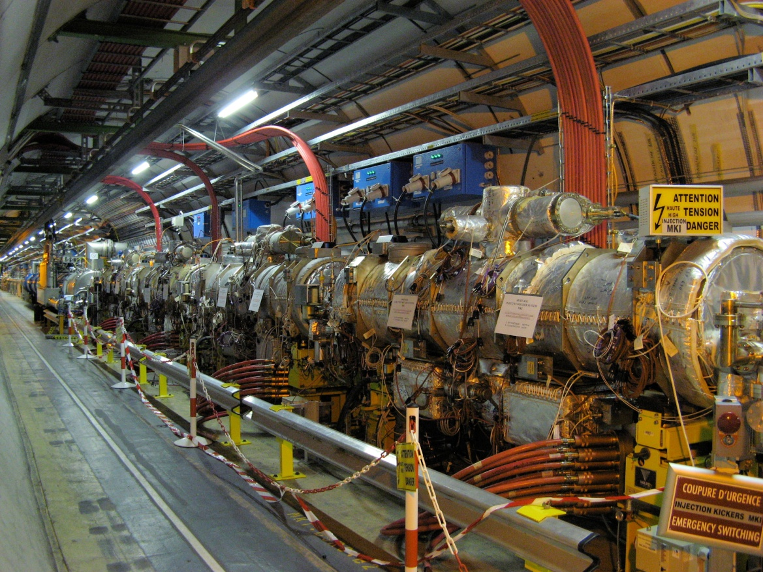
1. Context
MKI: Injector kicker magnets for the LHC
Typical MKI pulse
LHC anti-clockwise injection (4 MKI magnets)
Point 2
Point 8
Point 8
LHC clockwise injection (4 MKI magnets)
MKI8A
MKI8B
MKI8C
MKI8D
Beam 2 direction
Planning of MKI cool installation
1 MKI cool (proto) | 2 MKI cools | 2 MKI cools | 2 MKI cools | 1 MKI Cool
YETS 22/23 | YETS 23/24 | YETS 24/25 | Start of LS3 | During LS3

Slide 4
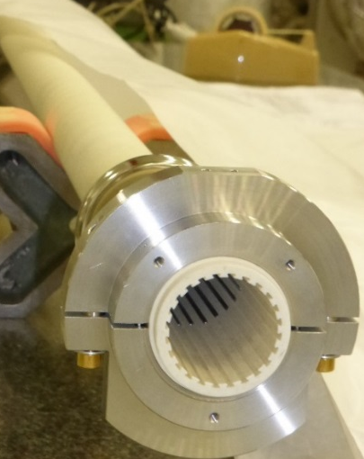
1. Context
Screen conductors inside MKI
Alumina tube
(installed in MKI)
Screen conductors carry image current of circulating beam
        ⇓
Lower beam induced heating
Conductors are supported and electrically insulated by alumina tube (high SEY)
2017-18 YETS upgrade of MKI8D: Alumina tube is coated on the inside with Cr₂O₃:
has a low SEY, does not produce UFOs and is high voltage compatible
Alumina tube
Slots on the tube, to insert screen conductors
Injected/
circulating beam
MKI magnet
Vacuum tank
Injected/
circulating beam
24 screen conductors
(one each 15 degrees, since LS1)

Slide 5
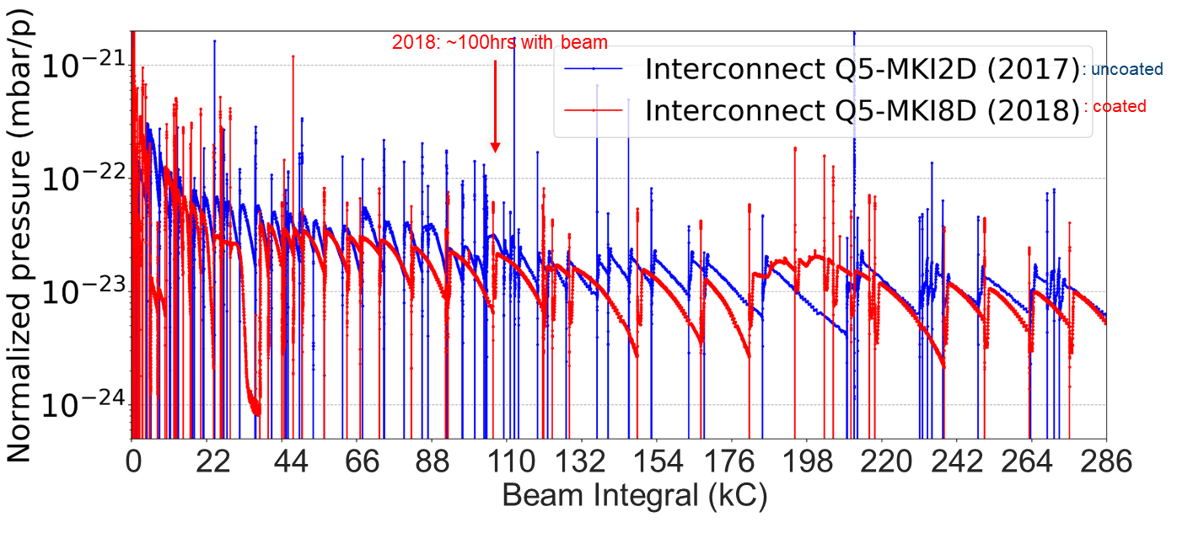
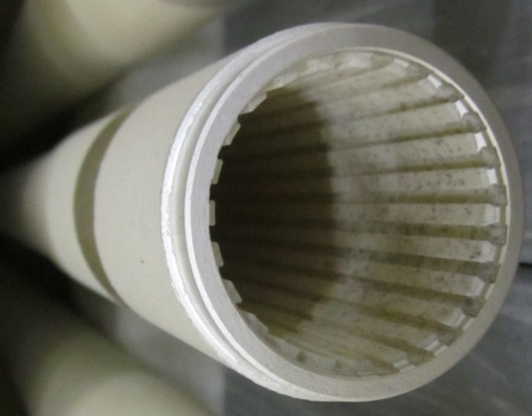
1. Context
Cr₂O₃ coating in MKI8D, installed in YETS 17-18
Before:
Pressure in MKI8D interconnect used to be a factor of ∼3 (2012, 2015 and 2017) and ∼12 (2016) higher than that of Q5-MKI2D
After:
This factor is not observed anymore.
No other vacuum modifications were done, so pressure reduction is attributed to Cr₂O₃ coating 👍
Alumina tube with Cr₂O₃ coating on the inside

Slide 6
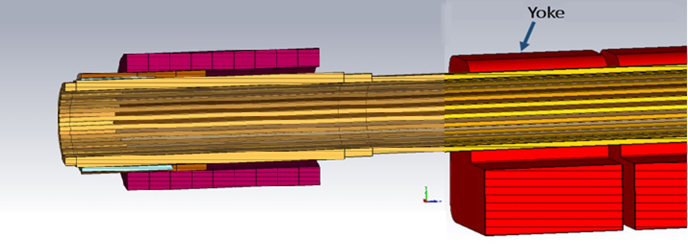
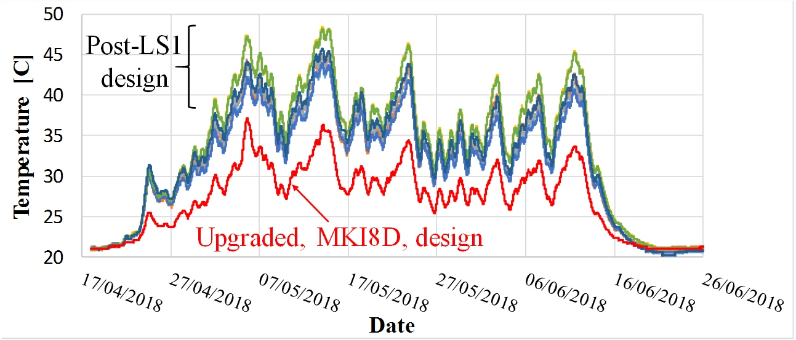
1. Context
Damping element: the origin of MKI cool
Screen conductors
Redesigned ferromagnetic rings (damper), placed on the alumina tube outside of the magnet aperture, re-locates beam induced power deposition from the ferrite yoke to the damper
Damper is not at pulsed high voltage
Conductive sleeve
Injected/circulating beam
Damper
(ferrite rings exposed to beam)
Alumina tube
Magnet
Reduced heating of ferrites

Slide 7
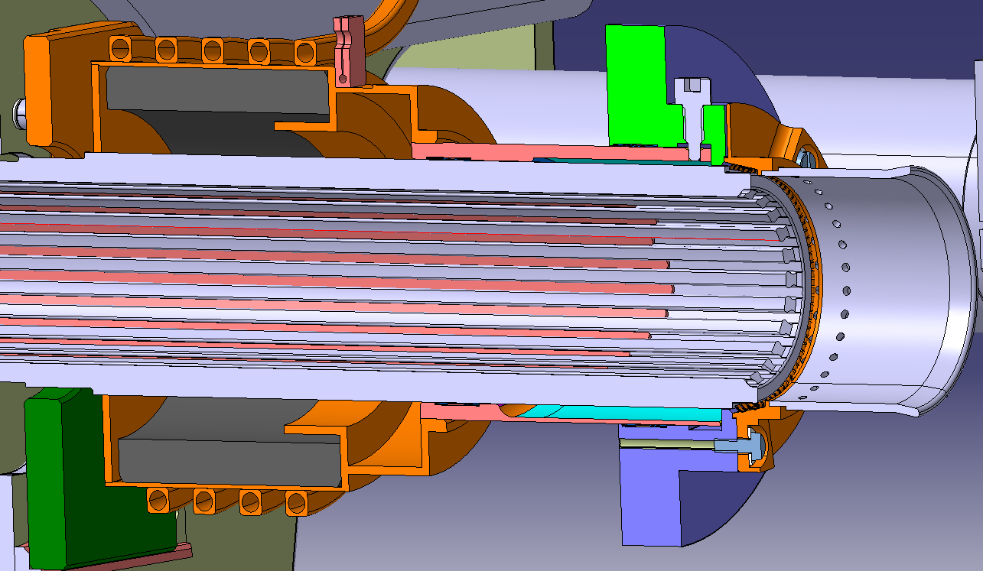
1. Context
MKI cool = damping element + water cooling
Damping element fulfils the function of re-locating beam induced power
BUT, with HL-LHC beam, it would reach the Curie temperature, and (temporarily) stop working
The idea of the MKI cool is to cool the damper with water to remove heat
Pipes for water cooling
Beam
Screen conductors
Alumina tube
Damper
(ferrite ring)
Magnet

Slide 8
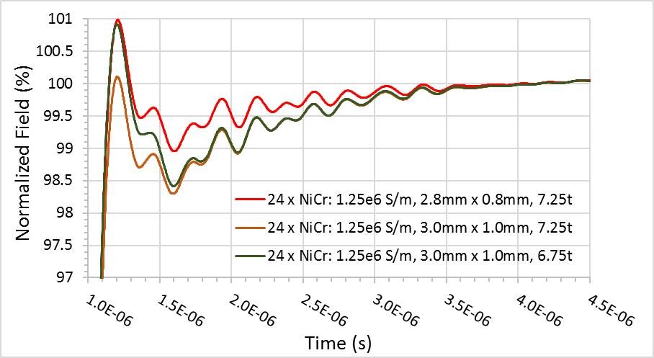
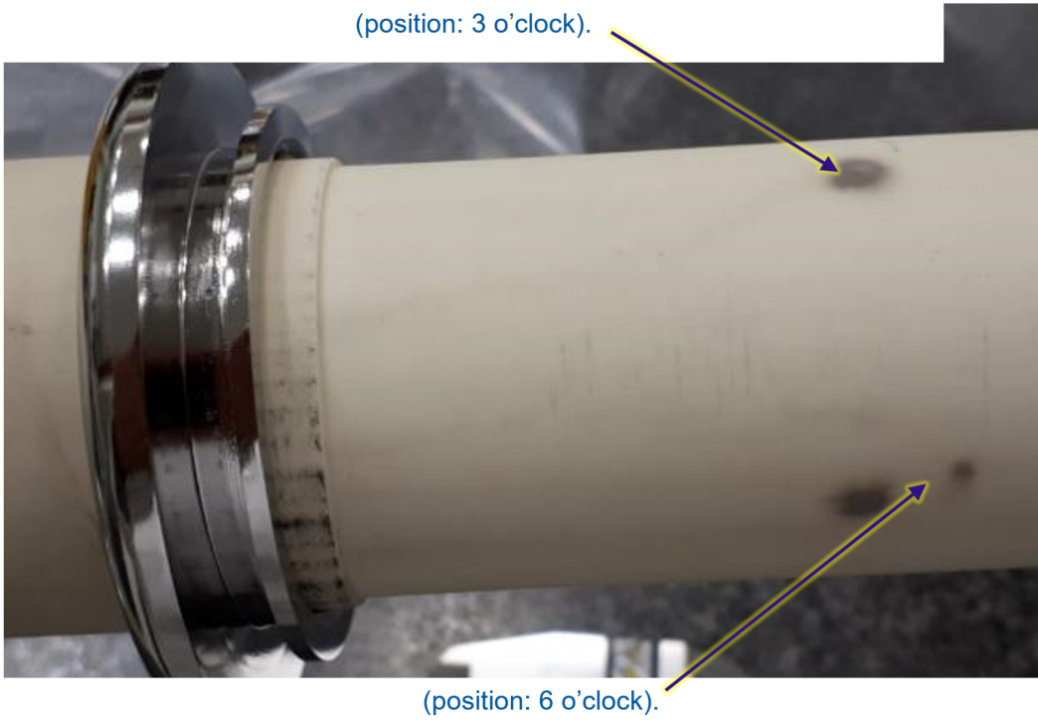
2. Issues – now solved
During 2019
Non-conformity of slots in alumina tubes purchased during 2017: slots were too wide. Thus, it was necessary to use screen conductors with a small zig-zag
[HL-NCR: https://edms.cern.ch/document/2440015/1.0]
HV pre-conditioning of MKI cool failed:
[HL-NCR: https://edms.cern.ch/document/2440015/1.0]
18 strong sparks occurred over two weeks
Conditioning plateaued at ~45kV (goal=56.1kV)
Three black marks from HV breakdowns to alumina tube
Wider screen conductors
Using wider screen conductors was discarded due to influence on magnetic field (eddy currents)

Slide 9
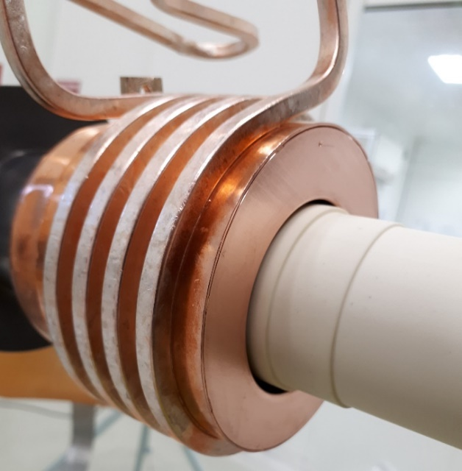
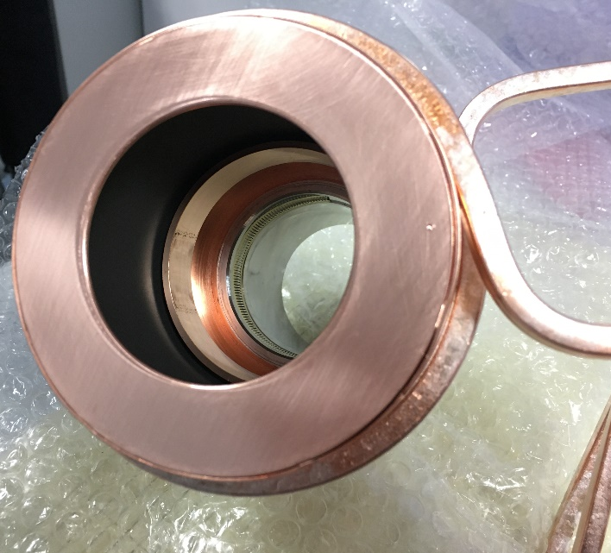
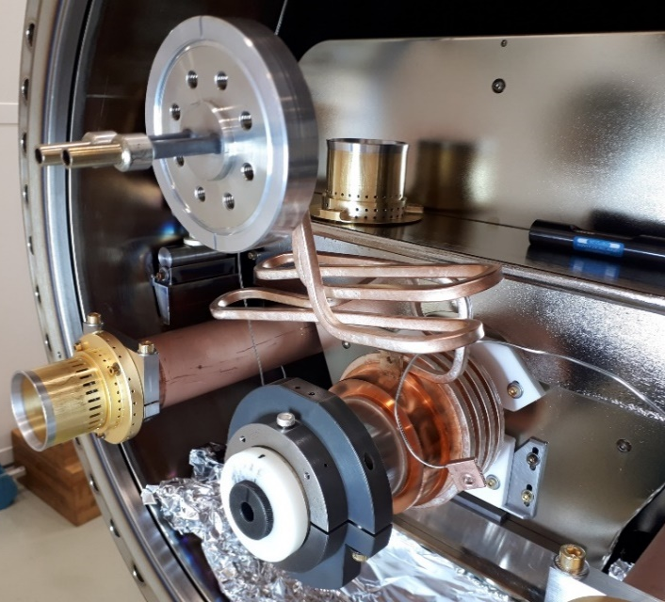
2. Issues – now solved
During 2019. Actions carried out
RF damper structure was modified to mitigate HV breakdowns:
Metal supports for tube replaced by macor
RF damper end cap inside diameter enlarged (from 56mm to 60mm), to increase distance to alumina tube
Sharp edge on stainless steel short eccentric tube removed (manufacturing error)
Cooling pipes for RF damper
RF damper
60mm & 1mm offset downwards
Macor supports
End-cap
1 mm radius
Sharp edge chamfered

Slide 10
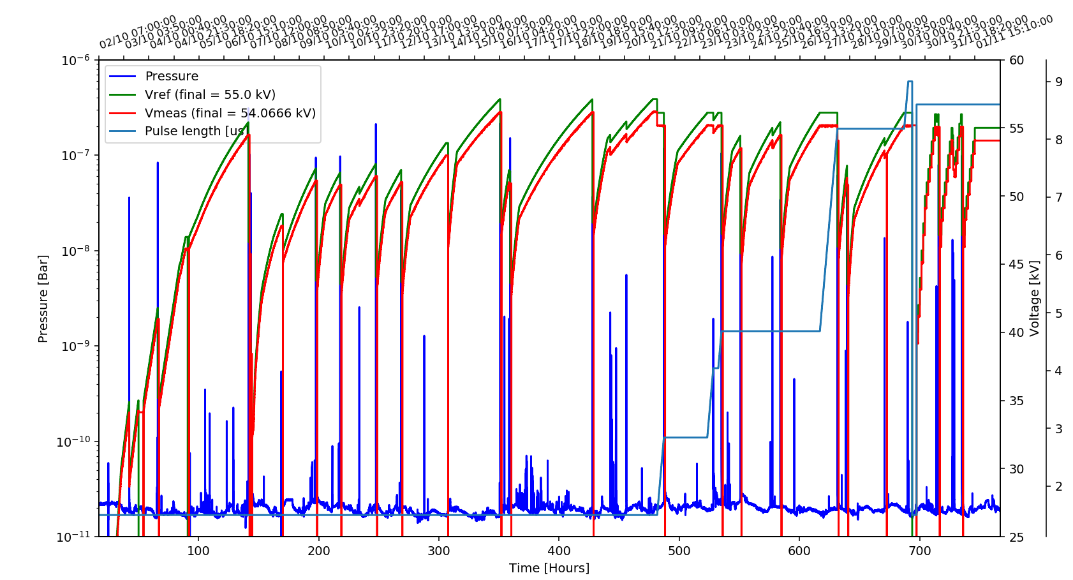









2. Issues – now solved
During 2020. HV conditioning
Conditioning completed and target of 56.1kV* and 8.8μs flattop reached,
BUT:
N
System reset
N
Strong spark
Conditioning required 230k
pulses (usually 50k to 100k)
18 strong sparks were observed (usually <6)
For the first time, two strong sparks during micro-discharge test
Hence, magnet was not installed, but opened and inspected instead
HV conditioning
µDisCh
3
8
1
4
6
7
56.1kV plateau
1
5
9
2
Pulse length [us]
2
Start of pulse elongation
1
*: 56.1kV is ~10 % above Point 8 operational voltage (51.3kV)

Slide 11
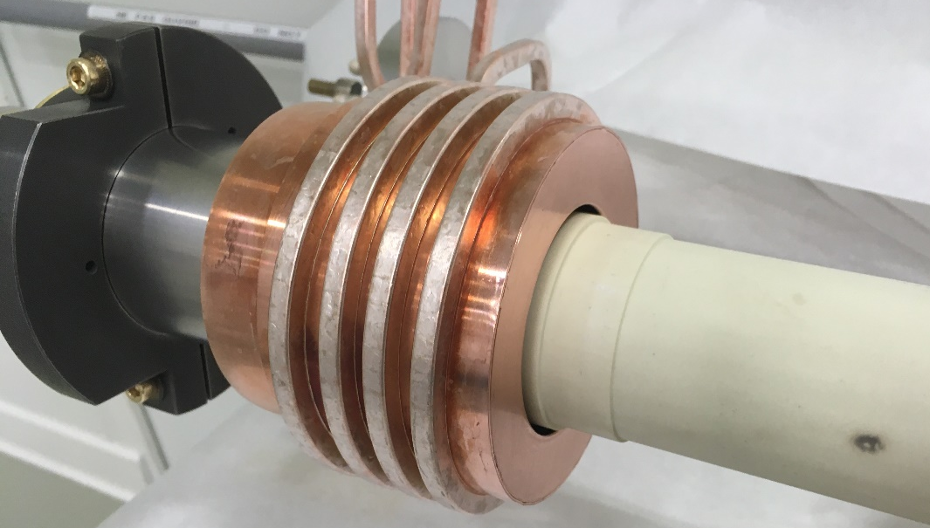
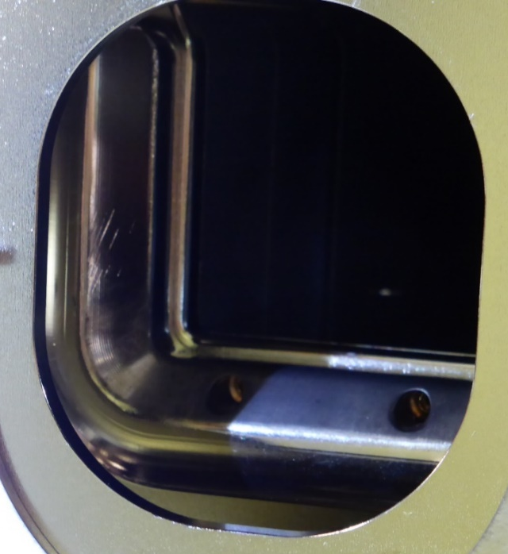
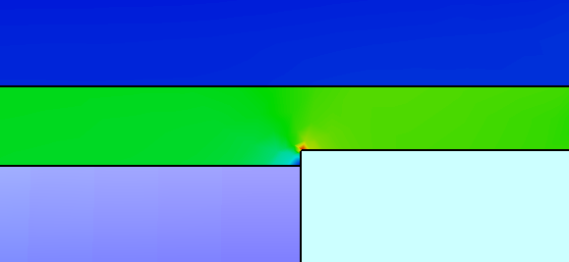
2. Issue – now solved
Inspection after conditioning (November 2020)
First observation: Still one black mark seen on the tube, at the end (3 marks in 2019)
The reason was a sharp edge due to mis-alignment of HV busbar of the magnet
Solved with correct alignment
Alumina tube
Field: ~16.3 kV/mm
1.2 mm
1.5 mm
Field: ~19.3 kV/mm
HV end plate
HV busbar
Alumina tube outside of magnet
Peak field ~34 kV/mm
Enhanced electric field (~doubled) due to dealignment of HV busbar
End of magnet, without tube

Slide 12
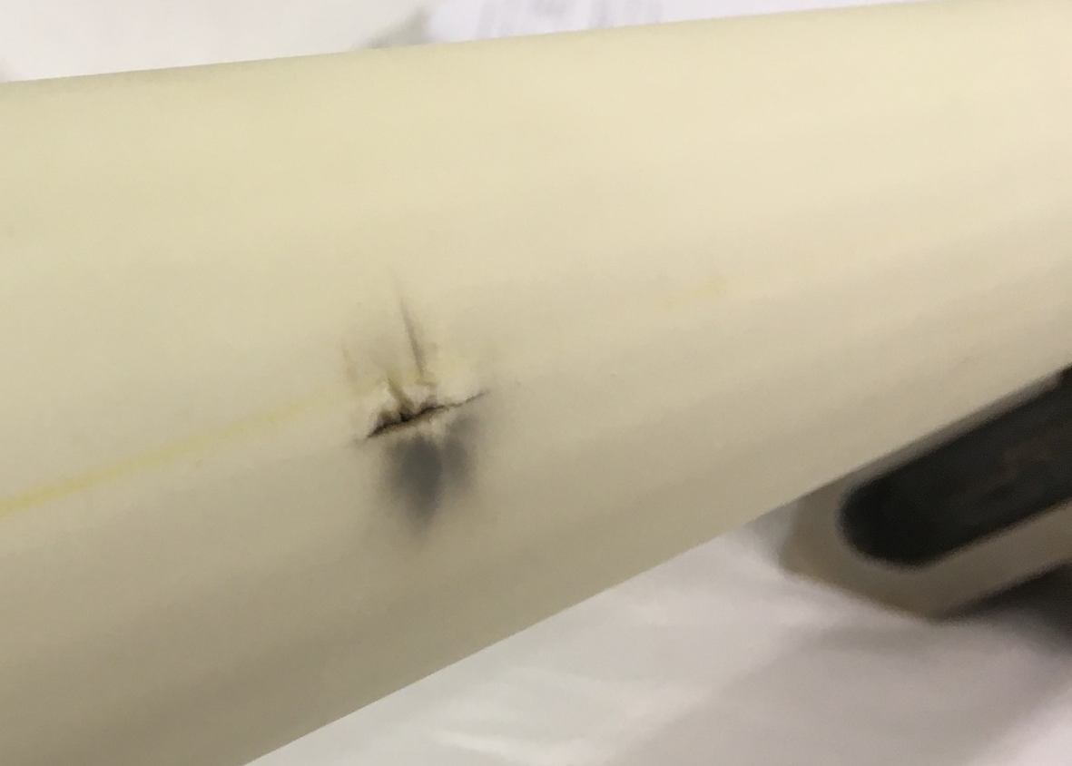
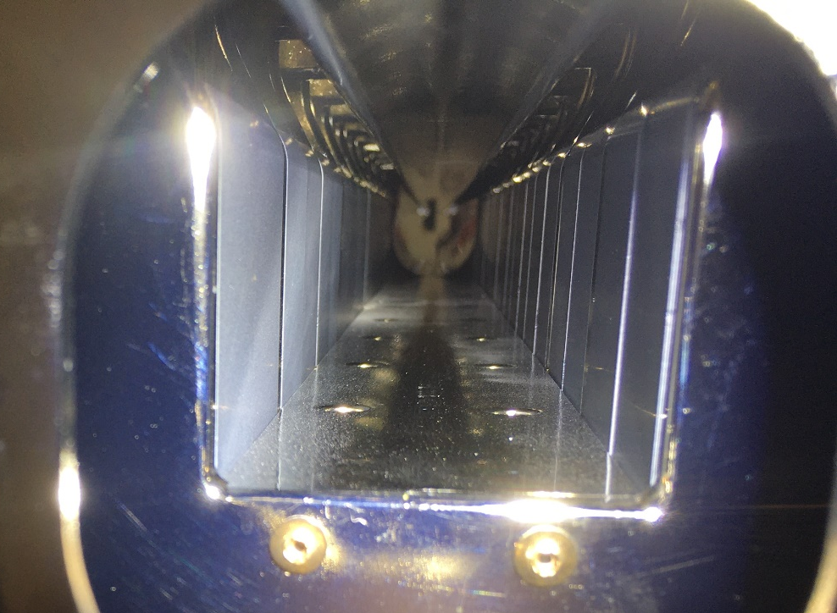
3. Issue – understood
Inspection after conditioning (November 2020)
Second observation: alumina tube was punctured, inside of the magnet (52cm from downstream end)
Reasons of puncture:
High voltage difference during pulse
Tube extremely thin at that position
(mis-manufactured)
Puncture
Inside of magnet, view from downstream end
Tomography of punctured tube.
Courtesy: B. Bulat
Punctured tube
Pieces of alumina & evidence of sparking (white dots)
1.2mm thick

Slide 13
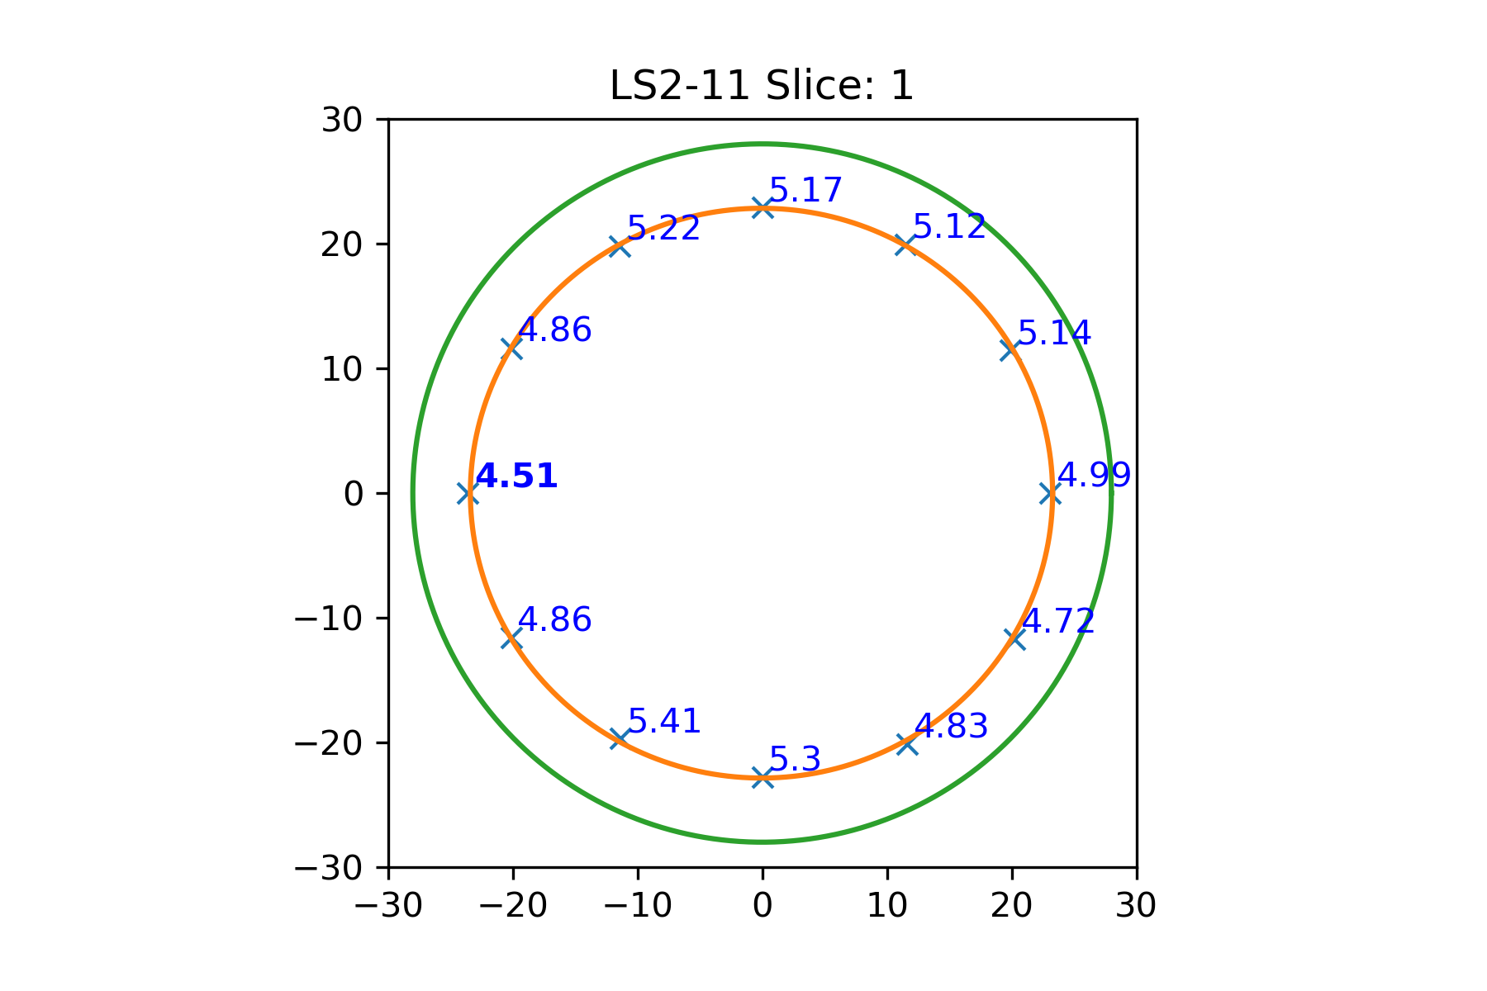
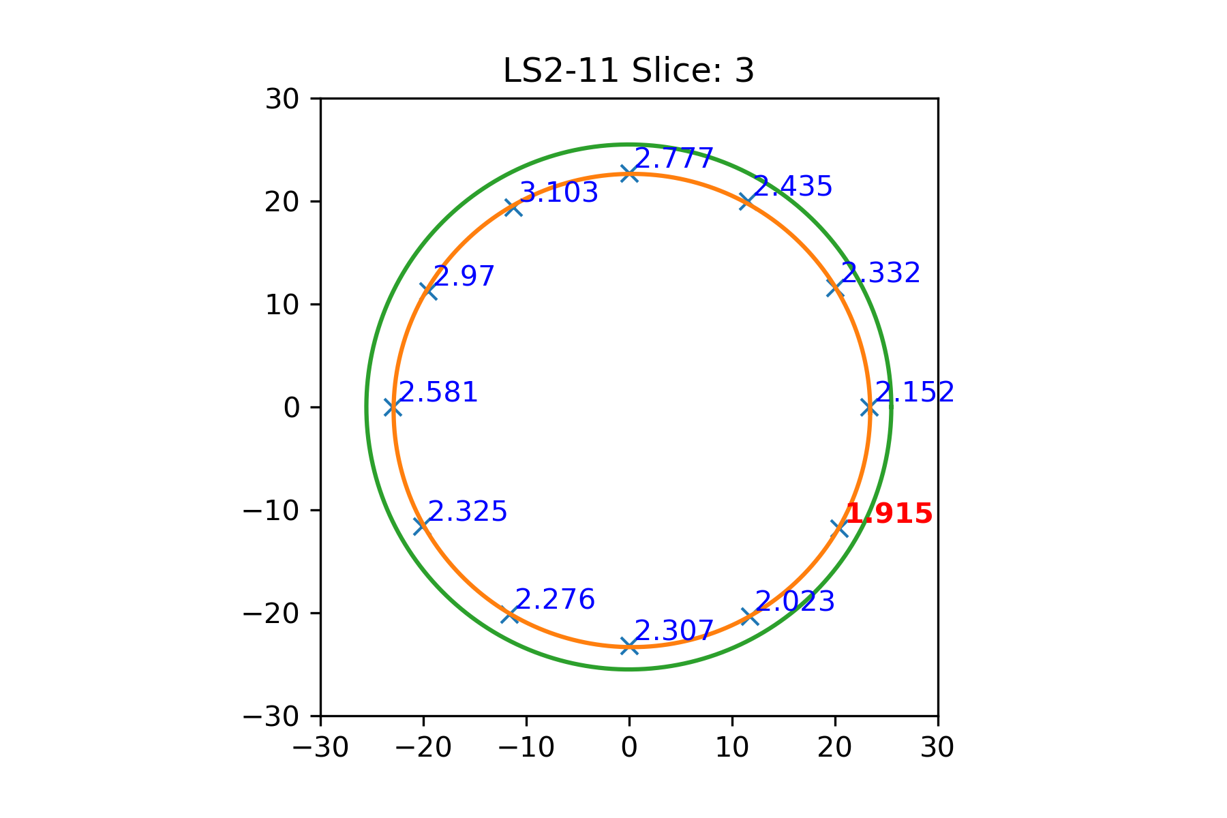
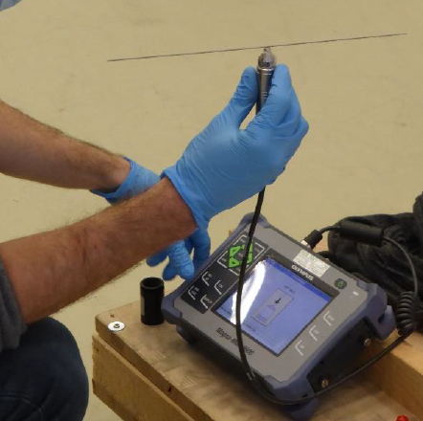
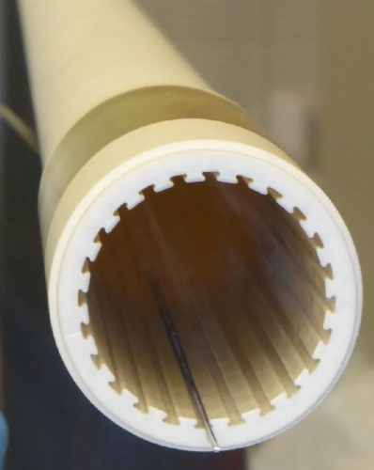
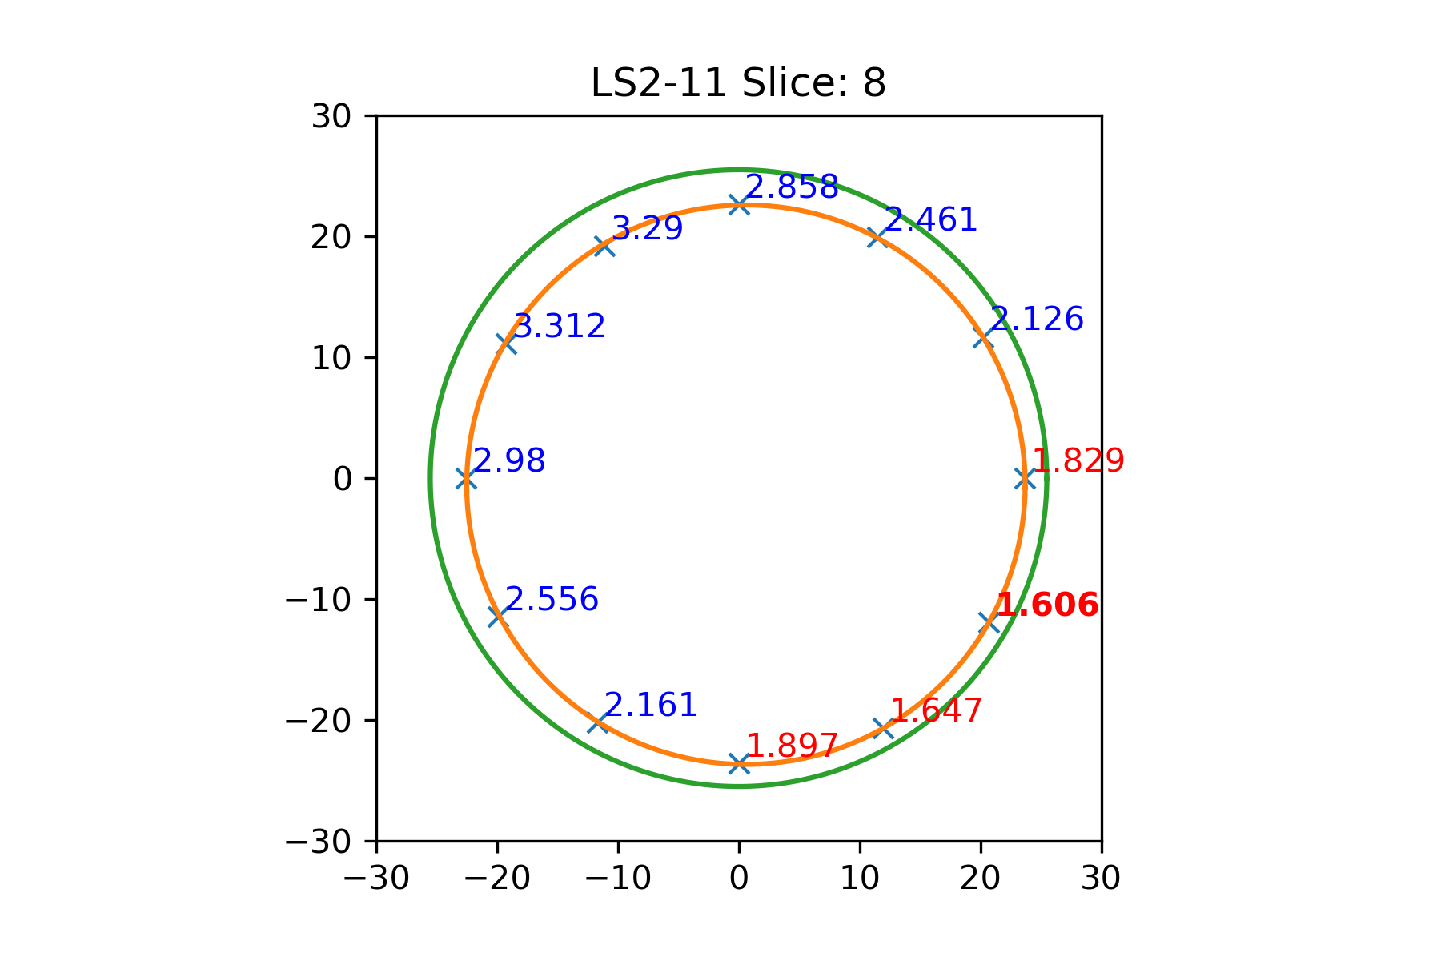
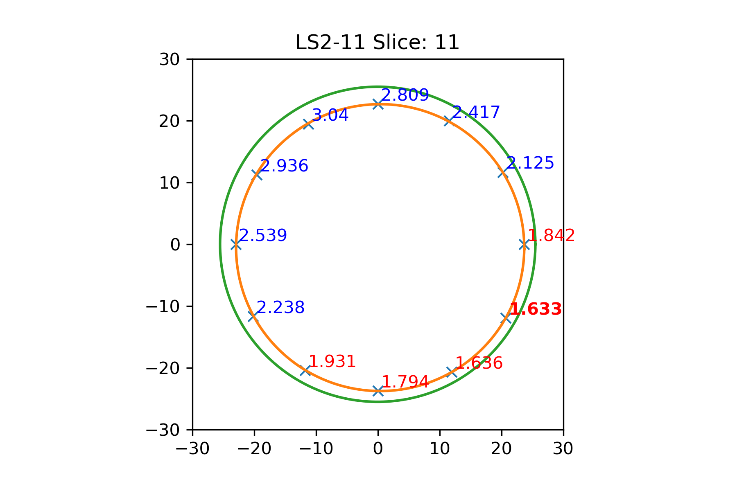
3. Issue – understood: mis-manufactured alumina tubes
Puncture triggered study of tube thickness of 2017 batch
All 2017 tubes were measured
Magnetic gauge measures wall thickness all along the tube
A dedicated Python programme was developed, to show the inner profile of the tubes
Thickness values
(<2mm in red)
Magnetic rod
Interpolated profile
Probe connected to device
Measured thickness

Slide 14

3. Issue – understood: mis-manufactured alumina tubes
Discussions with manufacturer + conclusions of study
No tubes, from 2017 batch, with required minimum wall thickness (2mm)
Axis for machining the tube could be better chosen, to have more uniform wall thickness
For manufacturing, tube is extruded with final inner profile, but larger outer diameter
Afterwards, the outside surface is machined
Outer profile
Outer profile
2mm min. thickness
2mm min. thickness
Inner profile: non straightness originated when extruded
Inner profile: non straightness is centred within outer profile
Too thin

Slide 15
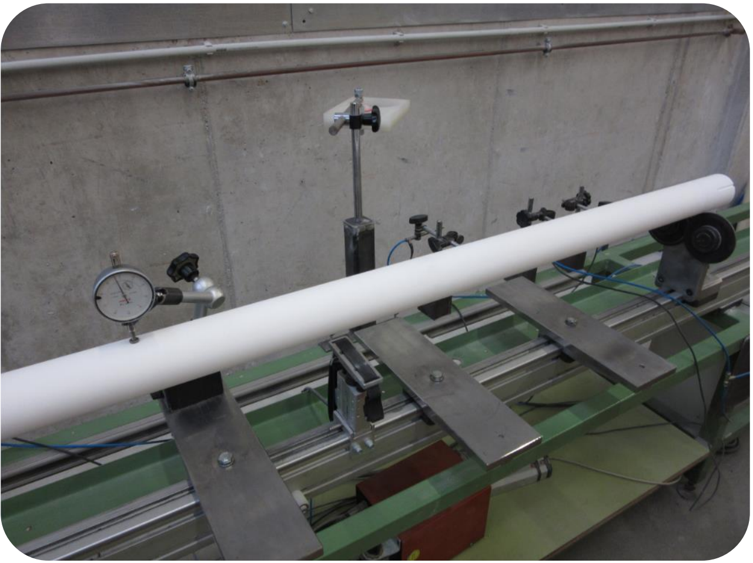
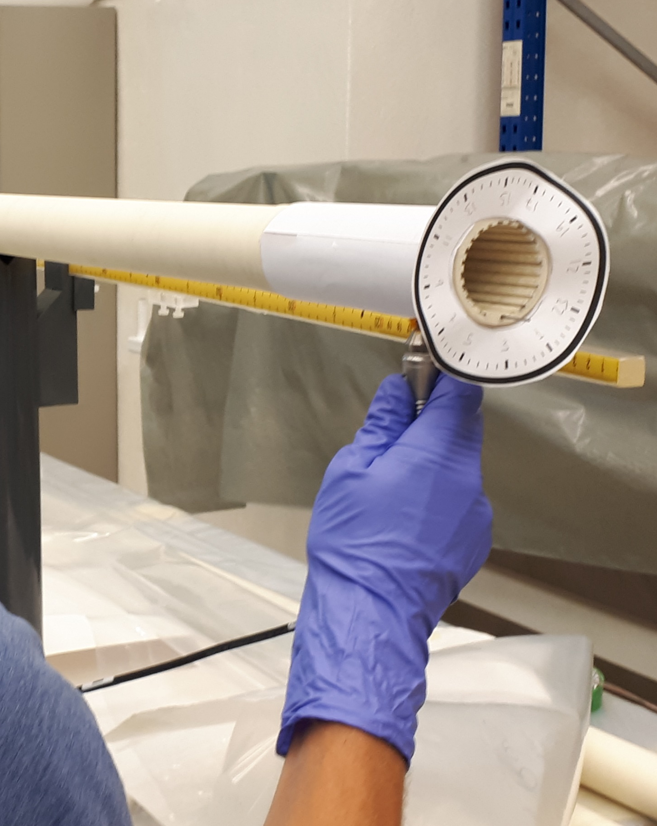
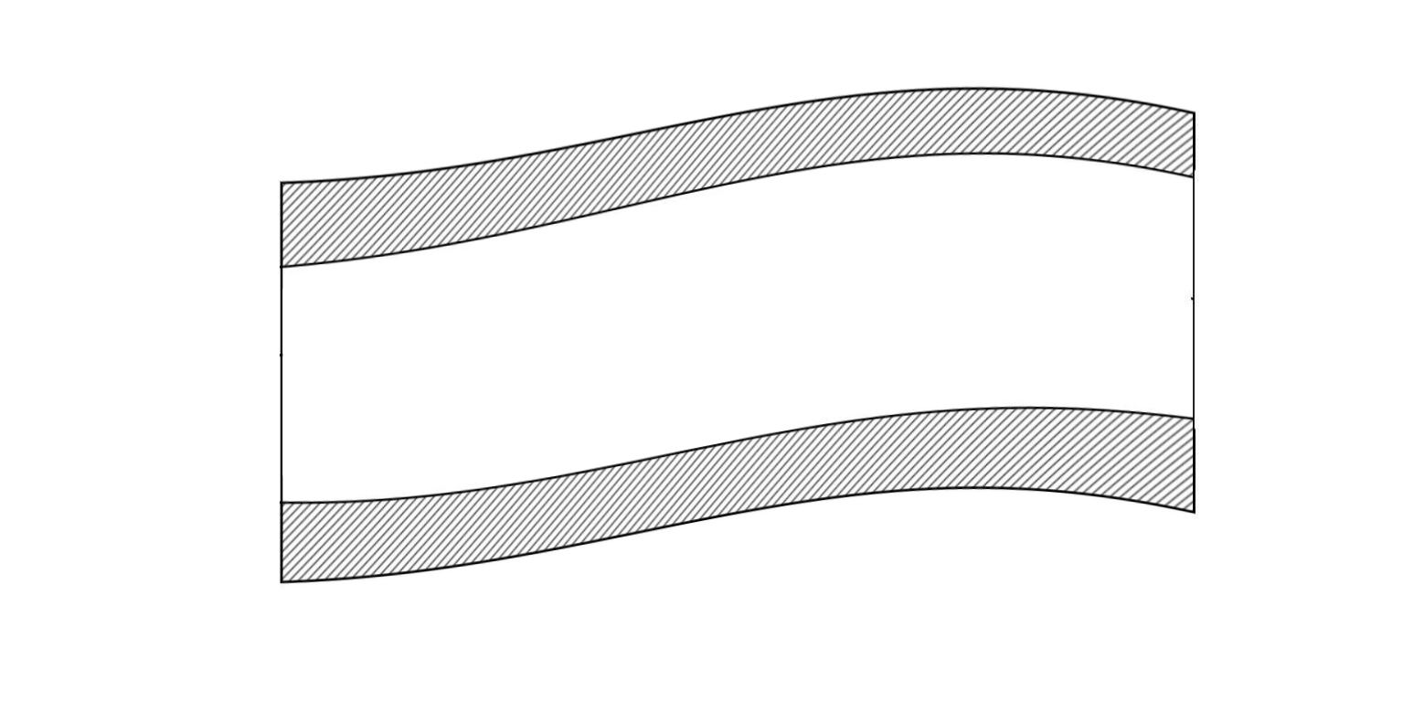

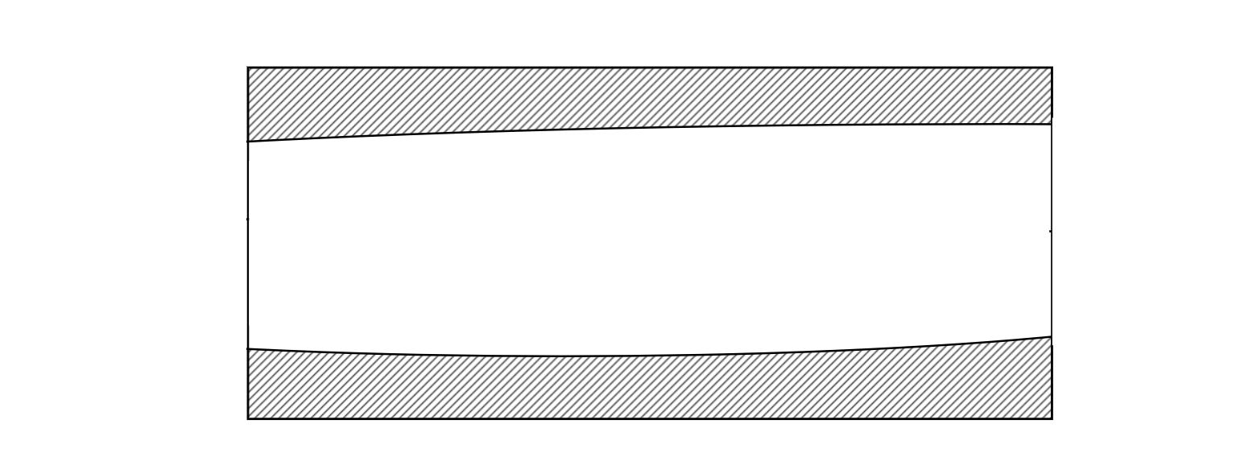
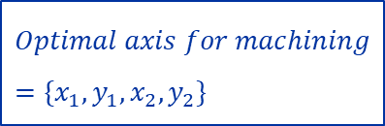
3. Issue – understood: mis-manufactured alumina tubes
Current work: determining the optimal machining axis
Shape of tube after extrusion is imperfect
Wall thickness measurement (before machining)
Extruded tube (exaggerated deformation)
Future
Outer profile characterisation
Before
Machined tube
$$Optimal axis for machining=\{x_{1},y_{1},x_{2},y_{2}\}$$
optimal_axis_machining.py

Slide 16
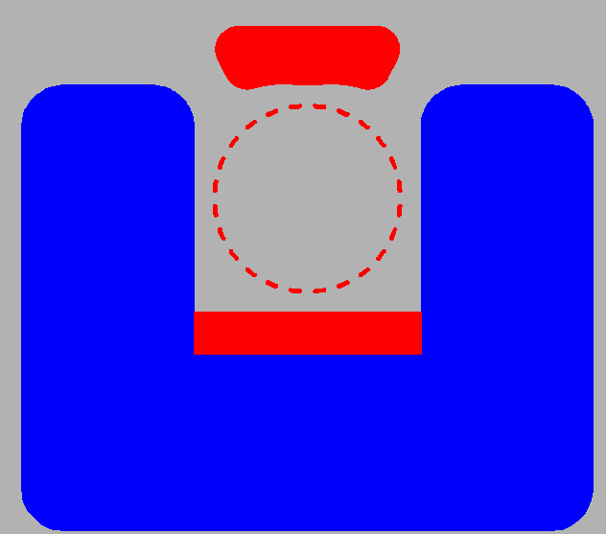
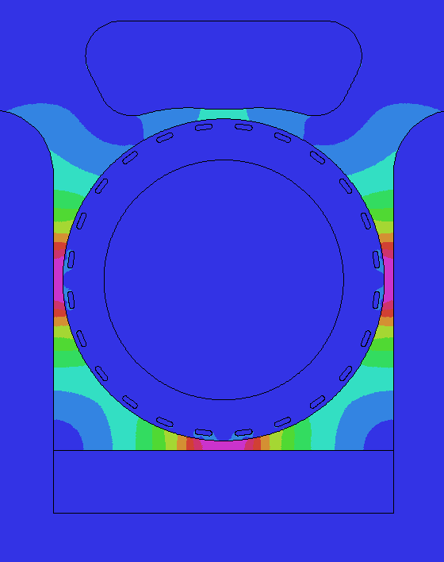

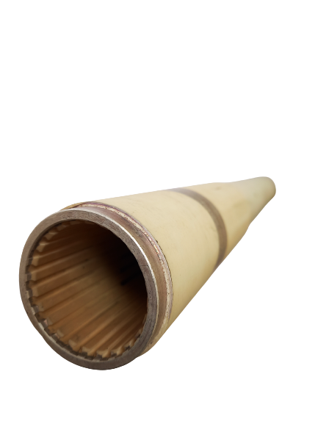
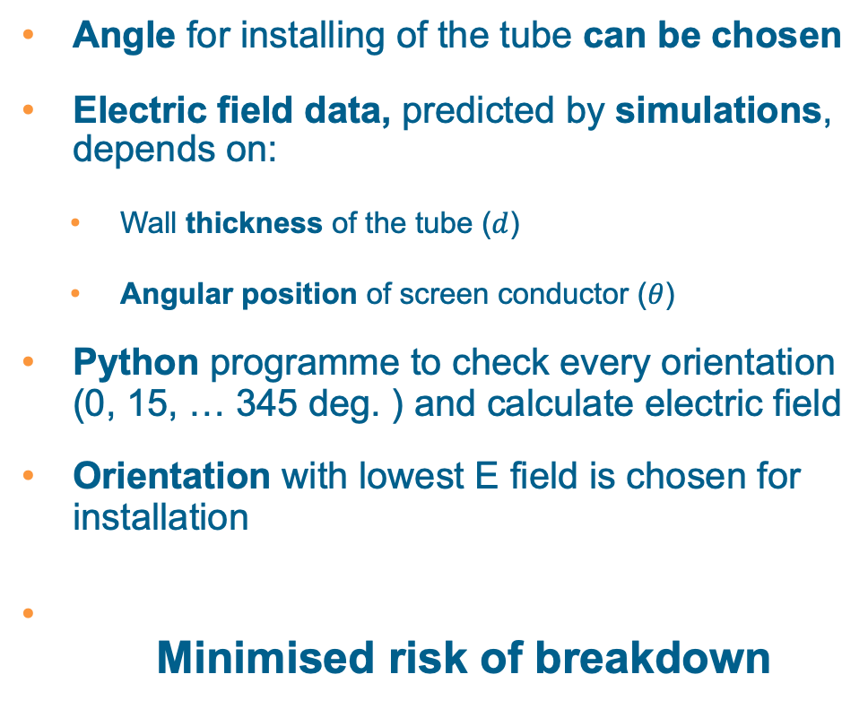

3. Issue – understood: mis-manufactured alumina tubes Optimization of tube rotational angle for installation
Screen conductors
(~0V)
Return Busbar 0V
Electric field results
Angle for installing of the tube can be chosen
Electric field data, predicted by simulations, depends on:
  Wall thickness of the tube ($d$)
  Angular position of screen conductor ($θ$)
Python programme to check every orientation (0, 15, … 345 deg. ) and calculate electric field
Orientation with lowest E field is chosen for installation
Minimised risk of breakdown
∆V=8kV
Ferrite (high voltage)
Ferrite (HV)
∆V=30kV
HV busbar (30kV)
Ferrite (HV)
Riskiness of thin wall depends on angular position inside magnet
$$E_{θ,d}=f(θ,d)$$
Check all orientations
optimal_
angle.py
Thickness data of tube after machining
Optimal orientation for installation

Slide 17
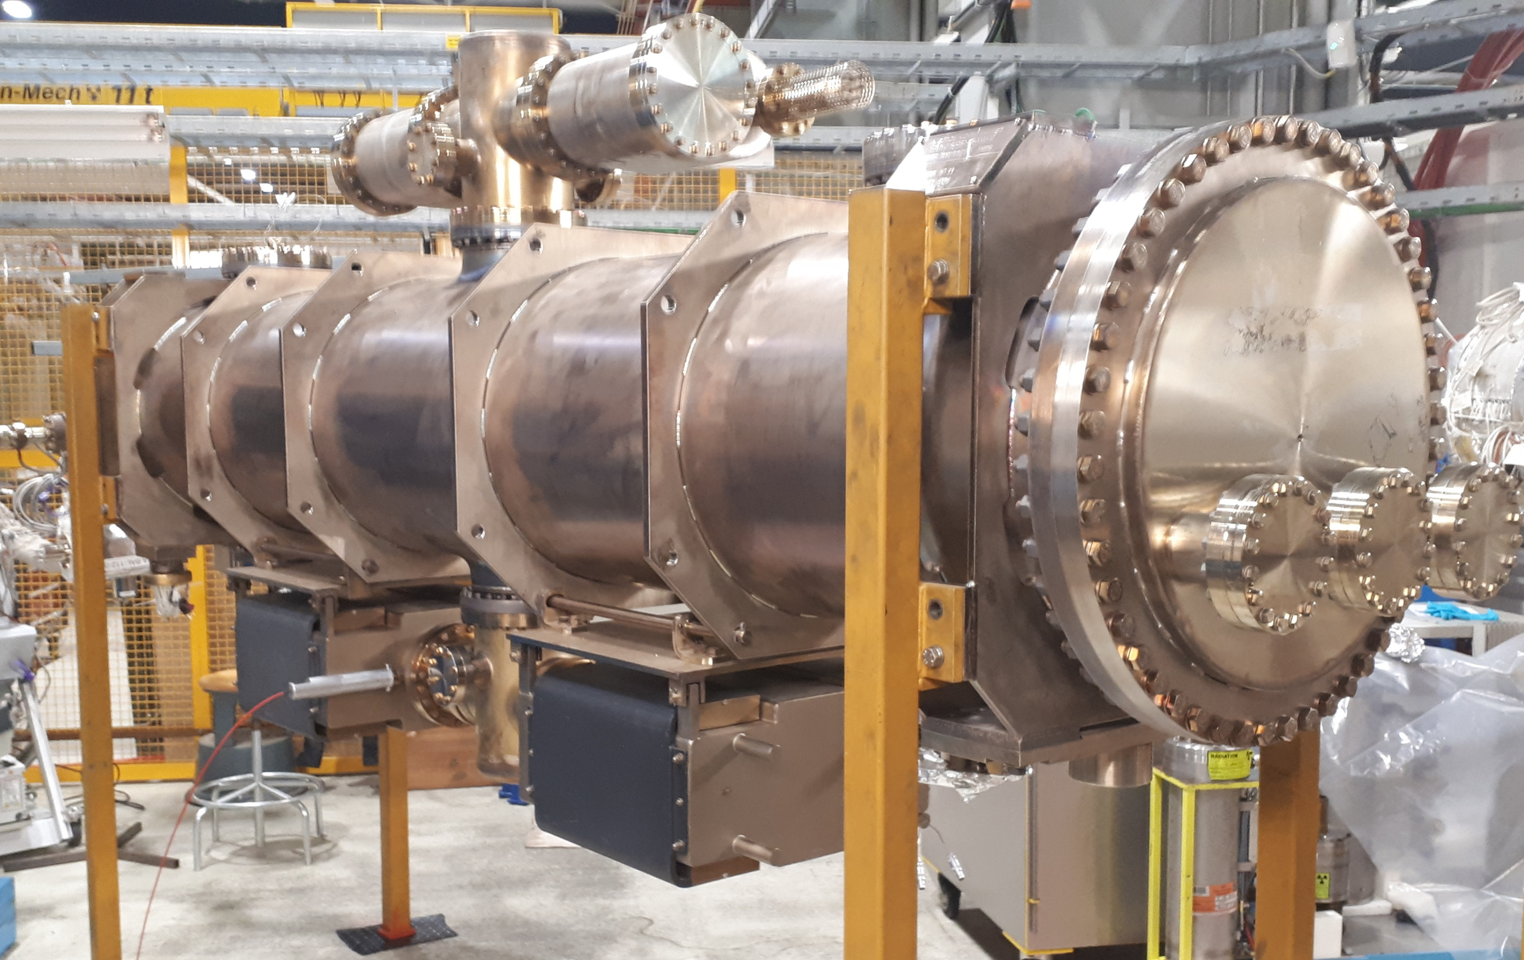
4. Status of first MKI cool to be installed in LHC
Installation planned for YETS 22/23
Successful HV pre-conditioning
Planning has been delayed due to a vacuum leak.
The seal is being replaced.
But still in schedule, for YETS 22/23, at location MKI8C
MKI cool in test cage

Slide 18


5. Conclusions
High voltage issues during 2019 and 2020 have been successfully solved
The remaining issue is the risk of puncture due to non-conforming alumina tubes:
  The issue is well understood and a there is good collaboration with the manufacturer
  Detailed measurements of the tubes prior to machining will result in achieving minimum of 2mm wall thickness
    Remeasuring the tubes after machining will validate correct machining, and therefore thickness
  Optimizing angular position, for installation in an MKI, will serve as an extra protection against HV breakdowns through the tube wall
$$E_{θ,d}=f(θ,d)$$
Thanks for your attention !

Slide 19
Spare slides

Slide 20
Context
MKI conditioning information
plateau
Operational voltage of MKIs is 49.6 kV at Point 2 and 51.3 kV at Point 8
All MKIs are conditioned to ~10 % above Point 8 voltage = 56.1 kV
During HV conditioning:
Voltage is ramped up to 56.1kV at a fixed pulse length of 1.5µs;
Ramping is followed by a plateau (1.5µs at 56.1kV for 1200 pulses);
Plateau is followed by enlarging mode (1.5µs to 8.8µs) at 55.1kV;
Finally, a plateau with 8.8µs at 55.1kV for 1200 pulses
HV conditioning is followed by a micro-discharge test, for validating the MKI:
Voltage is quickly ramped up to 55kV* at a fixed pulse length of 8.6µs, 500 pulses per step
Notes:
*: 1 kV above the maximum SoftStart PFN voltage at Point 8
A pressure rise is considered a micro-discharge (energy dissipated in the magnet or beam screen is relatively low) when the pressure takes a few minutes (e.g. 3 minutes) to recover to its pre-breakdown level.
plateau

Slide 21
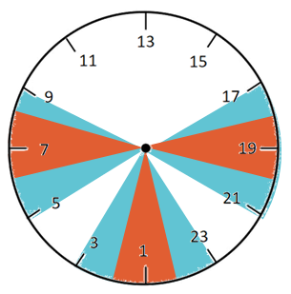
Alumina tube measurements summary
 | Tube | Absolute mininum thickness (mm) | Longitudinal position (cm) of the minimum thickness (starting from Ø56mm end) | Average hole radius (mm) | Average offset of centre of hole (mm) | Relaxed criteria Thinnest point on critical angles (± 15° inc.) after optimization (mm) | Exigent criteria Thinnest point on critical angles (± 30° inc.) after optimization (mm)
Old tubes | MKI2B | 1.98 | 112 | 22.85 | 0.43 | 2.24 | 2.24
 | LS1-1 | 1.75 | 22 | 22.93 | 0.27 | 2.25 | 1.955*
 | LS1-2 | 1.36 | 202 | 22.96 | 0.82 | 1.75 | 1.48
 | LS1-3 | 2.04 | 112 | 22.86 | 0.39 | 2.39 | 2.39
New tubes | LS2-1 | 1.23 | 52 | 23.12 | 0.71 | 1.79 | 1.65
 | LS2-2 | 0.95 | 202 | 23.23 | 0.68 | 1.64 | 1.25
 | LS2-3 | 1.44 | 232 | 23.11 | 0.42 | 1.72 | 1.72
 | LS2-4 | 1.42 | 232 | 23.09 | 0.57 | 1.82 | 1.82
 | LS2-5 | 1.68 | 82 | 23.12 | 0.52 | 1.84 | 1.84
 | LS2-6 | 1.15 | 262 | 23.08 | 0.51 | 1.85 | 1.56
 | LS2-7 | 1.04 | 262 | 23.08 | 0.91 | 1.32 | 1.18
 | LS2-8 | 0.78 | 262 | 23.08 | 0.61 | 2.06 | 1.36
 | LS2-9 | 0.93 | 202 | 23.08 | 1.06 | 1.21 | 1.00
 | LS2-10 | 1.34 | 262 | 23.07 | 0.65 | 1.62 | 1.34
 | LS2-11 | 1.43 | 262 | 23.12 | 0.49 | 2.04 | 1.61
 | LS2-12 | 0.82 | 262 | 23.08 | 0.59 | 1.93 | 1.45
 | LS2-13 | 0.70 | 262 | 23.13 | 0.91 | 1.16 | 1.16
 | LS2-14 | 0.98 | 262 | 23.11 | 0.52 | 2.06 | 1.35
 | Number of good tubes |  |  |  |  | (2 of 3 2013 + 3 of 14 2017) = 5 | (2 of 3 2013 + 0 of 14 2017) =2
Notes:
LS1-? = 2013 batch
LS2-? = 2017 batch

Slide 22
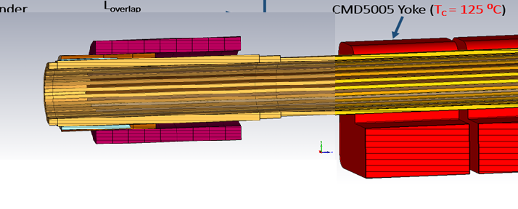

Slide 23
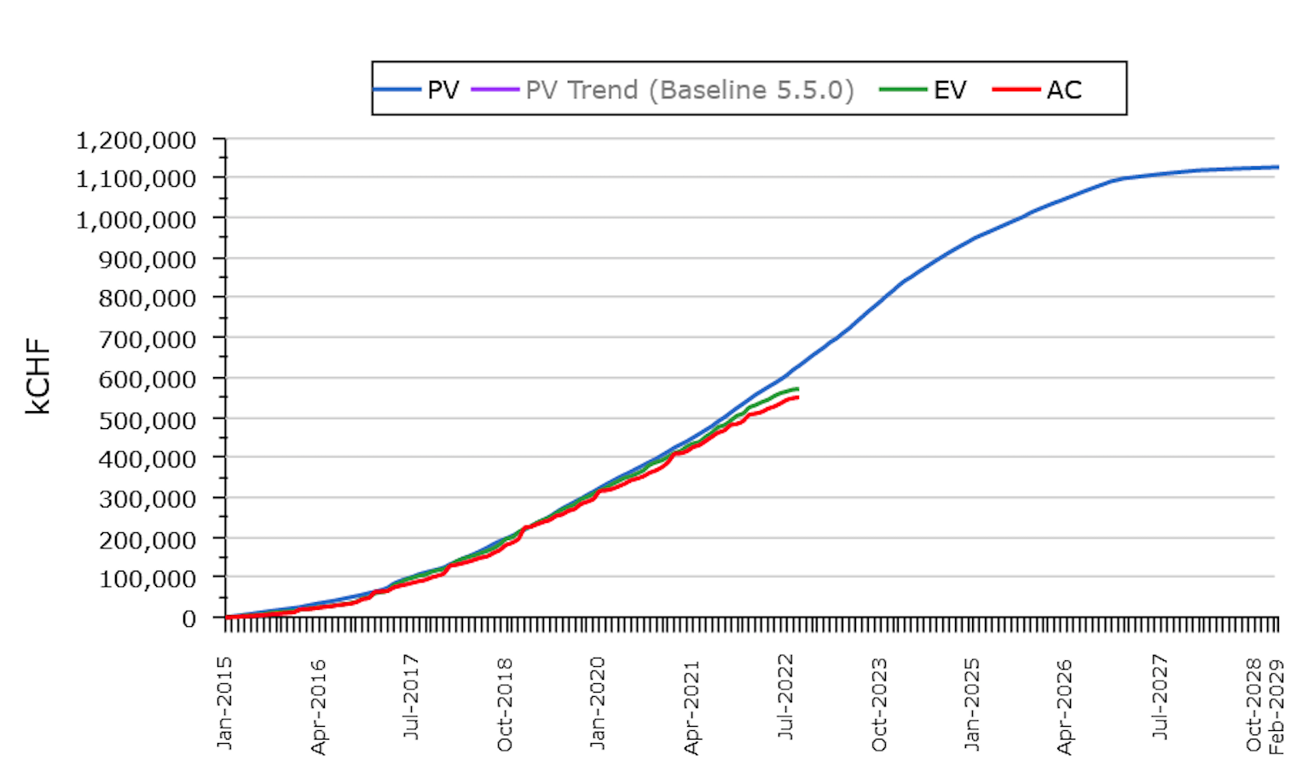
Reminder of the HL-LHC Goals
From FP7 HiLumi LHC Design Study application in 2010
The main objective of HiLumi LHC Design Study is to extend the LHC lifetime by another decade and to determine a hardware configuration and a set of beam parameters that will allow the LHC to reach the following targets:
A peak luminosity of L_{peak} = 5×10³⁴ cm⁻²s⁻¹ with levelling, allowing:
An integrated luminosity of 250 fb⁻¹ per year, enabling the goal of L_{int} = 3000 fb⁻¹ twelve years after the upgrade.
This luminosity is more than ten times the luminosity reach of the first 10 years of the LHC lifetime.
Transition from Prototype tests to Series production!!!
Ca. Half way!
With ca. 4 to 6 month schedule variance
Dealing with Challenges from post Covid supply chain issues and
the conflict between Ukraine – Russia !!!
Ultimate performance established 2015-2016. With same hardware
and same beam parameters, by using engineering margins:
L_{peak ult} ≅ 7.5 10³⁴ cm⁻²s⁻¹ and Ultimate Integrated L_{int ult} ∼ 4000 fb⁻¹
LHC should not be the limit, would Physics require more than nominal

