Slide 2

Radiation protection aspects for HL-LHC
A. Infantino & P. Dyrcz
On behalf of HSE-RP
With contributions from: HSE-RP management and colleagues, HL-LHC project management, PSO and WPs!
12th HL-LHC collaboration meeting – Plenary session 6 (Indico)
EDMS 2773490

Slide 3

Context and outline
A number of studies delivered in the last years, covering LS3, HL-LHC operation, new HL-LHC galleries, specific components (e.g. TAXN, QXL, etc).
RP studies disseminated in a number of ad-hoc presentations in WP meetings & HL-LHC TCC + dedicated HSE-RP Technical Notes → reference list in the backup slides.
Key EDMS documents highlighted throughout the talk (released, in-work, to be done)
Today’s talk:
Recall on area classification and ALARA levels at CERN
RP assessment for specific equipment dismantle/upgrade (e.g. TAXN, QRL)
Radioactive wastes
Air activation in the new HL-LHC galleries and access constraints
⁶⁰Co
Estimated residual radiation levels during LS3
RP constraints on the excavation of the HL-LHC cores
Projected radiation levels in the HL-LHC era
Cobalt content in steels

Slide 4
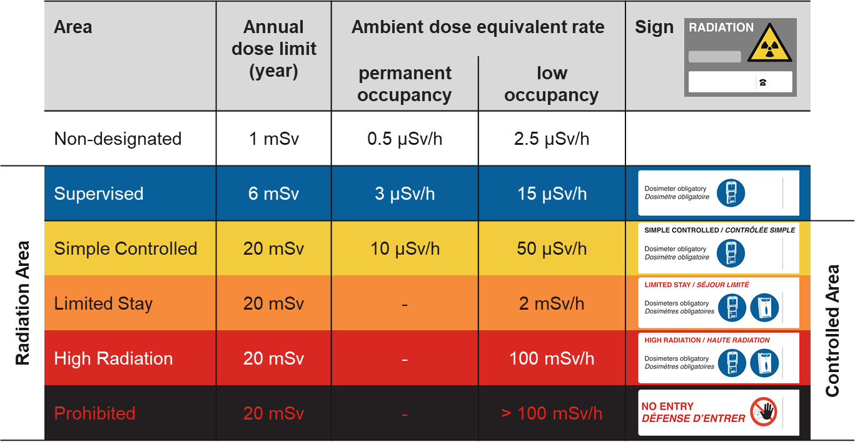
Radiation Areas classification
EDMS 810149
Low-occupancy:
< 20% working time
The CERN RP group has reviewed the signage used in radiation areas, by introducing a new colour code for better visualizing the radiological risk level
The RP rules determining the area classification were not changed

Slide 5
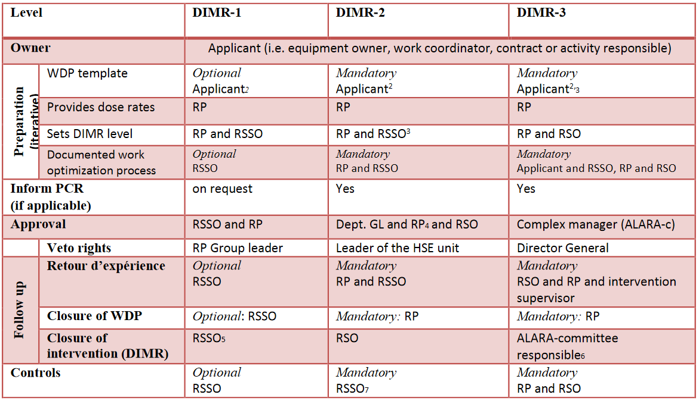
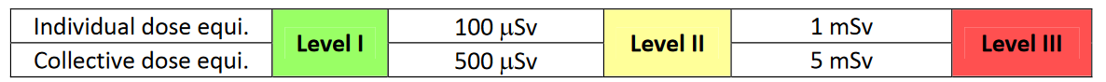
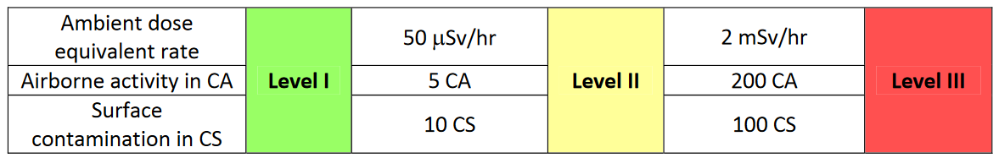
ALARA Levels at CERN
Group 1 Criteria:
EDMS 1751123
‘hard’ limits used to determine the minimum ALARA Level
Group 2 Criteria:
base of a radiological risk assessment
Note: 1 mSv = 100 mrem
ALARA level → Radiological risk assessment based on different criteria
WDP/optimization mandatory for ALARA II & III → early planning is crucial
ALARA III approval by “ALARA committee” (complex manager, GL responsible for the equipment, RSO, RP GL, and more) → early planning is crucial

Slide 6

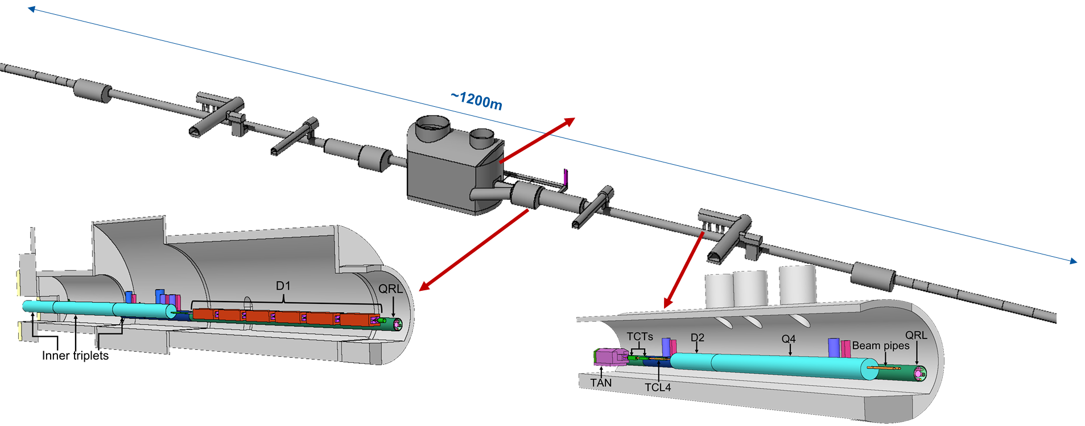
FLUKA modelling
HSE-RP preliminary LS3 estimates in EDMS 2435122 (v1.0) + ad-hoc studies within different HL-LHC WPs such as WP8, WP15, WP17. EDMS 2435122 v2.0 in-work following the extension of Run 3 up to 2025.
(HL-)LHC LSS1 & LSS5 updated geometry, including HL-LHC galleries. Common effort together with FLUKA team (M. Sabaté-Gilarte & F. Cerutti) to maintain/keep models up to date for both LHC & HL-LHC.
Reviewed (proton) irradiation profile (EDMS 2641646); Ion run considered as cool down (LSS1/LSS5).
Cooling times relevant for different types of interventions
EDMS 2435122 (v2.0)
Example: FLUKA model of LHC Point 1; cores highlighted just for visualization purposes

Slide 7
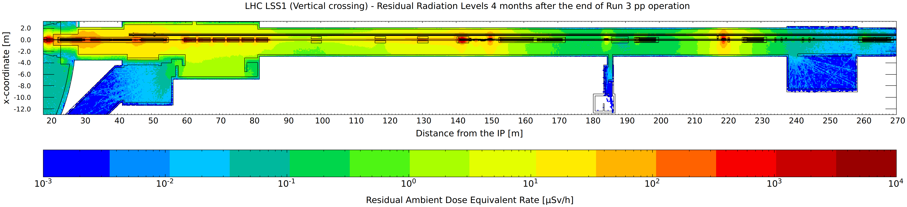
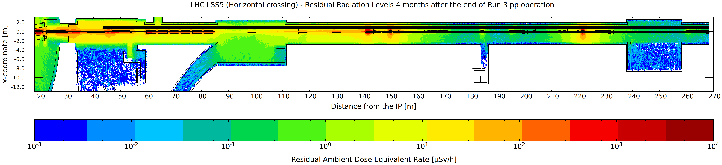
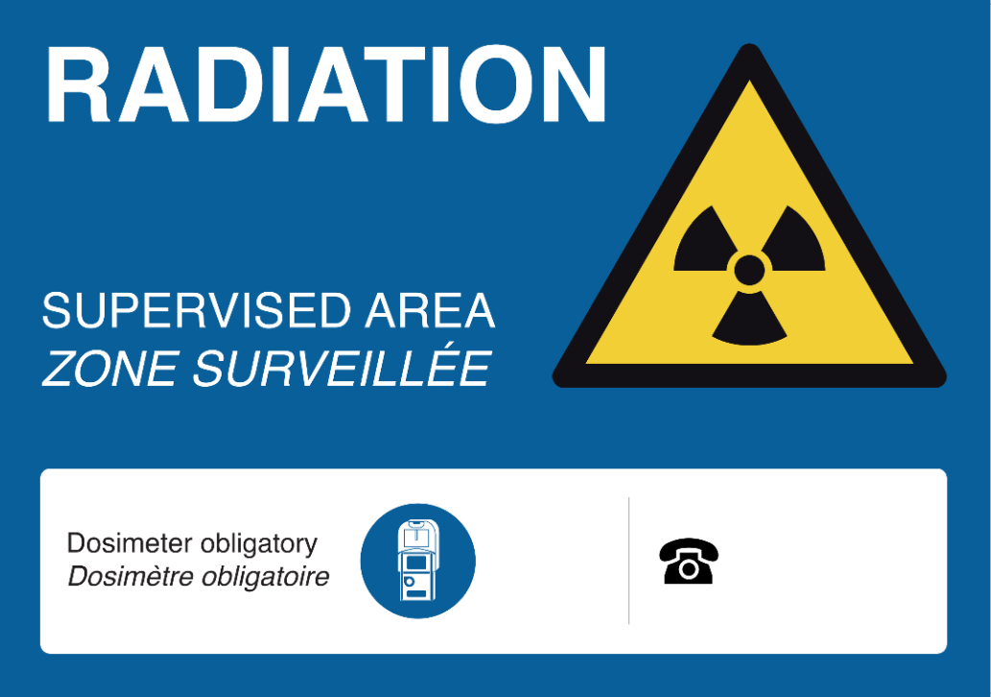
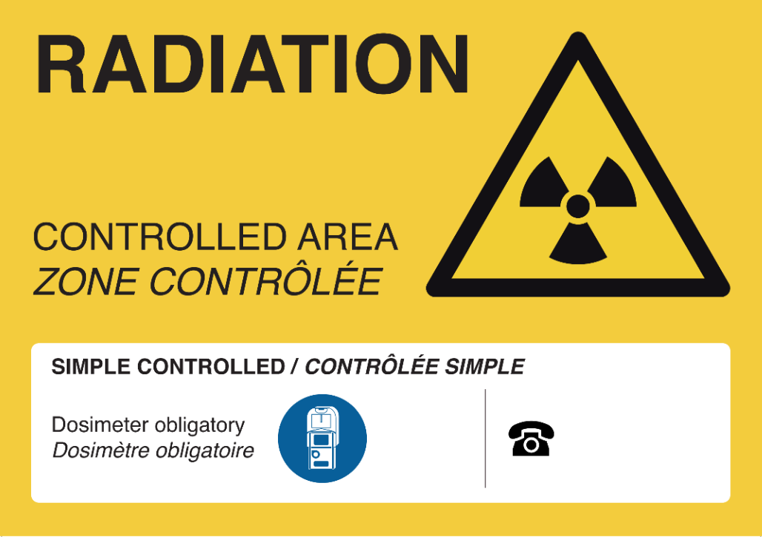
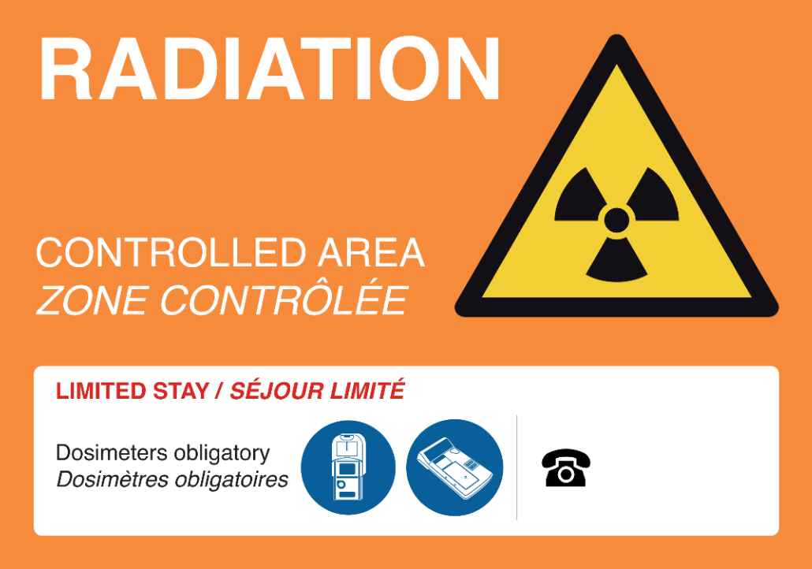
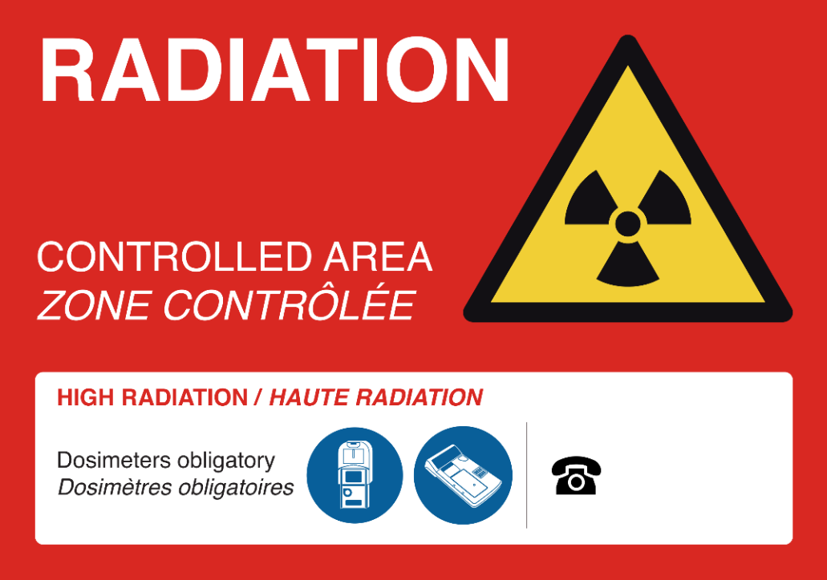
LS3: Residual H*(10)
Permanent workplace
Low-occupancy area (<20 % of working time)
EDMS 2435122 (v2.0)

Slide 8
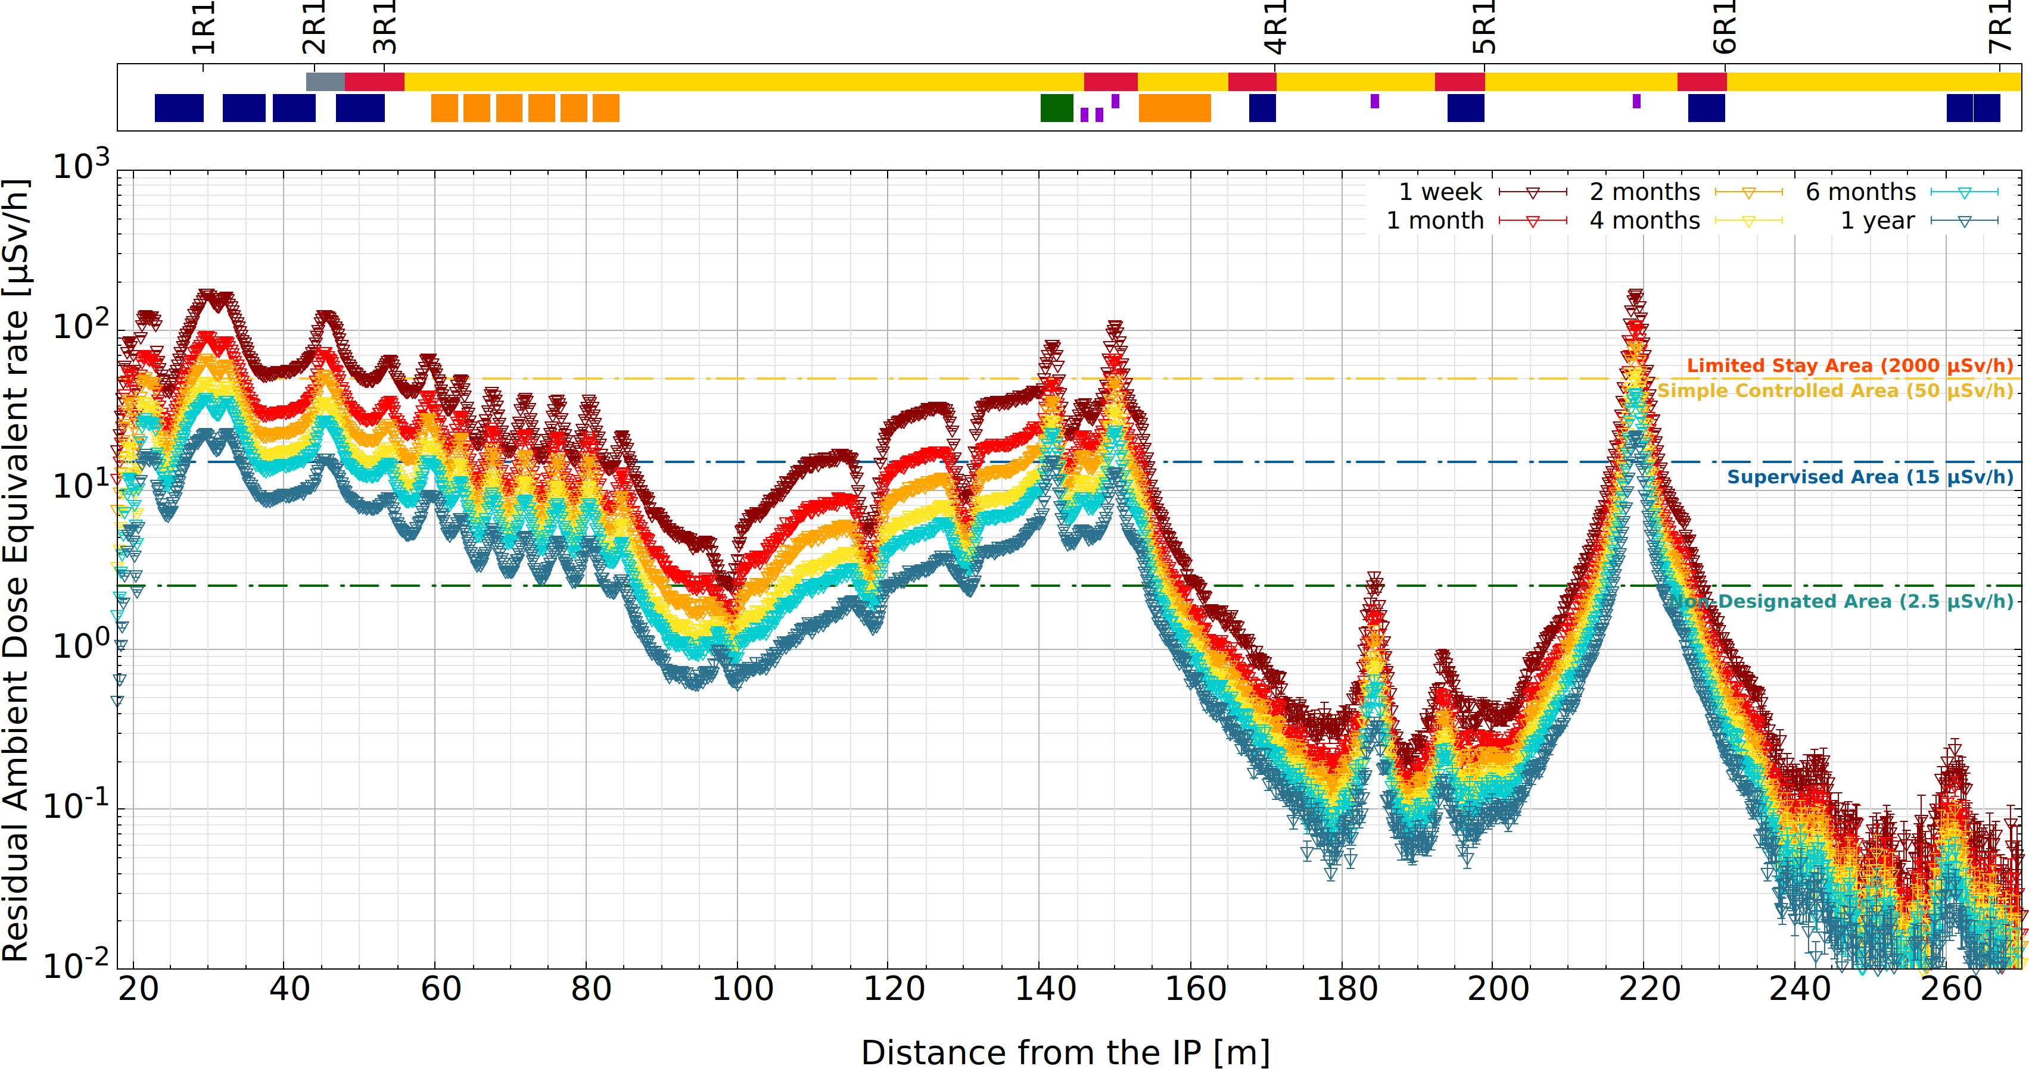
LS3: Residual H*(10) LSS1
Projected radiation levels at the end of Run 3 proton-proton physics (working distance, ~40 cm) for LSS1.
Limits for low-occupancy area (<20 % of working time)
EDMS 2435122 (v2.0)
Hotspots still present in the tunnel even after several months cool downs (e.g., inner triplet quadrupoles, absorbers, collimators) with expected dose rate up to few mSv/h at contact.
Early begin of the dismantle activities currently scheduled after 4 months cool down from the end of Run 3 proton-proton physics.
Difference between LSS1 & LSS5 mainly due to the different crossing scheme → TCL4 (see backup)

Slide 9
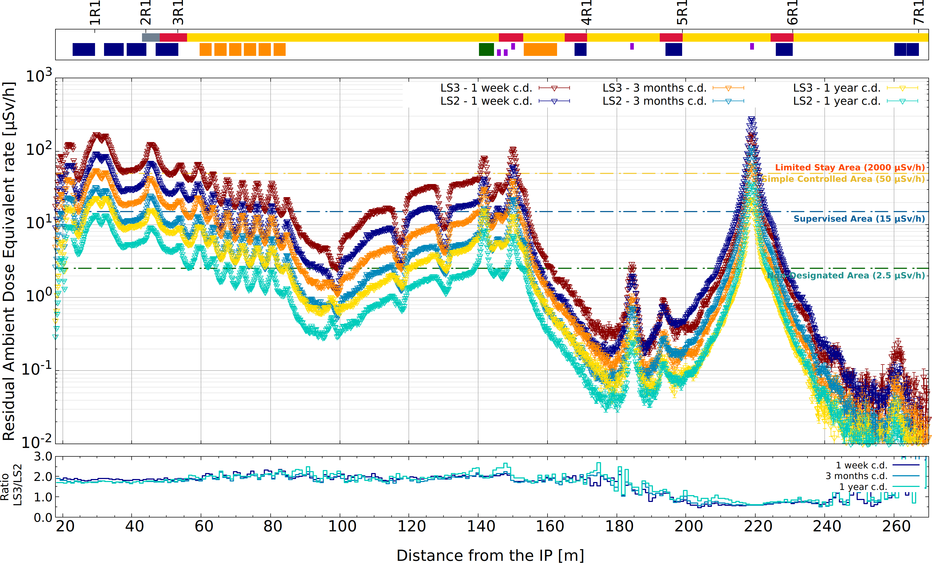
LS2 vs. LS3: Residual H*(10)
EDMS 2435122 (v2.0)
Projected radiation levels at the end of proton-proton physics (working distance, ~40 cm) for LSS1.
Run 3 up to end of 2025. Limits for low-occupancy area (<20 % of working time)

Slide 10
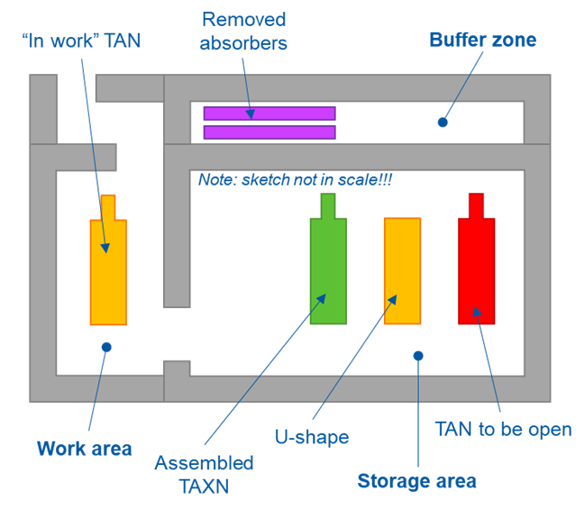
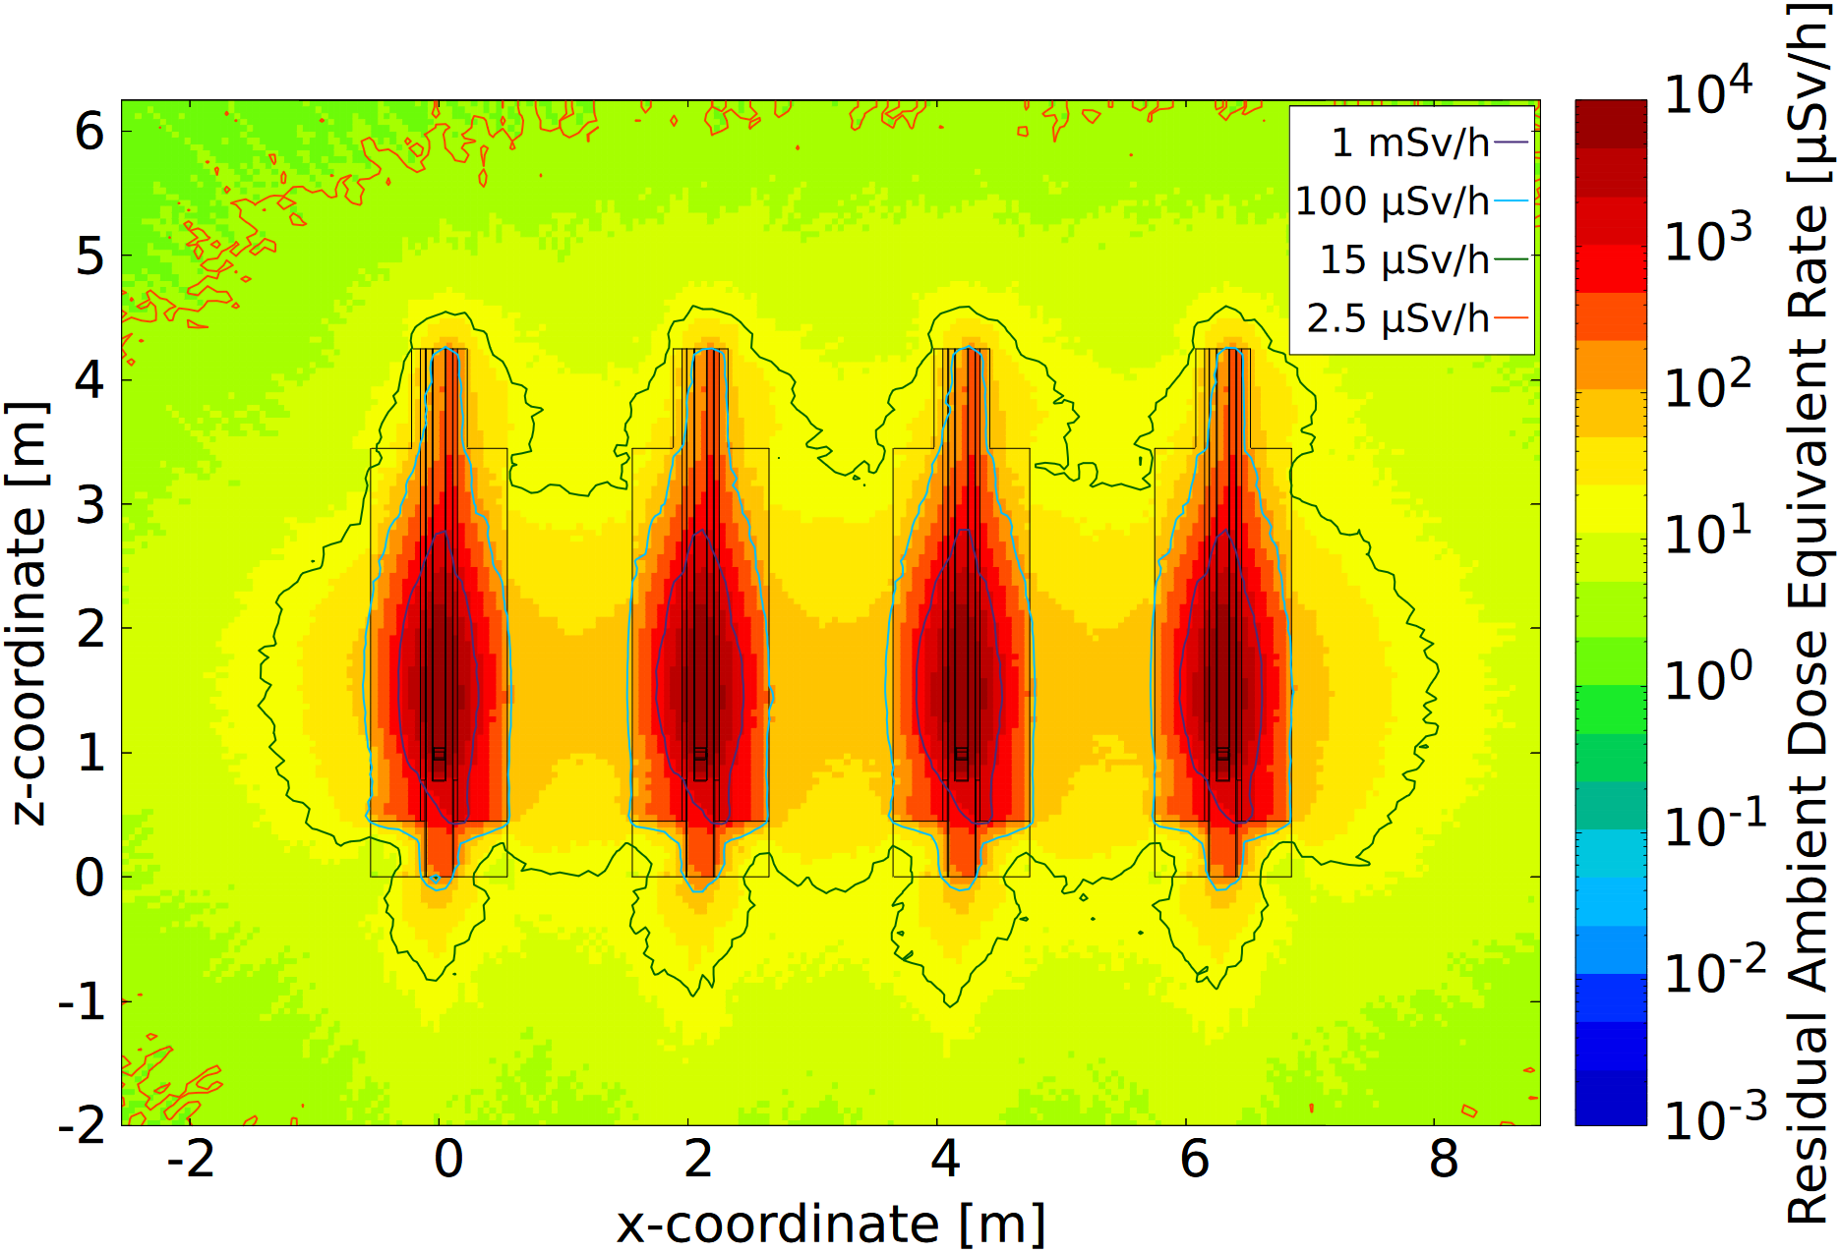
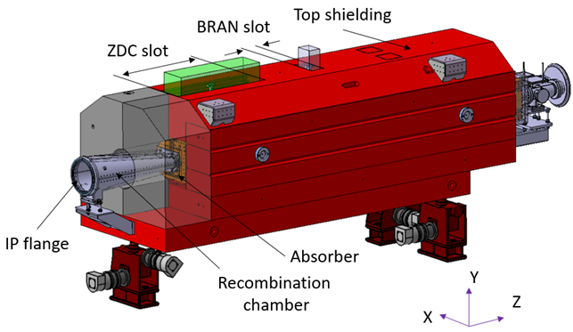
Upgrade of the LHC TAN
EDMS 2649832
Upgrade activities
Extraction of the TAN from the LHC tunnel after 4 months;
Storage of all four TAN in a dedicated area;
Removal of non-reused parts and disposal as radioactive waste;
Manipulation of the lateral/bottom shielding for the new TAXN;
Assembly of the new TAXN;
Storage of the four upgraded TAXN;
Installation of the TAXN in the HL-LHC tunnel.
4 months cool-down from end of Run3 pp operation
Complex manipulation on highly activated equipment
FLUKA (+ SESAME) simulations allow to estimate the residual radiation environment at different stages of the upgrade activities and in different configuration/geometries → “2-steps” method.
Estimates used for: defying the worksite and its radiological area classification, producing WDPs, optimizing the intervention and minimizing of the radiological risk, pre-characterizing radioactive waste.

Slide 11
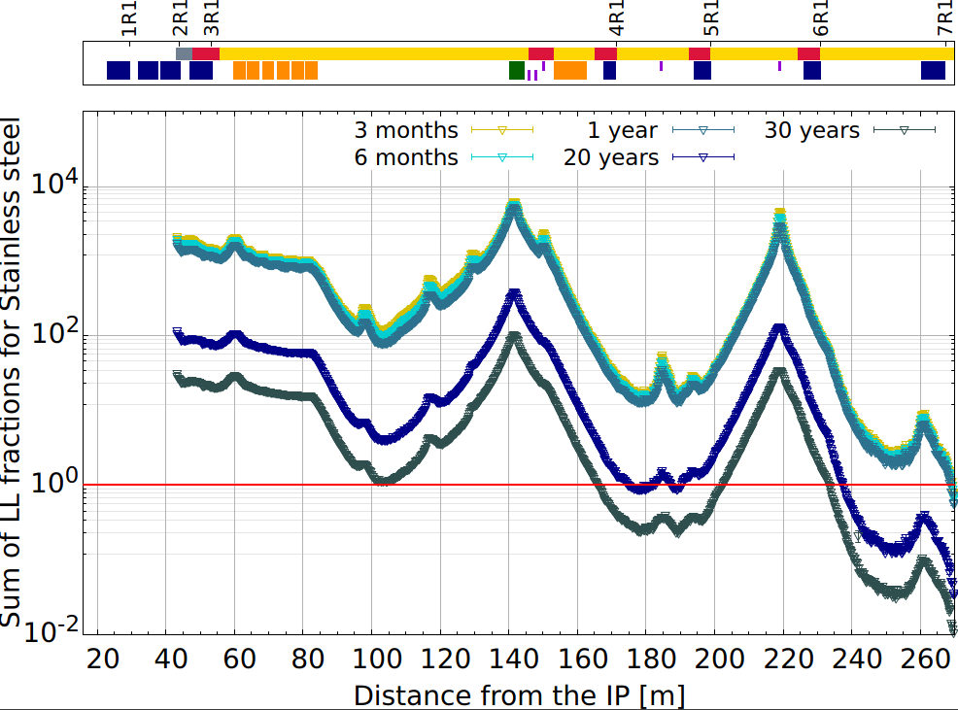
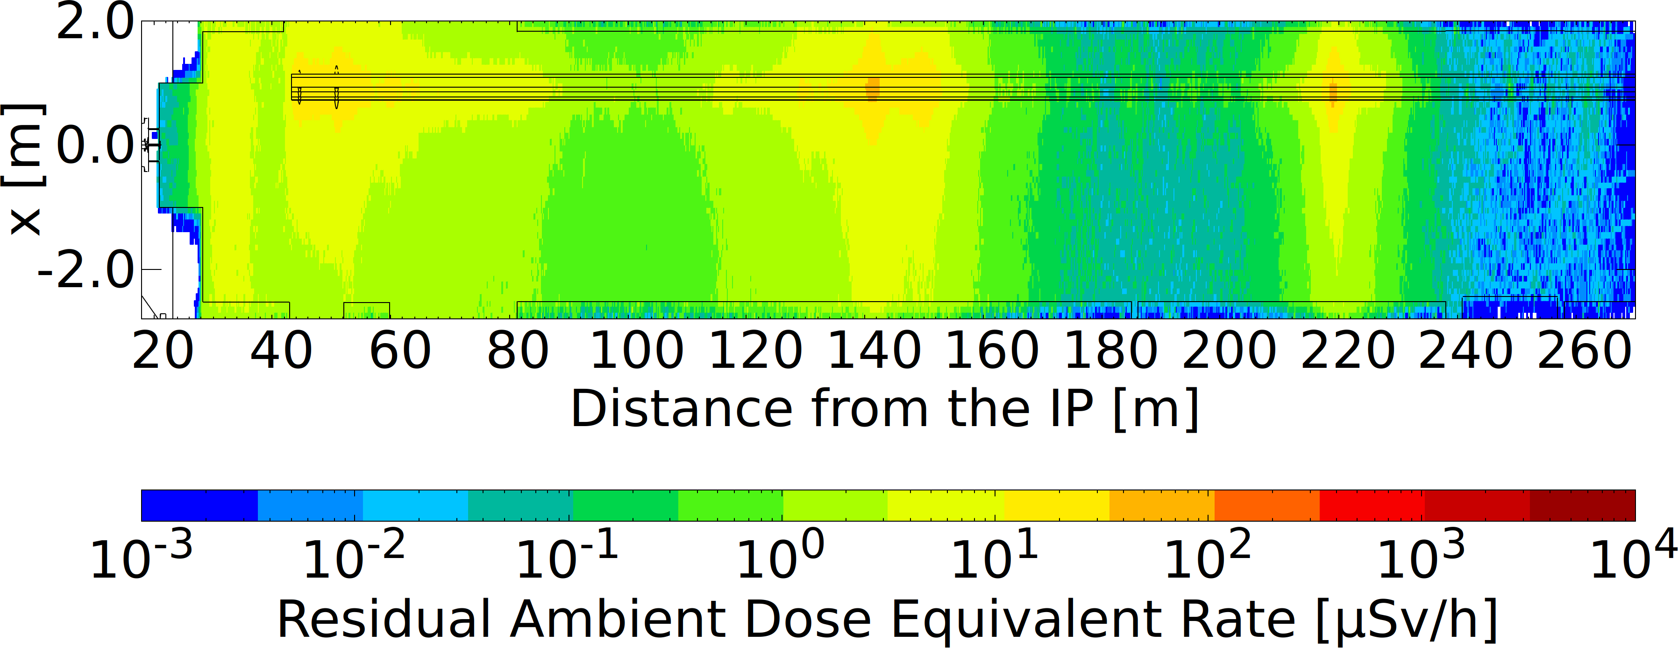
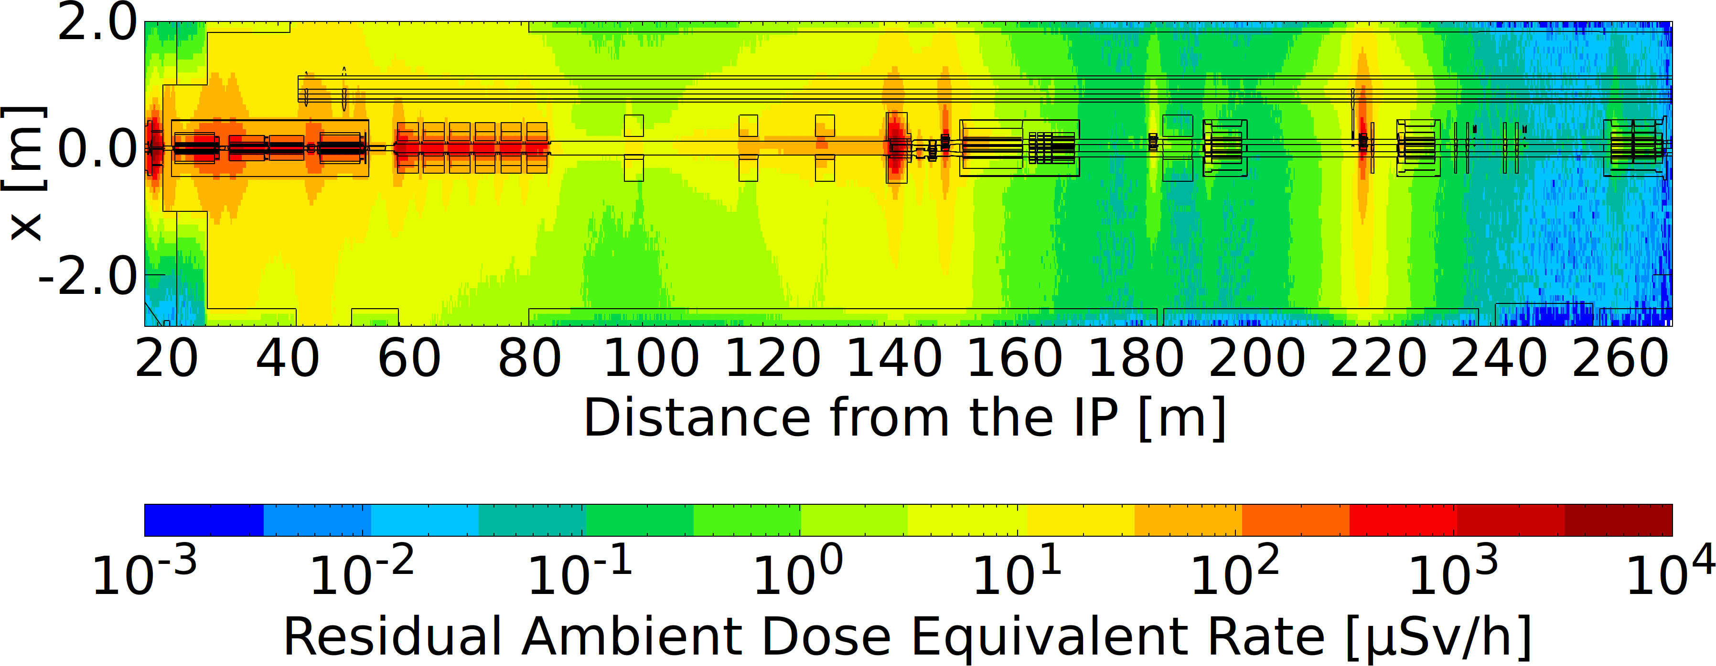
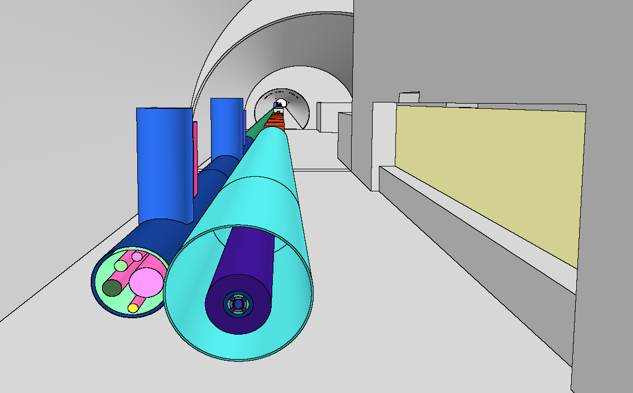
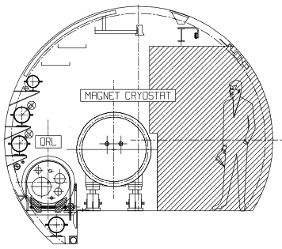
Upgrade of the LHC QRL
Estimated residual radiation levels 4 months cool down after the end of Run 3 proton-proton operation after the LHC beam equipment have been removed.
EDMS 2435122 (v2.0)
Multiple of LL in stainless steel along the QRL for different cooling times after the end of Run 3 proton-proton operation.
Dismantling of 800+ m of QRL → activity scheduled over several weeks.
FLUKA simulations of the radiological environment relevant for the QRL dismantle.
Significant reduction of the background radiation after the removal of LHC beam line equipment: on average <10 μSv/h in contact with hotspots close to jumpers, heat exchangers, collimators
→ integrated dose to be estimated (WDP)
QRL still radioactive after several years cool down → relevant for waste disposal/storage of spares.
QRL
LHC
FLUKA model

Slide 12
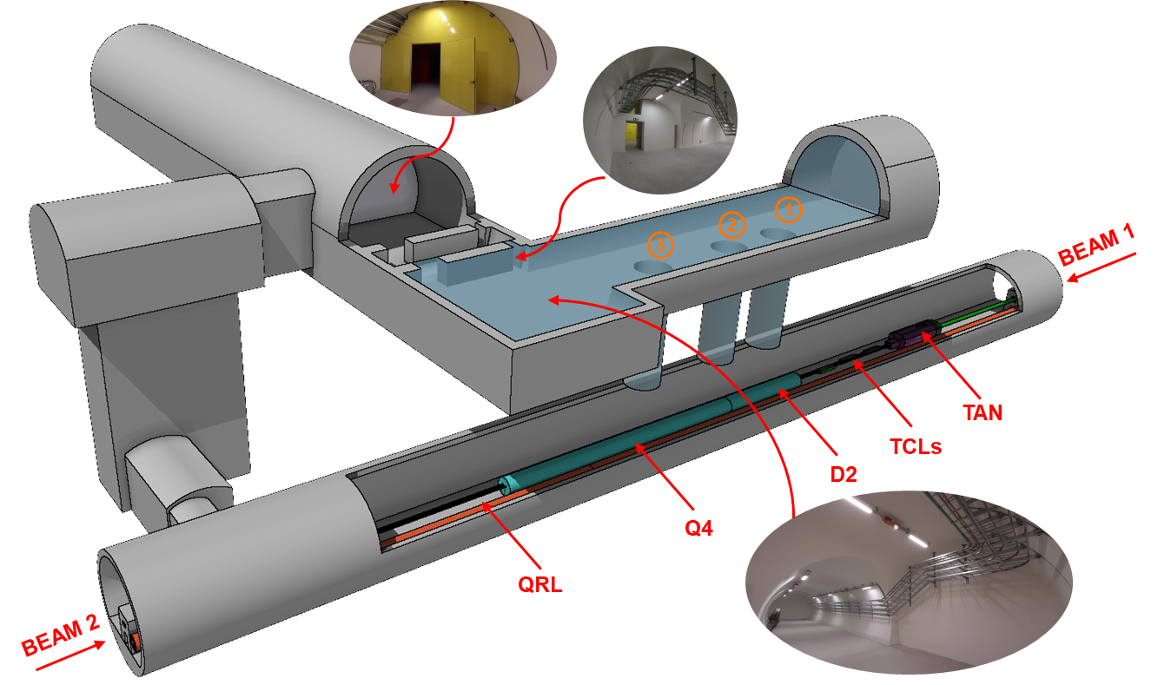
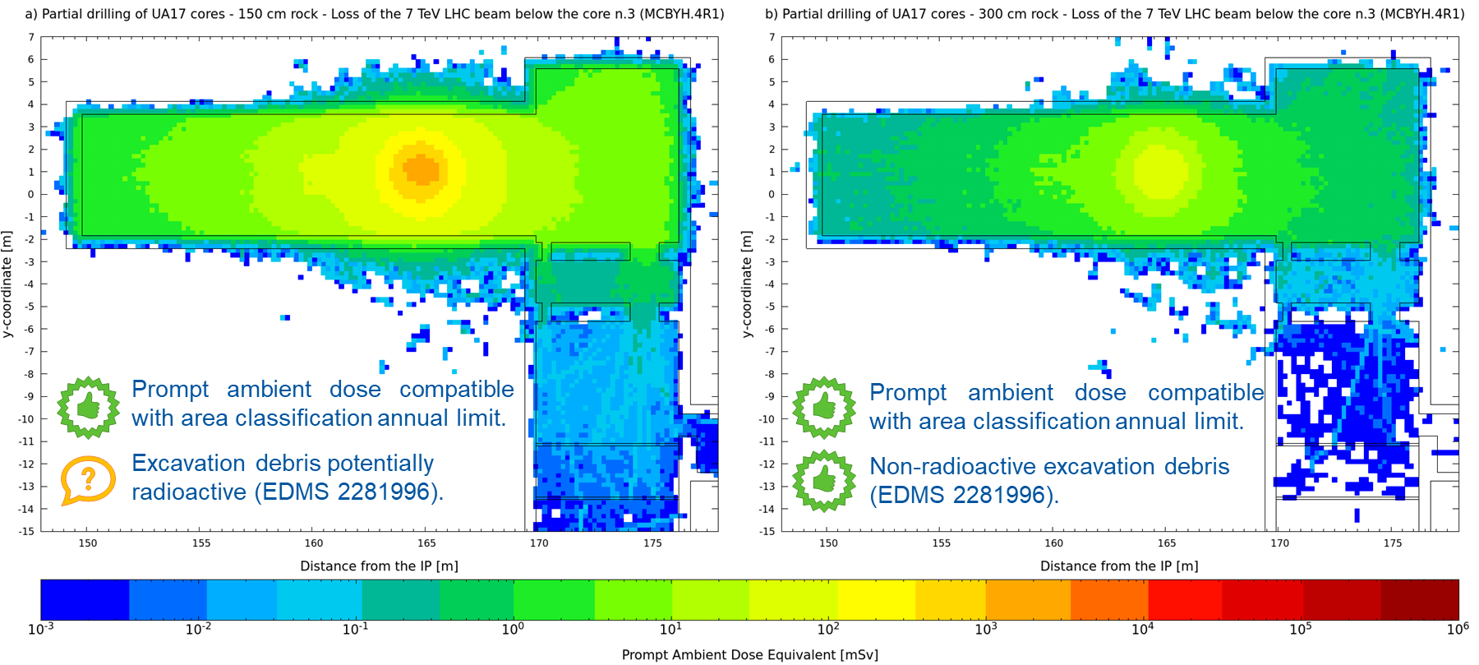
Core excavation: EYETS vs LS3
EDMS 2683459
Annual limit for Non-Designated Areas
Different (pre-)excavation options under discussion → detailed study presented in Chamonix 2022
FLUKA simulation to check potential RP constrains in UAs (and ULs) if cores pre-excavated during the EYETS 24/25
Beam loss in the LHC machine (MBRC.4R1 or MCBYH.4R1), Run 3 operational conditions and different soil thickness in the cores
Expected integrated dose due to the accidental scenario <1 mSv; Expected prompt ambient dose rate in Run 3 operation condition <<1 μSv/h at the sector door location (transmission factor ~10⁻⁸, EDMS 2212147)

Slide 13
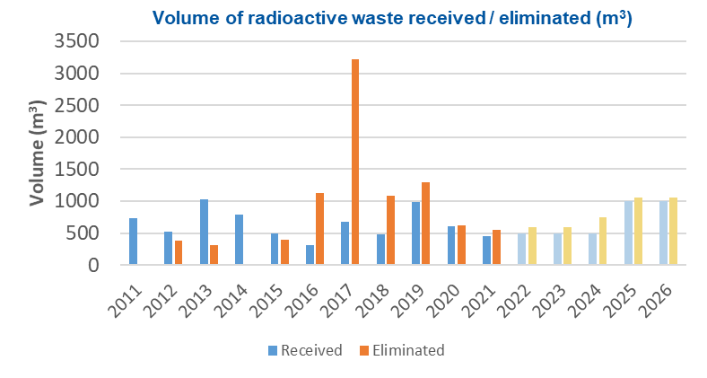
HL-LHC/LS3 RW forecast
RW waste at CERN: From 2010, tripartite agreement between CERN and Host States; “Fair Share” principle revised in March 2022.
LS3: Dedicated meetings (as from May 2021) coordinated by WP15 and devoted to collect data regarding RW and gathering contact persons & RP.
WPs with significant RW quantities identified.
HSE-RP-AS (A. Infantino/P. Dycrz) support to WPs to identify RW wastes + HSE-RP-RWM (C. Celce) collecting and registering the estimates.
Missing WPs are encouraged to provide data as soon as possible to keep forecasts up-to-date.
Rad. Waste description | Dep-Grp | Contact person
HL-LHC - WP3 Magnets | TE-MSC | Ezio Todesco
HL-LHC - WP5 Collimation | TE-ABT | Stefano Redaelli
HL-LHC - WP7: Machine protection | TE-MPE | Daniel Wollmann
HL-LHC - WP8: LHC-Experiment interface | BE-EA | Francisco Sanchez Galan
HL-LHC - WP9: Cryogenics | TE-CRG | Serge Claudet
HL-LHC - WP12: Vacuum & beam screen | TE-VSC | Vincent Baglin
HL-LHC - WP14 TDE LHC | SY-STI | Marco Calviani
HL-LHC - WP15 De-cabling LSS1/5 | EN-EL | Georgi Minchev Georgiev
HL-LHC - WP15 cable fibre and duct | EN-EL | Jeremy Blanc
LEP cavities
2000 m³
Note: currently shown forecast is an extrapolation from LS2 and not the quantities resulting from the ongoing exercise of collecting forecasts

Slide 14
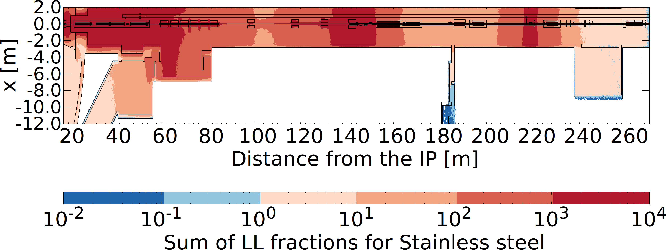
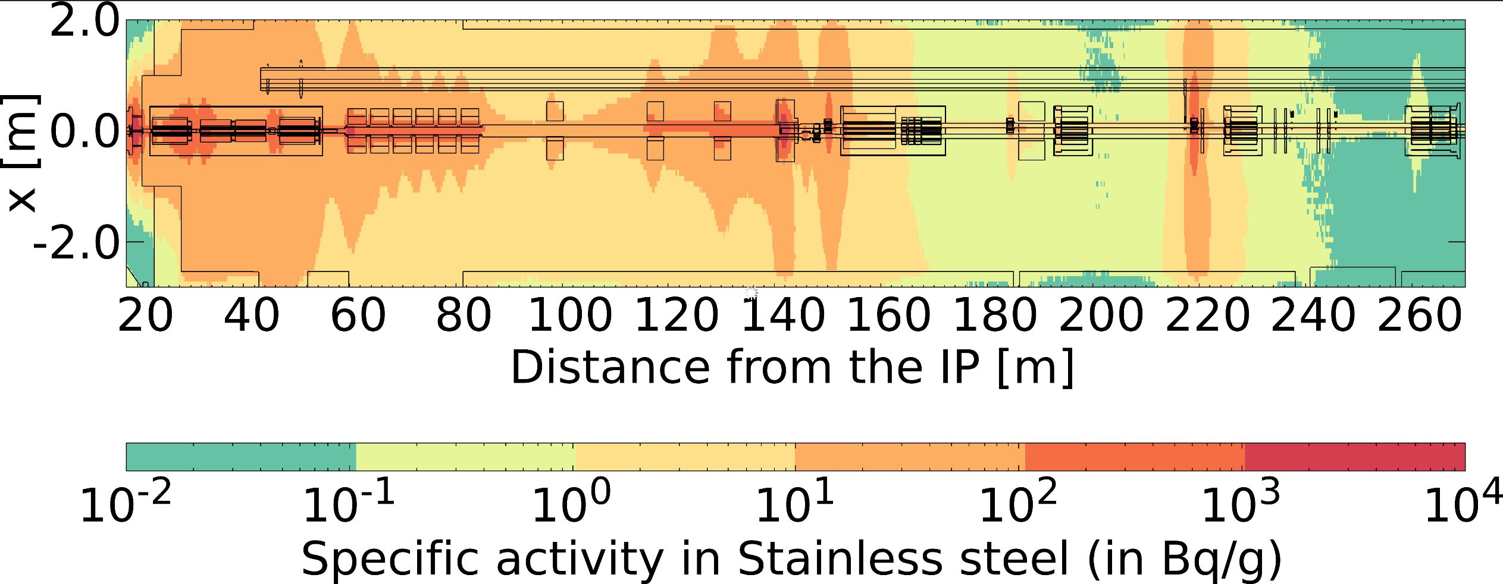
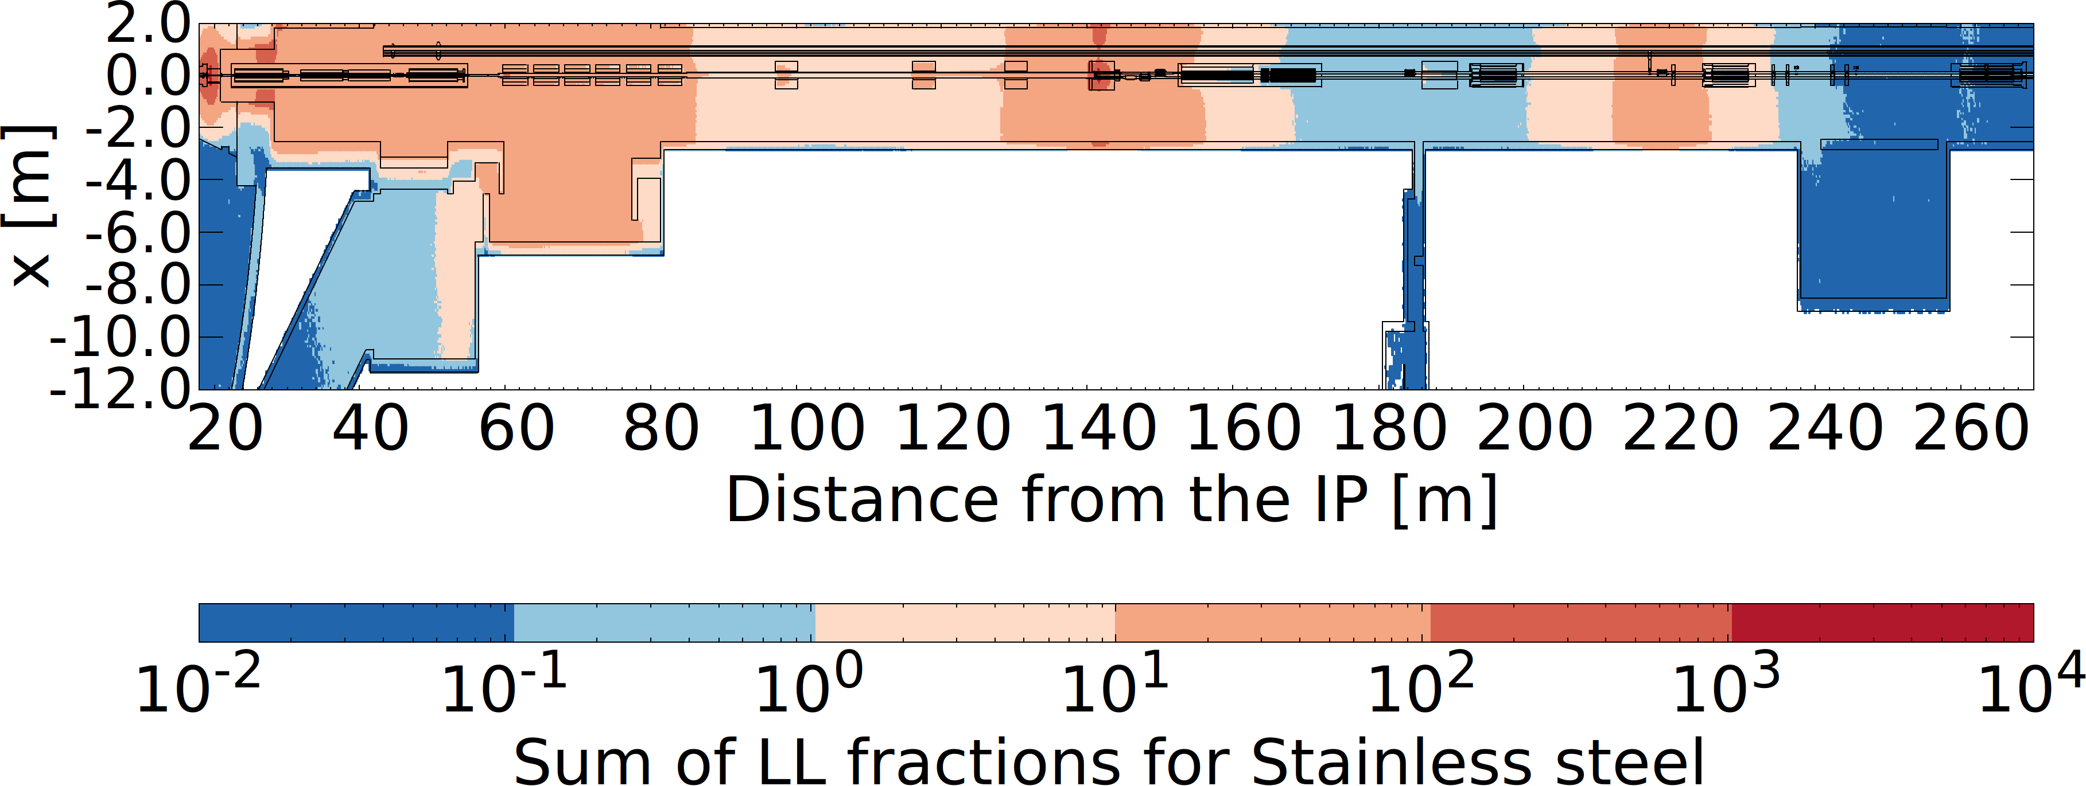
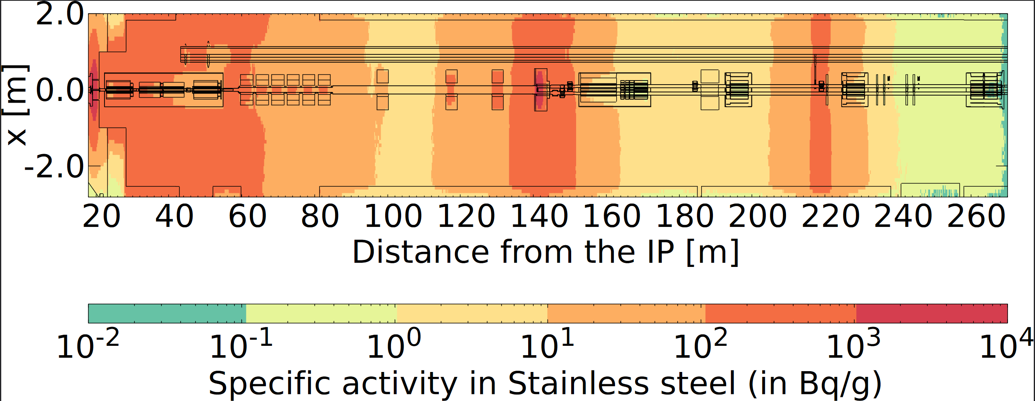
Radioactive material/waste
EDMS 2435122 (v2.0)
FLUKA simulations allow to estimate the activation levels of LHC equipment by targeting quantities such as multiple of Swiss clearance limits (LL) and/or specific key-radionuclides.
Detailed radiological characterization for radioactive waste pre-characterization and for determining the most suitable elimination path.
⁵⁴Mn
1 year cool down
1 year cool down
⁶⁰Co
30 years cool down
1 year cool down
Note: considered max 0.3 wt% Co in steel

Slide 15
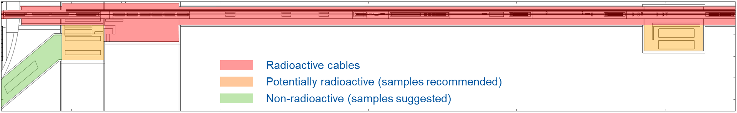
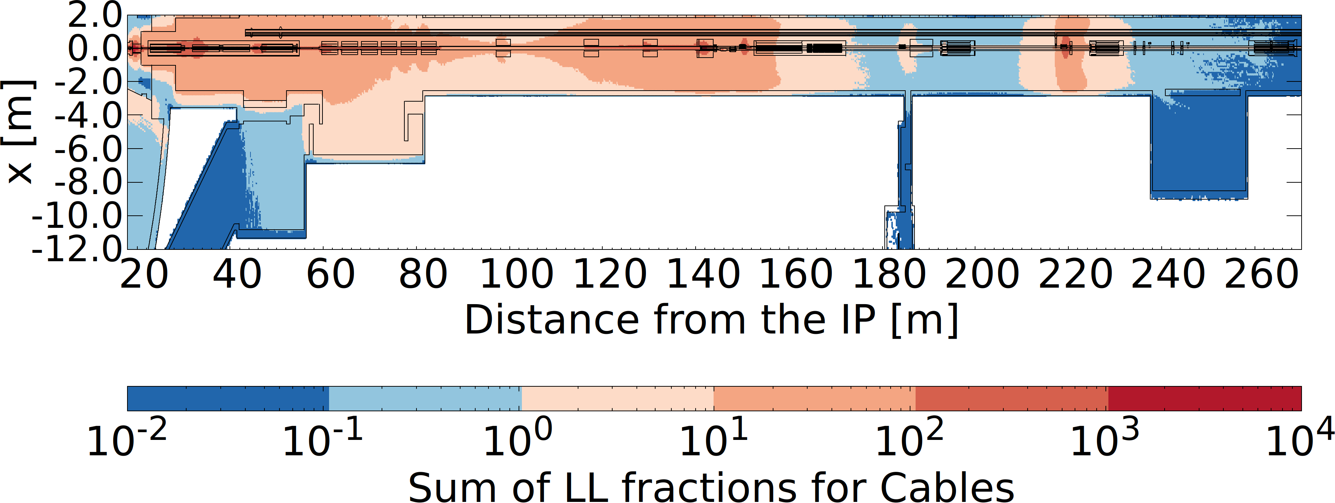
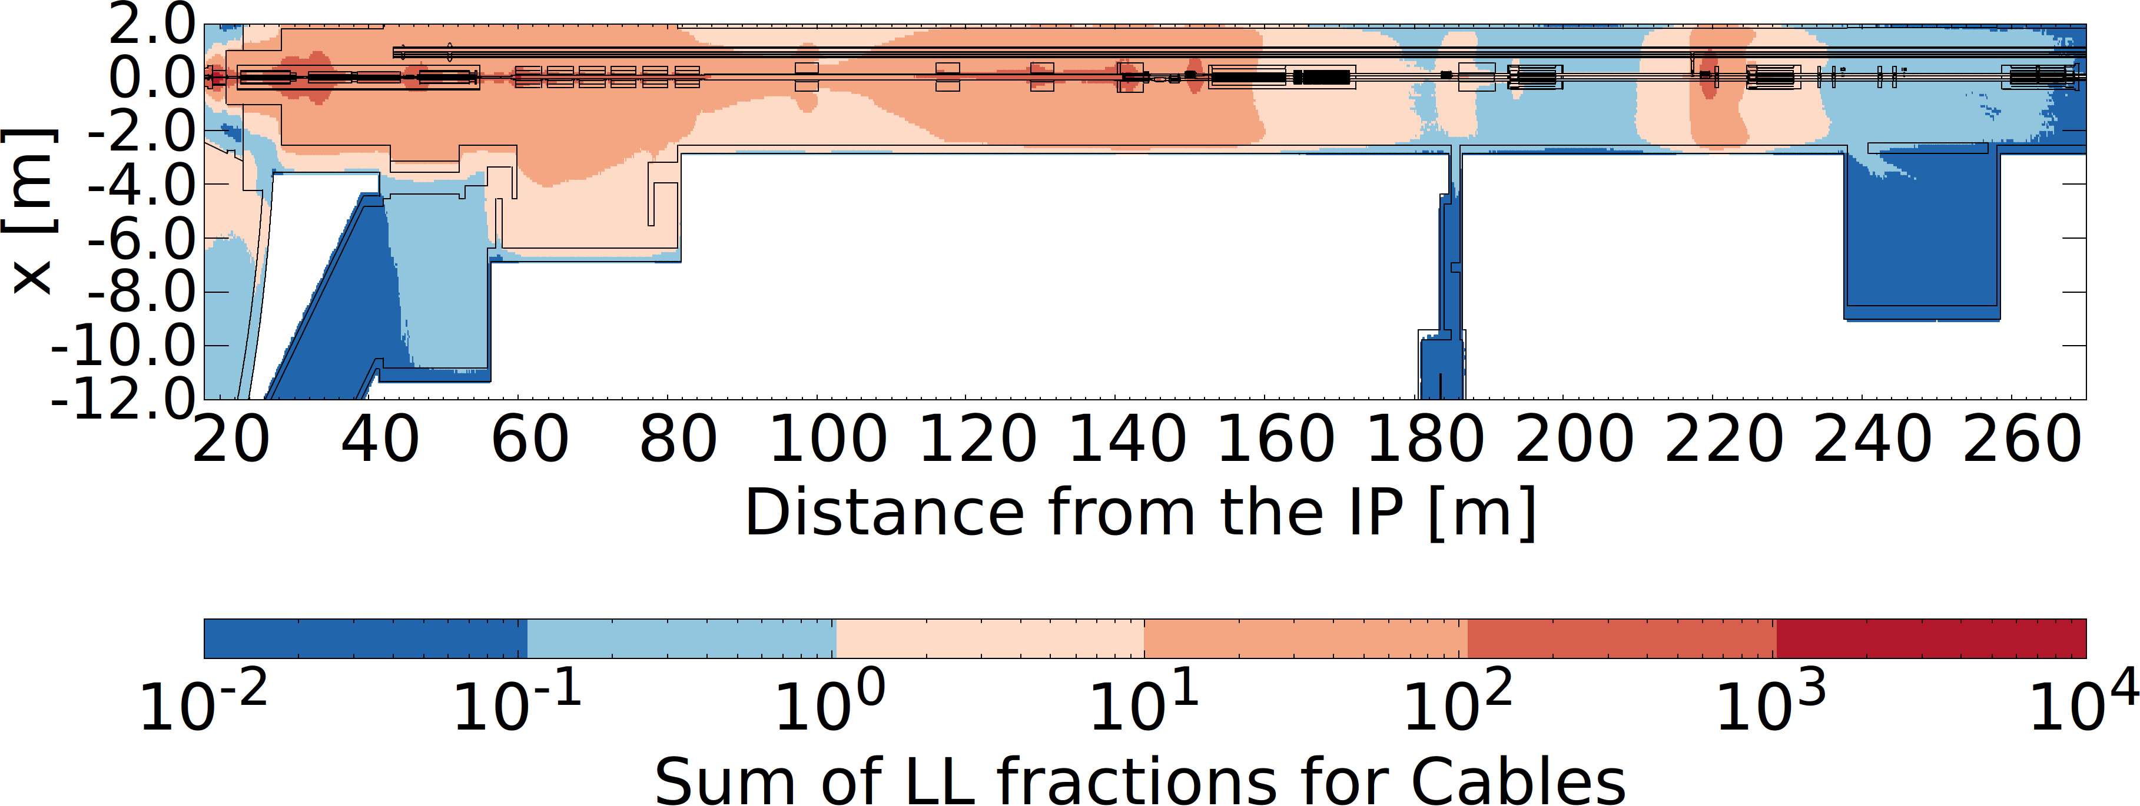
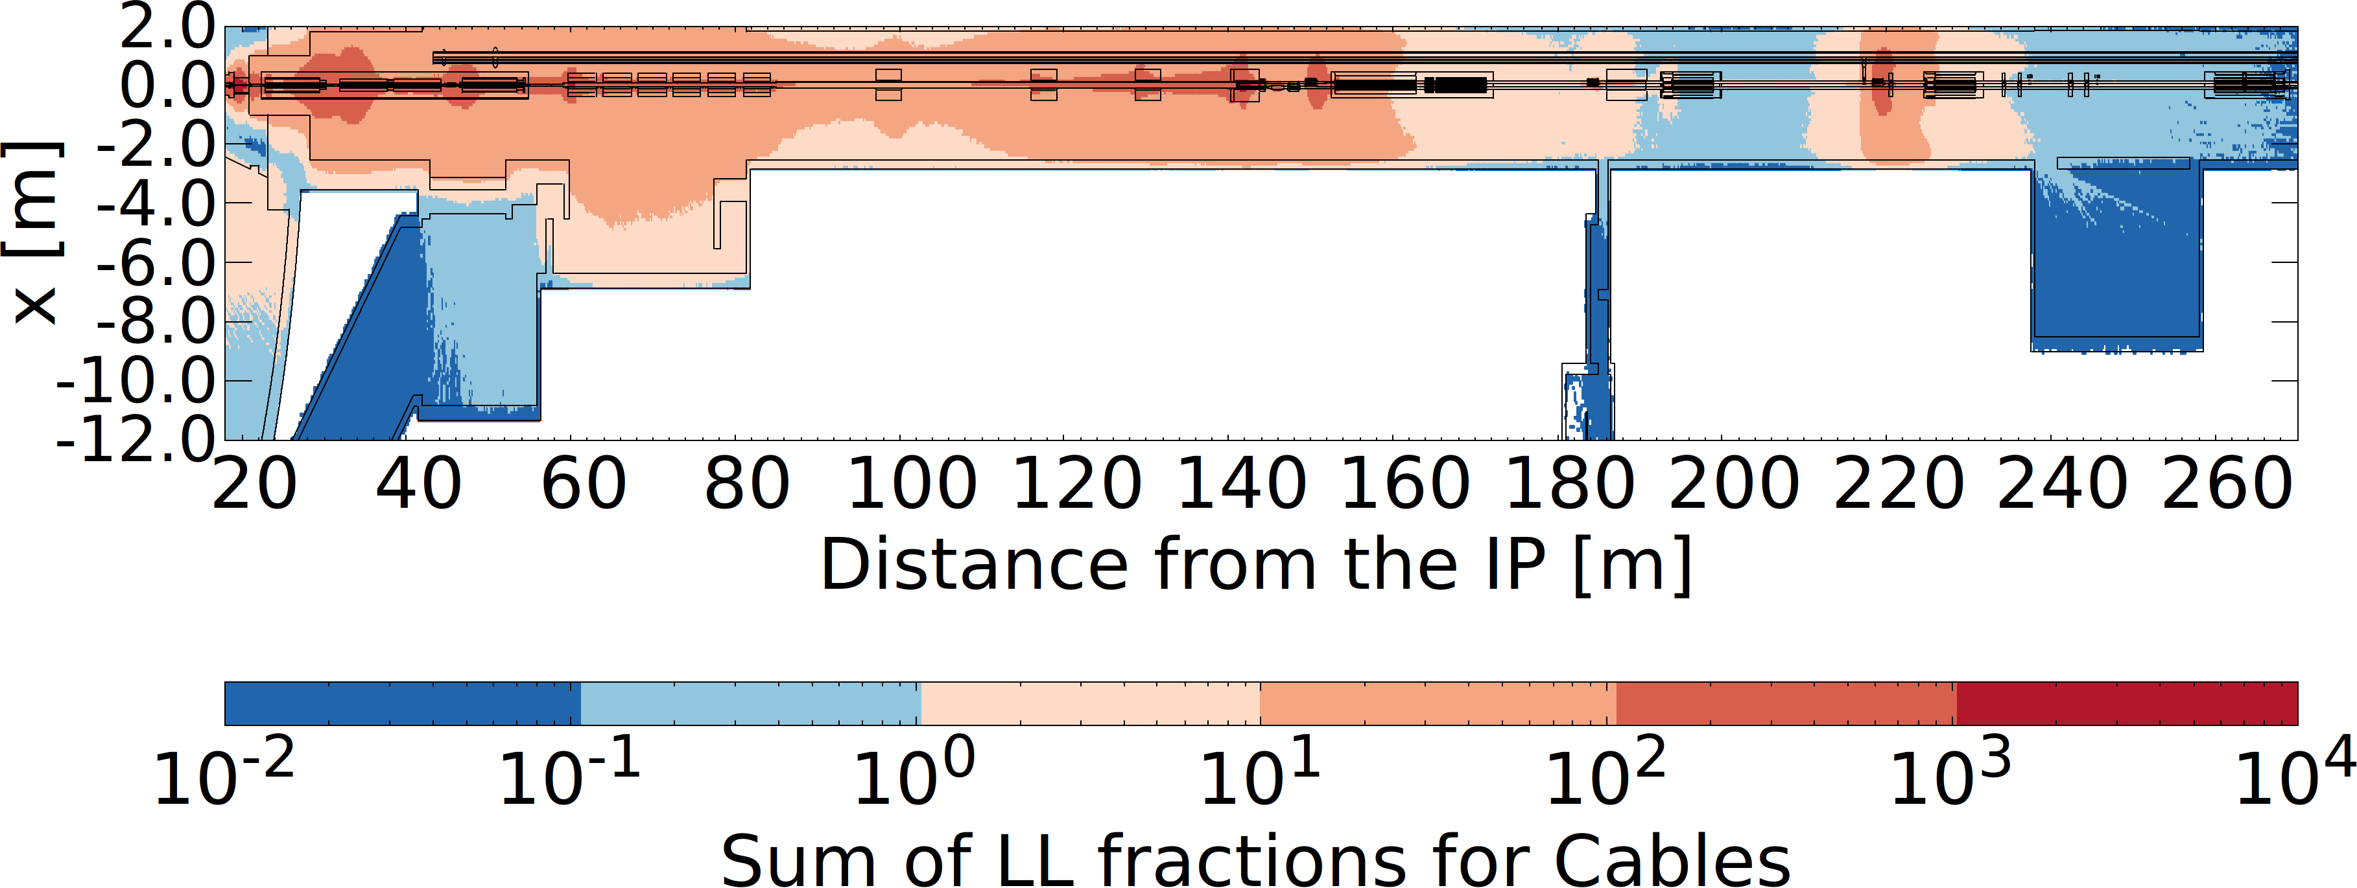
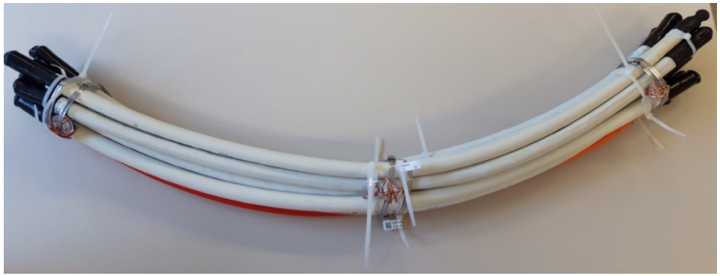
De-cabling
EDMS 2435122 (v2.0)
6 months cool down
EDMS 2725658
Note: similar zoning for LSS5
30% Cu
Ongoing ad-hoc discussions within WP15 Friday meetings.
New FLUKA simulations of multiple of the Swiss clearance levels in cables, assuming different ratio between conductor (Cu) and insulator.
Tentative zoning for the de-cabling campaign at LHC Point 1; similar approach for LHC Point 5.
Samples strategy: shared with CARE project (sample deployment to be discussed).
50% Cu
70% Cu

Slide 16
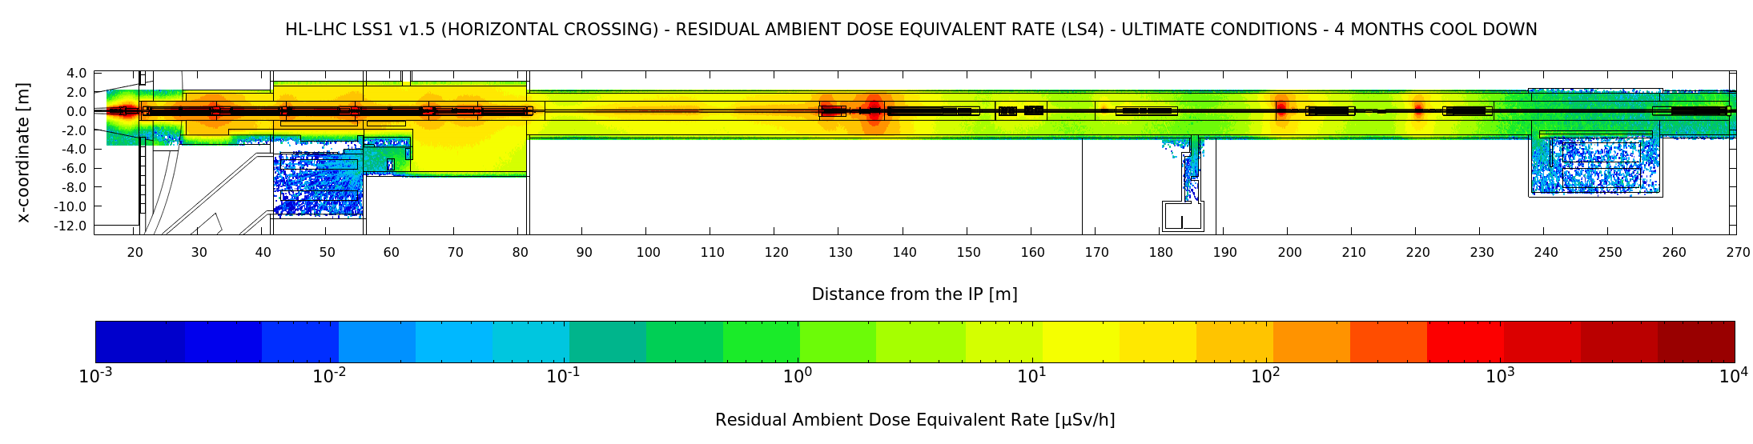
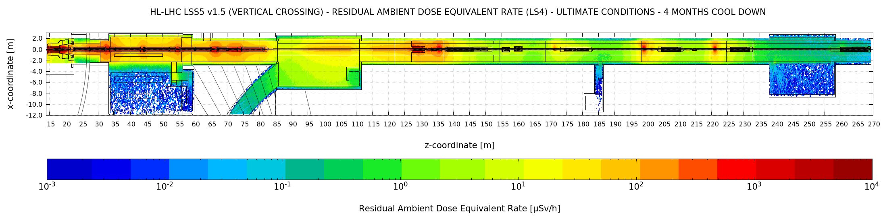
HL-LHC LSS1& LSS5 – RDR LS4
EDMS 2405113
update to optics v1.5

Slide 17
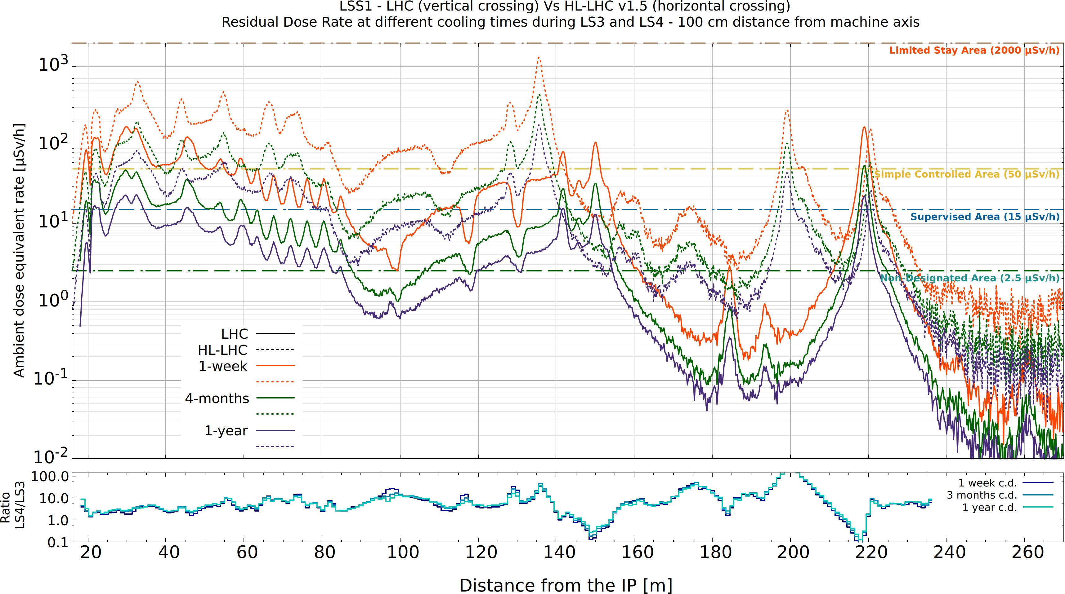
HL-LHC LSS1& LSS5 – RDR LS4
EDMS 2405113
Crossing scheme LHC/HL-LHC is swapped: HL-LHC Pt.1 horizontal, Pt.5 vertical.
Peaks in different position due to the different optics & crossing scheme.
Significant increase of radiation levels due to luminosity boost
More challenging access conditions → impact on interventions.

Slide 18
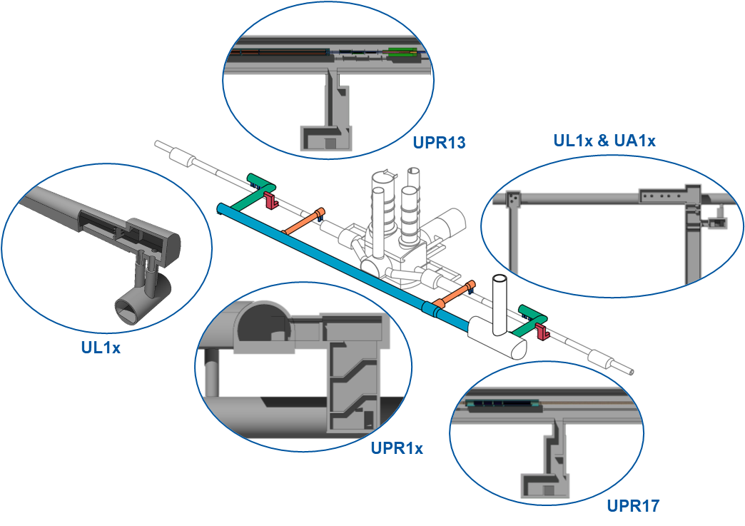
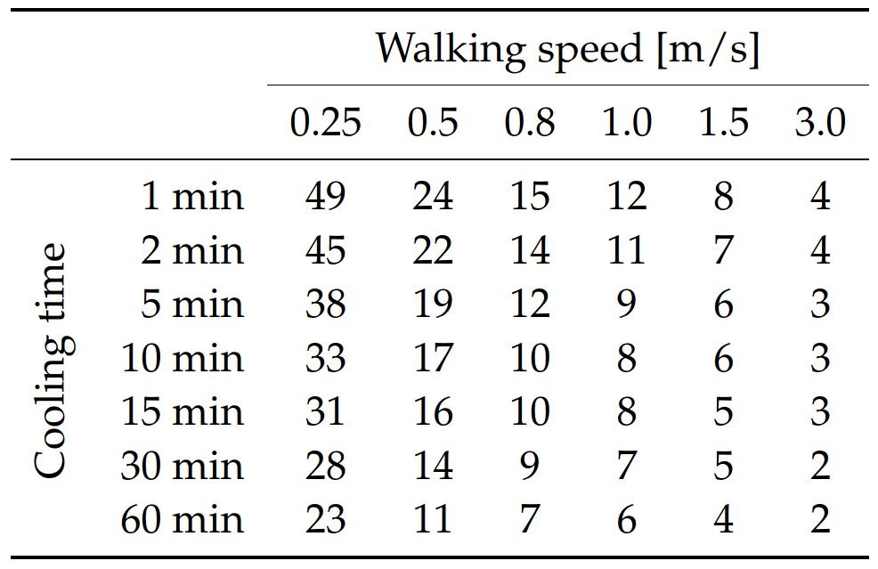
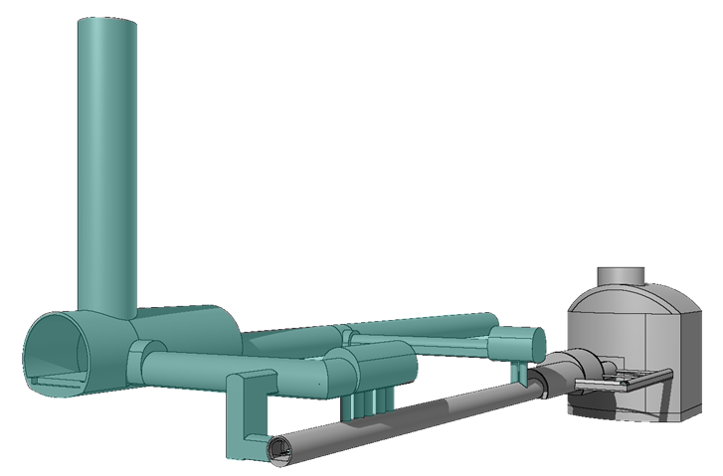
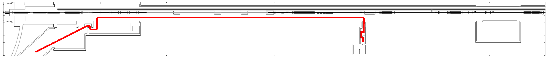
New HL-LHC galleries
Accurate FLUKA geometry of the “as-built” HL-LHC galleries at Pt.1 and Pt. 5.
A number of studies developed for the new HL-LHC galleries at Pt. 1 & 5 such as air activation, shielding requirements, dose during an emergency evacuation via the LHC tunnel, and more → List in backup.
Cumulated effective dose E (µSv) for different cooling times and walking speeds.
Run 3 operation, rounded numbers.
EDMS 2719989
FLUKA model of HL-LHC infrastructure at Pt. 1 (right)
Highlighted: new HL-LHC underground infrastructure, as built during LS2.
Sketch of the escape path in right LSS1 (UPR17 via PM15) as implemented in Flair’s WDP planner.

Slide 19
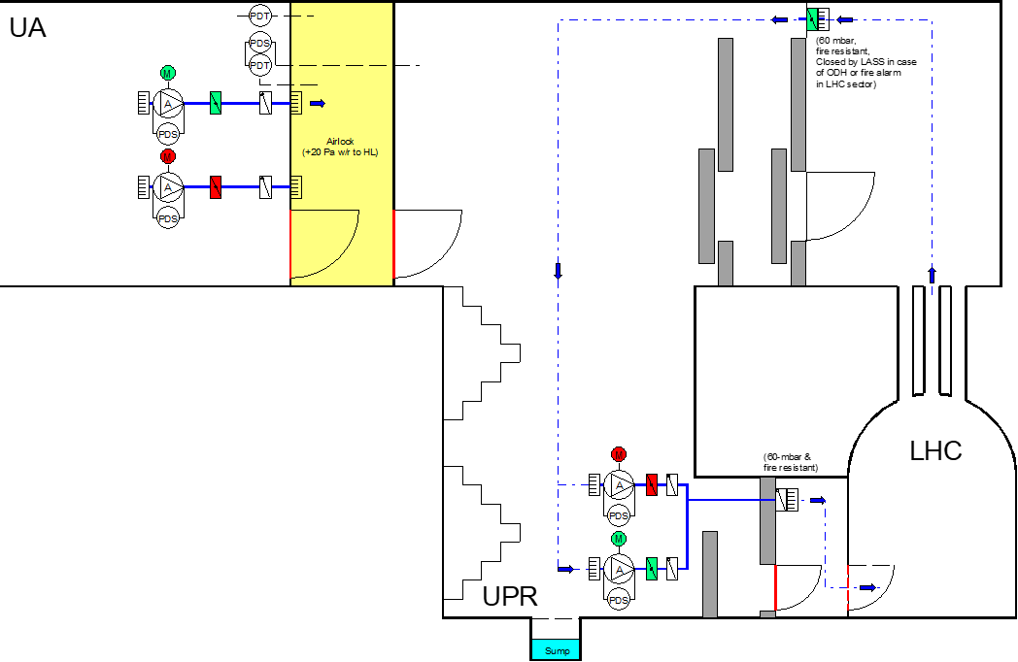
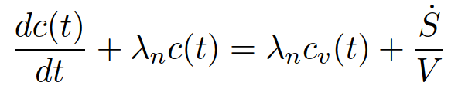

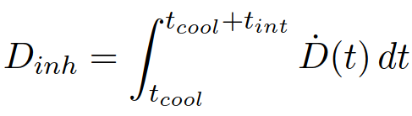
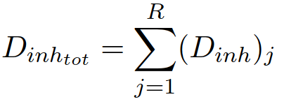
Air activation in the HL-LHC galleries
Final ventilation configuration (HL-LHC): complex ventilation model (loop) with radioactive air injected in a activation-free area (EDMS 2416918).
Optimization criteria: 1 μSv inhalation dose per 1 hour intervention.
Access requirements to be revised → solution of the ventilation model (considering effective decay constant, i.e. ventilation + physical decay) in the UA/UPR volume.
Assuming HL-LHC ultimate conditions, 1-week of operation, t_{int}=60 min and t_{cool}=30 min → D_{inh}~1.3 μSv.
Waiting time before access from 30 min → 60 min to match the optimization criteria.
EDMS 2489958

Slide 20
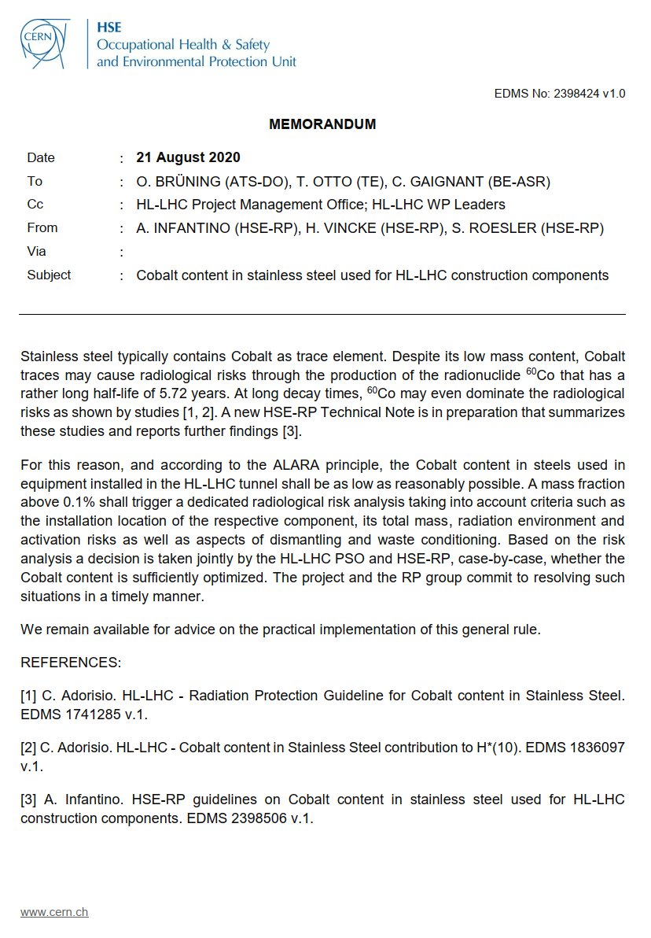
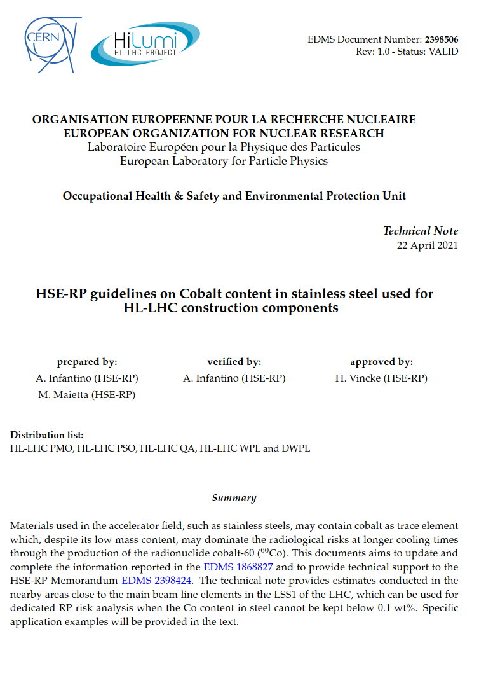
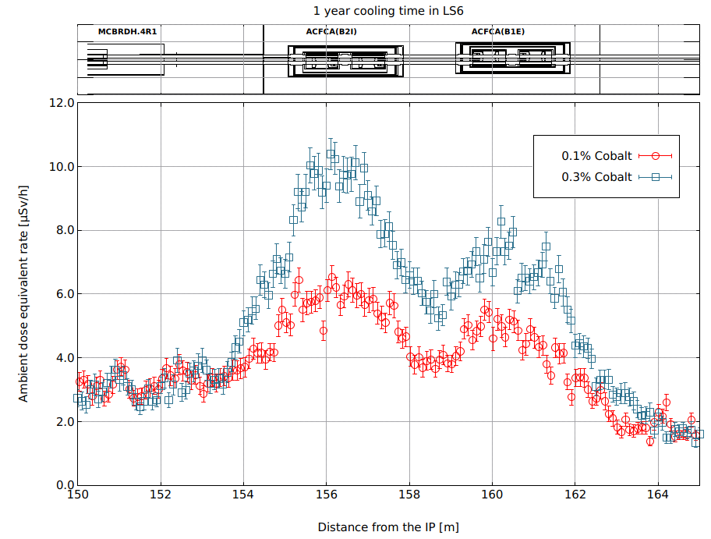
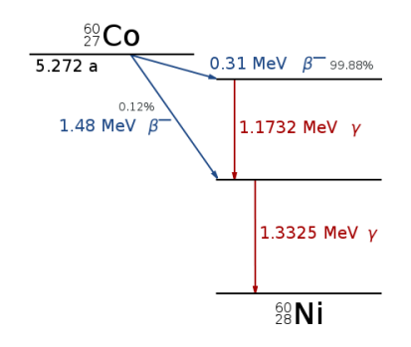
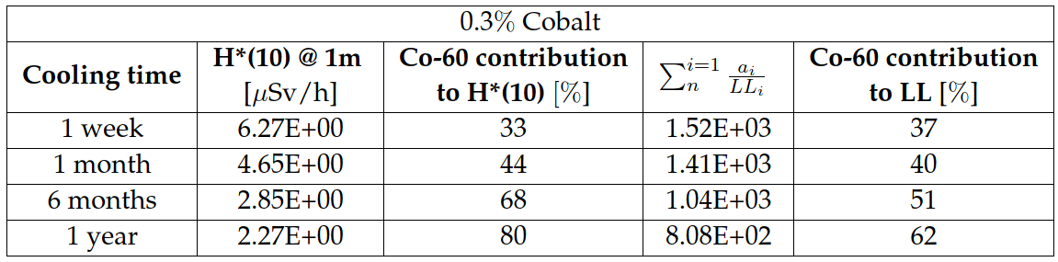
HL-LHC: Co content
EDMS 2398424
⁶⁰Co
EDMS 2398506
Cobalt content in steel is a critical parameter in the design of future accelerators due to the production of ⁶⁰Co which can dominate the radiation field at long cooling times (e.g. > 1y).
CERN approach: guideline value max. 0.1 wt% Co in steels based on market survey and radiological study.
Purchased steel quantity and retrieval through international collaborators are limiting factors. In addition Co content typically not indicated in the product specifications (minor impurity for the industry).
HSE-RP conducts dedicated risk analyses in case Co > 0.1 wt%.
Final decision taken together with hilumi management, evaluating cost-benefit aspects (ALARA).

Slide 21
Take home message
Number of studies deployed by HSE-RP in the context of LS3 preparation and HL-LHC operation.
LS3 will be challenging from RP point of view: working in a high residual dose rate environment, multiple co-activities to be carried out in the LHC tunnel, radioactive waste estimate/sorting.
LS3 ALARA optimization:
Ensuring adequate cool down, considering the general LS3 planning/coordination & ion operation;
Preparation and optimization of high-dose activities (WDP);
ALARA Level 3 interventions (such as triplet exchange, etc.) need approval from the ALARA committee. Approval has to be received (well) in advance of the start of the work (as for LS2);
Remote handling when possible;
Integration of radioactive waste aspects into shutdown planning is essential → ad-hoc WP15 integration meetings including link persons and RP (AS and RWM) ongoing.
Waste treatment should be considered at the source (e.g. TDE autopsy) for reducing dose to personnel and minimize costs for CERN.
HL-LHC operation will further challenge RP aspects
Expected higher radiation levels
New underground galleries (partially) accessible during operation
LHC tunnel possibly used as emergency/escape path
Ventilation between HL-galleries and LHC tunnel
Other ongoing studies on TDE, collimators, etc

Slide 22

ANGELO INFANTINO
CERN HSE-RP-AS
angelo.infantino@cern.ch

Slide 23
BACKUP SLIDES

Slide 24
Reference list (Technical Notes)
EDMS Id | HSE-RP Technical Notes relevant for HL-LHC
2159991 | HL-LHC TDIS: Evaluation of the residual dose rates in accidental scenarios
2212147 | HL-LHC UPR underground galleries: review of the ambient dose equivalent rate during operation
2212244 | HL-LHC TAXN: shielding requirements verification
2339490 | List of RP-related HL-LHC Technical Notes (in-work)
2489958 | Ventilation model for the LHC and HL-LHC operation
2719989 | Estimate of the individual effective dose during the evacuation from the HL-LHC underground galleries via the UPR and LHC tunnel
2435122 | Radiation Protection estimates for LS3 activities in LHC LSS1 and LSS5
2649832 | Radiation protection studies relevant for the LS3 TAN upgrade: usage of the existing shielding and preliminary considerations on the worksite
2398506 | HSE-RP guidelines on Cobalt content in stainless steel used for HL-LHC construction components
2405113 | Radiation levels in HL-LHC LSS1 and LSS5: update to optics v1.5
2641646 | LHC and HL-LHC luminosity and irradiation profiles for Radiation Protection studies
2773825 | Radiation Protection assessment of the activated collimators in the LHC Upgrade (in-work)

Slide 25
Reference list (Presentations)
EDMS Id | HSE-RP Presentations relevant for HL-LHC
2195180 | HL-LHC TDIS: Residual Dose Rate Estimation
2216246 | HL-LHC UPR underground galleries: review of the ambient dose equivalent rate during operation
2220425 | HL-LHC alignment: preliminary RP considerations
2248866 | Overview of the radiation levels (RP and R2E) in the HL-LHC UPRs/UAs underground galleries
2256546 | HL-LHC TAXN: RP considerations on shielding requirements
2331769 | RP-recap of the residual dose rates in the HL-LHC LSS 1 and 5
2339827 | List of RP-related HL-LHC presentations
2403936 | New TAXN shielding design for ZDC operation: radiation levels and preliminary considerations
2467997 | Radiation protection studies on the HL-LHC TAXN design and optimization
2683459 | HL-LHC LS3 Radiation protection aspects in IP1 and IP5
2748377 | Expected residual dose rates in LSS1/LSS5 during HL-LHC
2749148 | Radiation levels relevant for the HL-LHC TCLM in LSS1 and LSS5
2725658 | RP considerations on the LS3 decabling: activities and samples to be taken during RUN3
2411858 | Preliminary RP considerations for LS3 activities
2367047 | Overview of radiation levels in the LHC dump area (UD6x) during LS2, RUN3 and LS3
2574668 | Preliminary RP considerations on the QRL dismantling during LS3
2435416 | Update on Radiation Protection estimates for the HL-LHC project
2513434 | Preliminary considerations on collimators dismantling during LS3
2596841 | Preliminary RP considerations on the TAN dismantle, storing and upgrade during LS3
2744737 | Radiation protection challenges for the Large Hadron Collider upgrade
2513055 | RP risk analysis on the Co content for the Crab Cavities cryostat
2416918 | Air activation in the new HL-LHC galleries
2773490 | Presentation HSE-RP 12th HL-LHC collaboration meeting
2355222 | RP considerations on the air activation in the LHC experiments and IT region
2406245 | Radiation Levels in HL-LHC UPRs & UAs due to industrial radiographies
2780135 | Updated RP studies on the HL-LHC UL shielding requirements

Slide 26
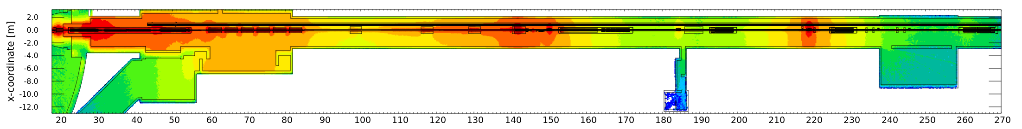


LS3: LSS1 Residual H*(10)
Permanent workplace
Low-occupancy area (<20 % of working time)
1 day
1 week
2 months

Slide 27



LS3: LSS1 Residual H*(10)
Permanent workplace
Low-occupancy area (<20 % of working time)
6 months
1 year
1.5 year

Slide 28

LS3: Residual H*(10) LSS1 vs. LSS5
Comparison of LSS1 and LSS5
Slight difference due to the different crossing scheme
Similar results in terms of residual radiation levels
Projected radiation levels at the end of Run 3 proton-proton physics (working distance, ~40 cm) for LSS1 and LSS5

Slide 29





FLUKA simulations: operational RP
EDMS 2744734
June 2021 –RP syrveys by using a remotely controlled robot
Combination of FLUKA-SESAME, FLUKA-FCC simulations to extend built-in FLUKA capabilities and to study residual dose field and activation in complex geometries.
Cross-validation with measurements within ± 20% (average).
February 2020 – opening of the TDE shielding and RP surveys.

Slide 30





FLUKA simulations: TDE autopsy sequence
EDMS 2744734
1D dose
rate profile
A
B
Configurations evaluated:
Entire TDE core (A)
LDG section + full steel jacket (B)
LDG section + ½ steel jacket (C)
LDG section + no steel jacket (D)
C
D
FLUKA-SESAME simulations allowed to optimize (ALARA) the cutting sequence (full 3D simulations of different steps).
Work-Dose Plan based on cross-validated FLUKA simulations.
WDP: initial estimate 4.8 mSv.man collective dose; 550 µSv max individual dose -> after intervention 4884 µSv.person & 508 µSv (final 2920 µSv.person; 255 µSv).

Slide 31



Radioactive Waste Management
The Radioactive Waste (RW) management at CERN is led by the Radioactive Waste Management (RWM) section within the Radiation Protection (RP) group.
CERN operates a Radioactive Waste Treatment Centre (RWTCS) inside the former accelerator tunnel of ISR which is also used as interim-Storage for Radioactive Waste pending disposal.
Waste pre-conditioning (sorting, etc) is needed → e.g. LHC TDE
Radioactive Waste produced from CERN activities are sent to the RWTCS to get processed, packed, characterized and finally disposed.
Stored waste (31.12.21) | Volume (m3)
Clearance candidates | 1604
TFA | 3881
FMA | 340
Total | 5824
Percentage of storage space | 60%

Slide 32
CERN Radioactive Waste disposal pathways
From 2010, tripartite agreement between CERN and Host States, represented by Swiss Federal Office of Public Health (OFSP) and the French Nuclear Safety Authority (ASN) -> link
“Fair Share” principle revised in March 2022, with three indicators: the volume eliminated, radiotoxicity and elimination costs.
With these indicators, it will now be possible to better compare and measure the share between the two Host States
CERN RW classification | Disposal pathway
Clearance candidates – CL (Candidats à la Liberation Inconditionelle) | Release from regulatory control in Switzerland (clearance ↔ “free release”)
Very Low-Level Waste – TFA (Très Faibles Activités) | Surface disposal in France, as defined by the acceptance criteria of the ANDRA CIRES repository.
Intermediate & Low-Level Waste – FMA-VC (Faibles et Moyennes Activités a Vies Courtes) | ﻿Short-lived intermediate and low level waste, half-life <30 years. Surface disposal in France as defined by acceptance criteria in ANDRA CSA repository.
Intermediate & Low-Level Waste – FA-MA (Faibles Activites et Moyennes Activités) | ﻿Intermediate and low-level waste which does not fulfil the FMA-VC criteria and disposal in Switzerland (PSI).

Slide 33







Context and FLUKA modelling
Several RP studies in the past considering HL-LHC conditions and different cores layout → 2x80 cm shielded doors.
RP memo EDMS 2281996 on activated excavation spoils.
Aim: verify RP constraints if the cores are partially excavated during Run 3 (e.g. EYETS).
Beam
1
2
3
Non-accessible UA area during LHC operation
LHC Point 1 geometry: UA17 + LHC tunnel from 130m to 190m from IP1. Main outcome applicable to all UAs.
Run3 beam conditions: Beam 1, E_{beam} = 7 TeV protons, 2748 bunches, 1.8E11 ppb.
Emergency escape path (UPR17)
Excavation scenarios: average rock thickness from the LHC vault of 150/300 cm → preliminary assumptions.
*
Accidental scenario: loss of the LHC beam below the 2nd or the 3rd core (i.e. on the MBRC.4R1 or MCBYH.4R1).
*
Ventilation and sector doors
Run 3:
UA Non-Designated area
No shielded doors in the UA → The presence of the shielded doors ensure the respect of the dose limits when the cores are fully excavated (see EDMS 1611872).
Accessible UA area during LHC operation
* Modified from EDMS 1611872

Slide 34



Prompt H*(10)
Excavation scenarios: average rock thickness from the LHC vault of 150/300 cm.
UA17
UA17
LHC
QRL
UA17
LHC
LHC
QRL
Prompt ambient dose compatible with area classification annual limit.
Prompt ambient dose compatible with area classification annual limit.
LHC
Excavation debris potentially radioactive (EDMS 2281996).
Non-radioactive excavation debris (EDMS 2281996).
Note:
Expected prompt ambient dose rate <<1 μSv/h at the sector door location (transmission factor ~10⁻⁸)
Similar considerations can be made for the ULs (based on UL shielding simulations not presented here)
Annual limit for Non-Designated Areas

Slide 35


Air activation in the HL-LHC galleries
Without physical decay included
With physical decay included

Slide 36





HL-LHC collimators:
EDMS
2773825
3D rendering of the TCT collimator using FLAIR
Update of EDMS 2280338
FLUKA-RP simulations to compare different materials for collimators, considering a generic loss term → impact of a 7 TeV proton beam
  tungsten alloy (Inermet180),
  copper–diamond (CuCD),
  molybdenum alloy containing Ti and Zr (TZM),
  molybdenum carbide – graphite (MoGr).
Work ongoing

Slide 37






New HL-LHC galleries
UPR13
UL1x & UA1x
UL1x
UPR1x
UPR17

