Slide 1




Beam Gas Curtain (BGC) Design and Plans
Gerhard Schneider for BGC Collaboration Team
Beam Gas Curtain (BGC):
baseline instrument for on-line monitoring of the overlap between proton and electron beams in the hollow e-lens and as a general non-invasive profile measurement diagnostic
12th HL-LHC collaboration meeting 20 09 2022 Uppsala

Slide 2
Content
BGC Collaborations
BGC v3 Tunnel installation Phase 1
BGC v3 on Electron Beam Test Stand (EBTS)
BGC v3 Tunnel installation Phase 2
BGC v4 final instrument
Notes:
BGC v3: Demonstrator instrument
BGC v4: Final instrument for Hollow Electron Lens
Presentation Share
My presentation: Hardware, Installations and Planning
Presentation Ondrej Sedlacek: Tests and Physics

Slide 3
BGC Collaborations
BGC Collaboration with deliverable v3
  Liverpool University/Cockcroft Institute: KE3298/BE/HL-LHC Addendum Nr. 3
  GSI: KE3036/BE Addendum Nr. 10
BGC v4 final instrument
  In-kind contribution Liverpool University/Cockcroft Institute (UK2), CERN EDMS 2369616
  CERN supply: HL-LHC infrastructure for LHC operation

Slide 4
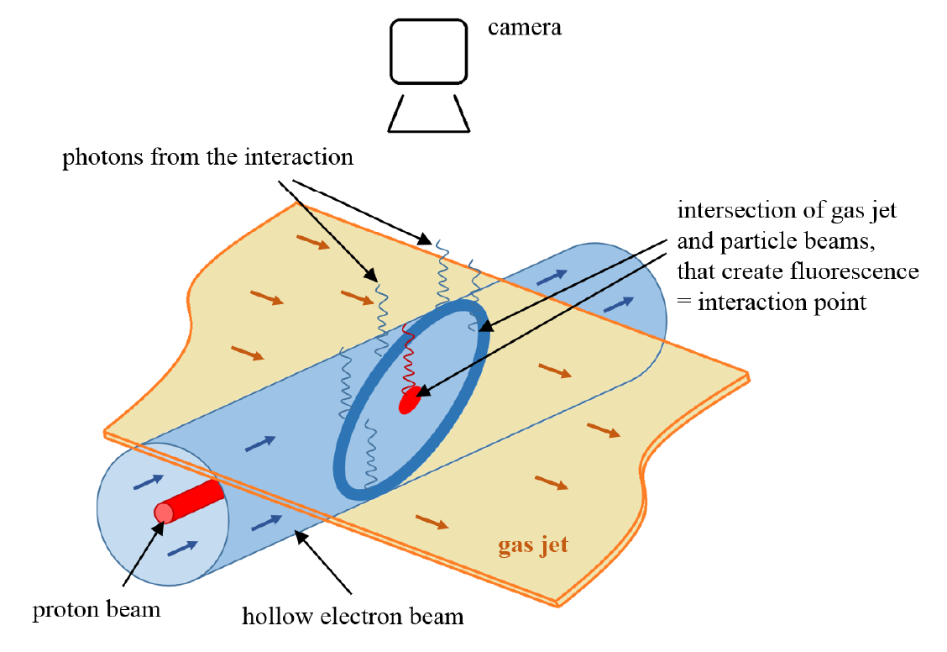
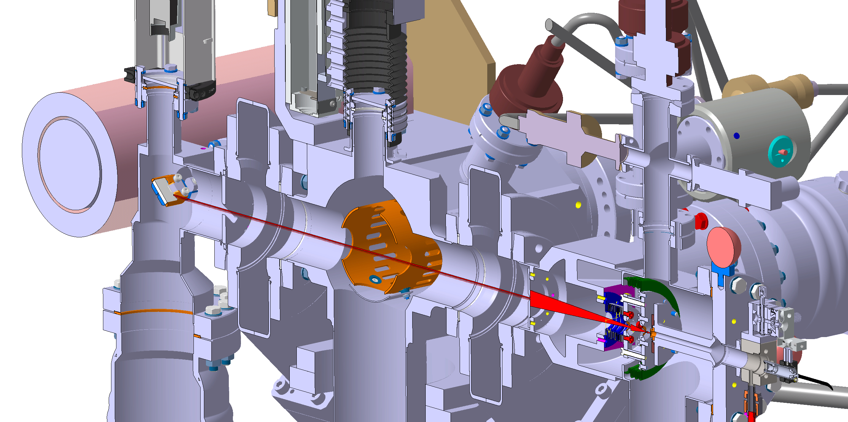
Beam Gas Curtain principle
4th Skimmer
(Gas return blockage)
3rd Skimmer: Background pressure 10⁻⁹ mbar
1st Skimmer: Background pressure 10⁻⁵ mbar
5 bar gas
Interaction with Proton/Electron beam
2nd Skimmer: Background pressure 10⁻⁷ mbar
Expansion after nozzle to supersonic jet
Background pressure 10⁻³ mbar

Slide 5
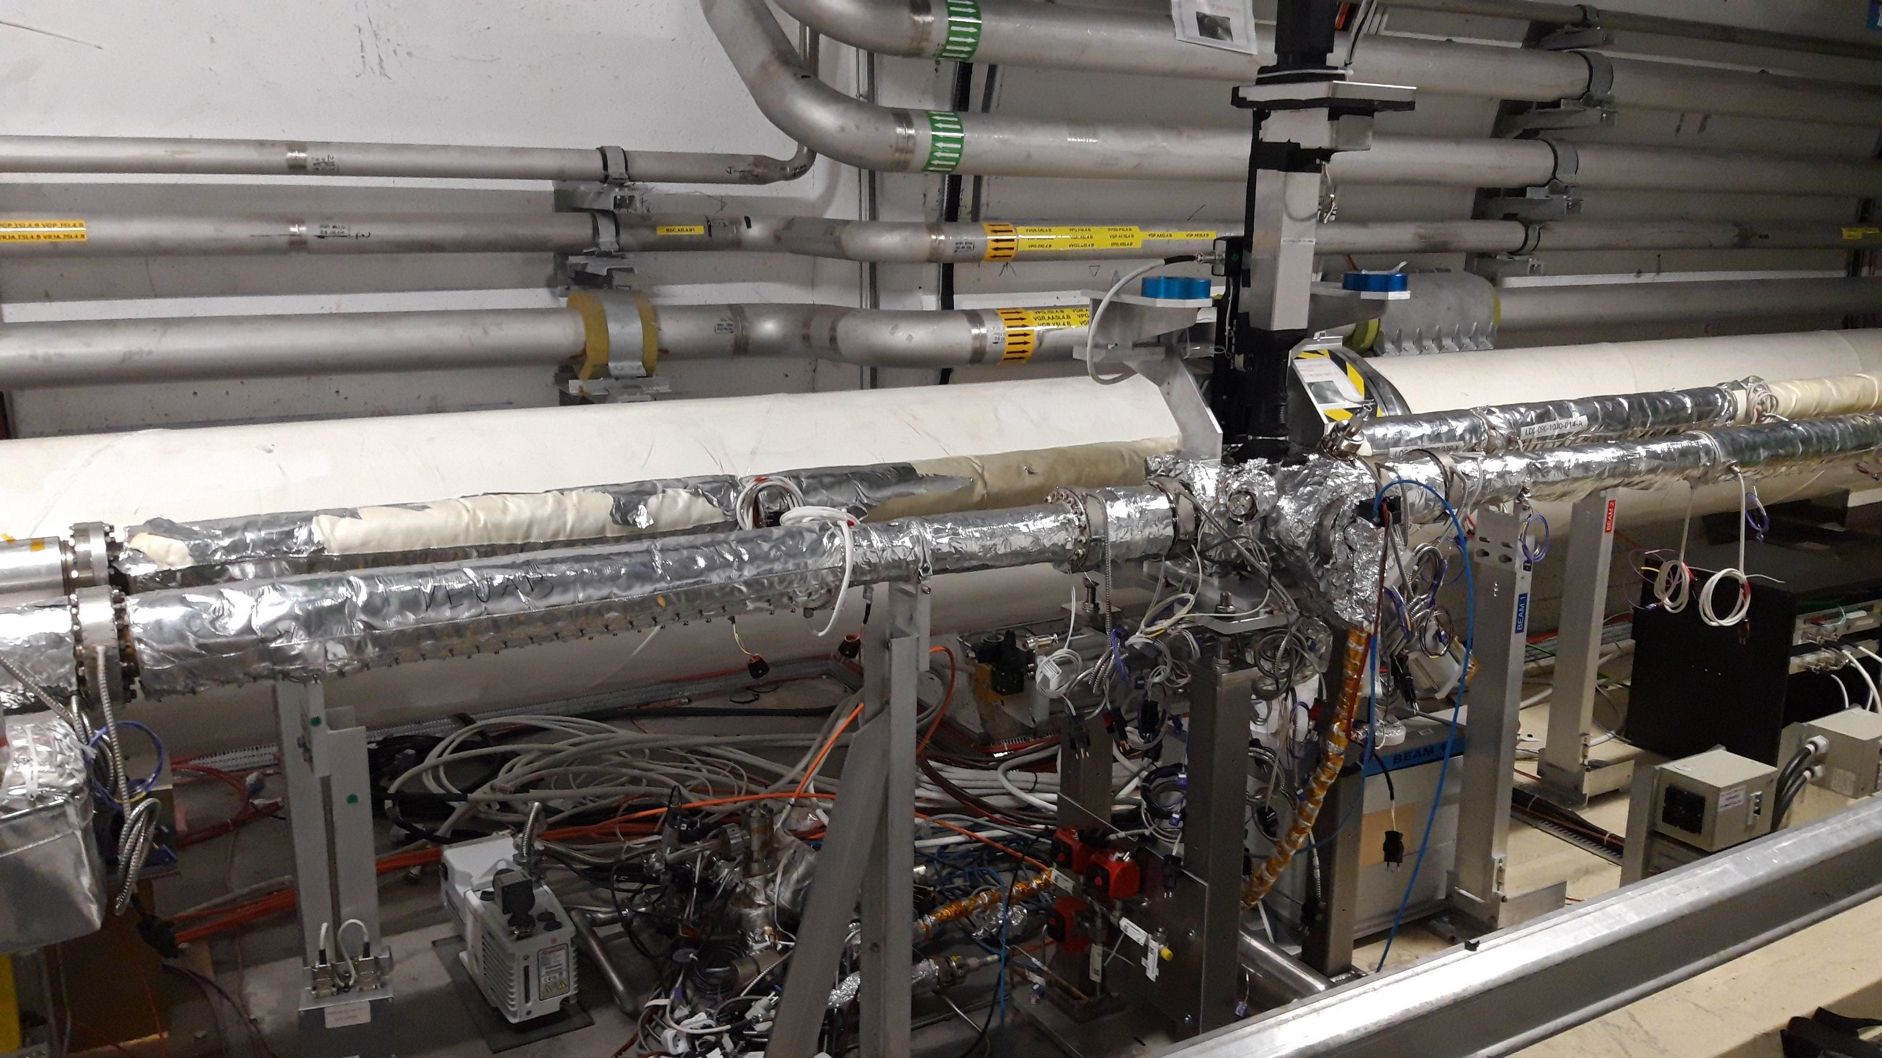
BGC tunnel installation today (Phase 1)
Optical system
Local BGI Penning
3x Gate valves
Local Racks
BGC cables for Phase 2
Gas injection for distributed gas
Phase 2 gas injection valves
BGI gas injection system

Slide 6
Summary LHC tunnel installations (Phase 1) resulting from approved ECRs
Done in LS2 and YETS 21/22
BGC Installed in the LHC
Gas line is pulled from the gas bottle to the BGC (for Phase 2)
Gas line valves installed
Compressed air for the valves pulled
Power cables pulled
Fibre optics cable pulled and rack installed
BGI gas system and control rack now operational on BGC, Injection made
Optical system installed and operational
ECR 2025553 + ECR 2363497 = LS2 + YETS 21/22

Slide 7
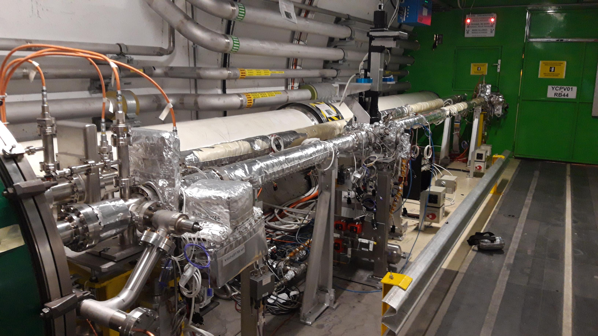
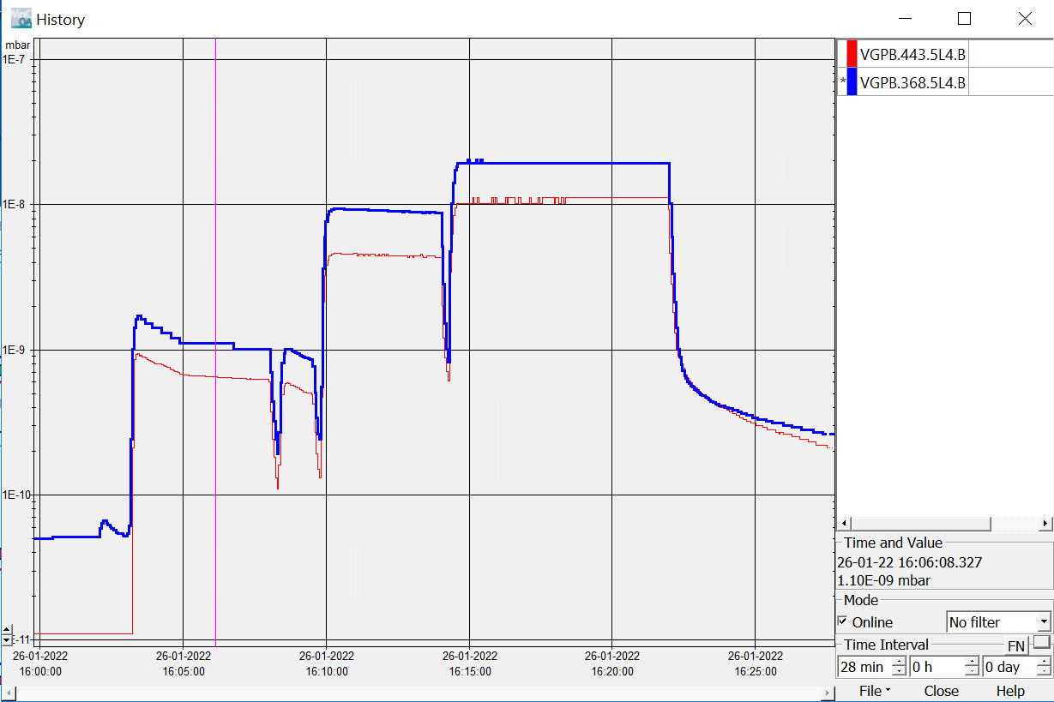
V3 Phase 1: Operational for distributed gas injection
(more see Ondrej)
Penning VGPB.368.5L4.B | Penning BGC | Penning VGPB.443.5L4.B
1.1E-9 mbar | 1.5E-9 mbar | 6.2E-10 mbar
9.0E-9 mbar | 1.0E-8 mbar | 4.4E-9 mbar
2.0E-8 mbar | 2.2E-8 mbar | 1.0E-8 mbar

Slide 8
A big thanks to all of you helped that we now can take data with the LHC beam and with distributed gas in the 2022 Run!!
First Neon gas injections with LHC beam were done with the BGC via the BGI gas injection system, looking forward for more data!

Slide 9
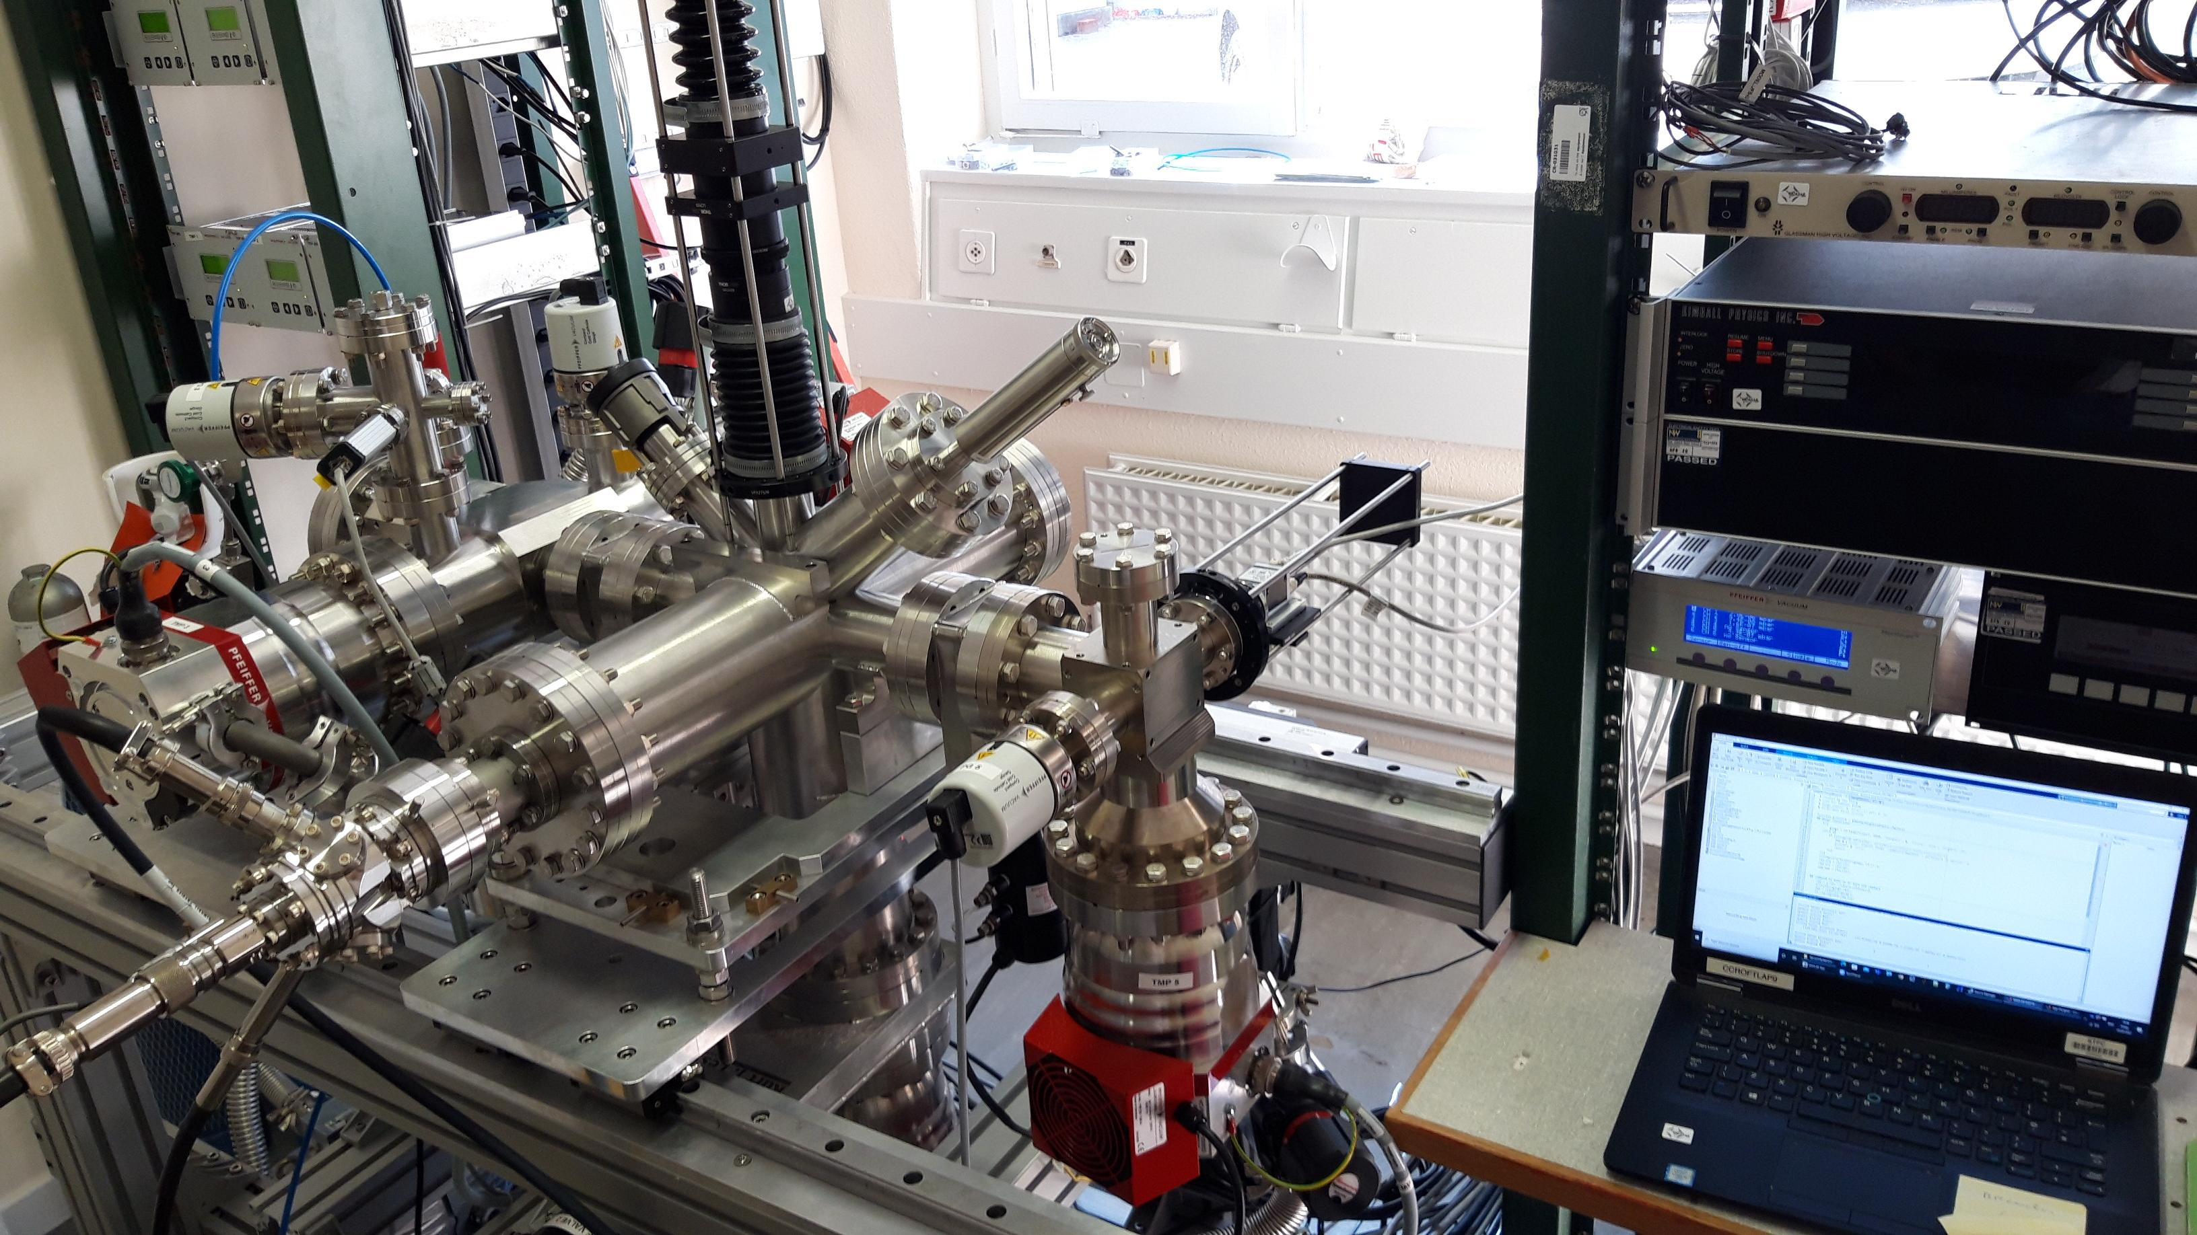
Phase 2 instrument with Gas Curtain delivered from Cockcroft Institute/Liverpool University to CERN in March 2022 → This is the real thing…
Optical system → parallel system already installed in LHC
Gas injection chamber → Passage side in tunnel
Interaction chamber → Sister/Brother chamber already installed in the LHC
Dump side between beam pipes
3x Gate valves
E-gun in lab instead of LHC beam or EBTS beam

Slide 10
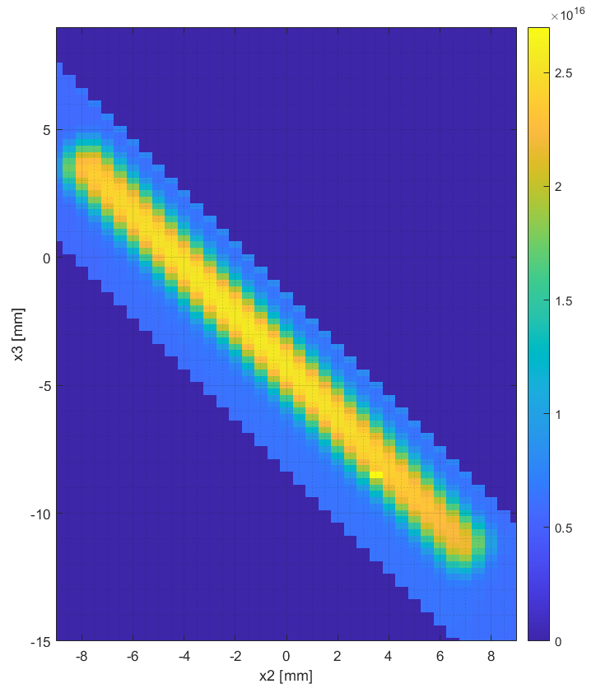
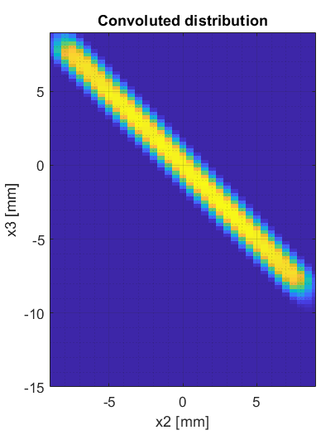
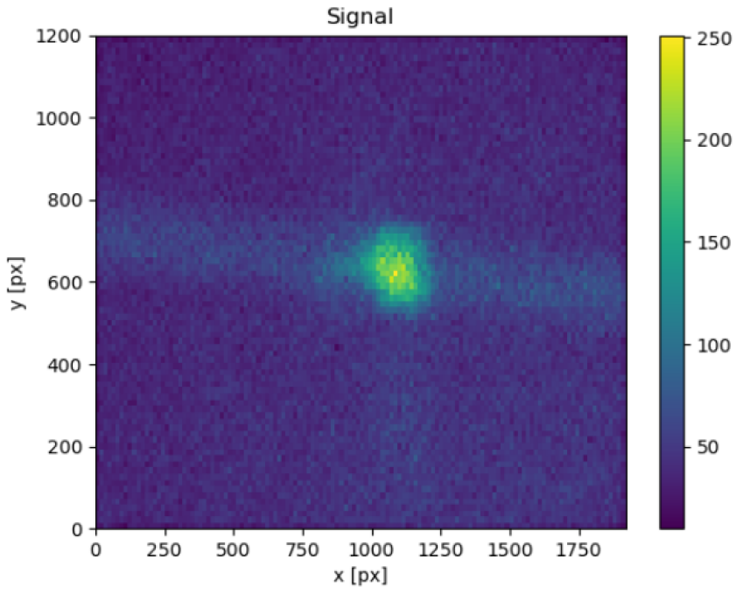
… and it works
Simulation
Measurements
22 mm
22.5 mm
16 mm
Observed E-beam v3 at CERN
Courtesy: Ondrej Sedlacek

Slide 11
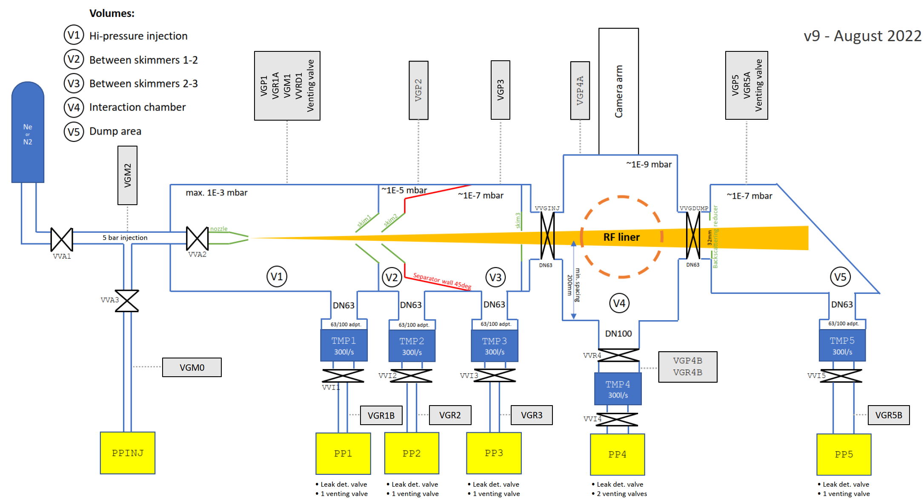
Phase 2: Go from Laboratory Vacuum system to LHC compatible Vacuum System
TE-VSC and EN-CV colleagues actively working on:
BGC vacuum aspects relevant for LHC operation (Gas loads, pump-down times…)
LHC compatible operation (Start, operation and stop…)
Implementation in the LHC (last cables requested)
Ordering PLC and other control equipment ongoing
Assure safe operation (separate compressed air arrival for BGC valves, local solution without de-pressurisation the compressed air mains)

Slide 12
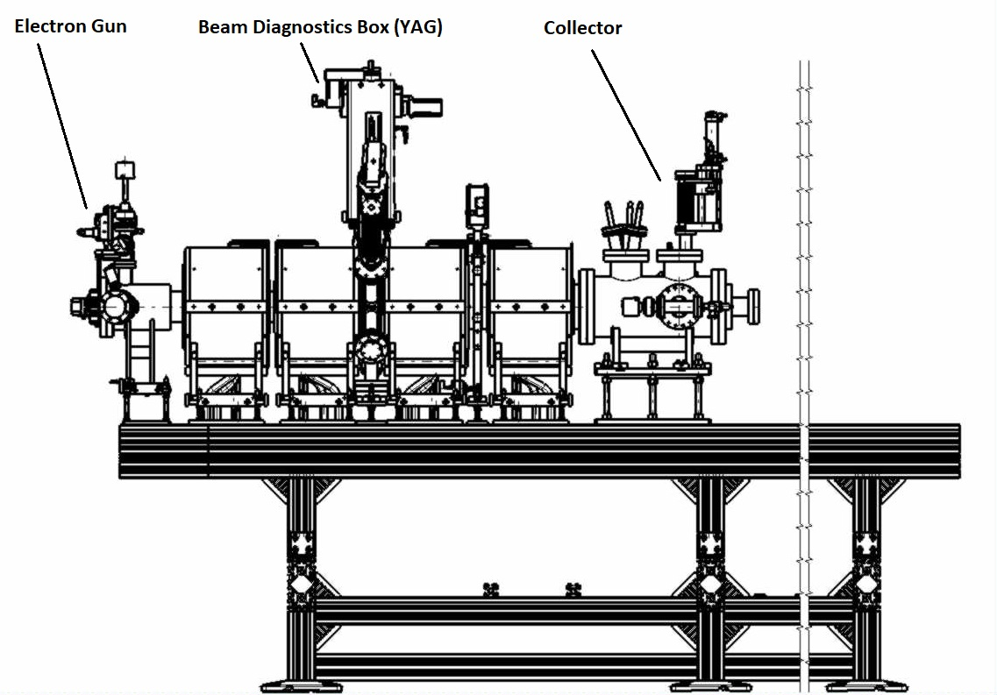
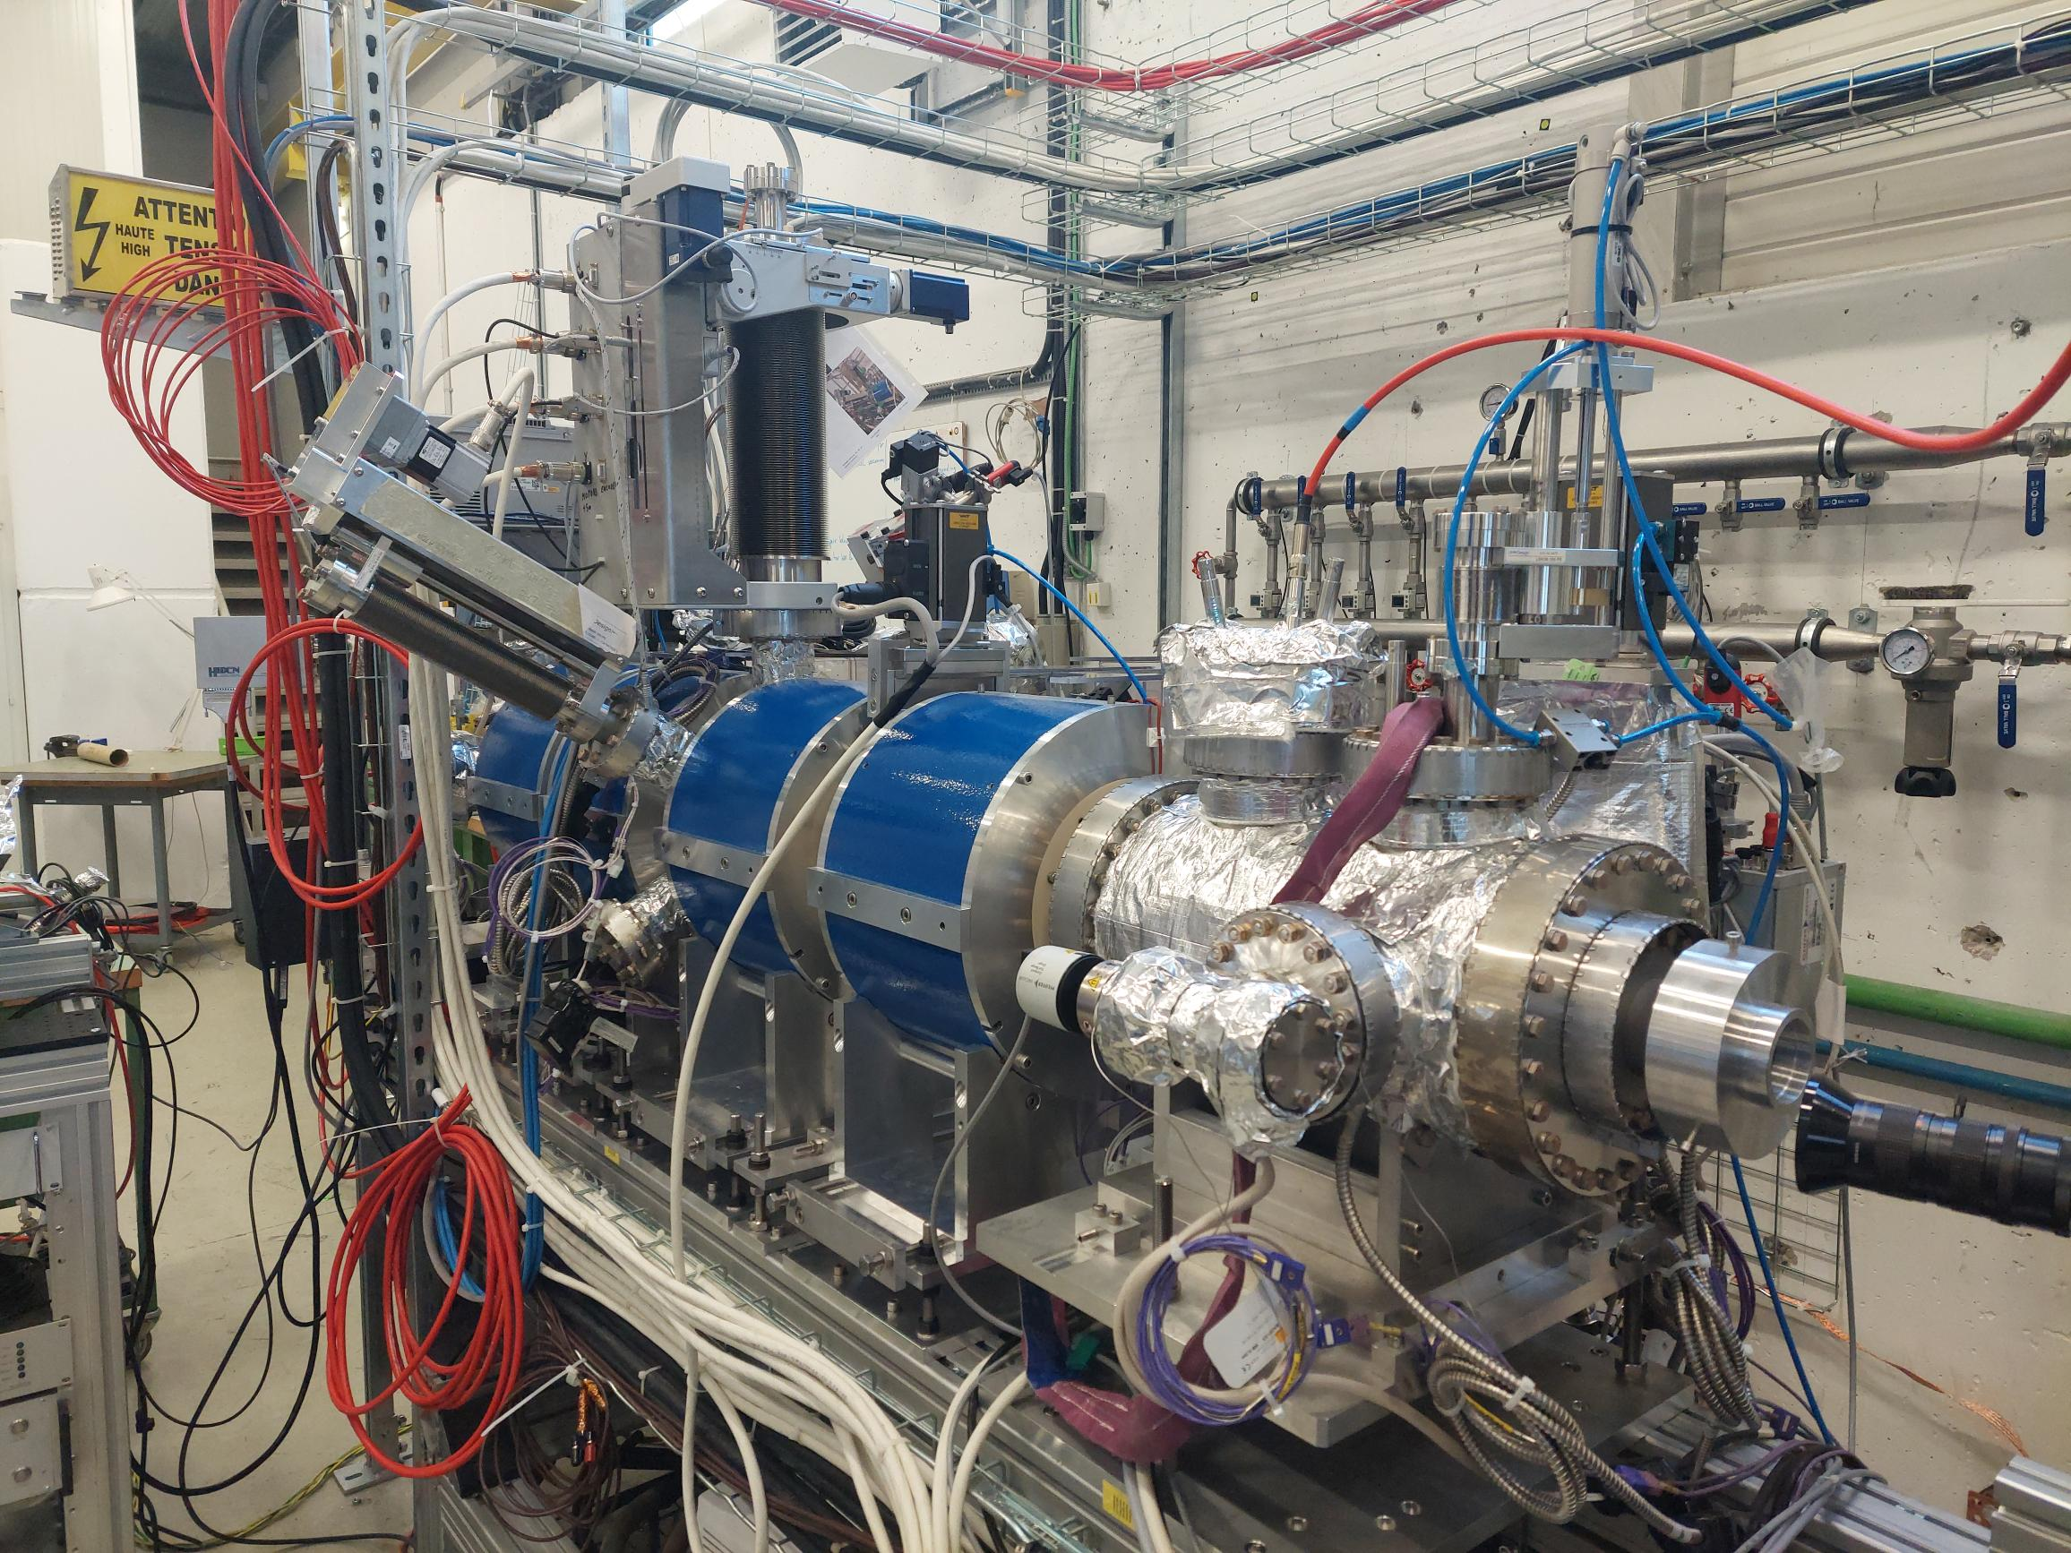

Before installation in the LHC: Test on
Electron Beam Test Stand (EBTS)
Current situation; Electron Gun & Collector Current
Notes:
Current phase of the EBTS.
Primary assets are the Electron Gun, BDB and Collector.
There is also a Sector Valve and x4 Solenoid magnets.

Slide 13
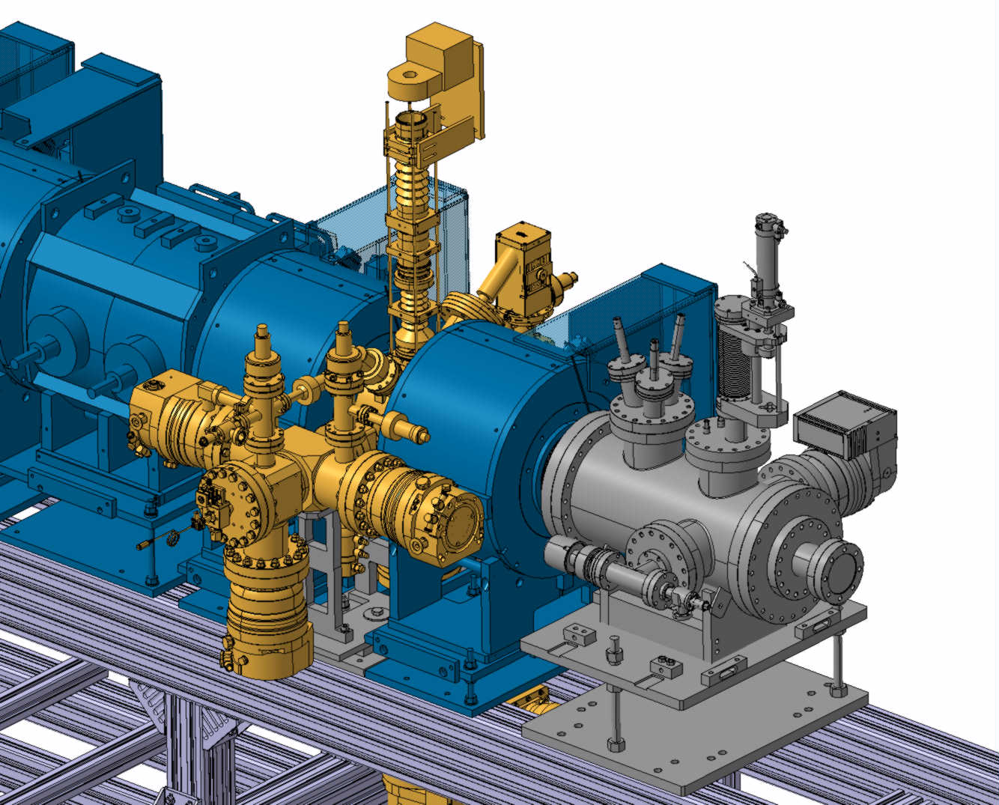
BGC on Electron Beam Test Stand (EBTS)
Install BGC on EBTS. Foreseen installation: October 2022 followed by operation
(Operational Programme → see Ondrej)

Slide 14
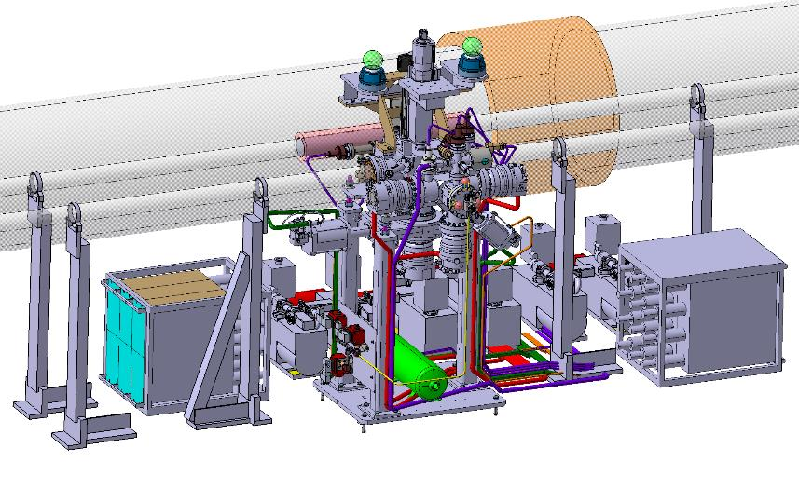
Phase 2 Installation in LHC
Remove:
  BGI gas system
  BGI control rack
Install:
  6 primary pumping units
  Gas injection system
  Gas dump chamber
  5 TMPs:
    Gas injection system with 3 TMPs
    Gas dump chamber with 1 TMP
    1 TMP directly on the interaction chamber
  Compressed air line to the valves
  3 solenoids for the gas injection valves
  Add independent compressed air supply for BGC vacuum pumping system
Connect everything to power and controls

Slide 15
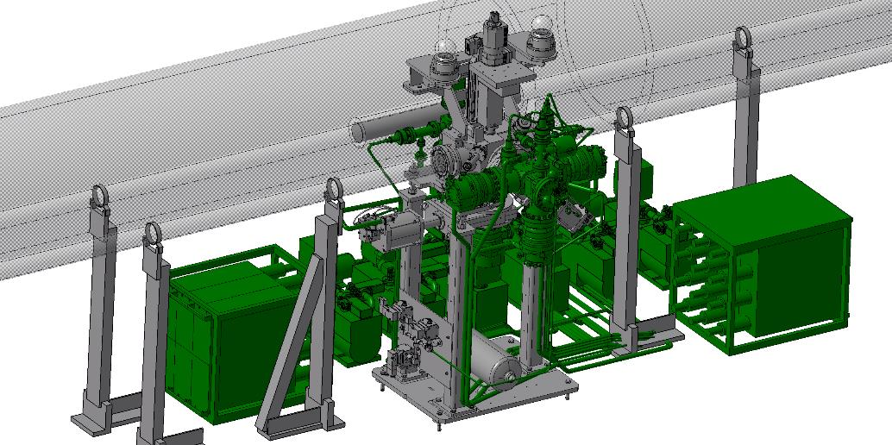
Phase 2 to be installed in green
12th HL-LHC Collaboration Meeting Uppsala 20 09 2022

Slide 16
Timeline v3
Phase 2 BGC validation operation ongoing
Change from laboratory vacuum system to LHC compatible system ongoing. Objective: Finish by Q4 2022. Challenging controls supply due to global events.
Validation on EBTS as from October 2022. Foreseen operation about 2 month
Very challenging but not impossible objective for YETS 2022/23 tunnel installation, not all cards in our hands. Alternative installation in YETS 23/24, which is the more likely scenario

Slide 17
BGC V4: Design constraints
Space
Notes:
QRL – cryogenic Ring line. Cryogenic supply line to supply helium to the magnets in the tunnel.
For Colling system
What is inside? Cold Helium

Slide 18
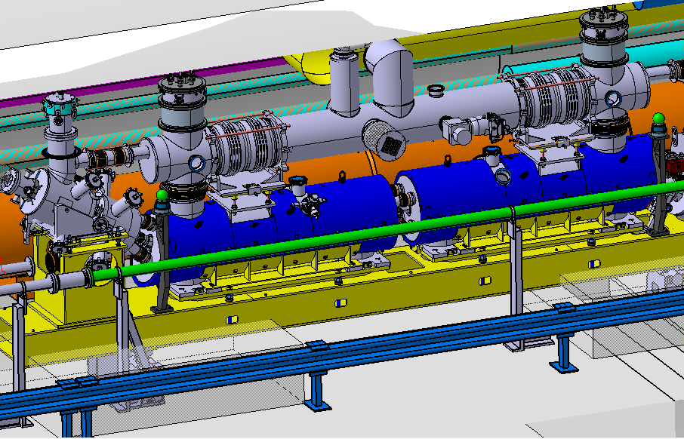
BGC V4 Installation environment P4 right
QRL
HEL CryoMagnets
Helium reservoir
2nd beam pipe
BGC location
Notes:
QRL – cryogenic Ring line. Cryogenic supply line to supply helium to the magnets in the tunnel.
For Colling system
What is inside? Cold Helium

Slide 19
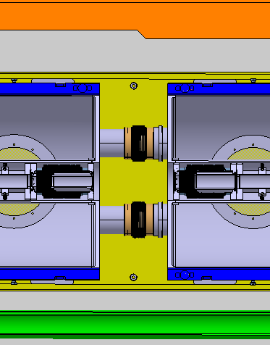
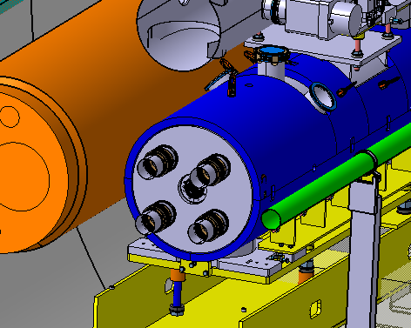
BGC V4 Space constraints Point 4 Right
HEL Top view
4x Rods in Bellows to compensate for magnets force
QRL
Helium reservoir
QRL
525mm
793mm
412mm
381mm
2nd beam pipe
679mm
200mm
Girder
HEL cut in BGC location
2nd beam pipe
Notes:
QRL – cryogenic Ring line. Cryogenic supply line to supply helium to the magnets in the tunnel.
For Colling system
What is inside? Cold Helium

Slide 20
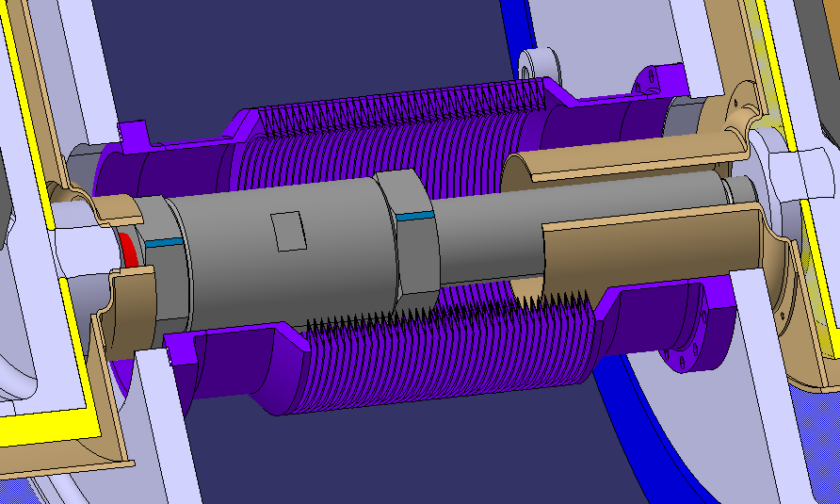
BGC V4 Space constraints Point 4 Right
≈ 20 ℃
Thermal shield
Rod
Thermal shield
Insulation vacuum
≈ -269 ℃
Edge welded Bellow
≈ 20 ℃
Notes:
QRL – cryogenic Ring line. Cryogenic supply line to supply helium to the magnets in the tunnel.
For Colling system
What is inside? Cold Helium

Slide 21
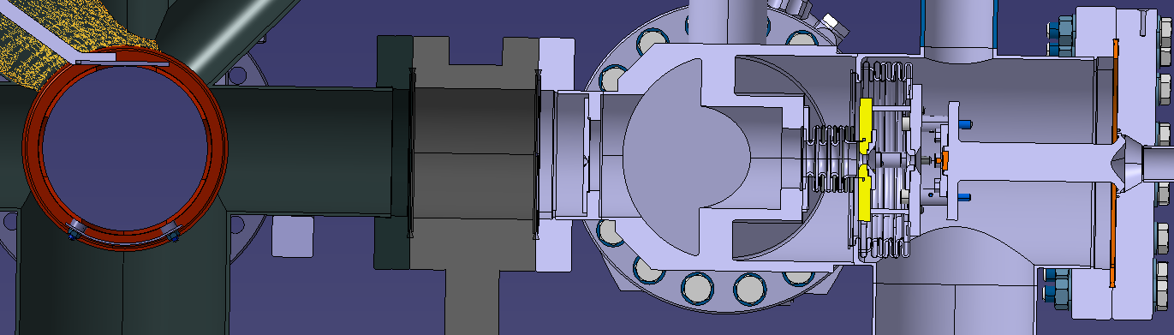
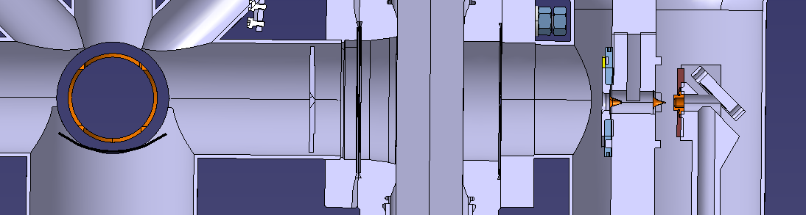
BGC V3/V4 Space comparison
Version 3
2nd skimmer
1st skimmer
3rd skimmer
Nozzle to IP: 378mm
IP
nozzle
222mm
135mm
17
4mm
Version 4 proposal
3rd skimmer
2nd skimmer
1st skimmer
nozzle
3rd skimmer location range
IP
Nozzle to IP: 280mm
104mm
155mm
17
4mm
Notes:
QRL – cryogenic Ring line. Cryogenic supply line to supply helium to the magnets in the tunnel.
For Colling system
What is inside? Cold Helium

Slide 22
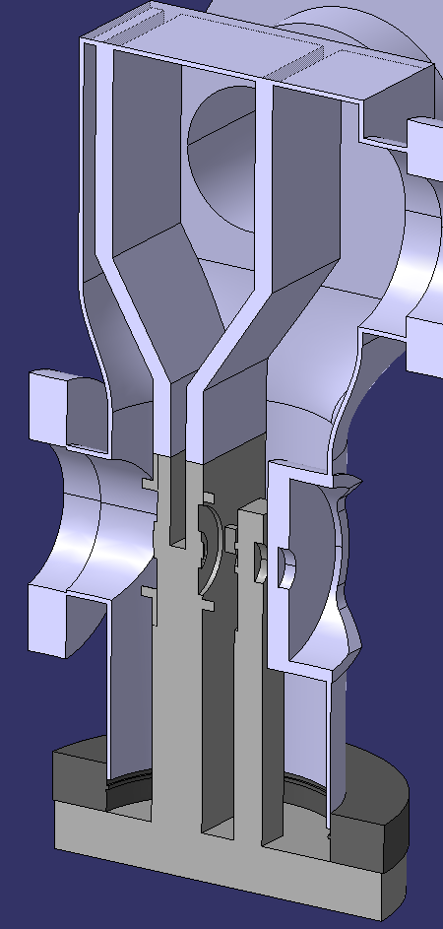
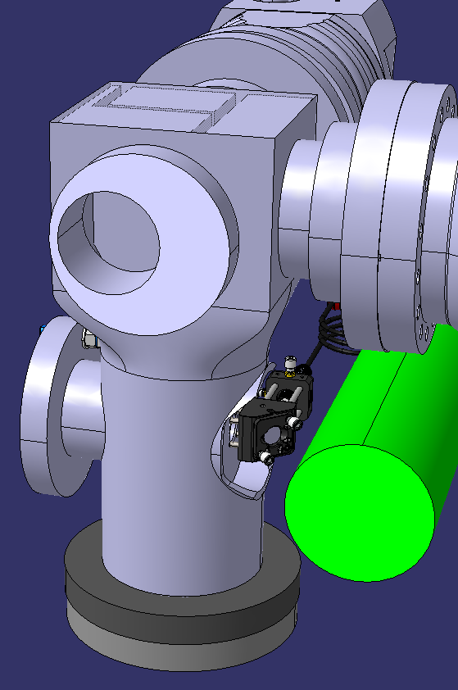
V4 related to Space:
Optimise conductances to remove injected gas
10⁻⁵ mbar
10⁻³ mbar
10⁻⁷ mbar
2nd beam pipe
Notes:
QRL – cryogenic Ring line. Cryogenic supply line to supply helium to the magnets in the tunnel.
For Colling system
What is inside? Cold Helium

Slide 23
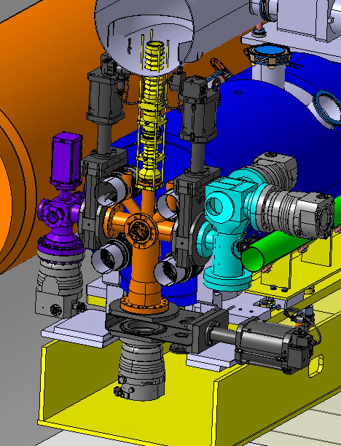
BGC V4 in HEL
Optical System
(possibly with mirror)
4x Rod
Helium reservoir
QRL
Gate Valve
Gate Valve
Beam direction
3x Turbo Molecular Pump (TMP) (3rd not shown)
Dump Chamber
2nd beam pipe
TMP
Gas Injection Chamber
Central Chamber
TMP
Gate Valve
Notes:
QRL – cryogenic Ring line. Cryogenic supply line to supply helium to the magnets in the tunnel.
For Colling system
What is inside? Cold Helium

Slide 24
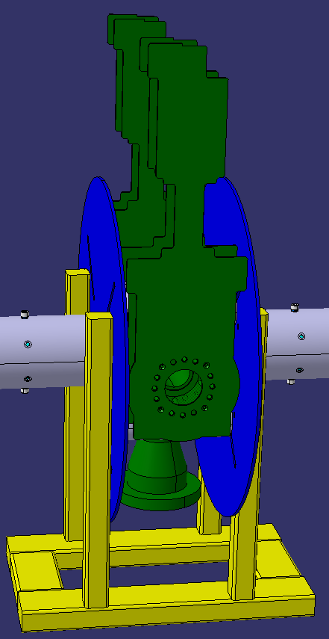
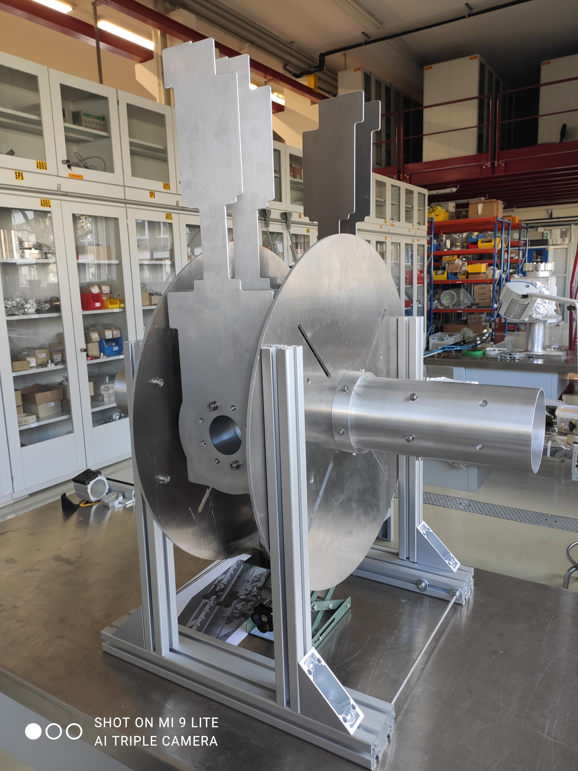
BGC V4 Installation Mock-up: Procedure checked
Notes:
QRL – cryogenic Ring line. Cryogenic supply line to supply helium to the magnets in the tunnel.
For Colling system
What is inside? Cold Helium

Slide 25
Summary v3
Phase 1 BGC installation objectives for distributed gas fully achieved, operation with Neon injected with LHC beam has started.
Phase 2 BGC installation underway
  BGC v3 Phase 2 instrument delivered to CERN and fully operational for laboratory use
  EBTS test required prior to installation
  Change to LHC compatible vacuum system under way
  Approval by LHC management after proof of vacuum compatibility
  Additional cable request by VSC for YETS 22/23 done, minor activity
  Additional compressed air connection in tunnel addressed
  Objective for full installation in YETS 22/23, very challenging. Alternative YETS 23/24

Slide 26
Summary v4
In-kind contribution from Liverpool/Cockcroft institute (UK2)
Engineering well advanced
Further challenges to optimise conductance on gas injection side

Slide 27
Questions?

Slide 28
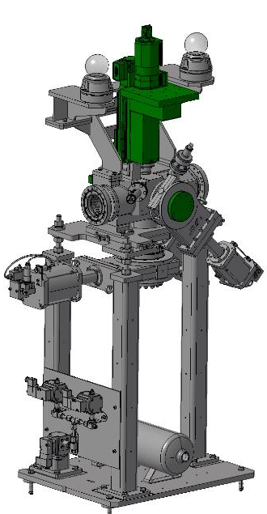
BGC Phase 1

Slide 29
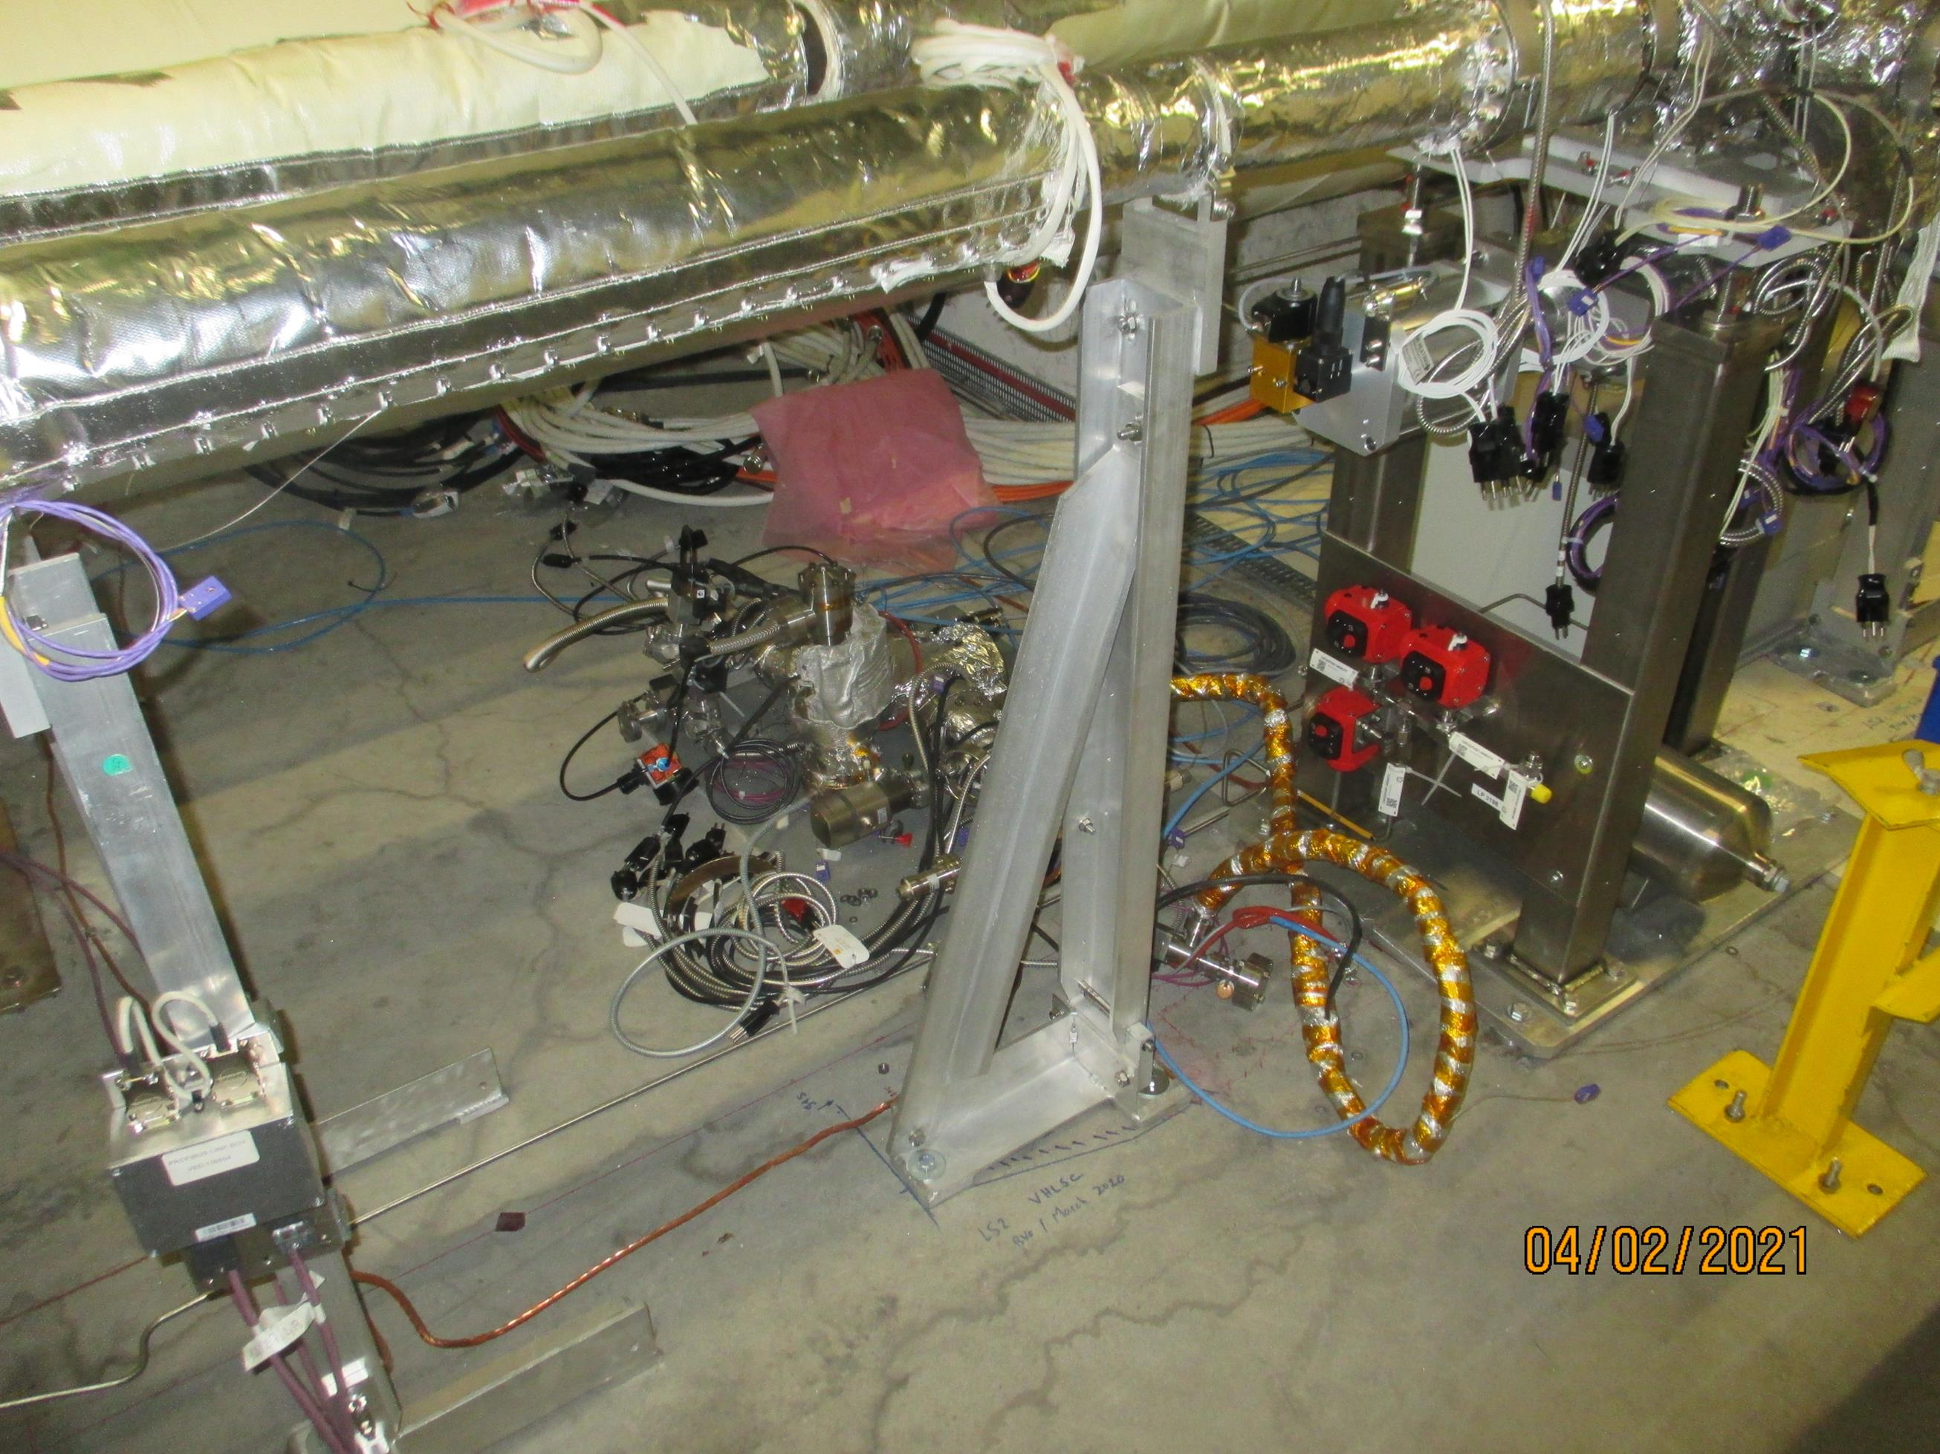
BGI Gas injection system next to BGC

Slide 30
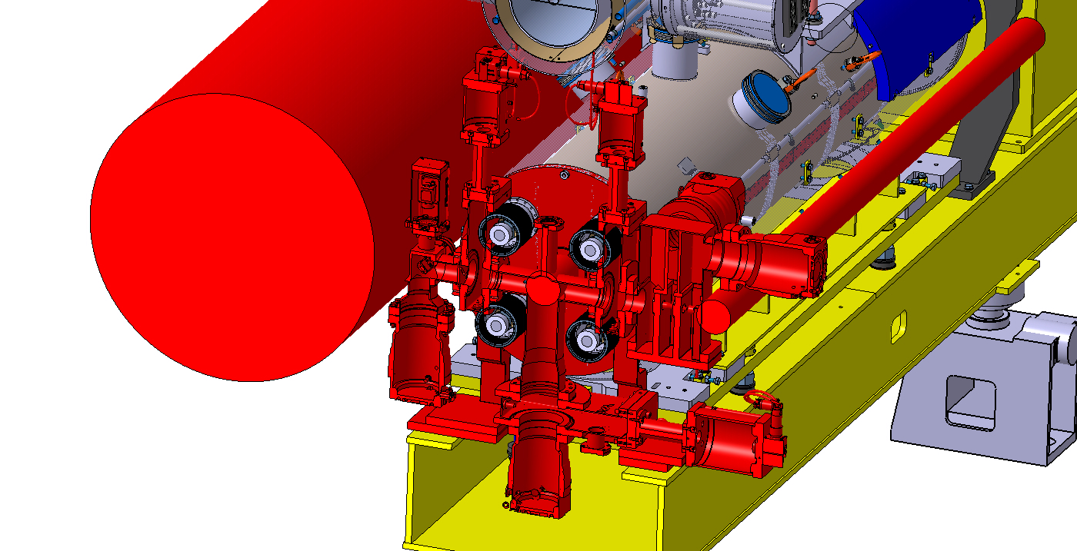
Final BGC version (V4) in HEL, here 4R

Slide 31
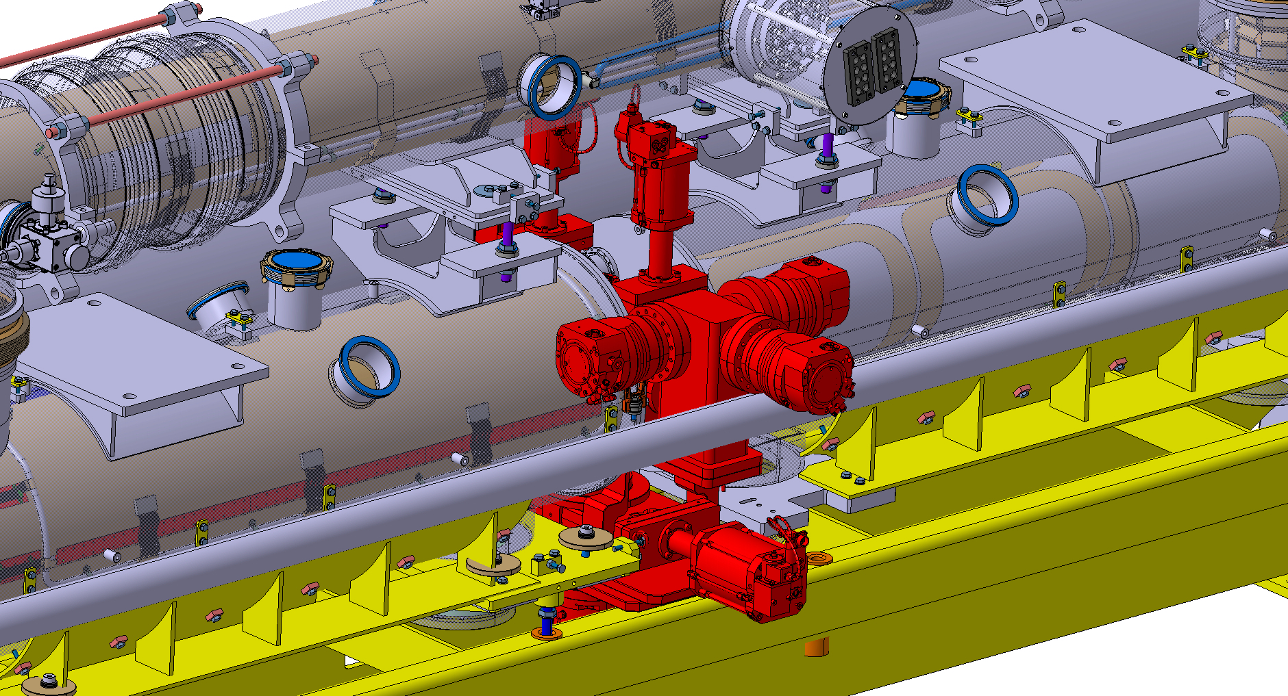
Design of final instrument (V4) for HEL well in Progress
Challenge: Space

