Slide 1

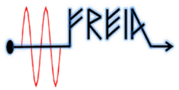

Activities on MCBXFB magnets at CERN
J. C. Pérez
CERN TE-MSC-SMT
On behalf of MCBXF team.
Acknowledgments to people who contribute to this presentation.
12th HL-LHC Collaboration Meeting - Uppsala-Sweden
19-22 September 2022

Slide 2
Outline
MCBXF project
Remind of MCBXFB01 & MCBXFBP2b performance
Coils shiming and instrumentation during assembly
MCBXFBP2c powering tests results & magnetic measurements
Summary

Slide 3
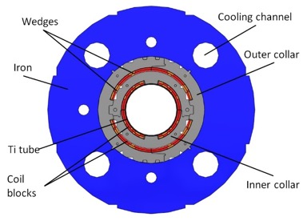
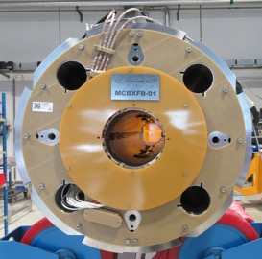
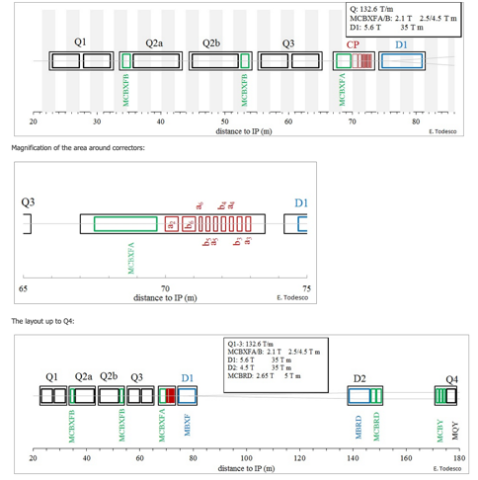
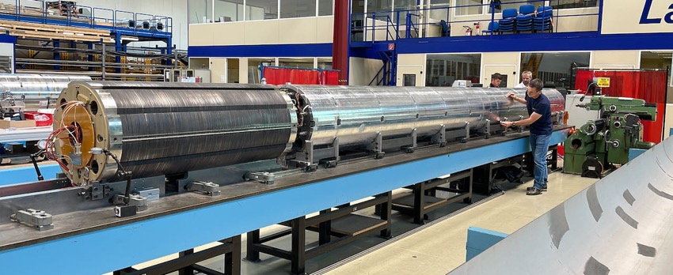
MCBXF combined dipole orbit correctors for HL-LHC
Insertion Region Layout
Q2 type Cold Mass assembly in LMF
JC. Perez – 21st September 2022

Slide 4
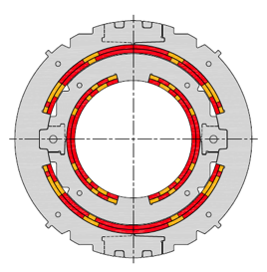
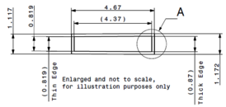
Magnet and cable specifications
MCBXFB Technical specifications
Magnet configuration | Combined dipole (Operation in X-Y square)
Integrated field | 2.5 Tm
Minimum free aperture | 150 mm
Nominal current | < 2500 A
Radiation resistance | 35 MGy
Physical length | < 1.505 m
Working temperature | 1.9 K
Iron geometry | MQXF iron holes
Field quality | < 10 units (1E-4)
Fringe field | < 40 mT (Out of the Cryostat)
Vertical dipole field (2.1 T)
Combined
dipole field
(Variable orientation)
Horizontal dipole field (2.1 T)
Cable Parameters
No. of strands | 18
Strand diameter | 0.48 mm
Cable thickness | 0.845 mm
Cable width | 4.37 mm
Key-stone angle | 0.67º
Cu:Sc | 1.75
Notes:
2 dipoles in quadrature
Innovative double collaring to contain the electromagnetic forces
Use of braided fibre glass for cable insulation and binder to build a double layer cos-theta coil

Slide 5
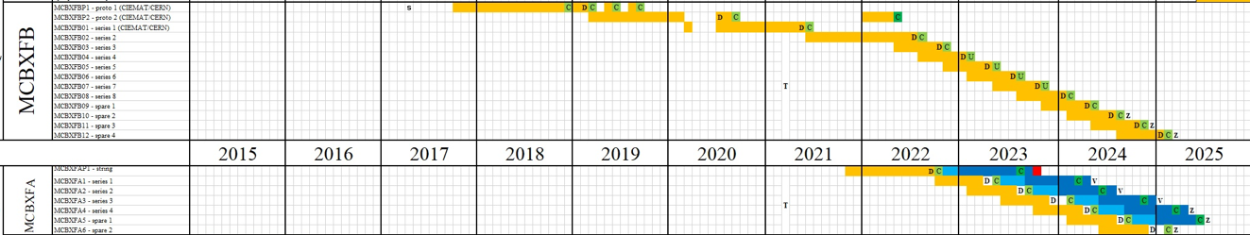
MCBXF project
The MCBXF combined orbit corrector magnets contract for the series was signed with ELYTT Energy in March 2021
6 MCBXFA & 11 MCBXB magnets to be produced before end 2024
The first 3 MCBXFB magnets have been produced within a close collaboration of CERN and CIEMAT teams ( MCBXFBP1, MCBXFBP2 & MCBXFB01)
  Coils and magnet components fabricated at CEDEX (Madrid)
  Magnet assembly, WMM and cold powering tests performed at CERN
The first MCBXFA prototype will be manufactured following the same organization
JC. Perez – 21st September 2022

Slide 6
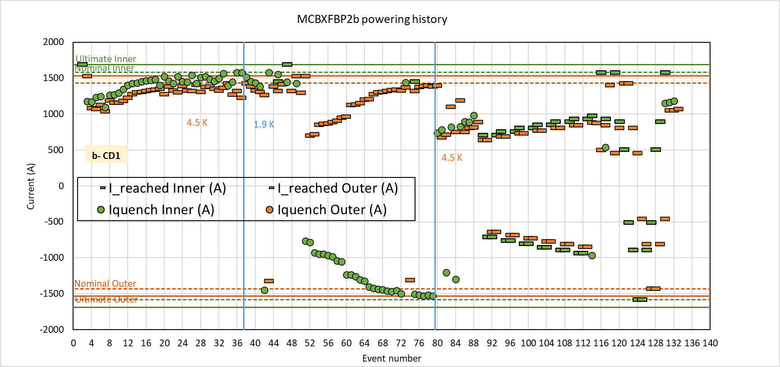
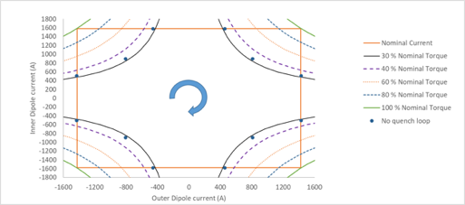
MCBXFBP2b powering history
Quench free area
  Quench free cycle attempt of 12 points at 35%, quench when ramping the outer to nominal current.
Reached ultimate in both circuits in standalone
132 Events and 85 quenchs
Reached 99.9% + nominal torque and 94.4% of -nominal torque
 | Training quenches
 | IC4 | IC5 | OC3
 | 9 (10%) | 76 (90%) | 0
Total | 85
  Quench free cycle of 12 points at 32% OK
JC. Perez – 21st September 2022

Slide 7
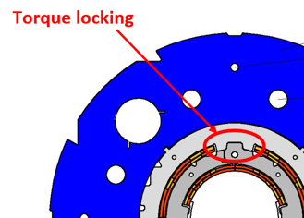
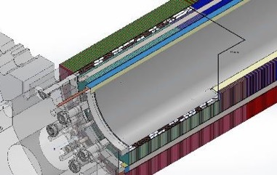
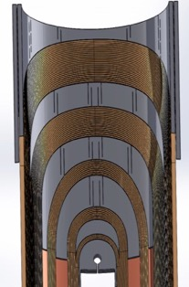
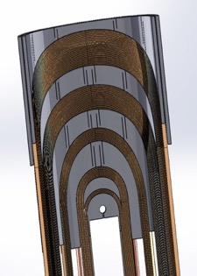
Modification of the inner dipole coil length from MCBXFB01
Torque locking is only posible along the OD pole window (828 mm long)
ID pole window for prototypes was 946 mm long → 59 mm at each side of the coil without torque locking
The inner coil lenght was reduced by 118 mm
The cantilever length of the inner coils was reduced by 59 mm at each coil extremity
The inner coil nominal current was increased from 1625 A to 1755 A to keep the same integrated field (model discrepancy wrt to MM + straight section reduction)
+5% of torque generated in the coil straight section
59mm
P1&P2
B01
JC. Perez – 21st September 2022

Slide 8
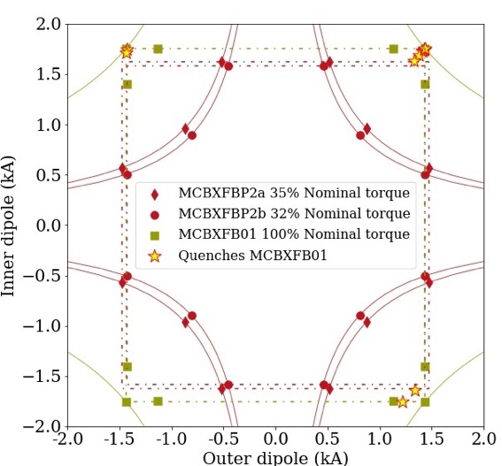
Reminder: MCBXFB01 performance
  B01 showed an excellent performance:
Ultimate current in both dipoles w/o quench in standalone configuration.
Virgin training reduced to 3 quenches.
Reached nominal in Q1 and Q2 no matter the powering sequence. Without re-training
Quench-free region improved to 100% of nominal torque.
After thermal cycle:
Good memory: few quenches during the tests, very close to nominal torque in combined operation.
Complete set of magnetic measurements: test results very close to calculations, within magnet specifications.
Courtesy S.Ferradas (CERN)
Test Results: https://edms.cern.ch/document/2618334/0.1
JC. Perez – 21st September 2022

Slide 9
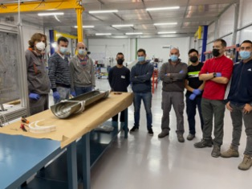
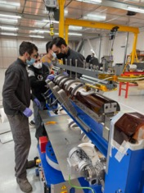
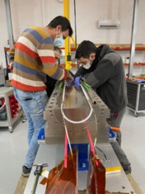
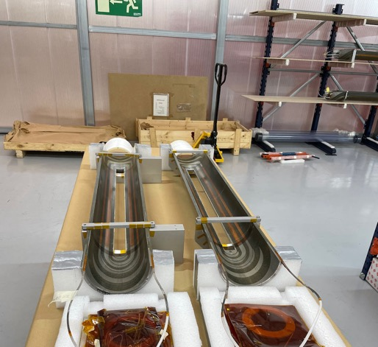
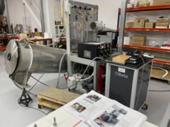
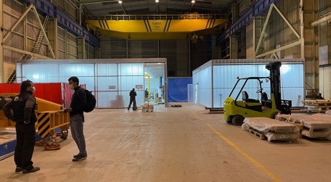
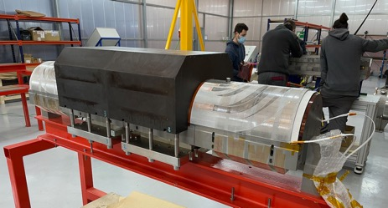
Inner coils for MCBXFBP2c manufacturing @ ELYTT
The 2 inner coils used for MCBXBBP2c assembly have been produced at ELYTT’s premises.
The assembly of these coils in a magnet was foreseen to provide an “early” qualification of the coil fabrication process for the series
The same outer coils used during MCBXFBP2b assembly have been assembled in MCBXFBP2c
JC. Perez – 21st September 2022

Slide 10
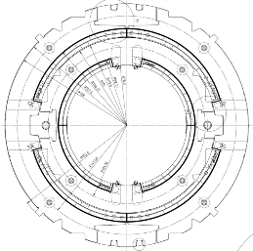
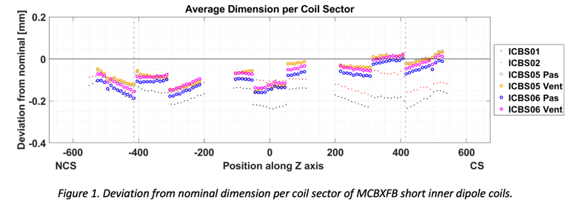
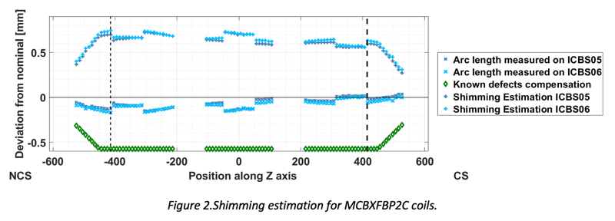
Coils geometry & Shimming configuration
The final shimming configuration includes:
Systematic shims part of the initial design
Compensation of coil modulus of elasticity used during calculations
Compensation of the thermal contraction coefficient used for calculations
Compensation of coil geometrical deviation from nominal size
Additional shims to achieve the nominal azimuthal pre-compression
JC. Perez – 21st September 2022

Slide 11
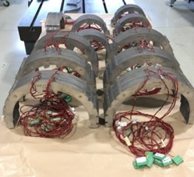
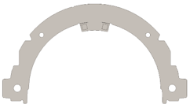
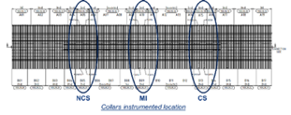
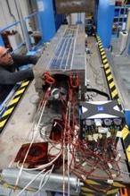


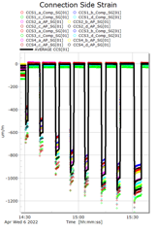
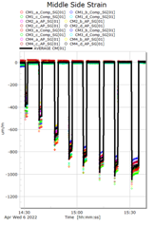
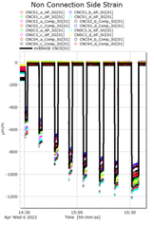



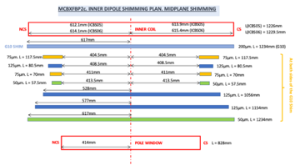
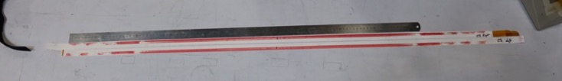

Mechanical measurements with instrumented collars during assembly
Equipment | Reference
Strain gauges | HBM: 1-XC11-1.5/350
Bridge power supply | 2.5 V @ 1,2 kHz
Bridge Configuration | Half bridge – Poisson compensation
Quantity (Used during collaring process) | 12 collars INNER 12 collars OUTER
Strain gauges a & c are on the same side of the collar, b & d are on the other side
The instrumented collar packs, are used during collaring operation as a measuring tool before the final collaring.
They validate the tailored shims configuration built to provide the required pre-stress to the coils at room temperature
JC. Perez – 21st September 2022

Slide 12
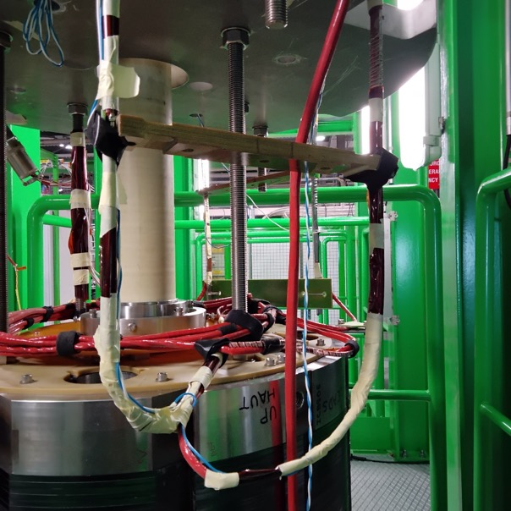
MCBXFBP2c: Acceptance criteria & Cold Powering tests results
JC. Perez – 21st September 2022

Slide 13
Update of MCBXF correctors acceptance criteria
The magnets shall provide the integrated field given in Table I, each one in two possible configurations.
According to the HL-LHC guidelines, we define the nominal integrated field as the requirement for proton (or ion) operation at 7 TeV, and ultimate integrated field as the requirement for proton (or ion) operation at 7.5 TeV.
 |  | Integrated field (T m)
 |  | Nominal | Ultimate
MCBXFA configuration 1 | MCBXFA inner | 4.500 | 4.821
 | MCBXFA outer | 2.500 | 2.678
MCBXFA configuration 2 | MCBXFA inner | 2.500 | 2.678
 | MCBXFA outer | 4.500 | 4.821
MCBXFB configuration 1 | MCBXFB inner | 2.500 | 2.678
 | MCBXFB outer | 2.000 | 2.143
MCBXFB configuration 2 | MCBXFB inner | 2.000 | 2.143
 | MCBXFB outer | 2.500 | 2.678
Integrated field and reference values
for the current
Required operational range
of MCBXFB at 7 TeV
JC. Perez – 21st September 2022

Slide 14
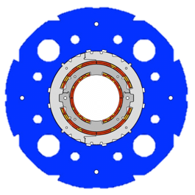
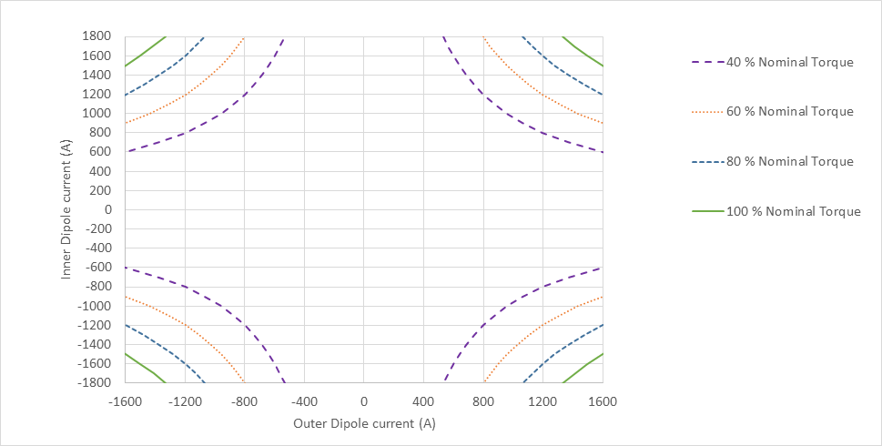
MCBXF Powering
Nominal torque per unit length at straight section is very high: 147 kNm/m, about 84 MPa at the inner dipole coil.
Q4
Inner Dipole
Outer Dipole
Inner Dipole
Outer Dipole
Q1
Q3
Inner Dipole
Outer Dipole
Inner Dipole
Outer Dipole
Q2
Inner Field
Outer Field
Torque direction
JC. Perez – 21st September 2022

Slide 15
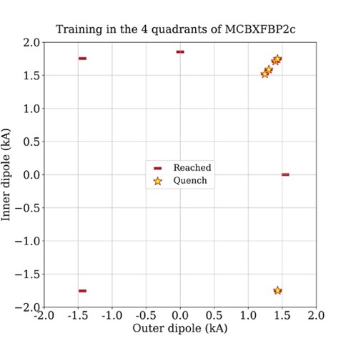
MCBXBP2c training in the 4 quadrants to compare with previous magnets. Virgin inner dipole coils from Elytt
Nominal current: Inner dipole 1755 A / Outer Dipole 1535 A
Nominal ramp rate (5.5/4.5 A/s)
No quenches in standalone powering up to ultimate current
3 training quenches to +nominal/+nominal in combined powering. (MCBXBP2a took 32 quenches, B01 took 3 quenches)
No quenches to -nominal/-nominal (Same as B01)
(!) No quenches to -nominal/+nominal in combined powering (1 quench in B01)
1 quench at -1749A/1433 A (same amount and same current level as B01). Then reached +nominal/-nominal
1 quench at 1588A/1302 A. Then reached +nominal/+nominal
Courtesy of S. Ferradas
JC. Perez – 21st September 2022

Slide 16
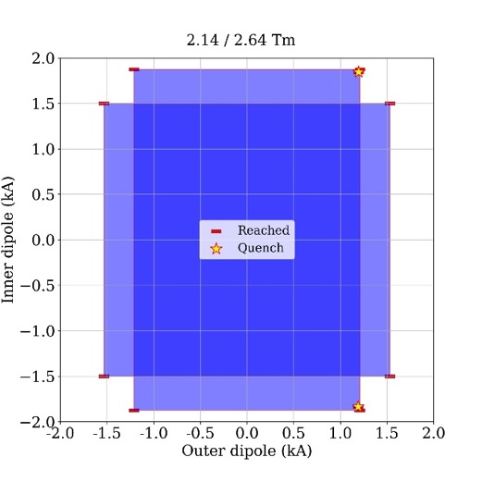
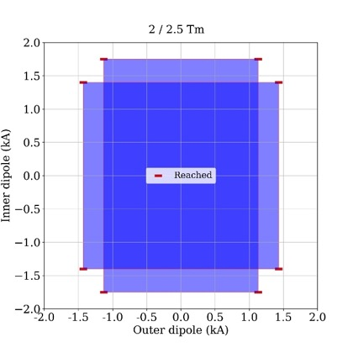
MCBXFBP2c Quench free working area in the four quadrants for a given integrated field
Max ramp rate (5 A/s)
No quenches in 2 / 2.5 Tm cycle
2 quenches in the inner dipole at almost ultimate current in the 2.14/2.64 Tm
After the quench the ramp was restarted and successfully performed
REQUIREMENT,
max 1 quench
After the thermal cycle no more Quench in any torque direction!
Courtesy of S. Ferradas & G. Willering
JC. Perez – 21st September 2022

Slide 17
MCBXFBP2c splice measurement
Courtesy of S. Ferradas & G. Willering

Slide 18
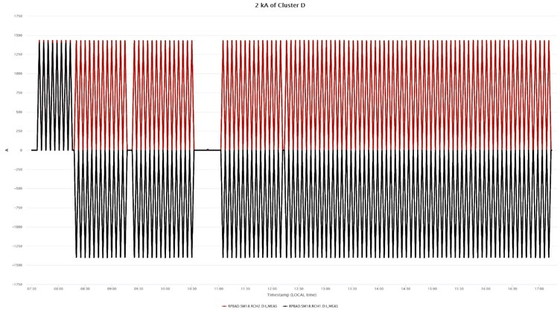
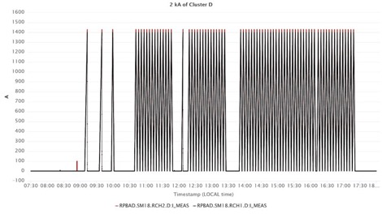
MCBXFBP2c endurance test campaign
An endurance test campaign has been launched
Around 250 cycles were performed. NO QUENCH
To be completed with MCBXFB02 first series magnet from ELLYT
Inner: +1400 A
Outer: + 1430
Courtesy of S. Ferradas & G. Willering

Slide 19
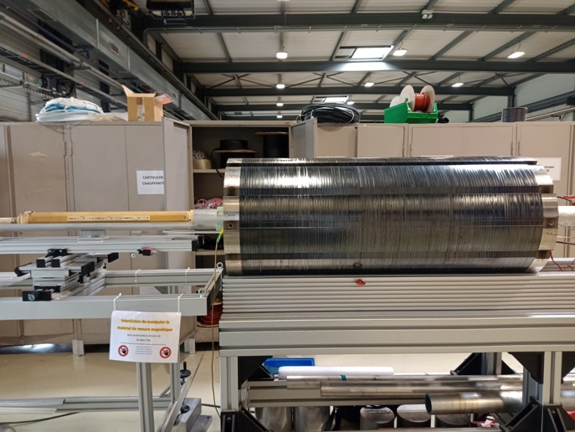
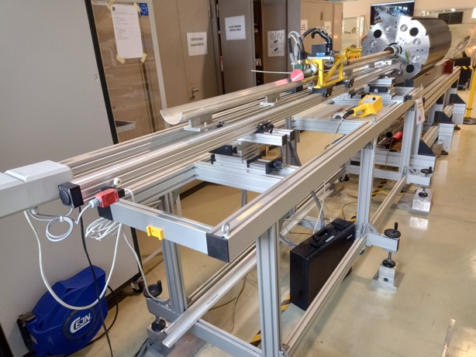
MCBXFBP2c magnetic measurements

Slide 20
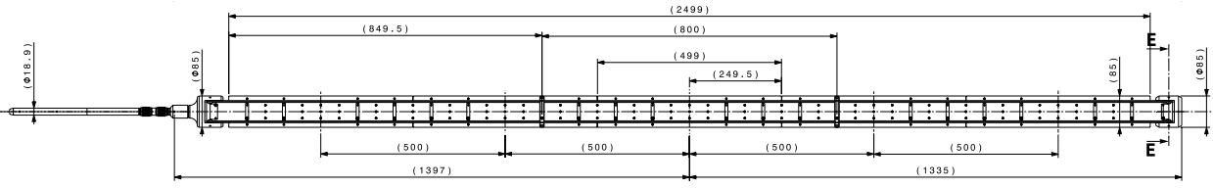
Magnetic measurements
Powering cycles
Vertical field from the inner coils:
main field B₁ (normal)
first allowed b₃
Horizontal field from the outer coils:
main field A₁ (skew)
first allowed a₃
Rotating-coil in the helium bath of vertical cryostat cluster D in SM18
  5 segments (500 mm each, 2.5 m total)
Reference radius 50 mm

Slide 21
MCBXFBP2c Inner Dipole
 | Center [units] |  | Integral [units]
n | bn | an | bn | an
2 | 1.27 | -2.83 | -1.24 | -1.42
3 | -11.16 | 0.23 | -4.91 | 0.10
4 | -0.04 | 0.04 | -0.51 | 0.07
5 | -5.88 | 0.03 | -5.33 | -0.27
6 | -0.26 | 0.63 | -0.08 | 0.15
7 | 0.44 | -0.05 | -3.77 | -0.02
8 | -0.10 | 0.41 | 0.15 | 0.27
9 | 1.42 | -0.04 | -0.29 | -0.05
10 | -0.12 | 0.43 | -0.07 | 0.33
11 | 2.86 | -0.06 | 1.65 | 0.02
12 | 0.03 | -0.33 | 0.11 | -0.43
13 | -1.67 | -0.01 | -1.4 | 0.03
14 | -0.02 | 0.02 | 0.01 | 0.04
15 | 0.22 | 0.02 | 0.13 | 0.03
~2 units
* Measurements at Rref = 50 mm and I=~5A
Courtesy L. Fiscarelli

Slide 22
MCBXFBP2c Outer Dipole
 | Center [units] |  | Integral [units]
n | bn | an | bn | an
2 | 1.18 | -1.92 | -0.74 | 0.21
3 | -18.88 | 0.03 | -7.14 | 1.10
4 | 0.00 | -0.33 | 0.19 | 1.02
5 | -1.00 | -0.03 | -0.26 | 0.49
6 | -0.35 | 0.18 | -0.30 | 0.29
7 | 3.33 | -0.05 | 2.62 | -0.06
8 | -0.08 | 0.05 | -0.04 | 0.03
9 | 0.61 | -0.02 | 0.43 | -0.01
10 | 0.00 | -0.01 | -0.02 | -0.03
11 | -0.05 | 0.02 | -0.06 | 0.01
12 | -0.01 | -0.02 | 0.02 | -0.07
13 | -0.29 | 0.13 | -0.11 | 0.30
14 | 0.00 | 0.01 | -0.02 | -0.11
15 | 0.00 | 0.00 | 0.02 | 0.04
* Measurements at Rref = 50 mm and I=~5A
MM results are reproducible and predictable
Courtesy L. Fiscarelli

Slide 23
Summary
The fine tuning of the design introduced during the assembly of MCBXFB01 was implemented in MCBXFBP2c by using 2 inner dipole coils produced by ELYTT.
MCBXFP2c reassembly and powering tests validate the coil fabrication technology transfer to ELYTT.
This new assembly proves the reproducibility of the results obtained during MCBXFB01 powering tests campaign.
MCBXFBP2c during powering:
  Reached nominal +/+ from virgin inner coils in 3 quenches. 2 retraining quenches and last 2 near ultimate current
  No quenches in the nominal integrated field area
  Reached ultimate integrated field requirement with only 2 quenches and no quench after TC
  No quench during the 231 cycles performed for endurance test
  Perfect memory after TC
Warm magnetic measurements are close to calculated values.
Field quality is under control and does not pose significant challenges with present specification
The first type B magnet of the series fully produced and assembled at Elytt premises will be cold tested at CERN by end of September 2022.
The powering test at CERN of the first MCBXA prototype is scheduled in December 2022.
JC. Perez – 21st September 2022

Slide 24
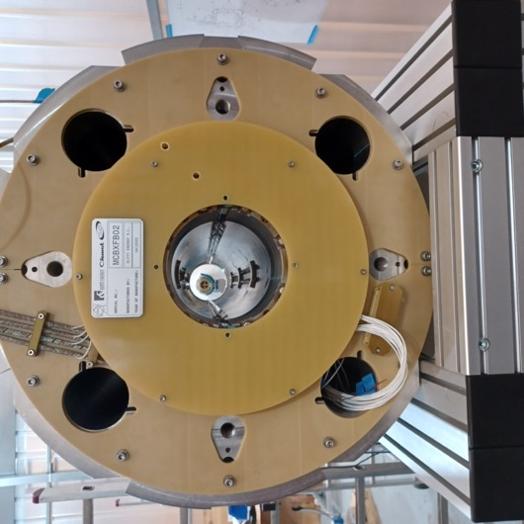
Thank you for your attention!

Slide 25
Acknowledgements to:
Pablo Abramian, Cristóbal Alcázar, Jesús Calero, Manuel Domínguez, Jesus Angel García Matos, Luis Garcia-Tabarés, Luis González, Pablo Gómez, Jesús Jiménez, Teresa Martínez, Carla Martins, Javier Munilla, José Antonio Pardo, José Manuel Pérez, Víctor Sanz, Sebastián Soto, Pablo Sobrino, Fernando Toral from CIEMAT
Marta Bajko, Nicolas Bourcey, Pierre-Antoine Contat, Ruth Diaz, Hugues Dupont, Nicolas Eyraud, Salvador Ferradas, Bertrand Fornes, Jean-Luc Guyon, Hector Garcia, Pablo Gomez, Michael Guinchard, Lucio Fiscarelli. Gregory Maury, Sylvain Mugnier, Francois-Olivier Pincot, Hervé Prin, Joan Rico, Ezio Todesco, Lorcan Quain, Gerard Willering from CERN

