Slide 1

MCBRDP4 prototype
CERN D2 corrector production and test
A. Foussat (TE-MSC-SMT) on behalf of the MCBRD team: Veronica Ilardi, Glyn Kirby, Ezio Todesco, Helene Felice, Frederic Garnier, Carlos Fernandes, Francois Olivier Pincot, Pierre-Antoine Contat, Hugues Dupont, Cedric Urscheler, Bharti Verma, Ahmed Benfkih, Pietro Ricci, Juan Carlos Perez, Daniel Molnar, Davide Tommasini, Ruth Diaz Vez, Franco Mangiarotti, Gerard Willering, Jerome Feuvrier, Jean Luc Guyon, Patrick Viret, Lucio Fiscarelli, Piotr Tomasz Rogacki, Greg Maury, Pierre Moyret, Andrea Musso, Steve Becle.
Uppsala University, Sweden,
12nd HL-LHC Collaboration Meeting 21/09/2022
https://indico.cern.ch/event/1161569
Notes:
To pay tribute to the large team who took part in part procurement, construction, test of MCBRDP4

Slide 2
Outline
Background
MCBRD Magnets parameters
MCBRDP4 production experience and feedback
Cold test results
Summary

Slide 3
Background
Following decision in Oct.2021, manufacturing of a fourth prototype MCBRDP4, series compliant, at CERN, with the following scopes:
Create an additional contingency in the schedule, leaving an adequate time to fully validate the magnets of the Chinese collaboration or to take mitigation actions if needed.
To assess training performances at 4.5 K wrt 1.9 K to verify if the slow training is related to the manufacturing quality, process or to the temperature of the test;
Notes:
Oct. 2021 steering meeting

Slide 4

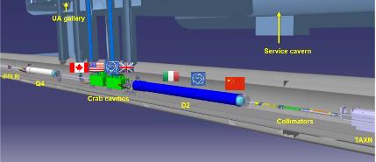
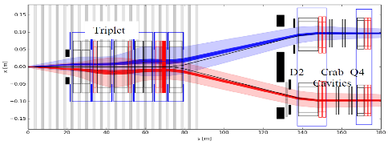
HL-LHC MCBRD Magnets
MCBRD magnets as part of the HL-LHC WP3 D2 orbit correctors (8 MCBRD units needed + 4 spares)
Based on Canted Cosine Theta (CCT) design
On going collaboration with IHEP-China on 12 MCBRDs series production
Completed MCBRDP4 production @ CERN over 7 months, ended last 07/2022.
Coming next CERN production of two series magnets MCBRD11,12 with IHEP components
MCBRDs
Parameters @ nominal current (7 TeV operation) | D2 MBRD | MCBRD
Material | Nb-Ti | Nb-Ti
# apertures | 2 | 2
Distance between apertures [mm] | 188 | 188
Aperture [mm] | 105 | 105
Field [T] | 4.50 | 2.60
Integrated field [T.m] | 35 | 5
Nominal Current [kA] | 12.328 | 0.394
Stored energy [MJ] | 2.26 | 0.143

Slide 5
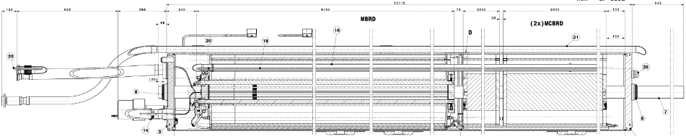
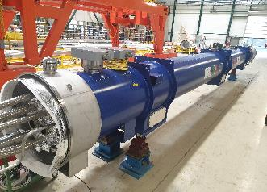
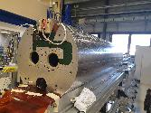
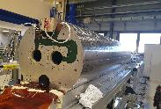
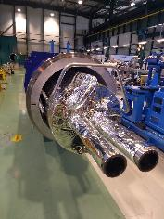
HL-LHC QBRD cryostated cold mass
Cryostat (QBRD) includes two double aperture MCBRDs orbit correctors. MCBRDP4 shall be part of spare series D2 corrector magnets.
Prototype QBRD (07/2022) Courtesy of Delio Duarte Ramos
Courtesy of Delio Duarte Ramos
Notes:
Following acceptance of MCBRDP4 meeting all criteria for series, it shall be part of spare corrector units

Slide 6
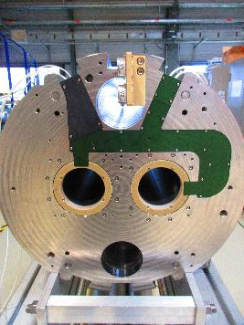
MCBRDP4 dipole parameters
MCBRDP4 2-in-1 magnet was built according to the series MCBRD magnet requirements. (EDMS 2051870)
All components were manufactured and controlled by CERN (MSC, EN-MME).
Parameter | Unit | Value
Aperture size | mm | 105
Magnetic length | m | 1.93
Nominal field | T | 2.59
Nominal integrated field | T.m | 5.0
Nominal current | A | 394
Ultimate current | A | 422
Short sample current at 1.9 K | A | 767
Short sample current at 4.2 K | A | 650
Loadline fraction at 1.9 K |  | 51%
Strand diameter | mm | 0.825
Cu/no_Cu | - | 1.95
Strand critical current at 4 T | A | 700
Nominal strand current density | A/mm² | 737
Nominal superconductor current density | A/mm² | 1695
Loadline fraction at 1.9 K |  | 51%
Nominal differential inductance per aperture | mH | 970
Nominal stored energy per aperture | kJ | 74.9
CCT skew angle |  | 30°
No. of turns per layer |  | 365
Slot size in former (mm) |  | 2.1 × 5.2
Number of CCT layers / Strands in channel |  | 2 / 5 x 2

Slide 7
MCBRDP4 return on experience
MCBRDP4 has inherited from CERN P1-3 prototypes experience on processes optimization. Opportunity given to focus onto key manufacture items below:
  Manufacture tolerances crosscheck, CMM metrology and QC checks of components ( Al-6082 formers, G10 insulating parts, SC wires) in support of each assembly step;
  High voltage withstand enhanced level;
  Winding dedicated tool;
  Impregnation process control upgrade, additional diagnostics test;
  Magnet dimensional checks during assembly;
Enhanced electrical insulation achieved in MCBRDP4 coils, implementing conservative approach in manufacture and design option.

Slide 8
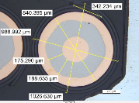
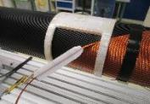
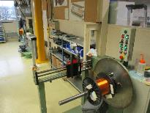
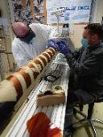
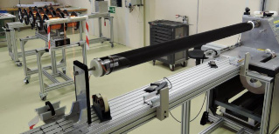
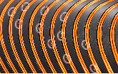

Feedback from winding
Initial 10 km long SC NbTi insulated wire ($$0.98mm) had few defects, electrically tested at 2 kV and repaired with polyimid tape.
  Alternative development of repair using cured liquid polyimide, under progress.
Multiple cleaning passes of 20 unit lengths (UL ≈ 500 m each).
Rounded grooves edges essential to keep insulation integrity.
Dedicated winding jig and better control of Fiber glass tension to ease wires placement and ext. tube insertion.
①
②
⑥
⑤
③
④
Notes:
Opportunity to develop new repair option base don cured liquid PI

Slide 9
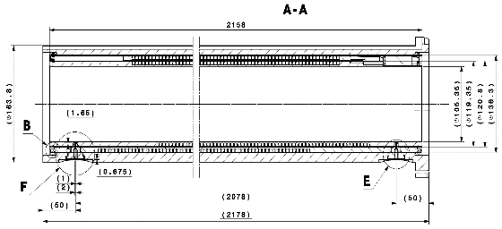
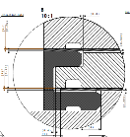
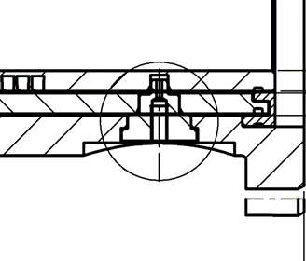

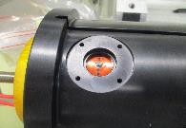
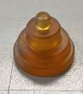

Feedback from High voltage management
Inner former
Outer former
External tube
To reach minimum insulation resistance of 1 GΩ at 3.2 kV (30 s hold time) a 4 mm spark distance shall be guaranteed between the outer former and external ground tube in case of any GI Kapton local interruption.
Conservative electrical design following past CERN prototypes and IHEP series performances:
  Improved cutting of Kapton GI, VPI resin parameters control, conservative 4 mm separation length.
Alignment pin hole
Ultem pin
Cutting of interlayer insulation
Notes:
The magnet electrical design should guarantee by design a minimum insulation level of 1 GOHM to ground at 3.2kV

Slide 10
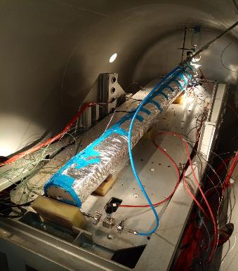
Vacuum pressure impregnation feedback
MCBRDP4 followed the standard CTD101K resin
Pressure-Temperature VPI cycle. Curing under pressure (1.5 bar applied through N2): 110 °C for 6 h + 125 °C for 16 h
  Curing under pressure (1.5 bar applied through N2): 110 °C for 6 h + 125 °C for 16 h
Thermocouples instrumentation was doubled to confirm maximum thermal gradient in transient of 5 °C
Degazing of the mould was enhanced at 110 °C for 6 h, then at 60 °C for 4 days and the resin at 60 – 70 °C
Better control of inlet resin temperature at 60°C, lower viscosity
Control of resin mould axial penetration time (∼ 50 mins) and total weight (2.5kg) through further ‘milking’ overhead pressure cycle.
AP1 in vacuum pressure impregnation chamber
Courtesy of Cedric Urscheler

Slide 11
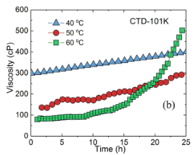
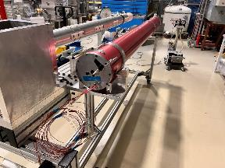
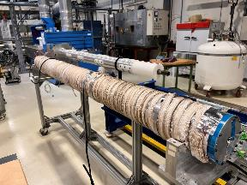
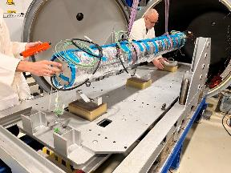
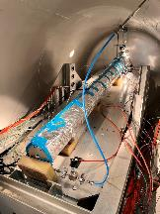
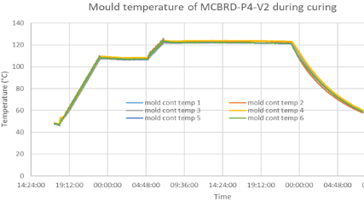
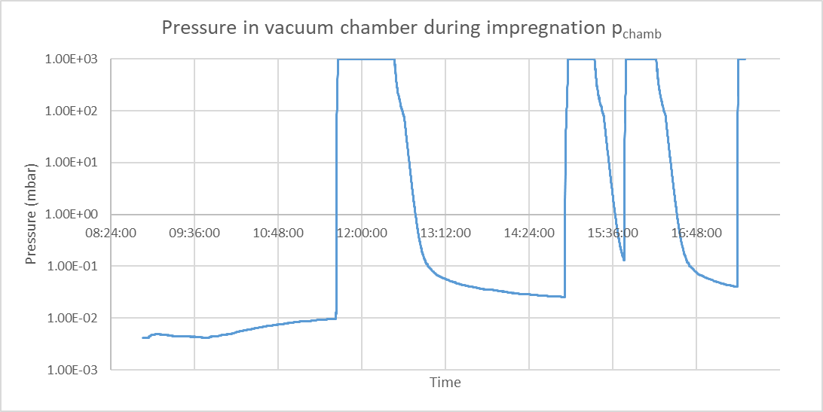
MCBRDP4 VP Impregnation steps
Mould with sealed leads exits
Heaters strips around mould mould
Fig.1 Viscosity measurement of CTD101K resin
Final mould assembly with insulating blankets and resin piping
Fig.2 a) Milking pressure cycles on MCBRDP4, b) resin polymerization T cycle
Notes:
This slide illustrates the usual preparation steps of the single aperture mould inside vacuum chamber and common P-T process implemented during VPI impregnation.

Slide 12
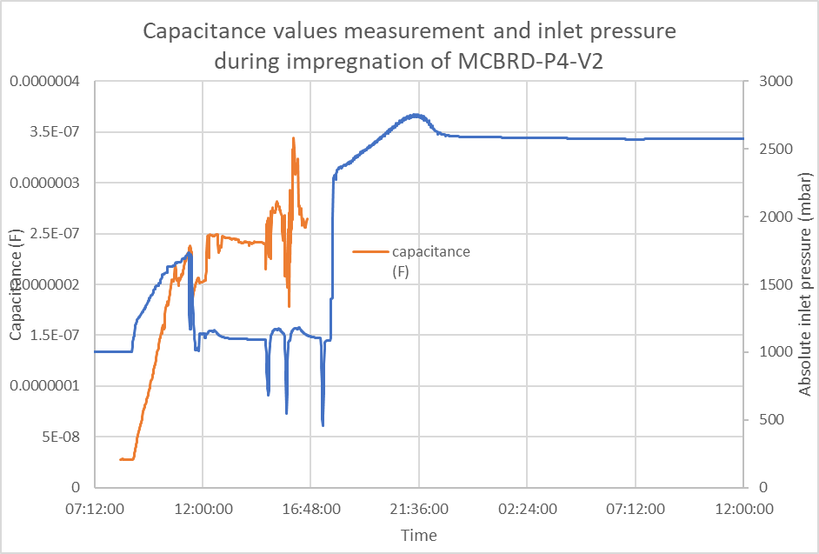
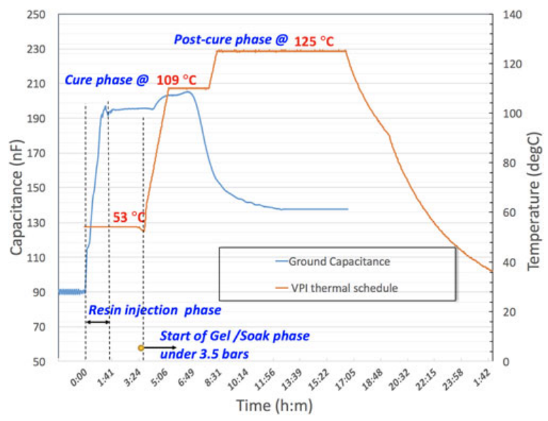
New impregnation diagnostics
Implementation on MCBRDP4 mould of new on-line capacitance measurement between winding and Ground during resin filling and polymerization cycle
  Dynamic range up to 260 nF on MCBRD ( Fig.1) showing effective filling time (∼ 3h) at injection.
  Influence on capacitance from pressure milking cycle. See reference similar measurement on 11T dipole in Fig.2
IEEE Trans. Appl. Supercond. 28 (2018) 4003505
Fig.1. MCBRDP4 capacitance to GND vs. time
Fig.2 reference 11T capacitance record.
Notes:
See saturation Cp time constant ( longitudinal vs transverse wetting).

Slide 13
Electrical Hi-voltage insulation tests
MCBRDP4 passed all manufacture QC Hi-pot acceptance tests criteria at RT. Final magnet insulation Rins_GND > 100 GOhms.
At 1.9 K Liquid Helium temperature, the high voltage 1.6 kV withstand criteria was finally met on MCBRDP4 after some initial breakdowns located outside the magnet.
  Residual coils to ground insulation respectively of 65 and 45 GOhm.

Slide 14
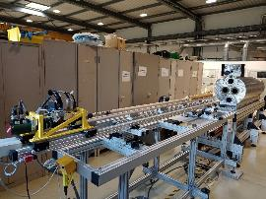
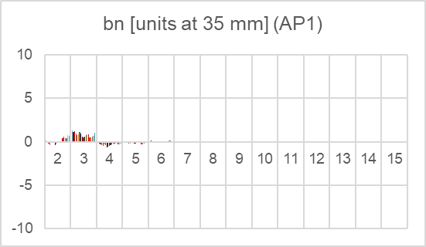
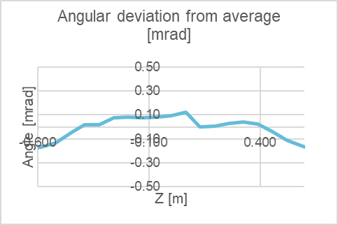
Magnetic measurement at ambient temperature
Similar levels of normal /skew harmonics (<1 unit) and field profile on both bare apertures AP1 (Claret) and AP2 (Black).
Comparison made with others past apertures, with standard deviation up to 15th order multipole ( see annex).
Courtesy of L Fiscarelli, P. T. Rogacki

Slide 15
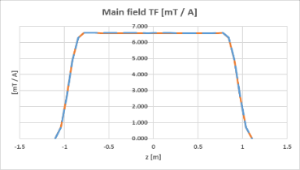
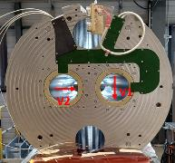
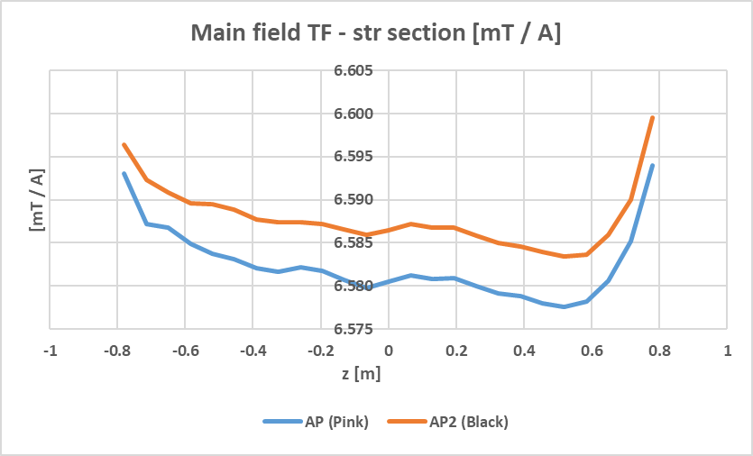
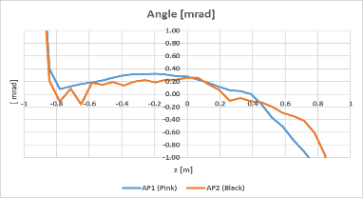
Magnetic transfer function (TF)
Magnetic TF (Tm/kA) as expected, slight effect seen from iron packing factor on slope. (Fig.1,2)
Good field alignment in magnet of both apertures within 1 mrad. ( Fig.3)
Fig 1
Fig 2
Fig 3

Slide 16

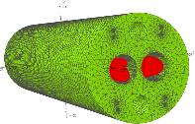
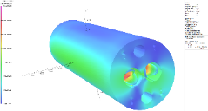
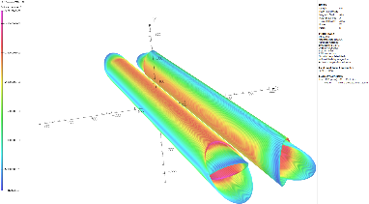
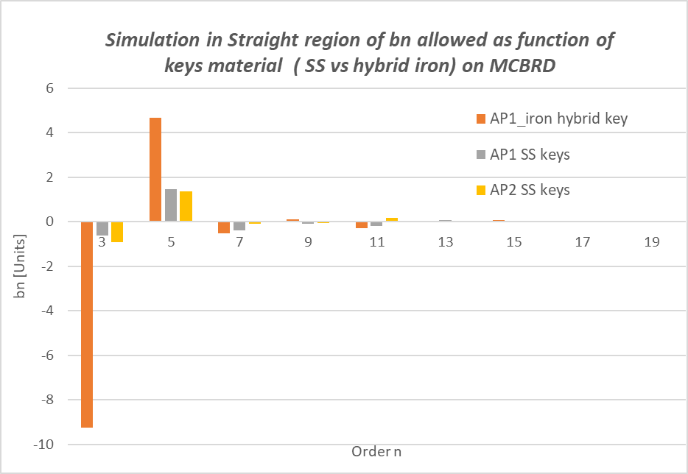
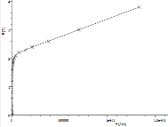
Magnetostatic model benchmarking
Recent update at CERN to elaborate a reference MCBRD non linear magnetic Opera Simulia model with yoke Armco iron b-h non linear curve, and the 304L SS keys.
Benchmark of integral allowed harmonics with SS keys. (acknowledgement to IHEP for sharing the initial FE model)
Armco b-h curve

Slide 17

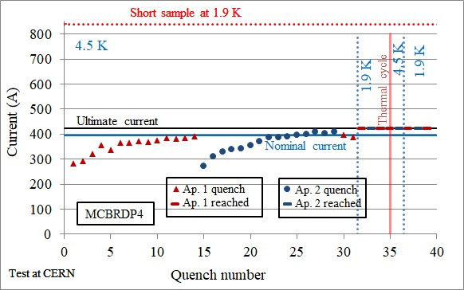
MCBRDP4 COLD TEST : Training summary
Powering to 394 A nominal @ 4.5 K with 14 training quenches in apertures during CD1. ( relatively fast training in comparison with magnets constructed so far)
Powering at 422 A ultimate current @ 1.9 K without any quenches, before & after second cool down CD2.
CD1 – 4.5 K single aperture - training quenches
CD1 – 1.9 K ultimate current single aperture - No quench
CD1 – 1.9 K ultimate current combined powering - No quench
CD2 – 4.5 K ultimate current single aperture – No quench
CD2 – 1.9 K ultimate current single aperture - No quench
CD2 – 1.9 K ultimate current combined powering - No quench
Excellent results:
After initial training at 4.5 K all cycles showed stable magnet performance, good memory at 1.9 K.
Courtesy of F Mangiarotti, G. Willering, E Todesco

Slide 18
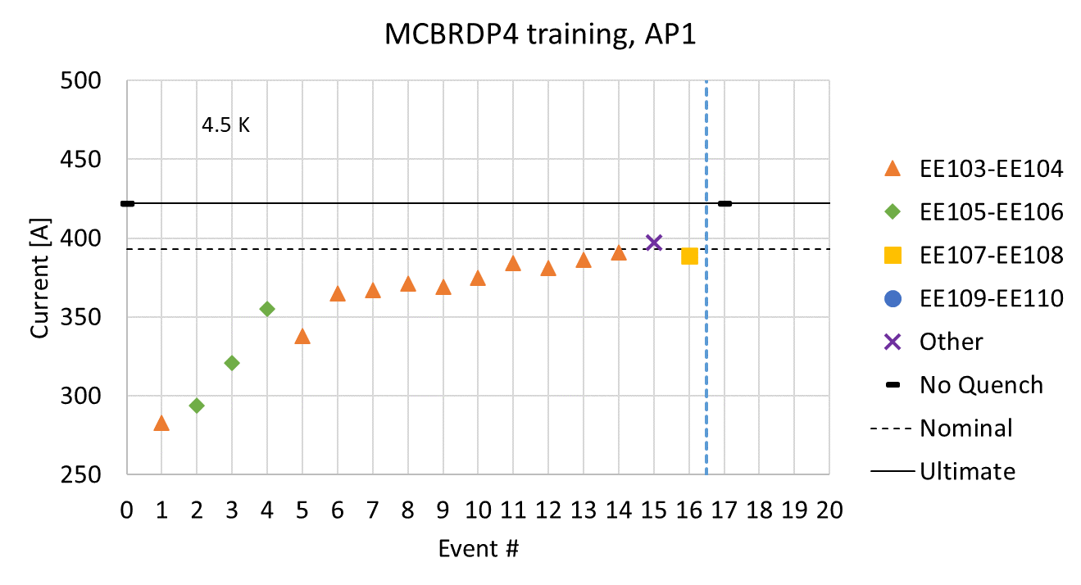
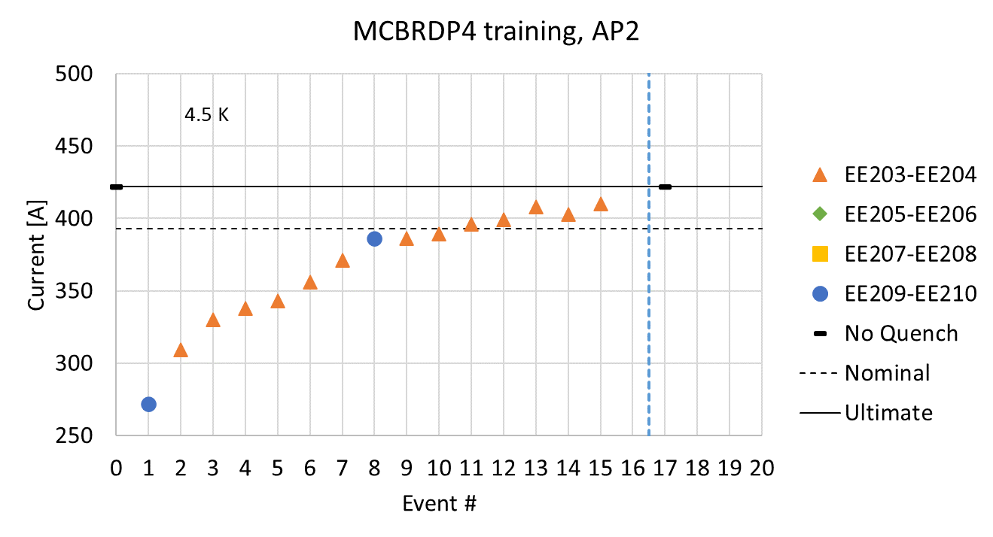
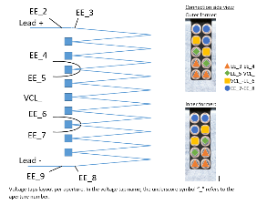
Single aperture training location
- First training at 4.5 K with single apertures in yoke:
start at 280 and 270 A with comparable training behavior on both coils
Note : Most of training quenches occurred in bottom turns in the groove, ( see orange triangles)
4.5 K
1.9 K
- No further quench at 1.9K to ultimate current.
4.5 K
1.9 K
Courtesy of F Mangiarotti, G. Willering

Slide 19
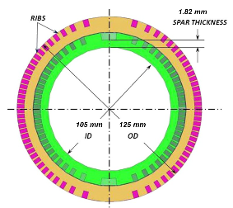
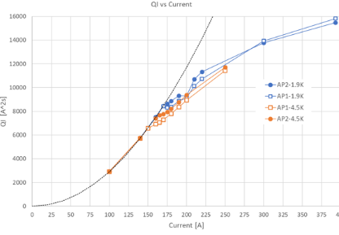
Quench back vs. current
Additional discharges performed on P4 for quench back studies in the 150-200 A current range showing a no-quench back to quench back regime transition in QI curve at both 4.5 K and 1.9 K.
Next benchmarking of CCT eddy current model using Protect package by Mariusz Wostniak (TE-MPE).
Courtesy of Filip Kosowski
Cross section of MCBRD winding layers into Al 6082 formers

Slide 20
Magnet field quality at 1.9K– Integral
APERTURE 1
Individual powering (positive-negative mean) |  |  | Difference from individual to combined powering
AP1 at ±393A AP2 at 0A |  |  | AP1 at ±393A AP2 at ±393A
 | Unit | Value |  | Unit | Value
Norm. TF | Tm/kA | 12.699 | Norm. TF Δ* | units | -18
Norm. Int. Field | Tm | 4.991 | Norm. Int. Field Δ* | units | -18
n | bn | an | n | Δbn** | Δan**
2 | 4.98 | 3.16 | 2 | 3.97 | ±5.60
3 | -4.29 | 0.14 | 3 | -3.41 | ±1.90
4 | -0.36 | -0.15 | 4 | 0.34 | ±0.81
5 | -1.74 | 0.23 | 5 | -0.32 | ±0.34
6 | 0.14 | 0.05 | 6 | -0.02 | ±0.12
7 | 0.36 | -0.09 | 7 | -0.02 | ±0.04
8 | 0.07 | -0.03 | 8 | -0.01 | ±0.00
9 | 0.02 | -0.07 | 9 | -0.01 | ±0.01
10 | 0.01 | 0.01 | 10 | 0.00 | ±0.00
11 | 0.01 | -0.01 | 11 | 0.00 | ±0.00
12 | -0.01 | 0.00 | 12 | -0.01 | ±0.00
13 | 0.00 | 0.00 | 13 | 0.00 | ±0.00
14 | 0.00 | 0.00 | 14 | 0.00 | ±0.00
15 | 0.00 | 0.00 | 15 | 0.00 | ±0.00
APERTURE 2
Individual powering (positive-negative mean) |  |  | Difference from individual to combined powering
AP2 at ±393A AP1 at 0A |  |  | AP2 at ±393A AP1 at ±393A
 | Unit | Value |  | Unit | Value
Skew TF | Tm/kA | 12.687 | Skew TF Δ* | units | -12
Skew Int. Field | Tm | 4.986 | Skew Int. Field Δ* | units | -12
n | bn | an | n | Δbn** | Δan**
2 | -4.66 | -7.46 | 2 | ±7.46 | -5.48
3 | 0.05 | 1.84 | 3 | ±2.22 | -0.82
4 | 0.11 | -0.18 | 4 | ±0.10 | -0.17
5 | 0.02 | -1.50 | 5 | ±0.14 | -0.16
6 | 0.07 | 0.15 | 6 | ±0.05 | -0.07
7 | 0.04 | -0.31 | 7 | ±0.02 | -0.01
8 | -0.10 | 0.04 | 8 | ±0.01 | 0.00
9 | 0.01 | -0.01 | 9 | ±0.01 | 0.01
10 | 0.01 | 0.01 | 10 | ±0.00 | 0.00
11 | 0.00 | -0.01 | 11 | ±0.00 | 0.00
12 | 0.00 | 0.00 | 12 | ±0.00 | 0.00
13 | 0.00 | 0.00 | 13 | ±0.00 | 0.00
14 | 0.00 | 0.00 | 14 | ±0.00 | 0.00
15 | 0.00 | 0.00 | 15 | ±0.00 | 0.00
* Relative difference in units to nominal value in individual powering
** Difference in units between individual and combined powering - the ‘±’ indicates that the sign of the difference is dependent on the powering quadrant.
MCBRDP4 met multipoles criteria at cold.
Courtesy of L Fischarelli, P. T. Rogacki

Slide 21
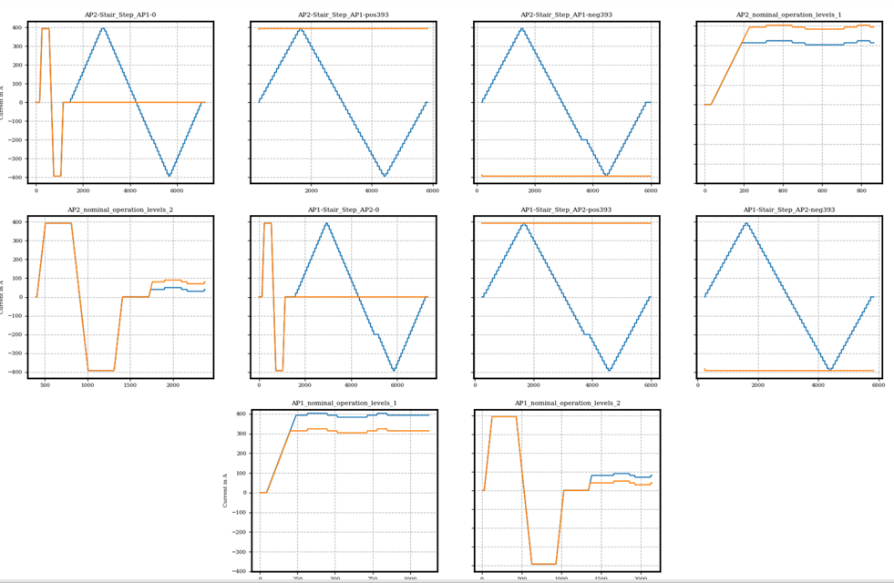
Stability & power plateaus
At 1.9 K powering to ultimate current in all quadrants was performed for 3.5 hours per quadrant (++, --, +-, -+).
Extensive number of powering cycles performed. Magnet was stable, including the magnetic measurement cycles.
Courtesy of L Fiscarelli, P. T. Rogacki
Notes:
Extensive number of power combination as prototype

Slide 22
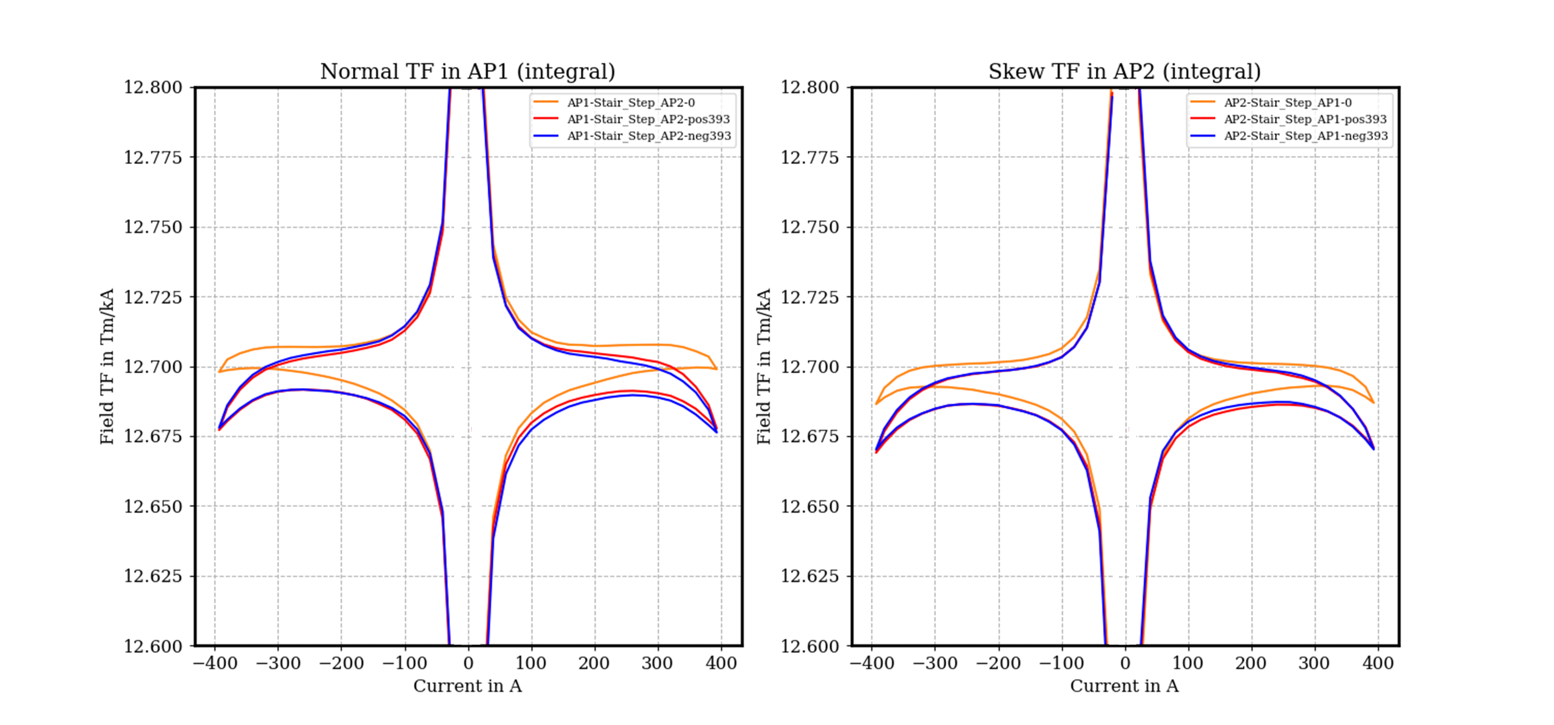
Magnetic transfer function @ 1.9K
0.4%
20 units
Courtesy of L Fiscarelli, P. T. Rogacki
      Individual powering saturation: < 0.1%
      Combined powering saturation: -0.15%
Warm TF: EDMS 1185245/
Cold TF: EDMS 2779805/
Notes:
Effect of iron saturation in single or combined powering is quantified < 0.2 %

Slide 23
Summary
MCBRDP4 magnet cold test was completed successfully last August 2022. It featured best training performances at both 4.5 K and 1.9 K including compliant electrical insulation levels.
  Maximum number of 14 training quenches at 4.5 K, no further quenches to ultimate current at 1.9K.
MCBRDP4 apertures and magnet assembly were carried out at CERN in SMT lab, passing all main QC tests ( dimensional, electrical Hi pot insulation test levels, RT & cold magnetic measurement)
  integral normal multipole < 2 units in single aperture, main field strength of MCBRDP4 as expected
  b3 and a3 within 10 units in magnet for all nominal powering combinations
  electrical joint resistances verified at 7-8 nOhms at 1.9K.
Upgrade of manufacture processes controls, new diagnostics as valuable insights in knowledge on CCTs. Further updates of MCBRD magnetic model done.
.
•
Overall, MCBRDP4 constitutes an excellent reference baseline for design,
the series manufacture and CCT magnet performances.

Slide 24





Acknowledgements to all contributors
MCBRDP4 apertures and magnet assembly at 927 (SMT)
MCBRDP4 in SM18 cryostat insert
Thanks to H. Felice, E. Todesco and G. Kirby for steady support to the project
12nd Hi-Lumi week meeting | MCBRDP4 manufacture and test A. Foussat 2022-09-20

Slide 25


Thanks for your attention

Slide 26
Back up slides
Thanks for your attention

Slide 27





Canted Cosinus Theta (CCT) features
Although much is known on the benefits and cons of CCT coils (economical construction way in 3-5 T range SC magnets, stress managed magnet, nearly perfect cos-theta coils, field errors superposition ability, least field efficiency), the P4 has been focusing on the manufacture QC details.
Fig.1 MCBRD Central dipole bore field profile
α
Ref Dissertation by Brouwer 2015

Slide 28
MAIN REQUIREMENTS
Ultimate integral field of 5.4 T.m has to be reached
  Positive and negative powering, any combination of aperture 1 and aperture 2 field as operation at flat top.
  Virgin training: no requirement. Training after thermal cycle: 1 quench to nominal
Magnet length has to fit within the 2.2 m (D2 cold mass)
Magnet size as to fit within the 614 mm diameter (D2 cold mass)
The magnet shall fulfill the electrical HL test requirements during assembly and at 1.9 K (EDMS 2363906)
  3.2 kV at RT to GND 1.6kV in LHe, 330 V at RT post cold test (1GOhms min or 10 μAmax leakage),
Field quality
  Field harmonics have to be smaller than 0.1% of main component (10 units) at Rref = 35 mm at nominal field in any aperture
  No requirement on saturation of main component (we measure and use in the HL-LHC field model)
Cooling: no heat exchanger, direct conduction
  Free X-sectional area of 200 cm2 and stacking factor lower than 98%

Slide 29




Winding improvements
2 layers of fiberglass (amino silane E-glass, thickness 0.09 mm)
  1 layer overlapped at 45%
  1 contiguous layer
2 polyimide sheets, 125 µm thick.
Better position of wires during winding using dedicated jigs. (fig.1)
Improved fiber E-glass tape with controlled applied tension to keep homogenous insertion gap (∼ 0.2 mm) (fig.2)
fig.2
fig.1

Slide 30



Comparison between past CCT apertures
Normal and skew components of same order (up to n=15) have a similar linear spread (within a few percent) : measurements are then coming from the magnet construction tolerances and not due to measurement errors.
No clear differences among manufactured apertures.
normal and skew harmonics are presented in LOG scale
Courtesy of L Fiscarelli, P. T. Rogacki
Fig. 1 Standard deviation in Normal , skew Terms at the Max. Field
Notes:
The exponential decay as function of the multipole order, linear when plotted in log scale, shows that what we measure is coming from the magnet coils and it is not due to measurement errors.

Slide 31


Inter layers series splicing, V-taps
Fig.1 Series splicing terminal connection box
Layout of 10 wires in series laid in two layers spliced in the connection box
  Includes 10 voltage taps wires and 9 SC wires joint splices (Crimped, Sn96Ag4 soldered then polyimide insulated)
  Joint electrical resistances verified at 7-8 nOhms at 1.9K.

Slide 32

CCS T sensors
Temperature rise monitoring due to quench back in Al6082 formers during quench event

Slide 33

Harmonics in the magnet straight section

Slide 34





Acoustic emission trials
First outcomes of acoustic activities during current ramp up/down, quench event triggering and frequency spectrum signature on CCTs ( Fig1-3). Post analysis under progress. Further development needed and characterization tests of in-layers quench initiation localisation
3 AE piezosensors, 300 kHz BW based on LBNL (M. Marchevesky) design and installed on one Aperture AP1
Courtesy of Daniel Molnar
Fig.1
Fig.2
Fig.3

