Slide 1




Update on HL-LHC radiation levels
G. Lerner, M. Sabaté Gilarte, D. Prelipcean, A. Ciccotelli, M. Cecchetto, A. Waets, F. Cerutti, R. García Alía
12th HL-LHC Collaboration Meeting, Uppsala (Sweden), 21st September 2022
https://indico.cern.ch/event/1161569/contributions/4921523/

Slide 2
Introduction
Review of WP10 activity aimed at providing HL-LHC radiation level specifications for R2E:
Short recap of the baseline set of specifications for electronics, as included in EDMS 2302154
New studies carried out over the last ~year:
  IR1-IR5: radiation level specifications on cables, TID in the UPRs and on the ODH detectors
  IR4: radiation levels from beam-gas detectors
  IR7: radiation levels on the top floor of UJ76
  IR8: FLUKA radiation levels in the LHC tunnel and shielded alcoves

Slide 3
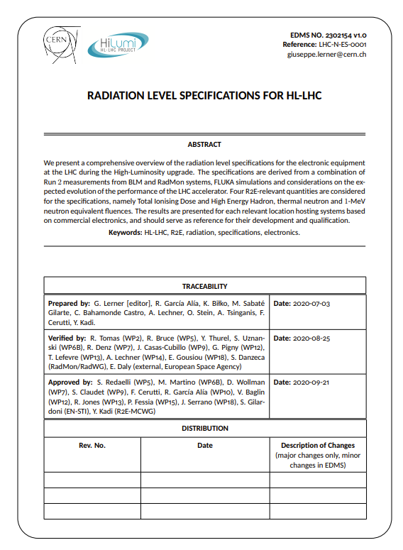
HL-LHC radiation level specification document
Radiation level specifications for electronics: EDMS 2302154 (09/2020)
Covered in EDMS 2302154:
  LHC DS and arcs, at the reference position of electronic racks (i.e., below the beamline)
  Shielded alcoves (with few exceptions)
Not covered in EDMS 2302154:
  LSS areas (typically not hosting electronics)
  Radiation levels on equipment on (or close to) the beamline
→ object of dedicated studies described in this talk

Slide 4
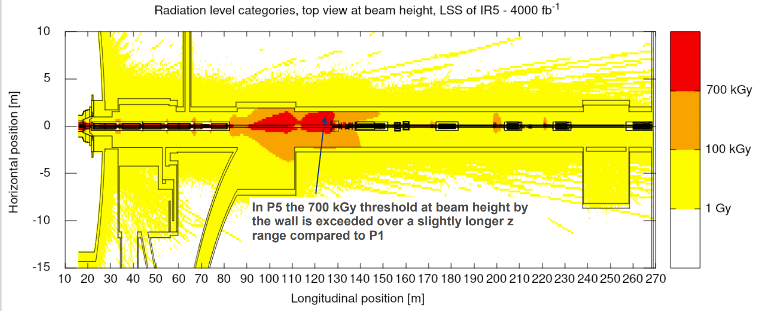
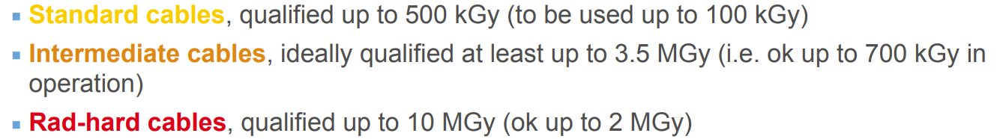
Radiation level specifications on cables
HL-LHC cable categories defined based on FLUKA simulations in IR1-IR5 by M. Sabaté Gilarte, with a safety factor of 5 due to dose rate effects
G. Lerner, WP15 meeting 09/2021
More on this in the talk by J. Gascon

Slide 5
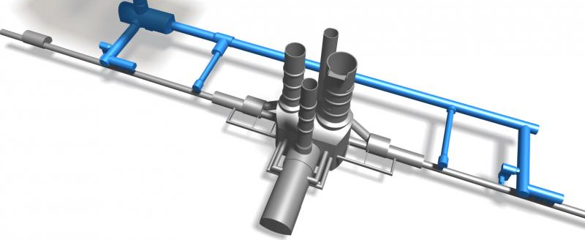
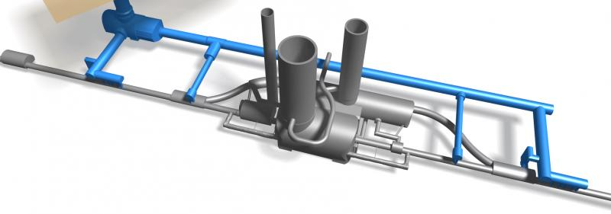
IP1-IP5: TID in the UPRs
New FLUKA simulations of Total Ionizing Dose (TID) at the ground floor of the UPRs (M. Sabate Gilarte)
Requested by EN-CV for fire damper equipment (EDMS 2599444)
Focus on UPRs 13-53 (left of P1-P5, closer to the IP center compared to UPRs 17-57):
UPR53
UPR13

Slide 6
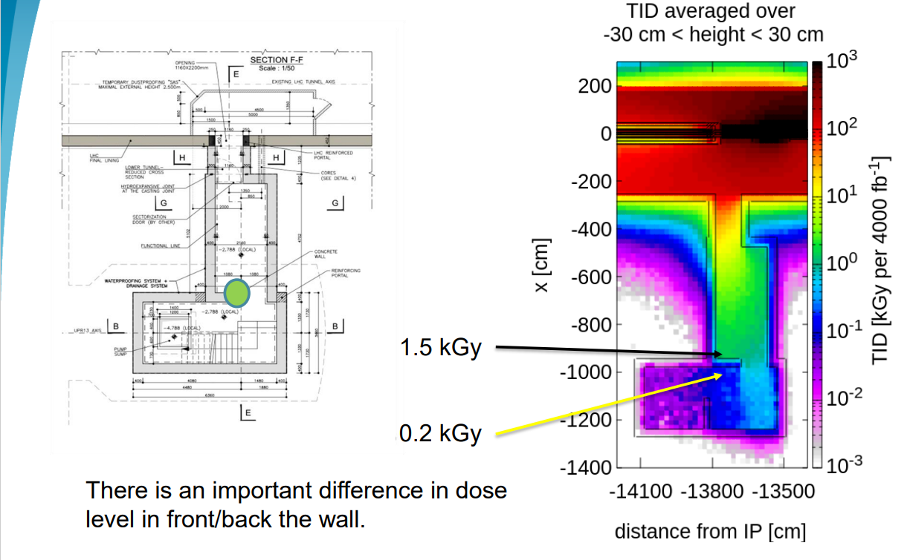
UPR13 FLUKA results – EDMS 2599444
M. Sabaté Gilarte
Significant TID in UPR13, with highest levels close to the LHC tunnel
The TID in UPR17 is much lower, due to the larger distance from IP1
If possible, we recommend installing the equipment behind the wall indicated in the figure
Similar situation in UPR53 (see backup)

Slide 7
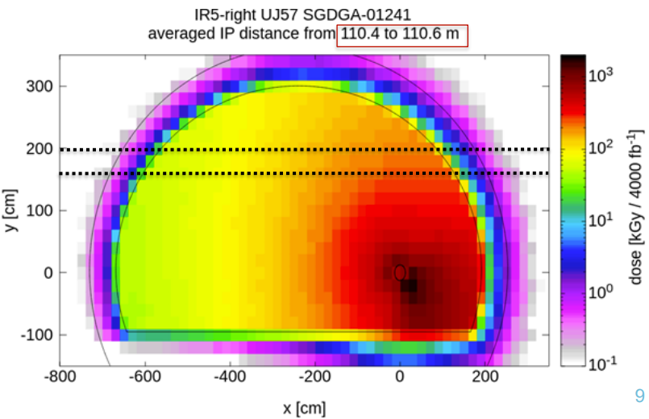
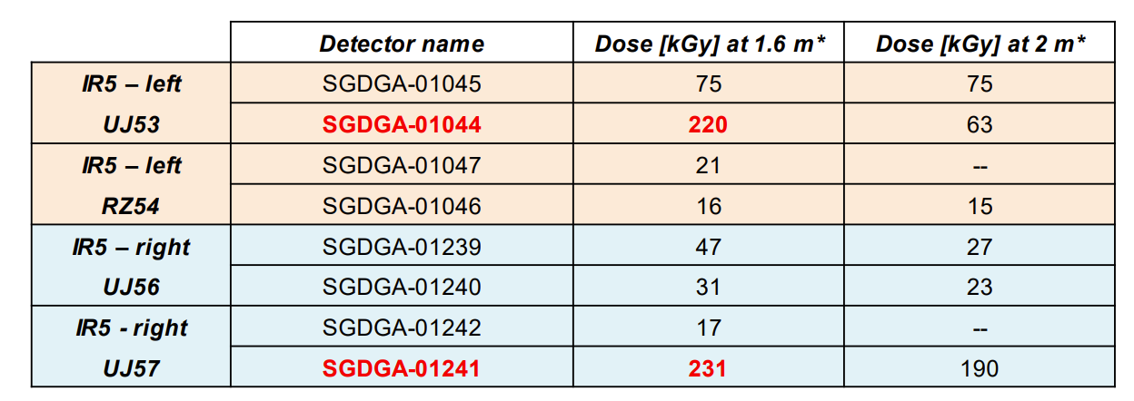
IR1-IR5 (and more): TID on ODH sensors and flashing lights
TID specifications for ODH detectors and flashing lights, requested by EN-AA (EDMS 2718033-2636143)
Highest TID in IR1-IR5, reaching up to 250 kGy / 4000 fb⁻¹ near UJ53-57, much lower TID in other locations
M. Sabaté Gilarte, M. Cecchetto

Slide 8
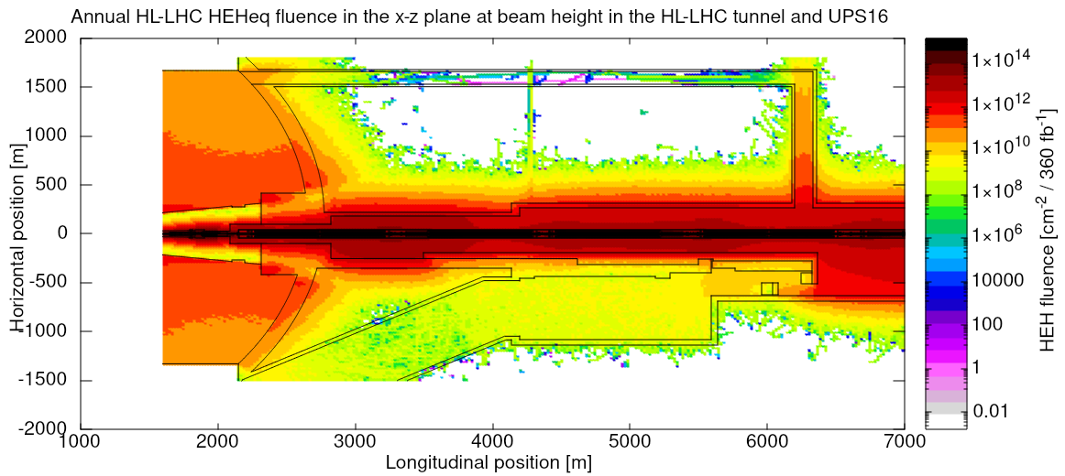
IR1: UPS16 radiation levels
UPS16 is foreseen to host FRAS equipment (DIOT, electronics)
The FLUKA simulations can model the leakage of radiation from the tunnel, but the leakage from the ATLAS cavern is inaccurate (as the
ATLAS detector
is not included
in the geometry
UPS16
→ BatMon deployed in 2022 on the ATLAS side of UPS16
(waiting for data)
FLUKA simulation by M. Sabaté Gilarte

Slide 9
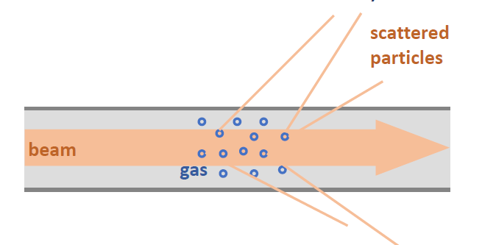
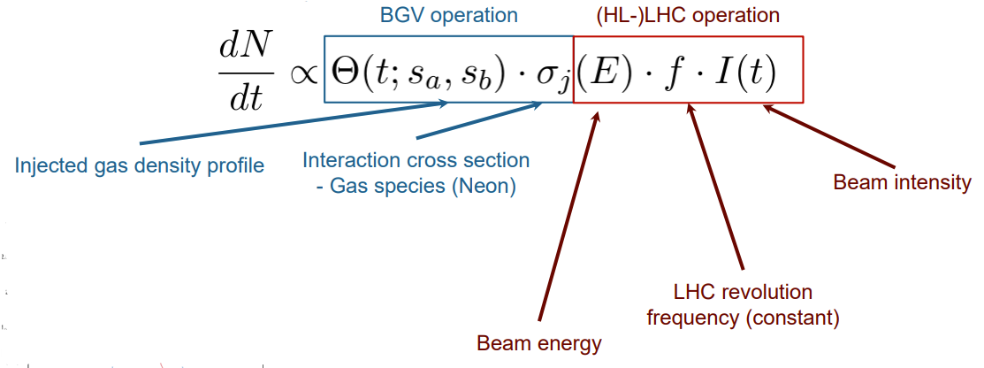
IR4: beam-gas detectors as a radiation source
FLUKA simulations have been carried out to analyze the radiation levels generated by the beam-gas detectors in IP4
Presentation at 150th TCC (February 2022) by D. Prelipcean
Radiation levels proportional to the beam intensity and to the integral of the pressure profile along z:

Slide 10
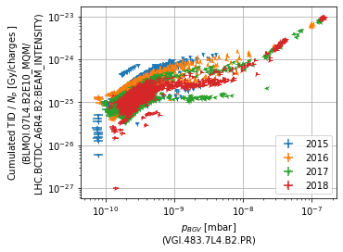
IR4: Run 2 BLM TID near the BGV
Clear correlation between BLM TID data downstream of the BGV prototype and the BGV gas pressure in Run 2
→ proof that the BGV is the main source of radiation in its proximity
D. Prelipcean
Similar analysis to be carried out with BGC data in Run 3, as soon as they become fully available

Slide 11
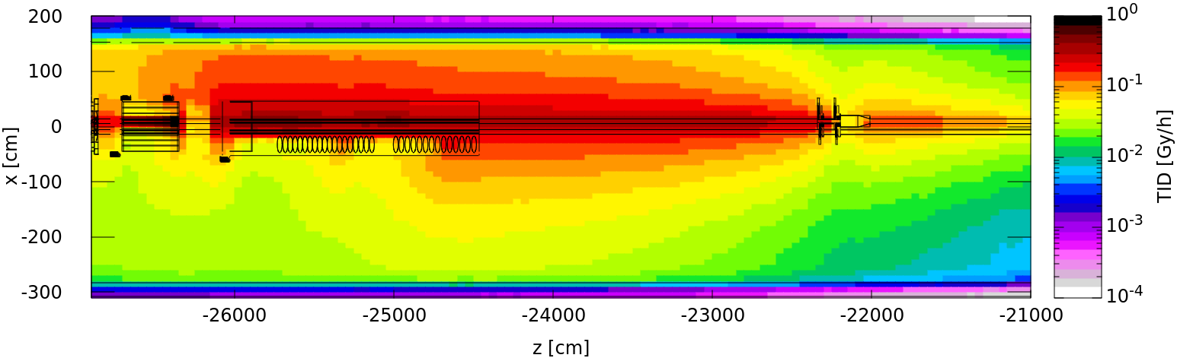
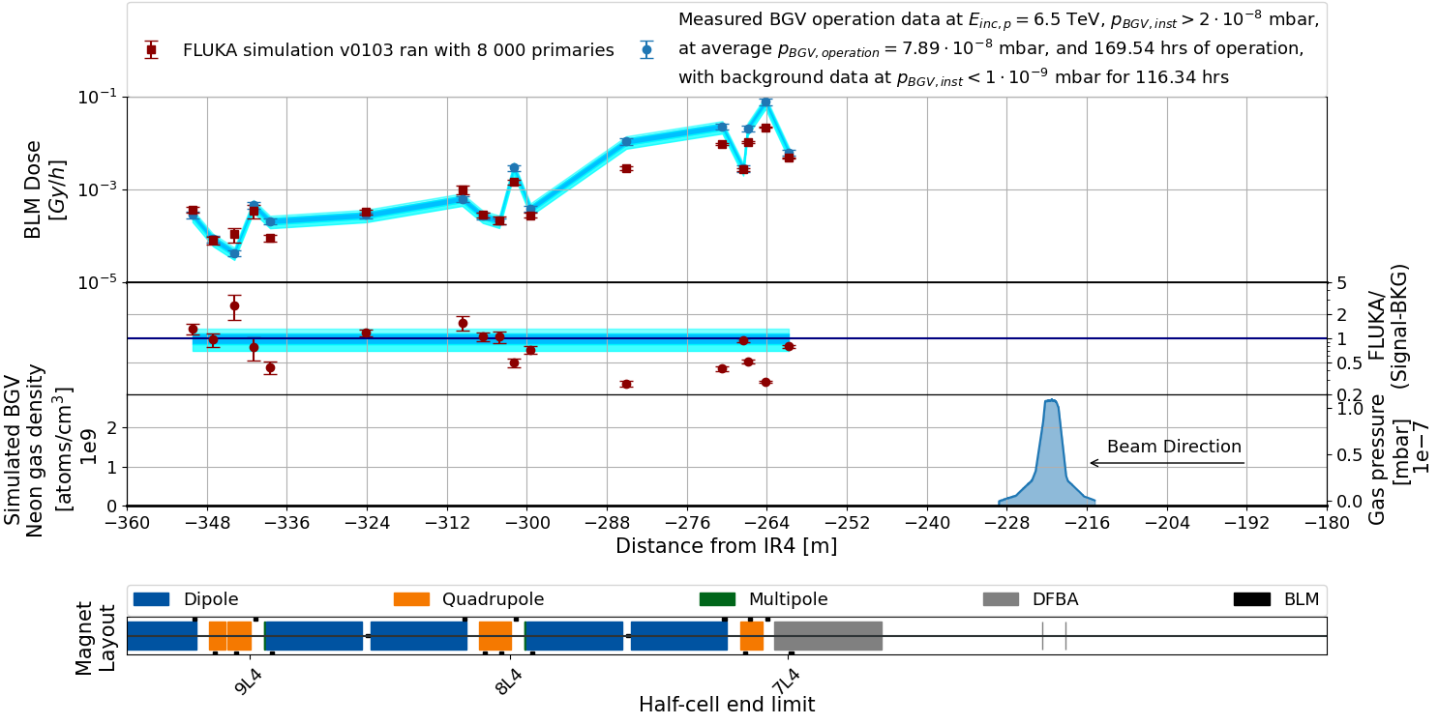
IR4: Run 2 FLUKA-data comparison for BLMs
Run 2 FLUKA simulation of B2 BGV, with radiation shower towards the DS
Improved agreement with Run 2 BLM data compared to the results shown at the TCC, but more investigations ongoing
Peak measured BLM dose around 0.1 Gy/h (underestimated by FLUKA)
→ ~20 Gy for ~200h of BGV operation per year
B2 BGV
D. Prelipcean
D. Prelipcean
Ne gas profile provided by TE-VSC (see backup)

Slide 12
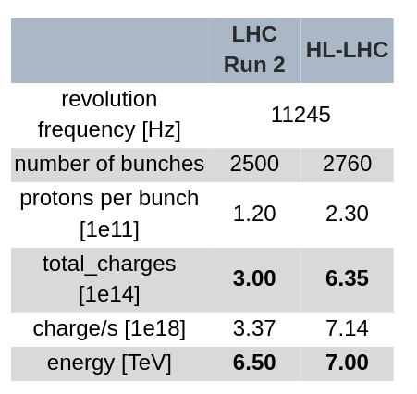
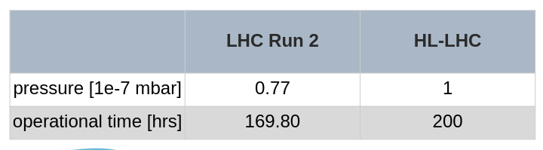
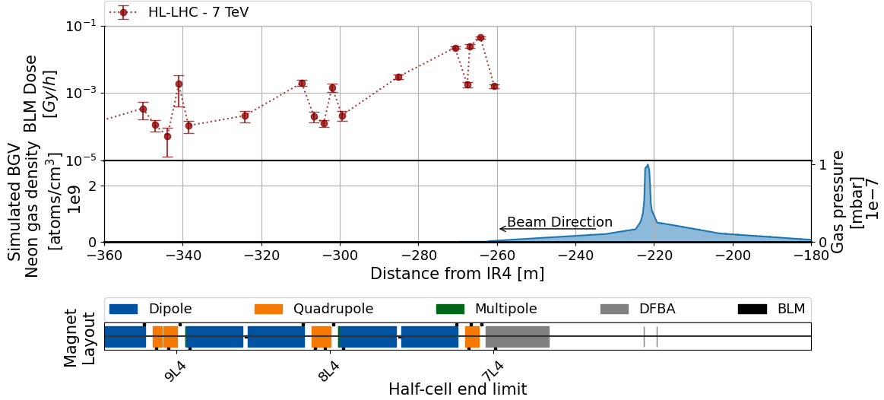
IR4: HL-LHC projections (preliminary)
HL-LHC FLUKA simulation of BLM TID per hour, using an updated gas profile
Peak BLM TID below 0.1 Gy/h, but the underestimation in Run 2 data signals that higher levels may be reached (investigation in progress)
400
Work in progress towards a full update of TCC results
D. Prelipcean

Slide 13
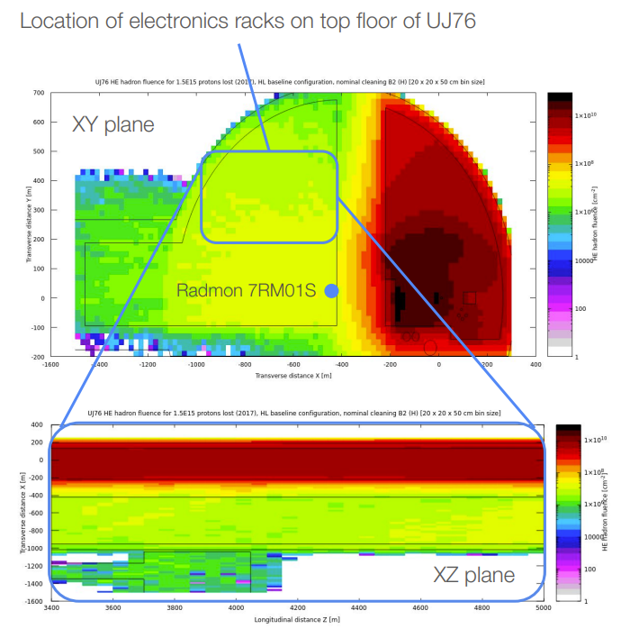
IR7: radiation levels in UJ76 at L1
A. Waets
Request by SY-BI for DOROS equipment in UJ76 L1 (EDMS 2715794)
FLUKA simulations by A. Waets combined with projections of integrated beam losses in IR7 lead us to set a conservative upper limit of 12 Gy over the full HL-LHC lifetime
A BatMon measurement this year (by BE-CEM) confirmed that this is a low-radiation area (<10⁷ HEH/cm², <10mGy in around 1 month of operation)
HEH-eq fluence in UJ76 for 1.5e15 lost protons in IR7
<1e8 HEH/cm²/y → <0.1 Gy/y

Slide 14
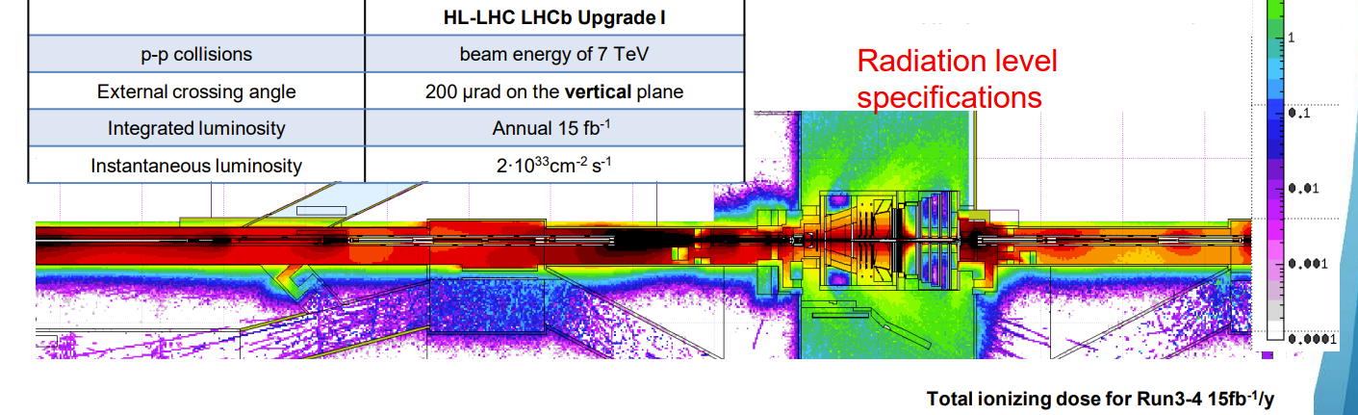
IR8: previous work
A comprehensive FLUKA study covering the radiation levels in IR8 (LHCb) has been presented at the 11th HL-LHC Collaboration meeting by A. Ciccotelli (2021 - link)
This included updated radiation level specifications with respect to EDMS 2302154
More has been done in the last year (see next slides)

Slide 15
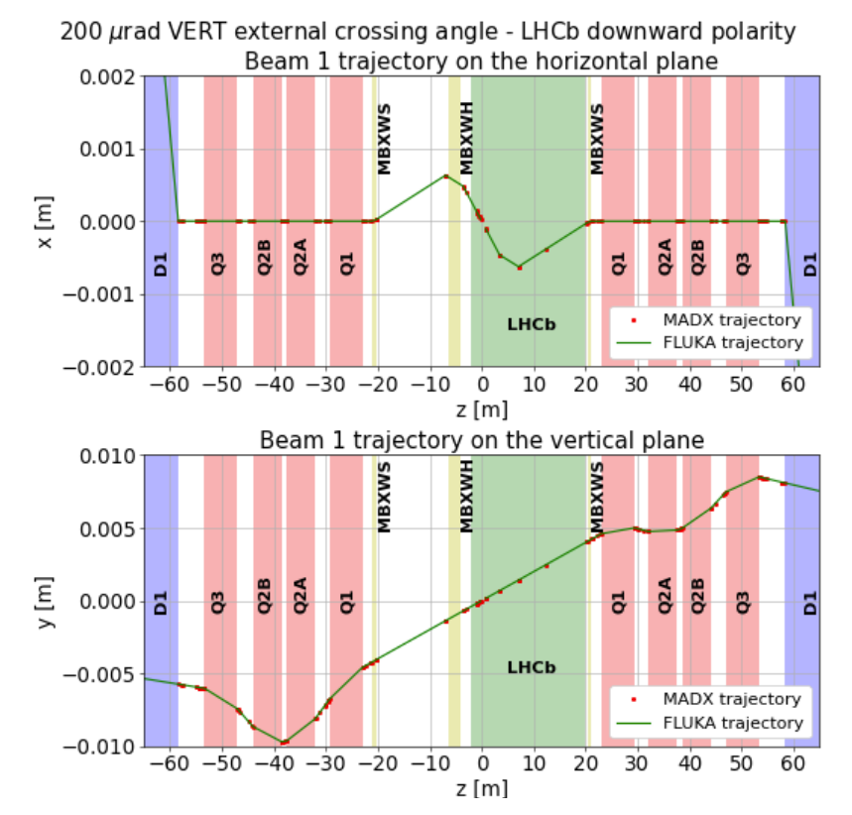
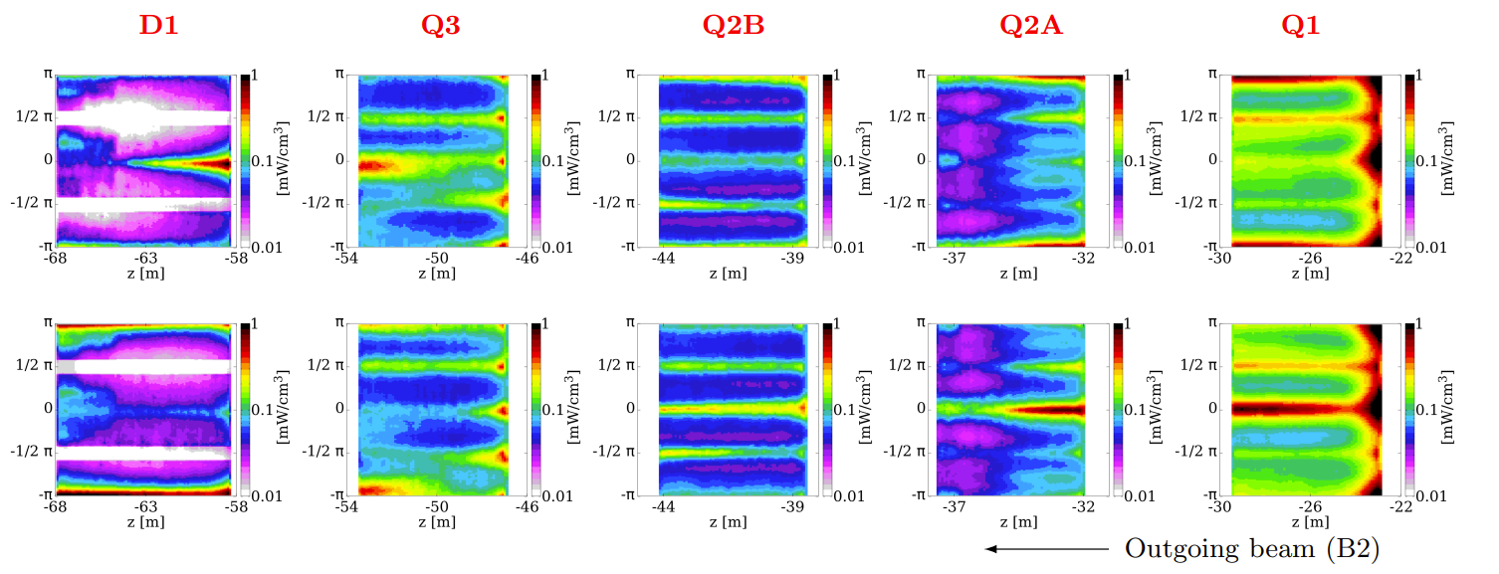
IR8 energy deposition studies
Recent paper (CDS 2813955) on energy deposition in IR8
Important result: crossing angle and LHCb spectrometer polarity affect the radiation levels in the tunnel and in nearby alcoves (e.g., the UAs)
→ important for the specifications!
Upward polarity
Downward polarity
Vertical crossing
A. Ciccotelli

Slide 16
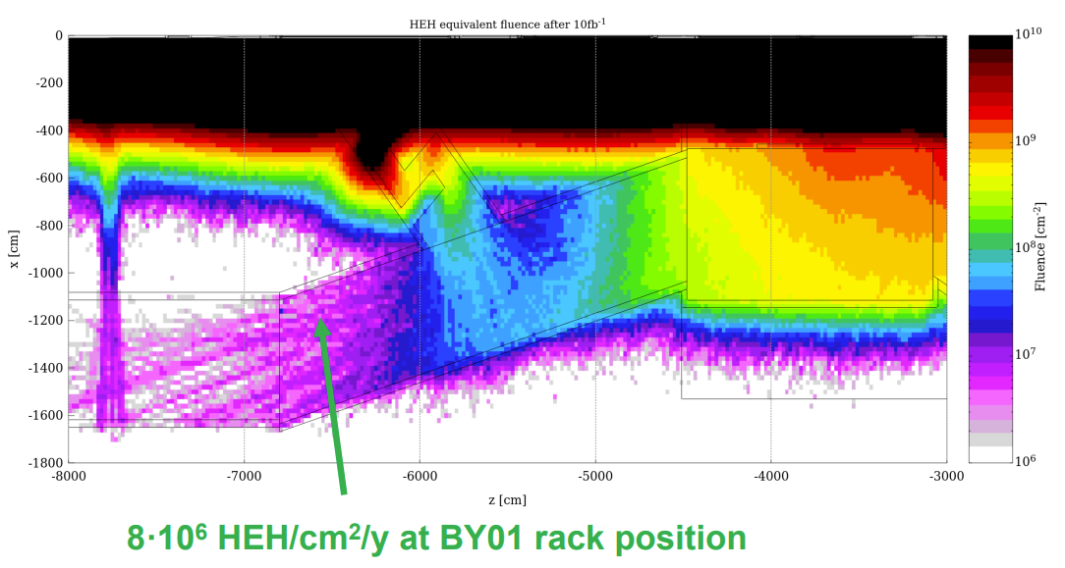
IR8: radiation level specifications in the UAs
Radiation level request by SY-BI for BPM electronics (EDMS 2663182) covering rack position BY01 in UA23-27 (IR2, low radiation levels) and US83-87 (IR8)
High radiation gradient in the UAs, with relatively higher HEH-eq fluence at the entrance (and near cable ducts)
Caveat: results obtained for downward polarity, while full specifications require averaging with the upward case (to be done)
A. Ciccotelli

Slide 17
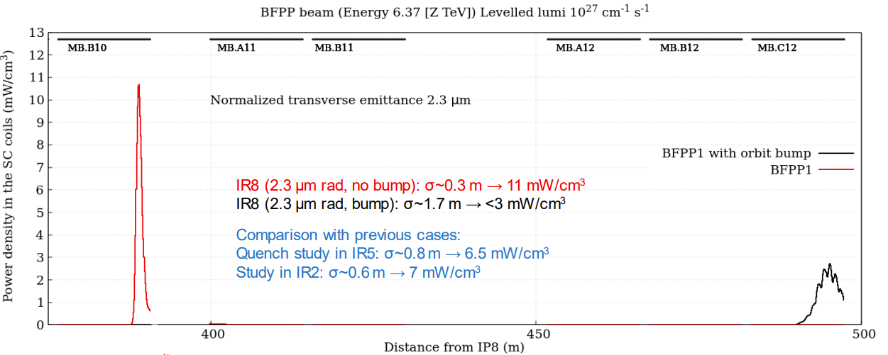
IP8 Pb-Pb operation with orbit bumps
FLUKA simulations of BFPP peak during Pb-Pb operation in good agreement with Run 2 BLM data (see talk by A. Ciccotelli)
Orbit bumps to be used in HL-LHC, reducing the peak power density in the magnet coils by ~3x
A reduction of the peak TID in the DS is expected as a result, but different equipment will be exposed
A. Ciccotelli

Slide 18
Summary
Even after the release of the specification document in 2020 (EDMS 2302154) WP10 has continued to perform multiple analyses with different purposes:
  Targeting areas/devices not covered in the specification document (e.g., cables and LSS equipment in IR1-IR5)
  Performing new analyses not available at the time (e.g., IR4, IR8)
  Addressing specific needs/requests (e.g., UJ76 in IR7)
The work will continue over the next years, with special attention devoted to the validation of HL-LHC specifications using Run 3 data
We also plan to update the specification document with new locations (e.g., IR4, IR8) once the related studies are completed

Slide 19
BACKUP

Slide 20
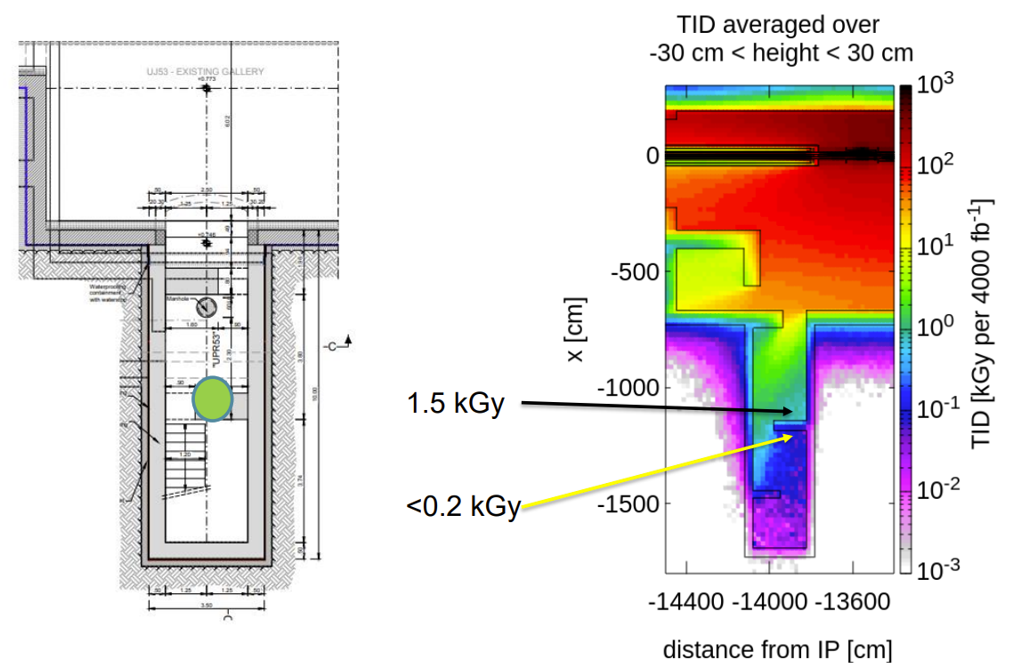
UPR53 FLUKA results – EDMS 2599444
Similar situation in IR5 (UPR53 ground floor)
The TID in UPR57 is much lower due to the larger distance from the IP5
The best position for the equipment is behind the wall shown in the figure

Slide 21
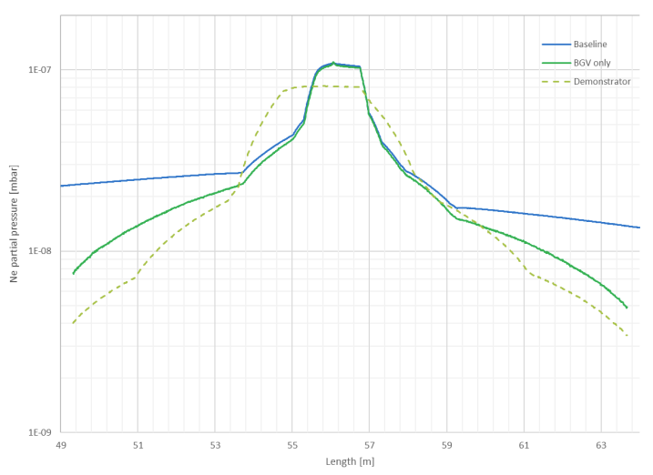
IR4: BGV gas profiles for Run 2 and HL-LHC
BGV gas profile provided by TE-VSC for:
  BGV demonstrator
  (Run 2)
  HL-LHC BGV only
  HL-LHC BGV plus baseline residual gas in the beam pipe
Input from A. Galloro

