Slide 1
BLM ASIC performance and future plans
Christos Zamantzas (SY-BI) on behalf of WP13.1
with contributions from: Francesco Martina, William Vigano', Ewald Effinger, Mathieu Saccani, Eva Calvo Giraldo, Anton Lechner, Belen Salvachua
12th HL-LHC Collaboration Meeting, Uppsala (Sweden), 19-22 September 2022

Slide 2

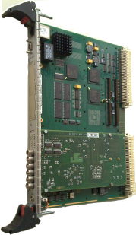

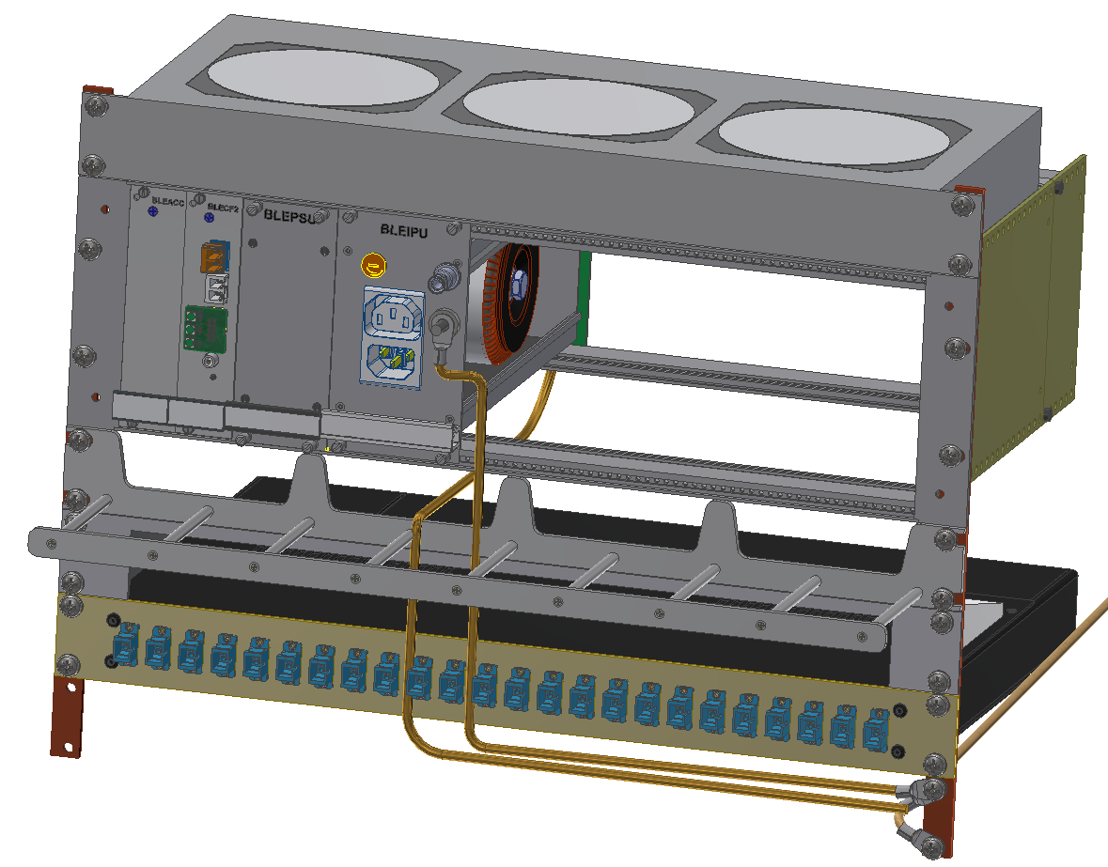
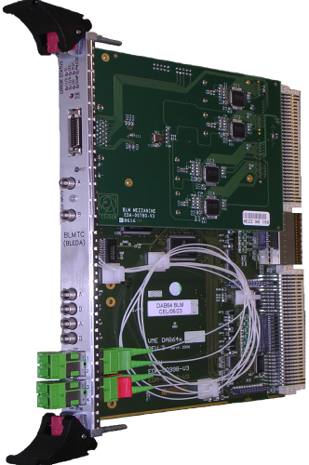
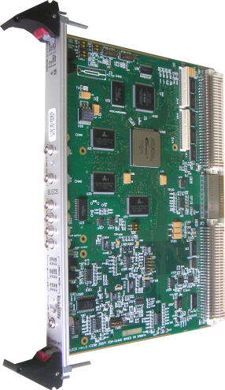
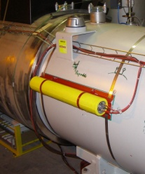
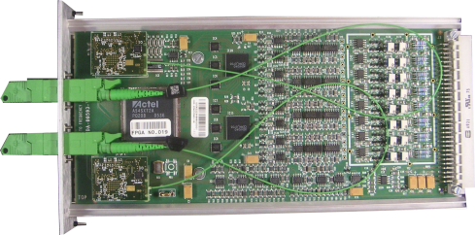
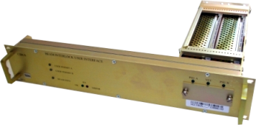
LHC Beam Loss Monitoring System – Upgrades
LS2
LS2:
New FESA & OS
Databases (LAYOUT, LSA & NXCALS)
Firmware for data processing
Settings and Thresholds
Front-end CPU
Logging, PM, fixed displays…
Funding through R2E, CONS & HL-LHC projects
LS4:
New mini-crate & acq. electr.
Firmware for data processing
Bidirectional optical link
x27
LS3:
New processing electronics
Temp. optical receivers
Firmware for data processing (new FPGA)
LS4
LS3
LS3
Processing, Analysis & Decision
Combiner & Survey
LS3+
Beam Loss Monitors
Acquisition & Digitisation
Beam Interlock System Interface
LS3+:
Detector production
x16
x4000
x750
x400
x27
Tunnel
Surface
around the LHC ring
grouped in 8 points
WP13.1 – Christos Zamantzas

Slide 3
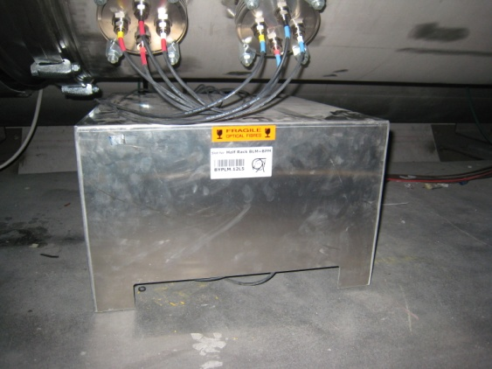
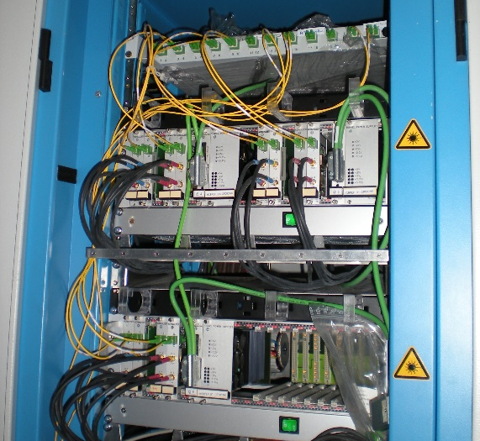
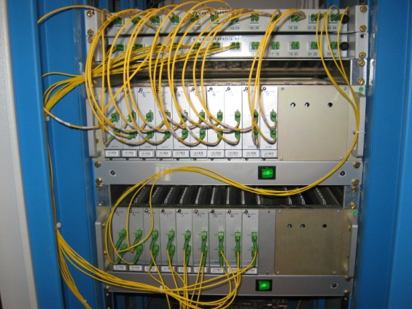
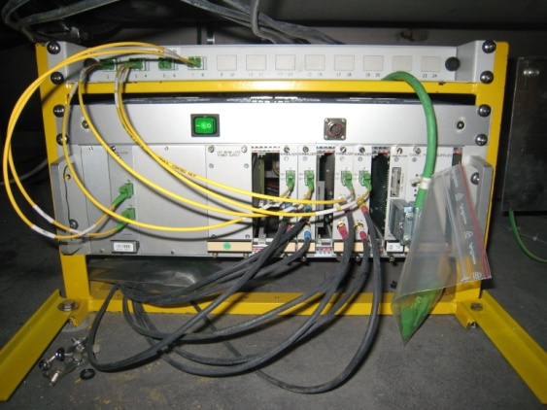
LHC Tunnel Installation
ARC electronics
DS & LSS electronics
BPM
BLM
Fibre & FIP distribution
feedthroughs
BLM
BPM
cover
Installed under each Quadrupole
Common mini-crate & fibre network
Separate power supplies
Localised in alcoves like UA, UJ or RR
Same electronics in a different configuration
    Exception the BLM power supply
Three variants of the mini-crate needed for LHC BPM & BLM systems
WP13.1 – Christos Zamantzas

Slide 4
Development & Deployment Plans

Slide 5
HL-LHC BLM Development Plan
Development required for new:
Rad-Tol card (BLEIC) to allow reduced cable lengths and improve S/N ratio
  Hybrid COTS & ASIC version would be challenging and limited to < 1 kGy
  (study made; will keep as backup plan)
  Rad-hard Application Specific Integrated Circuit (ASIC) under development to encapsulate all the analog-to-digital conversion.
Crate and power supplies to host acquisition electronics
  3 variants required
  ARC installations shared w/ BPM; LSS separate BPM & BLM installations
Communication layer between tunnel and surface electronics
  Multi-gigabit rad-tol bidirectional link
Integration to the surface electronics
  Processing and decision firmware
  Control and supervision firmware
WP13.1 – Christos Zamantzas

Slide 6
HL-LHC BLM Deployment Plan
LS3
  Extension of the current BLM system with additional detectors following HL changes
    e.g. IP1 & IP5 Triplet, Collimation, BBLR, etc. areas
  First deployment of the full new electronic stack at strategic locations in parallel to the current electronics
    to complete and validate development
LS4
  Full deployment of new electronics
    replacement of the complete tunnel electronics stack (mini-racks, crates, power supplies etc.).
WP13.1 – Christos Zamantzas

Slide 7
BLM detectors at LS3 Triplet Layout
Work in progress between SY-BL, SY-STI & WP15;
Final integration might change numbers
LHC triplet layout
During LS3 will extend the current system for the new topology and deploy the new system (BLEIC) in parallel in half of the locations.
Will allow validation for full deployment during LS4 and (some) redundancy in this critical area long-term.
B1
B2
Q1
Q2a
Q2b
Q3
DFB
D1
LIC
MCBX
MCBX
MCBX
20
30
40
50
60
70
80
HL-LHC triplet layout
distance to IP (m)
B1
B2
Q1
Q2a
Q2b
Q3
D1
SM
Current system w/ BLECF // BLEIC/2
(Half channel redundancy)
1.3
1.3
2.2
MCBX
CP
Number of detectors: Total for IP1 + IP5 (both sides) | Number of detectors: IP1 + IP5 (both sides)
 | Present System Run 3 | HL-LHC Upgrade Run 4 | New in Run 4
BLECF – standard | 72 | 128 | 56
BLEIC – new | 0 | 64 | 64
Total IP1+IP5 | 72 | 192 | 120
MCBX
MCBX
20
30
40
50
60
70
80
BLECF #1
BLECF #2
BLECF #3
BLECF #4
Single multiwire cable per module
One BLECF or BLEIC module accepts 8 channels
WP13.1 – Christos Zamantzas

Slide 8
BLM Detectors (IC) – Quantities Needed
HL-LHC : 200 units
  Cover new IP1 & IP5 triplet areas (~120 new channels) and
  Several new locations to cover for Collimation, BBLR etc.
LHC : 300 units
  Replenish spares (LIU needs were x2 more than originally assumed)
SPS : 500 units
  Renovation of all ring and some TL during LS3
  Includes needs for TDC2 (20 units) and ECN3 (50 units)
Missing Russian in-kind; new funding source is under discussion
WP13.1 – Christos Zamantzas

Slide 9
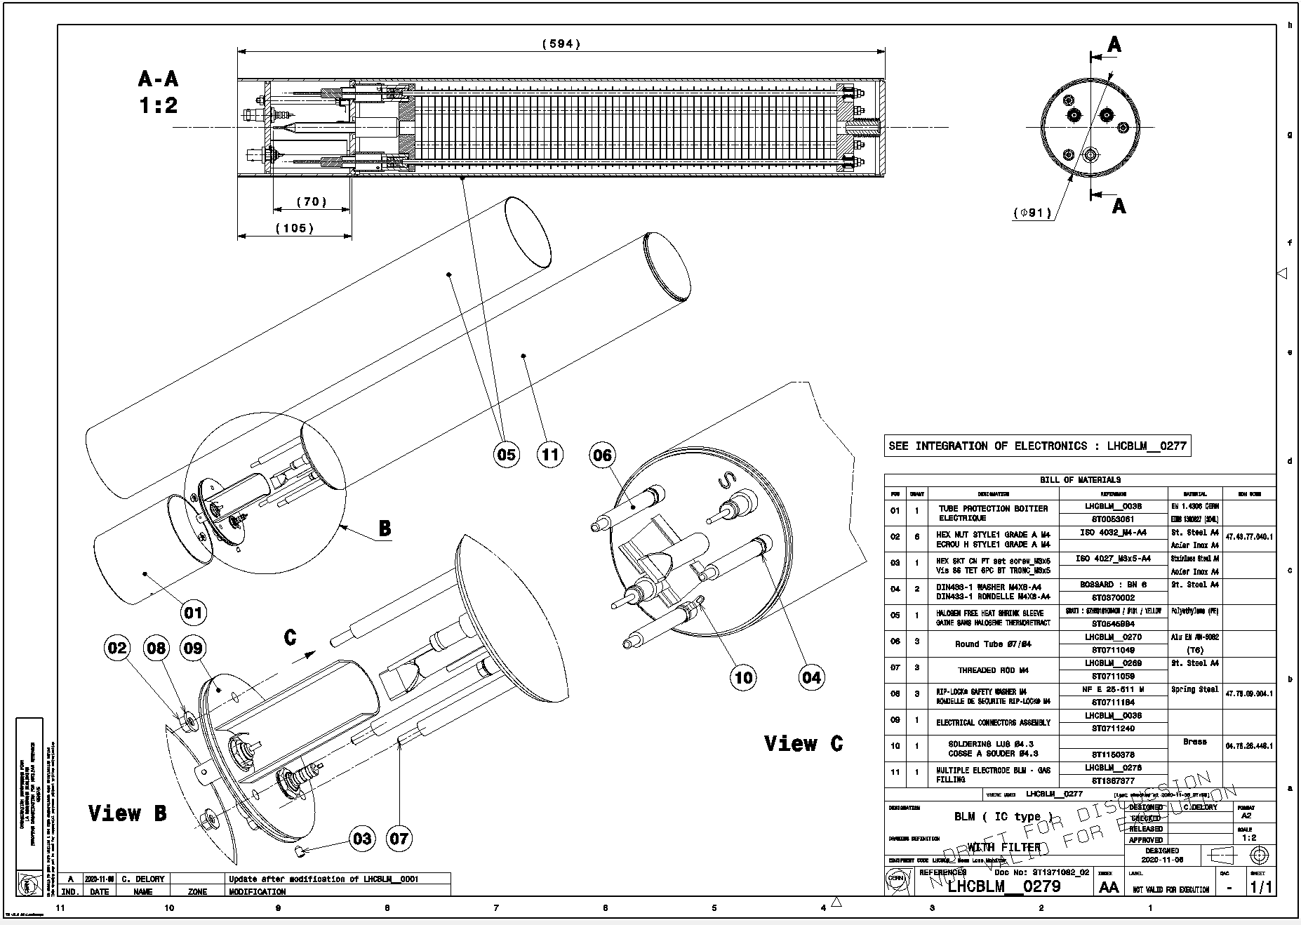
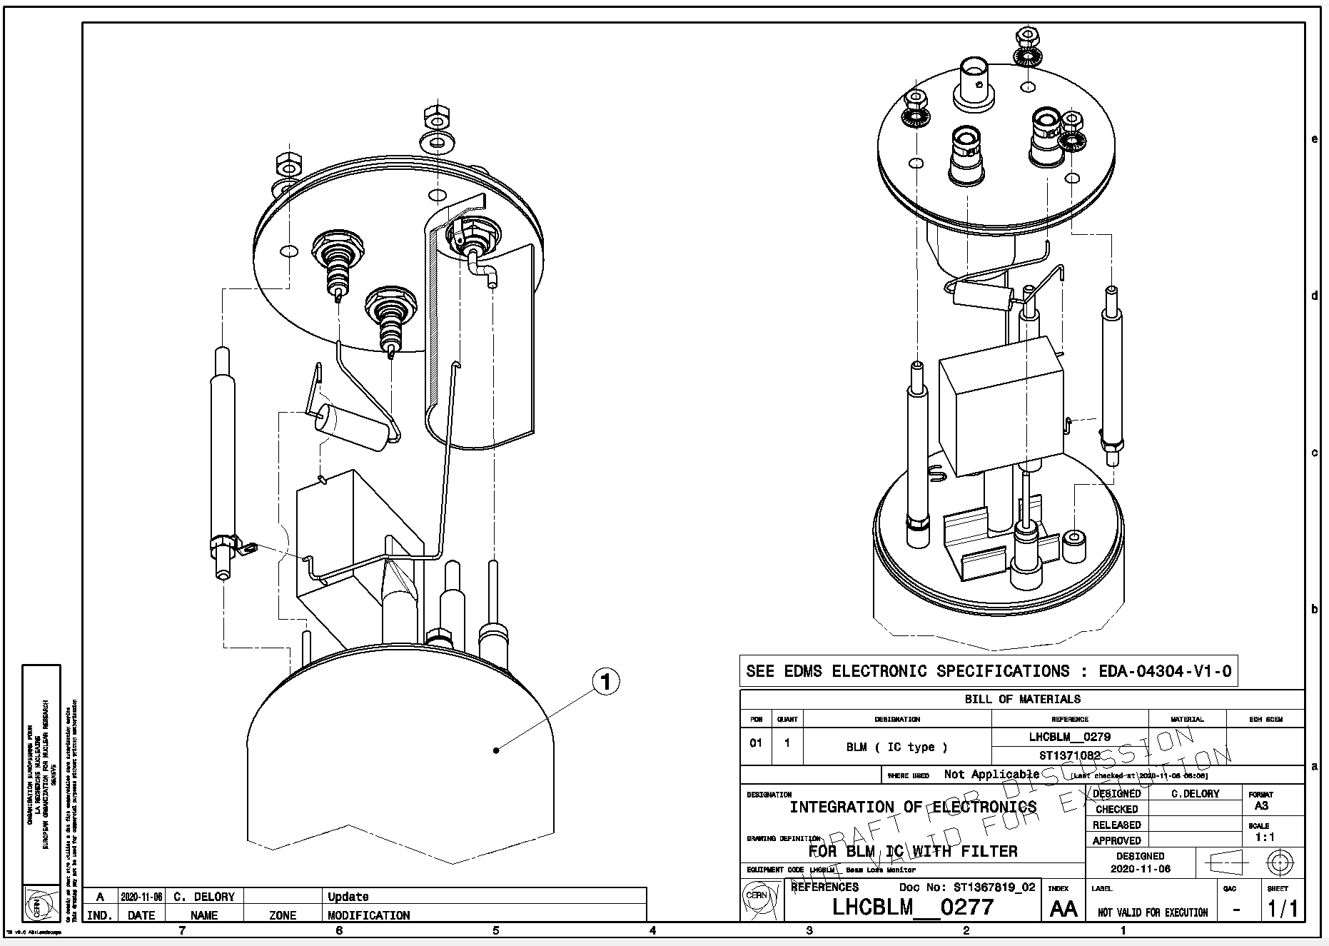
BLM Detectors (IC) – Production Plan
Work in progress between SY-BI, EN-MME & TE-VSC;
2021 – drawings for production
  recheck all drawing and add parts missing
  prepare them ‘for manufacturing’
2022 – prototype production at CERN (~ 5 units in total)
  use spare parts (for the complex/long delivery parts)
  verify new drawings and finalise production documents
2023 – planning, documentation and validation benches
  agree on production plan (e.g. which parts to outsource)
  order key/complex material (e.g. feedthroughts & ceramics)
  design electrical & vacuum stands
  award contract(s)
2023/4 – build the vacuum stand
2024/5 – Series Production (1000 units in total)
2025+ – Verification with beam (GIF++)
Under discussion; to be finalised
WP13.1 – Christos Zamantzas

Slide 10
Development progress

Slide 11
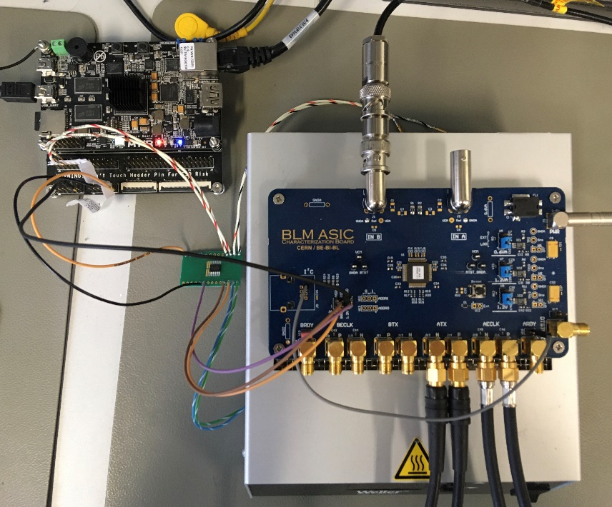
BLM ASIC R&D Timeline
Prototype development timeline:
2018 Q1: project start; technology selection and feasibility
  Parallel design of two methods:
    CFC asynchronous better suited to handle large currents and quickly varying signals
    Delta-Sigma ideal for high accuracy due to oversampling and filtering
2019 Q4: V1 delivery
  Issue with internal power distribution and ESD protection
  Could not test full range
2020 Q4: V2 delivery (some delays due to COVID)
  Mostly functional;
  Metastability issues with the sync between the analogue and digital domains
  High current leakage of the input stage FETs; poor low current meas.
  Decision to continue with the CFC asynchronous method only
2022 Q1: V3 delivery
  Analogue & digital circuits fulfil needs; all currently known issues resolved
  New minor issue w/ sync between CFC & ADC data; mitigation possible at the backend
Development of custom ASIC verification testbench

Slide 12
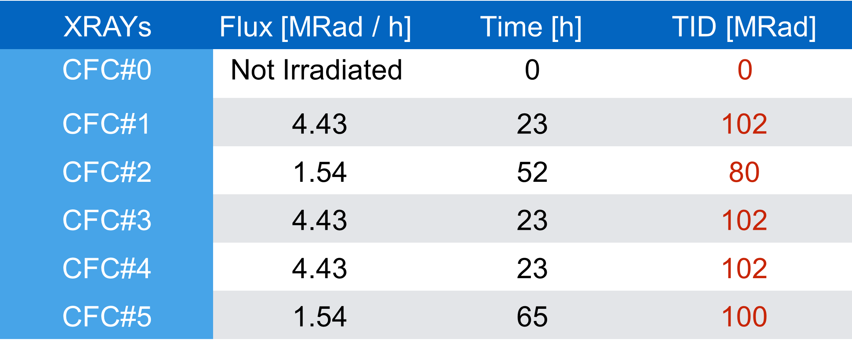
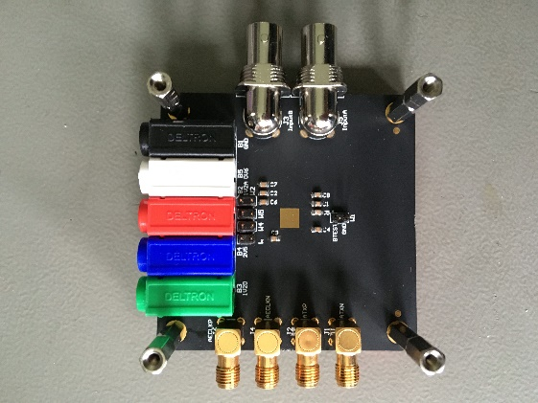
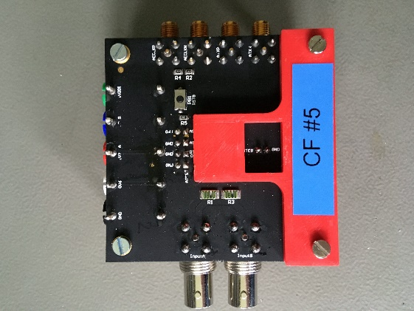
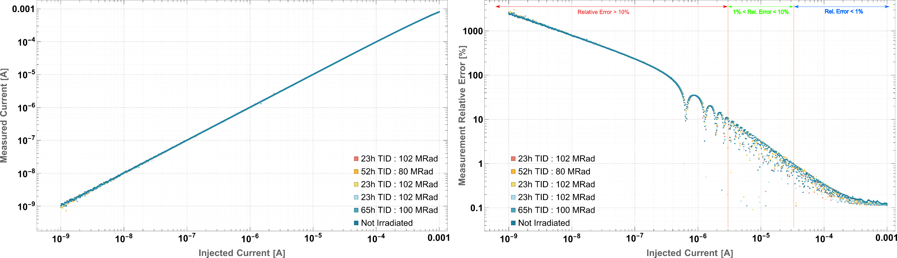
Irradiation Results – X-Rays
Conversion characteristic (left plot) and relative errors (right plot) by a logarithmic current sweep of 500 values from 1 nA to 1 mA.
The averaging time window is set to 100 𝜇s.

Slide 13
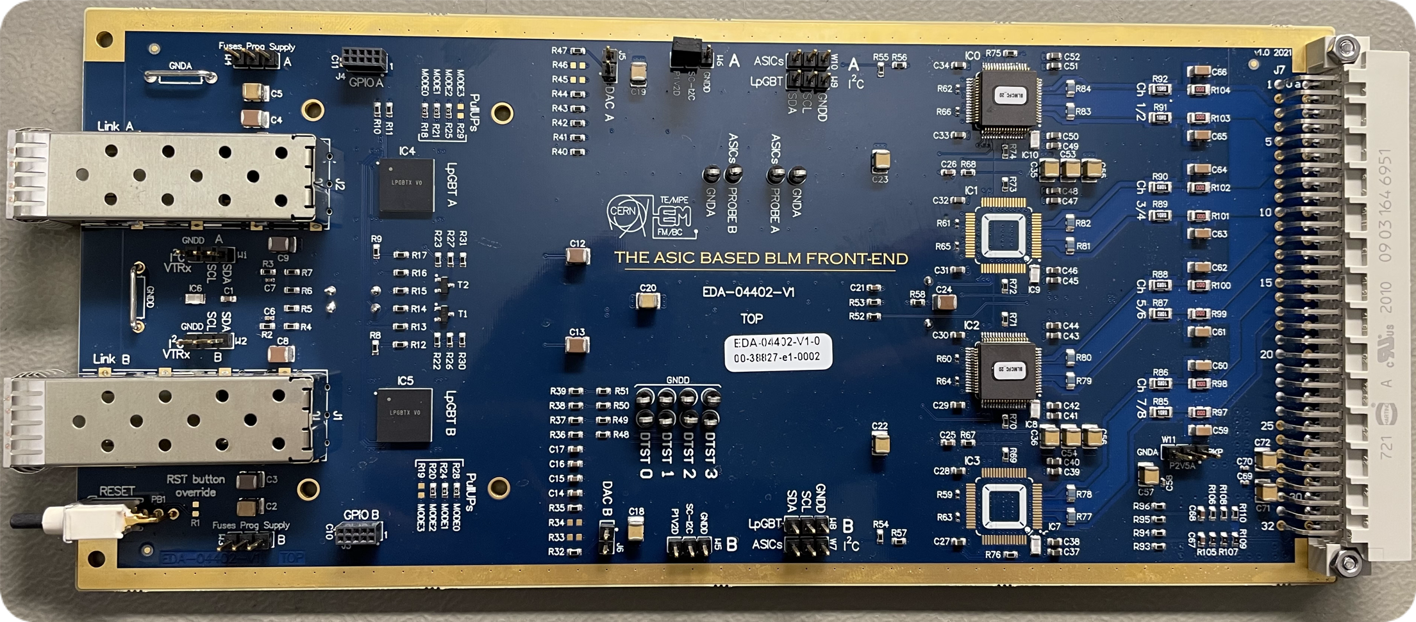
Printed Circuit Board Prototype (BLEIC)
New prototype PCB design complete
  Includes all functionalities expected from the final system
  Common digital parts, control and form with standard BLM acquisition board.
  Secured prototypes of the other custom parts, e.g. the SM-VTRx and LpGBT.
Prototype production completed and tested to be functional
  This board variant is able to accommodate both BLMASIC v2 & v3
Currently working on system integration (see also next slides)
  Development of back-end firmware for communication and control
  Next step, integration in the real-time data processing and decision making
Comparison of old and new technology
of radiation tolerant front-ends
 | BLECF COTS & ASIC hybrid version | BLEIC ASIC version
Components | > 2000 parts | < 400 parts
Cost | > 3 kCHF/unit | ~ 1 kCHF/unit
2 x SM-VTRx
2 x LpGBT
4 x BLMASIC

Slide 14
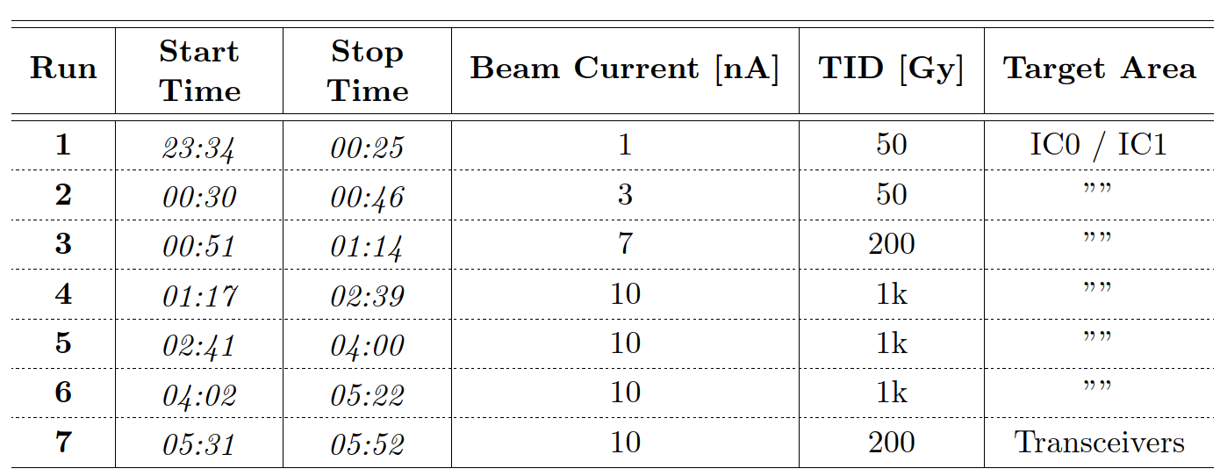
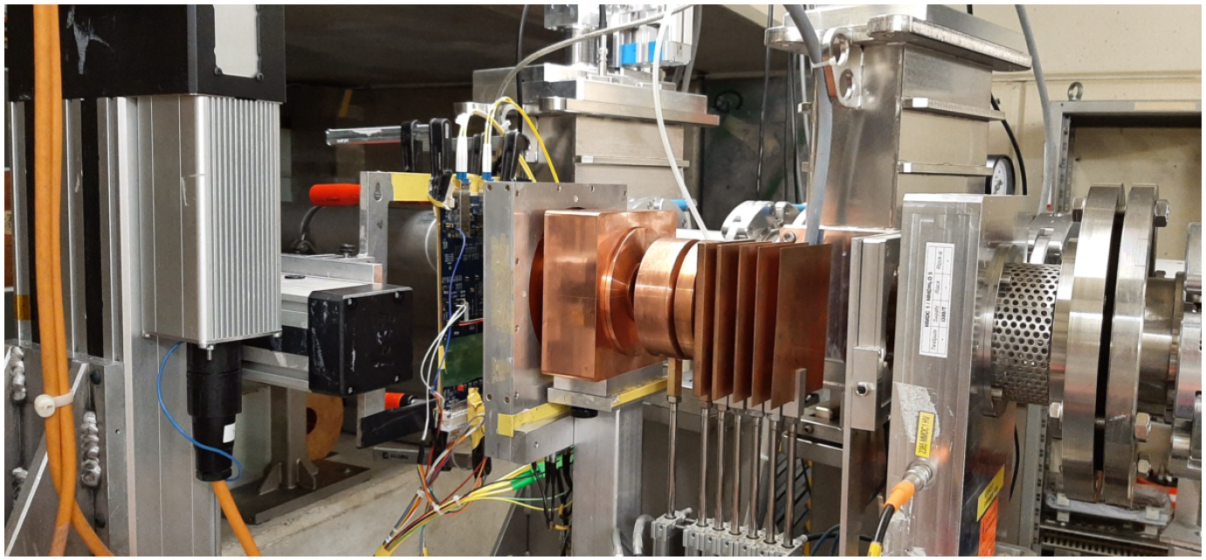
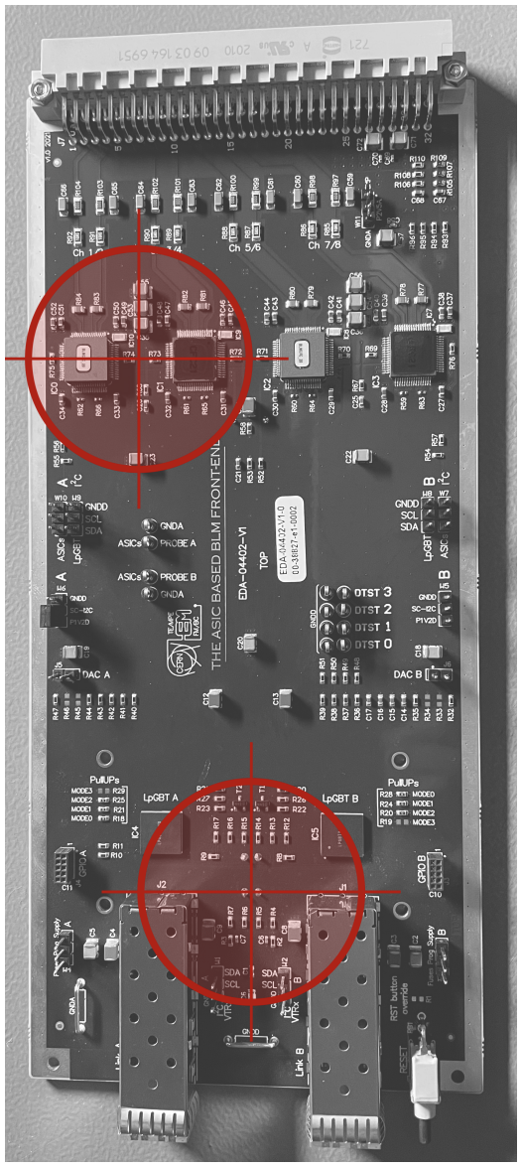
Irradiation – Protons (PSI)
Beam energy of 200 MeV and
Flux, at maximum current of 10 nA, was 3.7 × 10⁸ p*cm⁻²*s⁻¹
Run 1-6 targeted two ASICs and linPOL12V reaching ~3.3 kGy
Run 7 (short) targeted the transceivers with 200 kGy
Run 1-6
Run 7

Slide 15
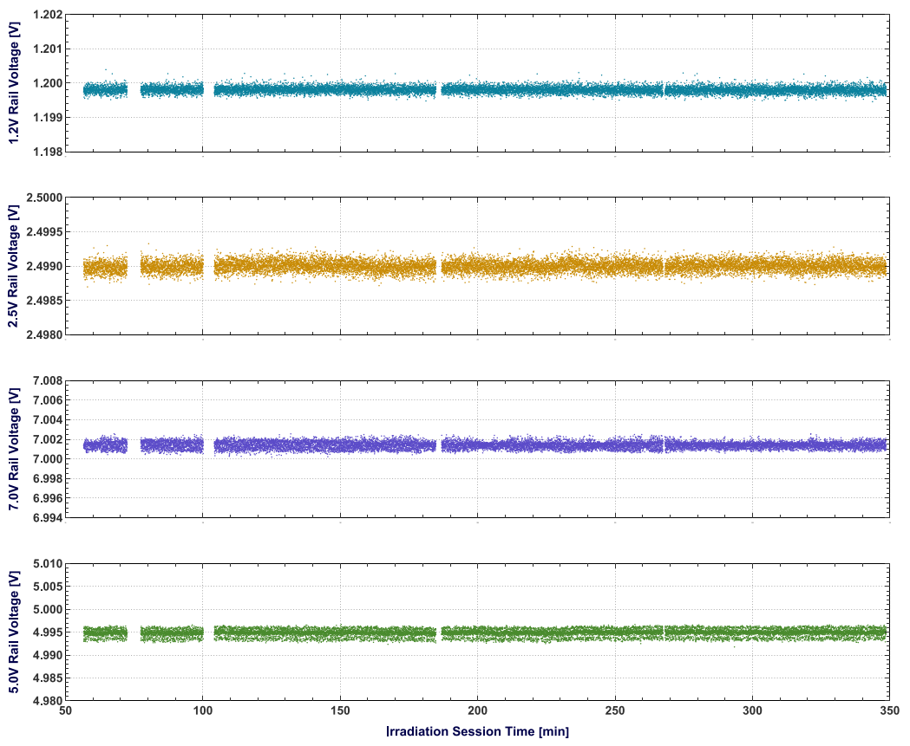
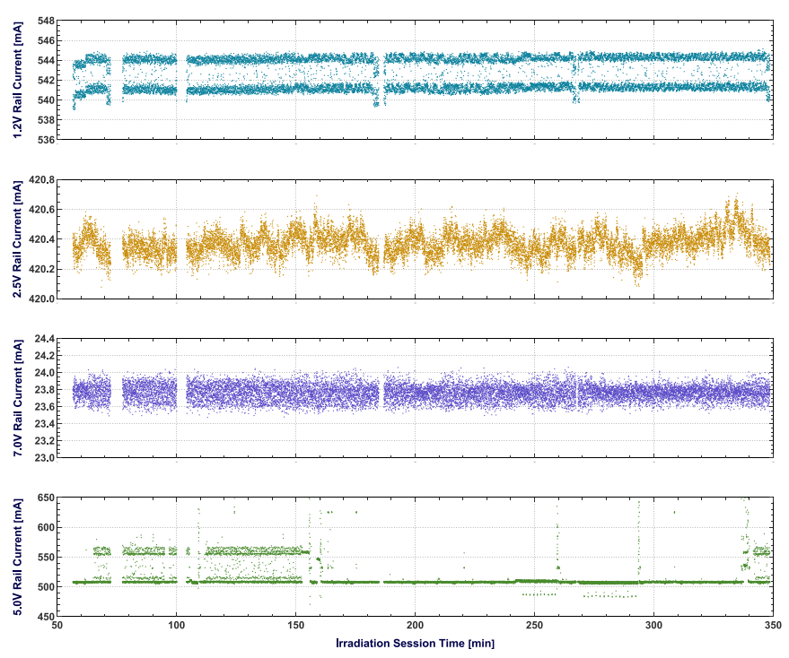
Irradiation – Protons (PSI)
1.2 V
2.5 V
7.0 V
5.0 V
Voltage (left) and Current (right) measurements of the supply rails
The 1.2 V rail ﬂuctuates into an interval of ≈ 3 mA. This is an intrinsic behaviour of the board that does not relate to radiation exposure nor to an abnormal condition
No significant change observed. We conclude the onboard regulation is functional and has maintained stable supply throughout the session

Slide 16
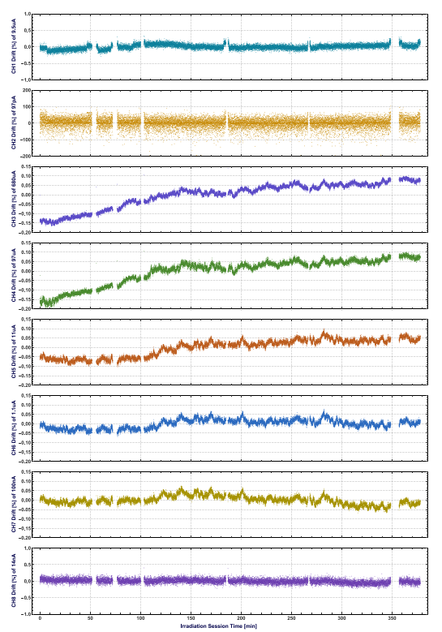
Irradiation – Protons (PSI)
CH1
Percentage drifts of the current measurements during the irradiation session for each channel
Channels 1-4 irradiated only
Max. measurement deviations never exceed 0.5%
Digital domain check
no errors detected in the 8b/10b coding and the frame parity check between the BLMASICs and the LpGBTs.
continuity of samples was guaranteed
no unexpected changes in the registers were observed in any BLMASICs.
This means that even if SEUs might have occurred, the internal triple redundancy managed to mitigate it.
…
CH8

Slide 17
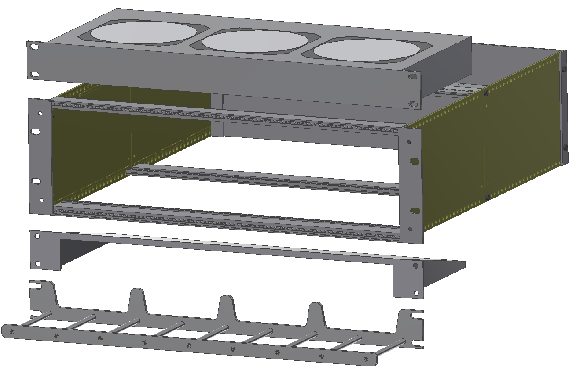
Tunnel crate: Mechanical parts
3U Rear Panel
(SCEM: 06.61.61.455.3)
Schroff 10713108
3U Europa Chassis
(SCEM: 06.61.61.023.3)
  Same part numbers with the current installation
  Most in the CERN store or easily procured
  Common parts to all variant designs
Air Deflector: 1U-84TE
(CERN design)
Cables Holder (CERN design)
WP13.1 – Christos Zamantzas

Slide 18
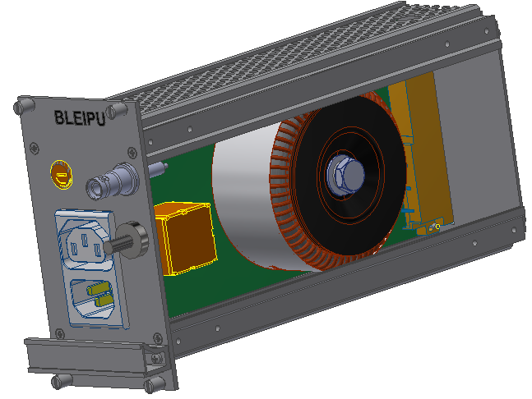
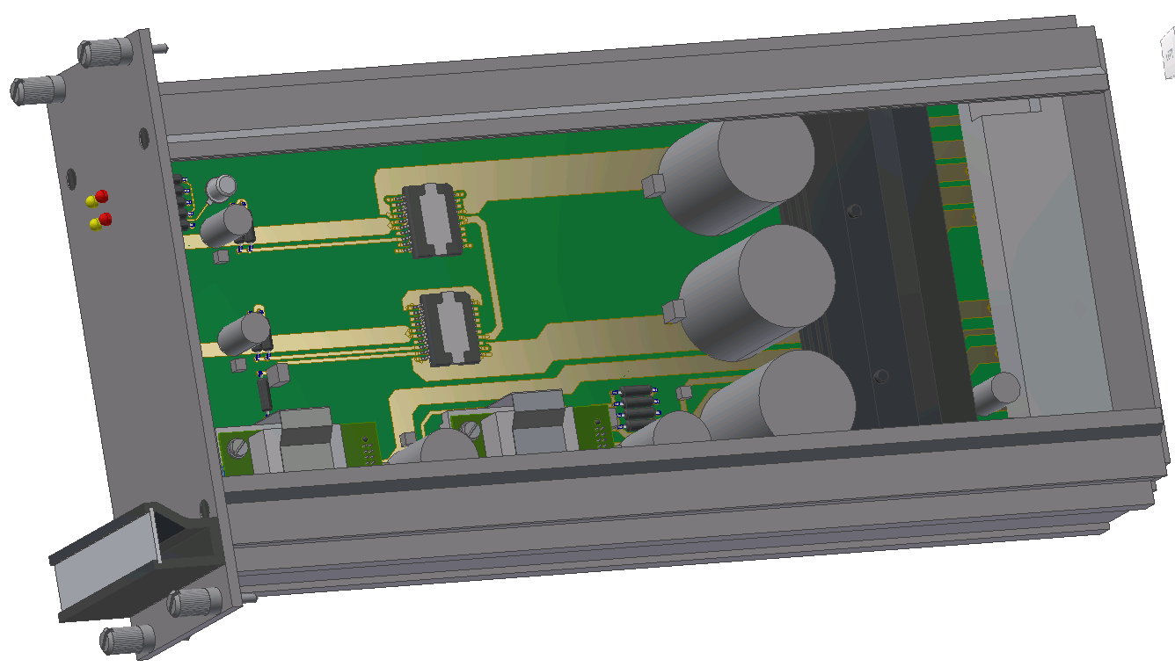
Power Supply Modules
Input Power Unit (BLEIPU)
  Front 230 VAC Inlet & Outlet
  HV input connector
  Rad-tol power transformer (custom design)
Power Supply Unit (BLEPSU)
  Schematic based on EDA-00691 (LHCPSU)
  Generation of +5VDC, -5VDC, 2.5VDC and 1.5VDC
  On/Off power supplies
  Redesign ongoing due to obsolete components
See dedicated presentation at RadWG Workshop of 14/09/2022
WP13.1 – Christos Zamantzas

Slide 19
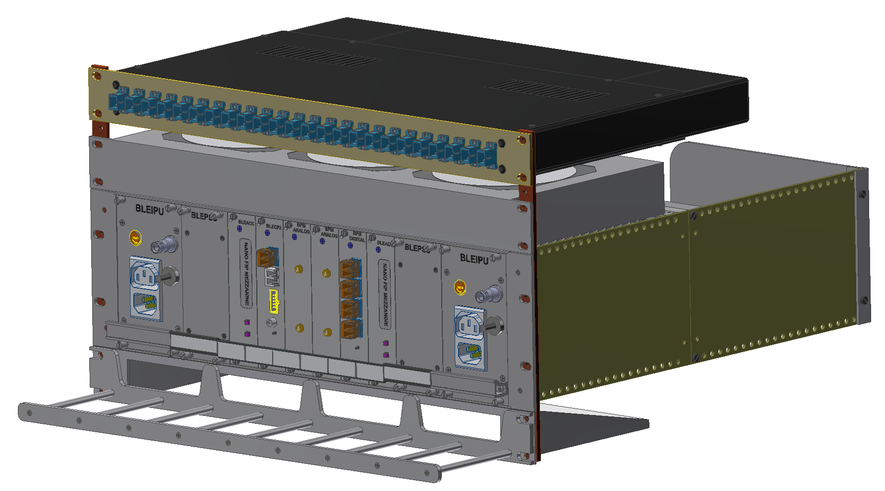
Common LHC (BPM & BLM) mini-crate
Characteristics:
Common chassis
  BPM & BLM shared
Separate Power supply
  Common part number
  Isolate failures per system
Separate backplane
  Targeted design
  Better cable management, i.e. for BLM 8x CB50 (coaxial) with BNC connectors & for BPM pass-through to digitiser
BLM side
BPM side
WP13.1 – Christos Zamantzas

Slide 20
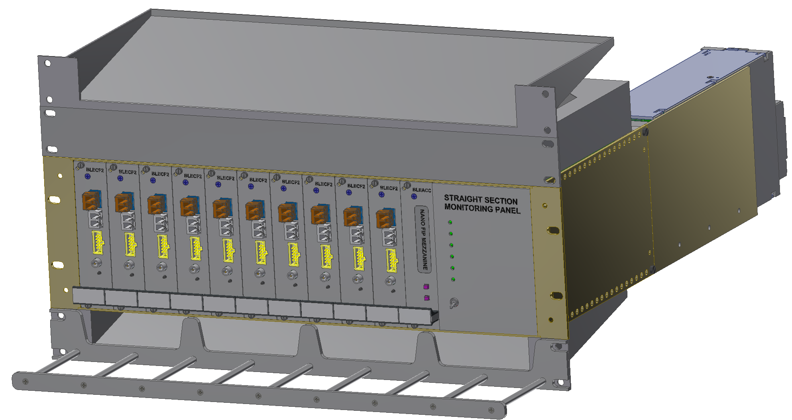
LHC BLM (LSS) mini-crate
Air deflector
Characteristics:
Mini-crate inside a 45U rack
Front connections
  all modules and
  all fibre connections
  WorldFip
Rear connections
  All analogue signals
Controller card
  Redundant functionality
Custom backplane
  Targeted design
  Completely passive
  Better cable management, i.e. 10 x NES18 (multiwire) with Burndy connectors
FAN Tray
AC/DC PSU developed with TDK
Air deflector
BLM Acquisition Cards (x10)
Controller Card (Optional)
WP13.1 – Christos Zamantzas

Slide 21
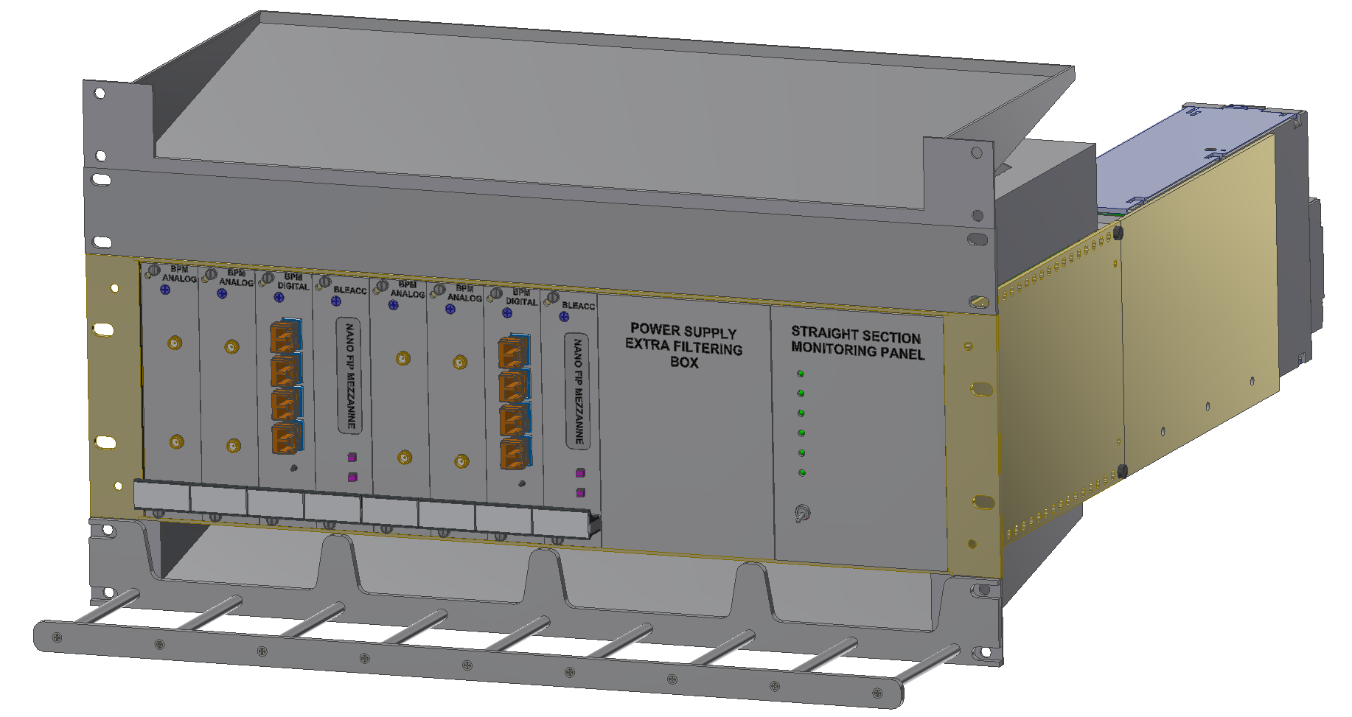
LHC BPM (LSS) mini-crate
Characteristics:
Front connections
  all modules and
  all fibre connections
  WorldFip
Rear connections
  none
Controller card
  Unique functionality, i.e. control and re-programming
Filtering module
  Foreseen for the case COTS power supply too noisy.
Custom backplane
  Targeted design
  Completely passive
BPM Cards group #1
BPM Cards group #2
WP13.1 – Christos Zamantzas

Slide 22
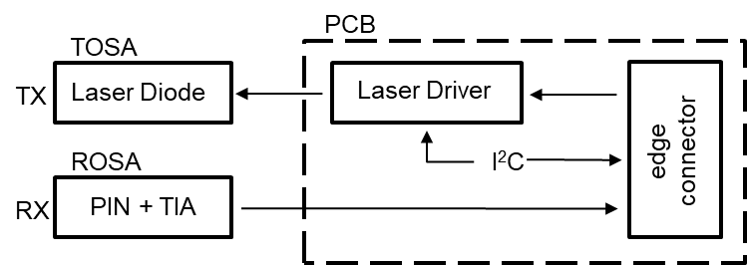
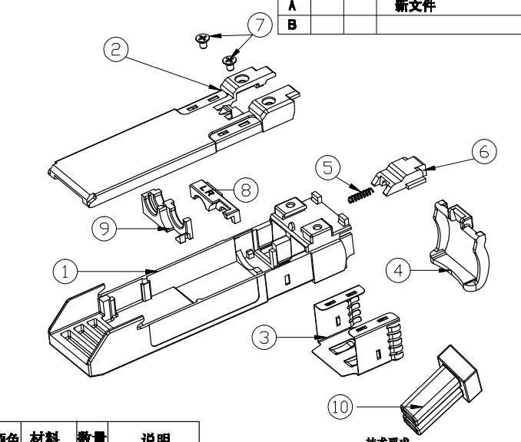
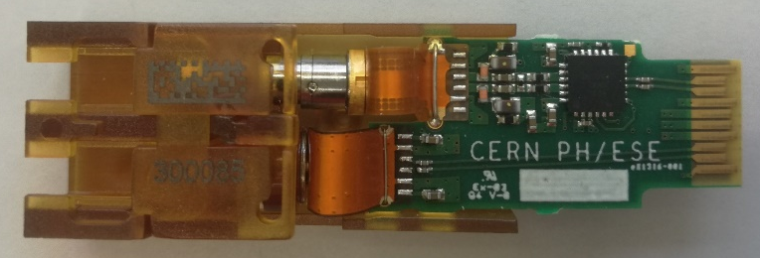
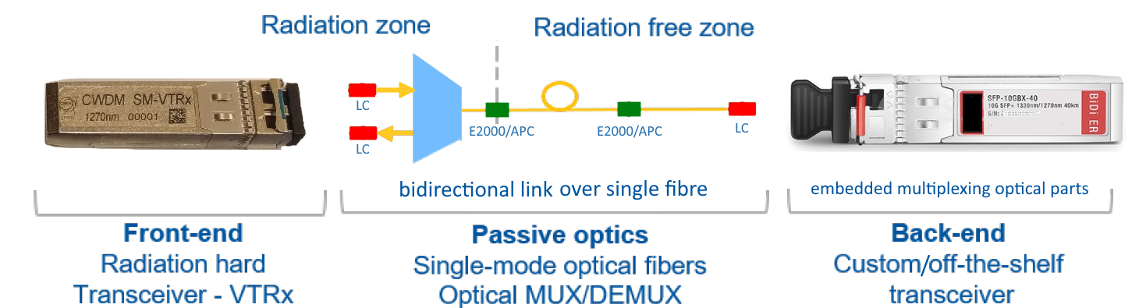
Rad-Tol Communication Layer
Single-mode Versatile Link Transceiver - VTRx
Custom design for SY-BI by EP-ESE
Directly compatible with the LpGBT serialiser
Bidirectional; operating from 4.8 to 10 Gbps
Enclosed in SFP format
Prototype qualified to 10 kGy
MS-4730/EP/ESE did not succeed / TOSA manufacturer retracted; new parts under qualification;
All other parts are being ordered and driver ASIC in manufacturing.

Slide 23
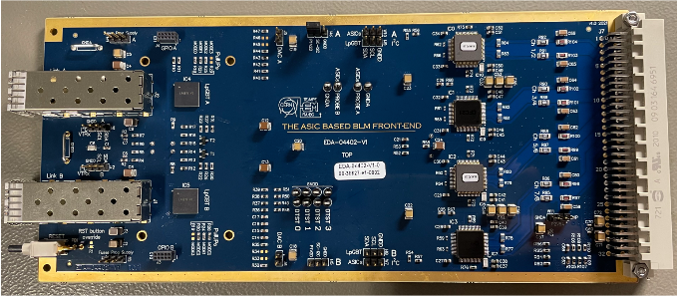
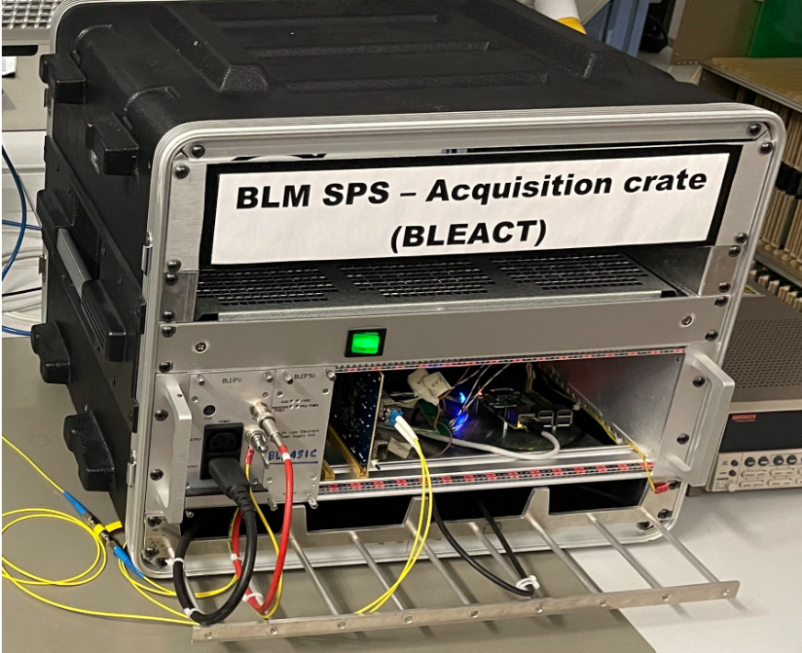
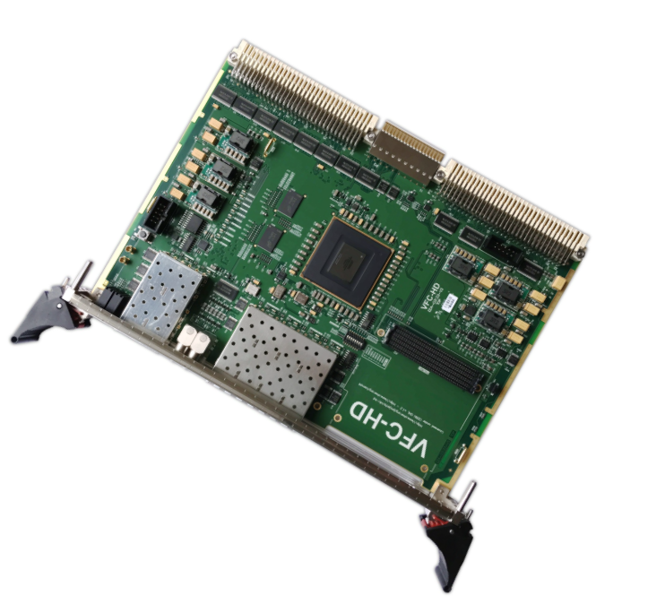
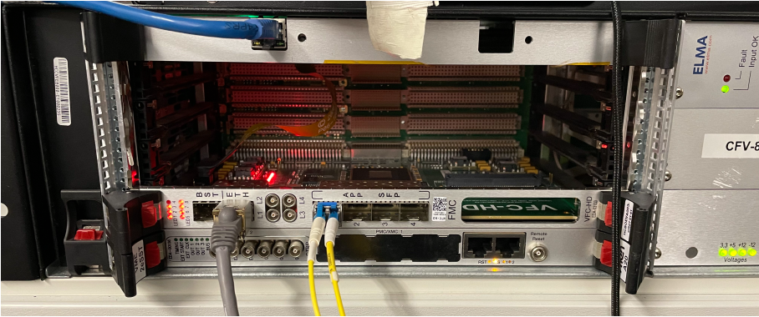
Surface Electronics
Integration to the acquisition & processing crates started
Firmware development (back-end) needed for
  Boot, setup and control over fibre link of the BLEIC
  Reception & decoding of the measurement packets
  On-demand self-diagnostic data
  Real-time processing & onboard high frequency data recording

Slide 24
Conclusions & Acknowledgements

Slide 25
Summary
Dedicated ‘Application-Specific IC’ (ASIC), currently testing v3
  Extensive qualification for performance and radiation (X-Ray, protons and mixed-field) resistance almost complete
  Significant cost optimisation with 5x fewer components than standard BLECF boards
New prototype PCB design complete
  Includes all functionalities expected from the final system
  Prototypes of the other custom parts, e.g. the SM-VTRx and LpGBT have been secured
New crate design (three variants) ready for production
  Power supply redesign on-going due to obsolete rad-hard components
Work started on system integration
  Development of back-end firmware for communication and control
  Next step, integration in the real-time data processing and decision making
Next steps
  Final review in Q1 2023 with ASIC fabrication expected in 2023-4
  Agree on IC detector production funding (missing in-kind) & plan

Slide 26
Acknowledgements
ADC & ASIC Production
  Kostas Kloukinas
BLMASIC
  Jan Kaplon
  Luca Giangrande
  Pedro Vicente Leitao
LpGBT
  Daniel Hernandez Montesinos
  Paulo Moreira
SM-VRTx
  Jan Troska
  Carmelo Scarcella
  Leonardo Marcon
Fibre & Copper connections
  Jeremy Blanc
  Daniel Ricci
Rad-Tol COTS
  Rudy Ferraro
  Salvatore Danzeca
R2E
  Giuseppe Lerner
  Ruben Garcia Alia
IC Manufacturing
  Nicolas Sebastien Chritin
  Thibaut Coiffet
  Alessandro Dallocchio

Slide 27
Spare Slides

Slide 28
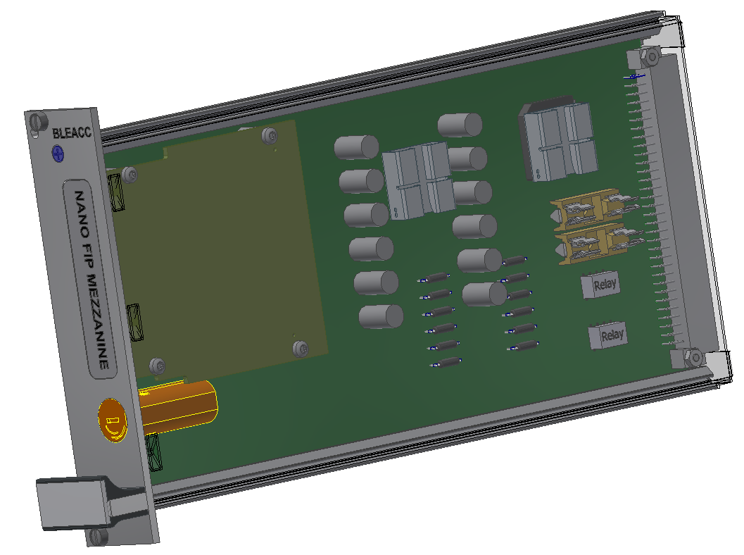
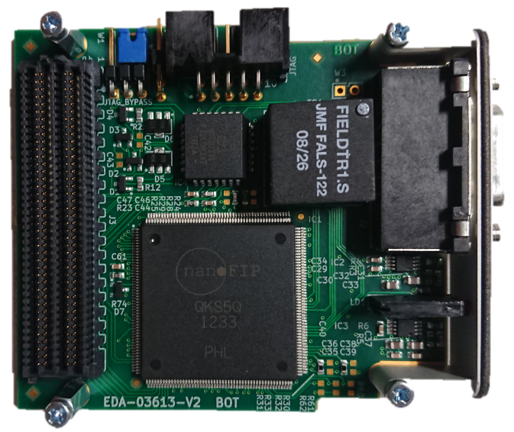
Crate Control Module (BLEACC)
Design in collaboration with BE-CEM
Carrier to host the nanoFIP mezzanine
Functionality:
  Pass commands to acquisition module
  Power cycle the acq. module through the PSU
  Diagnostic collection for the PSU statuses
New functionalities under design
  Deliver bitstream & re-program FPGA
Rectifier
3.3V_{DC}
+5V_{DC} and -5V_{DC} input protection
On/Off voltage lines for BLECF2
VAC input protection
WP13.1 – Christos Zamantzas

Slide 29
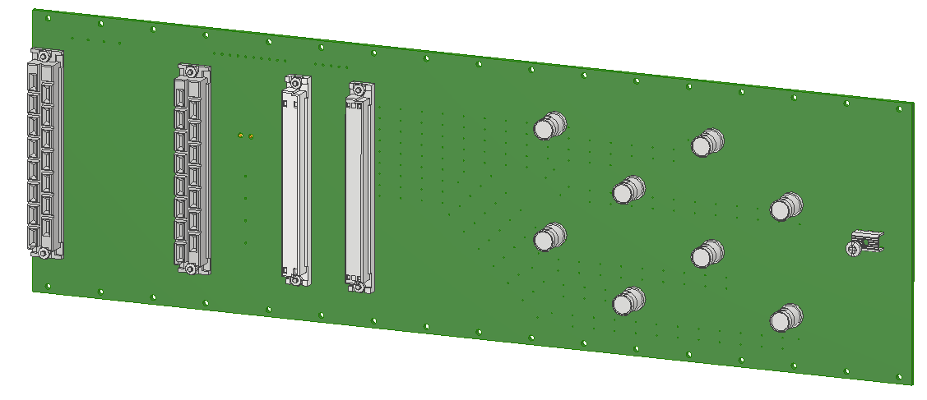
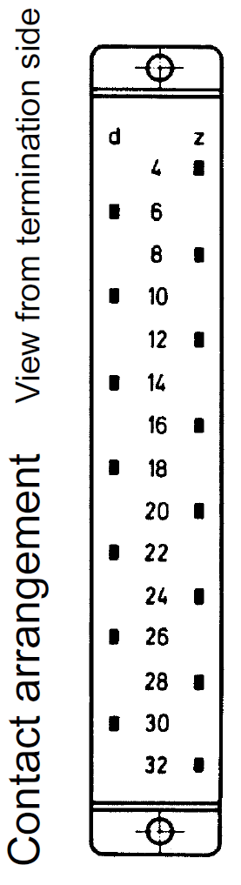
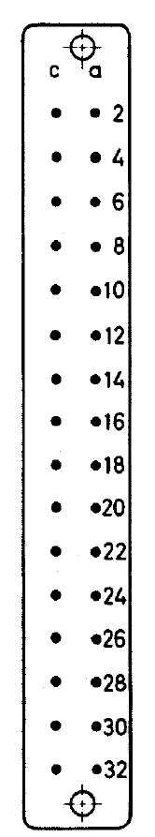
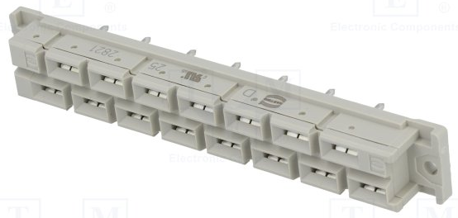
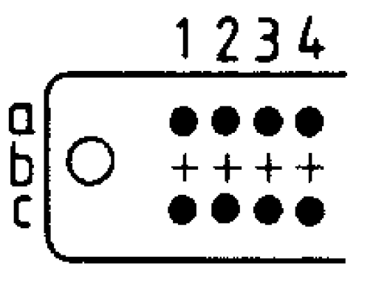
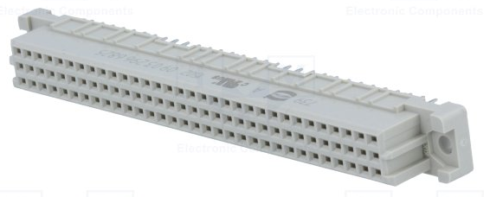
Backplane template
Multi-layer PCB design to create a “coaxial connection” between the BNC and the analogue input
PCB thickness = 2.2mm
PCB materials = FR4
Copper thickness = 35µm
BLEIPU and BLEPSU connectors
(SCEM: 09.61.41.565.4
Harting: 09 06 215 2821)
BLEACC connector
(Harting: 09 04 232 2831)
BLECF2 connector
(Harting: 09 03 264 2825)
Best connector IEC 60603 class 1 (mating times up to 500)
WP13.1 – Christos Zamantzas

Slide 30
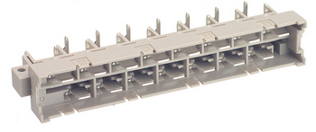
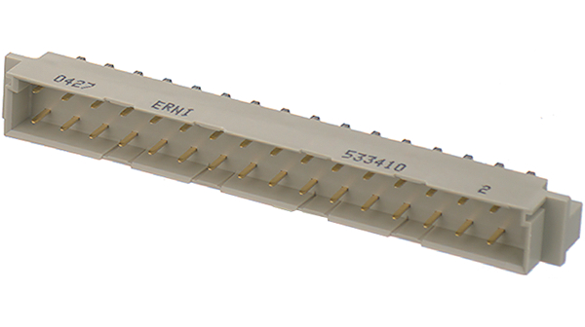
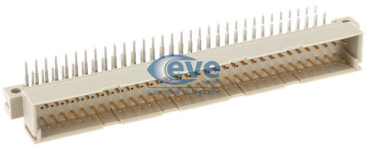
Module Connectors
Connector selection to prevent erroneous module swap
BLEPSU & BLEIPU connector
Harting: 09 06 115 2911
Size difference prevents accidental swap between them.
BLEACC connector
(SCEM: 09.61.36.015.4
Harting: 09 04 132 2921)
BLECF2 connector
(Harting: 09 03 164 2921)
WP13.1 – Christos Zamantzas

Slide 31

SPS BLM mini-crate
Input Power Unit
BLM Channels Input Cables
Air deflector
Characteristics:
Front access
  SPS specific requirement
  Applies to all connections and modules
  Allows mini-crate to be installed at the wall side
Controller card
  Redundant functionality
  Missing infrastructure at SPS
Custom backplane
  Targeted design
  Completely passive
  Better cable management, i.e. 8x CB50 (coaxial) with BNC connectors
FAN Tray
Power Supply Unit
Air deflector
Controller Card (Optional)
BLM Acquisition Card
GND Star Point
WP13.1 – Christos Zamantzas

