Slide 1


QDS R2E developments for the HL-LHC era
R. Denz
Acknowledgements:
G. Martin Garcia, T. Pridii, J. Spasic, J. Steckert and the QDS team
S. Danzeca, M. Barros Marin and the CERN radiation test service
R. Garcia Alia and the R2E project
12th HL-LHC Collaboration Meeting – 21 September 2022

Slide 2

Outline
T. Podzorny:
“DAQ systems for WP7”
https://indico.cern.ch/event/1161569/contributions/4921607/
J. Steckert:
“Deliverables for SC Link protection & current lead heater controls”
https://indico.cern.ch/event/1161569/contributions/4921614/
“PDSU prototype and test results”
https://indico.cern.ch/event/1161569/contributions/4921606/
“Symmetrical quench detection and QDS threshold management for HL-LHC”
https://indico.cern.ch/event/1161569/contributions/4921579/
HL-LHC and LHC quench detection systems
Required R2E performance for HL-LHC era
QDS inventory in LHC underground areas of concern
LHC QDS & DAQ – R2E developments
LHC QDS & DAQ – R2E production
Summary

Slide 3
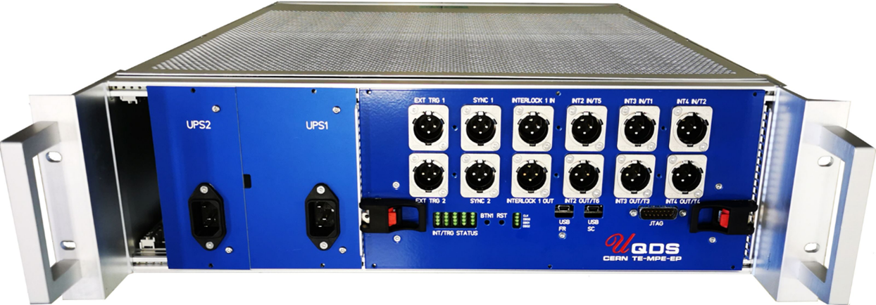
HL-LHC Quench Detection Systems (QDS)
HL-LHC QDS will be installed in the radiation free UR underground areas
  For those areas radiation tolerance is not taken into account as a specific design constraint
The only exception are the quench detection systems required for the protection of the 11 T dipoles
  Once confirmed, those systems will be installed in the RR73 and RR77 underground areas, The expected radiation levels are rather moderate reaching up to TID ~ 0.5 Gy/year
    R2E design nevertheless required
  Development completed and systems qualified for use in RR73/77

Slide 4
LHC Quench Detection Systems
The radiation environment will change significantly for a substantial fraction of the LHC QDS & DAQ
Dispersion suppressor (DS) areas around IP1 and IP5 are of major concern
  Expected radiation levels¹ will reach the design limits for COTS based developments (typically TID = 200-300 Gy for units with programmable logic)
  To a lesser extent IP2 and IP8 are as well of concern
    Ion runs
    LHCb request to increase its luminosity
The elevated radiation levels in the LHC RR areas around IP1 and IP5 also require some mitigation measures
¹https://edms.cern.ch/document/2302154/1.0

Slide 5
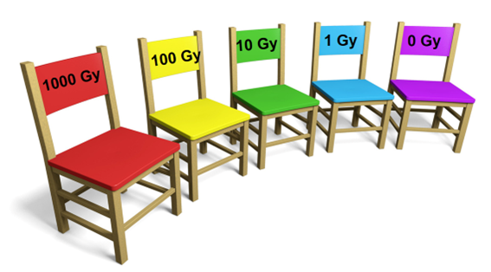
LHC QDS & DAQ – R2E performance
HL-LHC R2E performance target (including all accelerator systems)
  ~ 0.1 beam dumps / fb⁻¹
QDS R2E performance requirements for HL-LHC
  SEU mitigation must be bullet proof
  TID should not affect device performance for at least one year
    Ideally all exposed devices should remain operational during the period of one LHC run (~3 years) → TID ~ 300 Gy
    TID related problems can also be mitigated by pre-emptive maintenance, e.g. by rotating highly exposed systems with those installed in low radiation zones

Slide 6
LHC QDS – R2E performance LHC run 2
QDS R2E performance LHC run 2 in 2018
  0.16 beam dumps / fb⁻¹
  9 trips of DQQBS type QDS installed in half cells 8, 9 and 11 around IP1 and IP5
  Specific settings of the tertiary collimators in 2018 increased the losses in the dispersion suppressor areas significantly thus anticipating to a certain extent HL-LHC conditions
  A part the DQQBS also the DAQ systems suffered from radiation induced effects (known vulnerability of the MicroFIP™ field-bus chip)
The good news: none of the explicitly radiation tolerant QDS designs failed!
  Re-testing nevertheless strongly recommended
DQQBS: busbar splice protection system

Slide 7
LHC QDS & DAQ inventory half-cells 8 - 13
R2E conditions / requirements for QDS operation:
  TID_{MAX} ≈ 100 Gy/ year, SEU immune, TID ≥ 200 Gy
Only a fraction of the currently installed QDS equipment does not comply with those requirements and needs to be updated:
In addition to the device upgrade, the position of the QDS racks needs to be optimized with respect to the expected radiation distribution
In case of IP2, the upgrade would be only required for the ion runs
Equipment | IP1,2,5,8 | Comment
Quench detection board type DQQBS | 176 | Same technology platform
Earth voltage feeler type DQQDE | 96
Communication board type DQAMC MB/MQ | 136 | Same technology platform
Communication board type DQAMG S | 48
 | 456

Slide 8
LHC QDS & DAQ inventory in RR areas
R2E conditions / requirements for QDS operations:
  TID_{MAX} ≈ 25 Gy/ year, SEU immune, TID ≥ 100 Gy
Equipment | RR13, 17, 53, 57 | Comment
Current quench detection system DQQDC | 224 | Same technology platform as DQQBS and DQQDE
Communication board type DQAMG A/B | 36 | Same technology platform as DQAMC MB/MQ, DQAMG S
AC-DC power supplies | 312 | Different technology (linear instead of switch mode) and topology
Quench detection board type DQQBS | 24 | New device within QDS-CONS upgrade – same technology platform as DQQDC and DQQDE
Quench heater supervision system type DQHSU | 32 | New device within QDS-CONS upgrade – based on existing R2E qualified device
 | 628
Upgrades in the RR areas are part of the QDS consolidation project (QDS-CONS)
DQQDC: HTS current lead quench detection system

Slide 9
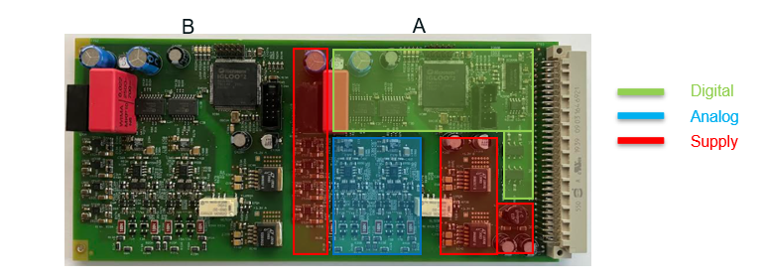
LHC QDS & DAQ – R2E developments
Quench detection system type DQQBS/DQQDC
  Two independent detector boards integrated on one PCB
    Fully backward compatible to existing device
  Based on proven designs and components
  FPGA used for filtering and quench detection algorithms
  Uses proven UQDS analog input channel technology with 20-bit SAR ADC
J. Spasic
For further info see R2E Developments Status Review: https://indico.cern.ch/event/1127987/timetable/

Slide 10
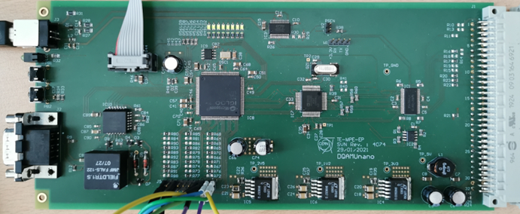
LHC QDS & DAQ – R2E developments
NanoFIP-based communication board type DQAMC/DQAMG
  World-FIP™ based communications board as plug-in replacement for obsolete µFIP™ based systems type DQAMC, DQAMG A/B/S
  NanoFIP IP-core + peripherals are implemented in M2GL010 FPGA
  ADuC831™ micro-controller (radiation tolerant and robust, 20 years old but still in production) is used for local monitoring and communication
  Includes substantial feature upgrade for improved time stamping and enhanced crate monitoring
J. Spasic

Slide 11

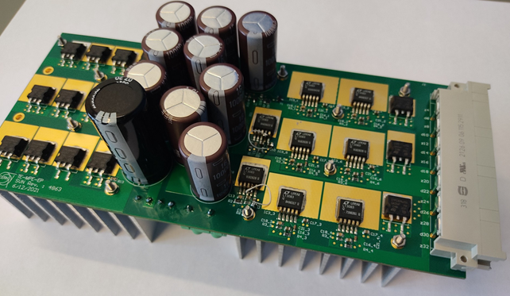

LHC QDS & DAQ – R2E developments
Radiation tolerant linear power supply for QDS crates type DQGPU A and B
  Total output power per crate: 120W (+5 V: 15 A, +15 V: 2A, -15 V: 0.5 A)
  Energy efficient design (V_{dropLDO} ~0.4 V, VF_{diode}~0.38 V)
  Classical, very lean design based on tested COTS
  Very lean design based on tested COTS
    LT3083 linear regulator, STPS30M60S Schottky diode
  Cooling provided by external fan tray (230V AC fans)
Innovative through-PCB cooling
of semiconductors!
T. Pridii, J. Steckert

Slide 12
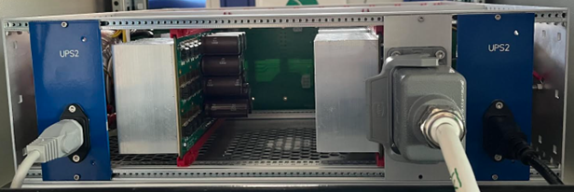
LHC QDS & DAQ – R2E qualification
Component level
  Whenever possible QDS R2E designs try to use already tested components or already used in one of our active radiation tolerant equipment; there is a very close collaboration with R2E/RADWG
  Components will be typically tested for SEU immunity using a proton irradiation facility (Paul Scherrer Institut PSI) and TID using a ⁶⁰Co source (CC-60 facility @ CERN)
Device and system level
  All developments will be submitted to a fully functional test in the CERN CHARM mixed field radiation facility prior to installation in the LHC
    Tests just resumed in June 2022 …

Slide 13

LHC QDS & DAQ – R2E qualification
Recent results
Equipment | SEU | TID limit [Gy] | Comment
DQQBS | OK | 240
DQQDS (symmetric quench detection system) | OK | 280 | Re-qualification of existing device
AC-DC power supply | OK | 170
Linear regulator LT3083 – a kind of surprise …
Recent tests show reduced TID limit in mixed field radiation tests compared to proton radiation tests
Problem observed by several teams
TID ~ 150 Gy compared to 1 kGy with proton irradiation → still ok for applications in the RR underground areas
Use of alternative part under consideration
First results are rather promising and confirm the technological choices
The successful re-qualification of devices developed more than a decade ago is re-assuring
Tests to be continued with the communication boards
This Photo by Unknown Author is licensed under CC BY-SA

Slide 14
Summary
The successful HL-LHC operation not only requires the installation of new protection equipment for the HL-LHC circuits but a substantial upgrade of the existing quench detection system
The significantly increased radiation levels in parts of the LHC tunnel and some underground areas are of major concern
The development of new devices adapted to the HL-LHC conditions is advancing well and the results of the first radiation test campaign are promising

