Slide 1

Update on the Inner Triplet quench simulations and current in the circuit branches
E. Ravaioli (CERN)
Thanks to:
S. Izquierdo Bermudez, L. De Mallac, F. Mangiarotti, M. Mentink, F. Rodriguez Mateos, A. Verweij, D. Wollmann, S. Yammine (CERN) and many other colleagues for their inputs
21 September 2022

Slide 2
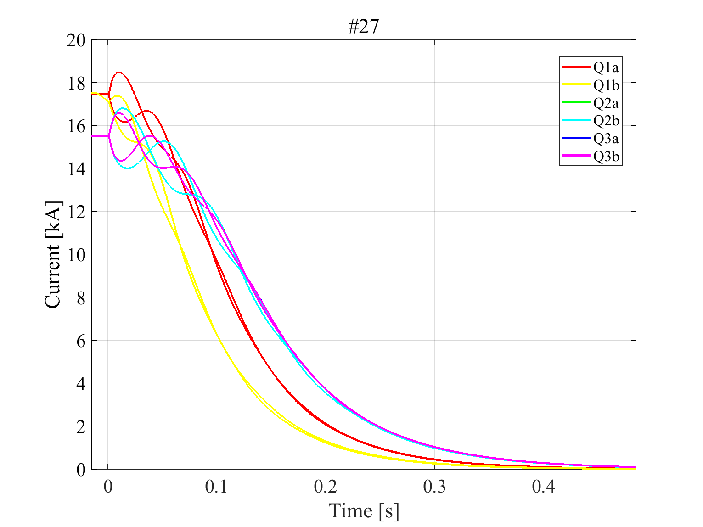
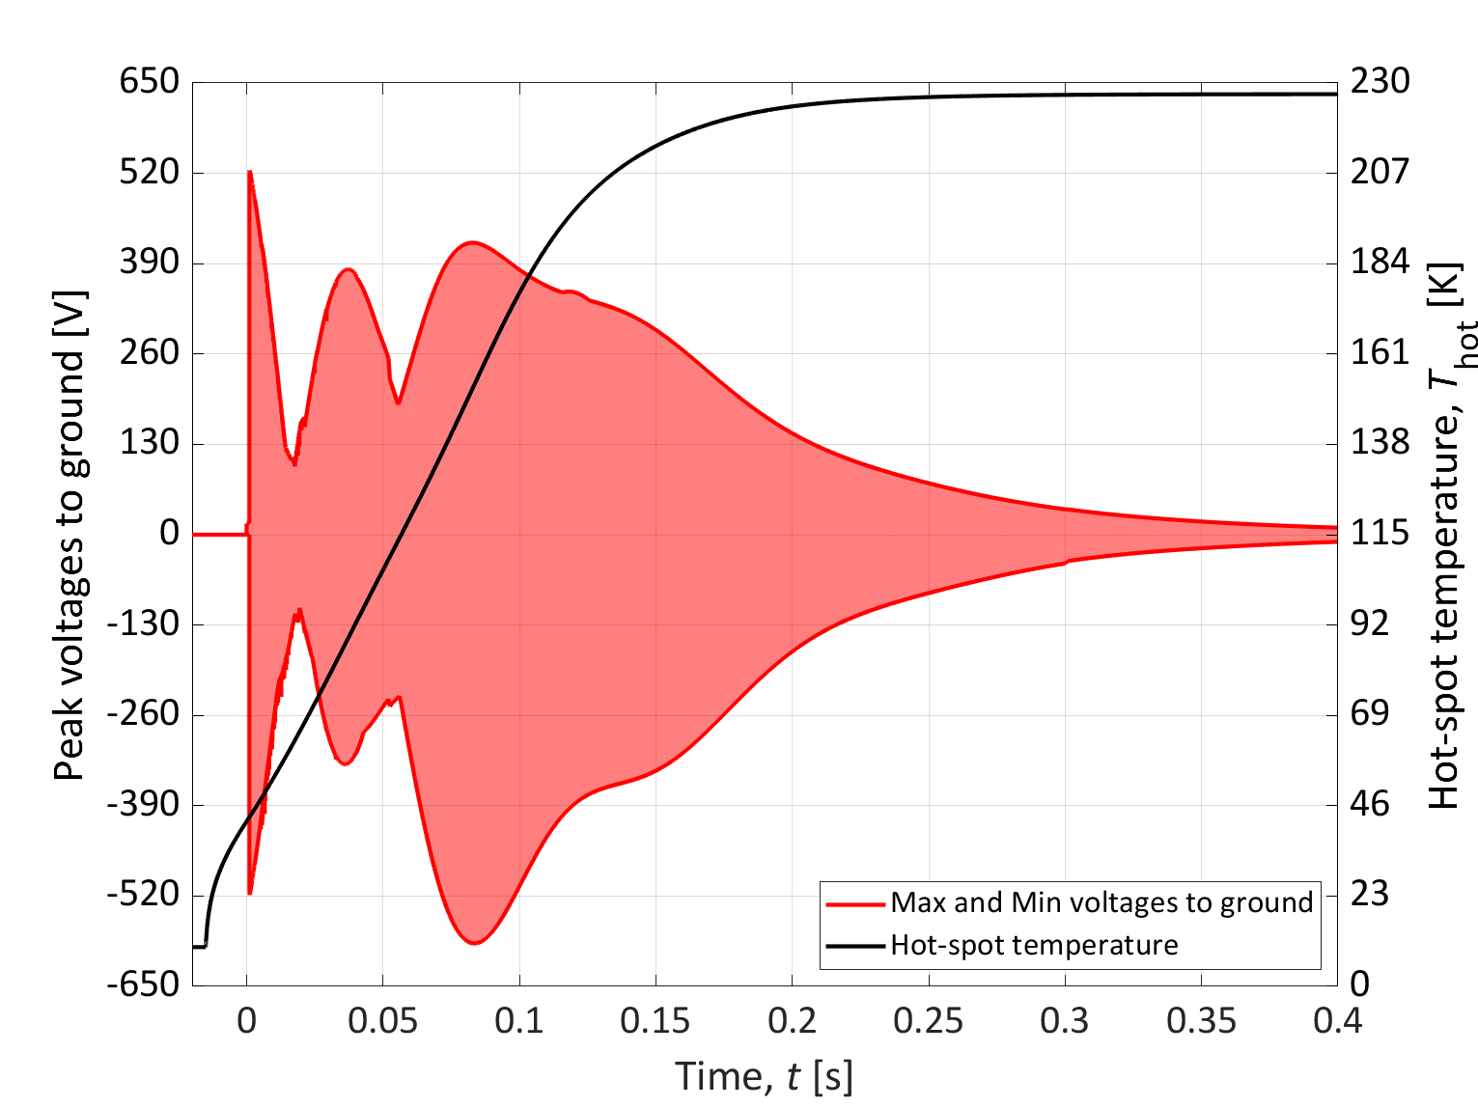
Update on the Inner Triplet quench simulations and current in the circuit branches
Circuit analysis
Calculate worst-case peak currents and thermal loads in all circuit branches
Update figures following circuit fine tuning
Circuit analysis
Calculate worst-case peak currents and thermal loads in all circuit branches
Update figures following last circuit fine tuning
Magnet quench protection analysis
Demonstrate protection strategy
Calculate worst-case hot-spot temperature and peak voltage to ground
The quench protection of the HL-LHC Inner Triplet circuit is adequate in all foreseen operation scenarios, and resilient to all plausible failure scenarios and conductor variations.

Slide 3
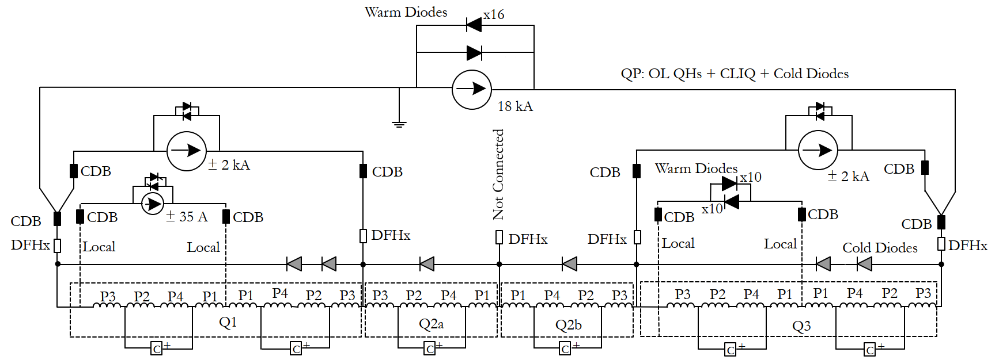
HL-LHC Inner Triplet Circuit
18 kA main supply
2 kA trim supply
2 kA trim supply
Warm Diodes
35 A trim supply
Cold Diodes
Cold Diode
Cold Diode
Cold Diodes
magnet
magnet
magnet
magnet
magnet
magnet
CLIQ
CLIQ
CLIQ
CLIQ
CLIQ
CLIQ
Note: This schematic includes the proposed changes to the crowbars, see MCF meetings #84, 91, 107
Schematic courtesy of S. Yammine

Slide 4
Circuit branches considered in the analysis
5
1
3
2
4
6
7
8
9
10
Identify conservative worst-cases for these components based on circuit operating cases, failure cases, magnet conductor parameters. For each case, calculate peak current and thermal load. | Main power supply crowbar and leads Q1 trim power supply crowbar and leads Q3 trim power supply crowbar and leads Q1a trim power supply crowbar and leads Main power supply reverse Diodes | Q3a Warm Diodes Q1 Cold Diodes Q2a Cold Diodes Q2b Cold Diodes Q3 Cold Diodes
Schematic courtesy of S. Yammine

Slide 5
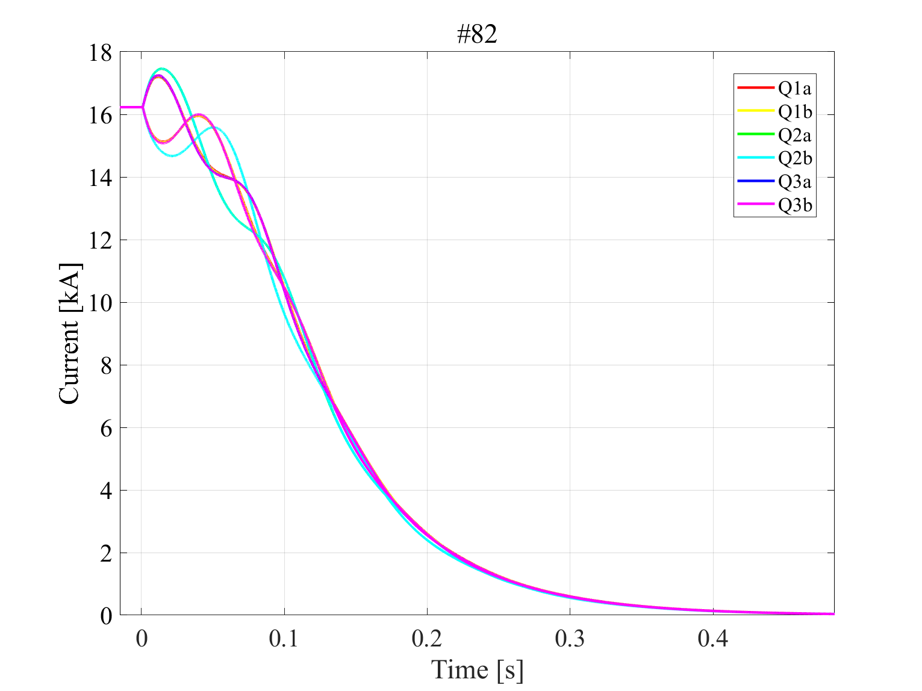
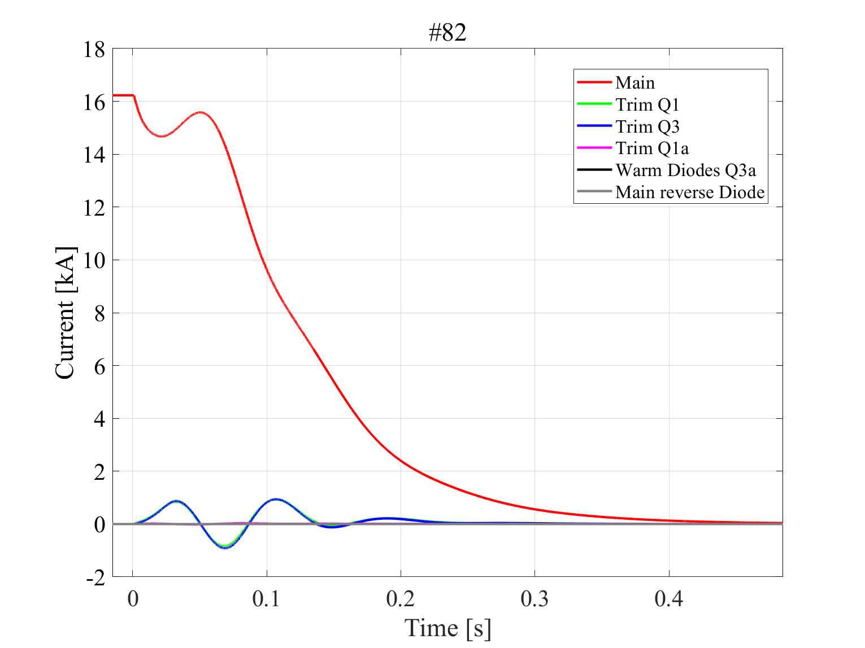
Reference circuit discharge after a quench
Magnets
Current leads, Crowbars, Diodes
STEAM simulations

Slide 6
Factor considered while identifying the worst-cases
Power supply initial currents
Conductor parameters
Sudden quench
of whole magnet
Diode forward voltages
Spurious triggers and failure cases
Very conservative worst-cases

Slide 7
Example: Identify worst-case for Q3a Warm Diode -1
I_main=15.5 kA, I_trimQ1=0, I_trimQ3=2 kA, I_trimQ1a=-35 A
All fours Q3a coils suddenly quench [by choice this is unrealistically conservative]
Q3a coils have f_Cu/noCu=1.1 and RRR=100. All other coils have f_Cu/noCu=1.3 and RRR=300
Schematic courtesy of S. Yammine

Slide 8
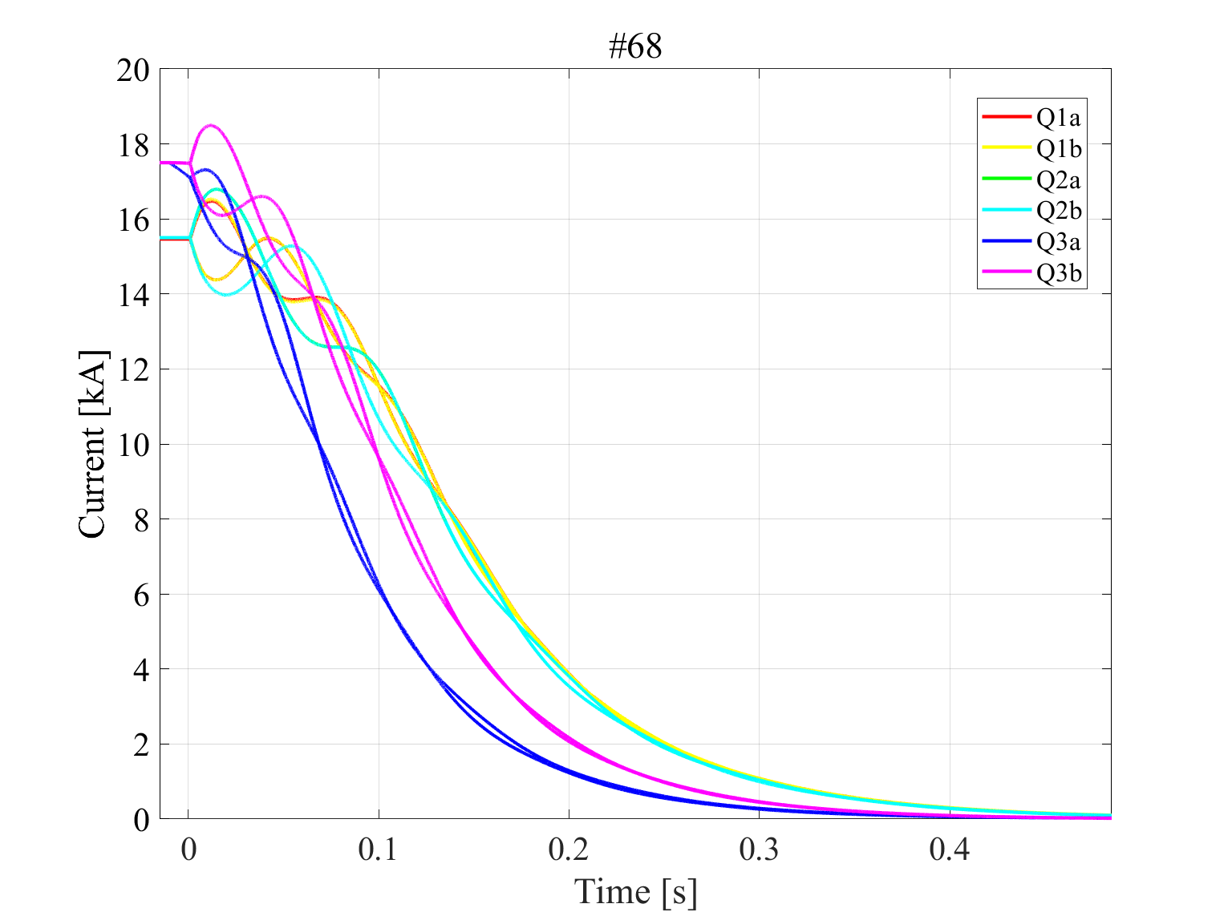
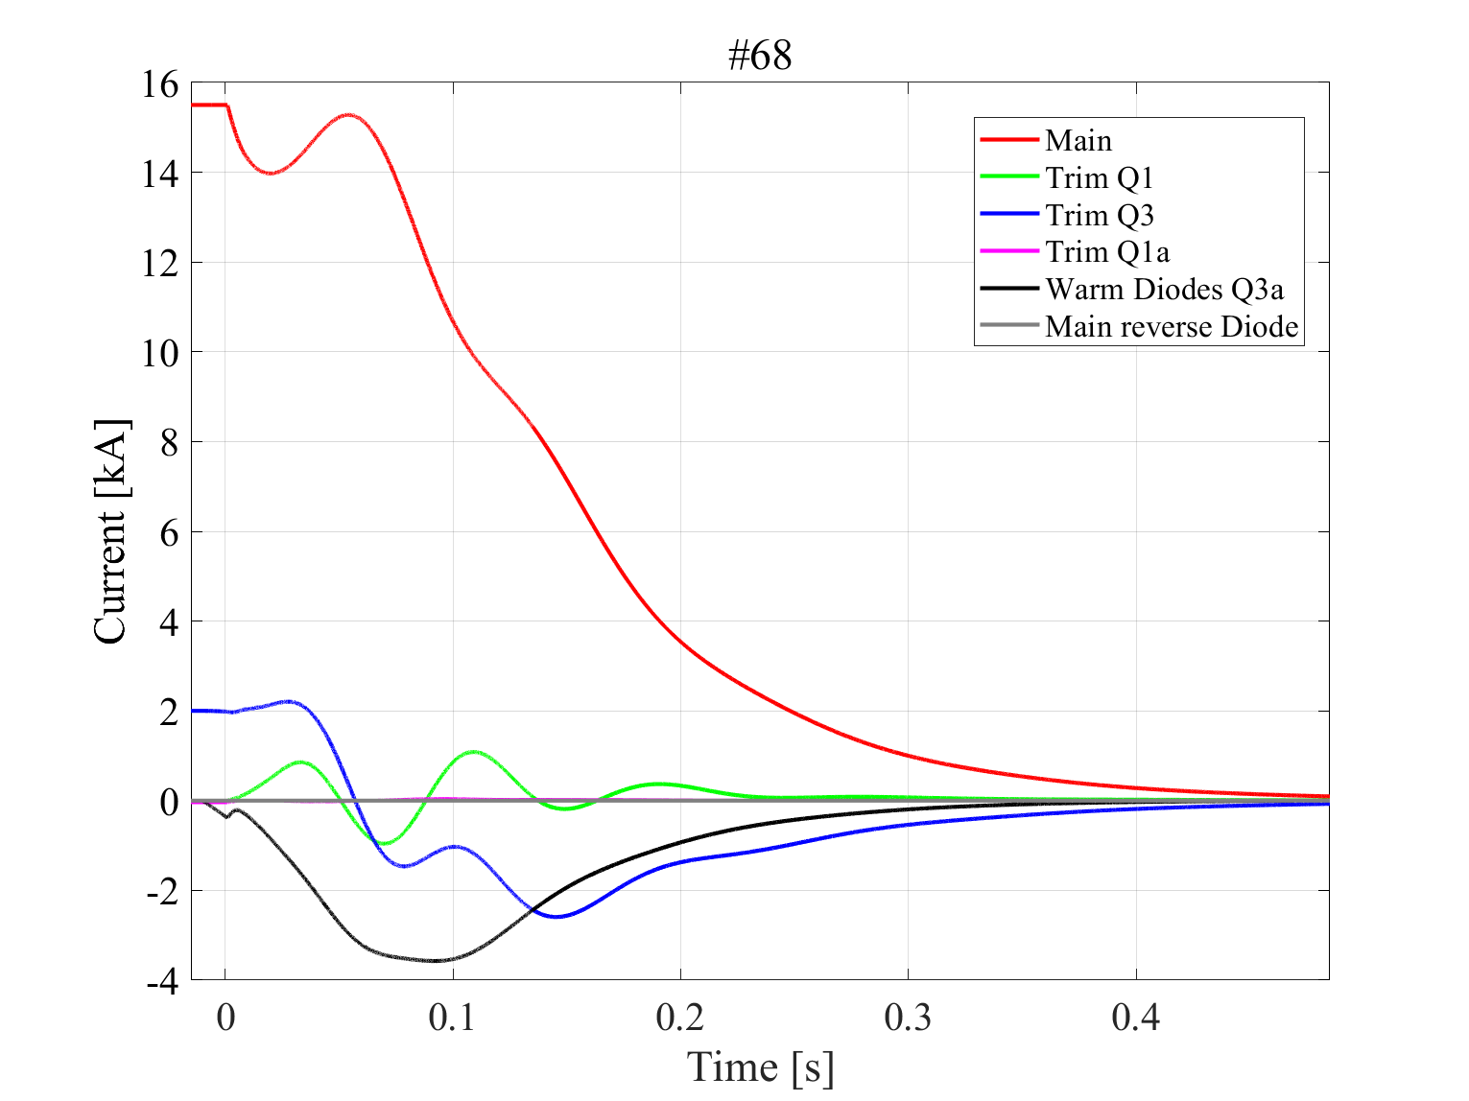
Example: Identify worst-case for Q3a Warm Diode -2
Magnets
Current leads, Crowbars, Diodes
Peak current ~3.6 kA
STEAM simulations

Slide 9
Max identified peak currents and thermal loads (magnets excluded)
Component | Peak current | Characteristic time
Main power supply crowbar and leads | 17.5 kA | ~120 ms
Q1/Q3 trim power supply leads | <5.0 kA | ~120 ms
Cold Diodes | <5.2 kA | ~120 ms
Q1a trim power supply crowbar and leads | <3.7 kA | ~100 ms
Q3a Warm Diodes | <3.6 kA | ~100 ms
Main power supply reverse Diodes | <1.0 kA | ~ 15 ms
Values obtained at ultimate current under very conservative assumptions
Circuit components dimensioned for these requirements without headaches
The proposed change of crowbar configuration did not increase significantly these figures
STEAM simulations

Slide 10
Update on the Inner Triplet quench simulations and current in the circuit branches
Circuit analysis
Calculate worst-case peak currents and thermal loads in all circuit branches
Update figures following last circuit fine tuning
Magnet quench protection analysis
Demonstrate protection strategy
Calculate worst-case hot-spot temperature and peak voltage to ground
The quench protection of the HL-LHC Inner Triplet circuit is adequate in all foreseen operation scenarios, and resilient to all plausible failure scenarios and conductor variations.

Slide 11
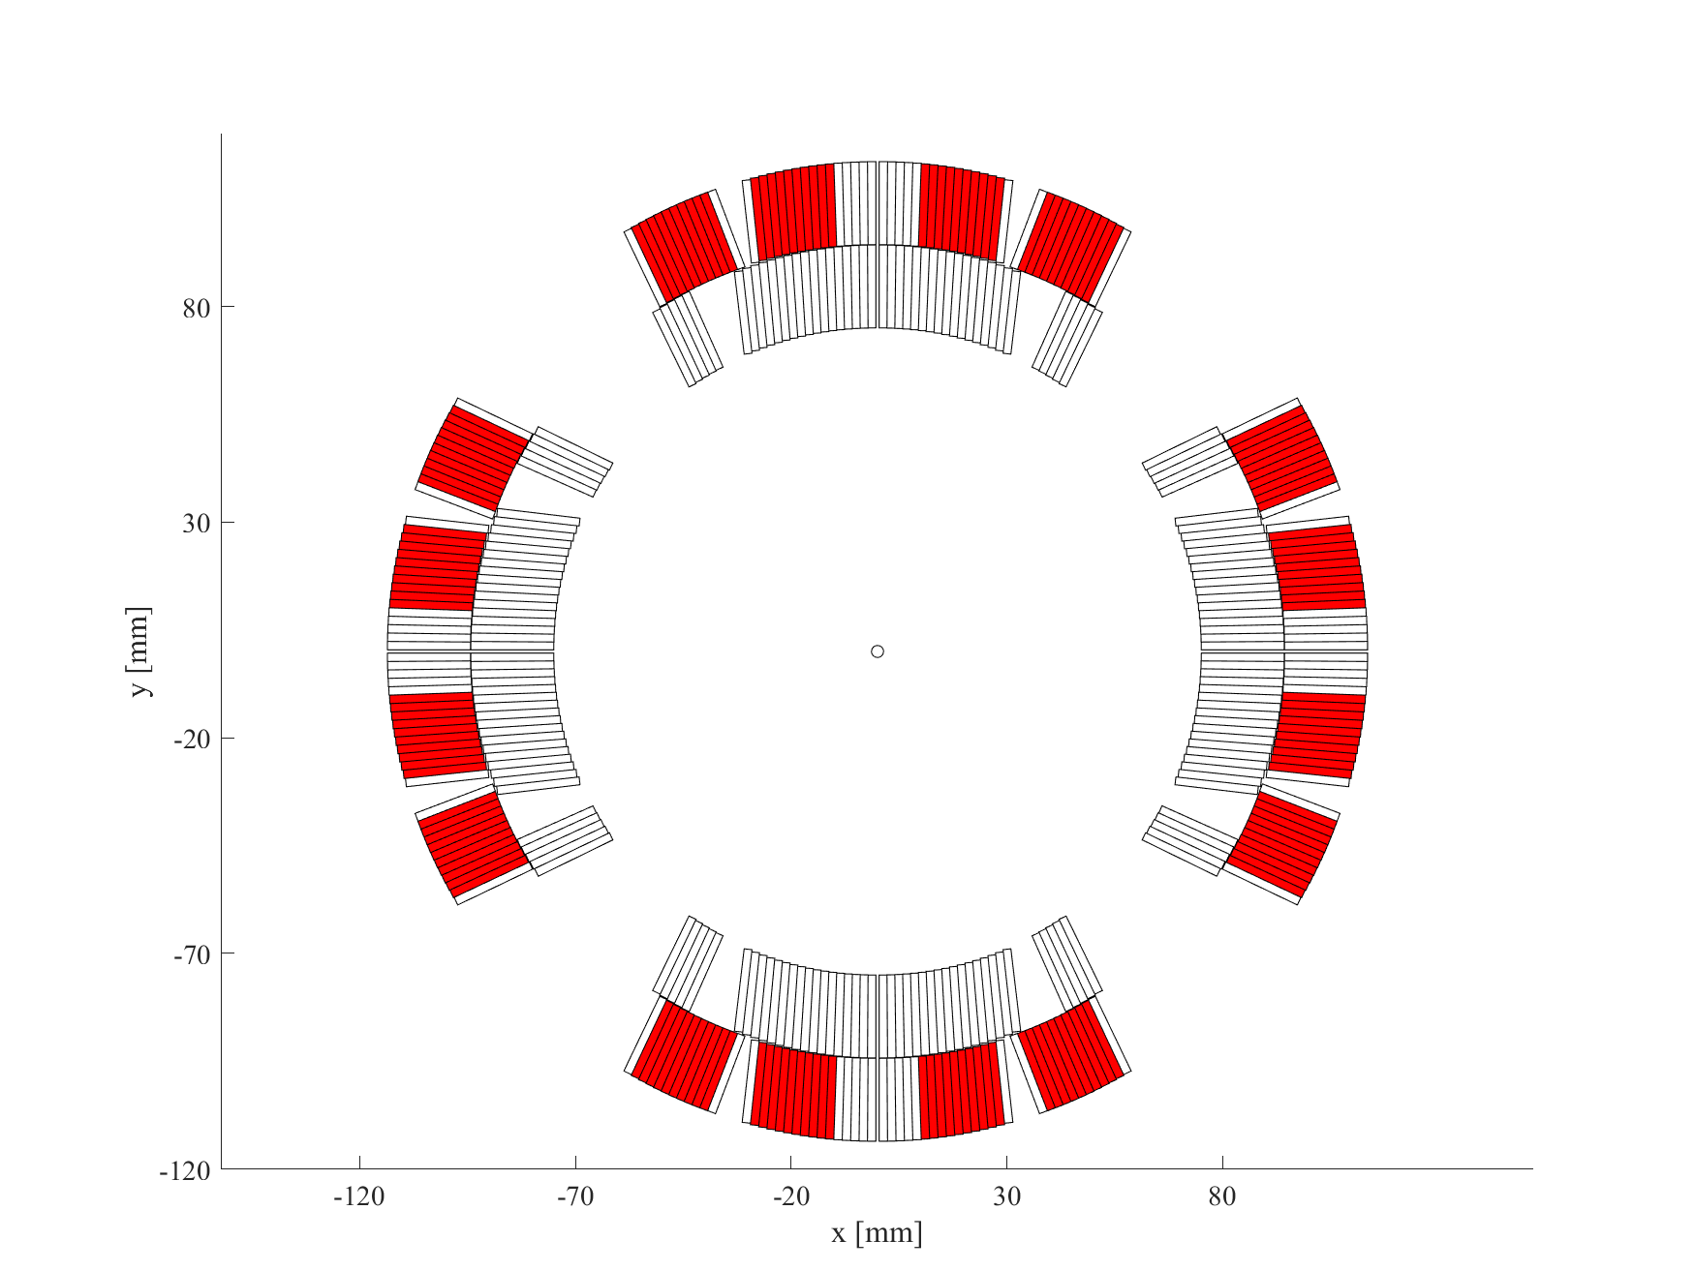
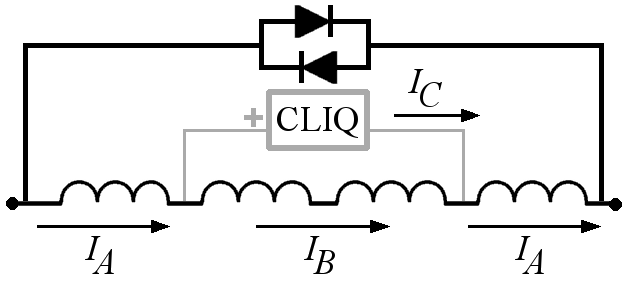
MQXF magnet quench protection system
QH3
QH4
QH2
QH1
QH5
QH6
QH8
QH7
QUENCH HEATERS
(QH)
CLIQ
(COUPLING-LOSS INDUCED QUENCH)
8x 7.05 mF QH units charged to 940 V
1x 40 mF CLIQ unit charged to 600 V or to 1000 V for 4.2 m or 7.15 m long MQXF

Slide 12
MQXF quench protection strategy
I_{nom}
16.2
I_{ult}
17.5
I [kA]
1.5
2
5
8
Self-protected ≤2 kA → Demonstrated with 3D simulations
QH effective ≥1.5 kA → Demonstrated with QH minimum energy to quench
CLIQ effective ≥5 kA → Demonstrated with CLIQ-only tests
At low to medium current levels, outer-layer quench heaters are fully redundant (4 out of 8 QH circuits are sufficient)
→ Demonstrated with dedicated tests at CERN
MQXF quench protection is most critical at high current.
CLIQ reduces the quench load by ~20% at medium-high current (hot-spot temperature reduced by ~100 K)
→ Demonstrated with dedicated tests at CERN, BNL, FNAL

Slide 13
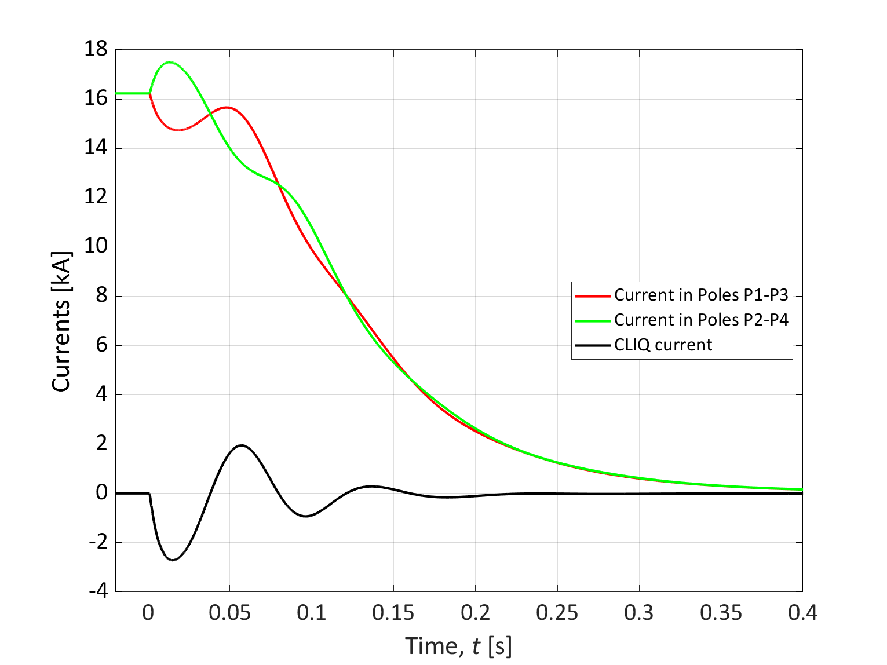
Simulation of quench discharge in the reference case
I [kA]
1.5
2
5
8
16.2
17.5
Currents in the system
Min/Max coil-to-ground voltages, and hot-spot temperature
Reference case: 8 QH units + 1 CLIQ unit per magnet. No failures. Uniform conductor parameters
→ Hot-spot temperature ~230 K → Peak voltage to ground ~600 V
STEAM simulations

Slide 14
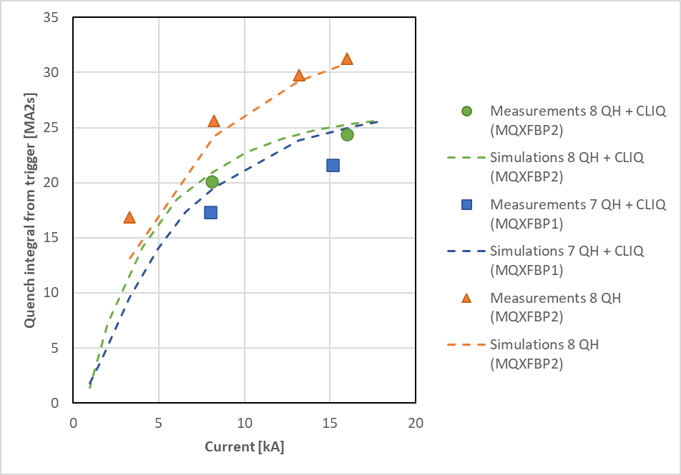
MQXFB protection
Measured quench integral in good agreement with computations.
  For nominal protection configuration (QH+CLIQ), QI from triggering ≈ 25 MA²s, with a hot-spot temperature ≈ 250 K
  In MQXFBP2, during the trim current test, the magnet was protected only with quench heaters, reaching a hot-spot temperature of ~330 K without impact on magnet performance
  → validate design choice of allowable T_{hot}
Measurements: F. Mangiarotti. Simulations: E. Ravaioli. Analysis: S. Izquierdo Bermudez

Slide 15
Worst-case analysis
  Reference case
  8 QH units + 1 CLIQ unit per magnet
  Uniform conductor parameters
  → Hot-spot temperature ~230 K
  → Peak voltage to ground ~600 V
  Worst case
  Two simultaneous units failing
  Non-uniform conductor parameters
  BUT electrical order of the four coils optimized
→ Worst-case temperature of 370-400 K considered acceptable for a one-in-a-lifetime event as a double failure
→ Worst-case voltage to ground at nominal current remains below electrical design criteria (<670 V)
STEAM simulations

Slide 16
Conclusion
The quench protection of the HL-LHC Inner Triplet circuit has been successfully demonstrated in all foreseen operation scenarios, and for various failure scenarios and conductor variations.
0-2 kA: Magnet is self-protected. Demonstrated with conservative 3D quench simulations.
1.5-8 kA: Quench heaters only are fully redundant. Demonstrated with dedicated measurements.
5-17.5 kA: CLIQ + Quench heaters are fully redundant. Demonstrated with dedicated measurements.
  → Results from MQXFB test campaigns are in line with simulations
  Circuit analysis:
  → Peak currents and quench loads in all circuit components calculated and judged not critical
  Magnet quench protection analysis:
  Reference case: 8 QH units + CLIQ unit per magnet, and uniform conductor parameters
  → Hot-spot temperature ~230 K → Peak voltage to ground ~600 V
  Worst-case: Two failing units and non-uniform conductor parameters
→ Worst-case temperature of 370-400 K considered acceptable for a one-in-a-lifetime event as a double failure
→ Worst-case voltage to ground at nominal current remains below electrical design criteria (<670 V)

Slide 17
Annex

Slide 18
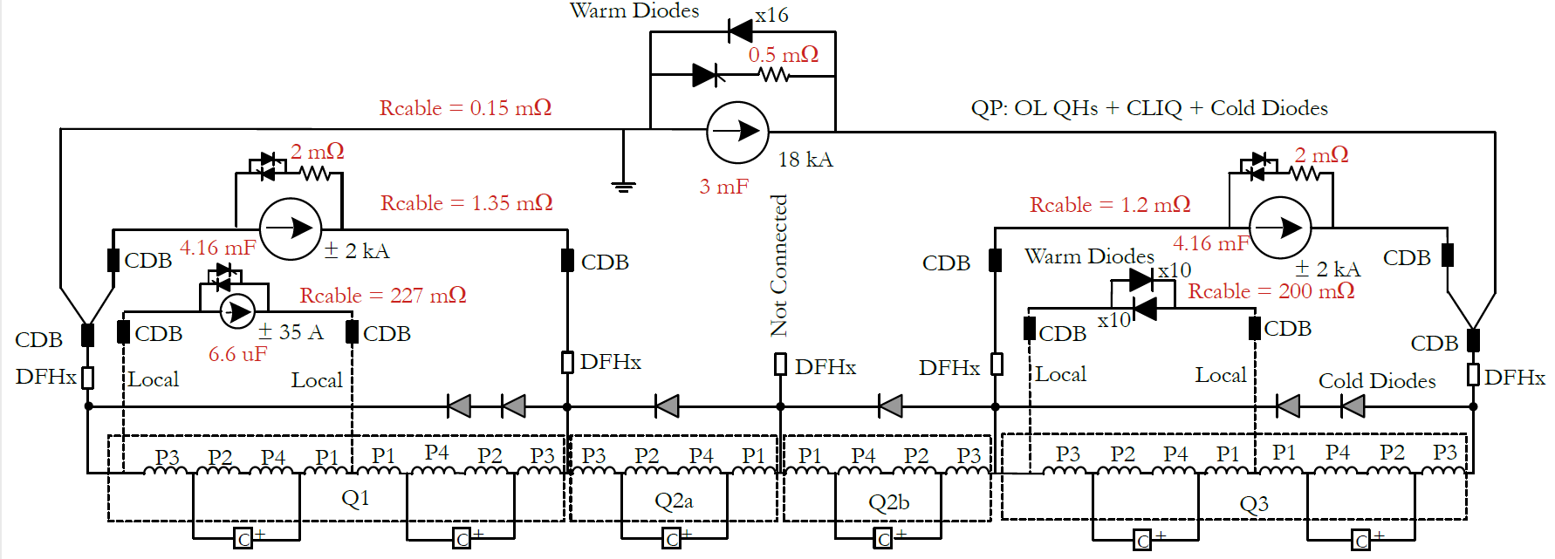
HL-LHC Inner Triplet Circuit – Current baseline
5
Schematic courtesy of S. Yammine
1
3
2
4
6
7
8
9
10
Identify conservative worst-cases for these components based on circuit operating cases, failure cases, magnet conductor parameters. For each case, calculate peak current and thermal load. | Main power supply crowbar and leads Q1 trim power supply crowbar and leads Q3 trim power supply crowbar and leads Q1a trim power supply crowbar and leads Main power supply reverse Diodes | Q3a Warm Diodes Q1 Cold Diodes Q2a Cold Diodes Q2b Cold Diodes Q3 Cold Diodes

Slide 19
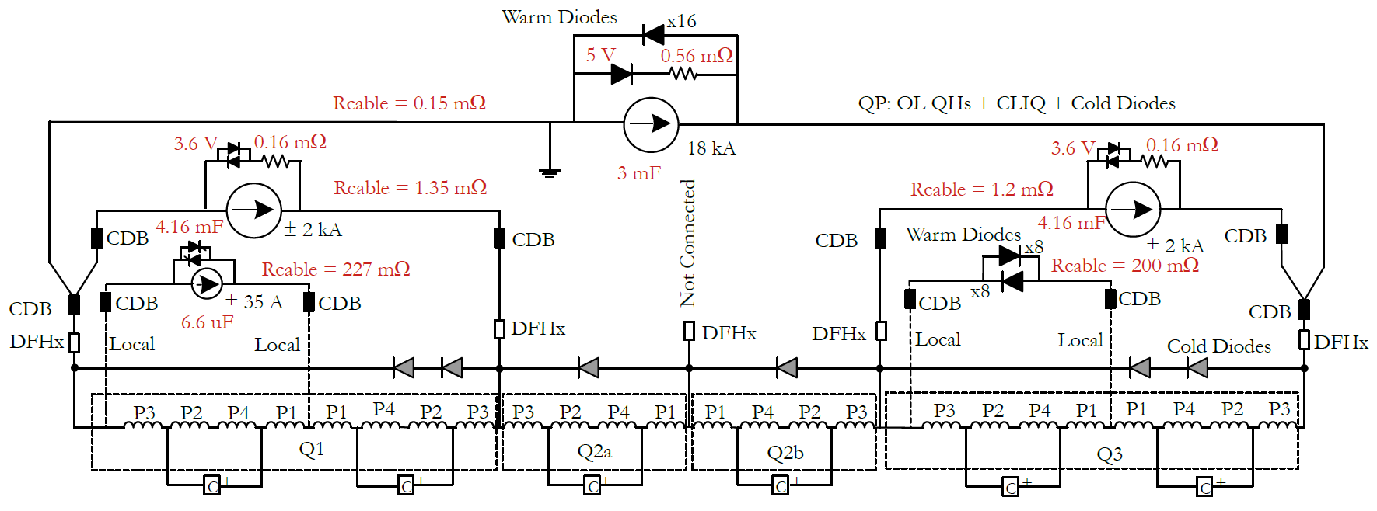
HL-LHC Inner Triplet Circuit – Fine tuning
A
Schematic courtesy of S. Yammine
B
C
https://indico.cern.ch/event/1039101/
https://indico.cern.ch/event/1083268/
https://indico.cern.ch/event/1191497/
The alternative configuration includes these main changes:
Crowbar of RQX main power converter has Diodes (rather than thyristors)
Crowbar of RQTX1 trim power converter has Diodes (rather than thyristors)
Crowbar of RQTX3 trim power converter has Diodes (rather than thyristors)
Note: Crowbar of RQTXA1 trim power converter is unchanged with respect to the baseline (i.e. it has thyristors)

Slide 20
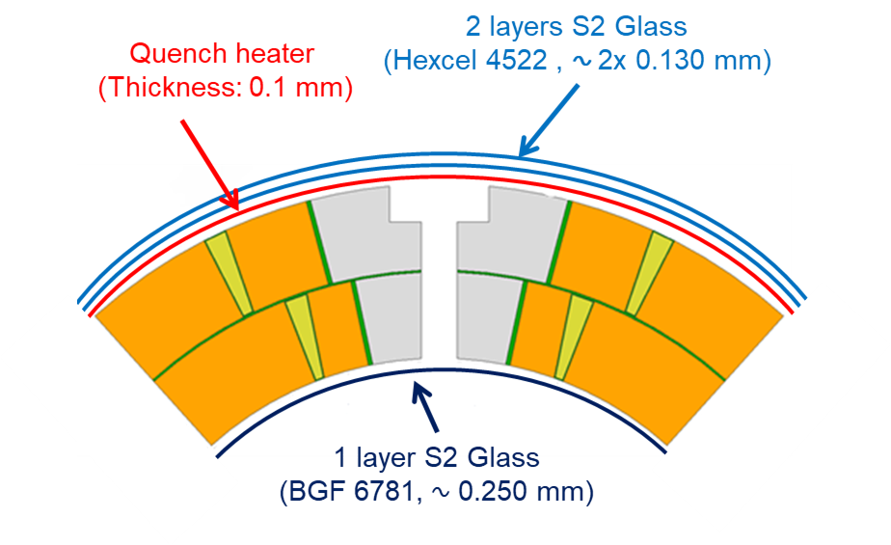
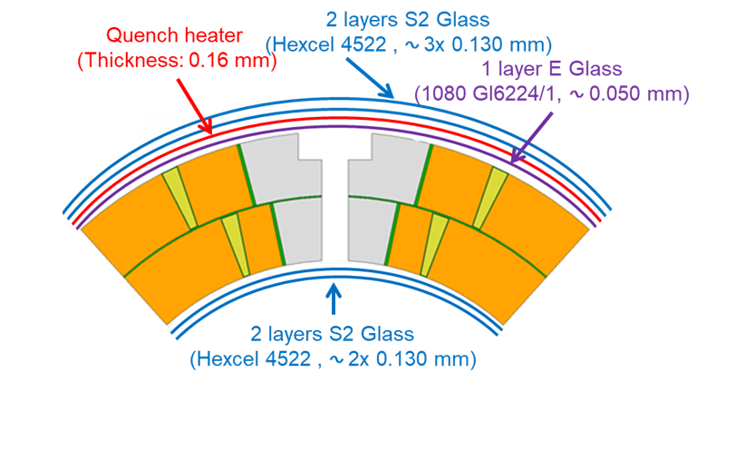
Quench protection heaters (QH)
MQXFB
“mini-swap”
MQXFA
Original design
MQXFB magnets: Added a 0.055 mm layer of E Glass between quench heater and coil (“mini-swap”)
  Better insulation between heater and coil
  Limited impact on quench protection
MQXFA magnets stay with the previous QH design
8x 7.05 mF QH units charged to 940 V
Spread on QH power supplies parameters decreased: magnet is protected including tolerances
David Carrillo, Edward Nowak
https://indico.cern.ch/event/1079026/contributions/4546310/

Slide 21
CLIQ (Coupling-Loss Induced Quench)
CLIQ lead parameters confirmed for Q1/Q2/Q3
  CLIQ lead lengths: 350-420 m (2-ways)
  CLIQ total circuit resistance: 26-38 mΩ
  CLIQ lead self-inductance: 0.35-0.42 mH
These parameters do not pose any performance problem
1x 40 mF CLIQ unit charged to 600 V or to 1000 V for 4.2 m or 7.15 m long MQXF
https://indico.cern.ch/event/1079026/contributions/4546310/
David Carrillo, Edward Nowak, Samer Yammine

Slide 22
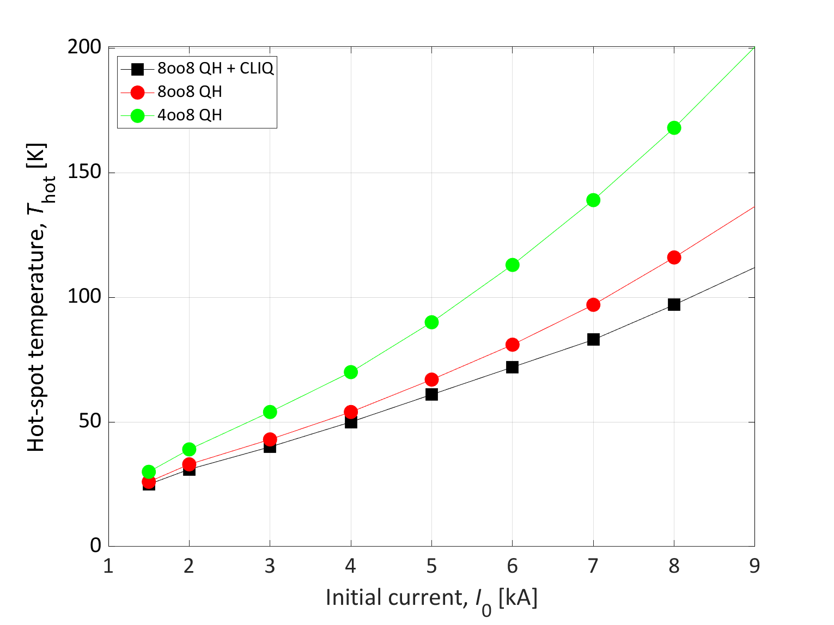
[1.5-8 kA] Low-medium current: QHs are fully redundant
I [kA]
1.5
2
5
8
16.2
17.5
→ At low-medium current, QH system is fully redundant
→ Simulations show that half of the QHs are sufficient to maintain the peak temperature <170 K at 8 kA
STEAM-LEDET simulations

Slide 23
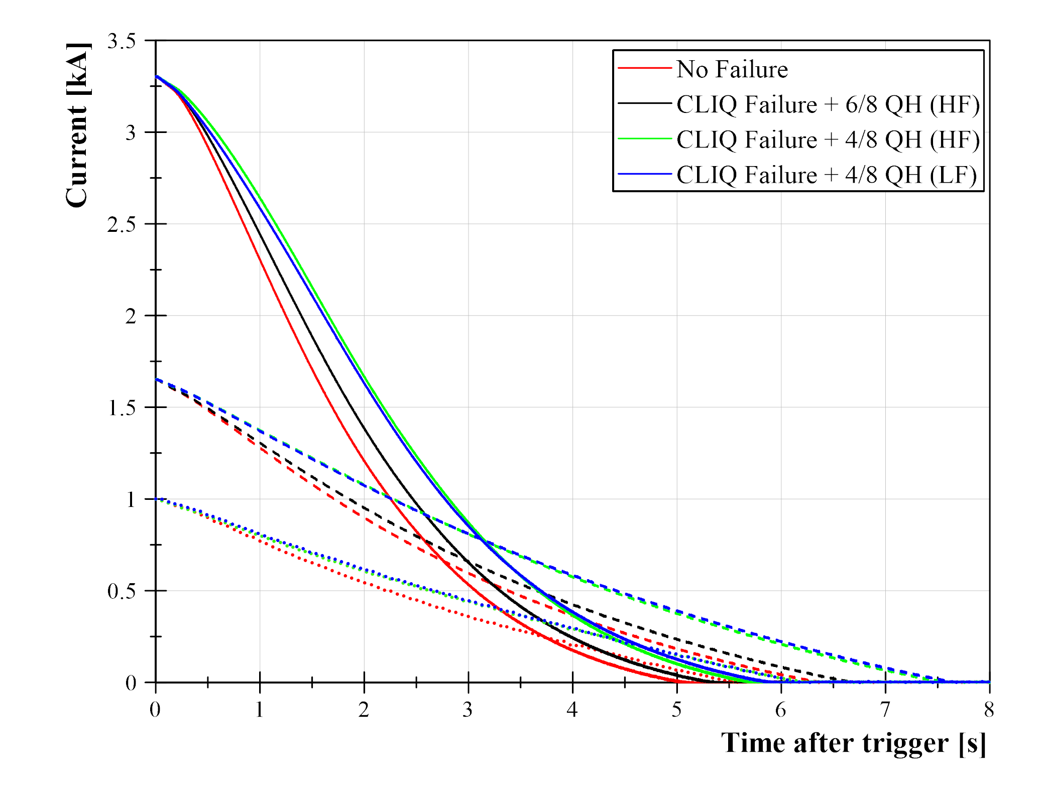
Redundancy of the quench protection at low current
I [kA]
1.5
2
5
8
16.2
17.5
Measured quench integral (MA²s) from protection triggering
Case | CLIQ | Low-field QH | High-field QH | I, kA | QI, MA²s
No failure | Yes | 4oo4 | 3oo4 [1 strip unavailable] | 1 | 1.54
 |  |  |  | 1.65 | 4.26
 |  |  |  | 3.3 | 12.36
CLIQ failure + 2 QH failures | No | 4oo4 | 2oo4 | 1 | 0.24
 |  |  |  | 1.65 | 4.58
 |  |  |  | 3.3 | 13.67
CLIQ failure + 4 QH failures | No | 0oo4 | 3oo4 [1 strip unavailable] | 1 | 1.82
 |  |  |  | 1.65 | 5.54
 |  |  |  | 3.3 | 15.50
 | No | 4oo4 | 0oo4 | 1 | 1.78
 |  |  |  | 1.65 | 5.53
 |  |  |  | 3.3 | 15.98
Measured current
→ Excellent redundancy demonstrated at low current on MQXFS4 short model
→ 4 out of 8 QH circuits (4oo8) assure quench protection at low current.
Franco Mangiarotti, Michal Duda, Salvador Ferradas

Slide 24
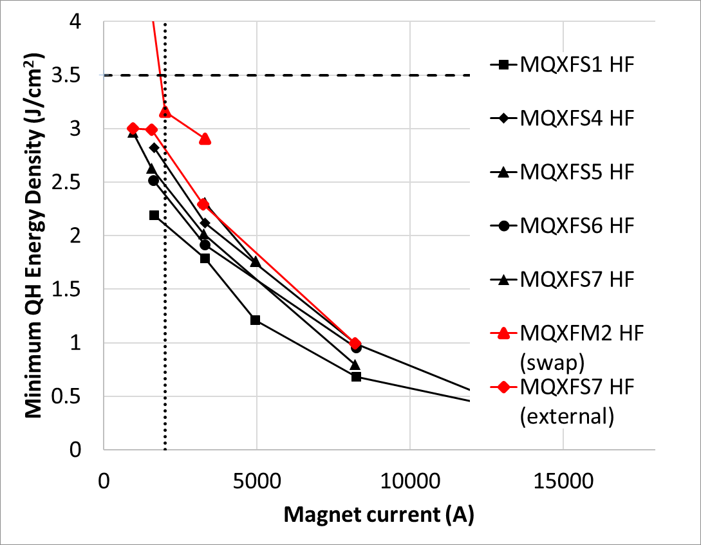
Minimum quench-heater energy density to quench
I [kA]
1.5
2
5
8
16.2
17.5
Baseline MQE
→ Minimum quench-heater energy density (MQE) to start a quench was systematically measured on model magnets
→ QH configurations featuring additional 0.1 mm S2 glass (“swap”/”external”) tested on a mirror coil and a model coil
→ QH design provides sufficient energy density to protect the magnet
Self protection limit
Franco Mangiarotti, Michal Duda, Stoyan Stoynev, Maria Baldini

Slide 25
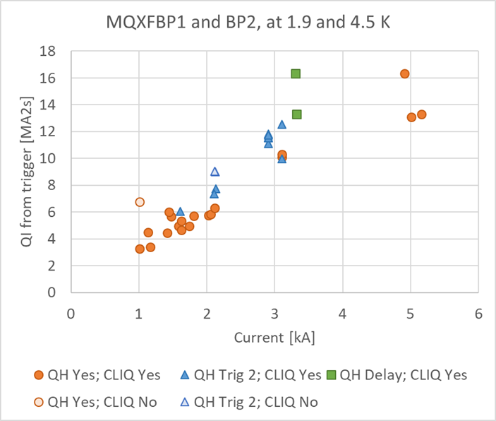
MQXFB prototype quench protection tests at low current
I [kA]
1.5
2
5
8
16.2
17.5
→ Based on the experience with two MQXFB prototypes, the magnet is well protected at low current.
Manual trigger without quench
2 QH circuit powered to start quench, rest triggered upon detection
Manual trigger without quench, QH delayed 500 ms
Franco Mangiarotti

Slide 26
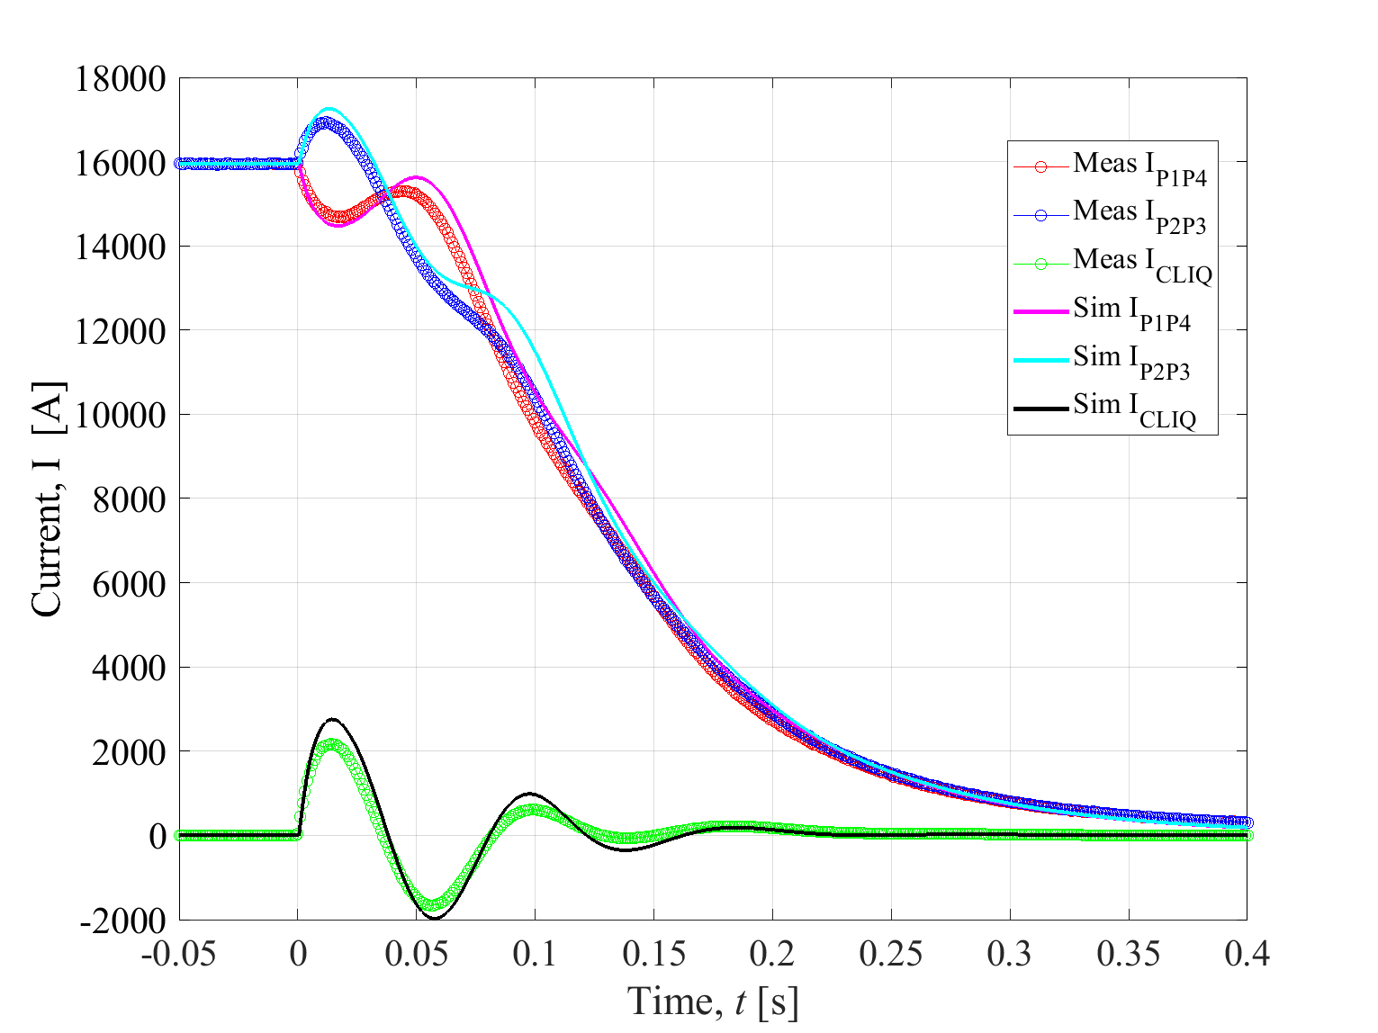
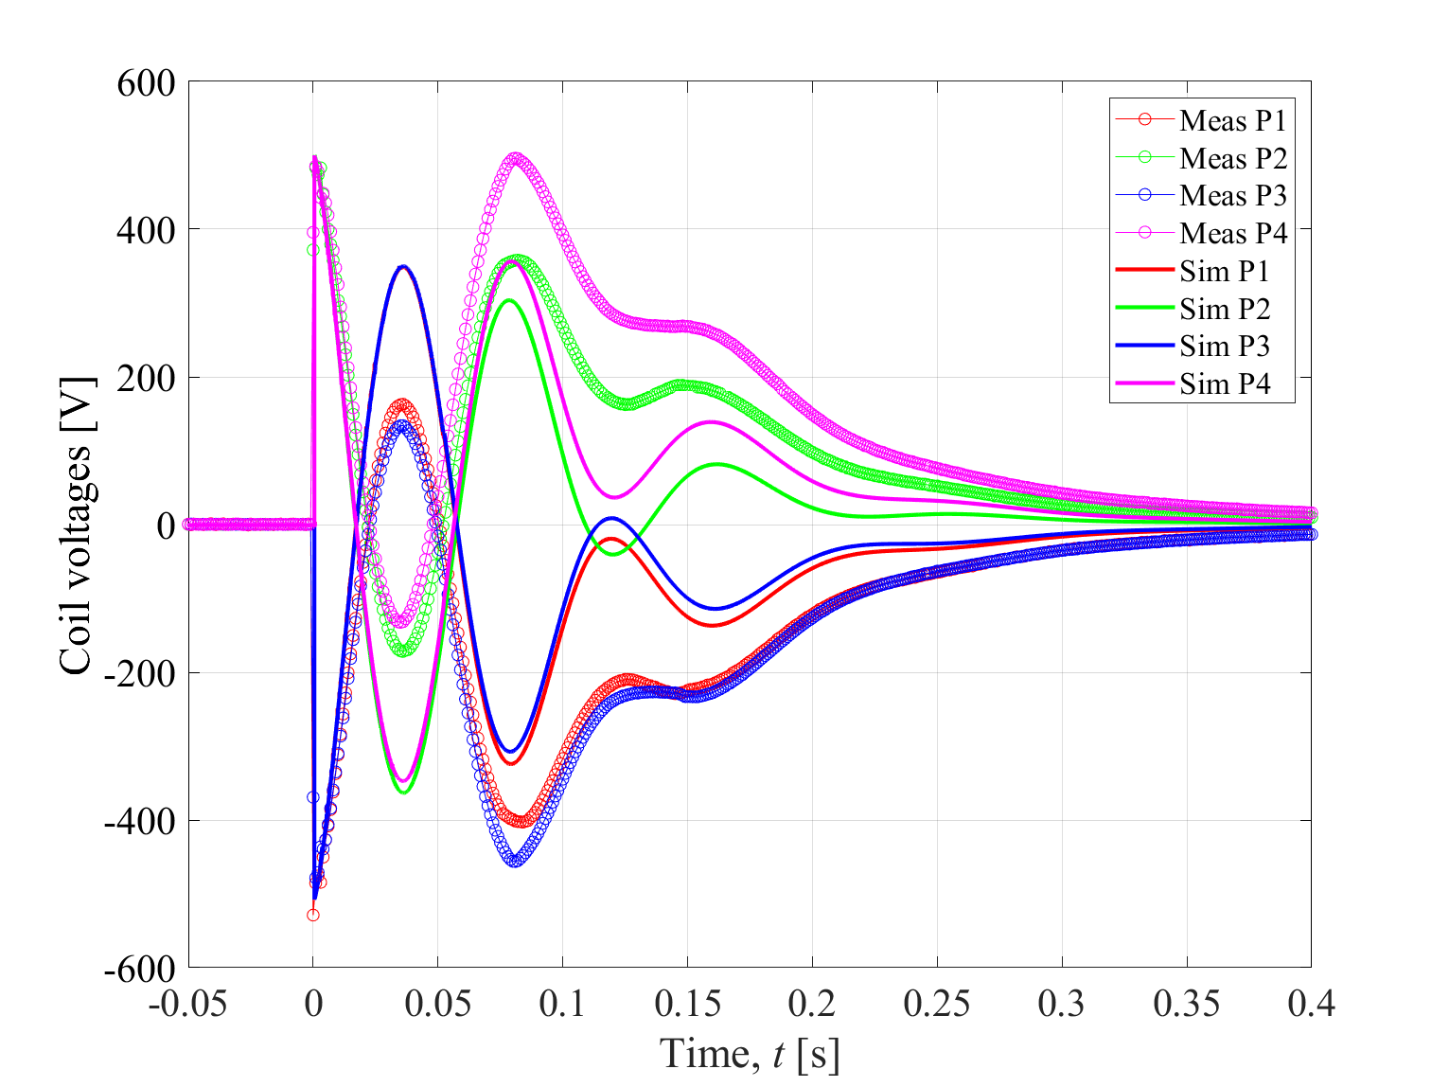
Example of validation of simulation model [MQXFBP02, 16 kA]
I [kA]
1.5
2
5
8
16.2
17.5
Currents in the system
Voltages across the four coils
→ Typical expected error, before applying any fitting parameters:
<10% error on the quench load and <20% error on the coil voltages
Measurements: Franco Mangiarotti
STEAM-LEDET simulations

Slide 27
[8-17.5 kA] Redundancy of the quench protection at high current
I [kA]
1.5
2
5
8
16.2
17.5
Measured quench integral (MA²s) from protection triggering
Case | CLIQ | Low-field QH | High-field QH | I, kA | QI, MA²s
No failure | Yes | 4oo4 | 3oo4 [1 strip unavailable] | 16.47 | 24.8
4 QH failures | Yes | 4oo4 | 0oo4 | 13.2 | 27.8
 |  |  |  | 16.47 | 26.2
CLIQ failure | No | 4oo4 | 3oo4 [1 strip unavailable] | 13.2 | 28.9
 |  |  |  | 16.47 | 30.9
Note: In the first test, CLIQ unit U=200 V, C=40 mF. In the other four tests: CLIQ unit U=200 V, C=50 mF.
Measured current
→ Redundancy demonstrated at 80%-100% of nominal current on MQXFS4 short model
→ Tests more conservative than realistic worst-case, i.e. two simultaneous failures (no CLIQ and 7oo8 QH)
→ If CLIQ doesn’t fail, failure of 4 QH circuits increases quench load by ~1.5 MIIt (~20 K), consistent with model
Franco Mangiarotti, Jose Ferradas Troitino

Slide 28
Simulated hot-spot temperature – Reference and worst-case
I [kA]
1.5
2
5
8
16.2
17.5
Reference case: No failures. All coils have reference conductor parameters (RRR, Cu fraction).
Worst-case: Worst combination of two failure cases. Coils have largest expected spread of conductor parameters [see Annex]. Optimum electrical order of four coils within each magnet selected.
Hot-spot temperature [K] | Reference case |  | Worst case
 | I_{nom} | I_{ult} | I_{nom} | I_{ult}
Impregnated heaters [previous baseline] | 227 | 250 | 346 | 374
Mini-swap heaters (0.055 mm G10 layer) | 231 | 253 | 375 | 404
→ New QH design increases the hot-spot T only by <5 K in the reference case, and <30 K in the worst-case
→ Temperature of 370-400 K considered acceptable for a one-in-a-lifetime event such as a double failure
STEAM-LEDET simulations

Slide 29
Simulated peak voltage to ground – Reference and worst-case
I [kA]
1.5
2
5
8
16.2
17.5
Reference case: No failures. All coils have reference conductor parameters (RRR, Cu fraction).
Worst-case: Worst combination of two failure cases. Coils have largest expected spread of conductor parameters [see Annex]. Optimum electrical order of four coils within each magnet selected.
Peak voltage to ground [V] | Reference case |  | Worst case
 | I_{nom} | I_{ult} | I_{nom} | I_{ult}
Impregnated heaters [previous baseline] | 589 | 751 | 639 | 818
Mini-swap heaters (0.055 mm G10 layer) | +2% | +3% | +2% | +3%
→ Confirmed that the expected worst-case at nominal current is within electrical design criteria (<670 V)
→ The new QH design increases the peak voltage to ground only by 2-3%
→ In first approximation, MQXFA voltages are scaled with the magnetic length, i.e. they are ~40% lower
STEAM-LEDET simulations

Slide 30
List of simulated cases
Assumptions to identify the worst-cases
# | I_main [kA] | I_Q1 [kA] | I_Q3 [kA] | I_Q1a [A] | fCu [-] | RRR [-] | Quench | Cold Diode OV [V] | Failure
1 | 16.23 | 0 | 0 | 0 | ref | ref | no | 6 | no
2 | 17.5 | 0 | 0 | 0 | ref | ref | no | 6 | no
3 | 17.5 | 0 | 0 | 0 | ↑all | ↑all | no | 6 | no CLIQ-Q2a +QH-Q2a
4 | 0.05 | 0 | 0 | 0 | ref | Ref | no | 6 | No
5 | 16.23 | 0 | 0 | 0 | ref | Ref | no | 6 | Spurious CLIQ-Q1a
6 | 16.23 | 0 | 0 | 0 | ref | Ref | no | 6 | Spurious CLIQ-Q1b
7 | 16.23 | 0 | 0 | 0 | ref | Ref | no | 6 | Spurious CLIQ-Q2a
8 | 16.23 | 0 | 0 | 0 | ref | Ref | no | 6 | Spurious CLIQ-Q2b
9 | 16.23 | 0 | 0 | 0 | ref | Ref | no | 6 | Spurious CLIQ-Q3a
10 | 16.23 | 0 | 0 | 0 | ref | Ref | no | 6 | Spurious CLIQ-Q3b
11 | 15.5 | 2 | 0 | 0 | ↓Q1a, ↑others | ↓Q1a, ↑others | full Q1a | 6 | No
12 | 15.5 | 2 | 0 | -35 | ↓Q1b, ↑others | ↓Q1b, ↑others | full Q1b | 6 | No
13 | 17.5 | -2 | -2 | -35 | ↓Q2a, ↑others | ↓Q2a, ↑others | full Q2a | 6 | No
14 | 17.5 | -2 | -2 | -35 | ↓Q2b, ↑others | ↓Q2b, ↑others | full Q2b | 6 | no
15 | 15.5 | 0 | 2 | -35 | ↓Q3a, ↑others | ↓Q3a, ↑others | full Q3a | 6 | no
16 | 15.5 | 0 | 2 | -35 | ↓Q3b, ↑others | ↓Q3b, ↑others | full Q3b | 6 | no
17 | 16.23 | -2 | 0 | -35 | ↓Q1a, ↑others | ↓Q1a, ↑others | no | 6 | no CLIQ-Q1a +QH-Q1a
18 | 16.23 | -2 | 0 | 35 | ↓Q1b, ↑others | ↓Q1b, ↑others | no | 6 | no CLIQ-Q1b +QH-Q1b
19 | 14.23 | 2 | 2 | 0 | ↓Q2a, ↑others | ↓Q2a, ↑others | no | 6 | no CLIQ-Q2a +QH-Q2a
20 | 14.23 | 2 | 2 | 0 | ↓Q2b, ↑others | ↓Q2b, ↑others | no | 6 | no CLIQ-Q2b +QH-Q2b
21 | 16.23 | 0 | -2 | 0 | ↓Q3a, ↑others | ↓Q3a, ↑others | no | 6 | no CLIQ-Q3a +QH-Q3a
22 | 16.23 | 0 | -2 | 0 | ↓Q3b, ↑others | ↓Q3b, ↑others | no | 6 | no CLIQ-Q3b +QH-Q3b
23 | 17.5 | 0 | 0 | 0 | ref | ref | no | 6 | short in Q1 crowbar
24 | 15.5 | 2 | 0 | -35 | ↓Q1b, ↑others | ↓Q1b, ↑others | full Q1b | 6 | short in Q1 crowbar
25 | 16.23 | -2 | 0 | 35 | ↓Q1b, ↑others | ↓Q1b, ↑others | No | 1 | no CLIQ-Q1b +QH-Q1b
26 | 16.23 | 0 | -2 | 0 | ↓Q3b, ↑others | ↓Q3b, ↑others | No | 1 | no CLIQ-Q3b +QH-Q3b
27 | 15.5 | 2 | 0 | -35 | ↓Q1b, ↑others | ↓Q1b, ↑others | full Q1b | 1 | no
28 | 15.5 | 0 | 2 | -35 | ↓Q3b, ↑others | ↓Q3b, ↑others | full Q3b | 1 | no
Power supply initial currents
Conductor parameters
Complete magnet quenches
Diode forward voltage
Failure cases

