Slide 1

Criticality of fast failures in the HL-LHC with depleted transverse halo
Cédric Hernalsteens, Daniel Wollmann
With contributions from C. Wiesner, O. Tuormaa, M. Villen Basco, C. Lannoy
12th HL-LHC Collaboration Meeting, Uppsala, Sweden – 21 September 2022

Slide 2
Outline
Fast failures: definitions and classification
Beam distributions with depleted transverse halo
Beam losses from spurious discharge of Coupling Loss Induced Quench system (CLIQ) with depleted halo
Other fast failures: quench heaters, symmetric triplet quench, ADT and BBCW
Conclusions: criticality and protectability with depleted transverse halo

Slide 3
Fast failures
Failures: events leading to uncontrolled beam losses
  Protection from ultra-fast failures (damage limit reached within 3 turns) relies on passive absorbers
  Protection from fast failures (damage limit reached within 10ms) relies on dedicated interlocks
Machine protection critical loss level for fast failures: 1 MJ deposited in IR7 within 10ms
Key quantitative parameters:
  time from failure onset to critical loss level
  time from failure detection to critical loss level must provide sufficient margin to safely dump the beam

Slide 4
Fast failures
Classification | Failure | Detection | Elements
Beam effect of magnet protection equipment | QH | Direct | Triplets, D1, D2 (+ MB, MBH)
 | CLIQ | Direct | Triplets IP1 & 5
Active device failure | ADT | Indirect | ADT H & V
 | Crab cavities | Direct | IP1 & 5
Powering failure (resistive component) | BBCW | Direct | IP1 & 5
Powering failure (SC component) | Symmetric triplet quench | Direct / Indirect | Triplets IP1 & 5
Direct detection: external fault detection mechanism is interlocked
Indirect detection: protection relies on interlocked beam-based measurements

Slide 5
Machine parameters
HL-LHC layout v1.4 with round optics (β* 15 cm)
Collimator settings: TCP @ 6.7 sigma
 | Beam parameters
Beam energy | 7 TeV
Beam stored energy | 674 MJ
Bunch intensity | 2.2 x 10¹¹ p⁺/bunch (2736 bunches)
Beam emittance | 2.5 μm
TCP / E-lens settings | 6.7 / 4.7 sigma
Crossing angle at IP1-5 | 500 μrad
BCCM threshold | 3.0 x 10¹¹ protons *
* for short integration windows (≤ 64 turns)

Slide 6
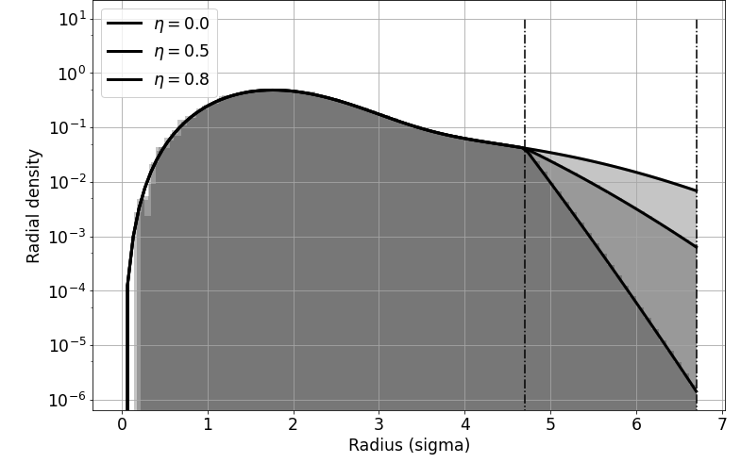
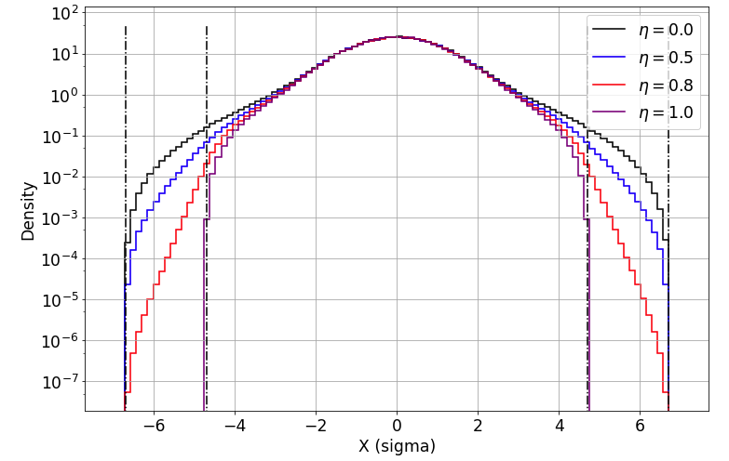
Partially depleted transverse halo
4 degrees of freedom beam distribution and halo depletion
Modified radial chi-distribution: exponential decrease in the halo
Partial depletion using a modified PDF: exponential decrease in the halo
We define η ≔ halo depletion factor (η = 1 for fully depleted halo)
Depleted halo
Projection
Depletion below 4.7 sigma from projection effect

Slide 7
Margins with depleted halo
Increased orbit excursion margin to reach critical losses
But reduced margin between beam loss detection and reaching critical loss level
Protection with dedicated interlock
    gain, delayed losses
Indirect protection
(beam losses)
    reduced margin
Illustration for BCCM triggering

Slide 8
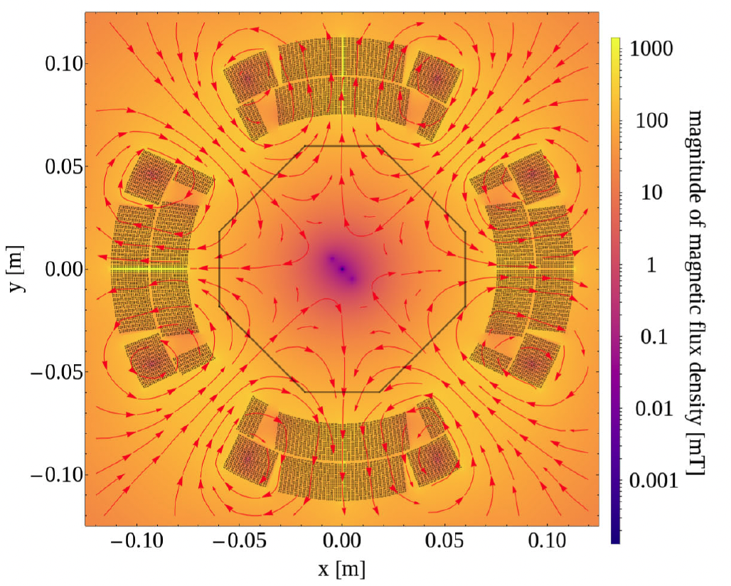
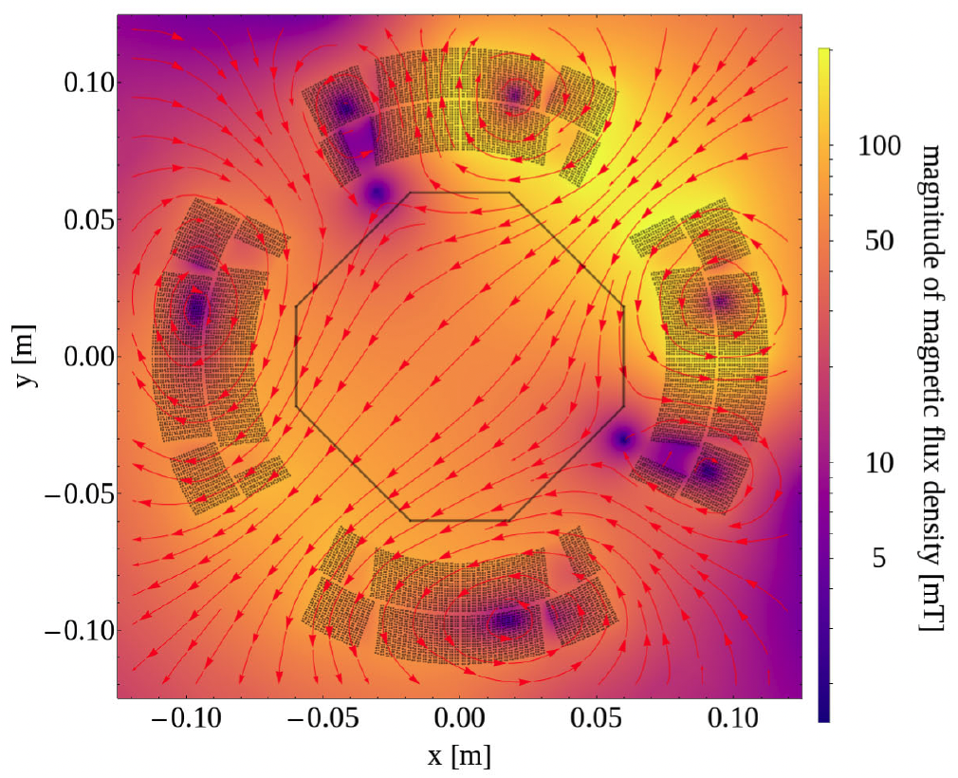
CLIQ and impact of magnet protection on the beam
Failure mode: erratic firing of CLIQ unit
  In case of a quench, for HL-LHC, the QPS will trigger a beam dump before CLIQ firing (and QHs)
Initial connection scheme for Q1-3 magnets exhibited a strong dipolar field *
  Past studies concluded that this is not compatible with the protection of the machine
  Baseline connection scheme now has a Q2-like connection for all magnets
Q2-like connection
Q1-3 connection
Field dominated by a skew-octupolar component
Field dominated by normal and skew dipolar components
LEDET/SIGMA simulations (E. Ravaioli) – Difference w.r.t main field after 5ms
(*) Additionally, in the old scheme for Q1-3, a single CLIQ unit would act on both halves of the magnet, doubling the effective length

Slide 9
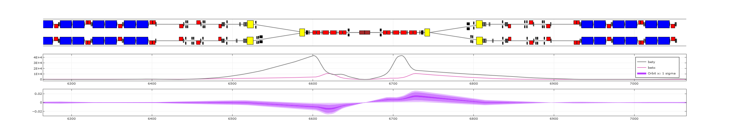
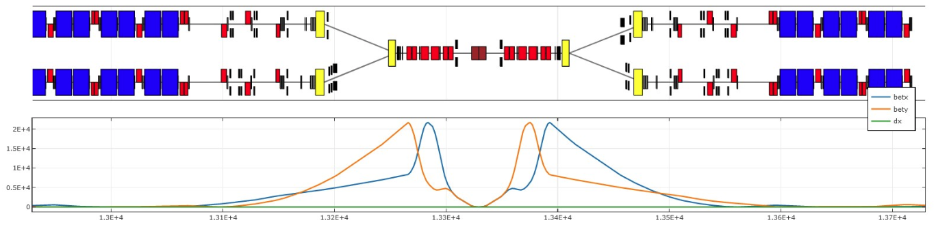

Impact on the beam
2 x 4.2m
7.15m
7.15m
2 x 4.2m
21 km
Large amplification from the $β$ function at full squeeze
Important magnetic length (4.2m for Q1-3, 7.15m for Q2)
Crossing angle (feed-down)

Slide 10
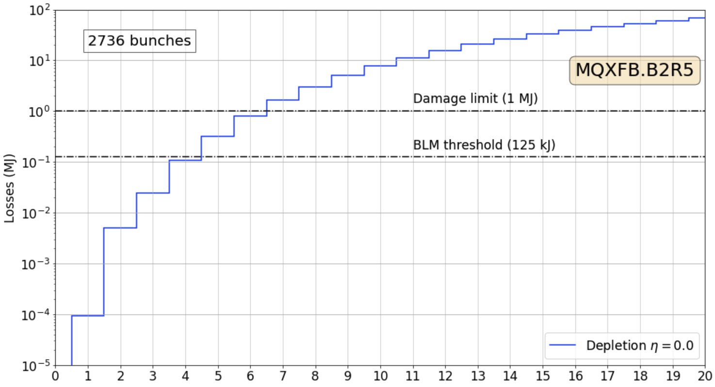
Beam losses
Losses computed from multi-particle tracking simulations
Worst case identified: MQXFB.B2R5, detailed simulation and analysis for different machine configurations
Large losses compared to the initial understanding (based on orbit excursion and beta-beating)
Critical level reached in 5 turns
Much faster than the 10-turn initially foreseen interlock

Slide 11
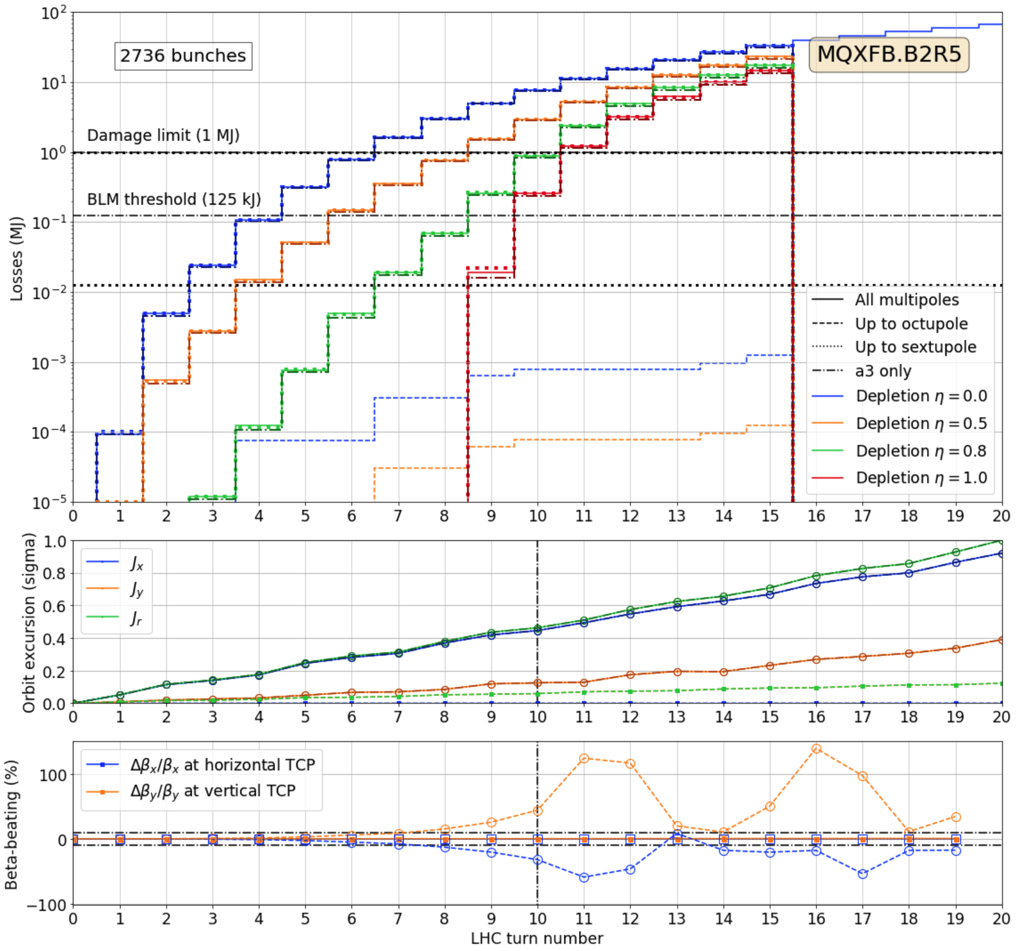
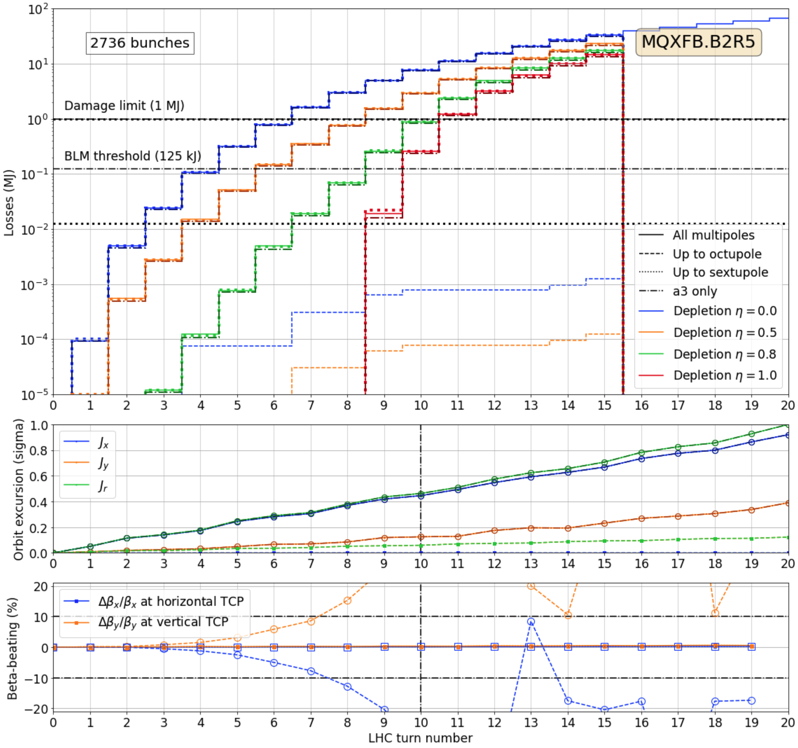
Beam losses
Q2b R5
Cannot correlate with orbit excursion nor beta-beating
Isolate the multipoles and conclude that the skew-octupolar field is solely responsible
Halo depletion (e-lens) effects:
  Margin further reduced
  (1 turn at 50% depletion)

Slide 12
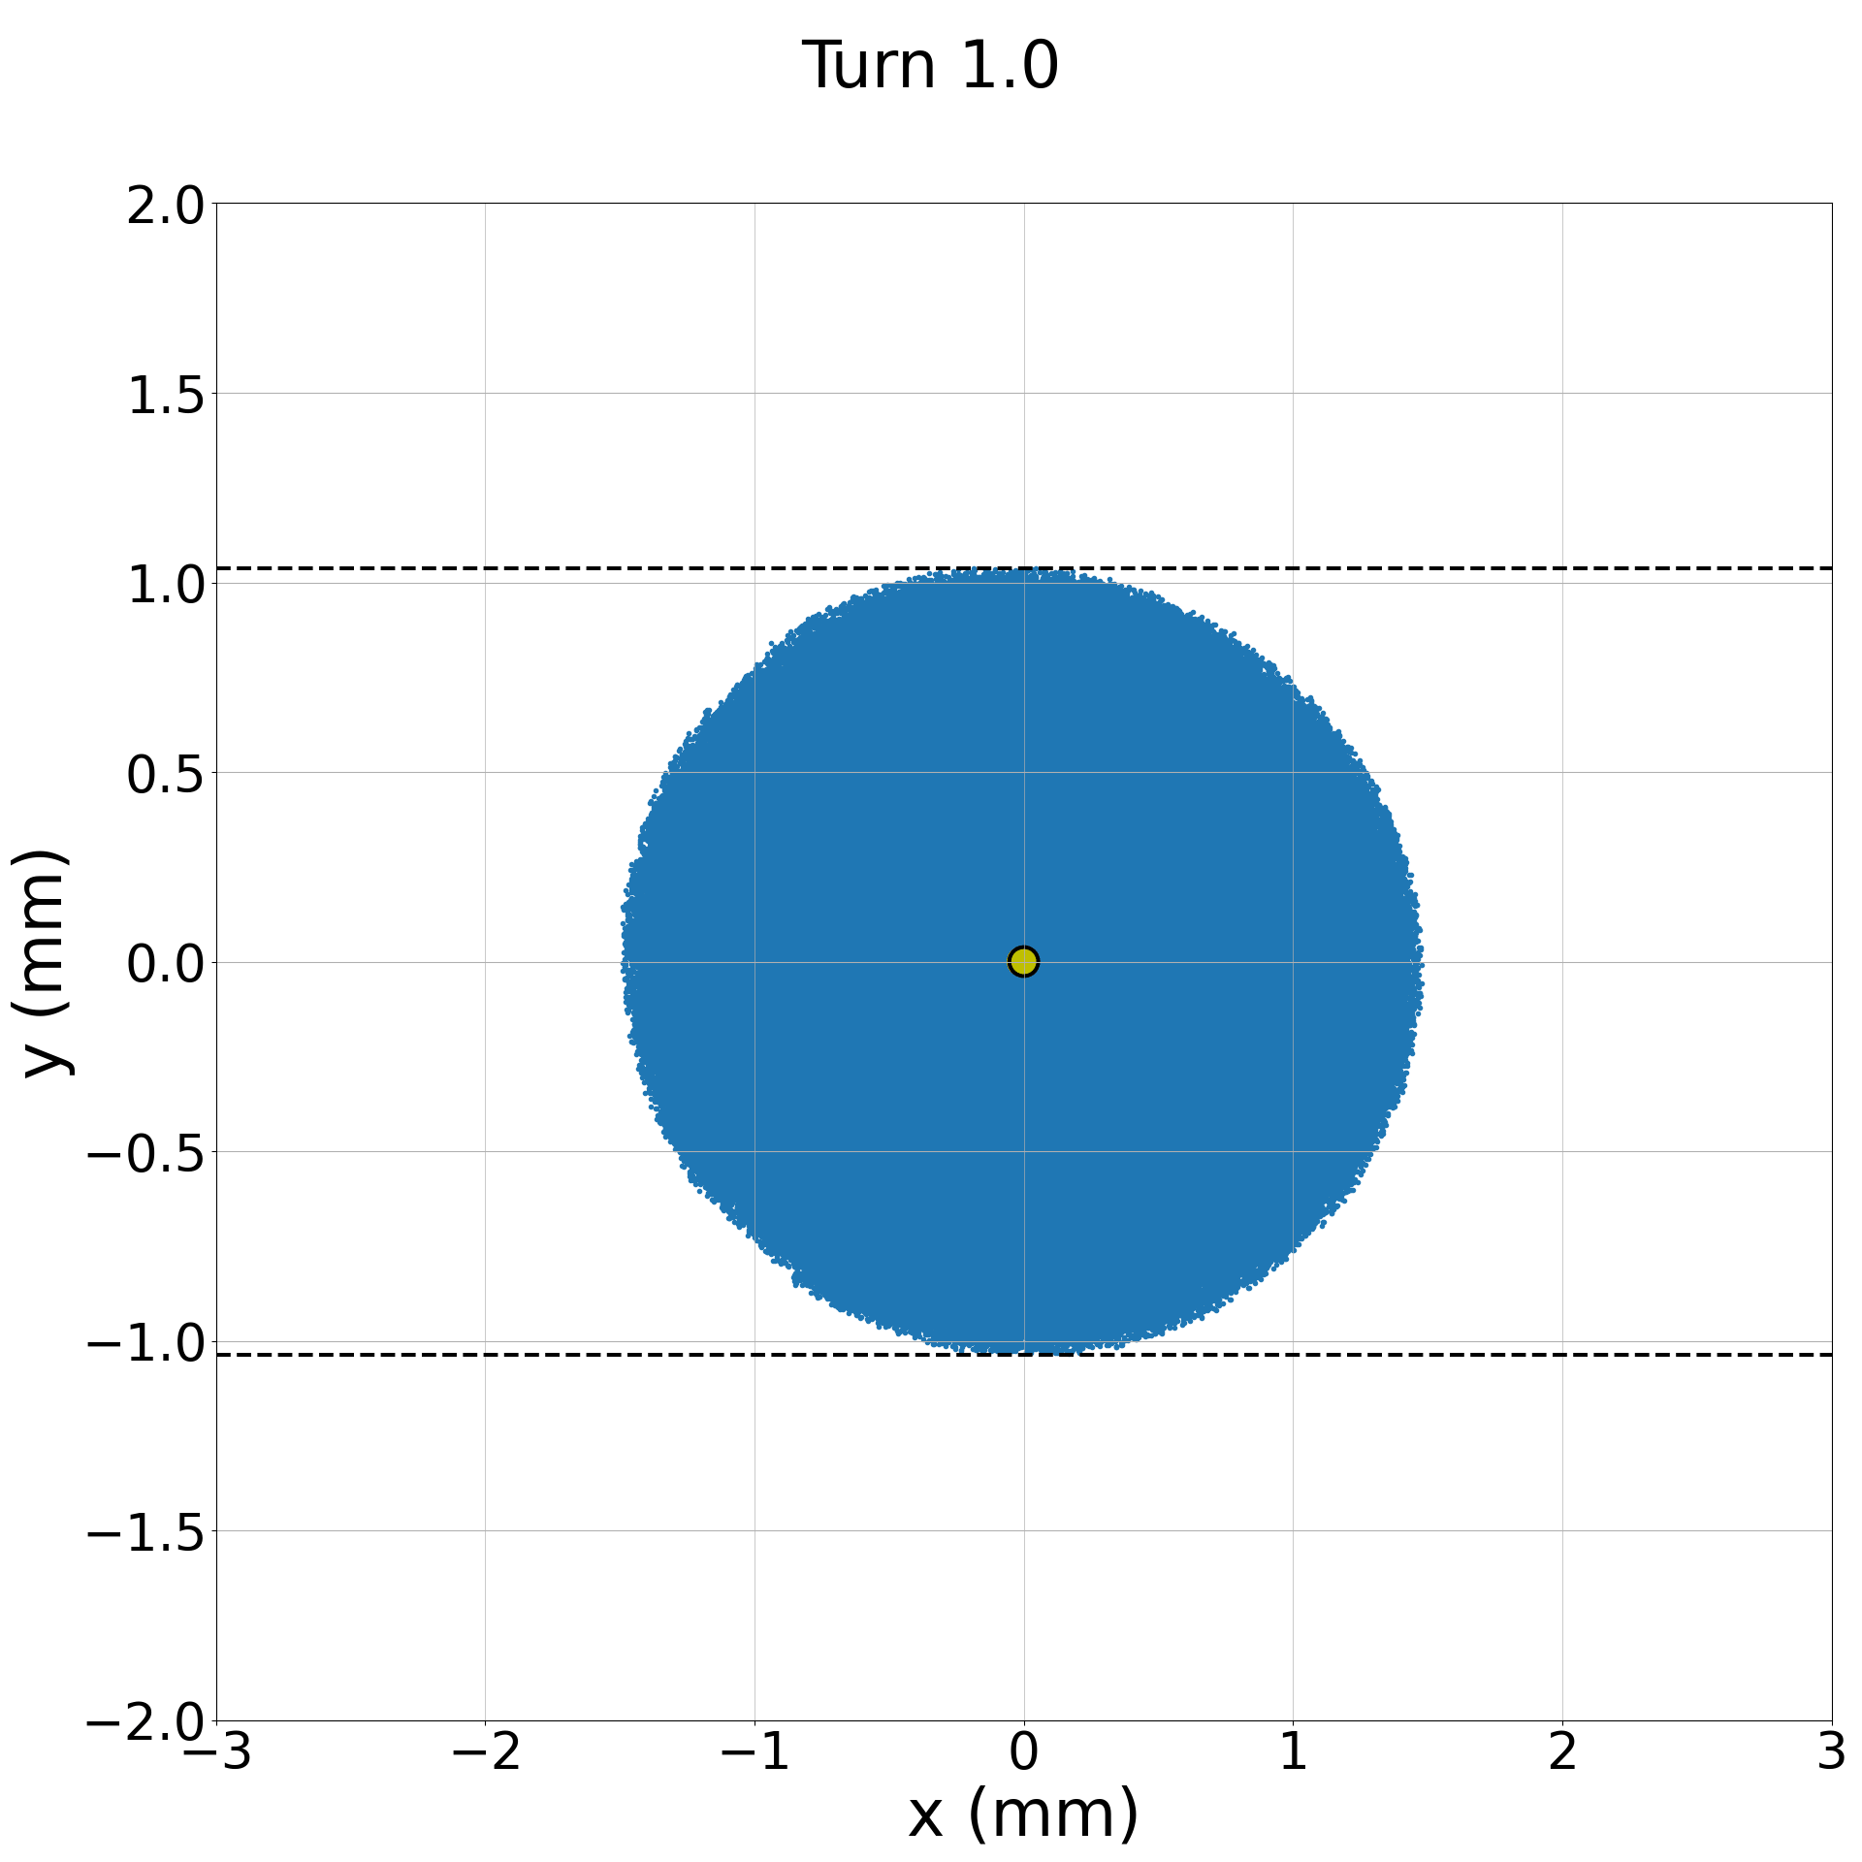
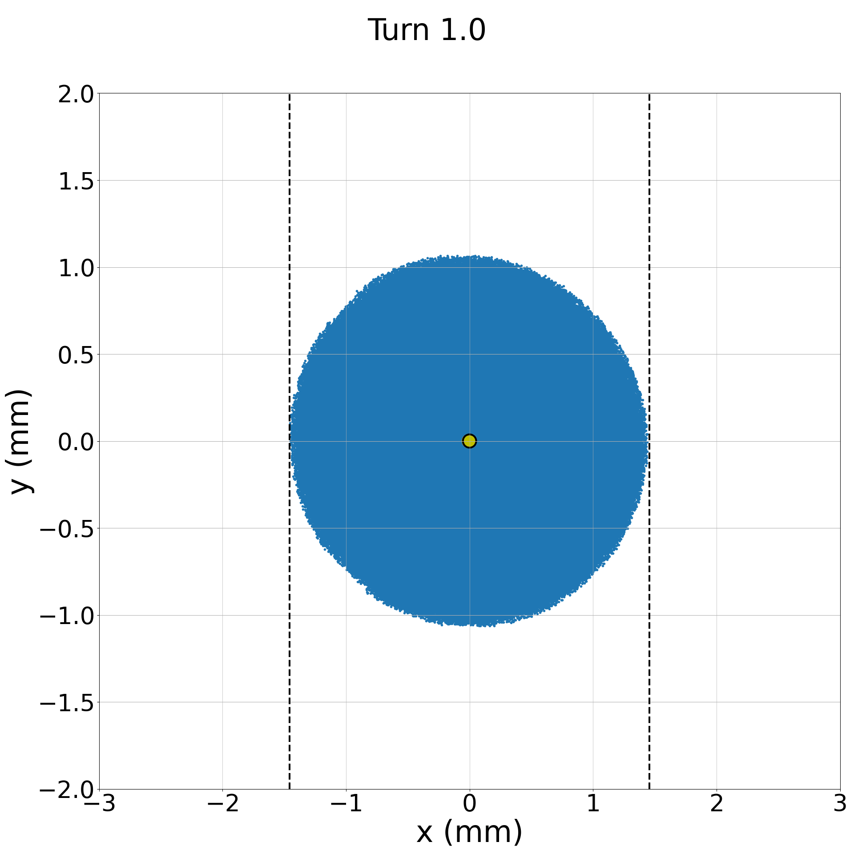
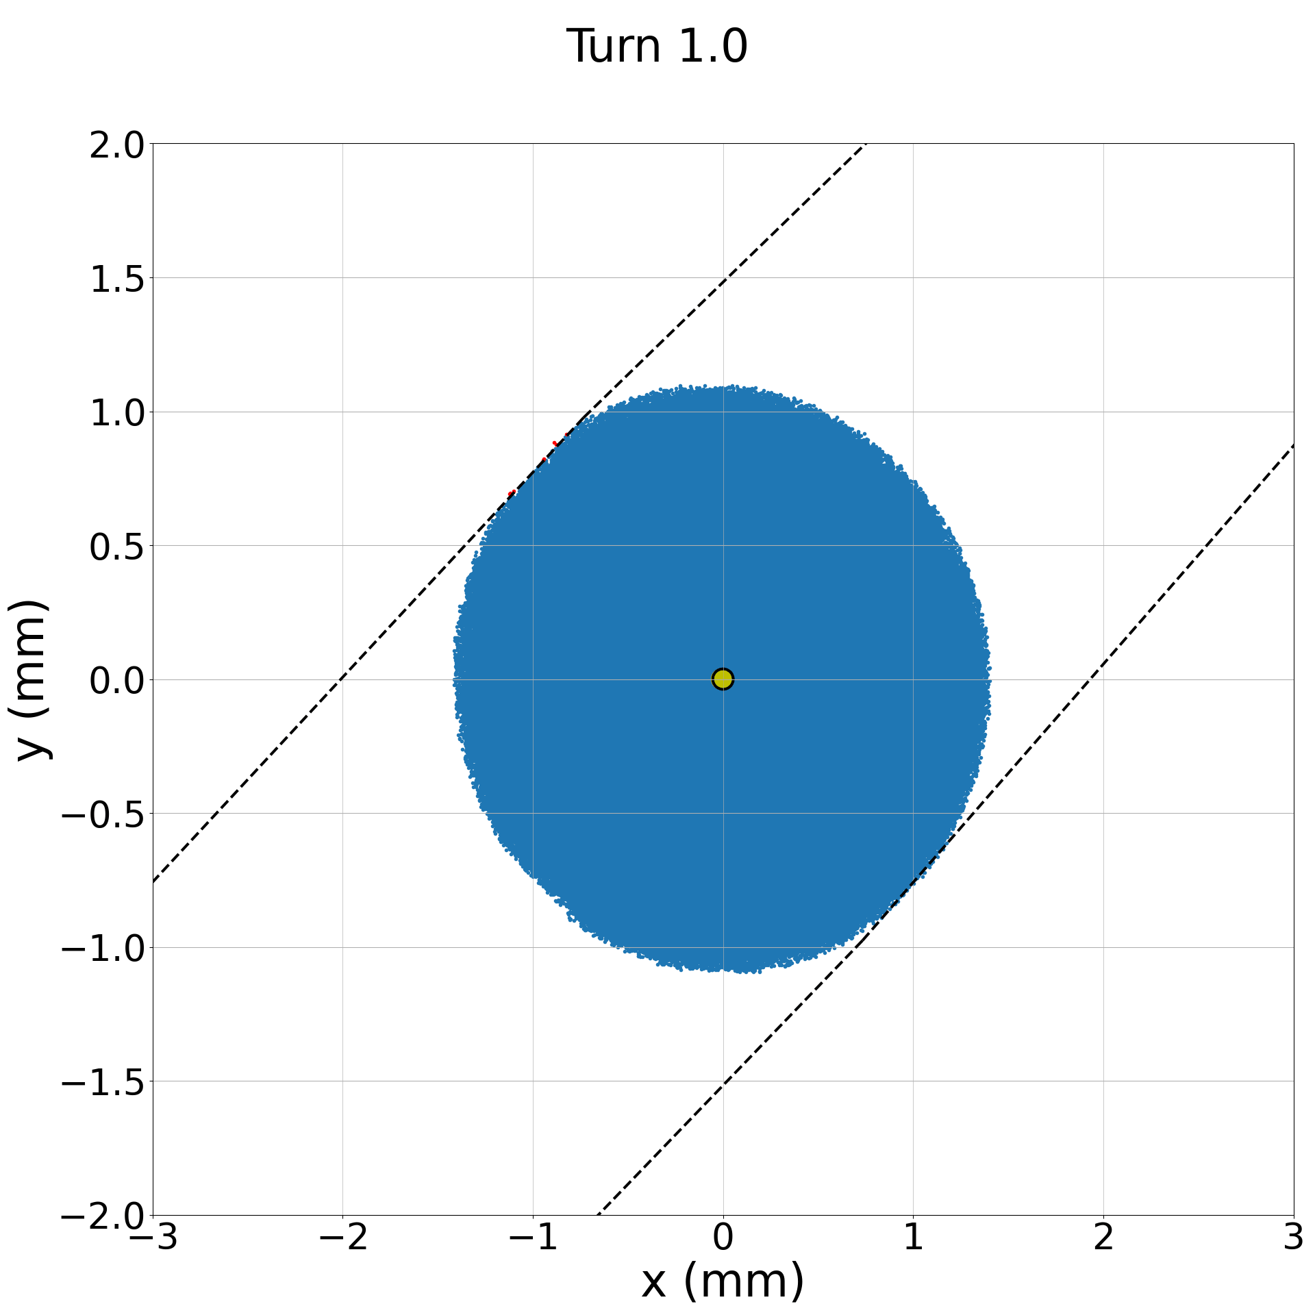
Beam losses at the TCPs
Turn-by-turn losses at the TCPs in IR7
TCP.D6L7 (vertical)
TCP.C6L7 (horizontal)
TCP.B6L7 (skew)

Slide 13
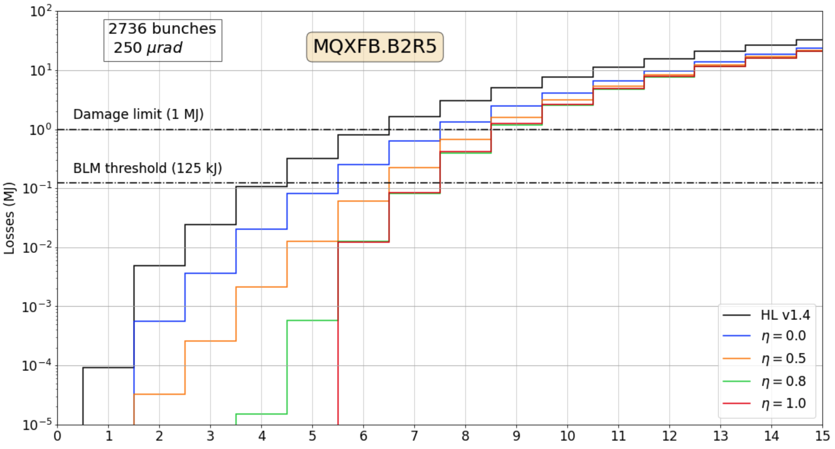
HL-LHC v1.5 configuration with relaxed collimator settings
Open collimator settings (8.5 sigma) provide 1 turn additional delay but the failure detection to loss margin is not increased

Slide 14
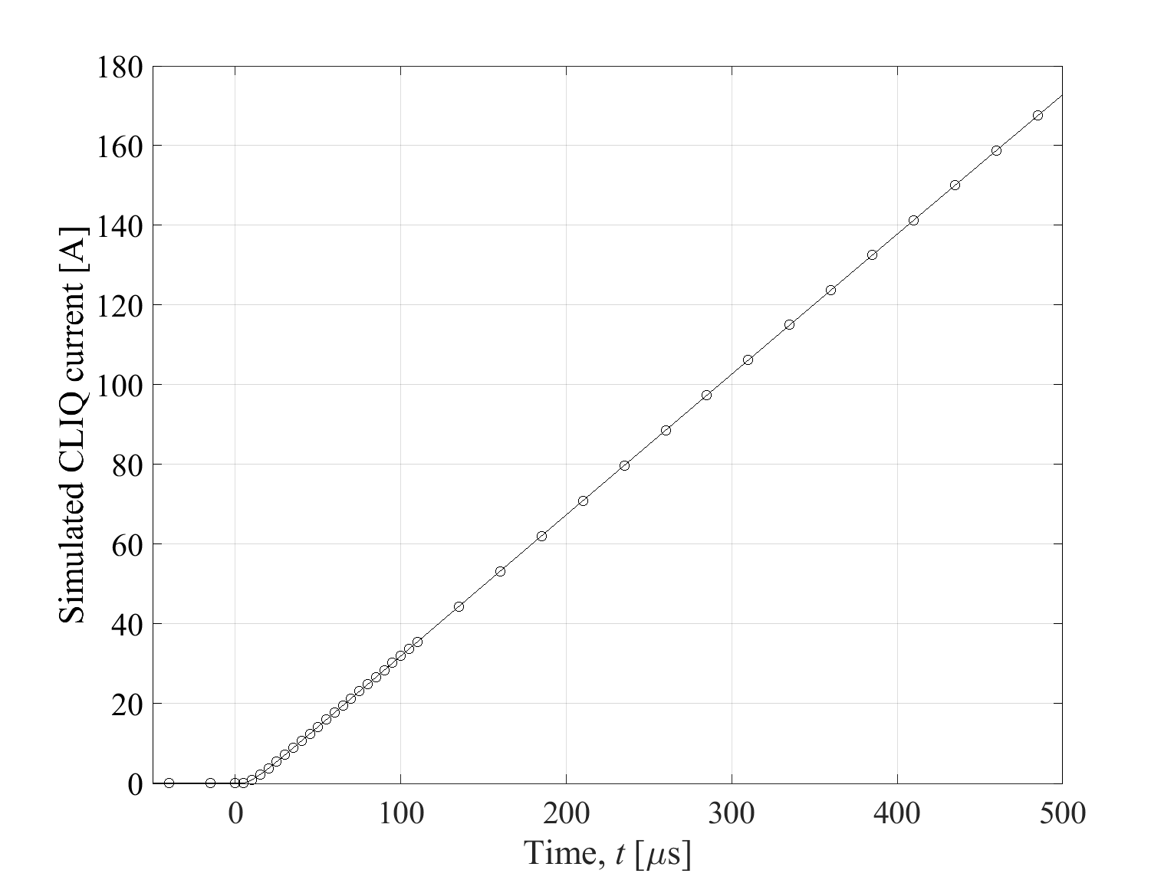
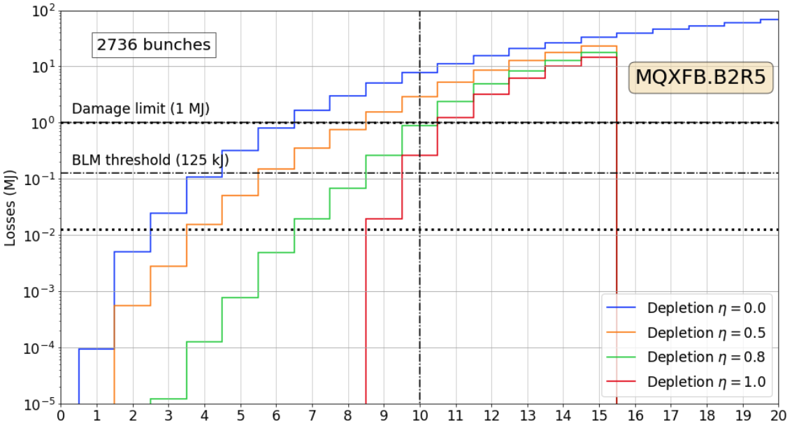
Conclusions on criticality and interlocking
Need a very fast dedicated interlock
  Interlock the capacitive discharge protects the worst-case scenario, also for depleted halo
See J. Uythoven’s presentation: R2E development for PIC and BIS in HL-LHC
Onset to damage margin | 450 μs
Propagation via BIS from P1 to P6 | - 100 μs
LBDS synchro. | - 89 μs
Extraction | - 89 μs
Allowed interlock reaction time | = 170 μs

Slide 15
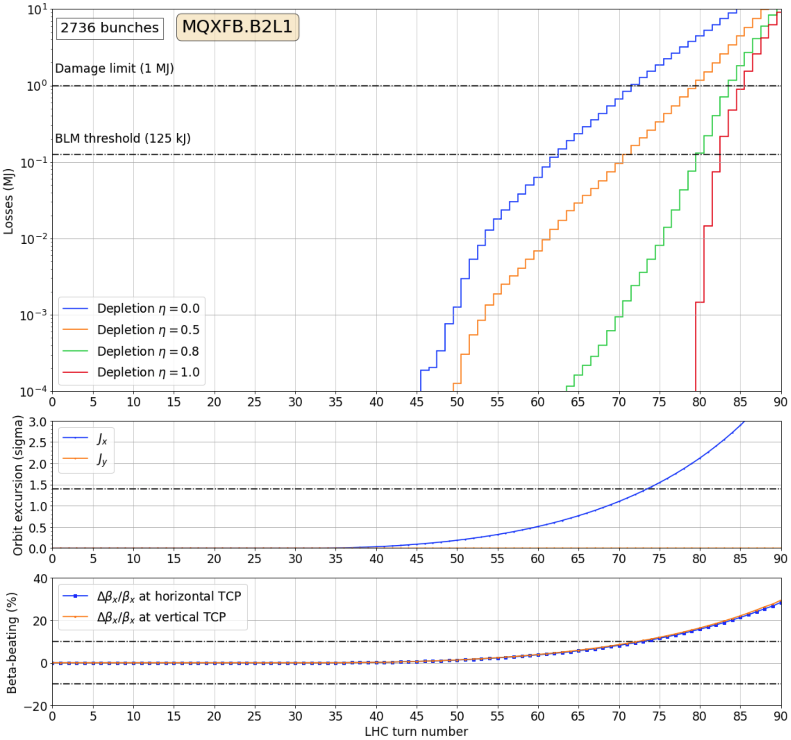
Symmetric triplet quench
Use the orbit excursion estimates to identify the worst case (MQXFB.B2L1) and perform a detailed simulation and analysis
Tracking losses confirm the initial understanding
Critical level reached in 72 turns (non depleted halo) or 85 turns (fully depleted)
2-turn margin for BLM interlock
Beta-beating does not play a major role, collimation hierarchy not an issue

Slide 16
Conclusions on criticality and interlocking
Constraints on the symmetric quench detection | TCP @ 6.7 | TCP @ 8.5
Onset to damage margin | 6480 μs | 7476 μs
Propagation via BIS from P1 to P6 | - 100 μs | - 100 μs
LBDS synchro. | - 89 μs | - 89 μs
Extraction | - 89 μs | - 89 μs
Allowed interlock reaction time | = 6200 μs | = 7200 μs
For non-depleted halo, dumping on the BLM losses provides sufficient margin (10 turns)
Maximum tolerable halo depletion at 50% to provide sufficient margin between beam loss detection and critical losses
Dynamics of the symmetric quench and its detection is crucial for beams with depleted halo!

Slide 17
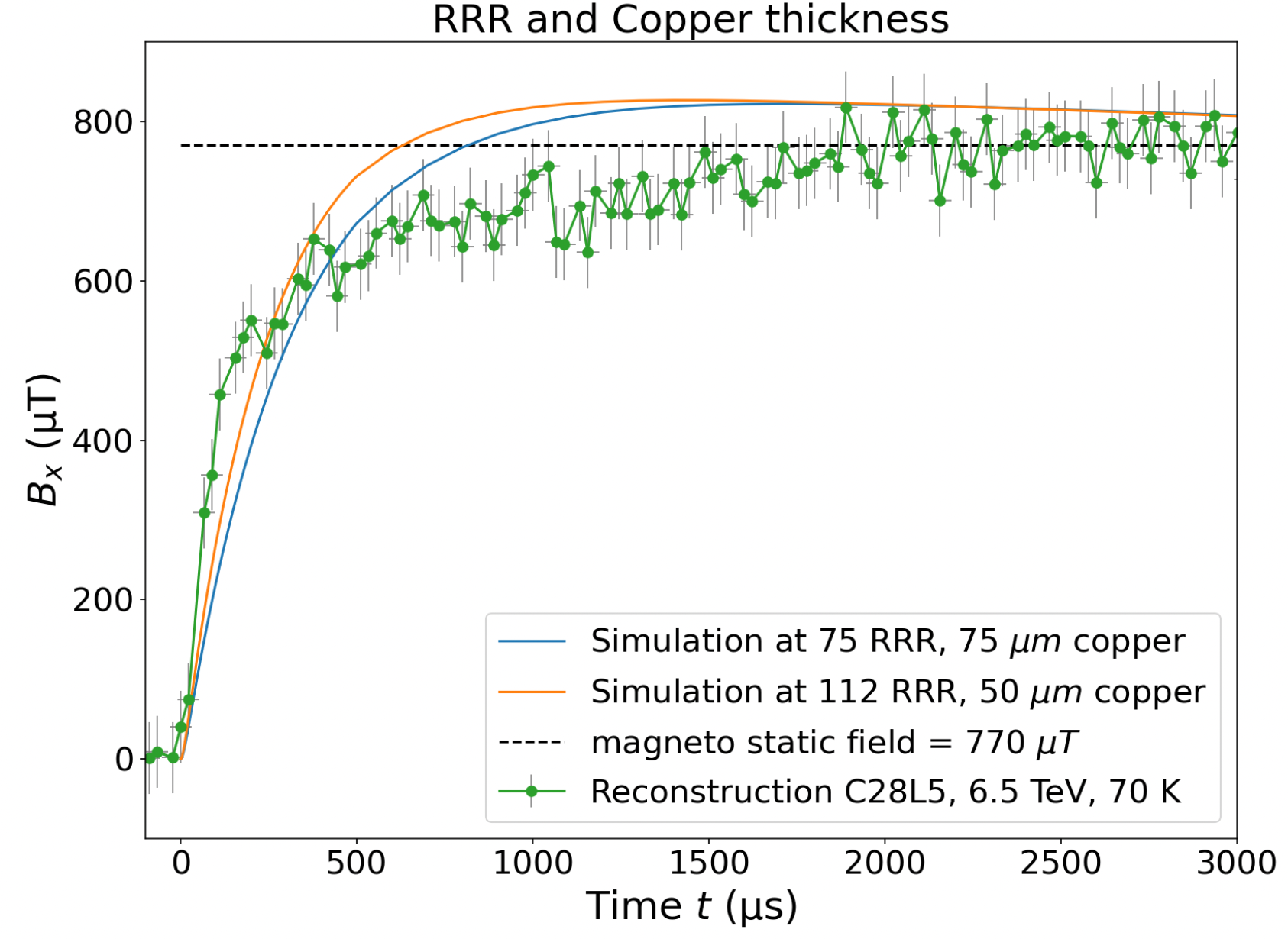
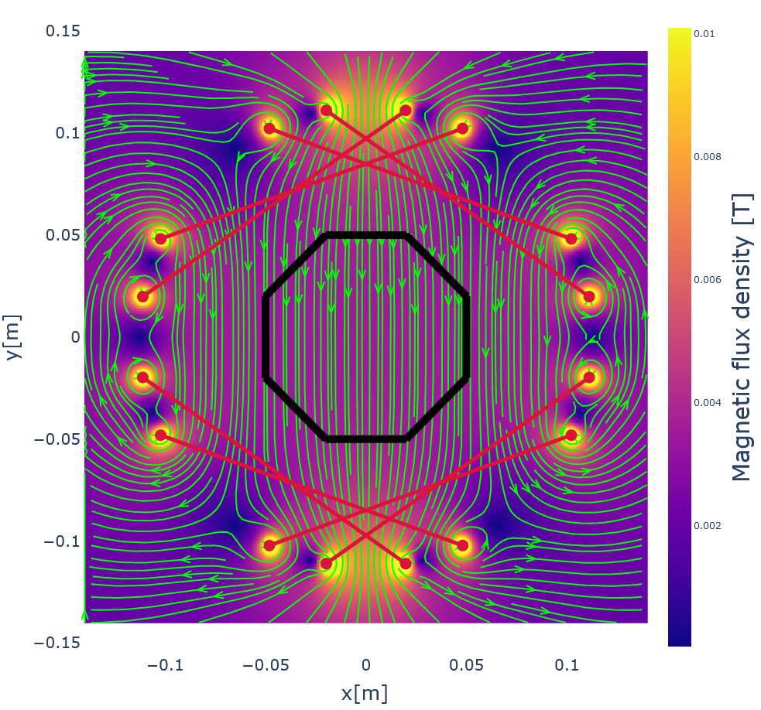
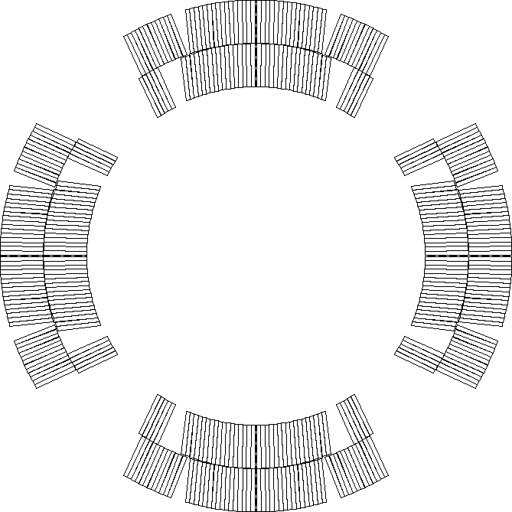
Quench heater effect on the beam
Spurious triggering of one QH unit cannot be excluded
Very fast current rise ~30 μs
Beam oscillations observed at the LHC
Field reconstruction from BPM data consistent regarding field levels and rise times
QH field reconstruction from BPM measurements
HF3
LF3
LF2
HF2
HF4
HF1
LF4
LF1
LF1
LF4
HF1
HF4
L. Richtmann, M. Sc. Thesis, 2021.
HF2
LF2
LF3
HF3

Slide 18
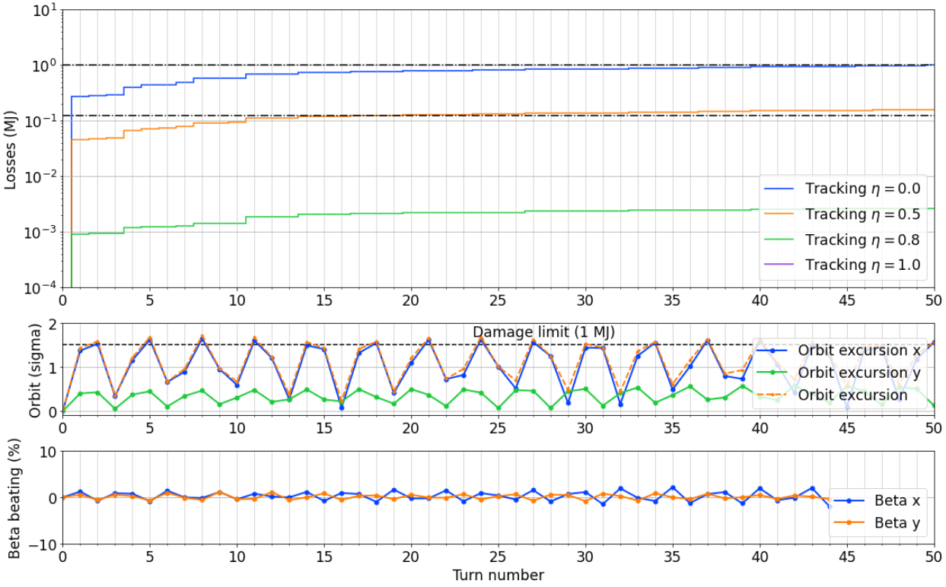
Quench heater spurious discharge
D1 – Single QH circuit (worst case)
For non-depleted halo, dumping on the BLM losses provides sufficient margin (10 turns)
At full halo depletion, only 2-turn margin between BLM detection and damage Dynamics of the symmetric quench and its detection is crucial for beams with depleted halo!

Slide 19
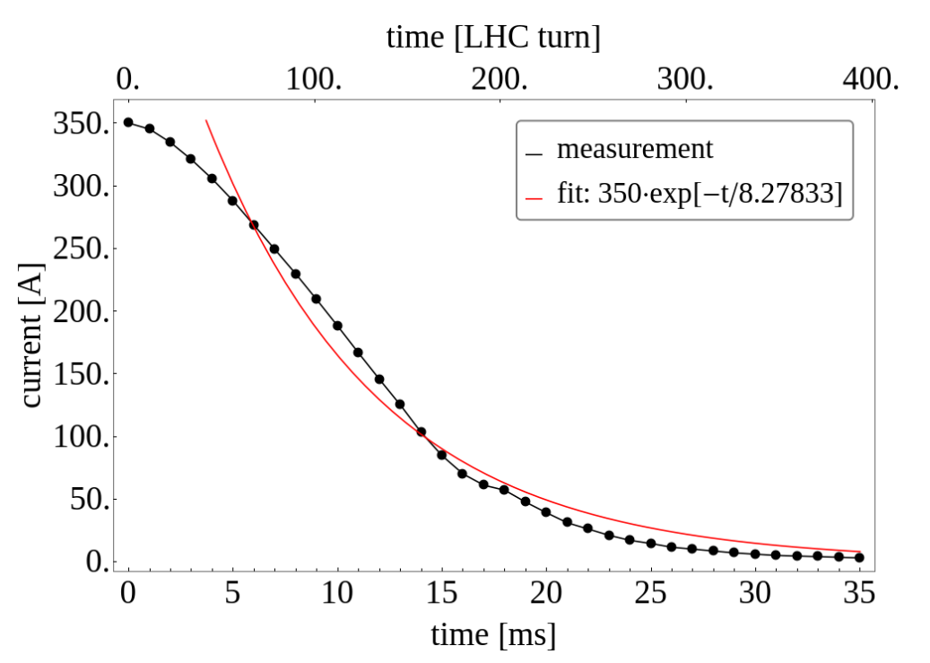
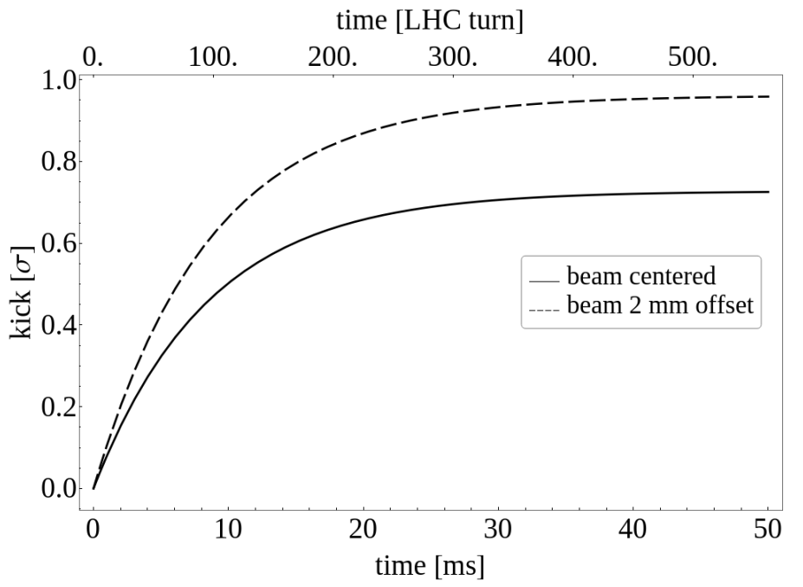
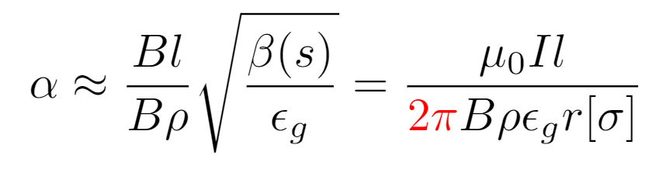
BBCW powering failure
The powering failure implies a current decay modeled with an exponential fit on measured data
We also consider the (hypothetical) case where the fields go to zero instantly
In case of failure, we did not model
  The reaction of the orbit feedback
  The tune feedback
Dipolar effect
But all multipoles present

Slide 20
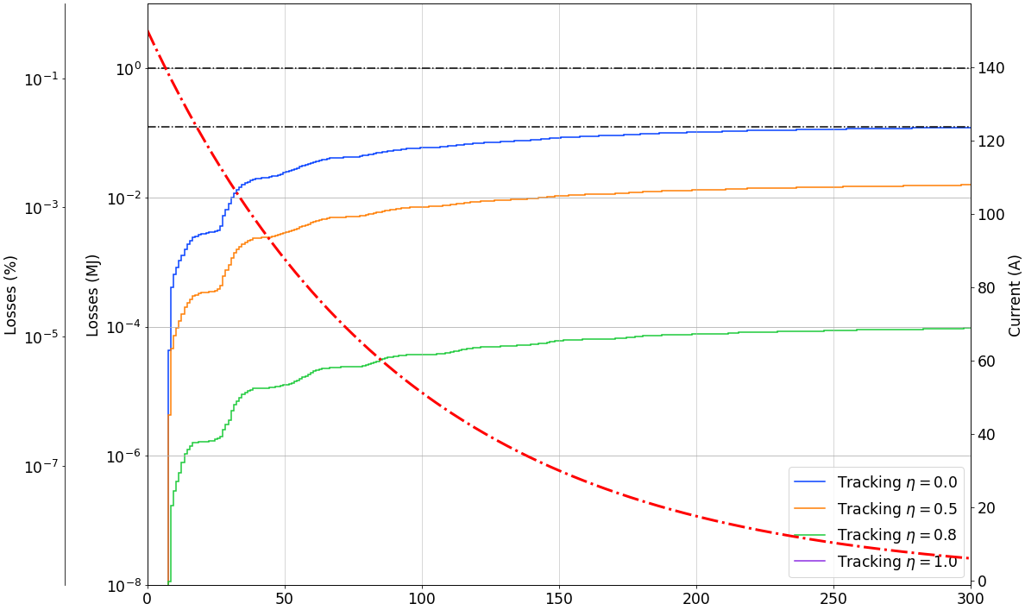
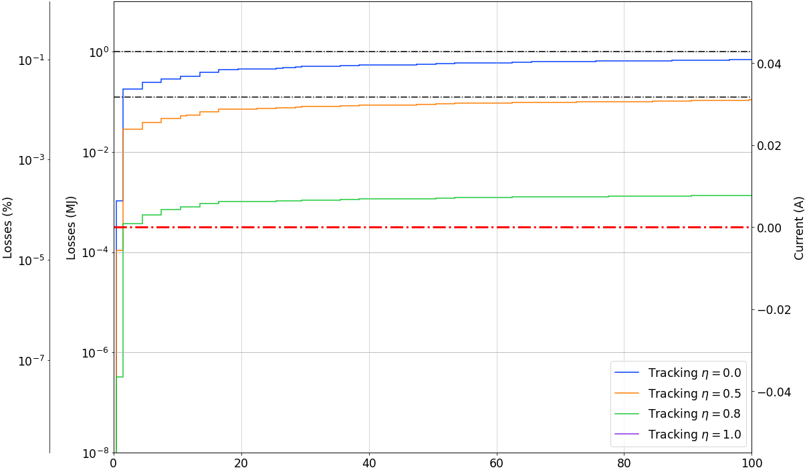
Beam losses
Exponential decay starting at 150 A
for wire installed in 4L5
  BLM threshold reached “asymptotically” (not before 300 turns, 26.7 ms)
  Critical loss level not reached
Instantaneous switch off
  “Worst case” for the field decay
  BLM threshold reached at turn 2
  Critical loss level not reached
Critical loss level
Critical loss level
BLM threshold
BLM threshold

Slide 21
Conclusions on criticality and interlocking
Criticality is low: losses remain below the critical loss level
For an exponential decay, reaching BLM threshold would occur late (> 300 turns, 26.7ms) leaving enough time for the WIC interlock to act as protection
Halo depletion has a beneficial effect !

Slide 22
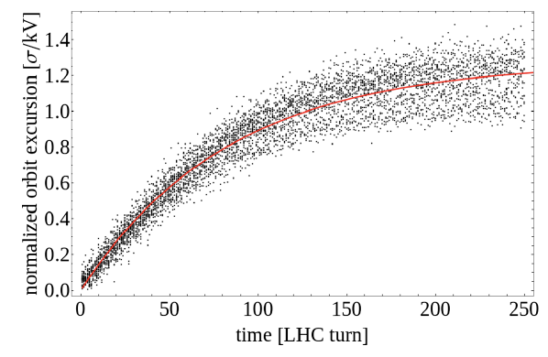
ADT coherent excitation
ADT operation in coherent excitation mode
Potential fast-failure leading to beam losses reaching the critical loss limit within few milliseconds
Orbit excursion is a superposition of coherent excitation and always-on damping
Objectives
Determine the operational envelope for allowed operation with the ADT in coherent excitation for HL-LHC with different halo depletion factor
ADT model from measurements
Measured coherent excitation of the beam by the ADT normalized to the applied voltage at 6.5 TeV with fitted scaling law

Slide 23
ADT coherent excitation
Operational envelope (211th MPP) defined:
  Limit the ADT active window length to 2 batches (480 bunches) for HL-LHC
    Further restriction to 1 batch (240 bunches) if operating with depleted halo
  Limit the maximum voltage at injection energy to 5.0 kV

Slide 24
Conclusions
Derived a parametric beam model for partially depleted halo
  Need to refine beam halo measurements at larger amplitudes during Run III
CLIQ
  Most critical fast failure case identified for HL-LHC: fast dedicated interlock foreseen (PDSU-PIC)
Quench heater spurious discharge - Beneficial effect from partial halo depletion, D1 most critical
Symmetric triplet quench - Sufficient margin for non-depleted halo; 2-turn margin at full depletion
ADT coherent excitation - ADT excitation window limited to 480 bunches; voltage limited at injection
BBCW - Low criticality, protection from WIC sufficient - beneficial effect from halo depletion

Slide 25
Questions?

Slide 26
Back-up

Slide 27
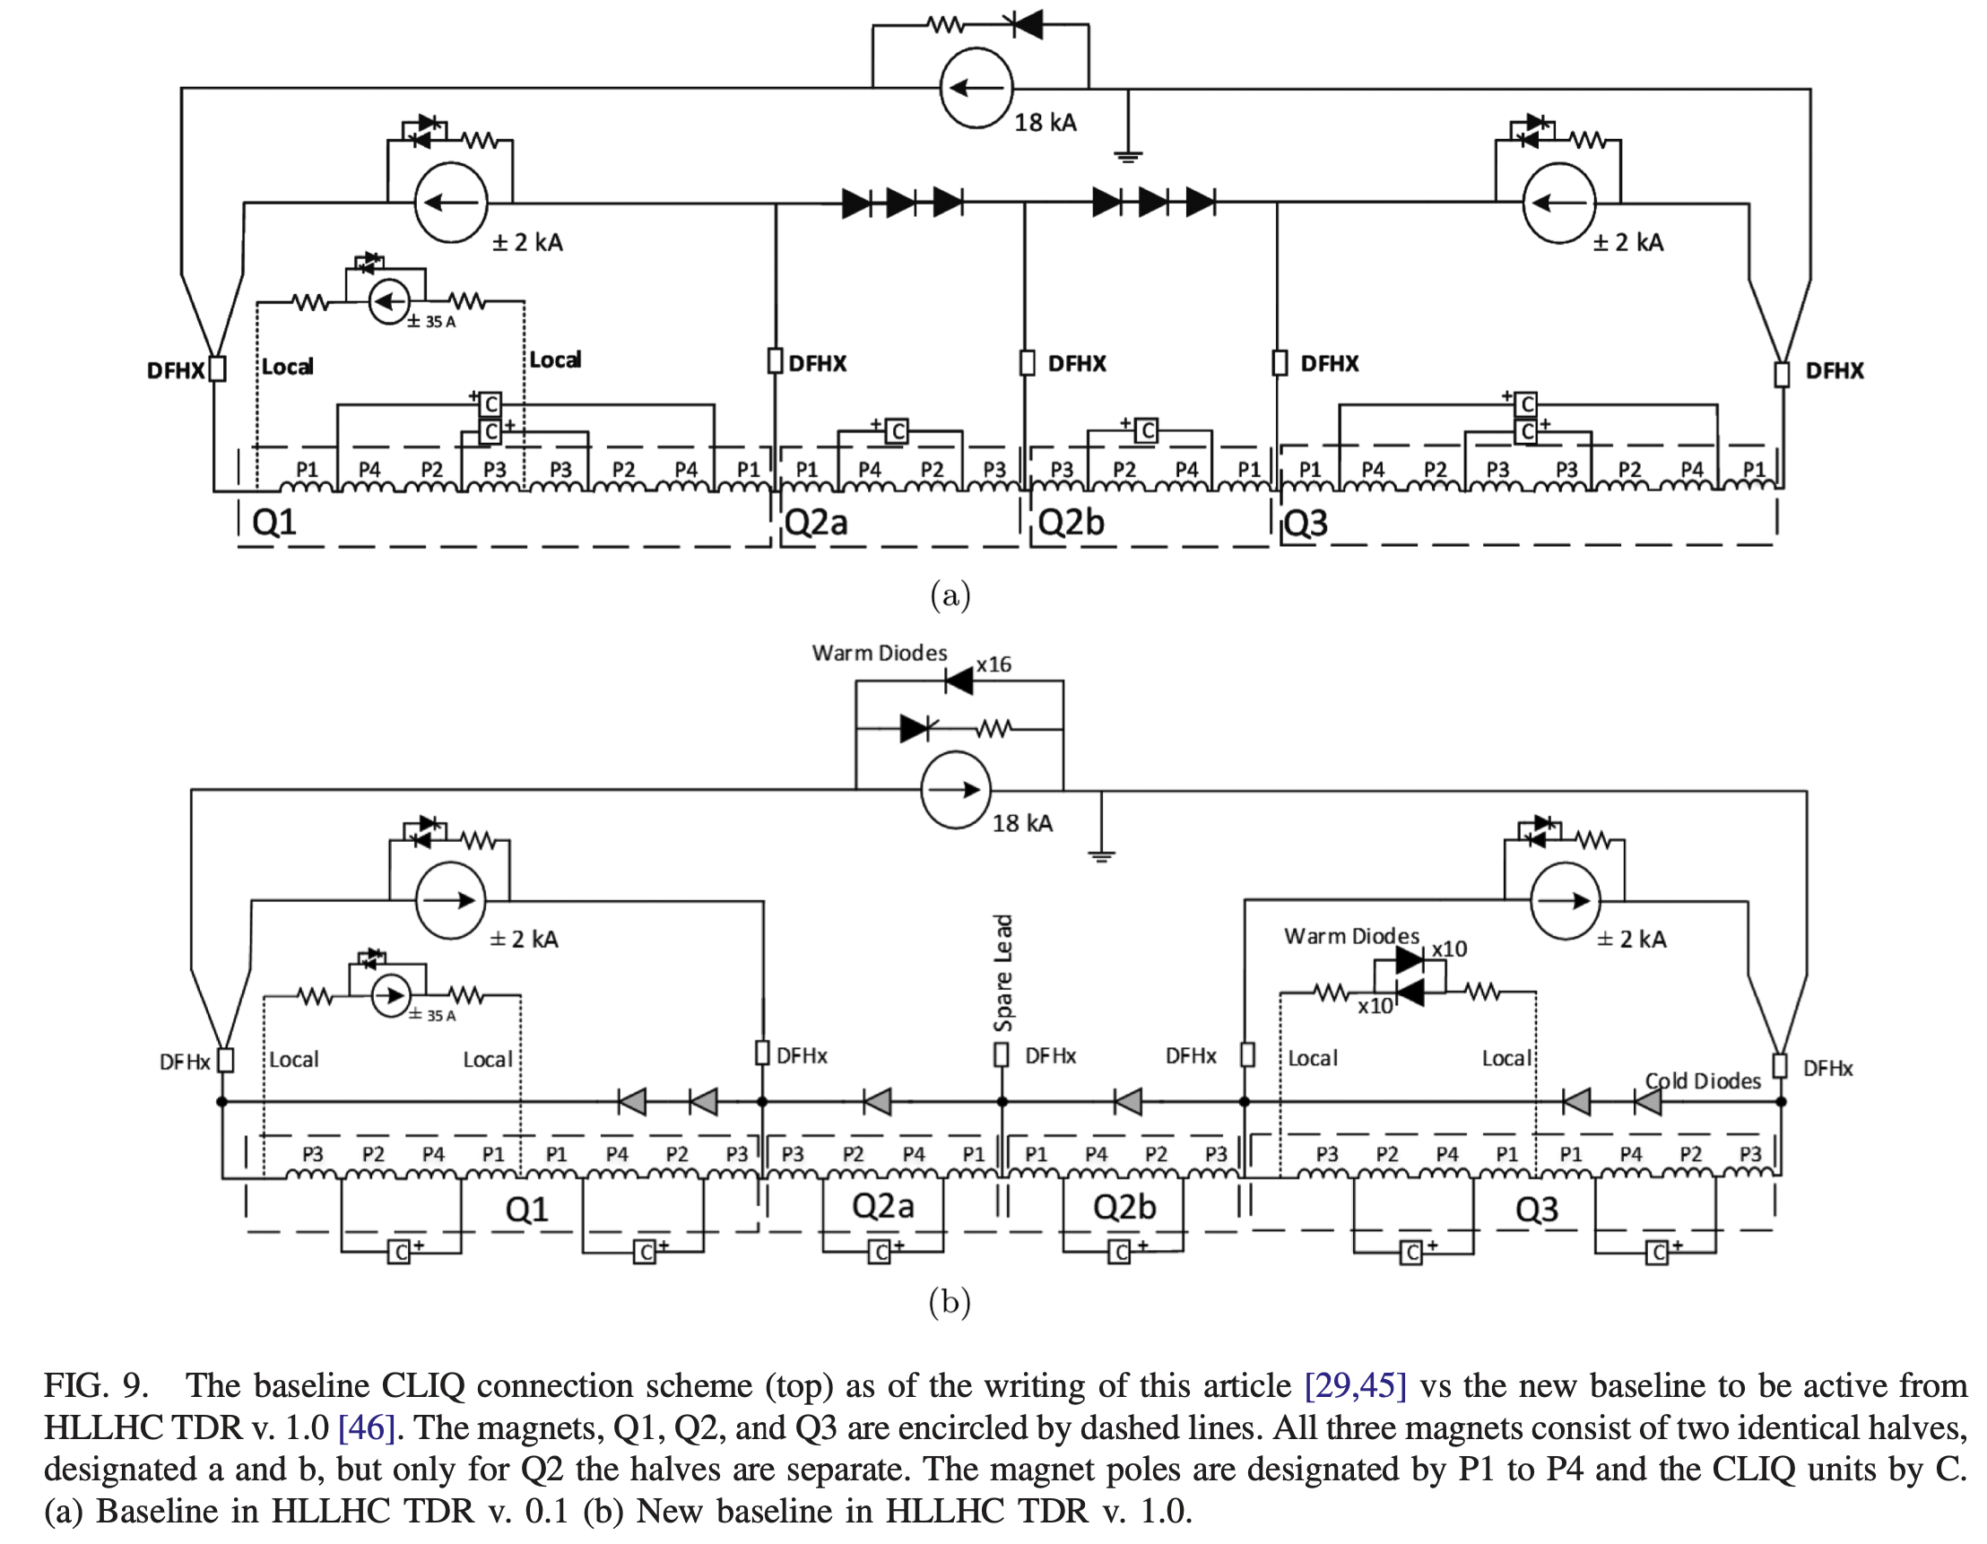
CLIQ connection scheme
Old
Baseline
For reference

Slide 28
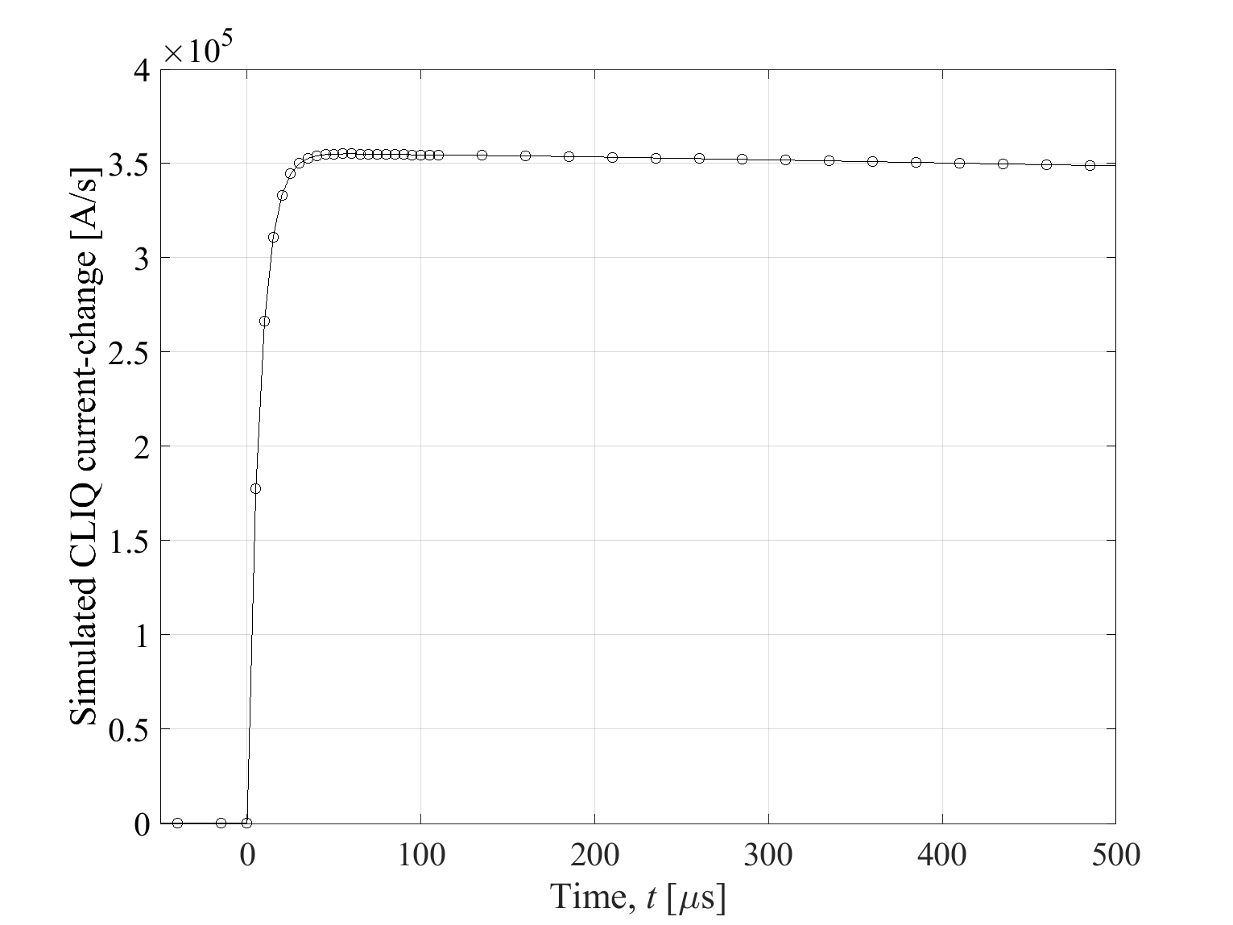
CLIQ current
Rise-time shown below for the first 5 turns
LEDET simulations (E. Ravaioli)

Slide 29
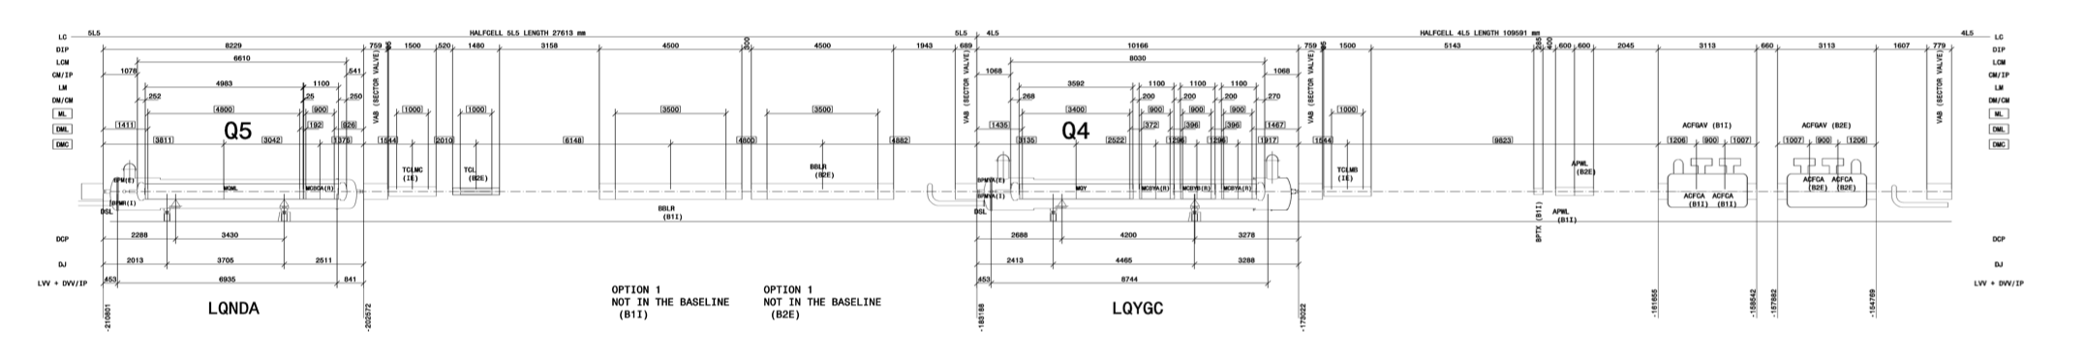
BBCW for HL-LHC
Layout based on EDMS-2037987
Space reservation request based on HL-LHC v1.3
Drawings of space reservation
  Left of IP1 & Right of IP1
  Left of IP5 & Right of IP5
Q5
BBLR
B1 & B2
Q4
CC

