Slide 1


12th HL-LHC Collaboration meeting, Uppsala, 22.09.2022
Status of the cryogenics system of the HL-LHC IT String
A. Perin, on behalf of the WP16 cryogenics team
Indico: https://indico.cern.ch/event/1161569
A. Perin, CERN TE-CRG

Slide 2
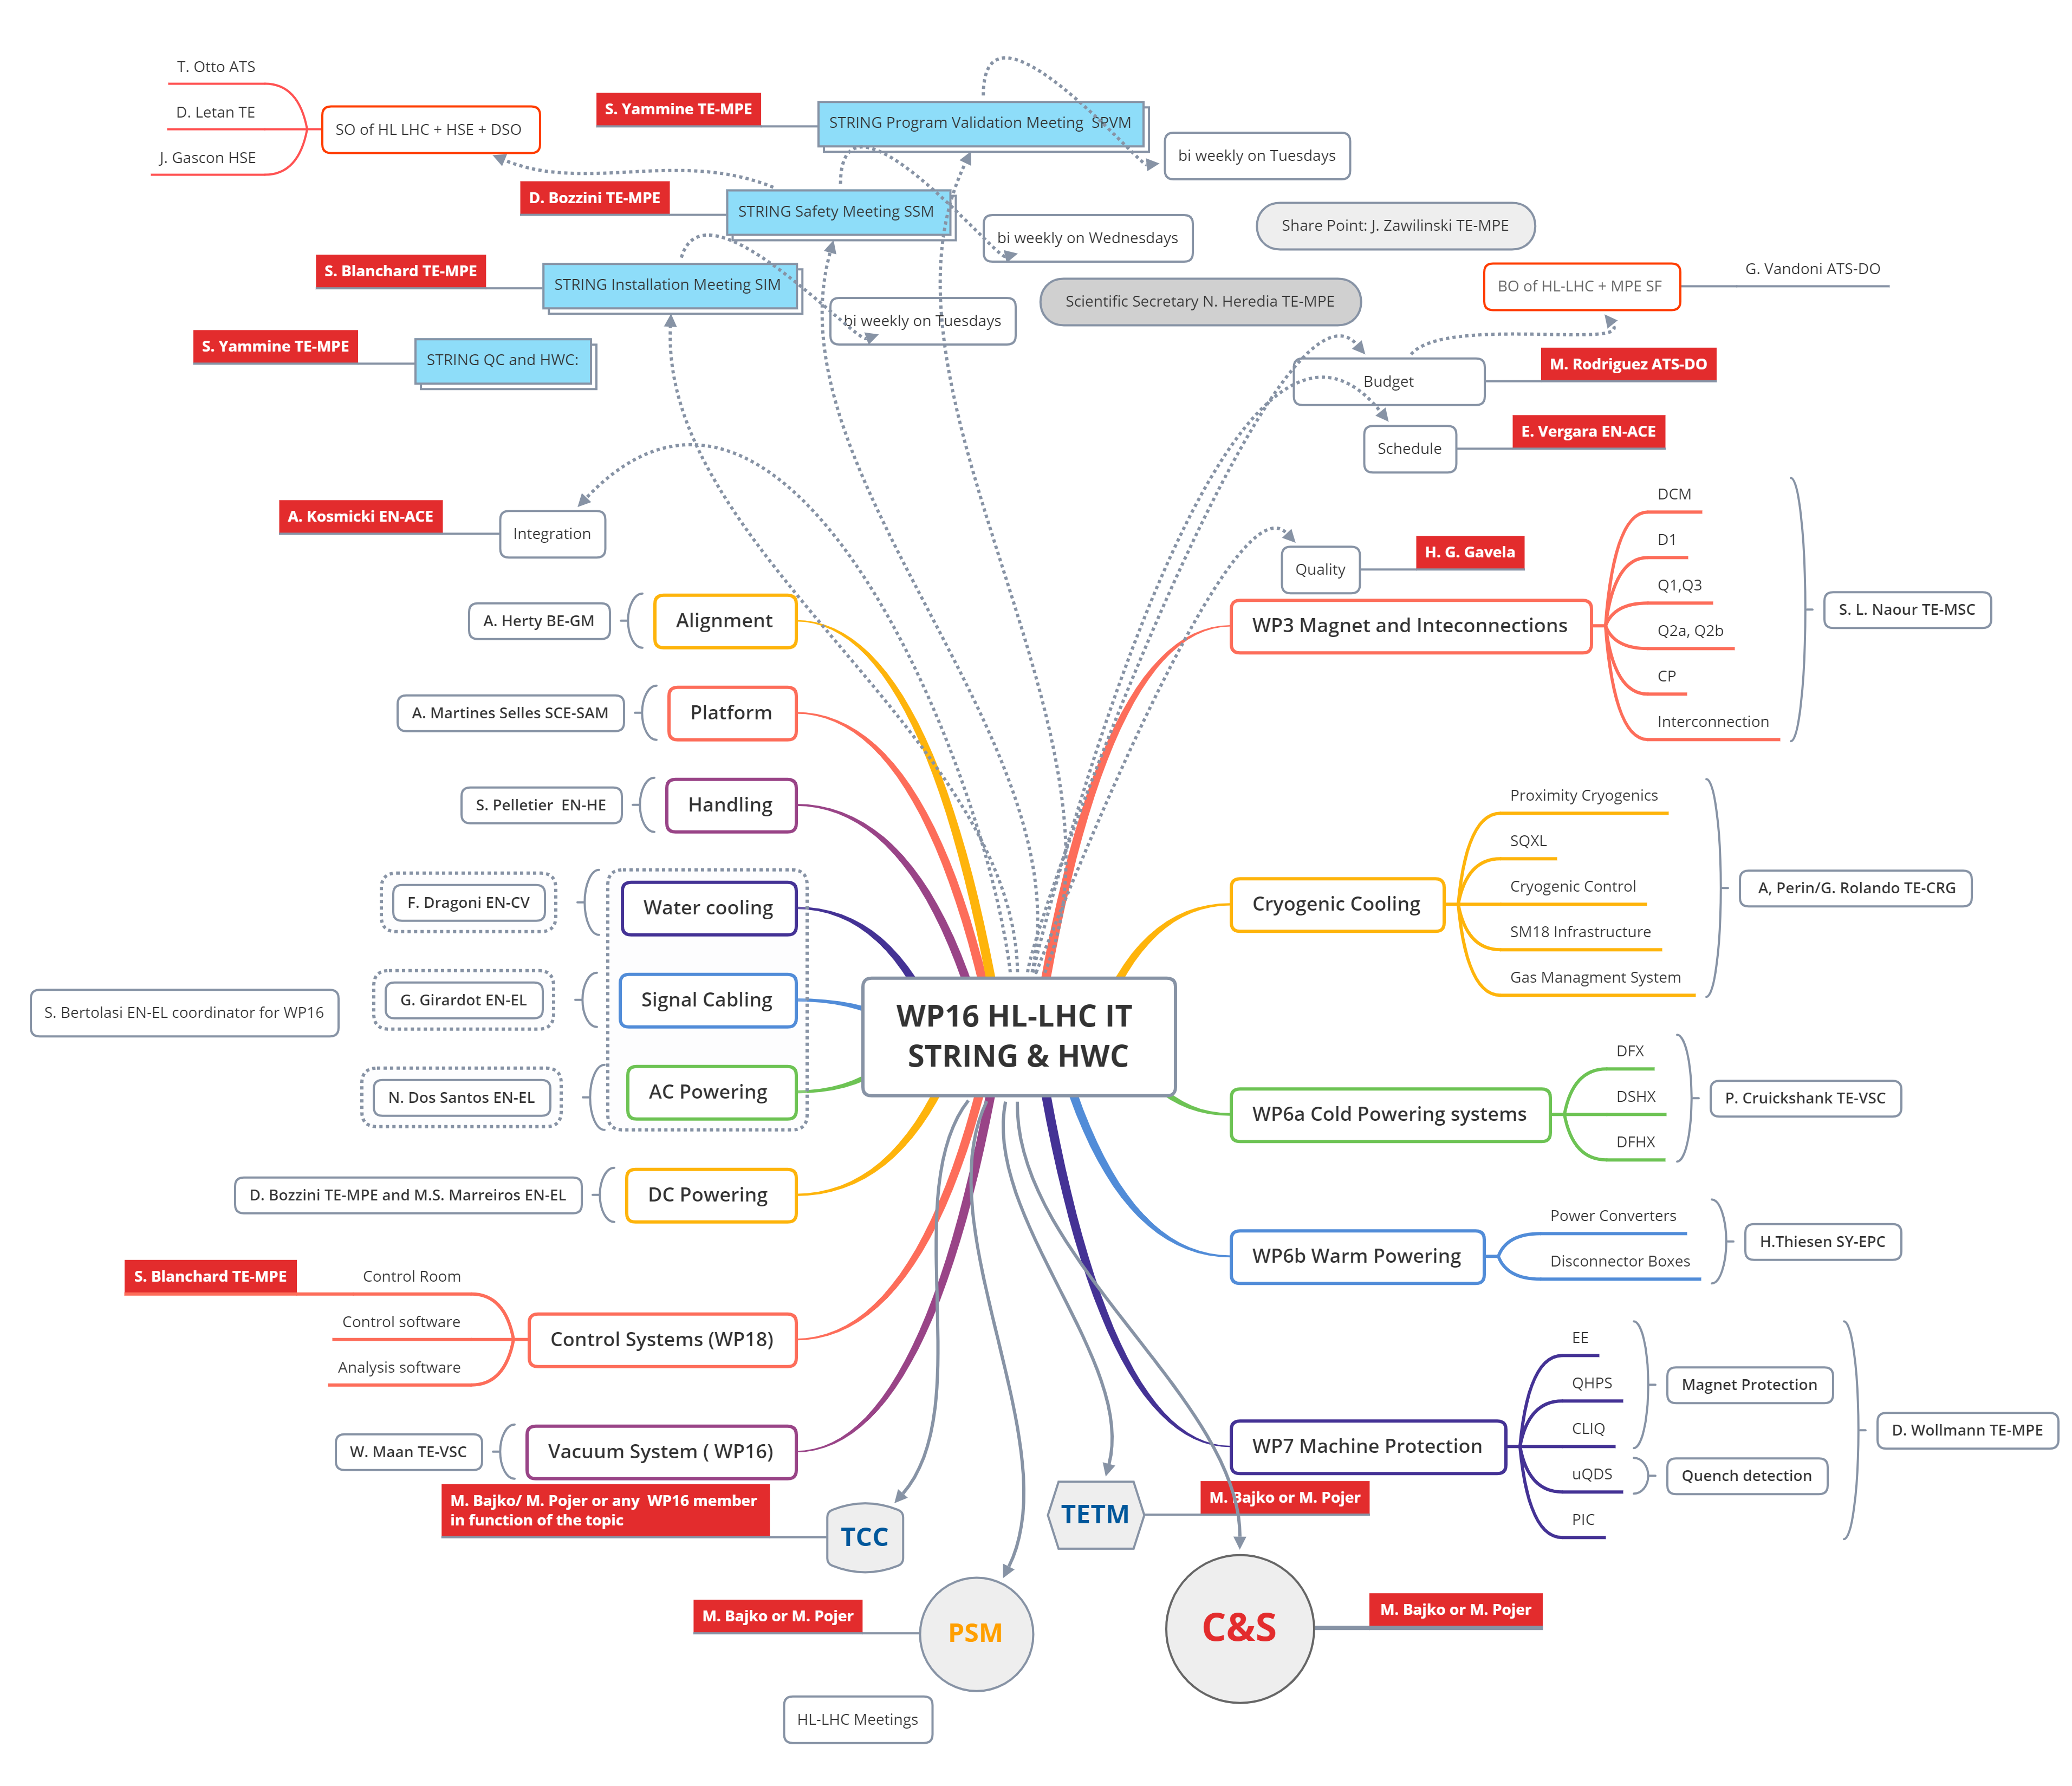
Overview – Cryogenics for WP16
All cryogenic process aspects
Design, construction and installation of the String specific cryogenic infrastructure and cryogenic distribution system
Cryogenics data acquisition and control system
Commissioning and cryogenic validation program
Operation of all cryogenic aspects

Slide 3
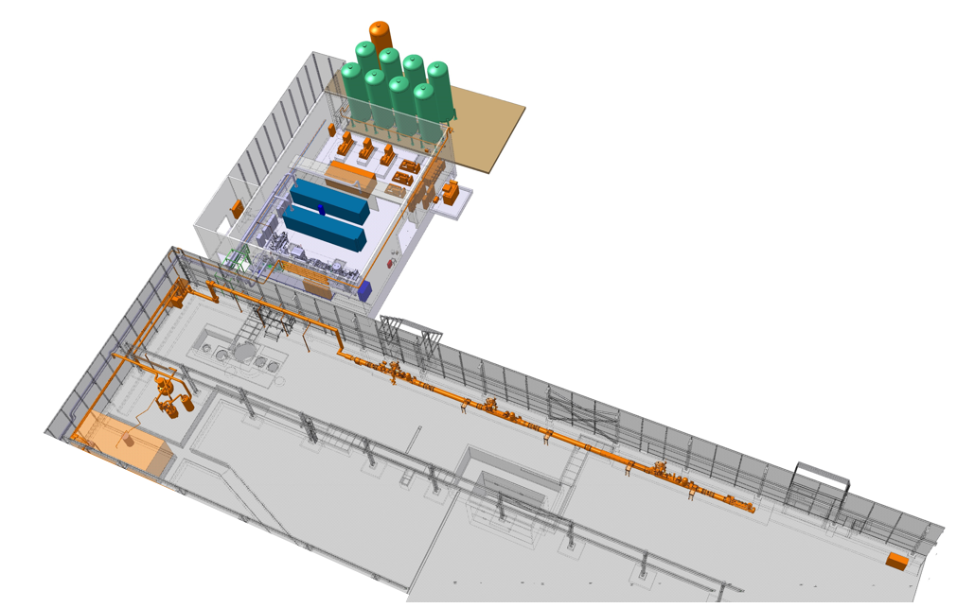
Layout of the cryogenic system
Specific to the IT String
PCDS: proximity cryogenic distribution system
SQXL: cryogenic distribution line
CCU: cold compressor unit
Quench relief line
Part of SM18 infrastructure
Warm quench buffer
Existing refrigerator
Warm pumping units
Main helium storage
+ electrical & control system
PCDS
PFD of the cryogenic system for the HL-LHC IT string
Refrigerator
CCU
SQXL
In orange: cryogenic equipment for the operation of the HL-LHC IT string

Slide 4
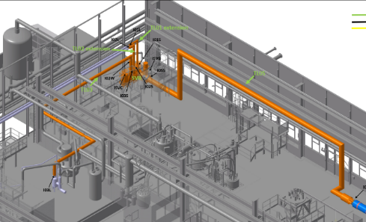
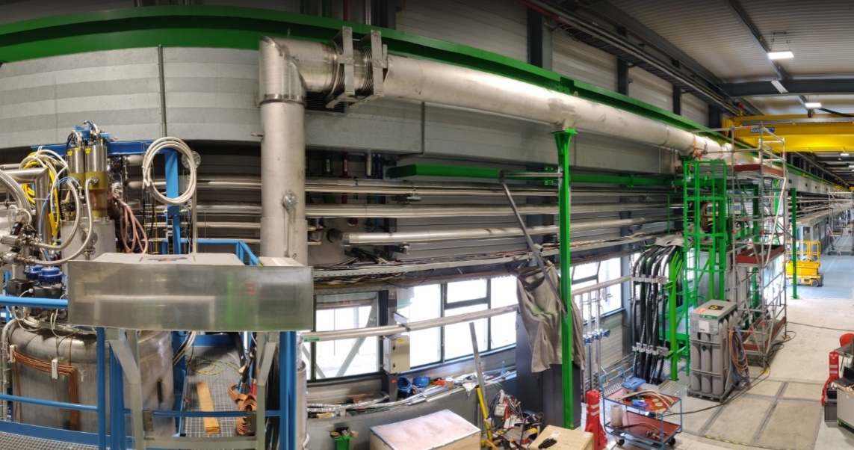
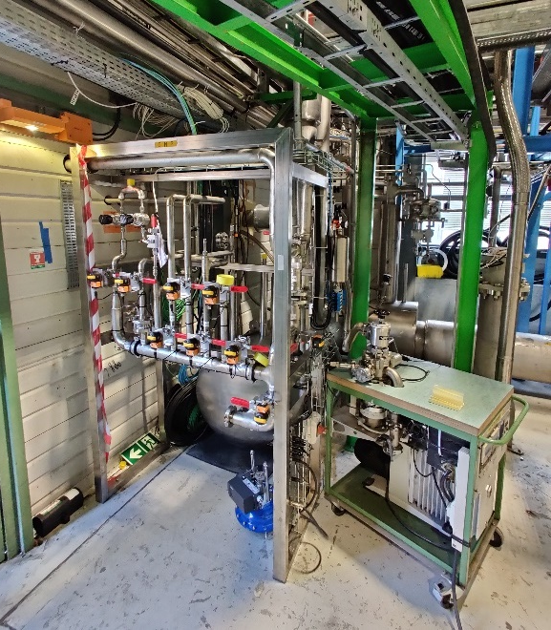
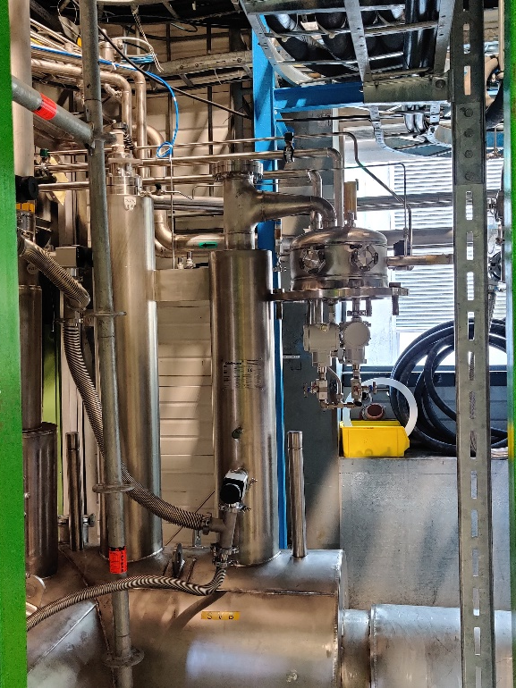
Status of the proximity cryogenics
Installation of the String Valve Box (SVB) and of the PCDS cryogenic transfer lines completed in September-October 2021
Other components :
  Gas Management Panel, completed
  Main He guard, completed
Pressure and leak tests of the PCDS, completed
SVB and GMP
Main He guard
TL05

Slide 5
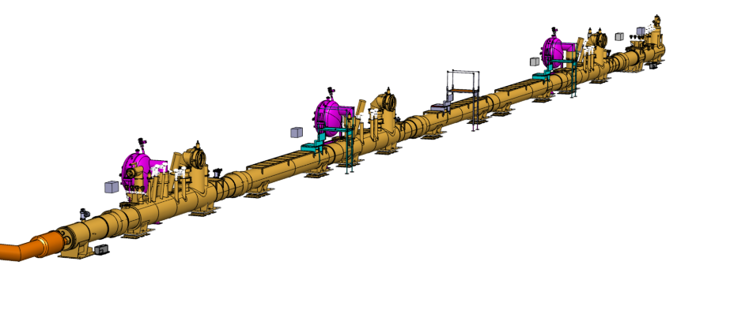
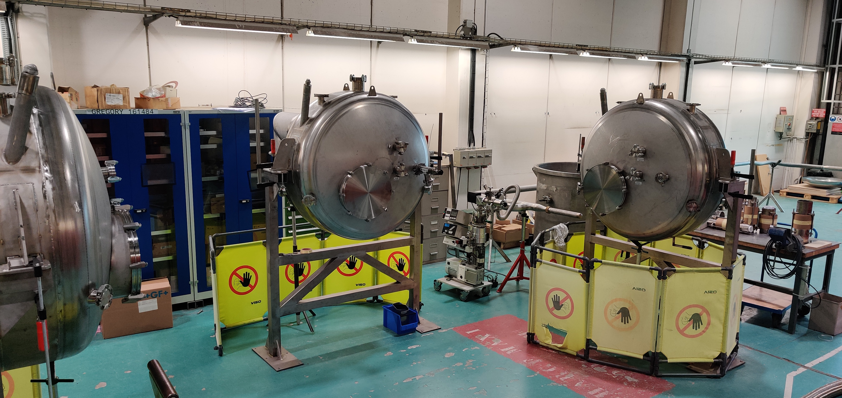
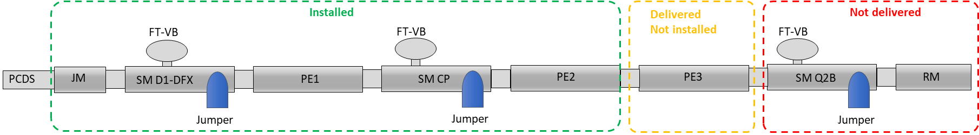
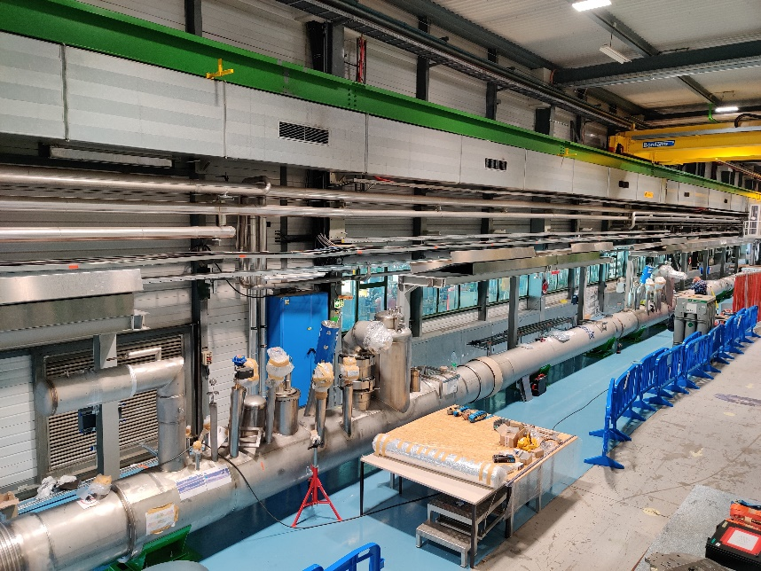
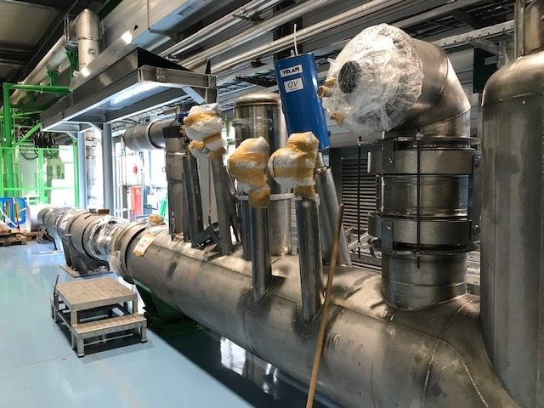
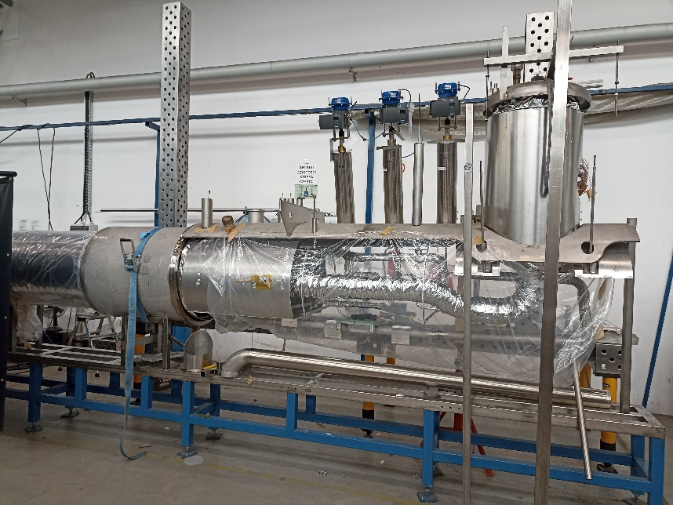
Status of the SQXL
Junction module, jumpers DX-D1 & CP and pipe elements PE1 and PE2: installed
Delivery of jumper Q2b and return module planned September 2022
End of installation, including pressure & leak tests, by november 2022
Assembly of flowmeter boxes at CERN
SQXL being installed in SM18
Assembly of the return module at Kriosystem.

Slide 6
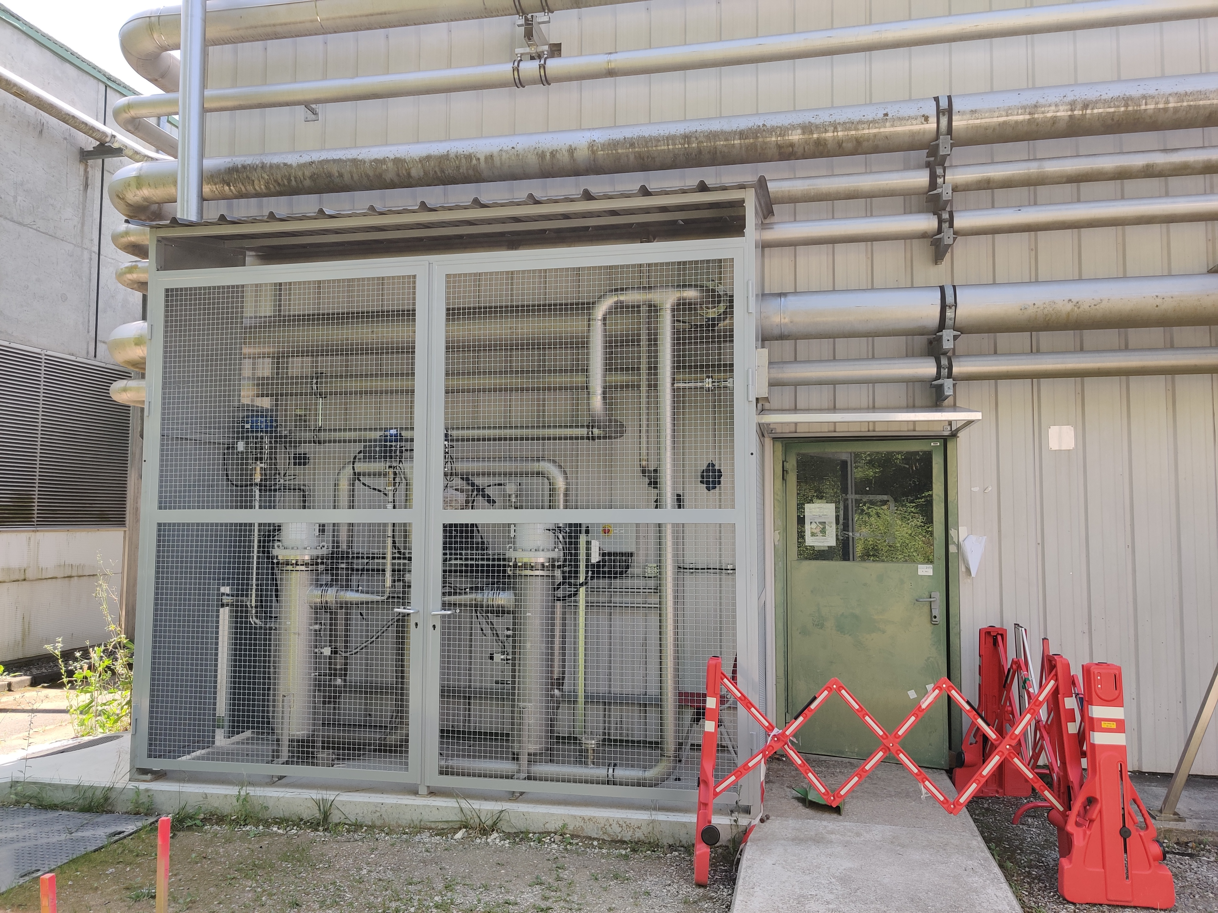
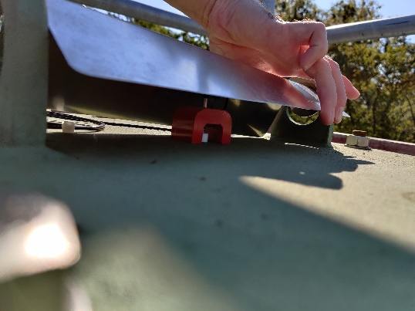
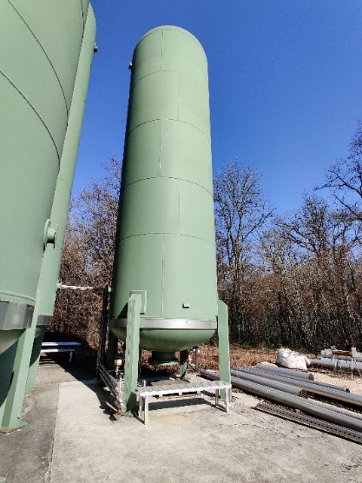
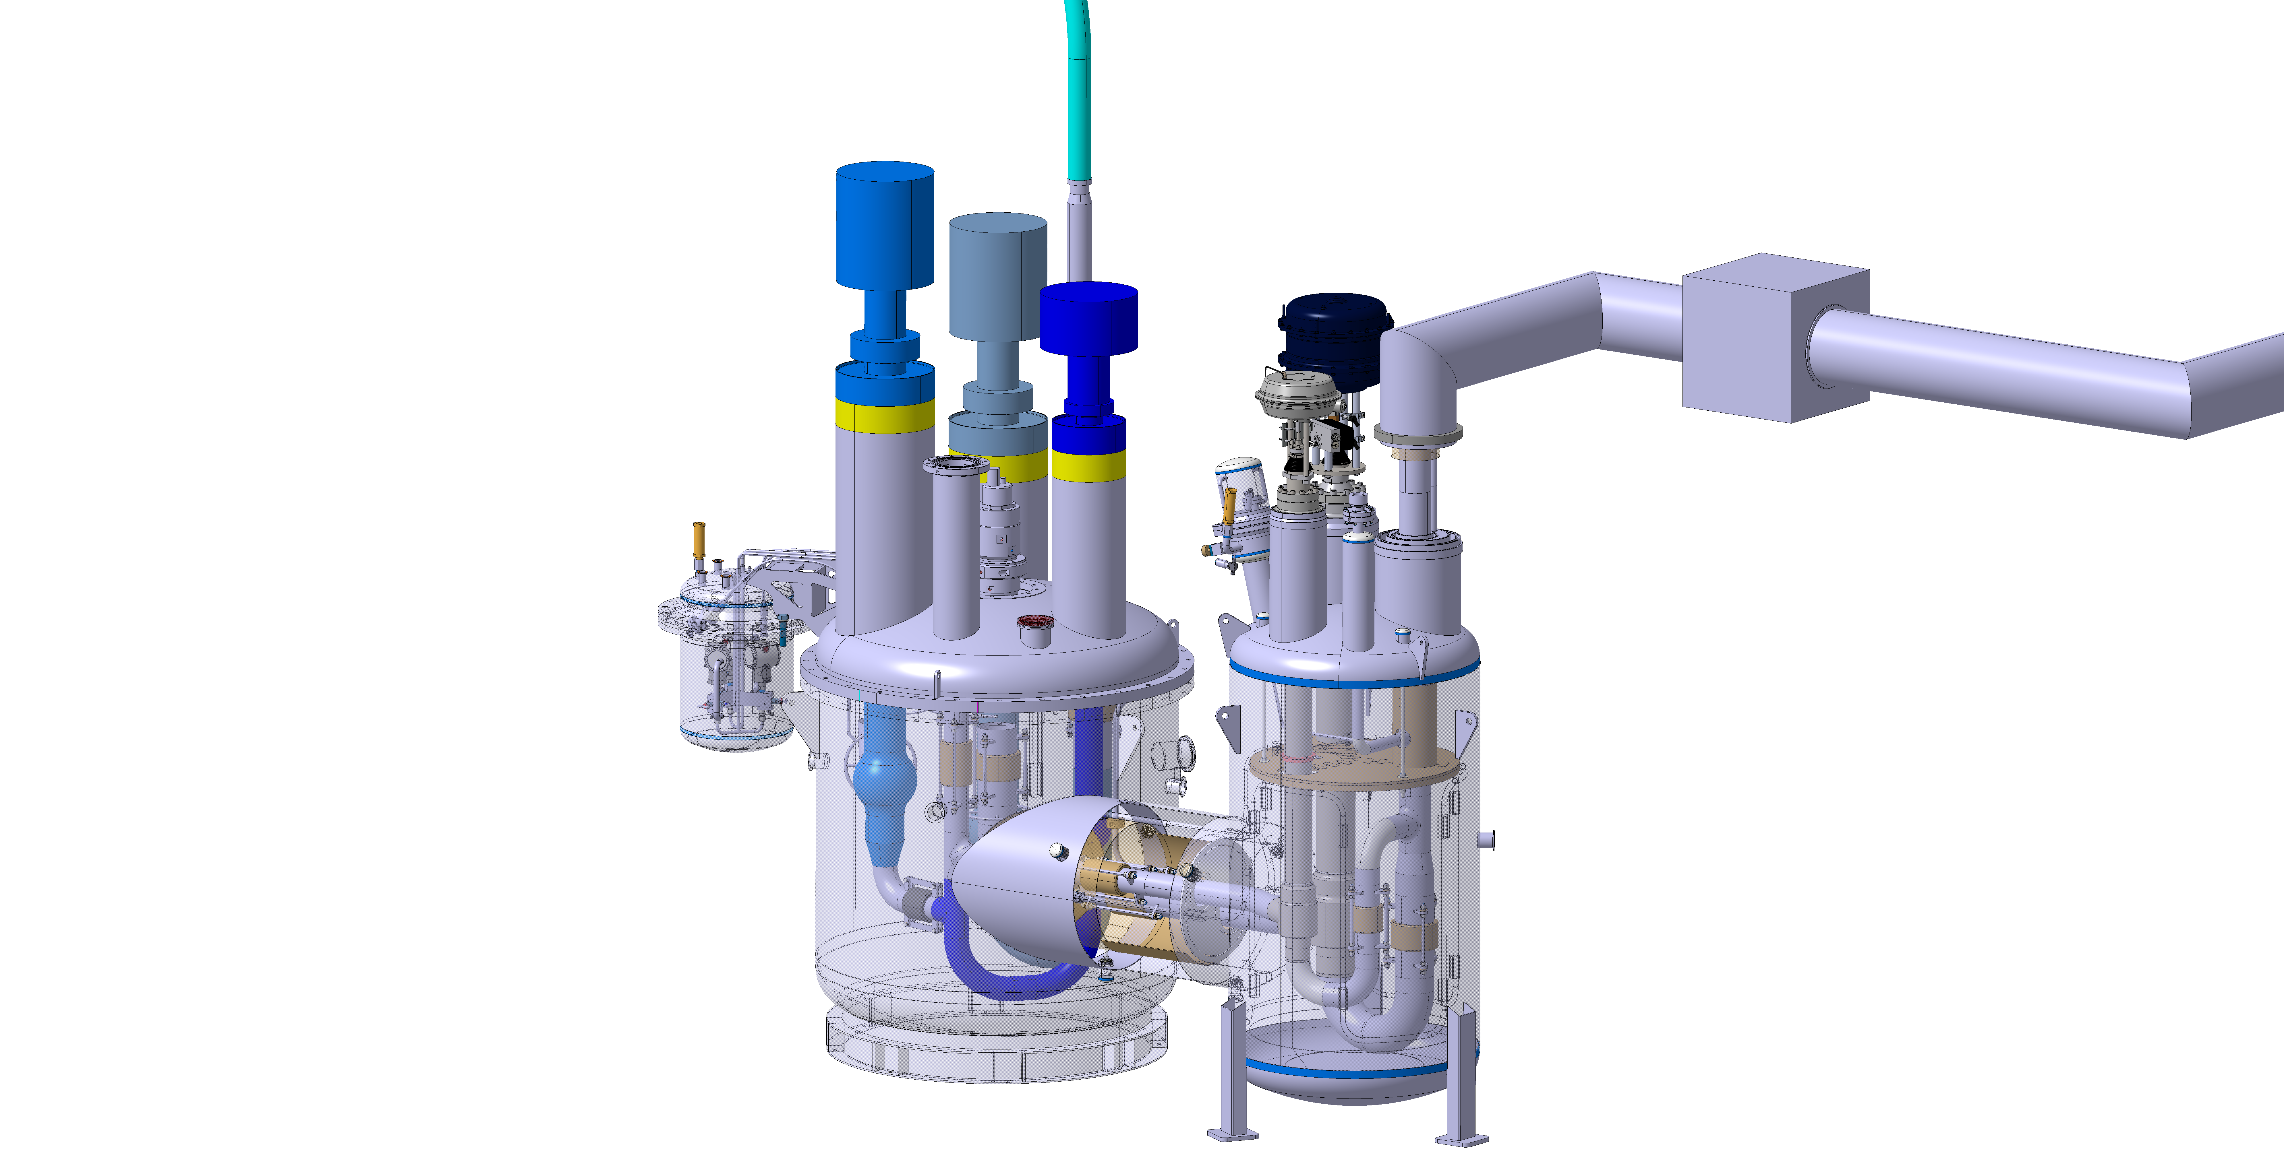
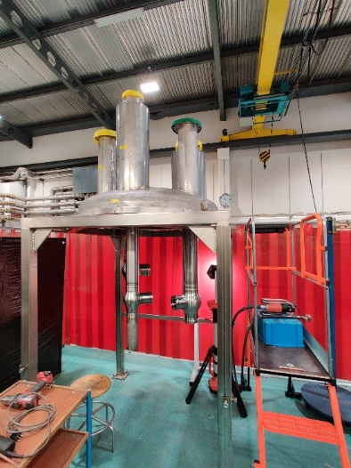
Status of the String infrastructure
Manufacturing and installation of the heater unit completed
Warm Quench Buffer (WQB) connected to SH18 infrastructure and compressor station during shutdown in January 2022
Thermometers for WQB wall temperature monitoring, installed
Installation of thermometers on top of WQB
TL04
In production
Heater unit outside SM18
TL03
WQB connected to SM18 cryo infrastructure
Order for new CC drive unit placed with Linde (delivery end of 2022)
Refurbishment and extension of the Cold Compressor box, ongoing
Installation of the Cold Compressor unit planned during the SM18 shutdown (1st quarter 2023)
Warm piping and quench line extension, to be completed by mid-2023
CCU box
CCU box being refurbished
Existing, requiring refurbishment

Slide 7
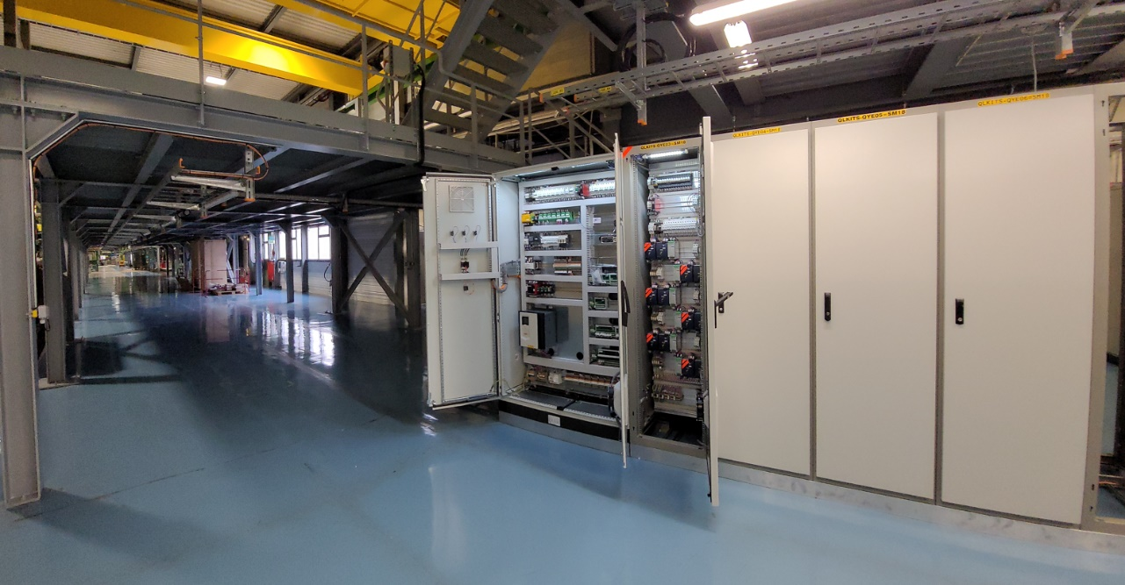
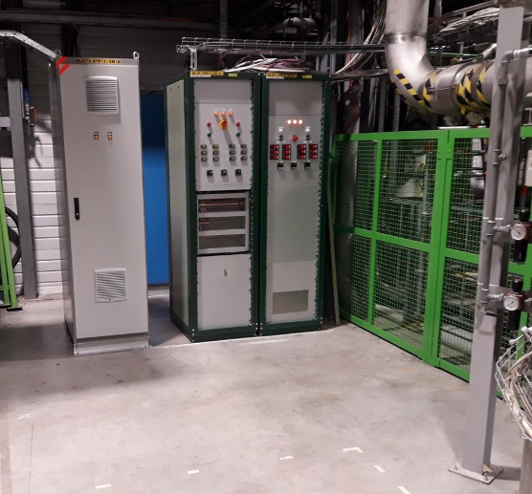
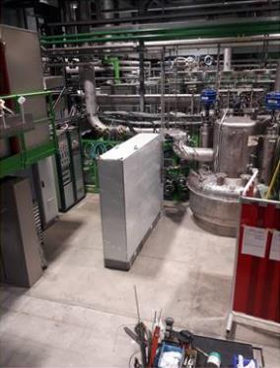
Status of the electrical & control systems
ELECTRICITY
Electrical cabinet for PCDS, CCU and heater unit, installed. CCU part to be finalized
Electrical cabinets and fieldboxes for the SQXL, completed and installed
Manufacturing of the crates for IT magnets instrumentation, in progress
PCDS, heaters unit and WQB cabling, completed
Cabling for SQXL and magnets dependent on SQXL installation and cabling campaign
All electrical cryo cabinets installed in SM18
CONTROL
PLC skeleton including all instrumentation, completed
Synoptic of cryo infrastructure, in progress
Front End Computer (FEC) installation, completed
Control logic and interlocks, in progress
24V rack
PCDS, CCU and heater unit cabinet

Slide 8
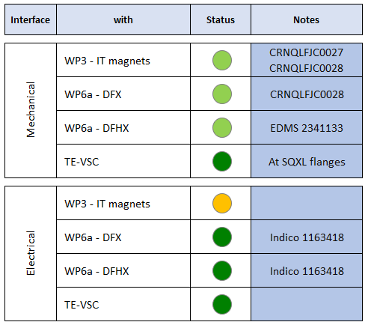
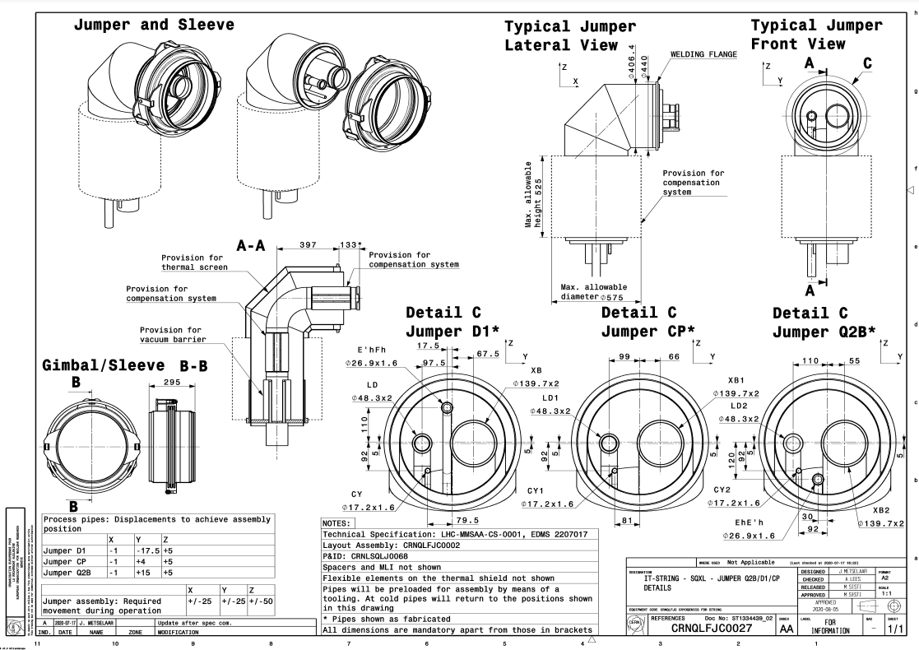
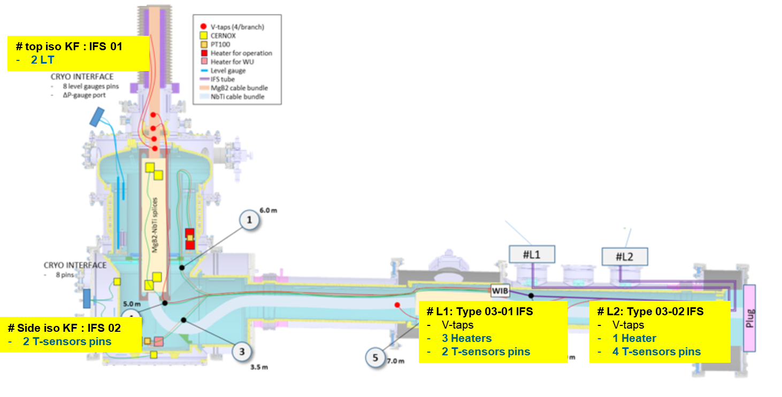
Interfaces
SQXL – IT magnets interface
*
DFX electrical interfaces
* SQXL – IT magnets interconnection is performed by WP3. Detailed flanges and procedure in work, to be jointly defined by WP3 and TE-CRG

Slide 9
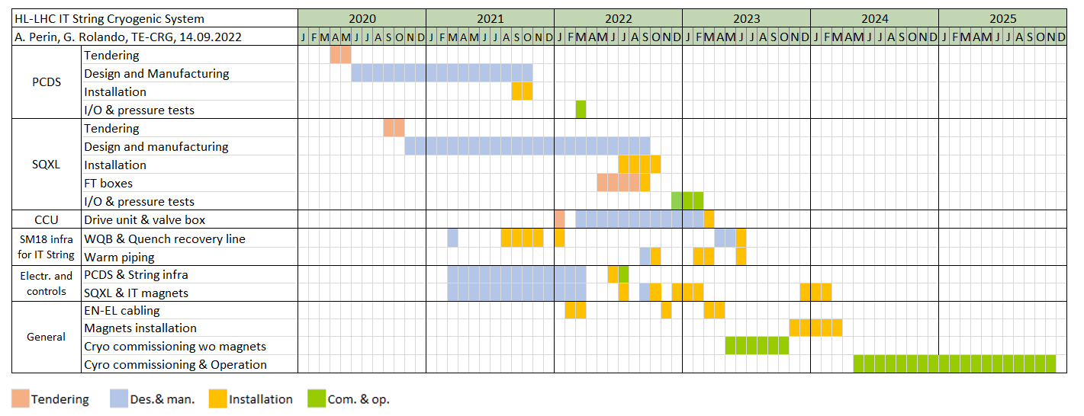
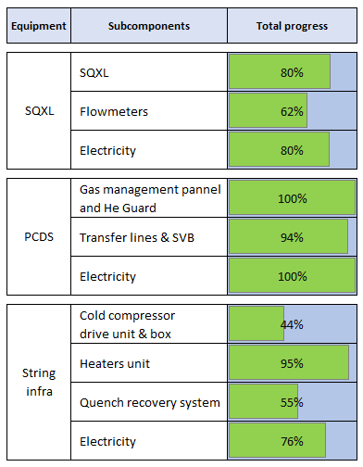
Schedule
PCDS: installed & tested, String infrastructure: to be completed in 2023
Manufacturing and installation of SQXL: schedule shift of ~10 months . End of installation in October
Cold compressor drive unit and box: installation planned during SM18 shutdown of March 2023
Cold commissioning of the cryogenic system without magnets from May 2023
SQXL installed
CCU installed
today
Ready for cryo commissioning wo magnets

Slide 10
Commissioning without magnets
Reference document: EDMS 2620402
Commissioning of the cryogenic system without magnets from May 2023
Objectives of the commissioning of the IT String cryogenic system without magnets:
  Validate the mechanical and thermal design of the cryogenic system
  Verify the operation and calibration of the instrumentation at Room Temperature & cold conditions
  Validate the cold compressor performance
  Tune the control loops to reduce commissioning time with magnets
Cryo commissioning wo magnets
Magnets installation
Cryo commissioning before powering
IT String test program

Slide 11
Commissioning with magnets & operation
Commissioning before powering
Validate the mechanical and thermal design of IT magnets and Cold powering system
Verify the operation and calibration of the instrumentation at Room Temperature & cold conditions
Tune magnet and Cold powering control loops
Cryo commissioning wo magnets
Magnets installation
Cryo commissioning before powering
IT String test program
IT String test program
SM18 cryo infrastructure limitations: lower liquefaction and low-pressure pumping capacity in SM18 wrt to IP1 and IP5. No beam screen circuit
Assessment of bayonet heat extraction capacity (max. < 500 W), heat loads during current ramping
Thermo-hydraulic analysis of quenches
Assessment of heat conduction in magnet cryostat & heat removal capacity of adjacent cooling loops
Characterization of the subcooling heat exchanger
(In work) Pressure waves analysis with cold pressure sensors: work ongoing with CRG instrumentation team & MSC
Cryo commissioning wo magnets
Magnets installation
Cryo commissioning before powering
IT String test program

Slide 12
Conclusions
Mechanical activities:
  Proximity cryogenics: manufacturing complete, installation well advanced
  Delays in manufacturing and installation of SQXL and cold compressor unit, compatible with global project schedule
  Main components of the infrastructure to be completed by March 2023
  Jumper connection final details and procedures to be finalized
Electricity and control system
  Electrical system and cabling completed for PCDS, quench recovery system, heater unit and cold compressor (minor modifications needed)
  Electrical system and local cabling for SQXL after mechanical installation and EN-EL cabling campaign (November 2022)
Next main milestones
  End of SQXL installation in November 2022 and pressure test by end of 2022
  Cold commissioning of the cryogenic system without magnets in May 2023

Slide 13
Operation modes & requirements
Additional requirements:
Supply up to 10 g/s of LHe to the Cold Powering
Supply up to 26 g/s of LHe for the bayonet HX test
Provide up to 26 g/s of low-pressure pumping capacity @ 1.9 K for bayonet HX test
Provide thermal shield circuit at 50 – 75 K
Recover warm GHe from current leads outlet
Not interfere with other SM18 test benches

Slide 14
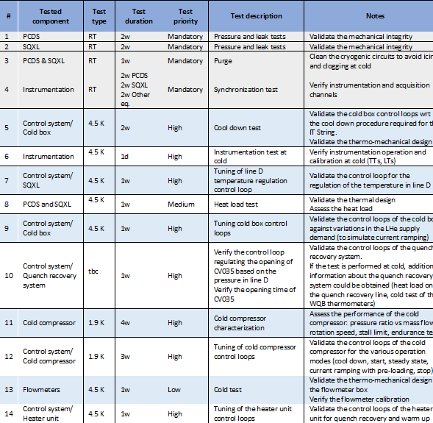
Commissioning without magnets
Reference document: EDMS 2620402

Slide 15
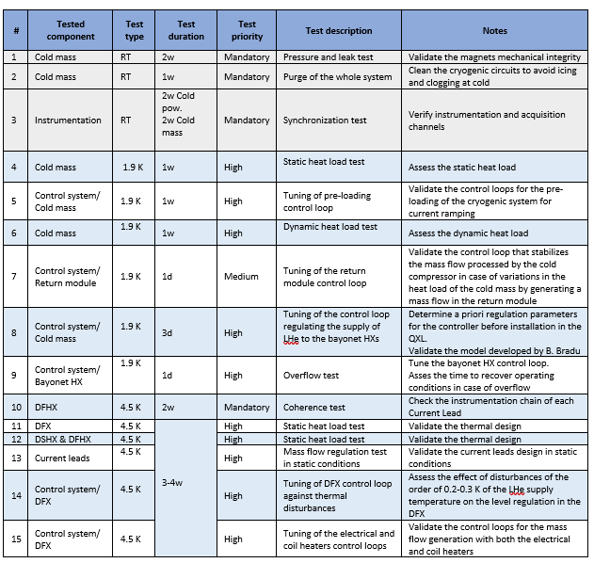
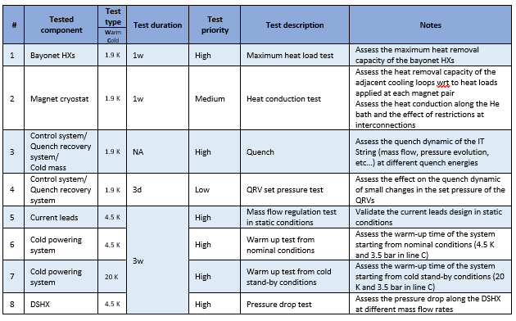
Commissioning with magnets & operation
Commissioning before powering
IT String test program
Reference document: EDMS 2620402

