Slide 1

DAQ systems for WP7
Tomasz Podzorny
On behalf of the TE-MPE EDAQ team
12th HL-LHC Collaboration Meeting – Uppsala, Sweden – 19-22 September 2022

Slide 2
Contents
HL-LHC quench protection system
Requirements for QPS data acquisition
System architecture and configuration
Communication and software stack
QPS data acquisition hardware
Development status and validation
Summary

Slide 3
HL-LHC quench protection system
UQDS based systems are the baseline for quench detection
  Highly configurable with extensive processing capabilities
  High definition data available
Only QDS enables detailed analyses of effects occurring in superconducting circuits
  SM18 tests have demonstrated that protection of Nb₃Sn magnets is demanding
  Powering of HL-LHC circuits is expected to be non-trivial
  Efficient commissioning and operation will require high quality data
Data acquisition is a key to reliable and smooth operation
  High quality data is mandatory for automatic analysis of events
DAQ design considerably benefits from HL-LHC radiation shielded areas

Slide 4
Requirements for QPS data acquisition
High data bandwidth: 1-20 Mbps per node
Number of nodes per network segment: up to 40
High accuracy timestamping: ≤1 us
Decoupled hardware from the controls infrastructure
  Eases hardware and software upgrades
  Guarantees long-term obsolescence management
Low to moderate complexity
  Lightweight communication stack
  Portability between hardware platforms
Industrially accepted solutions
  Key for flexibility and scalability and eases maintenance and training experts
  Reduces risk of accumulation of the technical debt

Slide 5
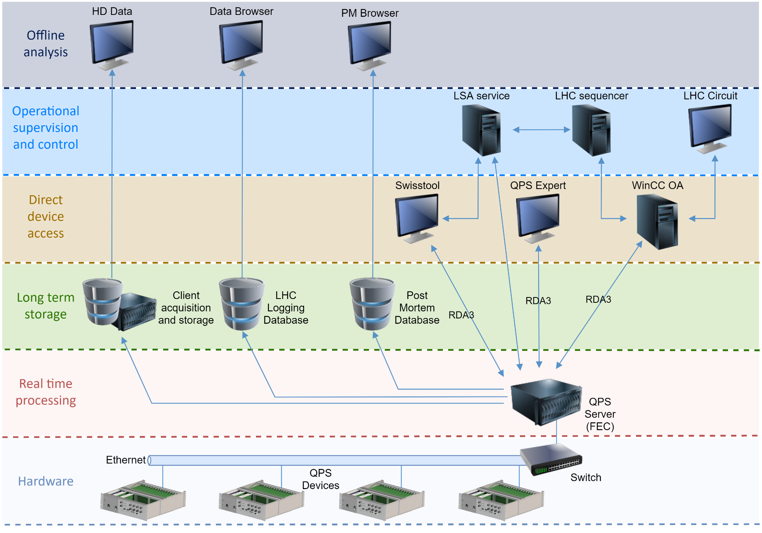
QPS system architecture

Slide 6
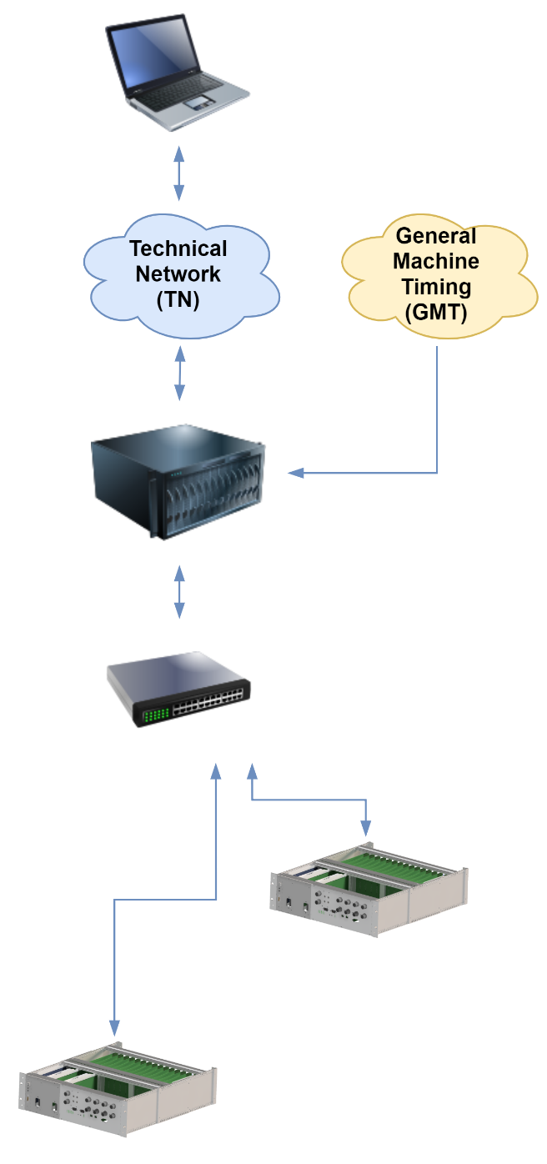
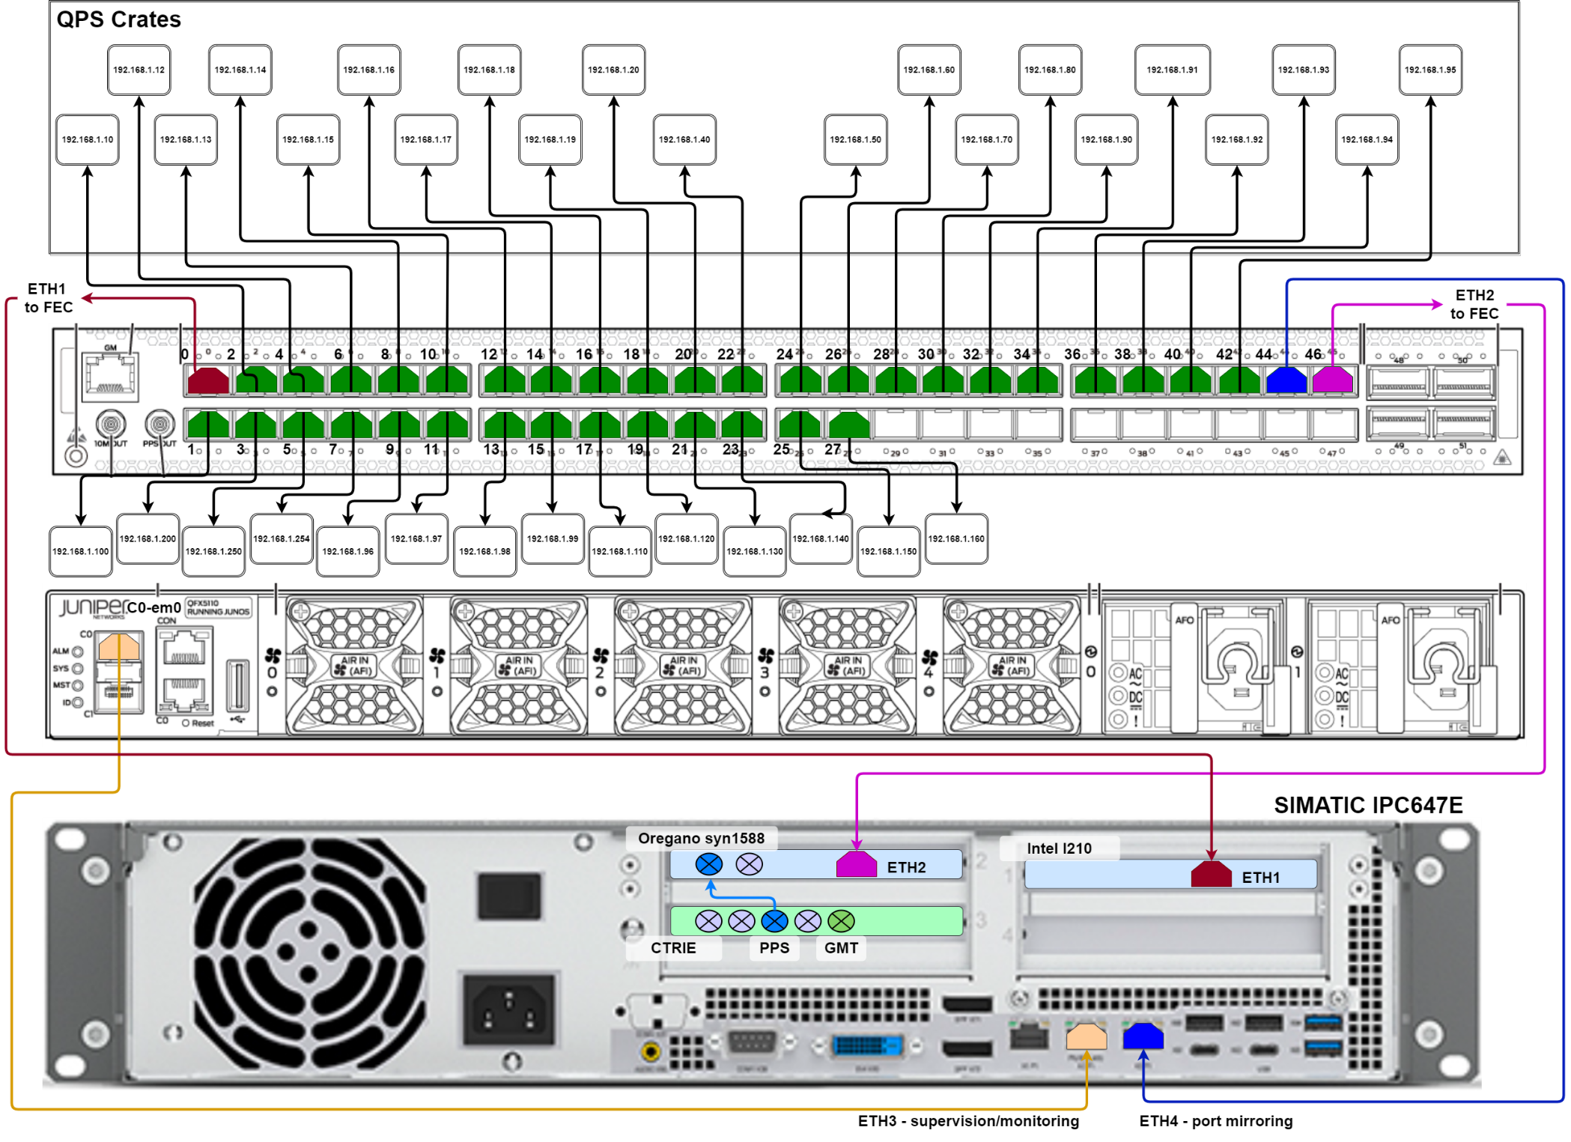
DAQ infrastructure configuration
Courtesy of M. Murillo Moya

Slide 7
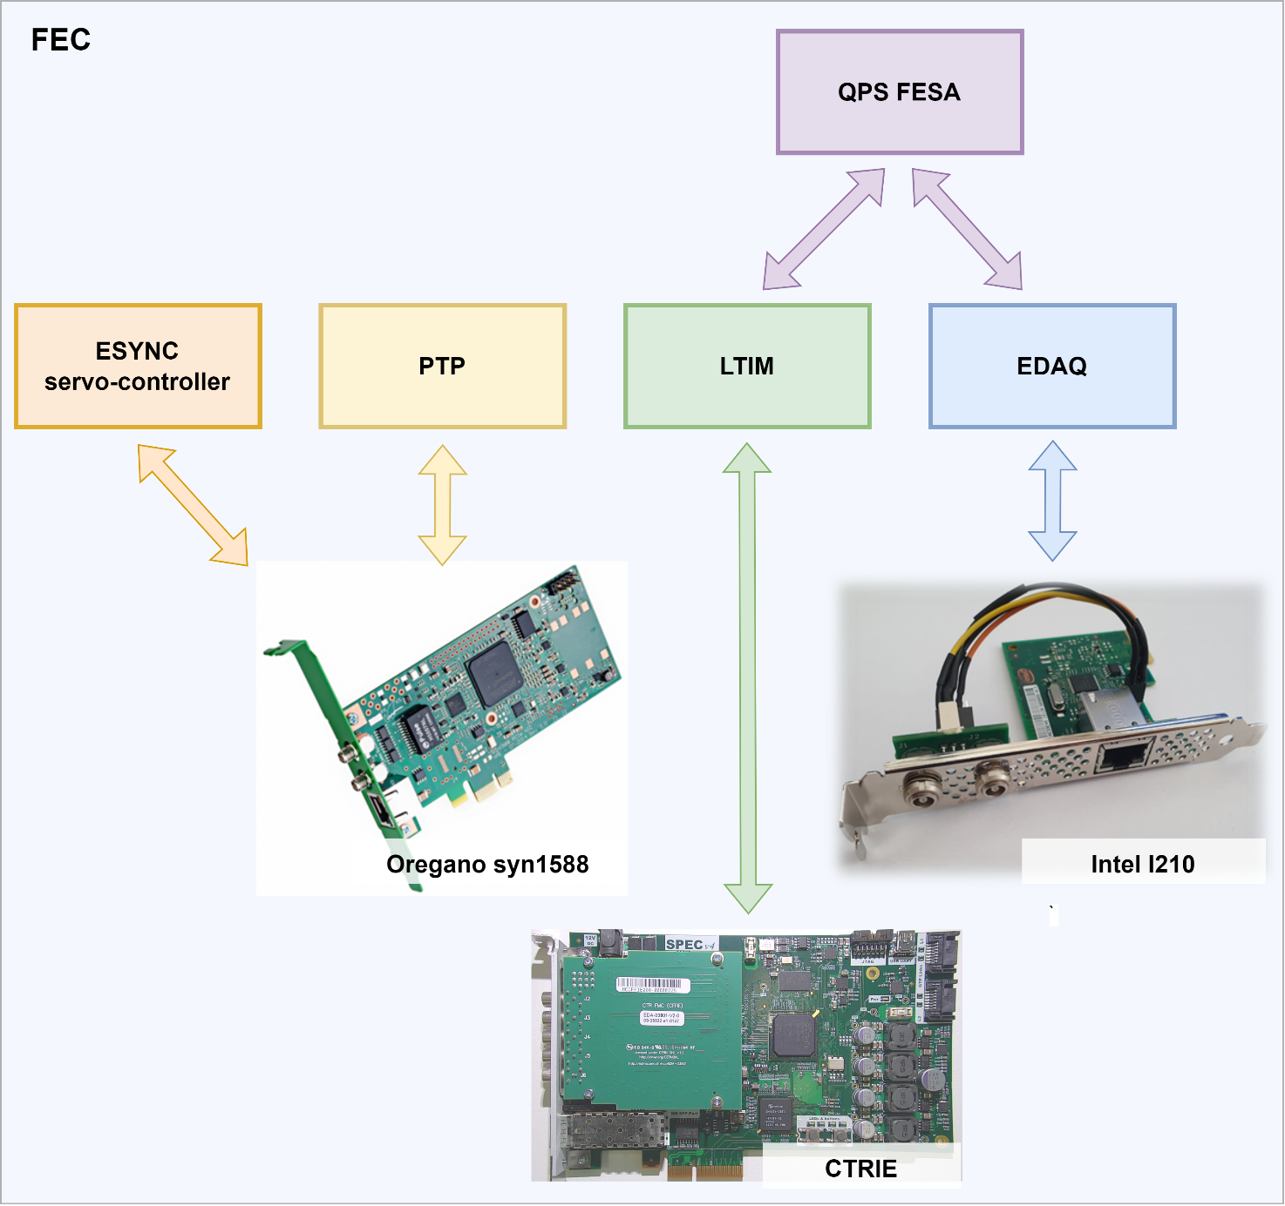
Front-end computer configuration
Hardware
  NIC#1: Intel I210
  NIC#2: Oregano Systems syn1588 PCIe
  CTRIE: CERN GMT receiver
Configuration
  Static IPs and constrained packet routing
  Specific buffer sizes for Ethernet sockets
Synchronisation services
  PTP server
  LTIM with custom configuration
  CTRIE to NIC#2 servo-controller
DAQ services
  Communication server – EDAQ driver
  FESA controls application – DQAmEth

Slide 8
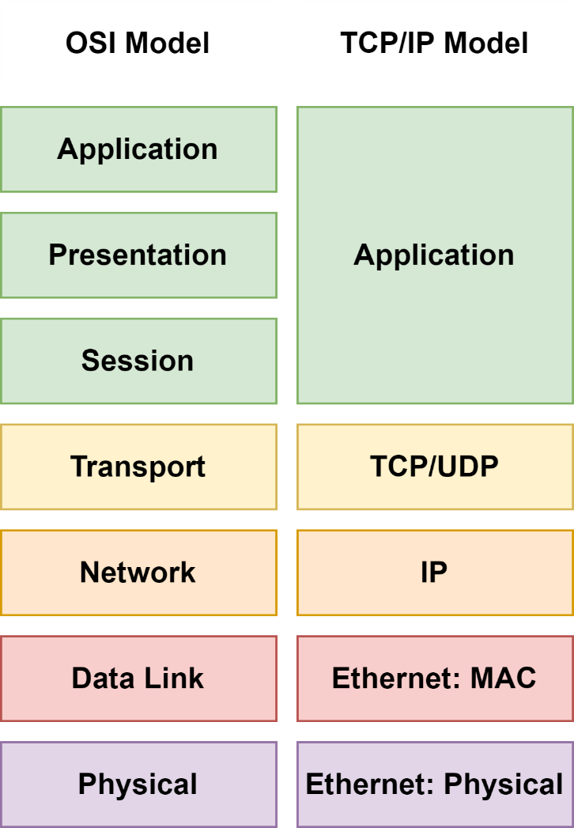
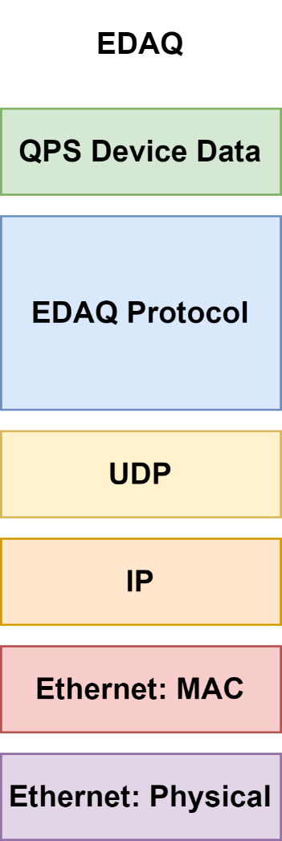
EDAQ communication protocol
Protocol uses UDP for transport
  Limited buffering available on devices’ side
  Lighter implementation with facilitated porting
Protocol without time constraints
  Data emission initiated by both server and client
  Deterministic transactions enable real time control
Protocol implements:
  Buffering on the server side
  Transactions with different delivery guarantees
  Data ordering, loss detection and retransmission
  Data corruption detection
Strict layered architecture
  Protocol is application agnostic
  Facilitated definition of devices types

Slide 9
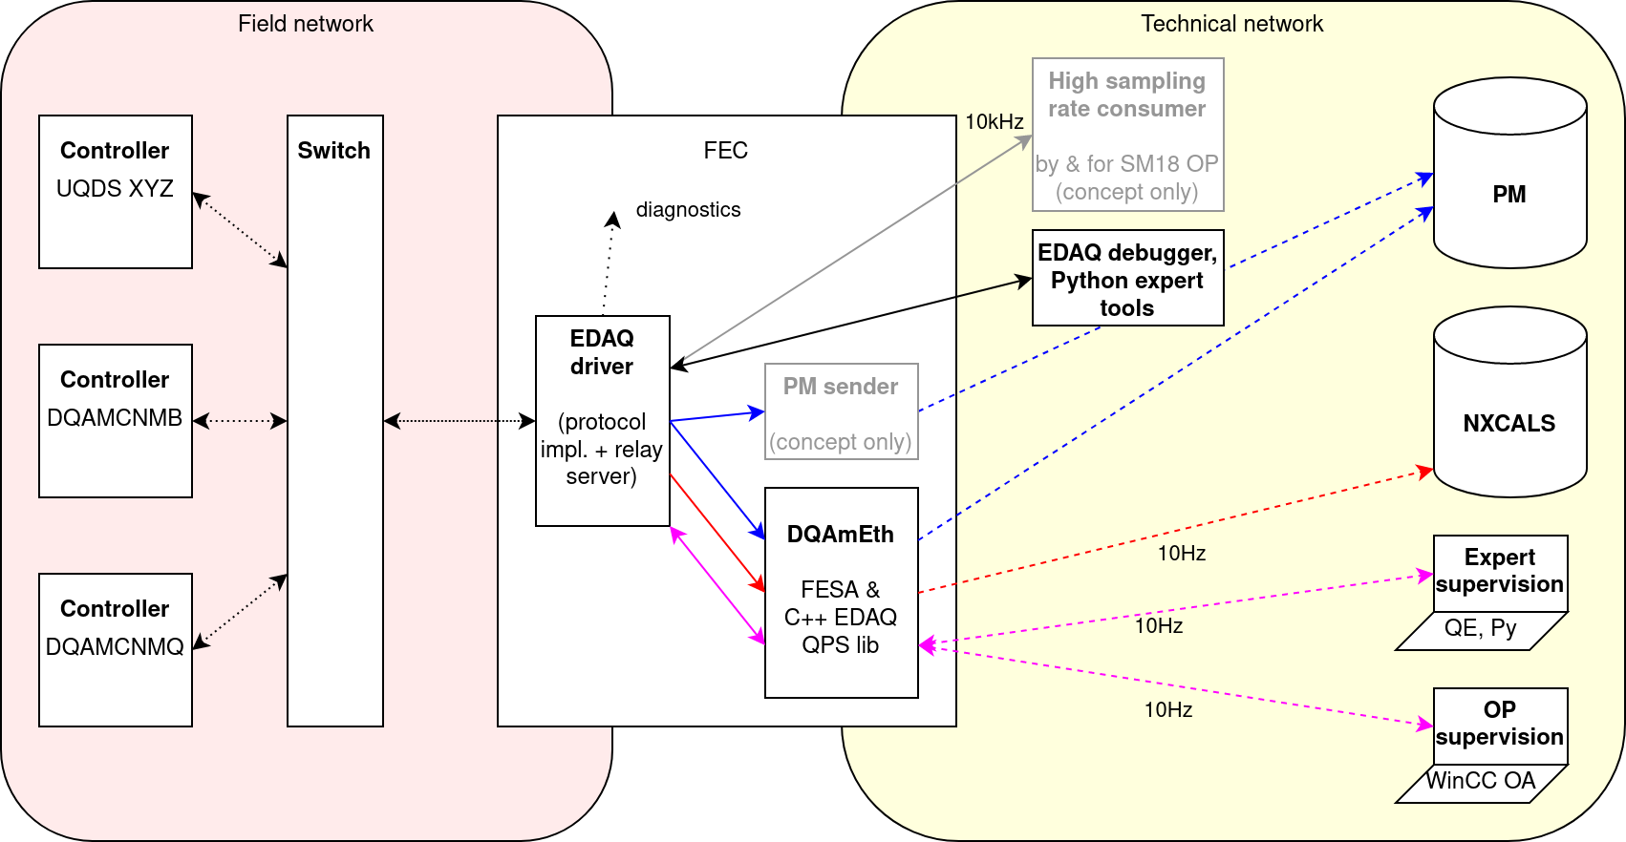
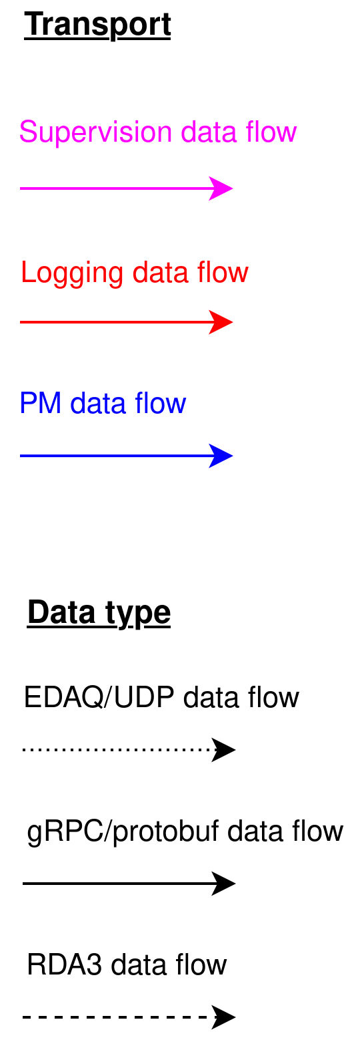
QPS DAQ stack overview
Courtesy of M-A Galilee and MPE-CB

Slide 10
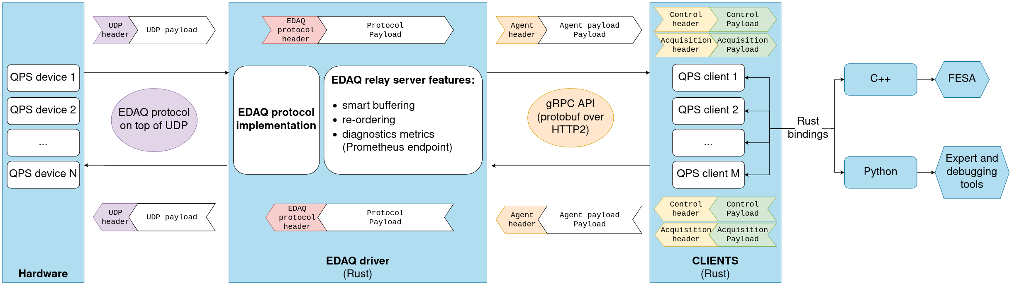
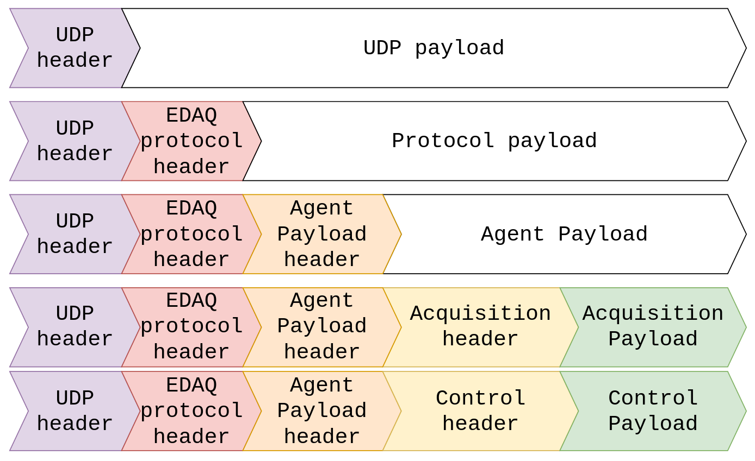
Dataflow diagram
Domain agnostic
Courtesy of L. Rayon and MPE-CB

Slide 11
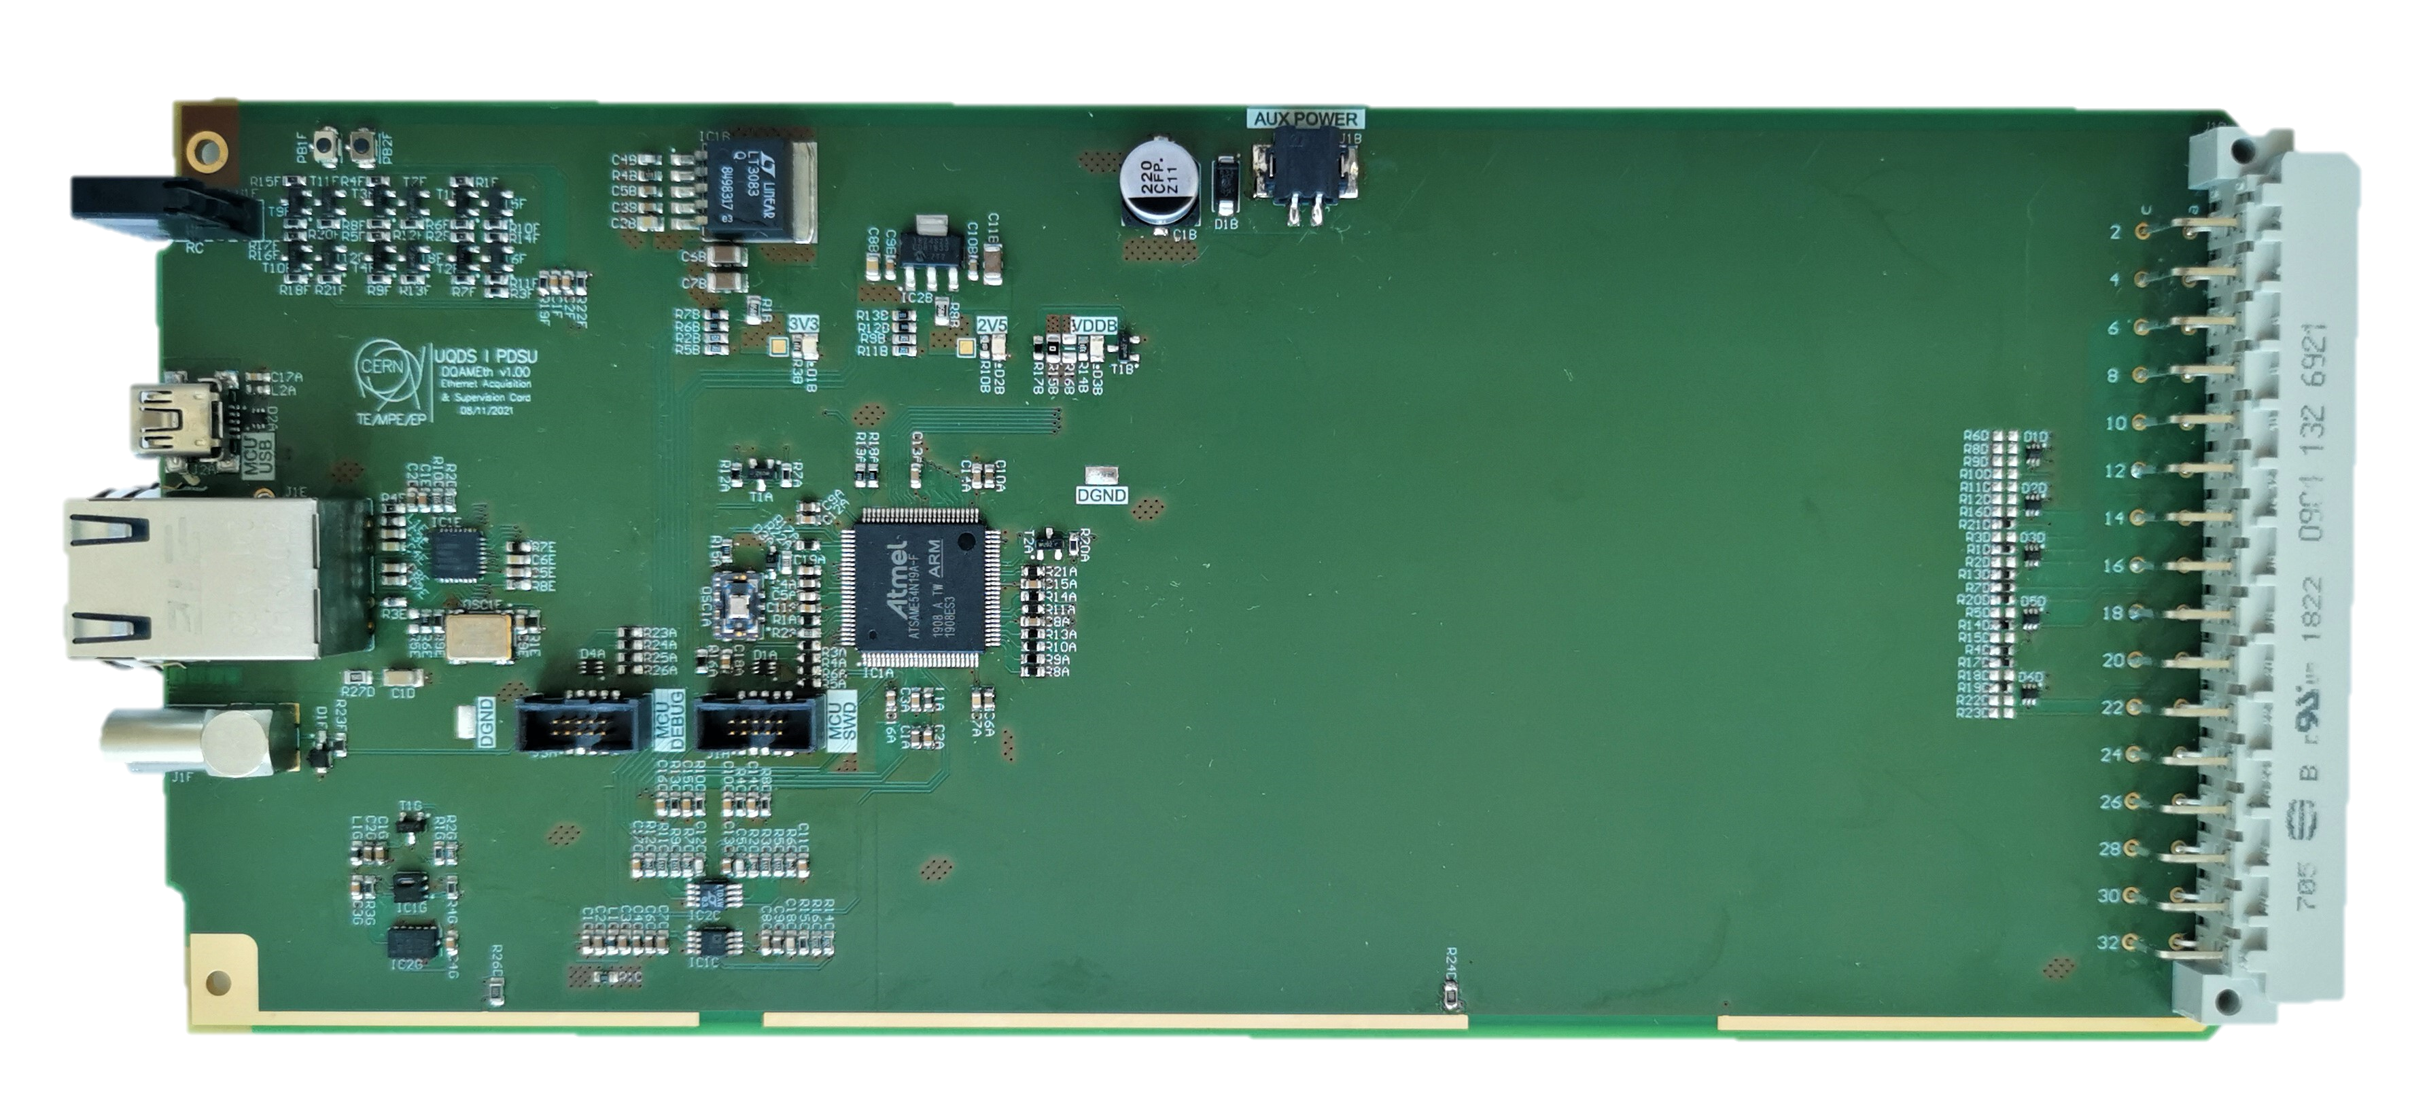
QPS Ethernet hardware
Reference design
Microcontroller based
  Performant Cortex M4F architecture
  Rich peripheral set, and large FLASH and RAM memories
  100 Mbps Ethernet with HW PTP timestamping
  Full speed USB (12 Mbps)
  SPI or QSPI internal communication interface
TCXO oscillator
Adaptable and modular bare metal firmware
  Implements PTP and EDAQ modules
  Controls local time for accurate timestamping
  Implements data acquisition and device specific control
Data throughput up to 22 Mbps
Continuous logging rate up to 10 kHz

Slide 12
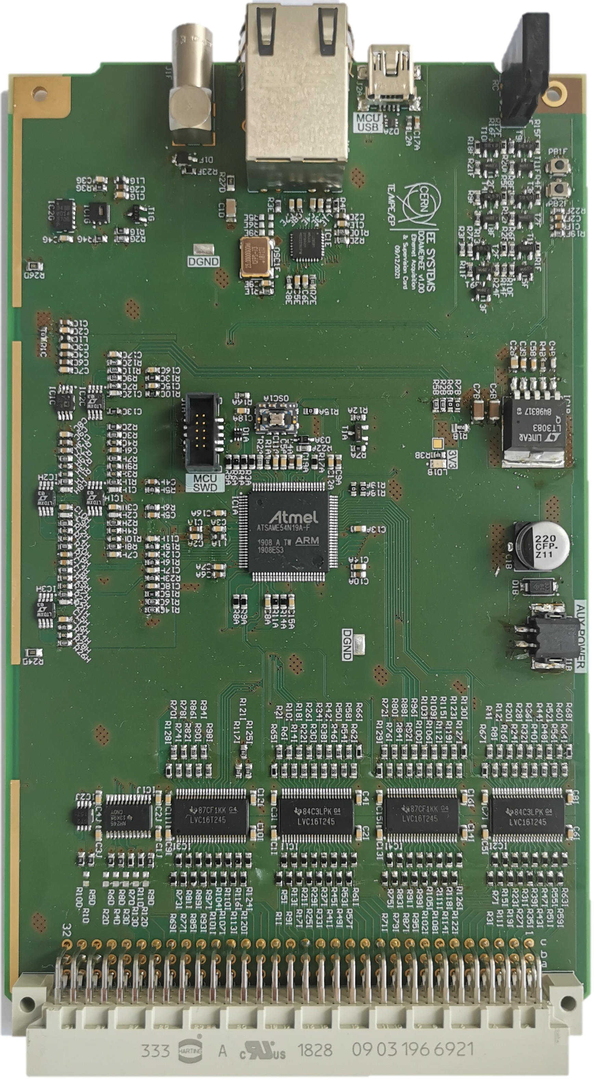
Communication cards
Reference DAQ card
UQDS 2.0 and generic use cases
Integration very advanced
  Development methodology and toolchain is fully established
  Core firmware modules developed
  Stable data acquisition and control processes
HL-LHC Energy Extraction systems
Rapid design cycle
Card partially validated
Features
  Core functionality as the reference card
  Analog: 5 inputs
  Digital: 56 inputs and 5 command outputs

Slide 13
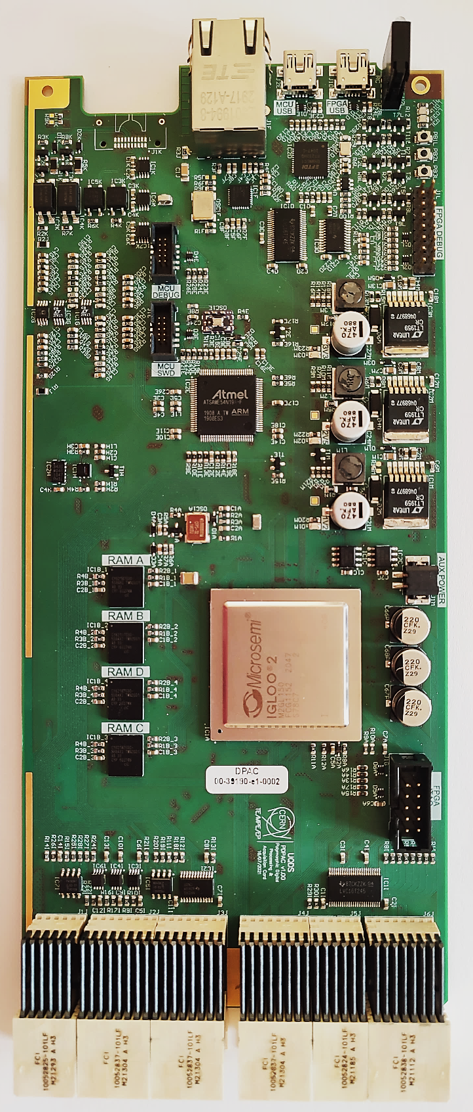
DSP and communication card
Applications
  UQDS 3.0 versatile digital platform
  PDSU main processing unit
  CLIQ data acquisition and control unit
Identical microcontroller subsystem as the reference card
  Shared development methodology, modules and toolchain
Slight evolution of UQDS FPGA subsystem
  High performance and DSP optimized IGLOO2
  32 MB RAM memory
  288 general purpose IO ports
  Shared development methodology, modules and toolchain
Features
  Streamlined development for high performance applications
  Compact crate layout and superb design flexibility

Slide 14
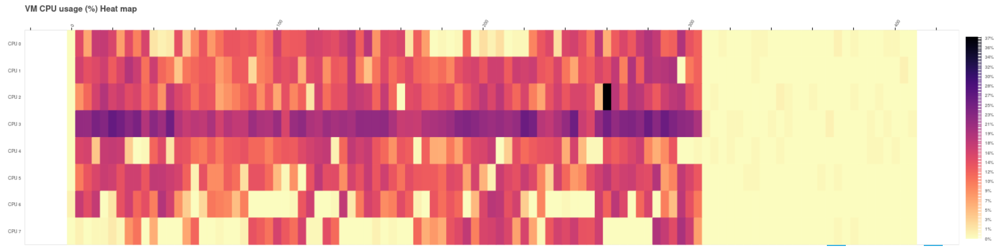
Software benchmarks
EDAQ driver stress-testing
Objective
Monitor the driver process with varying workloads from simulated devices.
Test Conditions
4 simulated devices​
20kHz sampling rate
1 Gbps total throughput​​
Monitored metrics​​
CPU utilization​​
Memory consumption​​
Dropped messages
Courtesy of L. Rayon and MPE-CB

Slide 15
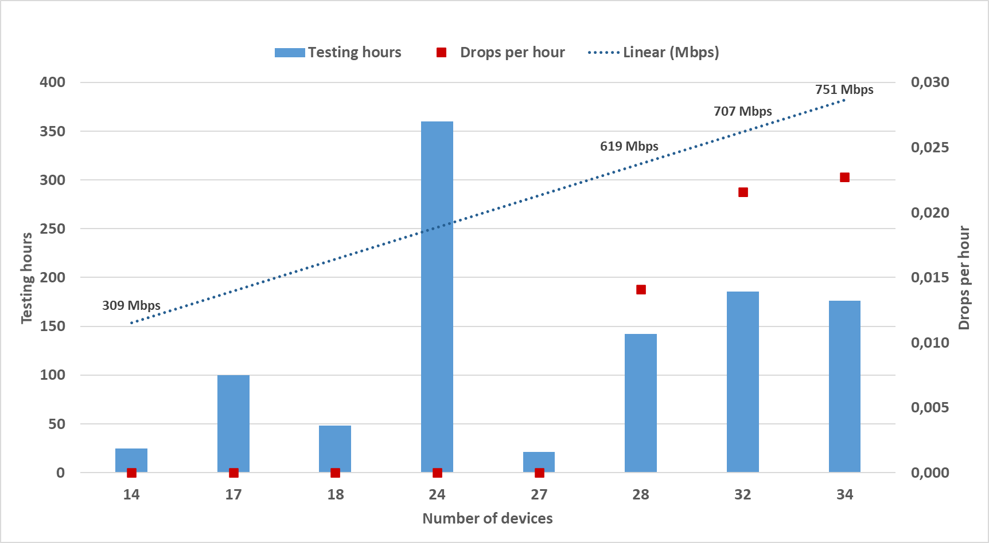
Data throughput and scalability
Courtesy of M. Murillo Moya

Slide 16
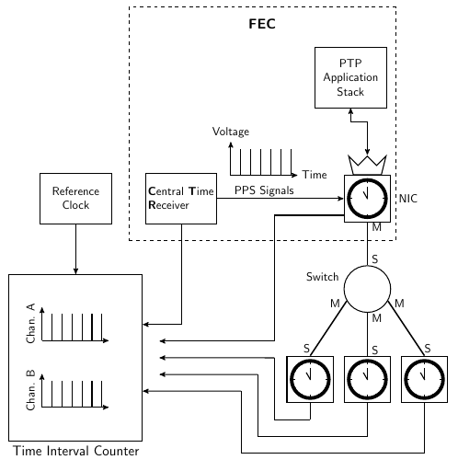
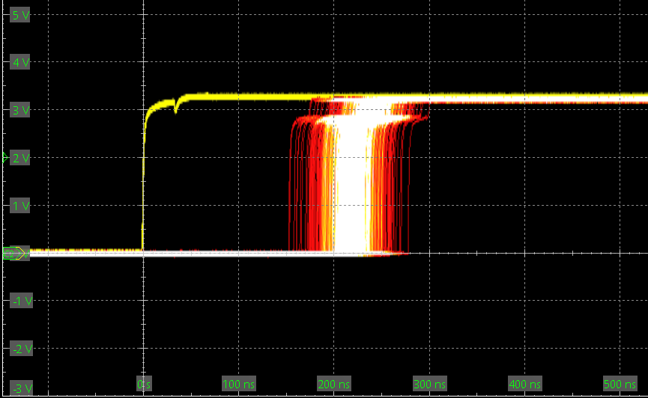
Synchronization performance
Synchronized PPS output stability
Courtesy of M. Christensen and M. Murillo Moya

Slide 17
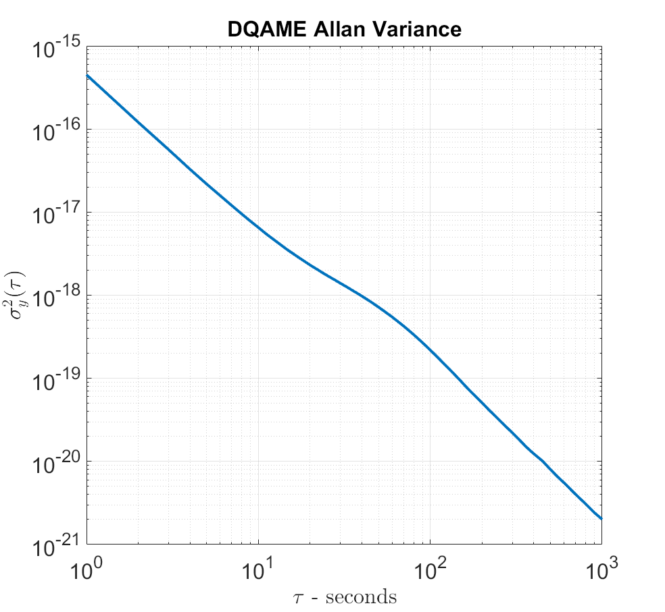
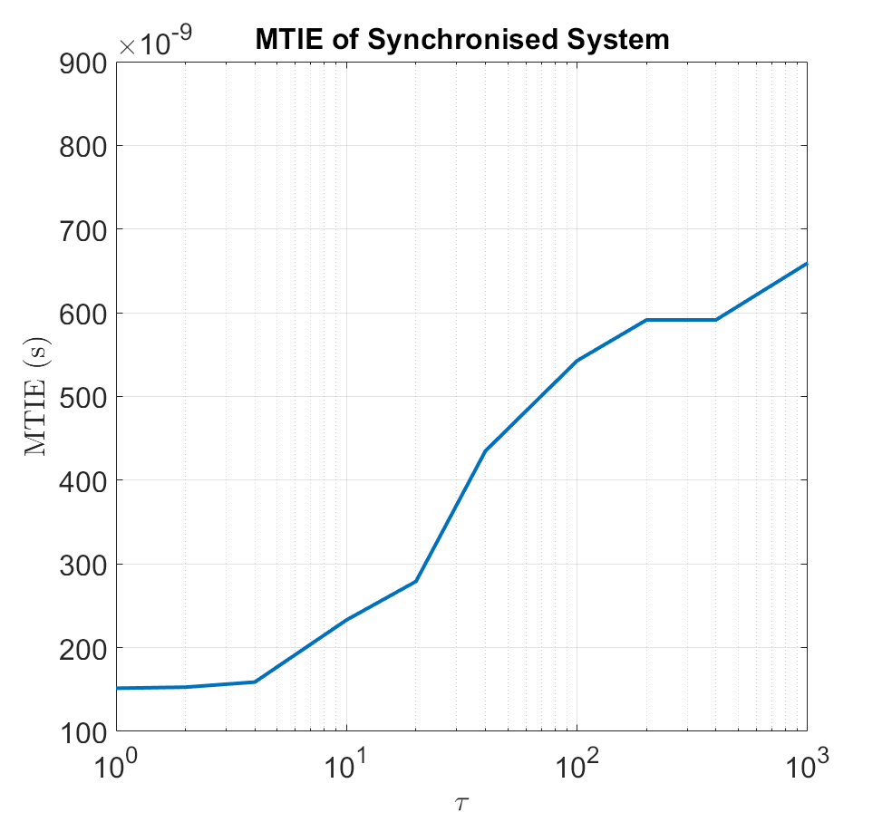
Synchronization performance
Courtesy of M. Christensen and M. Murillo Moya

Slide 18
Summary
Great interest in high data throughput for QPS
  High quality data is mandatory for automatic analyses of events
  Ethernet will be the baseline for developments underway
Reference hardware design validated
  Firmware development methodology and toolchain established
  Core functional modules stable and operational
Selected communication architecture tested
  Configuration of the system and communication protocol specified
Low level software stack operational and mature
  Stable firmware and EDAQ driver, QPS clients library and C++/ Python bindings
All required technologies validated and available
  Requirements are fulfilled
  Standard solutions throughout the entire operational stack

Slide 19
Thank you!
Acknowledgements:
The TE-MPE EDAQ team: Jonas Andresen, Magnus Christensen, Marc-Antoine Galilee, Guzman Martin Garcia, Jean-Christophe Garnier, Maria Murillo Moya, Laura Rayon Ropero and Emanuel Thaller
TE-MPE-EP: Daniel Calcoen, Vincent Froidbise, Jelena Spasic, Jens Steckert and Vito Vizziello
Reiner Denz and Daniel Wollmann

