Slide 1

CLIQ - experience from prototype production & fabrication status
David CARRILLO
on behalf of the CLIQ project team
12th HL-LHC Collaboration Meeting. Uppsala. Sweden
19th – 22nd Sep 2022

Slide 2
Contents
  Key figures
  From prototypes to machine version
  Accomplished milestones
  Ongoing activities

Slide 3
Introduction
Coupling-Loss Induced Quench (CLIQ) is a quench protection method based on a discharge resulting in high inter-filament and inter-strand coupling losses
CLIQ is in the baseline of the HL-LHC project for the protection of the new Inner Triplet magnets that will be installed during LS3

Slide 4
CLIQ. Numbers and key parameters
Q1 and Q3: 2 CLIQ units each, with V=600 V, 40 mF
Q2a and Q2b: 1 CLIQ unit each, with V=1000 V, 40 mF
I peak ~ 2- 3 kA
Triggering time = 1 ms
Resistance CLIQ circuit < 50 mΩ
The Inner Triplet circuit needs 6 CLIQ units for QP (+ 48 DQHDS) per IP side
24 CLIQ in the machine
6+2 CLIQ for the String

Slide 5
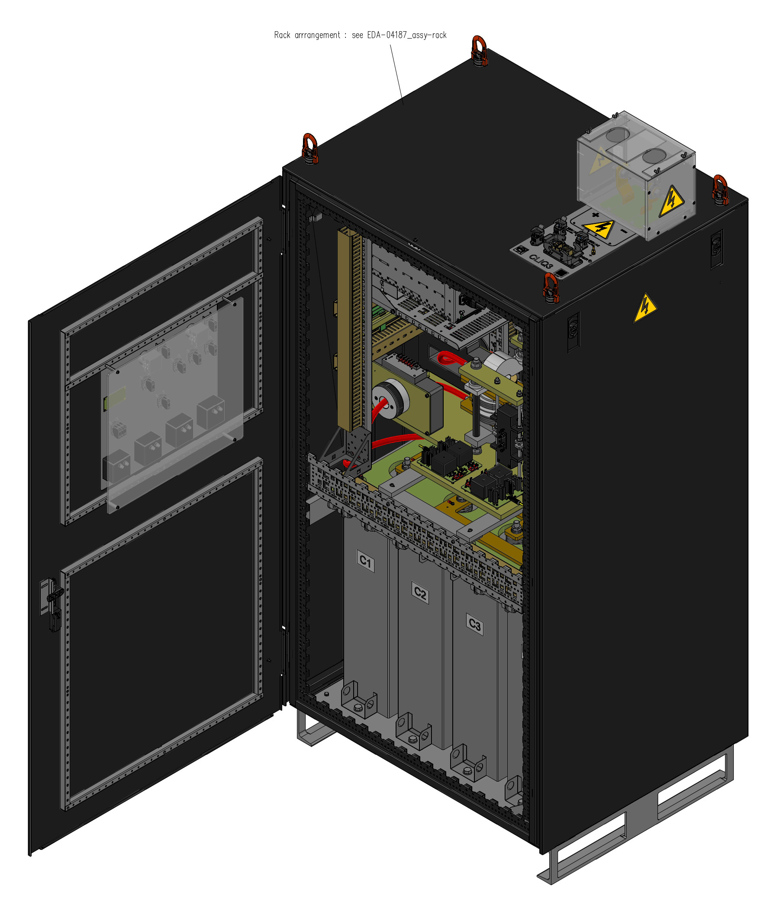
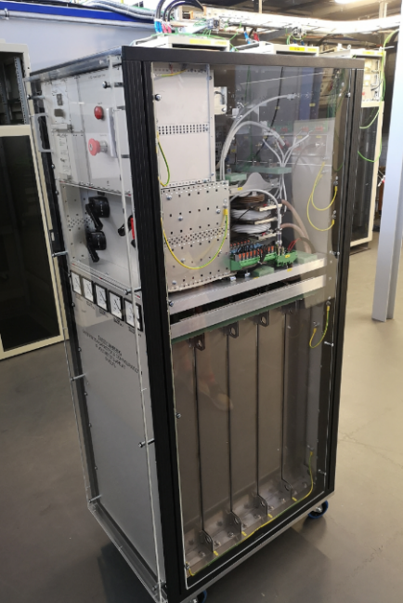
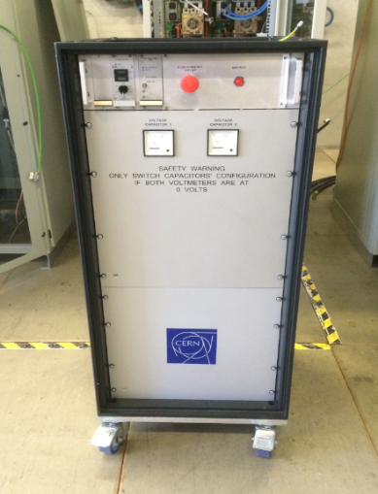
Prototypes timeline
v1
v2
v3
CLIQ unit = CLIQv3 unit = Machine Version unit
CLIQ prototypes timeline
2015 2017 2021

Slide 6
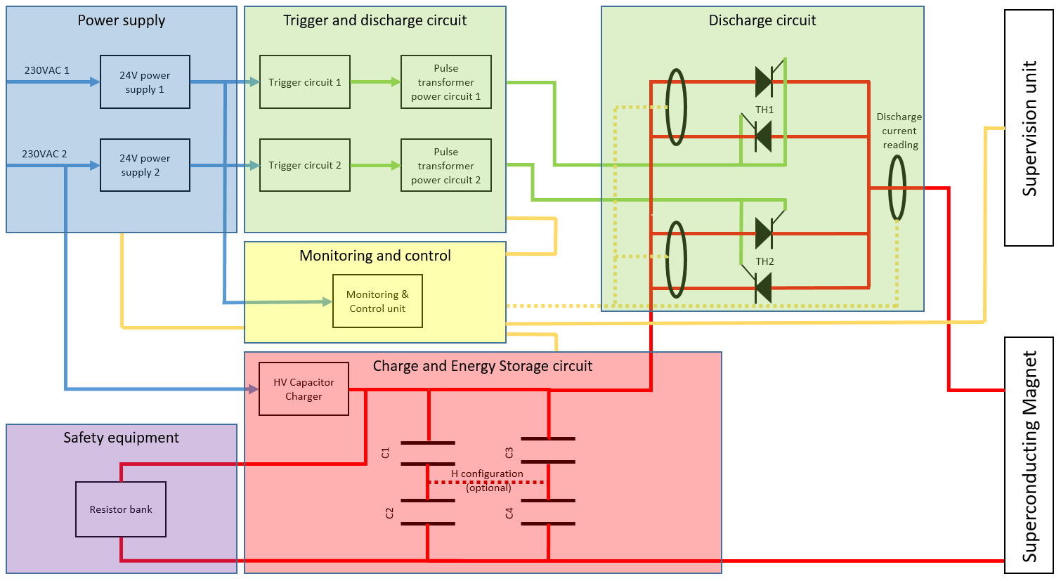
CLIQ v3 - Machine version
CLIQ v3
Redundant trigger
Redundant 230
VAC power supply
Capacitor bank in square configuration (4x40 mF, 1000 V DC)
Monitoring and control unit
C=40 mF
Layout of the CLIQ machine version

Slide 7
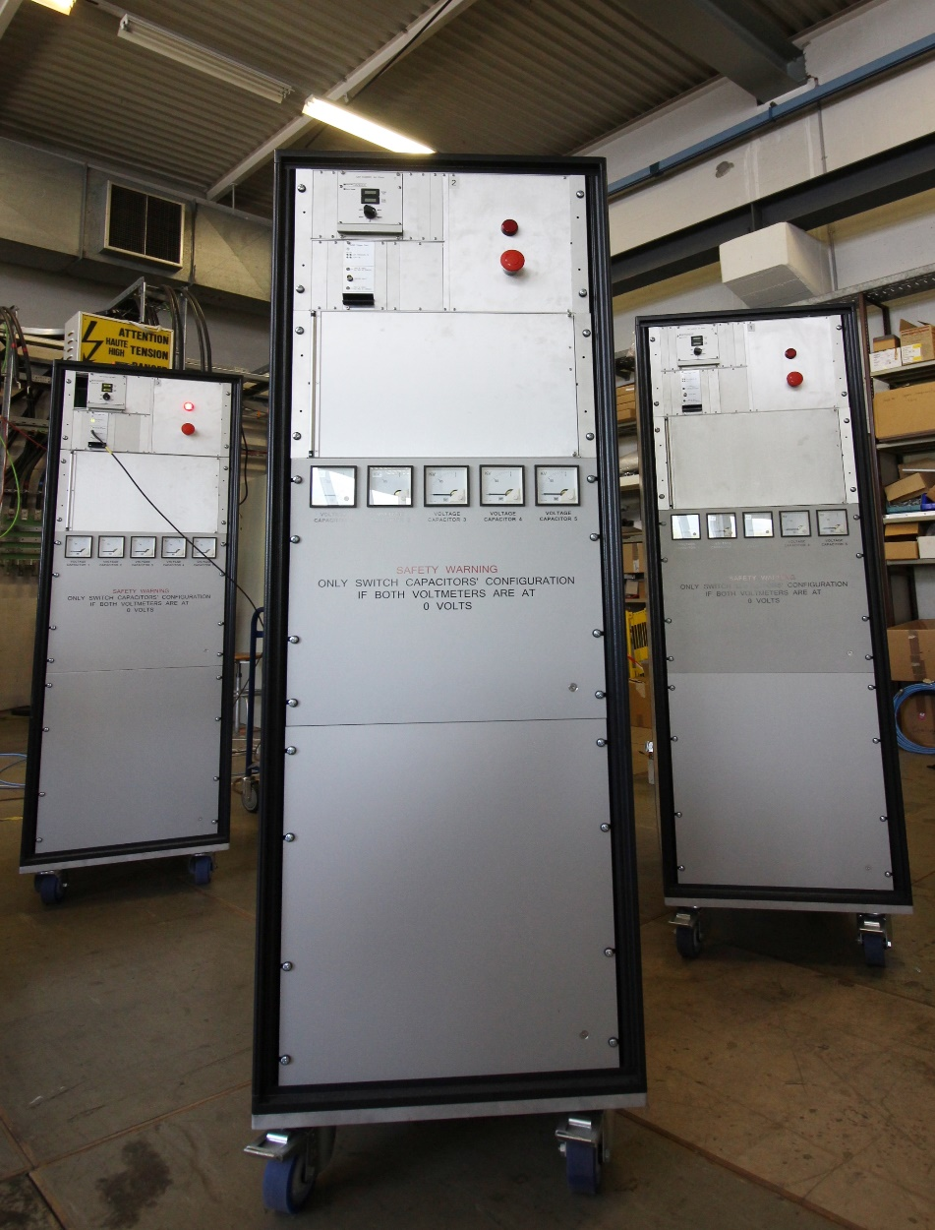
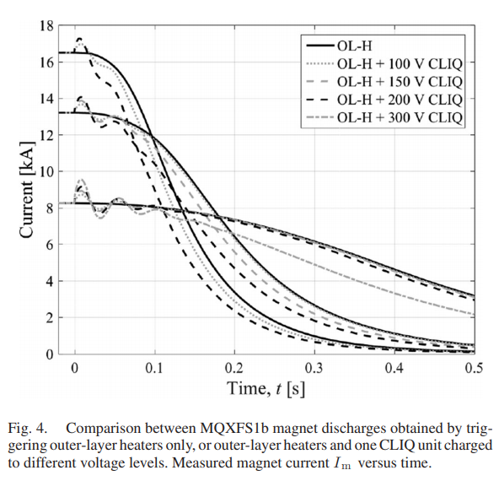

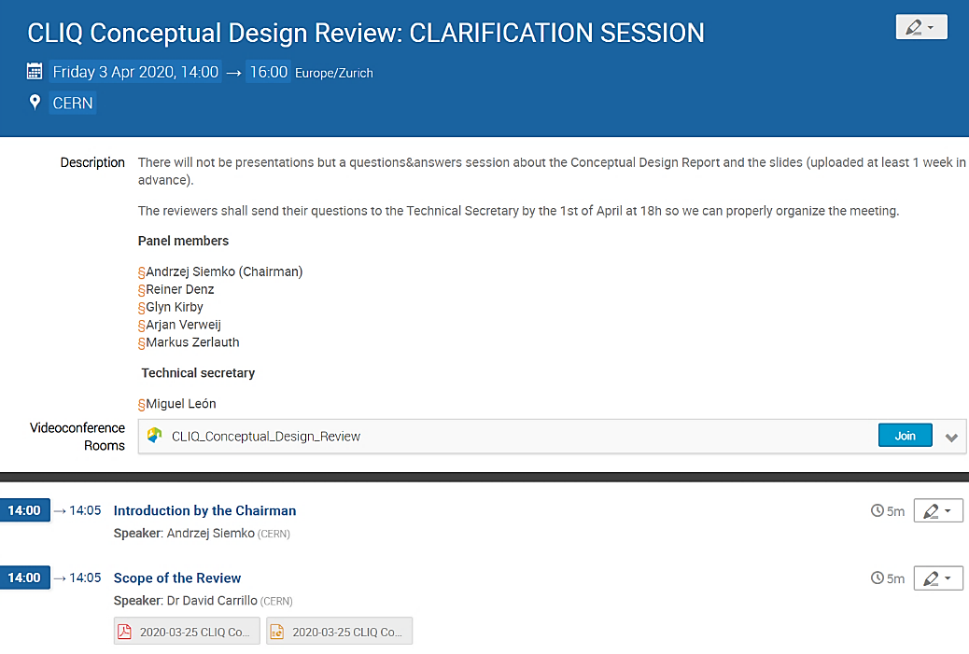
Accomplished milestones
E. Ravaioli, et al. "Quench Protection Performance Measurements in the First MQXF Magnet Models," in IEEE Transactions on Applied Superconductivity, vol. 28, no. 3, pp. 1-6, April 2018, Art no. 4701606
Extensive R&D program at the SM18 test facilities at CERN and at Fermilab with CLIQv1 and CLIQv2
Comparison between MQXFS1b magnet discharges obtained by triggering outer-layer heaters only, or outer-layer heaters and one CLIQ unit charged to different voltage levels. Measured magnet current Im vs time
Two CLIQ versions fully validated (11 units manufactured)
Industrialization of CLIQv2 units
Conceptual Design Review – Apr 2020
Production Readiness Review – Dec 2021

Slide 8
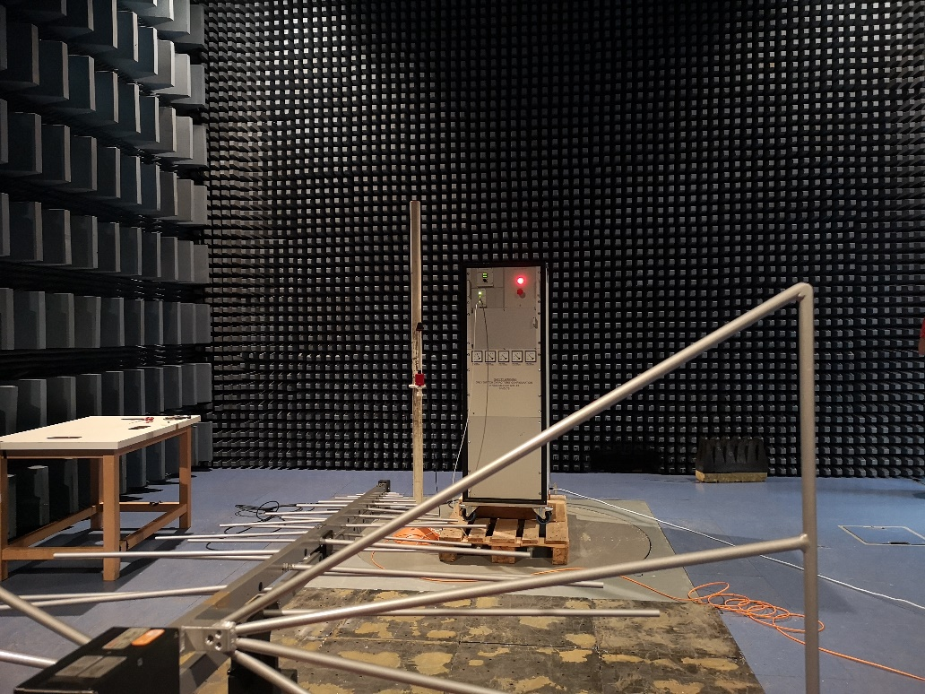
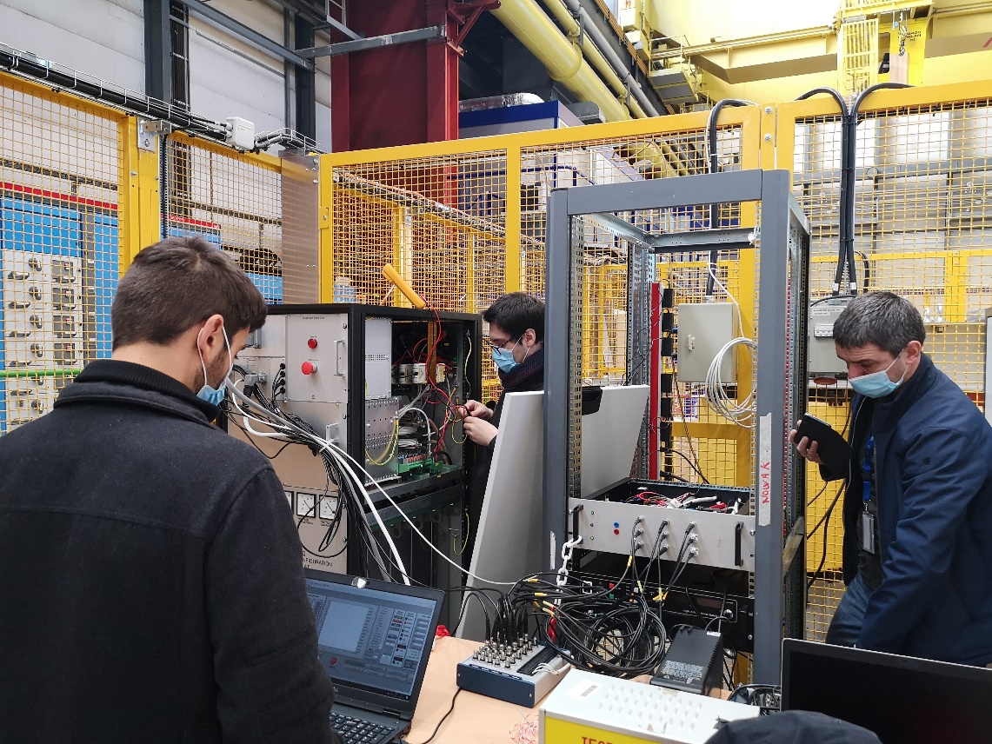
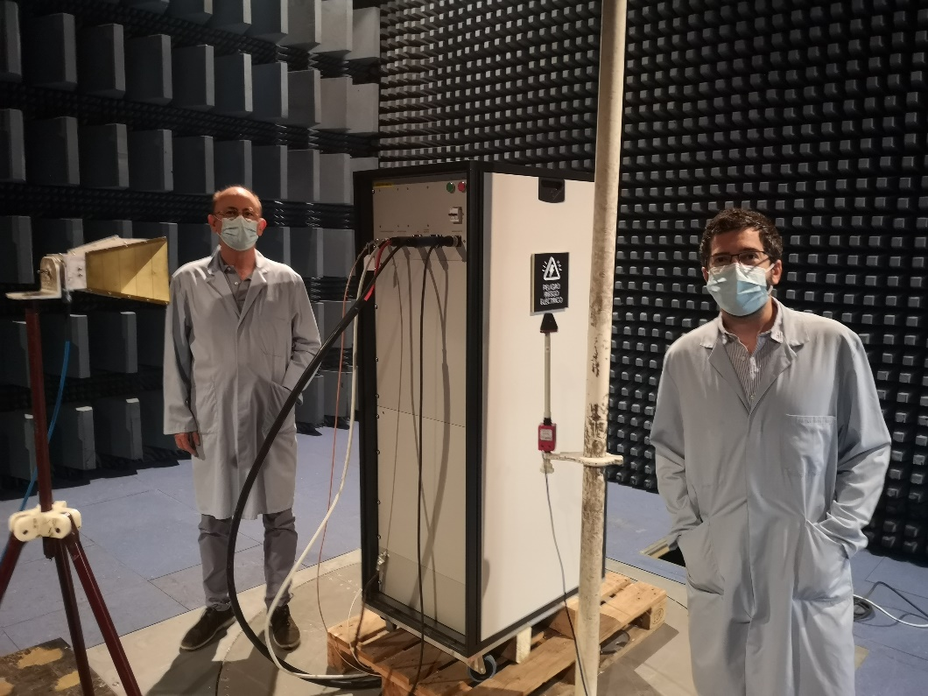
Accomplished milestones
Reliability run with CLIQv2 units (>8000 cycles of charge/discharge in nominal conditions)
CE marking studies of CLIQv2
Core system of CLIQv1, v2 and v3 is the same, so previous prototypes, already in SM18 and Fermilab are considered reliable and safe
CE marking will be eventually repeated on the CLIQv3 units

Slide 9
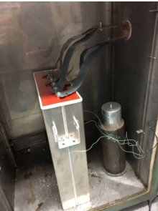
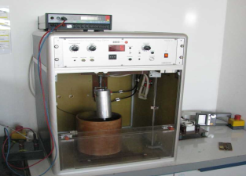
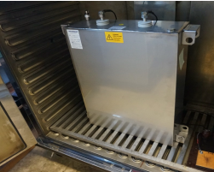
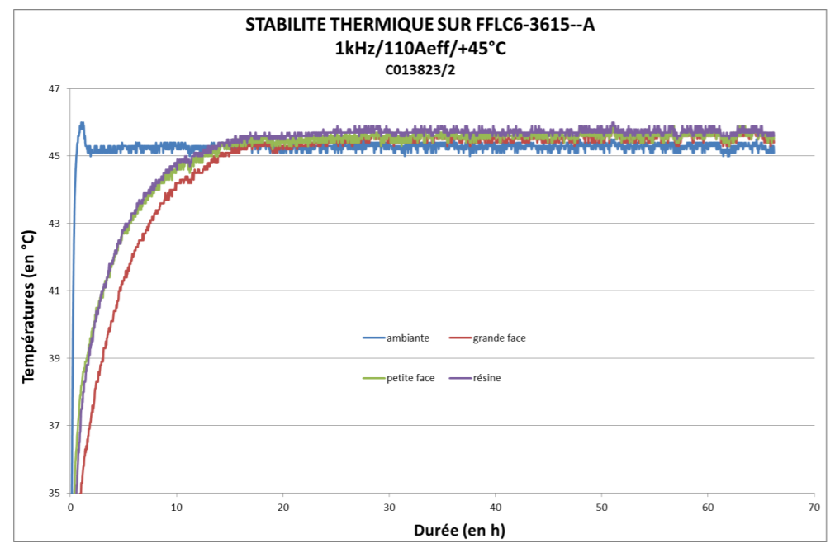
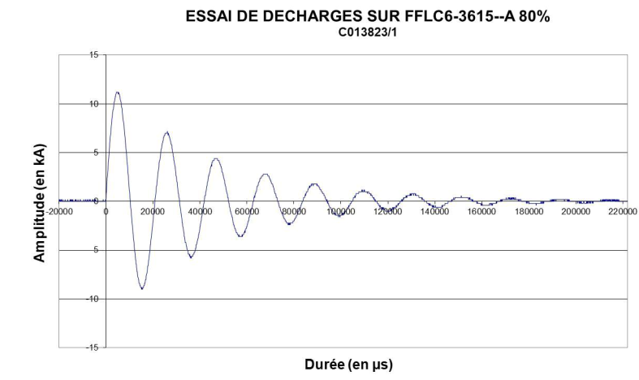
Accomplished milestones.
Qualification and production of of CLIQ capacitors
Capacitors for the String already delivered (Q1 2022)
Self-healing tests
Thermal stability test
Endurance tests
Inversion tests 80%

Slide 10
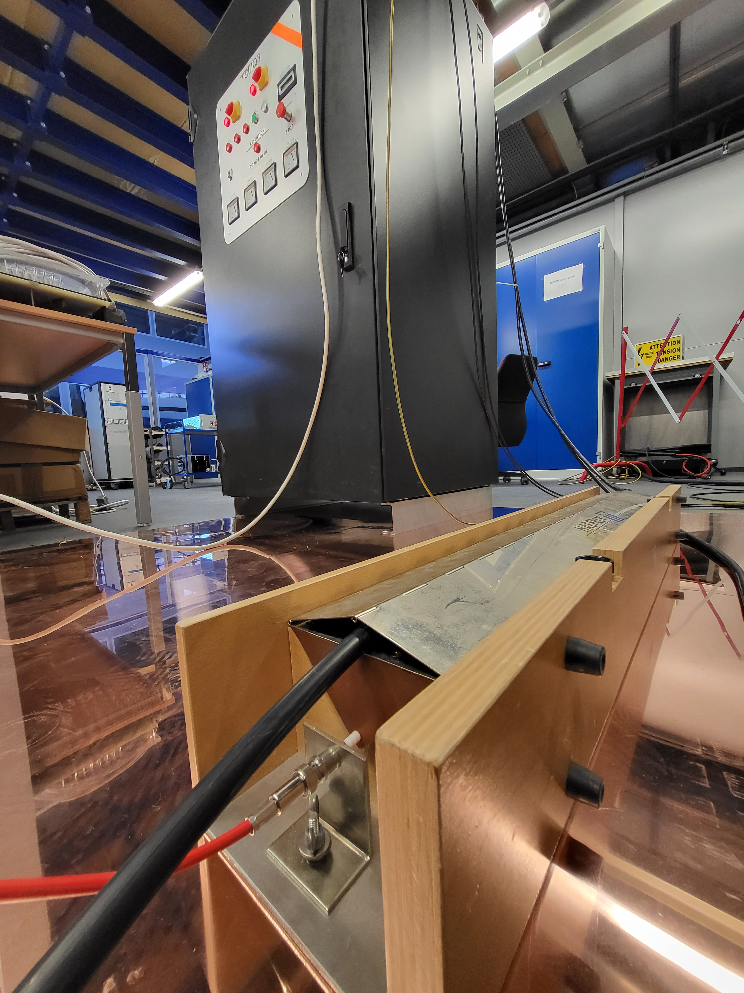
Accomplished milestones.
Spurious triggering detection
New budget time requirements for the interlock in case of a CLIQ spurious triggering * called for a campaign on the CLIQ current sensors immunity tests
  *see presentation by C. Hernalsteens & D. Wollmann about the criticality of fast failures (Wed 16h30)
Fast transients (up to 5 kV) applied by capacitive coupling to the monitoring and power cables
Present baseline sensors (main current transformer from Schneider and branch current transformers from N.Talema) found sufficient to detect a spurious trigger with the new requirements
Nevertheless, two Rogowski coils have been added (negligible delay and cost impact) in order to have a complementary method detection, and also faster in case of future change of requirements
Burst/Fast transient tests

Slide 11
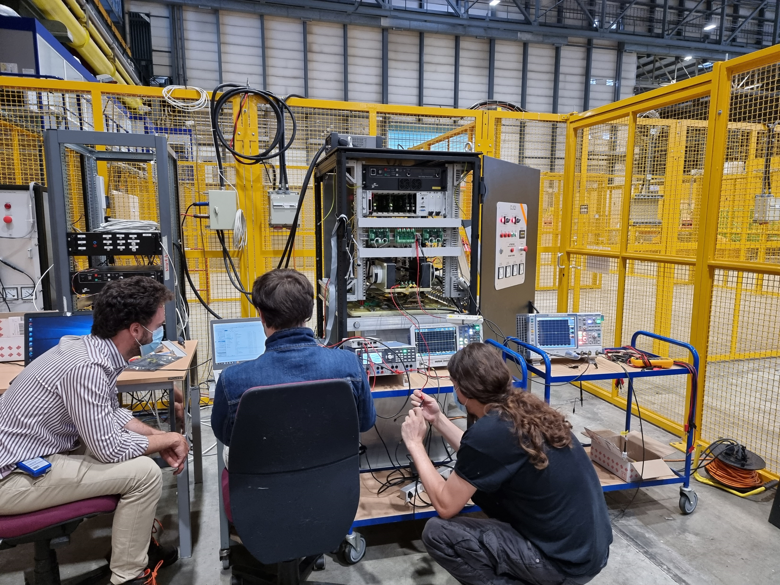
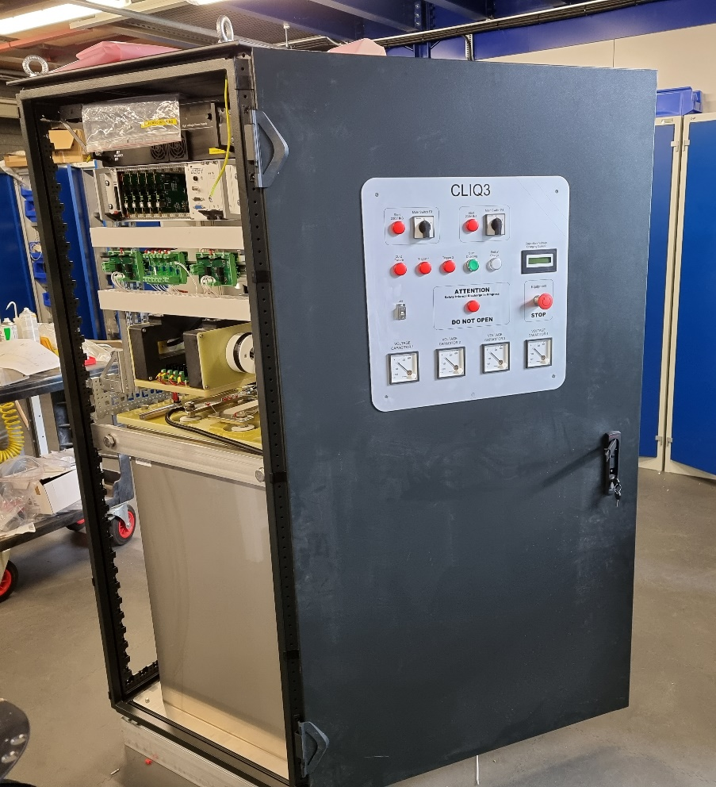
Accomplished milestones
Qualification of CLIQv3 prototype finished in 2022
Worldwide shortage of electronics forced the re-design of most of the CLIQ boards during 2022
CLIQv3 prototype qualification
CLIQv3 prototype

Slide 12
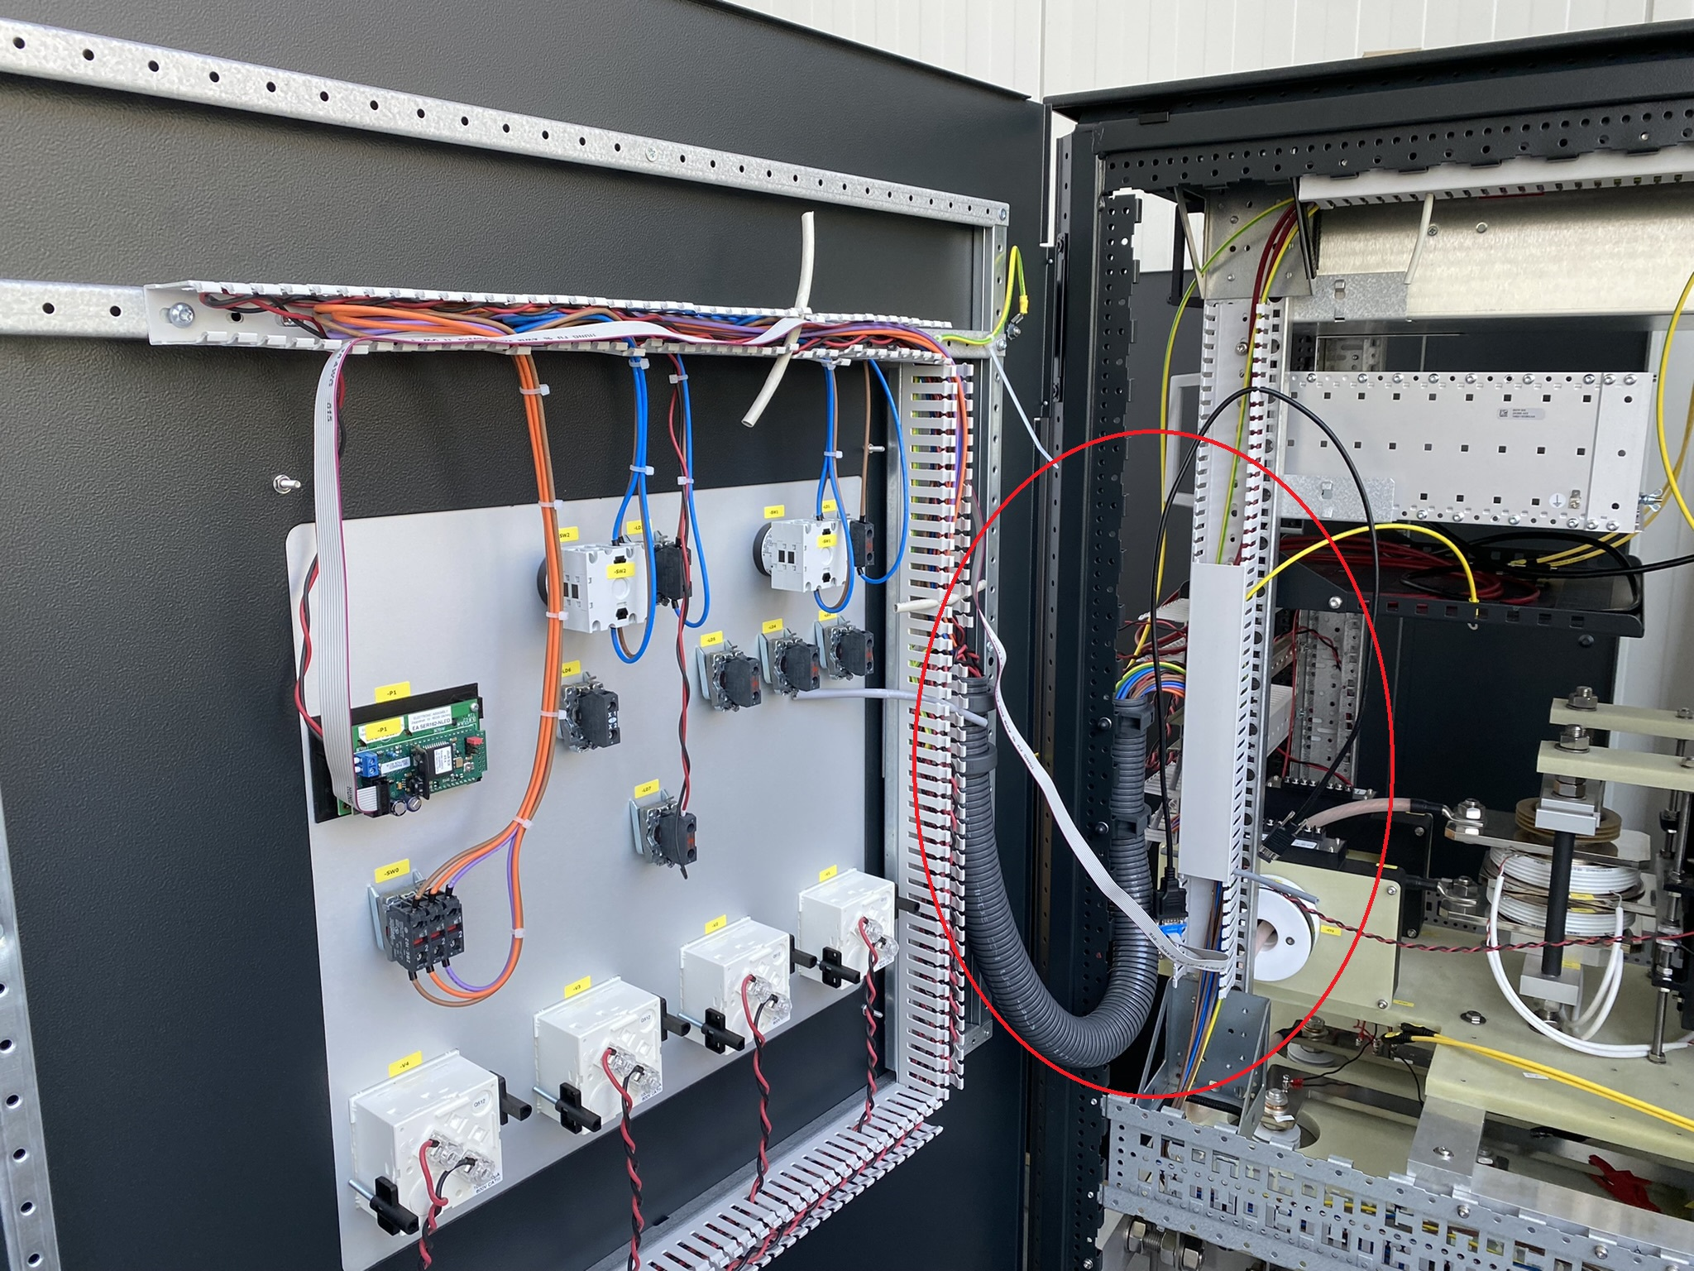
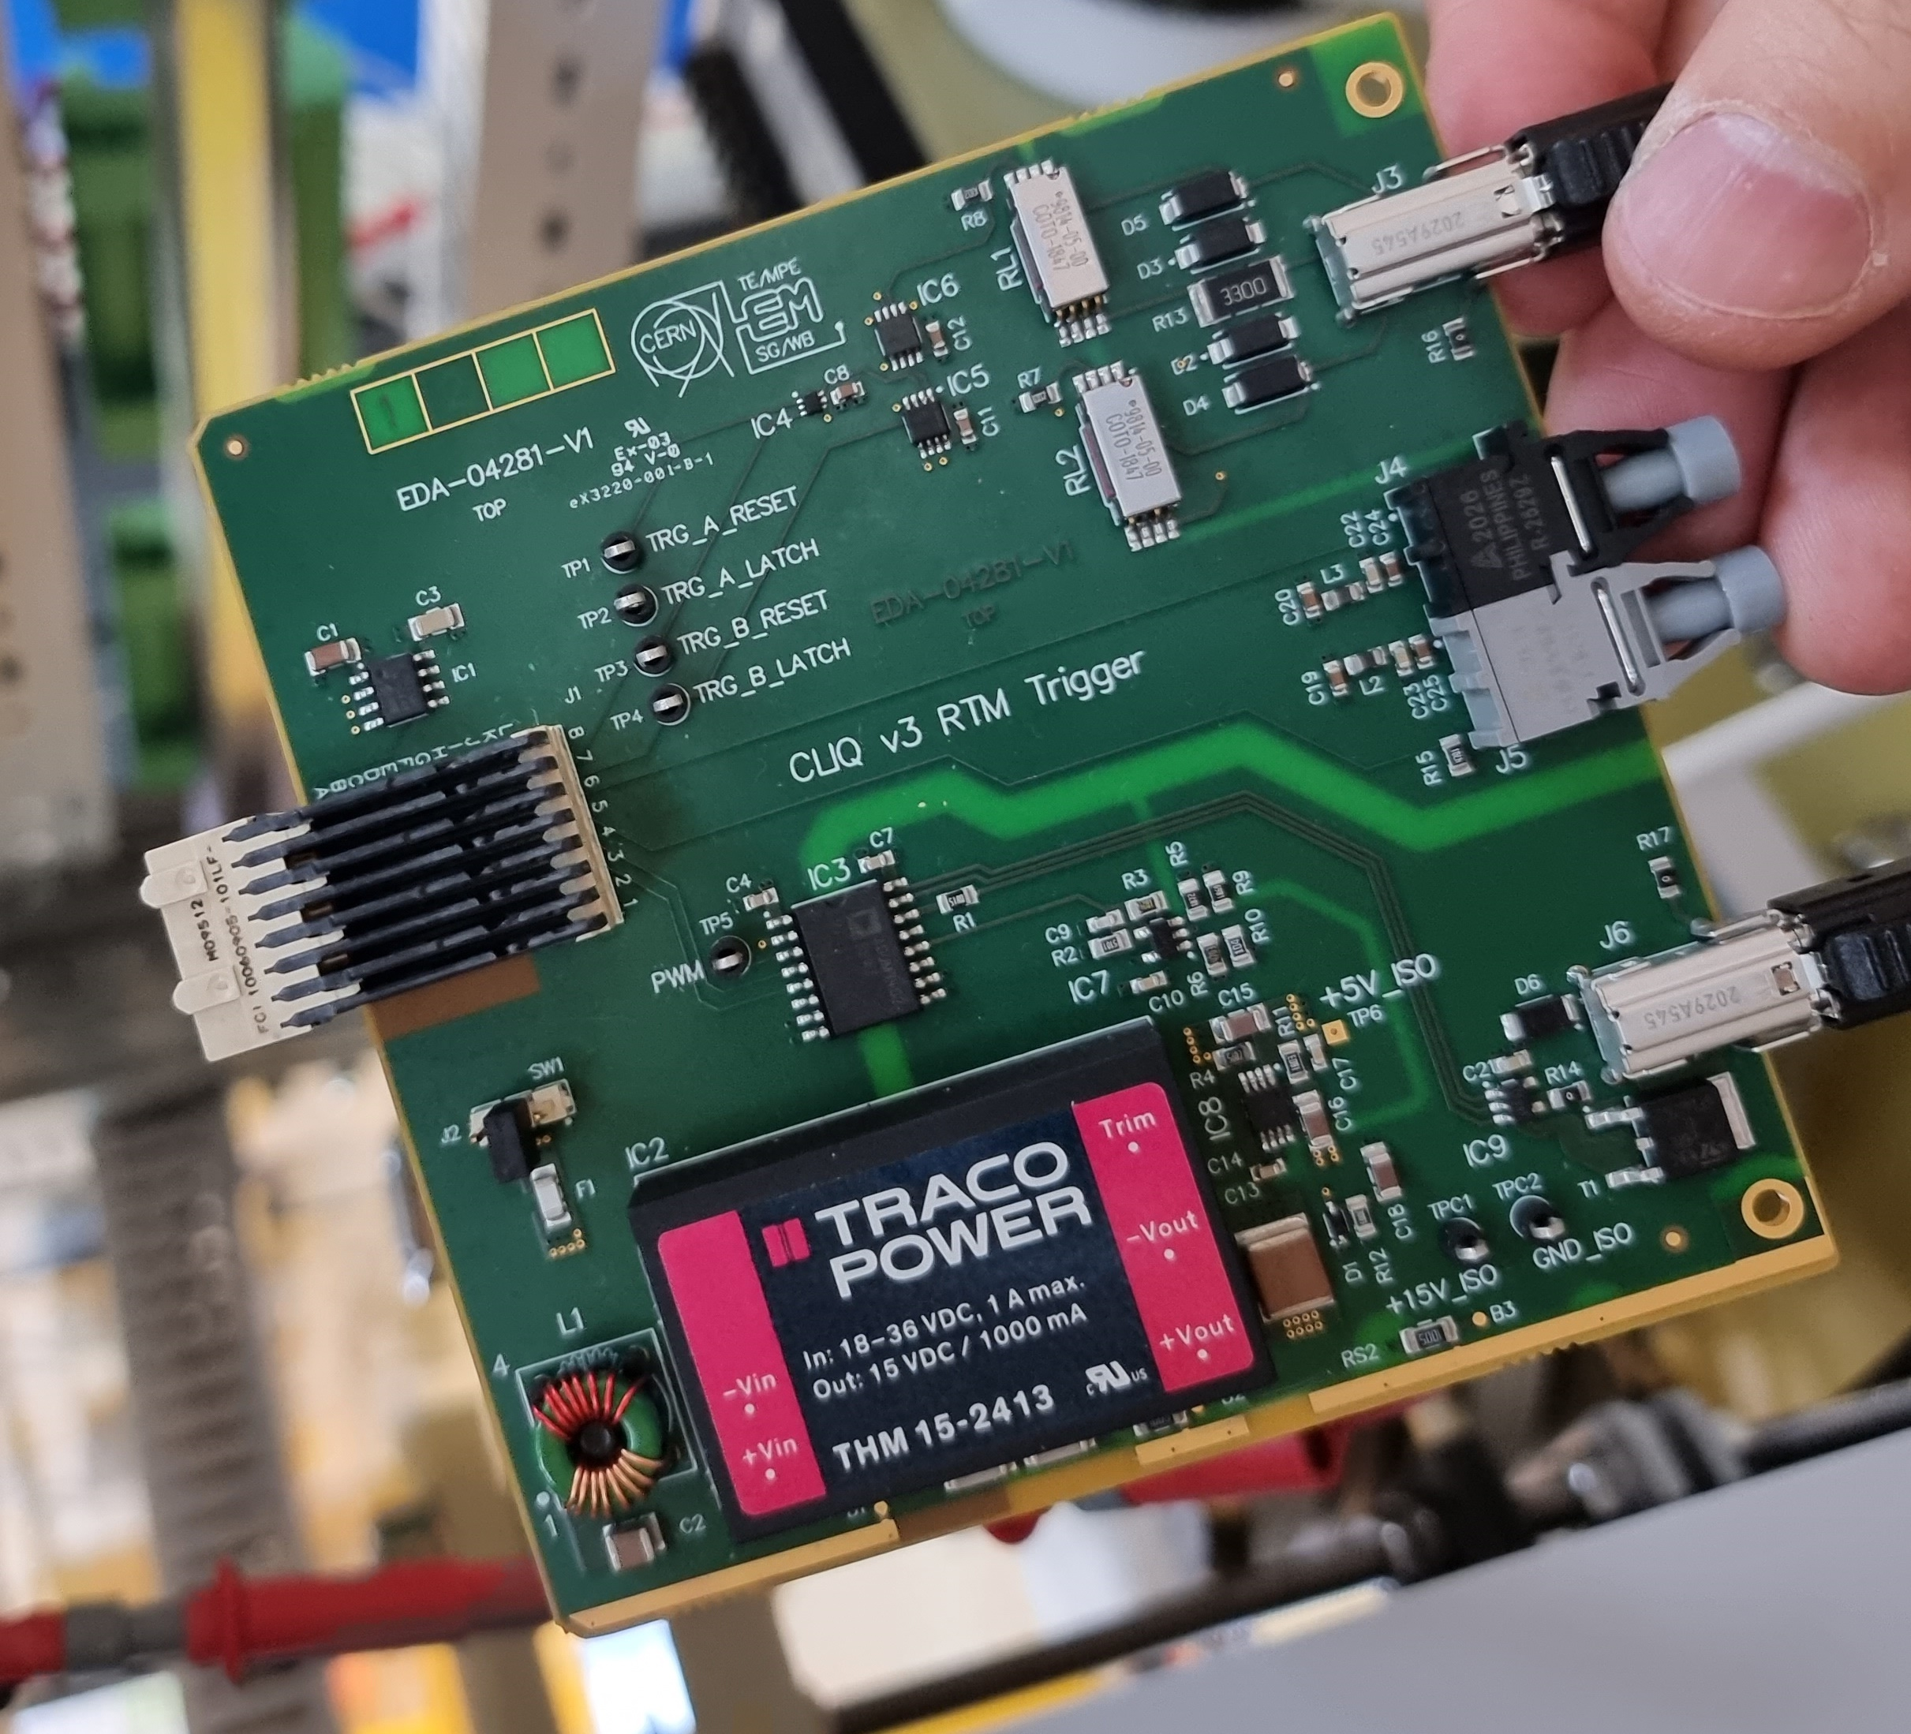
Ongoing activities
CLIQ pre-series unit being assembled
Green light given for their pre-series production of the recently re-designed CLIQ boards
Control & monitoring boards firmware development
CLIQ pre-series unit assembly
One of the CLIQ control boards re-designed due to the shortage of components

Slide 13
Next steps
Q4 2022
CLIQ pre-series unit by the industry
Q1 2023
CE and environmental studies with pre-series
Q2 2023
CLIQ units for IT String facility
(6+2 units )
Q4 2024 CLIQ series production
(24 units)

Slide 14
CONCLUSIONS
CLIQ machine version prototype fully qualified
Dependability studies validated by the reliability run (more than 8000 discharges)
CE marking studies (including safety assessment) for CLIQv2, CLIQv3 immunity tests performed
CLIQ Machine version (v3) pre-series being assembled
CE marking and CLIQ String production expected in Q2 2023 (as long as a all components are delivered according to present information from suppliers)

Slide 15
Thank you very much for your attention

