Slide 1
SPS DQW Module: Tests & next steps
HL-LHC WP4
CERN & Collaborations
19 September 2022

Slide 2
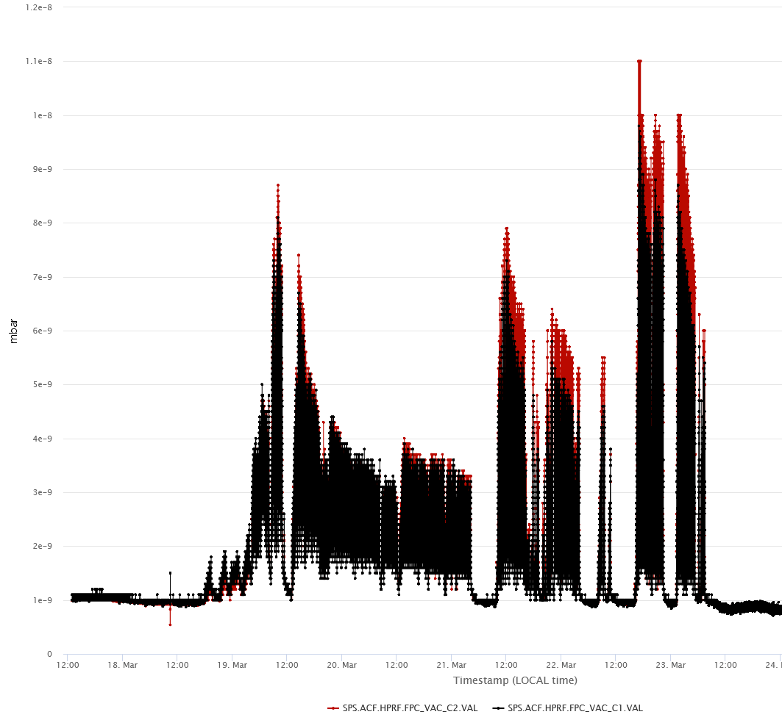
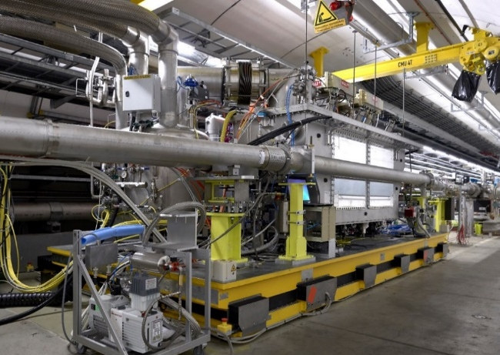
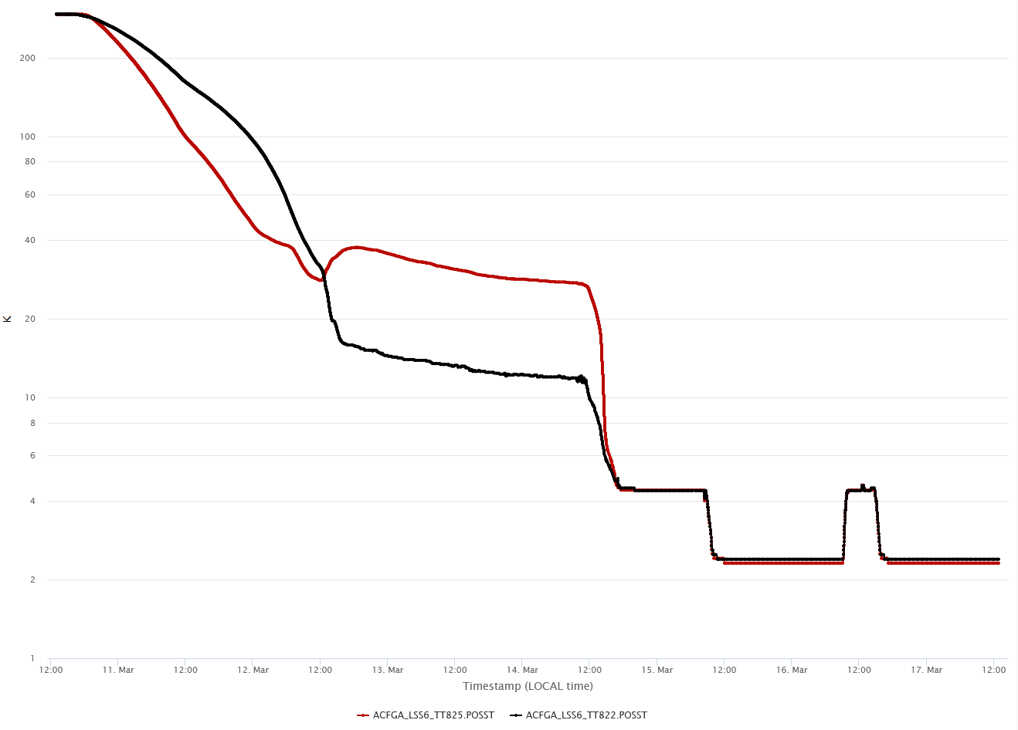
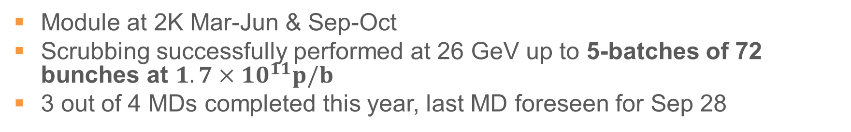
DQW-SPS Re-commissioning, 2022
Module at 2K Mar-Jun & Sep-Oct
Scrubbing successfully performed at 26 GeV up to 5-batches of 72 bunches at $1.7×{10}^{11}p/b$
3 out of 4 MDs completed this year, last MD foreseen for Sep 28
300K
C2
C1
2K
11-Mar
17-Mar
17-Mar
23-Mar

Slide 3
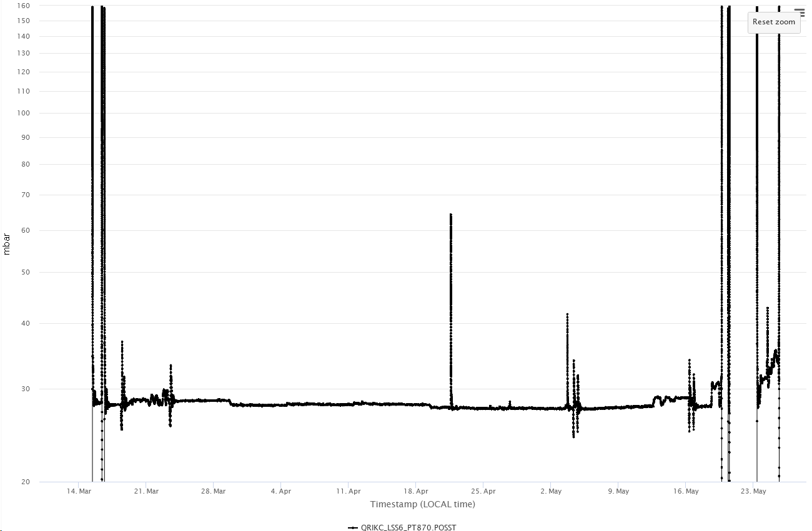
2022 Overview, Period 1
Cooldown (mid-March)
Warmup (end-May)
MD1 (1 MV, 4 May)
MD2 (1 MV, 11 May)
2K

Slide 4
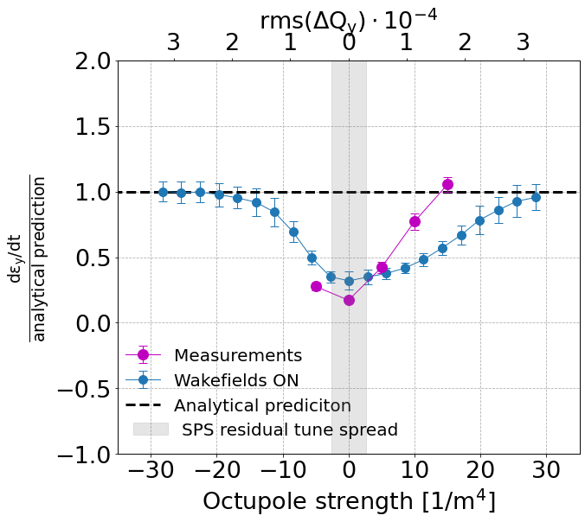
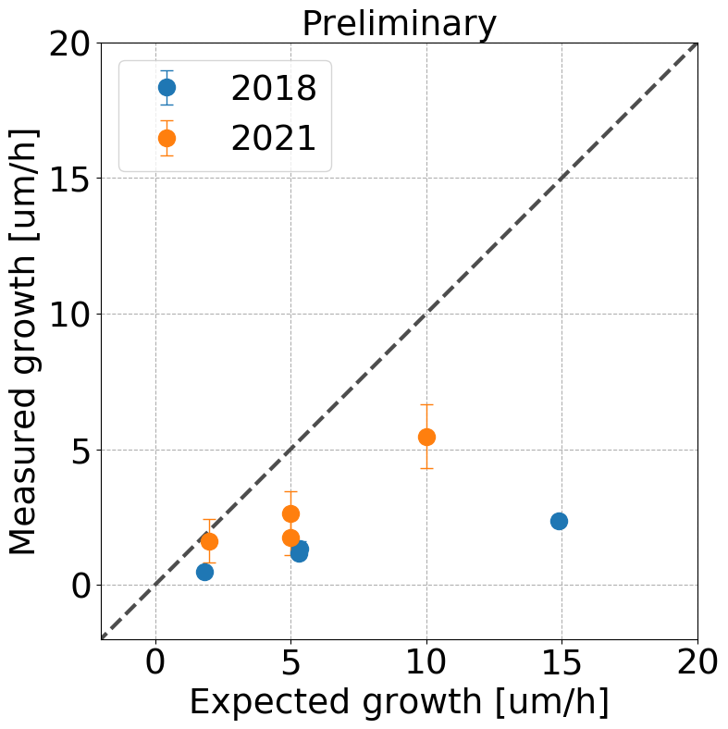
Highlight Result: Emittance Growth with RF noise
Measured growth smaller by x4 than predicted (2018 & 2022)
Suppression of emittance growth due SPS machine impedance confirmed – see talk by N. Triantafyllou Thursday
May 2022 Measurements

Slide 5
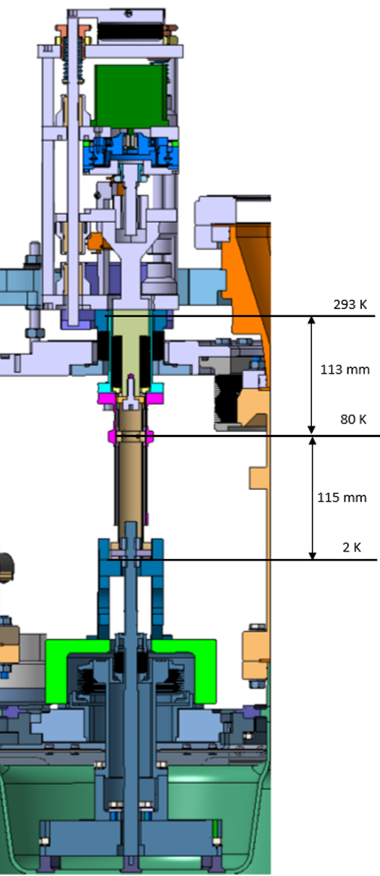
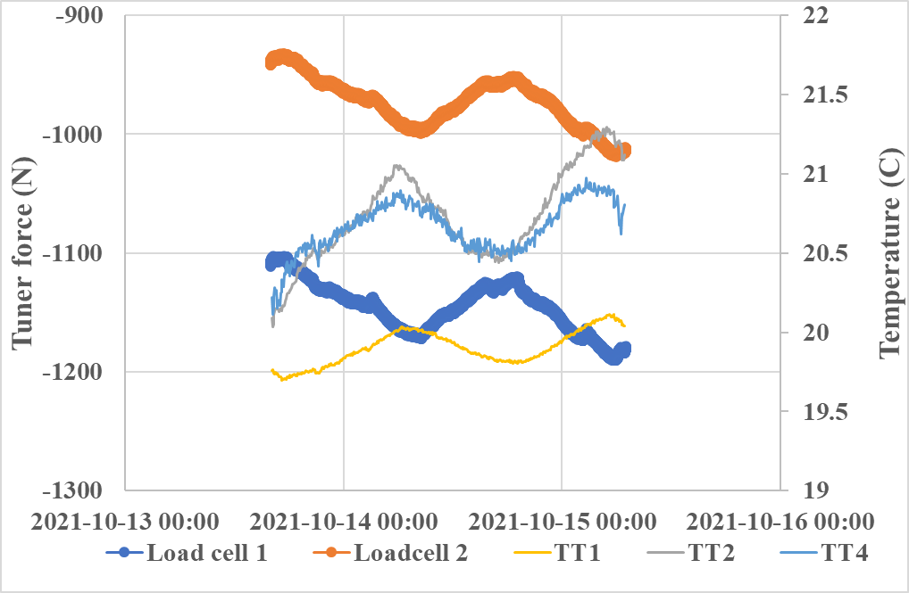
Frequency Drifts observed during “Quiet Periods”
2K no tuner changes
Feedthrough bellow: sensitive to pressure (atm)
1% change atm >> ~ 3N *
Temperature gradient, change will change tuner load
Thermalisation temperature not measured, refer to FPC thermalisation
He Tank feedthrough + cavity surface. Sensitive to He tank pressure (and temperature when saturated liquid)
1 mbar >~3 N*
Courtesy K. Artoos – Tuner Observations
* Rough estimate

Slide 6
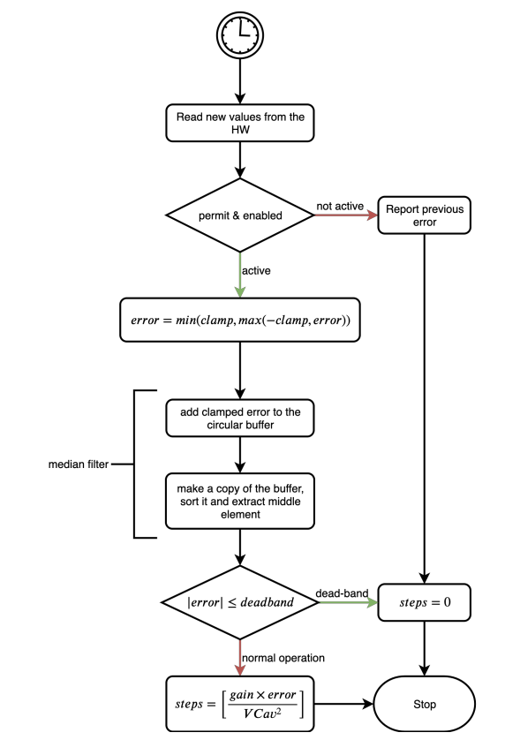
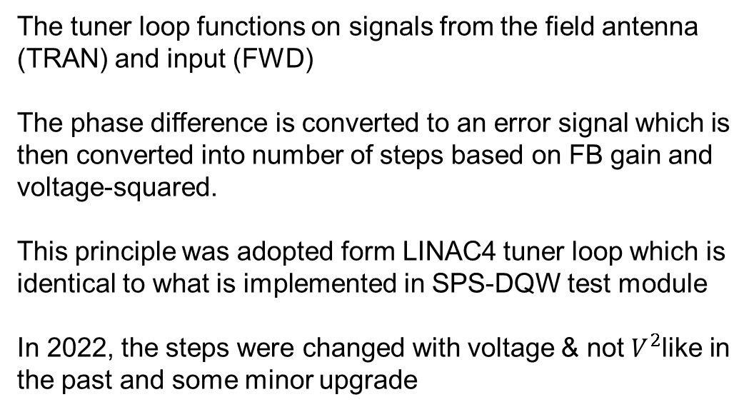
Tuner Loop Updates
The tuner loop functions on signals from the field antenna (TRAN) and input (FWD)
The phase difference is converted to an error signal which is then converted into number of steps based on FB gain and voltage-squared.
This principle was adopted form LINAC4 tuner loop which is identical to what is implemented in SPS-DQW test module
In 2022, the steps were changed with voltage & not $V^{2}$like in the past and some minor upgrade
Since, then the appears to have improved stability than in the past. However, the RF-on flattop has to be long enough for the tuner to latch and add correctly which is not true in all SPS cycle

Slide 7
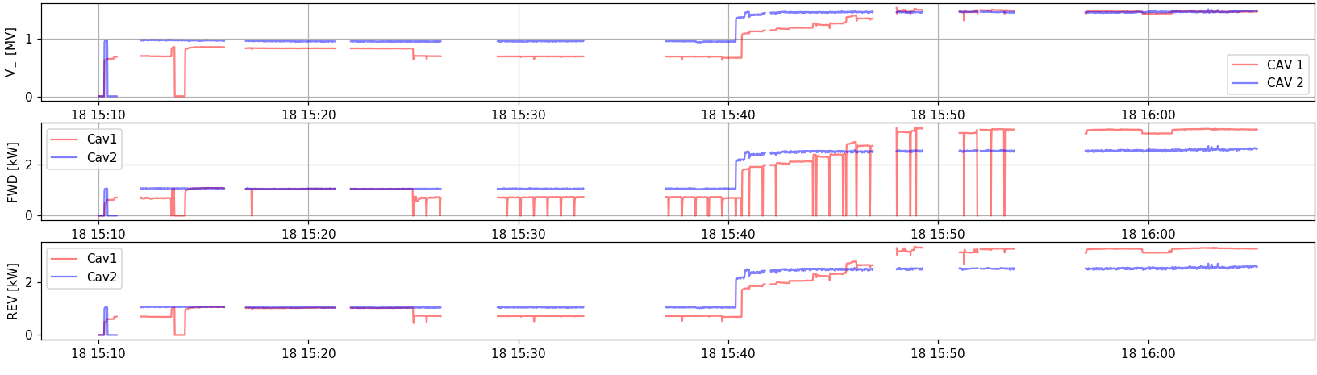
Pushing the Voltage – slowly (May 2022)

Slide 8
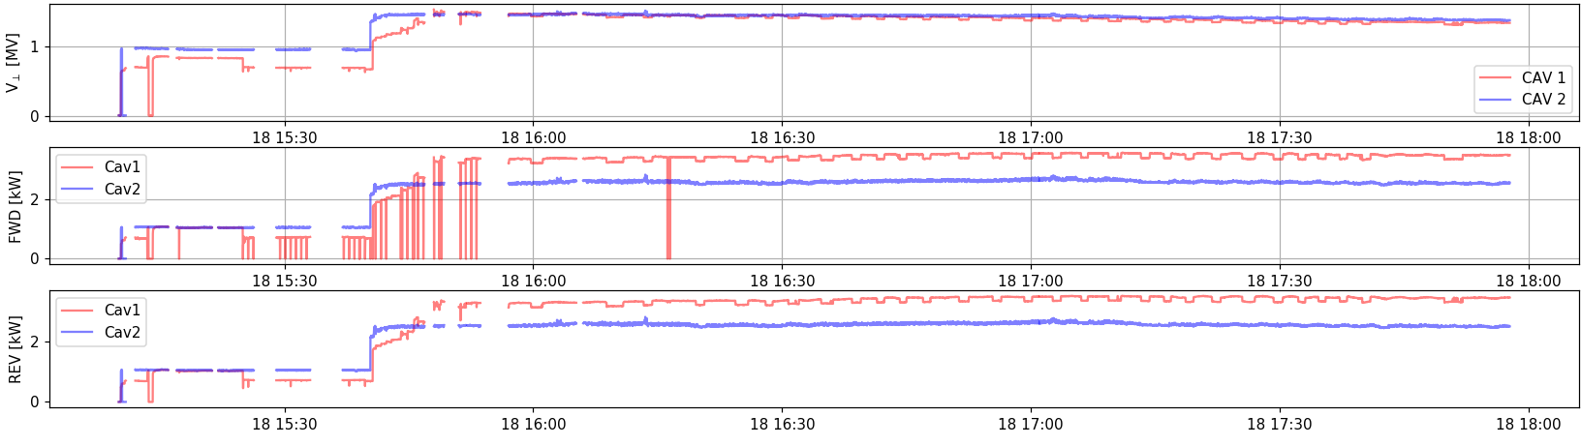
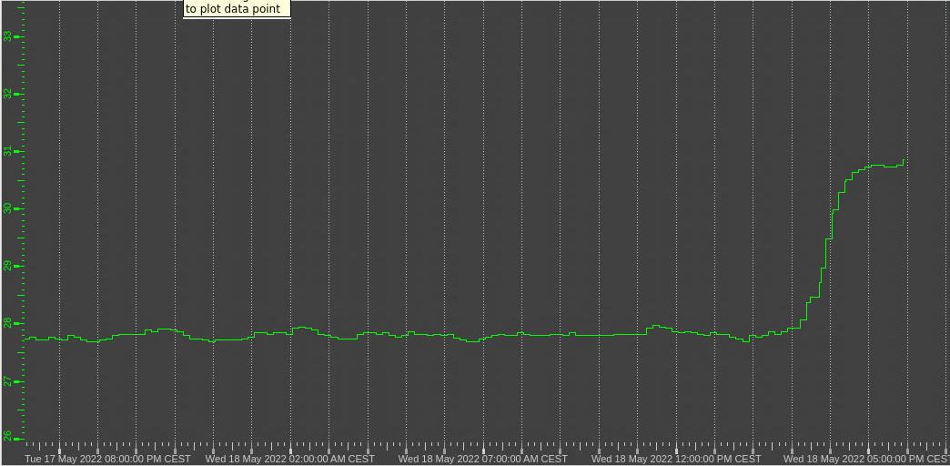
Pushing the Voltage – slowly (May 2022)
~1.5 MV
3PM (start RF)
31 mbar
28 mbar

Slide 9
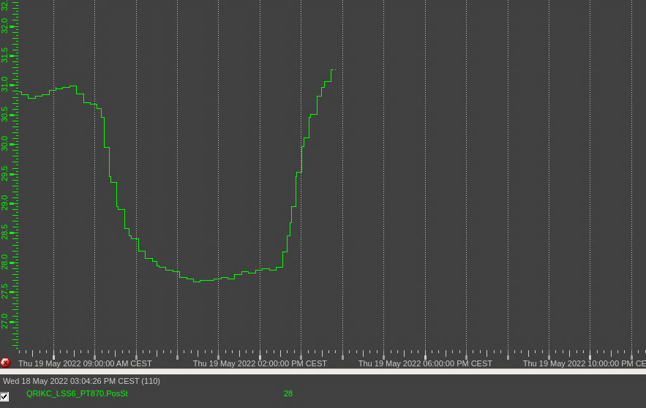
Cryo Evolution
Increase in ~0.5 MV → 3 mbar is real
1.5 MV (overnight)
Restart RF at 1.5 MV
Power cut

Slide 10
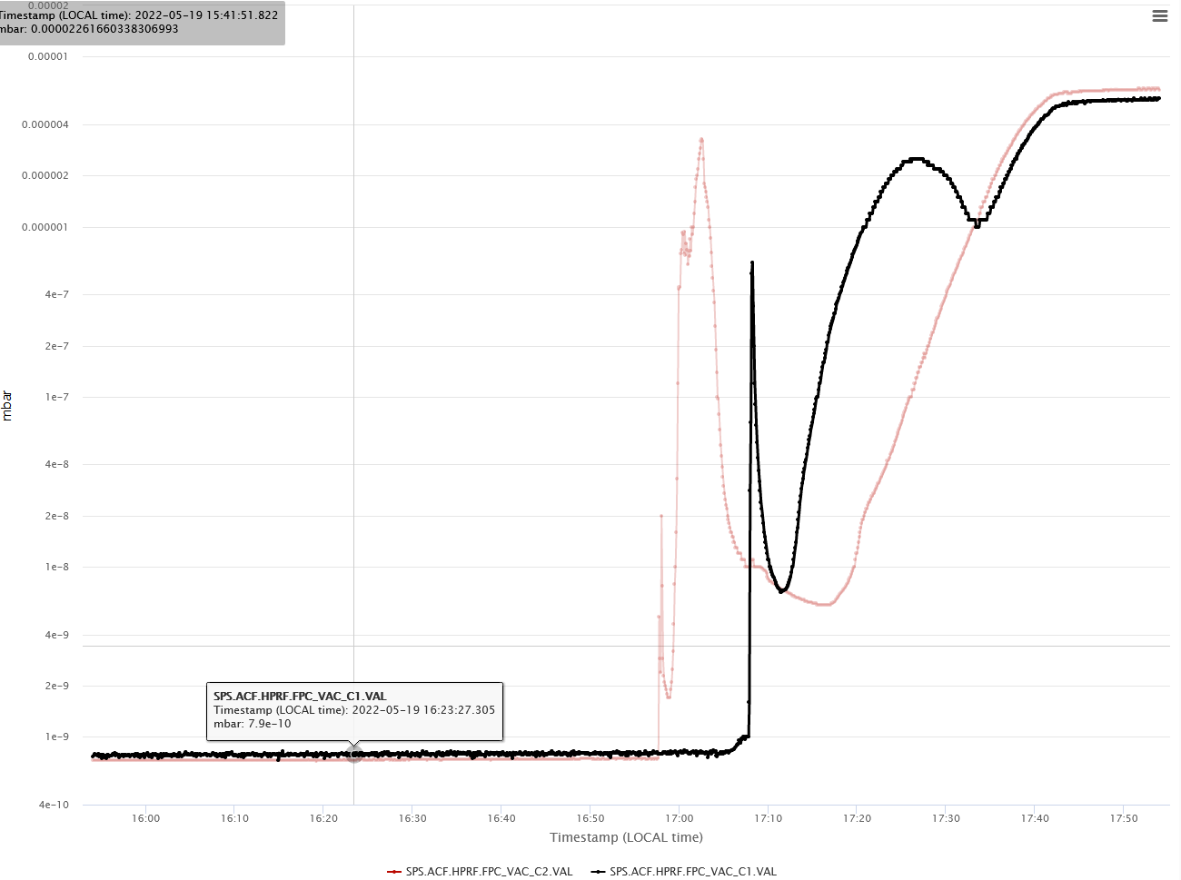
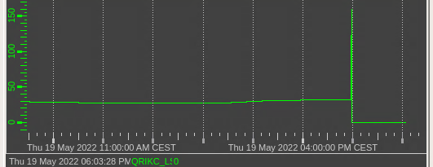


Pushing more: 1.7 MV in both cavities
Large vacuum rise, cryo conditions lost
To go higher in voltage, we need to setup a PLL in the RF conditioning loop which is presently done in open loop. This guarantees conditioning on tune with the cavity
$${10}^{−6}$$
$${10}^{−9}$$
After this incident, turbo pumps turned on ~1day

Slide 11
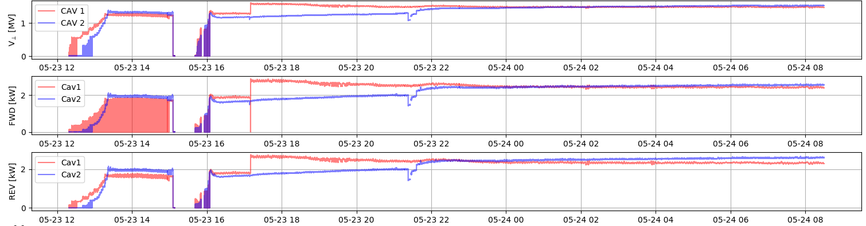
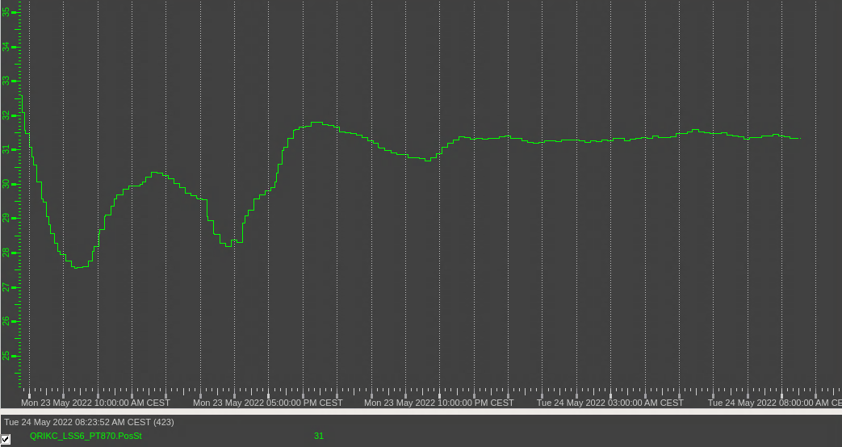
2 days later
1.5 MV (overnight)
~31 mbar

Slide 12
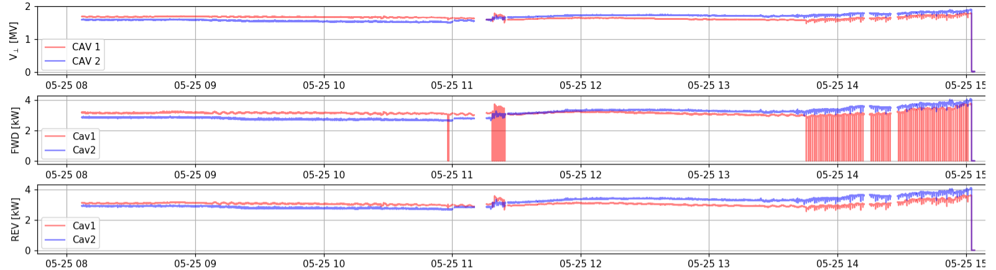
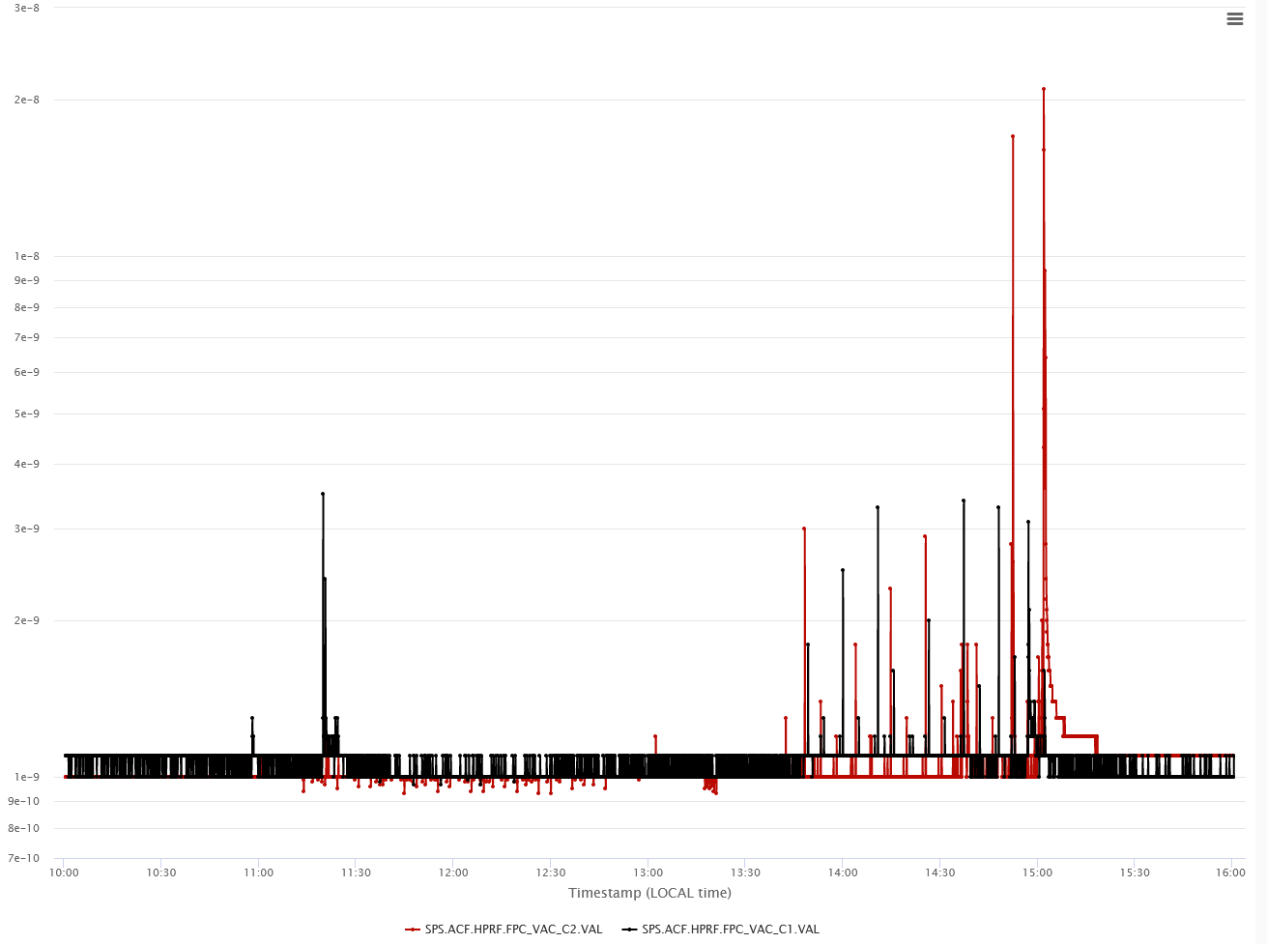

Towards 2 MV
Very slow increase in steps of 0.01 MV
Cav 1 ~1.9 MV
Cav 2 ~1.8 MV
$3×{10}^{−8}$ mb
Voltage oscillations visible even on SEL. RF Conditioning needed

Slide 13
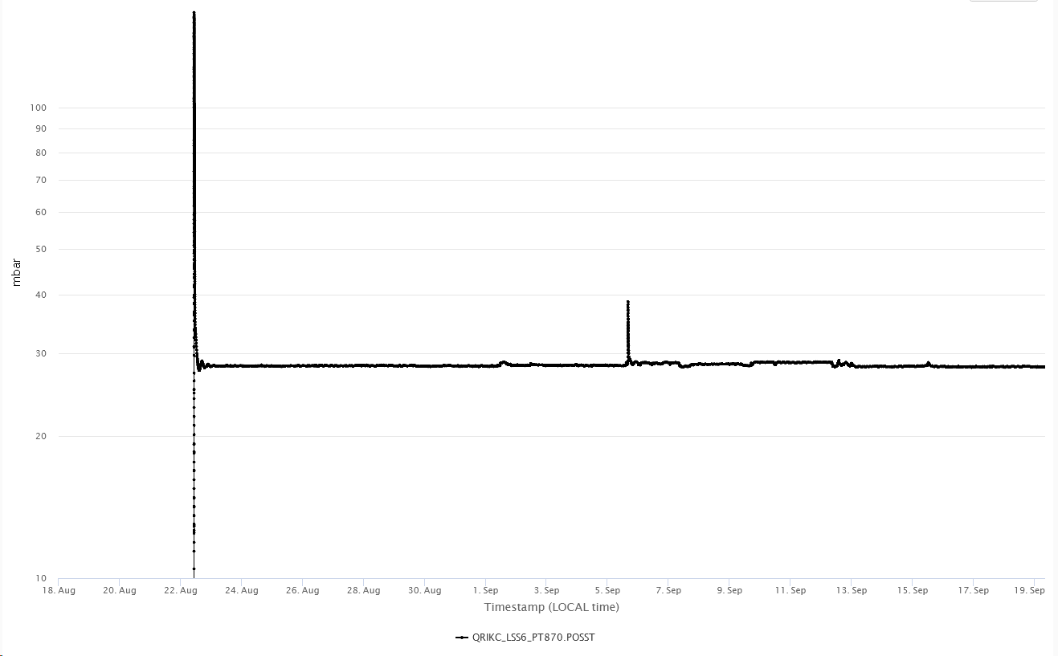
2022 Overview, Period 2
MD4 (28-Sep, high intensity)
MD3 (1 MV, 12-Sep)
Cooldown (mid-Aug)
RF Conditioning
LLRF setup
2K
Warmup (expected mid-Oct)

Slide 14
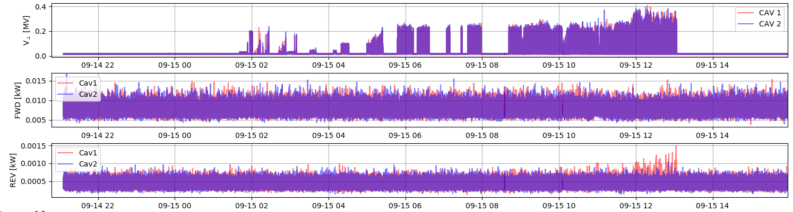
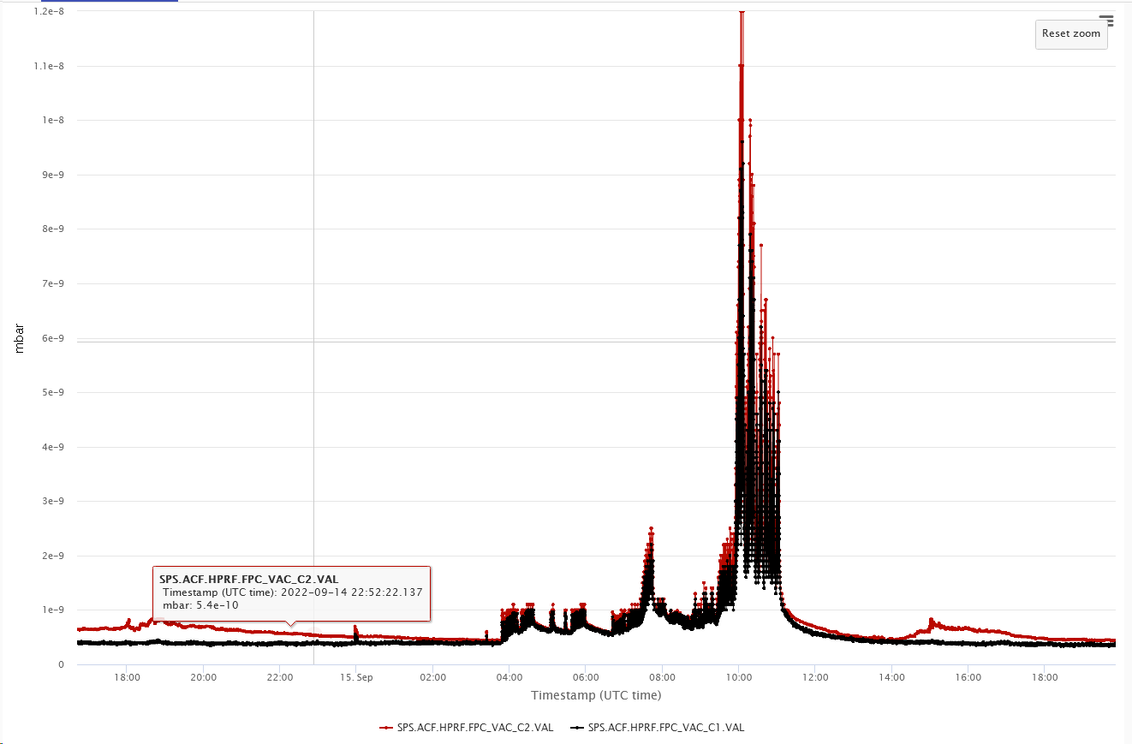
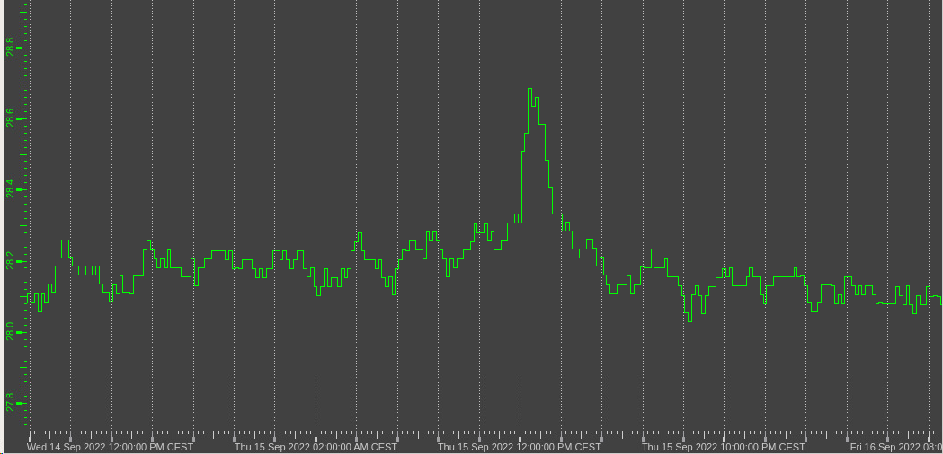
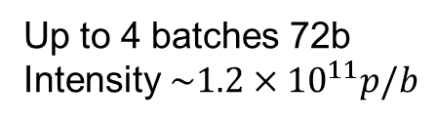

15-Sep (COLDEX MD, Crabs off but Scrubbing)
Up to 4 batches 72b
Intensity $\sim 1.2×{10}^{11}p/b$
${10}^{−8}$mb
28.5 mbar
28.2 mbar

Slide 15
Some comments
The cool-down of the module and stability at 2K well understood and feasible ~2 weeks
  Note that each thermal cycle or warm up has to be closely coordinated with vacuum for TMPs to be opened/closed
RF conditioning up to 10 kW (but low voltage) also relatively fast after thermal cycle ~1 week or less
  To move to 2MV and higher, we need special setup with RF conditioning
LLRF setup including closing feedback has improved dramatically and up to 1 MV can easily be done ~ 1day
  A setup to start with SEL and lock to driven loop is being implemented for easier freq finding and setup (“automatic sequencer”)
No effect seen yet at low voltage with sector valves opened and closed several times & strong beam conditioning of the bypass

