Slide 1

Status of the Beam Gas Vertex (BGV) Monitor
WP 13.7
Bernadette Kolbinger on behalf of the BGV team (CERN SY-BI-XEI)
Acknowledgements:
BGV team: H. Guerin, J. Storey
With input from: G. Breggliozzi, A. Galloro, D. Hynds, R. Kersevan, R. De Maria, J. Oliveira,
R. Plackett, D. Prelipcean, T. Ramos Garcia, B. Salvant, G. Schneider, T. Lefevre, B. Salvant,
A. Salzburger, H. Sandberg, R. Veness
Notes:
Overview of activities in last 2 years

Slide 2
Outline
Introduction
Simulations
Status of the new design
  Gas target
  Tracking detector
  Integration
Expected performance
Summary & outlook

Slide 3
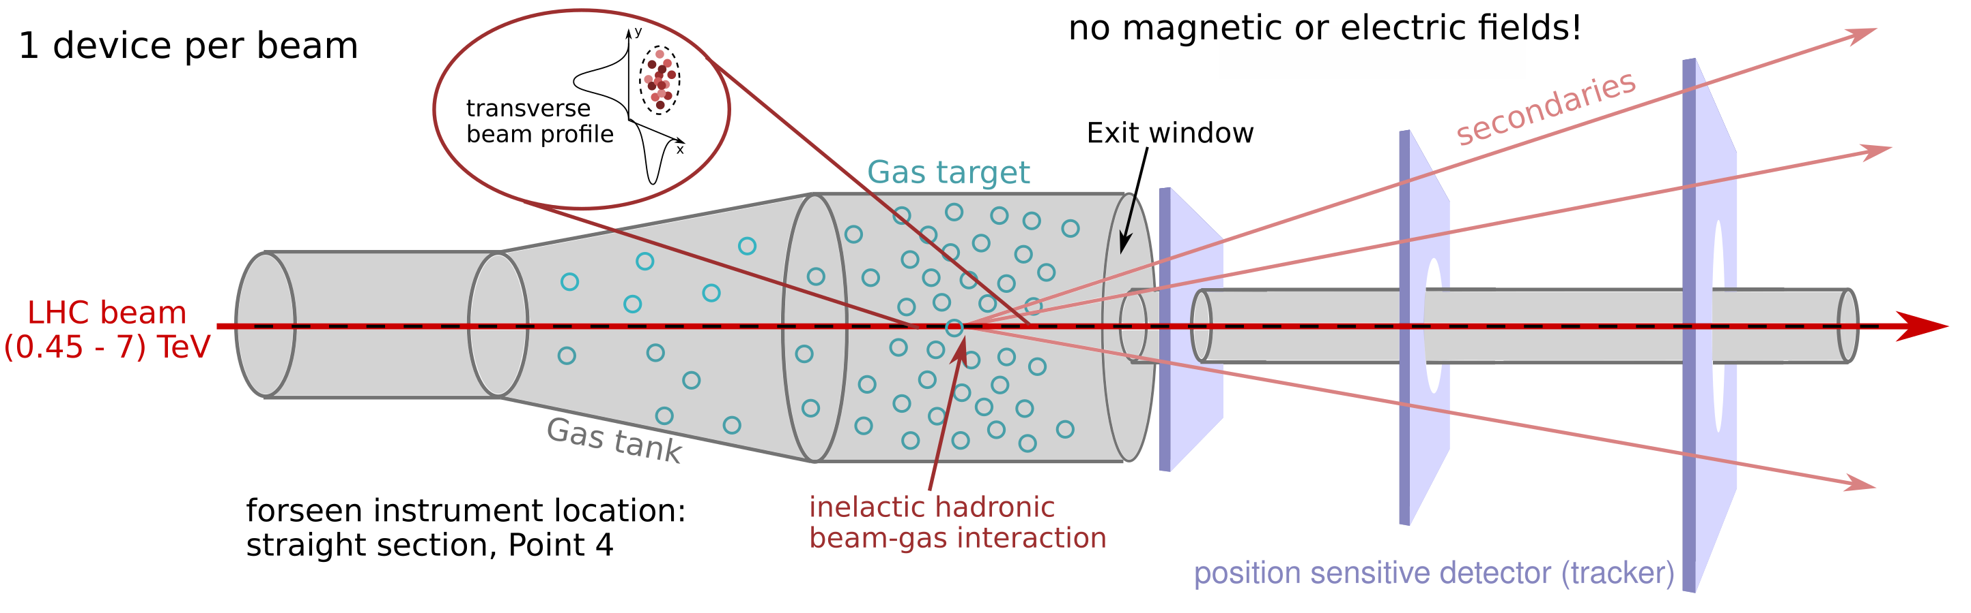
Introduction - principle
Noninvasive transverse beam profile monitor based on the reconstruction of vertices of inelastic hadronic beam-gas interactions - BGV (Beam Gas Vertex) monitor.
Provide continuous emittance and beam profile measurement throughout the LHC accelerator cycle (450 GeV to 7 TeV).
Consists of: a gas target, a forward tracking detector and computing resources dedicated to event reconstruction.

Slide 4
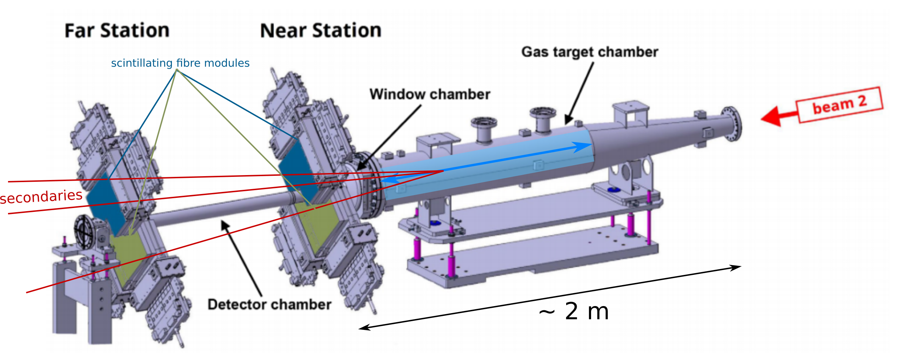
History – BGV demonstrator
Installed, commissioned and operated in LHC Run 2 (PhysRevAB)
Tracking detector based on scintillating fibre stations (LHCb SciFi).
Neon gas target of ~1.8m length and 10-7 mbar (~200 kHz interaction rate).
Successful beam size measurements (200 µm to 800 µm), throughout the LHC cycle with required precision. Bunch-by-bunch measurements.
Coherent with other beam size measuring devices.
Reconstruction of beam-gas interaction vertices not possible ➡ no beam profile measurement.

Slide 5

Future BGV
Beam size review after Run 2 Oct. 2019:
“None of the present instruments provide a bunch-by-bunch profile measurement for the physics beam along the whole cycle. An additional non-invasive measurement device complementary to the WS and BSRT devices is therefore required."
Case for a new device is solid.
Work on new design - conceptual design report will be reviewed in October 2022.
Requirements for the future HL-LHC transverse beam profile monitor:
Emittance measurement with accuracy $$≤$$ 10 % (beam size $$≤$$ 5%).
Bunch-by-bunch measurements of beam size with ~ 1 % precision after ~1 min of accumulating data.
Provide transverse profile measurements.
accuracy
add. design goals: aim for simplicity, maintainable by small team, minimise R&D: robust technologies.
precision
true value
mean

Slide 6
BGV performance - what’s important?
Method: deduce beam profile from spatial distribution of reconstructed vertices.
Key performance measure = response function. Not easy to determine with high precision - keep its width (= vertex resolution $$σ_{v}$$) small!
What $$σ_{v}$$ do we need, to achieve a beam size measurement with accuracy of $$≤ 5 \%$$?
  ➡ Depends on beam size!
  Minimum beam size at BGV locations is 235 µm (7 TeV). Assume knowledge of $$σ_{v}$$ with 10 % accuracy ➡ $$σ_{v}$$ $$≲$$ 166 µm (see calculation).

Slide 7
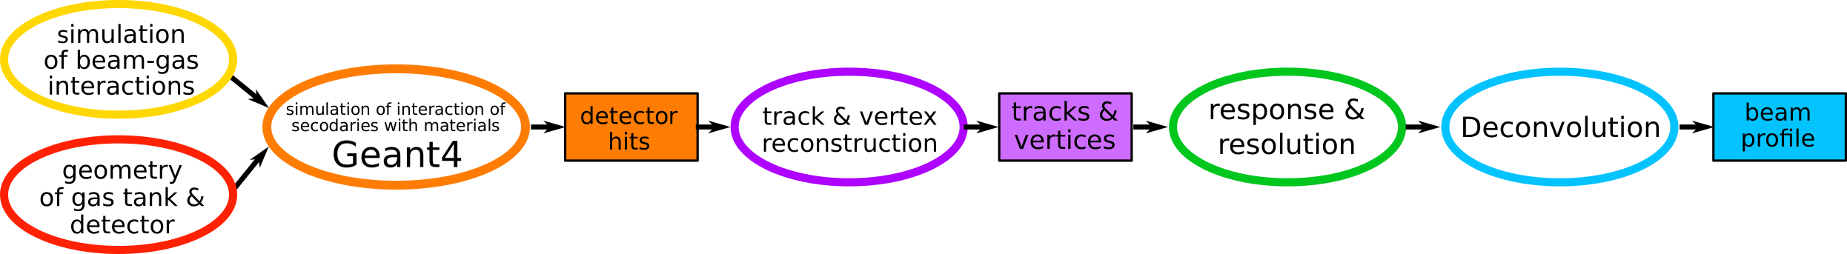
Performance study & optimisation
What impacts the vertex resolution $$σ_{v}$$?
What are the requirements for BGV gas target and tracker, to:
  fulfilling performance specifications,
  within the boundary conditions of: feasibility of integrating it into the LHC?
answer with complete simulation study!
➡ simulation and reconstruction framework
Test important design parameters and their impact on performance:
  Detector dimensions, material budget, position resolution etc.
  Gas target extension, pressure, gas species etc.
Conclusions
Results point towards possibility of compact tracker with a high spatial resolution.
Extended gas target not a show stopper -
~1 m neon, with ~10⁻⁷ mbar.
➡ see: BGV talk at 2021 Hilumi Collaboration Meeting, IBIC paper 2021, or back-up slides.
Notes:
Strategy:
Phase 1: generic BGV setup to ease navigation of extensive parameter space.
Efficiently identify impact of design parameters and provide first estimates of promising setup’s dimensions and identify promising technologies.
Phase 2: simulate specific detector technologies and detailed setup.
Conclusions:
Performance results point towards possibility of compact tracker with a high spatial resolution.
Promising candidate: compact Si pixel tracker with detector layers ~250 mm apart.
Localised gas target improves performance, but extended gas target is no show stopper.
(BGV talk at 2021 Hilumi Collaboration Meeting, IBIC paper 2021).
Furthermore: analysis framework that can be later adapted and used with measurements.

Slide 8
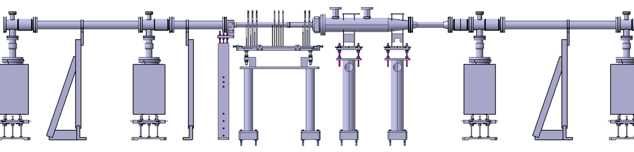
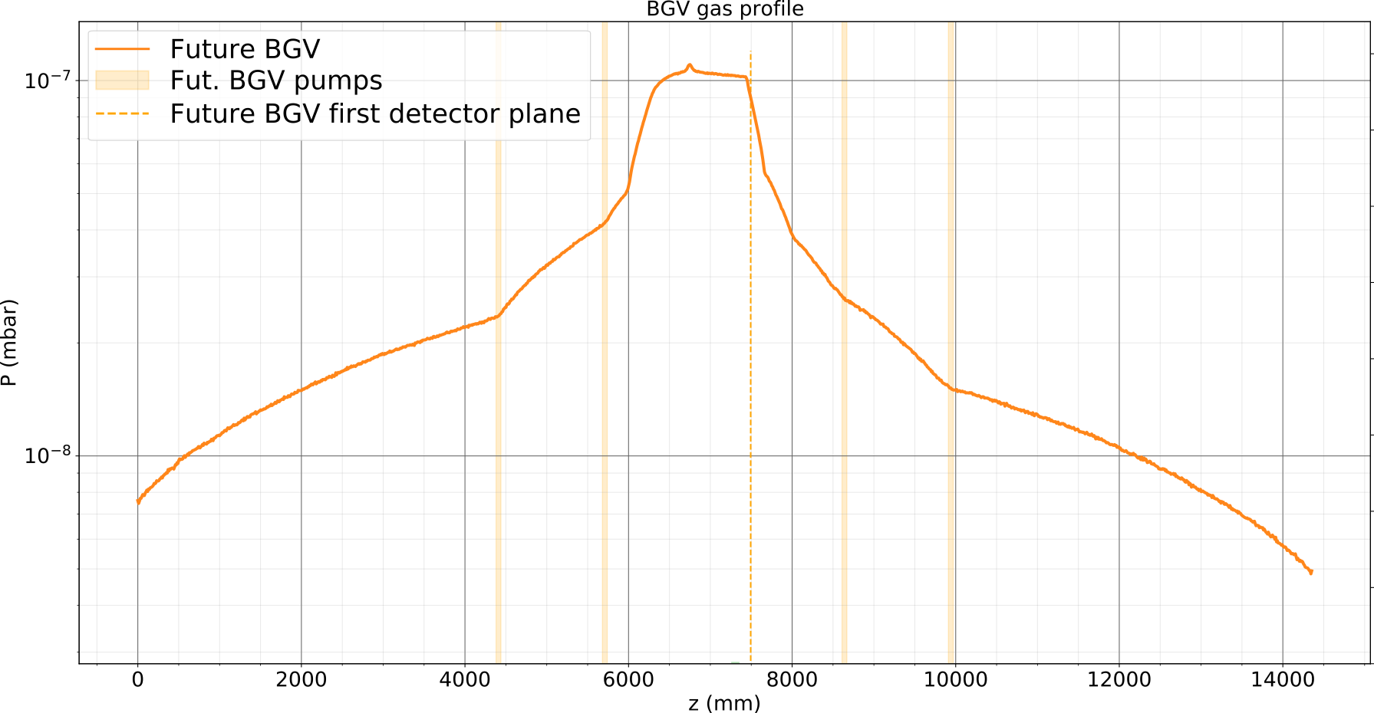
BGV gas target & chamber
y
gas injection
z
Ø50 mm
Ø45 mm
Ø130 mm
Ø50 mm
drawing by M.T. Ramos Garcia
ion pump
ion pump
ion pump
ion pump
nominal LHC beam pipe
nominal LHC beam pipe
1300 mm
550 mm
200 mm
700 mm
727 mm
detector beam pipe with
reduced diameter
Redesign of the demonstrator target - more compact.
Neon gas injected on the tank via a capillary.
Distributed gas target, with density plateau $$Δz$$ ~ 1m.
10⁻⁷ mbar at plateau ⇒ ~200 Hz inelastic collisions per bunch.
Gas tank design: taking impedance, performance needs and mechanical stability into consideration.
Exit window (0.9 mm to ~2 mm), aluminium alloy.
Potential future upgrade: gas curtain target.
Molflow simulations of longitudinal gas density profile, work by H. Guerin
~1m
Neon
Notes:
Keep in mind: mechanical stability, integrational requirements such as impedance and also performance (EW thickness)

Slide 9
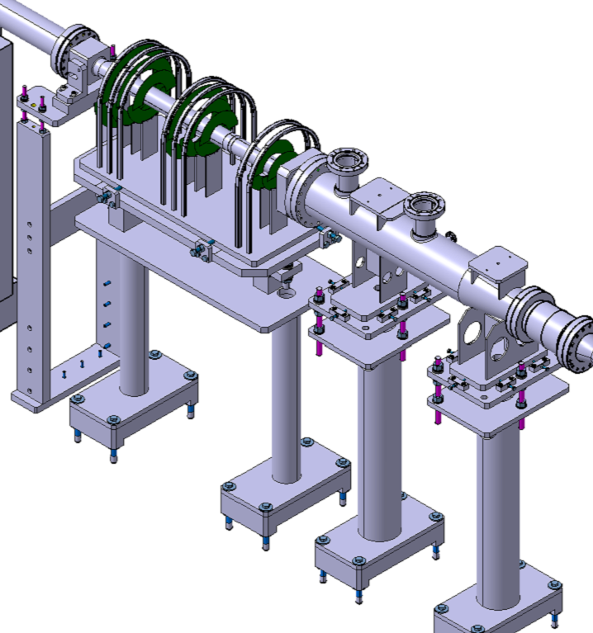
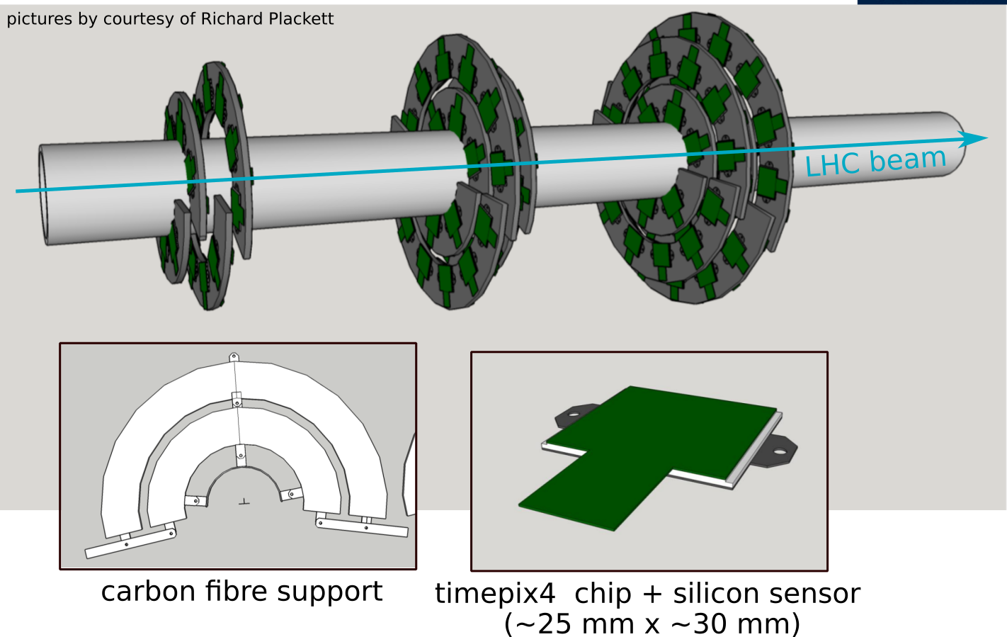
A BGV tracker based on silicon hybrid pixel detectors
Collaboration with Oxford University: D. Hynds and R. Plackett
Design based on the ATLAS ITk HiLumi upgrade.
Timepix technology: robust and widely used detectors.
XP within Beam Instrumentation group.
  DAQ:
    Read-out system based on BGI read-out.
    CPU farm in service tunnel for event reconstruction.
Around 120 timepix4 detectors, per device.
Support structures preliminary
Drawing by M.T. Ramos Garcia
610 mm
modules mounted on both sides of rings
Project planning on-going:
    Module design & building, support structure @Oxford.
    Read-out, reconstruction software, commissioning @CERN.
  Installation could be foreseen in 2028.
Notes:
Why Timepix4?
Timepix XP within Beam Instrumentation group.
Size.
Reliable technology.
Time resolution to suppress background events.

Slide 10
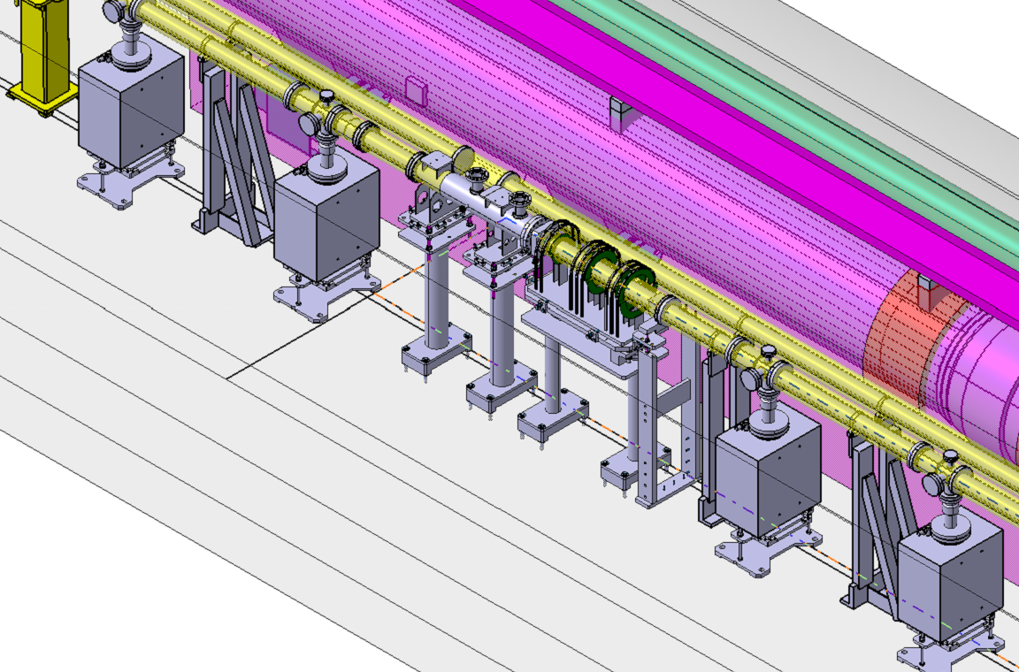
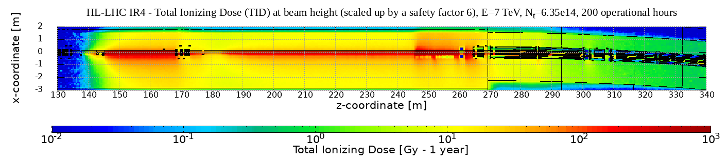
Integration aspects
Location: LSS of Point4, beam 2 device at s ~-220 m, beam 1 device at s ~142 m.
  Total instrument length ~6 m (demonstrator: ~11 m).
Integration study on-going - taking inputs from integration (WP15), ABP, survey & alignment, impedance and vacuum teams into account for instrument design.
FLUKA study of radiation environment downstream of BGV:
Impact on magnets (heat loads) and other equipment and electronics (TID, fluence).
Caused radiation impacts total max. up-time of BGV and max. gas pressure.
Integrated pressure ~25% less compared to demonstrator.
Support structures preliminary
Drawing by M.T. Ramos Garcia
Work by D. Prelipcean
PRELIMINARY
Notes:
ABP = BE-ABP (Accelerators and Beam Physics Group), alignment: BE-GM
https://edms.cern.ch/document/2769059/0.1 (Joao integration doc)

Slide 11
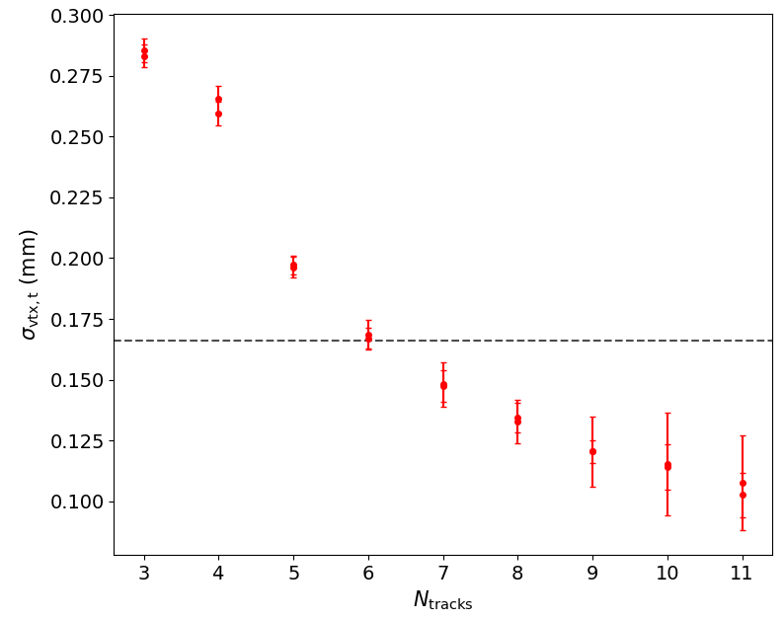
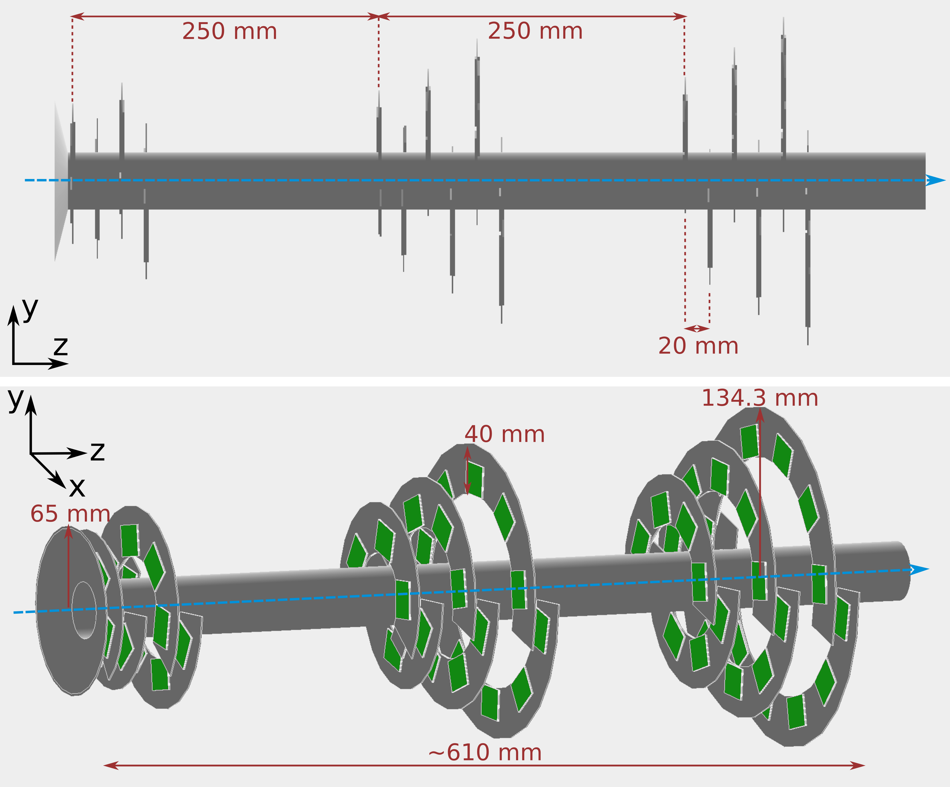
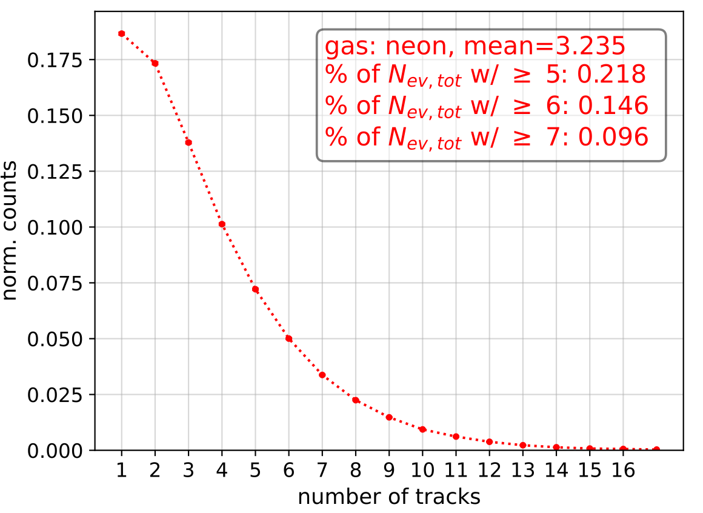
Expected performance – bunch width precision
transverse $$σ_{v}$$ vs measured #tracks per collision.
simulation set-up including
all important materials.
166 µm
7 TeV protons (most stringent case).
Accept events with N_{tracks} $$≥$$ 6 ➡ 14.6 % of total number of collisions.
  Cut on N_{tracks} can be relaxed for larger beam sizes.
Precision on bunch width:
Reminder: bunch-by-bunch measurements with ~1% precision in ~1 min.
How many interactions in 1 min with N_{tracks} $$≥$$ 6?
Assume a gas pressure of 10⁻⁷ mbar.
1740 recorded coll. in 1 min ➡ bunch width relative precision 1.7 %.

Slide 12
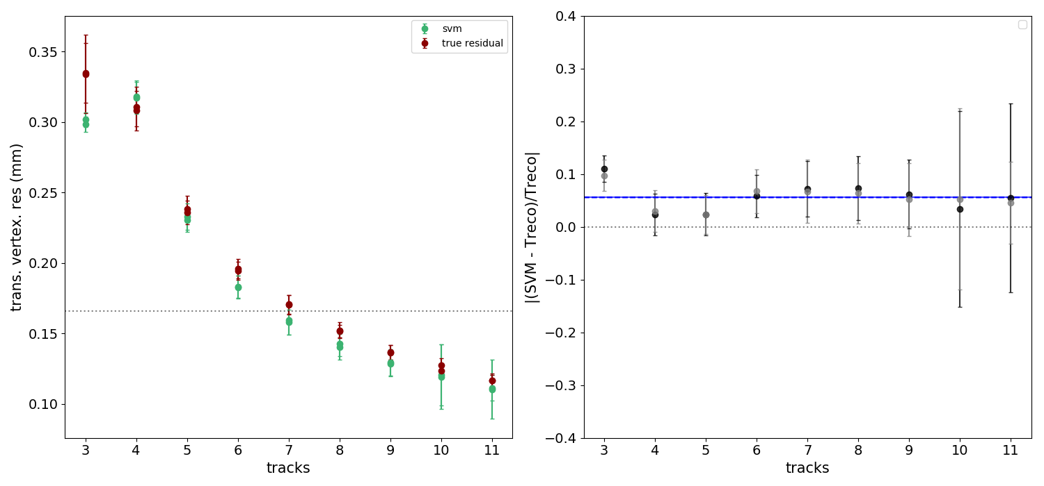
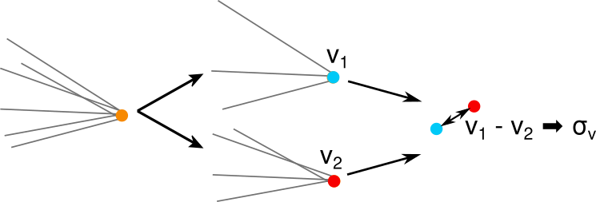
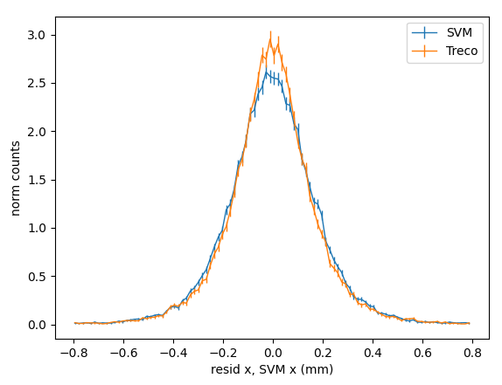
Vertex response and resolution for a profile measurement
During the measurements - need to determine response and vertex resolution.
Common method of LHC experiments:
split vertex method (SVM).
  Filter for collisions with N tracks in detector.
  Split N tracks into two groups, fit same vertex twice ➡ v₁ & v₂.
  v₁ - v₂, is measure for $$σ_{v}$$ of events with N/2 tracks.
Simulation, Truth
Simulation, SVM
relat. difference Truth and SVM,
x- and y-vertex resolution.
split N tracks in two groups, reconstruct vertex twice.
difference of v₁ and v₂ is
measure for $$σ_{v}$$ for events
with N/2 tracks.
Events with 6 tracks.
true response
approx. response
Applied to simulation data, SVM shows agreement of ~ 6% with the true vertex resolution (determined by comparison of reconstructed vertex to generator level).
Method to determine vertex response during BGV measurements, no need to rely on simulations or additional measurement with known source!
$$σ_{v}$$

Slide 13
Summary & outlook
The BGV is currently being optimised for the HL-LHC – work on conceptual design report.
Design is based on extensive performance study - based on established tools, support from experts.
Gas target baseline: extended neon gas target with ~1m density plateau of 10⁻⁷ mbar, via injection of neon into gas chamber.
Compact tracker based on silicon pixel detectors in collaboration with University of Oxford.
Integration constraints are taken into account, no showstoppers identified.
Performance study shows promising results in accord with specifications - bunch width precision 1.7 % in 1 min.
Method of measuring vertex response and resolution for deconvolution of true profile.
On-going: deconvolution, detector alignment, pattern recognition.
Next milestone - Review of BGV (& BGI) proposal on October 19th 2022.
Thank you for your attention!

Slide 14
BACK UP

Slide 15
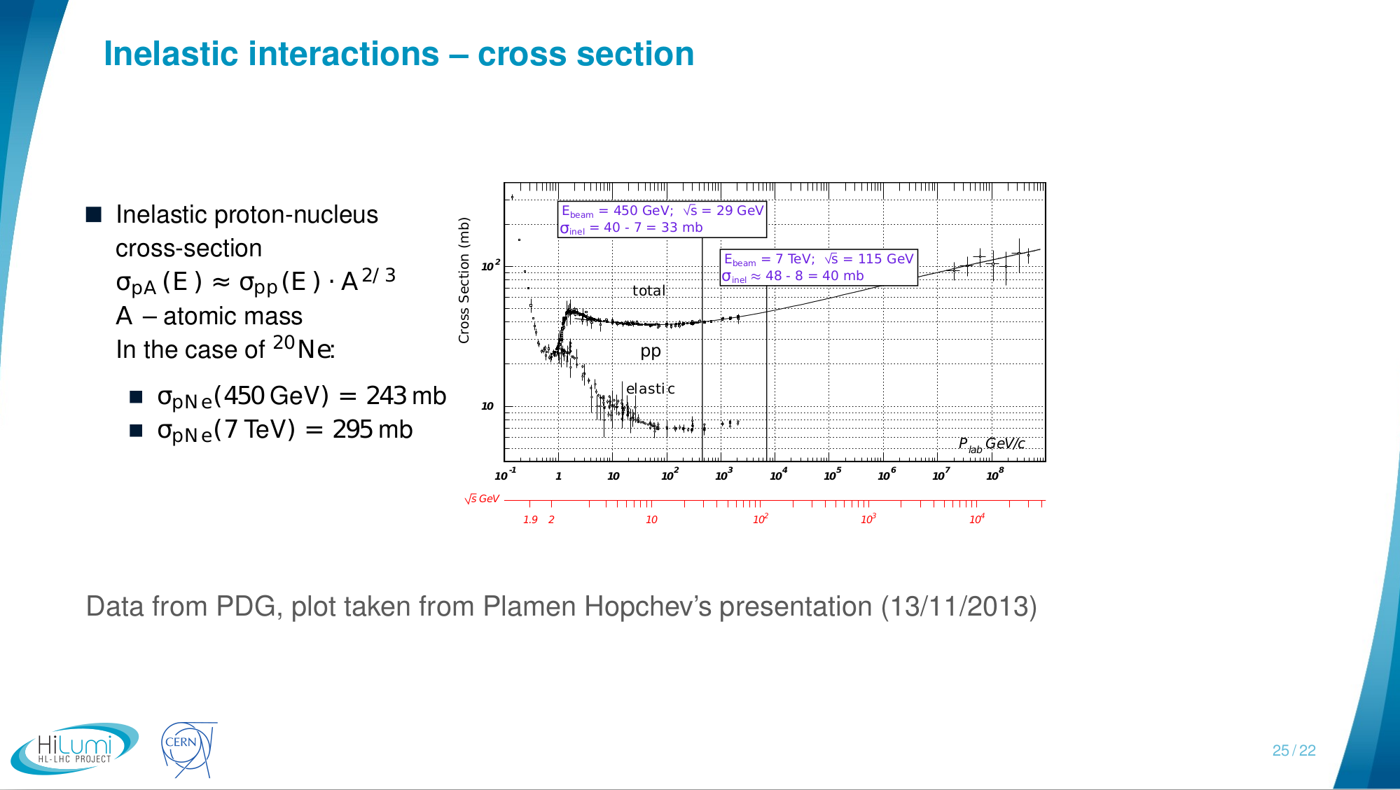

Inelastic collisions
Rate of inelastic collisions per bunch:
with the revolution frequency (11245 Hz), the number of protons per bunch N (2.2 x 10¹¹), the gas density $$ρ$$ and the gas width $$Δ$$z.

Slide 16
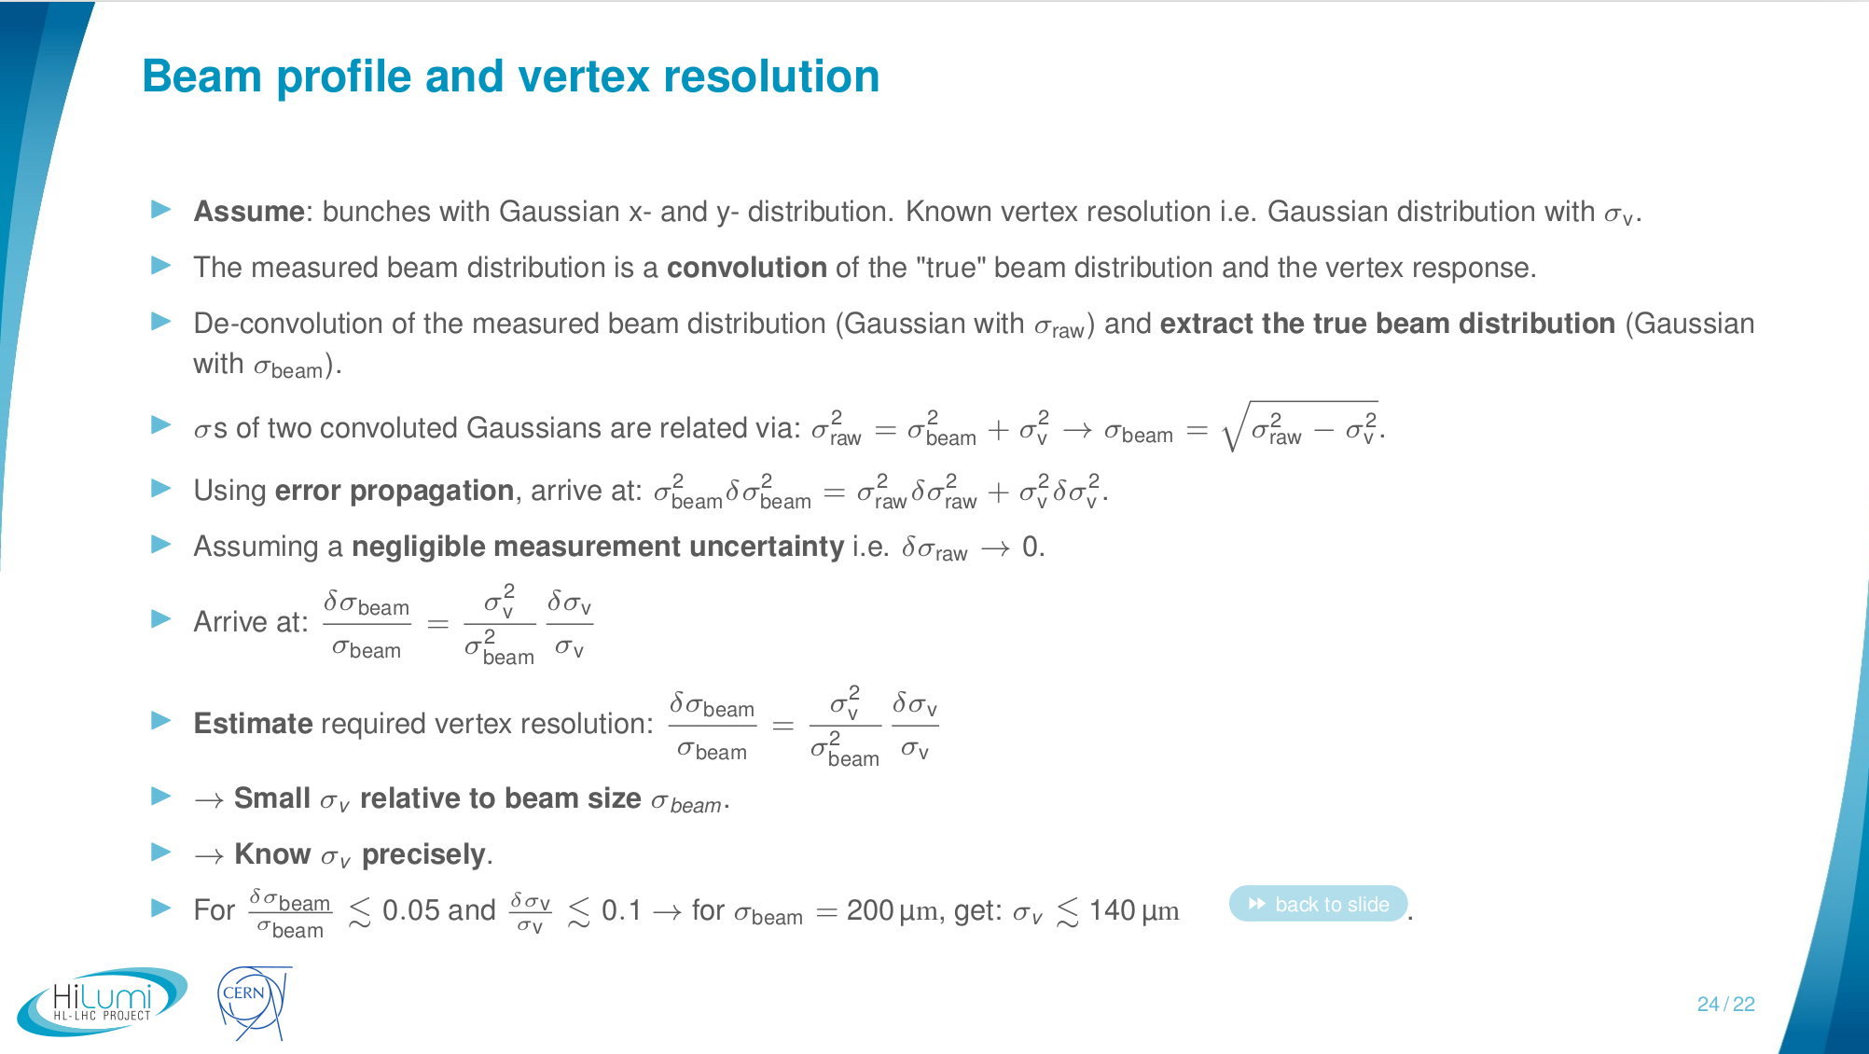

Slide 17
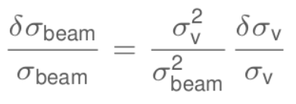
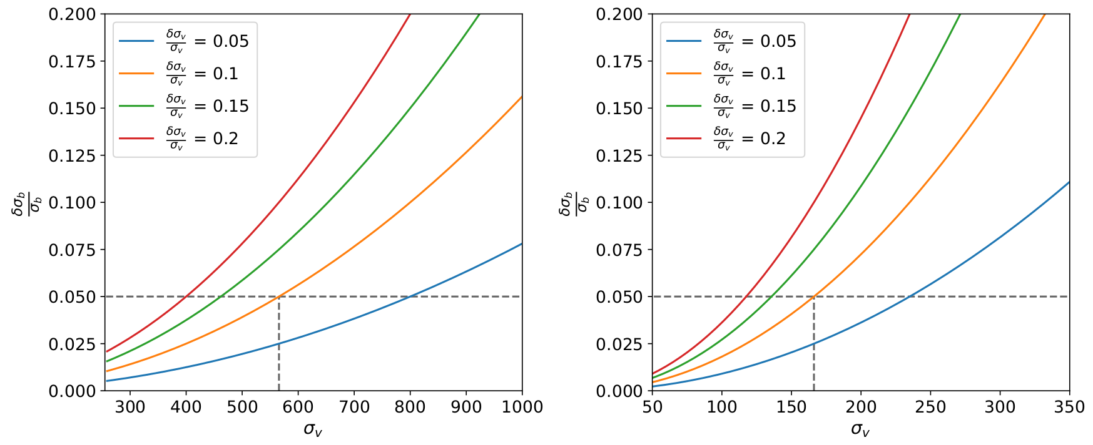

Slide 18
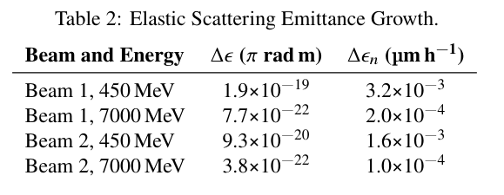
Emittance growth (negligible)
Consider beam particles scattered elastically within BGV gas target.
Emittance growth budget should be below 10 to 15 %.
Emittance growth per turn of gas target with length L [Ref]:
$$Δε = \frac{1}{2}q_{p}²\left(\frac{13.6 MeV}{pβ_{r}}\right)²\overline{β_{x}}\frac{L}{L_{rad}}$$
q_{p} is the charge of the projectile, p the momentum, $$β_{r}$$ the relat. velocity, $$\overline{β_{x}}$$ the average transverse beta-function along the gas targets length L. L_{rad} is the radiation length of neon.
For running the BGV 2h per fill: 0.16 % (beam 1) and 0.08 % (beam 2).
from latest IBIC paper by H. Guerin et al.

Slide 19
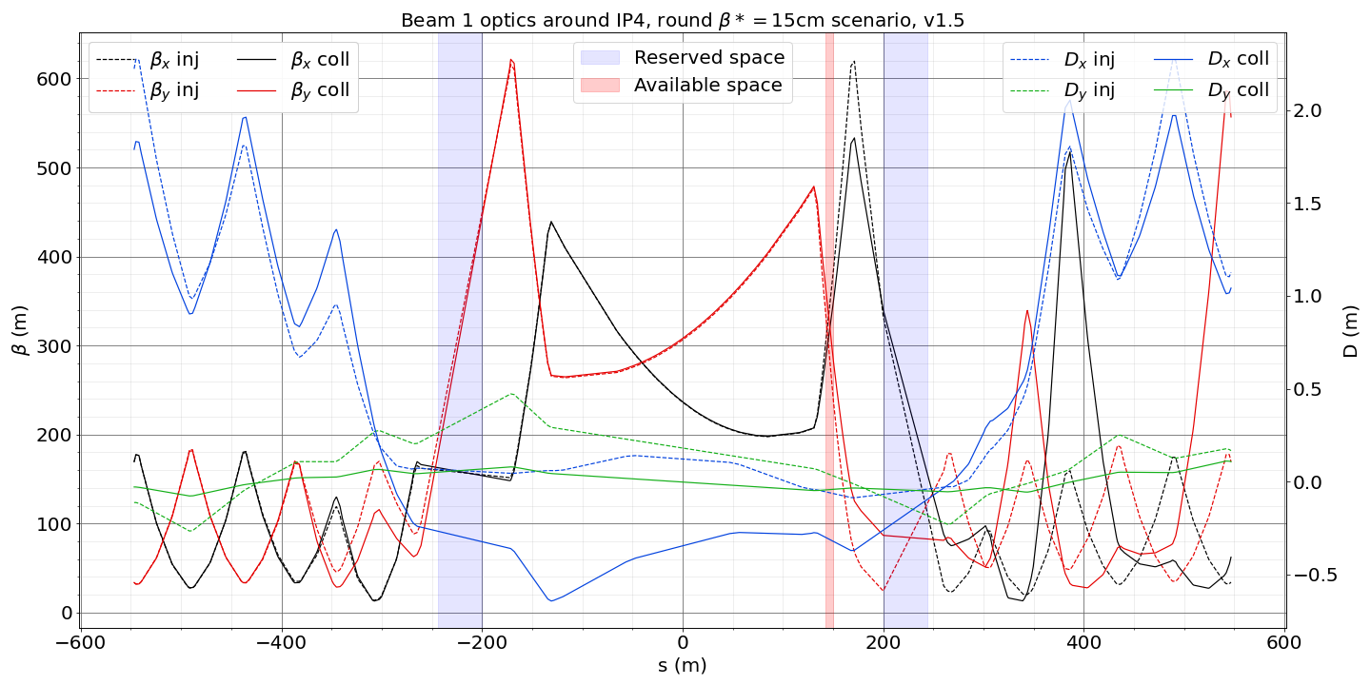
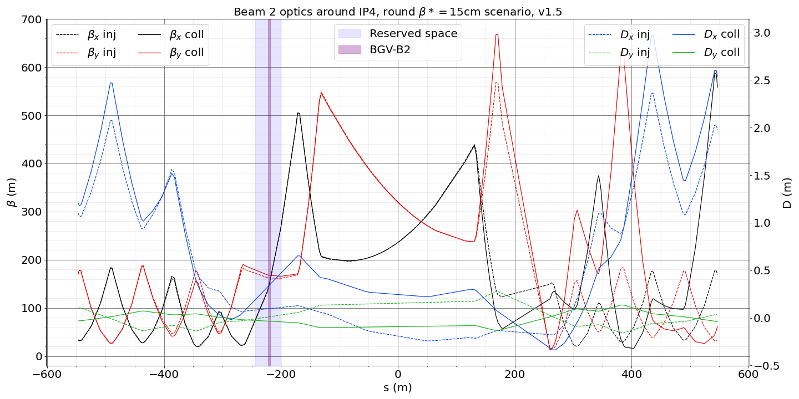
slide taken from HiLumi integration meeting 03/06/22:
https://indico.cern.ch/event/1165410/
Location and space reservations
Initial space reservation from LHC-BGV-EC-0001
B2-BGV is foreseen to be installed where the demonstrator is on left of IP4, with space reservation [-244, -200]m
([9753.081, 9797.081]m DCUM) w.r.t IP4 centre
The initially foreseen location for B1-BGV was symmetric to IP4 centre [200, 244]m but now shows too demanding beam optics for instrument vertex resolution.
The new foreseen location is now [141.052, 148.572]m ([10138.133, 10145.653]m DCUM) w.r.t IP4 centre for B1-BGV.
Possibly additional 1.2m on each side of this location, currently occupied by disconnected BQKH&V (confirmed by Thibaut).

Slide 20
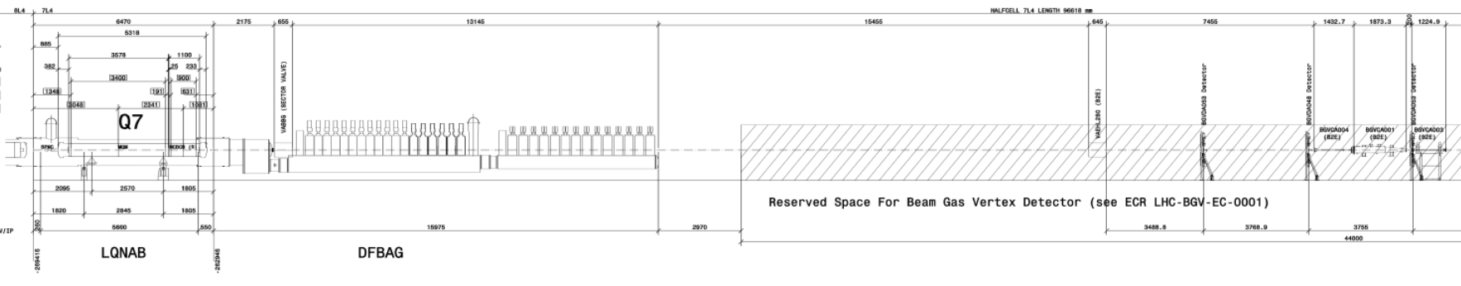
BGV2 foreseen location
https://edms.cern.ch/document/1395361/0
~40 m
BGV demonstrator location

Slide 21
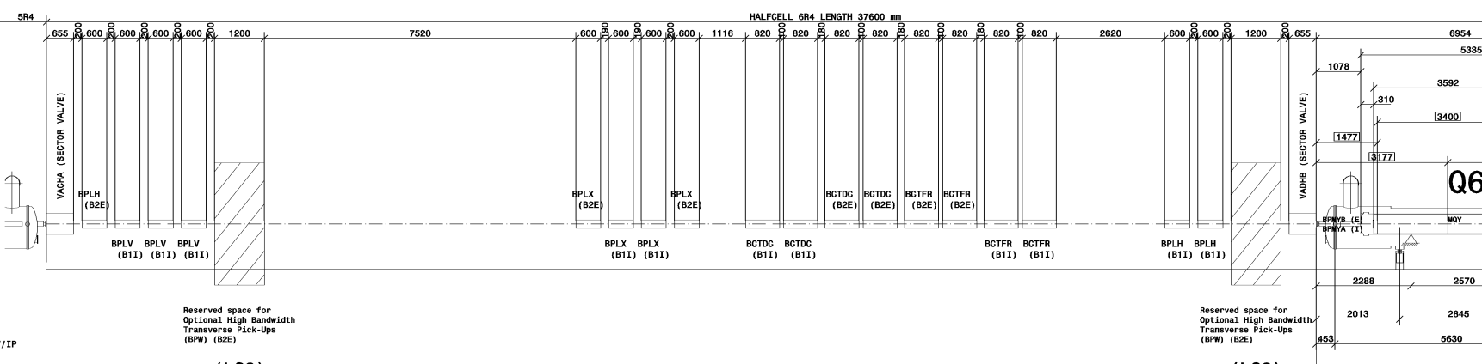
BGV1 foreseen location
https://edms.cern.ch/document/1395360/0
foreseen location
~20 m

Slide 22
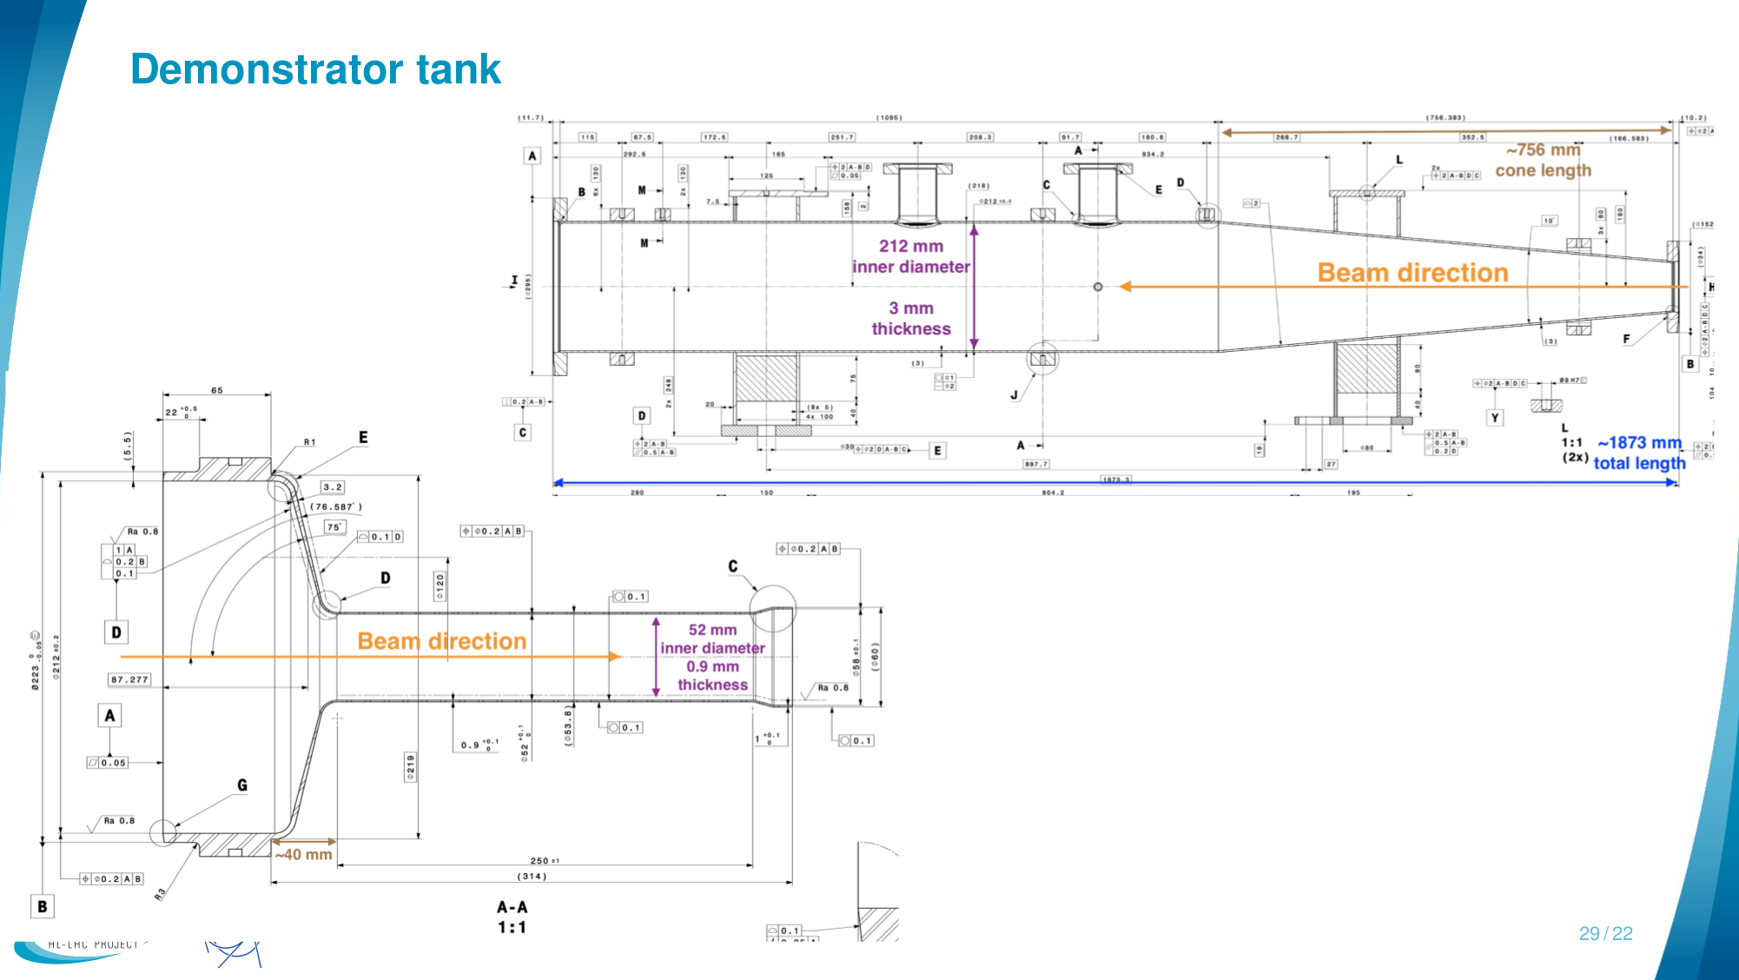
Materials:
Steel, apart from:
exit window and reduced aperture beam pipe: Al alloy AA2219 (rad. length 89 mm, 5x higher compared to steel)

Slide 23
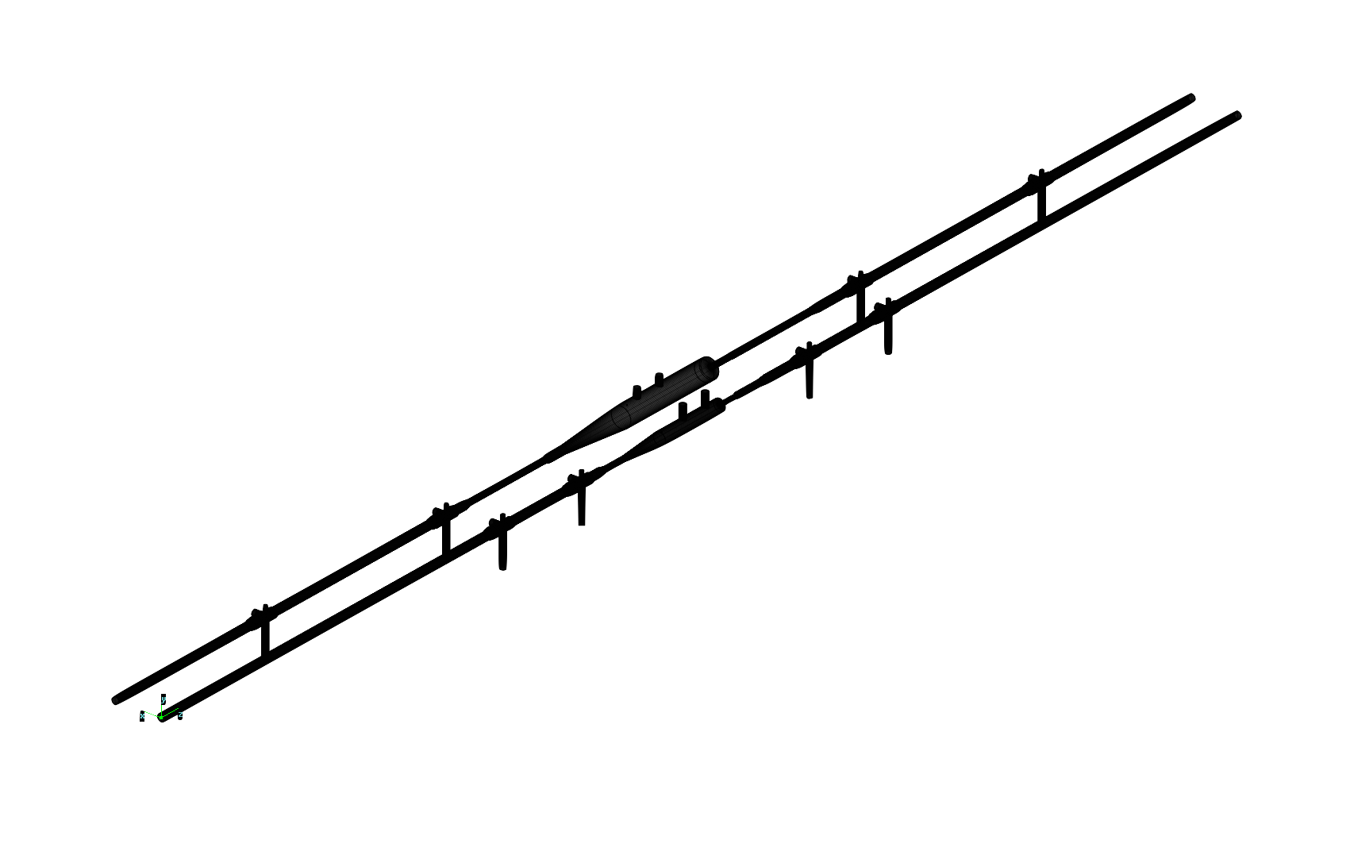
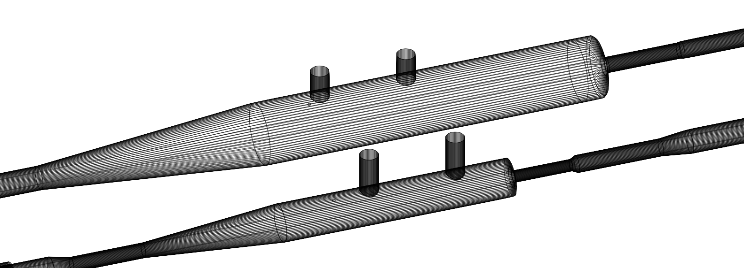
Preliminary layout
slide taken from HiLumi integration meeting 03/06/22:
https://indico.cern.ch/event/1165410/
The beam chamber layout has been modified compared to the demonstrator device:
Smaller aperture of the downstream small radius beam pipe to maximise track acceptance
Smaller gas tank diameter to reduce beam-coupling impedance
Shorter total length (upstream taper, distance between pumps), to fit into the new B1-BGV location and reduce the radiations due to the longitudinal gas density profile tails.
Old and new design shown side-by-side for comparison:
Demonstrator
Future BGV
 |  | Cone 1 | Upstream chamber | Upstream taper | Tank cylinder | Exit window | Detectors beam pipe | Cone 2 | Transition beam pipe | Cone 3
Demonstrator | ID (mm) |  | 52 |  | 212 |  | 52 |  | 58
 | length (mm) | 48 | 1108 | 815 | 1185 | 50 | 251 | 12 | 988 | 44
Future BGV | ID (mm) |  | 50 |  | 130 |  | 45 |  | 50
 | length (mm) | 50 | 250 | 477 | 700 | 11 | 200 | 12 | 350 | 100
+ 500mm beam pipes at each pump connection + 750mm between pumps for the future instrument (vs. 2000mm demonstrator) -> total length ~5.5m (vs. ~10m total demonstrator length)

Slide 24
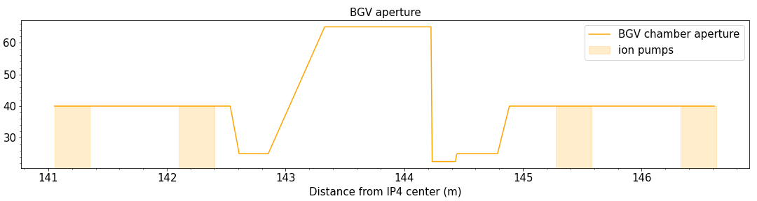
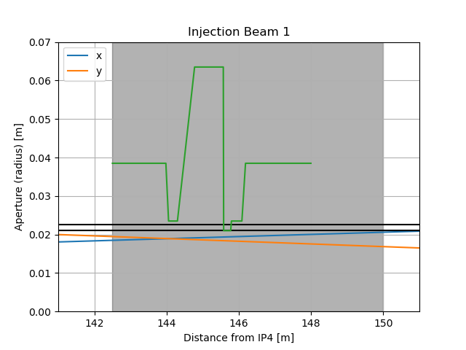
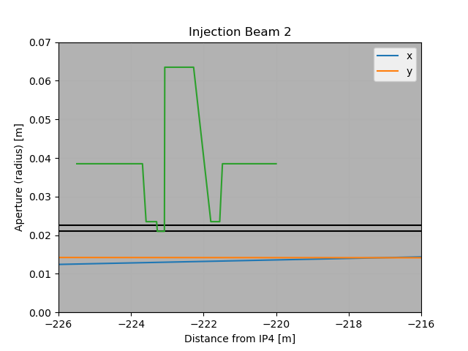
slide taken from HiLumi integration meeting 03/06/22:
https://indico.cern.ch/event/1165410/
Aperture profile
Preliminary aperture profile of B1-BGV (position can be shifted along z), total length ~6 m:
aperture radius (mm)
Reduced-diameter beam pipe placement - as close to beta x/y crossing point as possible.
Plots by Riccardo de Maria (BE-ABP-LNO).
Tolerance budget: 1.5 mm (estimation from demonstrator page 6: LHC-BGV-EC-0002).
Smallest aperture size: 22.5 mm (inner radius).
Ok from ABP (if tol. can be guaranteed).
See: initial discussion (2020), WP2 meeting (2022) and recent follow-up discussion.
aperture profile
aperture profile
aperture (0.0225 m)
aperture+tol. (0.0225 m + 0.015 m)

Slide 25
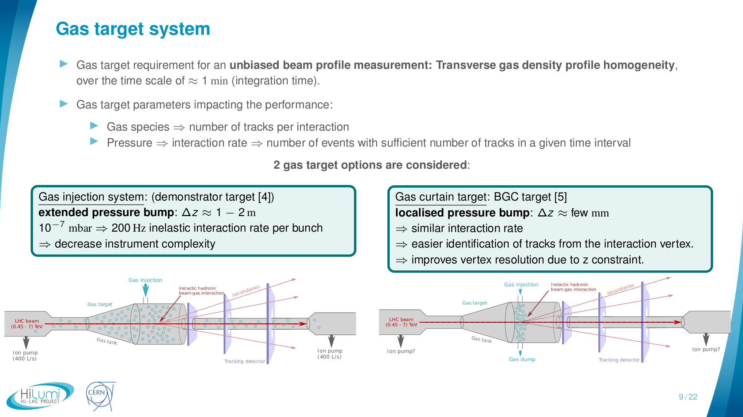

Slide 26
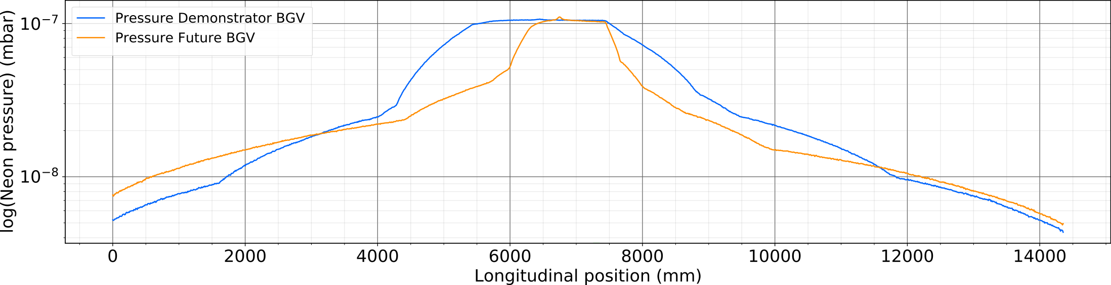
Longitudinal gas profile comparison
Molflow simulations by H. Guerin, with input from R. Kersevan

Slide 27
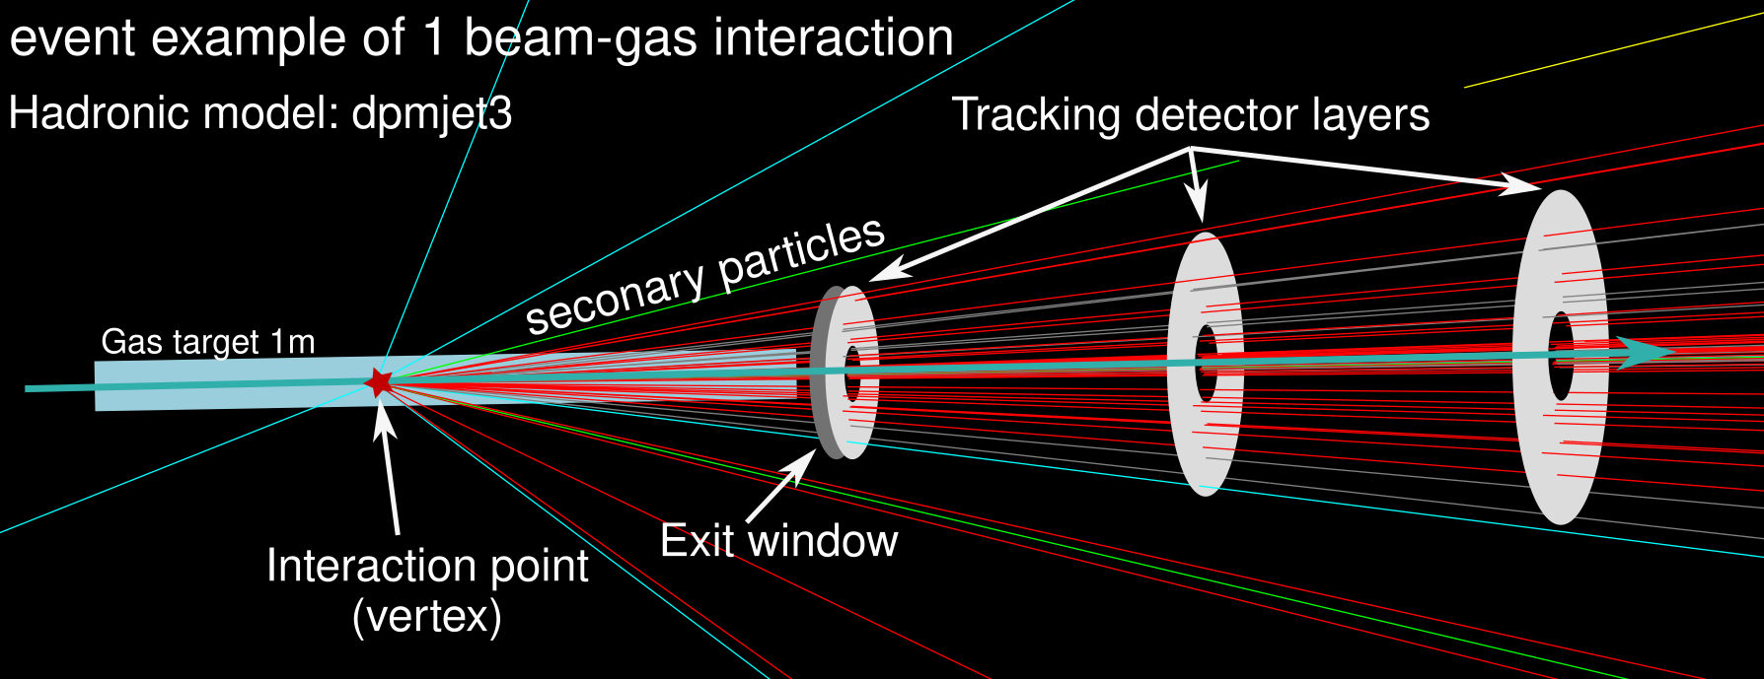
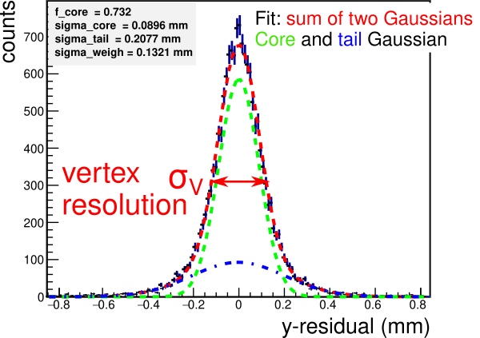
Performance study - overview
Initially: generic BGV setup to ease navigation of extensive parameter space.
Goal: efficiently identify impact of design parameters and provide first estimates of promising setup’s dimensions etc.
neon
detector parameters studied:
material budget, size, separation, spatial resolution.
extended gas target of 1 m in z.
Evaluation of performance:
compare reconstructed vertices to generator level vertices.
determine response and vertex resolution.

Slide 28
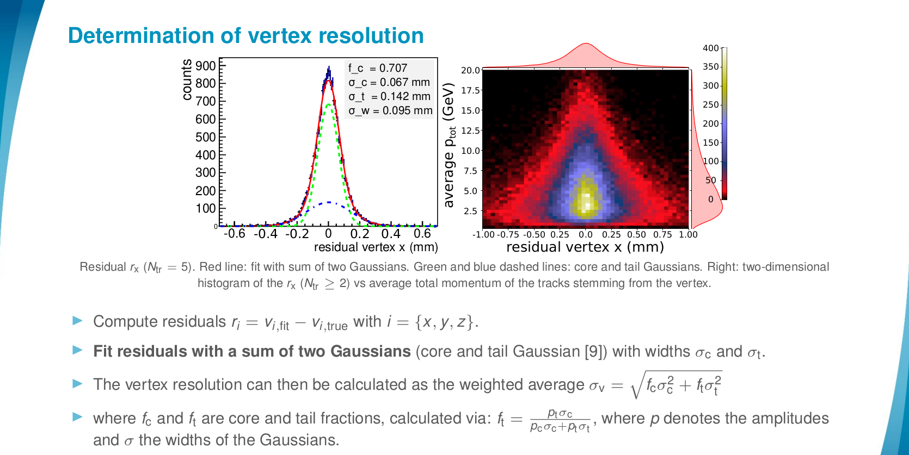

Slide 29
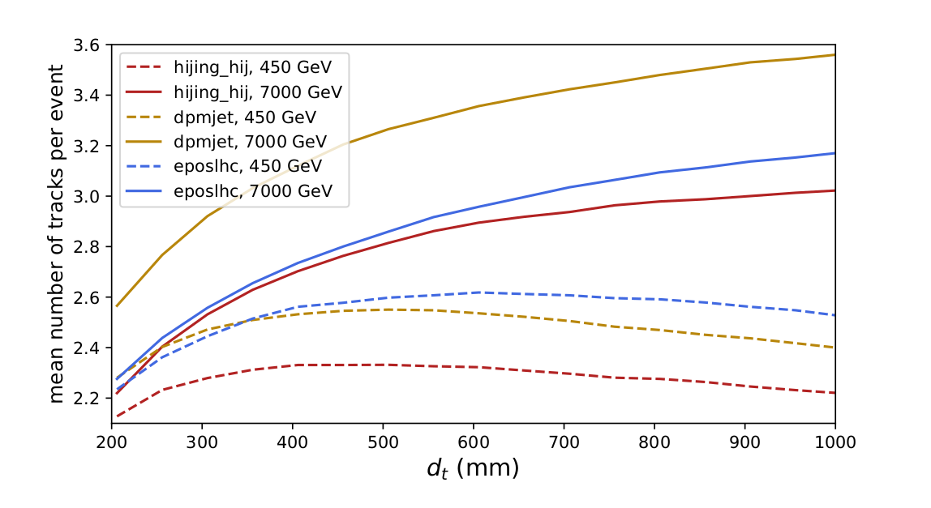
Distance source-detector vs mean #tracks per event

Slide 30
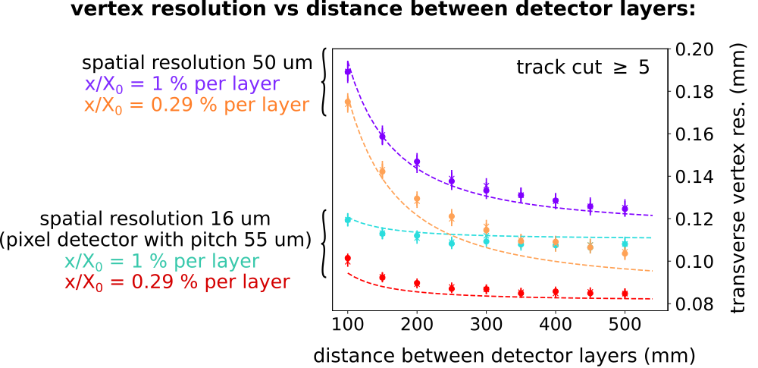
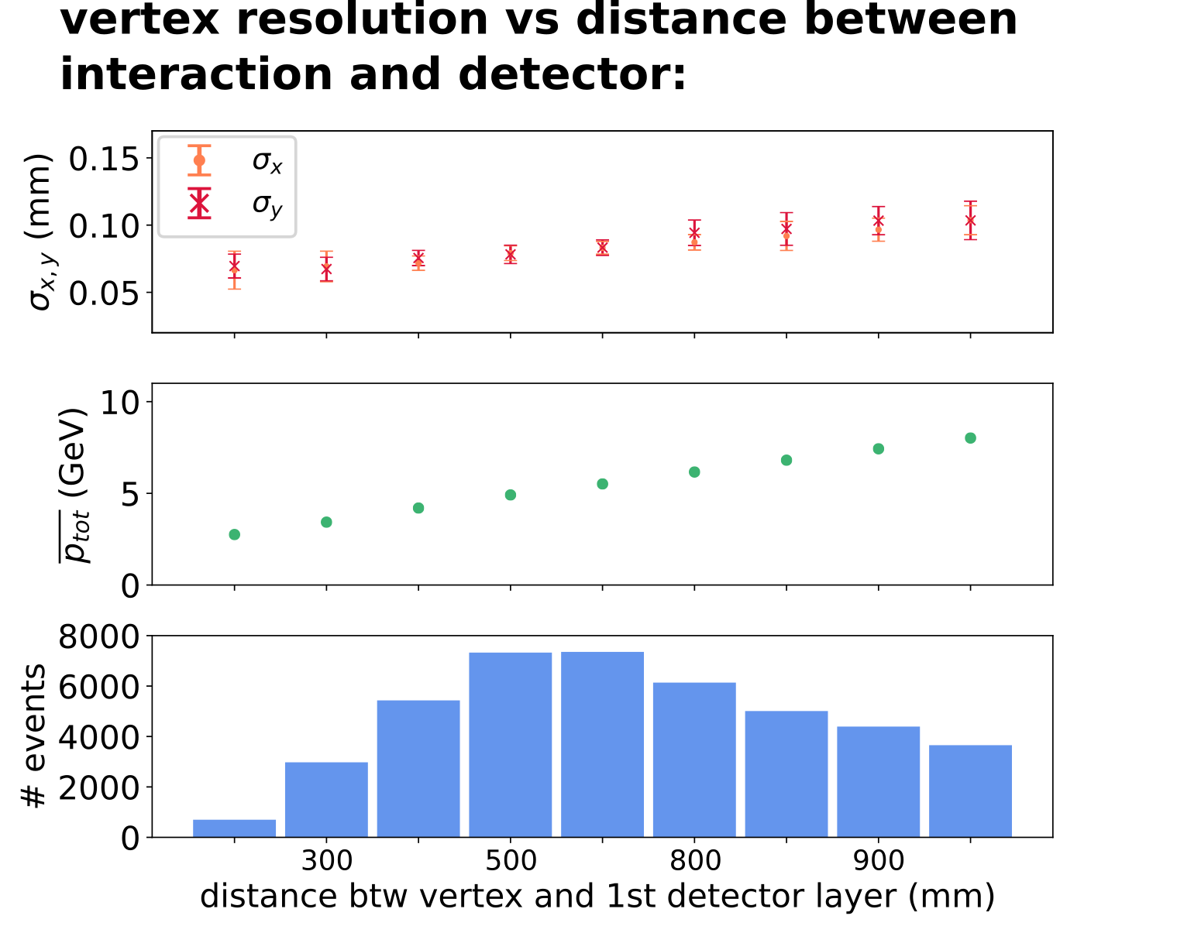
Results and conclusions of generic BGV study
Distance between vertices and first detector layer that showed highest average number of tracks is 550 mm.
Extended gas target is no show stopper.
Performance results point towards a compact tracker with a high spatial resolution.
neon
Eliminates any x/y hit association issues (demonstrator BGV).
Promising candidate: compact Si pixel tracker with detector layer ~250 mm apart.
Fits within space between the LHC beam pipes.

Slide 31
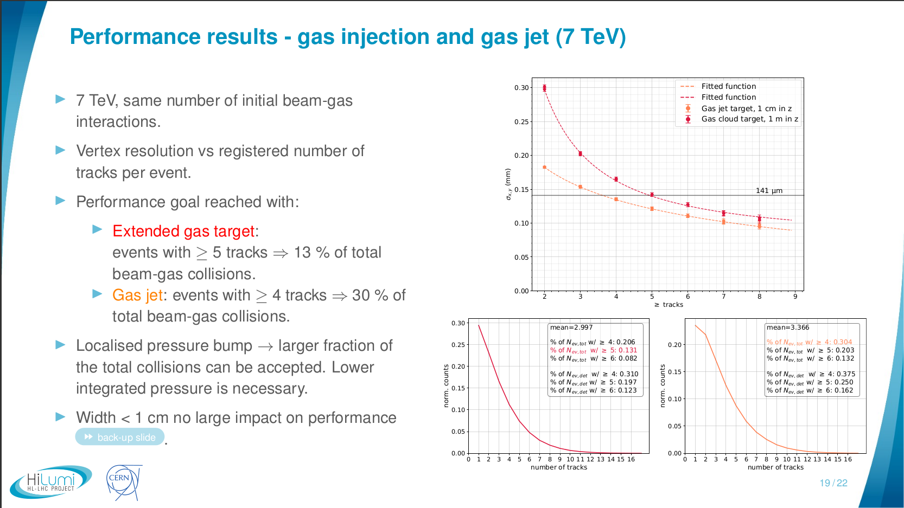
Gas curtain target - performance
slide from: BI/TB Meeting, March 2022
PRELIMINARY

Slide 32
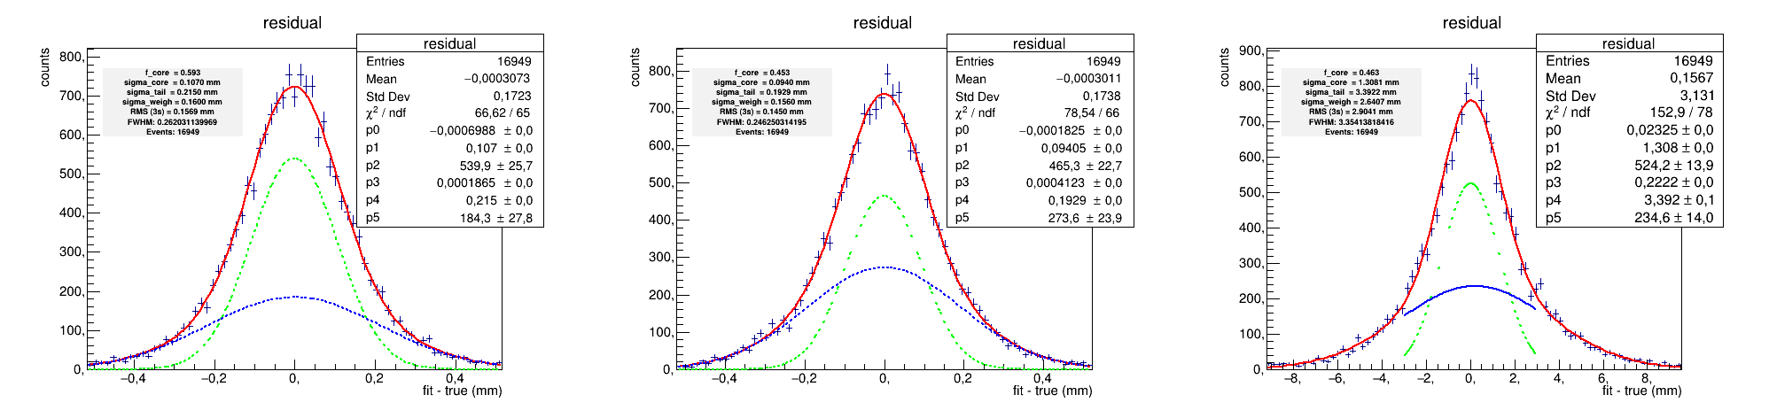
Vertex residuals examples (x, y, z)

Slide 33
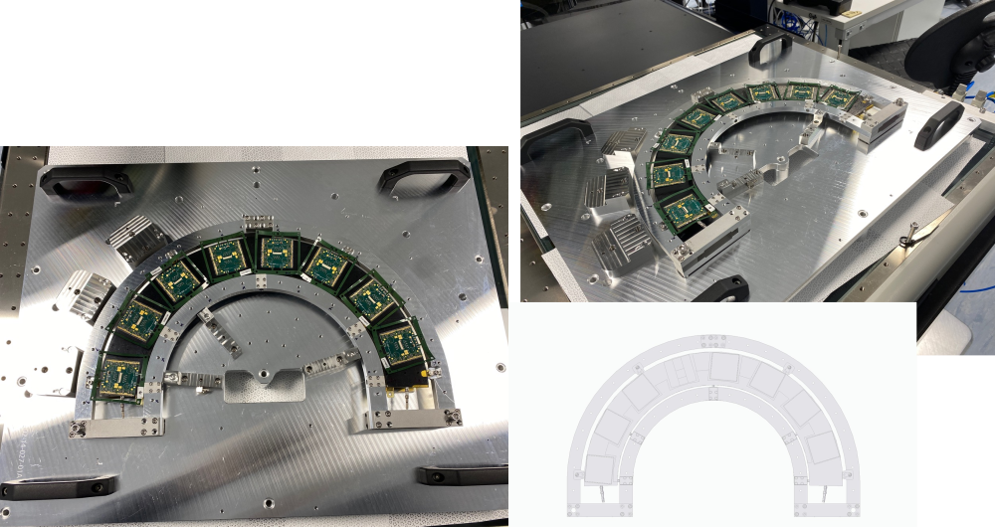
A glimpse in the future? -
ATLAS iTk prototype
pictures by courtesy of D. Hynds

Slide 34
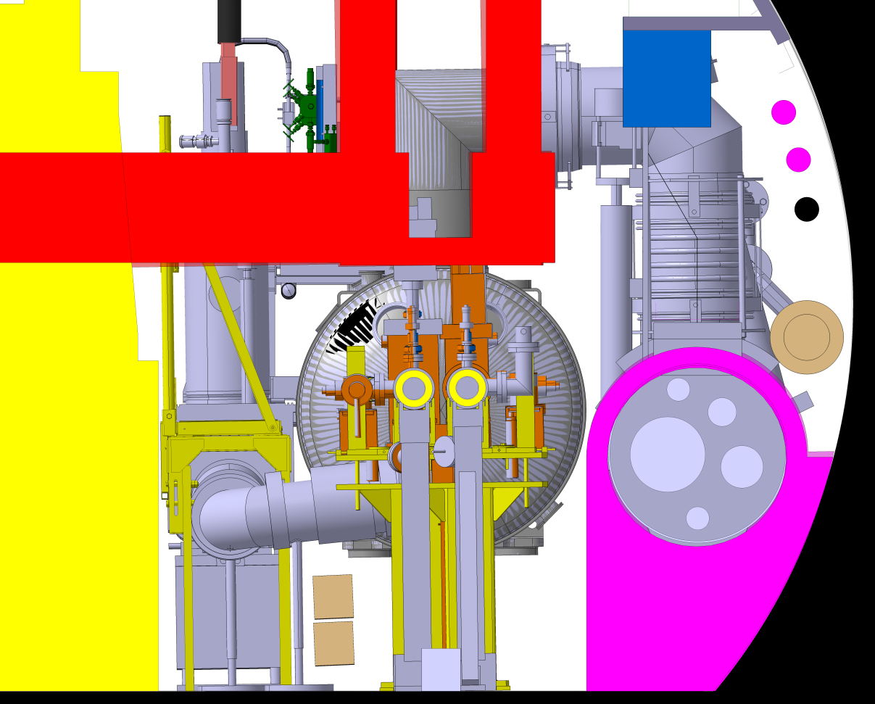
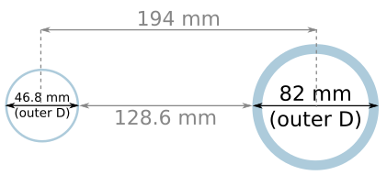
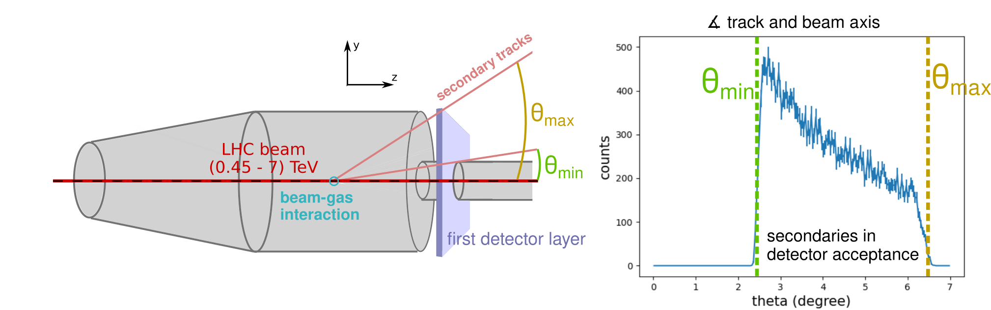
Detector space and placement
Tunnel cross section, location for BGV beam 1
Integrational space constraints (reserved areas in tunnel).
Allow access to beam pipes for e.g. baking prior to runs. Take into account for detector support.
Space constraint transversally due to second beam pipe:
survey space reservation
transport
space
reservation
447 mm
other LHC beam pipe
928 mm
436 mm
y
1100 mm
QRL space
reseveration
BGV detector beam pipe
x
y
picture provided
by J. Oliveira
x
Place detector layers transversally as close to beam axis as possible.
Size of 1st detector layer is determined by diameter of gas tank.

Slide 35
Details of updated geometry
Tracker simulation geometry
Dimensions based on generic BGV dimensions.
Module:
    Material: Sensor 300 µm Si, Timepix 700 µm Si, Flex cable: 8 µm Cu, 170 µm Kapton, 300 µm C, Glue.
    Transverse size: 24.7 mm x 29.96 mm.
Support half rings: dz = 1 mm carbon fibre.
122 modules in total.
Reconstruction analysis:
  Gaussian smearing $$σ=55µm$$/12 of hits (spatial resolution).
  Track and vertex fitting.
  To be added: digitisation, clustering, track finding.
  3D track info of timepix4 not yet included in analysis.
support rings 100% CF,
1 mm thickness
122 modules
x/X0 = 0.0216 (1 mm CF plus 1 Module)

Slide 36
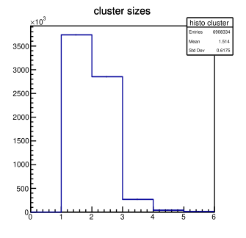
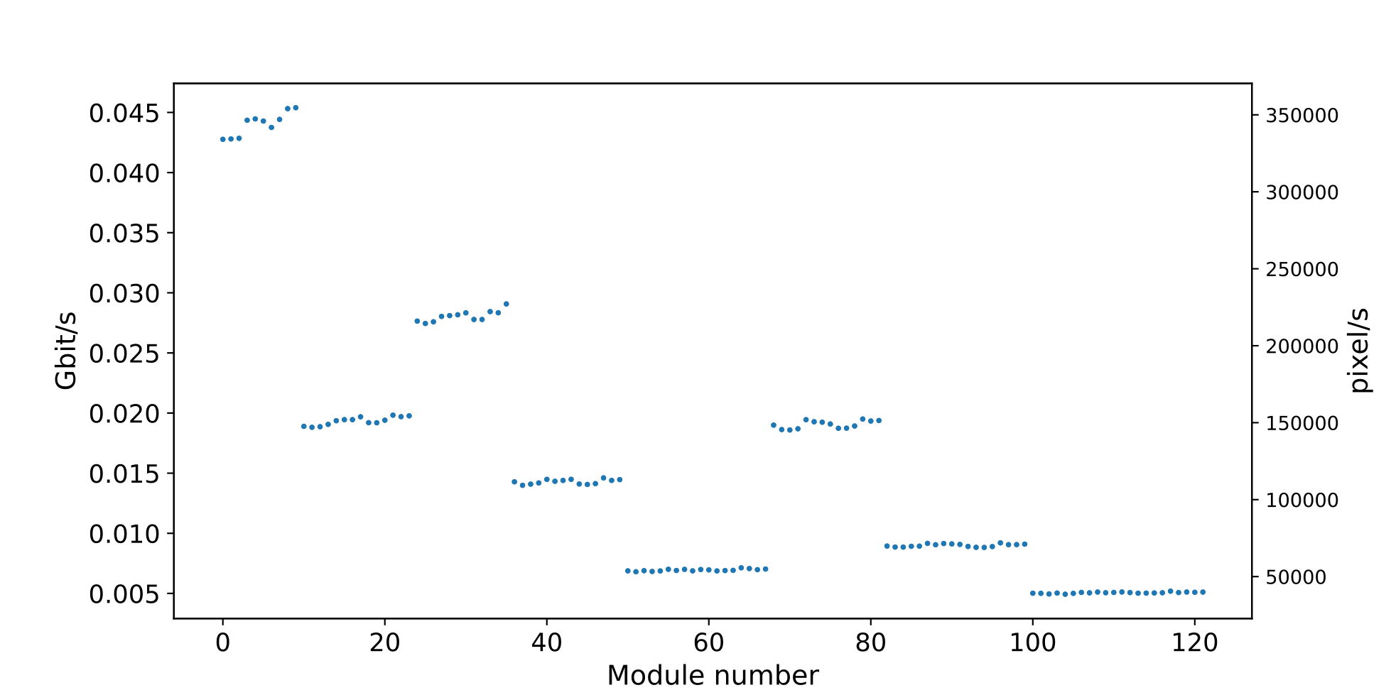
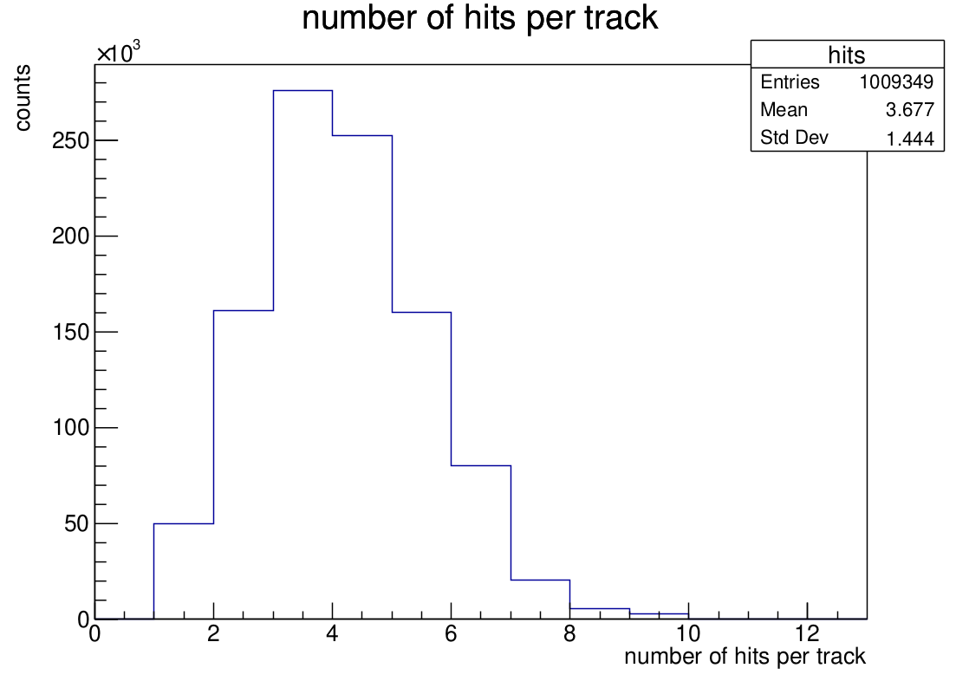
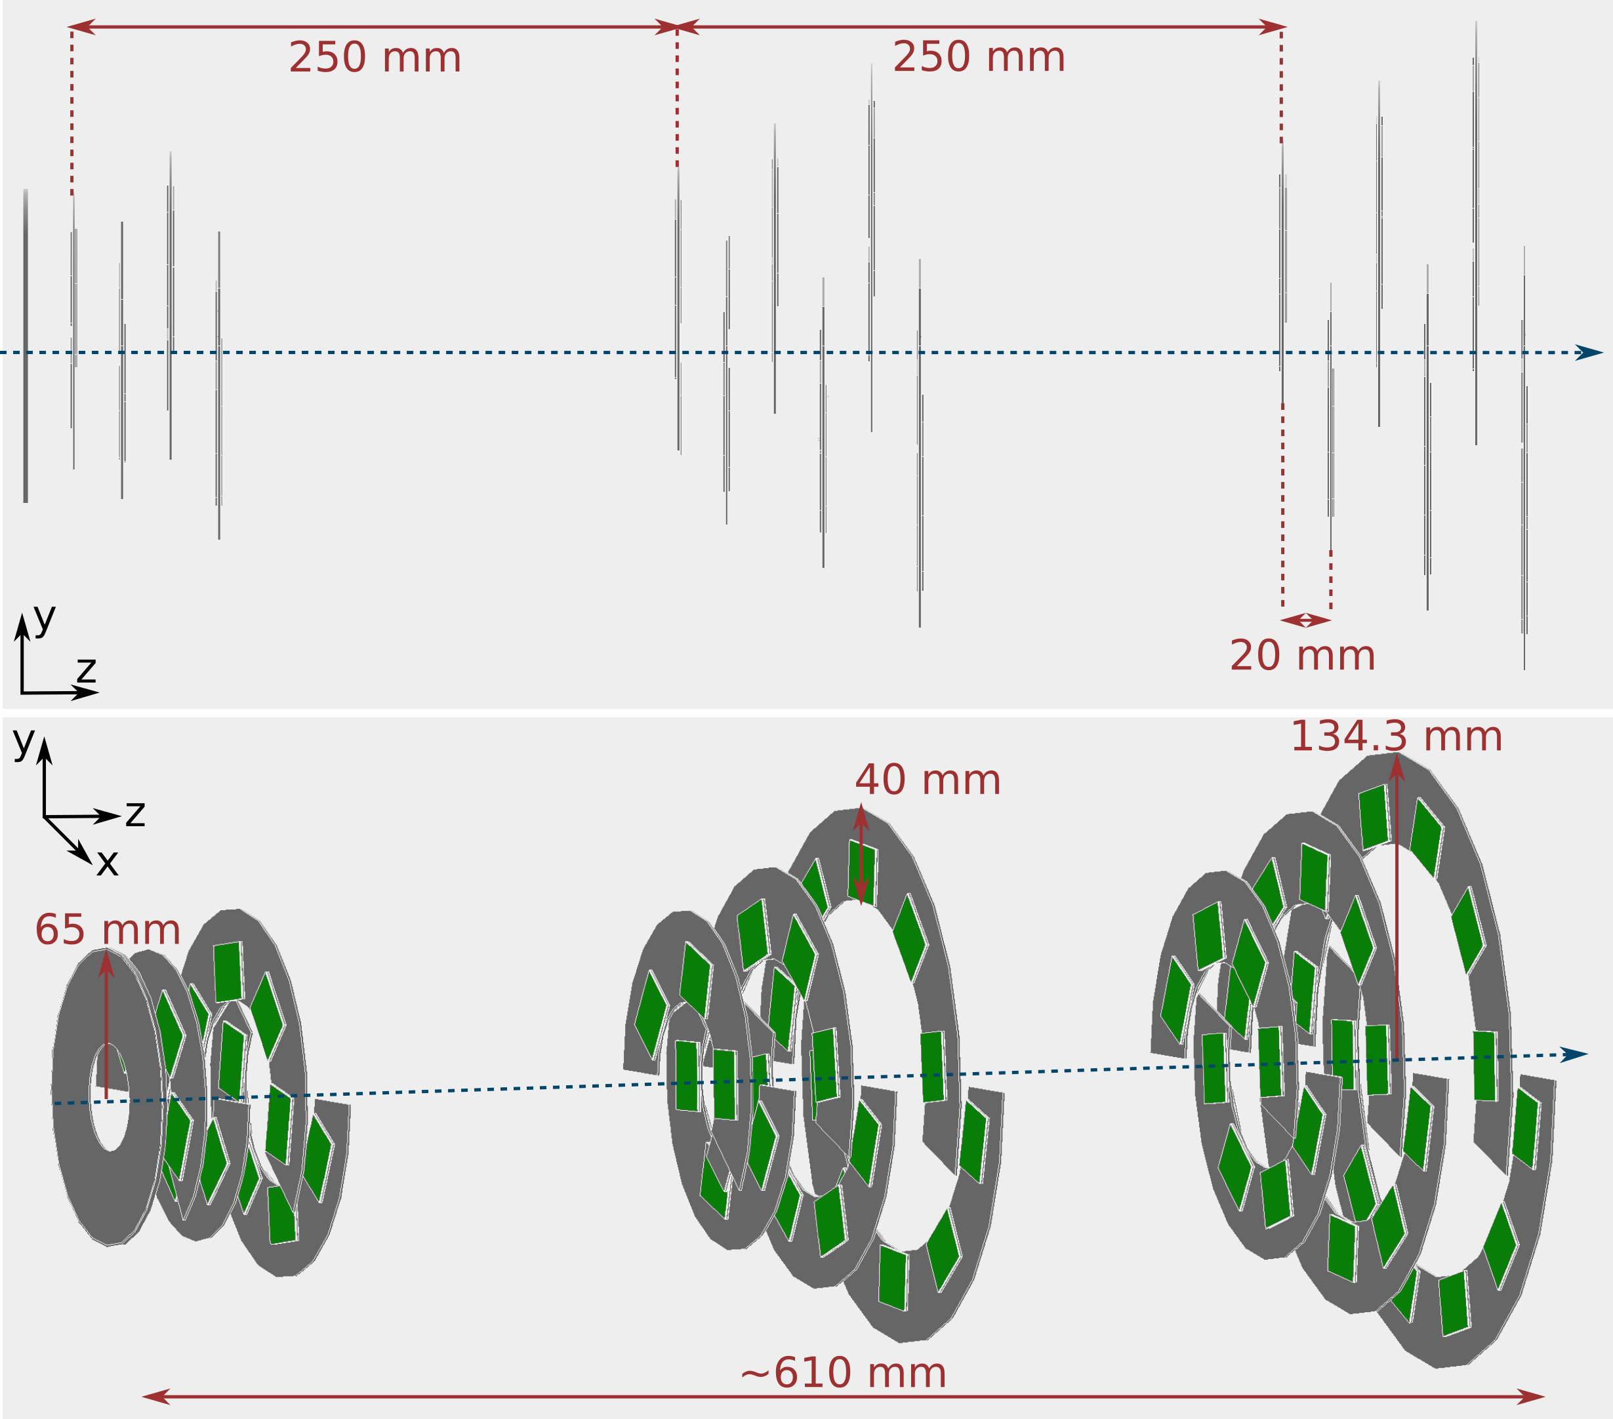
Hit and event rate estimation for DAQ via G4 simulations
Collision rate 6 x 10⁵ Hz, (7 TeV & gas pressure of 10⁻⁷ mbar).
Total number of secondaries traversing all detector modules:
8.96 x 10⁶ per sec.
Geometric digitisation - average pixel cluster size is 1.5 pixels. 1.35 x 10⁷ activated pixels/s.
Assume event size of 128 bit (64 bit plus padding). Total amount of 1.72 Gbit/s data.
Better estimation: Allpix2 and inclusion of background sources.
ring 1 of layer 1
ring 1 of layer 2
Data amount of “interesting” events (N_{tracks} $$≥$$ 6).
~45 average activated pixels per event.
Total event rate of N_{tracks} $$≥$$ 6: 53 kHz, 2.37 x 10⁶ pixels/s.
0.3 Gbit/s.
upstream downstream
Processing time for reconstruction per recorded collision: ~6 ms (rough conservative estimate).
with 100 CPUs - 16.7 kHz.

Slide 37
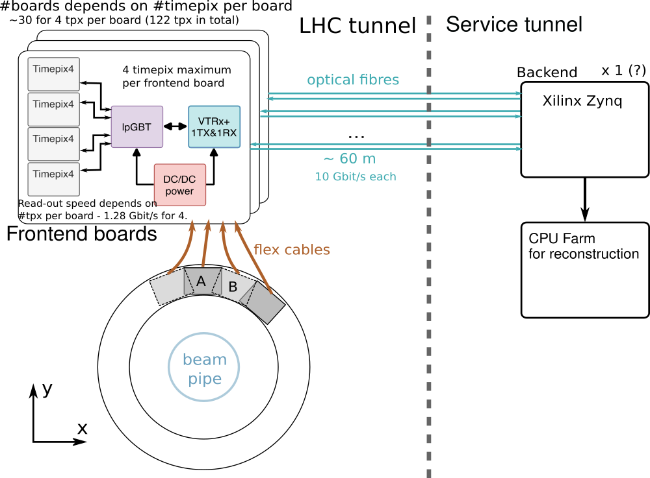
Detector read-out
Read-out system mock-up based on Beam Gas Ionisation monitor (BGI) by H. Sandberg.
Around 120 timepix4 modules.
Frontend: Low Power Giga Bit Transceiver (lpGBT) + an optical link module for data transmission (VTRx+) + DC/DC power supply.
Backend: Based around a system-on-chip (SoC) from Xilinx: contains both programmable logic (FPGA) and processors.
Flexibility to process data in both gateware and software on Zynq - possibility to do some steps of the analysis on backend.
Analyse selected events with reconstruction software on CPU farm similar to demonstrator (~100 CPUs).

