Slide 1
MQXFA magnet assembly: lessons learnt from MQXFA07/08
P. Ferracin
on behalf of the MQXF collaboration
12th HL-LHC Collaboration Meeting
Uppsala, Sweden
September 19-22. 2022

Slide 2
Acknowledgements
US HL-LHC Accelerator Upgrade Project (AUP)
  BNL: K. Amm, M. Anerella, A. Ben Yahia, H. Hocker, P. Joshi, J. Muratore, J. Schmalzle, H. Song, P. Wanderer
  FNAL: G. Ambrosio, G. Apollinari, M. Baldini, J. Blowers, R. Bossert, R. Carcagno, G. Chlachidze, J. DiMarco, S. Feher, S. Krave, V. Lombardo, C. Narug, A. Nobrega, V. Marinozzi, C. Orozco, T. Page M. Parker, S. Stoynev, T. Strauss, M. Turenne, D. Turrioni, A. Vouris, M. Yu
  LBNL: D. Cheng, P. Ferracin, L. Garcia Fajardo, E. Lee, M. Marchevsky, M. Naus, H. Pan, I. Pong, S. Prestemon, K. Ray, G. Sabbi, G. Vallone, X. Wang
  NHMFL: L. Cooley, J. Levitan, J. Lu, R. Walsh
CERN: HL-LHC Project
  A. Ballarino, M. Bajko, C. Barth, N. Bourcey, S. Izquierdo Bermudez, B. Bulat, M. Cruovizier, A. Devred, H. Felice, S. Ferradas Troitino, L. Fiscarelli, J. Fleiter, M. Guinchard, O. Housiaux, N. Lusa, F. Mangiarotti, A. Milanese, P. Moyret, C. Petrone, J.C. Perez, H. Prin, R. Principe, E. Ravaioli, T. Sahner, S. Sgobba, E. Todesco, J. Ferradas Troitino, G. Willering

Slide 3
Acknowledgements
CERN
  Coil die penetration test,
    Gonzalo Arnau Izquierdo
    Alexandre Porret
  CT scan
    Bartosz Bulat
  Metallurgical inspection
    M. Crouvizier
    S. Sgobba
    A. Moros
      Talk on Thursday, 8.30 am, “Coil post-mortem inspection”

Slide 4
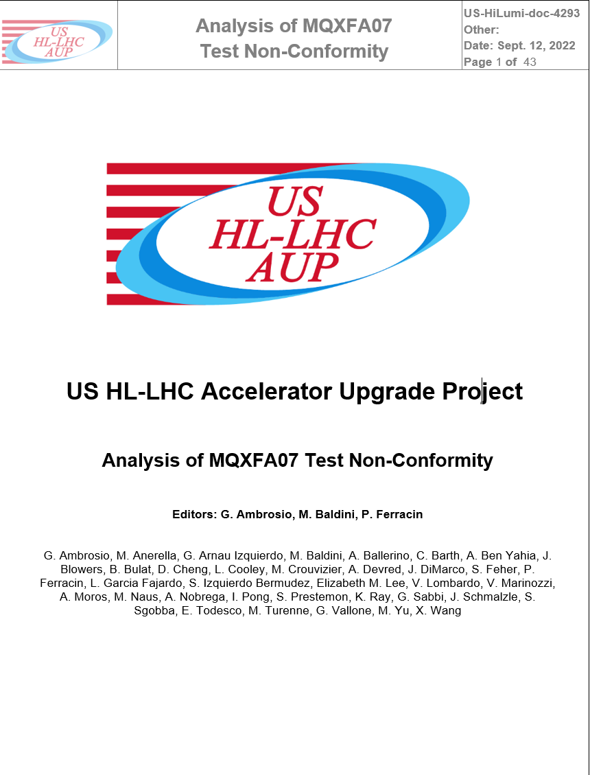
References
US-HiLumi-doc-4293
https://edms.cern.ch/document/2777612/1

Slide 5
Outline
MQXFA07/A08 test results
Magnet disassembly: coil-pack
Coil visual inspection
Finite element analysis
Coil die penetration test, CT scan, metallurgical inspection
Corrective actions for magnet A10 and beyond
Conclusions

Slide 6
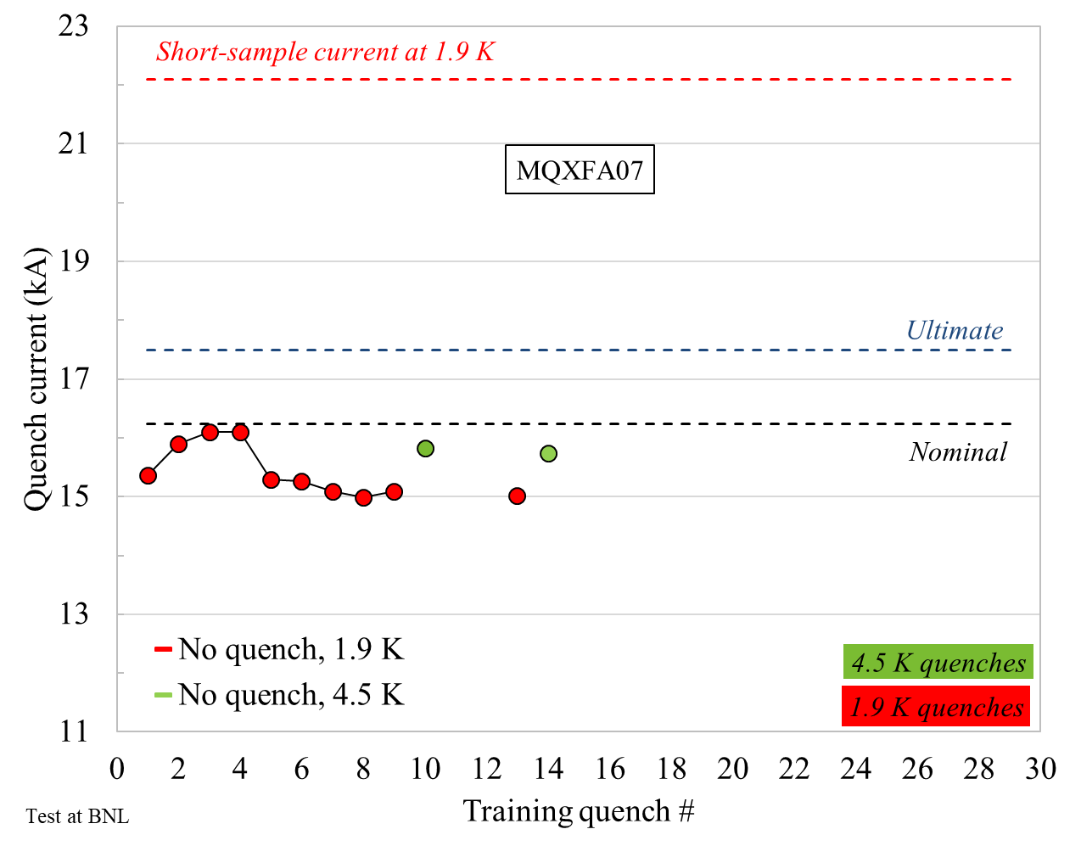
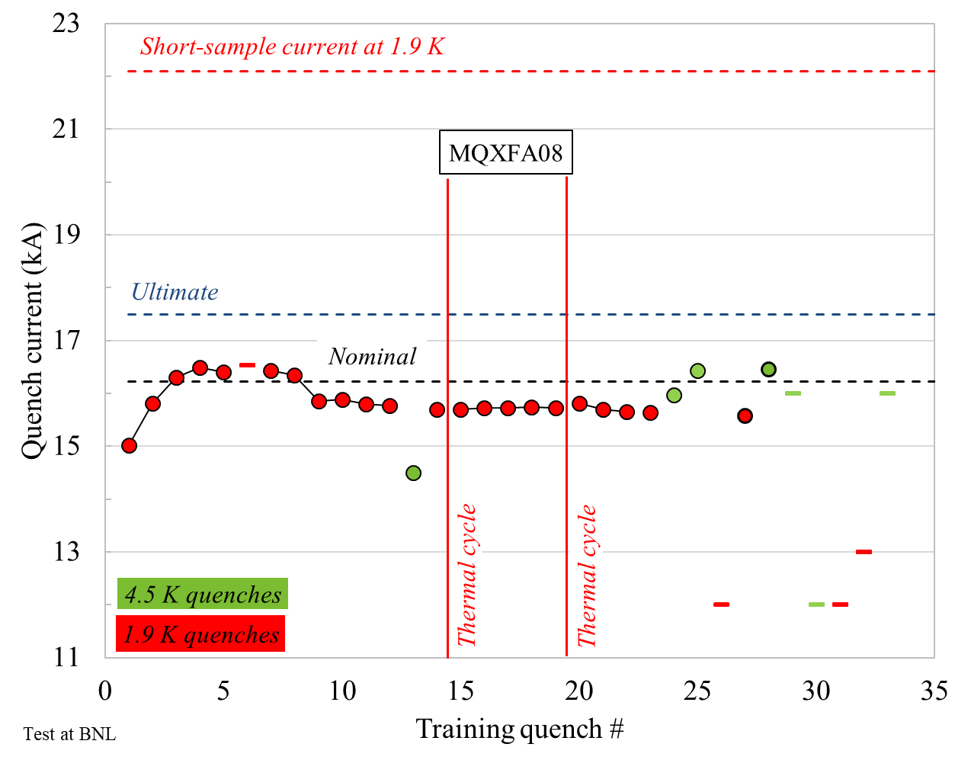
MQXFA07 and A08 test results
Both magnets with detraining after few quenches
  Reverse temperature and ramp-rate dependence
  Both magnets limited by segment a3-a4
    Coil 214 in A07 and coil 213 in A08

Slide 7
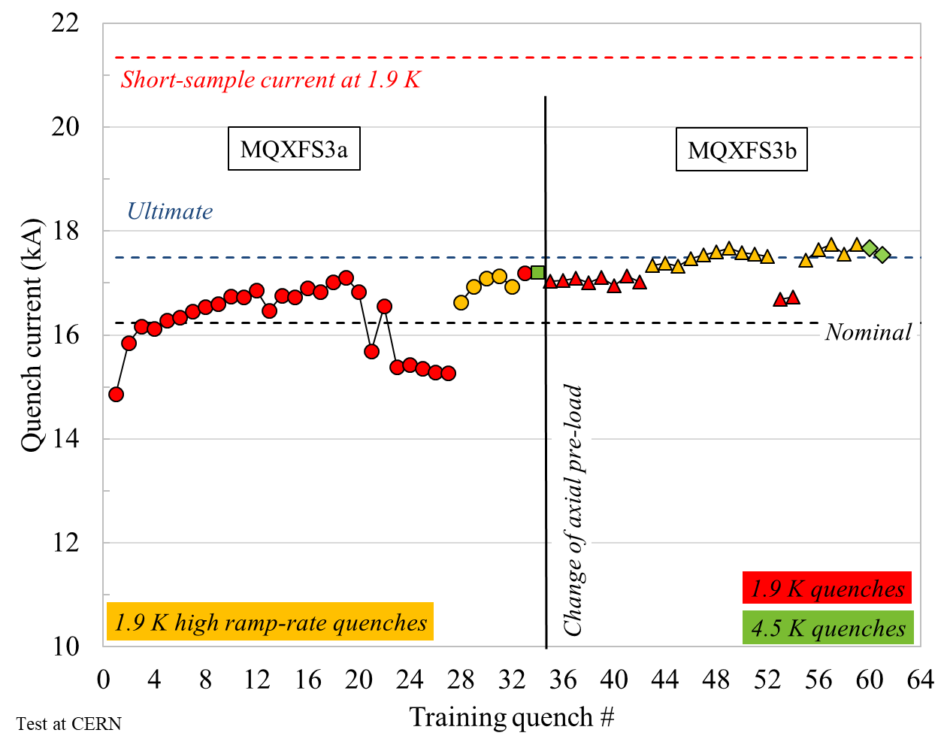
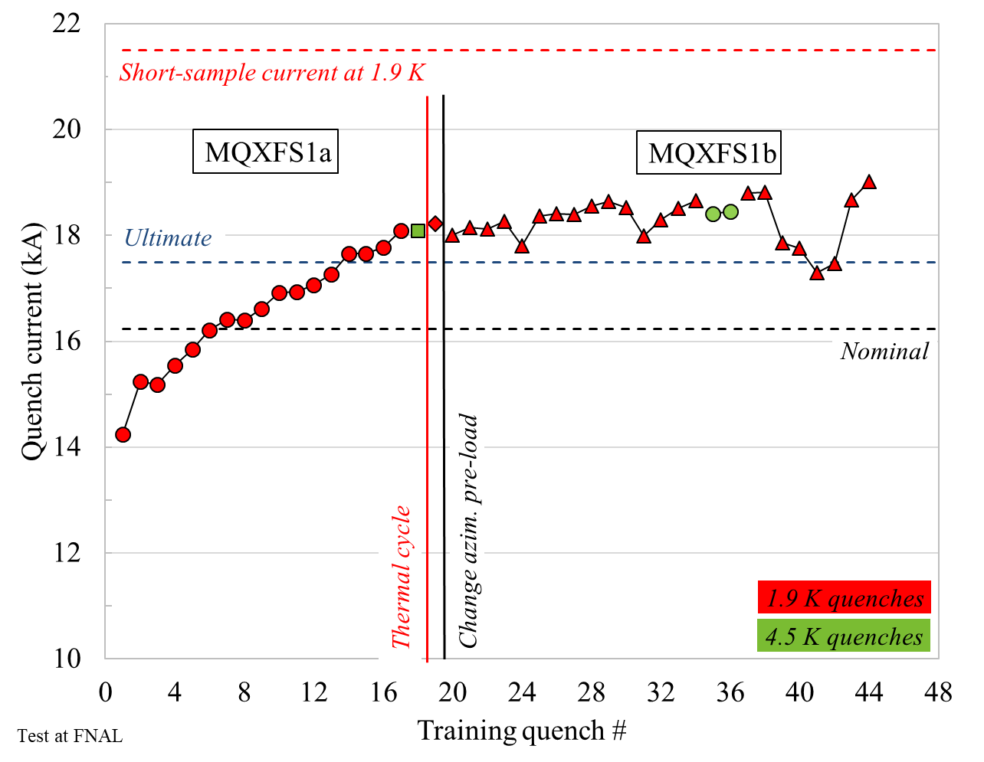
Segment a3a4….an “old friend”
Also in MQXFS3 (Oct 2016)
  Detraining…a3a4…increase with ramp-rate,4.5 K….and with axial loading
MQXFS1b (Oct 2016)
  a3a4 appeared after increase of azimuthal, with low axial
  No clear detraining, but more erratic….
Interpretation of behavior: self-field instability triggered by a local issue, likely affecting only some strands, that pushes more current in adjacent strand(s)

Slide 8
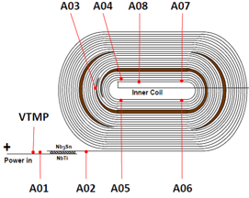
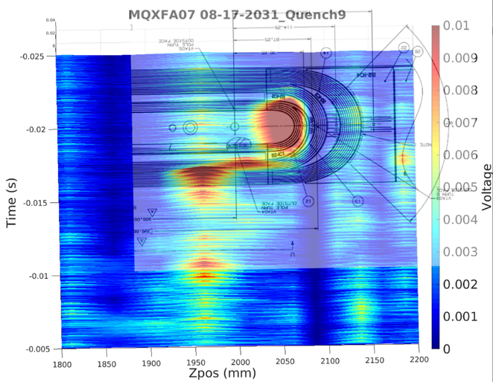
Back to MQXFA07 and A08 test results
Quench location
  a3a4: multi-turn segment including turns 2 to 6
    Turns 2-5 are included in the pole-block multiturn
    Turn 6 is the first turn outside the wedge
  Quench antenna signals (50 mm long circuits) point out LE, where pole block turns go around the pole tip

Slide 9
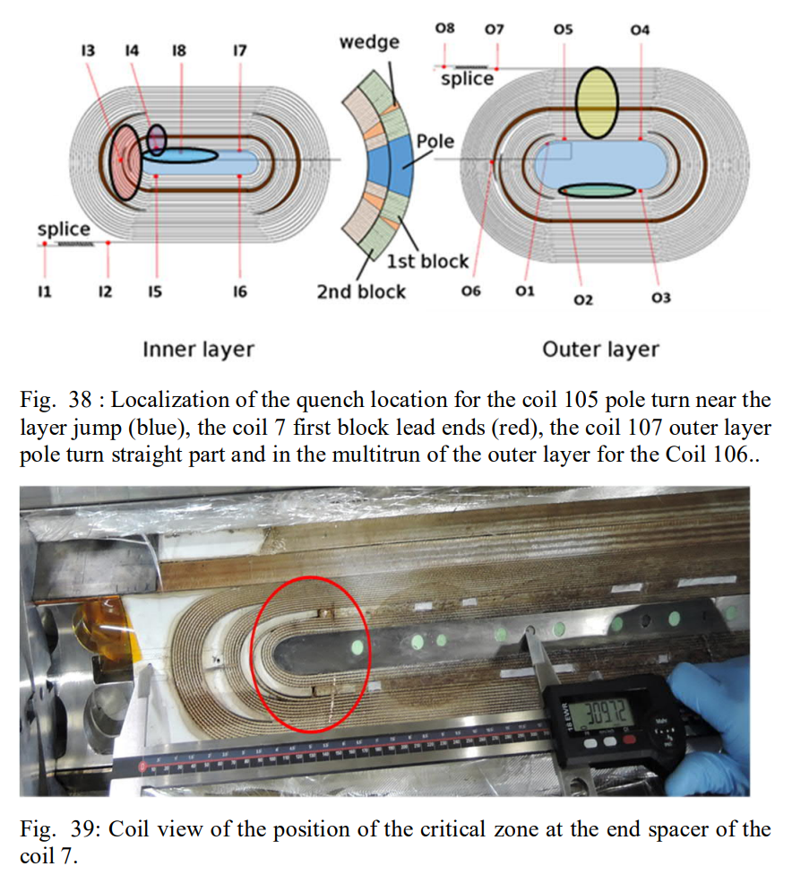
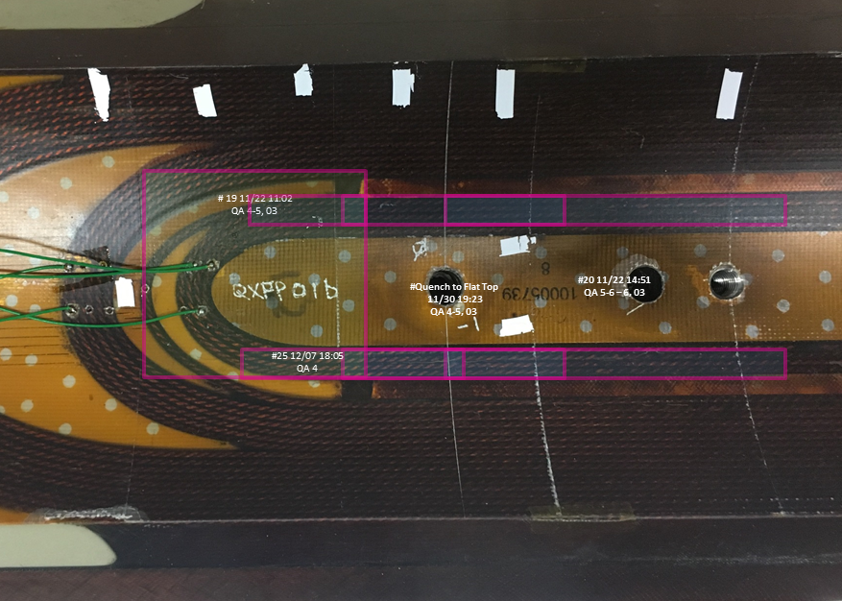
Again…lead end, pole block….an “old friend”
MQXFS3
By H. Bajas
CERN
MQXFS1b
By Guram Chlachidze
LARP

Slide 10
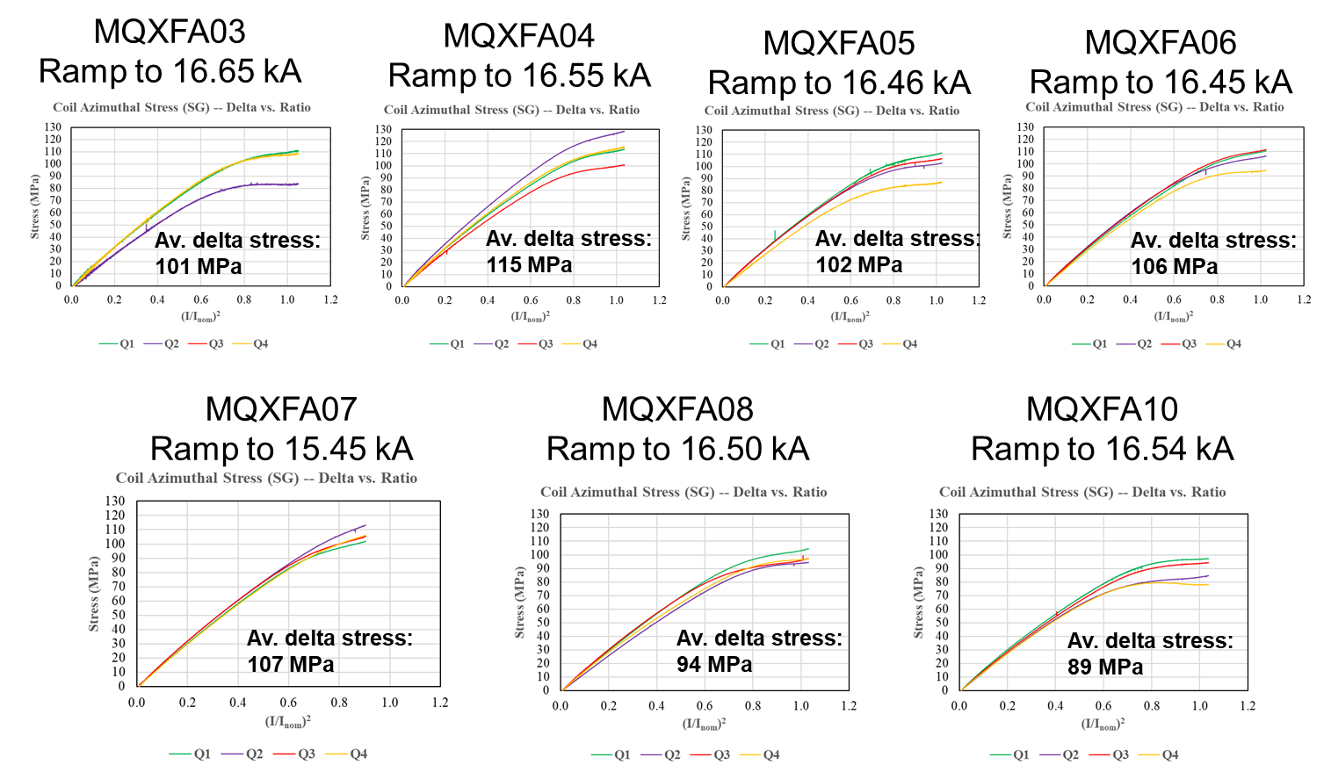
Strain gauges in MQXFA07-A08
No major anomaly in azimuthal pre-stress of shell and coil
  Nothing unusual in the coil unloading
    However, measurements only on the RE (4 m from quenching)

Slide 11
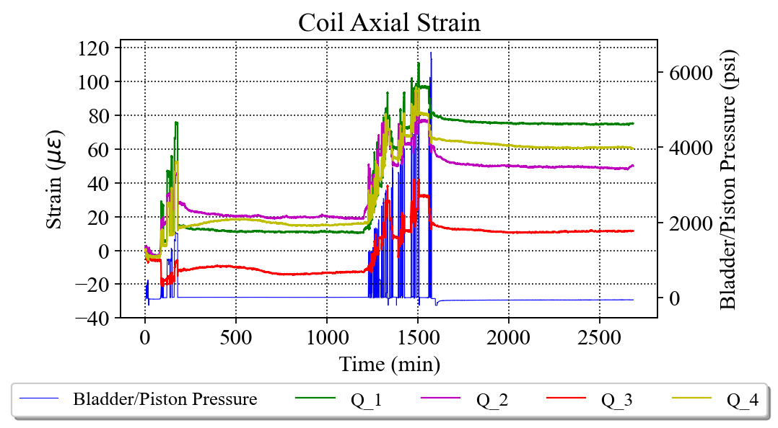
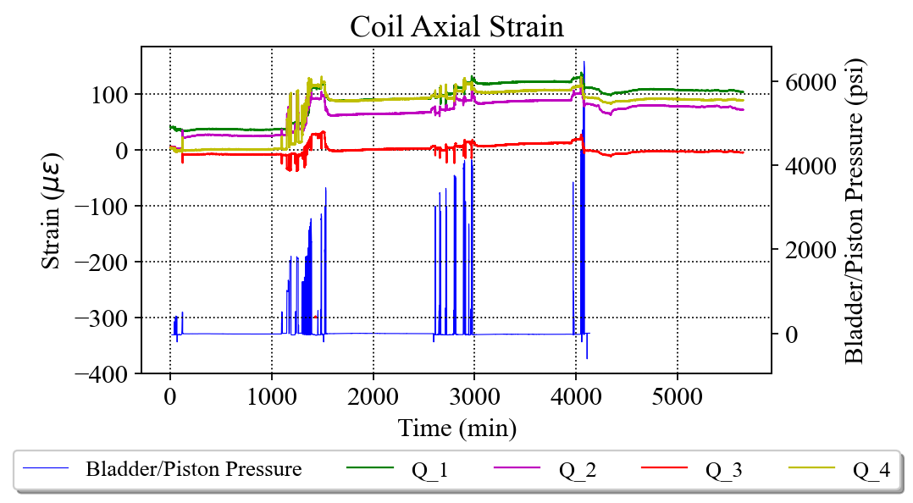
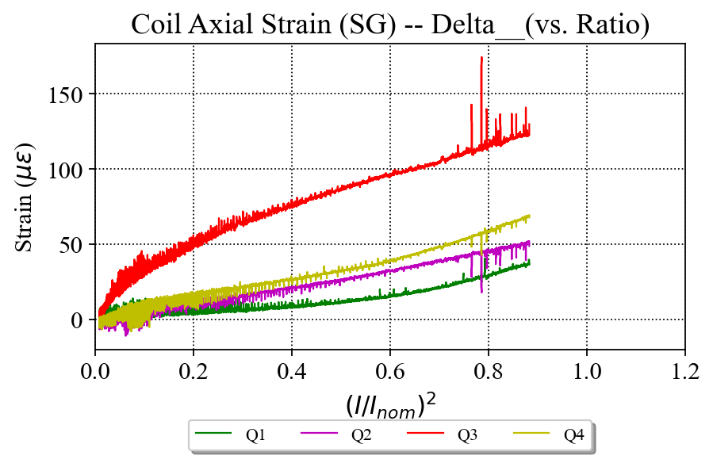
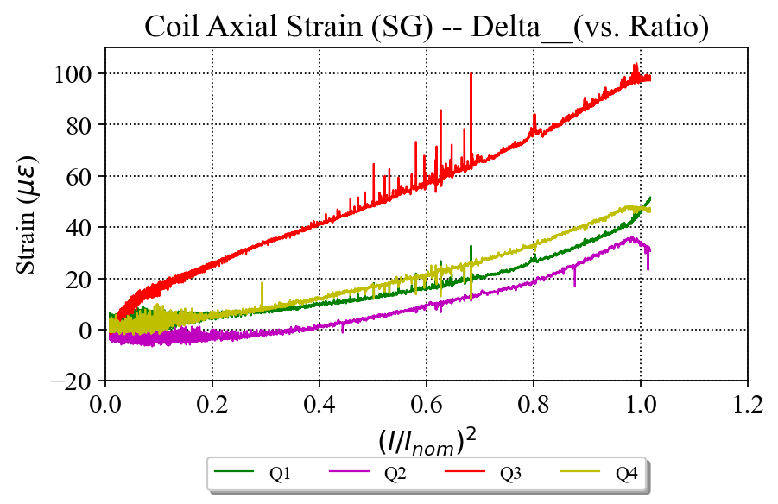
Strain gauges in MQXFA07-A08
“Suspicious” coil z behavior during loading/excitation, however
  Visible also in some previous magnets
  Not reproduced by any of the FE models
  Again measured far from the quenching zone
MQXFA07
MQXFA08

Slide 12
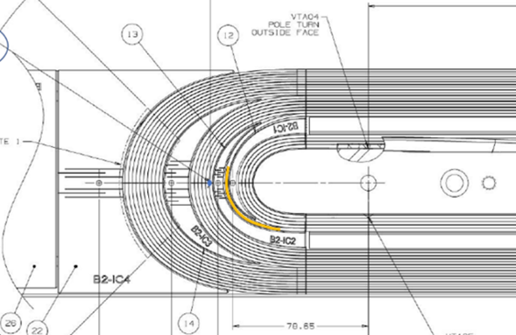
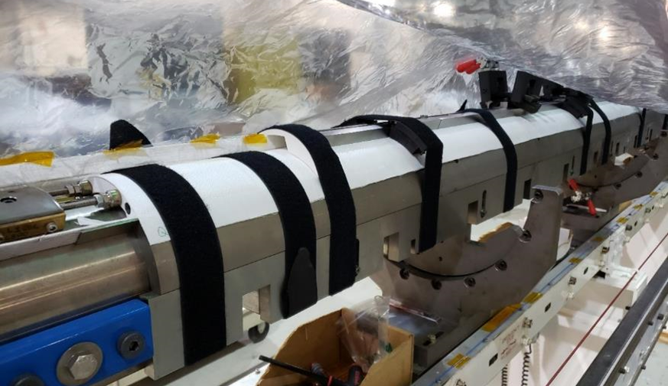
Review of coil fabrication
NCRs or off-normal procedures
In MQXFA08, splice between the magnet negative lead, connected to inner layer LE Q3, and the test facility had resistance equal to 42 nΩ
  Thermal analysis from CERN did not show any significant impact on quench zone
A07 coil 214:
  Some strands popped out during winding, then fixed, popped out overnight, fixed a second time
    Occurred in previous coils
  Affected by COVID lockdown: 14 weeks stop after winding & curing of inner layer
A08 coil 213
  Affected by COVID lockdown: 14 weeks stop in the reaction fixture, in the oven.

Slide 13
Outline
MQXFA07/A08 test results
Magnet disassembly: coil-pack
Coil visual inspection
Finite element analysis
Coil die penetration test, CT scan, metallurgical inspection
Corrective actions for magnet A10 and beyond
Conclusions

Slide 14
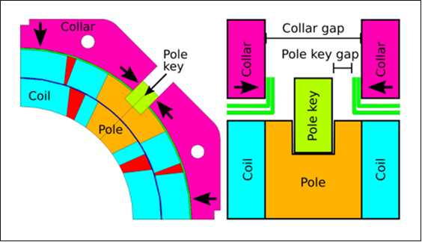
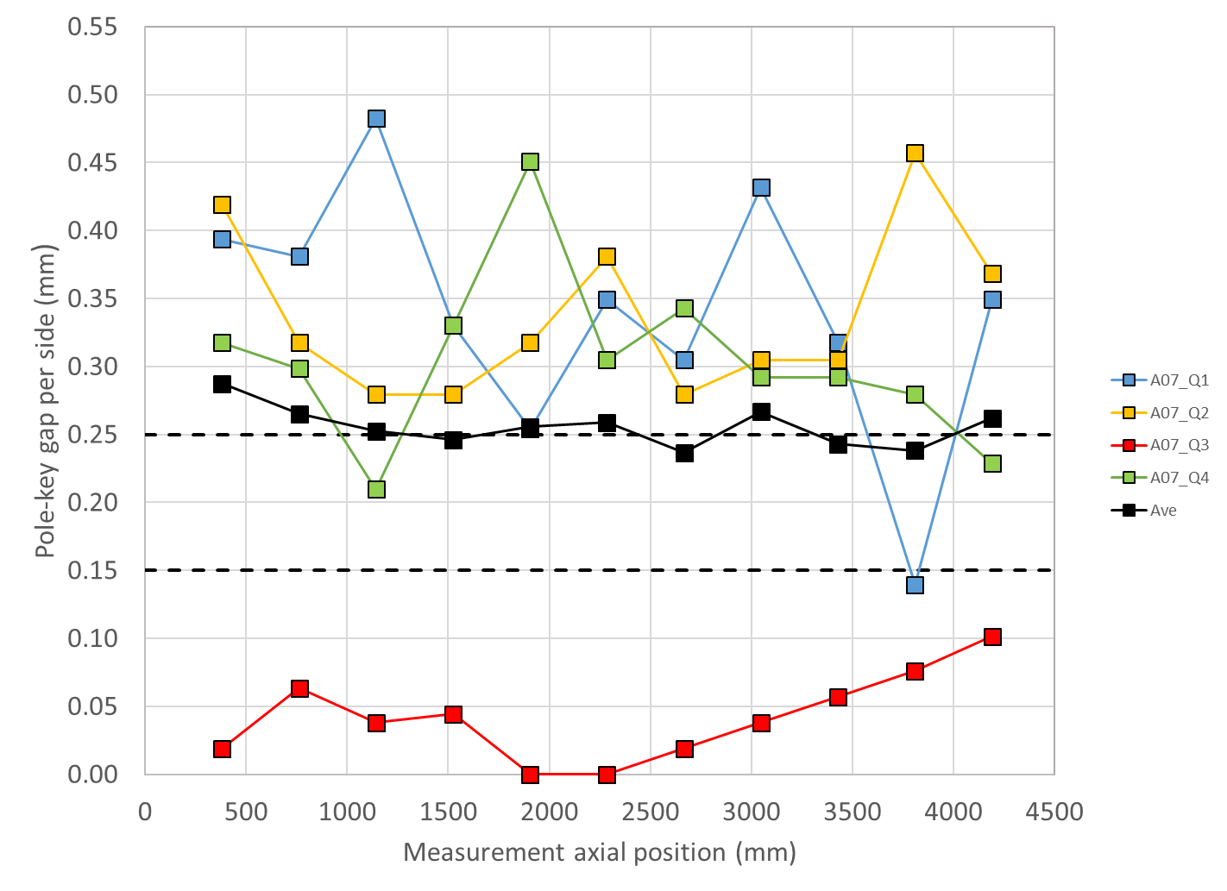
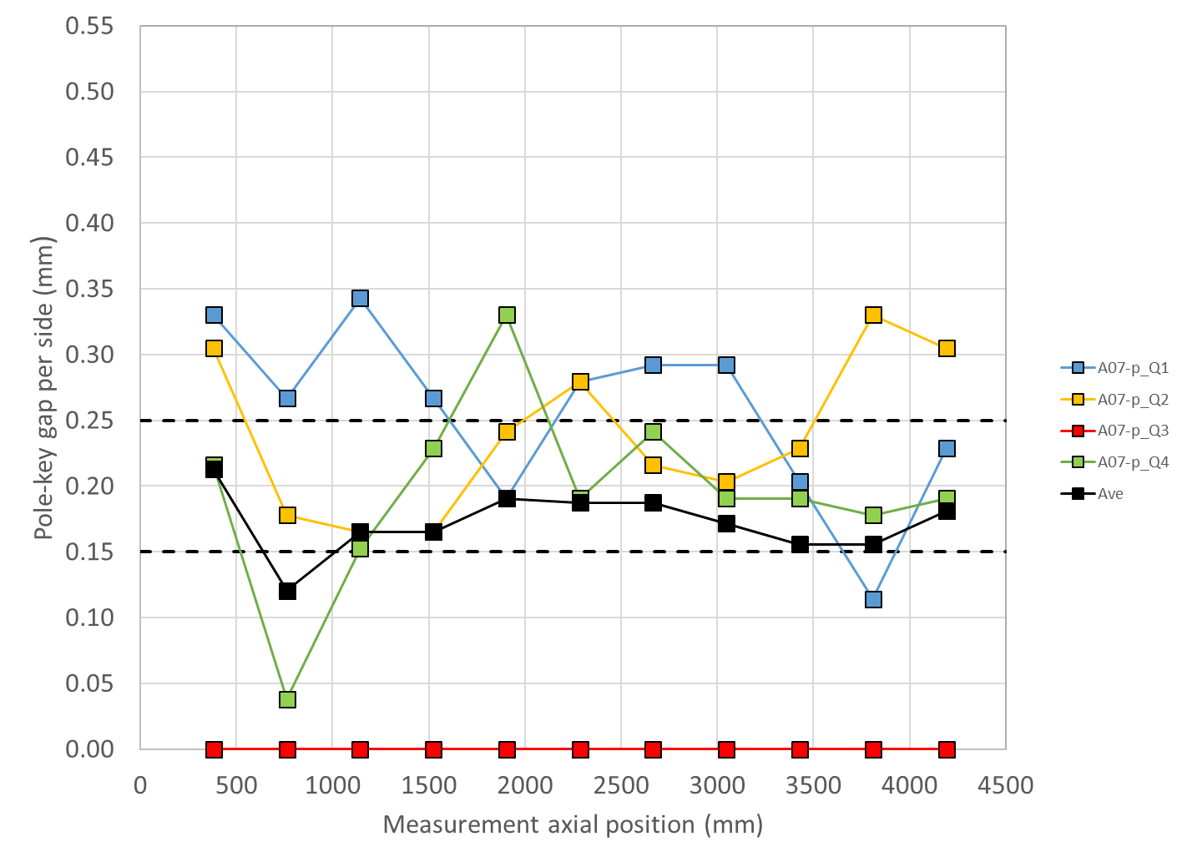
Disassembly: coil pack inspection
Pole key gap
Spec. pole key gap (local ave. on cross-section)
  0.200± 0.050 mm
Before to after the test
  Q3 with an very low gap both before and after the test
  Average decreased by about 0.100 mm
  Same profiles after pre-load and test
MQXFA07
MQXFA07-p

Slide 15
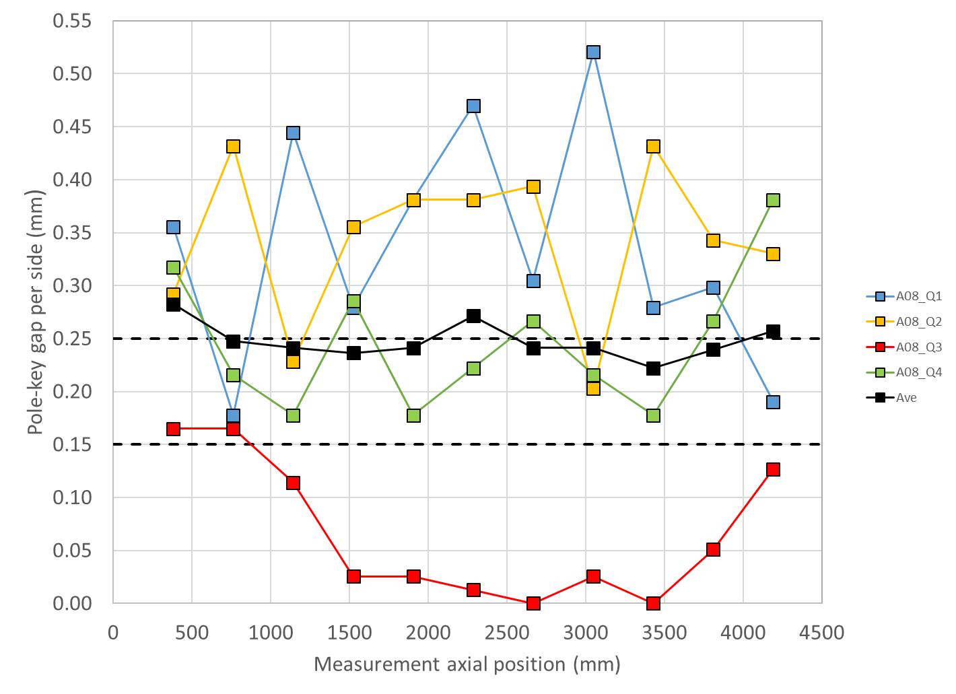
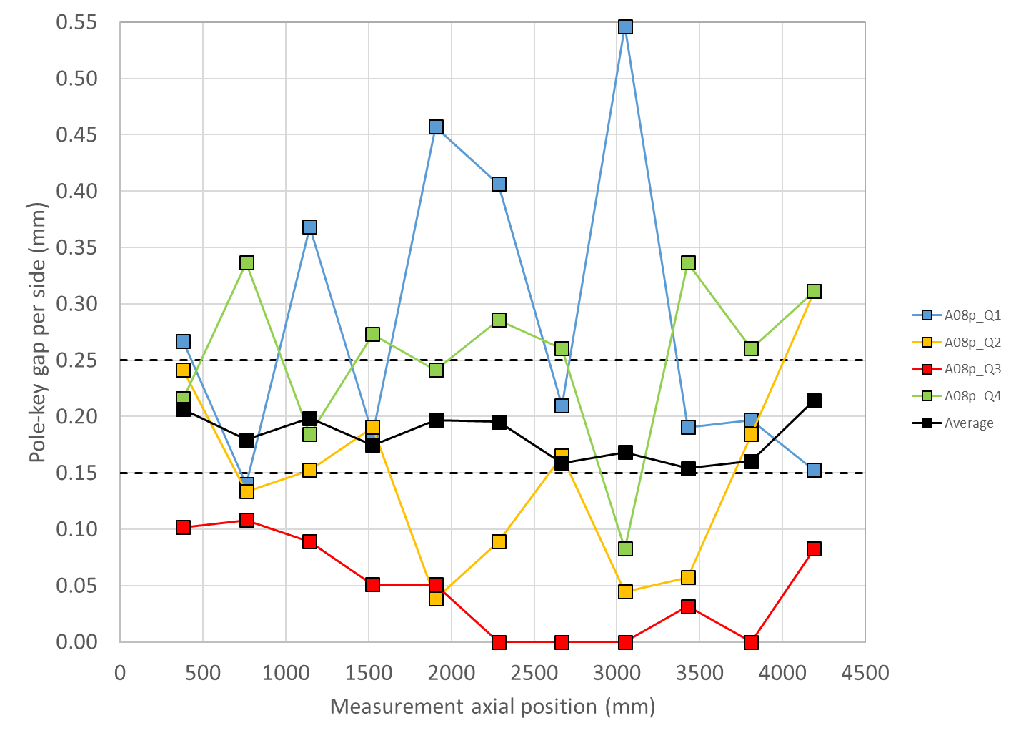
Disassembly: coil pack inspection
Pole key gap
Similar results on MQXFA08
  But not as dramatic as in A07-p
MQXFA08
MQXFA08-p

Slide 16
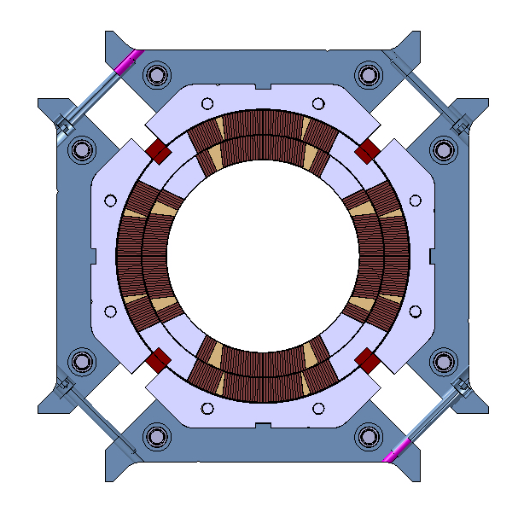
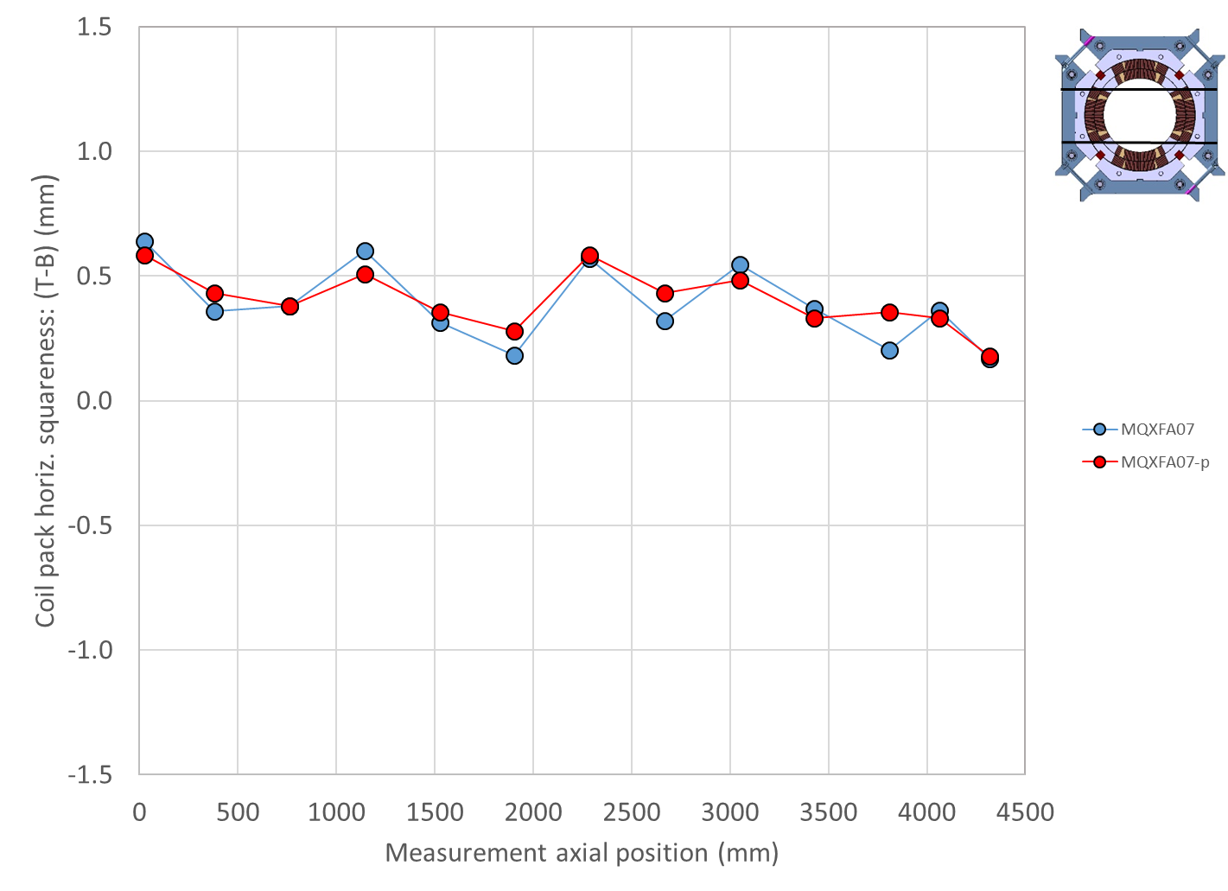
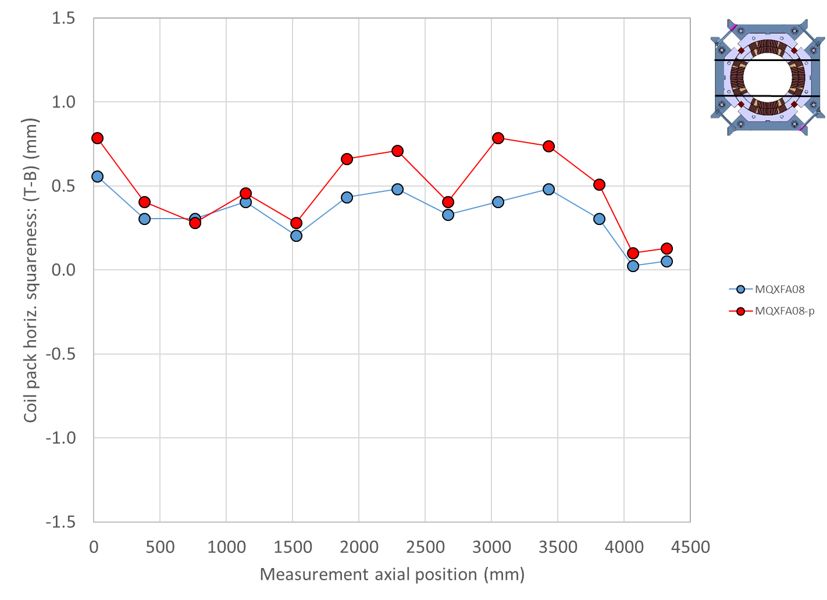
Disassembly: coil pack inspection
Pole key gap
The same conclusion could be drawn looking at the coil pack dimensions
  Significant trapezoidal shape
  No change from before to after test
T
T
B
B
MQXFA07 vs A07-p
MQXFA08 vs A08-p

Slide 17

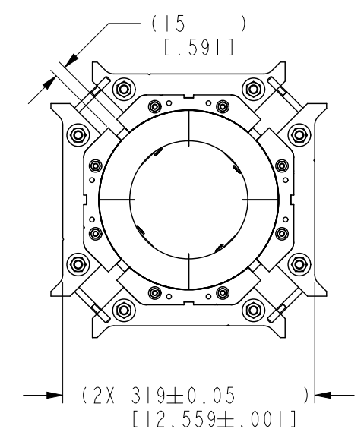
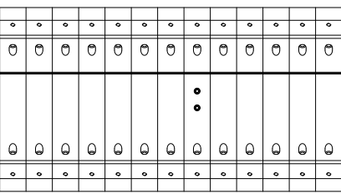
Review of coil-pack fabrication
NCRs or off-normal procedures
Changes to magnet assembly procedures due to Covid requirements:
  #1: change in bolting procedure for increasing tech distance
  #2: the technician who had been leading the coil-pack assembly operations up to magnet MQXFA05 was removed from that task (starting from MQXFA06) because not vaccinated.
Also, end-plate mis-aligned, so magnet unloaded axially and re-loaded
Center
Center

Slide 18
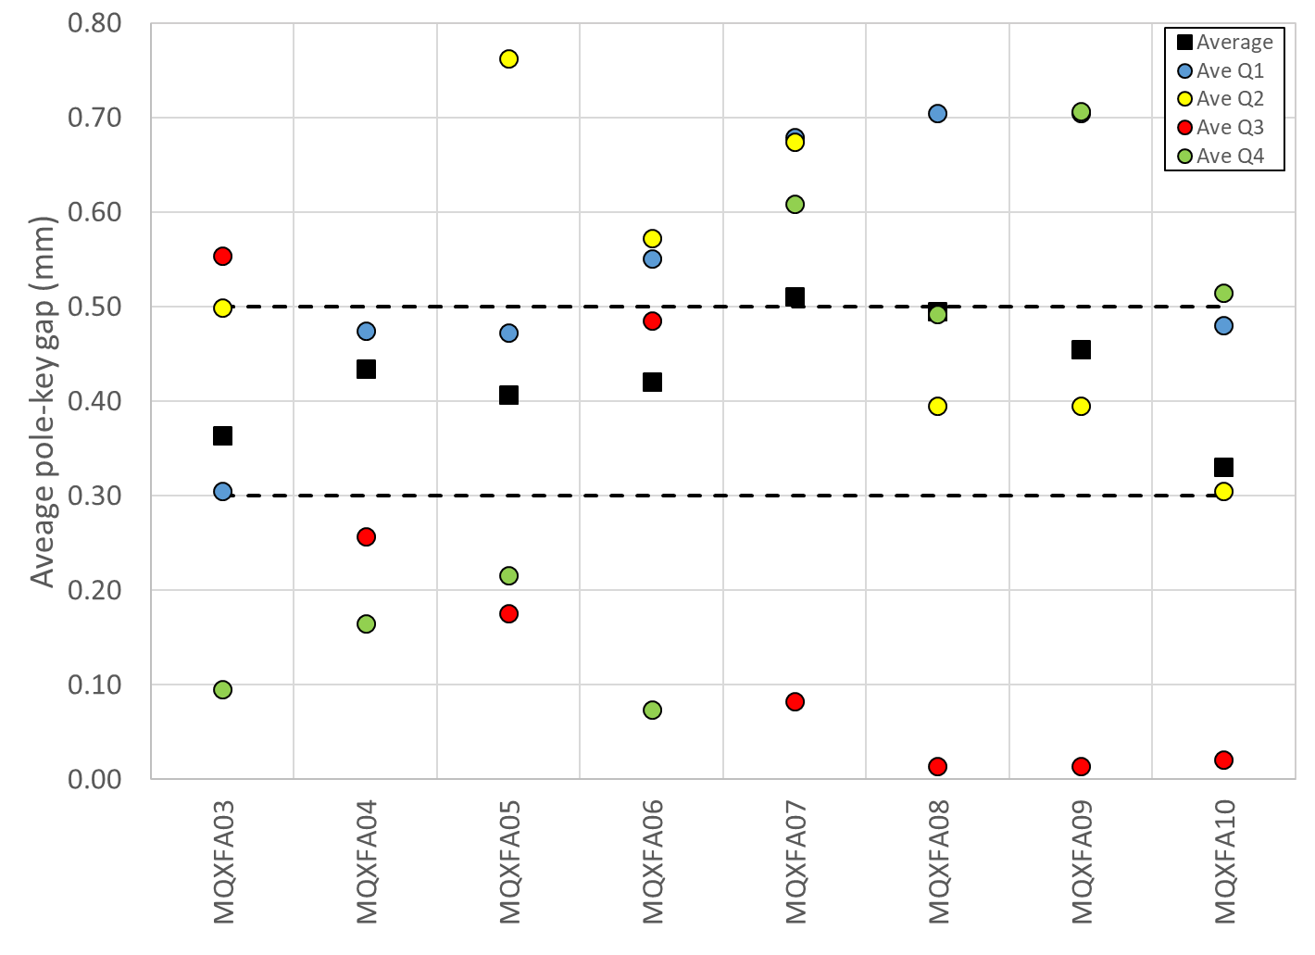
Review of coil-pack fabrication
NCRs or off-normal procedures
Covid lockdown
#2
#1

Slide 19
Outline
MQXFA07/A08 test results
Magnet disassembly: coil-pack
Coil visual inspection
Finite element analysis
Coil die penetration test, CT scan, metallurgical inspection
Corrective actions for magnet A10 and beyond
Conclusions

Slide 20
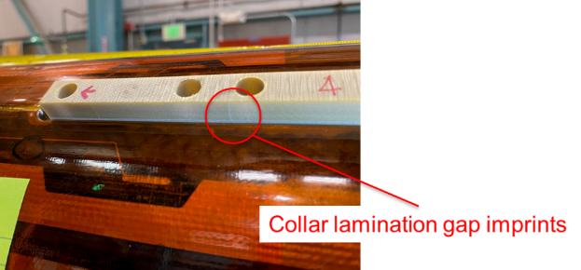
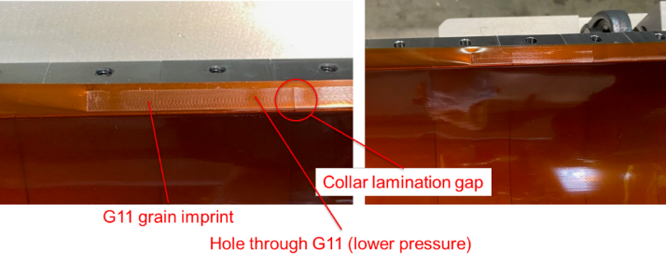
Coil visual inspection
In Q3, deep imprints in the Kapton indicating collar lamination lines, G11 grain, and “lower pressure” spots at every hole
  These imprints, all indicative of a higher pressure, not seen in the other quadrants.
The G11 keys in Q3 also showed high pressure imprints of collar lamination gaps
  Not observed in the other quadrants.

Slide 21
Outline
MQXFA07/A08 test results
Magnet disassembly: coil-pack
Coil visual inspection
Finite element analysis
Coil die penetration test, CT scan, metallurgical inspection
Corrective actions for magnet A10 and beyond
Conclusions

Slide 22
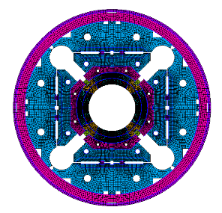
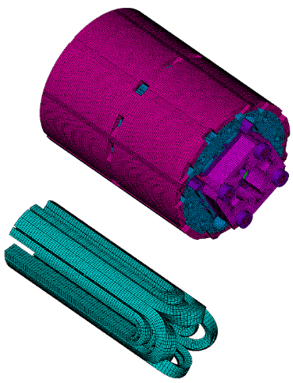
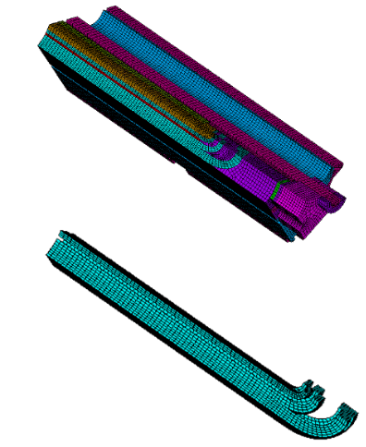
Finite element analysis
Effect of a close pole key gap
Three different finite element models:
  360-degrees, full cross-section 2D model
  360-degrees, full cross-section 3D model (MQXFS)
  45-degrees, octant 3D model (MQXFS)

Slide 23
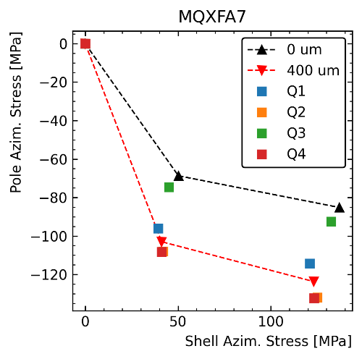
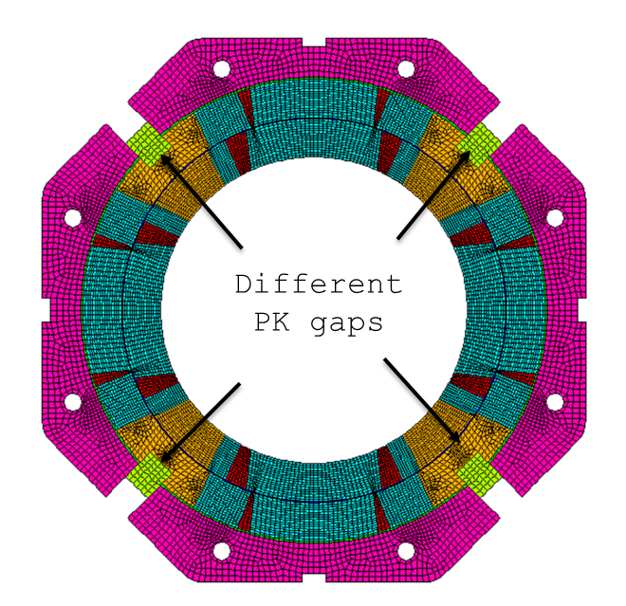
Finite element analysis
360-degrees, full cross-section 2D model
With a close pole key gap in Q3, the azimuthal pre-stress is
  Significantly lower (~30 MPa reduction) in the Q3
  ‘Medium’ on the opposite side (Q1),
  “Maximum” on the two remaining quadrants
This effect is not measured by the strain gauges
  However, measurement on a single axial location in RE
Q2
Q1
Q3
Q4

Slide 24
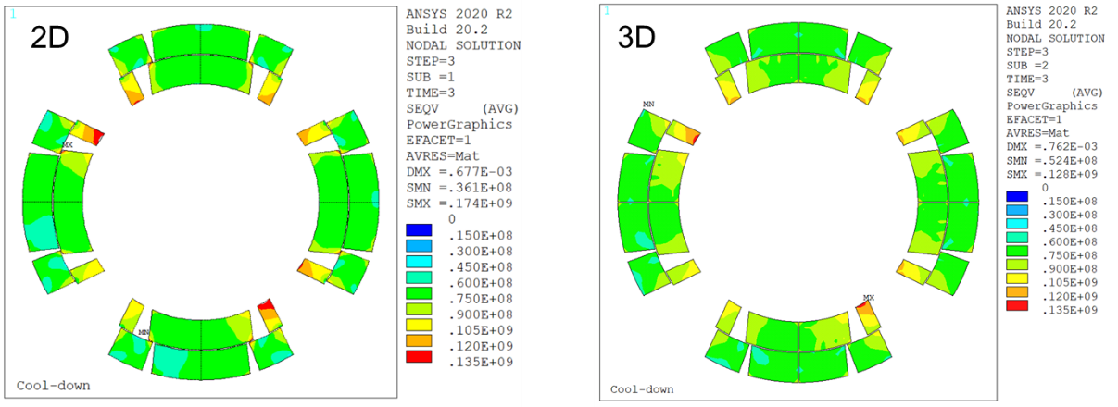
Finite element analysis
360-degrees, full cross-section 3D model
Lower pre-stress in Q3 confirmed by 3D model

Slide 25
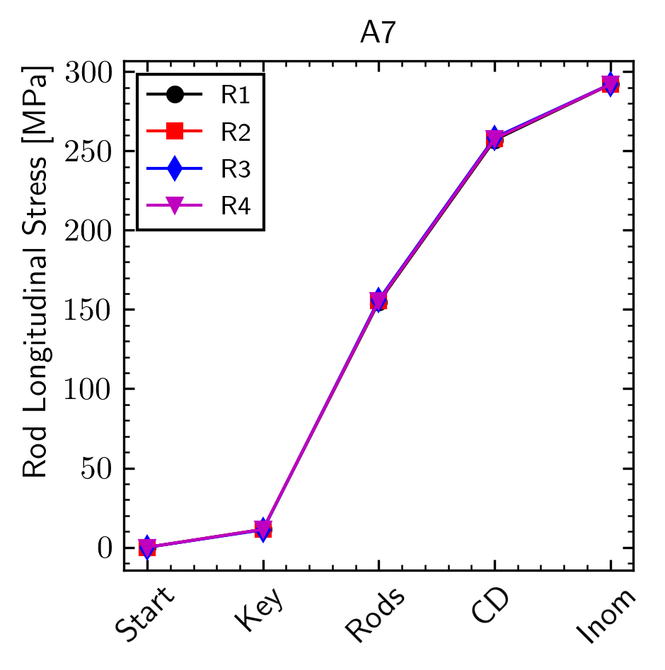
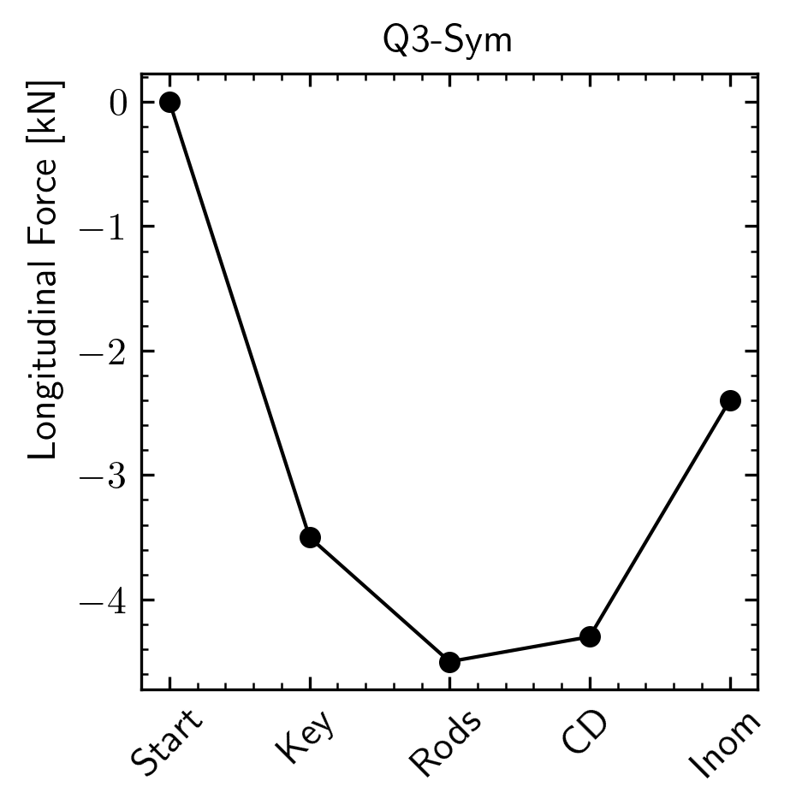
Finite element analysis
360-degrees, full cross-section 3D model
Axial behavior
  No difference in the rods stress, but less force axial pre-load on the Q3 coil
    Lower azimuthal pre-stress results in less friction coil-structure → “axially softer coil”

Slide 26
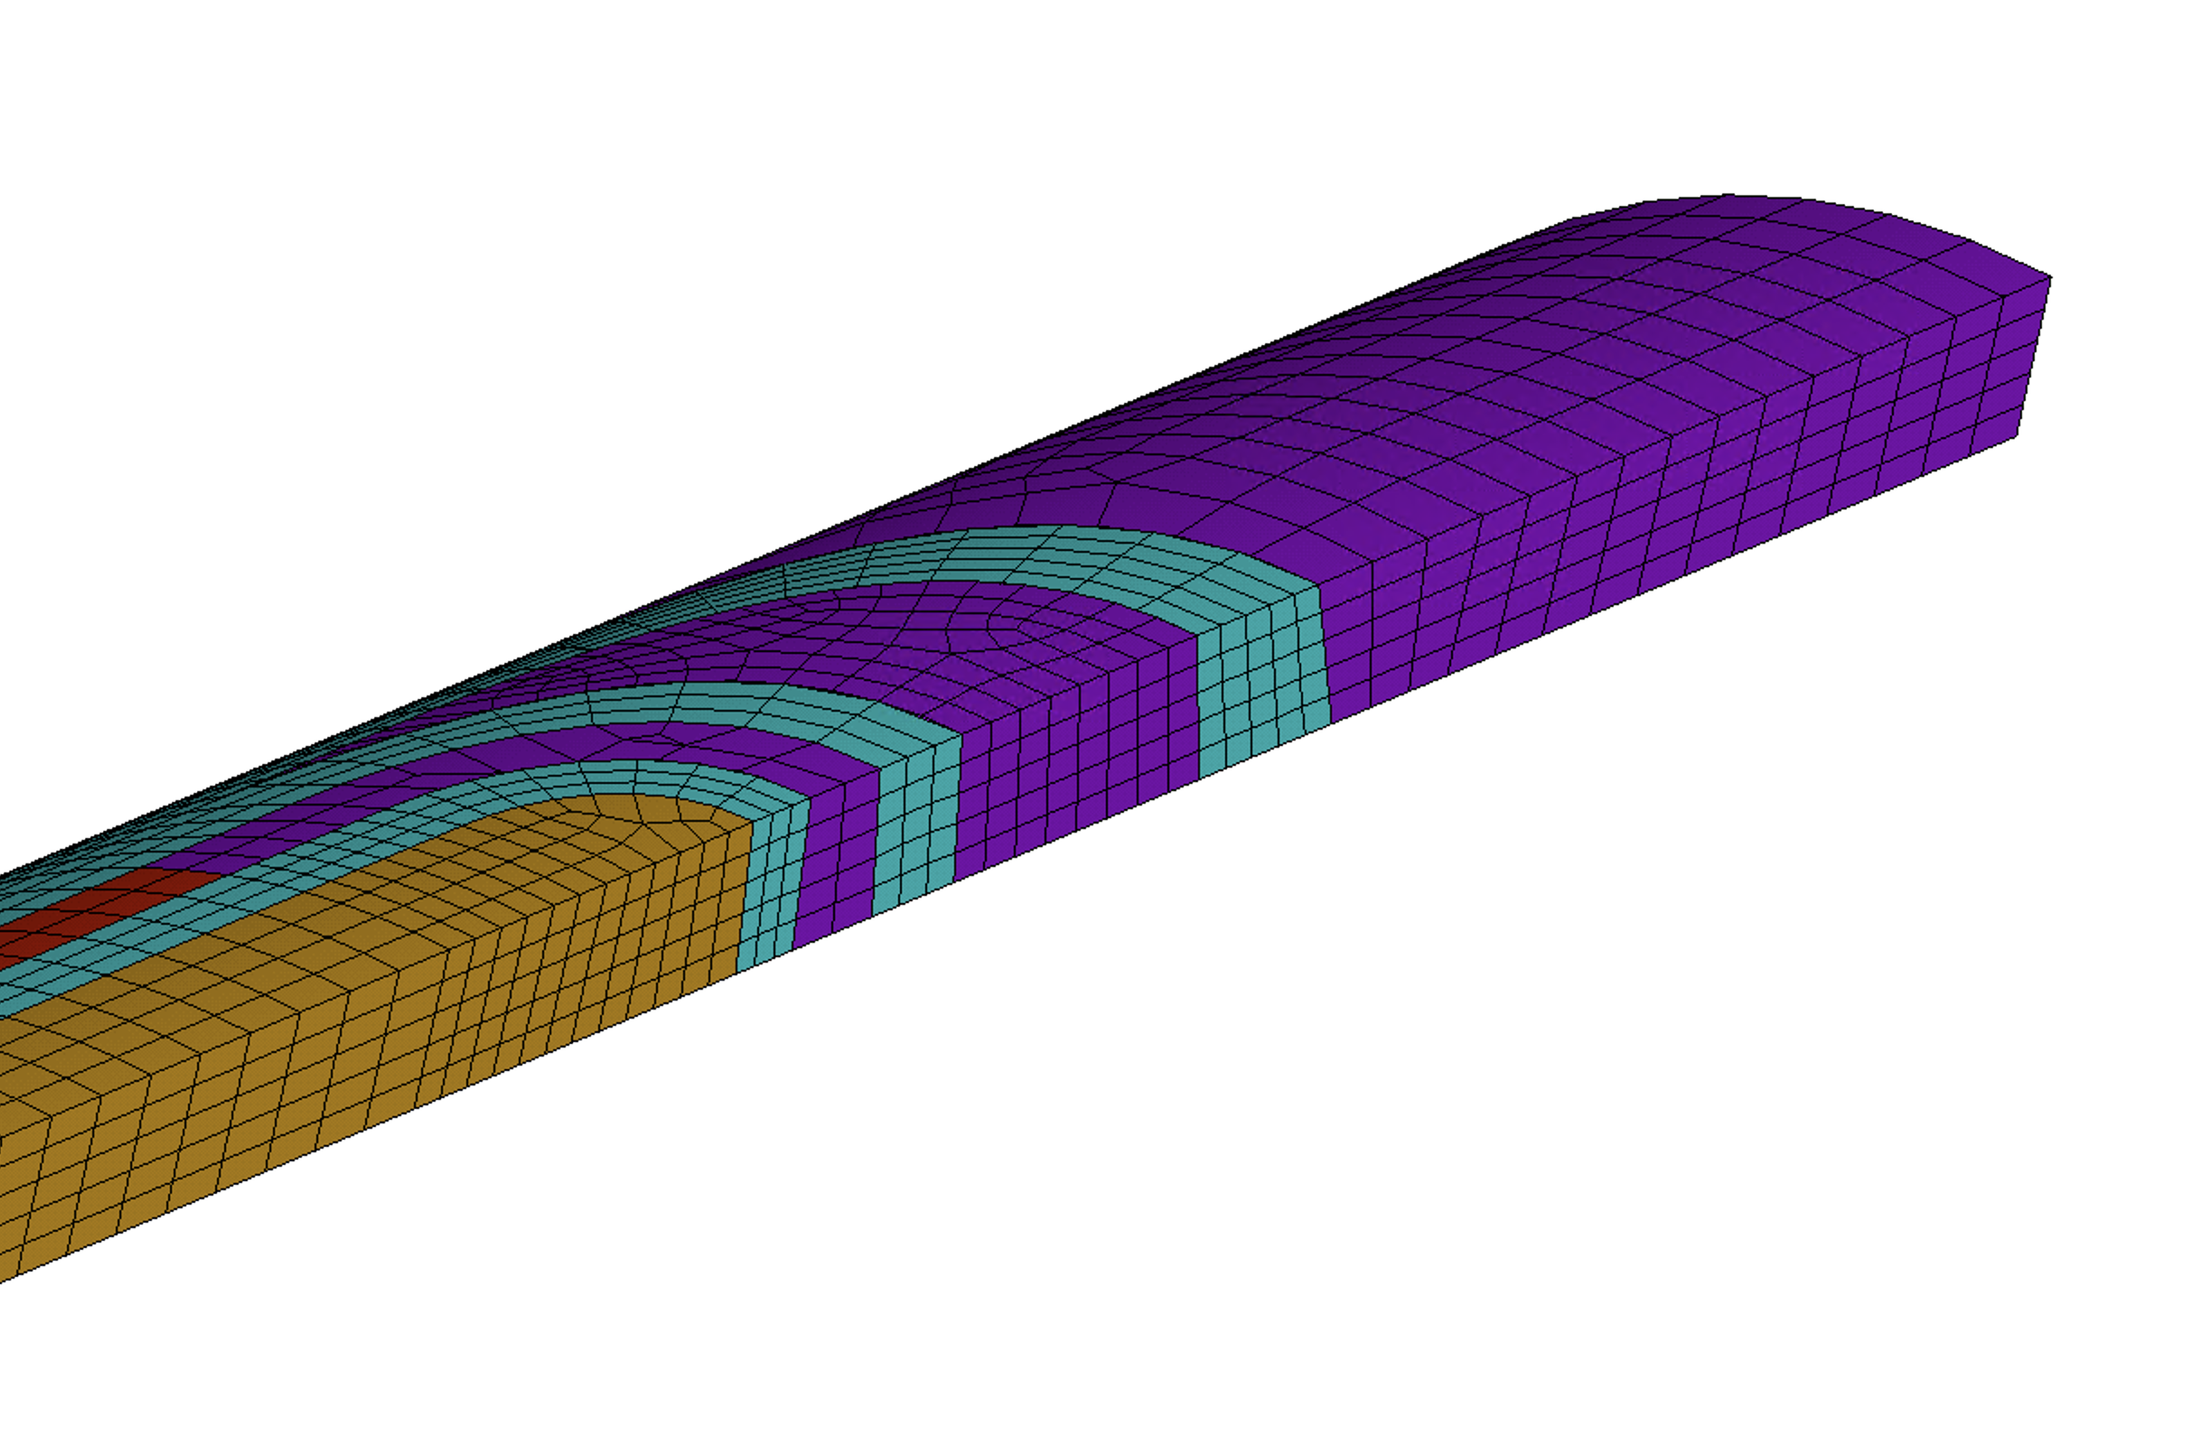
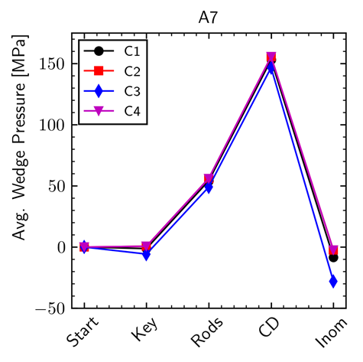
Finite element analysis
360-degrees, full cross-section 3D model
“a3a4 LE area”
  Contact between wedge and end spacer in L1
  Considering bonded conditions
    Tension occurs in Q3 during excitation

Slide 27
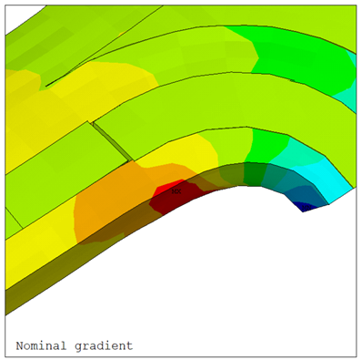
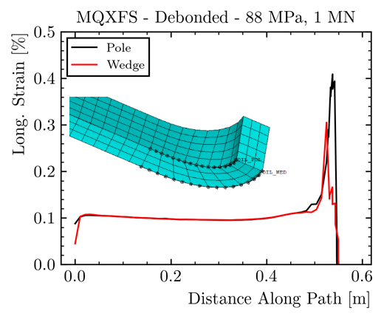
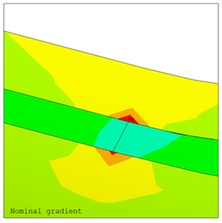
Finite element analysis
45-degrees, octant 3D model
More detailed analysis with refined meshed
  Not bonded, so as if epoxy cracking has occurred
  The gap between wedge and end-spacer, induces a spike in axial strain in the coil, which can reach the 0.4% level
    larger increase in the turn towards the pole.

Slide 28
Outline
MQXFA07/A08 test results
Magnet disassembly: coil-pack
Coil visual inspection
Finite element analysis
Coil die penetration test, CT scan, metallurgical inspection
Corrective actions for magnet A10 and beyond
Conclusions

Slide 29
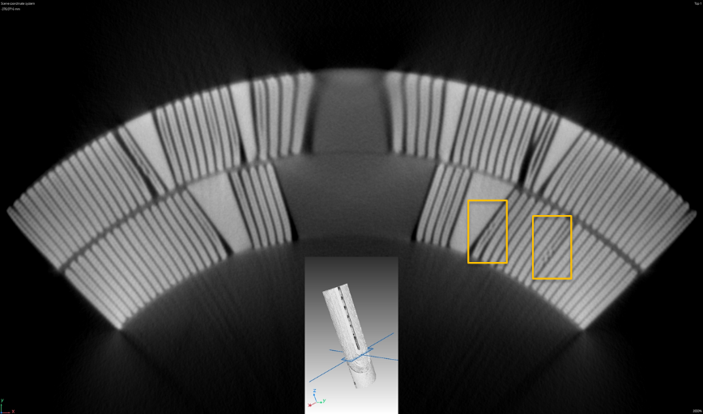
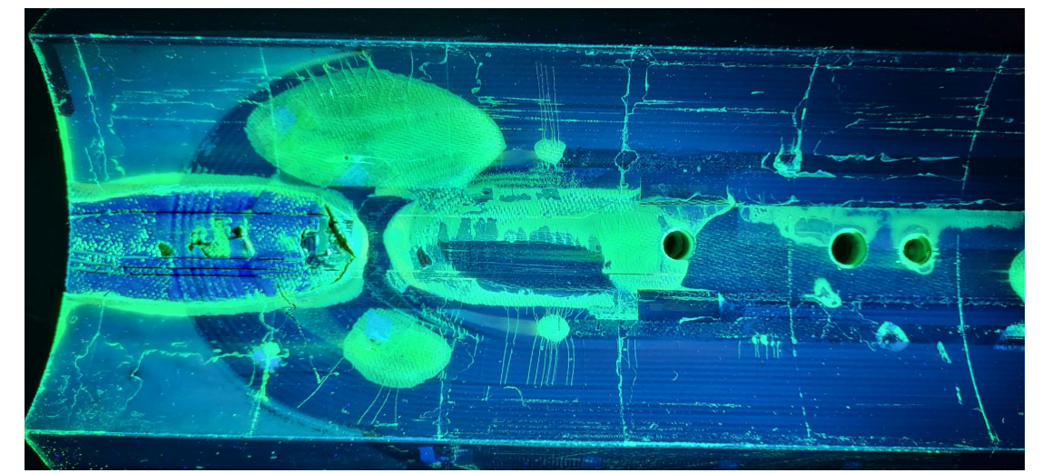
CT scan and die penetrant test
In total 12 popped strands between LE and RE
  But only one in the a3a4 segment, LE
Bubbles/blisters also in the wedge - end-spacer interface
  Horizontal cracks seen by die-penetrant test at CERN
By Bartosz BULAT, CERN
By Gonzalo Arnau Izquierdo, CERN

Slide 30
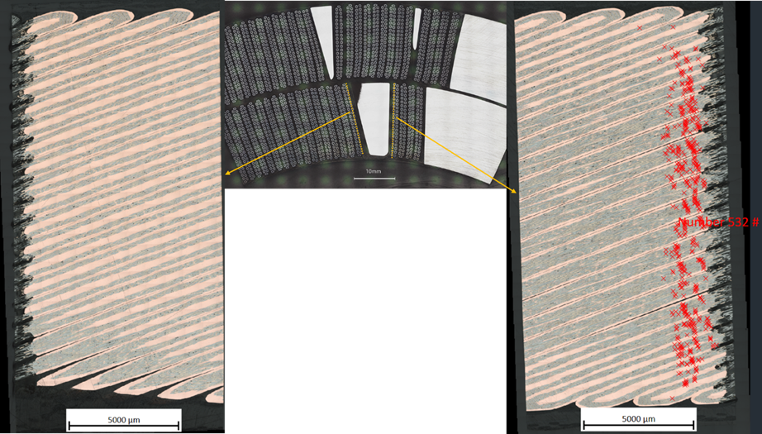
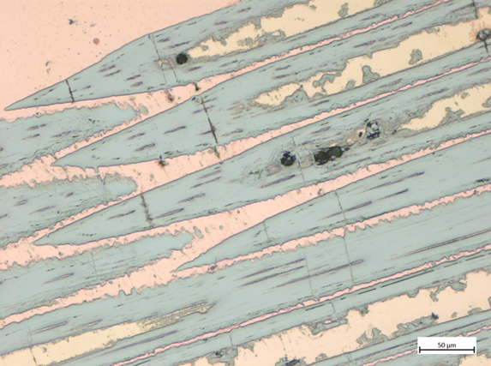
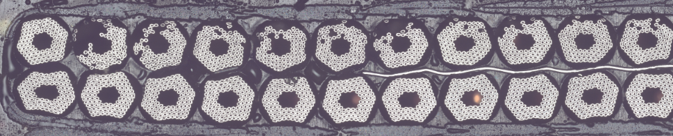
Metallurgical inspection
Longitudinal cuts of first row of Rutherford cables adjacent to the end spacer/copper wedge transition
  Localized field of cracked filaments, especially at pole block, between resin and copper wedge
By M. Crouvizier, A. Moros, S. Sgobba, CERN

Slide 31
Outline
MQXFA07/A08 test results
Magnet disassembly: coil-pack
Coil visual inspection
Finite element analysis
Coil die penetration test, CT scan, metallurgical inspection
Corrective actions for magnet A10 and beyond
Conclusions

Slide 32
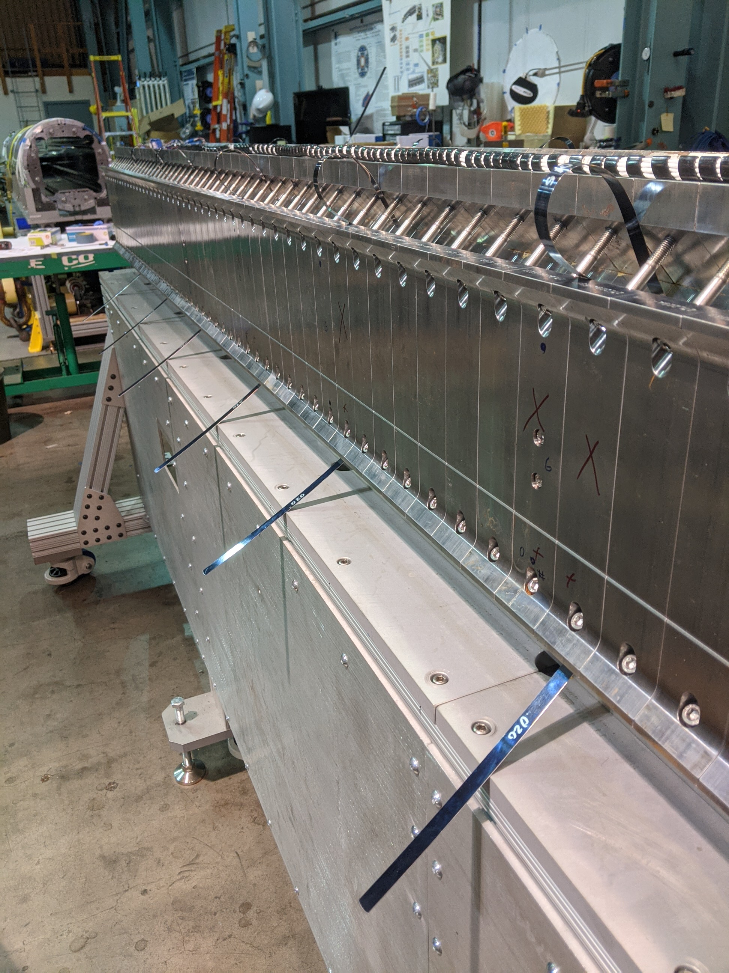
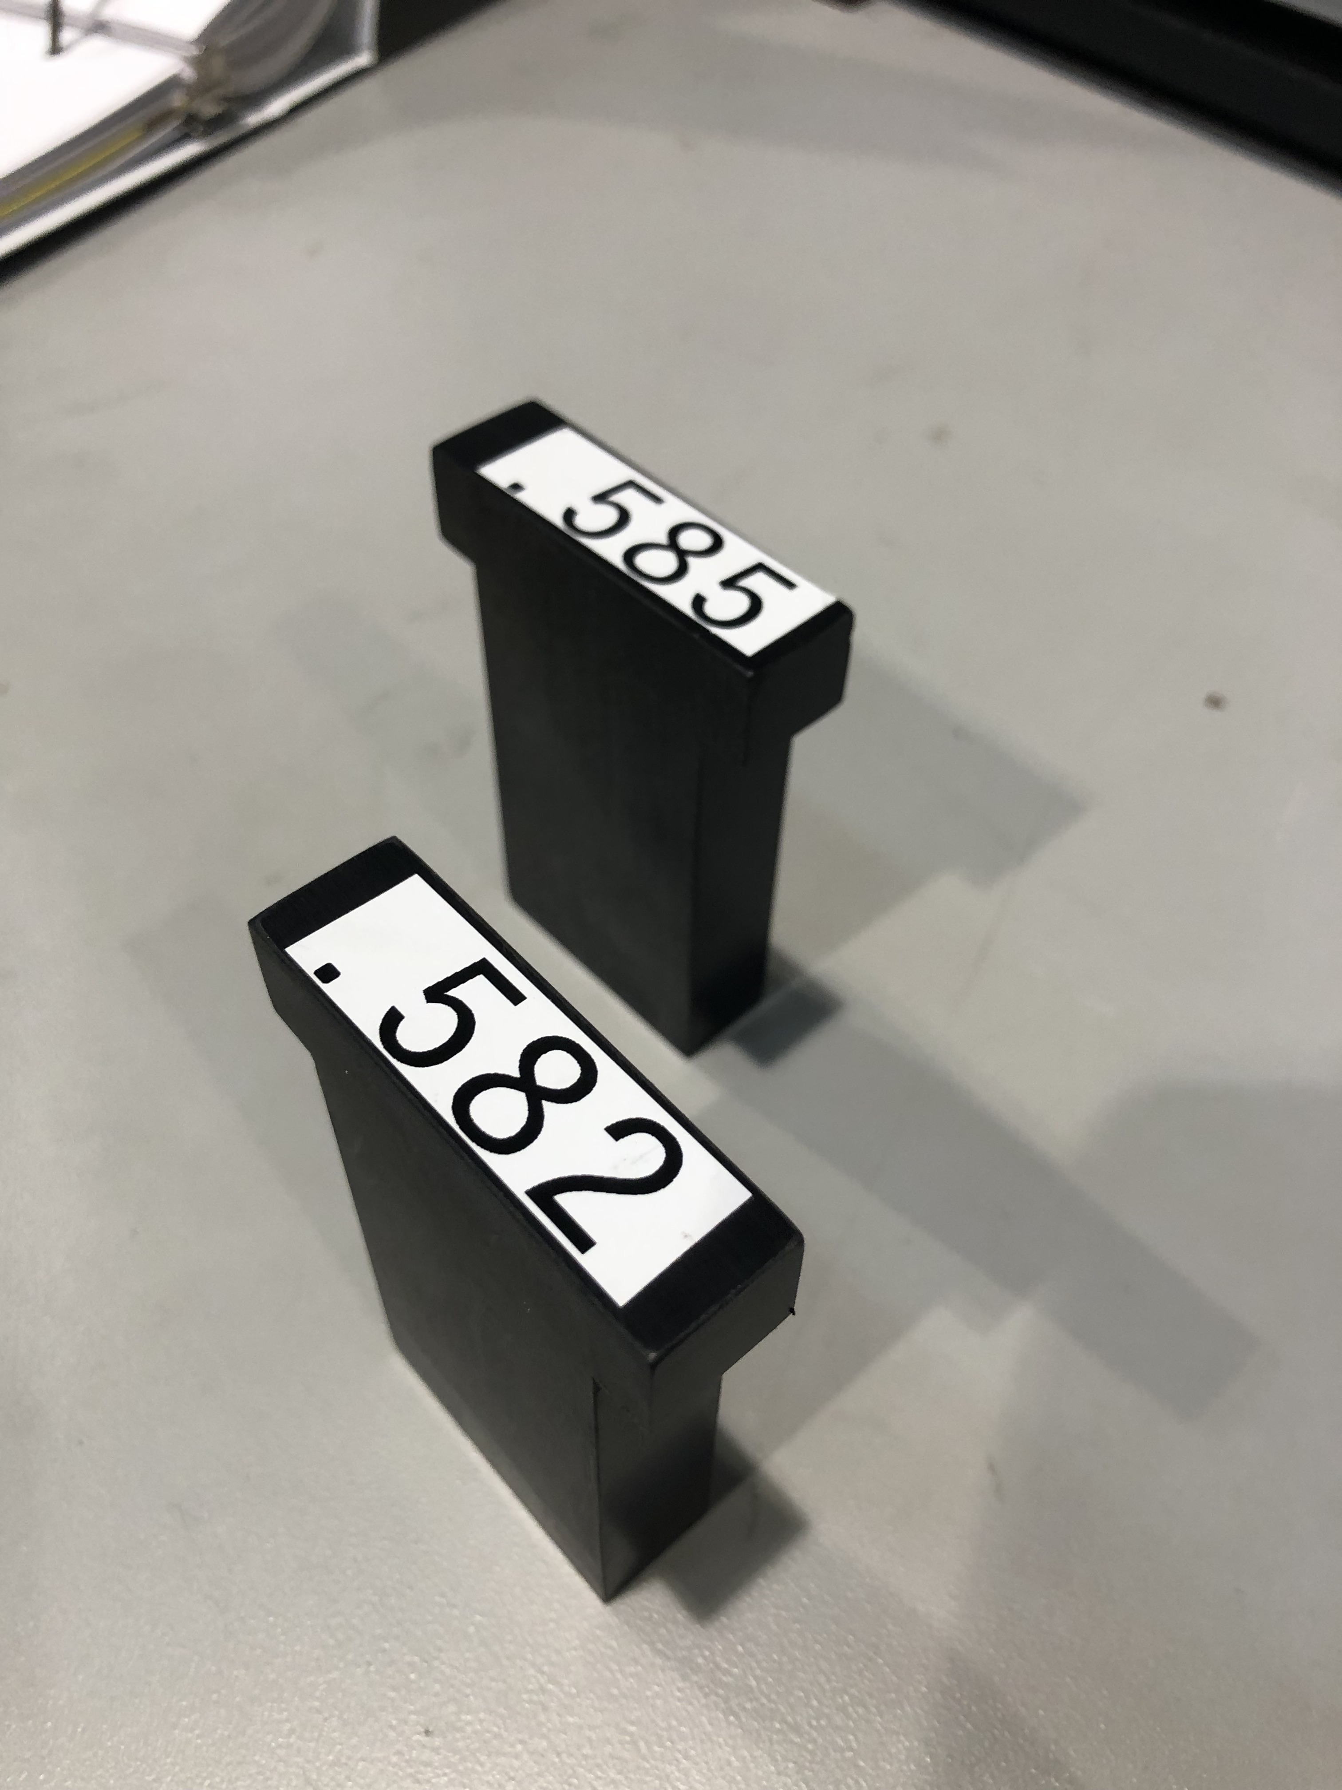
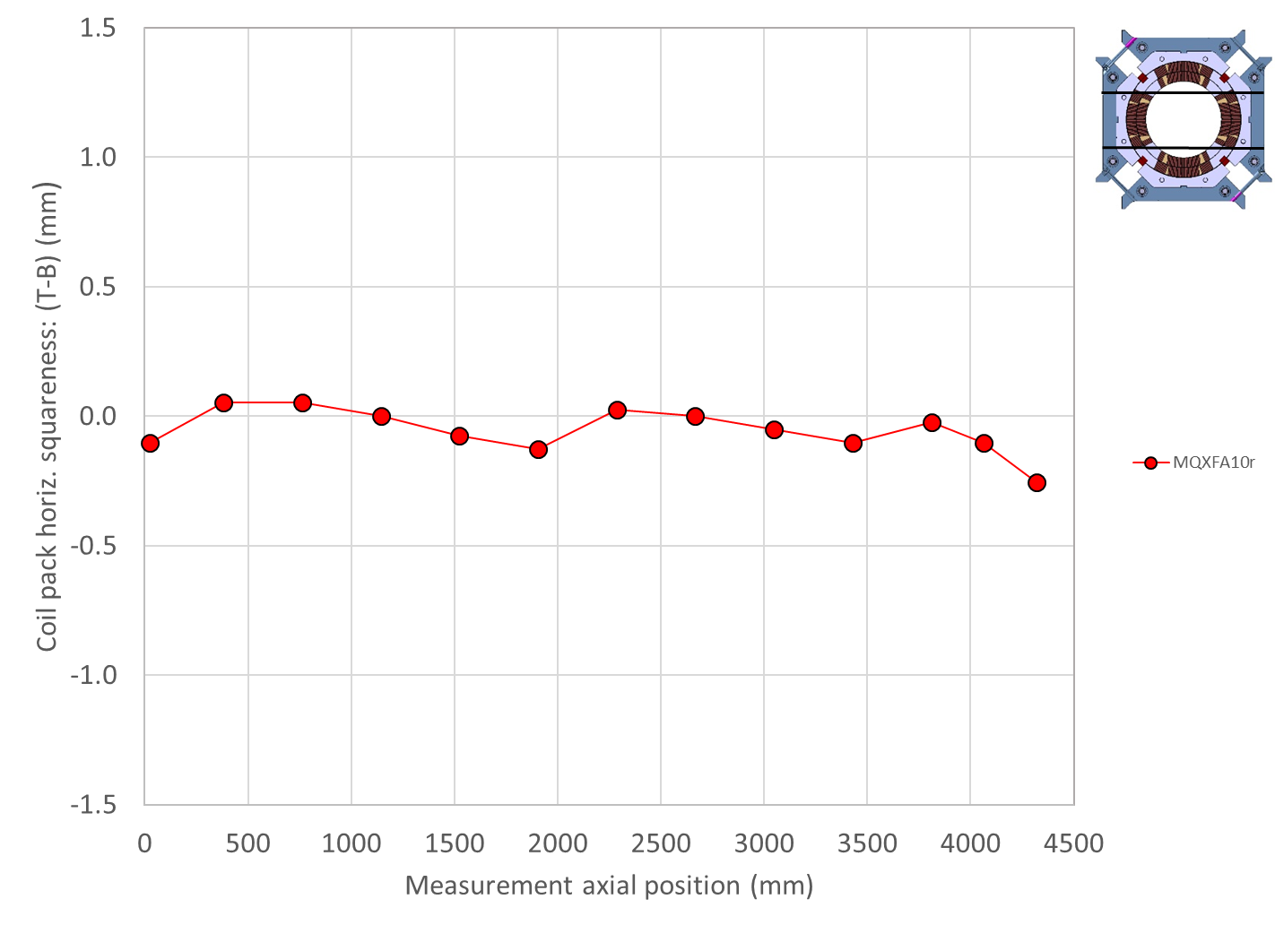
New assembly procedure
Before
  start with squaring, then torqueing
Now
  Start with counter-trapezoidal shape
  Then squaring while torqueing
More intensive use of pole-key shims and collar spacers

Slide 33

New specifications
First we set a local minimum of pole key gap
  Min. > 0.100 mm
    Implemented in A10, which met the test requirements
MQXFA07
MQXFA10

Slide 34

New specifications
Then we increased the pole key gaps for the following magnets
  Ave. > 0.350 mm, min. > 0.300 mm
    Implemented in A8b
MQXFA10
MQXFA8b

Slide 35
Outline
MQXFA07/A08 test results
Magnet disassembly: coil-pack
Coil visual inspection
Finite element analysis
Coil die penetration test, CT scan, metallurgical inspection
Corrective actions for magnet A10 and beyond
Conclusions

Slide 36
Conclusions
MQXFA07-A08 limited by quenches in “a3a4 LE”
  Interpretation: self-field instability triggered by a local degradation
Post-test coil-pack meas. and coil visual inspection
  Pole key gap closed in Q3 (quenching coil)
  Covid impact on both coil and magnet fabrication
2D-3D finite element analysis
  In Q3, lower ϑ pre-stress, more tension in wedge/end-spacer
    Debonding → spike in coil axial tension → strand damage → self-field instability behavior
Confirmed by metallographic inspection
  Cracked filaments between resin and copper wedge
New assembly procedure and target gaps implemented
  Implemented in MQXFA10 that met test requirements

Slide 37
Appendix

Slide 38


Coil visual inspection (II)
The coil inner surface was characterized by many bubbles/blisters, predominantly on the LE
  Also in the wedge/end-spacer interface

Slide 39


Die penetrant test
Within the “critical zone” (a2a3…quench antenna…)
  Bubbles/blisters also in the wedge - end-spacer interface
    Observed in all coils
  Horizontal cracks seen by die-penetrant test at CERN
Coil 214
Coil 214
Coil 213
By Gonzalo Arnau Izquierdo, Alexandre Porret, CERN

Slide 40

Metallurgical inspection
Inspection of SC filaments did not reveal any major events.
  Some radial “closed” microcracks can be observed
  No collapsed filaments
By M. Crouvizier, A. Moros, S. Sgobba, CERN

Slide 41


Slide 42



Slide 43

On strain measurements….
  Strain gauge locations
    Shell: 3 axial location, 4 quadrants, azimuthal and axial
      Shell 2, shell 4, shell, 7
    Coil: 1 axial location, 4 coils (pole), azimuthal and axial
      Center of shell 7
    Axial rods: 1 axial location, 4 rods, axial
Shell gauges
Shell gauges
Shell and coil gauges

Slide 44
On strain measurements….
  Six fiber optic gauges installed on Q1 and Q2:
    Three azimuthal (Z-gauges)
    Three axial gauges (T-gauges)
  They are located at three positions along the coils:
    700 mm
    1900 mm
    3800 mm
Sensor 5: 700-T
Sensor 3: 1900-T
Sensor 1: 3800-T
LE
RE
Sensor 6: 700-Z
Sensor 4: 1900-Z
Sensor 2: 3800-Z

