Slide 1



Highlights on status of activities in BAMA
Yingzhe Wang
IHEP, CAS

Slide 2
Progress of series production
 |  |  |  |  |  |  |  |  |  |  |  |  |  |  |  |  |  |  | Completed mission
 |  |  |  |  |  |  |  |  |  |  |  |  |  |  |  |  |  |  | Plan to do
 |  |  | 2021 |  |  |  | 2022 |  |  |  |  |  |  |  |  |  |  |  | Location
 |  |  | Sept. | Oct. | Nov. | Dec. | Jan. | Feb. | Mar. | Apr. | May | Jun. | Jul. | Aug. | Sept. | Oct. | Nov. | Dec.
MCBRD01 | Magnet delivery |  |  |  |  |  |  |  |  |  |  |  |  |  |  |  |  |  | CERN
 | CB08 | Coil Fabrication |  |  |  |  |  |  |  |  |  |  |  |  |  |  |  |  | IHEP
 |  | Stand-alone test
MCBRD02 | Magnet assembly |  |  |  |  |  |  |  |  |  |  |  |  |  |  |  |  |  | on the way to CERN
 | Magnet test
 | Magnet delivery
Upgrade of BAMA VPI station & modify the groove depth
MCBRD03 | CB09 | Coil Fabrication |  |  |  |  |  |  |  |  |  |  |  |  |  |  |  |  | IMP
 |  | Stand-alone test
 | CB012 | Coil Fabrication
 |  | Stand-alone test
 | Magnet assembly
 | Magnet test
 | Magnet delivery
MCBRD04 | CB013 | Coil Fabrication |  |  |  |  |  |  |  |  |  |  |  |  |  |  |  |  | IHEP
 |  | Stand-alone test
 | CB014 | Coil Fabrication |  |  |  |  |  |  |  |  |  |  |  |  |  |  |  |  | BAMA
 |  | Stand-alone test
Components of CB10 and CB11 have been shipped to CERN.

Slide 3
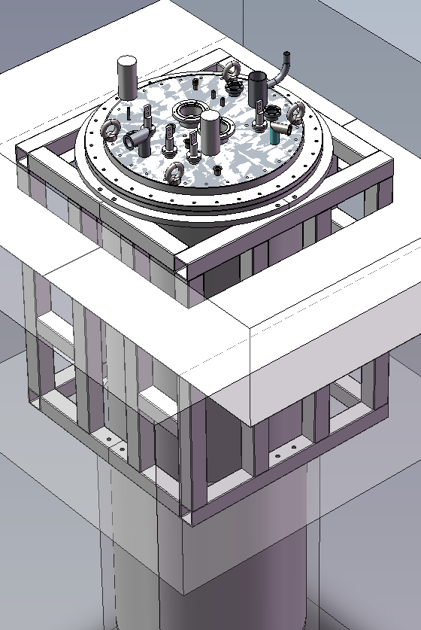
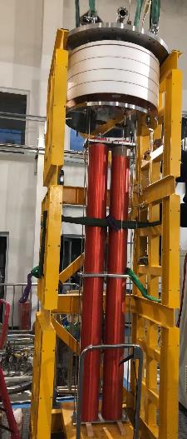
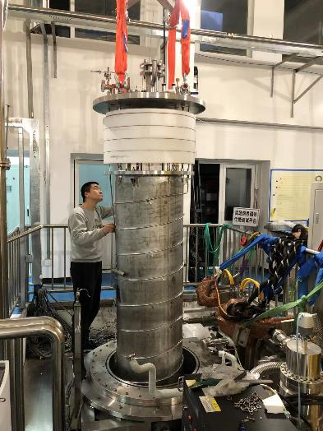
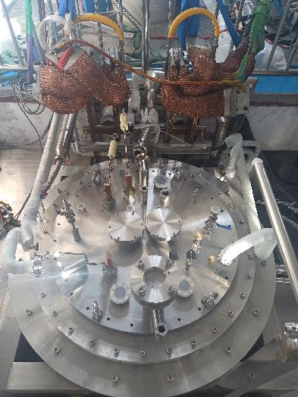
New test station at IHEP(Aug. ~Dec. 2021)
IHEP test station was put into use from Dec. 2021.
CB04&CB06, CB05&CB09, CB012, CB013 were tested at this station.
Stand-alone test of each aperture will be performed at IHEP.

Slide 4
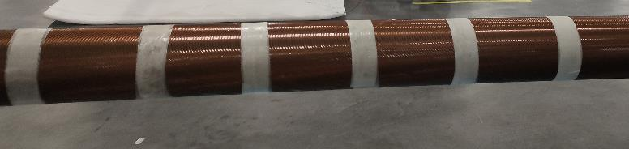
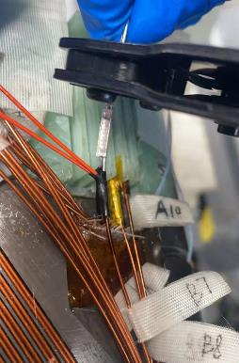
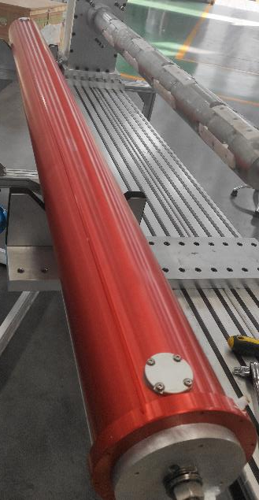
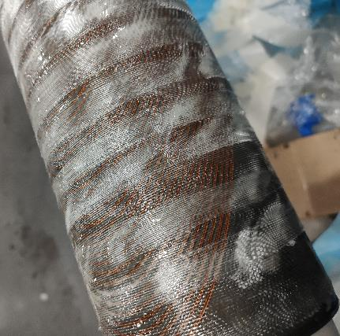
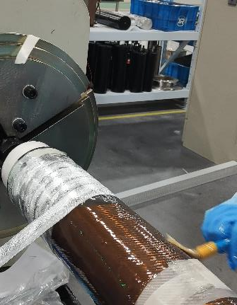
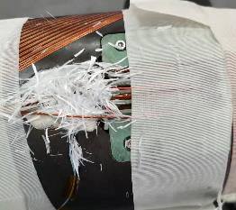
Fabrication of CB08 (Nov. 2021)
The last wet-winded Aperture.

Slide 5
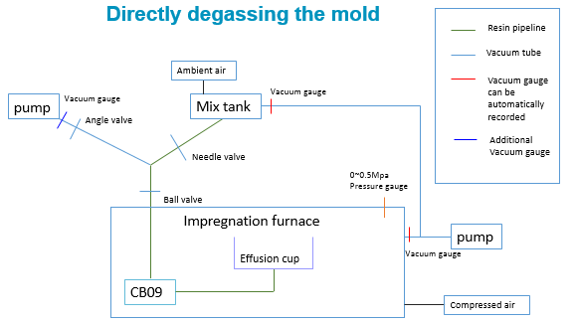
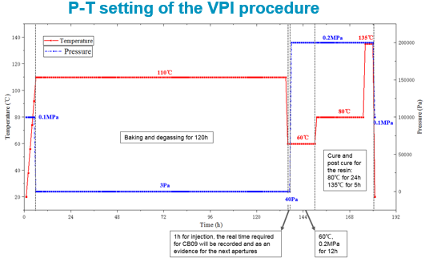
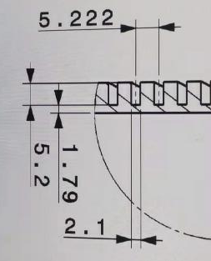
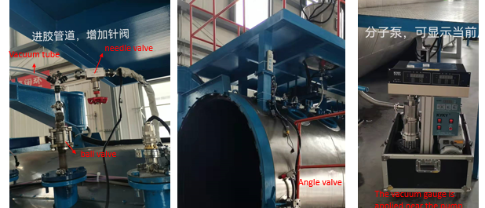
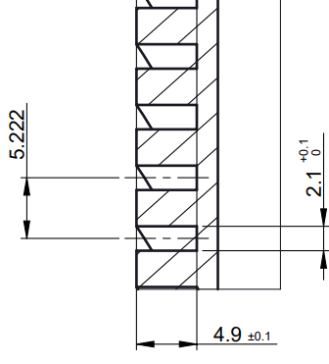
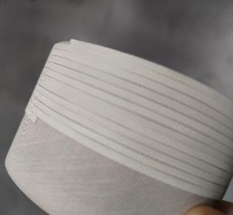
Upgrade of BAMA VPI station & modify the groove depth
(Feb. ~ Mar. 2022)

Slide 6
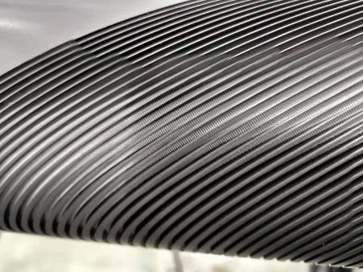
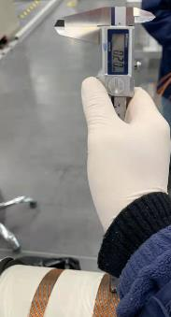
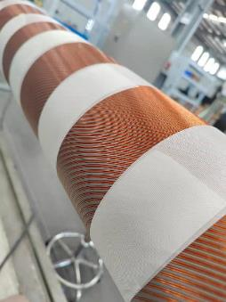
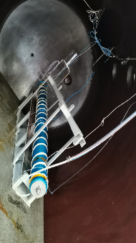
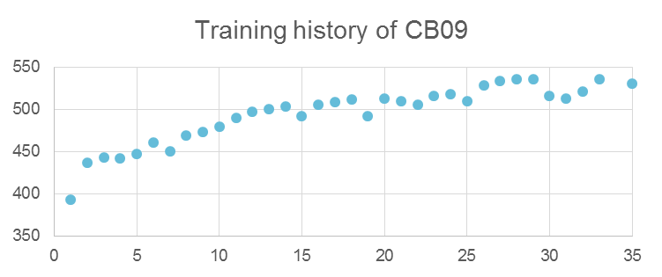
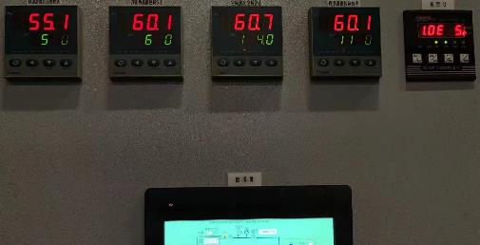
Fabrication of CB09 (Feb. ~ Mar. 2022)
Thermal cycle
530A

Slide 7
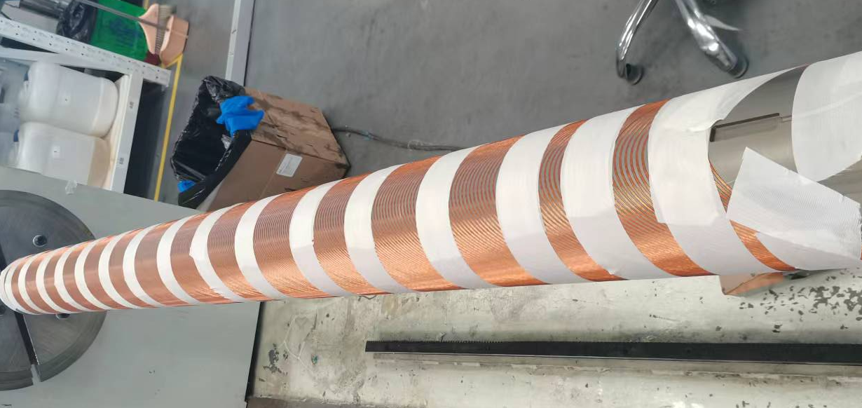
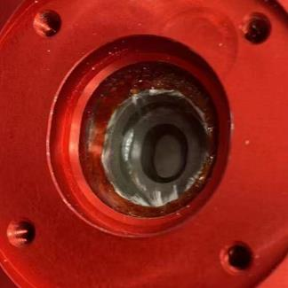
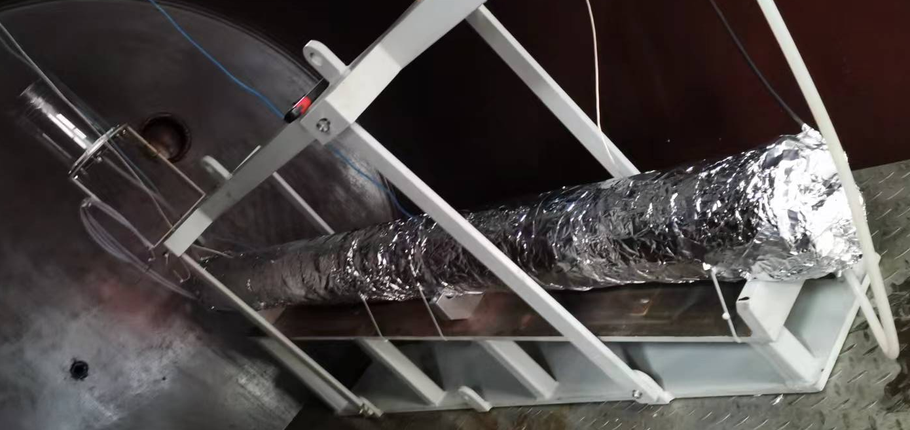
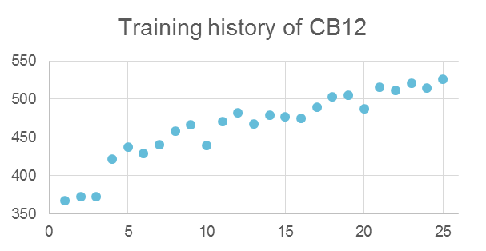
Fabrication of CB012 (May. ~ Jun. 2022)
Correct the diameter of holes on polyimide sheets to increase the insulation strength between coils to ground.
526A

Slide 8
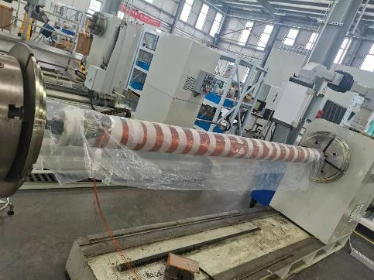
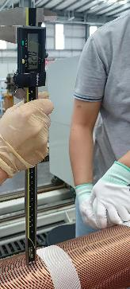
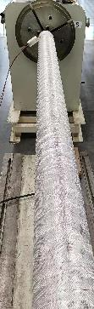
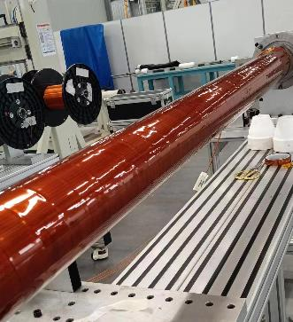
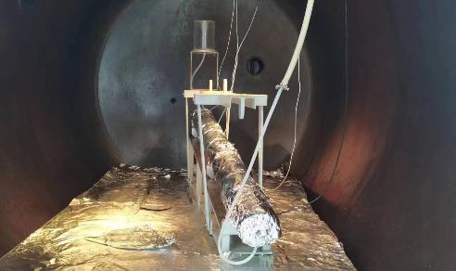
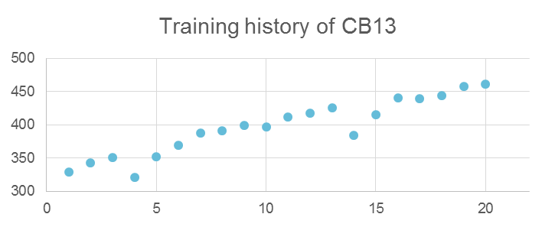
Fabrication of CB013 (Aug. ~ Sept. 2022)
461A

Slide 9
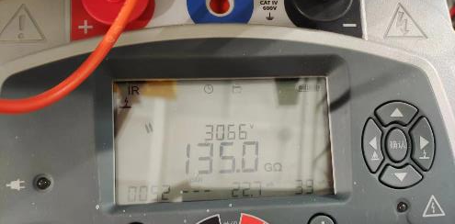
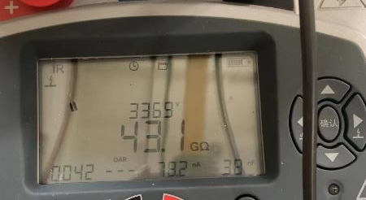
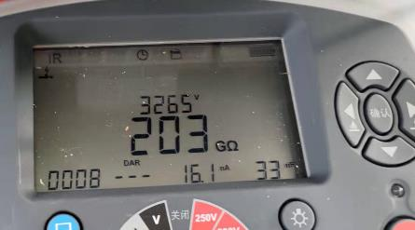
Insulation test result
Equipment | Object | Aperture | Function | Voltage | Current | Test Time | Resistance
Megger MIT 525 | Coil to ext. tube | CB09 | IR | 3265V | 16.1nA | 30s | 203GΩ
 |  | CB12 | IR | 3369V | 78.2nA |  | 43.1GΩ
 |  | CB13 | IR | 3066V | 22.7nA |  | 135.0GΩ
CB09
CB12
CB13

Slide 10
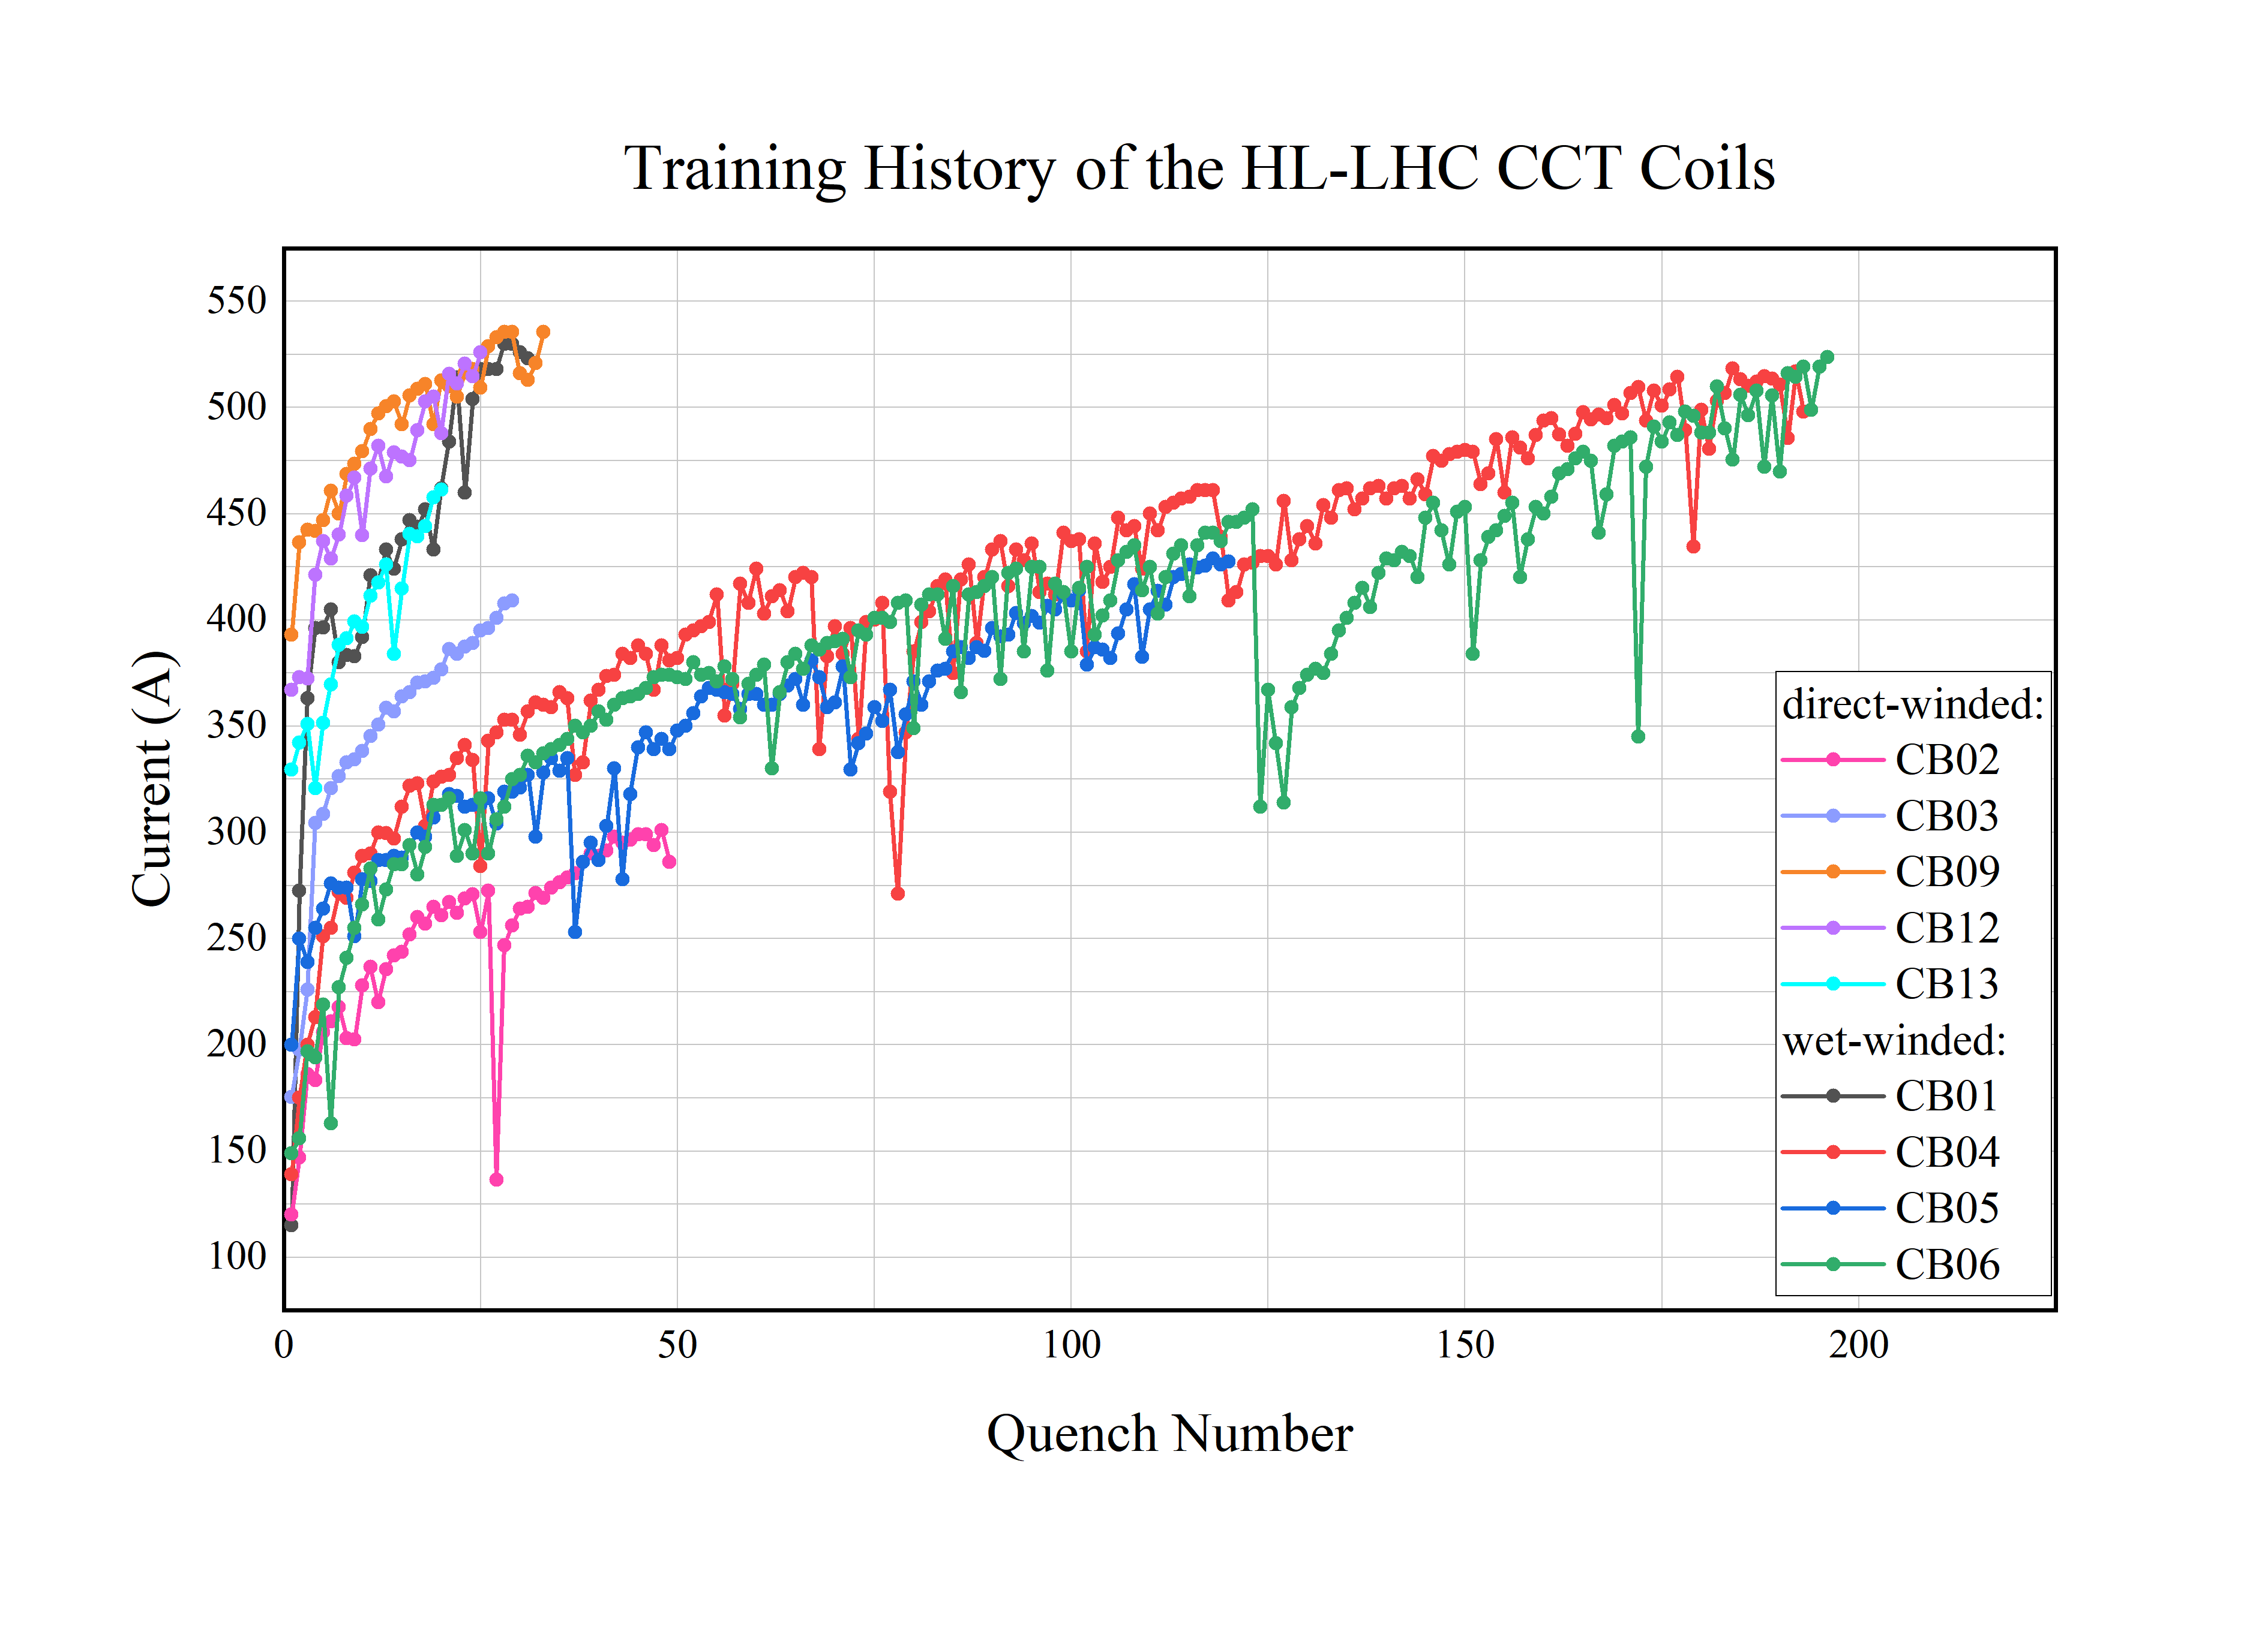
Training history of the HL-LHC CCT coils

Slide 11
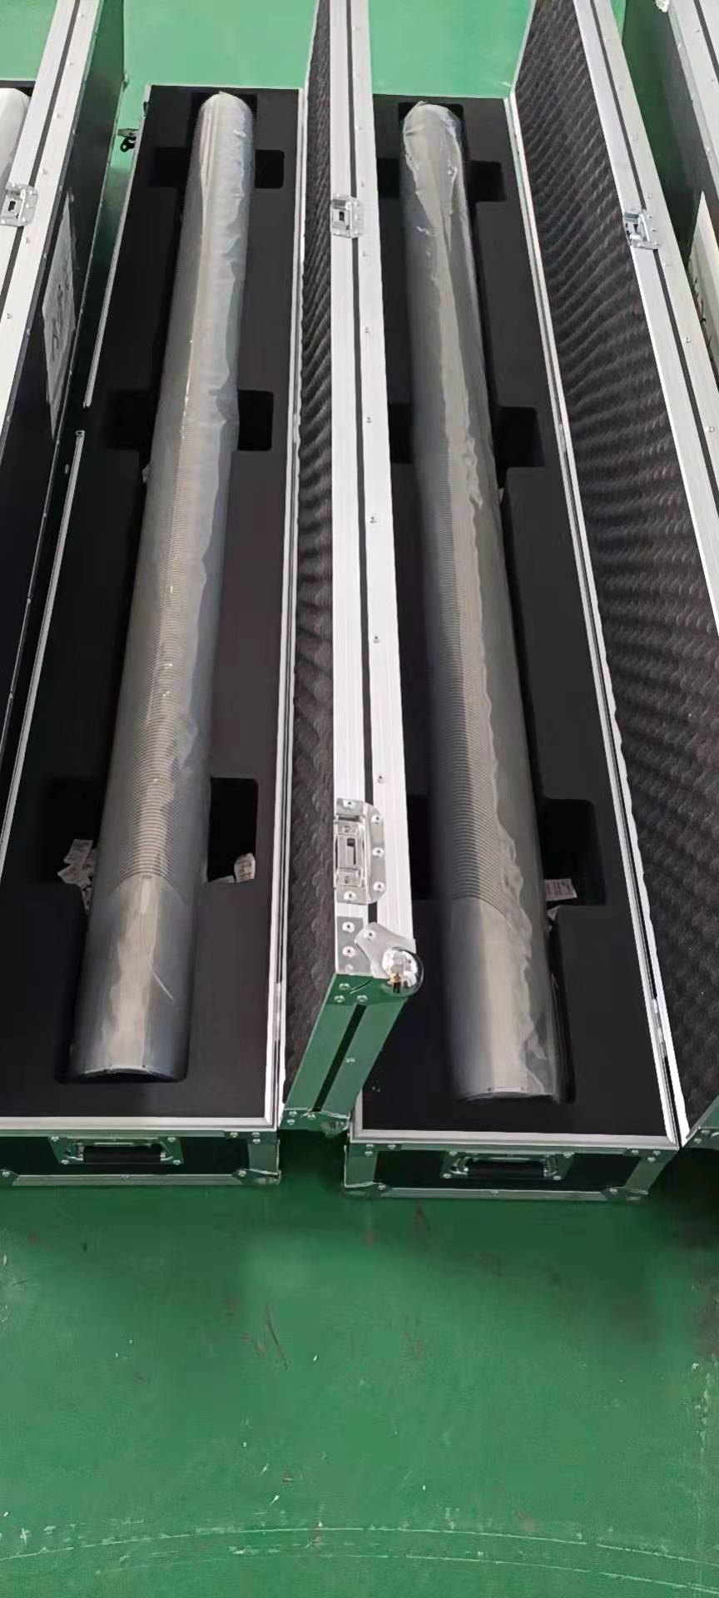
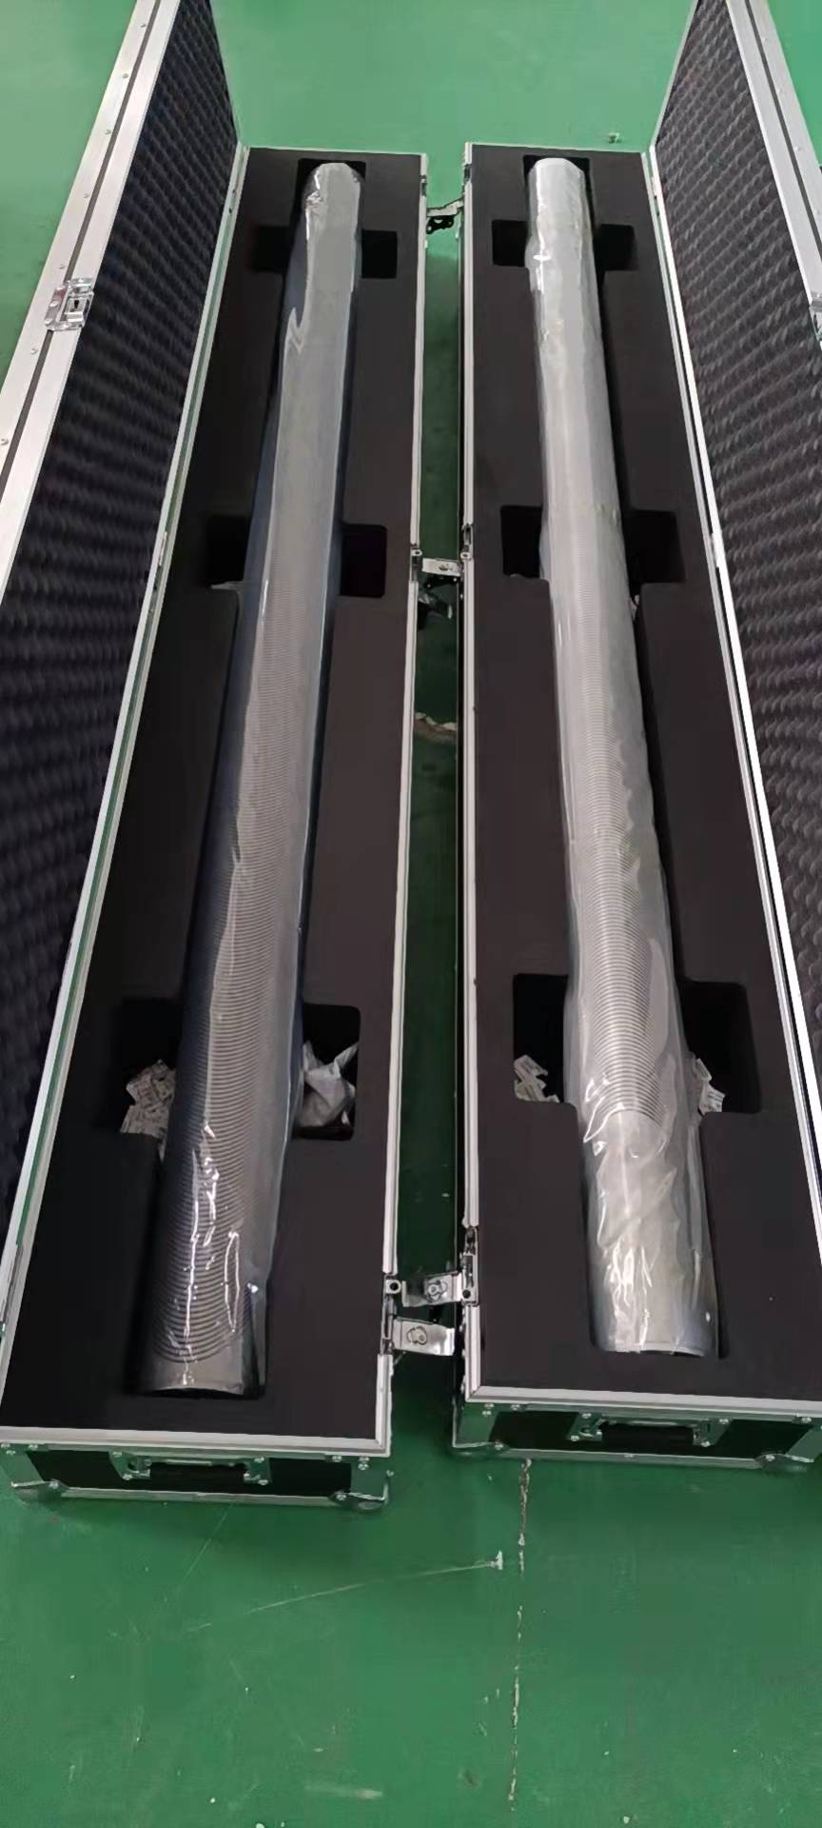
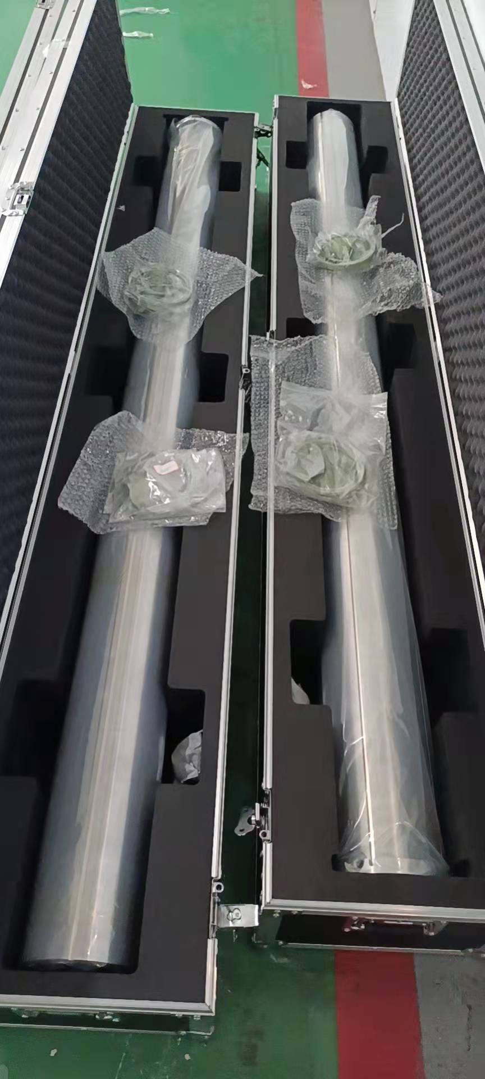
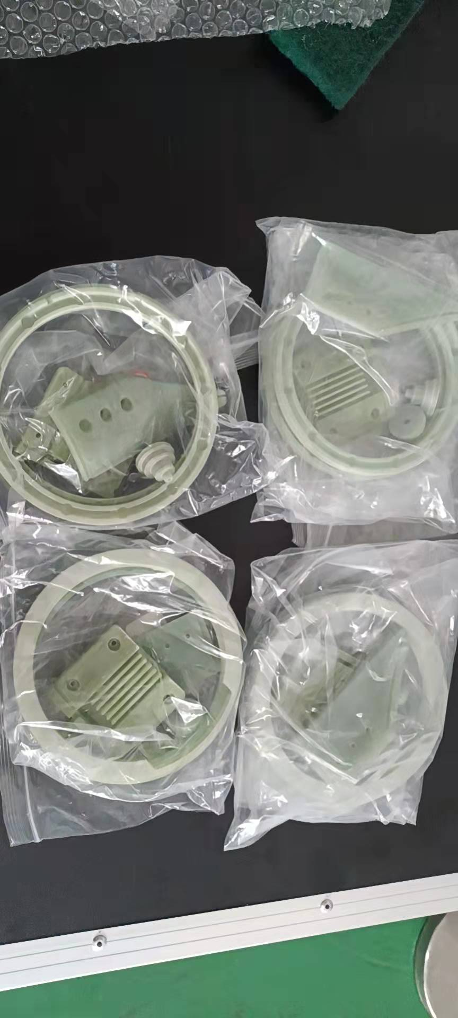
Components of CB10 and CB11 have been shipped to CERN
Inner-formers
Outer-formers
Ext.-tubes
G10 components

Slide 12
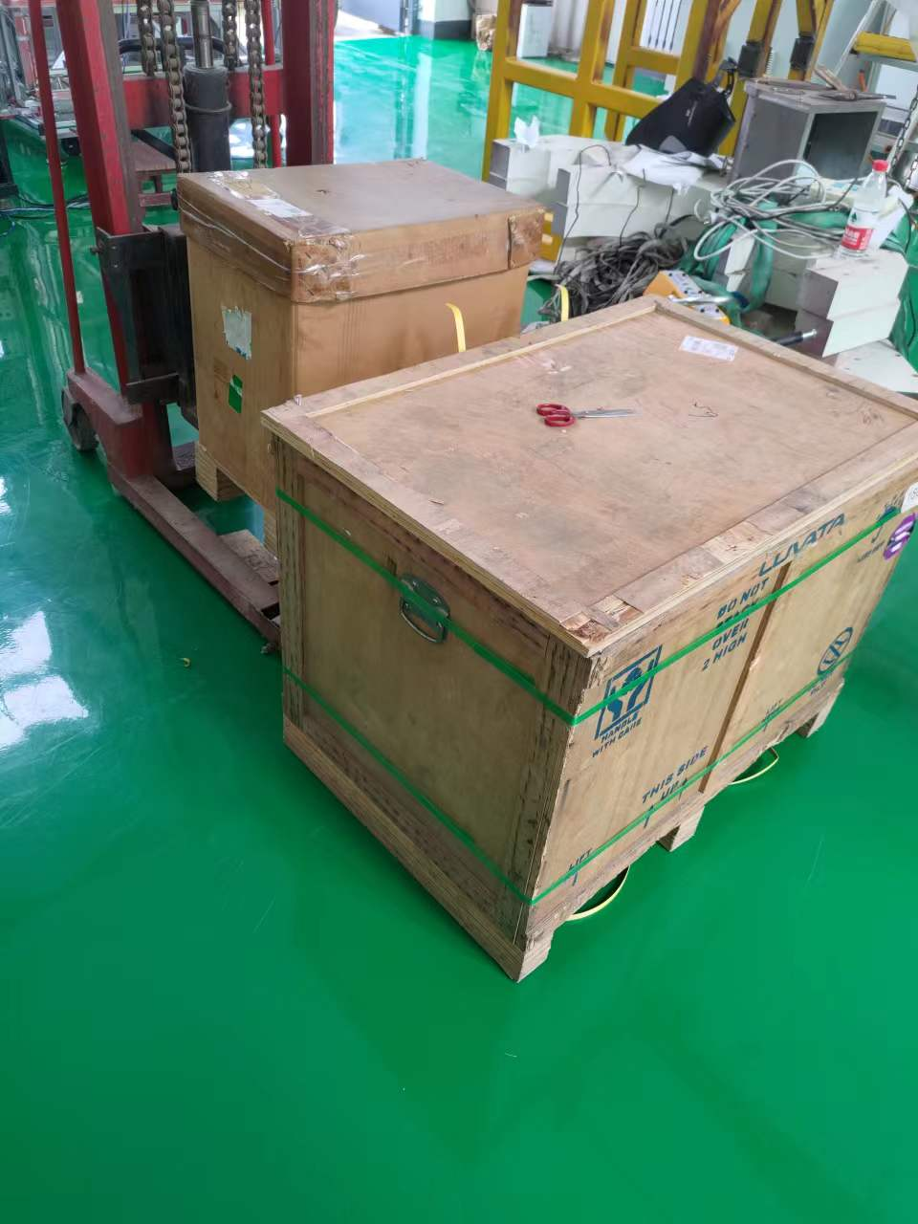
Components of CB10 and CB11 have been shipped to CERN
No. | Packing size（mm） | Name |  | Quantity
1 | 420*600*700 | 铌钛超导线 | NbTi Superconducting wires | 21Km
2 | 1000*800*700 | 聚酰亚胺膜 | Polyimide sheet | 20m
 |  | 玻璃丝布 | Glass fiber tape | 8 rolls
 |  | 玻璃丝布胶带 | Glass fiber tape(with glue) | 4 rolls
 |  | 特氟龙套管 | φ6mm Teflon insulating sleeve | 17 m
 |  | 3.3mm聚酰亚胺套管 | φ3.3mm Polyimide sleeve | 3*4m
 |  | 1mm聚酰亚胺套管 | φ1mm Polyimide sleeve | 3*3m
 |  | 6mm编织型套管 | φ6mm Braided Sleeve | 4m
 |  | 2mm编织型套管 | φ2mm Braided Sleeve | 4m
 |  | 2mm热缩管 | φ2mm Heat shrink tube | 4m
 |  | 中接管 | crimping tube for splicing | 160
 |  | 9k针脚 | 9k Pin Connector | 80
 |  | 23k针脚 | 23k Pin Connector | 12
 |  | 48针脚电接头 | 48-Pin Connector | 4
 |  | 电插头固定支座 | holder for electrical connector | 2 set
1
2

Slide 13

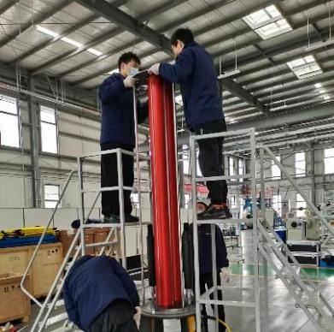
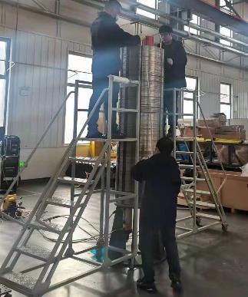
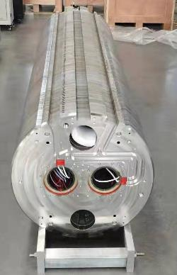
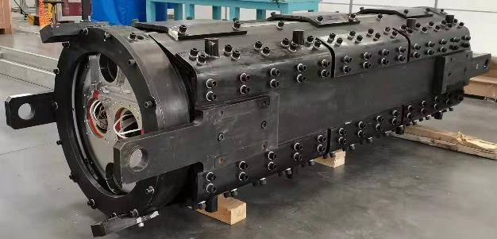
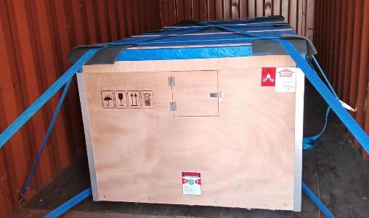
Assembly of MCBRD02 (Jan. 2022)

Slide 14
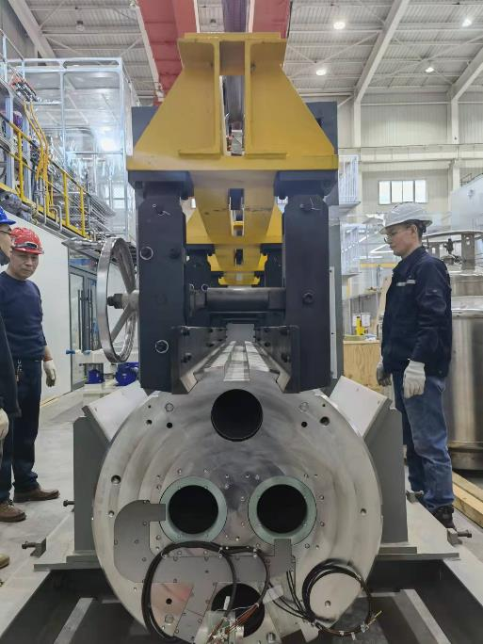
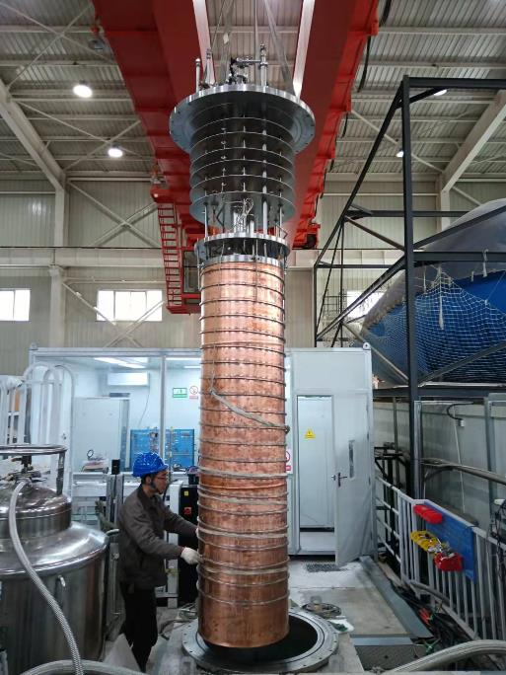
Test of MCBRD02 (Feb. ~May 2022)

Slide 15
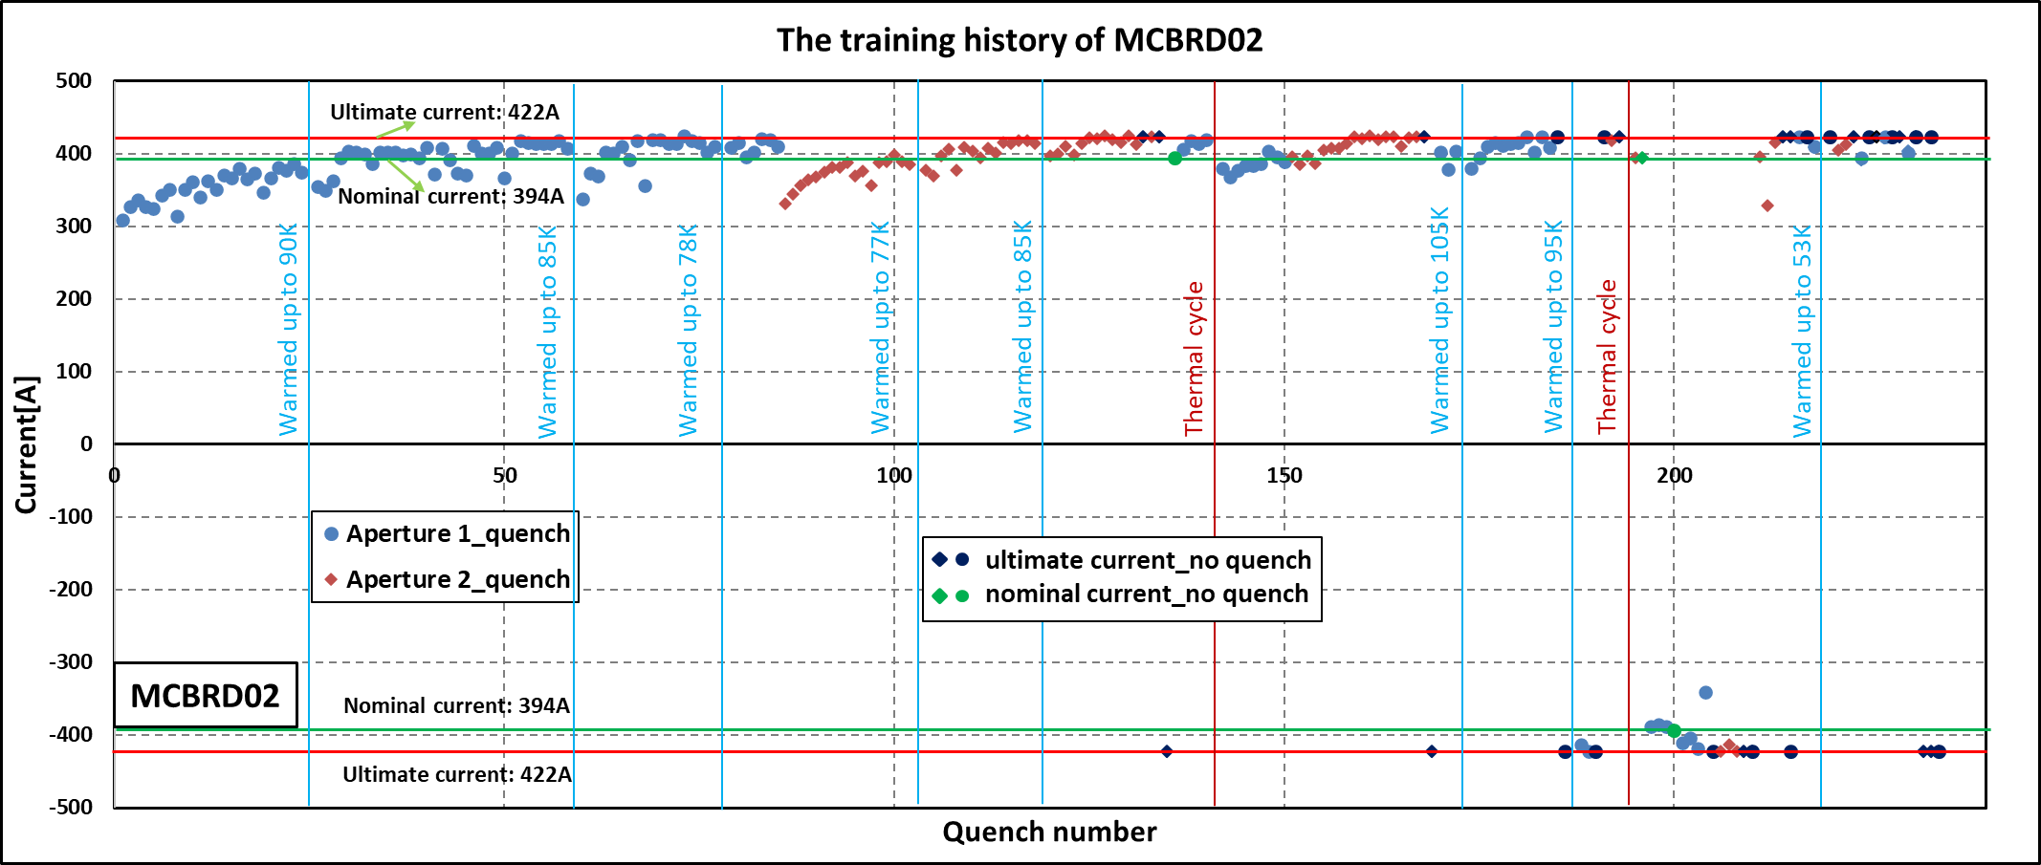
Test of MCBRD02 (Feb. ~May 2022)
At the end of the second thermal cycle, the magnet tends to be stable.
AP1: a total of 123 quenches
AP2: a total of 72 quenches
At the end of the second thermal cycle, the magnet tends to be stable.

Slide 16
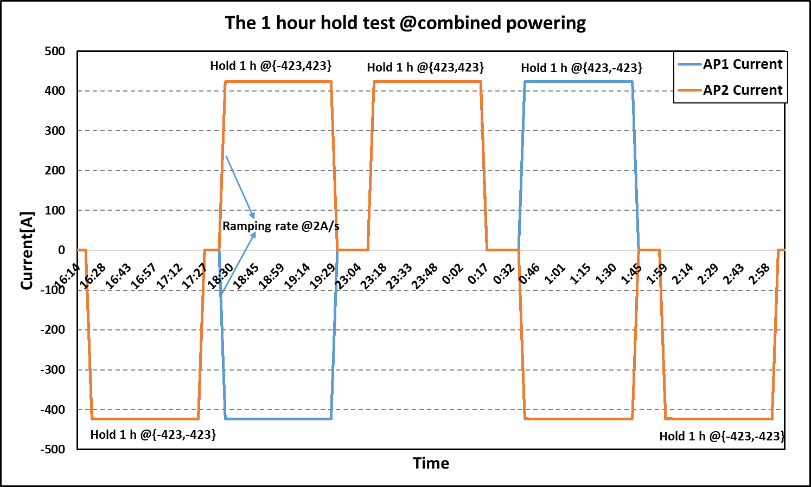
Test of MCBRD02 (Feb. ~May 2022)

Slide 17



Assembly of MCBRD03 (Jul. 2022)

Slide 18


Test of MCBRD03 (Jul. 2022)
Test steps（Coil-Ground） | EDMS 2363906
Magnet reception at room temperature | 3240 V
Magnet in cryostat in Liquid helium (1.9 or 4.5 K) | 1620 V
Magnet after powering test at RT | 330 V

Slide 19
Test of MCBRD03 (Jul. 2022)

Slide 20
Summary
MCBRD02 has passed all the test procedures and has been shipped to CERN.
From CB09 important modifications to the design and fabrication procedures have been adopted, to improve the training performance of the CCT coils
CB09, CB12 and CB13 tested at IHEP show significant improvement of the training performance.
MCBRD03, consists of CB09 and CB12, is being tested at IMP and up to now the test results are very good.

Slide 21

Thanks for your attention

