Slide 1


Highlights of MCBXF Activities at Elytt Energy
O.Durán, C. Martins, F. Toral (CIEMAT)
J. C. Pérez (CERN)
12th HL-LHC Coll. Meeting – 21th Sept. 2022

Slide 2
Index
MCBXF series contract
Production of components
First short magnet assembly MCBXFB02
Quality assurance
Conclusions

Slide 3
Let’s start with a reflection…
  The key question is: Should a magnet prototype be developed in house or in industry?
  In the case of MCBXF magnets, I have no doubt:
    Short experience on nested magnets in the community
    Some novel problems to overcome:
      Hard radiation resistance requirement for a nested superconducting magnet
      Coil wound with a high number of Rutherford-cable turns
    Some surprises:
      Cables at coil heads are not laying down
      Internal stresses in slim 3D-printed stainless steel spacers
      Tolerances in large fine-blanked collars
    An enemy more dangerous than initially expected: torque at coil heads

Slide 4
Let’s conclude from the reflection…
  Series contract strategy is based on accumulated experience:
    Clear mitigation of risks
    Shorter learning curve
    Precise definition of manufacturing procedures
    Easier choice of quality assurance methods
  Last but not least:
    Overall cost is lower
    Long lead times of some components is overcome with stocked ones
    The traveling distance to the company is time-consuming and follow-up cannot be so close

Slide 5
MCBXF series contract
  Contract signed with Elytt Energy at March 2021: delivery of 6 long (A) and 11 short (B) MCBXF magnets.
  All documents and templates (technical specification, acceptance criteria, manufacturing and inspection plan, quality documentation…) have been agreed with CERN.
  CIEMAT has prepared detailed procedures for each step of production: coil winding, binder, impregnation, assembly, parts production (ground insulation, collar packages, collaring shoes). They are uploaded to EDMS. There are thousands of photos to help know-how transfer.
  CIEMAT staff has been at Elytt premises during six months for know-how transfer on coil production. Daily support for production follow-up, questions and incident solving. CIEMAT and CERN staff has supported the first magnet assembly at Elytt.
  CIEMAT is supporting Elytt to contact suppliers for components, tooling and materials.

Slide 6
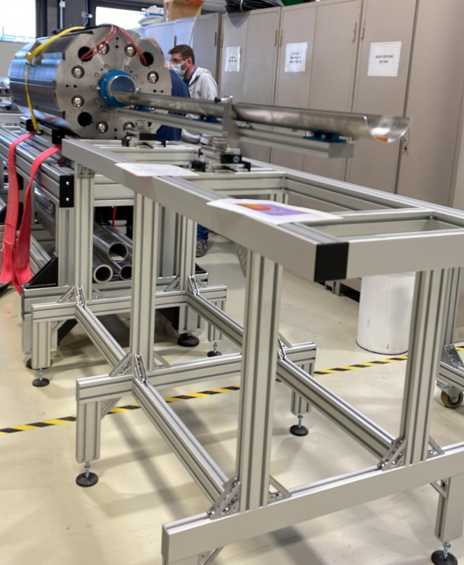
MCBXF series contract: parts exchange
CIEMAT is supplying the copper wedges, the end spacers and the collars (fine blanked). It means an important effort for quality assurance.
CERN is supplying the insulated superconducting cable, the steel for the collars, the iron for the yokes, the keys for the outer dipole collars and the instrumentation of the collars.
CERN has supplied the warm magnetic measurement bench and training.
  CERN has trained a CIEMAT colleague during three months.
CERN will take care of powering tests (at SM18 or FREIA).
CIEMAT and CERN are supplying some components for series production that are not arriving at Elytt in time.
Magnetic measurement bench (Courtesy J. C. Pérez)

Slide 7
Index
MCBXF series contract
Production of components
First short magnet assembly MCBXFB02
Quality assurance
Conclusions

Slide 8
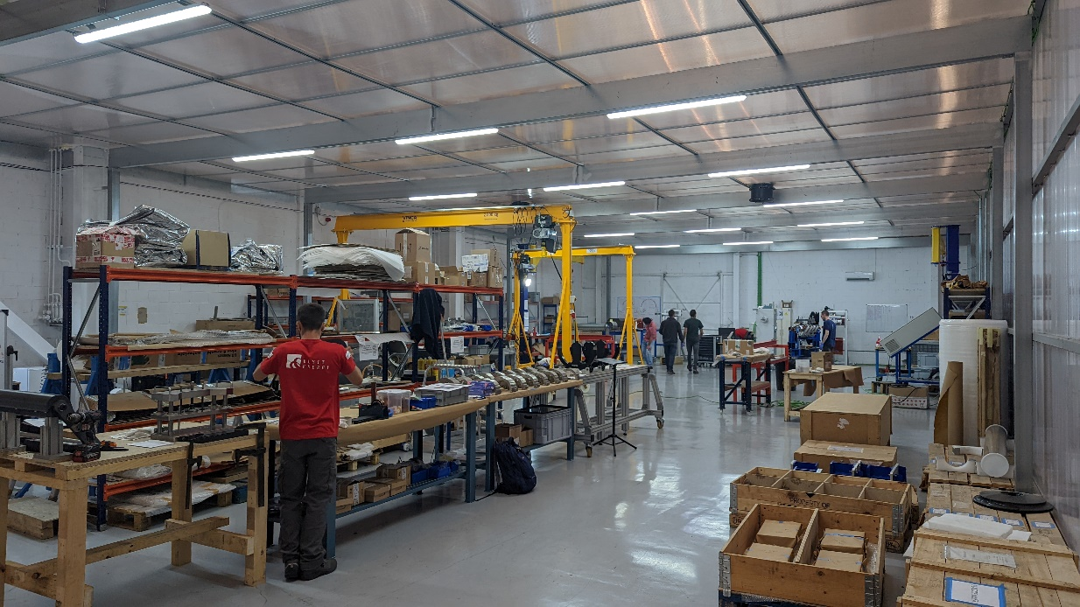
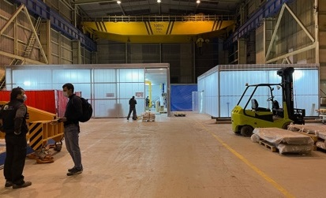
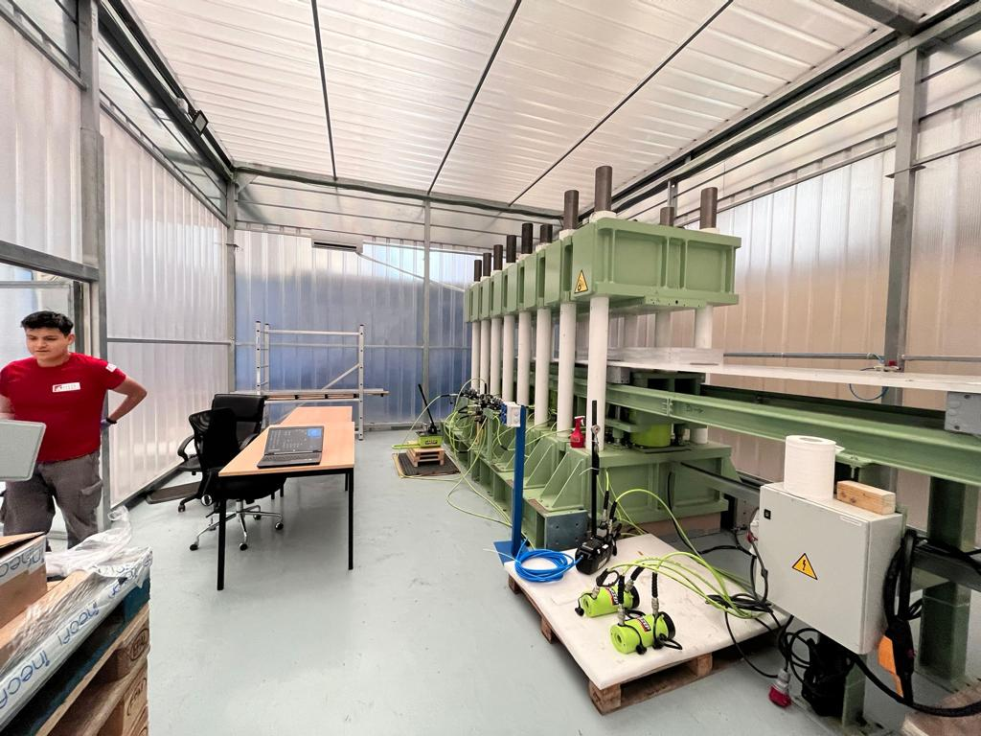
MCBXF series: Elytt Energy facilities
  Two closed clean rooms with controlled humidity and temperature:
    Coil production: two lines (winding machine + binder mould + impregnation), component preparation (preforming ground insulation and collaring shoes, collar package assembly, collared coil assembly).
    Magnet assembly: collaring press, yoke assembly, magnetic and final electrical measurements.
Magnet assembly area
Coil production area
Hall with two clean areas: coils (left) and magnets (right)
Courtesy: Elytt Energy

Slide 9
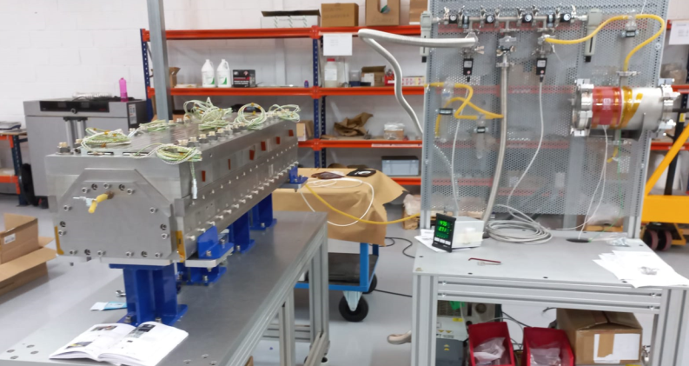
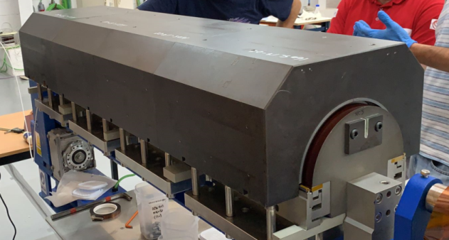
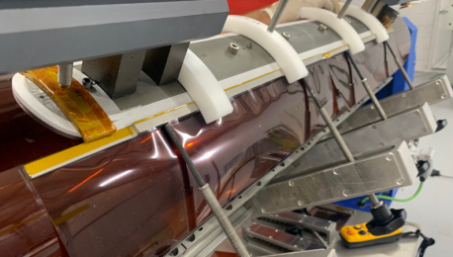
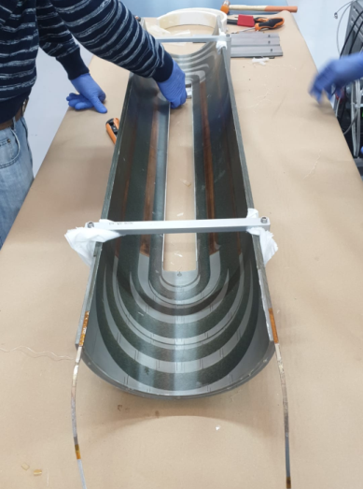
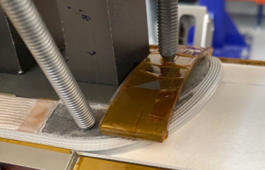
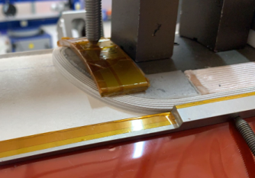
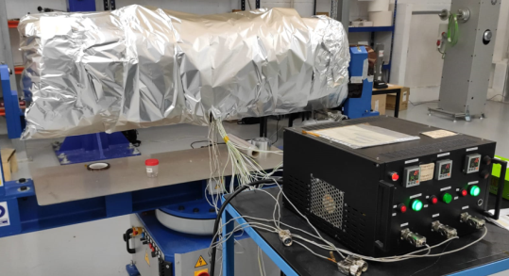
MCBXF series: coil production at Elytt
IL Winding
IL Binding
Impregnation mould assembly
First finished coil
OL Winding
OL Binding
Courtesy: M. Oñate (Elytt Energy)
12th HL-LHC Coll. Meeting – F. Toral - 21th Sept 2022

Slide 10
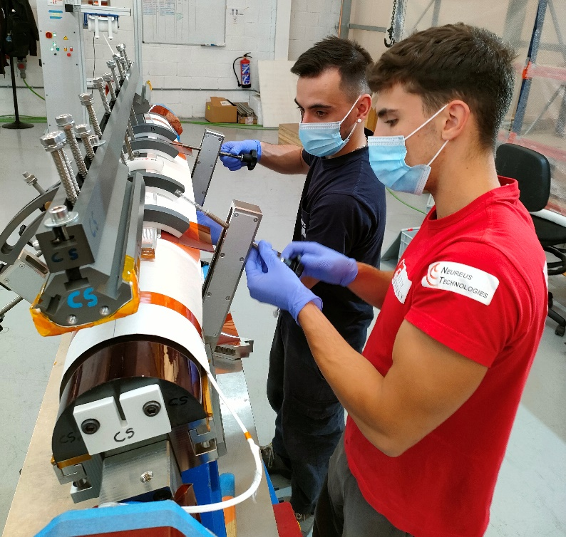
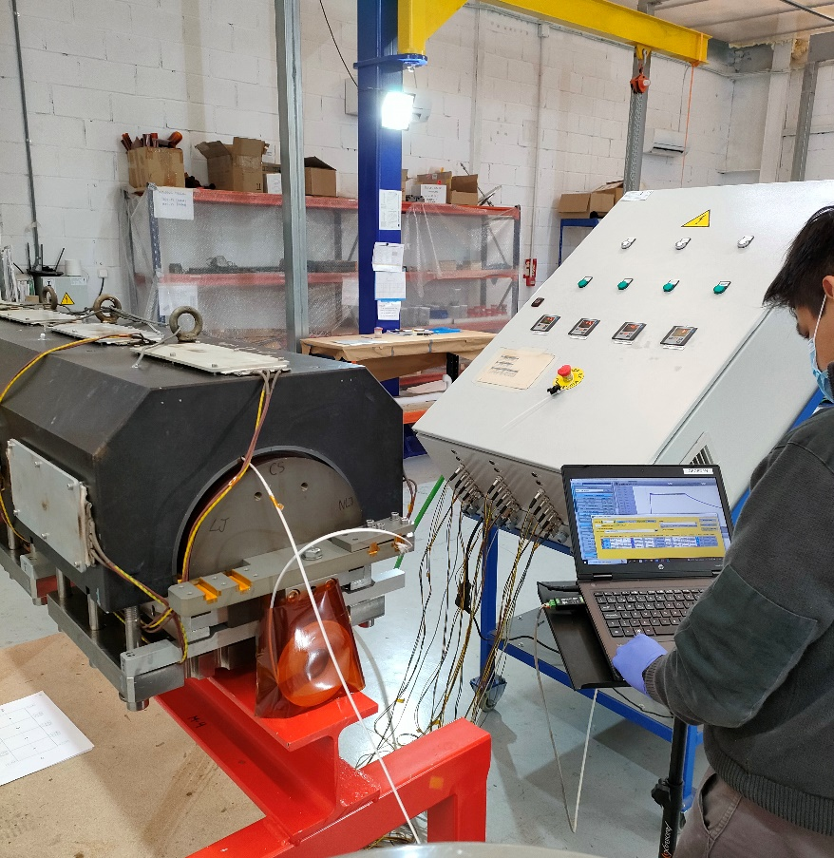
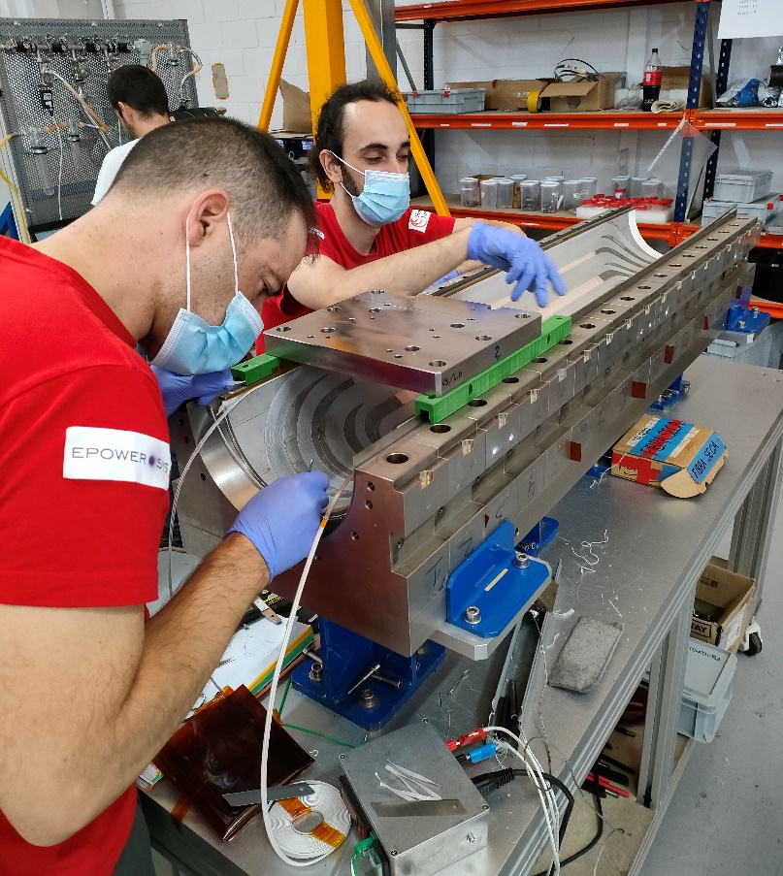
MCBXF series: coil production
  Delicate production process with a long learning curve: in-site support with detailed procedures.
  Three inner coils and one outer coil are in quarantine because of faulty impregnation.
  Two inner coils were used for reassembly of second prototype (MCBXFBP2c) to validate the production techniques.
  Only B-type coils up to now. A-type coil production is being set-up.
Courtesy: Elytt Energy
Coil winding
Binder curing
Impregnation mould assembly

Slide 11
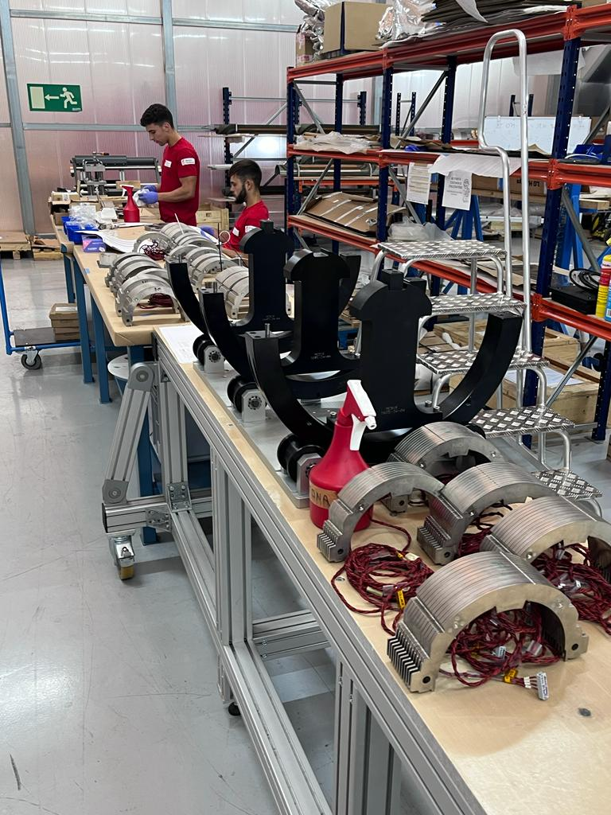
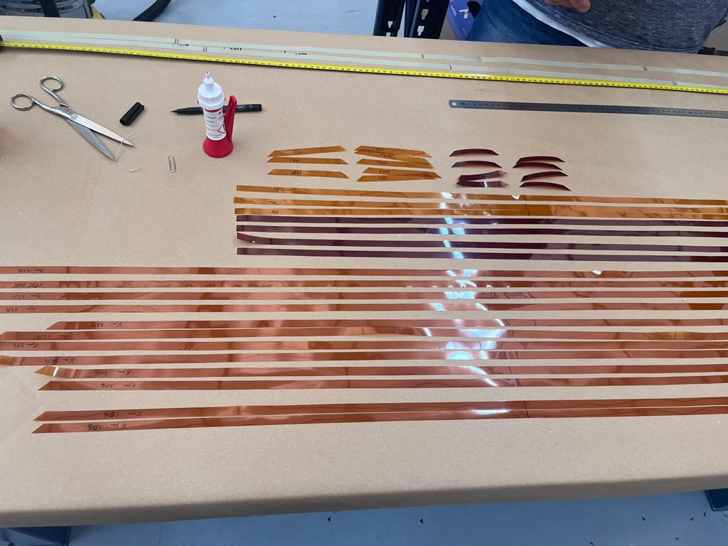
MCBXF series magnets: other components
  Elytt is following CIEMAT procedures to produce ground insulation, collaring shoes and collar packages.
  CIEMAT provides support to find suppliers for other magnet components, like the iron laminations.
Shimming plan for inner dipole
Collar packages for inner dipole

Slide 12
Index
MCBXF series contract
Production of components
First short magnet assembly MCBXFB02
Quality assurance
Conclusions

Slide 13
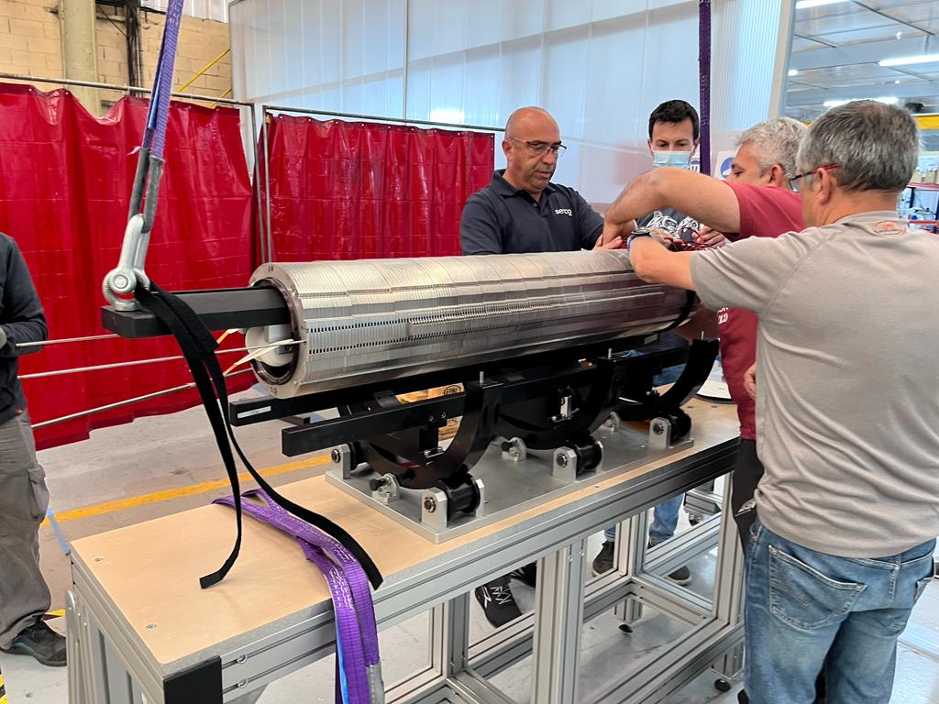
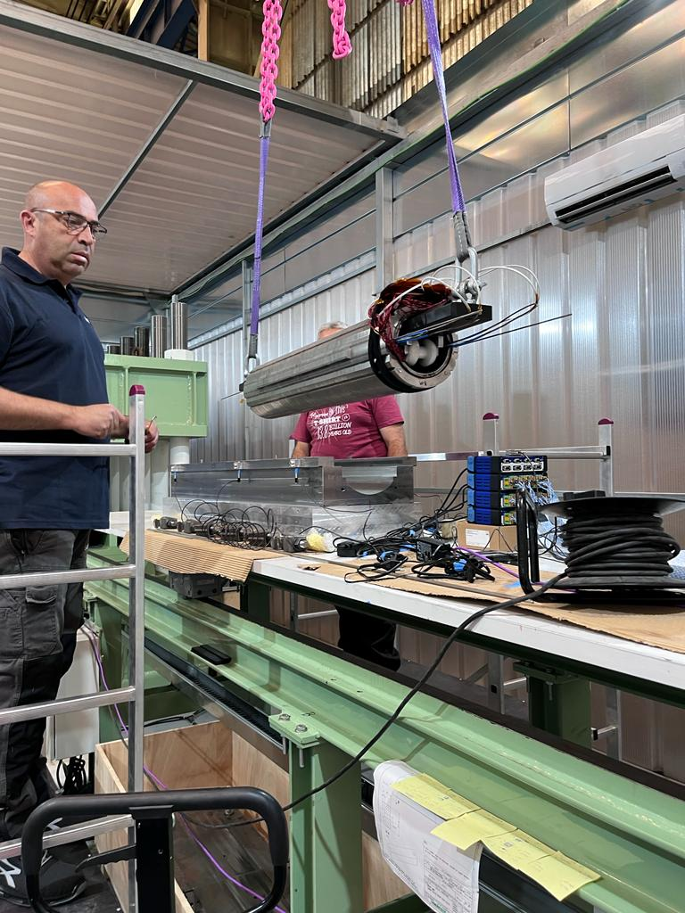
MCBXF series magnets: first magnet assembly
  CERN and CIEMAT have provided in-site support for the assembly of the first magnet last Summer.
Inner dipole ready for collaring press
Inner dipole entering the collaring press

Slide 14
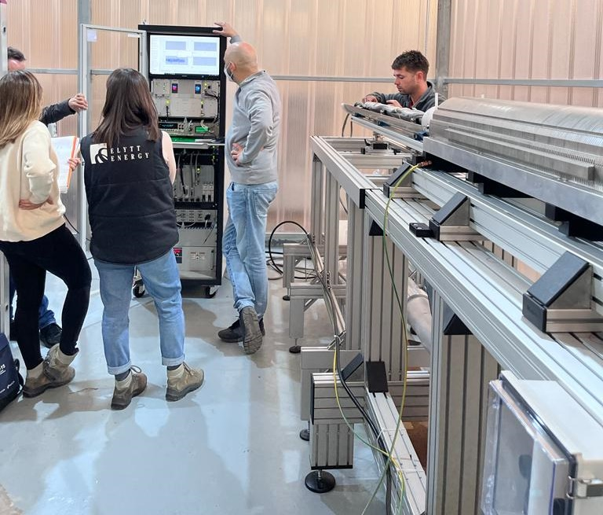
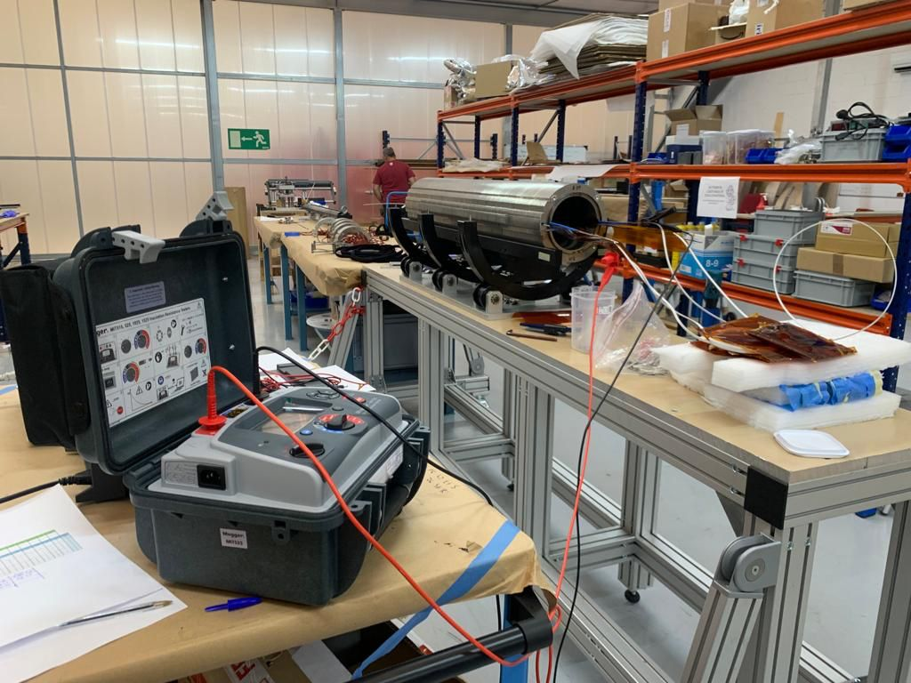
MCBXF series magnets: final measurements
  CERN and CIEMAT have provided support for electrical, mechanical and magnetic measurements.
Electrical measurements
Magnetic measurement bench

Slide 15
Index
MCBXF series contract
Production of components
First short magnet assembly MCBXFB02
Quality assurance
Conclusions

Slide 16
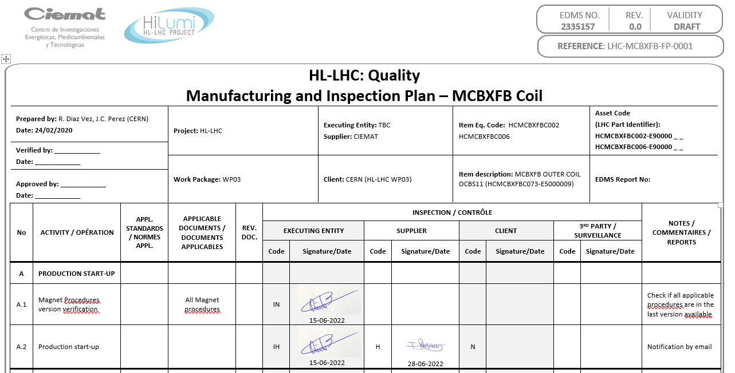
MCBXF series: quality assurance
Quality controls of each step of production are defined in the manufacturing and inspection plan (MIP), both for coils and magnets.
A third-party inspector will follow-up production till the end of the contract.
MIP for coil production
MIP for magnet assembly

Slide 17
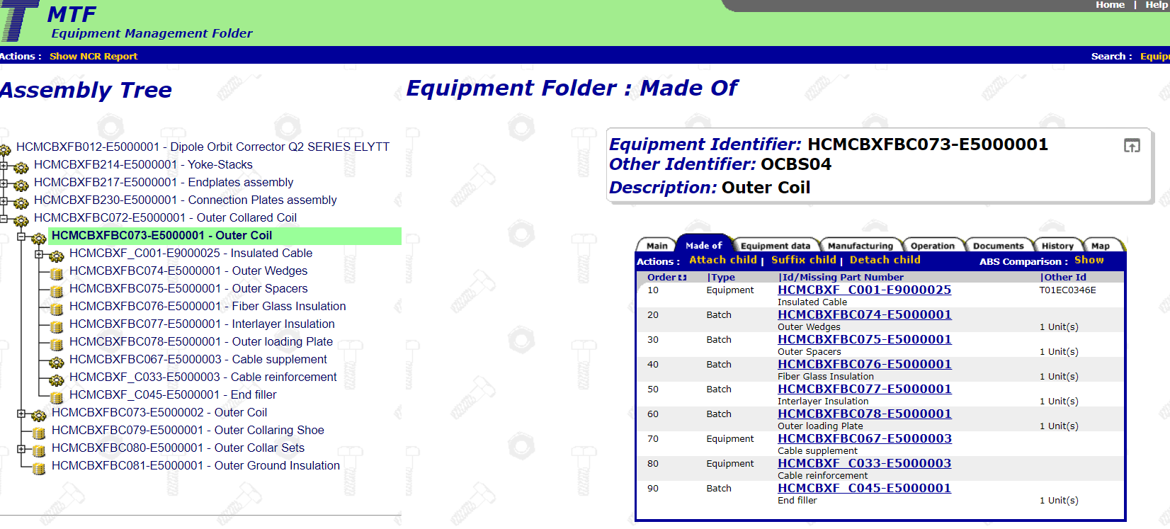
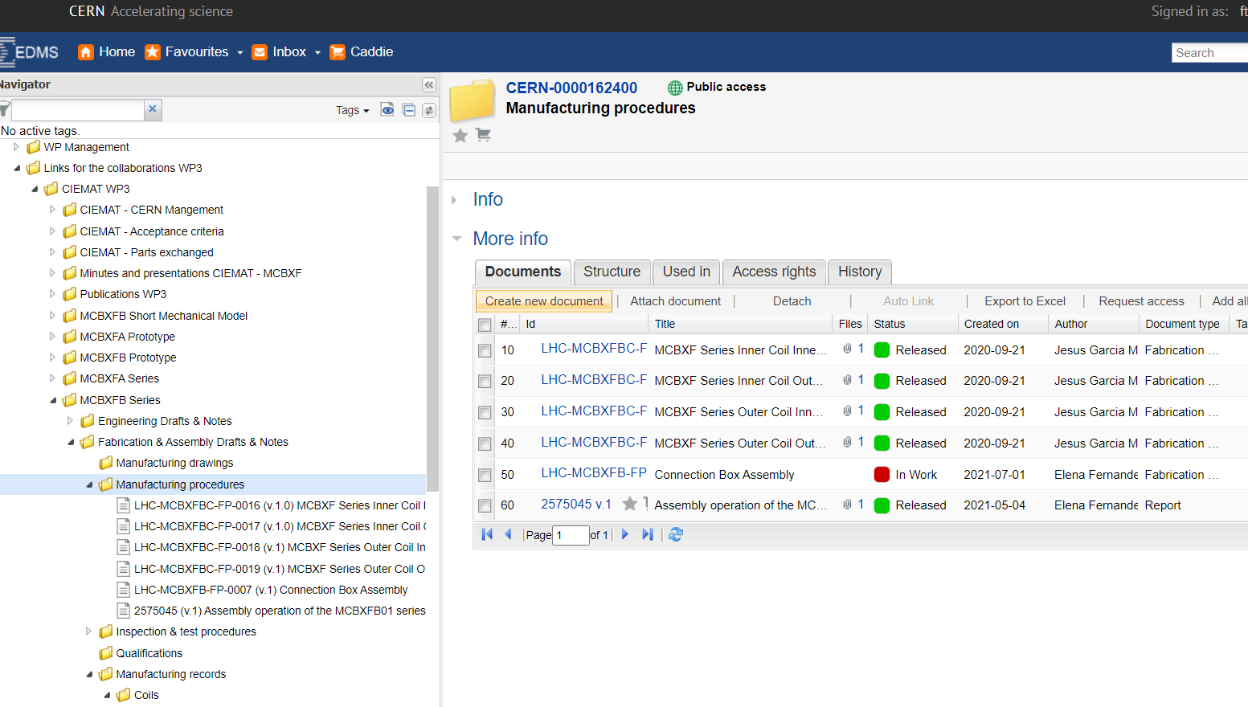
MCBXF series: documentation
Traceability is guaranteed thanks to documentation stored in MTF.
Drawings, minutes, measurements and other documents are stored in EDMS.
Example of coil data stored at MTF
Example of procedures stored at EDMS

Slide 18
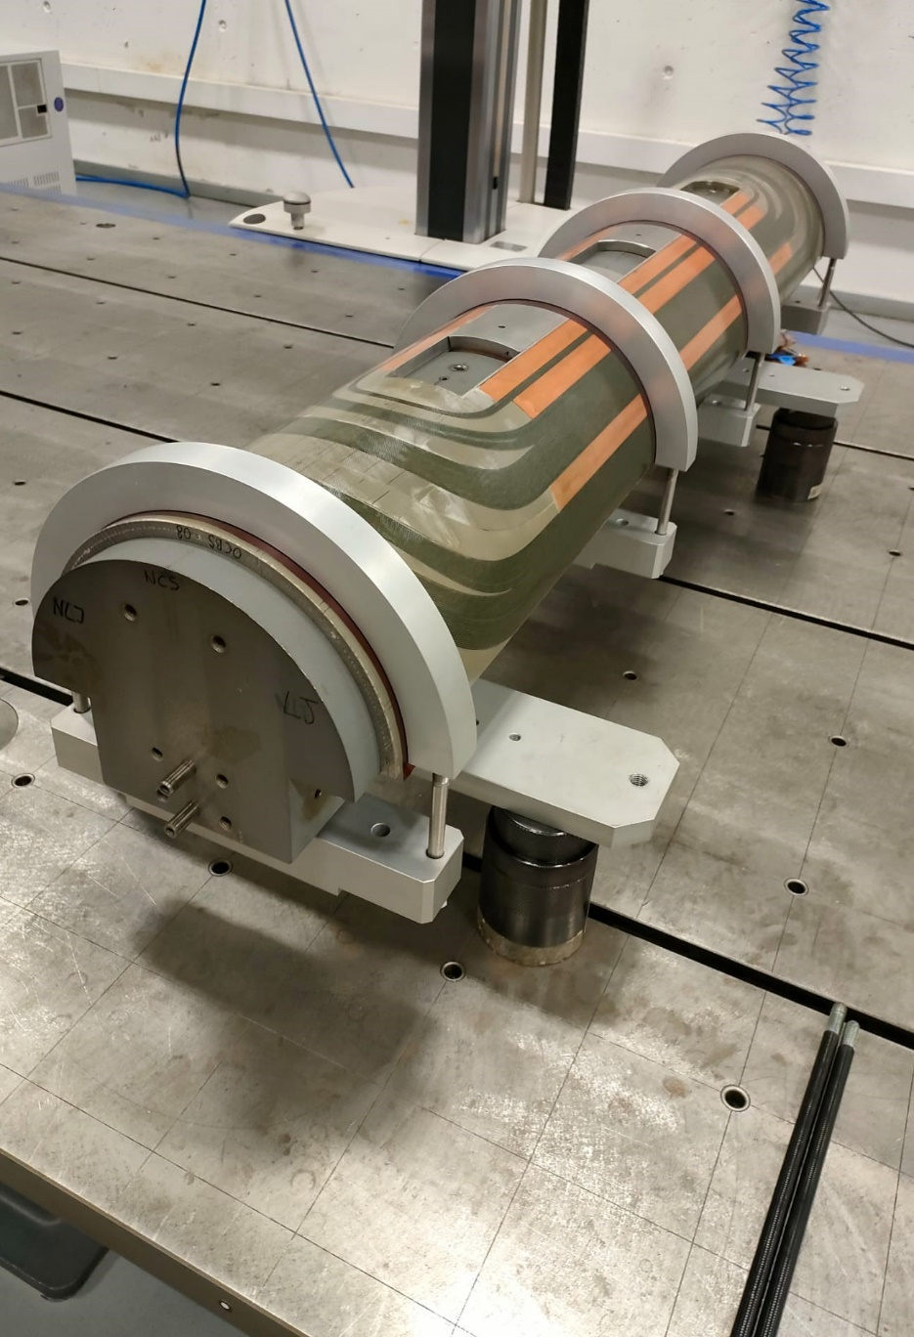
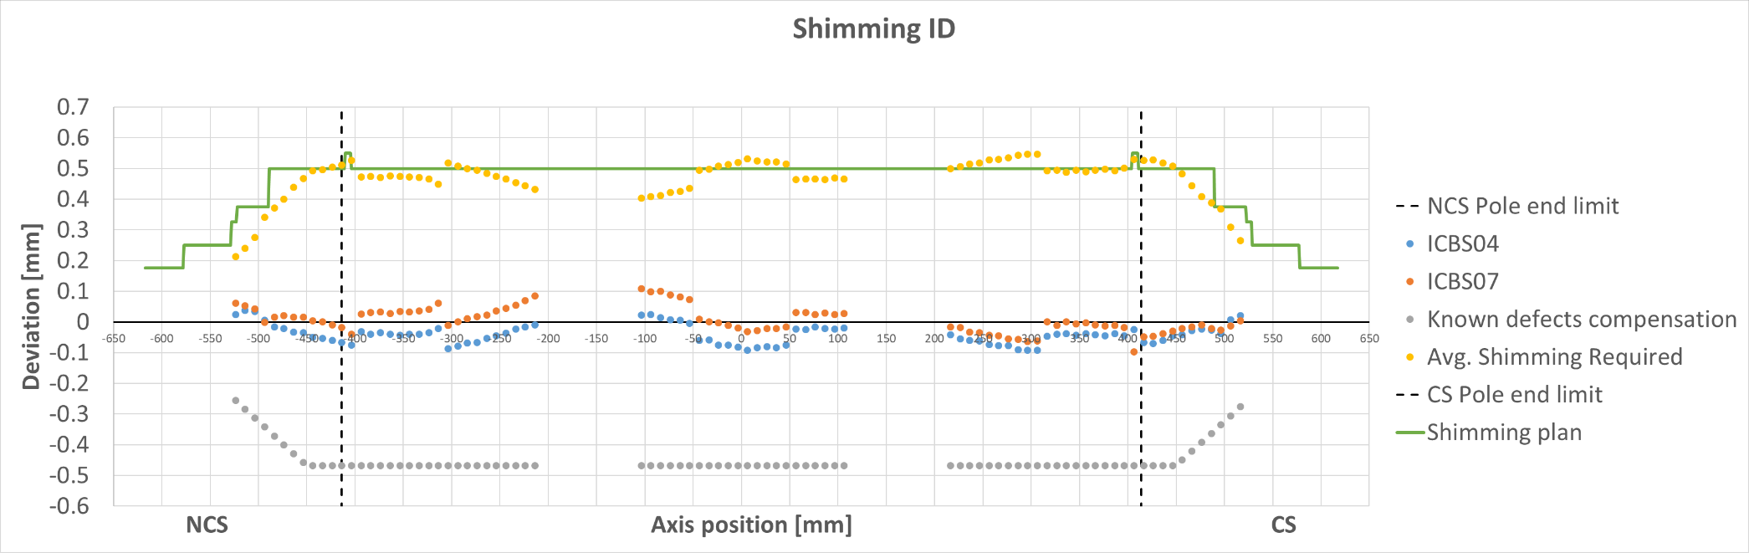
MCBXF series: coil dimension measurements
Coil dimension is measured with accuracy in a coordinate measurement machine.
The coil is clamped to the winding mandrel to reduce the deformation due to internal stresses in free state.
Those measurements are used to define the shimming plan (0.1 mm shim -> 15 MPa preload).
Outer coil at CMM

Slide 19
MCBXF series: electrical measurements (I)
Electrical design criteria are defined in EDMS 2363905.

Slide 20
MCBXF series: electrical measurements (II)

Slide 21
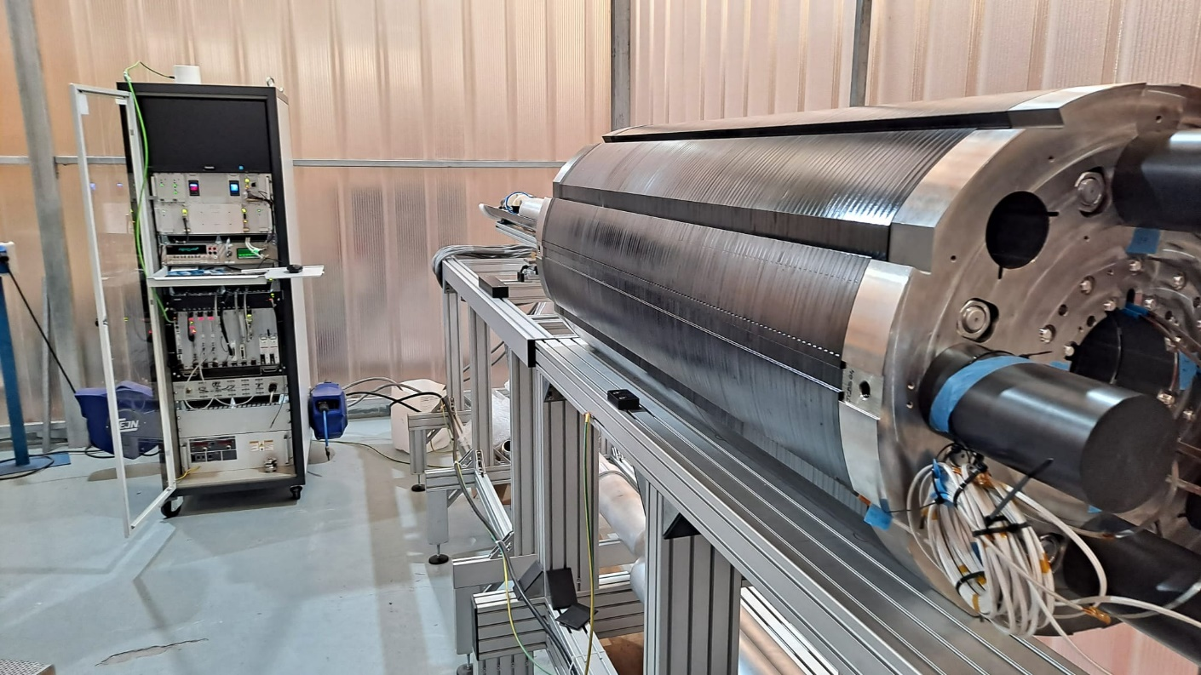
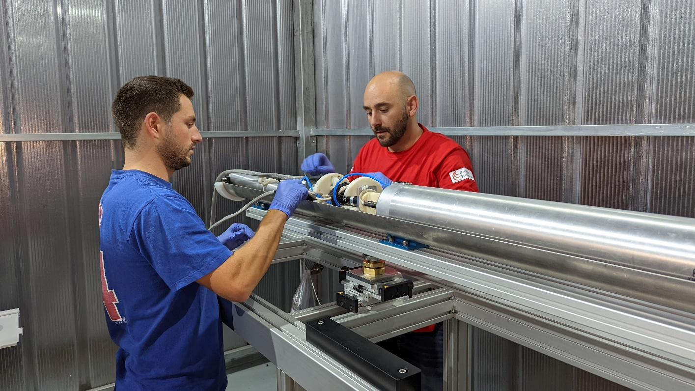
MCBXF series: magnetic measurements
Magnetic measurement bench developed by CERN.
CIEMAT staff has been trained at CERN to handle the bench and post-process the measurements.
CIEMAT staff is supporting the first measurements at Elytt and training them to use the bench.

Slide 22
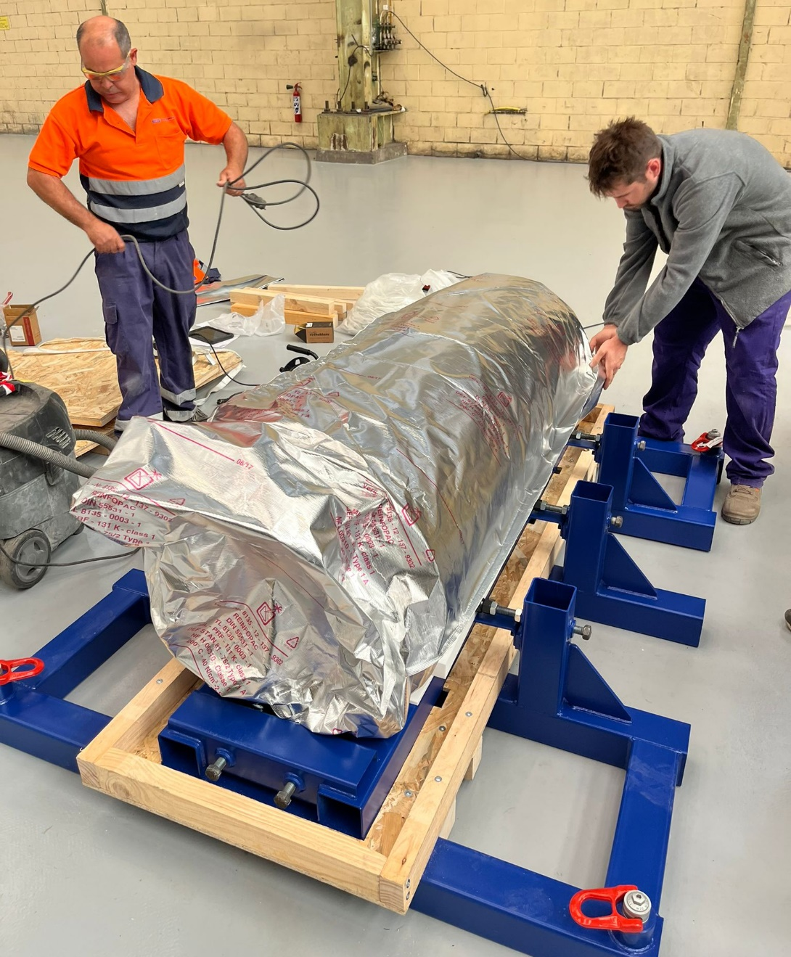
Conclusions
  The series magnets are in production at Elytt Energy.
  CIEMAT and CERN have provided support to set up the production: in-site help, procedures and know-how transfer.
  The first two valid inner dipole coils have been assembled into MCBXFBP2c magnet, which has been successfully tested. It validates the coil production process at the company.
  The first short magnet is being shipped to CERN today.
  A-type coil production is being set-up.

Slide 23
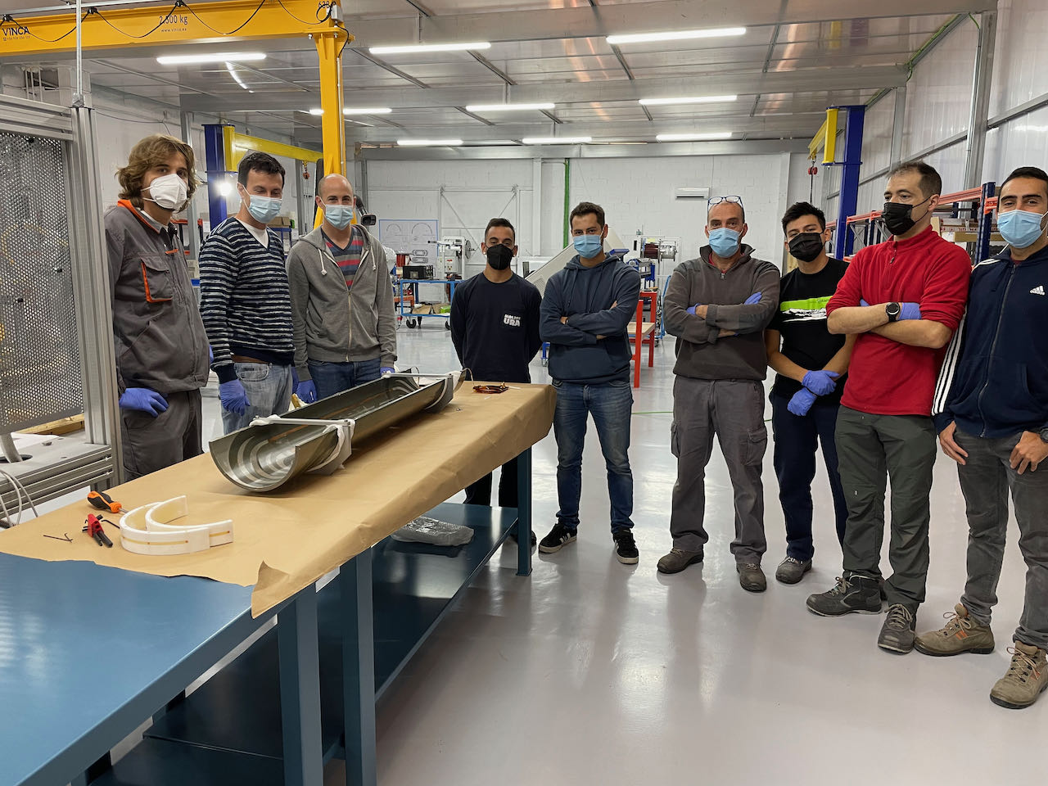

Acknowledgements to:
Manuel Domínguez, Óscar Durán, Jesus Angel García Matos, Luis González, Jesús Jiménez, Carla Martins, José Antonio Pardo, Pablo Sobrino from CIEMAT
Hugues Dupont, Nicolas Eyraud, Michael Guinchard, Lucio Fiscarelli, Sylvain Mugnier, Juan Carlos Pérez, Ezio Todesco from CERN
All the Elytt Energy staff participating in this project

