Slide 1

Overview of WP6A electrical requirements and instrumentation
J. Fleiter on behalf of WP6a
12th Annual HL LHC meeting 19-22 Sept 2022

Slide 2
Outline
Current rating and dielectric insulation of circuits
Current leads naming and attribution to circuits
Current leads heating system
Instrumentation of WP6a
  Electric protection of circuits
  Cryogenic
  Vacuum
Instrumentation feedthrough system of SC Link
Instrumentation splitting modules of SC Link

Slide 3
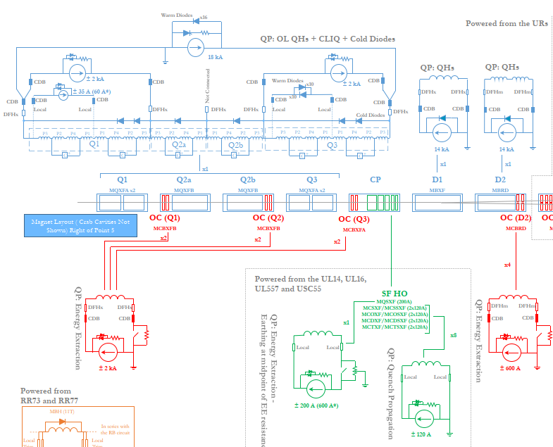
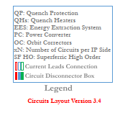
Current rating of electrical circuits of WP6a
Inner triplets (9 circuits)
  MQXF main 2 x 18 kA
  MQXF trim 3 x 2 kA (3x7 kA AC)
  D1 2 x 18 kA
  MCBXF 12 X 2 kA
Matching Section (5 circuits)
  D2 2 x 18 kA
  MCBRD 8 x 0.6 kA
HL-LHC_CircuitParameters_HL-MCF_V9.5.xlsx

Slide 4
Operating temperature of cold powering systems
Operating temperature
  4.5 K Nb-Ti bus bars, NbTi/NbTi splices, MgB₂/NbTi splices
  4.5 - 17 K MgB₂ cable (~100 m long)
  17 -50 K HTS cables
  50-300 K Resistive heat exchanger of leads
  300 K Warm terminal of current leads
Cooling scheme (LHe or GHe)
  DFX => LHe, 4.5 K @ 1-2 bar
  Sc Link, DFHX and current leads => GHe 5-300 K @ 1-2 bar

Slide 5
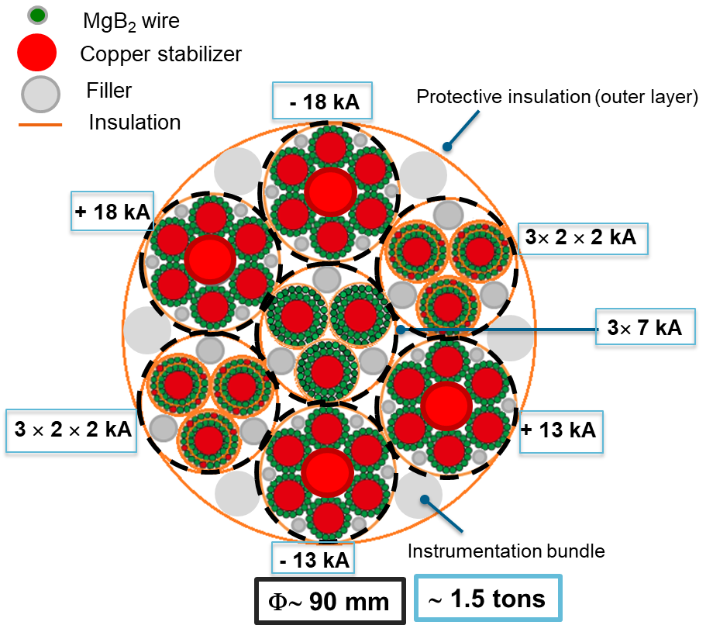
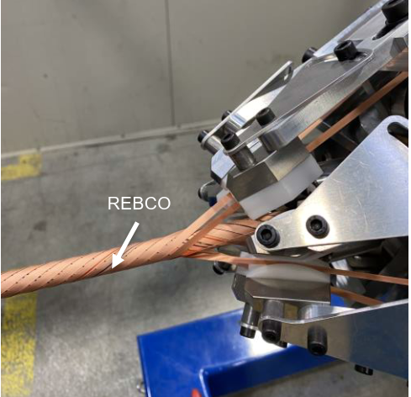

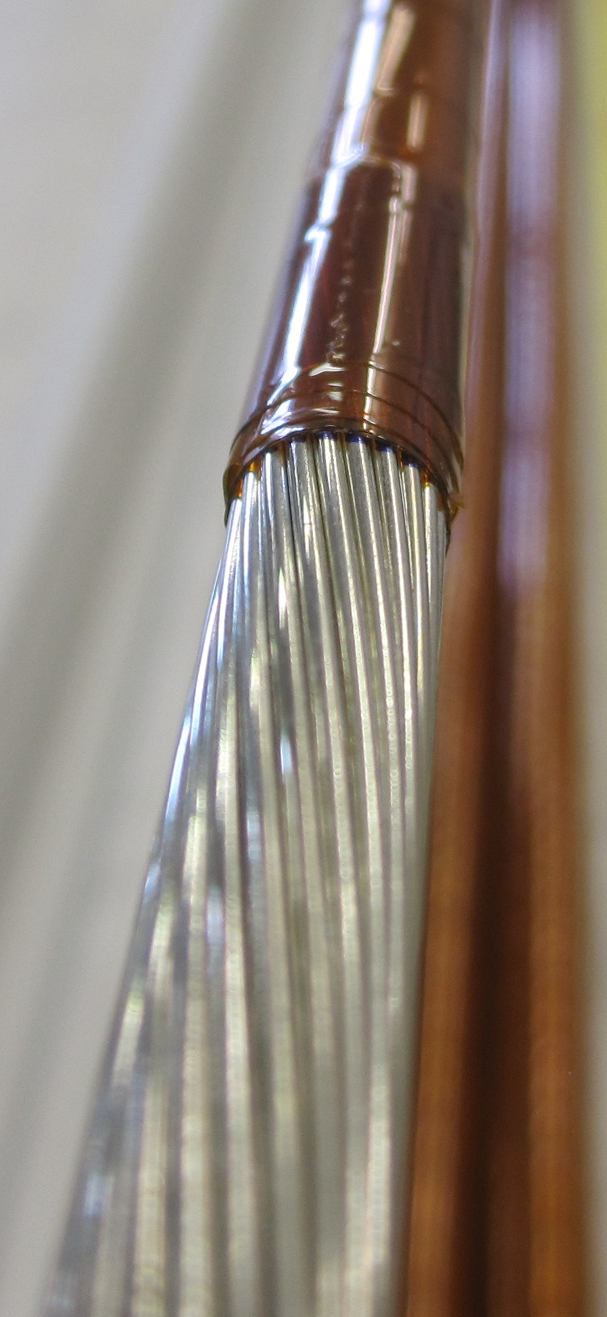
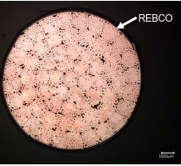
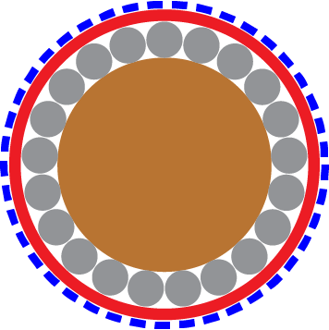
Sc cables of cold powering systems
NbTi bus bars
~7 m long
0.825 and 1 mm OD LHC strands
MgB₂ cables
~70-140 m long
1 mm OD strands
HTS cables
~3 m long
REBCO tapes 4 mm x 0.01 mm
Nb-Ti wire, type 01
18 kA cable
Copper core
Nb-Ti wire, LHC type 02
2 kA
cable
IT MgB₂ cable assembly
3 kA sub cable

Slide 6
Electrical Insulation and transients
Electrical components ( Sc cables, Instrumentation, splices…) designed and produced to fulfill circuit insulation and transient requirements.
Dielectric insulation of components tested prior to installation.
EDMS 1821907
Rating (kA) | Worst case voltage to ground during operation (V) | Acceptance tests of components to ground (V) |  | Insulation test voltage of system to ground (V) |  | Leakage current per component (µA) | Test duration (s)
 |  | RT | NOC | RT | NOC
18 | 900 | 4600 | 2300 | 460 | 1080 | ≤10 | 30
7 | 900 | 4600 | 2300 | 460 | 1080 | ≤10 | 30
2 | 540 | 3160 | 1580 | 316 | 648 | ≤10 | 30
EDMS 1821907
RT → Room Temperature NOC → He gas @ RT, 1 bar
EDMS 1821907
Rating (kA) | MIITs (MA²⋅s) | dI/dt (kA/s) | τ_{n} (no quench of magnets) (s) | τ_{Q} (quench of magnets) (s) | Equivalent time (s)
18 (*) | 32 | 250 | 130 | 0.2 | 0.1
7 | 5 | 250 | 130 | 0.2 | 0.12
2 (**) | 1 | 20 | 20 | 0.5 | -

Slide 7
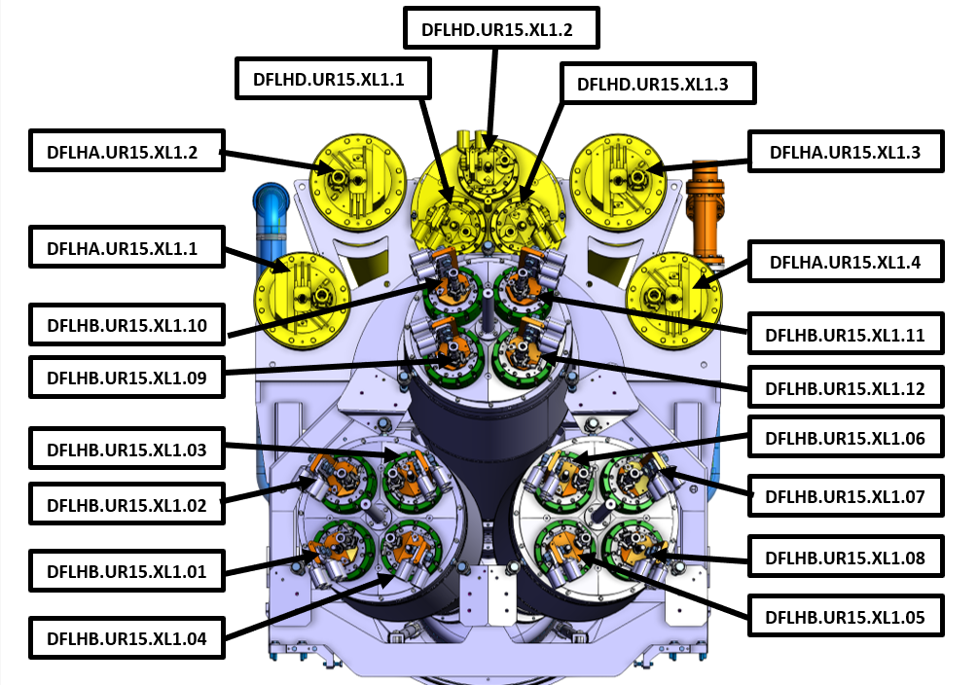
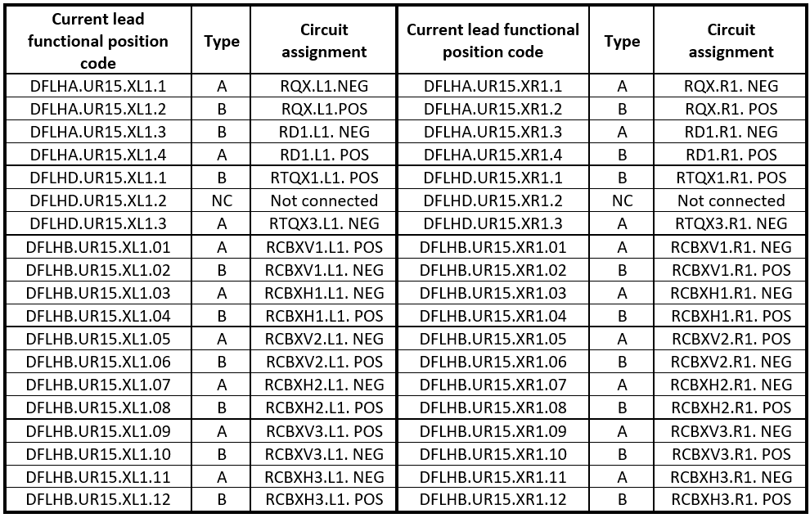
Current lead position codes and circuit assignments IT
Position codes and circuit assignments defined in EDMS 2450769
Naming follows the general rules for naming of HL-LHC equipment
Current lead assignment for Inner Triplets of Point Left 1
Current lead assignment for Inner Triplets of Point 1

Slide 8
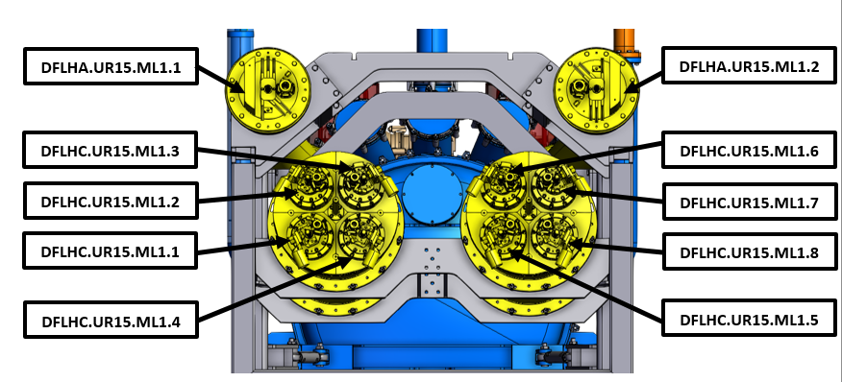
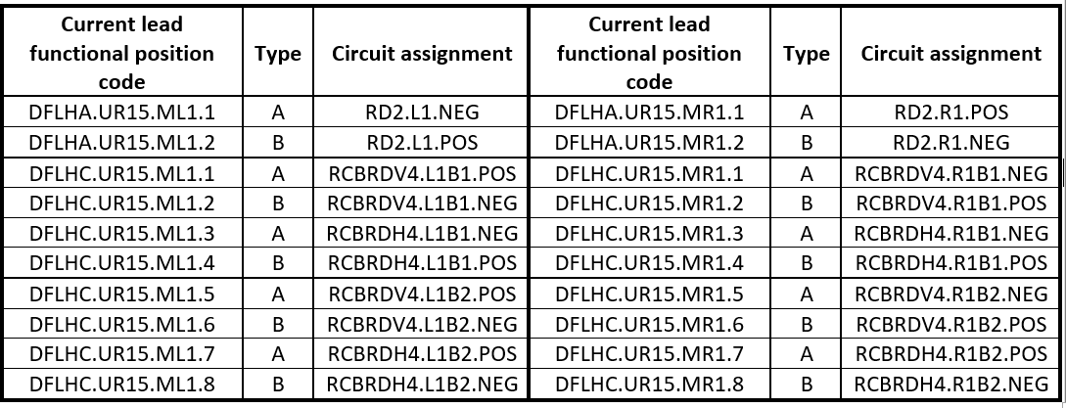
Current lead position codes and circuit assignments MS
Position codes and circuit assignments defined in EDMS 2450769
Naming follows the general rules for naming of HL-LHC equipment
Current lead assignment for Matching Sections of L1
Current lead assignment for Matching Sections of P1

Slide 9
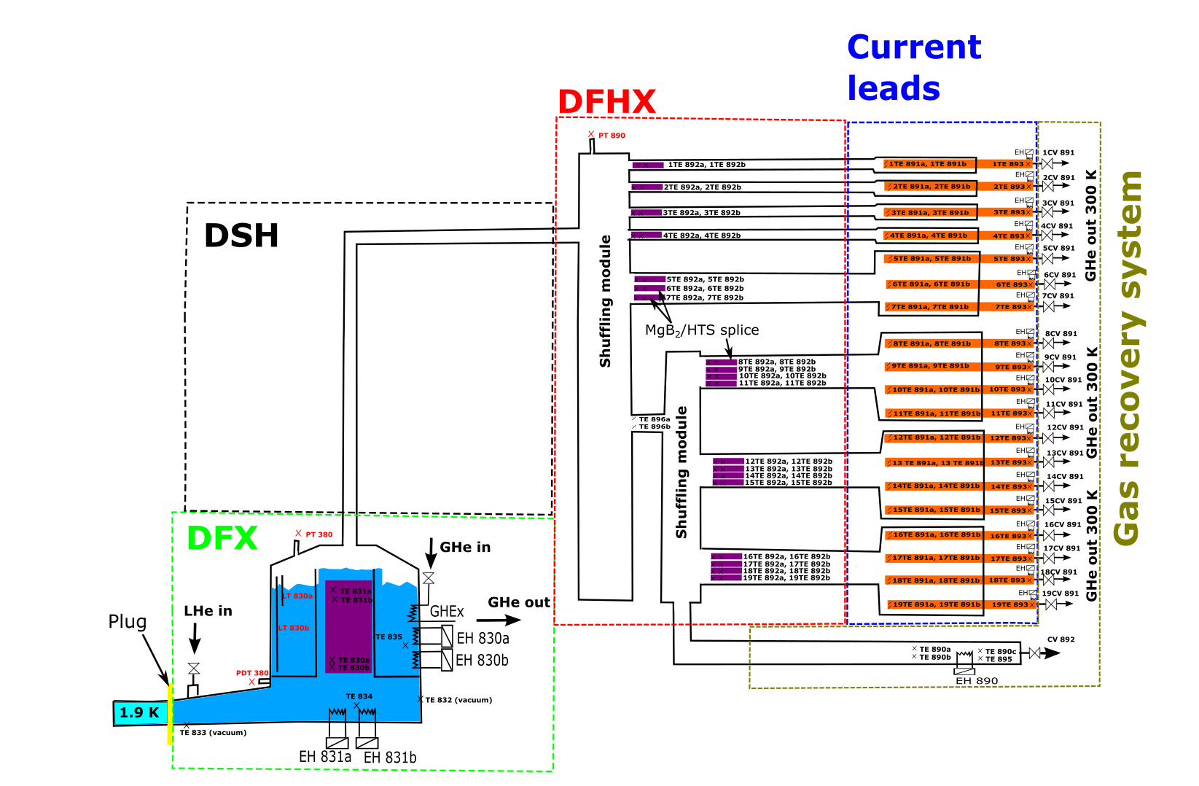
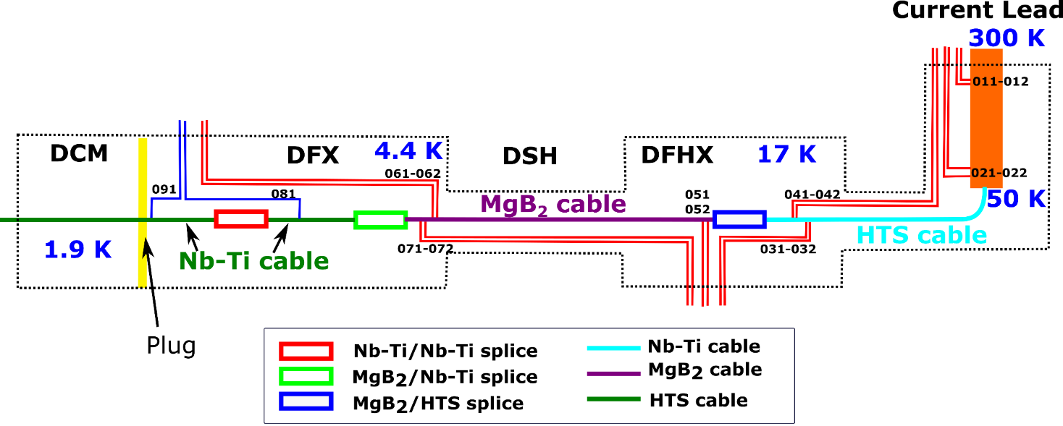
SC Link electrical instrumentation
Each Sc Link equipped with specific instrumentation for a safe and controlled operation:
  Electrical protection of circuits
  Cryogenic control
  Vacuum control
Instrumentation of each Sc Link defined in :
  Matching section EDMS 2512704
  Inner Triplet EDMS 2591698
  Layout of CRG instrumentation
  (more details in next slides)
  Layout of Vtaps (more details in next slides)

Slide 10
SC Link electrical instrumentation
Each branch of circuits equipped with 16 Vtaps for the protection and monitoring of: Current lead heat exchanger, SC cables (HTS, MgB₂, NbTi), Splices (HTS/MgB₂, MgB₂/NbTi and NbTi/NbTi)
Same layout of Vtaps for all branches of circuits (0.6-18 kA)
Naming of Vtaps defined in EDMS 2512704 and 2591698: a unique ID of Vtaps defined for each system based on the ID of branch of circuit and the position along the branch. “<EE> <ID of the branch > <Position >” e.g. EEA011, EES091 ...
HL-LHC Circuit Voltage Taps Layout of SC Link (EDMS 2411822 )

Slide 11
SC Link cryogenic instrumentation
For a safe operation of SC Link system, during nominal operation but also during transients, dedicated instrumentation is required:
  Temperature transducers
  LHe level gages
  Pressure gages
  Heaters
  He control valves (not part of SC Link)
More details in next slides
P&I Diagram of IT String =>EDMS 2244008
Engineering Specification: Instrumentation of the Cold Powering System EDMS 2512704 and 2591698

Slide 12
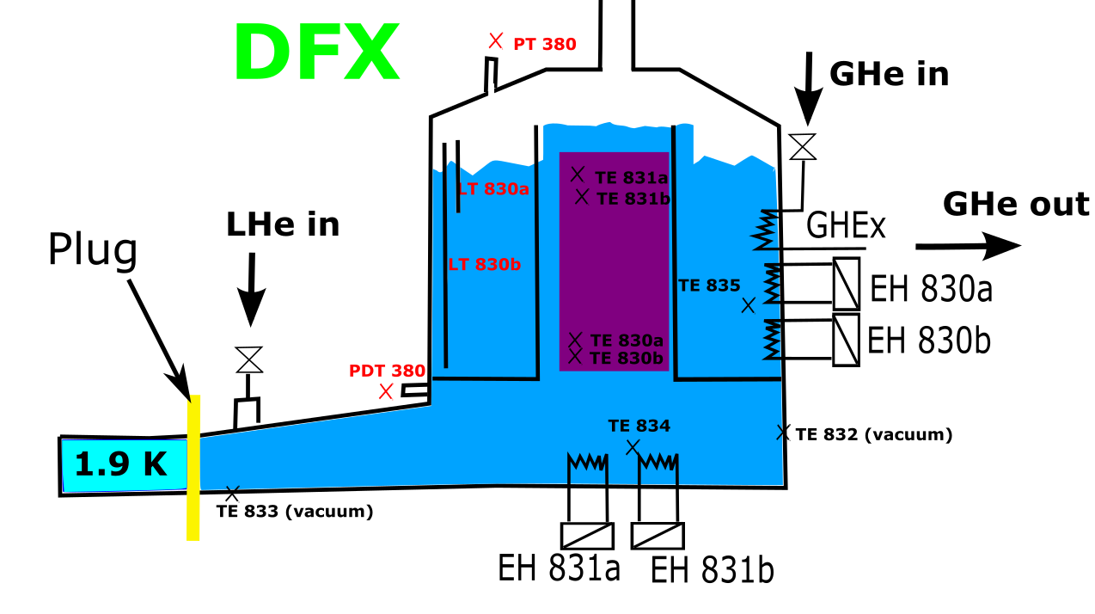
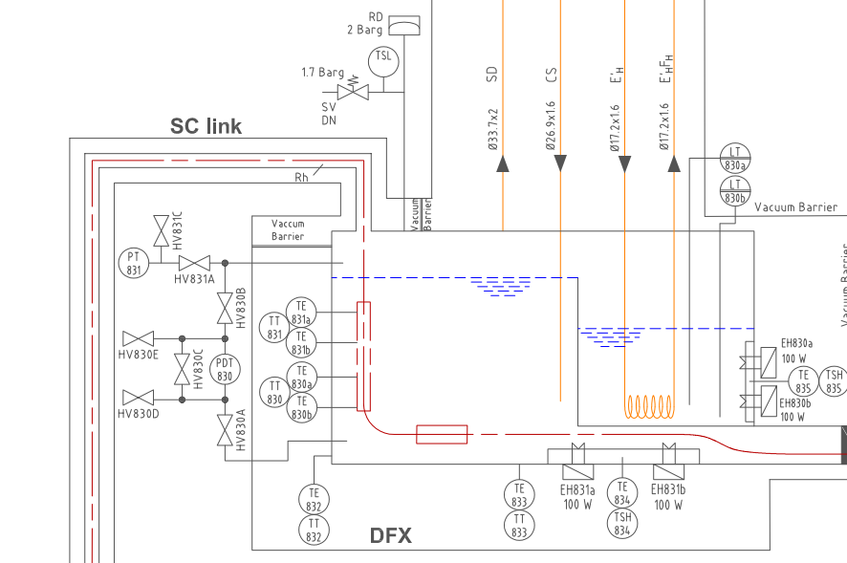
Cryogenic instrumentation of DFX
Splice box (MgB₂/Nb-Ti)
Cryogenic instrumentation of DFX :
8 Thermal transducers (TT)
  2 in vacuum attached to He vessel (Cernox)
  4 in the splice box (He vessel) (Cernox)
  2 temperature sensors attached to the resistive heaters
5 Heaters
  1 GHe/LHe Heat exchanger
  2 resistive Heaters in external bath
  2 resistive Heaters in the lower bath
1 He pressure gage
1 He delta P gage to measure level of liquid in the fountain
Two LHe level transducers
Cryo control valves are part of cryo jumper
HL-LHC IT STRING SQXL - P&I DIAGRAM, EDMS 2244008

Slide 13
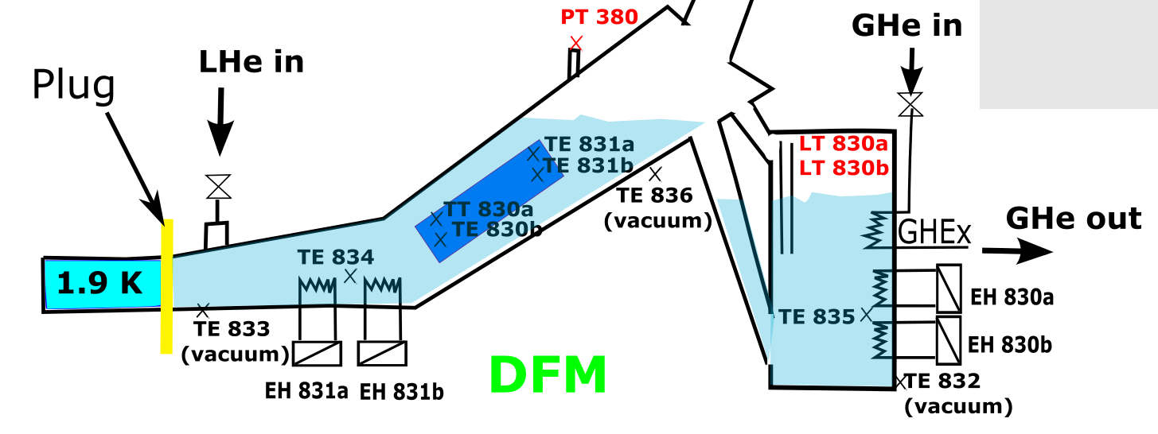
Cryogenic instrumentation of DFM
Cryogenic instrumentation of DFM :
9 Thermal transducers (TT)
  3 in vacuum attached to He vessel (Cernox)
  4 in the splice box (He vessel) (Cernox)
  2 temperature sensors attached to the resistive heaters
5 Heaters
  1 GHe/LHe Heat exchanger
  2 resistive Heaters in external bath (includes 1 spare)
  2 resistive heater in the lower bath (includes 1 spare)
1 He pressure gage
Two LHe level transducers
Cryo control valves are part of cryo jumper
Splice box (MgB₂/Nb-Ti)

Slide 14
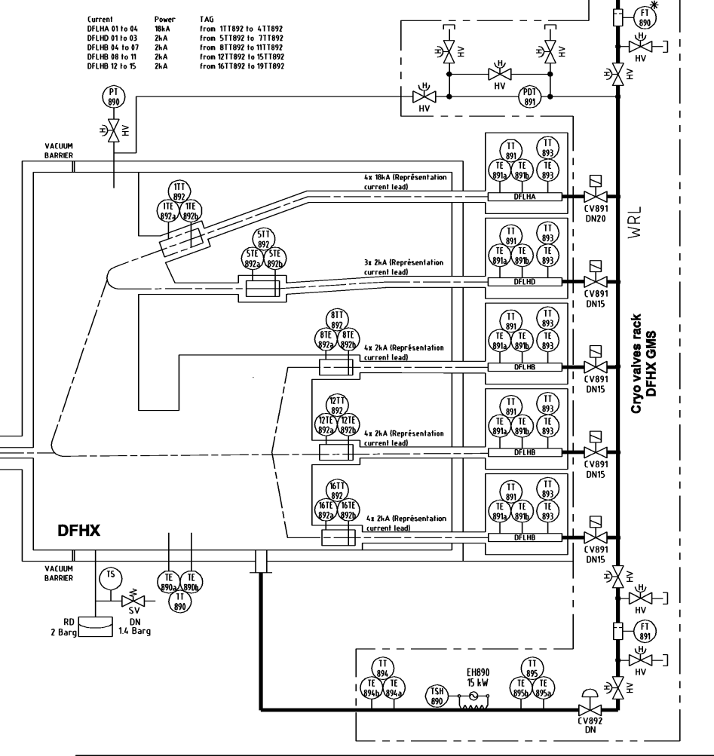
Cryogenic instrumentation of DFH and leads
Instrumentation of DFH
  1 active and 1 spare Thermal Transducers (TT) Cernox per MgB₂/HTS splice
  1 active and 1 spare Thermal Transducers (TT) Cernox In GHe
  1 He pressure gage, external to He tank
Instrumentation of current leads
  Two active and one spare Thermal transducers (PT 100) per current lead
HL-LHC IT STRING SQXL - P&I DIAGRAM, EDMS 2244008
HL-LHC IT STRING SQXL - P&I DIAGRAM, EDMS 2244008

Slide 15
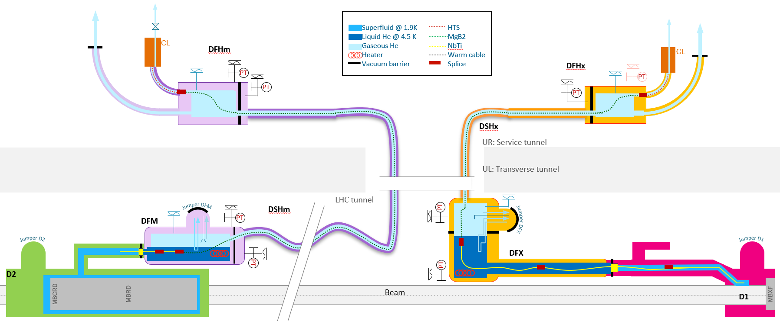
Vacuum instrumentation
The cold powering chain of each SC Link system is made of three vacuum volumes as defined in EDMS1824906: DFX(M), DSH and DFHX(M)
The DFX(M) and DFHX(M) vacuum vessels will be equipped with vacuum ports (EDMS 2157597) use to plug pumping units and/or vacuum instrumentation
All the vacuum instrumentation (Pirani, Penning and membrane gauge) will be external to the DFX vacuum vessel (attached to ports)
=> no wiring in the vessel for vacuum instrumentation is required
EDMS1824906

Slide 16
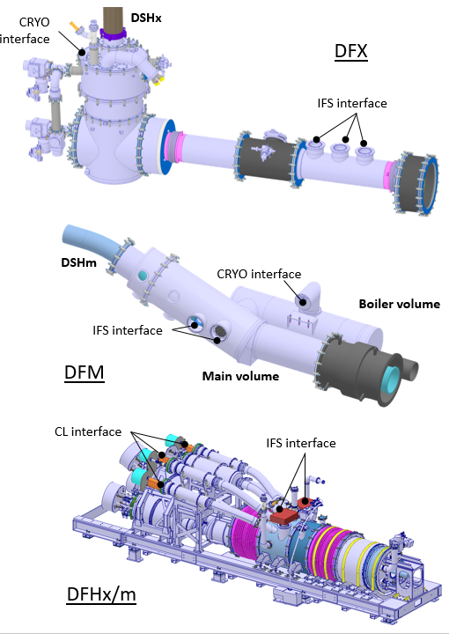
Instrumentation Feedthroughs of SC-Link systems
Feedthroughs located at three specific locations:
  DFX(M): Vtaps, temp probes, LHe level gage and heaters
  DFHX(M): Vtaps and temp probes
  Current leads: Vtaps and temp probes
Instrumentation feedthrough systems of WP6a designed, constructed and tested accordingly to voltage requirements EDMS 1821907
16

Slide 17
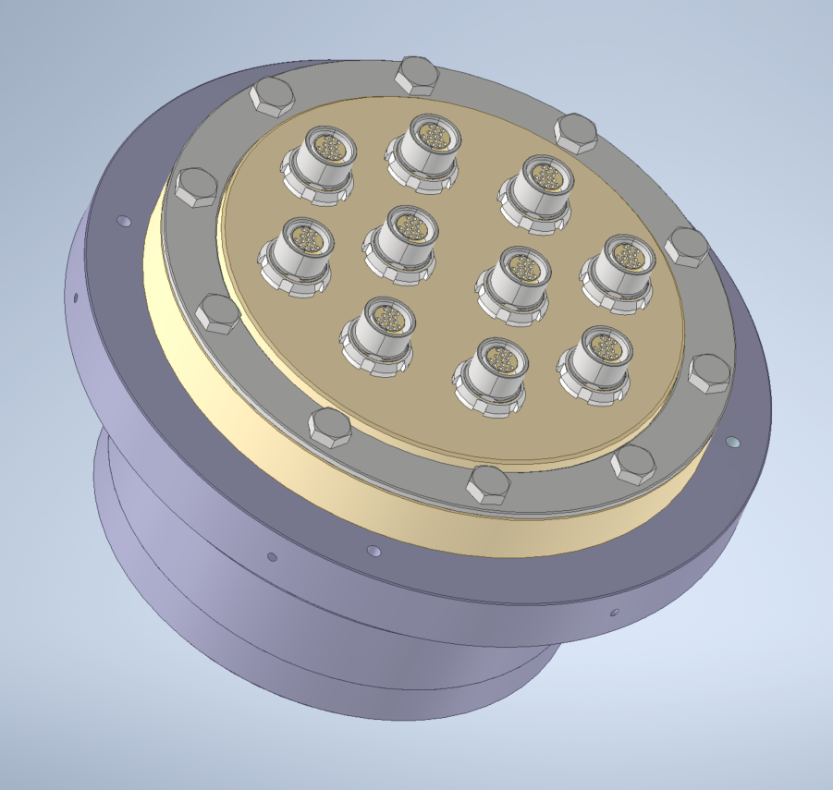
Instrumentation Feedthroughs of DFHX(M) and current leads
  Each HL-LHC Current leads equipped with one Fischer connector and a 4 pin Lemo connector as for LHC
  Feedthroughs of DFHX(M) composed of multiple Fischer connectors (one connector per branch of circuit, Vtaps and TT) mounted on an insulating flange.
Lemo connector
Fischer connector
Feedthroughs of current leads
Fischer connectors
Feedthroughs of DFHX(M)

Slide 18
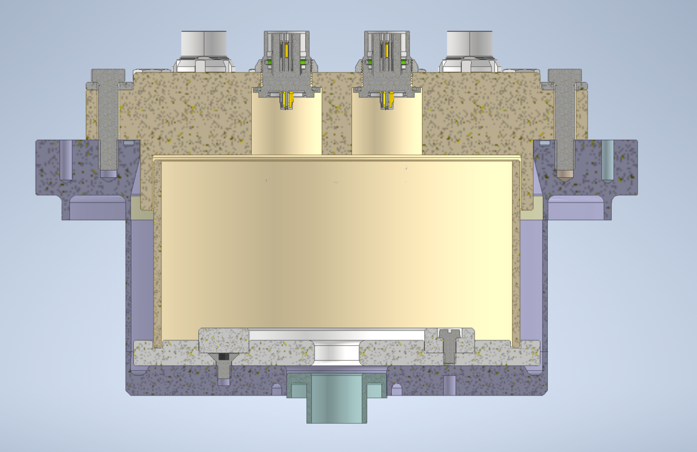
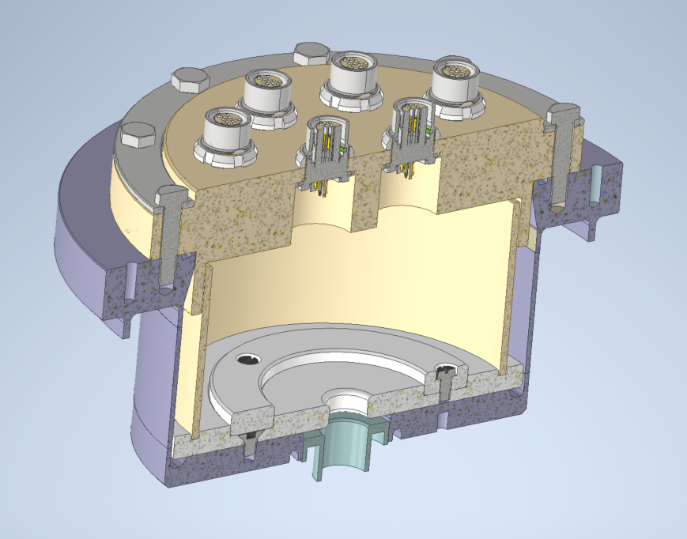
Design of feedthroughs of DFHX(M)
Vtaps and TT equipping same branch of circuits regrouped in dedicated connector (same electrical potential ~+/- 10 V in transients)
TT of GHe regrouped on a separate connector
A total of 20 connectors required for DFHX, 11 connectors for DFHM
Leak tight Connectors of type Fischer S105A058 distributed among two insulated flanges (PEEK, with O-ring seal)
Connector insulation (in air) :Pin to pin 1.6 kV, Pin to body 1.4 kV
Clearance and creepage distance between body of connectors (14 mm air, 56(66) mm Ghe)
MCF meeting #105, June 2022, https://indico.cern.ch/event/1170478/

Slide 19
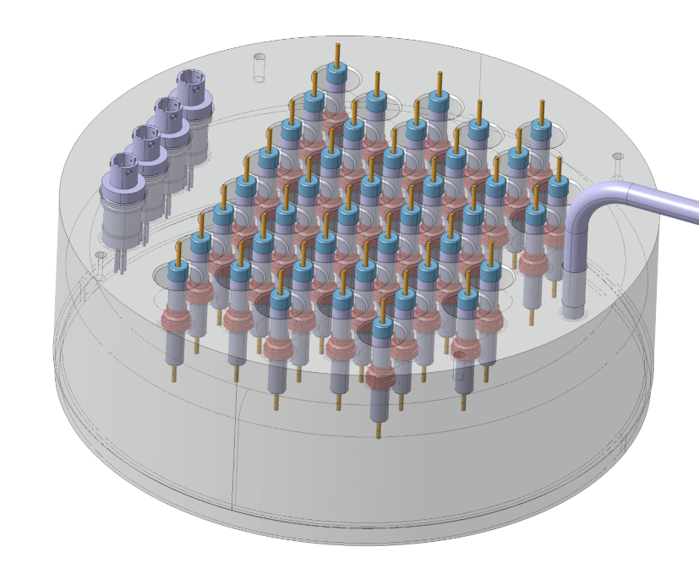
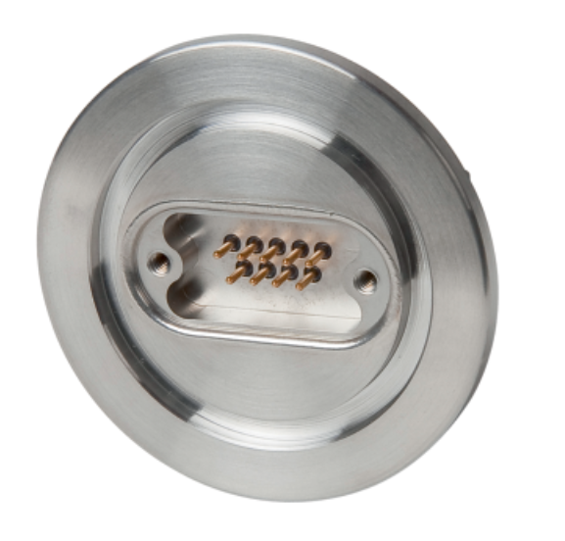
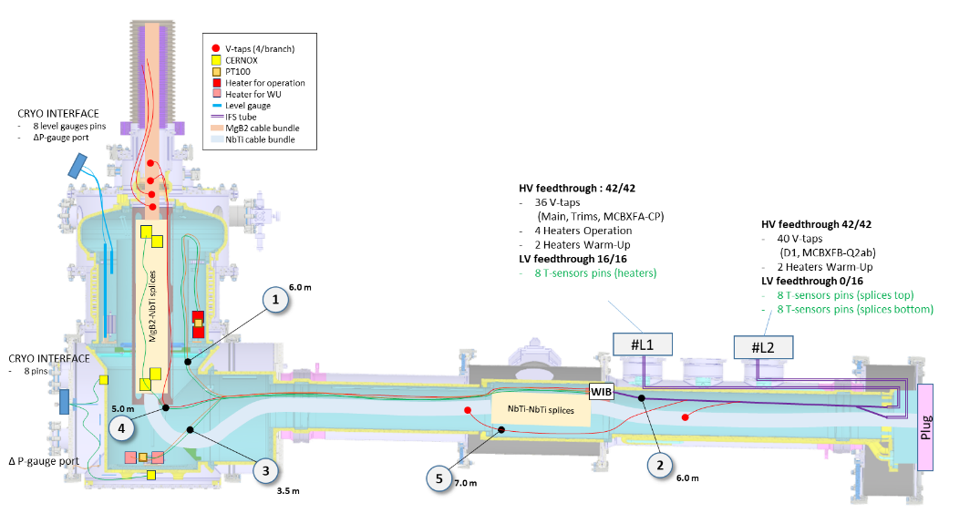
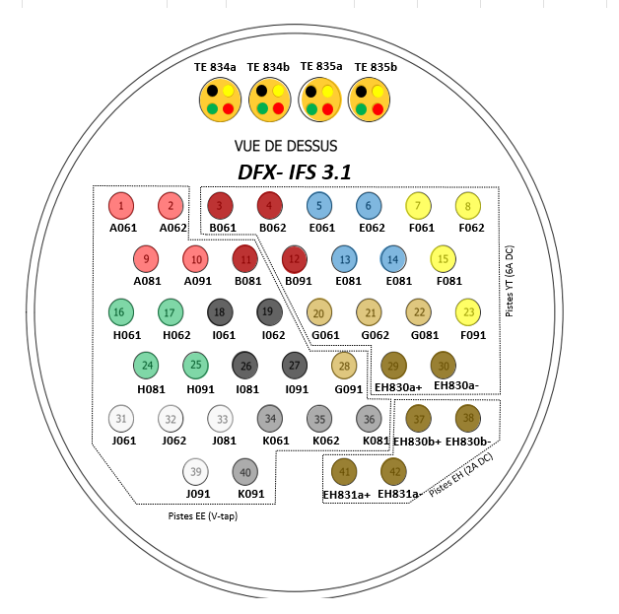
Instrumentation Feedthrough of DFX
  Feedthroughs of DFX(M):
    HL-LHC cryo-magnet IFS (L-Type)
    SubD connector mounted on Iso-K flange for LHe level gage
    SubD connector mounted on Iso-K flange for TT in vacuum
L Type IFS of DFX
SubD IsoK flange
Pinout of L Type IFS

Slide 20
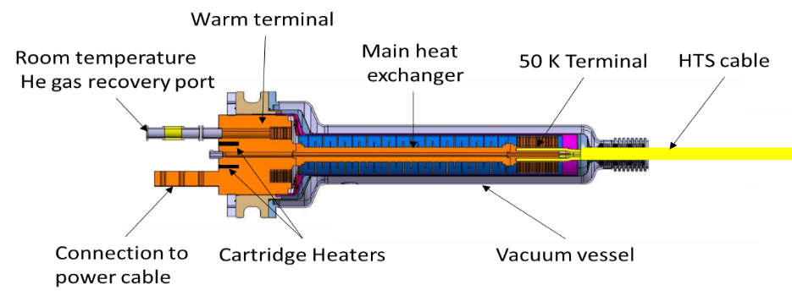
Heating system for current leads
For a safe operation of the HL-LHC current leads, each of them will be equipped with a dedicated heating system to avoid the formation of condensation and ice that would lead to gas leakage or degradation of HTS current leads.
Functional specification defined in EDMS 2770173
Each heating system shall:
  Maintain the warm terminal of the leads to 300 K (+/- 3 K) during the entire operational cycle of machine
  Set point could be monitored and changed remotely
  Provide sufficient dielectric insulation to HL LHC circuits (~3 kV)
  Deliver a power (48V) ranging between 125 W and 1.8 kW
  Being made of components quickly replaced with reliable connectors
  Restart and get back in control mode after power cut
  Having appropriate electrical protection to limit shut down only to faulty elements/components

Slide 21
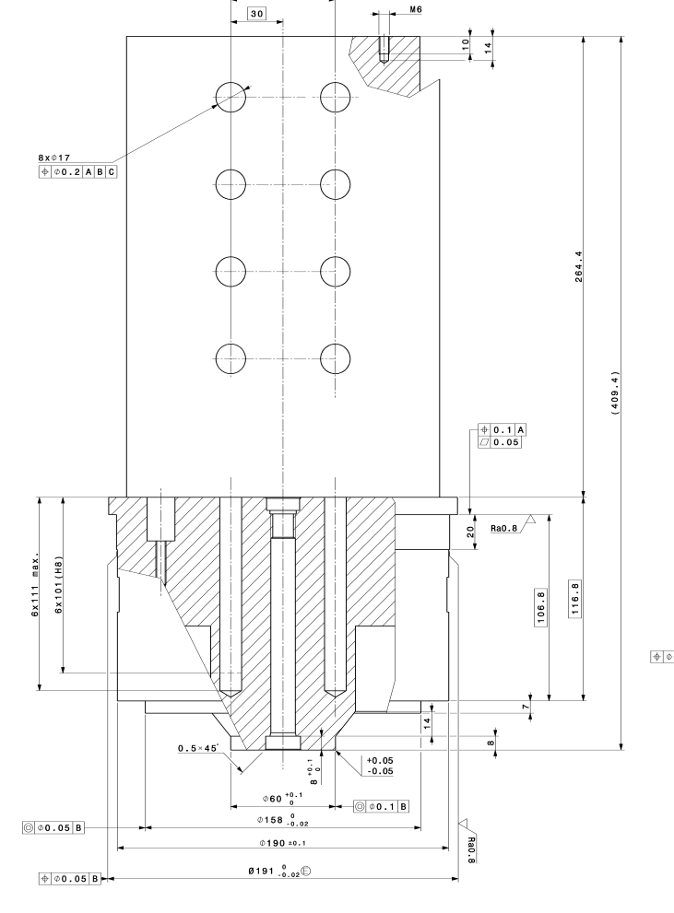
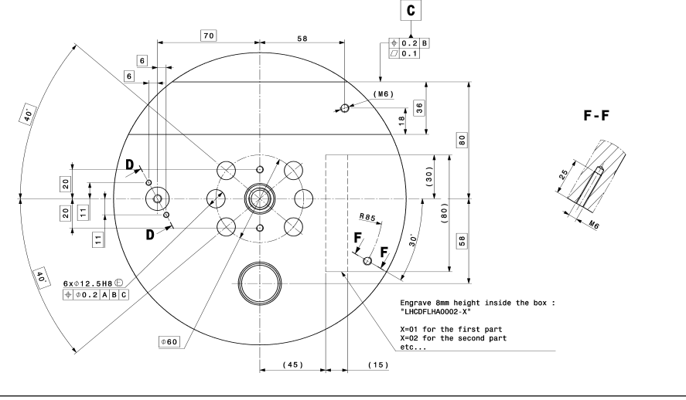

Resistive heaters for the current leads
 | Type of lead | Number of leads per system | Technical drawing of warm terminal of the leads | Diameter of cartridge heater | Length of cartridge heater | Number of cartridge heater per lead | Power and voltage of each Heater
Inner Triplet | 18 kA | 4 | LHCDFLHA0002 | 12.5 mm | 100 mm | 6 | 300 W/ 48 V
 | 7 kA | 3 | LHCDFLHBP0025 | 6.5 mm | 50 mm | 2 | 125 W/48 V
 | 2 kA | 12 | LHCDFLHBP0025 | 6.5 mm | 50 mm | 2 | 125 W/48 V
Matching Section | 18 kA | 2 | LHCDFLHA0002 | 12.5 mm | 100 mm | 6 | 300 W/ 48 V
 | 0.6 kA | 8 | LHCDFLHBC0001 | 6.5 mm | 50 mm | 1 | 125 W/48 V
18 kA lead warm terminal
More details on the Heating system of the leads in presentation of G. D’Angelo.
CARTRIDGE HEATER of CURRENT LEADS

Slide 22
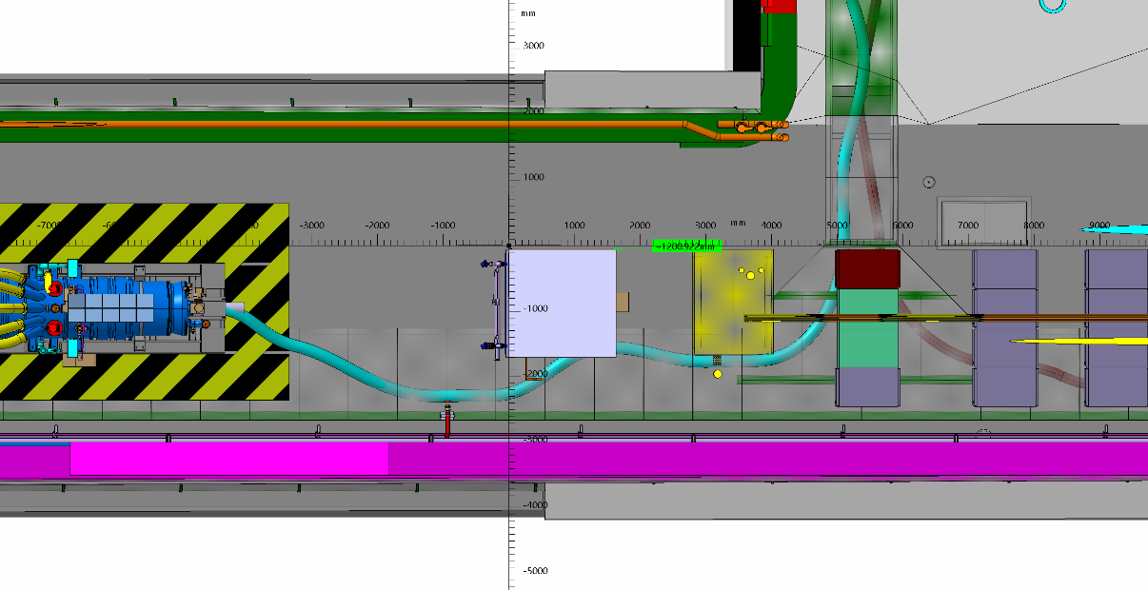
Integration of Heating system in the HL-LHC machine
Integration of components :
  Power units next by current leads, installed on top of the DFHX and DFHM in individual box
  Resistive heaters mounted on current leads, with wiring running of cable trays installed on top of the DFHX and DFHM
  Control units installed ~15 m from the current leads in dedicated racks
Power Units
Control units

Slide 23
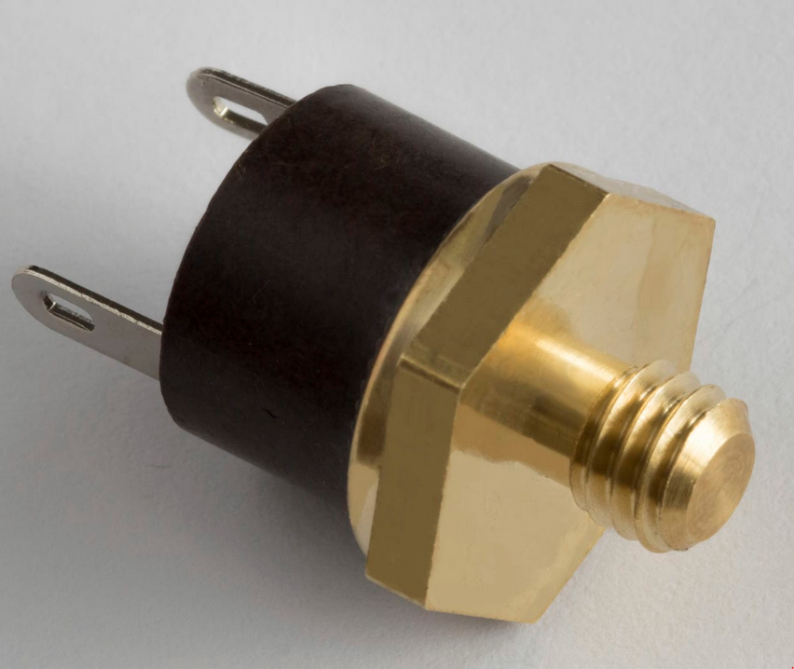
THERMOSWITCH of CURRENT LEADS
Each current lead will be equipped with a thermoswitch that will triger a discharge of the circuit if temperature of lead is exceeding 60 degC in operation
  The type chosen is open by raising temperature.
  They are insensitive to shocks, accelerations and vibrations.
  Dielectric holding between the HTS C.L. and the inner parts of the thermostat: 3.5 kV
  Nominal voltage : 250V
  Nominal current : 6A
  Signals from Thermoswitch will be collected by the means of a dedicated proximity equipment:
    19 Thermoswitch for IT
    10 Thermoswitch for MS

Slide 24
Splitting modules of Sc Link
External splitting module (proximity equipment) are required to route in dedicated cables instrumentation signal of Sc Link to cryo and electrical protection racks
Splitting modules will be located close by the DFHX(M) and DFX
  Splitting module of DFX/DFM under responsibility of WP7 (see presentation of G. D’Angelo
  Splitting module of DFHX/M under responsibility of WP6a, described in next slides

Slide 25
Splitting modules of DFHX and DFHM
Instrumentation cables of CL and IFS of DFHX(M) will be collected in the proximity equipment
Connectors of Proximity equipment: Harting type
Interface among WP at the level of output connectors of splitting modules
One proximity equipment for four branch of circuits: 5 PE for IT, 3 PE for MS
Functional spec of proximity equipment drafted in Sept 2022.
WP7
WP6a
QDS Racks
Splitting modules
WP9
CRG racks

Slide 26
Splitting modules of DFHX and DFHM
Specification drafted in Sept 2022, that defines for each connector (input and output):
  Connector ID
  Type of connector
  Type of cable
  Pinout
List of output connectors of the splitting module of DFHM
List of output connectors of the splitting module of DFHM
Vtaps/ Temperatre sensors | Current leads/ leg of circuit | Signals |  | Connector ID |  | Cable
 |  | Nb of wires for Vtaps | Nb of wires for Temp probe | Connector ID | Connector Type
Temp | DFLHA.UR_.M_.1 | - | 20 | PE-MCRG-1 | |Rack: 09 16 072 3101| 11 x |cable : 09 16 072 3001| | EMC: 09 62 816 0301| | 20x DRAKA HV
 | DFLHA.UR_.M_.2 | - | 20 | PE-MCRG-2
 | DFLHC.UR_.M_.1 | - | 20 | PE-MCRG-3
 | DFLHC.UR_.M_.2 | - | 20 | PE-MCRG-4
 | DFLHC.UR_.M_.3 | - | 20 | PE-MCRG-5
 | DFLHC.UR_.M_.4 | - | 20 | PE-MCRG-6
 | DFLHC.UR_.M_.5 | - | 20 | PE-MCRG-7
 | DFLHC.UR_.M_.6 | - | 20 | PE-MCRG-8
 | DFLHC.UR_.M_.7 | - | 20 | PE-MCRG-9
 | DFLHC.UR_.M_.8 | - | 20 | PE-MCRG-10
 | None (TT832A/TT832B) | - | 8 | PE-MCRG-11
Vtaps | DFLHA.UR_.M_.1 DFLHA.UR_.M_.2 - - | 16 | - | PE-MMPE-01a | |1 x 09 14 016 0371| 6 x |4 x 09 14 008 3101| |1 x 09 30 016 0318| | NE36
 |  | 16 | - | PE-MMPE-01b |  | NE36
 | DFLHC.UR_.M_.1 DFLHC.UR_.M_.2 DFLHC.UR_.M_.3 DFLHC.UR_.M_.4 | 32 | - | PE-MMPE-02a |  | NE36
 |  | 32 | - | PE-MMPE-02b |  | NE36
 | DFLHC.UR_.M_.5 DFLHC.UR_.M_.6 DFLHC.UR_.M_.7 DFLHC.UR_.M_.8 | 32 | - | PE-MMPE-03a |  | NE36
 |  | 32 | - | PE-MMPE-03b |  | NE36
  Pinout of output connector for CRYO
Sensor ID | Signal | Source signal |  | Conn PE-XCRG-01
 |  | Conn ID | PIN | Type | Con. Pin ID | Cab. con. ID
1TE892a | U+ | PE X4-01 | 7 | Rack: 09 16 072 3101, Cable: 09 16 072 3001, EMC: 09 62 816 0301 | V+ | 1
1TE892a | U- | PE X4-01 | 8 |  | V- | 2
1TE892a | I+ | PE X4-01 | 9 |  | I+ | 3
1TE892a | I- | PE X4-01 | 10 |  | I- | 4
1TE892b | U+ | PE X4-01 | 11 |  | V+ | 5
1TE892b | U- | PE X4-01 | 12 |  | V- | 6
1TE892b | I+ | PE X4-01 | 13 |  | I+ | 7
1TE892b | I- | PE X4-01 | 14 |  | I- | 8
1TE891a | U+ | PE X5-01 | 7 |  | V+ | 9
1TE891a | U- | PE X5-01 | 8 |  | V- | 10
1TE891a | I+ | PE X5-01 | 9 |  | I+ | 11
1TE891a | I- | PE X5-01 | 10 |  | I- | 12
1TE891b | U+ | PE X5-01 | 11 |  | V+ | 13
1TE891b | U- | PE X5-01 | 12 |  | V- | 14
1TE891b | I+ | PE X5-01 | 13 |  | I+ | 15
1TE891b | I- | PE X5-01 | 14 |  | I- | 16
1TE893 | U+ | PE X6-01 | 1 |  | V+ | 17
1TE893 | U- | PE X6-01 | 2 |  | V- | 18
1TE893 | I+ | PE X6-01 | 3 |  | I+ | 19
1TE893 | I- | PE X6-01 | 4 |  | I- | 20

Slide 27
Conclusion
  Current leads named and attributed to circuits
  List of instrumentation for safe cryogenic, electrical and vacuum operation of the SC Links system defined
  Instrumentation feedthroughs of SC Link defined
The functional specification for current leads heating system was defined, it is developed by WP7.
Safety thermoswitch will equip each HTS current lead that will cut off the power converter if the temperature reaches 60ºC.
Splitting module for DFX(M) and DFHX(M) are being designed. The one of DFX(M) is with WP7. Interfaces are defined, the detail design of DFHX(M) splitting module will be completed by Q2 2023.

Slide 28
Thanks for your attention

