Slide 1
Speeding up convolution operations in RooFit with GPUs
Hanna Olvhammar
Supervisor: Jonas Rembser
Notes:
ID=d924773e-9a16-4d6d-9803-8cb819e99682
Recipe=text_billboard
Type=TextOnly
Variant=0
FamilyID=AccentBoxWalbaum_Zero

Slide 2
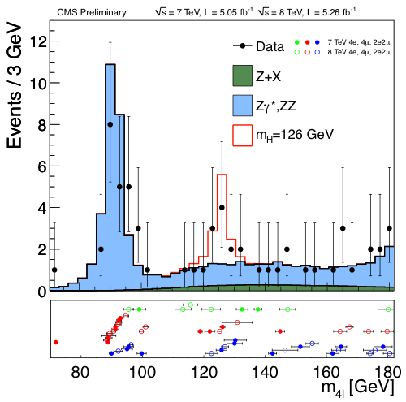

RooFit
Fit probability density functions (pdfs) to data
Uses classes to describe mathematical objects (pdfs, histograms…)

Slide 3
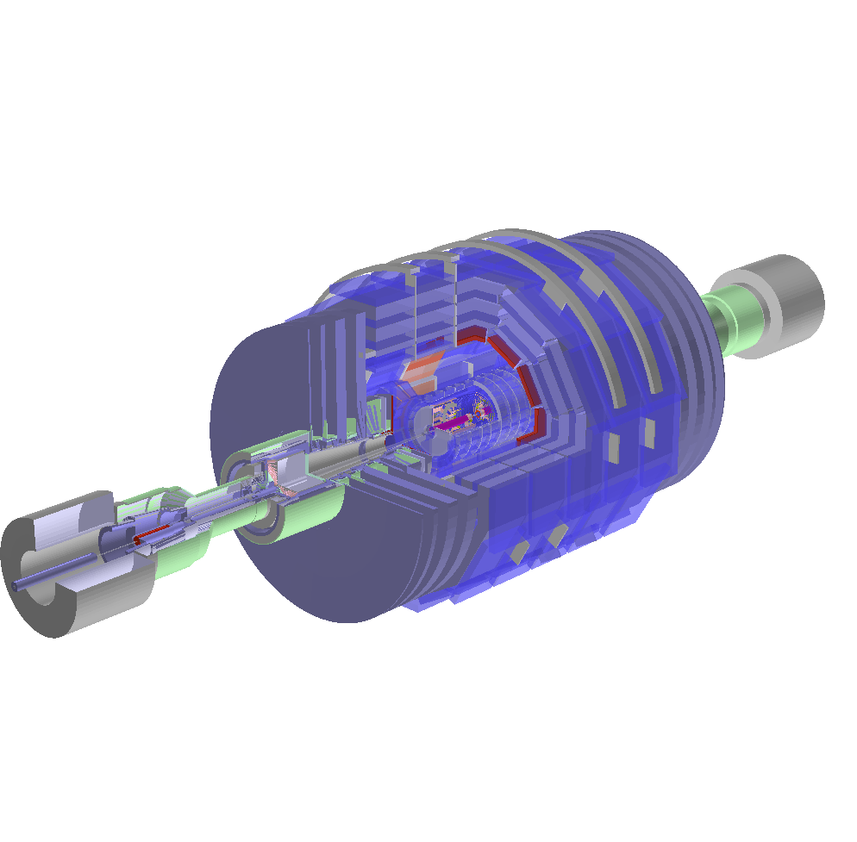
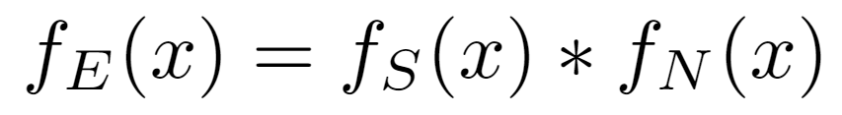
Convolutions in HEP
Number of events is a random variable
Different origins → different distributions
Events in detector = Signal + Noise
E = S + N means

Slide 4
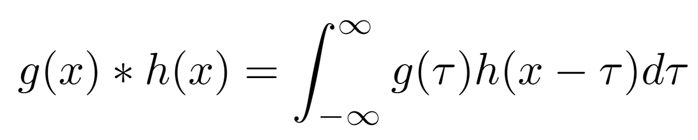
Numerical convolution
Use FFT for the convolution
Fit convolution to data: Vary parameters and repeat convolution many times

Slide 5
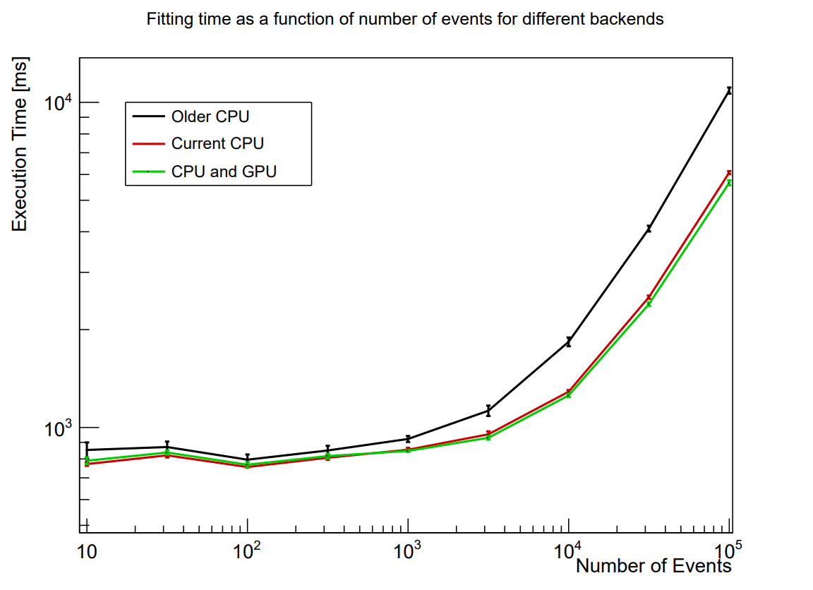
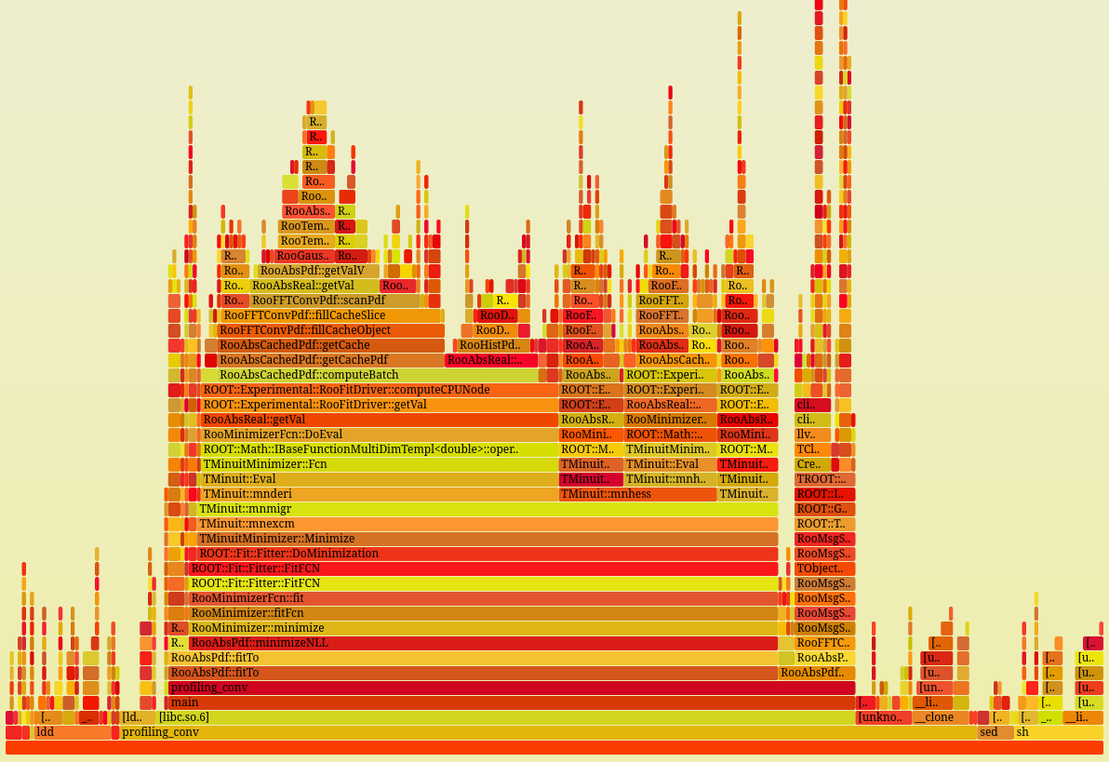
Profiling

Slide 6
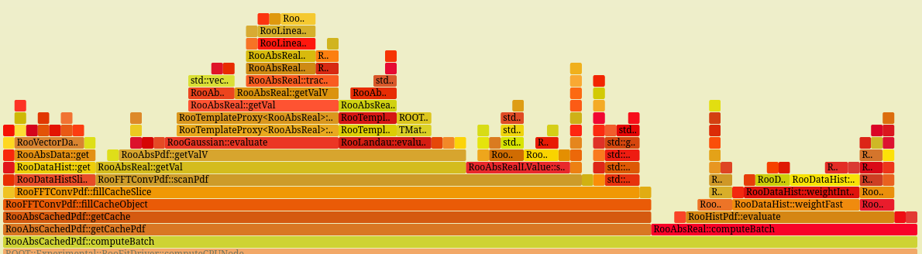

Slide 7
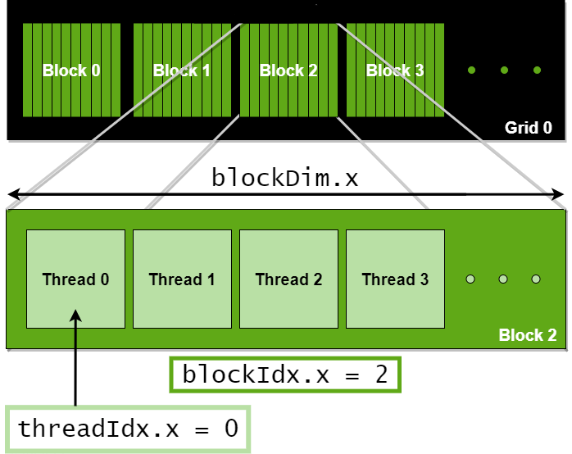
Using GPU computations
Find ways to vectorize functions
Then use parallel computations on the GPU

Slide 8

Thank you!
Any questions?

