Slide 1
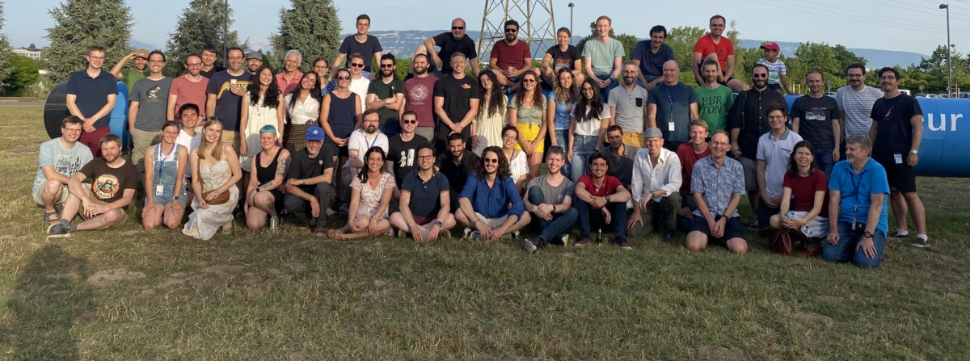
INTC 70: ISOLDE coordinator presentation
2022 schedule and feedback from first runs
Around the hall: Space and new setups – a growing challenge
First dates for 2023
Training

Slide 2
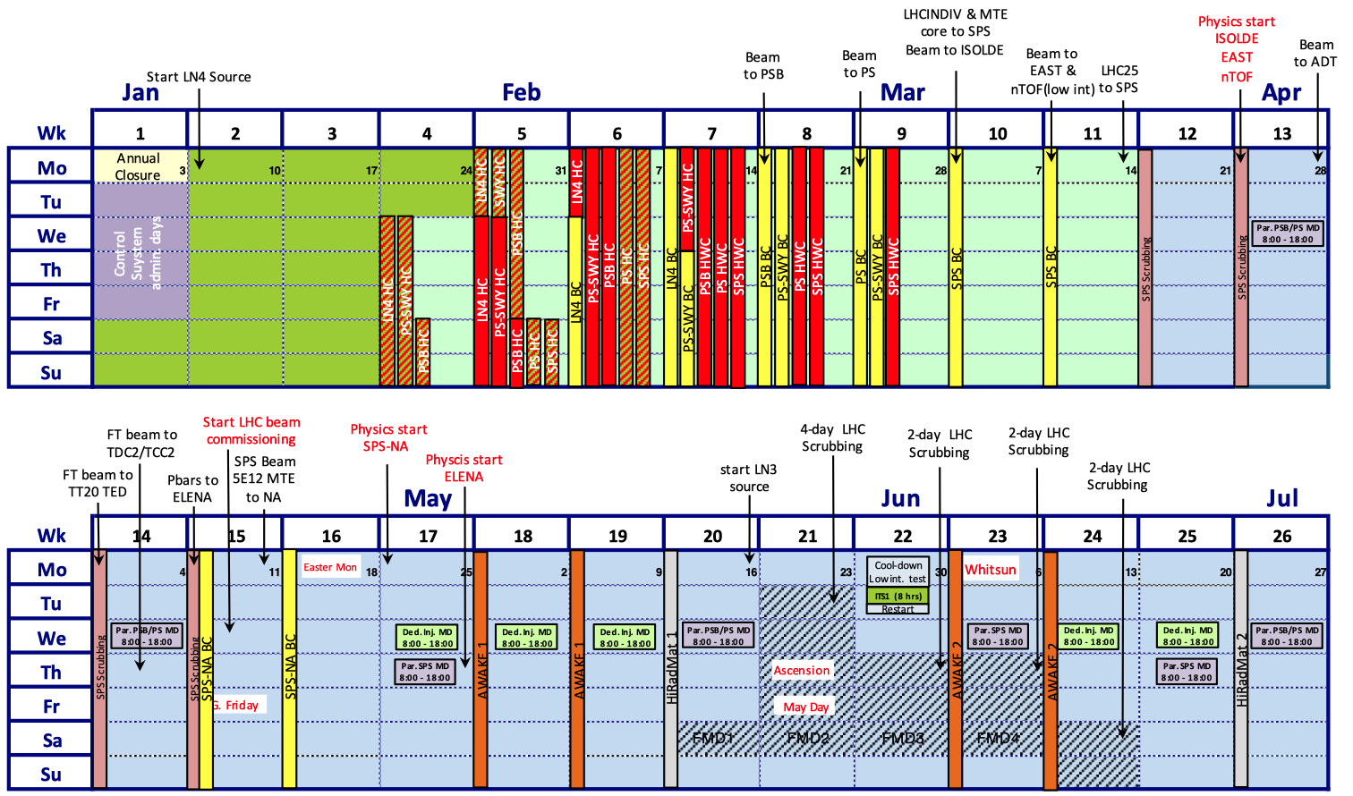
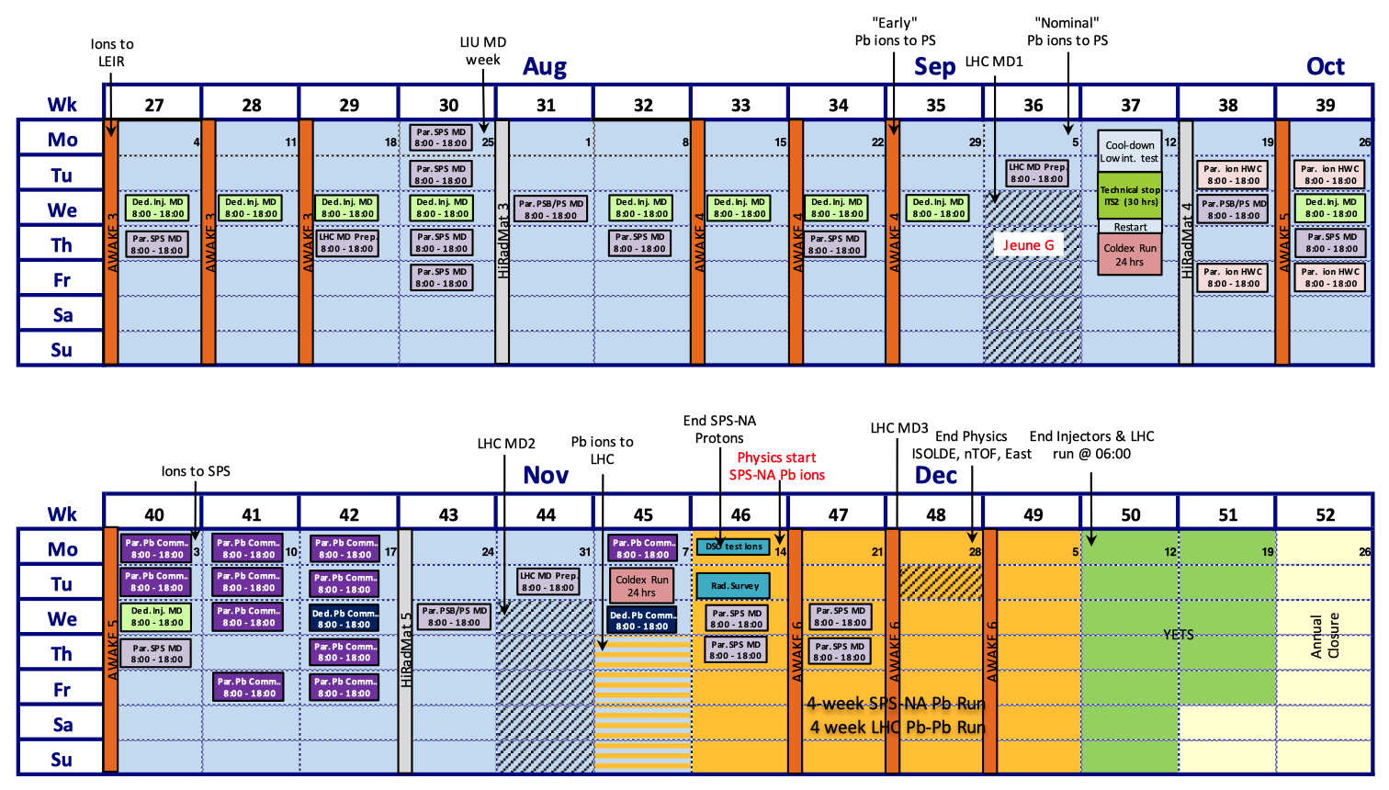
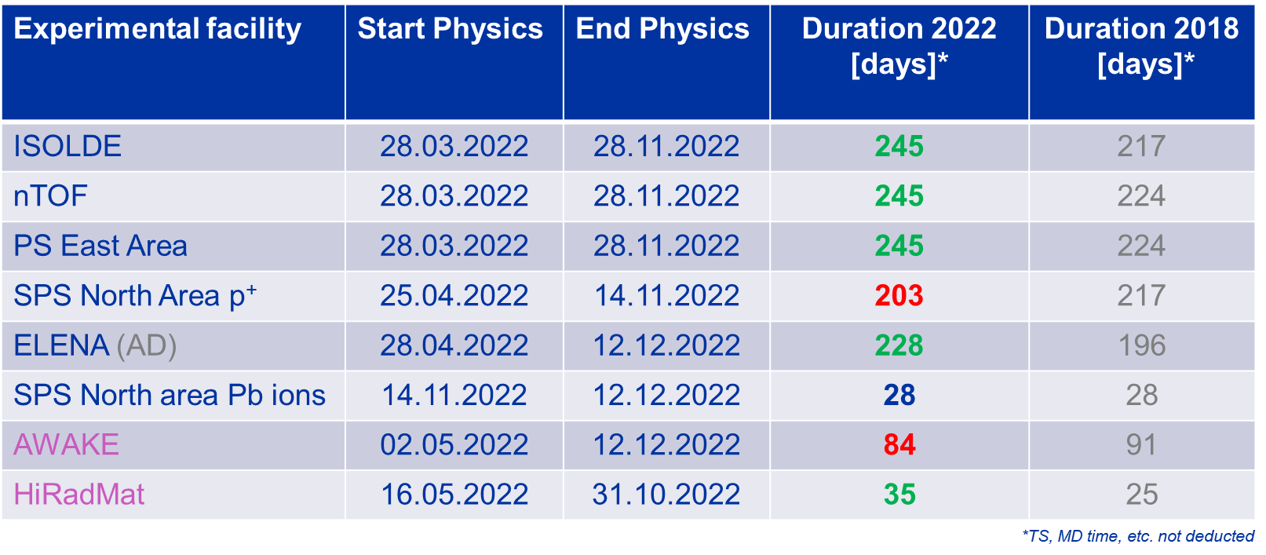
Accelerator schedule for 2022
Update of the YETS schedule
Further optimisation requested by Research Board in favour of NA62 and NA64e
ISOLDE physics start: March 28th
End of protons, not necessarily of physics: November 28th
(but short period for winter physics).
245 days of physics
Very high demand throughout the complex. Number of supercycles can be limited at times: change of supercylces is out of booster’s direct control

Slide 3

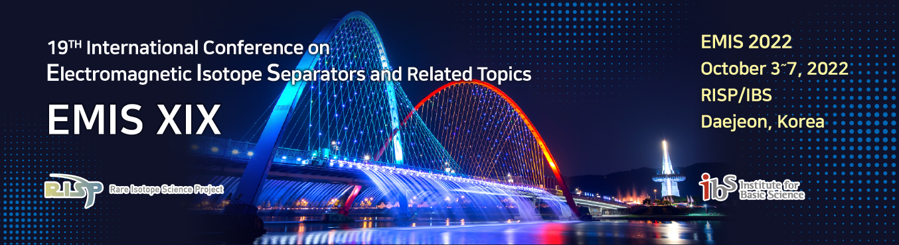
Beam requests and schedule for 2022
As can be seen: very high demand, but more competing opportunities also exist (not the case last year) e.g. conferences, experiments elsewhere, holidays(!)
Miniball is back in 2022, but no T-REX in 2022. Delays with DAQ mean stable beam only from September onwards.
Almost 50% of the shift request for HIE ISOLDE but only 50% of the running period possible.
Issue with the 7gap (and delay with Miniball) has resulted in August being reshuffled with focus on beam development and low energy

Slide 4
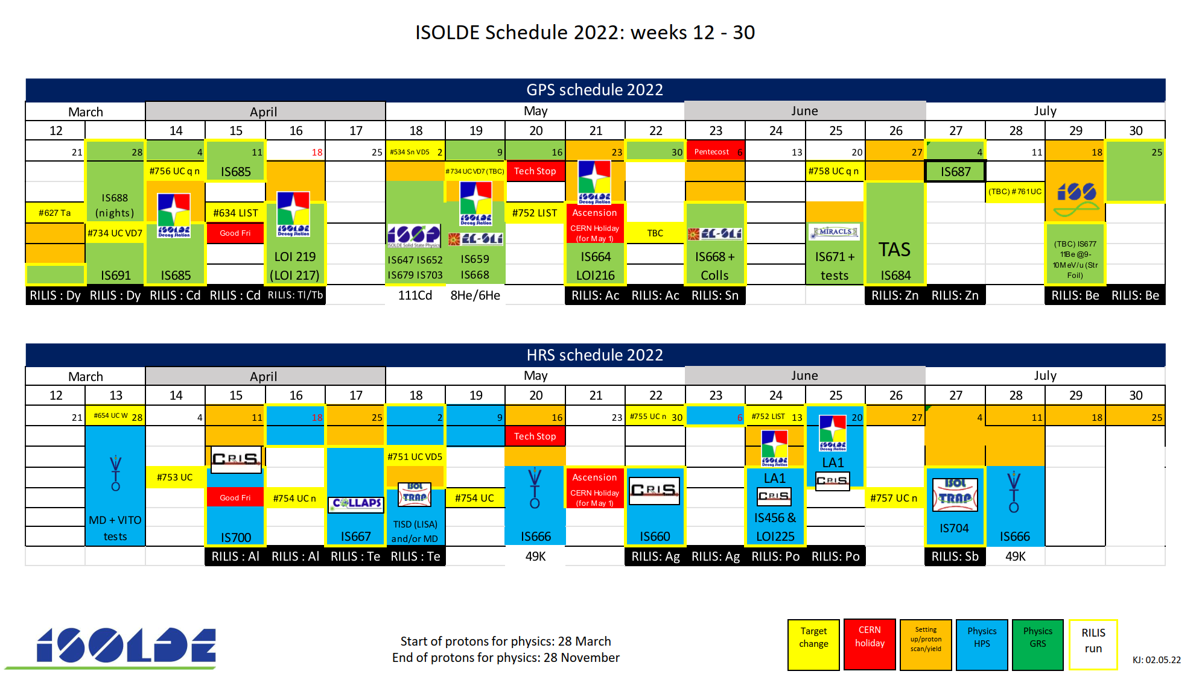
So far 20 experiments have run with ~187 shifts delivered for low energy physics (and some beam development)

Slide 5
Feedback from runs
As Joachim mentioned today: relatively few requests for “standard” target units e.g. no UC Ta on GPS until 11th week of physics…
LIST is now becoming a highly requested unit.
  Needs considerable setting up time and expertise.
  Difference in behaviour between GPS and HRS: loss of time structure in PI-LIST mode due to the ISCOOL. (solution would be upgrade of beamgates)
  RILIS can’t be considered “standard” operation for such runs either: extra resources for personnel would be useful. Some fine-tuning of schedule has been required
Quartz lines also being requested more frequently, still some development work needed e.g. water leak developed during Cd run.
Heavy period for IDS, but strong local team has coped well.
Position of proton beam has been an issue especially for neutron convertors: needs to be confirmed in future commissioning runs at beginning of year.
Reuse of previous targets has been mostly successful: vacuum leak after 5e18 protons not seen as before. Inevitably some failures….

Slide 6
MEDICIS and the Irradiation station
Relatively quiet period for MEDICIS
Some irradiations have been made
The issue with the proton beam position is of particular relevance for MEDICIS.
GPS irradiation station has been producing much higher activities.
MEDICIS frontend has been useful for checking some used ISOLDE targets.

Slide 7
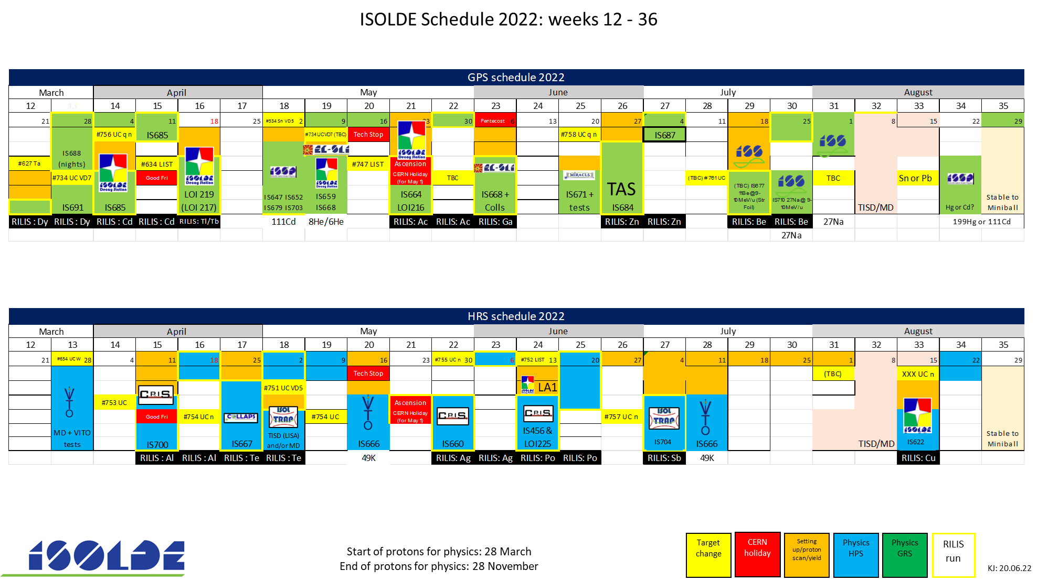

Slide 8
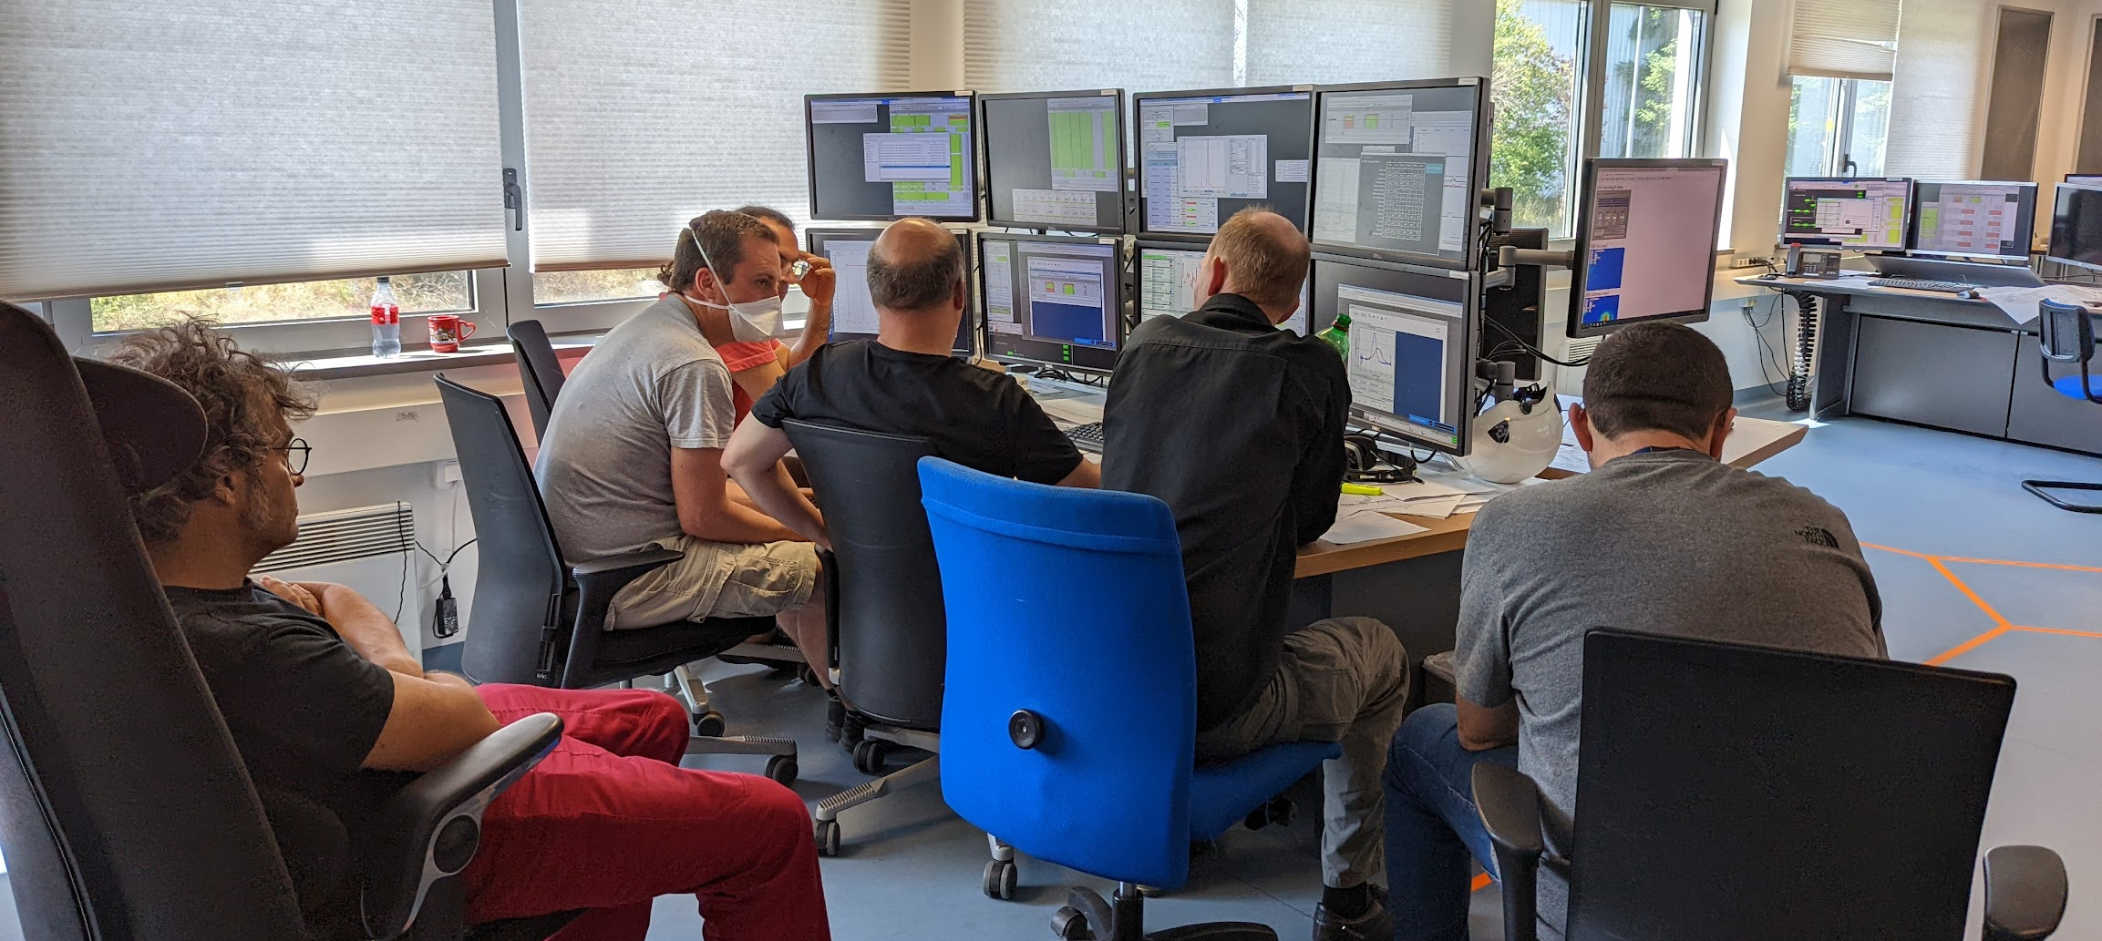
Concerns/issues for the Autumn
7gap vibrations could come back again
Lack of commissioning time has resulted in loss of reference setups for HIE ISOLDE (which have been invaluable for low energy this year).
EBIS not holding LHe as well as previously.
Miniball will be one of the principal experiments in the Autumn: assuming that all will be up and running
Delivery of H3 targets for HIE ISOLDE experiments.
Expect that some teams won’t be available at various stages in the Autumn
Nonetheless a draft planning is being worked on which should be released quite soon.
Good news!
  Euroloabs TNA will allow for more general support of users.

Slide 9
ISOLDE: draft planning for 2023 (still at discussion stage)
  Key Dates:
    Low energy
      Hardware Commissioning from the 24/02/2023 to the 12/03/2023
      Beam Commissioning from the 13/03/2023 to the 09/04/2023
      Beam for ISOLDE physics: 10/04/2023
    HIE-ISOLDE
      Hardware Commissioning from the 24/02/2023 to the 21/05/2023
      Beam Commissioning from the 22/05/2023 to the 19/07/2023
      Beam for HIE physics: 20/07/2023
  Relevant information
  Despite being in the YETS maintenance and installation works period HIE-ISOLDE requires stable Cryo plant cooling conditions up to the end of week 50 (16/12/2022 for 2 wks controlled warm up of the Cryo Modules)
  Start of hardware commissioning in week 8 for the HIE-ISOLDE depends on the completion of cooling maintenance
  Start of hardware commissioning in week 8 for the low energy ISOLDE depends on the completion of ventilation works
  Beam from PSB to Low Energy ISOLDE in the beginning of week 13 (27/03/2023 for 2wks setting up BTY and SEMGRID tests)
Prepared with E. Siesling, J. Vollaire and J. A. Rodriguez
F Pedrosa from last week’s IEFC

Slide 10
Row Labels | Count of Count | Sum of Shifts remaining before 2022 till end of Run3
biophysics | 1 | 9.5
COLLAPS | 4 | 39
Collections: 108Ag | 1 | 30
Collections: 163Ho | 1 | 5
CRIS | 7 | 86.5
Gandalph | 1 | 8
Gandalph/CRIS | 1 | 6
HIE ISOLDE | 35 | 548
ISS | 11 | 135
ISS/Miniball | 1 | 17
Miniball | 17 | 275
Prototype | 1 | 0
SEC | 1 | 23
XT03 | 1 | 23
XT03: Actar | 1 | 21
XT03: Corset | 1 | 12
XT03: Edinburgh | 1 | 42
IDS | 15 | 170.5
IDS/ISOLTRAP | 1 | 6
ISOLTRAP | 5 | 43
Medical physics | 2 | 11
MIRACLS | 1 | 17
SSP | 11 | 97.5
TAS | 4 | 53
TISD | 8 | 37
TISD/IDS | 1 | 9
Travelling Setup | 2 | 17
Travelling Setup; ECSLI | 1 | 0
VITO | 1 | 28
WISARD | 1 | 24
TISD/Miniball | 1 | 4
TISD/TDPAC | 1 | 4
Grand Total | 106 | 1253
Reminder of backlog (including INTC69, but not the running period this year)

Slide 11
INTC 70 summary
ISOLDE | 13 | 232
Decay spectroscopy | 3 | 55
Addendum | 1 | 4
Letter of Clarification | 1 | 23
Proposal | 1 | 28
HIE | 4 | 62
Letter of Clarification | 1 | 21
Proposal | 3 | 41
Laser Spectroscopy | 3 | 49
Letter of Intent | 1 | 16
Proposal | 2 | 33
Mass spectrometry | 1 | 18
Proposal | 1 | 18
Proton upgrade | 1 | 28
Proposal | 1 | 28
Solid state | 1 | 20
Proposal | 1 | 20
https://indico.cern.ch/event/1162031/

Slide 12

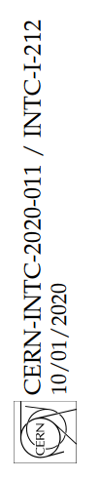
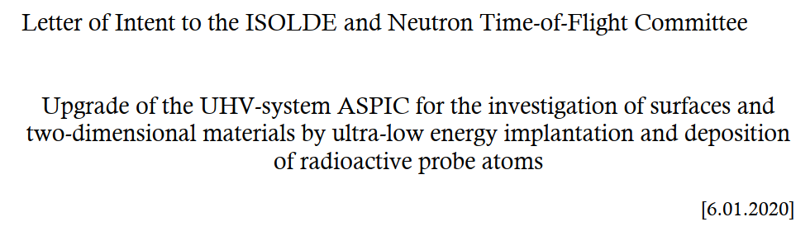
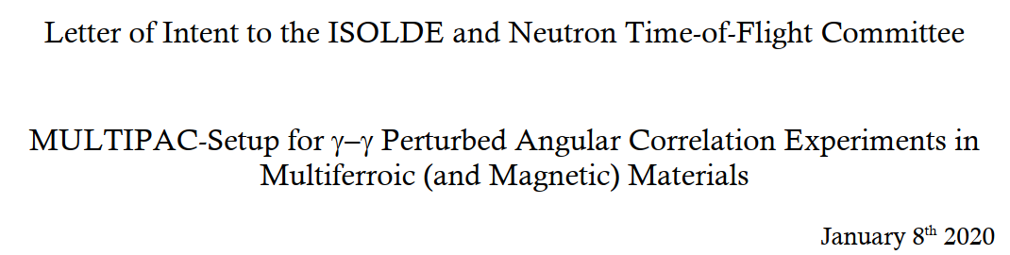


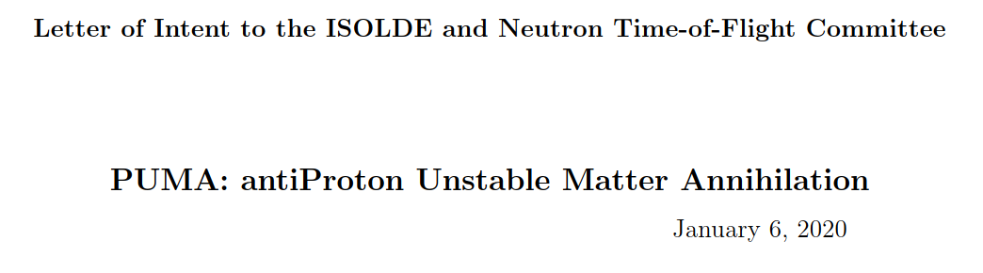
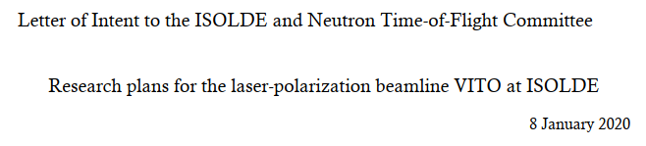

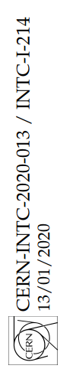
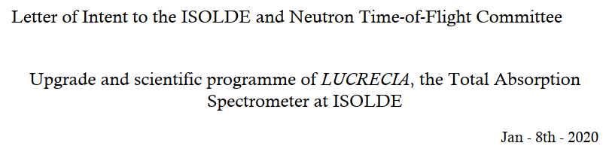
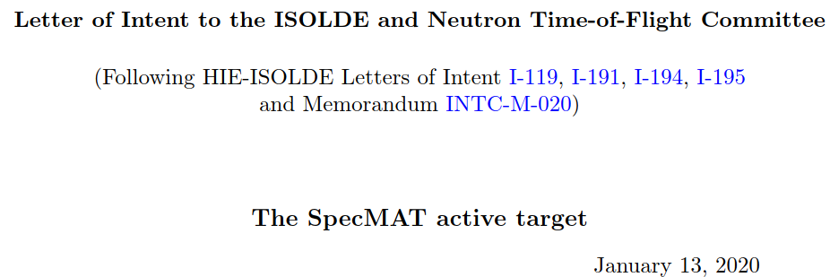


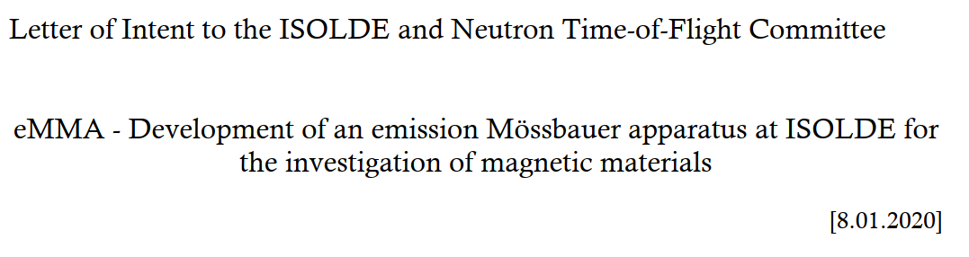
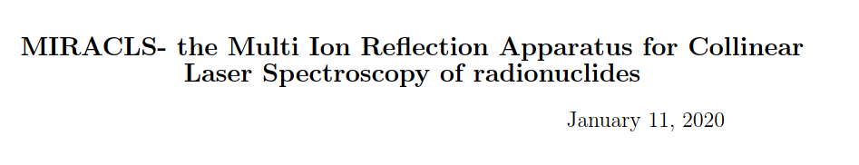
New setups/space in the hall

Slide 13
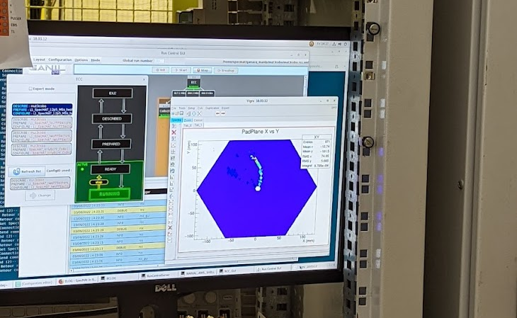
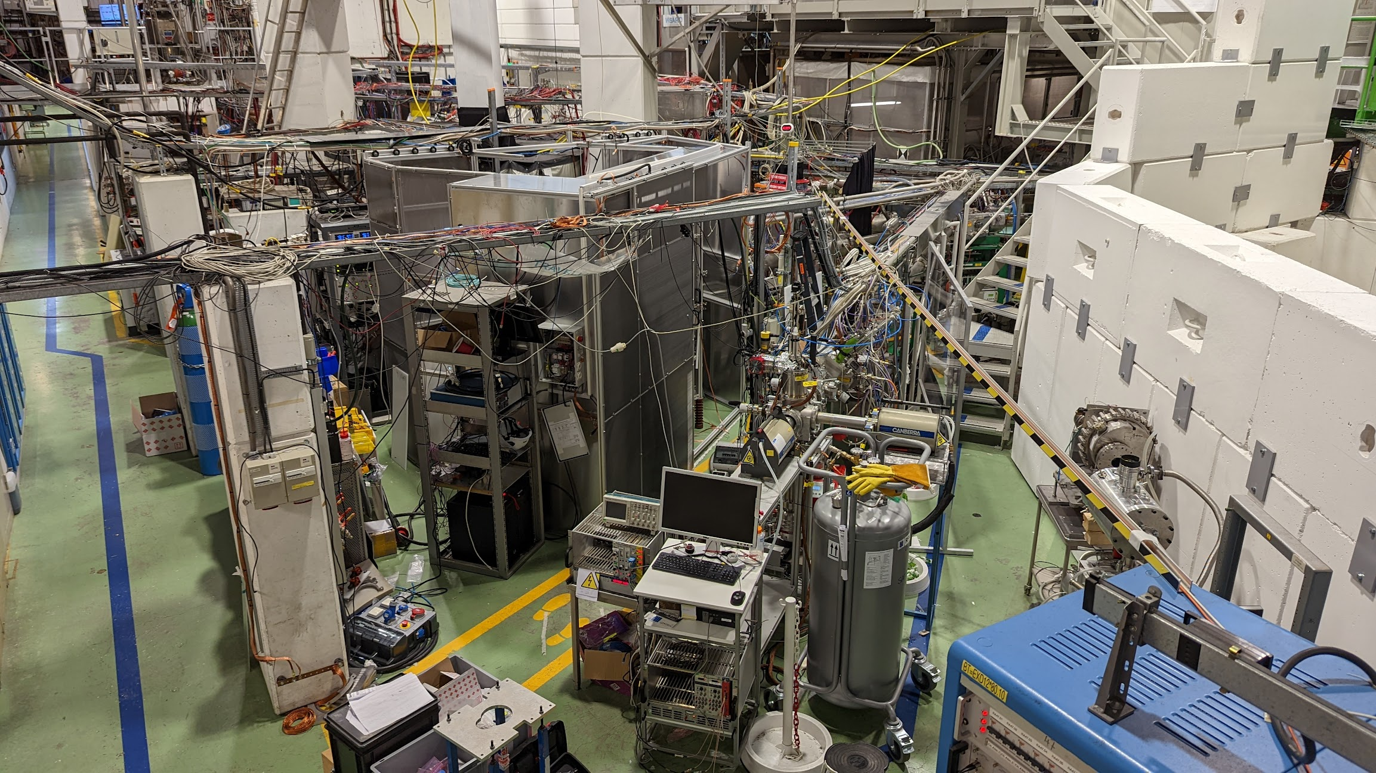
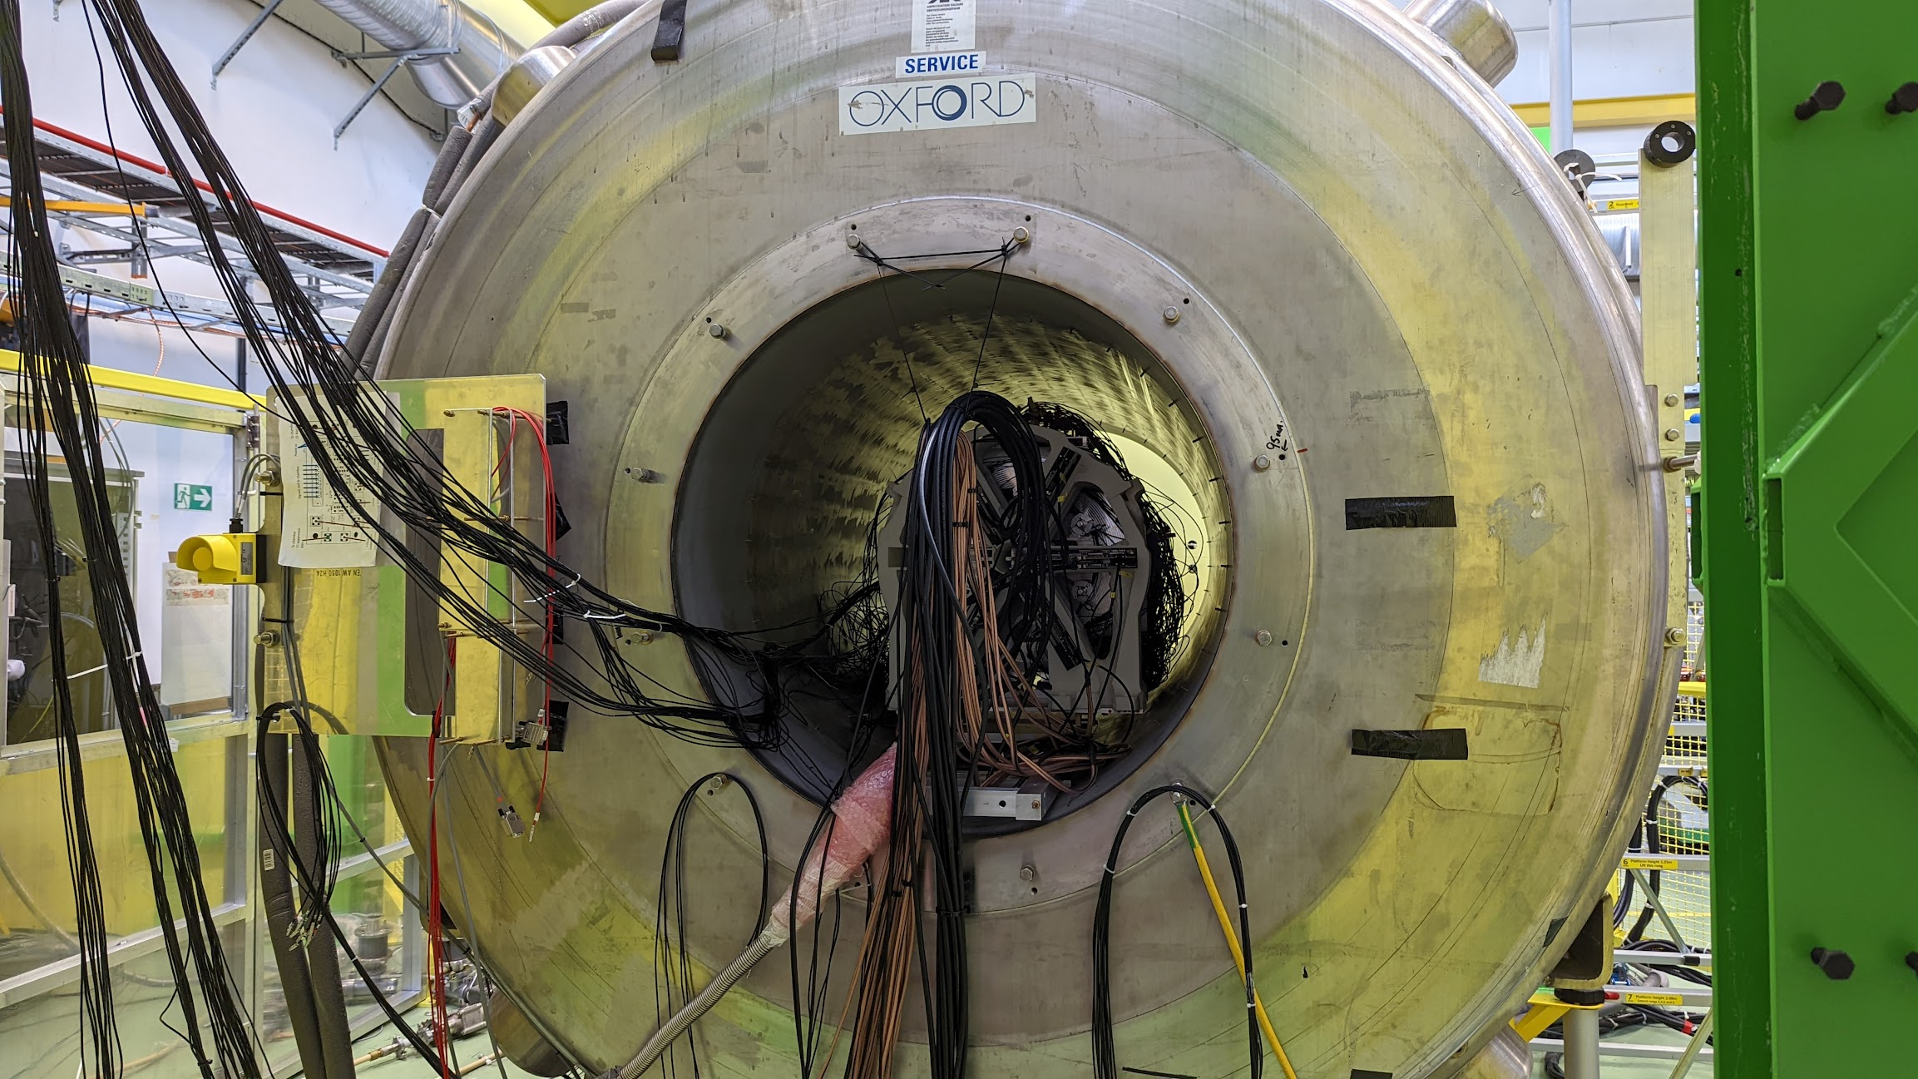
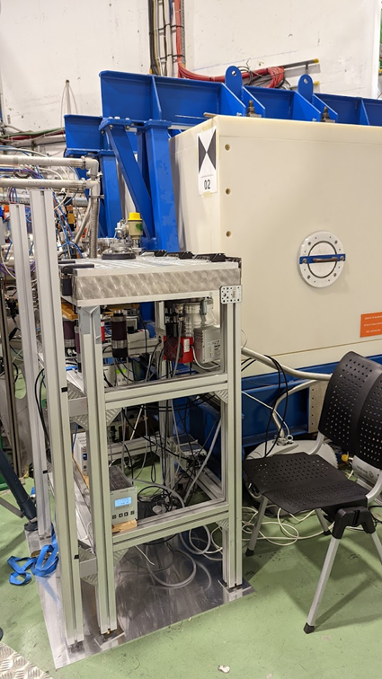
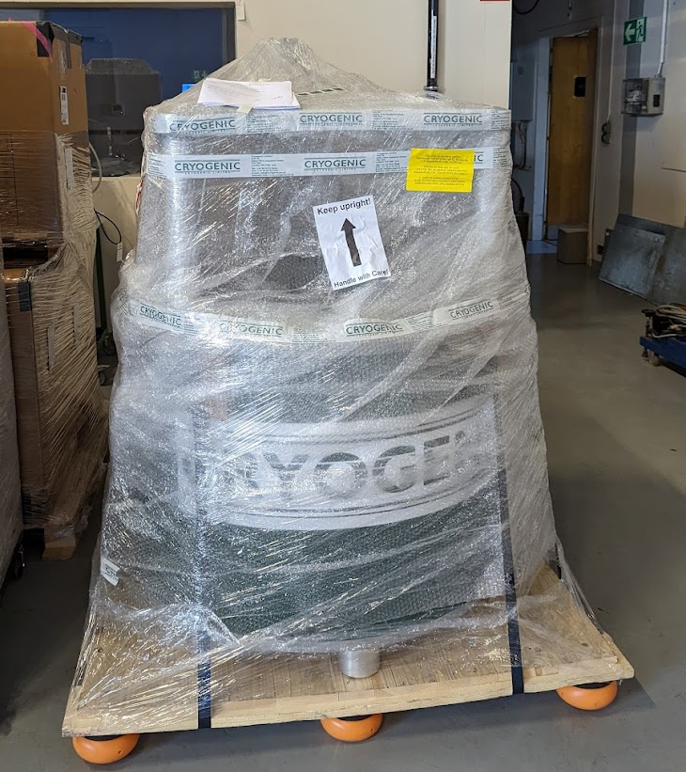
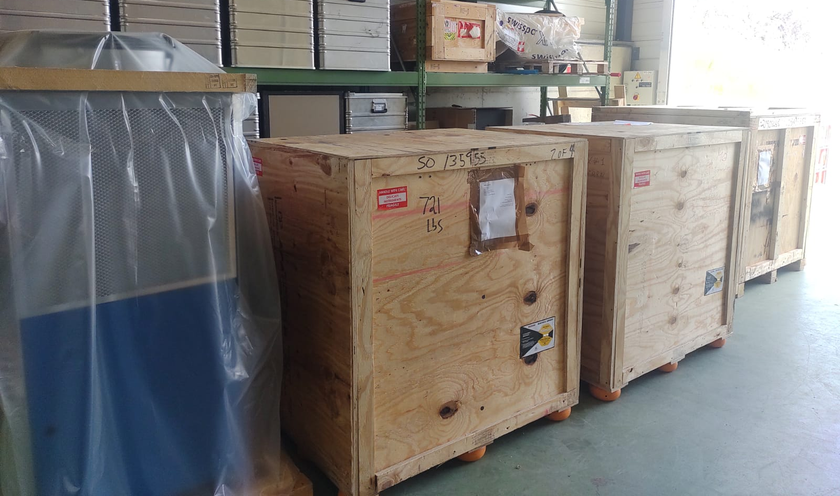
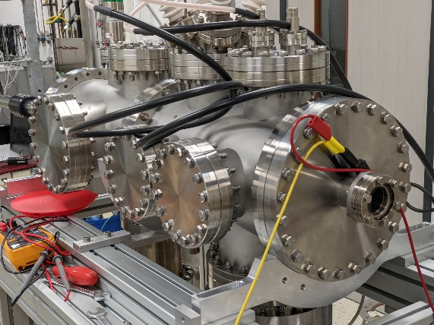
New/Updated setups: challenge of space in the ISOLDE hall
MIRACLS
SPECTMAT
TAS
MULTIPAC
EMMA
ASPIC/ASCII
Ultra-low energy implanation
Control of probe isotopes

Slide 14
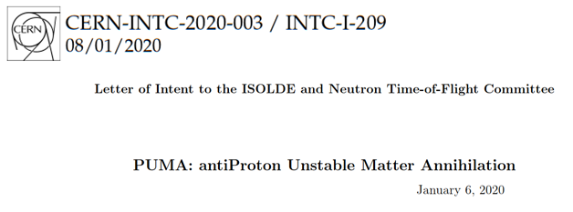
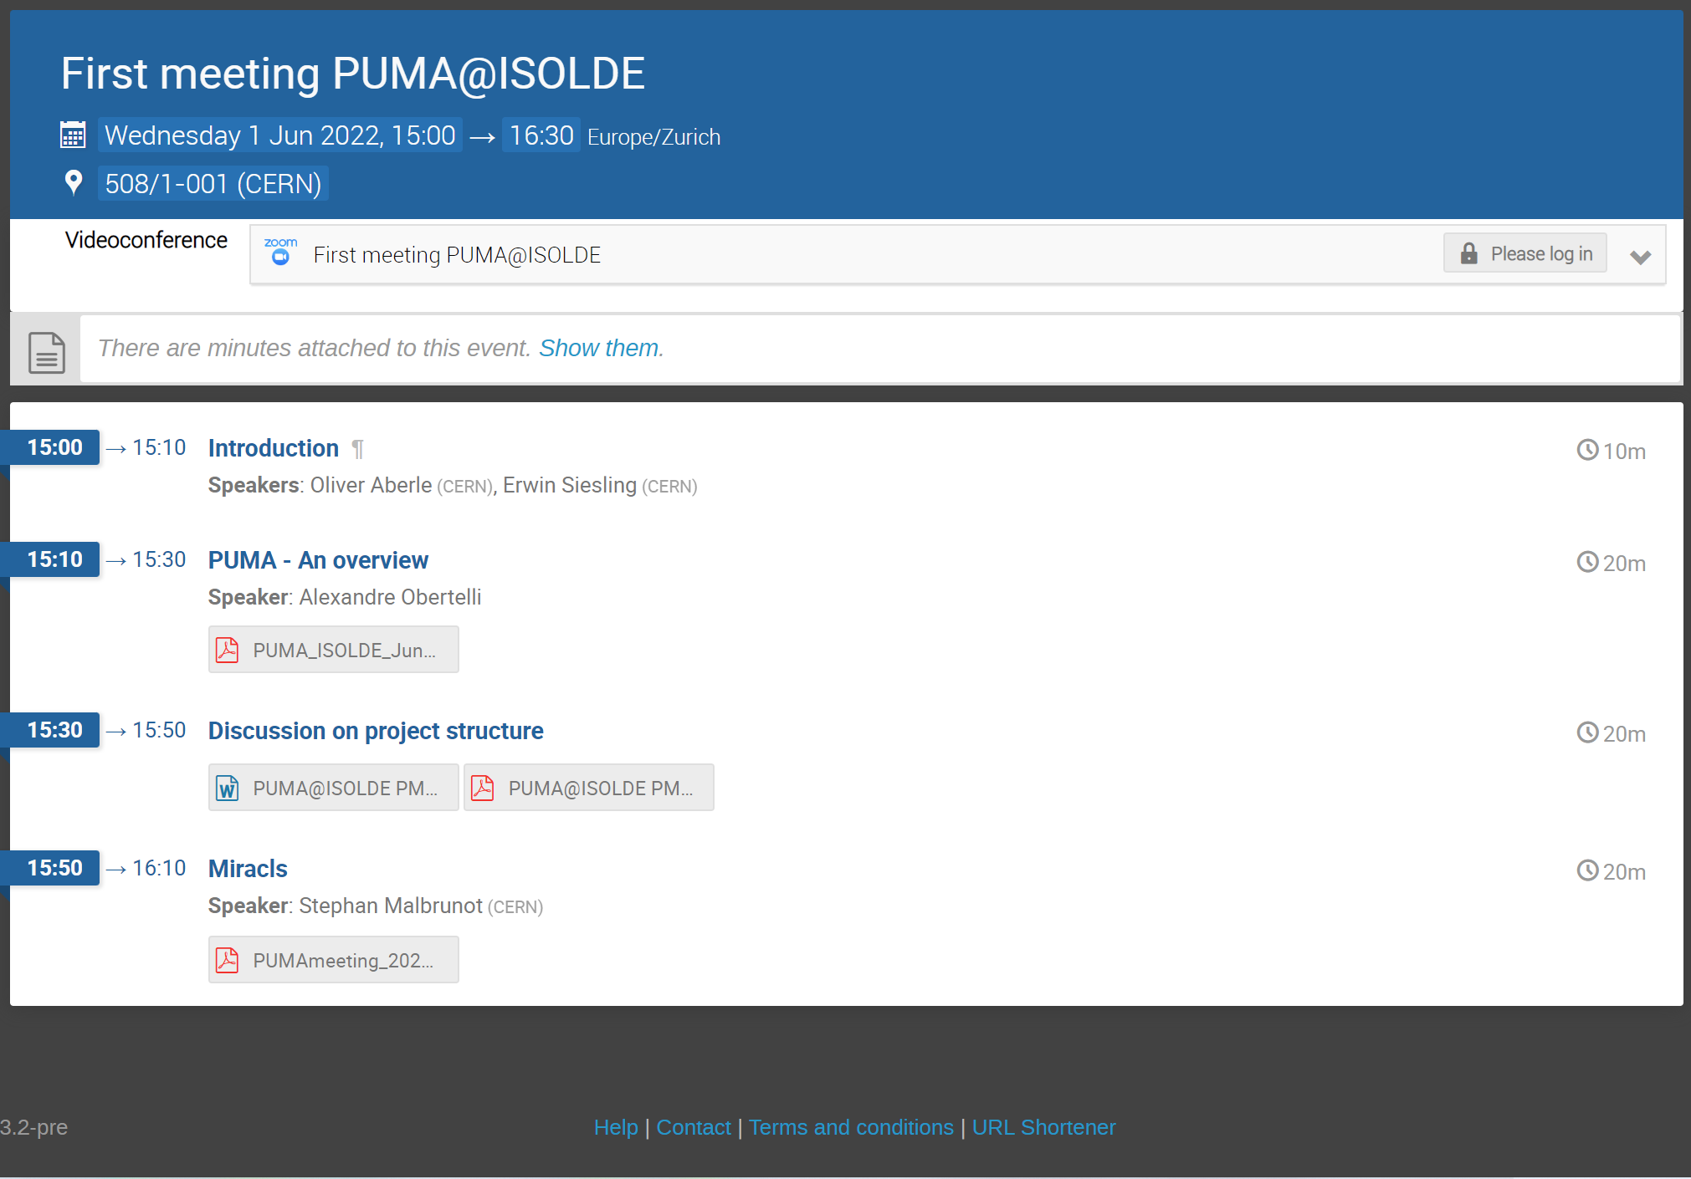

Slide 15
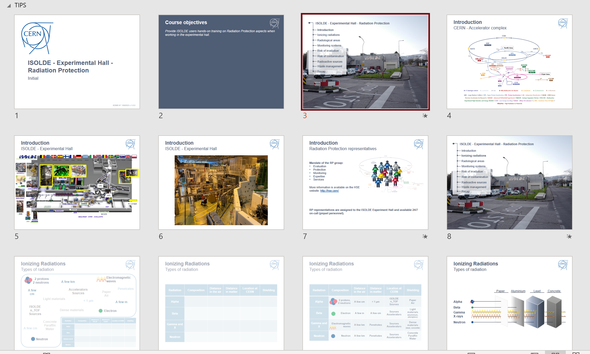
Training
In addition to the (ever-growing) number of online courses…
Hands-on RP and Electrical training
15 day deadline before scheduled course is cancelled. (has led to issues last year)
New EP-wide electrical course for all users/staff who need to work in an experimental area (legal requirement)
Both will take place on Tuesday but time has increased:
  EP course 0830 till 1230
  RP course 1400 till 1630
Availability of Electrical course not very stable. Taking all online courses will grant electrical training ranks (for the moment at least). Long term users based at CERN should try to take it when possible.
In LMS:
ISOLDE - Experimental Hall - Radiation Protection - Handling (Covid-19)
Electrical Safety - Working in EP experiments
Ad hoc sessions are available, but (especially in running period!!) are difficult to manage
Discussion with safety training ongoing to see if the hands-on sessions are still required for the majority of users (RP)
For laser users: new LSSO (laser safety officer) course will need to be followed and be appointed for local representatives of laser labs.

Slide 16
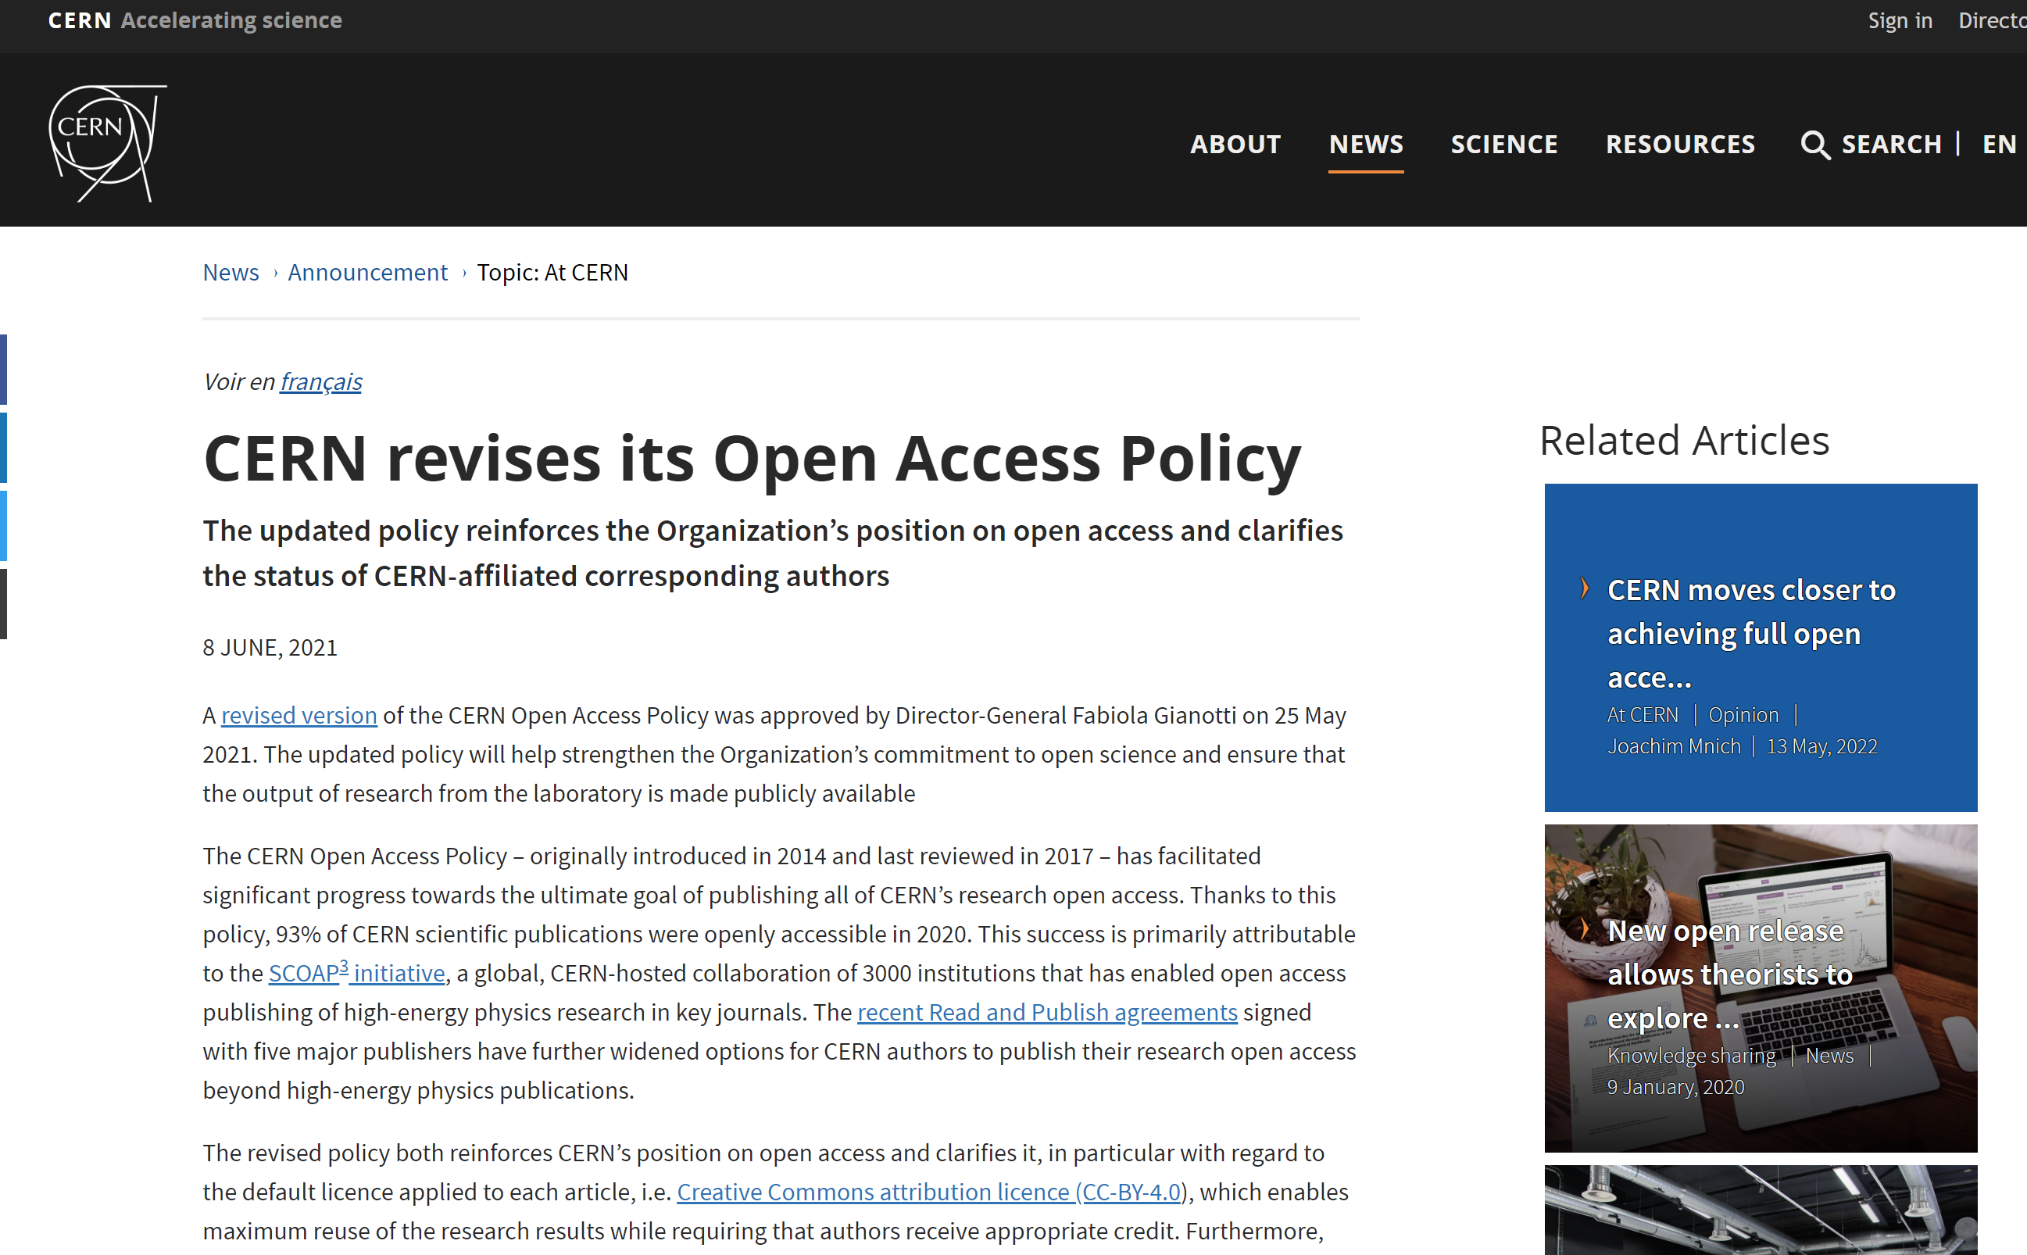
Publications: Open access
For any questions regarding publications originating from ISOLDE work: please contact the CERN Library (SIS)
https://scientific-info.cern/submit-and-publish/publish-open-access

Slide 17
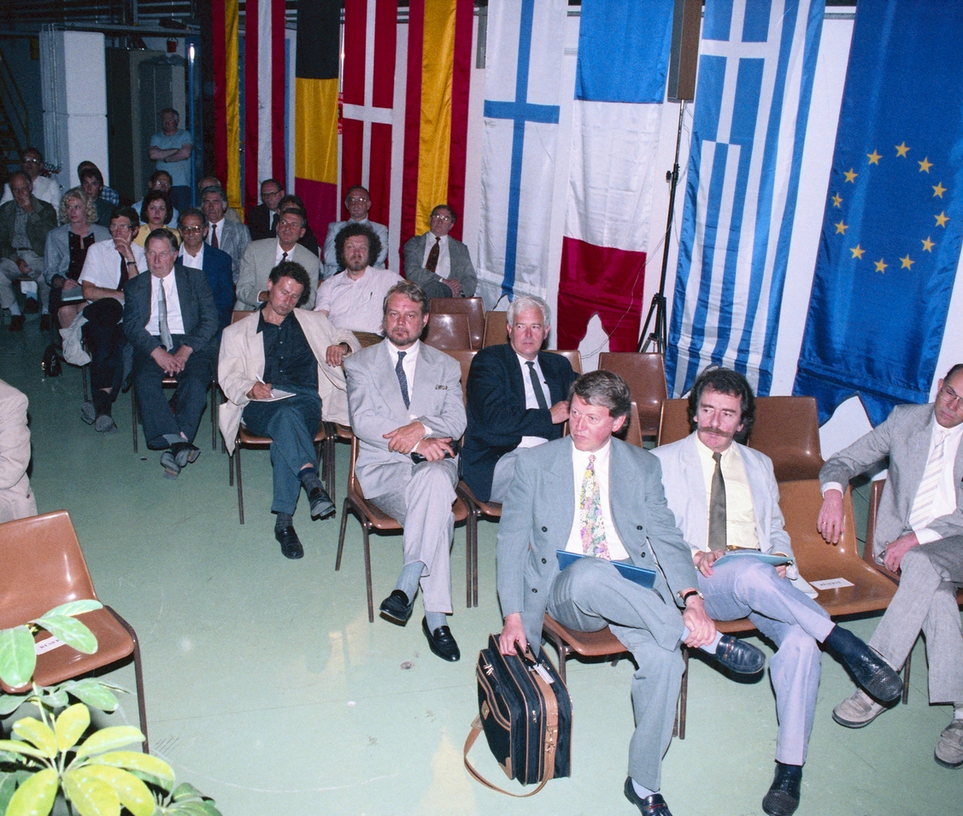
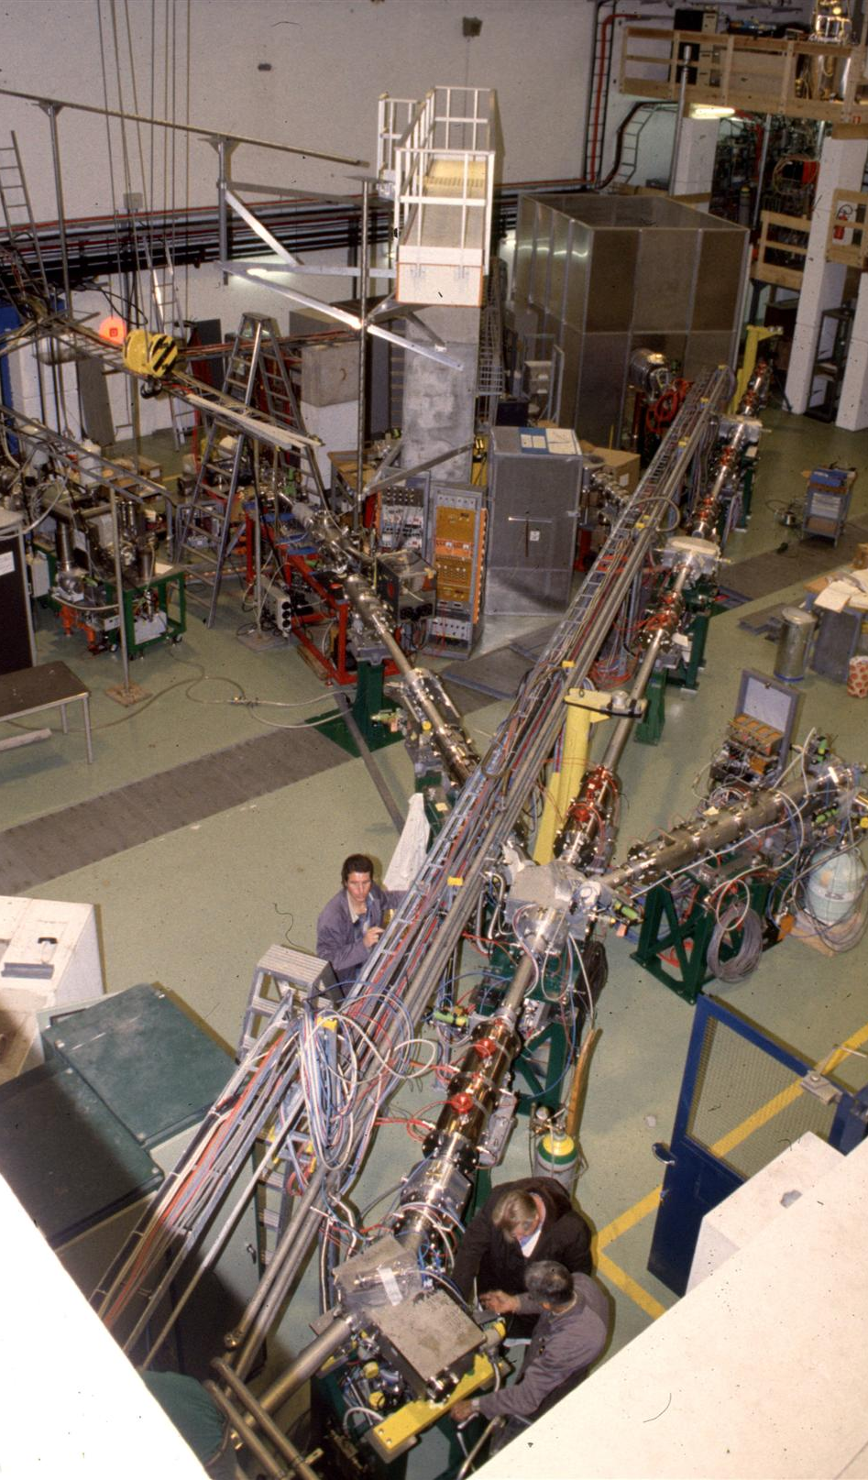
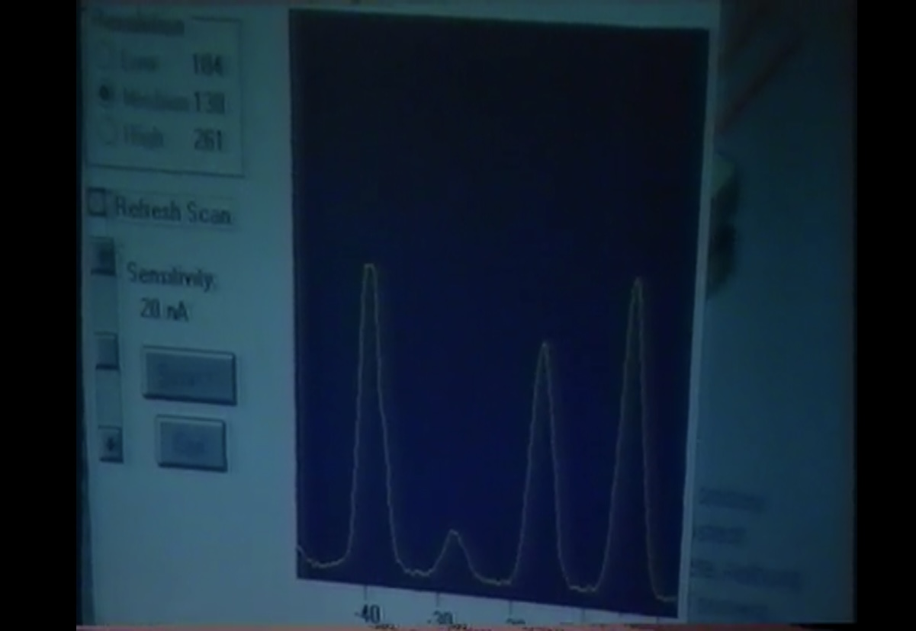
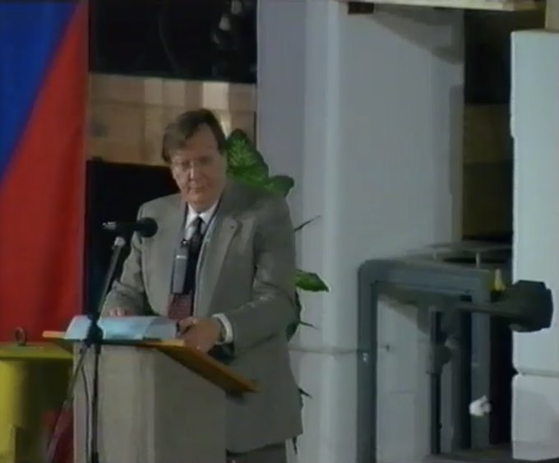
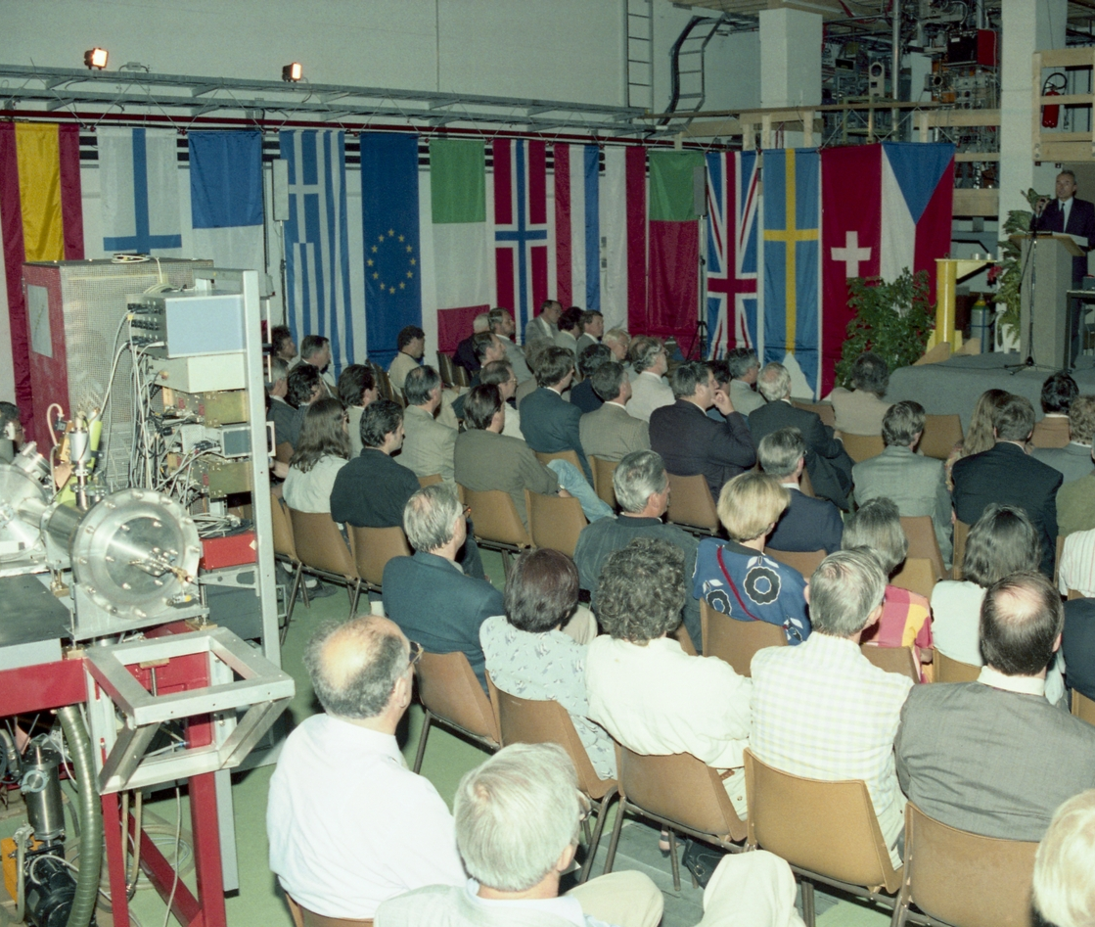
26 May 2022: 30 years since the inauguration of ISOLDE at the PSB
https://home.cern/news/opinion/cern/30-years-isolde-proton-synchrotron-booster

