Slide 2
Nikhef-INFN-CERN kick-off meeting
Vacuum system of the ET’s arms

Slide 3
Content:
Why is CERN involved in vacuum for GWT?
The Nikhef-INFN-CERN agreement and addendum.
Beam vacuum pipe: proposed WBS.
Potential contributions for ET collaborators.

Slide 4

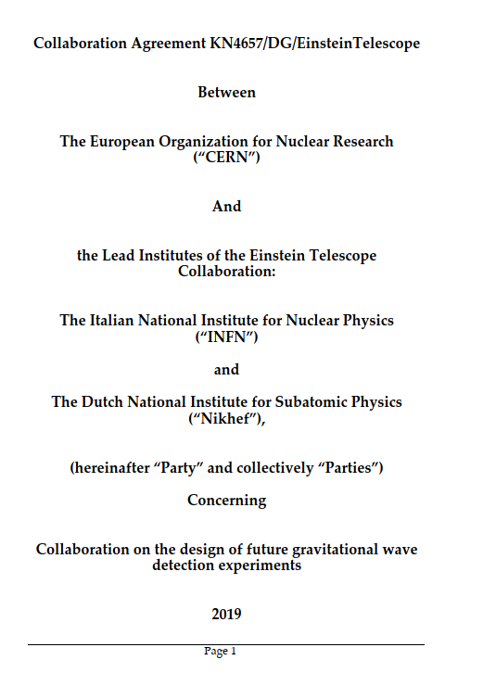
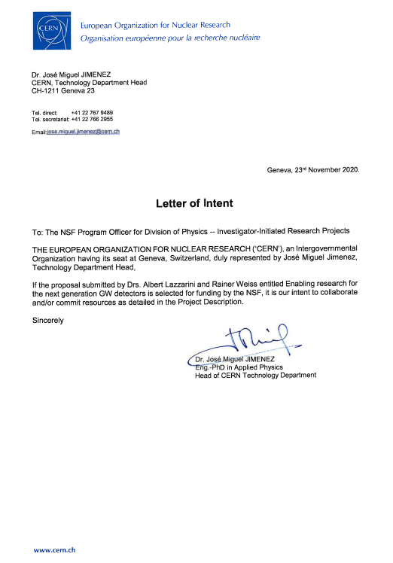
CERN participation in vacuum studies for Gravitational Wave Detectors
2019: NSF workshop on vacuum in GWT
2019: CERN-INFN-Nikhef agreement
2020: CERN-NSF L.o.I.

Slide 5
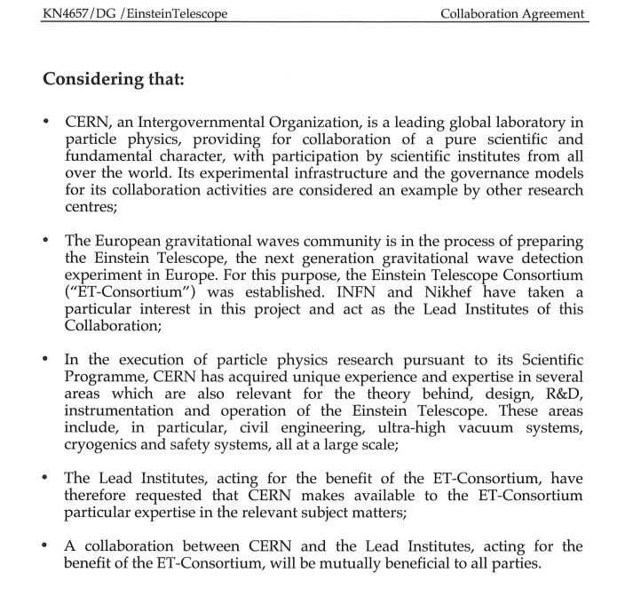

Slide 6



Slide 7
European strategy for particle physics
Synergies with neighbouring fields
The ground-breaking discovery of gravitational waves has occurred since the last Strategy update, and this has contributed to burgeoning multi-messenger observations of the universe.
Synergies between particle and astroparticle physics should be strengthened through scientific exchanges and technological cooperation in areas of common interest and mutual benefit.’

Slide 8
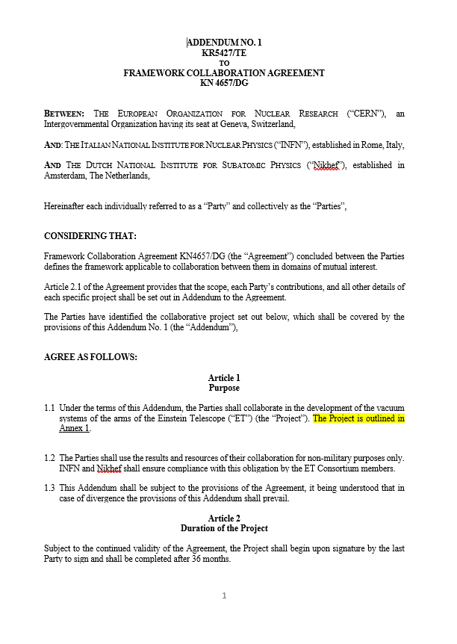
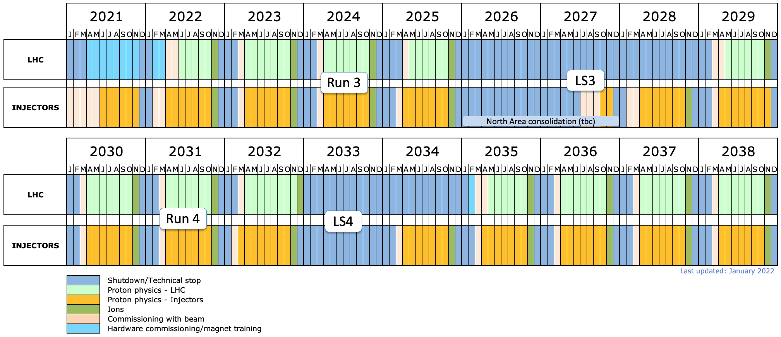
CERN participation in vacuum studies for Gravitational Wave Detectors
2022: Nikhef-INFN-CERN addendum
Nikhef-INFN-CERN
addendum

Slide 9
Main technical objectives of the addendum to the agreement
Re-evaluate the baseline solution (Virgo/LIGO) with minor modifications imposed by the new requirements.
Design and test technical solutions that fulfil the ET requirements and are less expensive than the baseline. The required technical infrastructure will be evaluated and optimized as well.
Manufacture, assembly and test a pilot sector.
Write the technical design report, including cost estimations.
Main coordination objectives of the addendum to the agreement
Coordinate the effort of ET collaborators interested in the same technical objectives.
Coordinate the contact and sharing of information with Cosmic Explorer in the field of vacuum technology.

Slide 10
Boundaries of the addendum to the agreement
This collaboration:
does not include the vacuum of the experimental towers. Ongoing discussion about cryogenic traps at the pipe extremities;
needs important inputs from the other services, including civil engineering, alignment, cooling-ventilation, electrical infrastructure, transport and handling, logistics, premises and planning;
needs essential input from the physics teams to froze the functional specification.
First step
The first step of this collaboration is the definition and editing of the functional specifications, which comprise beam pipe requirements, and constraints with respect to infrastructures and services.

Slide 11
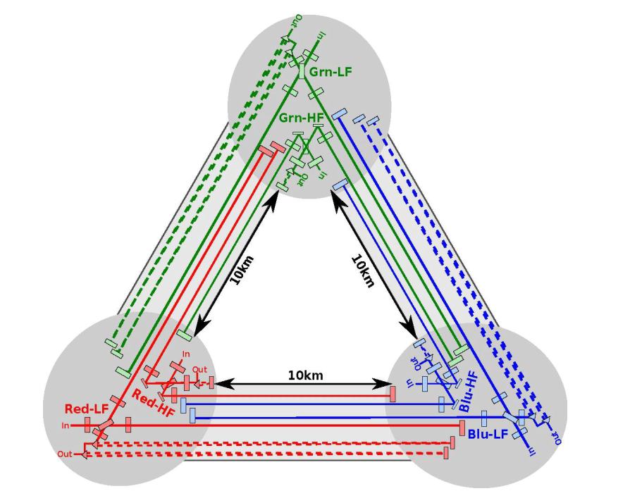
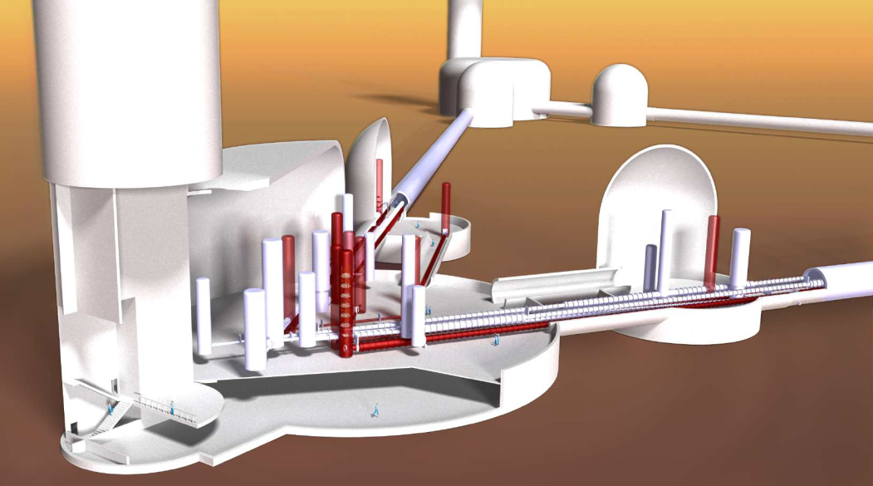
Known vacuum & mechanical requirements of the ET’s arms
Items | Requirements | Comment
Pipe diameter | 1.0 m | Exact value not yet decided
Total length | ≈120 km | 3 arms of 10 km, 4 pipes per arm
Hydrogen partial pressure | order of 10⁻¹⁰ mbar
Water vapour partial pressure | < 5x10⁻¹¹ mbar
Hydrocarbon partial pressures | < 10⁻¹⁴ mbar
Lifetime | 50 years

Slide 12
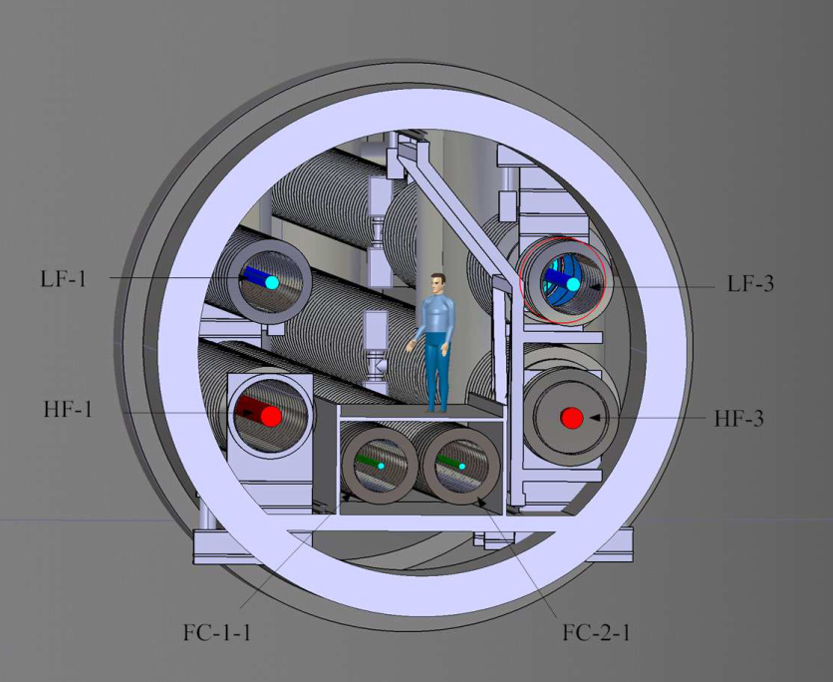

Slide 13
The baseline (VIRGO)
Material: AISI-304L, 4-mm cold rolled sheets, solution annealed, surface finish 2B (EN1.4307 by Avesta), ring reinforced, modules 15-m long, 1.2-m diameter
Production rate: 1 module per day, made of 3 consecutive cylinders and an hydroformed bellow
Total number of modules: 404 (for ET 20 times more are needed)
Degassing treatment: air firing 400°C for 72 hours (4 modules per treatment)
Bakeout: 150°C for 1 week, Joule effect (2000 A)
Hydrogen outgassing rate: less than 5x10⁻¹⁴ mbar.l.s⁻¹.cm⁻²

Slide 14
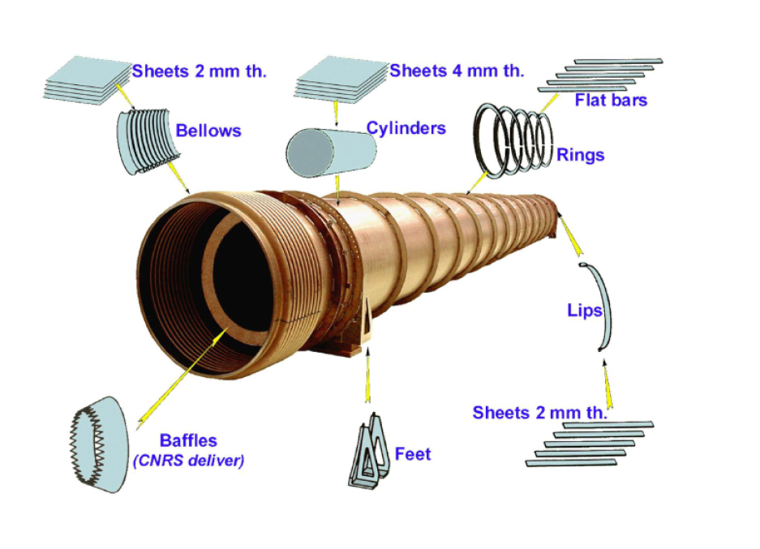
The baseline (VIRGO)
Courtesy of A. Pasqualetti

Slide 15
Other technical solutions
Other technical solutions will be investigated only with the well-defined objective of reducing the overall costs with respect to the baseline, while fulfilling the required performance.
Examples are:
Corrugated stainless steel pipes.
Use of less expensive materials, for example mild steels and ferritic stainless steels.
Use of coatings and/or surface treatments to avoid bakeout.

Slide 16
Pilot sector
The choice of beam pipes and vacuum system for the pilot sector(s) will be made by the ET directorate two years after the beginning of this collaboration based on the design, tests and cost analysis obtained at that time.
CERN will manufacture, install, and test a pilot sector of the selected solution for the fine-tuning of the design and the measurement of vacuum performance. The main objective will be the test of the selected design(s) at the ET scale, except for the length.
This includes:
Supply of the vacuum pipes by the EU industry.
Welding of pumping ports and extremity flanges.
Real scale cleaning and its assessment by surface analysis.
Assessment of the proposed degassing treatments.
Test of tolerances, support stability and adjustment.
Installation of the selected pumping system.
Bakeout, leak tightness and ultimate pressure measurements.
All infrastructure for the installation of the pilot sector are already available at CERN, including metrology and handling, without a significant investment.
This is an asset for ET, in addition to the presence of experts.

Slide 17
Technical design report
The TDR will be the main outcome of this contribution.
The TDR will include manufacturing, post-production treatments, installation, and commissioning procedures.
The interfaces with the tunnel infrastructures and services will also be included in the TDR.
It will contain the manufacturing drawings necessary for the prototypes and the integration with the other vacuum systems (towers and cryogenic traps).

Slide 18
Contacts with Cosmic Explorer
CERN will ensure the link with the CE vacuum technology community.
Experimental data, results, and progress will be openly shared in regular meetings.
Such contacts will have the positive effect of cross-fertilisation and peer review between the two communities.

Slide 19
Personnel & Material
In the frame of the Nikhef-INFN-CERN agreement, two full-time CERN staff and two CERN fellows are dedicated to the project for three years.
Material costs up to 200 kCHF are considered in the agreement.
Additional resources are welcome.

Slide 20
WP1: engineering
WP2:
production
WP3:
treatments
WP4:
transport
WP5:
installation
WP6:
vacuum
Design and engineering of the vacuum chamber
Choice of materials and manufacturing technology
Choice of post-manufacturing treatments
Handling and logistics
Installation procedure and interface with other systems
Choice of vacuum pumps and valves
WP7:
prototyping
WP8:
coordination
Installation and test of a pilot sector
Coordination of the different work packages and contribution of collaborators
Work-Breakdown Structure

Slide 21
Work-Breakdown Structure: WP1
WP1: engineering
1.1 Mechanical design and stability analysis of the pipe (pipeline and corrugated).
1.2 Provide a detailed design of the supports for the two versions.
1.3 Design of the pumping modules and their interface with the main pipes.
1.4 Assessment of the thermal characteristics during bakeout and choice of thermal insulation.
1.5 Design of the baffle and their integration in the pipes.
1.6 Provide cost analysis of pipes, supports, baffle and pumping modules.
Design and engineering of the vacuum chamber

Slide 22
2.1 Choice and acceptance tests of steel grade and processing for corrugated and pipeline-like vacuum chambers
2.2 Choice of raw material treatments before manufacturing
2.3 Choice and tests of manufacturing for corrugated walls and pipeline-like vacuum chambers
2.4 Methods for hydrogen degassing of materials, including precleaning if necessary.
2.5 Choice of manufacturing for the pumping module
2.6 Choice of manufacturing for the supports.
2.7 Qualification of the weld procedures for ex-situ welding.
2.8 Quality control including leak test procedure during production
2.9 Mechanical finishing and preparation for in-situ welding.
2.10 Cost assessment of manufacturing
Work-Breakdown Structure: WP2
WP2:
production
Choice of materials and manufacturing technology

Slide 23
Work-Breakdown Structure: WP3
3.1 Choice of the final surface treatment for the corrugated walls.
3.2 Choice of the final surface treatments for the pipeline-like vacuum chamber.
3.3 Procedure to validate surface cleanliness.
3.4 Choice of contamination barriers and packaging after cleaning.
3.5 Measurement of the thermal insulation efficiency (for bakeout) .
3.6 Feasibility study of coatings for the reduction of water vapour outgassing.
3.7 Cost assessment of post-manufacturing treatments.
WP3:
treatments
Choice of post-manufacturing treatments

Slide 24
Work-Breakdown Structure: WP4
4.1 Maximum length and weight for transport and handling.
4.2 Transport and handling procedures for pipes on road, on surface and in underground tunnels.
4.3 Storage strategy at the production unit, surface cleaning plant, and at surface buildings.
4.4 Procedure for installation and bakeout sequence (access point to tunnels).
4.5 Define logistics and quantity of thermal insulation and bakeout materials.
4.6 Estimation of costs for transport, logistic and storage.
WP4:
transport
Handling and logistics

Slide 25
Work-Breakdown Structure: WP5
5.1 Design of tooling for assembly in the tunnel.
5.2 Procedure for alignment.
5.3 Procedure for in-situ welding.
5.4 Procedure for final leak test.
5.5 Procedure for the repairing/replacement in case of leaks or non-conformities in the phase of assembly.
5.6 In-situ bakeout methods, equipment and procedure.
5.7 Constraints from and impact on the other systems in the phase of installation.
WP5:
installation
Installation procedure and interface with other systems

Slide 26
Work-Breakdown Structure: WP6
WP6:
vacuum
6.1 Complete the vacuum layout: sectorisation, pumps and gauge positions.
6.2 Choice of sector valves.
6.3 Choice of the vacuum system.
6.4 Choice of pressure measurement, control system and monitoring.
6.5 Design the vacuum system at the interconnection (boundaries) with the experimental areas.
6.6 Outgassing measurement of proposed materials and treatments.
6.7 Cost estimation for vacuum system.
Choice of vacuum pumps and valves

Slide 27
Work-Breakdown Structure: WP7
7.1 Purchasing of vacuum chambers, vacuum module, supports, pumping system, control system and instrumentation.
7.2 Purchasing of equipment for bakeout
7.3 Preparation of the area of installation at CERN.
7.4 Installation of supports and pilot sector.
7.5 Vacuum commissioning and tests.
WP7:
prototyping
Installation and test of a pilot sector

Slide 28
Work-Breakdown Structure: WP8
8.1 Coordinating the work packages of the Nikhef-INFN-CERN collaboration, including the tracking of the collaboration costs, planning, deliverables, and reporting. Share the sets of information via a webpage and CERN-EDMS data bases.
8.2 Coordinate the contribution in the frame of the Nikhef-INFN-CERN agreement with the contributions of the ET collaboration.
8.3 Organize the coordination meetings on average every two months and an annual meeting to address progress and challenges.
8.4 Ensure the contact and sharing of information with Cosmic Explorer in the field of vacuum technology.
8.5 Provide a detailed cost analysis of the vacuum system of the ET’s arms.
8.6 Prepare a global QA plan
8.7 Write the TDR integrating all contributions.
WP8:
coordination
Coordination of the different work packages and of contributions of collaborators

Slide 29
Global planning

Slide 30
Formal approval
Kick-off meeting
Start up phase
Functional specifications
Start-up phase
Availability of CERN FELLs
Definition of the contributions from ET collaborators
Contact with the Industry
Review of the baseline costs
Thin wall solution.
GEO adapted to ET scale.
Alternative materials and design for pipelines
Technical work
Contact with the Industry
Procurement of pilot sector
Prototyping
Manufacturing

Slide 31
Potential contributions of ET collaborators to WPs
All WPs are open to ET collaborators that are or intend to be involved in the study of the beam pipe of the ET’s arms.
The collaboration of other institutes in the frame of the Nikhef-INFN-CERN agreement :
would create a common platform for the proposal of the ET’s arms, that would ensure cohesion, coherence and a critical size in one of the most expensive systems of the ET project;
could be direct, when responsibilities in WP deliverables are ascribed, or indirect, participating in the regular meetings and sharing data and progress reports;
might increase the chance of receiving funding from national agencies,
would benefit of the coordination of CERN leading to the TDR under the guidance of the ET directorate,
would be site independent.

