Slide 1
WLCG DC Monitoring follow-ups
WLCG Monitoring TaskForce
07.11.2022

Slide 2
WLCG Monitoring Task Force
WLCG Monitoring TaskForce was presented on December 2021
  During WLCG Operations coordination meeting
  Real activities started January 2022: meetings, JIRA project...
Core team of ~6 people in "best effort"
  Alessandra Forti, Borja Garrido, Derek Weitzel, Julia Andreeva, Rizart Dona, Shawn McKee
  Meeting every 2 weeks for checkpointing and planification
  Special thanks to Katy Ellis and Robert Currie for their contributions in XRootD Improvements

Slide 3
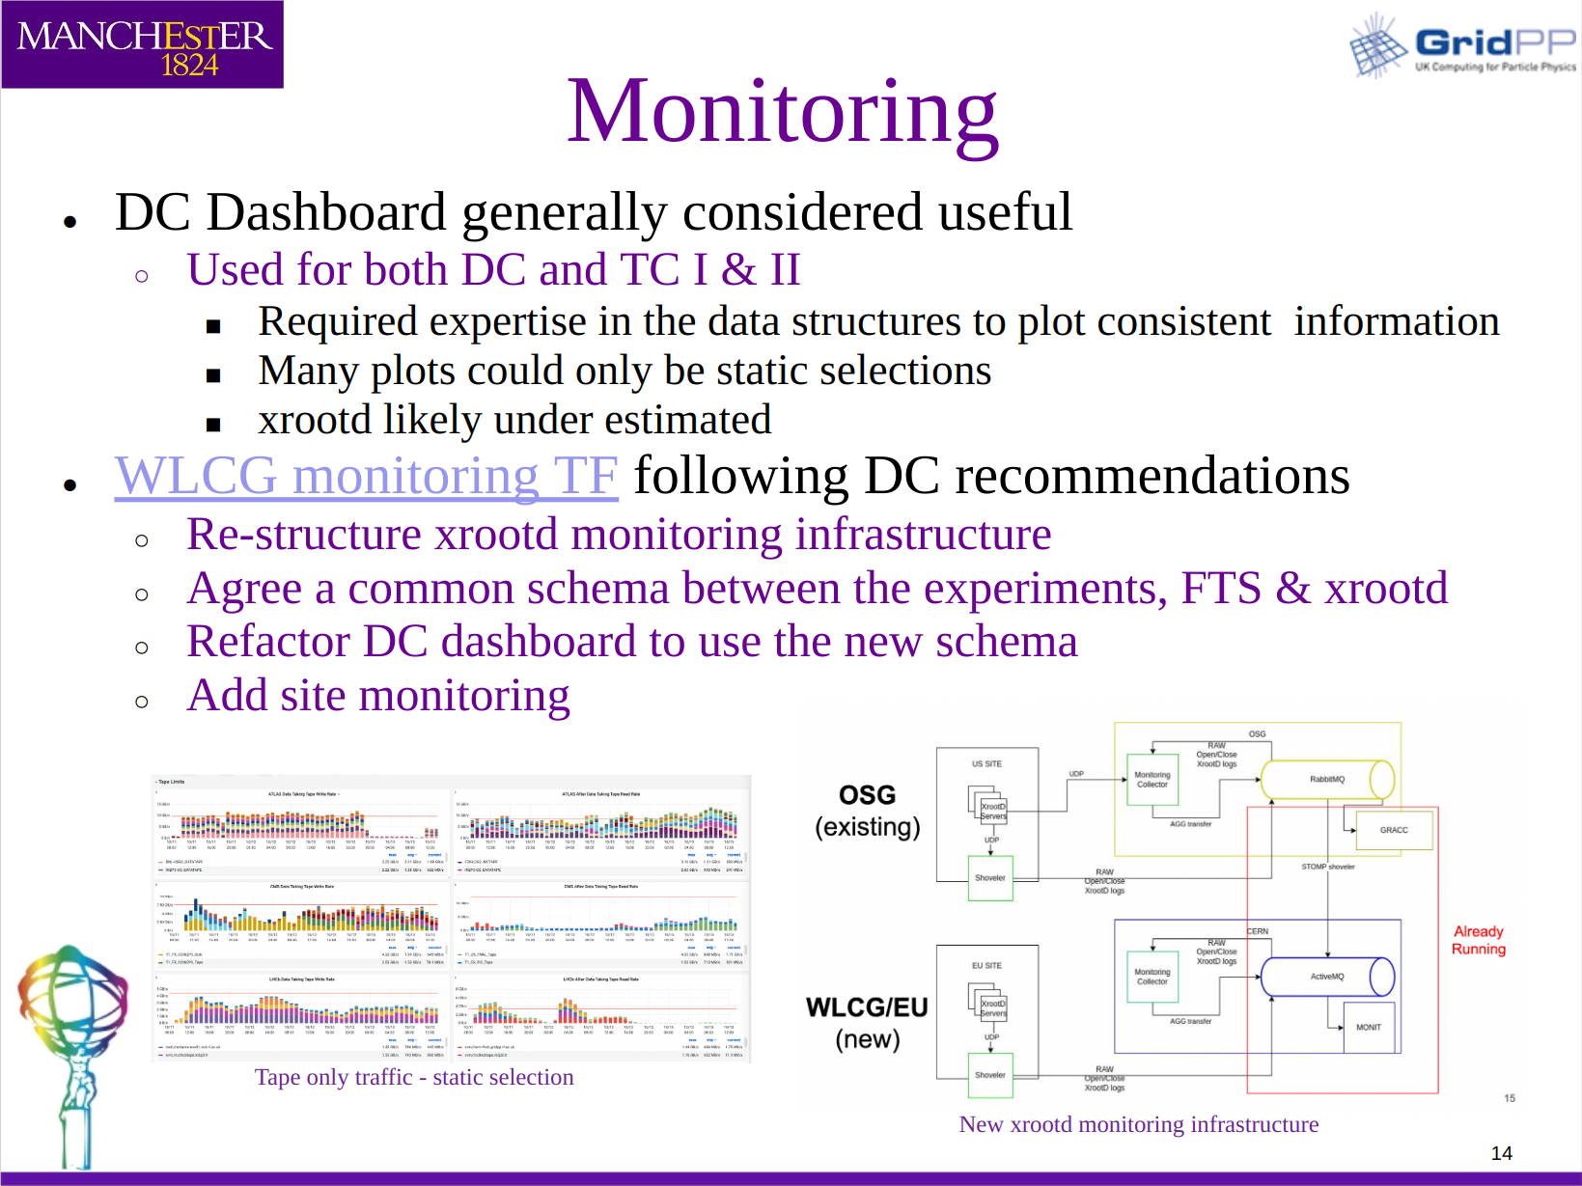
Introduction
WLCG DC 2021
  Successfully performed
  Last presentation provided May 2022
  Monitoring recommendations were done
WLCG Monitoring TF
  Focused on three main areas:
    XrootD Monitoring re-structure
    Transfer data harmonization
      Common Schema
      Common DC Dashboards
    Site monitoring
Last update provided during GDB

Slide 4
WLCG transfers data harmonization

Slide 5
Main goals
Consolidate schema between FTS/XRootD transfer documents
  Agree on a minimum required schema for both flows
Adapt WLCG transfers dashboards to new common schema
  Provide a set of useful dashboards under the WLCG umbrella
  Avoid specificalities for experiments

Slide 6
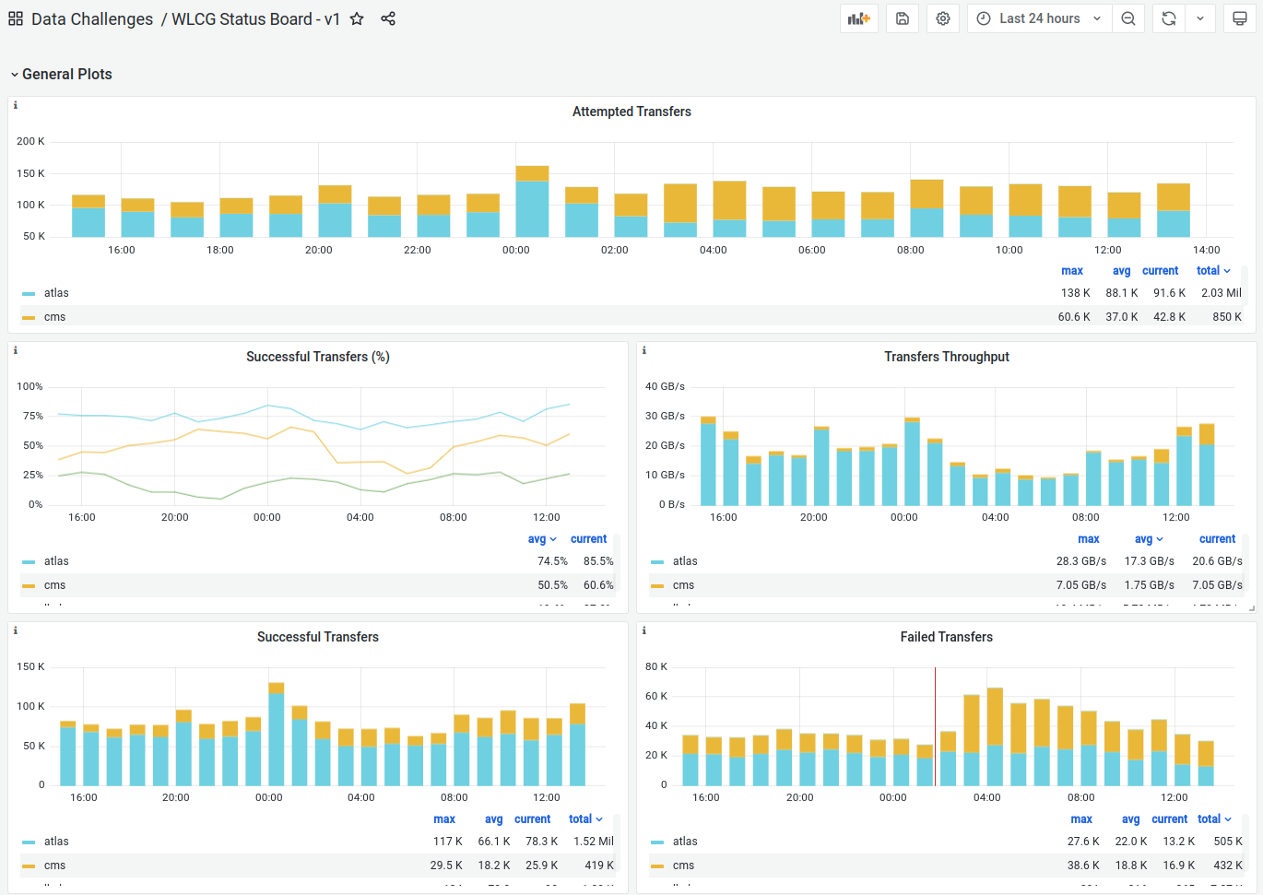

Slide 7
Status update
First dashboard version was created
  With striped VO specificalities and current available schema
Draft document was created and circulated
  Proposing the minimum required fields that the tools will need to provide
Feedback was collected and discussed
Agreement reached with experiments on the fields to aim for
Meet developers (XRootD, FTS, dCache)
  To understand need for changes to fit the schema
Adapt dashboard to make full usage of the new schema

Slide 8
XRootD monitoring improvements

Slide 9
Main goals
Redesign current implementation based on XRootD server reports
  Relying on the UDP protocol
  Work implies collaboration between MONIT and OSG developers
Coordinate with dCache developers to enable monitoring flow
  For the use case dCache+XRootD port
Make sure that XRootD is properly integrated in the WLCG transfer monitor
  Including also ALICE XRootD monitoring flow

Slide 10
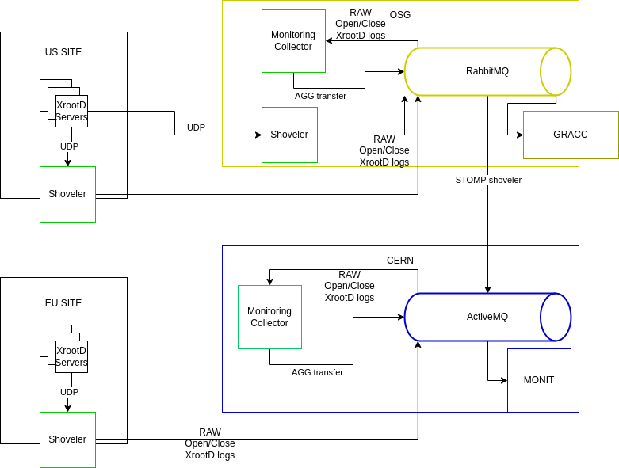
"New" Architecture
OSG
WLCG

Slide 11
Architecture Components
Two new components XRootD shoveler and XRootD collector
  Already developed and deployed for OSG when WLCG work started
XRootD Shoveler
  New component that ships XRootD monitoring streams to a message queue
  Main goal is to deploy it as close as possible to the XRootD server
    Motivation is to reduce the chance of losing UDP packets
XRootD Collector
  Similar component to the previous GLED collectors
  Receives and aggregates XRootD monitoring streams into a "transfer" document

Slide 12
Architecture Components (Missing development)
XRootD Shoveler
  Currently using non-TLS connection with basic auth
    Request to allow TLS (will require the usage of robot certificates)
  Improve shoveler installation docs for “non-docker” deployments
XRootD Collector
  Possible improvements driven by few issues found during first validation phase
    Will be mentioned later on another slide

Slide 13
Current situation OSG + WLCG
OSG
CERN MQ
(xrootd.aaa.cms.ng)
MONIT
ES (cms_raw_aaa_ng)
To be discussed if still needed or can be removed
Once WLCG flow is fully tested/validated
CERN
CERN MQ
(xrootd.transfers)
MONIT
CRIC enrichment
ES (xrootd_enr_transfers)
ES (xrootd_raw_transfers)
Temporary flow, required for early data validation

Slide 14
Current situation (OSG)
Running deployment for several sites already
  All Open Science Data Federation Caches - 9 shovelers across the U.S. and Europe (Amsterdam, Cardiff), Purdue, Florida, Nebraska, UCSD, Caltech, MIT T2 and T3
Sending monitoring data to CERN
  On a CMS specific flow (so not integrated with WLCG XRootD as for now)
Completed validation of the new flow
  Correctness and Scale

Slide 15
Last reported situation (WLCG)
Test bed deployment running on a Kubernetes cluster
  Currently we are running a battery of shovelers and a collector
    Shovelers should not be run centrally, but required for testing phase
Integrating EOS ALICE servers at CERN
  Closer to the development team, within CERN network (so less UDP loss risk)…
  Few servers reconfigured temporarily for sending data to the new flow
  Data was flowing as expected, but we observed a lack of VO information
Shoveler deployed in a few sites for testing purposes
  Manchester (ATLAS), RAL (CMS)
  Data integrated shows as well a lack of VO information in some of the cases
  First numbers comparison with internal monitoring from RAL don’t seem to match

Slide 16
Current situation (WLCG)
Started several tasks to tackle issues found on first phases
Numbers validation
  Validation of numbers between new flow and Monalisa
  Set a new test flow between OSG CERN to compare numbers between both deployments
  Re-do numbers validation for RAL with experts to understand discrepancies
Lack of fields
  Deemed to be produced by specific server configurations
  The idea is to start deploying the available components to more sites to assess situation better
    Missing a small development for the shoveler to work with certificates (CERN MQ requirement)

Slide 17
Other producers of XRootD data
ALICE Monalisa
  Current aim is to converge with this new flow
    XRootD servers will report in parallel to Monalisa and new shovelers
    WLCG Monitoring information will be based on the shovelers flow
xCache
  OSG already monitors their XCache instances with this new flow
    The same will be applied for WLCG
dCache
  Data will need to be integrated in a separate flow in MONIT
    Schema of the "final" data checked to be compatible

Slide 18
Network site monitoring

Slide 19
Motivation
Lack of information about network traffic for sites During DC1 in October 2021
Total traffic to/from our sites needed to identify issues/bottlenecks
Find a way to gather the minimal amount of information that will help us understand and improve how our sites work across the WAN.

Slide 20
Main goals
Provide human readable information about a sites network
  Template created for sites to clone and fill our following the instructions
  Examples can be found in Gitlab
  File needs to be converted to HTML, uploaded to a Site webserver and linked in WLCG CRIC
Provide site’s IN and OUT network traffic (total)
  Updated each minute, in a publicly accessible URL in JSON format
  Example Python3 script implemented
    Queries one or more interfaces representing site’s boundary

Slide 21
Status update
Preparation of Network template for sites to fill in
Add needed fields in CRIC for sites to define Monitoring links
Develop script to gather and expose minimum set of network metrics
Integrate metrics in MONIT for visualization
Tune-up script as required for different sites
Deploy script in T1s initially so a dashboard can be created

Slide 22
Site’s homework
Sites will be expected to:
Document their network at a high-level, with options to provide helpful details
  Information about site topology, peering, hardware and capacity can allow WLCG network experts to better support, diagnose and fix network problems
Gather (via snmp or other data source) the IN/OUT traffic of their whole site
  This requires identifying the interface(s) that represent the “border” of the site and a mechanism to gather the interface(s) traffic
Provide URLs to access the network information and monitoring files
Maintain the documentation and update monitoring as networking at the site evolves

Slide 23
Questions & Answers
Contact: wlcgmon-tf@cern.ch
Shoveler installation docs

Slide 24
Acknowledgments
OSG contributed XRootD and Site Monitoring improvements:
This project is supported by the National Science Foundation under Cooperative Agreements OAC-1836650, MPS-1148698 and OAC-2030508. Any opinions, findings, conclusions or recommendations expressed in this material are those of the authors and do not necessarily reflect the views of the National Science Foundation.

