Slide 1



UK Flat Cash
Thoughts on Power Costs
WLCG Workshop
9th Nov 2022
David Britton
GridPP Project Leader
University of Glasgow

Slide 2
Part-1: Hardware cost trends in the UK

Slide 3
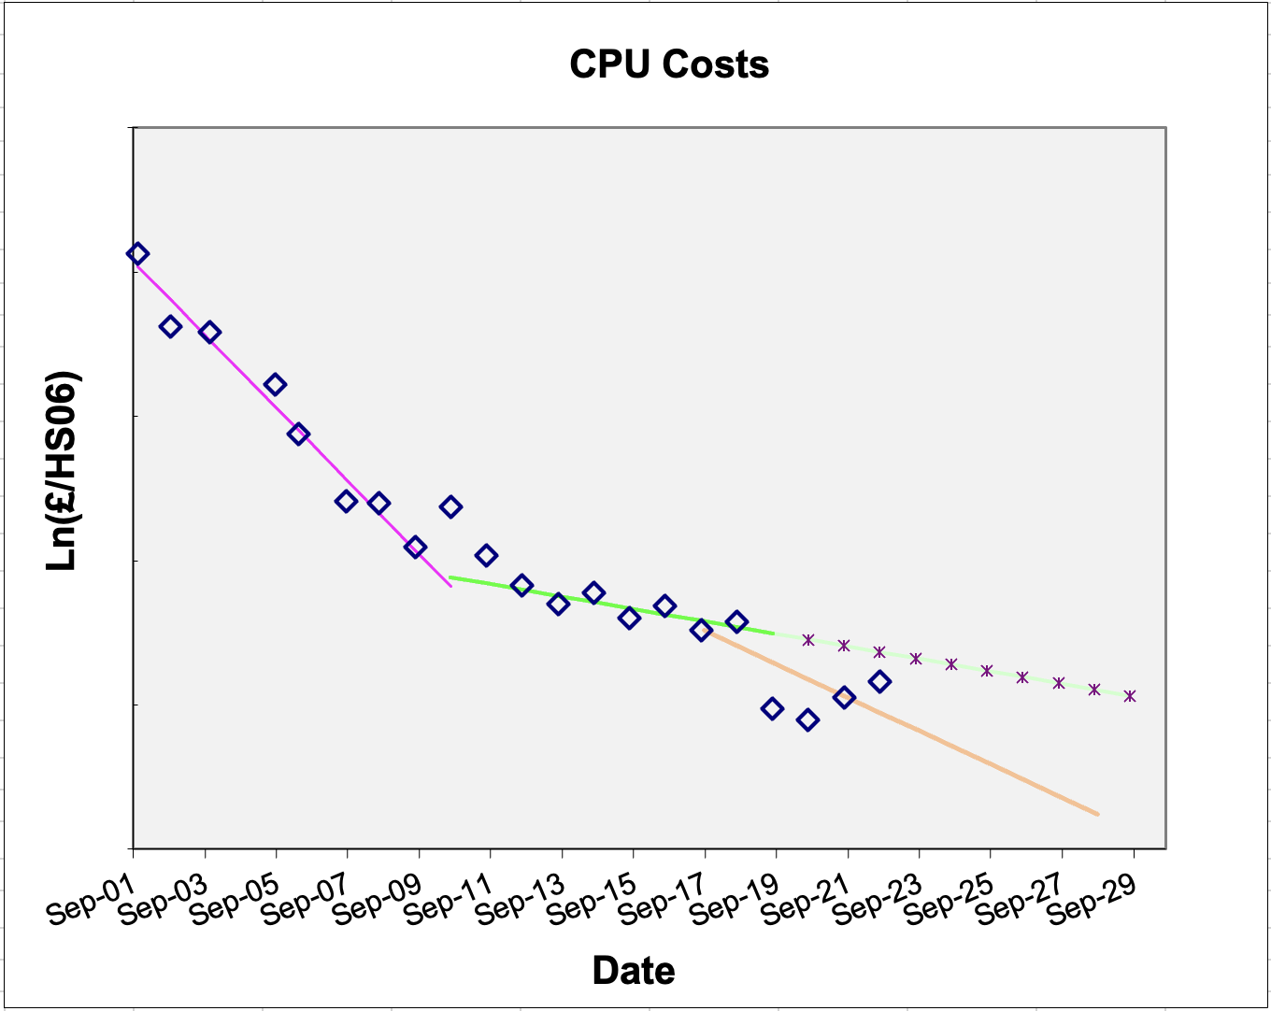

20 Years of RAL CPU Costs
Up until 2009, CPU costs fell at around 30%/year. As we ran out of “clock speed” this became more like 6%/year.
The 15% “flat-cash” assumption:
Has proved sensitive to global events.
Is probably too optimistic for the UK.
Actual Costs
Planning Costs
30%
6%
+24%
+16%
15%

Slide 4
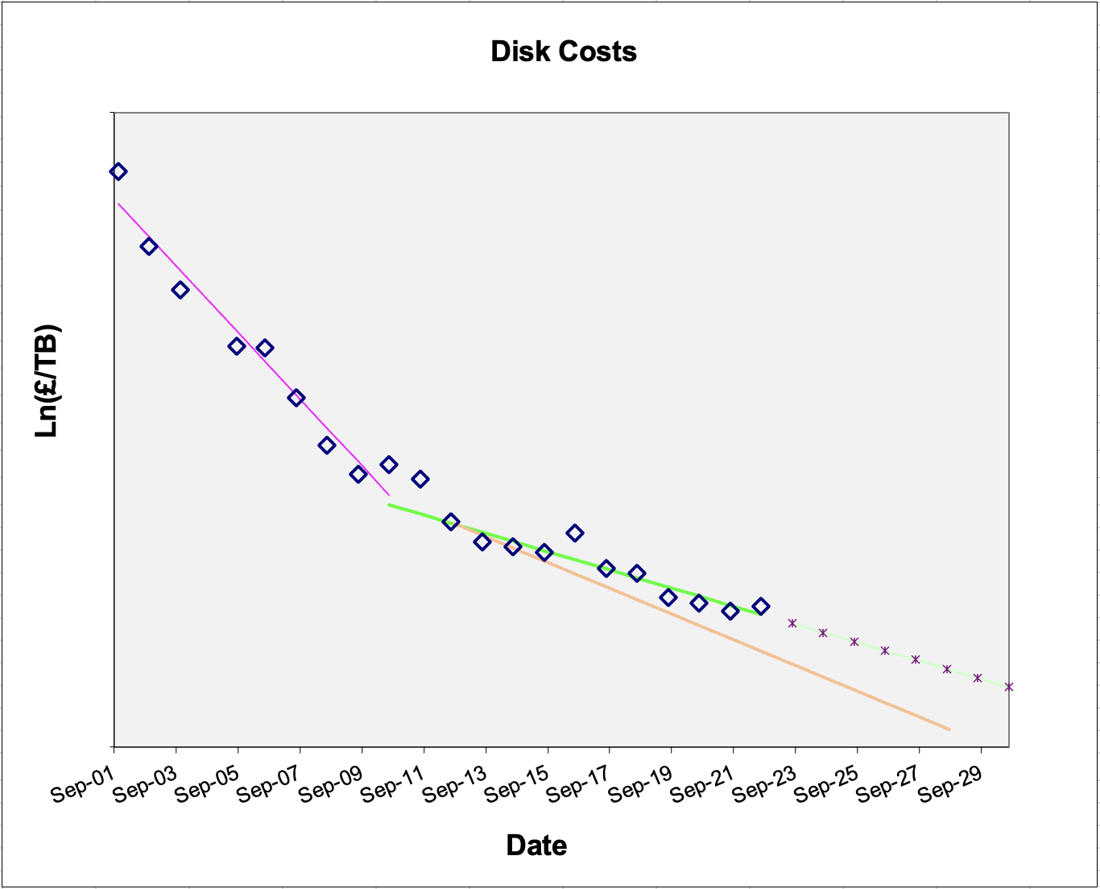
20 Years of RAL Disk Costs
Up until 2009, Disk costs fell at around 34%/year and then became more like 11%/year.
The 15% “flat-cash” assumption is probably just a little optimistic once integrated over several years.
Actual Costs
Planning Costs
34%
11%
+7%
15%

Slide 5
Part-2a: Power savings using ARM

Slide 6
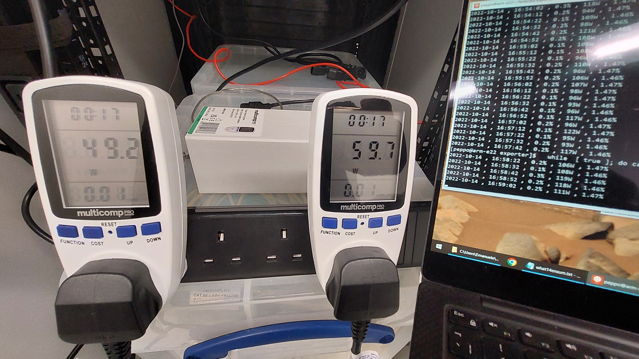
ARM vs X86
Compared power consumption of two ~similar spec-ed and priced machines: X86_64 and ARM_64 (see back-up slide for details).
Most relevantly, ran the available ATLAS and CMS HEPSCORE benchmarks. This means the images were compiled (presumably ~optimally) for the two architectures by the experiments.
Power consumption monitored from IPMI interface and and validated (at 5% level for now) with metered-plugs.
See ACAT presentation by Emanuele Simili:
https://indico.cern.ch/event/1106990/contributions/4991256/

Slide 7
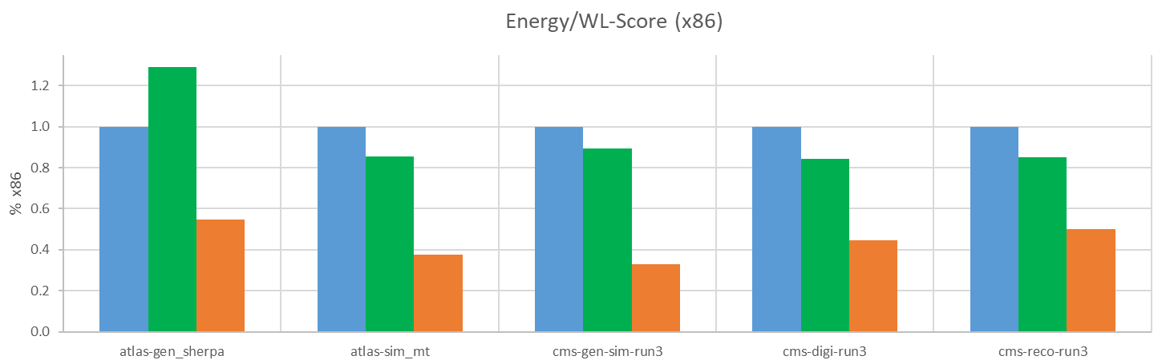
Energy/WL-Score: ARM vs X86
Measured energy-used per unit WL-Score for 2 ATLAS and 3 CMS HEP-Score workloads.
Three test machines:
  x86_64: Single AMD EPYC 7003 series (SuperMicro)
  2*x86_64: Dual AMD EPYC 7513 series Processors (DELL)
  arm64: Single socket Ampere Altra Processor (SuperMicro)
Normalised to (first) x86. Lower is better!
50%

Slide 8
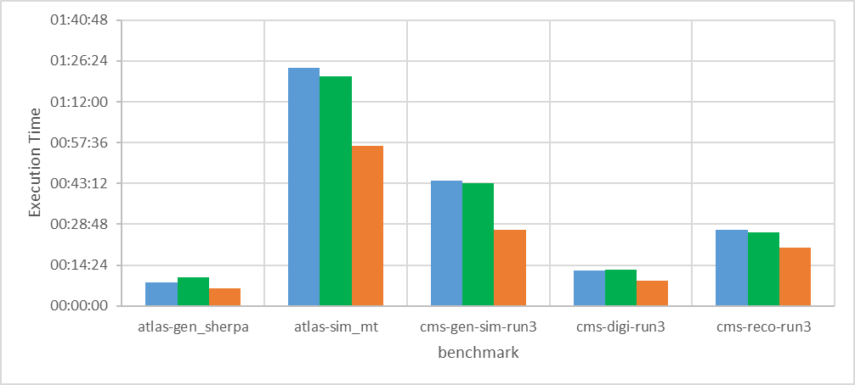
Execution time: ARM vs X86
  x86_64: Single AMD EPYC 7003 series (SuperMicro)
  2*x86_64: Dual AMD EPYC 7513 series Processors (DELL)
  arm64: Single socket Ampere Altra Processor (SuperMicro)
Lower is better!

Slide 9
Comments on ARM
Still need some physics validation of ARM (e.g. ATLAS Reco)
  1-3 million-core run (under discussion)
Power-use balance may shift again with each generation
  Need to maintain agility.
Competition is healthy!
HEPScore should also measure power-consumption
  Two-dimension optimisation between computational power and power usage (discussed with Domenico).

Slide 10
Part-2b: Load Shaping
Responding to supply shortages
Reducing carbon footprint by using power when there is a bigger fraction of renewable energy.

Slide 11
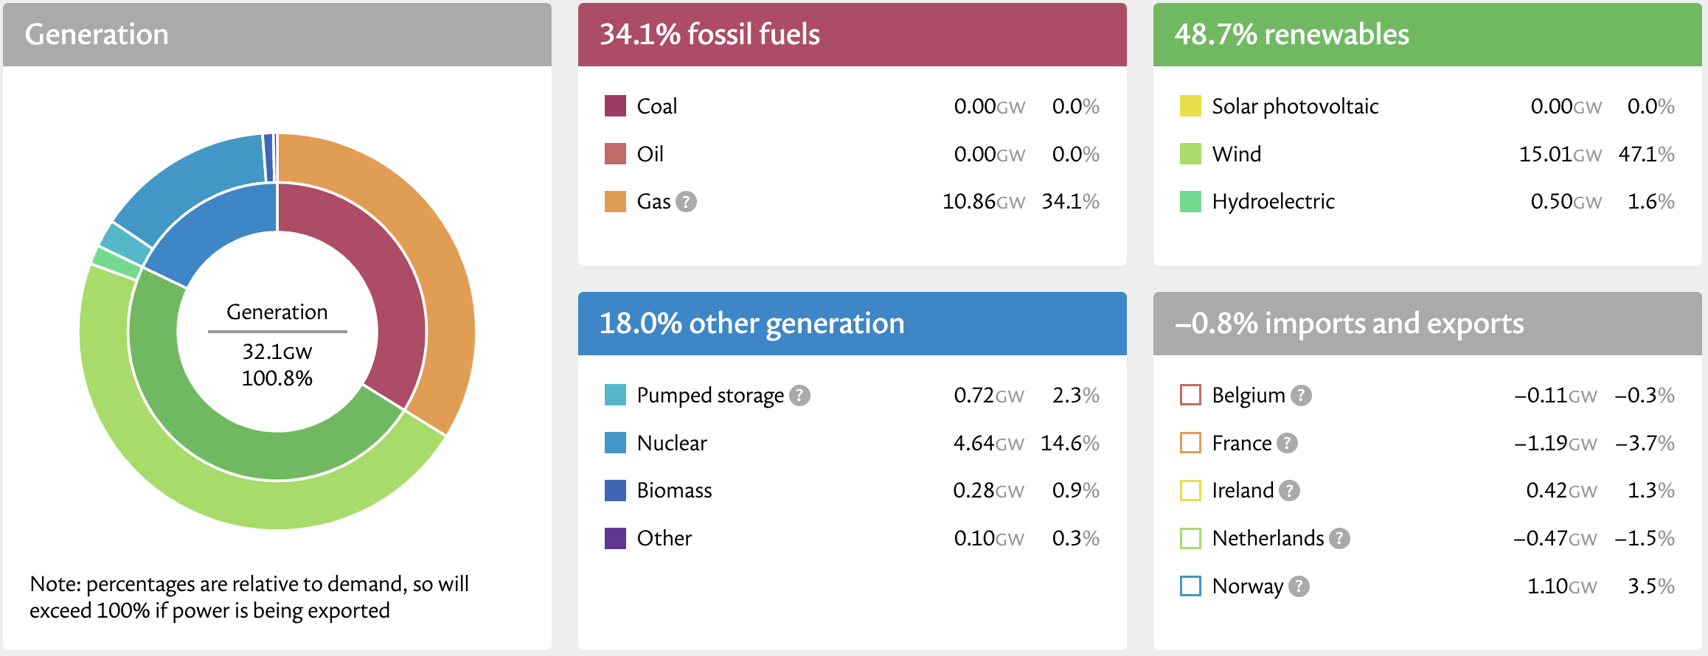
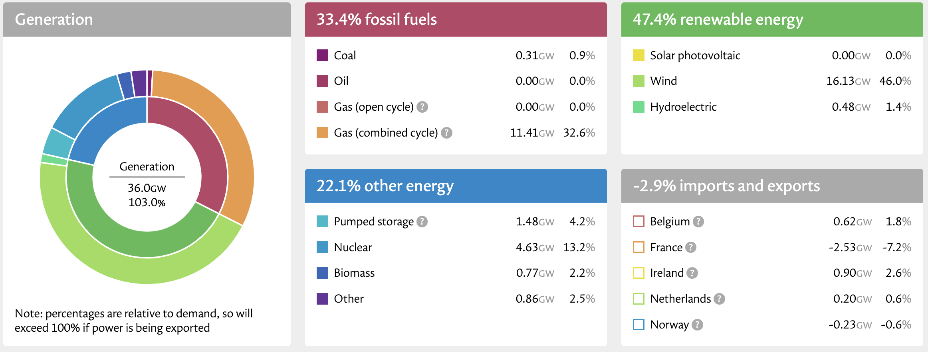
Load Shaping
If we reduced computational workloads during periods of high fossil-fuel power generation, how much does it reduce our carbon footprint?
UK Power Generation (3pm, 2/Nov/22)
Source: https://grid.iamkate.com/
UK Power Generation (6pm, 8/Nov/22)

Slide 12
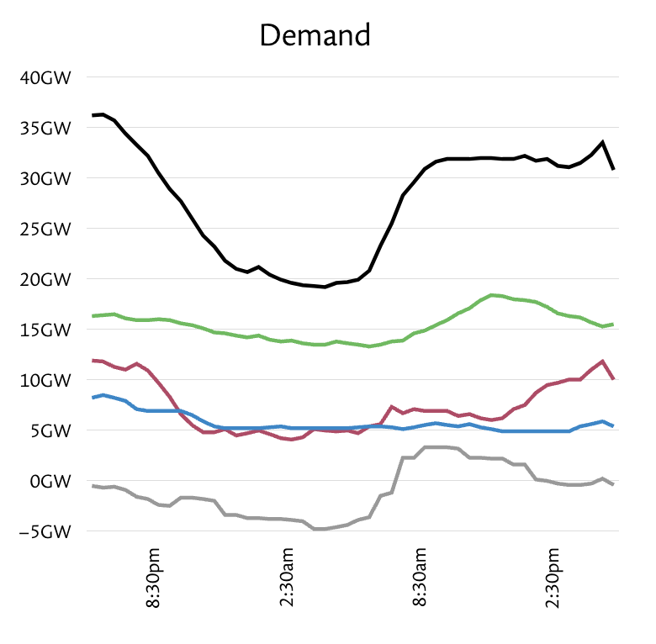
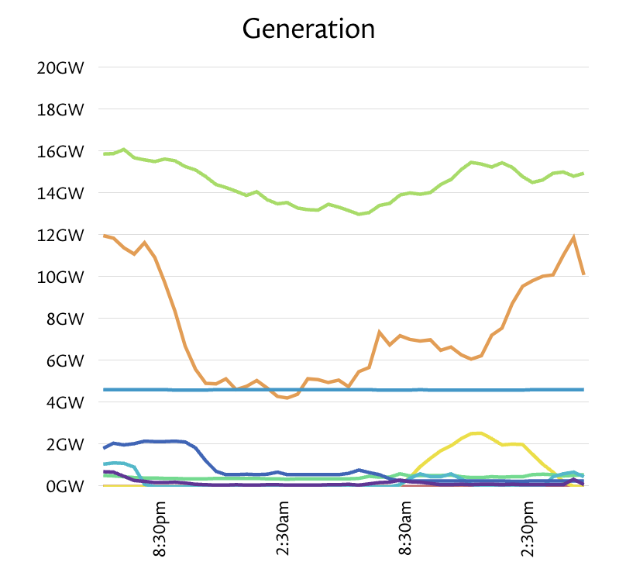
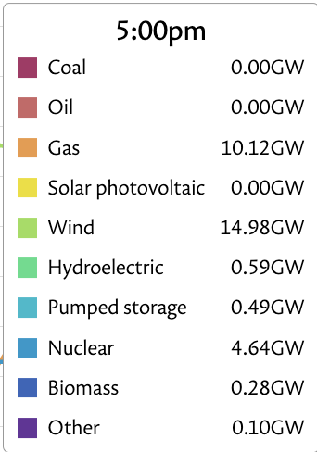
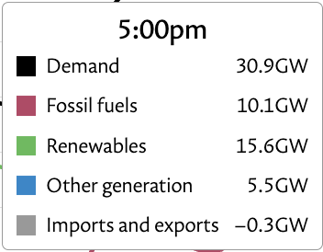
UK Power Demand
Source: https://grid.iamkate.com/

Slide 13
Proof of Principle
Looked at 1 year of UK power generation data.
Assume we turned off compute every time fossil-fuel generation exceeded a certain threshold (e.g 20 GW).
Calculate our down time / loss of work.
Calculate reduction in our carbon footprint by two methods:
  Using average fossil-fuel fraction of power saved.
  Assuming that all power saved would have been dirty-power (BrownwashingTM).
Example:
Run all the time and use 100 units of power, 50 units from fossil-fuels.
Turn off 10% of the time when fossil-fuel fraction is highest; lets say fossil-fuel generation accounted for 75% of power generated when we were off:
  7.5/50 = 15% (7.5 is 75% of 10 units of power we avoided using while down)
  10/50 = 20% (10 is 100% of 10 units of power we avoided using while down)

Slide 14
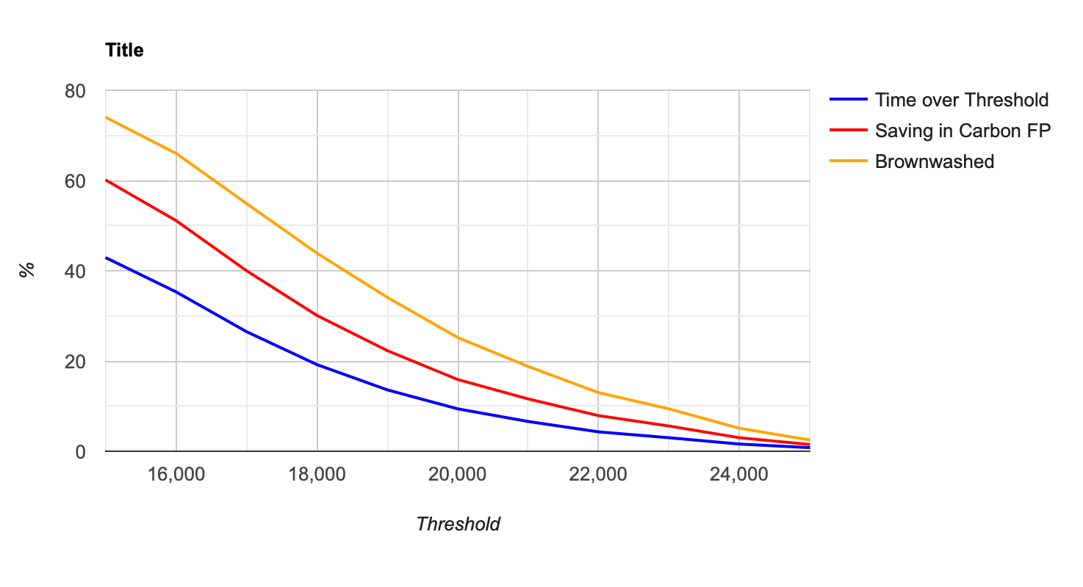
Carbon Footprint Reduction
Fractional Reduction in Carbon Footprint (Red or Orange) as a fraction for range of down-times (blue) calculated by applying a threshold cut to UK power data (Oct 2021 – Sep 2022)
For a 9% reduction in workload, we could reduce carbon footprint by 18% (25%).
But how?
Threshold (MW)
Figure made in collaboration with Steve Lloyd

Slide 15
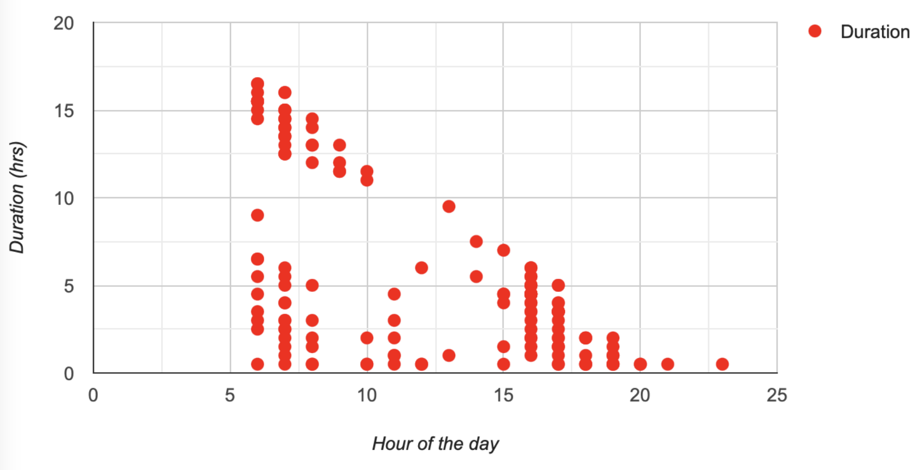
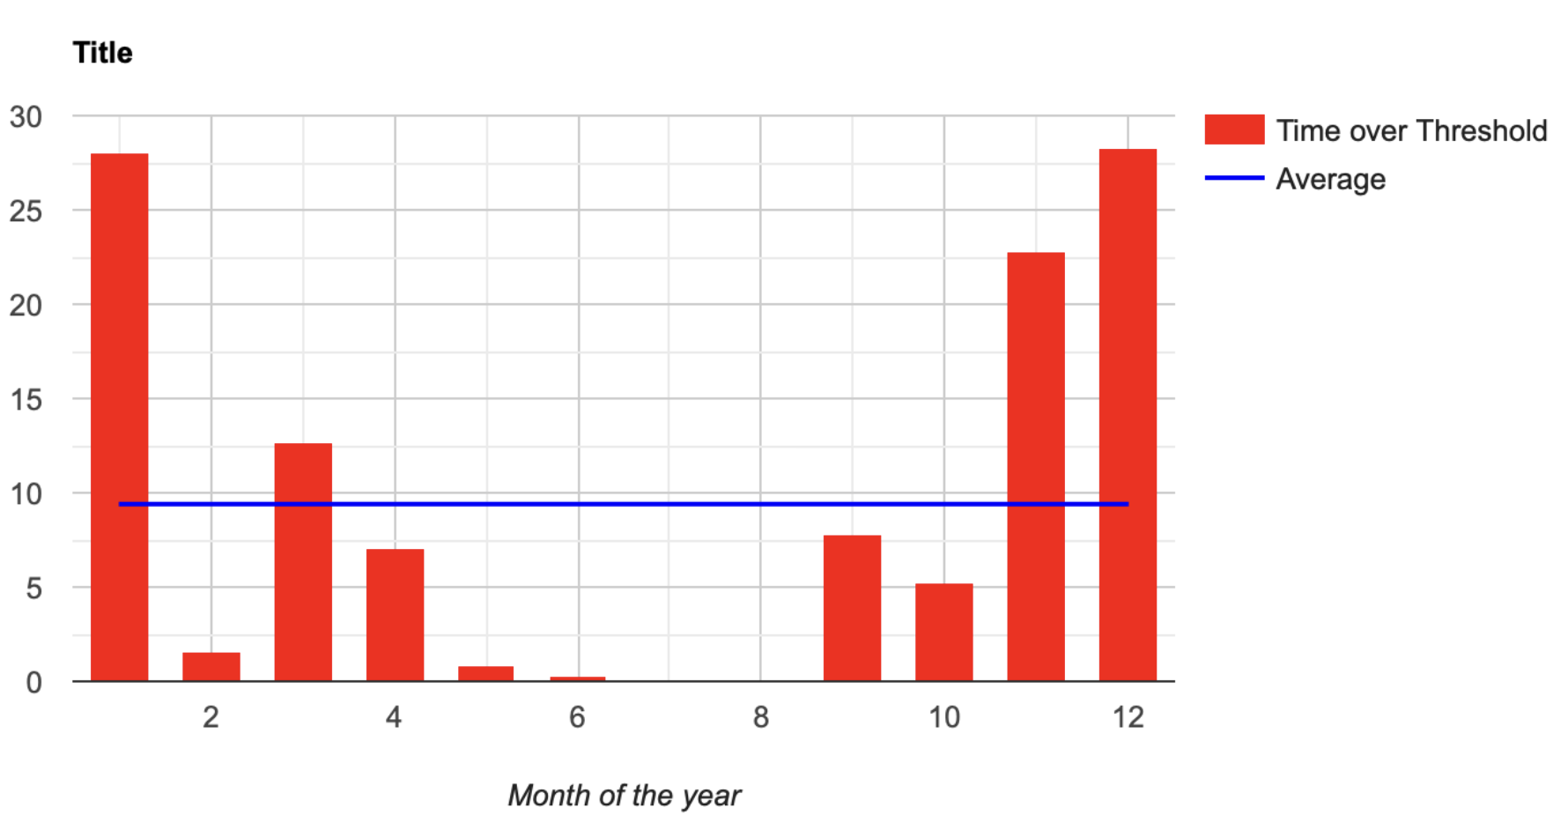
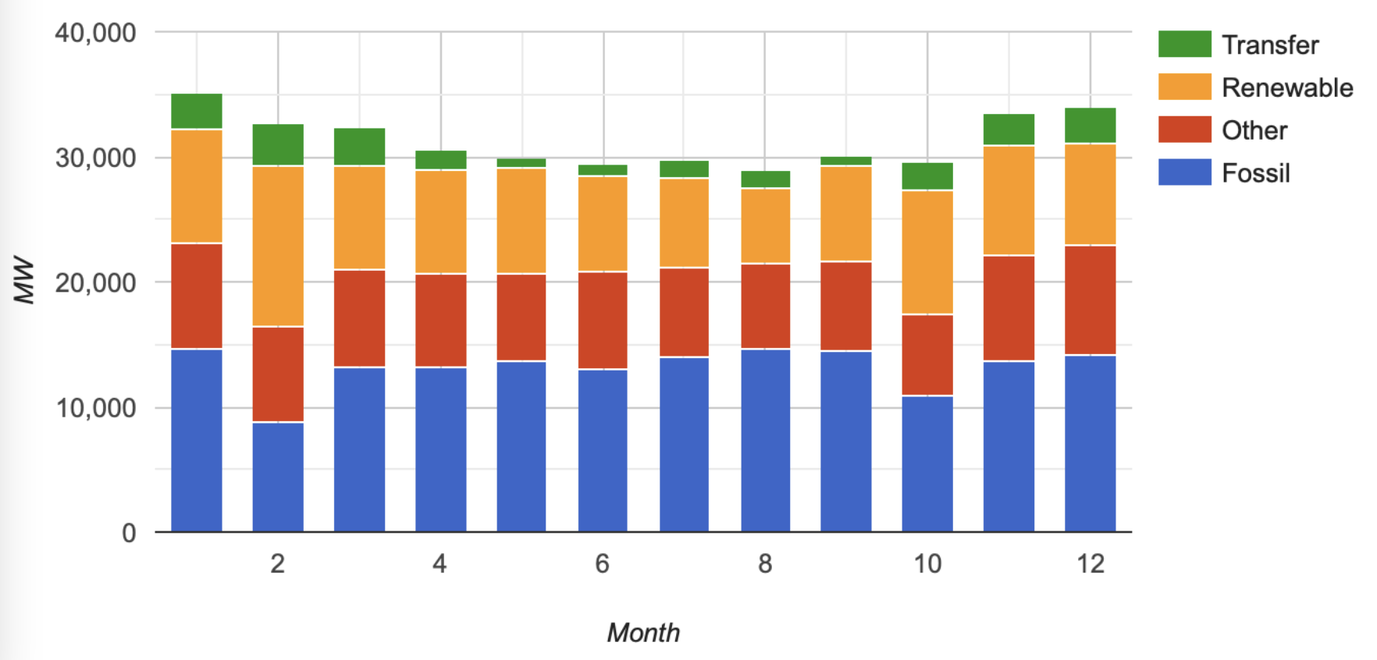
Distributions
Down-time is bi-modal (~4h and ~14hrs) but ~never extends overnight (low demand). So jobs unlikely to get suspended for days.
Down-time is zero in the summer and peaks in December/January.
Figures made in collaboration with Steve Lloyd

Slide 16
But how?
Of course, you can’t just turn off the compute and switch it back on later.
Could sites run at reduced clock-speed? (Rod’s talk?)
Could experiments control jobs via pilot framework?
Could experiments checkpoint/snapshot jobs? (ATLAS: “Not impossible”)
Could sites predict periods of high fossil-fuel generation and restrict queues?
Could sites kill jobs that had only just started?
Other ideas?
Combination of ideas?

Slide 17
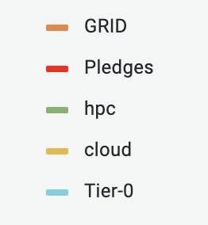
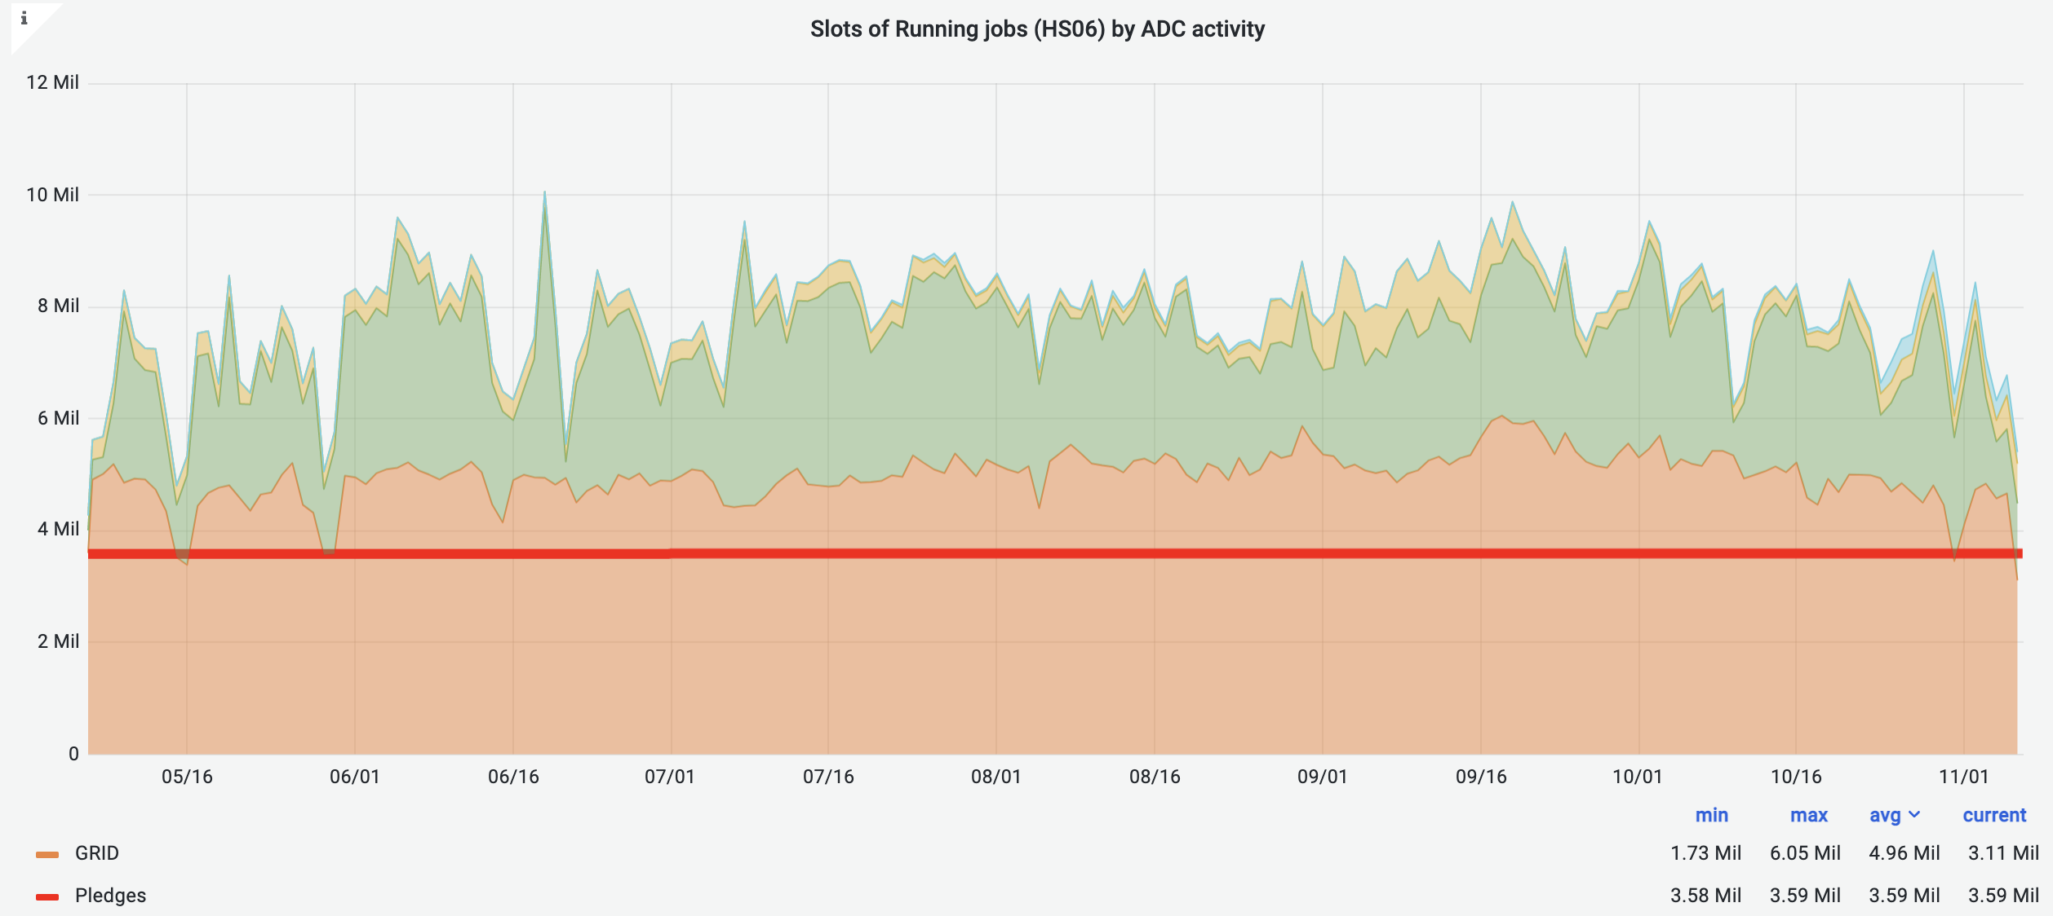
But what about the lost work?
In principle, one could ask funding agencies for 10% additional hardware to allow an overall reduction in Carbon Footprint. Unlikely!
In practice, the LHC experiments depend very much on opportunistic resources:
The UK delivers 2-3x Tier-2 pledged CPU partly using old hardware on the Grid.
Therefore, in some ways, we already HAVE the additional hardware.
Of course, old hardware is less energy efficient, so it is not as good a solution.
But this gives motivation for not simply “turning off hardware” as soon as it gets to 5-years (which in the UK case would mean the loss of a lot more than 10%) because it can be used to compensate for load-shaping. (Cunning-PlanTM)

Slide 18
Thanks to Emanuele Simili (Glasgow) for the ARM/x_86 work.
Thanks to Steve Lloyd (GridPP) for collaborating on Load Shaping and making the plots.
Thanks to Dwayne Spiteri (Glasgow) for taking an independent look at the UK power data and the issue of reporting Carbon savings, and Sam Skipsey (Glasgow) for helpful insights.

Slide 19
Back-up Slides

Slide 20
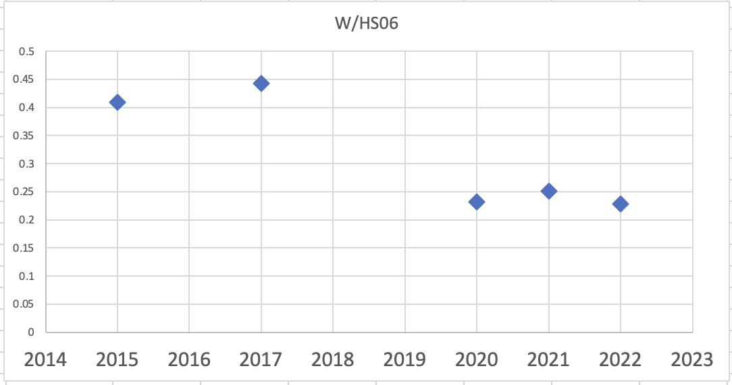
Power
Quick look at power consumption of different generations of Glasgow CPU (needs to be investigated more fully).

Slide 21
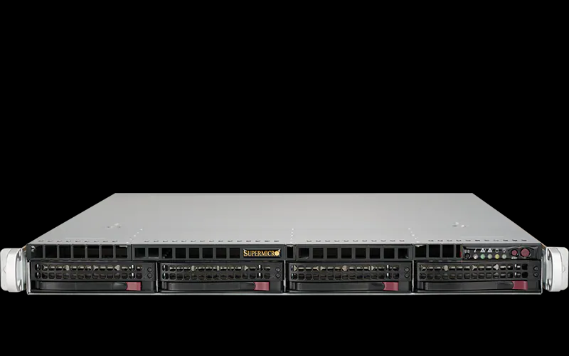
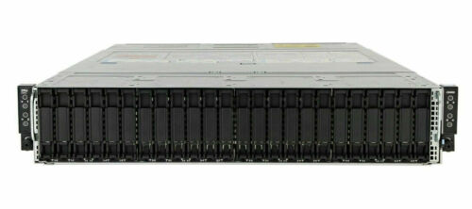
Hardware
We have recently purchased two almost identical machines of comparable price, one with an AMD x86_64 CPU (with HT enabled), the other with an Ampere arm64 CPU:
x86_64: Single AMD EPYC 7003 series (SuperMicro)
CPU: AMD EPYC 7643 48C/96T @ 2.3GHz (TDP 300W)
RAM: 256GB (16 x 16GB) DDR4 3200MHz
HDD: 3.84TB Samsung PM9A3 M.2 (2280)
arm64: Single socket Ampere Altra Processor (SuperMicro)
CPU: ARM Q80-30 80 core 210W TDP processor
RAM: 256GB (16 x 16GB) DDR4 3200MHz
HDD: 3.84TB Samsung PM9A3 M.2 (2280)
And we included in the comparison a standard workernode of our Grid cluster, with 2 AMD x86_64 CPUs (with HT enabled), which is also comparable in price* to the machines above:
2*x86_64: Dual AMD EPYC 7513 series Processors (DELL)
CPU: 2 * AMD EPYC 7513, 32C/64T @2.6GHz (TDP 200W)
RAM: 512GB (16 x 32GB) DDR4 3200MHz
HDD: 3.84TB SSD SATA Read Intensive
* this machine is part of a 2 unit / 4 node chassis.
4
Notes:
ARM server: Single socket Ampere Altra Processor
Architecture: aarch64
Byte Order: Little Endian
CPU(s): 80
Vendor ID:
Model name:
Manufacturer:
Ampere(R) Family: ARMv8
External clock: 1.650 GHz
Max speed: 3.000 GHz
Speed: 3.000 GHz
Core count: 80
Thread count: 80
TDP (*): 210W
---
AMD server: Single AMD EPYC 7003 series processor family
Architecture: x86_64
Byte Order: Little Endian
CPU(s): 96
Vendor ID: AuthenticAMD
Model name: AMD EPYC 7643 48-Core Processor
Manufacturer: Advanced Micro Devices, Inc.
Family: Zen
External clock: 100.000 MHz
Max speed: 3.625 GHz
Speed: 2.300 GHz
Core count: 48
Thread count: 96
TDP (*): 300W
---
DELL Epyc workernode (compute node)
DELL PowerEdge C6525
2 * AMD EPYC 7513 2.6GHz, 32C/64T, 128M Cache (200W) DDR4-3200
16 32GB RDIMM, 3200MT/s, Dual Rank 8Gb BASE
1 3.84TB SSD SATA Read Intensive 6Gbps 512 2.5in Hot-plug AG Drive, 1 DWPD,
---
GPU server (A.I. sandbox)
DELL PowerEdge + 2 * Nvidia A100 80GB
2 * AMD EPYC 7443 24Core/48T Processors @ 4.00 GHz & 512GB RAM
---

Slide 22
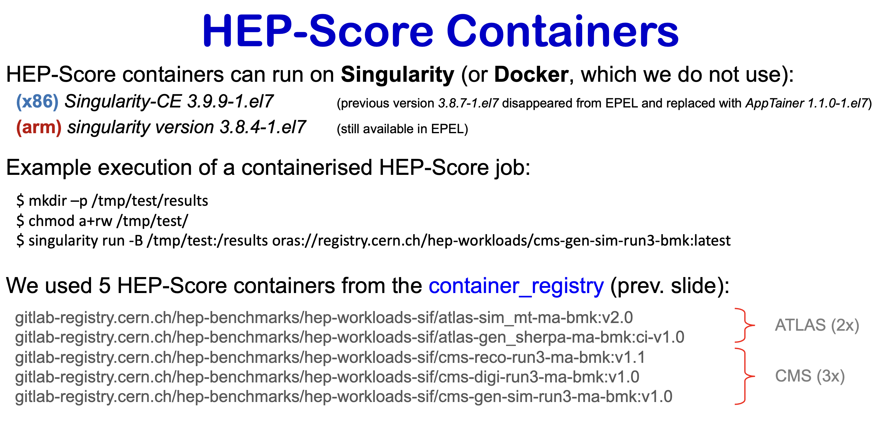
ARM vs X86

