Slide 1
MAMMA achievements in 2010
New results since RD51 Collaboration meeting in Bari
Marcin Byszewski
On behalf of the MAMMA collaboration
Notes:
See comments

Slide 2
Outline
Test Beam Oct/Nov 2010
Large Chamber
2D readout in R16
New resistive chambers R14-R15

Slide 3
Test Beam – OCT / Nov 2010
- New electronics
- Resistive strips width

Slide 4
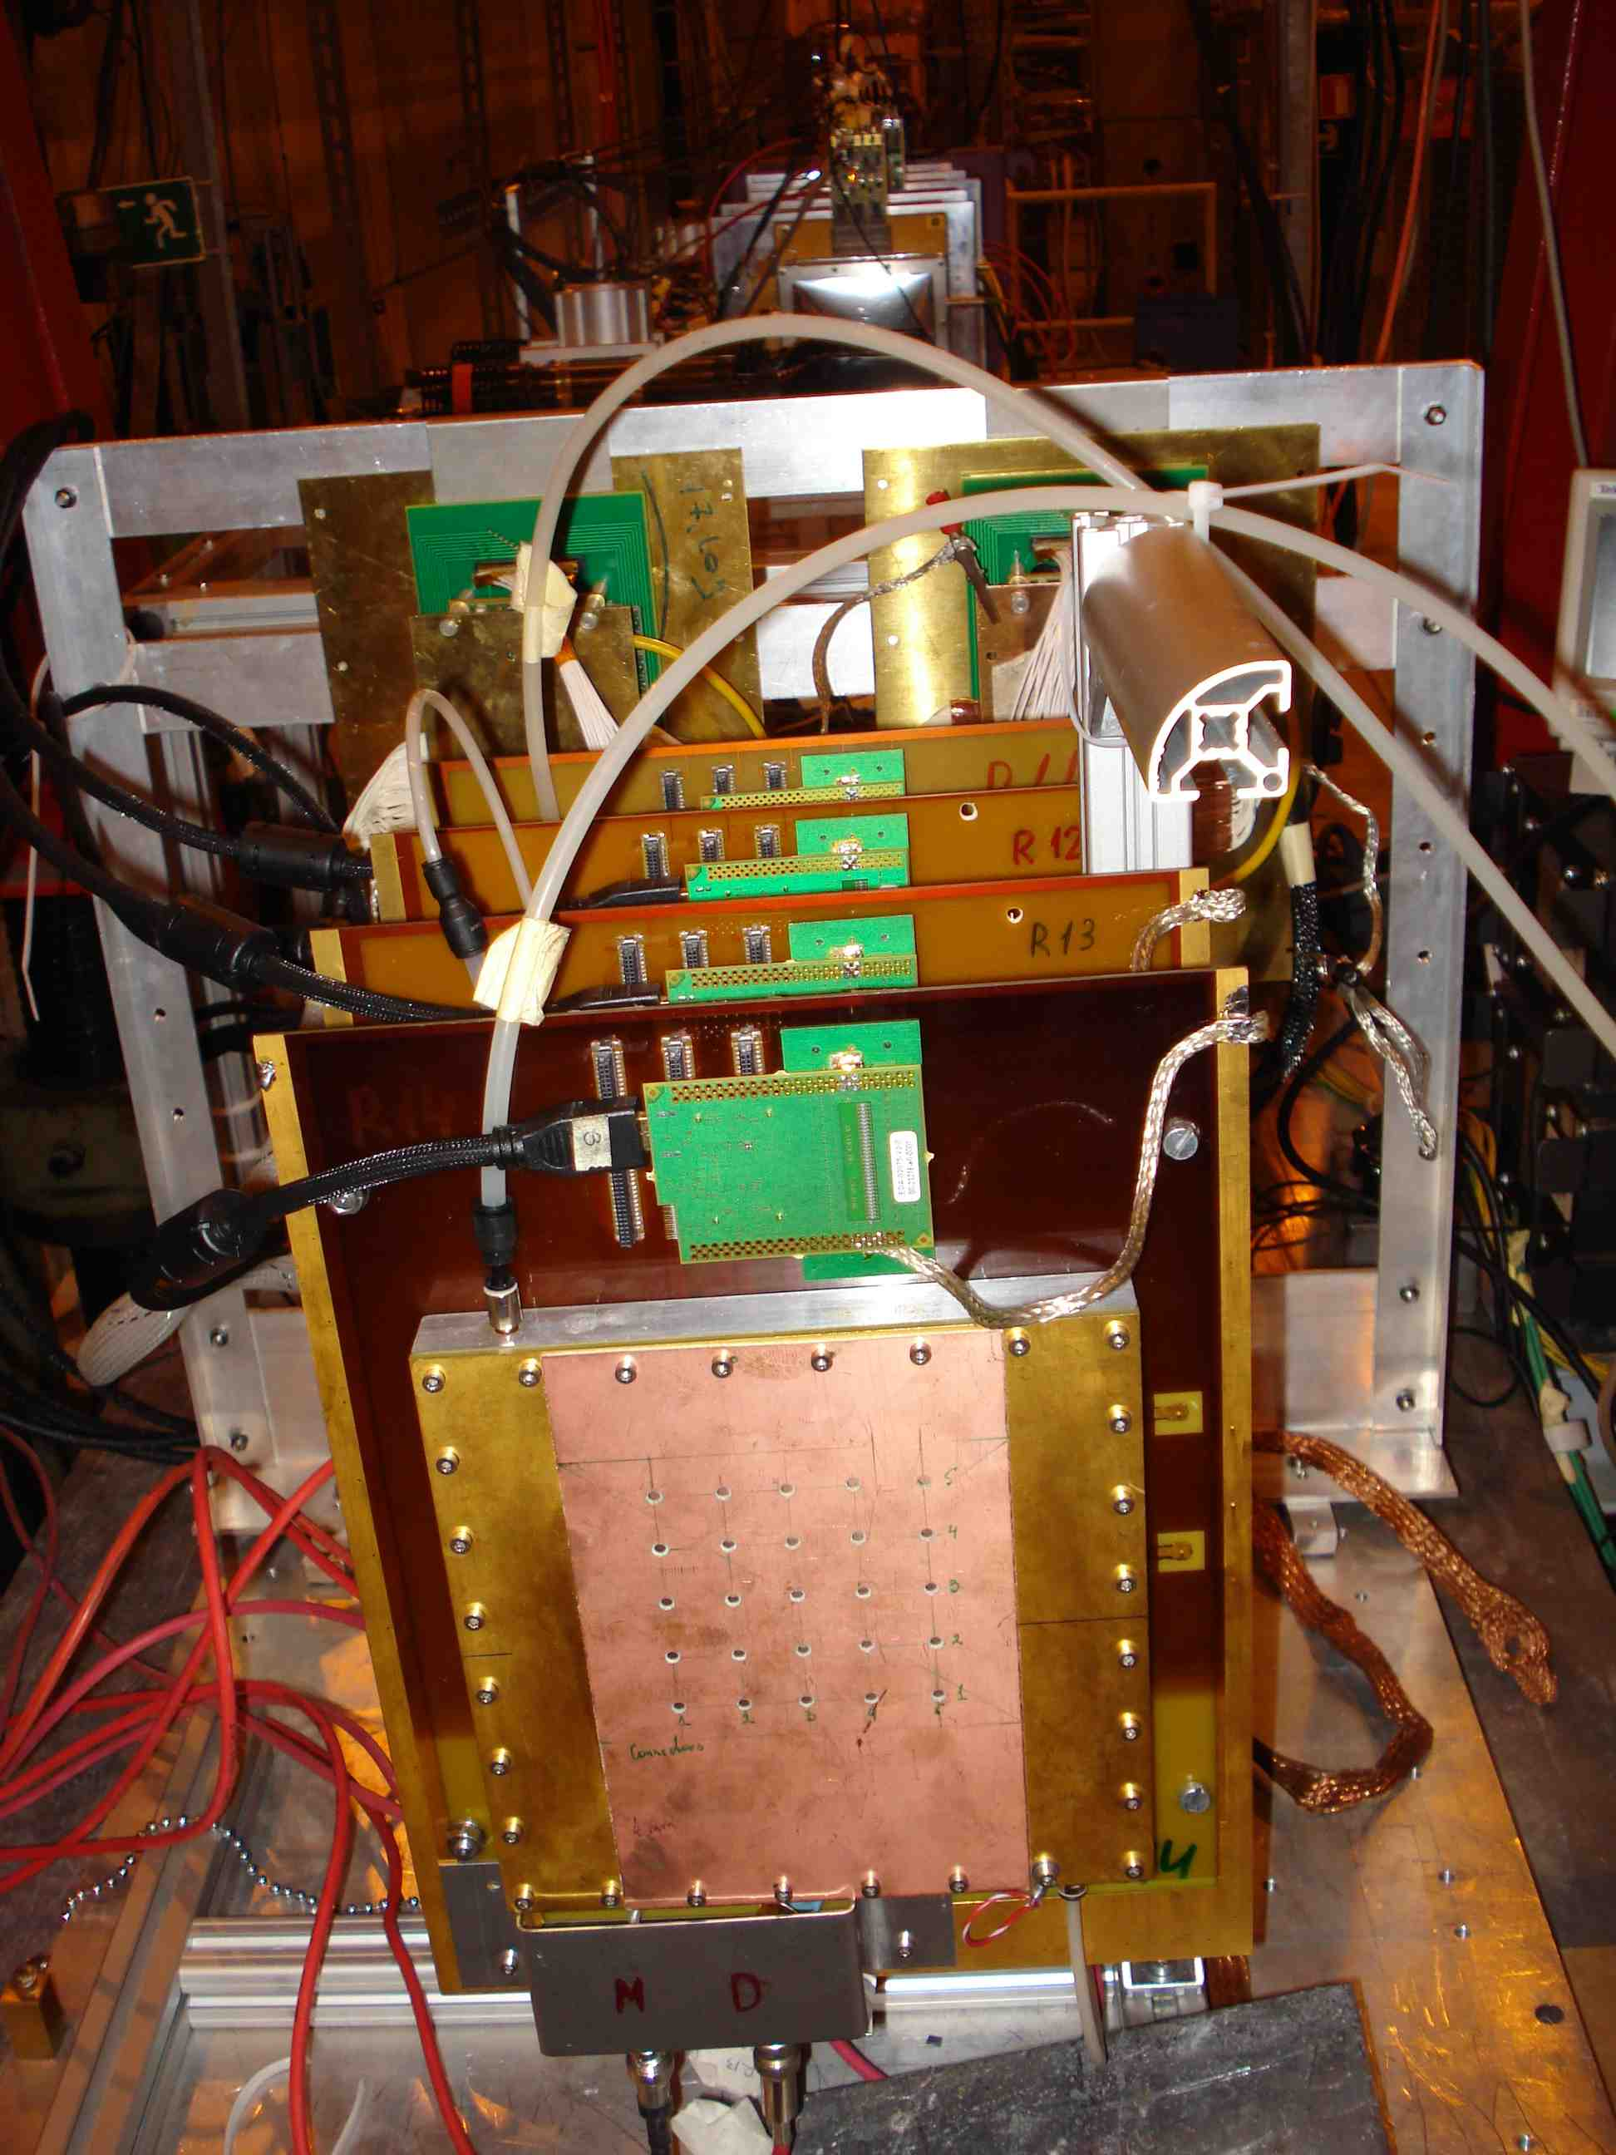
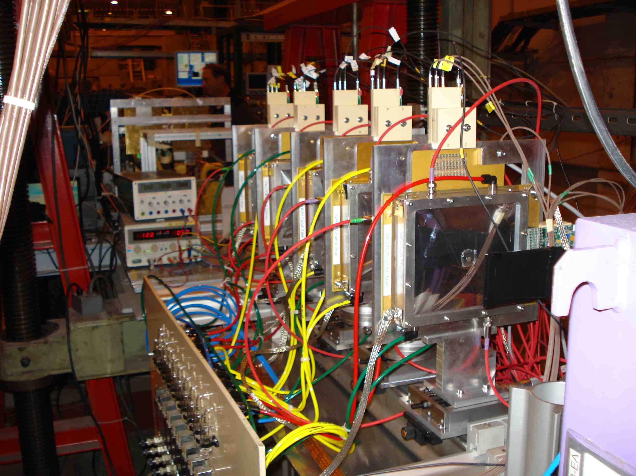
The setups in H6 in Oct-Nov 2010
Two sets of micromegas
with resistive coating
CERN et al.
CEA Saclay

Slide 5
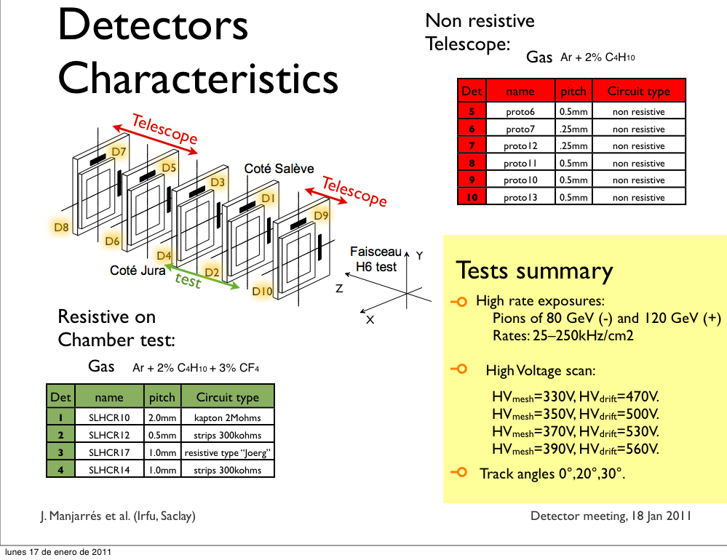
CEA Saclay (1)

Slide 6
CEA Saclay (2)

Slide 7
CEA Saclay (3)

Slide 8
CEA Saclay(4)

Slide 9
The setups in H6 in Oct-Nov 2010
CERN et al.
We have simultaneously read up to four chambers.
One APV chip per chamber.
R11 – R13 – ‘old’ small resistive chambers
R14, R15 – new chambers

Slide 10
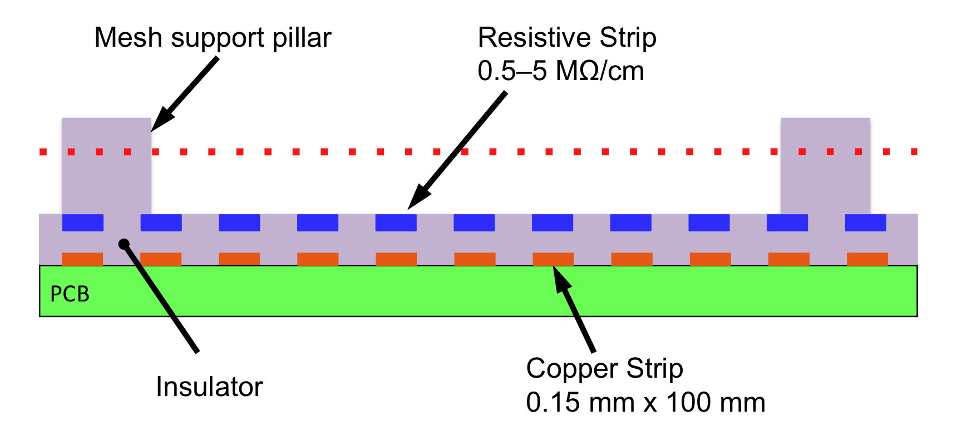
Resistive Micromegas
R11-R13
Standard small 100 x 100 mm² chambers
Readout strips 250 μm pitch
Resistive strips along readout strips.
R14, R15
Small 100 x 100 mm² chambers
Readout strips 250 μm pitch
Varied width of the resistive strips.
150 (1), 400 (2), 650 (3), 900 (4) μm and
18 mm (72 r/o strips) (presented data)
 | R14 | R15 | remarks
R(GND) (MOhm) | 100 | 300
R(strip) (MOhm/cm) | 10 | 60
Mesh pillar spacing | 2.5mm | 10mm | Mesh oscillation R15 for high HV – spacing too large

Slide 11
New readout system
Scalable Readout System:
4x APV25 chips (128ch)
4x HDMI cables
1 FEC (max 16 chips)
DAQ - ALICE’s DATE connected by Gigabit Ethernet
We got it few days before the test beam start…
it “just worked” and worked reliably.

Slide 12
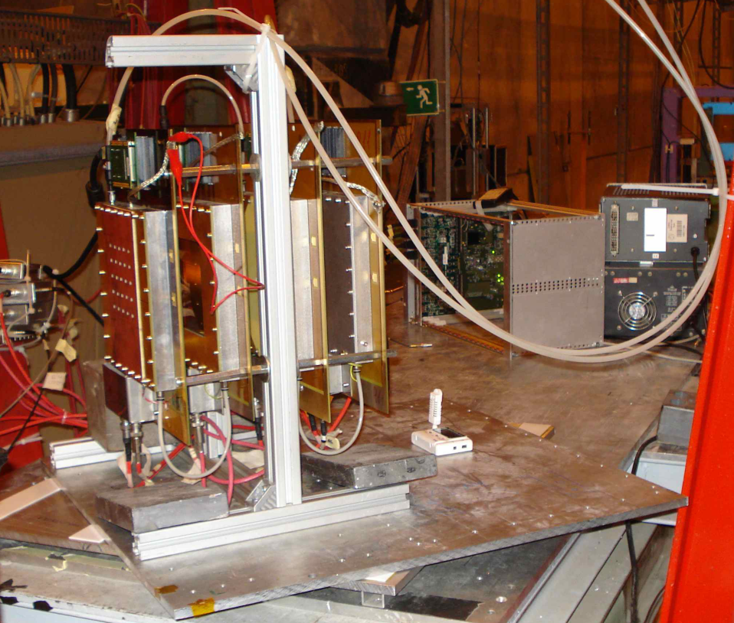
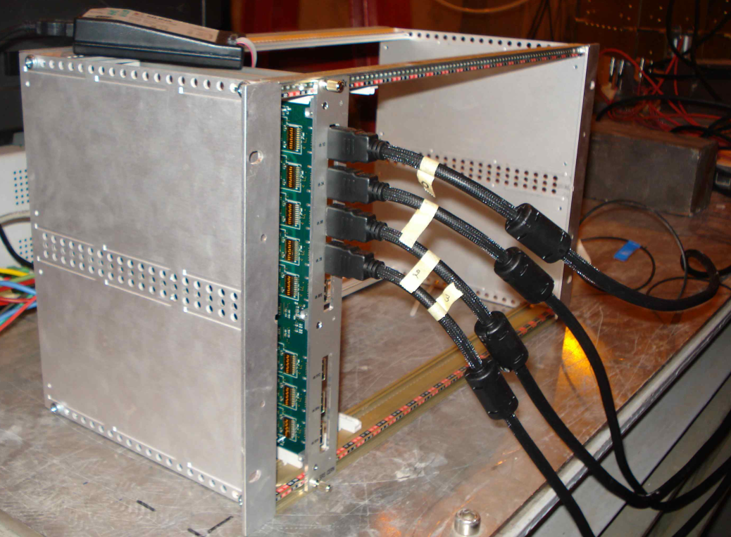
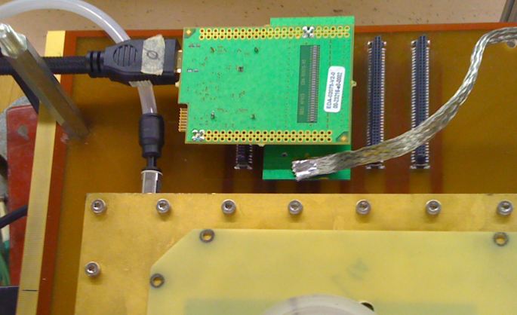
Test beam set up
FEC
Hybrid card with an Apv25 chip
We have simultaneously read up to 4 chambers, one APV chip per chamber
  R11 – R13 – ‘old’ small resistive chambers;
  R14, R15 – new

Slide 13
Representative raw data
  Since test beam, we are very happy users of the SRS :
  - simple and reliable system
  - clean data with only two steps: pedestal subtraction, zero suppression
Example:R12,
2 tracks
1mm
Strip charge (ADC counts)
Time bin (25ns)
Strip number (pitch 250um)

Slide 14
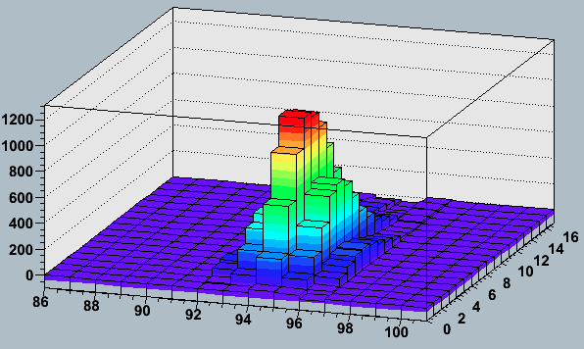
Strip Charge, Time
A simpler example
3D -> 2D
R11, run 6230 event 1
Strip charge (ADC counts)
Time bin (25ns)
Strip number (pitch 250um)

Slide 15
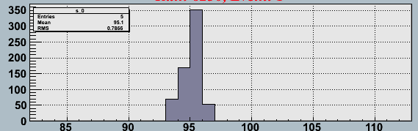
Strip Charge
Strip charge - maximum value of Q for all time bins
3D -> 2D
R11, run 6230 event 1
Strip charge (ADC counts)
Time bin (25ns)
Strip number (pitch 250um)
Max Q
(strip)
Qmax
Strip number

Slide 16
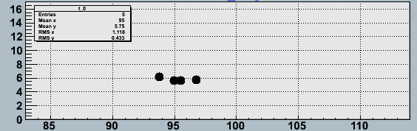
Time information
Strip charge - maximum value of Q for all time bins
Time - time bin of maximum value of Q (strip)
R11, run 6230 event 1
Strip charge (ADC counts)
Time bin (25ns)
Strip number (pitch 250um)
Time of max Q (strip)
Qmax
Max Q
(strip)
Time bin
Strip number
Strip number

Slide 17
Test Beam Data - 0deg
4 chambers in a row
Track at 0deg incidence angle
Max Q
(strip)
Time of max Q (strip)
R11
R12
R13
R15

Slide 18
Test Beam Data - 0deg
4 chambers in a row
Track at 0deg incidence angle
Max Q
(strip)
Time of max Q (strip)
R11
R12
R13
R15
R15 vs R13
Wider resistive strips

Slide 19
R15 - resistive strips
Region 1:
1 resistive strip covers 72 r/o strips
Charge spreads across ≈15 r/o strips due to the charge dispersion in resistive strips.
To neighbouring r/o strips charge comes
much later (>100ns)

Slide 20
Test Beam Data - 10deg
Track at 10deg incidence angle
R11
maxQ(strip)
Time(strip)
R12
R13
R14

Slide 21
Test Beam Data - 40deg
Track at 40deg incidence angle
Remark: strip numbering is local for each APV
R11
Q(strip)
Time(strip)
R12

Slide 22
CSC-size chamber
Non-resistive prototype
See Monday talk by Joerg Wotschack

Slide 23
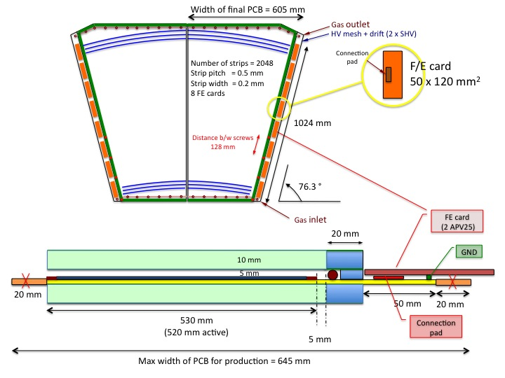
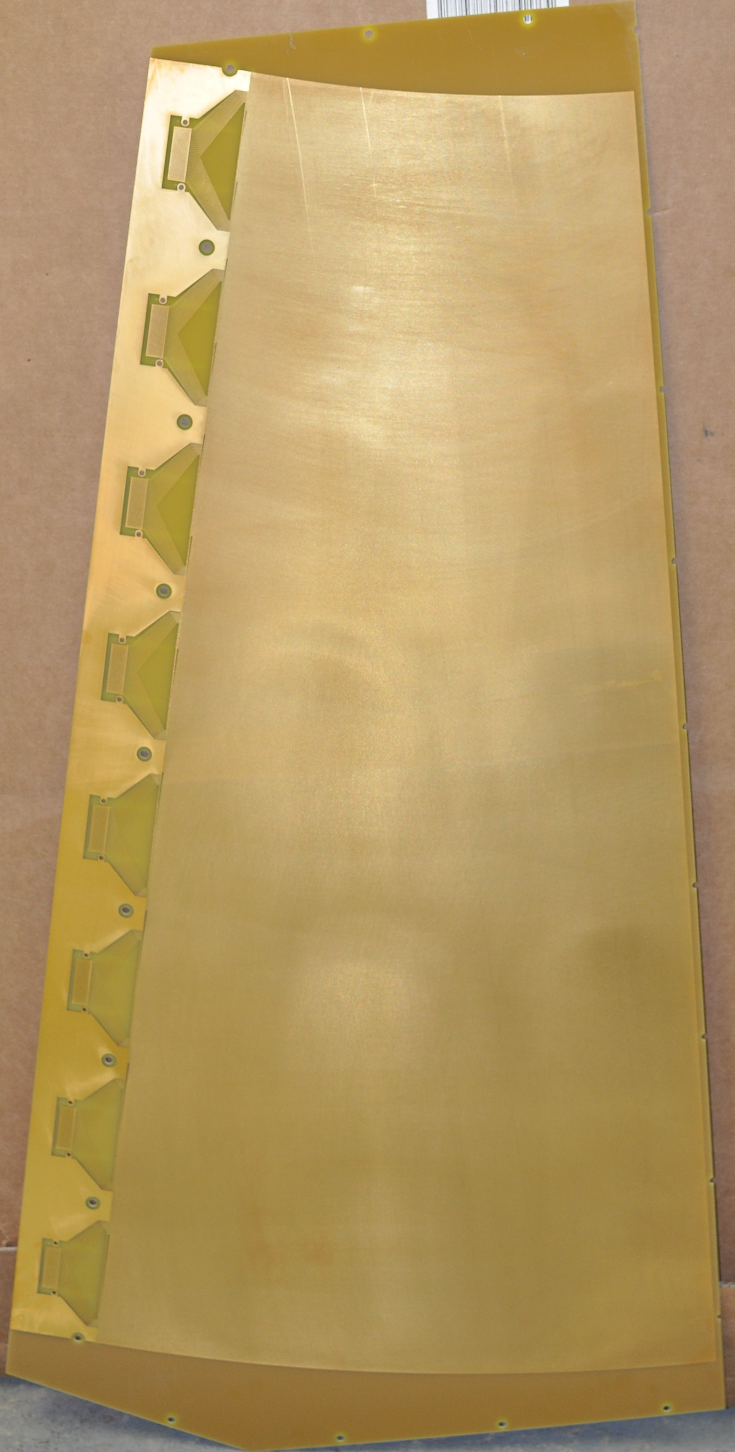
Large Chamber - design
Chamber with same dimensions as large CSC, but only one half is equipped with MM (owing to present limit of machines in CERN PCB workshop)
  First half-chamber is non-resistive (test of procedure)

Slide 24
R16
Micromegas with 2D readout

Slide 25

R16 - 2D readout
Design of a standard resistive MM.
Modified by an additional layer of readout
strips perpendicular to resistive strips.
X
X strips:
250 µm pitch
150 µm width
Y strips
250 µm pitch
80 µm width
Y
Resistivity values
R_{G} ≈ 55 MΩ
R_{strip} ≈ 35 MΩ/cm
Resistive strips

Slide 26
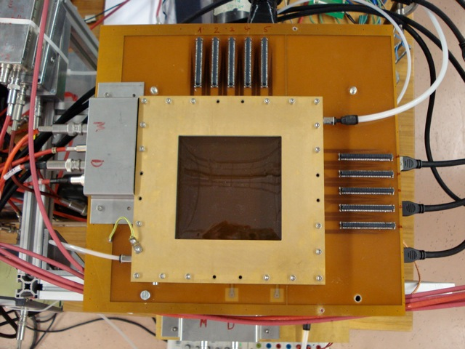
R16 – 2D readout (10x10cm²)
X readout
Y readout
HV

Slide 27
R16 Event Display (⁵⁵Fe γ)
X
along resistive strips
Y
across resistive strips
Effect as in R15 (and R14):
The charge spreads to the neighbouring r/o strips that are covered by the same wide resistive strip
R16: The charge spreads along resistive strips to the neighbouring Y r/o strips

Slide 28
Other activities
Software for:
- Data acquisition (afternoon talk)
- Data analysis

Slide 29
Summary
Test beam data with SRS Electronics
Reliable system
Clean data
Large Chamber
Non-resistive prototype
2D readout in R16
We can read two coordinates in the same plane
Charge dispersion along resistive strips
Other activities
Software DAQ and Analysis
R14-R15
Wide resistive strips allow charge dispersion
Mesh pillars spacing of 1cm too big
Resistive prototype is being made

