Slide 1
Identified topics for upcoming meetings
G. Iadarola and H. Timko
with input from link persons from ATS groups
Scientific Computing and Simulations kick-off meeting - 7 June 2021

Slide 2
Introduction
We would like to have each SCS forum meeting focused on a topic (e.g. HTCondor, GPUs, storage, software licenses, etc.)
Different teams present their experience / views / needs on the selected topic
Based on presentation contents and discussions, prepare common proposals to be brought up at the CTTB and at the ATS-IT committee.
We count on your participation in:
Forwarding invitation to members of your team who are involved with the topic being discussed
Propose contributions from your team for the upcoming meetings
  Feel free to choose the format that is more appropriate – full presentation, or just few slides with the main messages from your team
Propose topics from future meetings
A first set of topics has been collected in discussions with link-persons from the different groups, which took place over the last weeks
2

Slide 3
Servers, workstations and VMs
Tentative date for topical meeting: 30 Aug, 14:00
Several teams purchase and maintain servers or powerful workstations for software development, demanding simulations, hardware design, CAD, FPGA compilation, etc.
Solution perceived as not ideal by many teams:
Lack of expertise and manpower for system administration and updates
Issues with powering, network, cooling, space
Often usage is not continuous → could optimize costs by sharing resources
There is an interest in moving to remote computers administrated by IT
Different teams report different constraints
Specific OS/Software requirements (windows / specific Linux distributions)
Need for admin rights to install and configure software
Need for GPU computing capabilities
Need for hardware configuration certified for a given software package (Catia)
License constraints for commercial software (cannot run on cloud services, license limited to a given machine)
3

Slide 4
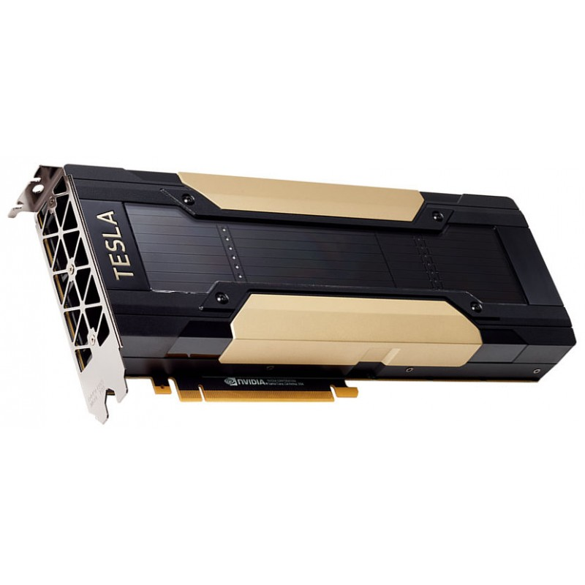
GPUs and access to commercial cloud services
Tentative date for topical meeting: 28 June, 14:00
Several groups are exploiting GPUs for computationally intensive tasks
Activities can be devided in two main categories:
"Large" simulations campaigns using multiple GPUs through
the lxbatch service (HTCondor)
Other activities presently done with "private" hardware or
commercial cloud services
  Code development
  Simulations using commercial software supporting GPUs (e.g. PIC simulations in CST)
  Machine learning (training of neural networks)
  → several teams would like to move away from "privately managed" hardware
There is interest in using GPUs in CD/CI workflows on GitLab or GitHub
Users gave positive feedback from "CloudBank" initiative (access Google Cloud / AWS resources)
Access to a very large variety of hardware (including D-Wave quantum computers)
Forum meeting to discuss experience and needs from different will take place on 28 June
Dedicated project being launched by the ATS-IT TC to follow up on these needs
4

Slide 5



Storage (EOS, AFS, DFS, Ceph, …)
Different needs identified by the teams:
  Long-term storage of large amounts of simulation data
  Storage space accessible rapidly on computing nodes or VMs
  Shared filesystems used for simulation I/O, interactive development, software compilation etc.
Several solutions available from IT:
  AFS (extensively used in lxplus, lxbatch) → IT would like to retire it on the medium term
  EOS (+CernBox)
  DFS
  Ceph (on HPC cluster…)
  CVMFS
Need to identify needs and specifications and make sure that they are compatible with medium/long term strategy from the IT storage team
5

Slide 6
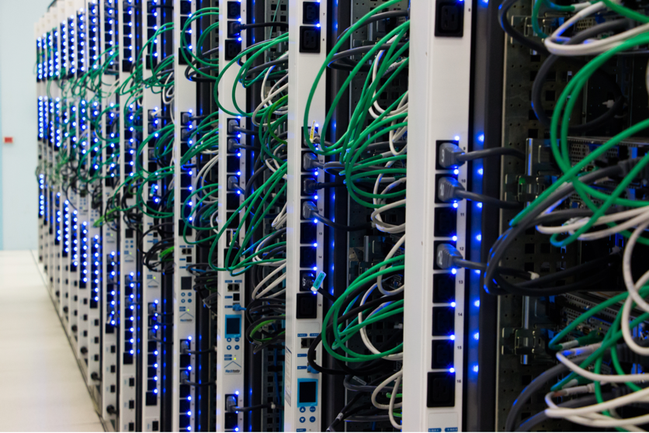
Usage of batch service and HPC clusters
The batch service (HTCondor) and the HPC cluster service provided by IT are exploited by several teams working on large simulation campaigns
We plan to hold a meeting to discuss experience from the different teams and collect needs/wishes for improvement
Some points that were raised by the groups' link persons:
  Need for better integration with EOS
  Priority management across ATS needs to be rationalized
  Ease learning curve for newcomers
  Interest to extend HTCondor and HPC usage to a wider range of applications
6

Slide 7
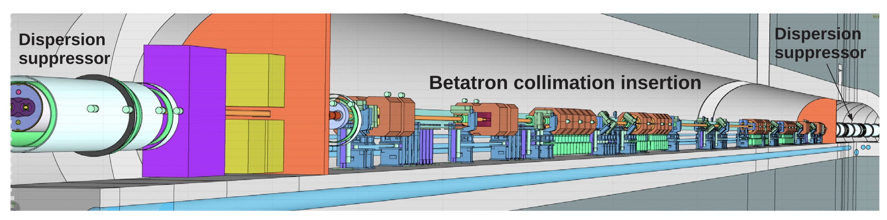
Integration of accelerator modeling tools and databases
Several simulations and analysis activities rely on manipulation and combination of input/output form different software and and databases:
Layout database
Drawing database (CDD)
Alignment data
Magnet models
Vacuum layout
Interaction of different simulation software
  MAD-X, Sixtrack, Xsuite, FLUKA, Geant
3D models used for integration studies
Combination of different models and tools is often a manual process, which is error prone and difficult to automatize
We can devote a meeting to discuss experience and wishes from the different teams with the goal of identifying possible synergies
Synergy with Engineering to Alignment (E2A) team
7

Slide 8
Some more topics that came up
License management for commertial software
  Managed by IT and/or by individual teams
Guidelines for licensing open-source software developed at CERN
Experience with python development and usage (joint meetings with acc-py community)
Experience with commercial software usage (e.g. CST, ANSYS)
Training and seminars:
  Share experience/plans/issues/needs
Synergies in software development (identification of possible common development projects)
  Foster adoption of similar solutions and standards to profit from others' experience and ease interface among software tools
8

Slide 9
Summary
Based on discussions with the groups link persons we identified a first set of topics to be addressed in upcoming meetings
  Access to GPUs and commercial cloud services (meeting foreseen for 28 June)
  Servers, workstations and VMs (meeting foreseen for 30 August)
  Data storage services - EOS, AFS, DFS, Ceph, …
  HTCondor and HPC clusters
  Integration of accelerator modelling tools and databases
Please don't hesitate to:
Propose contributions from your teams
Proposed further topics to be discussed
Thanks for your attention!
9

