Slide 1
The new CLIC BDS design at 7 TeV
Enrico Manosperti
19/05/2022

Slide 2
Table of contents
Optics at 7 TeV
Effects of the Synchrotron Radiation in the Collimation and Final Focus Systems
Chromaticity correction in the Final Focus
Enrico Manosperti 19/05/2022 2

Slide 3
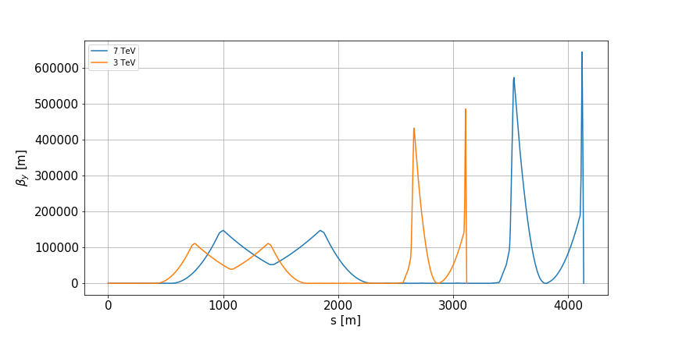
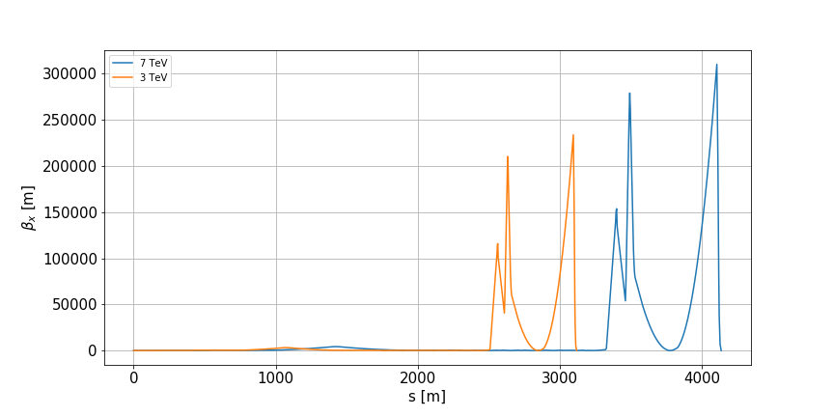
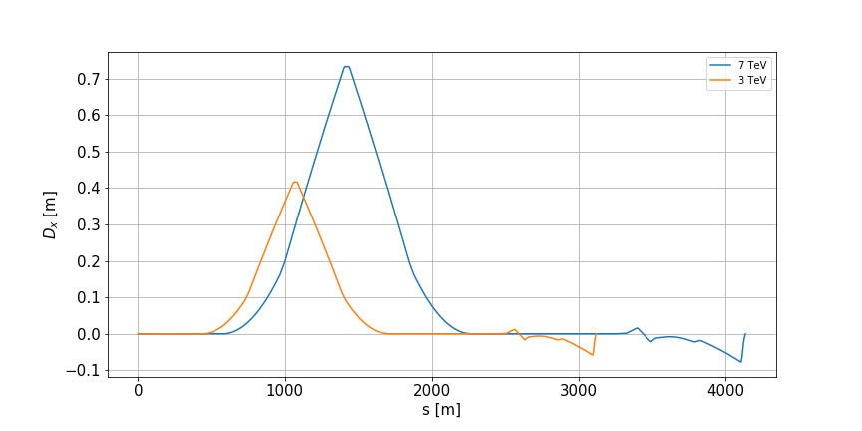
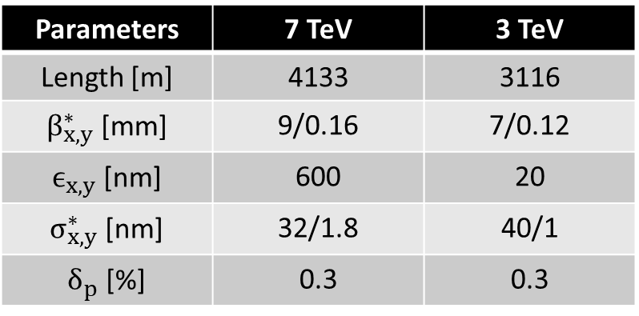
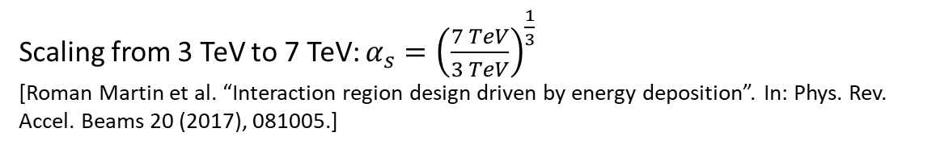
7 TeV BDS optics
Scaling from 3 TeV to 7 TeV: $α_{s}={\left(\frac{7 TeV}{3 TeV}\right)}^{\frac{1}{3}}$
[Roman Martin et al. “Interaction region design driven by energy deposition”. In: Phys. Rev. Accel. Beams 20 (2017), 081005.]
Parameters | 7 TeV | 3 TeV
Length [m] | 4133 | 3116
$β_{x,y}^{∗}$ [mm] | 9/0.16 | 7/0.12
$ϵ_{x,y}$ [nm] | 600 | 20
$σ_{x,y}^{∗}$ [nm] | 32/1.8 | 40/1
$δ_{p}$ [%] | 0.3 | 0.3
Enrico Manosperti 19/05/2022 3

Slide 4
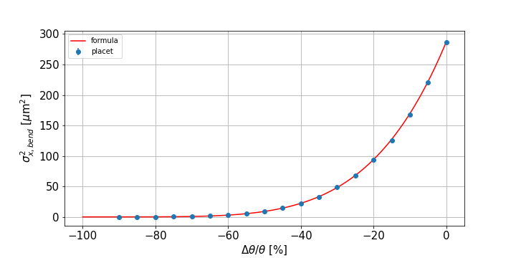
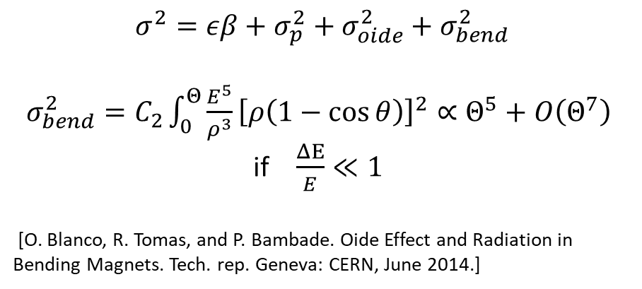
Synchrotron Radiation Effects
$$σ^{2}=εβ+σ_{p}^{2}+σ_{oide}^{2}+σ_{bend}^{2}$$
$σ_{bend}^{2}=C_{2}\int_{0}^{Θ}{\frac{E^{5}}{ρ^{3}}{\left[ρ\left(1−\cos{θ}\right)\right]}^{2}}∝Θ^{5}+O\left(Θ^{7}\right)$
if $\frac{ΔE}{E}≪1$
[O. Blanco, R. Tomas, and P. Bambade. Oide Effect and Radiation in Bending Magnets. Tech. rep. Geneva: CERN, June 2014.]
Enrico Manosperti 19/05/2022 4

Slide 5
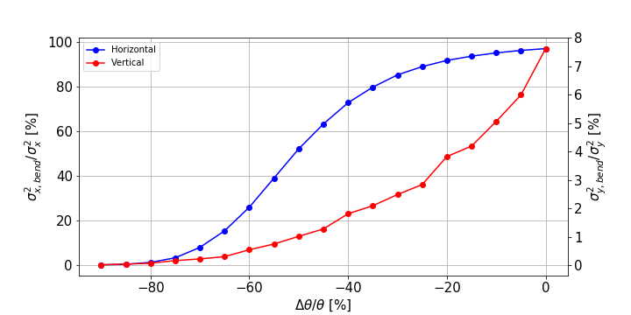
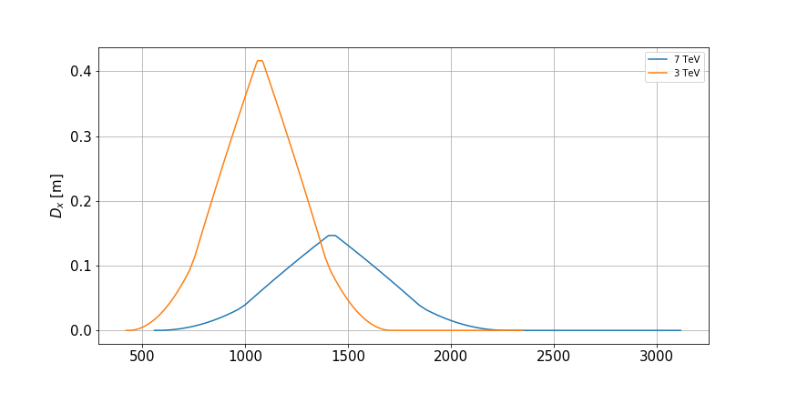
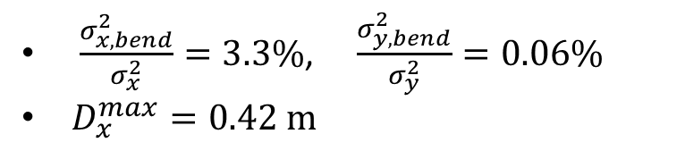
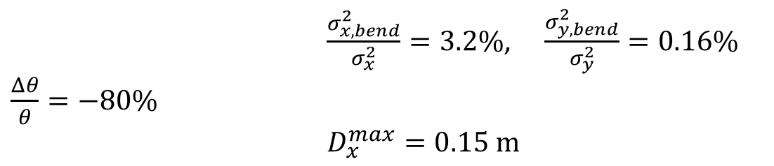
Collimation optimization
3 TeV
$\frac{σ_{x,bend}^{2}}{σ_{x}^{2}}=3.3\%$, $\frac{σ_{y,bend}^{2}}{σ_{y}^{2}}=0.06\%$
$D_{x}^{max}=0.42 m$
7 TeV
$\frac{σ_{x,bend}^{2}}{σ_{x}^{2}}=3.2\%$, $\frac{σ_{y,bend}^{2}}{σ_{y}^{2}}=0.16\%$ $\frac{Δθ}{θ}=−80\%$
$D_{x}^{max}=0.15 m$
S [m]
Enrico Manosperti 19/05/2022 5

Slide 6
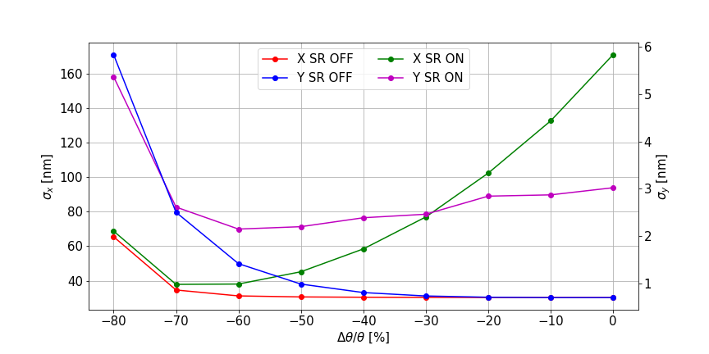
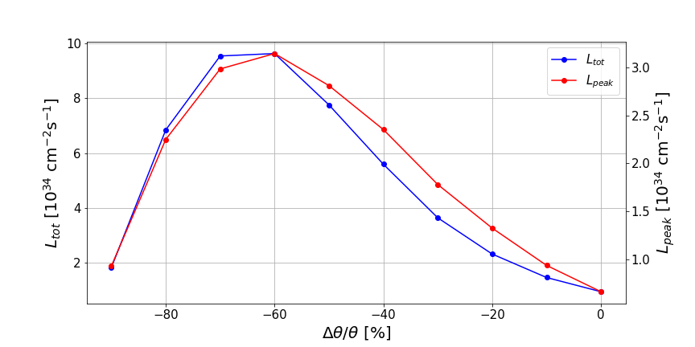
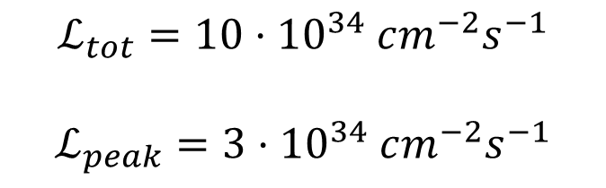
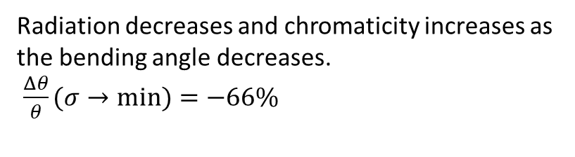
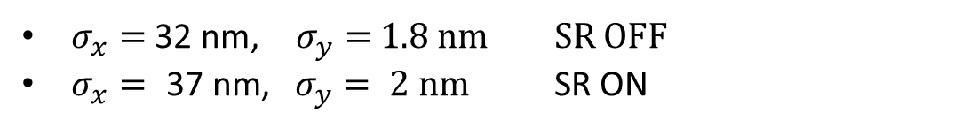
Final Focus optmization
Radiation decreases and chromaticity increases as the bending angle decreases.
$\frac{Δθ}{θ}(σ→min)=−66\%$
$σ_{x}=$ 32 nm, $σ_{y}=$ 1.8 nm SR OFF
$σ_{x}=\text{ 3}\text{7} \text{nm}\text{, }σ_{y}= \text{2} \text{nm}$ SR ON
$$ℒ_{tot}=10⋅{10}^{34} cm^{−2}s^{−1}$$
$$ℒ_{peak}=3⋅{10}^{34} cm^{−2}s^{−1}$$
Enrico Manosperti 19/05/2022 6

Slide 7
Next steps
Compute the beam collimation with this new design
Increase the length of the BDS.
Explore different energies.
Enrico Manosperti 19/05/2022 1

Slide 8
Summary
New optics of the BDS for the energy 7 TeV starting from the 3 TeV one.
Reduction of the beam size growth due to the radiation in the Collimation and Final Focus Systems minimizing the bending angles.
Optimization of the sextupoles to reduce the chromaticity at the IP.
Enrico Manosperti 19/05/2022 7

Slide 9
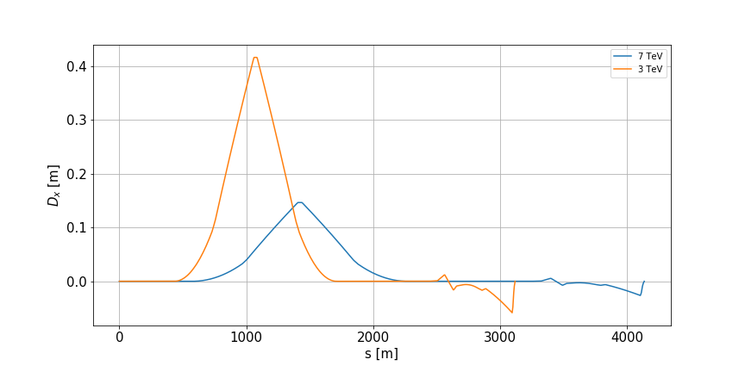
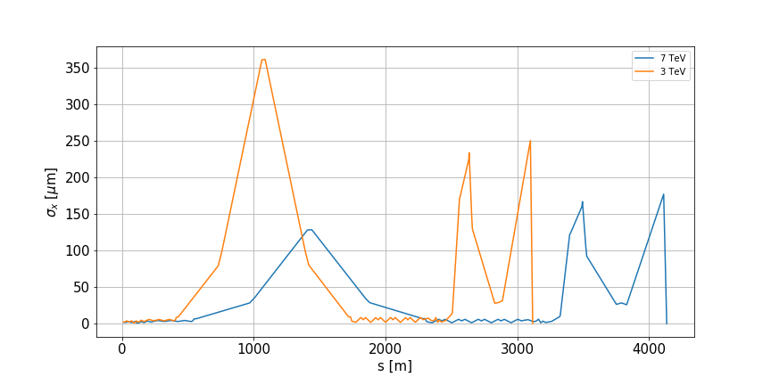
Enrico Manosperti 19/05/2022 1

Slide 10
Enrico Manosperti 19/05/2022 1

