Slide 1
EIC Central Detector Solenoid
Superconducting Detector Magnets Workshop
Renuka Rajput-Ghoshal
Magnet Group, JLab
September 12, 2022

Slide 2
Outline
JLab Introduction
JLab Magnet Group
Superconducting magnet at JLab
EIC
High Level Reference Schedule
EIC- High Level View
Interaction Region
Detector solenoid overview
Detector Solenoid New Magnet Specifications
Magnet- Area of interest
3D Magnetic Preliminary Design Results
EIC Solenoid Conductor
Other Magnets in EIC
Other Superconducting Magnets
2nd IR and 2nd Detector Solenoid
Summary

Slide 3
JLab- An Introduction
JLab is one of the Department of Energy’s 17 National Laboratories, Created to build and operate the Continuous Electron Beam Accelerator Facility (CEBAF), world-unique facility for Basic Research in Nuclear Physics:
  Mission is to gain a deeper understanding of the structure of matter
  In operation since 1995
  1,623 Active Visiting Scientist Participants
  ~200 Completed Experiments to-date
  150 patents produced
  Produces ~1/3 of US PhDs in Nuclear Physics
  ~800 Staff and ~1700 users
  K-12 Science Education program serves as national model
  Site is 169 Acres

Slide 4
JLab- Magnet group and Magnet expertise at Lab
Magnet Group:
2 Magnet Engineers
  ~ 60 years cumulative experience from industry and lab:
  Oxford Instruments, Scientific Magnetics and General Electric
3 mechanical engineers with significant SC magnet experience.
3 Mechanical designers with significant magnet experience
Other Technical Staff:
Numerous technicians and designers (electrical, mechanical, vacuum, cryogenics, etc)
A magnet measurement lab with various measuring capabilities

Slide 5
Superconducting magnet at JLab
Hall A
  There are two spectrometers, each with 3 superconducting magnets
    Q1 (resistive) - Q2 (SC) - Dipole (SC) - Q3 (SC)
      NbTi cable (30 strands of 1.64mm x 14.7 mm) wrapped in Kapton and glass for Q2 and Q3
      NbTi cable (36 strands of flattened Rutherford cable, 2.5mm x 19mm) for Dipole, insulated stainless steel strip co-wound with conductor for mechanical stability
Hall B
  Hall B has one spectrometer and utilizes two large superconducting magnets, a 6-coil Torus and a 5-coil actively shielded Solenoid (5T central field), SSC outer conductor soldered in Cu channel was used for these magnets
Hall C
  Hall C houses a High Momentum Spectrometer and a Super High Momentum Spectrometer (SHMS), SHMS utilizes 5 SC superconducting magnets; HB, 3 quadrupoles and dipole (3.9 T), SSC outer conductor was used for all the magnets and it was soldered in Cu channel for 2 Quads and one dipole.
Hall D
  One large superconducting magnet, the magnet was built in 70s at SLAC, repurposed to used at JLab
Others
  CLEO magnet reuse for some other experiments at Hall A
  There are some standard SC magnets bought from various vendors

Slide 6
Superconducting magnet at JLab

Slide 7
Electron Ion Collider (EIC)
The EIC will be a discovery machine for unlocking the secrets of the "glue" that binds the building blocks of visible matter in the universe.
The EIC at Brookhaven Lab will reuse key infrastructure RHIC and build on discoveries at RHIC and CEBAF at Jefferson Lab. But the EIC will have new features that greatly expand the ability to explore the building blocks of visible matter.
The EIC will be at Brookhaven Lab and JLab is a major partner in this project.

Slide 8
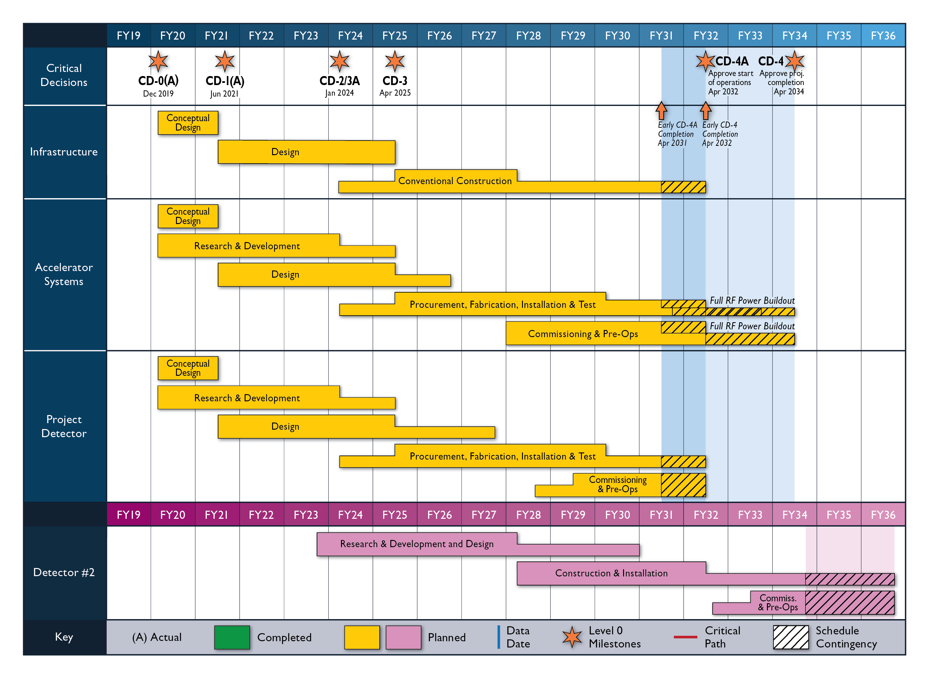
EIC High Level Schedule
Construction Phase
The thinner bars indicate that R&D and design
can continue at a small level beyond CD-2 and CD-3
for LLP construction
starts at CD-2/3A
Notional Schedule
2nd IR and
Schedule
Generic Detector R&D

Slide 9
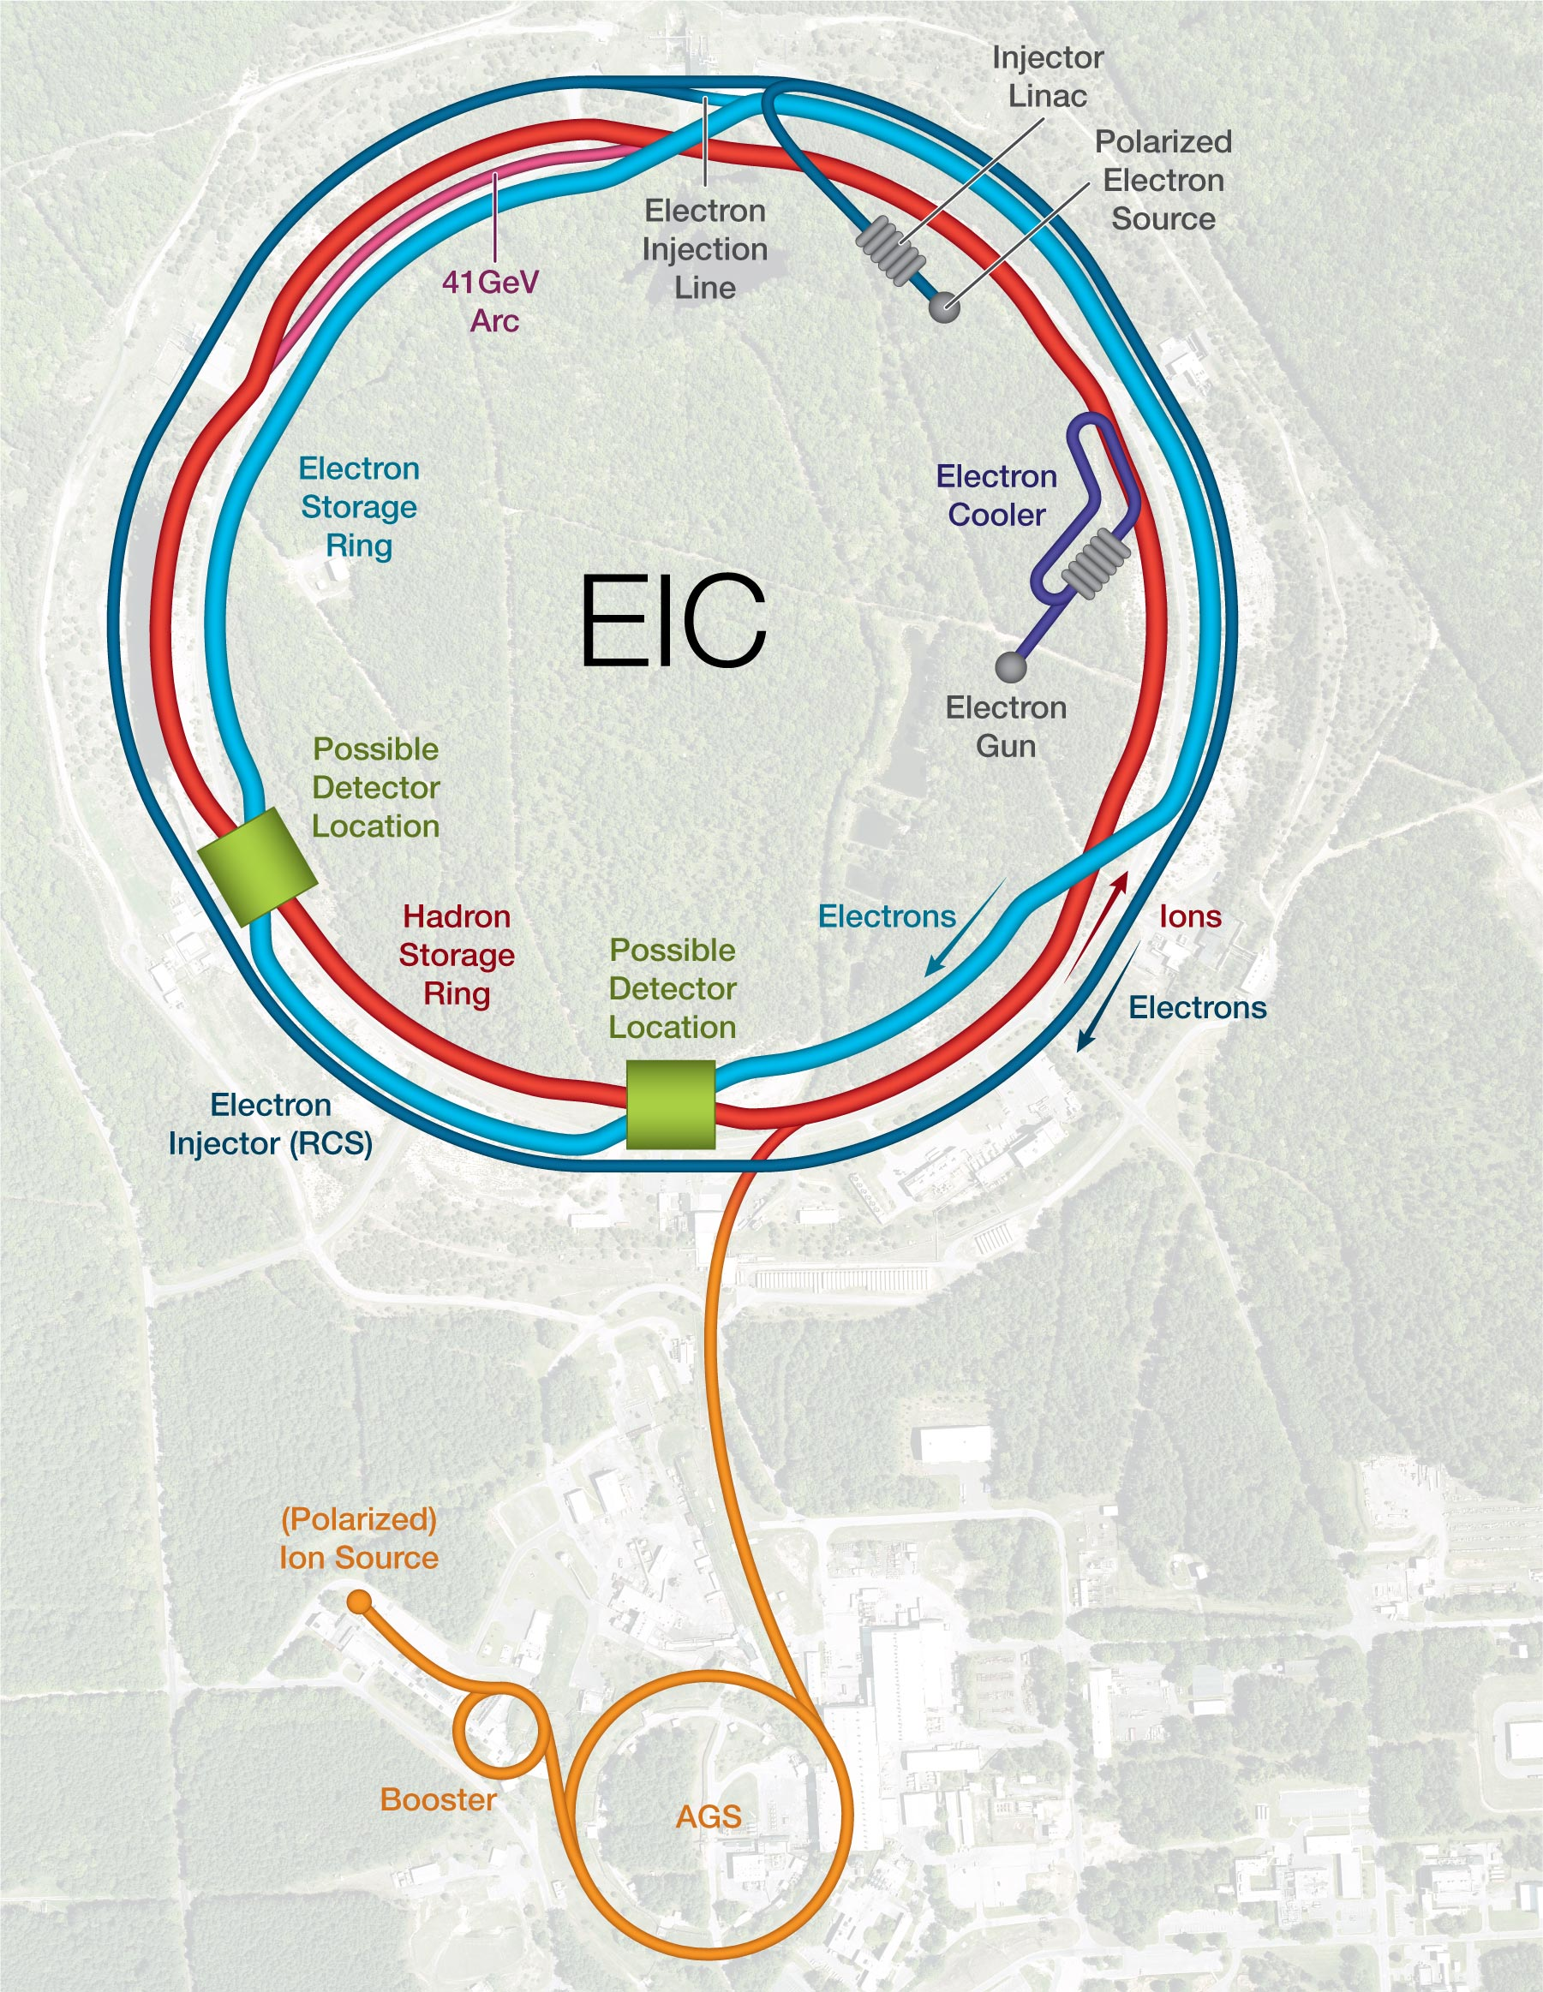
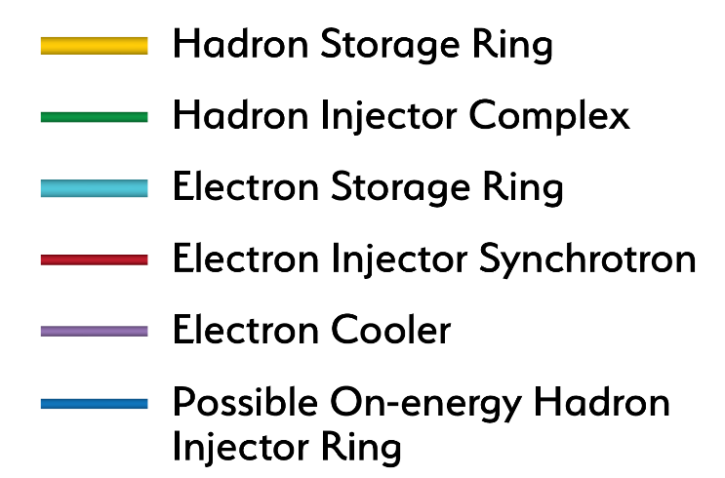
EIC- High Level View
Design based on existing RHIC
Hadron storage ring 40-275 GeV (existing)
Electron storage ring (2.5–18 GeV (new))
Electron rapid cycling synchrotron (new)
High luminosity interaction region(s) (new)

Slide 10
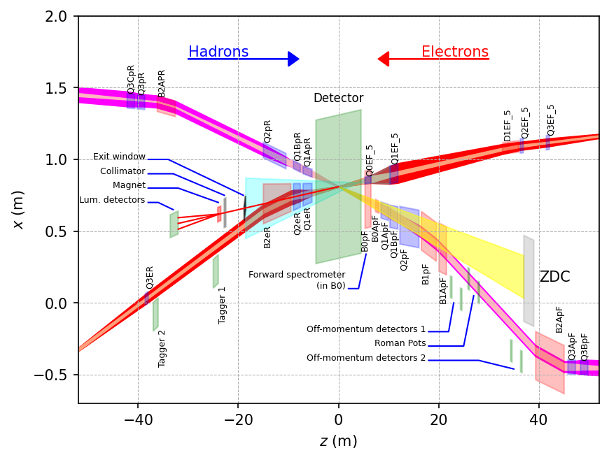
Interaction Region
RCS is not shown in this view

Slide 11
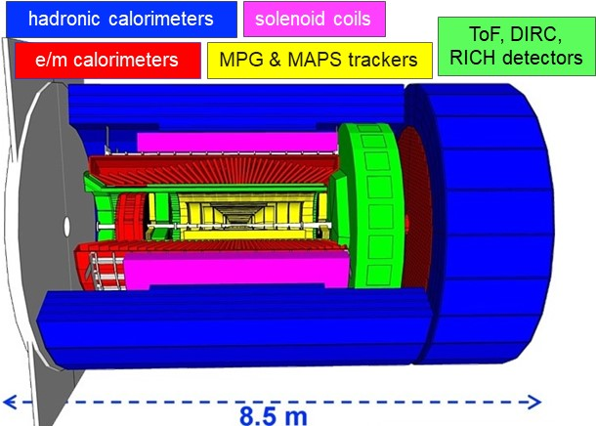
Detector Solenoid Overview
Superconducting Detector solenoid
3.5m long coil, 2.84 m room temperature bore diameter, 2T on-axis field
  Old BaBAR/SPHENIX magnet as contingency
Operating Temperature 4.5 K
Conductor: Copper Cladded, Rutherford Cable made with NbTi superconducting strands
Detector solenoid Design:
The Detector solenoid is foreseen as a long-lead procurement item.
In order to be ready for a long-lead procurement for the magnet at CD-2/3A, we need to complete the reference design, reference drawings and a SOW for the vendor by CD-2/3A
CEA, Saclay is our collaborator for the design phase.

Slide 12
Detector Solenoid New Magnet Specifications
Accelerator fringe field requirements, under further study.

Slide 13
Magnet- Area of interest
The solenoid Field specification document is finalized . There are three areas of importance from the magnetic field point of view, these are:
Flat Field Area
RICH detector Area
Stray field limitation at IR magnets and RCS
Flat Field Area: This are is 200 cm long and 80 cm in radius around the IP, the field uniformity required in this area is 12.5%
Stray Field:
The detector solenoid has neighboring IR magnets, in order to reduce the effect of solenoid magnet on IR magnets, there is a requirement of stray field less than 5G at B0ApF and Q1ApR magnets, these magnets extends from z= 7.4 m to 8 m and z=-5.3 m to -7.1 m respectively.
The RCS is radially 335.2 cm from the magnet central axis and stray field requirement there is <0.007 Tm
RICH detector Area: To maximize the RICH performance based on the gas radiator it is critical to minimize the bending of the tracks in the volume of the gas radiator.
For this one needs to shape the field that it is parallel to the different scattering angles of particles covered by the RICH. The RICH area extends from z=+180 cm to +280 cm.

Slide 14
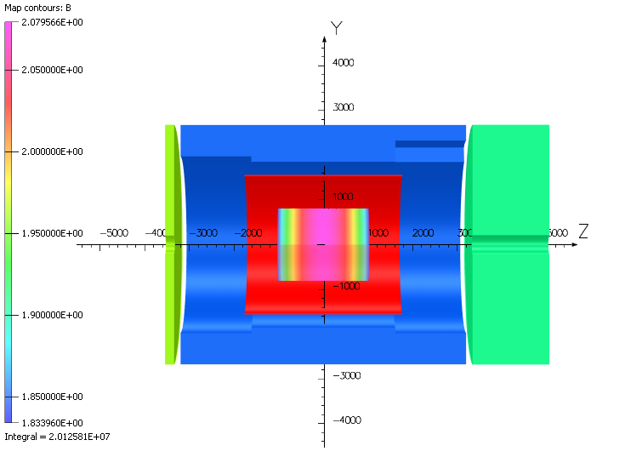
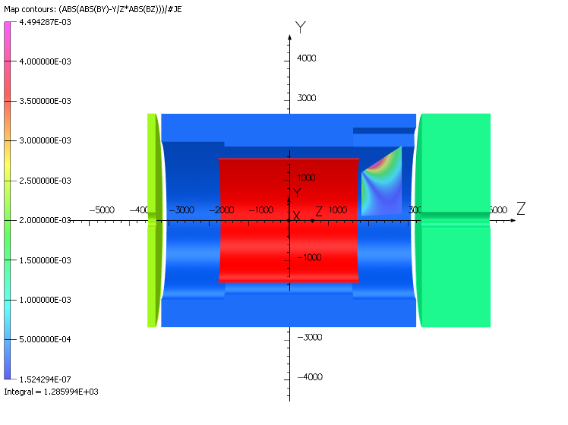
3D Magnetic Preliminary Design Results
2.08 T
Parameter | Parameter Value | Units | Validation
Coil R_{in} | 1509.5 | mm | OK
Coil R_{out} | 1543.1 | mm | OK
Coil Length | 3492.0 | mm | OK
3D RESULTS
B @ (0,0,0) | 2.000 | T | OK
Bpeak+self field | 2.602 | T
Stored Energy | 45.7 | MJ
B @ (0,0,-5300) | 61 | G | Tbd
B @ (0,0,7200) | 37 | G | Tbd
B @ (3400,0,0) | 62 | G | Tbd
Projectivity | 2.41 | T/Amm² | OK
Homogeneity | 12.3 | % | Validated by physics group
Homogeneity region
1.83 T
B field along Z axis
RICH Projectivity

Slide 15
EIC Solenoid Conductor

Slide 16
Other Magnets in EIC
Courtesy Holger Witte, BNL

Slide 17
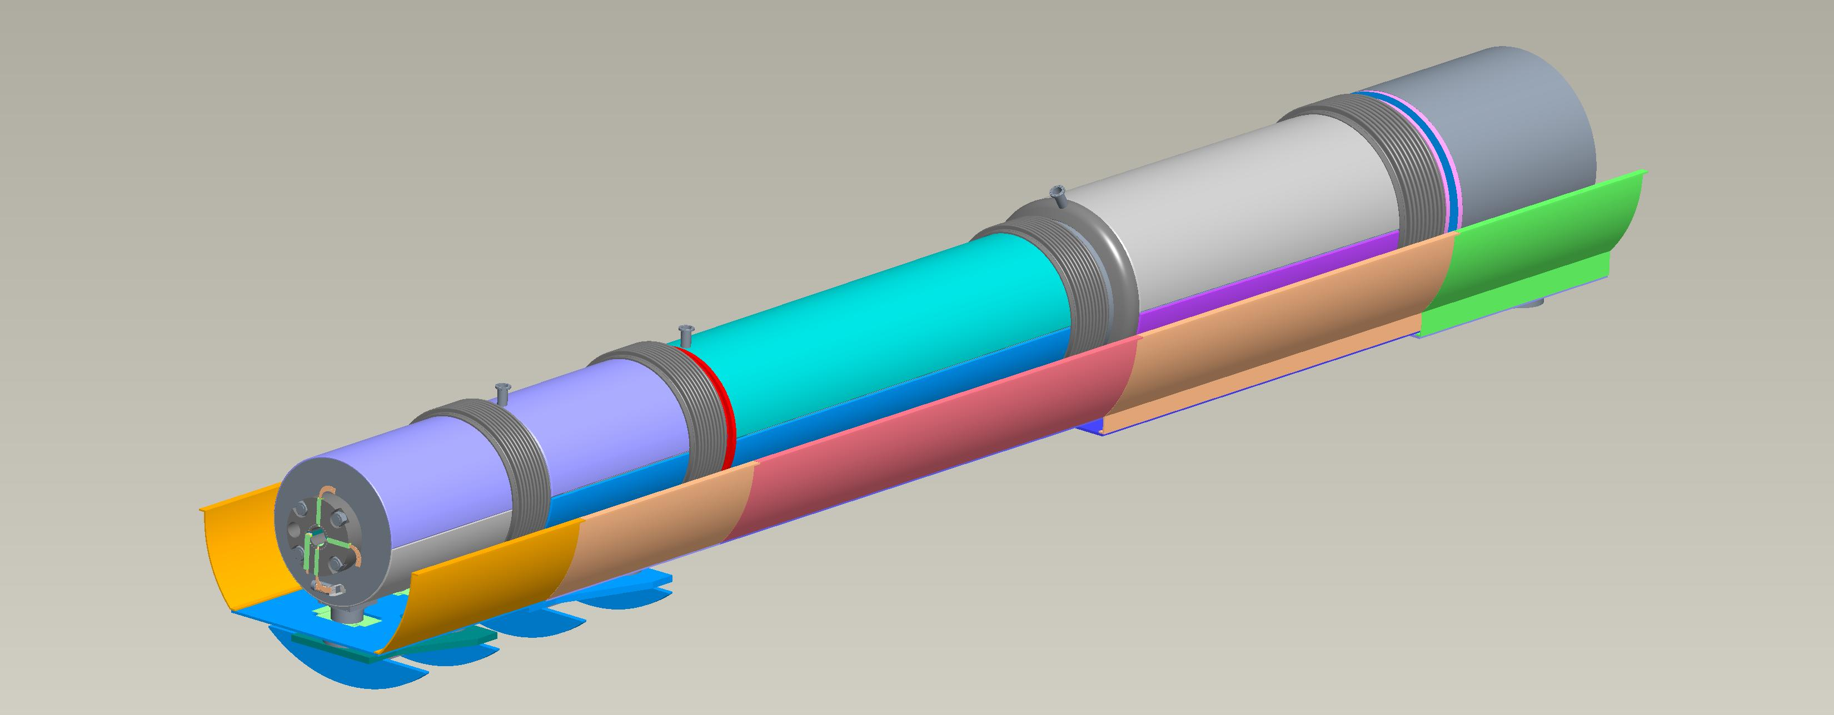
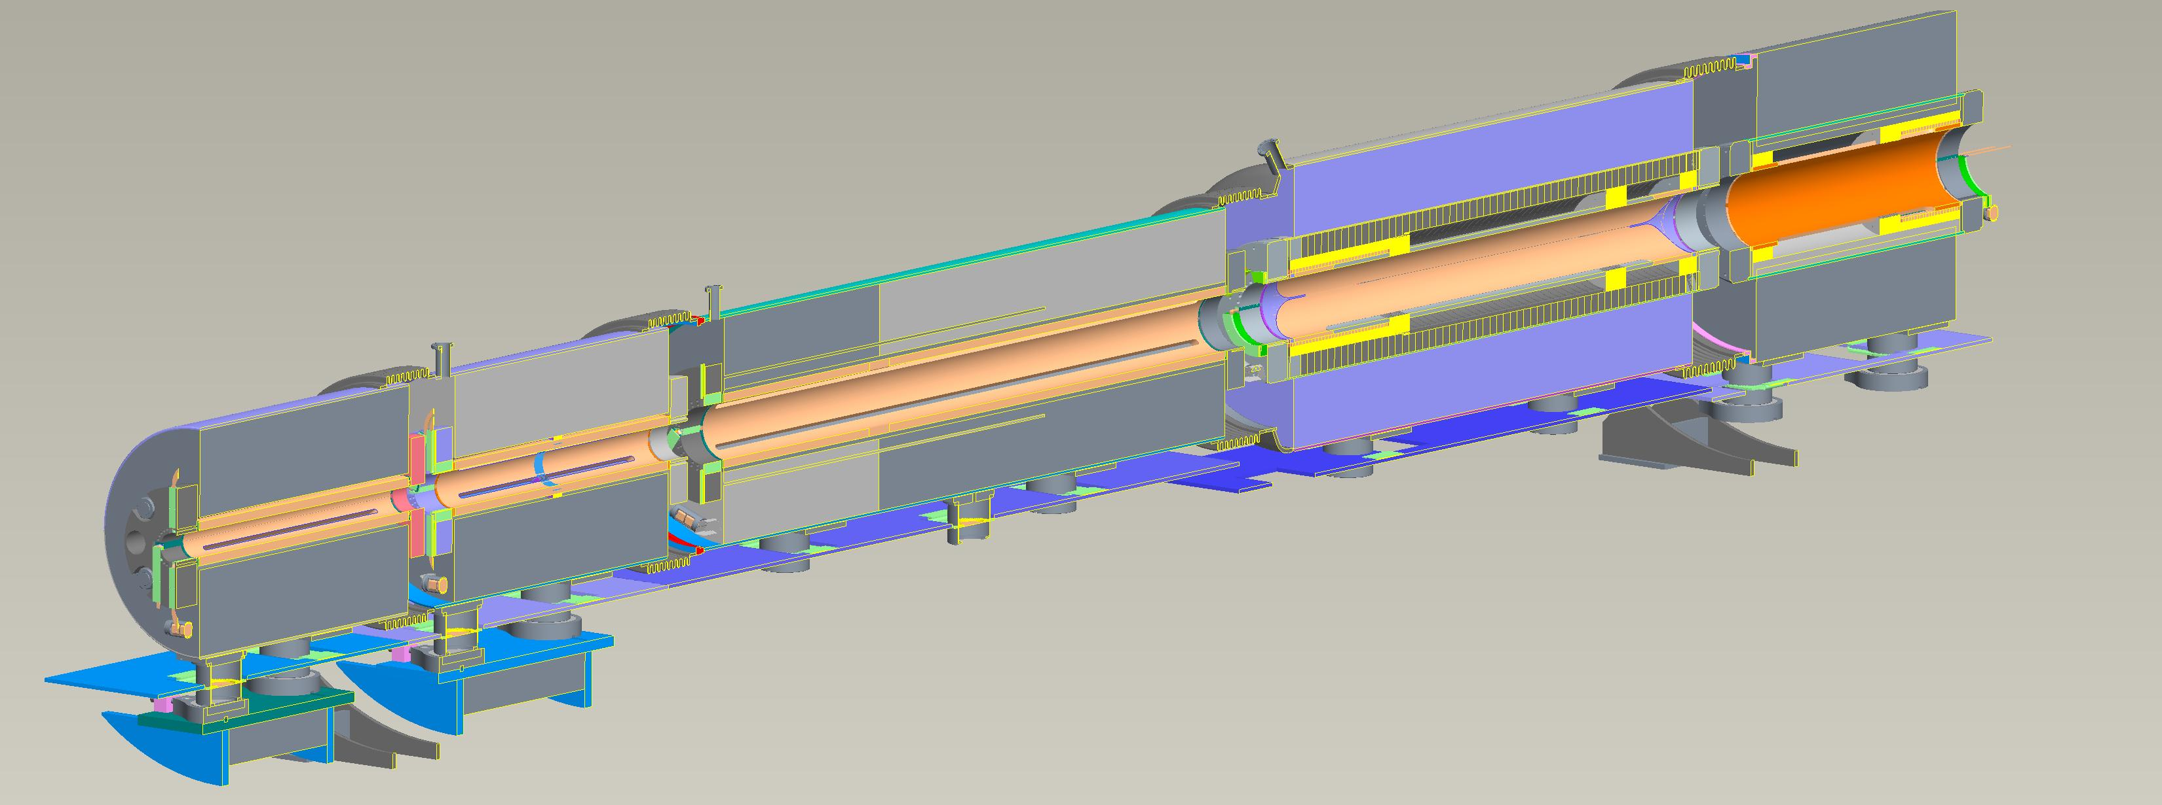
Other Superconducting Magnets
Spin Rotator Solenoids (not shown here)
  16 modules, 3m long, 7T on-axis field
IR Magnets
  Five collared magnets
    Dipoles and quads
    Based on Rutherford cable
  NbTi, 2K operation
  Cold mass only
    One cryostat for all magnets
  Additionally: Matching dipoles
    5T dipoles, 4m long
Courtesy Holger Witte, BNL
Q1ApF Q1BpF Q2pF B1pF B1ApF
Name | R1 | length | B | grad | B pole
 | [m] | [m] | [T] | [T/m] | [T]
Q1ApF | 0.056 | 1.46 | 0 | -72.608 | -4.066
Q1BpF | 0.078 | 1.61 | 0 | -66.18 | -5.162
Q2pF | 0.131 | 3.8 | 0 | 40.737 | 5.357
B1pF | 0.135 | 3 | -3.4 | 0 | -3.4
B1ApF | 0.168 | 1.5 | -2.7 | 0 | -2.7

Slide 18
2nd IR
2nd ID and 2nd Detector is not in the funded scope as of now.
One of the next levels of detailed design relevant to physics performance is detector solenoid integration is in progress
Solenoid field could be higher (~3T)
Solenoid will probably need Al-Stabilized Rutherford cable

Slide 19
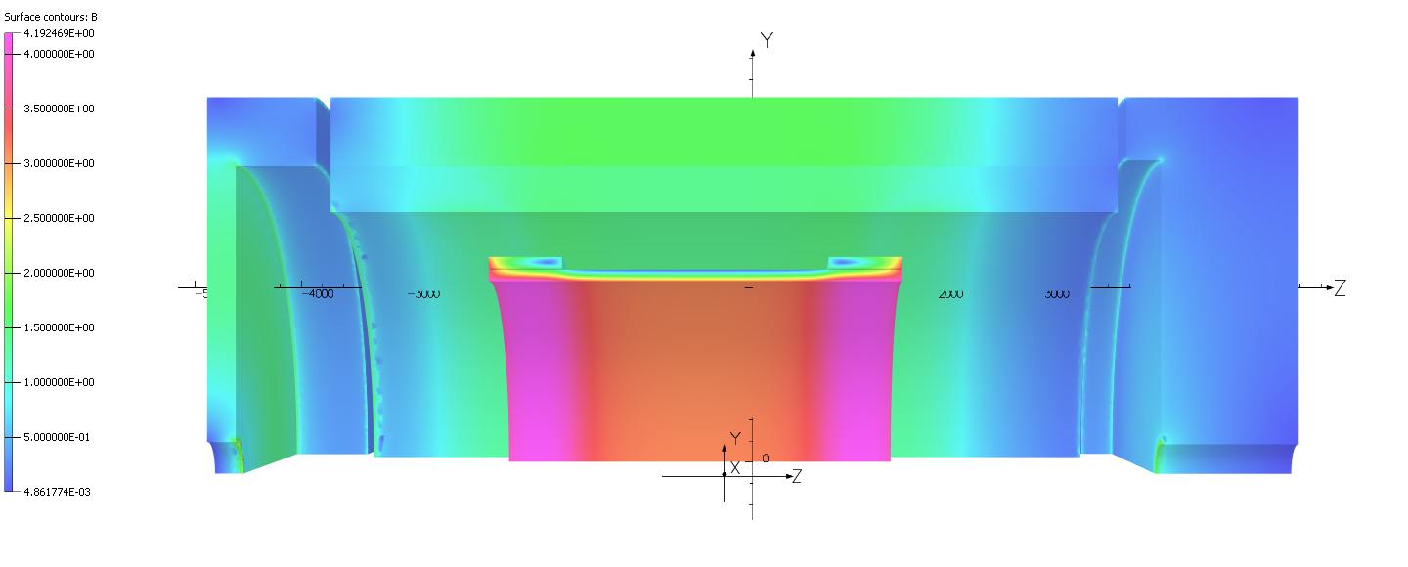
3T Solenoid Design

Slide 20
Summary
EIC is a DoE (Department of Energy) funded project and most of the sub-systems are in advanced stage of design.
CD2/3A is scheduled in January 2024, long lead procurement can start after CD2/3A.
Detector solenoid for the first detector is in advance stage of design.
Design is expected to be complete by October 2023.
Copper stabilized Rutherford cable is required for this magnet
The 2nd IR conceptual design work is progressing well, 2nd detector might need higher field solenoid, that will be need Aluminum stabilized Rutherford cable.
There are other superconducting and resistive magnets required for this project.

Slide 21
Acknowledgement
  I would like to thank my team members for all the work, EIC detector solenoid team is spread over 3 main institutes. All the team members are:
  JLab:
    Rolf Ent, Walter Wittmer, Mitch Laney, Giuseppina (Jessie) Tenbusch, Probir Ghoshal, Eric Sun, Sandesh Gopinath, Dan Young, and Kaiyi Hall
  BNL:
    Elke Aschenauer, Roberto Than, Holger Witte, Alexander Kiselev, Rahul Sharma and Roland Wimmer
  CEA, Saclay:
    Lionel Quettier, Valerio Calvelli, Christophe Berraud, Francesco Stacchi, Francois-Paul Juster, Hugo Reymond, Michel Segreti, Jean-Pierre Lotin, and Damien Simon

