Slide 1
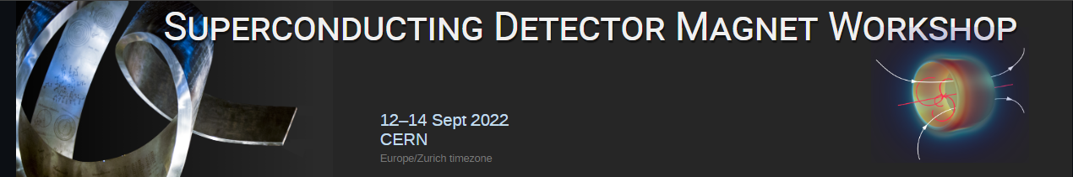

CLIC:
The Compact Linear Collider,
Detector and Magnet
Benoit CURÉ, CERN
On behalf of the CLICdp collaboration

Slide 2
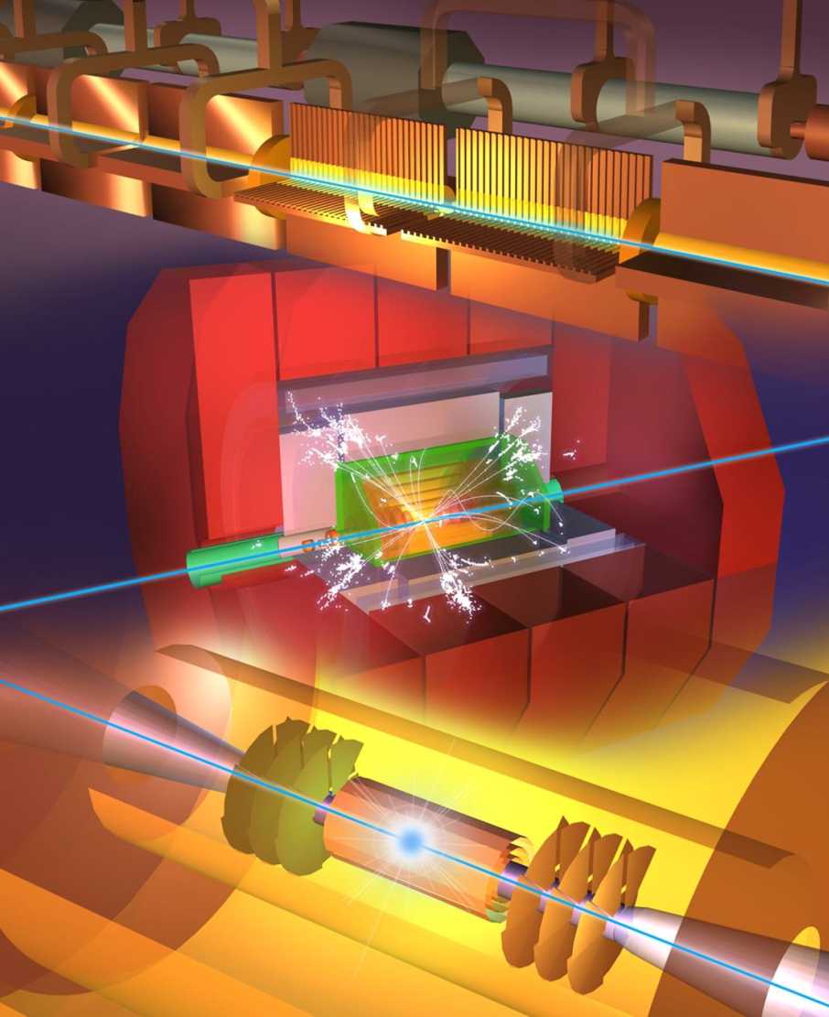
The Compact Linear Collider, Detector and Magnet
Outline
The CLIC Collaboration
CLIC physics context
The CLIC accelerator: overview
The detector for CLIC
The CLIC detector magnet
Summary

Slide 3
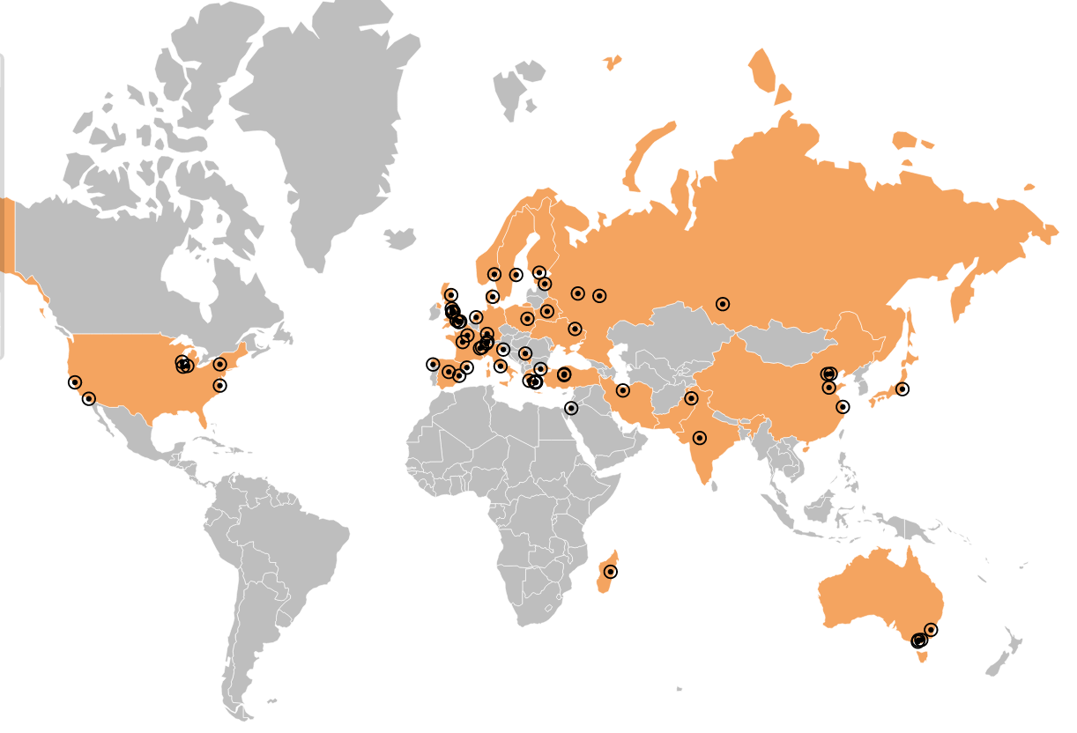
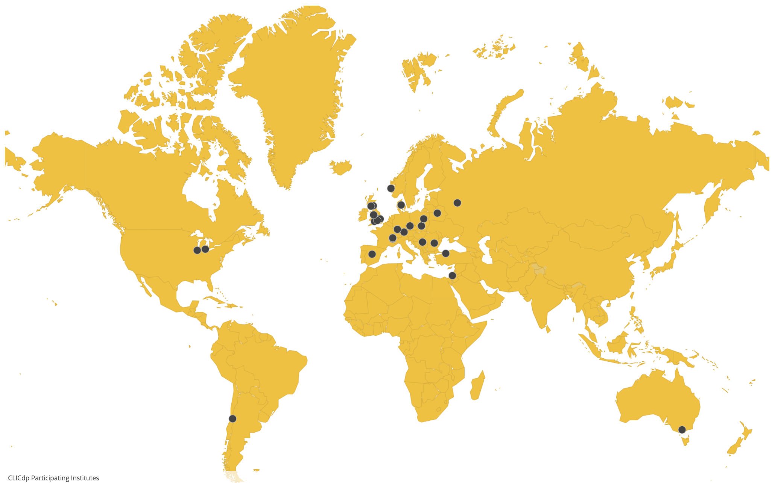
CLIC collaboration
CLIC/CTF3 accelerator collaboration
~70 institutes from ~30 countries
http://clic-study.web.cern.ch/
CLIC detector and physics (CLICdp)
30 institutes from 18 countries
http://clicdp.web.cern.ch/
CLIC accelerator studies:
CLIC accelerator design and development
Construction and operation of CLIC Test Facility
Focus of CLIC-specific studies on:
Physics prospects and simulation studies
Detector optimisation + R&D for CLIC
Sources: CLIC, CERN;
clic.cern;
clicdp.web.cern.ch

Slide 4
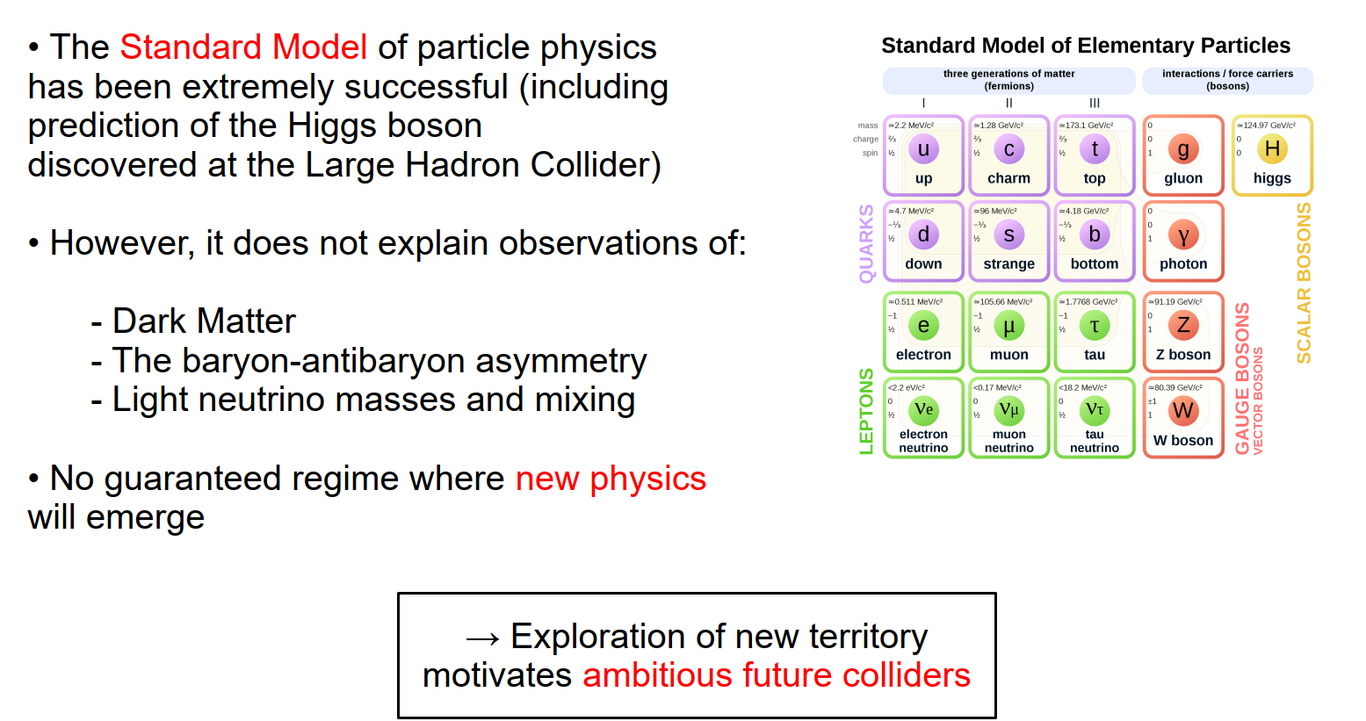
CLIC physics context
CLIC provides energy-frontier capability for electron-positron collisions, for precision exploration of potential new physics that may emerge from LHC
Philipp Roloff, CLIC 2019

Slide 5
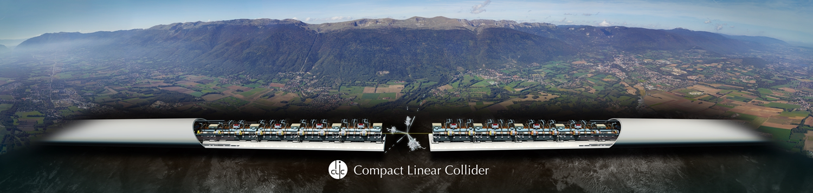
CLIC accelerator: overview
The Compact Linear Collider (CLIC) is a proposed accelerator that is being designed as an addition to CERN’s accelerator complex.
Its objective is to collide electrons and positrons (antielectrons) head-on at energies of up to several tera-electronvolts (10¹²eV or TeV).
For an optimal exploitation of its physics potential, CLIC is intended to be built and operated in three stages, at collision energies of 380 GeV, 1.5 TeV and 3 TeV respectively, for a site length ranging from 11 to 50 km
Accelerator optimisation, technical developments and system tests have resulted in significant progress in recent years including a reduced cost and an increased energy efficiency.

Slide 6
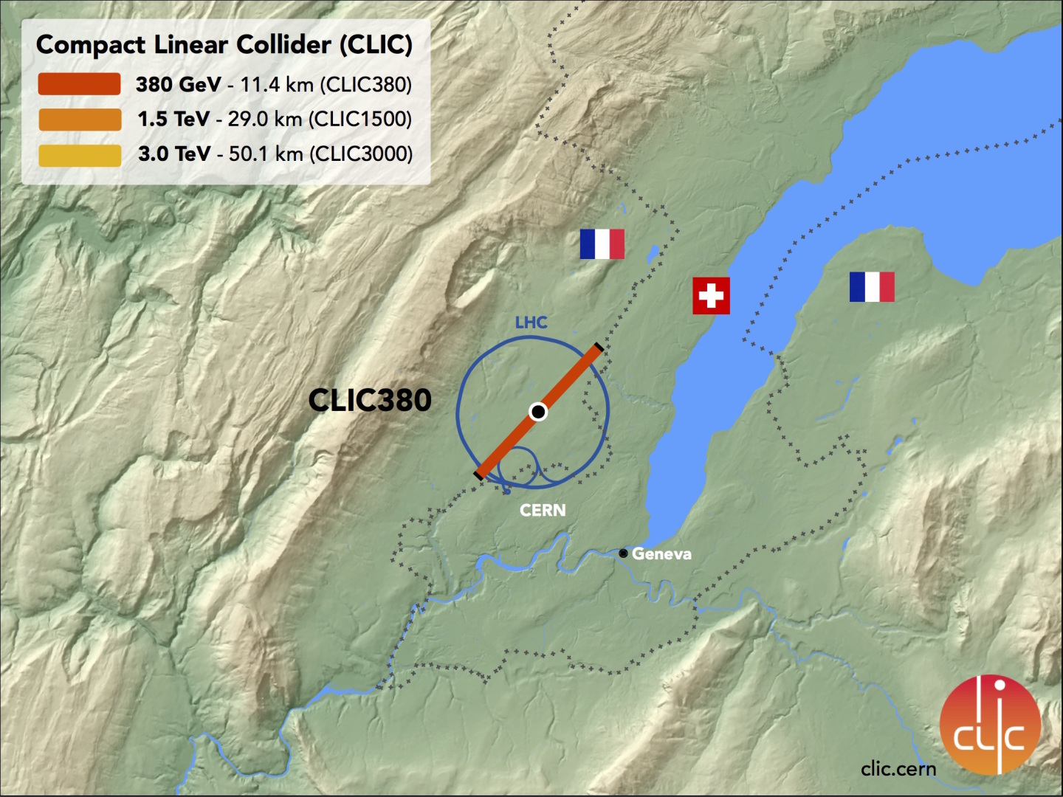
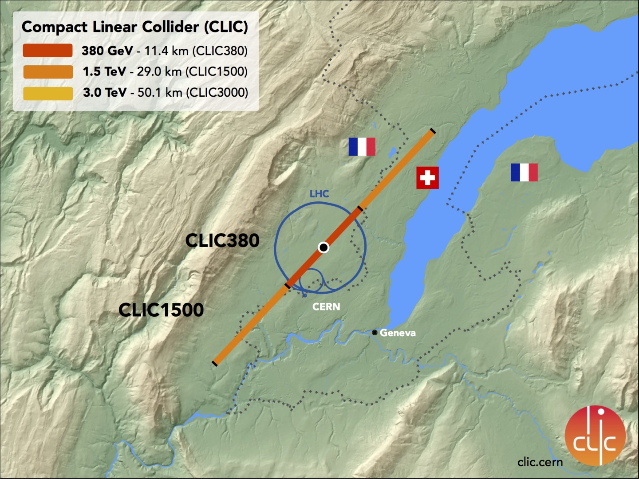
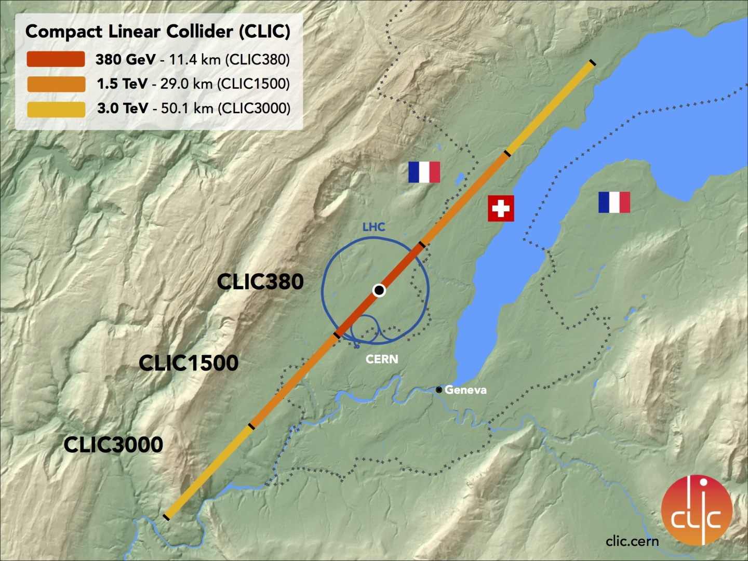
CLIC accelerator: overview
Optimized design w.r.t. cost and power for a staged approach to reach multi-TeV scales.
3 stages:

Slide 7
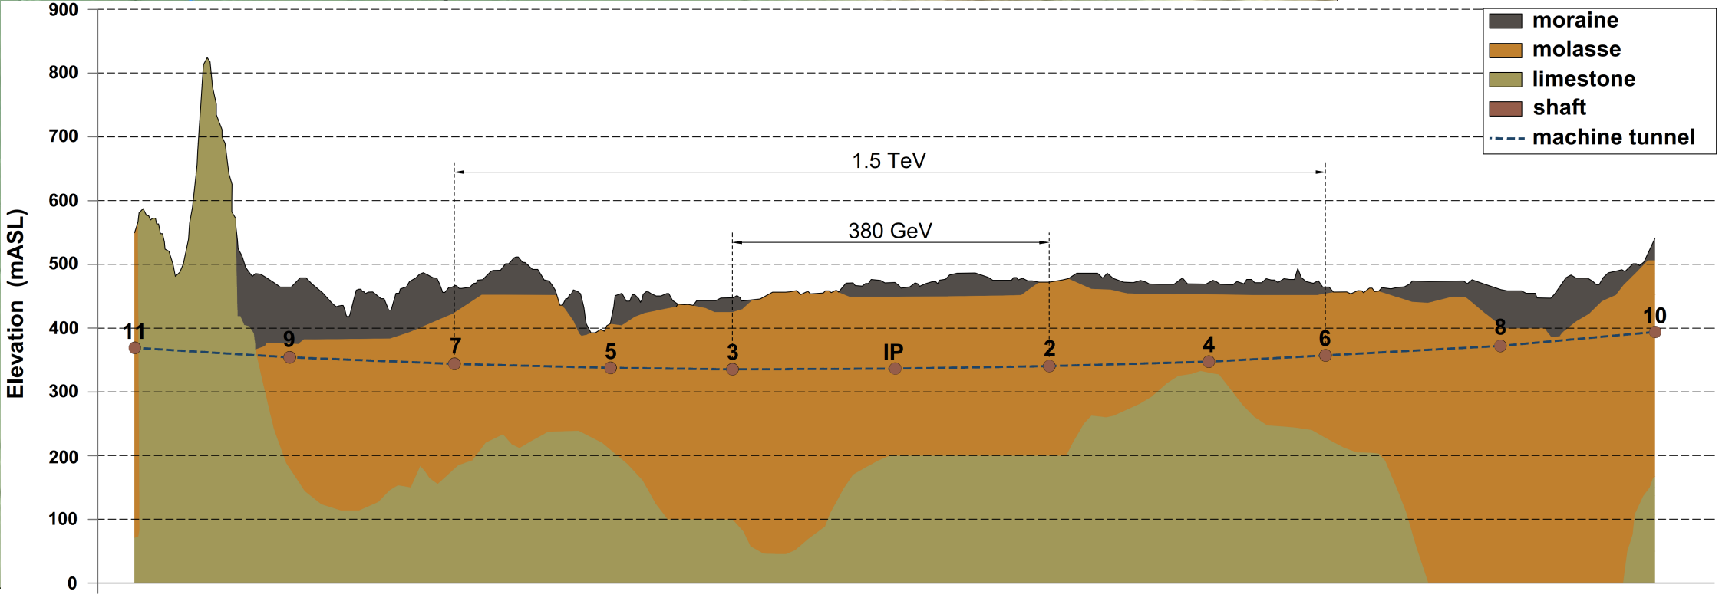
CLIC accelerator: overview
The underground tunnel
  Depth: -100m / -150m

Slide 8
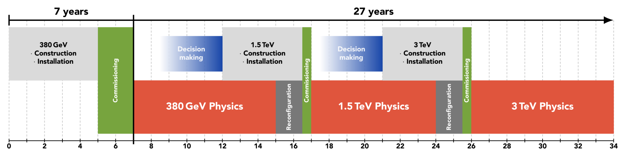
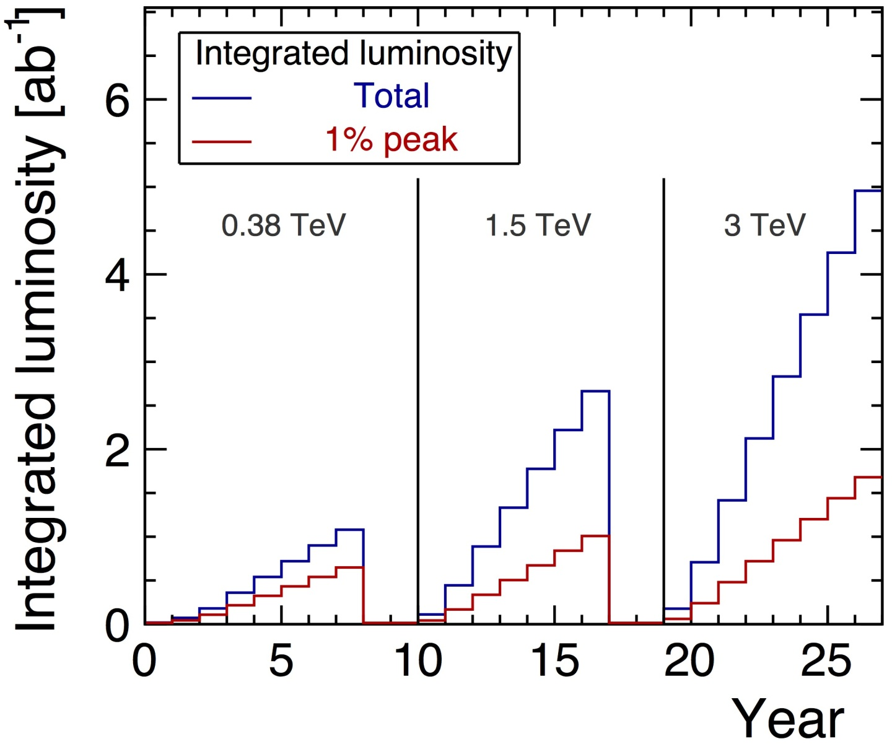
CLIC accelerator: overview
Staging scenario adapting appropriately to LHC + other physics findings
Number of particle collision events per attobarn (= 10⁻⁴² cm²) of target cross-section
380 GeV:
Optimised for precision SM Higgs and top physics
1.5 TeV, 3 TeV:
Best sensitivity for new physics searches,
Rare Higgs processes and decays
5 ab⁻¹
2.5 ab⁻¹
1 ab⁻¹
A. Robson, P. Roloff, Updated CLIC luminosity staging baseline and Higgs coupling prospects, 2018

Slide 9
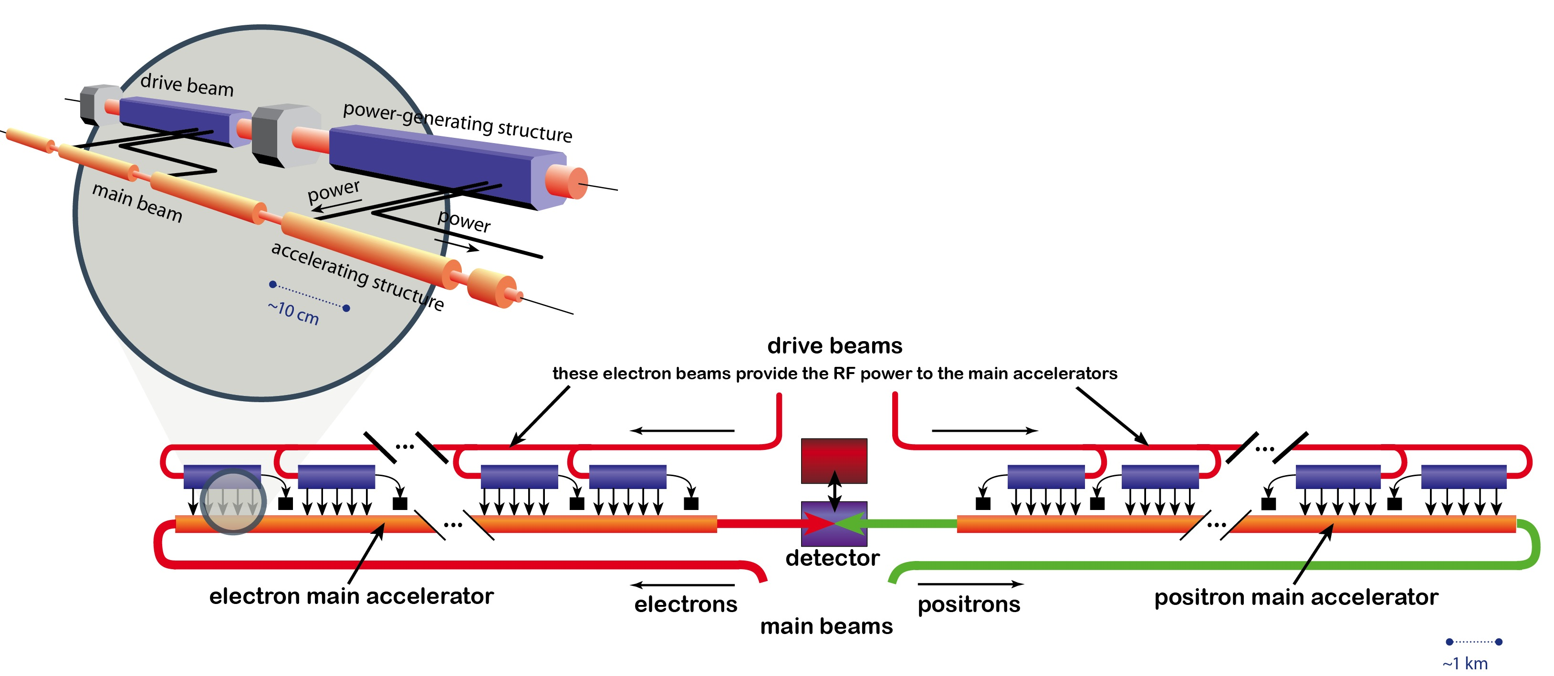
CLIC accelerator: overview
CLIC Technology : 2-beam acceleration scheme
A high intensity “drive beam” is decelerated to produce the radiofrequency power needed to accelerate the electrons and positrons of the “main beam”.
High centre-of-mass energy requires high-gradient acceleration
High gradients feasible in normal conducting structures with high RF frequency (12 GHz)
Initial transfer from wall plug to beam (klystron) is efficient at lower frequency (~1 GHz)
To keep power low, apply RF power only at the time when the beam is there.
Key technical challenges for CLIC :
solved
High-current drive beam bunched at 12 GHz
Power transfer + main-beam acceleration
100 MV/m gradient in main-beam cavities
CLIC uses a 2-beam acceleration scheme at 12 GHz, gradient of 100 MV/m
IP

Slide 10
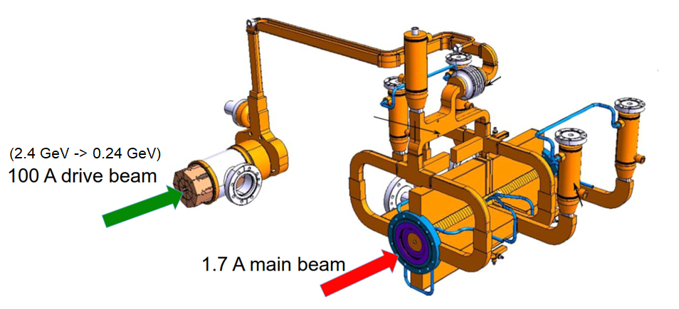
CLIC accelerator: overview
CLIC 2-beam acceleration scheme
The short and intense electron pulses of the “drive beam” are produced by interleaving bunches in a delay loop and two combiner rings.
The “main beams” have their independent “guns”, pre-accelerating and damping rings followed by a long transfer line to beginning of their respective linear accelerator.
Synchronization of the arrival time of “drive beam” and “main beam” bunches is crucial.
Modular system:
Drive Beam supplies RF power
12 GHz bunch structure
low energy (2.4 GeV - 240 MeV)
high current (100A)
Main beam for physics
high energy (9 GeV – 1.5 TeV)
current 1.7 A

Slide 11
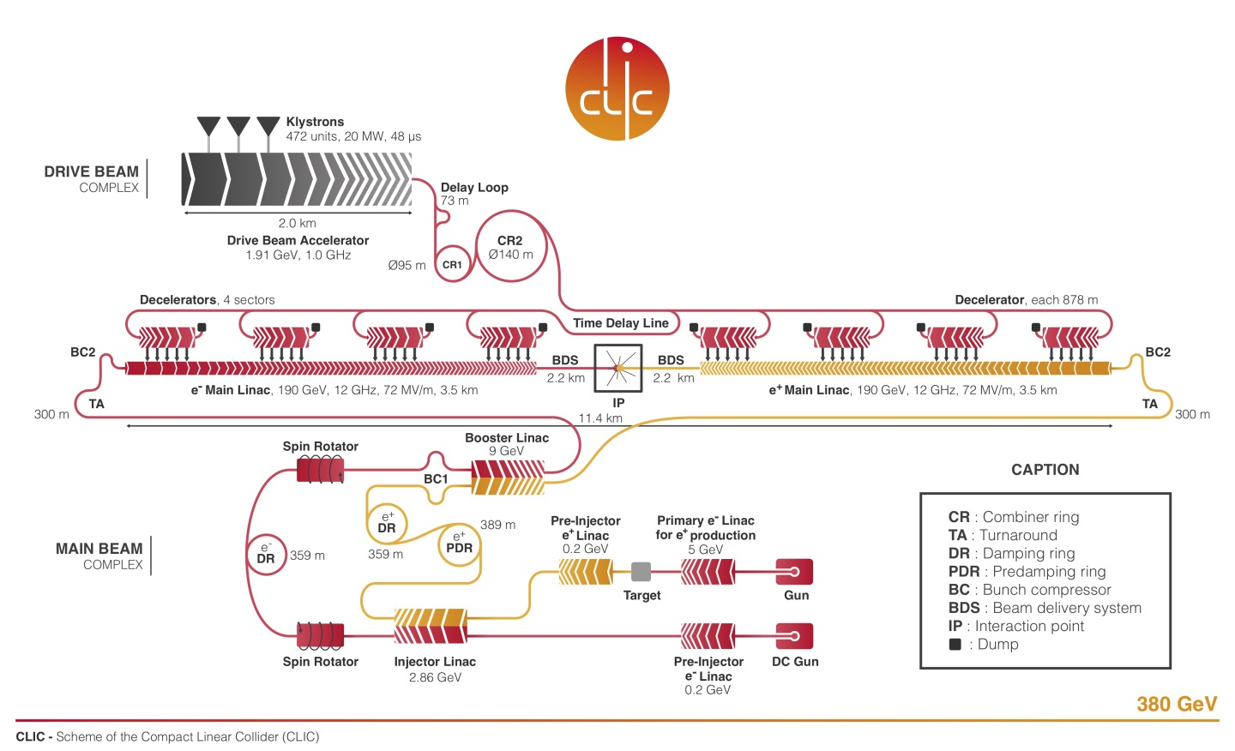
CLIC accelerator: overview
First stage:

Slide 12
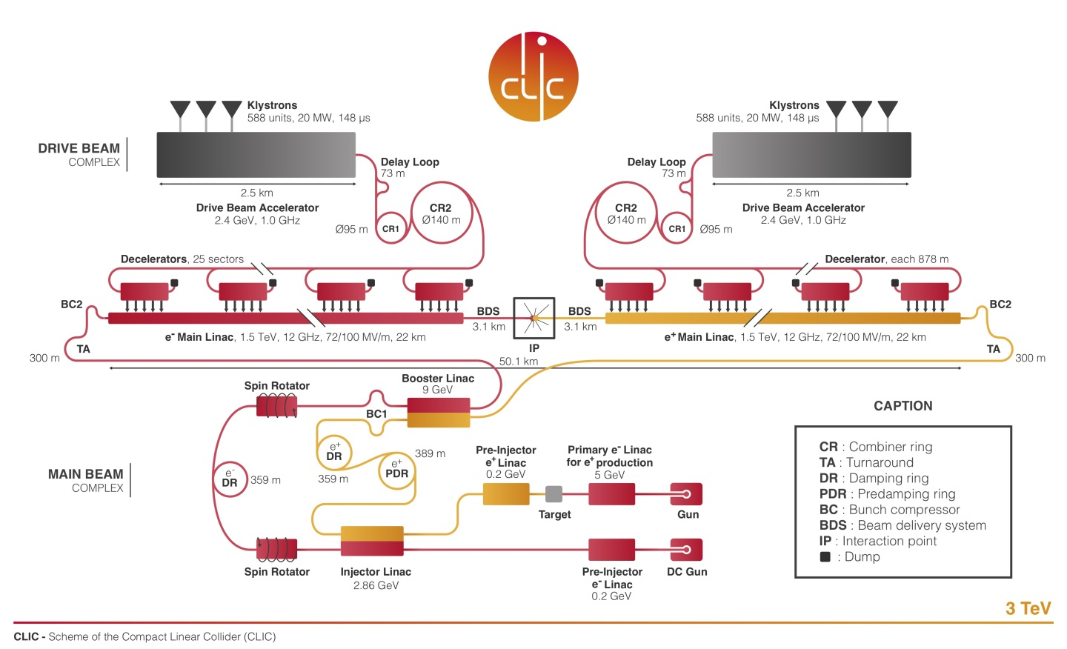
CLIC accelerator: overview
Next stages:
re-use systems / components
Add linac and drive pulse length
at 3 TeV, add 2nd drive beam

Slide 13
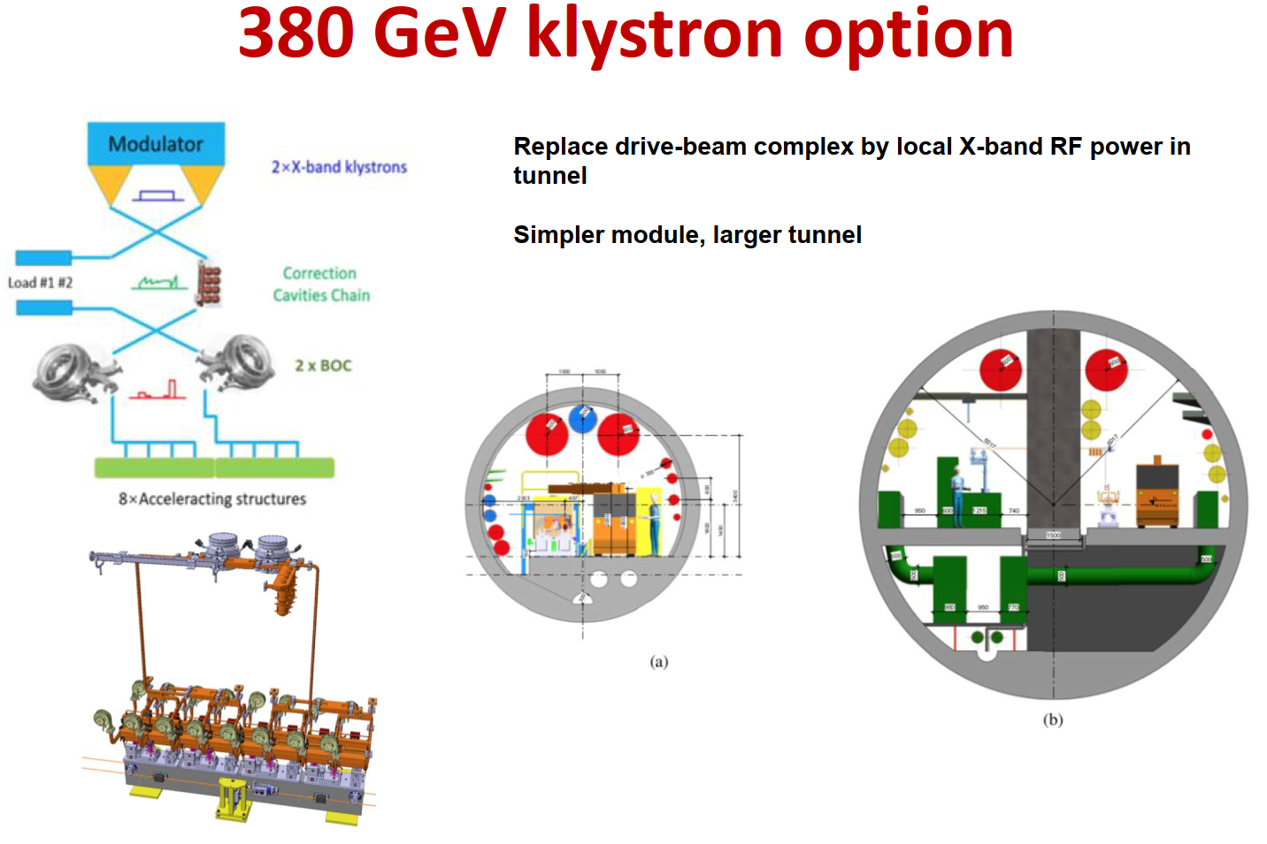
CLIC accelerator: overview
Several paths of development aiming at saving power and energy have been identified and are under investigation.
An alternative to the CLIC drive beam scheme : the main linac power is produced using X-band klystrons.
(inner diameter from 5.6 m to 10 m)
Philipp Burrows, ICHEP 2020,
CLIC Status and plans

Slide 14
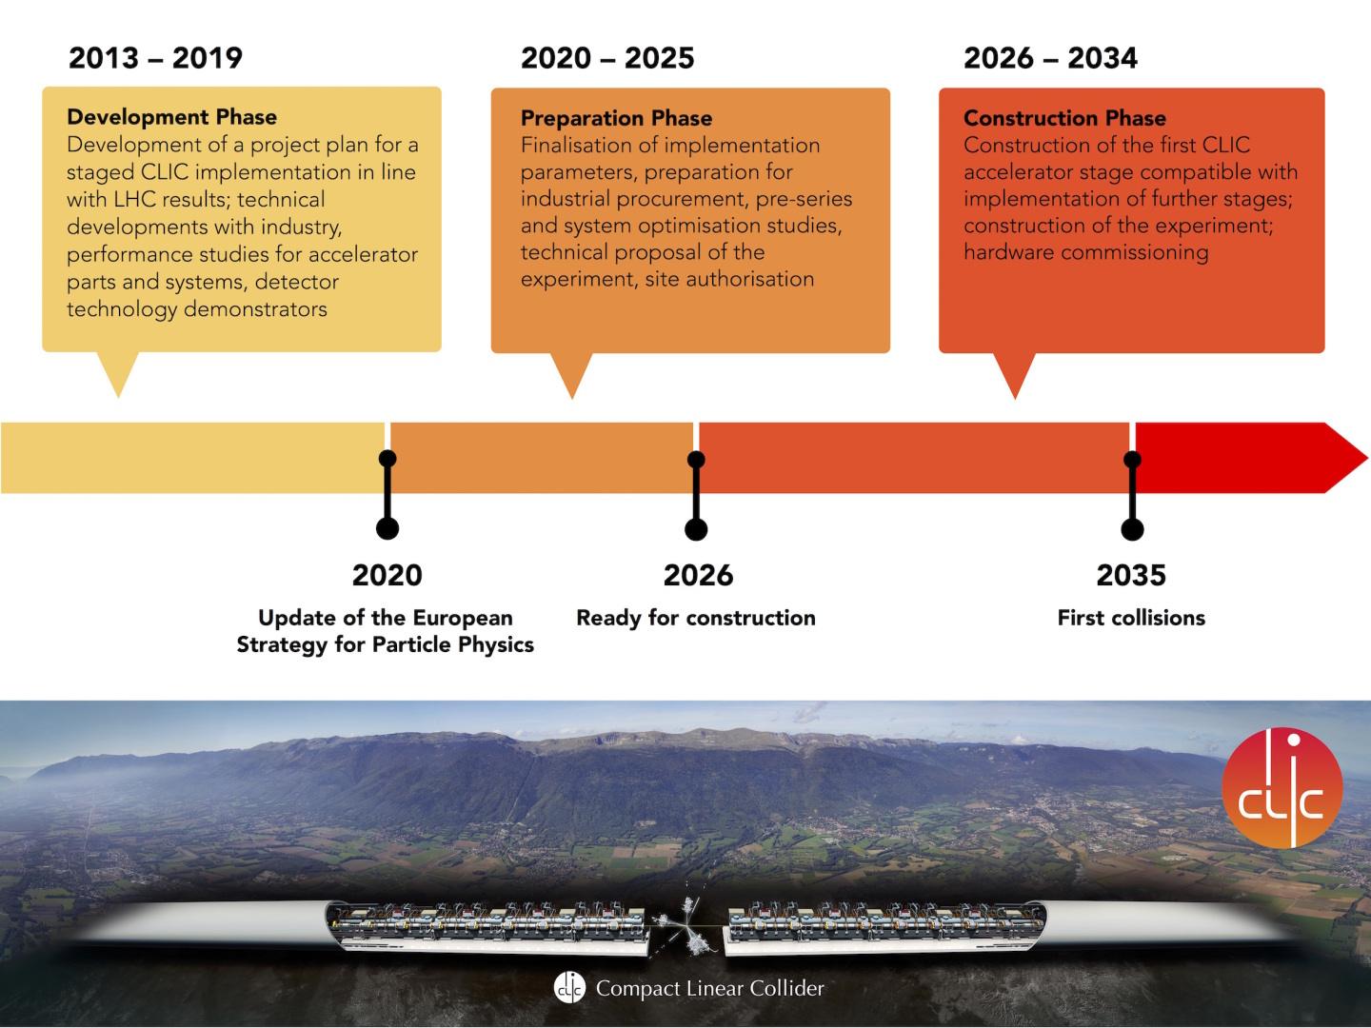
CLIC accelerator: overview
Initial plans revised according to European Committee for Future Accelerator roadmap,
with continuation of R&D studies, optimization and design.

Slide 15
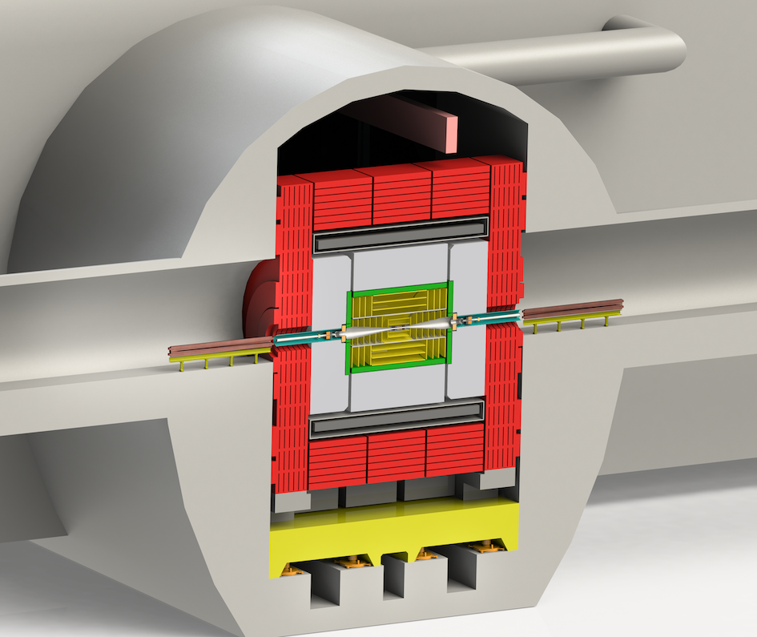
CLIC detector
The CLIC detector at the Interaction Point

Slide 16
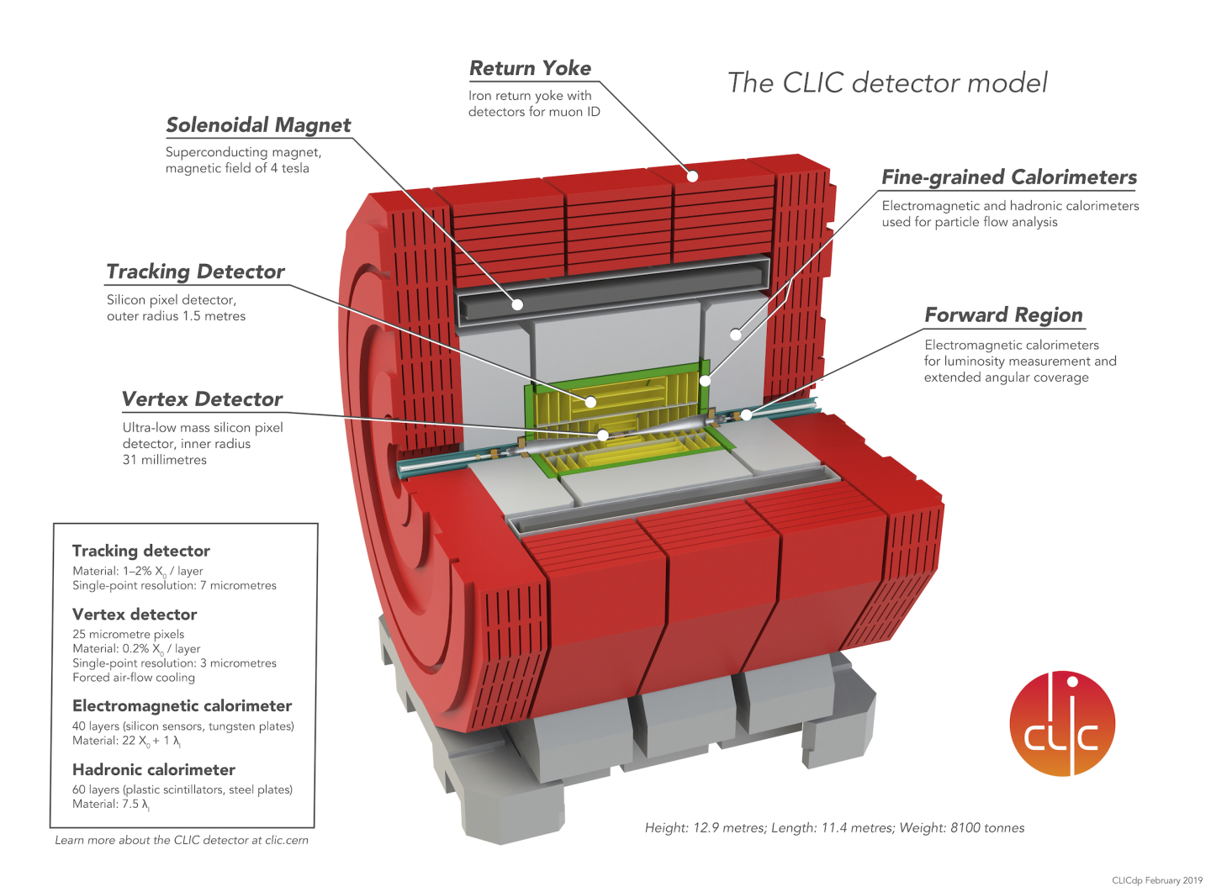
CLIC detector
Magnet provides background field for particle identification.
End Coils
For magnetic field shaping

Slide 17
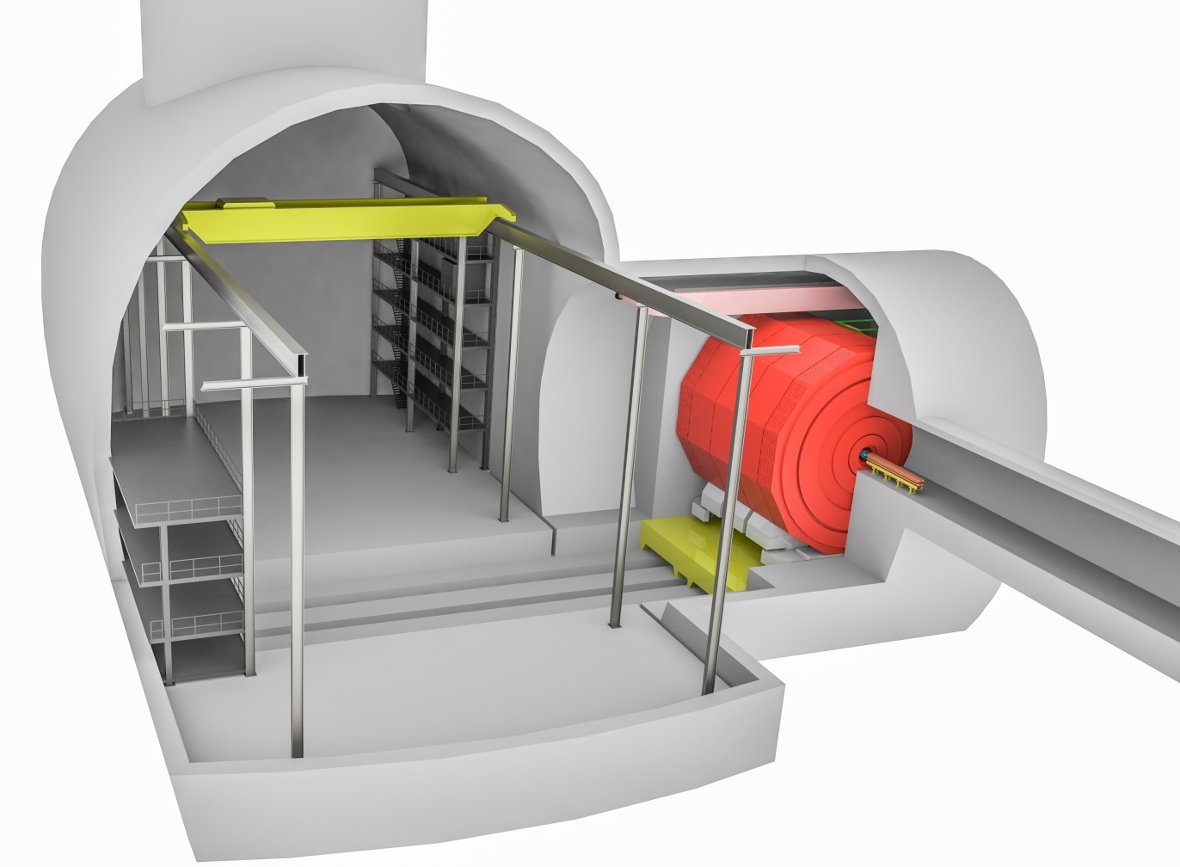
CLIC detector
Experimental underground cavern :
Main cavern for detector access and maintenance
Alcove for detector at accelerator IP
detector garage position : detector opening to access the inner detectors for maintenance and upgrades.
ancillary systems (control, safety, etc.),
infrastructure (cooling, power, HVAC, DAQ, etc.).
depth about 100 m
Cavern size : L x l x H = 62 x 31 x 33 m
Shaft : Ø18m

Slide 18
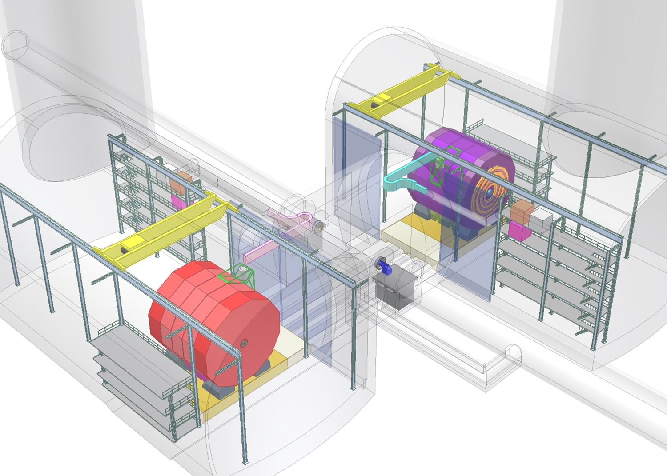
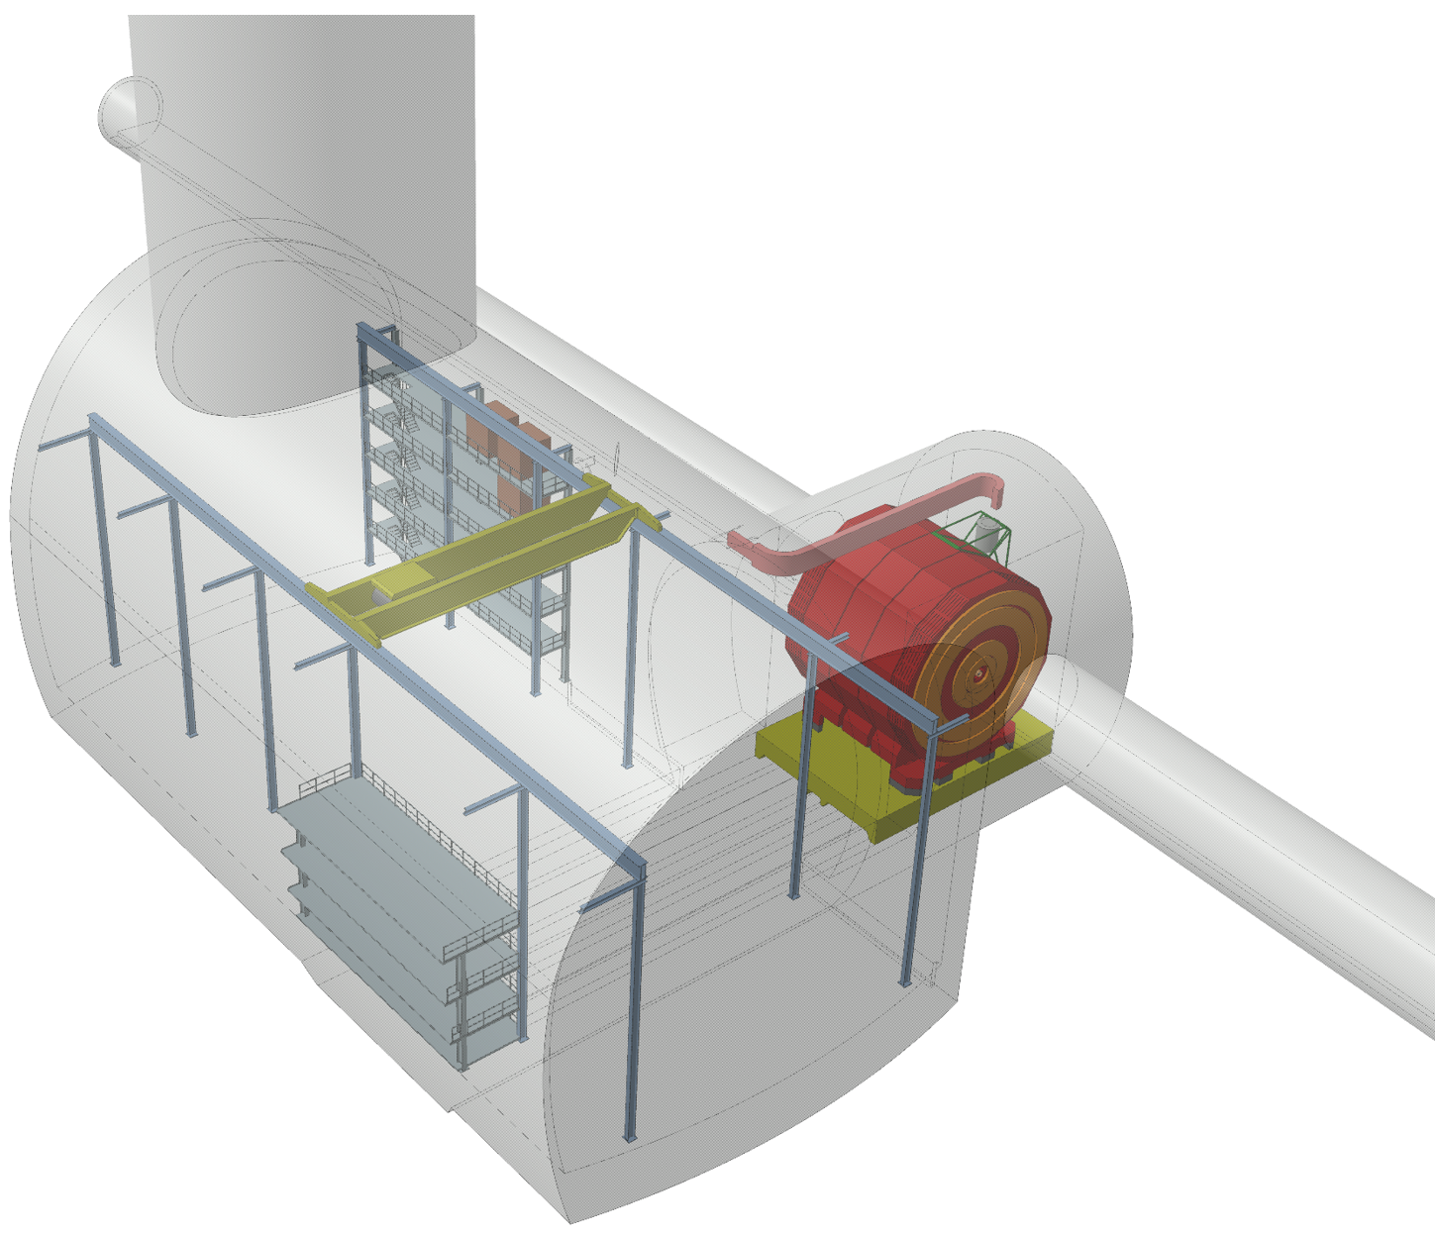
CLIC detector
Experimental underground cavern :
Original plan was with 2 different detectors sharing the same IP and a push-pull system with a mobile platform for each detector.
In latest design with one detector only: plateform kept for the detector move from IP to garage position.
Original plan
Latest cavern layout

Slide 19
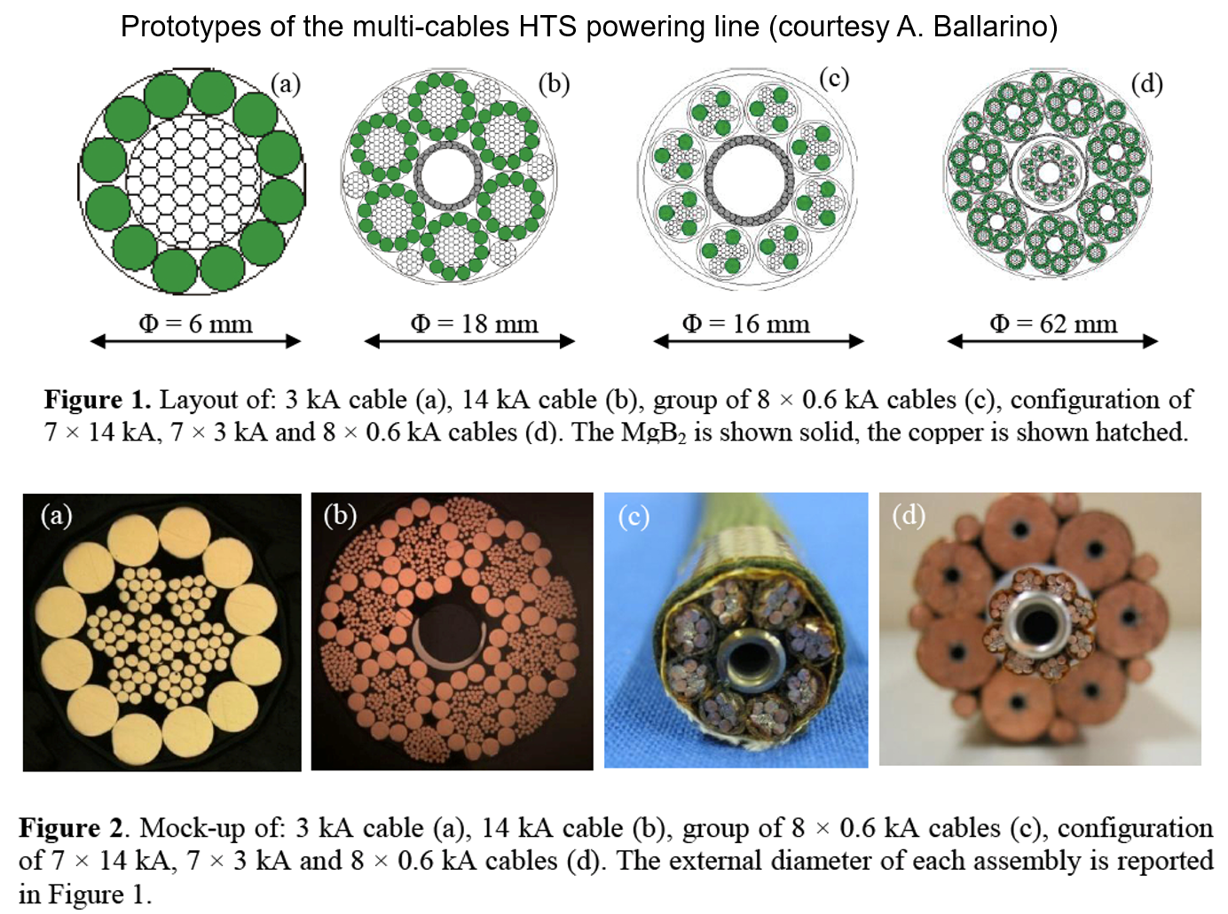
CLIC detector
Technological Challenges addressed for Detector Magnet in Push-Pull configuration (A. Gaddi, CERN):
Avoid Magnets’ services disconnection to keep magnet cold during Push-Pull with:
Flexibles fore vacuum pumping lines,
Flexibles cryogenics lines (similar to ATLAS end-cap toroid)
Max acceleration during push-pull at 0.05g.
Flexibles superconducting powering lines
A permanent connection of the solenoid power supply to the coil current leads would save time and avoid risks associated with connection & disconnection.
Superconducting lines provide a gain on space and voltage drop wrt resistive lines
Similar to MgB₂ superconducting links developed at CERN for HL-LHC.
Amalia Ballarino, 2014,
Supercond. Sci. Technol.
Superconducting links developed for HL-LHC upgrade

Slide 20
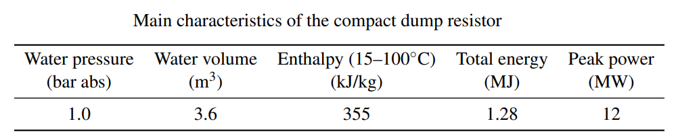
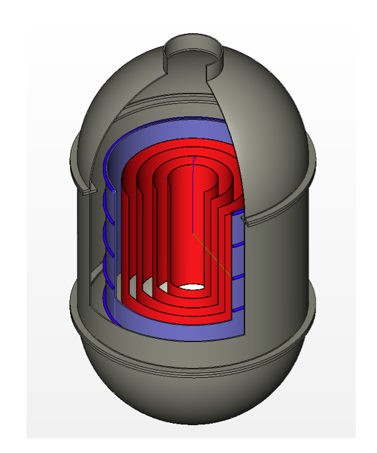
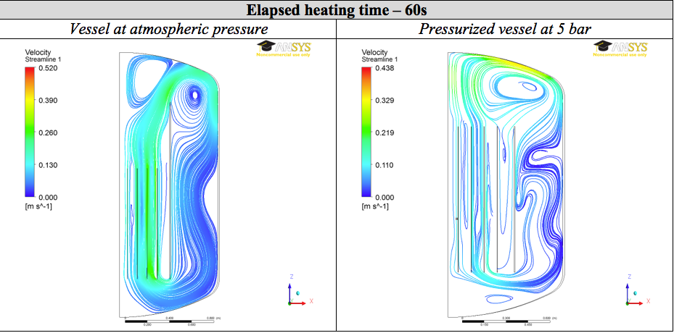
CLIC detector
Technological Challenges addressed for Detector Magnet in Push-Pull configuration (A. Gaddi, CERN):
On-board compact dump resistor to safely discharge the magnet energy.
3D model of a compact passive
water cooled dump resistor
Thermo-fluid dynamic simulation of the compact water cooled dump resistor

Slide 21
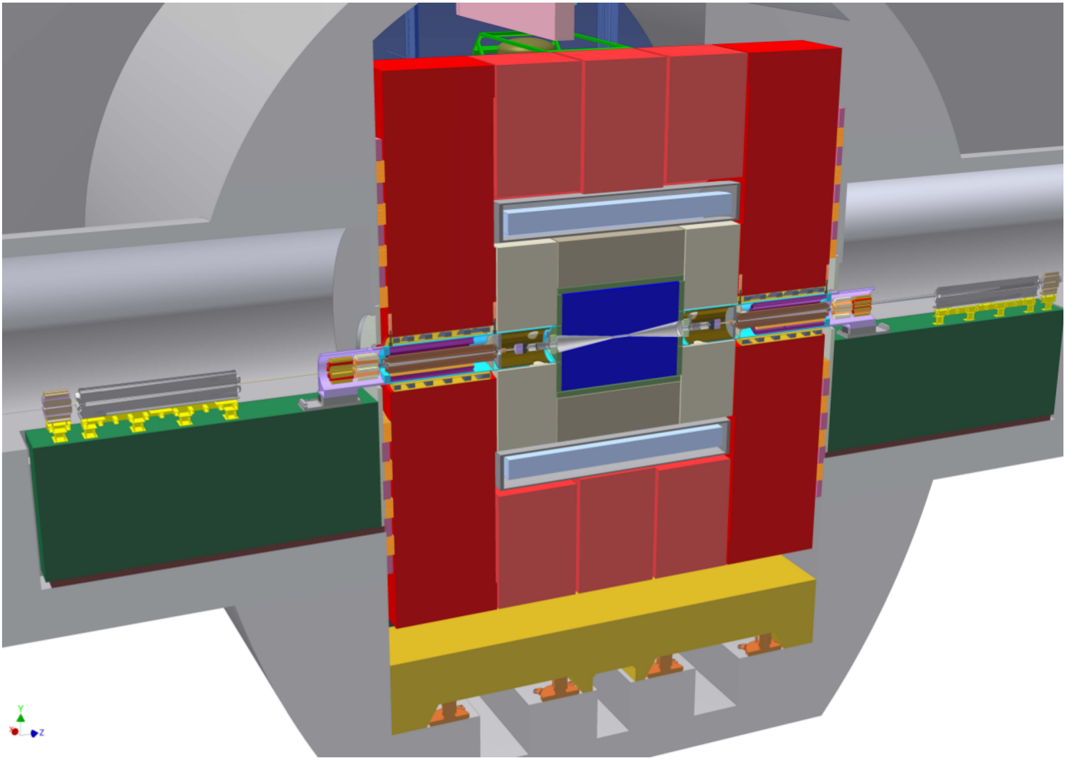
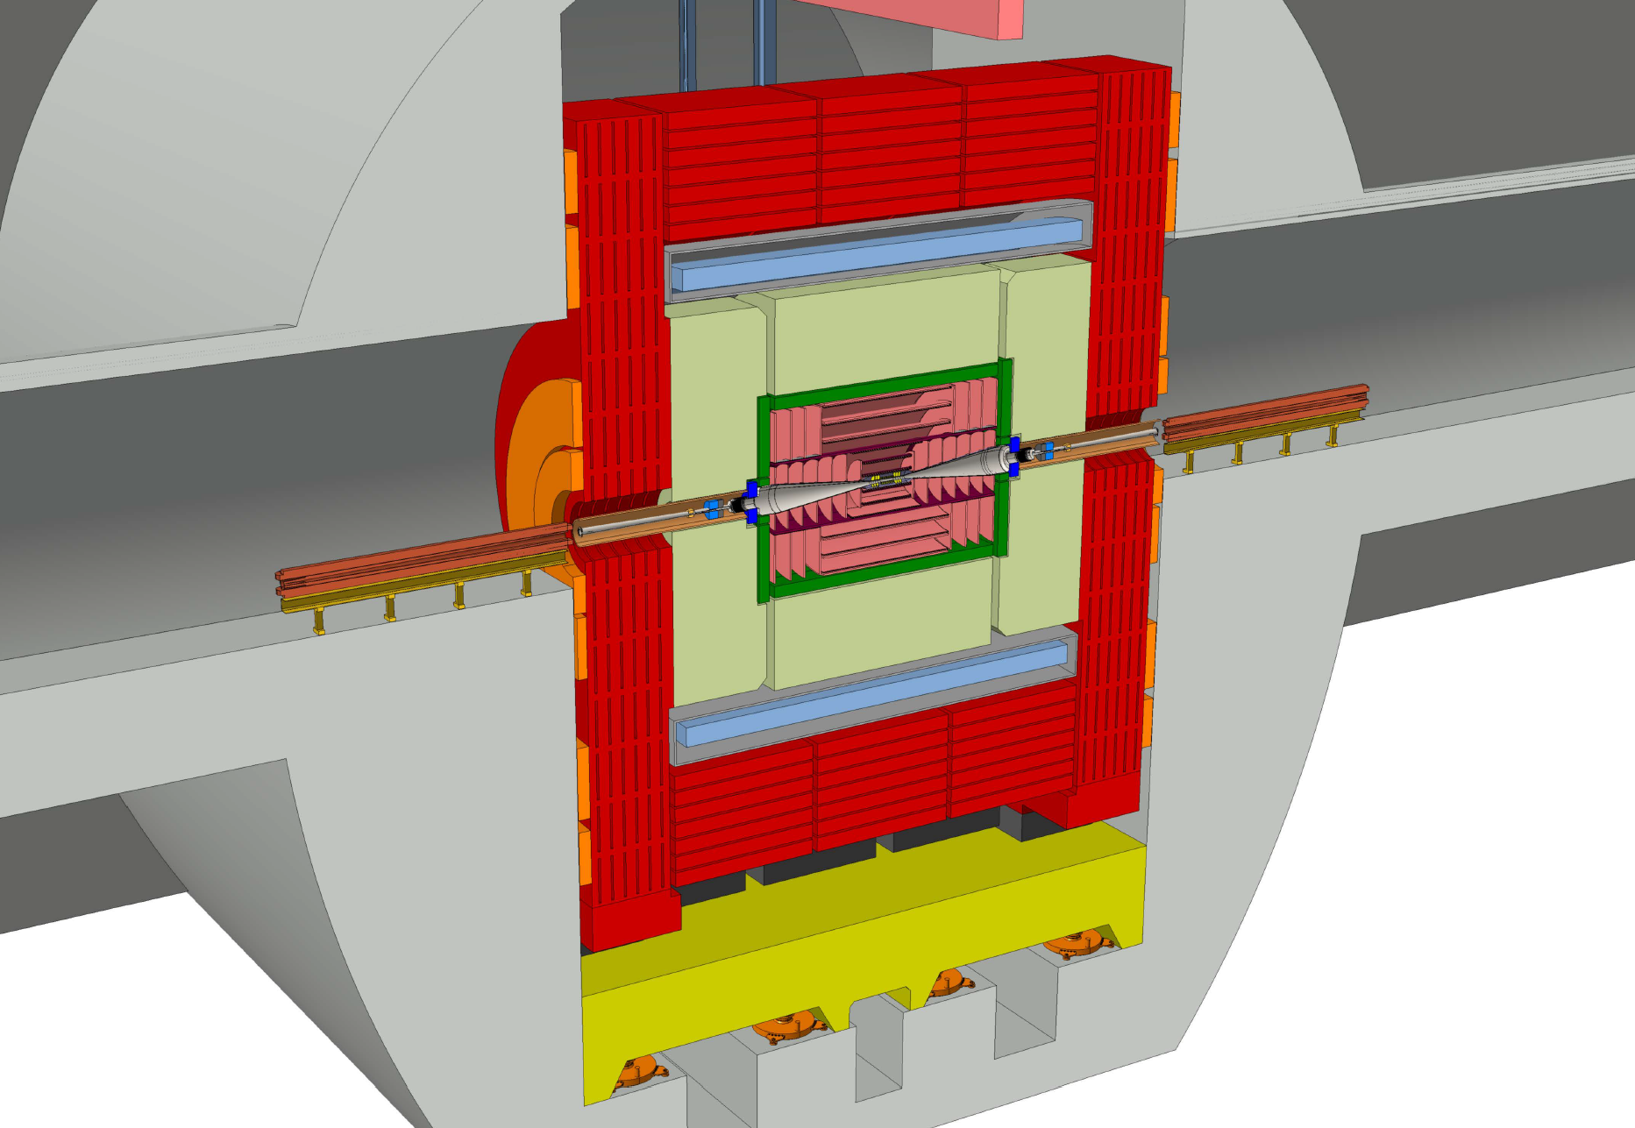
CLIC detector
Machine-Detector Interface: position of quadrupole QD0 needed for final beam focusing
Initial layout : QD0 inside detector L*=3.5m
Revised layout: QD0 inside tunnel L*=6m
Reduced yoke (end-cap and barrel),
No pre-insulator required,
Easier access for intervention,
Stray field zeroed near QD0 by end-coils,
Gain in detector detection range (acceptance).
Special support of QD0 inside the detector,
Pre-insulator system against vibration (δr < 0.1nm),
Complex access with reduced space for intervention,
Anti-solenoid to shield against main solenoidal field.
F. Plassard et.al., CLIC Workshop 2018

Slide 22
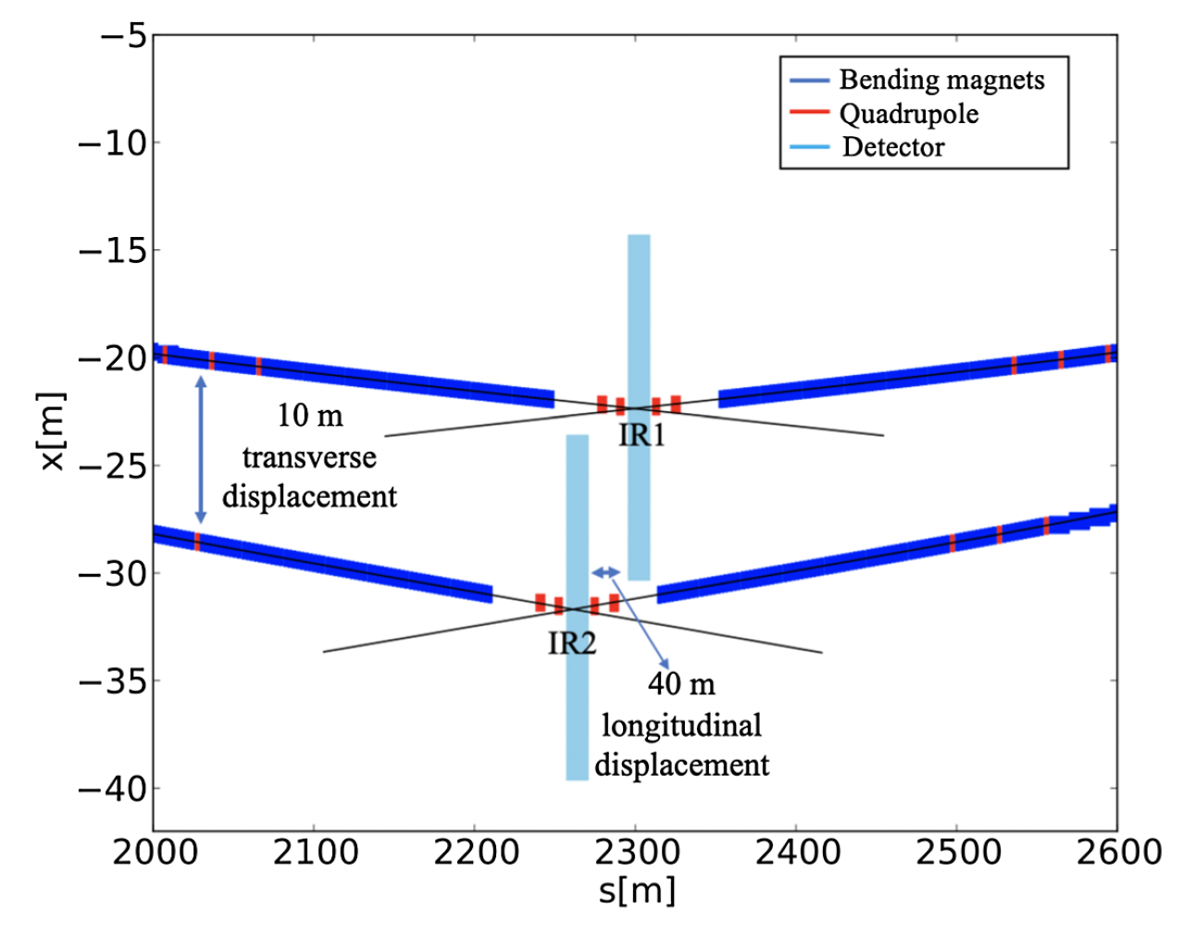
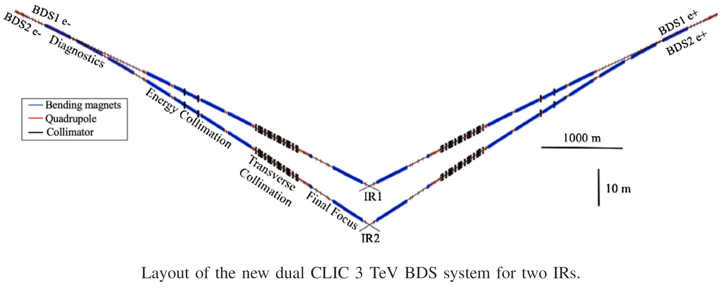
CLIC detector
Top view of interaction regions
Recent works on a Dual Beam Delivery System :
Study of luminosity performance with 2 interaction regions (2 detectors) with different crossing angles.
Vera Cilento et.al.,
Dual beam delivery system serving two interaction regions for the Compact Linear Collider,
PHYSICAL REVIEW ACCELERATORS AND BEAMS 24, 071001 (2021)

Slide 23
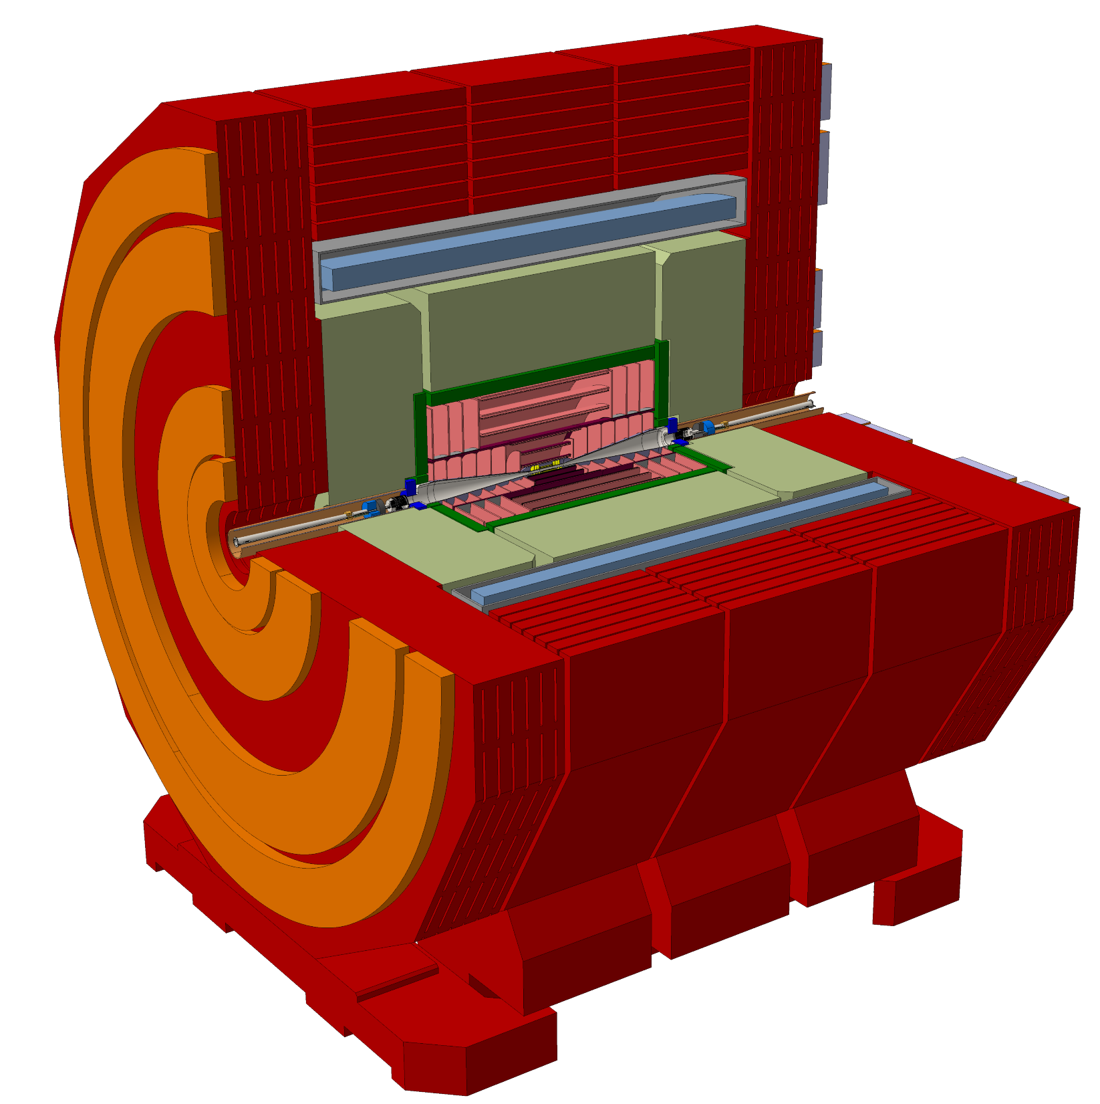
CLIC detector magnet
The Conceptual Design
Reference:
N. Alipour et al., CLICdet: The post-CDR CLIC detector model, CLICdp-Note-2017-001 (revised 05 April 2019), CERN 2017-03-01.-42. https://cds.cern.ch/record/2254048

Slide 24
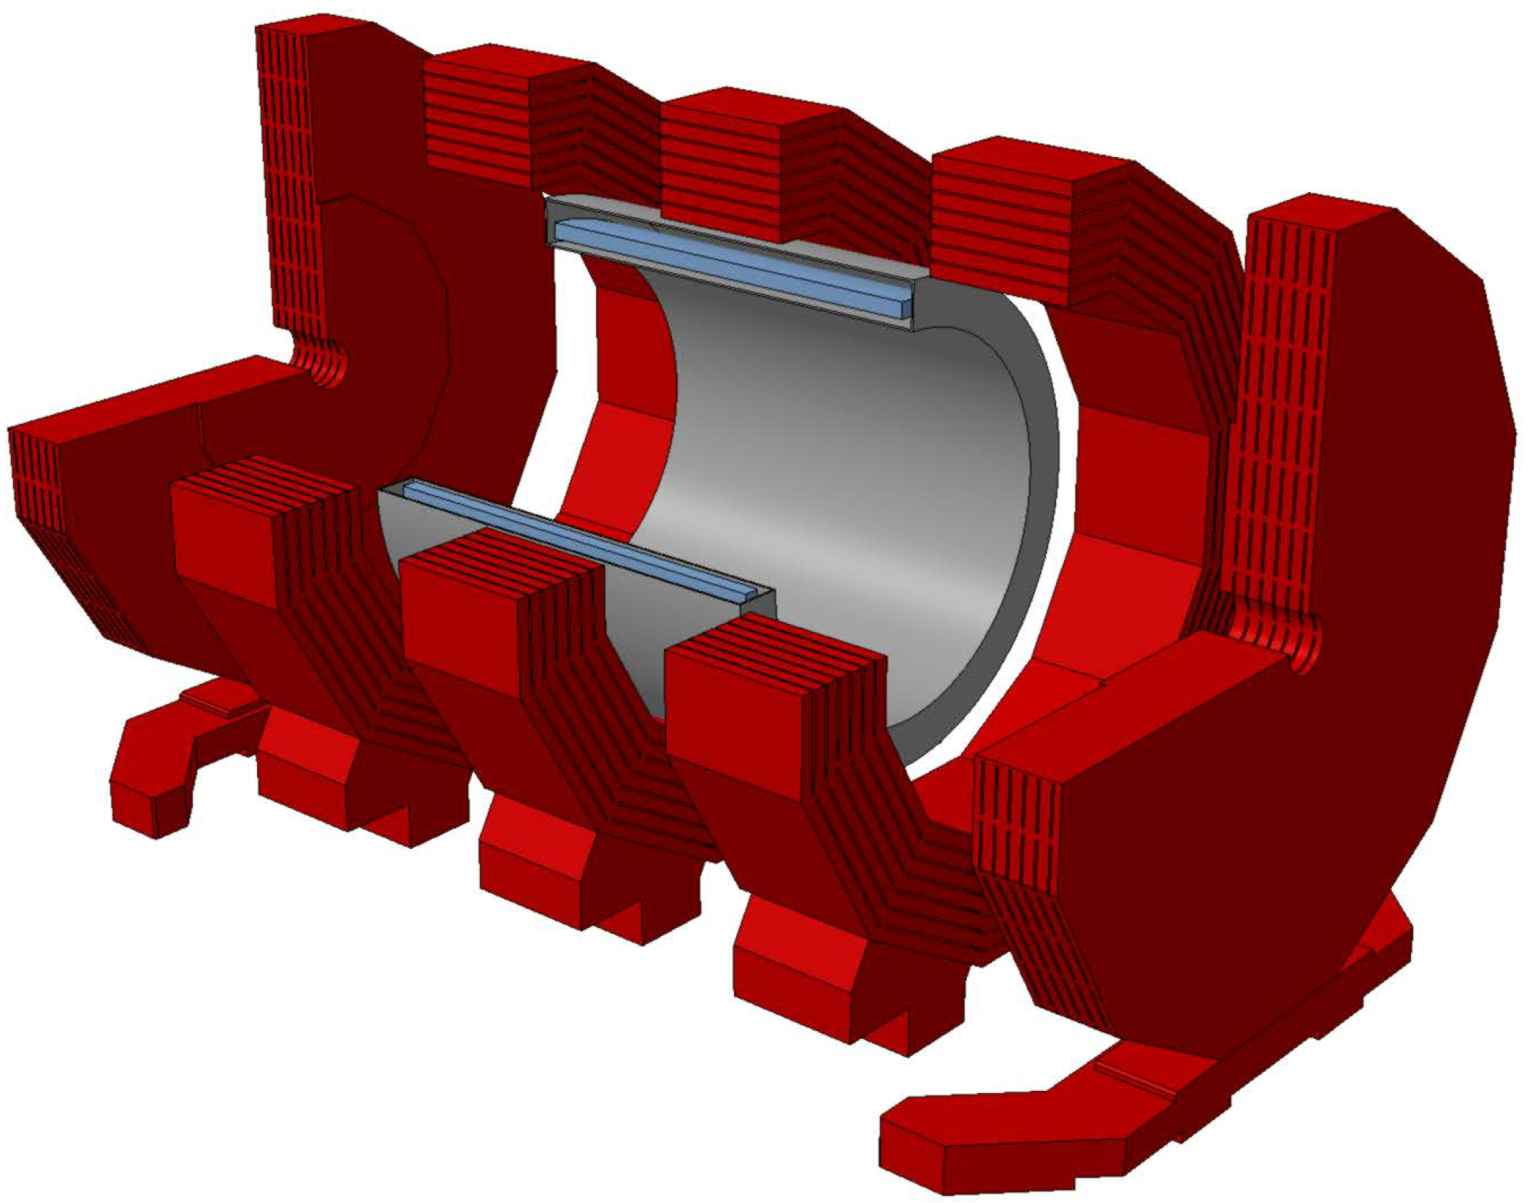
CLIC detector magnet
The magnet and its iron yoke
End-cap
Barrels
One superconducting solenoid
2x4 end coils
3 iron barrels
2 end cap iron disks
End-cap
Total weight: 8100 tons (iron: 6400 tons)
Dimensions
External diameter : 12.9m
Total length: 11.4m
Coil vactank bore radius: 3.5m
Coil vactank length: 8.3m
Detector opening/closing:
airpad + hydraulic jack systems.
End coils are attached to the end caps.
SC solenoid in a stainless steel vacuum tank fixed to the central barrel.
Vacuum volume for thermal insulation at 1e-6 mbar.

Slide 25
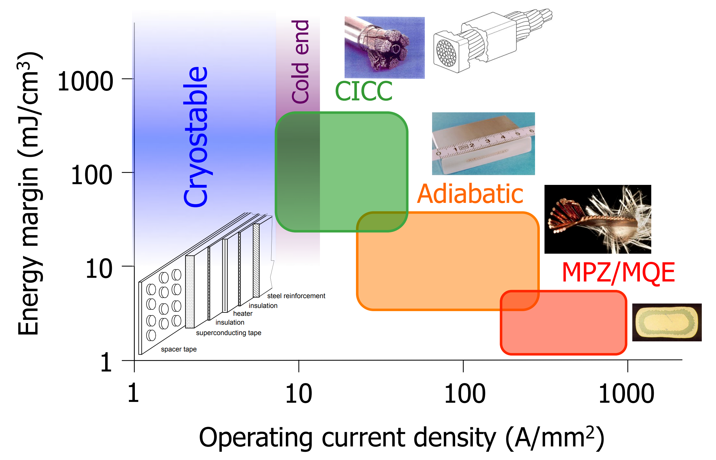
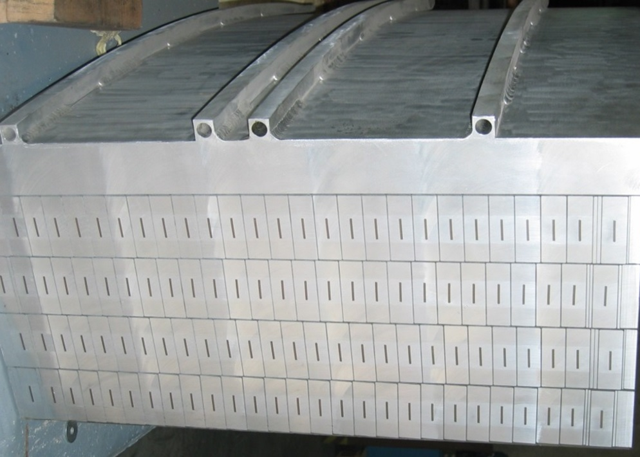
CLIC detector magnet
The superconducting solenoid – conceptual design
Superconductor Stability
CAS, 2013, L. Bottura
4-T solenoid that follows same concept and manufacturing methods as the CMS magnet: aluminium stabilized conductor (thermal and electrical conductivity, bonding SC/stab, indirect cooling, enthalpy stabilisation).
Conductor:
  NbTi/Cu Rutherford cable cooled at 4.2K,
  Reinforced aluminium stabilized superconductor.
Section of the CMS coil prototype
manufactured at Ansaldo
Winding:
  External aluminium mandrel (50mm-thick),
  Modular coil (3 modules),
  4 layers of conductor, inner winding technique,
  Insulation with fiberglass reinforced epoxy,
  Vacuum impregnated,
  Indirectly cooled in thermosiphon mode,
  Module/layer electrical joints in low field region.

Slide 26
CLIC detector magnet
The superconducting solenoid – conceptual design
Field at IP | 4 T
Inductance | 11.9 H
Nominal current | 20 kA
Stored energy | 2.4 GJ
Average Energy density | 13 kJ/kg
Number of layers | 4
NbTi/Cu Rutherford cable | 32 strands
Conductor cross section | 82.85 x 20.31 mm
Coil inner radius (length) | 3.65 (7.8) m
Inductance and
number of layers
kept at “acceptable levels”
Large conductor cross section
Weight of conductor in winding = 167 tons (total length about 37 km)
Weight of cold mass = 201 tons
Coil module (x3): 68 tons, L = 2.6m, ∅_{external} = 8.2m
  → at the limit of road transport capacities to CERN.

Slide 27
CLIC detector magnet
The superconducting solenoid – conceptual design
Large magnetic forces on the coil:
64 bar inner pressure,
axial compression 21 000 tons.
Pure Aluminum
High Strength Pure Aluminum
Aluminum Alloy
With 4 layers in the winding, the conductor reinforcement is necessary
NbTi/Cu Cable
a
b
c
→ 3 baseline options:
a/ CMS-like:
High purity aluminium stabilizer
+ Electron beam welded aluminum alloy bars
b/ ATLAS-CS like:
High strength stabilizer
+ Cold working for improved mechanical performances
c/ both a and b:
High strength stabilizer + cold work + EBW (Al alloy section may be smaller than in option a, keeping same total cross section)

Slide 28
CLIC detector magnet
The superconducting solenoid – conceptual design
Mechanical stress-strain for CLICdet
Option a compared to b and c:
Option a:
Reinforcement in the elastic domain σ_{eq}= 150 MPa
Pure aluminium at 0.15% hoop strain in elasto-plastic domain (pure aluminum : yield strength ∼ 30 MPa at 4K)
Options b & c:
Entire conductor cross section works in elastic domain σ_{eq}= 82 MPa
Hoop strain : 0.08%
Pure Aluminum
High Strength Pure Aluminum
Aluminum Alloy
NbTi/Cu Cable
a
b
c

Slide 29
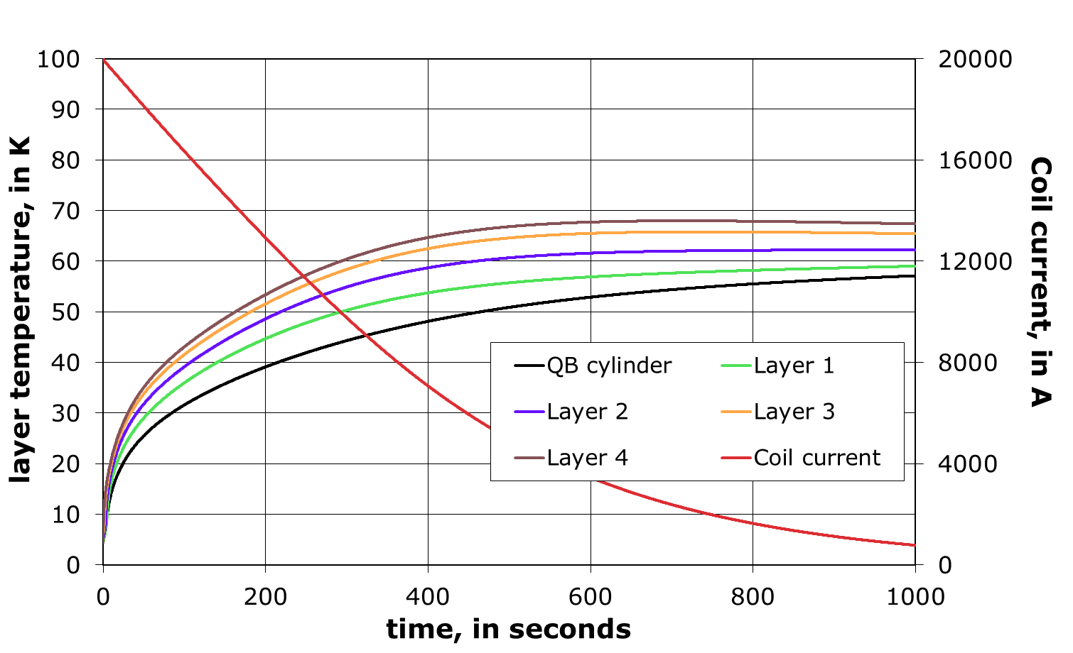
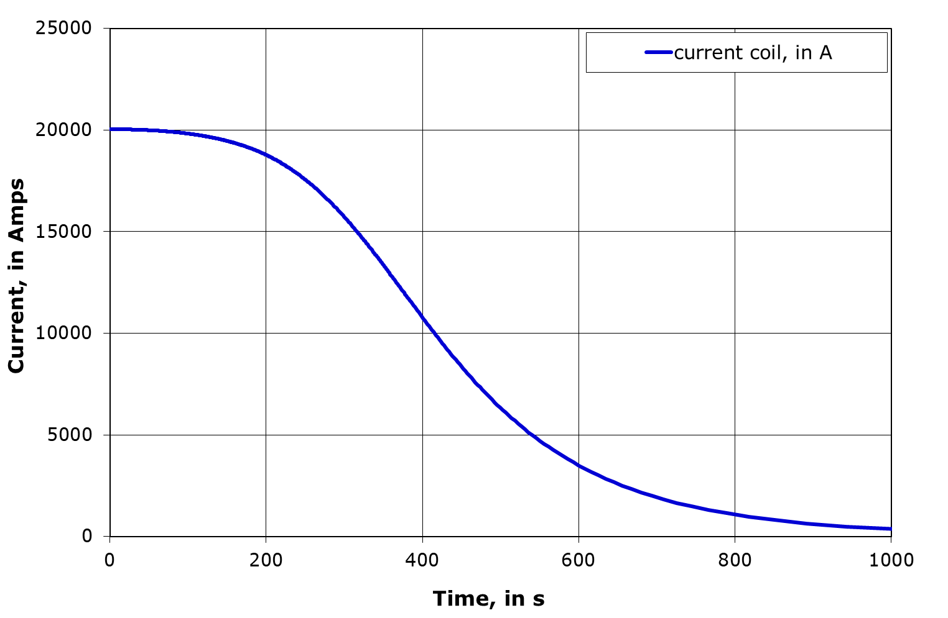
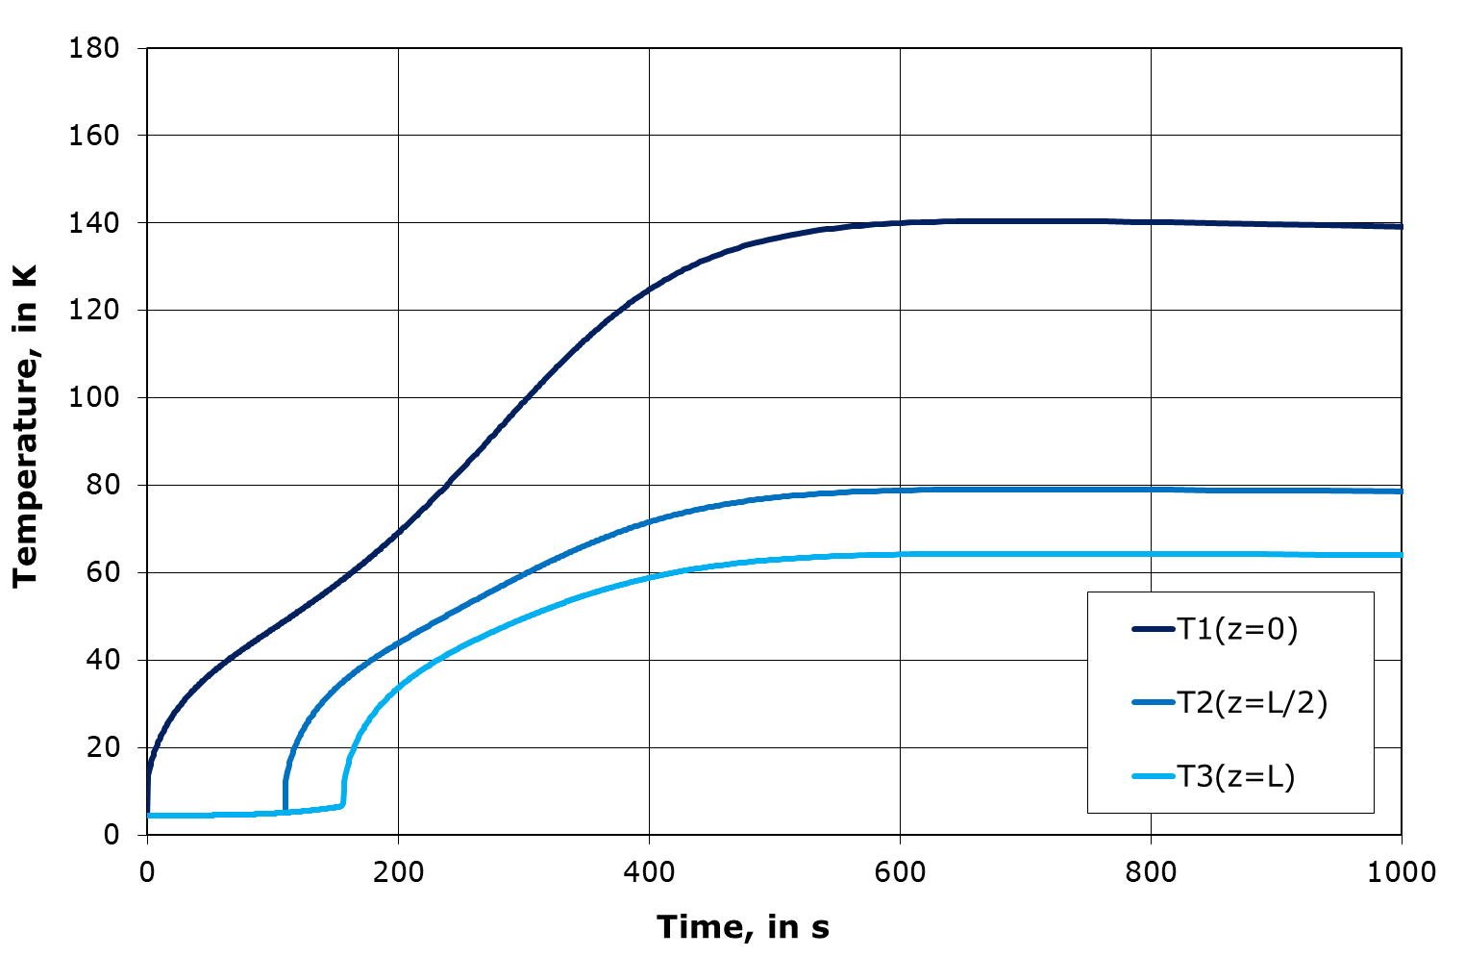
CLIC detector magnet
The superconducting solenoid – conceptual design
Quench protection
Extraction of the energy on external dumping system (resistor)
Quench back process: uniform heat release in the external mandrel (eddy currents): T<70K
In case of protection system failure, the coil must be able to withstand the full energy release : average temperature below 100K (min-max: 65K-140K)
Figures correspond to the high strength stabilizer option b

Slide 30
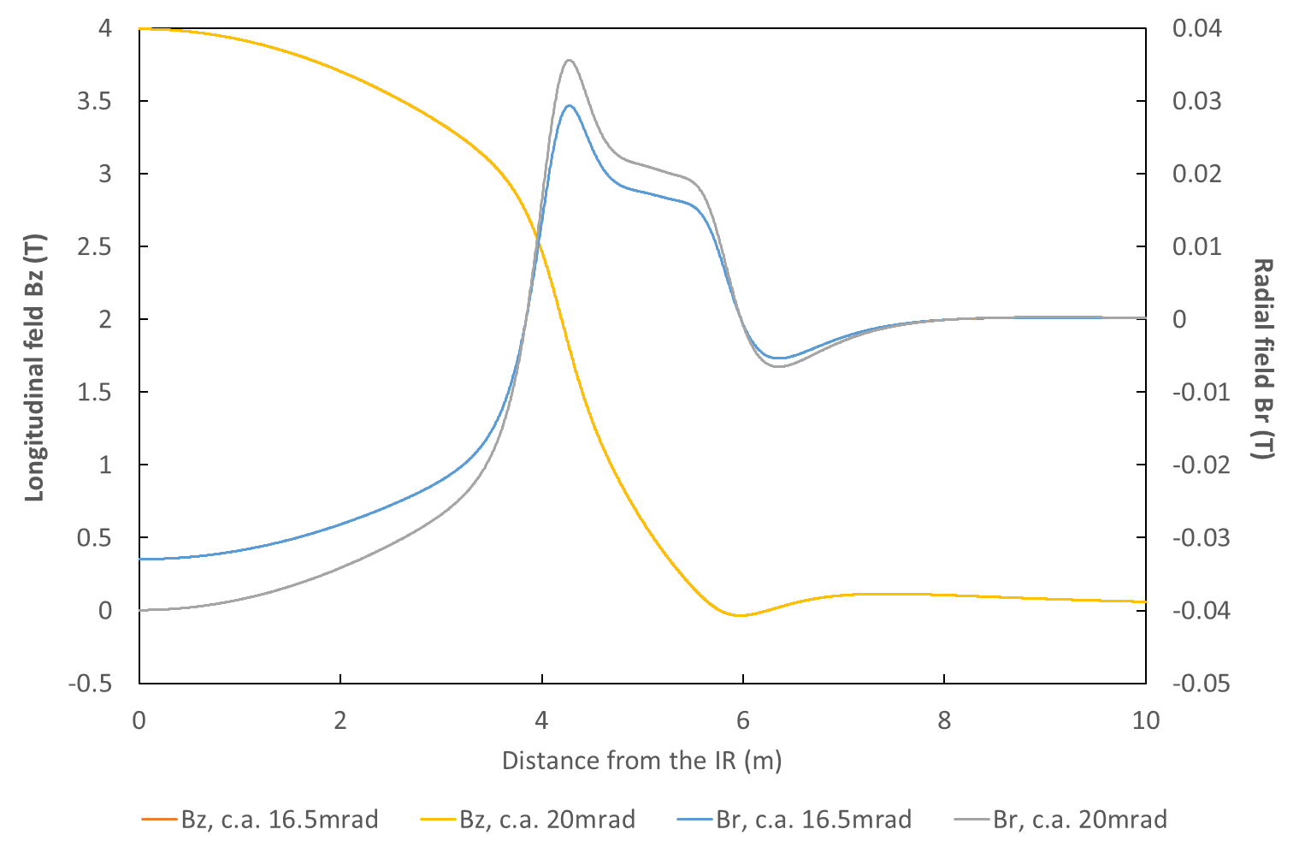
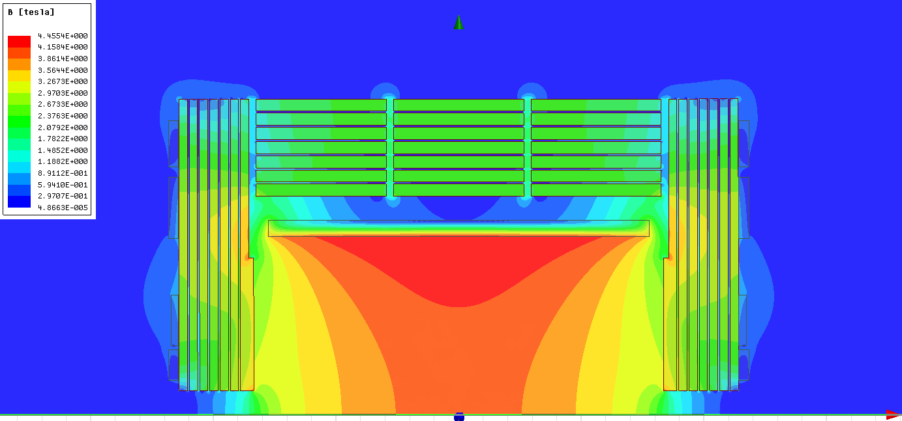
CLIC detector magnet
The end coils
limit the magnetic field in the machine detector interface region,
limit the stray field outside the detector,
contributes to reduce the amount of iron in the yoke (∼ 2 000 tons).
The radial Br and the longitudinal Bz magnetic along the beam axis.
Conceptual design is considering as baseline the use of resistive coils (2MW per side) with water cooling.
Potential application for more sustainable solution such as High Temperature Superconductor.
Longitudinal fieldmap
(half of the coil is represented)

Slide 31
CLIC detector magnet
The superconducting solenoid
Plans for manufacturing and assembly of the magnet:
Use of proven (and available!!!) technologies.
The baseline is the CMS magnet and conductor manufacturing.
Manufacturing outside CERN in industrial facilities of:
Conductor and components: strands, Rutherford cable, co-extrusion, reinforcement.
Module : mandrel + flanges, winding, vacuum impregnation.
Transport of modules to CERN.
Final assembly at CERN in a surface hall:
Coil assembled vertically stacking modules, with thermal shields, and final connections,
Swivelled horizontal for introduction and fixation into external vactank.

Slide 32
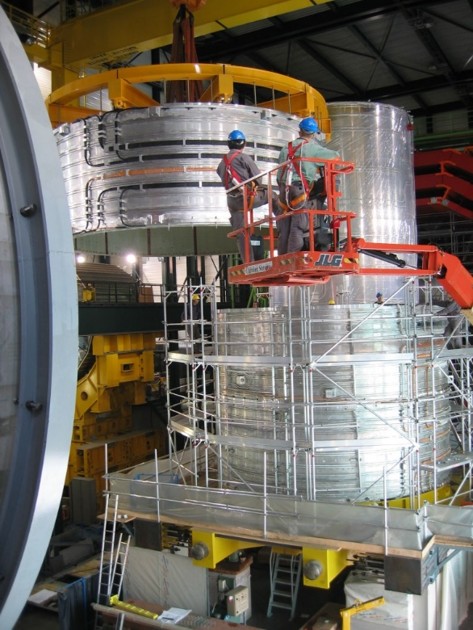
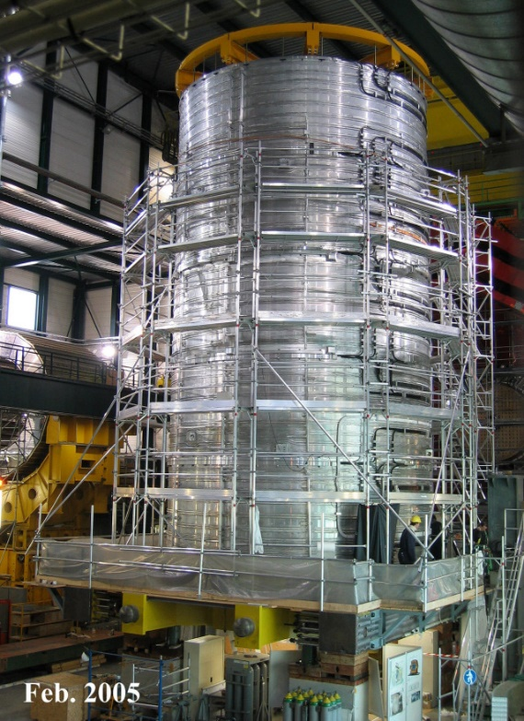
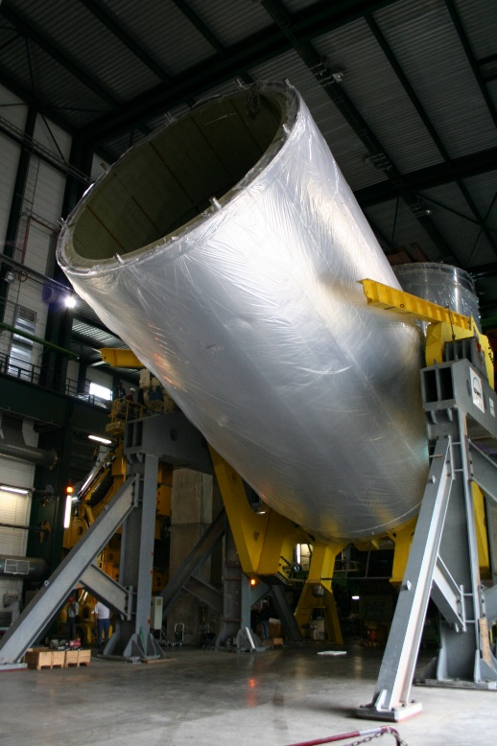
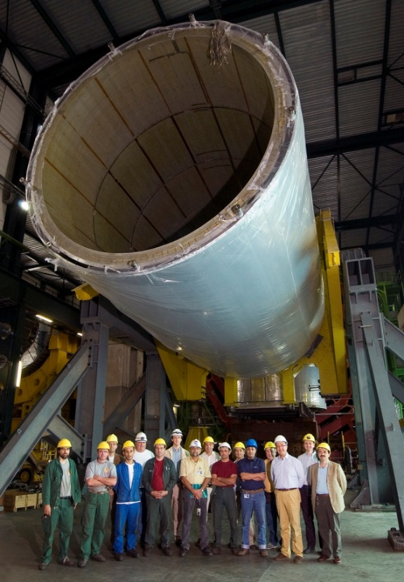
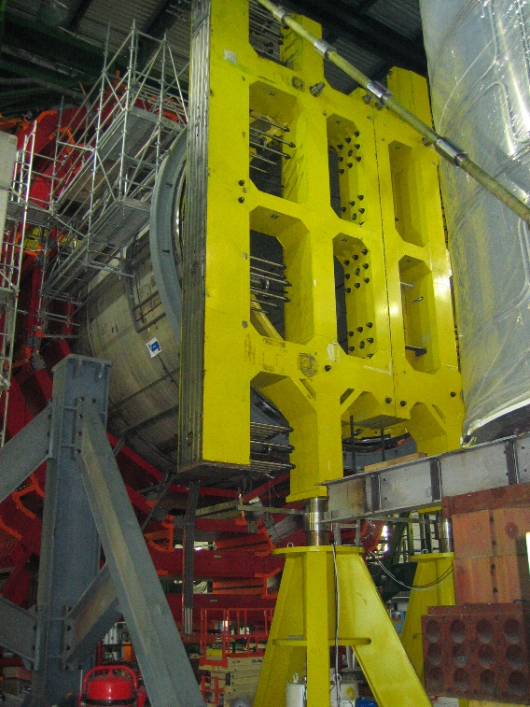
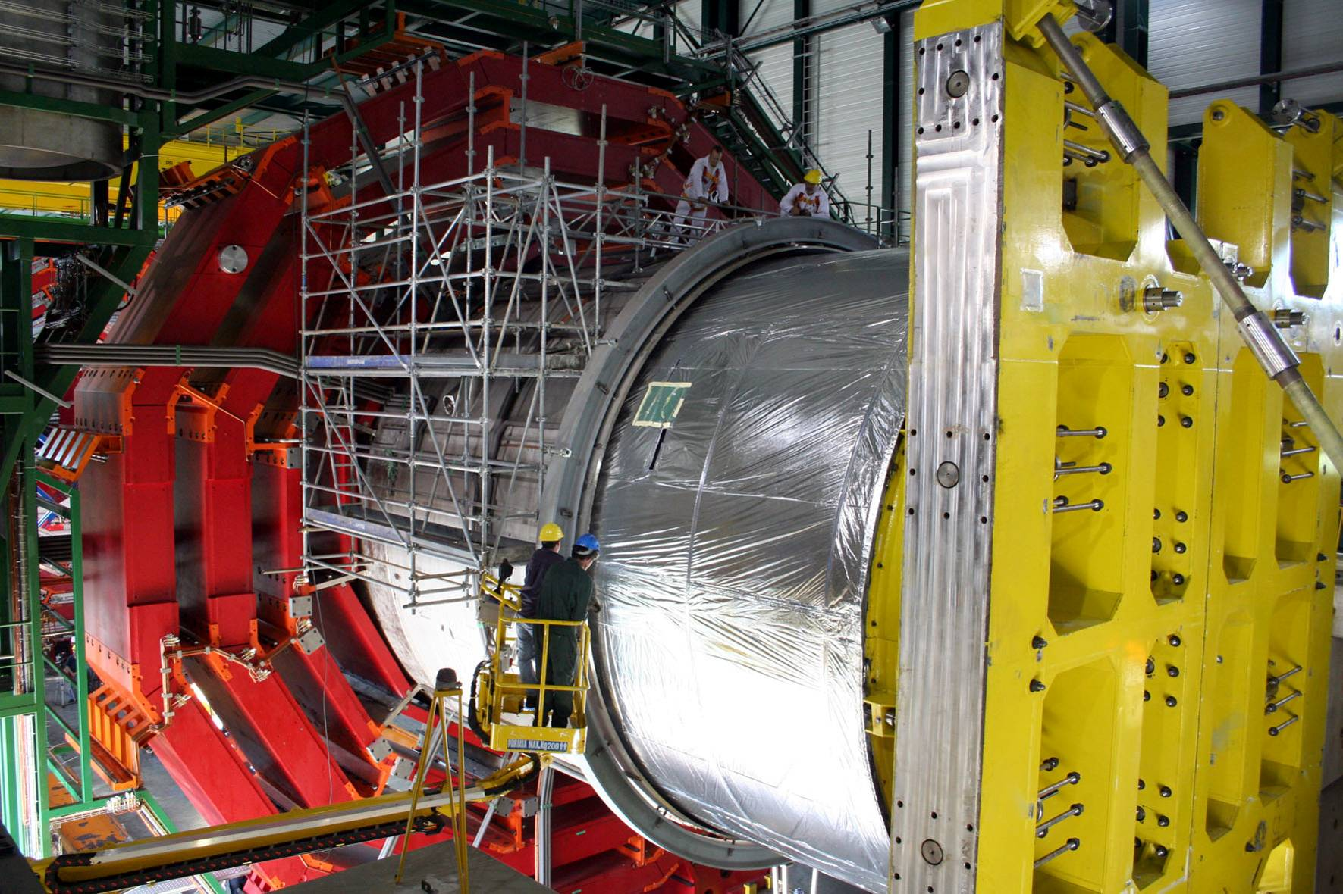
CLIC detector magnet
Credit: CMS, CERN

Slide 33
Summary
CLIC – an excellent option for a future e⁺e⁻ collider:
380 GeV, upgrade stages of 1.5 TeV and 3 TeV
great potential for precision physics beyond HL-LHC
(studied in detail, using full simulation incl. backgrounds):
< 1% accuracies on Higgs couplings already at the 1st stage
New Physics - direct discovery in the TeV range, or indirect observation: 1% precision on top quark couplings to Z and γ ; Higgs self-coupling measured to 10% precision
Konrad Elsener,
SPS Annual Meeting, 2018
A large 4-T detector superconducting magnet,
A sturdy design based on proven technologies with Al-stabilized NbTi/Cu SC,
Potential application for latest developed technologies on powering components with High Temperature Superconductor (end coils, current leads, superconducting links, power converter).

Slide 34
Spare slides

Slide 35
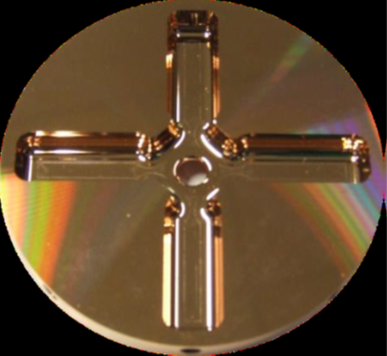
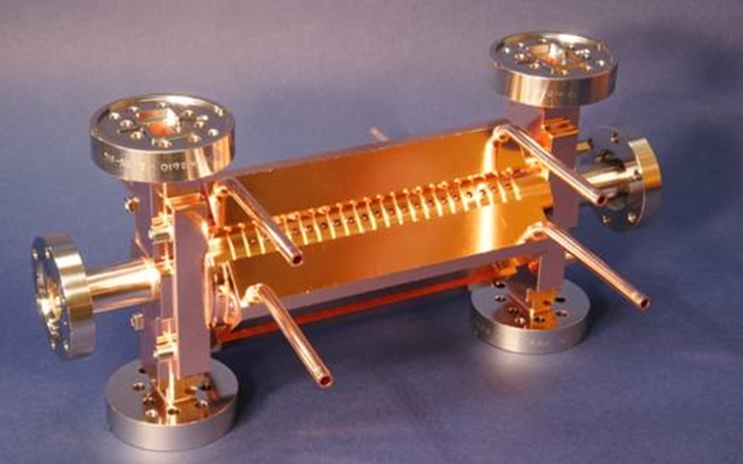
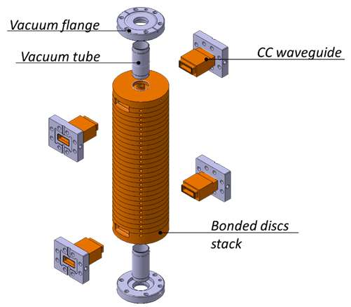
The CLIC accelerator: overview
CLIC accelerating structure – normal cond. technology
RF frequency 12 GHz;
244 ns pulses @ 50 Hz
 | 380 GeV | 3TeV
Length [cm] | 27 | 24
Gradient [MV/m] | 72 | 100
Number of structures | 20600 | 143000
35 mm
230 mm

Slide 36
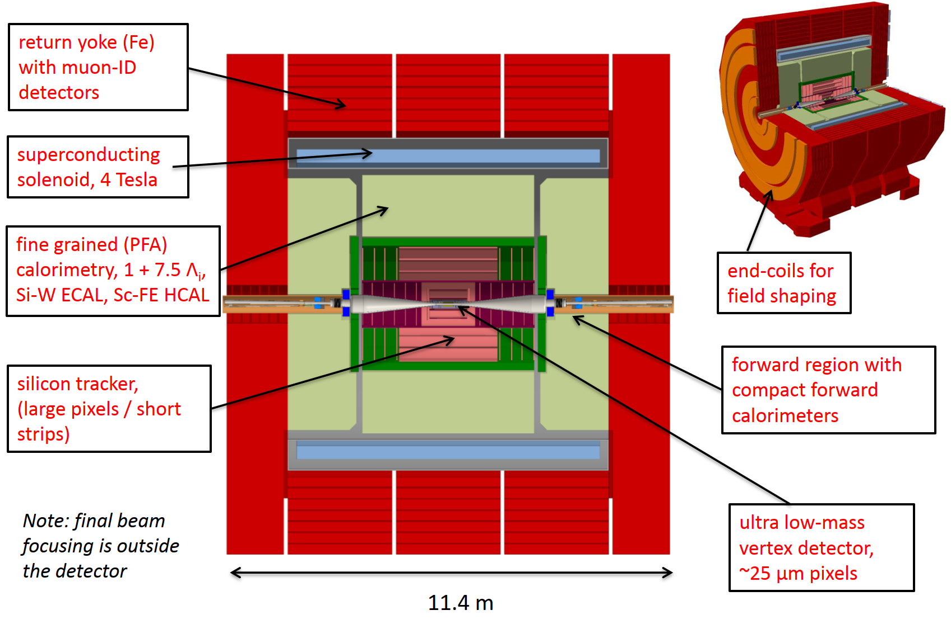
CLIC detector

Slide 37


CLIC detector magnet
CMS reinforcement alloy: AA6082 chosen.
Temper T6 obtained after coil curing cycle. Allowed winding with a not too stiff conductor.
A. Hervé, CLIC09 workshop

