Slide 1
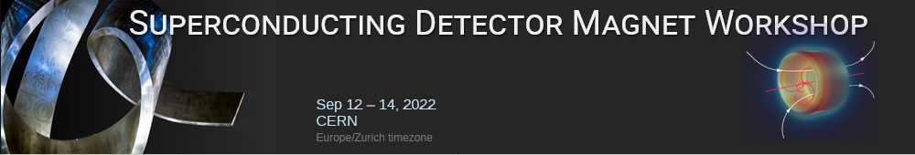
Magnets for the Mu2e experiment
Michael Lamm
For the Mu2e Experiment
September 12, 2022
  With contributions from the Fermilab Mu2e Solenoid Team:
  G. Ambrosio, K. Badgley, J. Brandt, D. Evbota, S. Feher, J. Hocker, Y. Huang, V. Kashikhin, M. Lamm, V. Lombardo, M. Lopes, D. Orris, T. Page, T. Nicol, V. Poloubotko, P. Schlabach, T. Tope

Slide 2
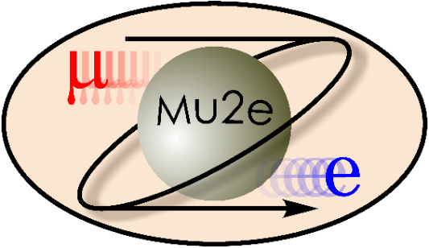
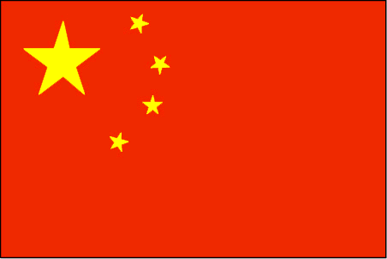





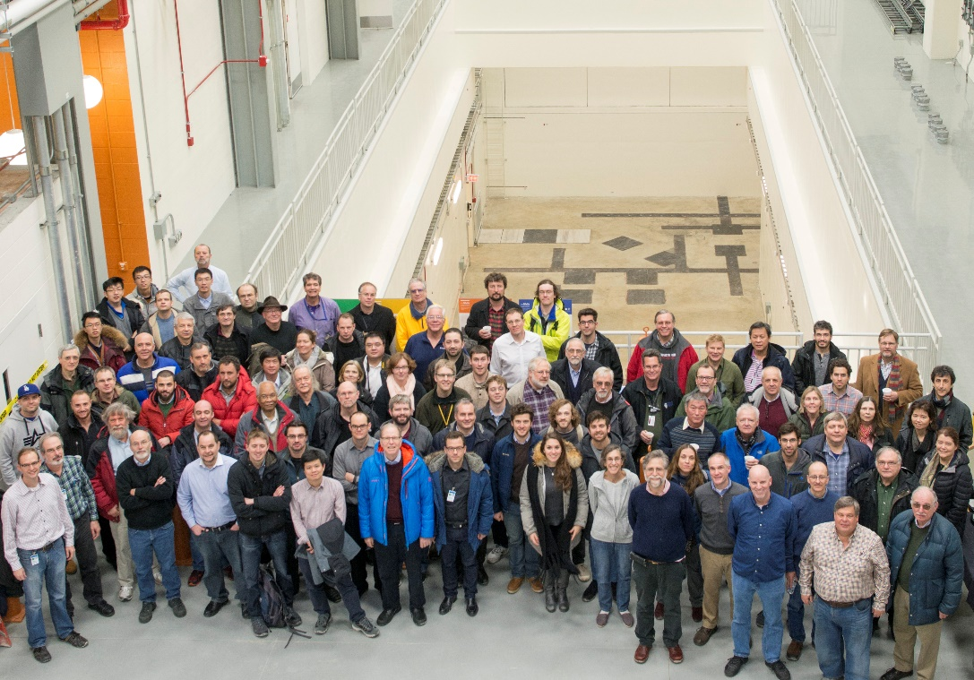
The Mu2e Collaboration
Over 200 scientists from 38 institutions
Argonne National Laboratory ● Boston University Brookhaven National Laboratory
University of California, Berkeley ● University of California, Davis ● University of California, Irvine California Institute of Technology ● City University of New York ● Joint Institute for Nuclear Research, Dubna Duke University ● Fermi National Accelerator Laboratory Laboratori Nazionali di Frascati ● INFN Genova Helmholtz-Zentrum Dresden-Rossendorf ● University of Houston ● Kansas State University ● Lawrence Berkeley National Laboratory ● INFN Lecce and Università del Salento ● Lewis University ● University of Liverpool University College London ● University of Louisville University of Manchester ● Laboratori Nazionali di Frascati and Università Marconi Roma ● University of Michigan ● University of Minnesota ● Institute for Nuclear Research, Moscow ● Muons Inc. ● Northern Illinois University ● Northwestern University Novosibirsk State University/Budker Institute of Nuclear Physics ● INFN Pisa ● Purdue University ● University of South Alabama ● Sun Yat Sen University ● INFN Trieste University of Virginia ● Yale University
The Mu2e Collaboration

Slide 3
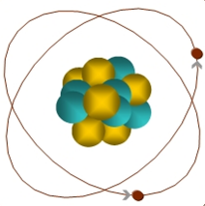
Mu2e Experiment Goal
Search for Charged Lepton Flavor Violation (CLFV) via the coherent conversion of
μ⁻N ➔ e⁻N
4 orders of magnitude greater sensitivity than previous experiments
μ
105 MeV e⁻
If discovered, unambiguous evidence of physics beyond the Standard Model
Mu2e Strategy
Create muonic atoms: stop muons in orbit around an aluminum nucleus
Look for events consistent with the signal
  105 MeV electron emanating from target
  Clean experimental signature

Slide 4
The Mu2e Experiment: 3 solenoids provide magnetic field
Production
Solenoid
Detector
Solenoid
protons
Transport
Solenoid
1 T
2.5 T
4.6 T
1 T
2 T
24 meters

Slide 5
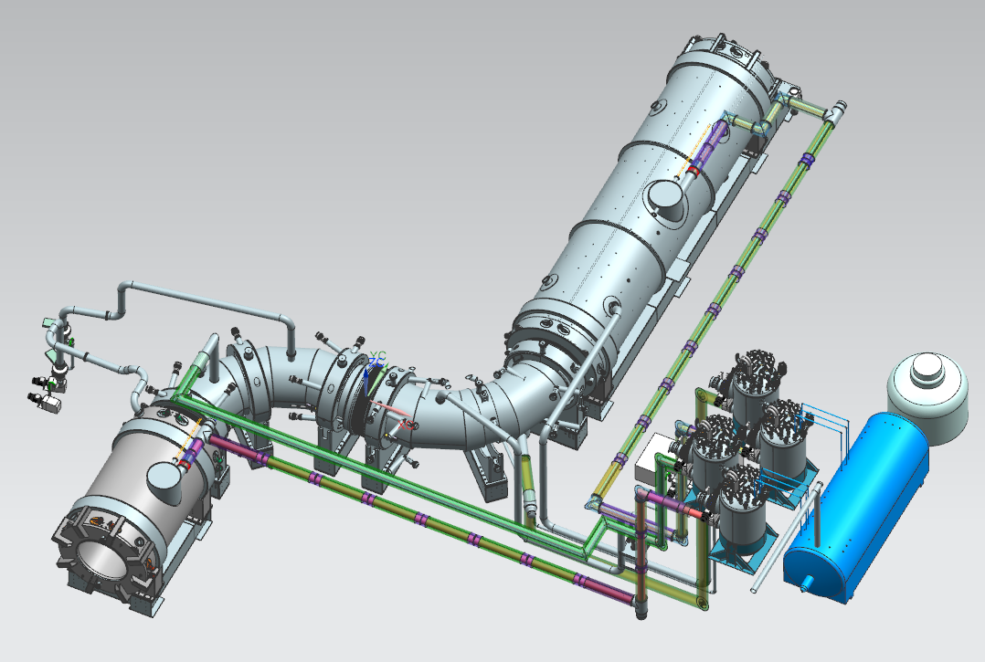
Production Solenoid (PS)
1.5 m warm bore, 4 m long
4.6 T to 2.5 T axial field
Operating current ~9kA
3 coils with 3-2-2 layers
High-strength aluminum stabilized NbTi superconductor (similar to ATLAS Central Solenoid)
5083-O aluminum outer support shells
5N aluminum thermal bridges to extract radiation heat
Thermal Siphon Cooling
Warm bore supports 55-ton Heat and Radiation Shield
DS
TSu
TSd
PS

Slide 6
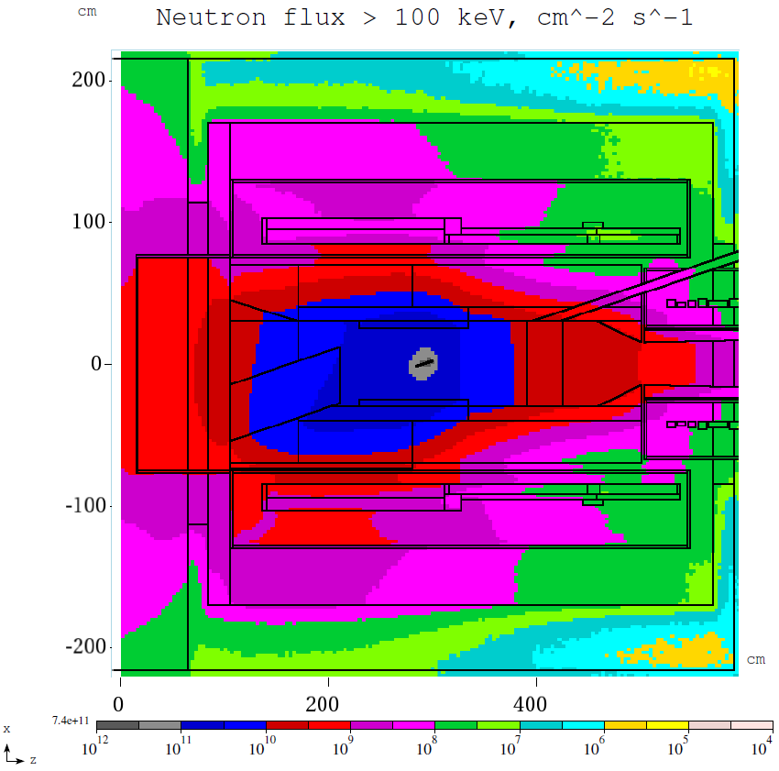
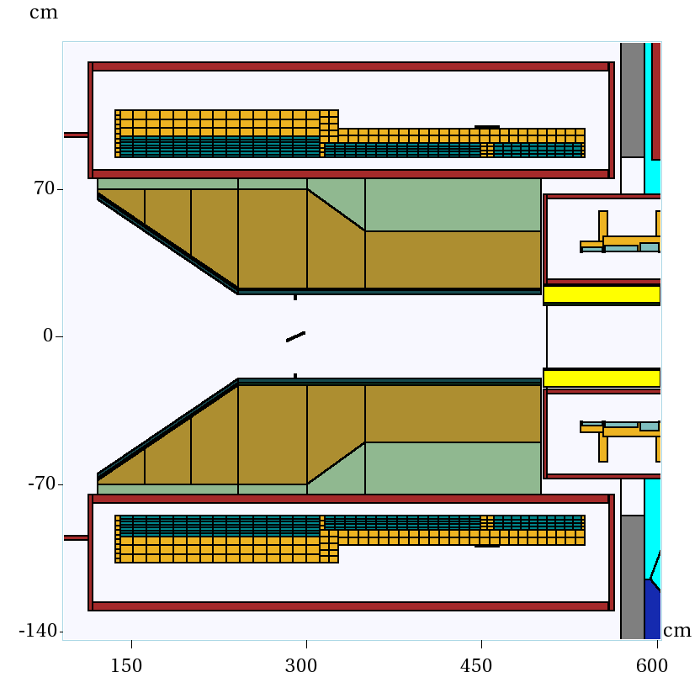
Unique PS feature: neutron radiation environment
It is expected that RRR will degrade after one year of operation to the following critical values:
Aluminum RRR 500 → 100;
Copper RRR 100 → 50;
Once the critical degradation is detected (by RRR gauges on the coil), the magnet will be thermo-cycled to room temperature that recovers the RRR:
100% recovery for aluminum
85% recovery for copper

Slide 7
Transport Solenoid (TS)
500 mm warm bore, 13 m long arch length
2.5 T at PS interface, 2.0 T at DS interface
Monotonic negative gradient in straight sections
Matching Toroidal fields for background suppression
Unique magnetic field is formed by 52 SC solenoid coils organized into two cryostats: TSu and TSd.
Each cryostat is powered by a separate 2kA power supply
DS
TSu
TSd
PS

Slide 8
Detector Solenoid (DS)
1.9 m warm bore, 10 m long
Gradient Section 2T to 1 T field
Spectrometer Section 1 T field with small axial gradient superimposed to reduce backgrounds
Operating current ~6kA
11 coils in total
Axial spacers in Gradient Section
Spectrometer section made in 3 sections to simplify fabrication and reduce cost
Magnet technology similar to PS
DS
TSu
TSd
PS

Slide 9
Magnet status at a glance
The magnet design work is complete
  Reference and Technical Designs
All aluminum-stabilized cables were fabricated by 2 vendors
  QA and acceptance testing performed by vendors and Fermilab
PS and DS magnets
  are being built by a single vendor
  Fermilab provides oversight and final acceptance testing
TS magnet
  all coil modules were fabricated by one vendor
  coil acceptance testing performed by Fermilab
  cold mass assembly completed at Fermilab
  thermal shield and vacuum vessel assembly in progress at Fermilab

Slide 10
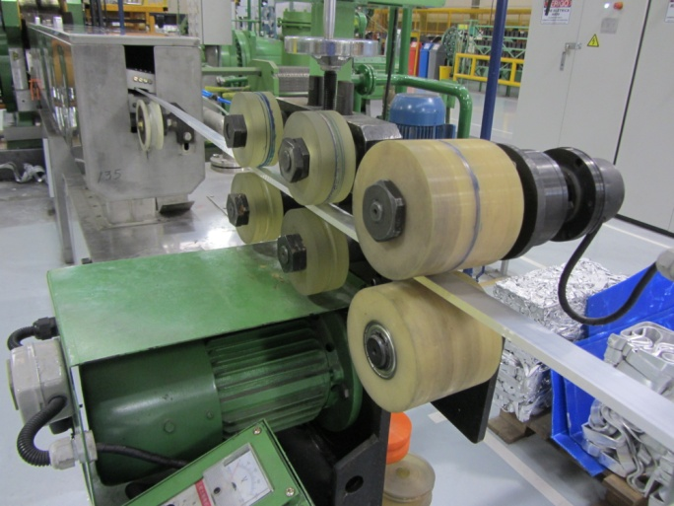
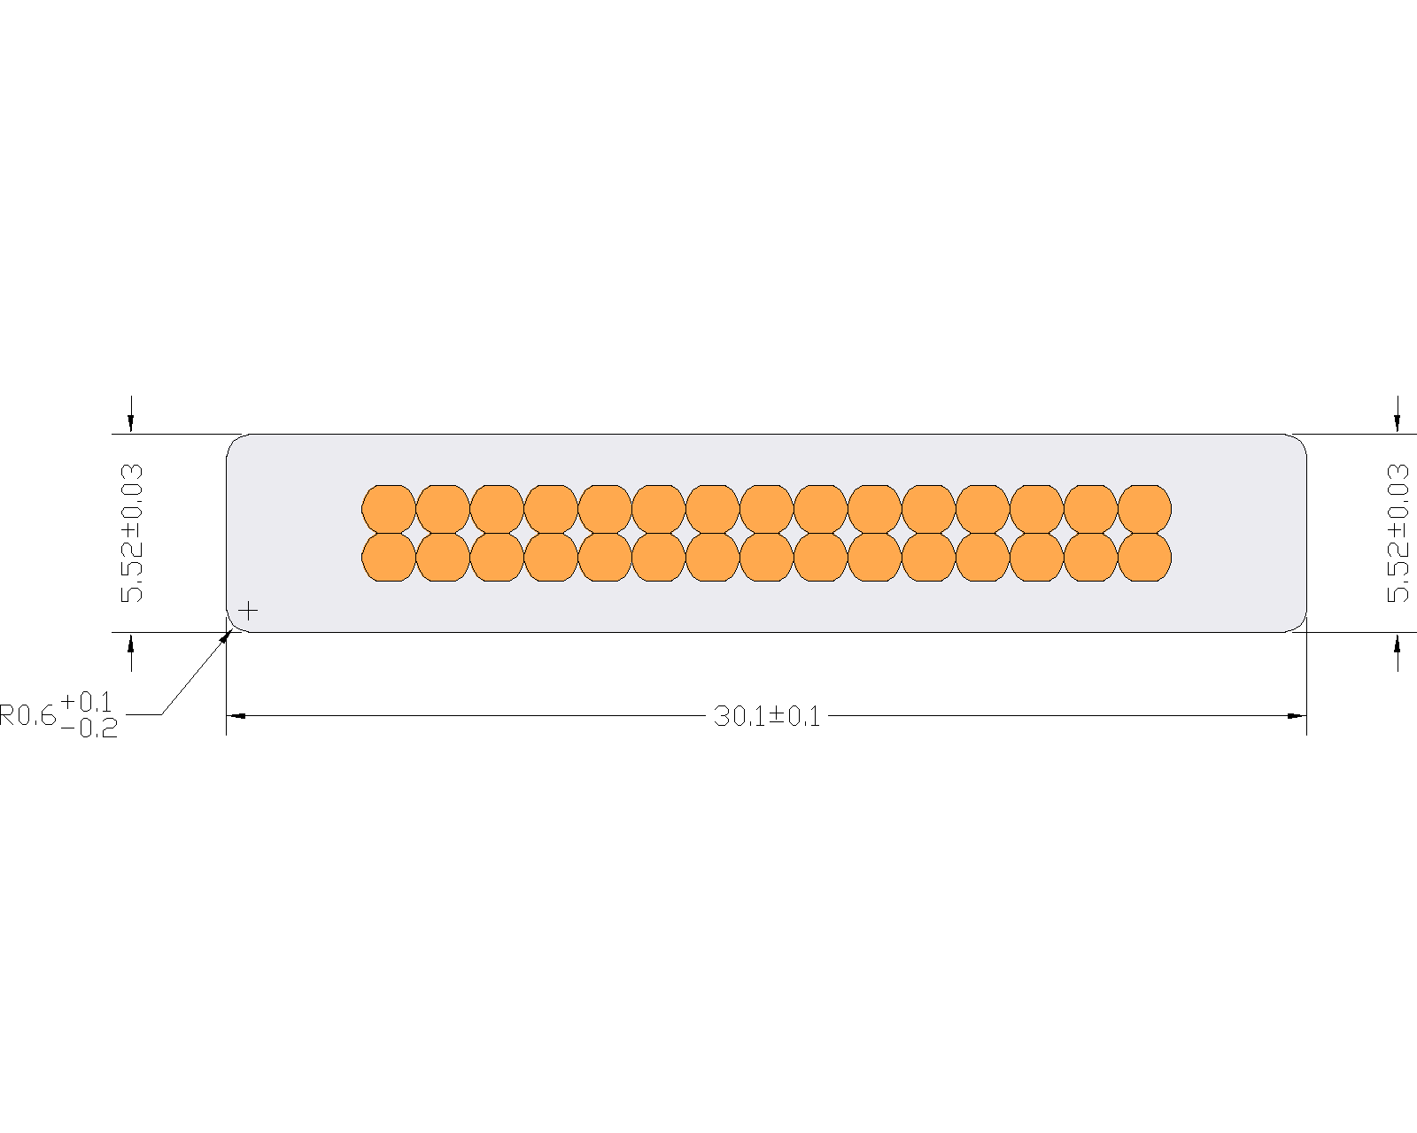
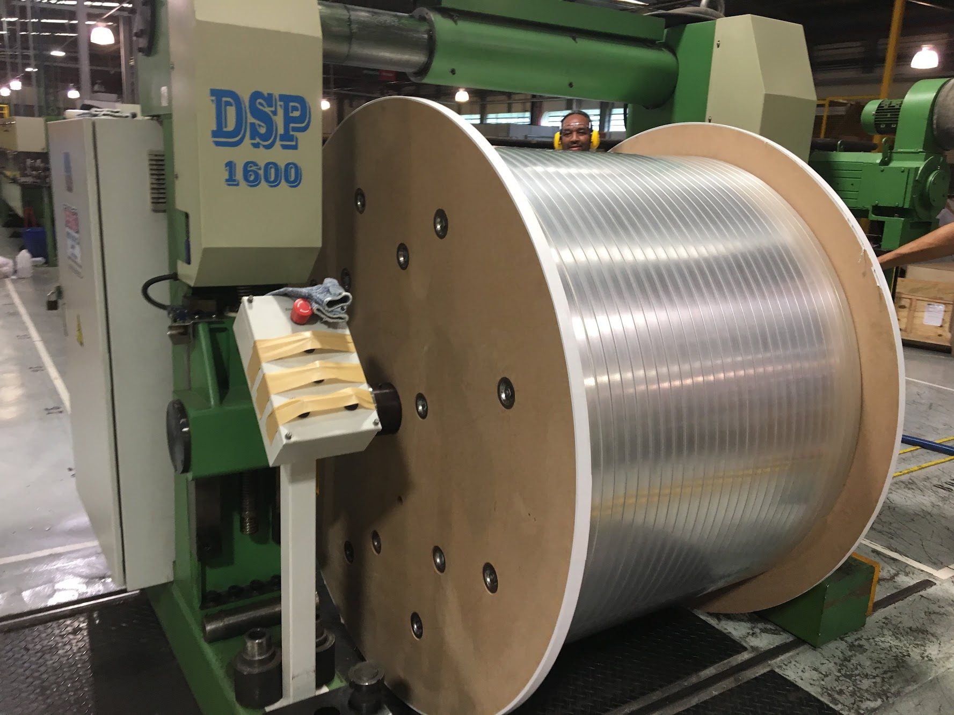
PS cable
Ni-doped 5N aluminum
Pictures courtesy of Furukawa Electric

Slide 11
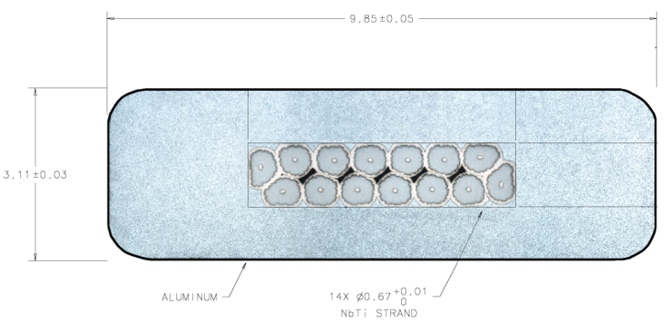
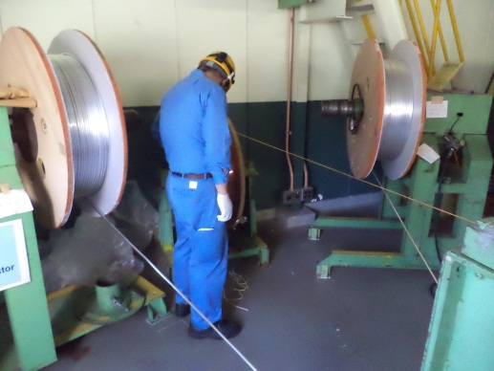
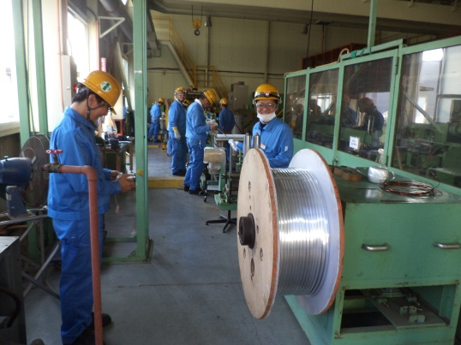
TS cable
5N aluminum
Conductor Parameter | Unit | Design Value
Cable critical current at 5T, 4.22K | A | 5900
Number of strands |  | 14
Strand diameter | mm | 0.67
Strand copper/SC ratio |  | 1 ± 0.05
RRR of Cu matrix |  | > 90
Filament size | µm | < 30
Strand twist pitch | mm | 15 ± 2
Rutherford cable width | mm | 4.79 ± 0.01
Rutherford cable thickness | mm | 1.15 ± 0.006
Al-stabilized cable width (bare) at room temperature | mm | 9.85 ± 0.05
Al-stabilized cable thickness (bare) at room temperature | mm | 3.11 ± 0.03
Initial RRR of Aluminum stabilizer |  | > 800
Aluminum 0.2% yield strength at 300 K | MPa | > 30
Aluminum 0.2% yield strength at 4.2 K | MPa | > 40
Shear strength between Aluminum and NbTi strands | MPa | > 20
See “Production of Aluminum Stabilized Superconducting Cable for the Mu2e Transport Solenoid” IEEE TRANSACTIONS ON APPLIED SUPERCONDUCTIVITY, VOL. 28, NO. 3, APRIL 2018
Pictures courtesy of Hitachi Cable

Slide 12
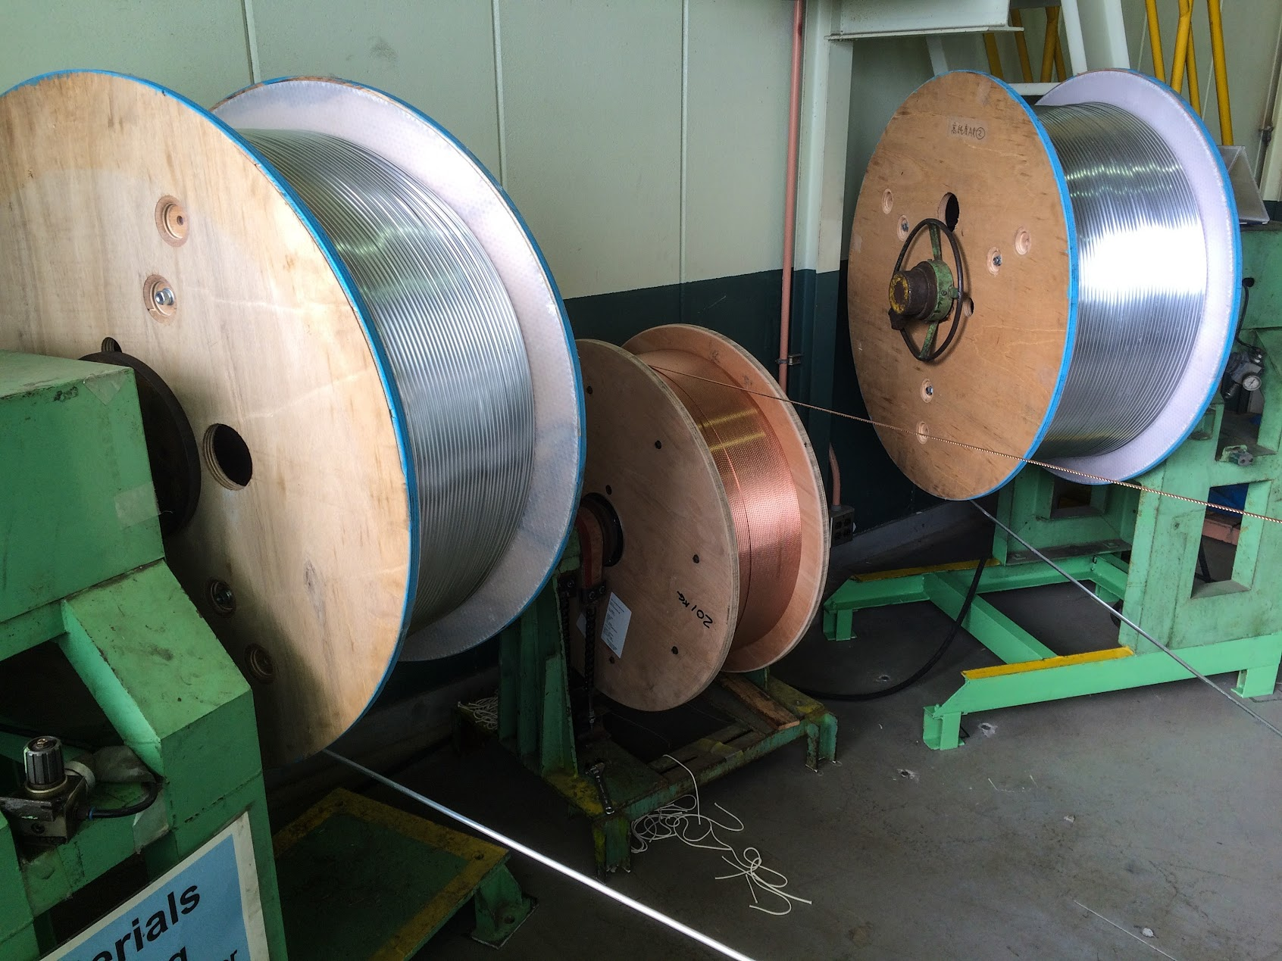
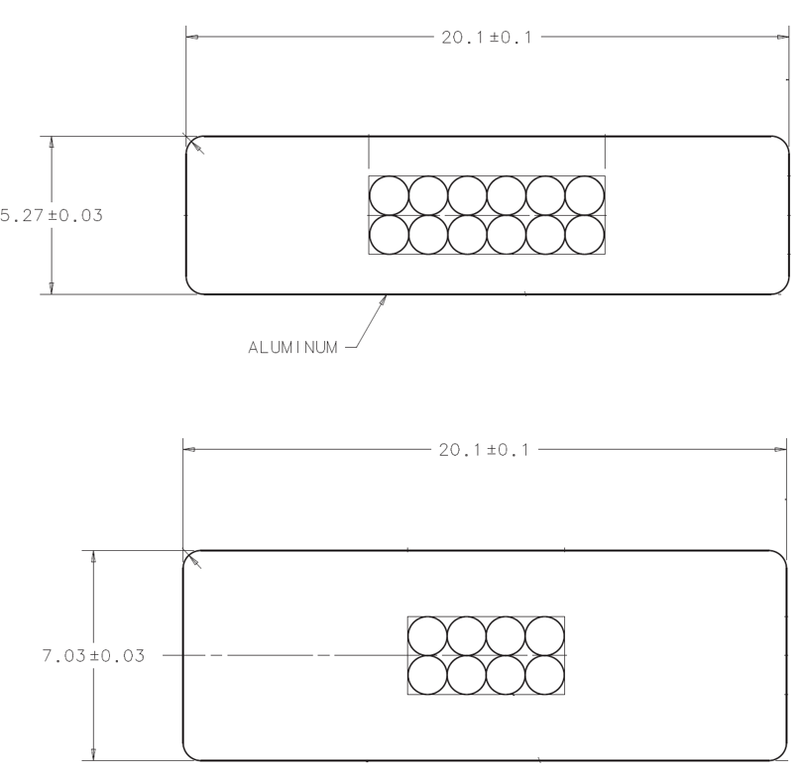
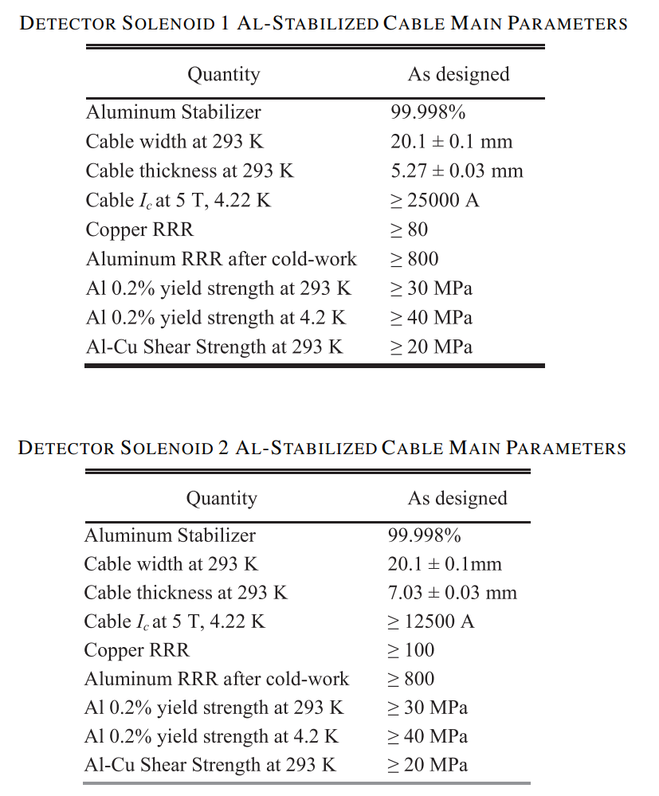
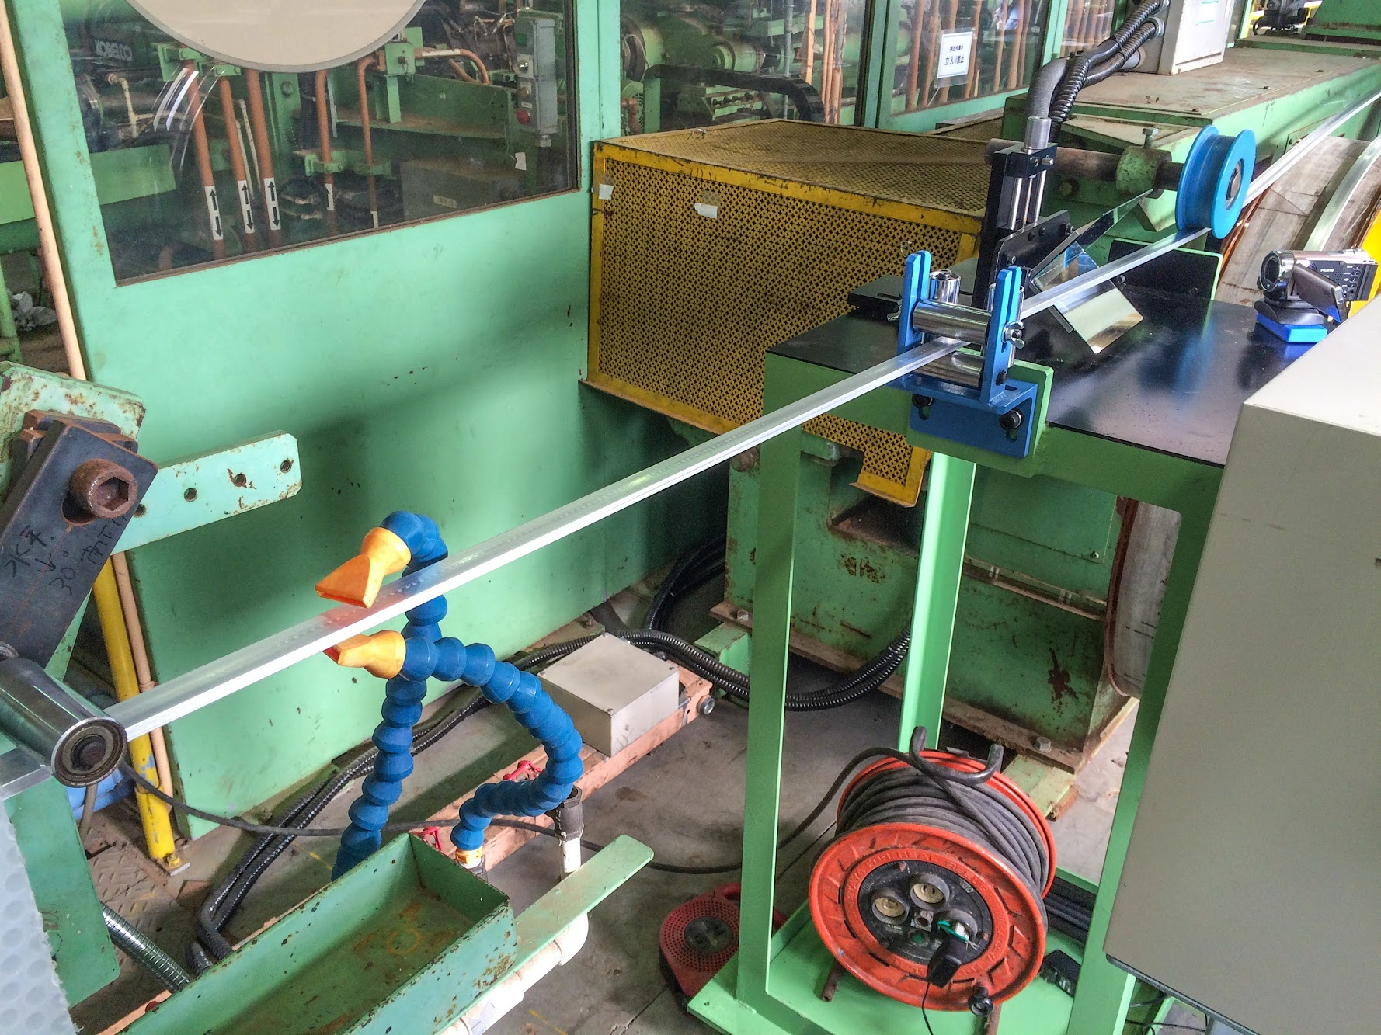
DS cable
DS1 cable manufactured by Furukawa Electric
5N aluminum
DS2 cable manufactured by Hitachi Cable
See “Development of Aluminum-Stabilized Superconducting Cables for the Mu2e Detector Solenoid” IEEE TRANSACTIONS ON APPLIED SUPERCONDUCTIVITY, VOL. 26, NO. 4, JUNE 2016
Pictures courtesy of Hitachi Cable

Slide 13
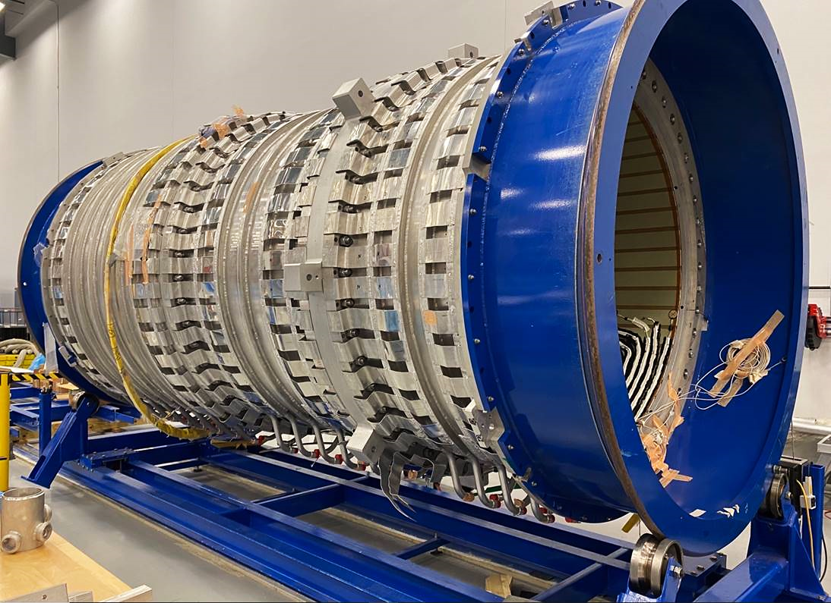
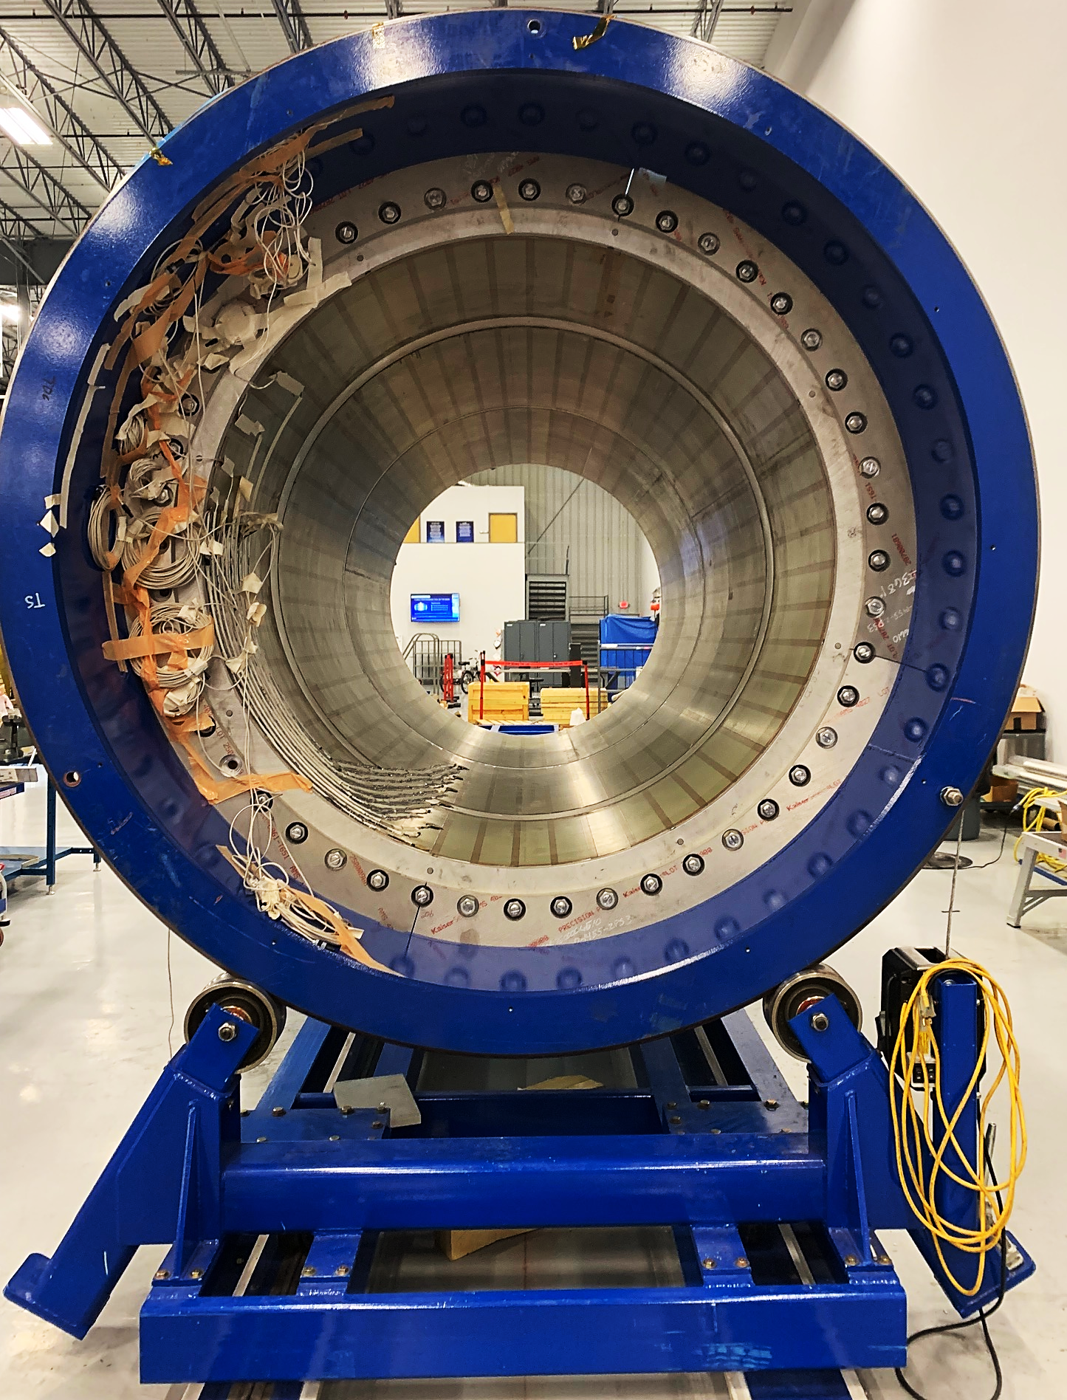
PS fabrication: cold mass assembly
Cold mass on the rolling fixture
1.7 m
PS1 coil PS2 coil PS3 coil
RRR gauges
4.0 m
Pictures courtesy of General Atomics

Slide 14
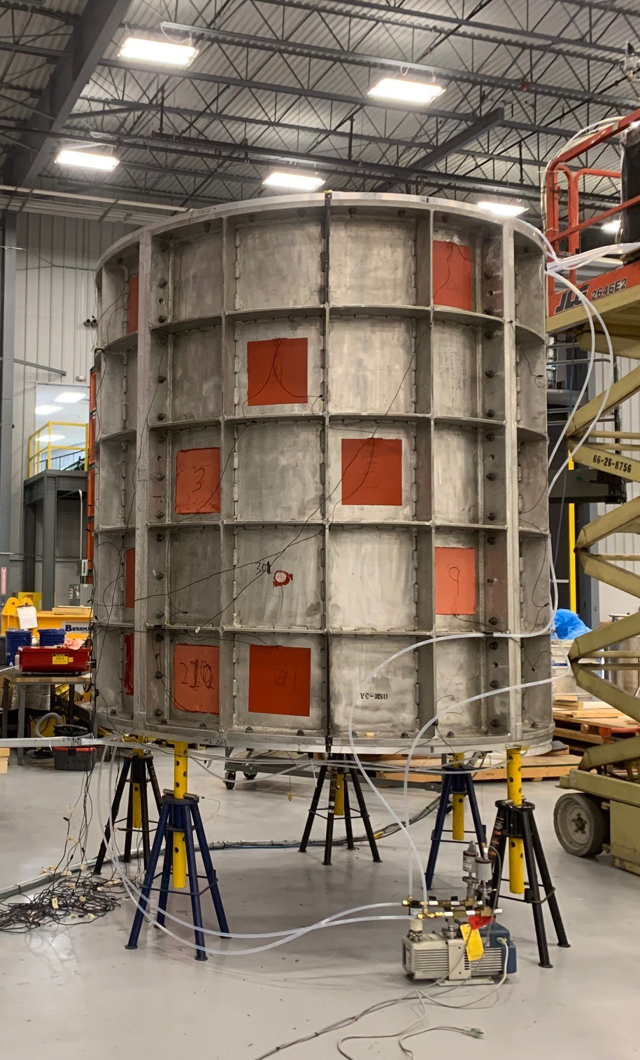
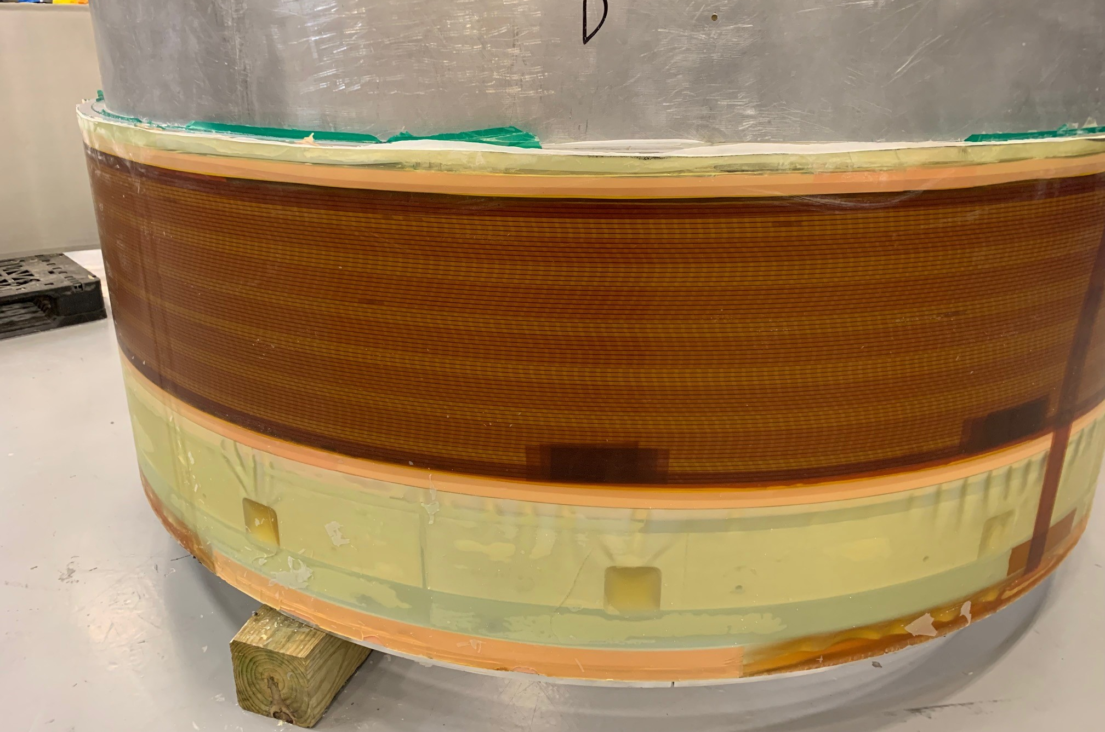
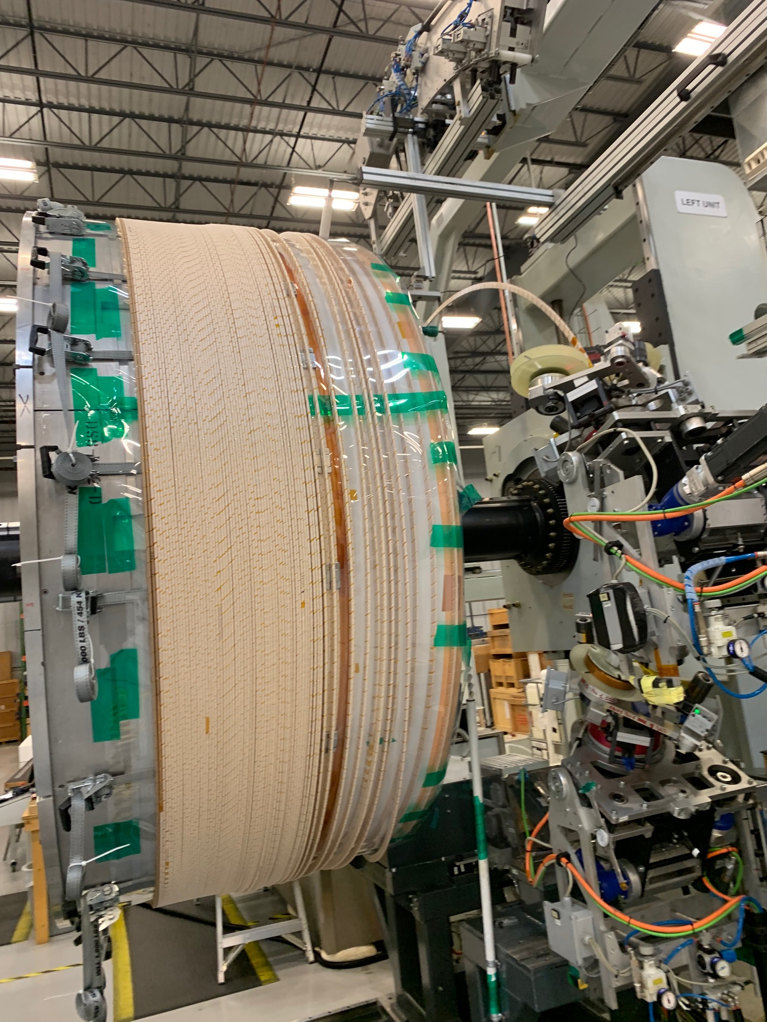
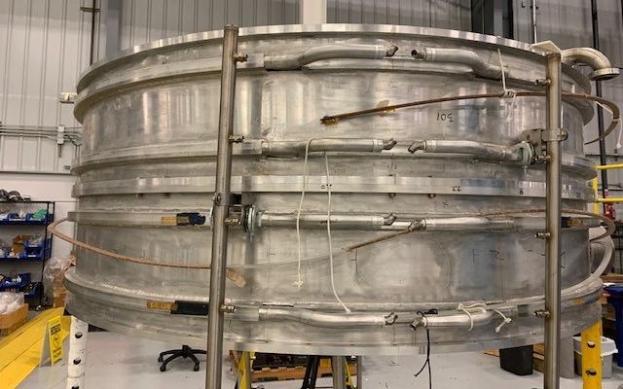
DS fabrication: coil production
Coil winding
VPI setup
Impregnated coil
Coil prepared for cold test
Pictures courtesy of General Atomics

Slide 15
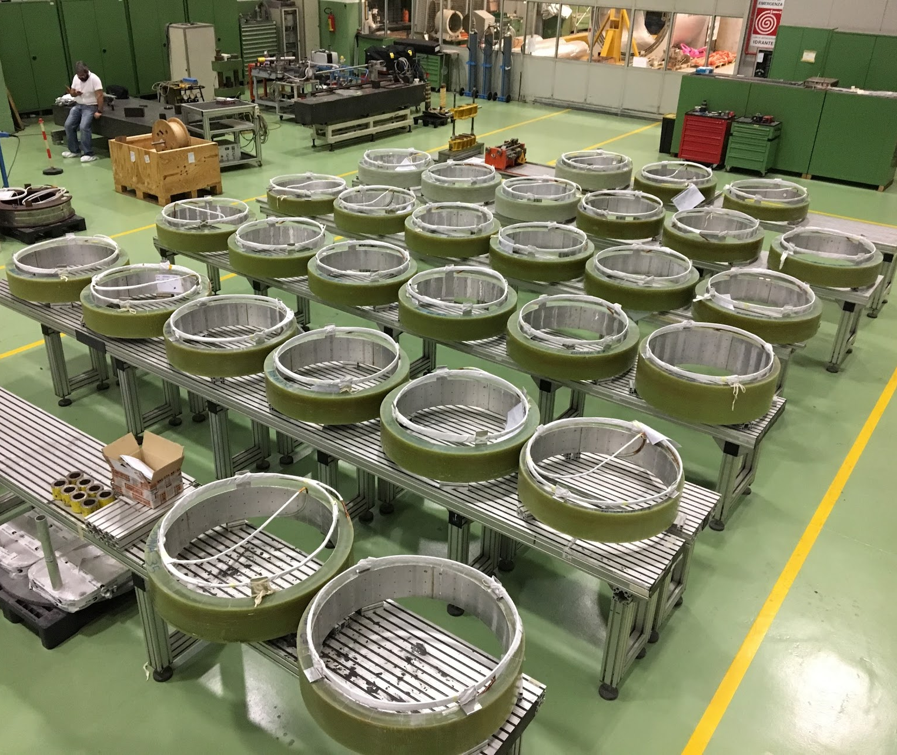
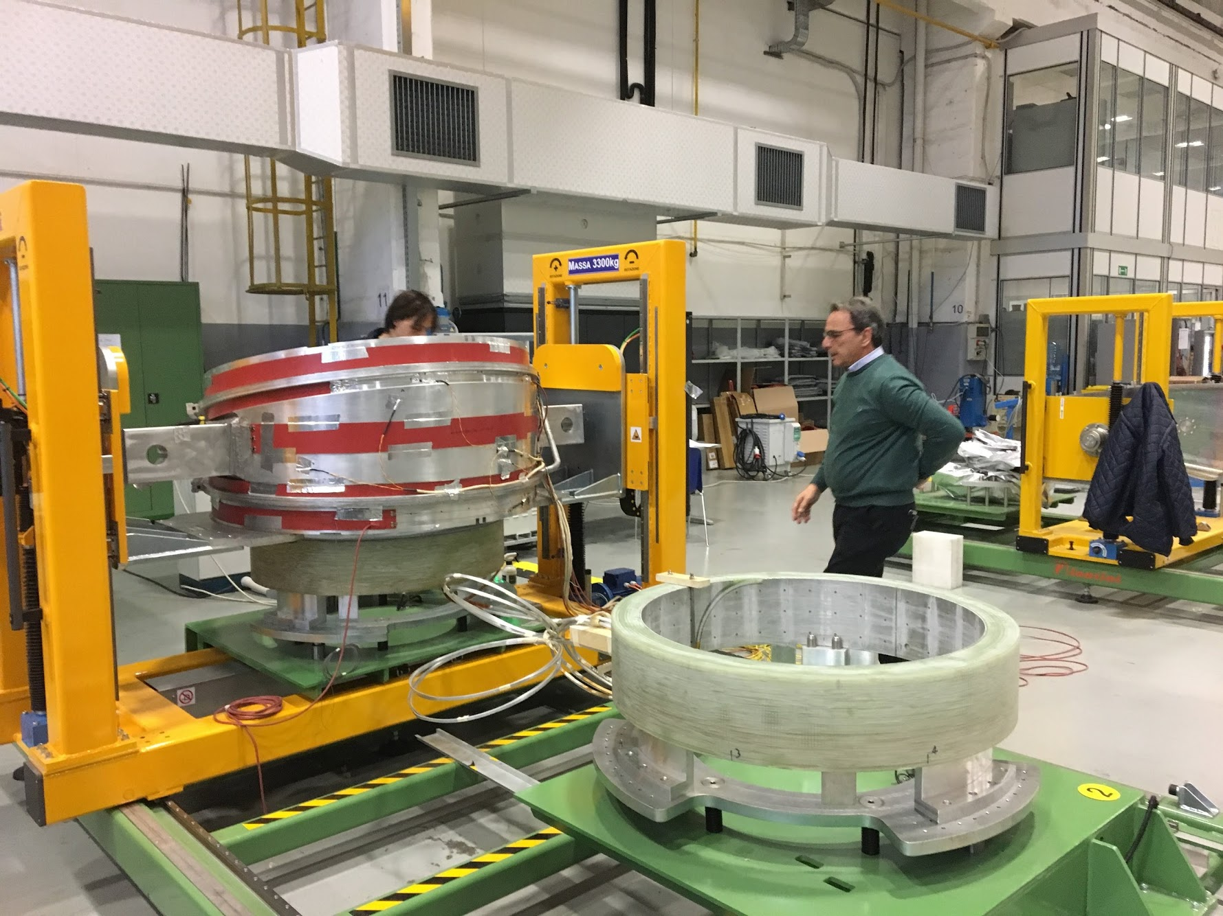
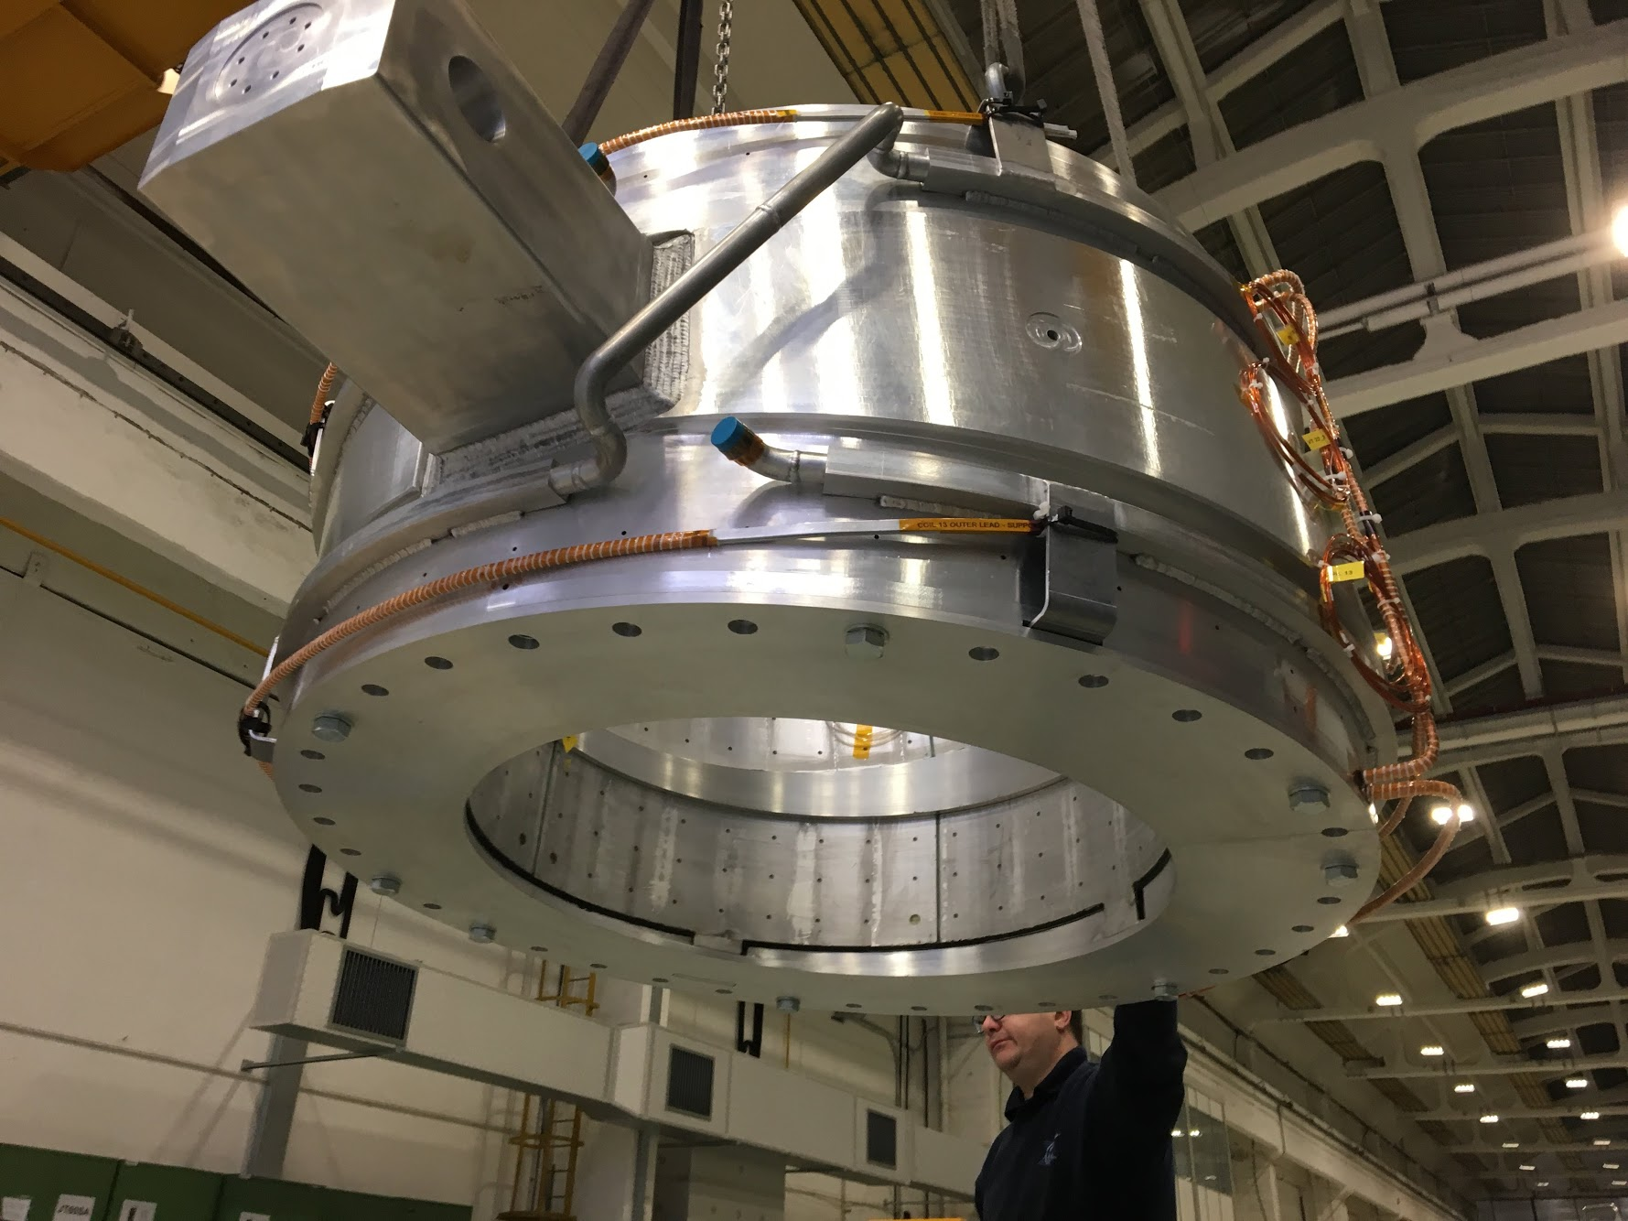
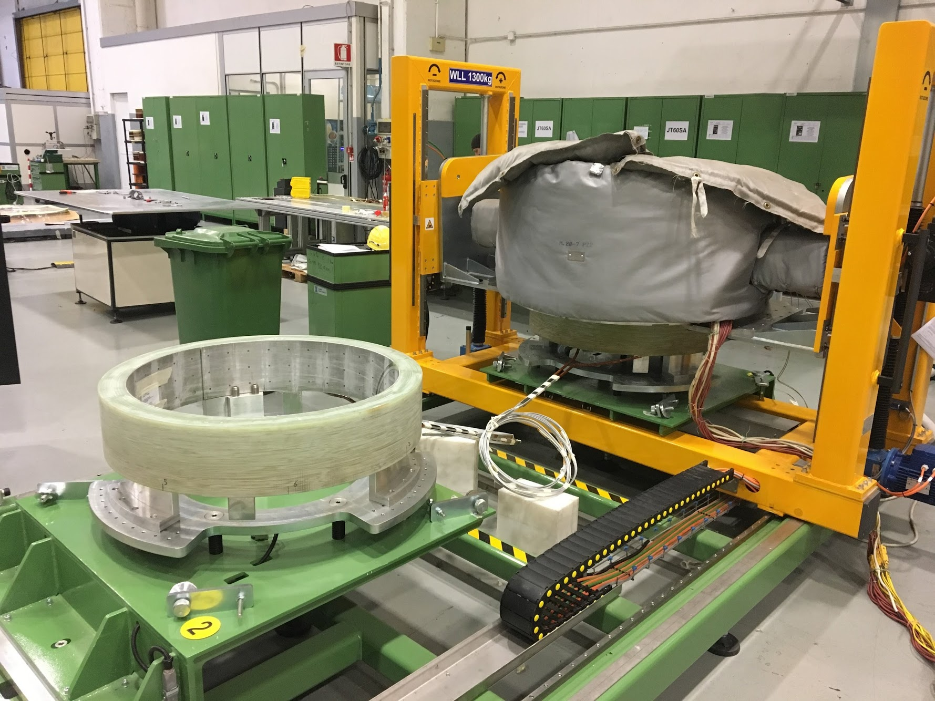
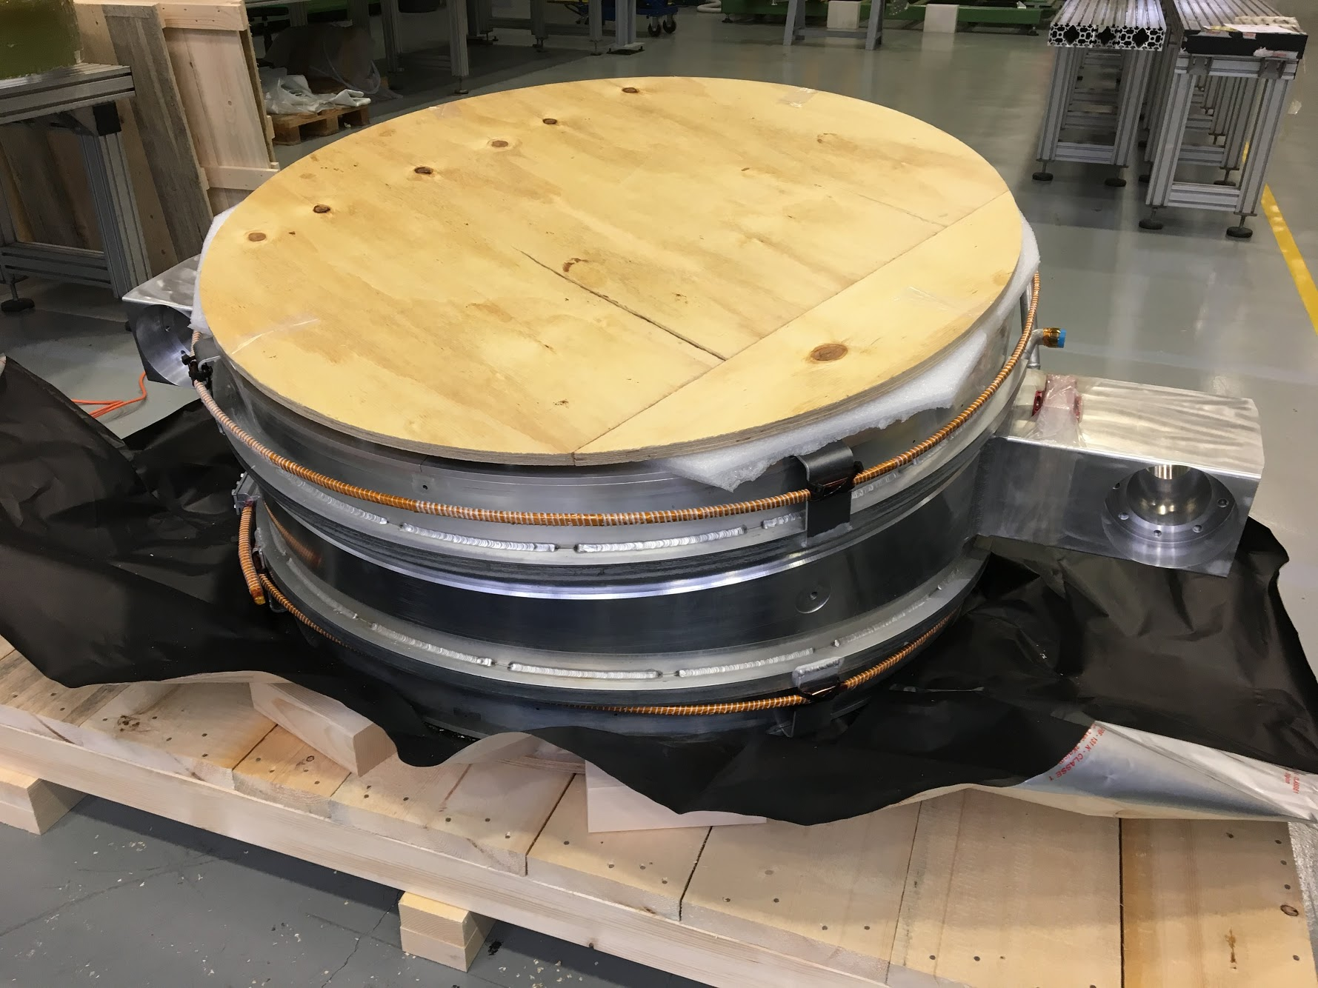
TS cold mass fabrication successfully completed
Completed coils
Coil module assembly
Shell insertion
Packing for shipment
Pictures courtesy of ASG Superconductors

Slide 16
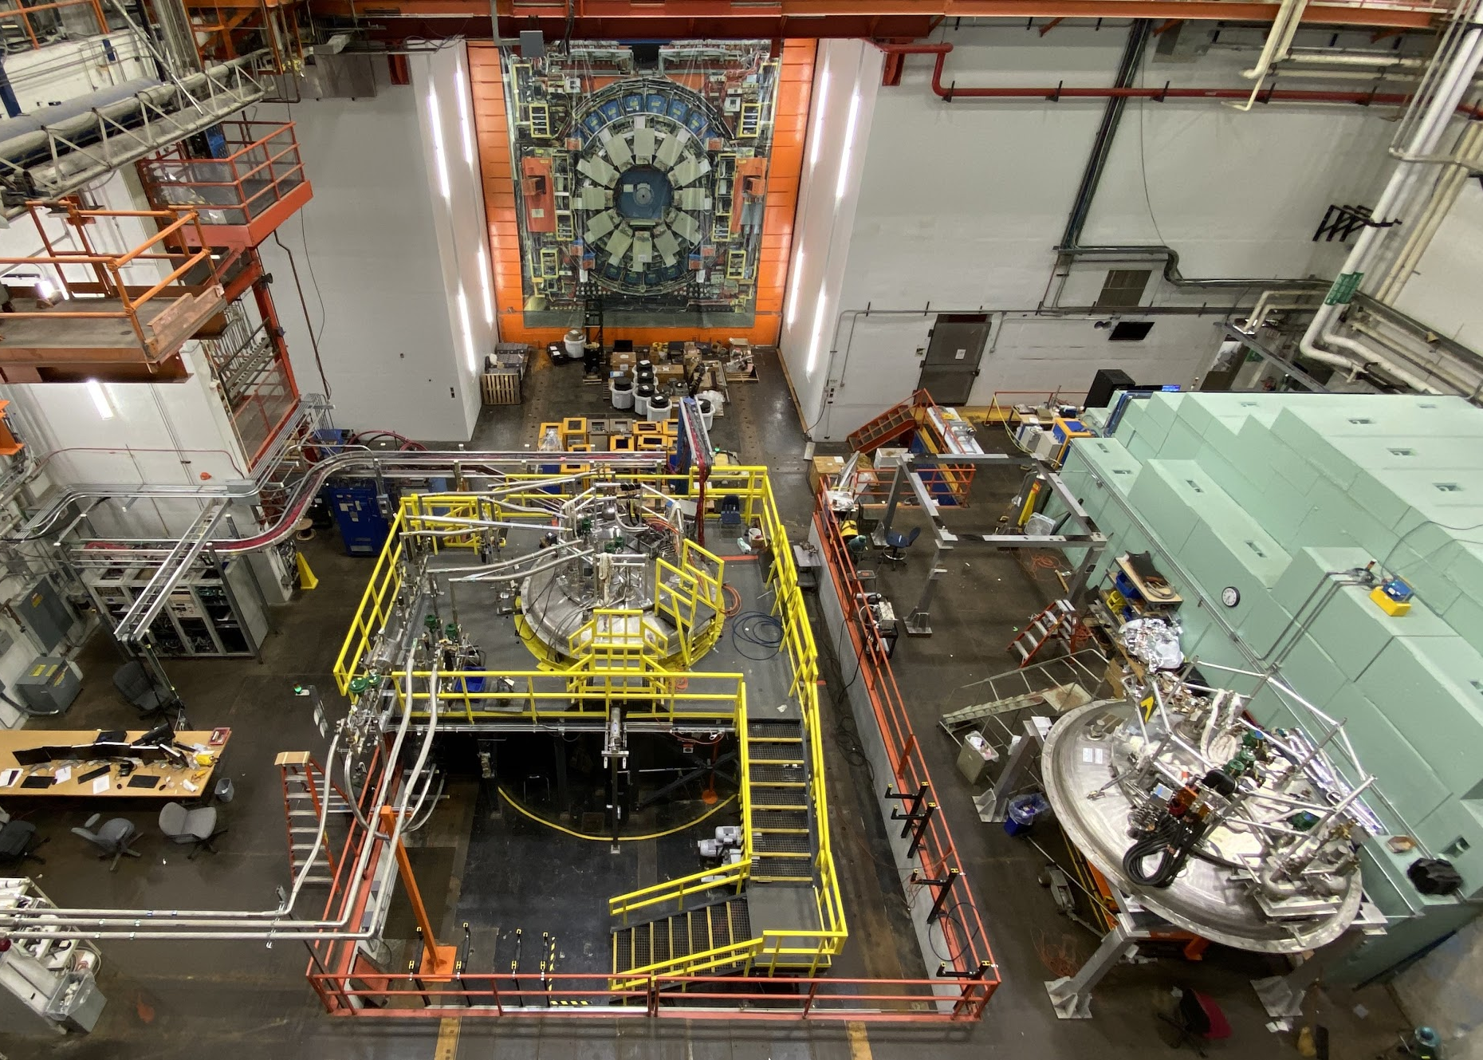
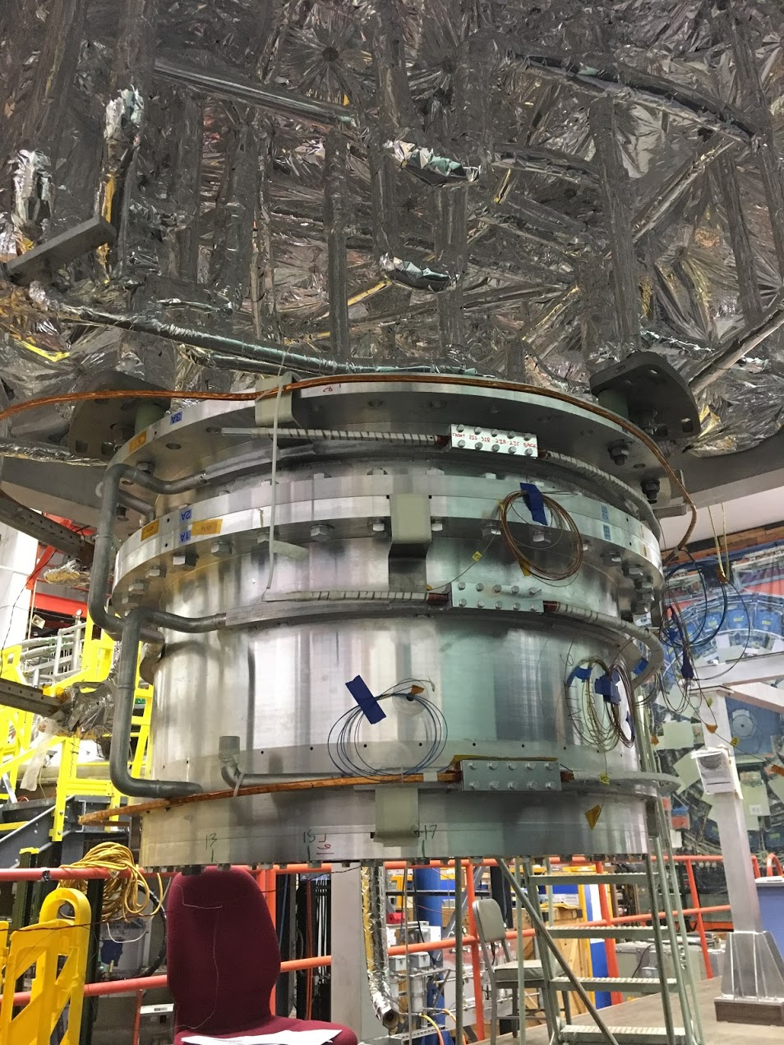
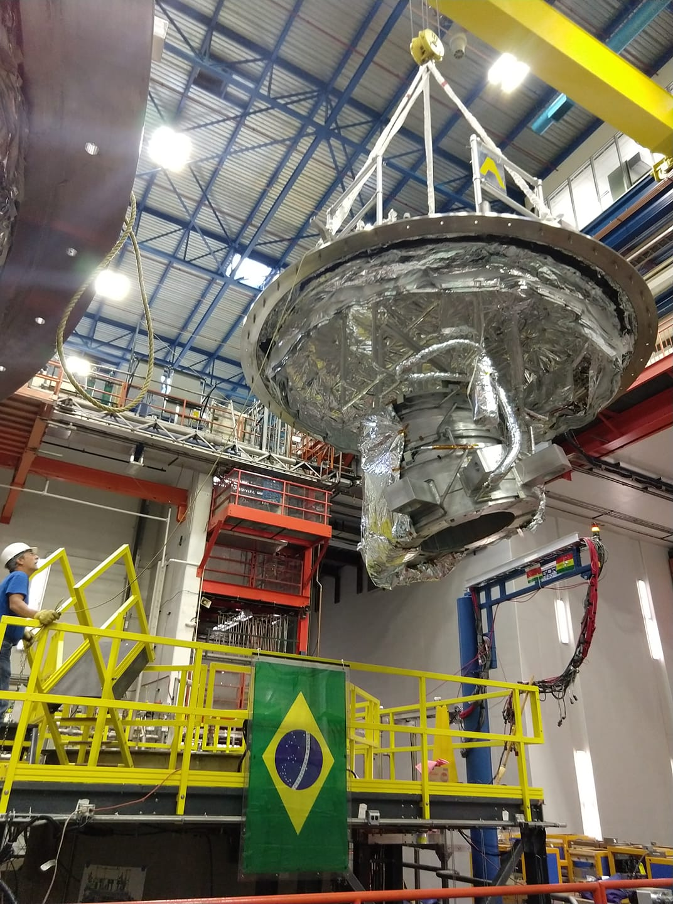
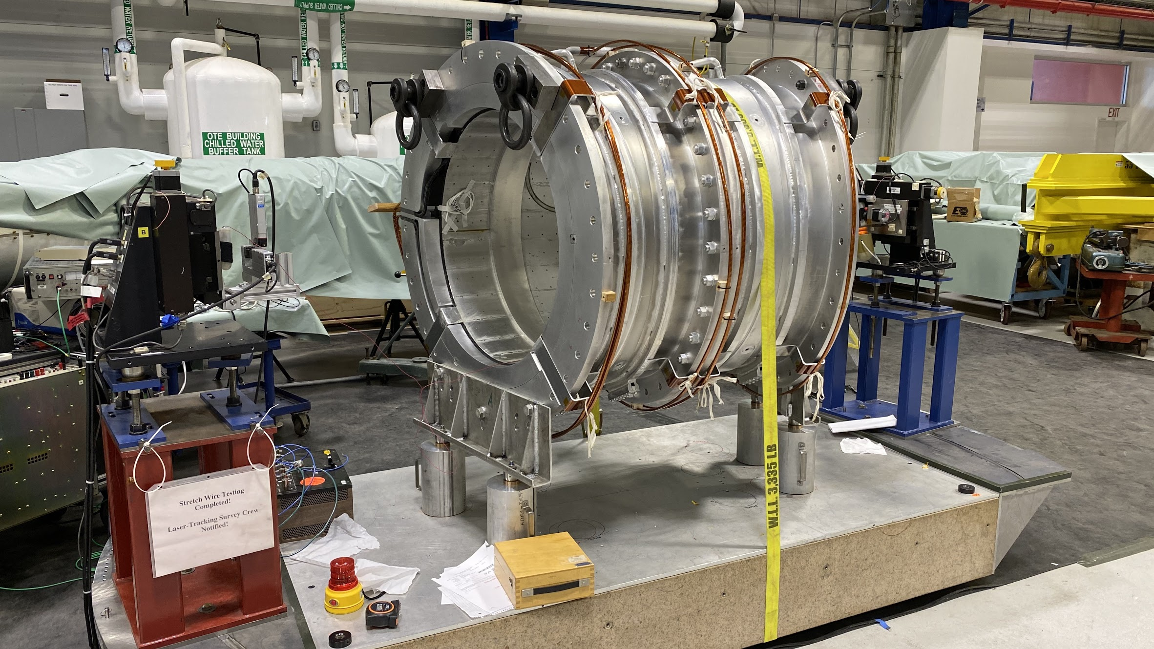
TS coil acceptance testing successfully completed
TS unit prepped for cold test
TSU
HAB test facility at Fermilab
Stretched wire measurements

Slide 17
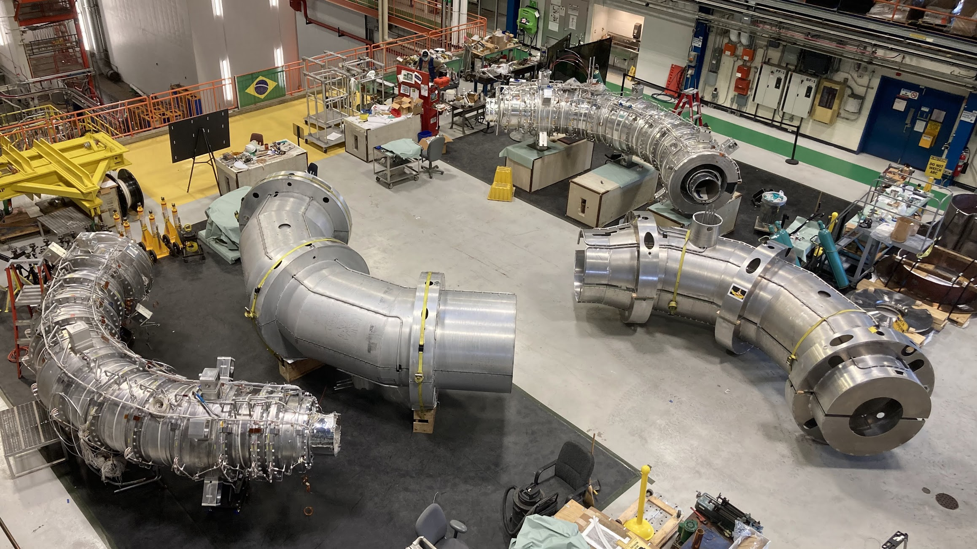
TS cold mass and thermal shield assembly at Fermilab
TSU inner
thermal shield
TSU cold
mass
TSU inner
warm bore
TSU outer
thermal shield
TSD outer
thermal shield
TSD inner
warm bore
TSD inner
thermal shield
TSD cold
mass

Slide 18
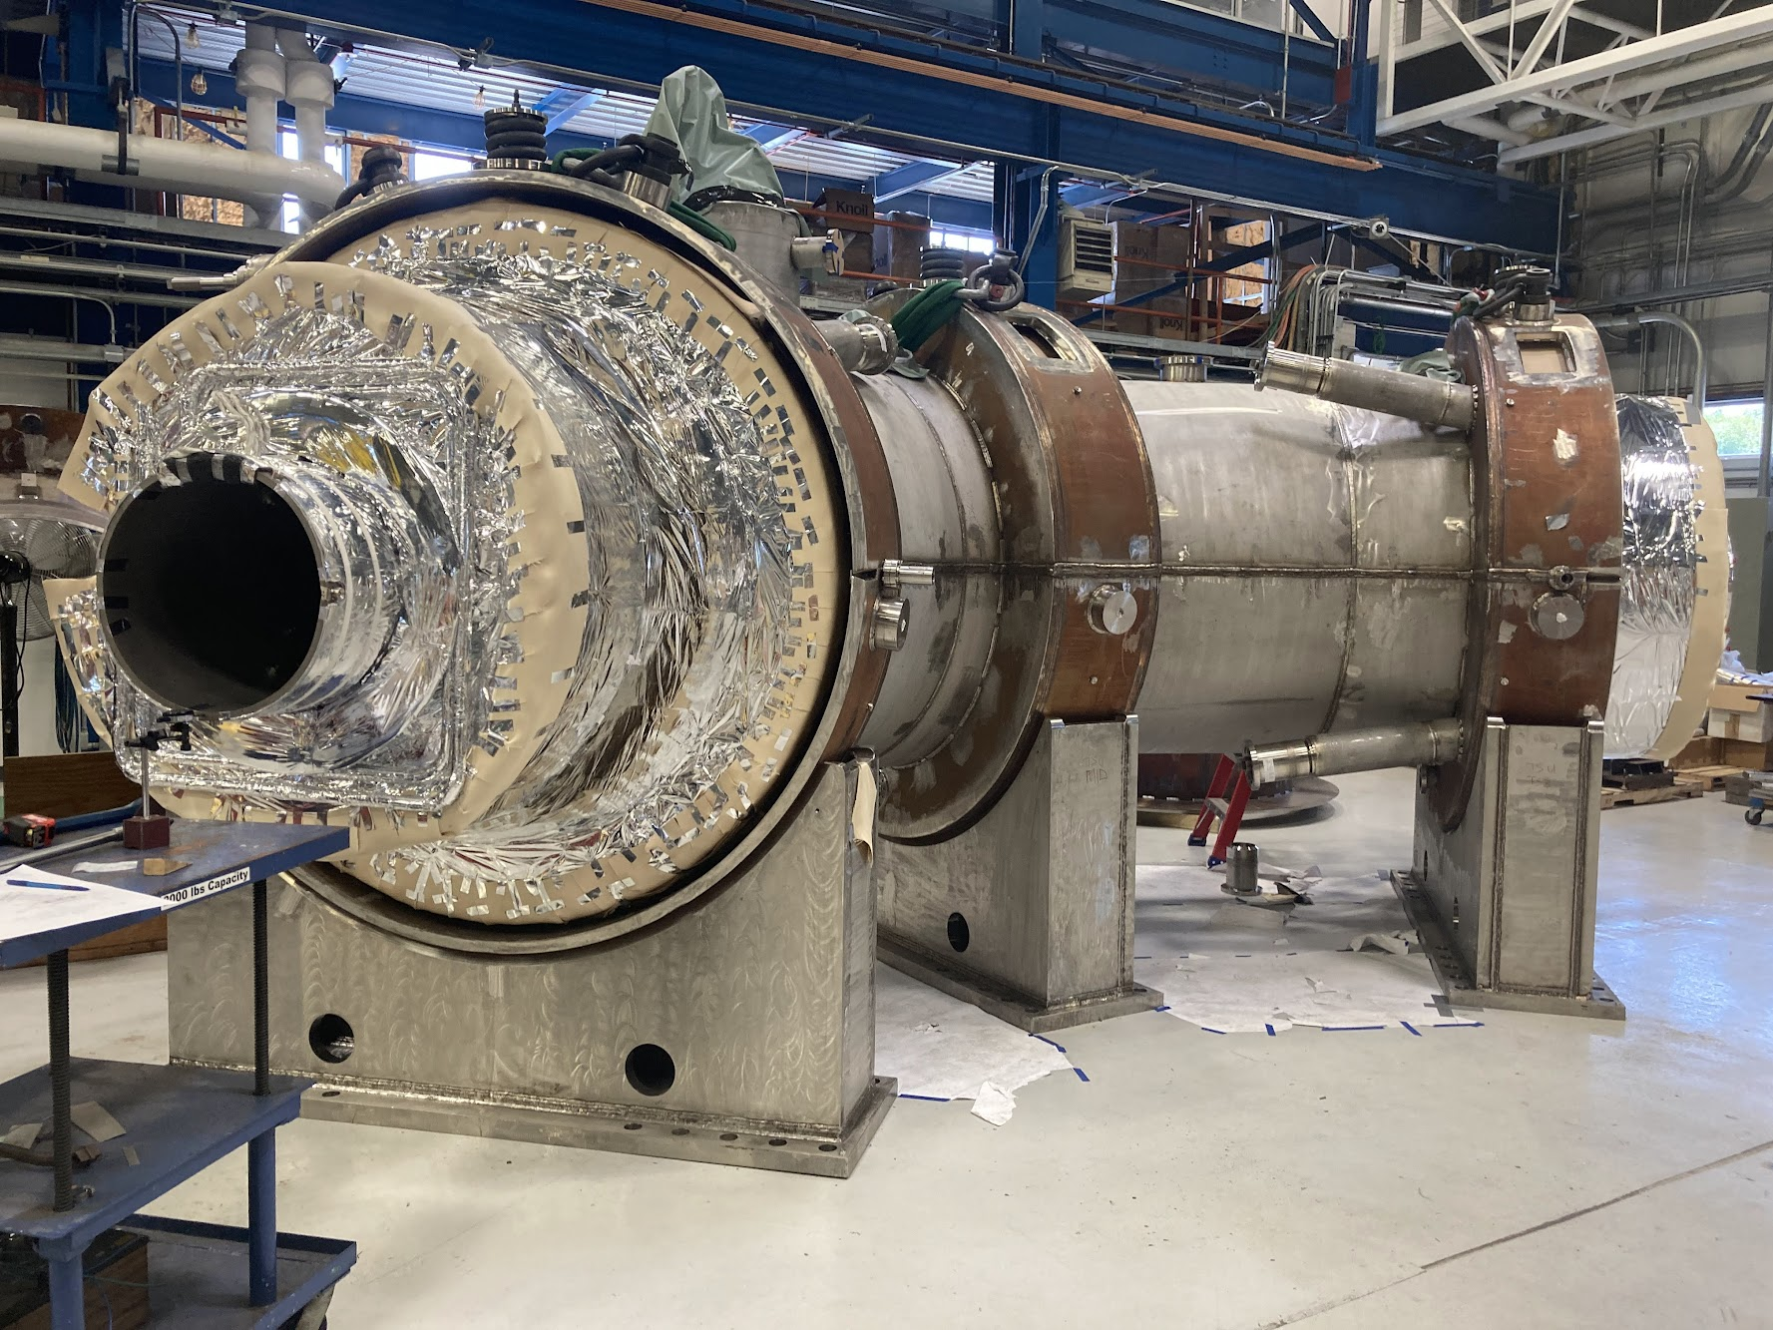
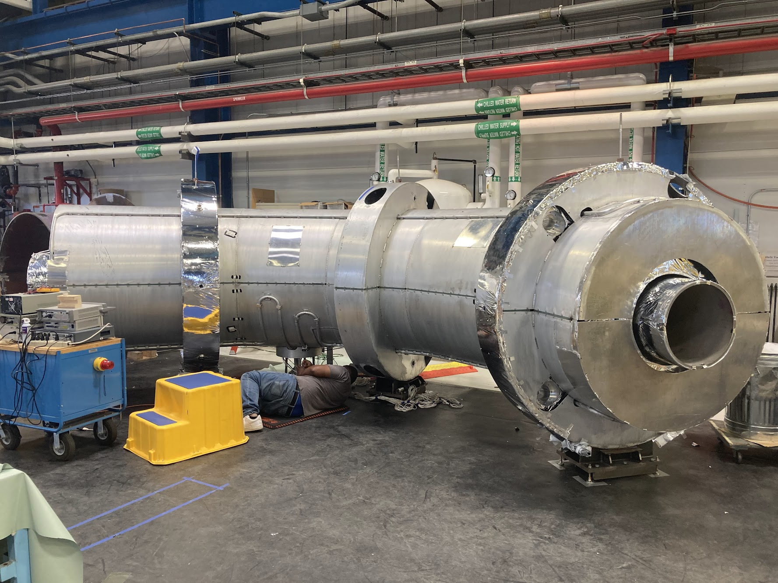
Current status of TS assembly at Fermilab
TSU cryostat assembly ongoing
TSD thermal shield assembly completed

Slide 19
Planning for the future: Mu2e-II
Mu2e-II is a natural evolution of Mu2e that provides the nearest-term next step in a possible muon program at Fermilab. After the PIP-II linac construction, Mu2e-II will have access to 100 kW proton beam vs. 8 kW beam in Mu2e experiment. It allows an order of magnitude gain in sensitivity and discovery reach over Mu2e.
The main challenge for the magnetic system is that PS magnet will see a proportional increase of the neutron radiation load coming from the production target.
The Mu2e PS magnet likely has to be replaced
The magnet and the cooling system should be redesigned to cope with a factor of ten higher heat load
  Conduction cooling no longer seems to be an option
  Direct cooling by LHe may be the only feasible solution to extract the heat from the coils
Cable-in-Conduit Conductor (CICC) could be a natural choice; however, it has several drawbacks:
  High-density materials (Cu for the stabilizer and SS for the conduit). Would triple the heat dissipations and the load on the cryo-system comparing with the Al-stabilized conductors;
  May have to use Nb₃Sn (expensive and difficult to work with) instead of NbTi to cope with the higher thermal load;
  RRR of Cu permanently degrades under neutron irradiation, while RRR of Al completely recovers during a thermo-cycle;
For these reasons, a different technical solution is being considered for Mu2e-II

Slide 20
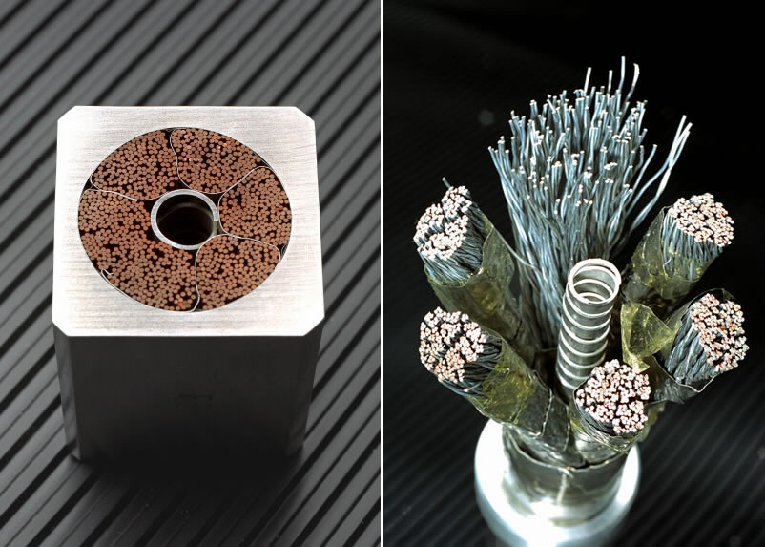
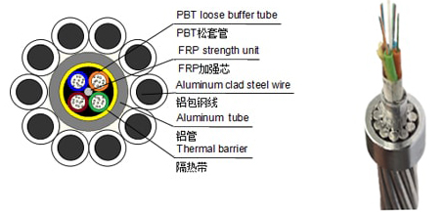
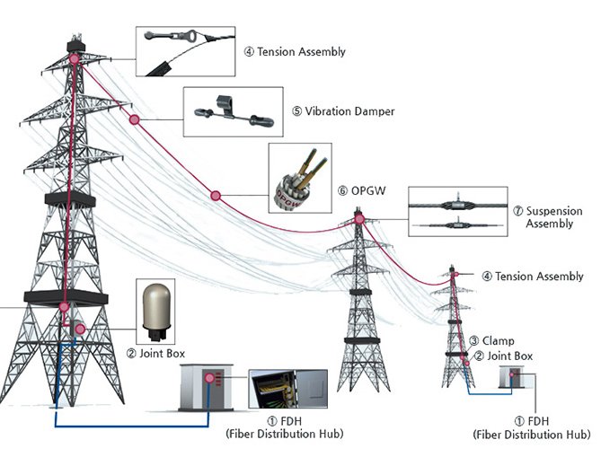
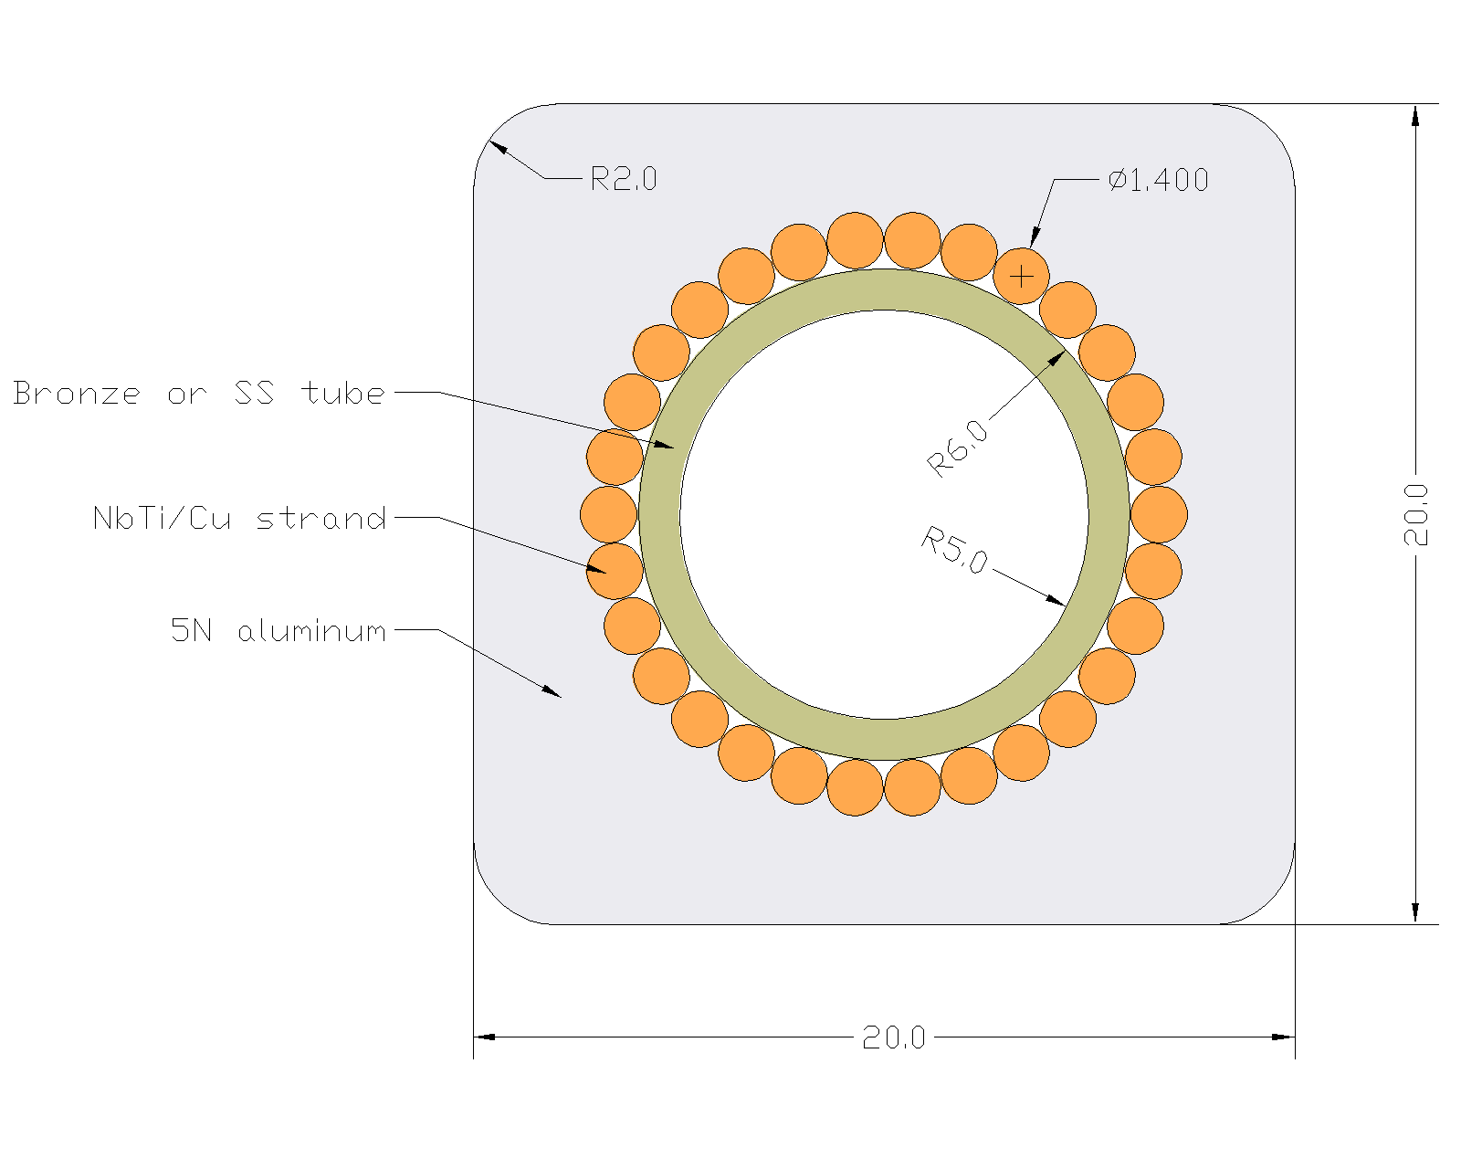
Mu2e-II solution: internally-cooled aluminum stabilized cable
Regular Al-stabilized cable
CICC
OPGW
LHe forced flow
  Nearly direct cooling of superconductor by LHe
  Mostly low-density materials
  No permanent stabilizer degradation under irradiation
OPGW fabrication technology serves as an example that it can be done
Still requires a dedicated R&D with cable vendor to develop a proof of principle cable
A preferred solution for Mu2e-II

Slide 21
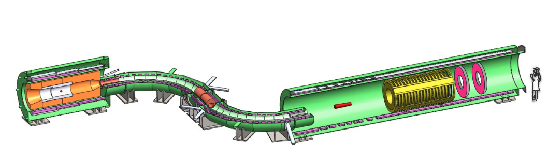
Summary
The Mu2e experiment is to search for Charged Lepton Flavor Violation to probe the physics beyond the Standard Model.
The Mu2e magnet system consists of three solenoid magnets that use four types of aluminum-stabilized cables to meet the physics requirements.
The magnet construction is well under way.
Mu2e-II is being considered as a natural successor of Mu2e. It is a challenging upgrade that will require a dedicated cable and magnet R&D.

