Slide 1
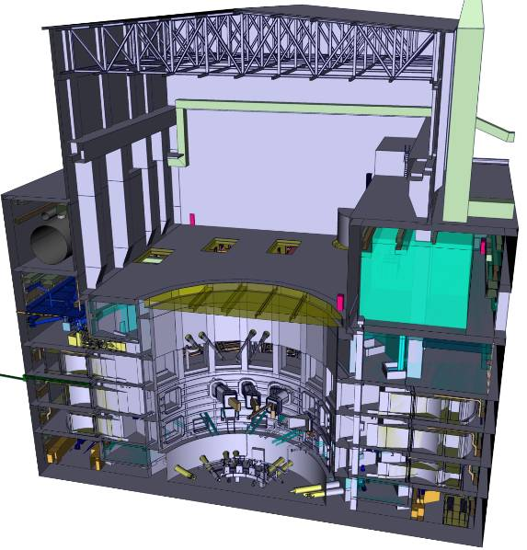
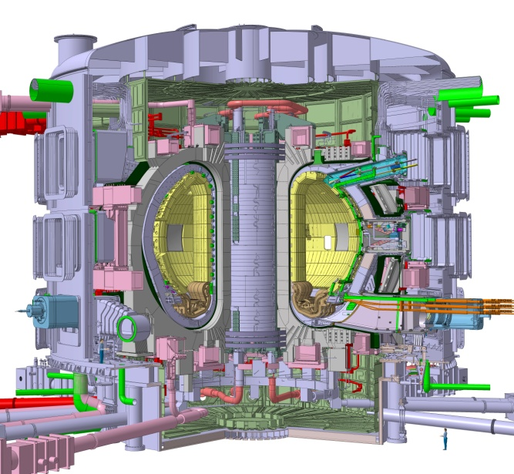
ITER History and Layout
Fusion Technology for ITER Part 1
(ITER at CERN Lecture 3)
Scientific Lectures
CERN
14. April 2011
Guenter Janeschitz
ITER Organization, Route de Vinon, CS 90 046 13067 St Paul Lez Durance Cedex, France
Notes:
1

Slide 2
Outline Lecture 3 (14th April 2011)
A short History of ITER
Basic Parameters and Features of a Tokamak
The Layout of a Reactor Class Fusion Machine
  The large ITER Machine (1.5 to 3.0 GW Fusion Power)
  The reduced size ITER of today (0.5 GW Fusion Power)
Fusion Technology, Challenges, ITER Design
  Magnets
  Vessel & In Vessel Components
  Remote Maintenance & Hot Cell
Summary of lecture 3

Slide 3
Outline Lecture 4 (15th April 2011)
Fusion Technology, Challenges, ITER Design continue
  Cryostat and Thermal Shield
  The D-T Fuel Cycle
  Plasma Heating Systems and Plasma Diagnostic Systems
  The Cryo system
Status of the ITER Project
Which Technologies are needed for a DEMO Reactor
  The T- Breeding Blanket & a He Cooled Divertor
  Structural and Functional Materials for the In Vessel Components
  Improvements in H&CD, in RH, and possibly in Magnets
What if Mankind needs Fusion Faster ?
  The Apollo like program – the Ultra Fast Track to Fusion Energy
Summary

Slide 4
A short History of ITER

Slide 5

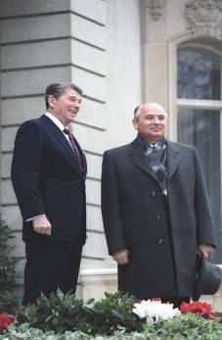
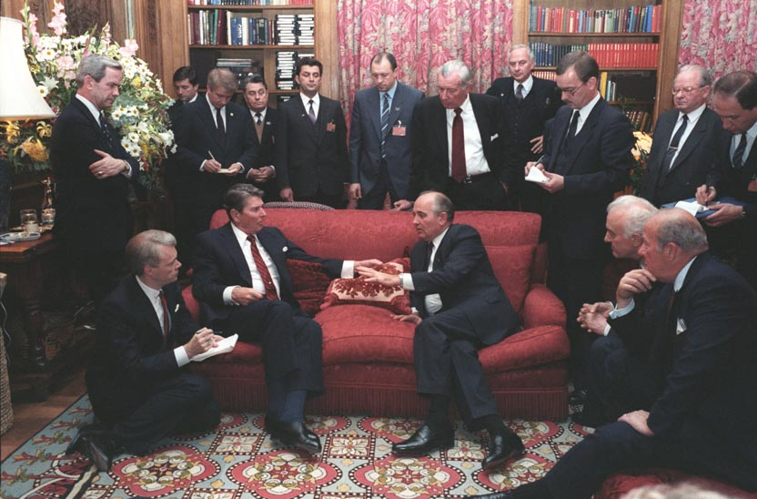
ITER Cooperation
1978 (November): First “Steering Committee of the INTOR Workshop” convenes in Vienna. INTOR was the first attempt at building a truly international fusion programme. INTOR was very close to ITER in its concept.
1985 (November): At Geneva Superpower Summit in 1985 US president Reagan and Secretary General Gorbatchev propose an international effort to develop fusion energy... "as an inexhaustible source of energy for the benefit of mankind". This is the first political step to the ITER programme

Slide 6
ITER Cooperation
1988-1990 ITER CDA ( Garching)
1992-1999 ITER EDA ( San Diego, Garching, Naka).
USA leaves ITER cooperation .The EU ,Japan and Russia decide to continue.
1999-2001 Redesigning of ITER from Ignition to Q=10 ( 21MA to 15 MA)
2001: ITER Council approves design of the ITER machine. Symbolically, the meaning of ITER is changed. It is not the acronym of International Thermonuclear Experimental Reactor anymore, but the Latin word “iter” which means “the way”.
2005 (June): Decision on building ITER in Cadarache is reached on 28th June at ministerial meeting in Moscow
21/11/2006: ITER Agreement is signed at Elysée Palace in Paris by the seven Parties: China, Europe, India, Japan, Korea, Russian Federation and the United States of America

Slide 7
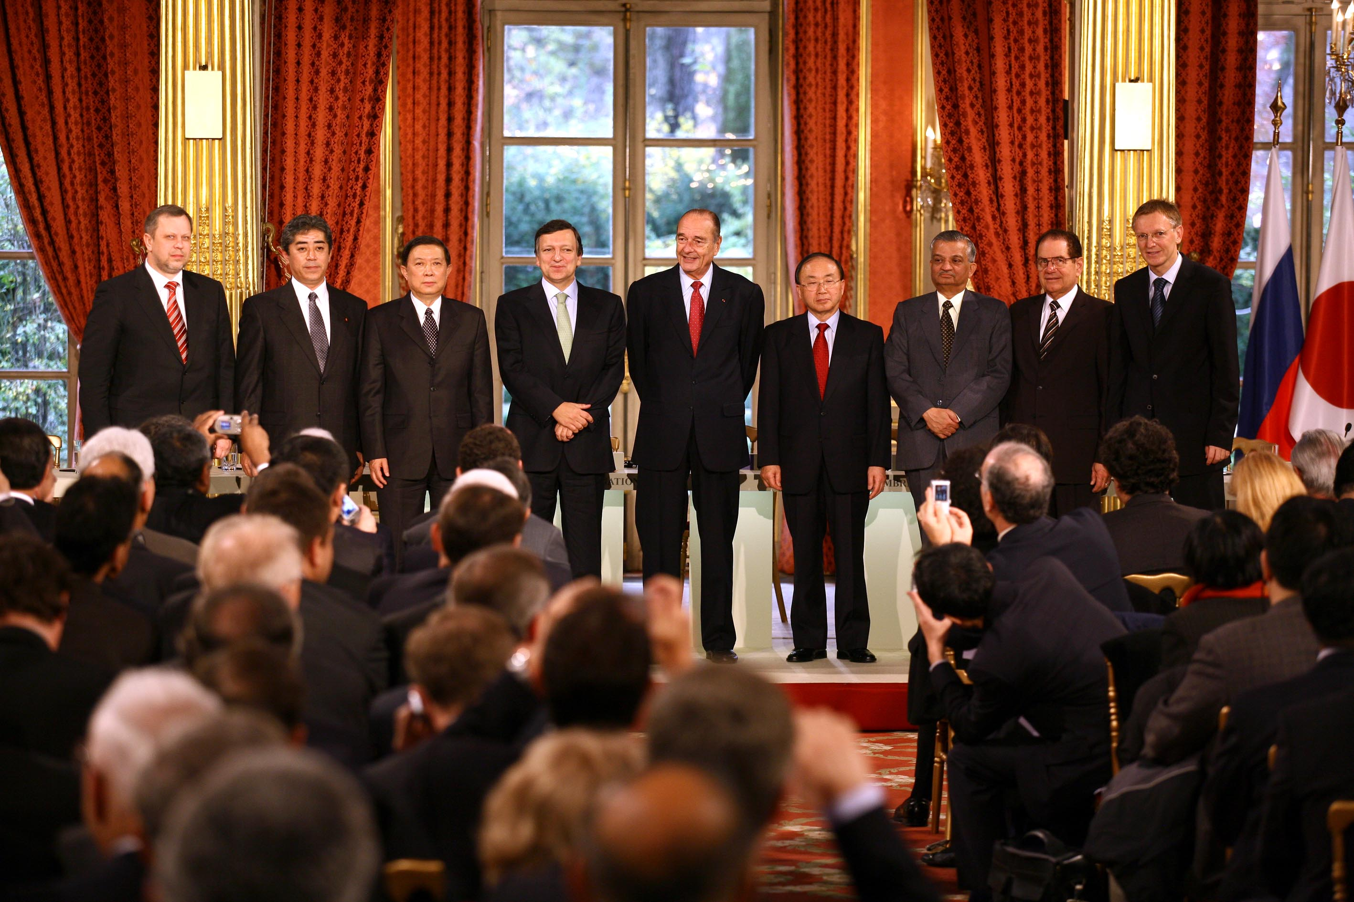
21/11/2006: ITER Agreement Signed

Slide 8
Basic Parameters and Features of a Tokamak

Slide 9
Basic parameters of a Tokamak
R = Major Radius (distance machine center to plasma center
a = minor radius ( radius of plasma)
ε = Aspect Ratio is R/a
κ = Elongation is b/a (plasma center to top or bottom / minor radius)
δ = Triangularity Ratio of c / a – see picture
TF = Toroidal Field
PF = Poloidal Field
S = Separatrix
CS = Central Solenoid – Transformer
VS = Vertical Stability (e.g VS – coils)
τ_{E} = Energy Confinement Time (1/e time)
n_{e} = Density (10²⁰ m⁻²)
Ti = ion temperature
b
R
a
c

Slide 10
A Modern Tokamak – Magnetic Field Structure
Vertical Field
Magnetic well
Radial control
Poloidal field coils
Radial Field
vertical control
VS-Coils
Transformator
TF- Coils
Divertor

Slide 11
Methods for the heating of a tokamak plasma
ICRH
transmission line
ionized atoms
antenna
wave guide
ECRH
HIGH FREQUENCY HEATING
plasma current
OHMIC HEATING
high energetic atoms
HEATING BY NEUTRAL BEAM INJECTION
„ion cemetery“
accelerator
neutraliser
ion source
source: Forschungszentrum Jülich

Slide 12
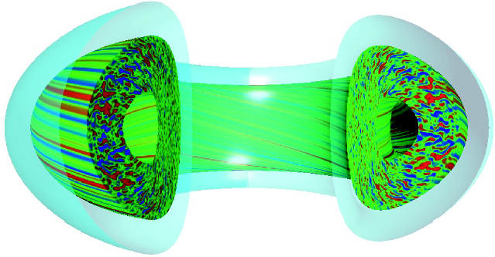
Energy and particle Transport is governed by turbulence
Ion Turbulent energy transport sets in at a critical temperature gradient which depends on the local temperature
Radial size of turbulent structures can be reduced by ExB shear, by magnetic shear and by zonal flows produced by the turbulence itself

Slide 13
Confinement Scaling Relation
Extrapolation of global thermal confinement time to ITER-FEAT (R = 6.2 m), using the IPB98(y,2) scaling (t_{E}=3.9s)
  Only Q= 10 possible, no ignition
  For ignition R~ 8 m and t_{E} >5.7 sec needed
ITER represents an extrapolation of a factor ~4 beyond existing database

Slide 14
The Layout of a Reactor Class Fusion Machine
  The large ITER Machine
  The reduced size ITER – present ITER

Slide 15
How do we size a Reactor class Fusion machine (1)
Trippel Product Diagram

Slide 16
How do we size a Reactor class Fusion machine (2)

Slide 17
A System Code finds self-consistent Design Options
A typical flow diagram of such a system code can be seen on the right side
The system code combines physics rules with engineering design knowledge
It can only be used if a more detailed design of a particular type of machine has been done and the experience / knowledge has been implemented
Beside a set of non linear equations representing physics and engineering rules / knowledge, the system code contains also a cost algorithm which is based on the industrial cost estimates established for ITER-1998

Slide 18
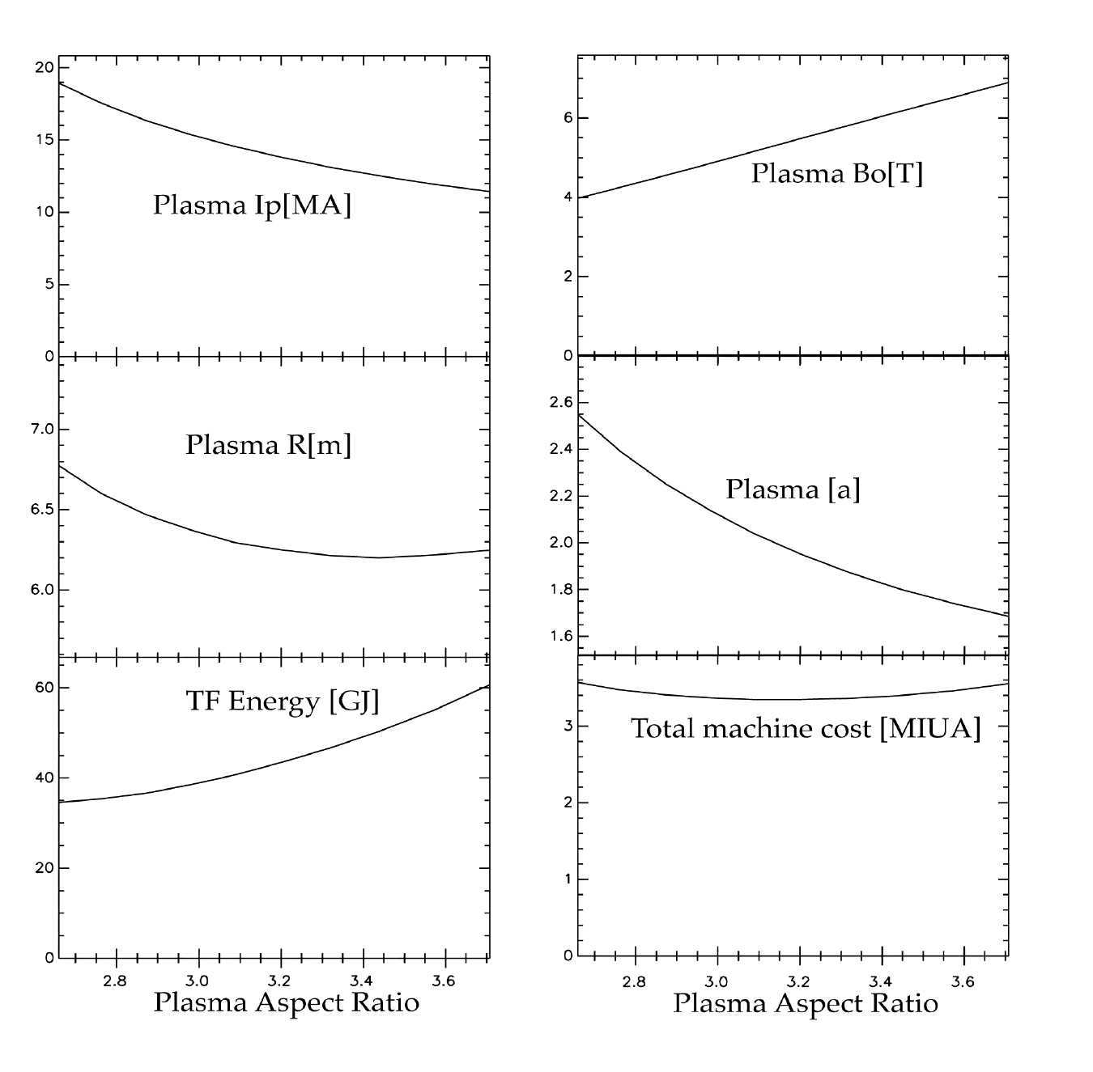
Typical results from the System Code Study
The main machine parameters and the cost change with increasing aspect ratio in the following way:
  The toroidal Field, the Magnetic Energy increase with Aspect Ratio
  The minor radius, The major Radius and the Plasma Current decrease with Aspect Ratio
  However, the cost of the machine stays constant over most of the Aspect Ratio range investigated

Slide 19
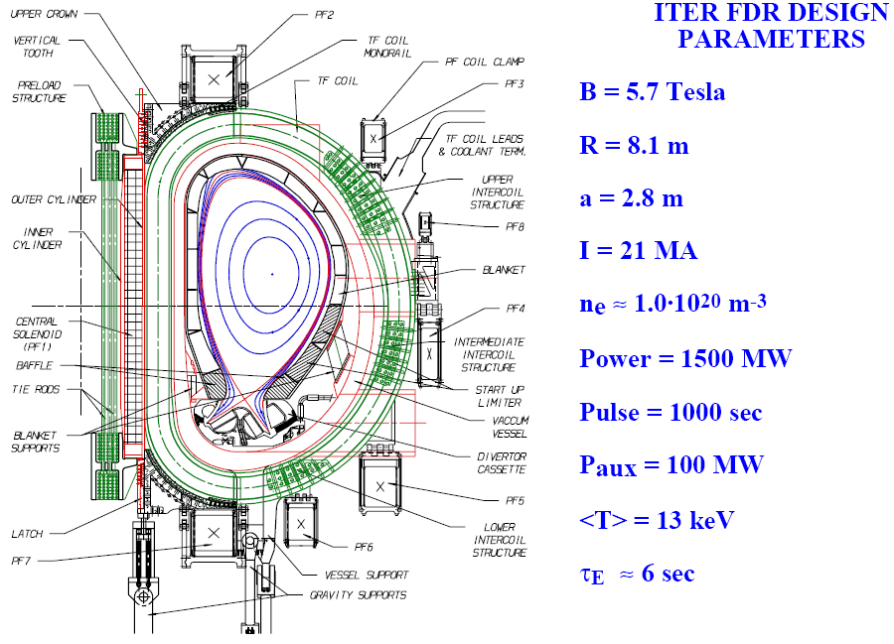
The Large ITER Machine 1998

Slide 20
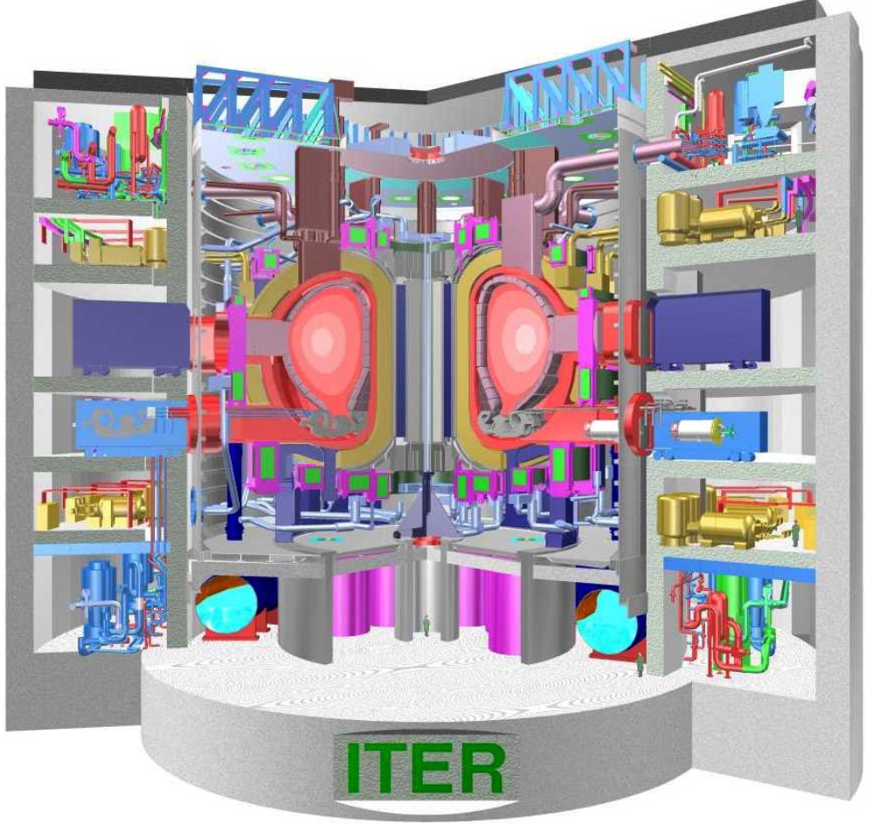
The Large ITER Machine

Slide 21
Requirements for ITER-98 and present RC-ITER
Inductive Performance ITER-1998:
  achieve controlled ignition and extended burn (>1000 sec)
  An average neutron wall loading of > 1 MWm⁻²
    i.e. ~ 1.5 GW of fusion power
Steady State Performance:
  Demonstrate Steady State as an ultimate Goal (~ 10000 sec)
Demonstrate Fusion Technology :
  Super Conducting Coils
  High Heat Flux Components
  Shielding / Breeding Blanket
  Remote Handling
Inductive Performance ITER-FEAT:
  Driven burn with Q = 10 for > 400 sec, (ignition not precluded)
  Neutron wall loading > 0.5 MWm⁻²
    i.e. ~ 0.4 GW of fusion power
  Cost < 50% of ITER-1998
Steady State Performance:
  Achieve Steady State with Q = 5 as a goal (~ 3000 sec)
Demonstrate Fusion Technology :
  Super Conducting Coils
  High Heat Flux Components
  Shielding / (Breeding Blanket)
  Remote Handling

Slide 22
Comparison of ITER-98 with a typical RC-ITER
In order to reduce
the cost by ~ 50%
and to achieve
Q = 10 the machines
major radius is
reduced from 8.2 m
to ~ 6 m
The general concepts for the main machine components remains largely unchanged which allows to make full use of the R&D performed during the EDA
However, a simple downscaling of ITER-98 is not possible !!

Slide 23
Cross section of ITER and machine parameters
Parameters of ITER-FEAT
Inductive pulse length ~ 400 sec

Slide 24
What were / are the major Challenges in Physics ?
The solution to the divertor peak heatflux problem (solved / ongoing)
  The development of the radiative divertor heatflux from 40 MWm⁻² to < 20 MWm⁻²
The prediction of the ITER Energy Confinement and thus the definition of its size (solved / ongoing) –> major radius = 6.2 m
  Shortfalls of scaling as a predictive tool => Physics understanding needed !
The impact of magnetic ripple on energy confinement (solved / ongoing)
  Impact low at ripple < 0.5% at separatrix, however, not understood !!
The developing understanding of ELMs and RWM and their stabilisation (solved / ongoing)
  In vessel coils foreseen in ITER – physics not understood – risk !
The definition of a credible steady state scenario (solved / ongoing)
  Development needs new generation of Tokamaks (EAST, KSTAR, JT60SA, ITER)

Slide 25
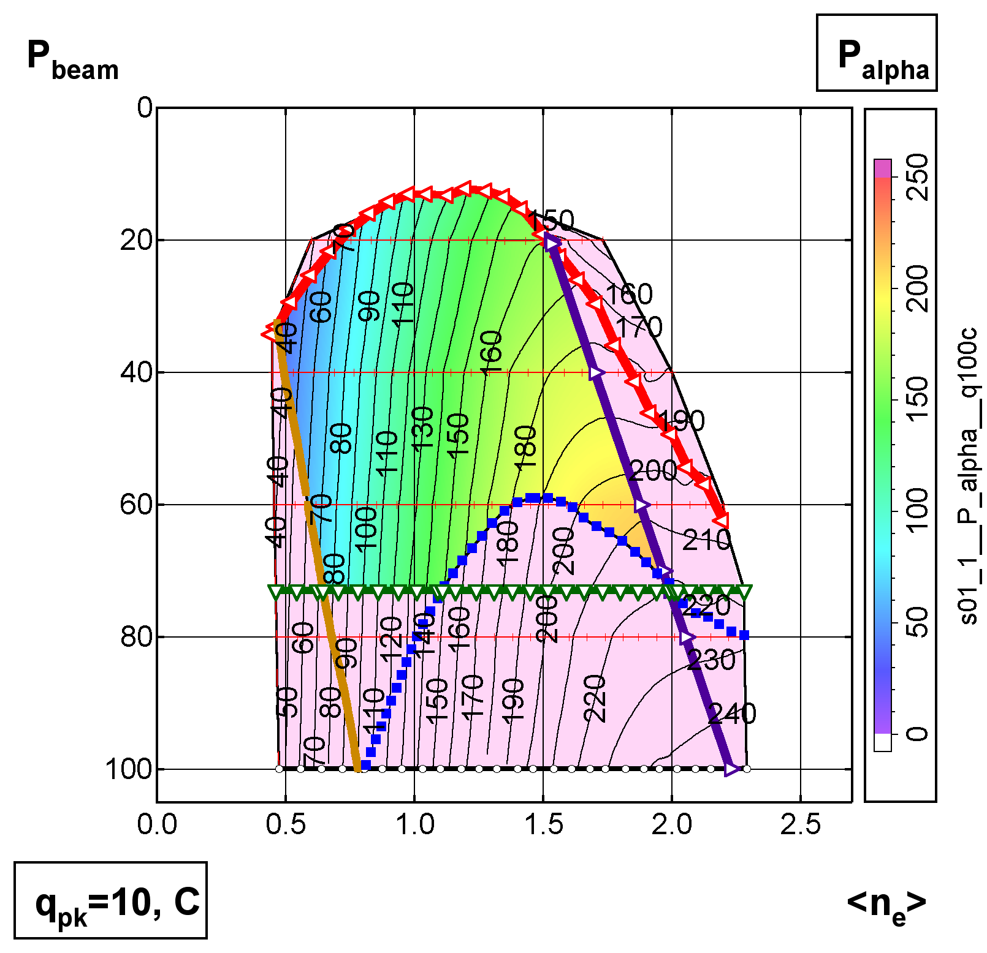
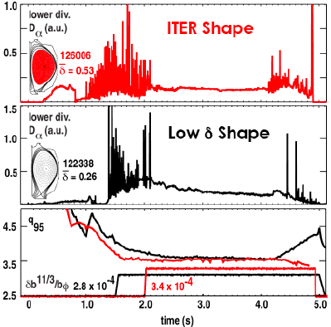
ITER Operation Space in H-mode
-> Integrated Plasma Model
ELM Control / Mitigation
  G. Pacher, H. Pacher, Y. Igitkhanov, M. Sugihara, G. Janeschitz
ELM Mitigation by edge ergodization
  by RMP coils
Q=5, LH transition, low temperature limit on alpha power, auxiliary power, edge density limit
  see foreseen ELM- coil layout below

Slide 26
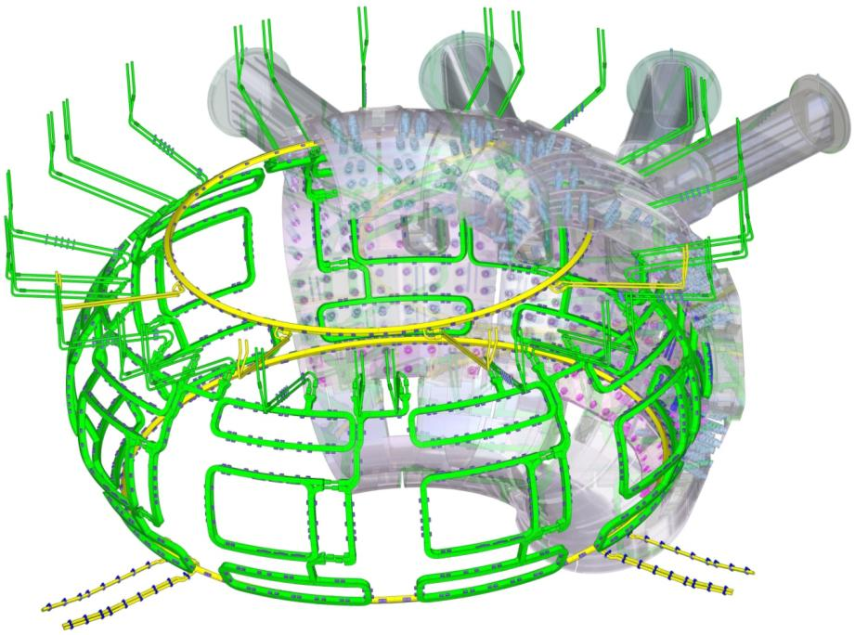
In-Vessel Coils for VS and ELM control
Purpose: Vertical Stability, ELM suppression
ELM Feeders
(27 sets in Upper Ports)
Upper VS Coil
Upper VS Feeders
(1 set in 4 upper ports)
ELM Coils
(3 per sector)
Lower VS Feeders
(2 sets in 2 lower ports)
Lower VS Coil
See also Lecture 2 ( D. Campbell) – H-mode

Slide 27
The Technological Challenges which had to be overcome
The resulting ITER Design
The ongoing Procurement - Construction

Slide 28
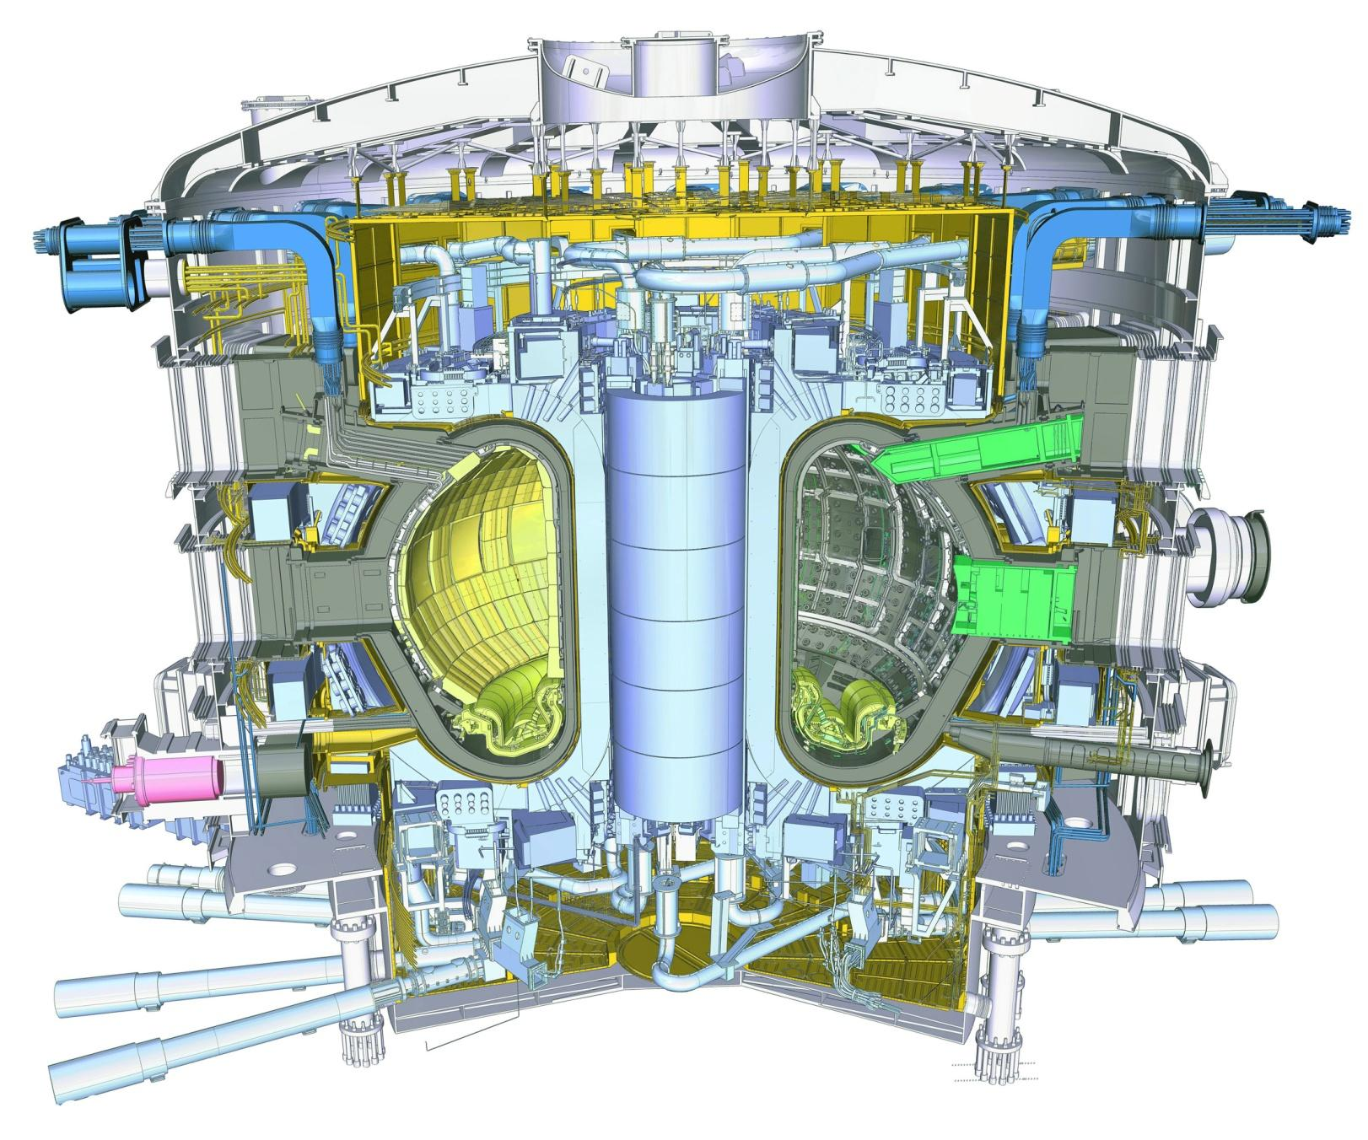

The ITER Tokamak (500 MW of Fusion Power)
Cryostat
(29 m high x 28 m dia.)
Feeders (31)
(NbTi)
Toroidal Field Coils (18)
(Nb3Sn)
Thermal Shield
(4 sub-assemblies)
Blanket
(440 modules)
Poloidal Field Coils (6)
(NbTi)
Vacuum Vessel
(9 sectors)
Feeders
(NbTi)
In-vessel Coils
Central Solenoid (6)
(Nb3Sn)
Divertor
(54 cassettes)

Slide 29
ITER Technology Challenges / Developments
The development of high field large superconducting magnets
  Requirements seemed unfeasible 20 years ago (ongoing / solved)
The development of Divertor High Heatflux Components
  A large step in development to achieve 20 MW/m² (ongoing / solved)
The development of Remote Maintenance
  Thought to be impossible by engineers from nuclear industry (ongoing / solved)
The development of the DT fuel Cycle
  A key for ITER and DEMO – a challenge up to today (ongoing / solved)
The development of Heating and Current Drive systems
  A challenge for all systems envisaged, not fully solved today
The development of ITER compatible Diagnostics
  A step from laboratory type systems to a reliability similar to space

Slide 30
Magnets

Slide 31
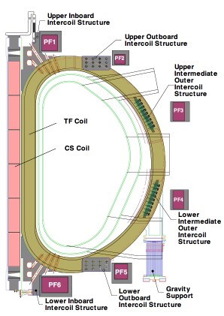
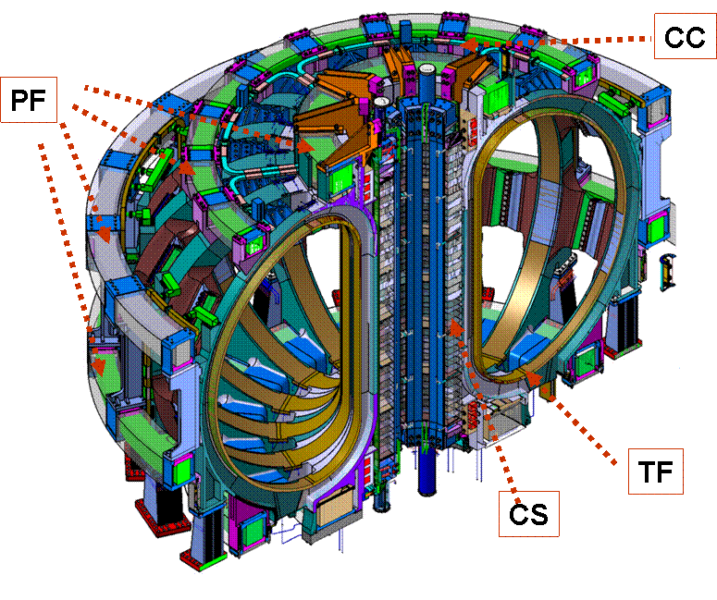
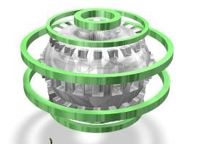
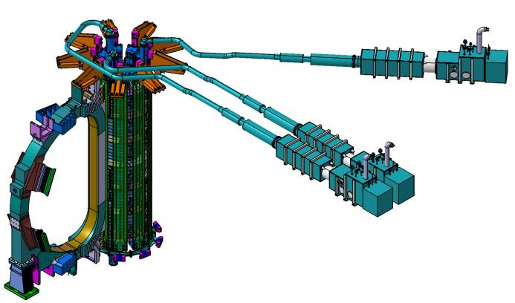
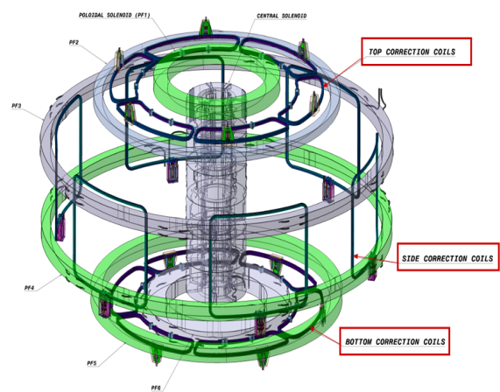
The ITERMagnet System
6 PF Coils (EU & RF)
18 TF Coils
(EU & JP)
Facts
- 48 superconducting coils (~9800 tons)
- 11.8 T (peak TF field)
- 68 kA (peak current)
- Stored energy – 51 GJ
Technical Challenges
- Large size
- Tight tolerances
- High field performance
- Conductor and magnet manufacturing
31 Feeders (CN)
CS Coils – Stack of 6 (US)
9 Pairs of Correction Coils (CN)

Slide 32
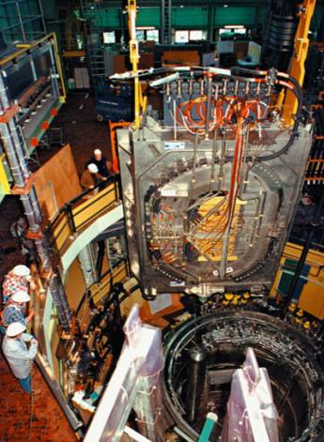
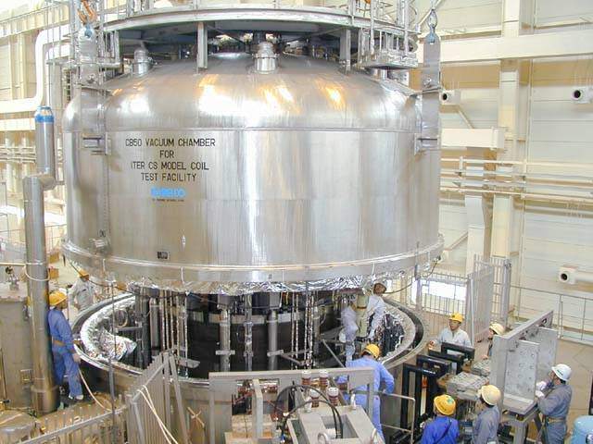
Magnet Development: Current-Field-Chart (Lorentz-Force)
Situation today – gives confidence to be able to built the ITER magnets
8
0
0
0
0
Situation at the beginning of the 90th
T
F
M
C
-
P
h
a
s
e
I
Phase II
7
0
0
0
0
TFMC = Toroidal Field
Model Coil
CSMC = Central Solenoid
Model Coil
T
F
-
I
T
E
R
6
0
0
0
0
]
A
T
F
I
C
[
5
0
0
0
0
C
S
M
C
4
0
0
0
0
Current
C
S
-
I
T
E
R
U
S
3
0
0
0
0
J
a
p
a
n
E
U
,
S
c
h
w
e
i
z
Superconducting coils
from earlier experiments
2
0
0
0
0
G
e
r
m
a
n
y
W
7
-
X
J
a
p
a
n
,
U
S
G
e
r
m
a
n
y
J
a
p
a
n
1
0
0
0
0
J
a
p
a
n
J
a
p
a
n
J
a
p
a
n
F
r
a
n
c
e
J
a
p
a
n
0
4
5
6
7
8
9
1
0
1
1
1
2
1
3
1
4
Field
[
T
e
s
l
a
]

Slide 33
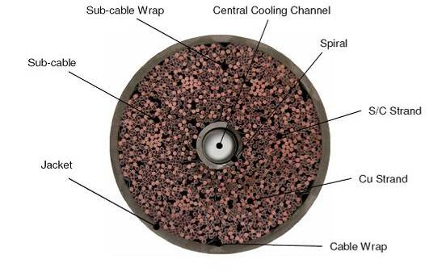
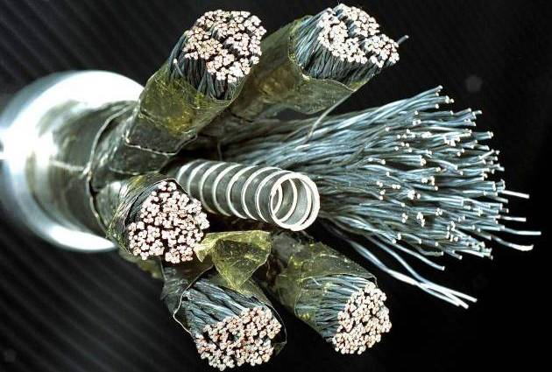
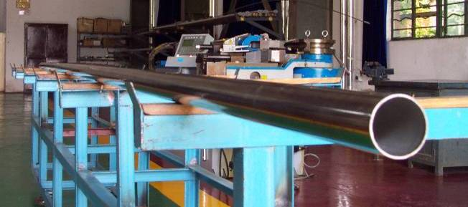
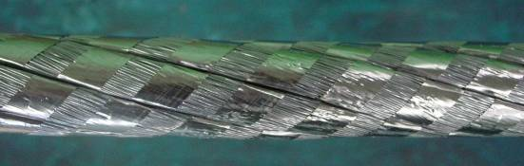
ITER Conductors
ITER coils are wound from Cable-In-Conduit Conductors (CICC’s), relying on superconducting multifilament composite strands mixed with pure Cu strands/cores.
Fakts:
~90 km / 400 t of Nb₃Sn conductor
(The biggest Nb₃Sn conductor procurement in history)
- ~150000 km of strand (15 x around Earth)
- Operates at ~5 K
- 11.8 T (peak TF field)
- 68 kA (peak TF current)
X-section of 70kA ITER TF Conductor (CEA)
Cooling Spiral
Final-Stage Cable
Stainless Steel Conduit
(NFRI)
(ASIPP)

Slide 34
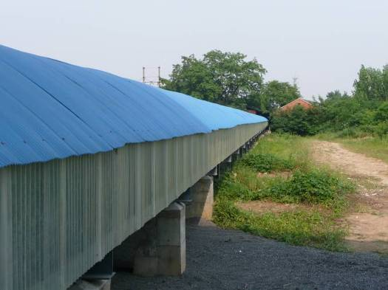
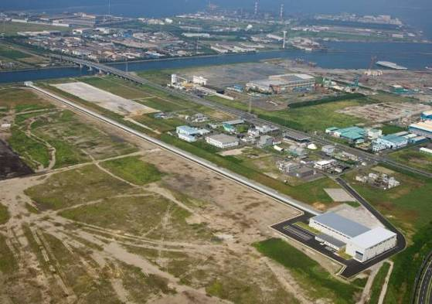
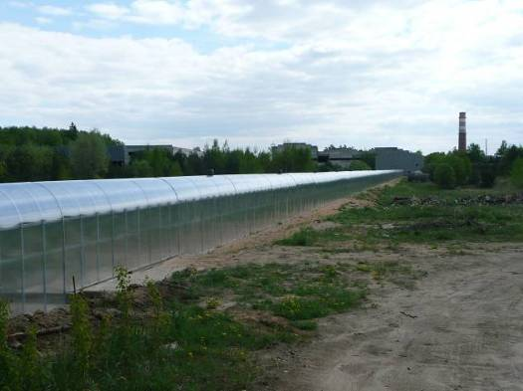
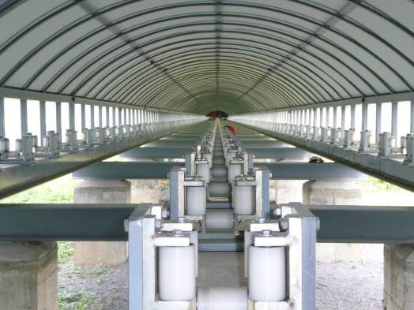
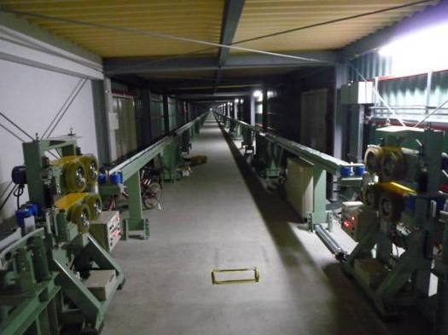
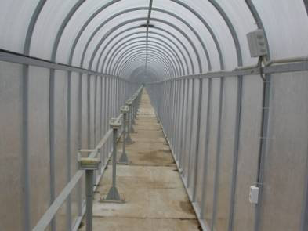
Jacketing Lines Status
CN, JA and RF have set up their jacketing lines; EU and US will award contracts in oncoming 2 months; KO is negotiating with JA.
CN Jacketing Line
at ASIPP
JA Jacketing Line
at NSE
RF Jacketing Line
at UNK

Slide 35
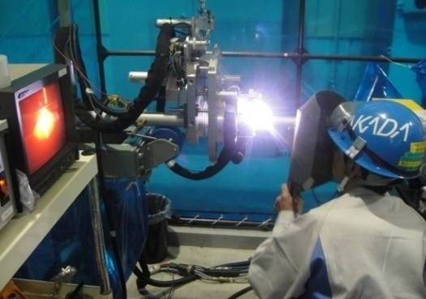
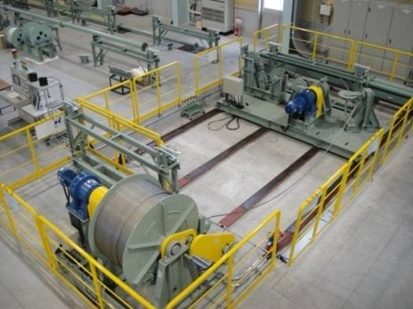
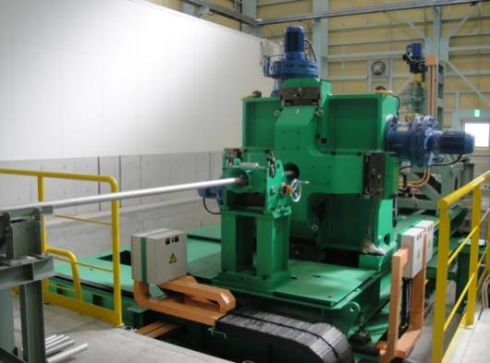
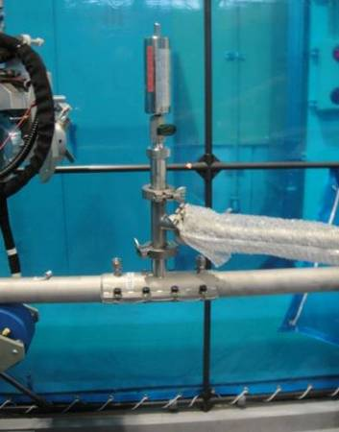
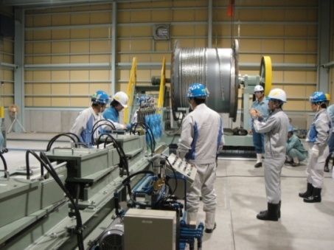
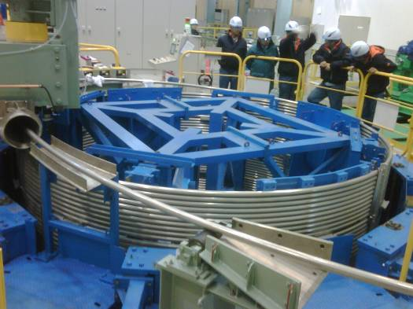
TF Conductor Production Status
JA has completed jacketing of 760 m Cu dummy cable and first three superconducting cables (100m and 2 x 420m).
Welding
& Leak Checking
Cable Insertion
Compaction
& Spooling
Notes:
35

Slide 36
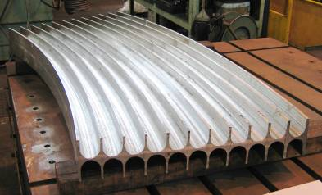
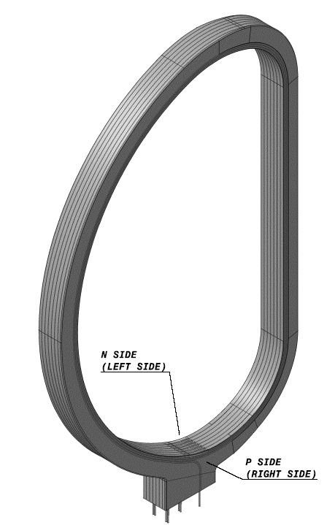
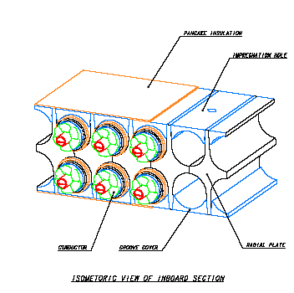
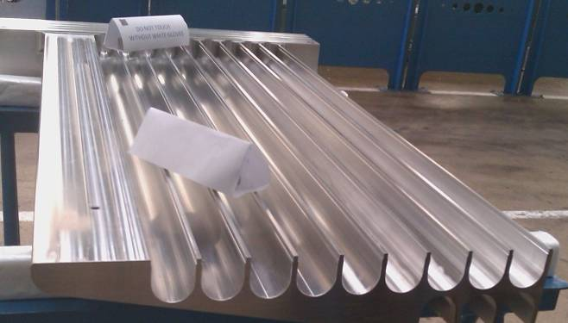
TF Coil Design (1)
Inner Leg Cross Section
Radial plate mock-up at CNIM
(Forged segments jointed by EB welding)
TF Winding Pack
TF – conductors are embedded in radial plates
force on isolation is only from one conductor and not from winding pack
second insulation around radial plates – double pancake
radial plates are embedded in a strong casing which provides the backbone of the machine

Slide 37
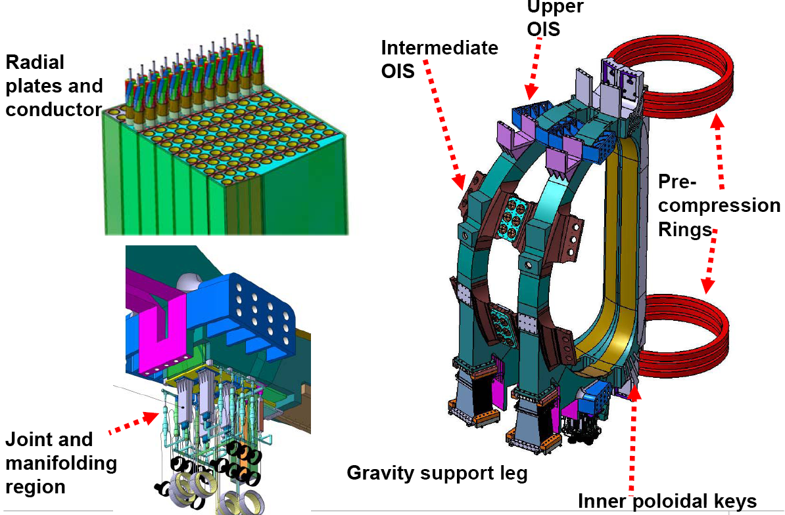
TF Coils Design (2)
~ 900 mm

Slide 38
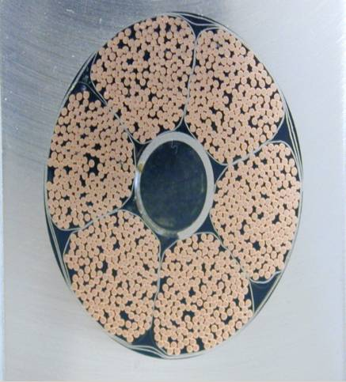
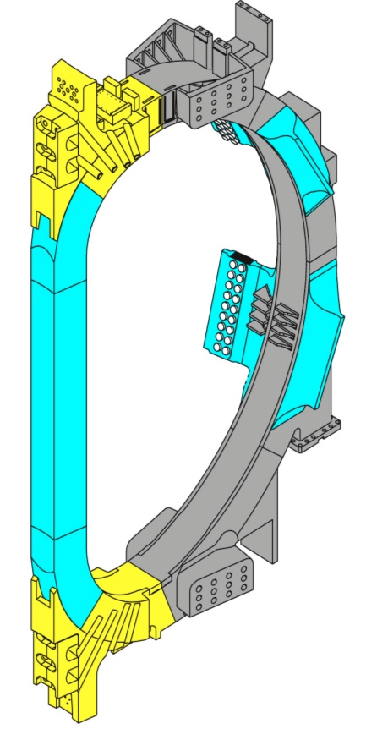
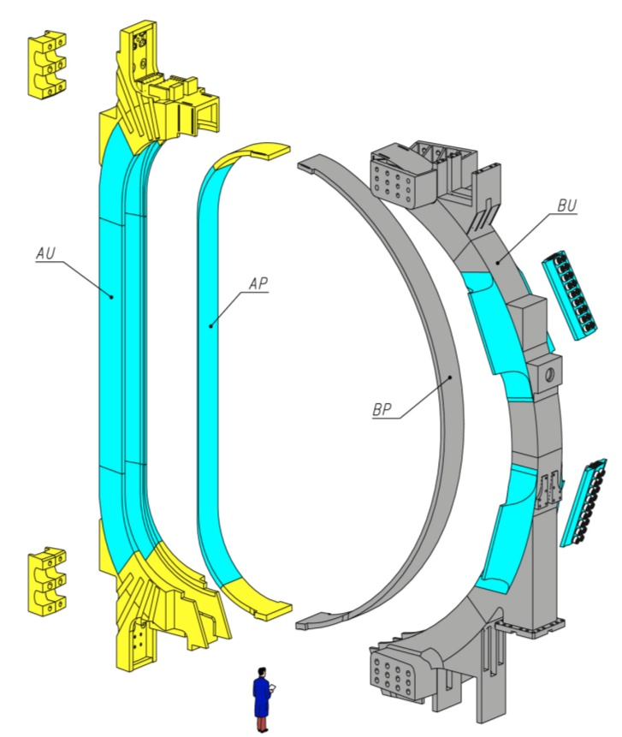
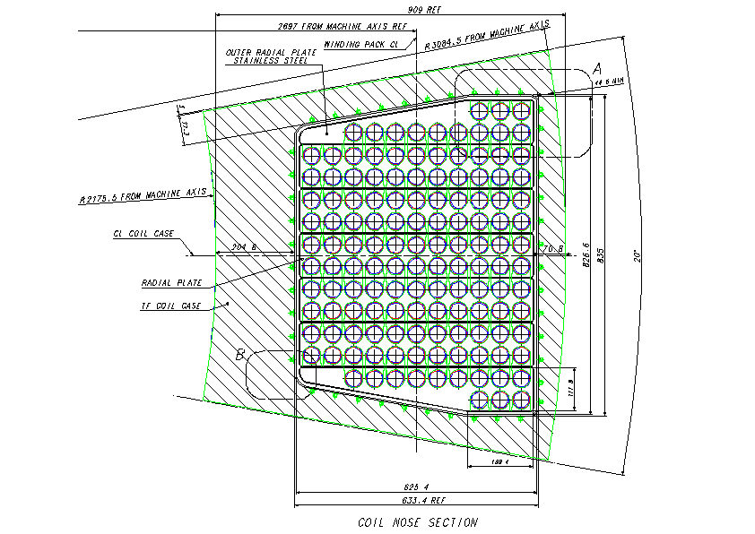
ITER Toroidal Field Magnets Manufacturing

Slide 39
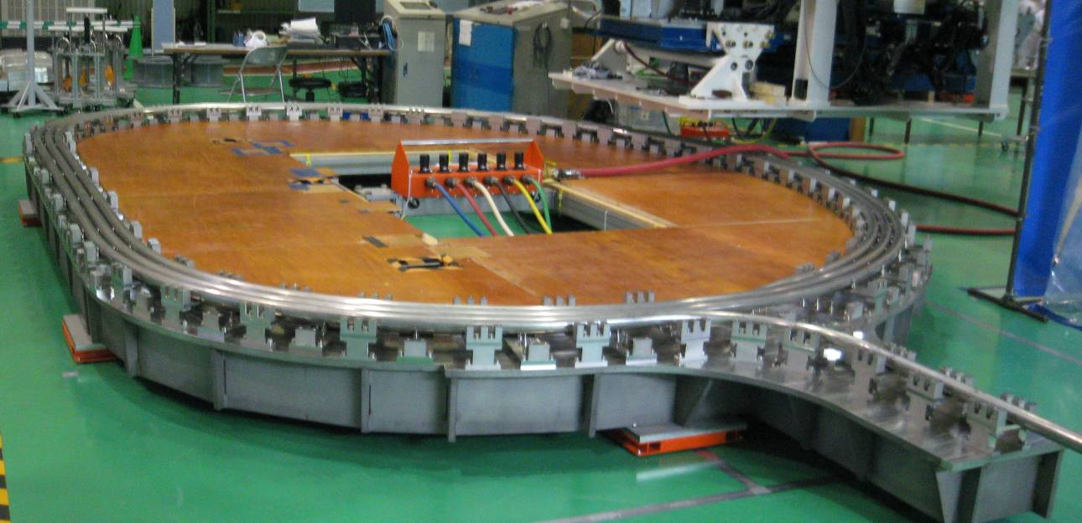
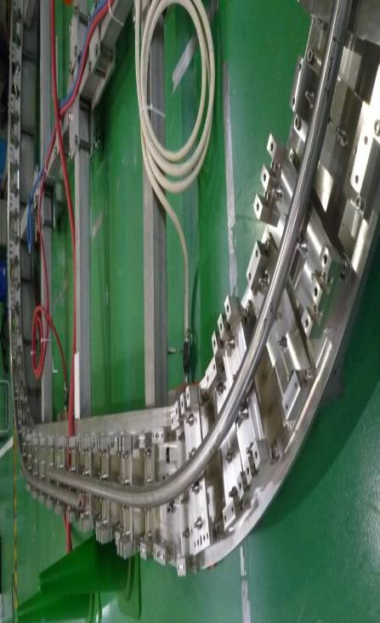
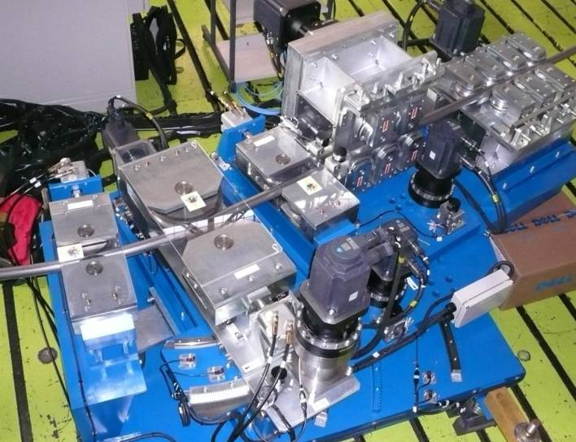
TF Coils Progress – JADA
Completed one third scale 3-turn winding trials at Toshiba
Winding Support Jig
Winding & Bending Rollers
Pictures courtesy JAEA & Contractor Toshiba
Notes:
39

Slide 40
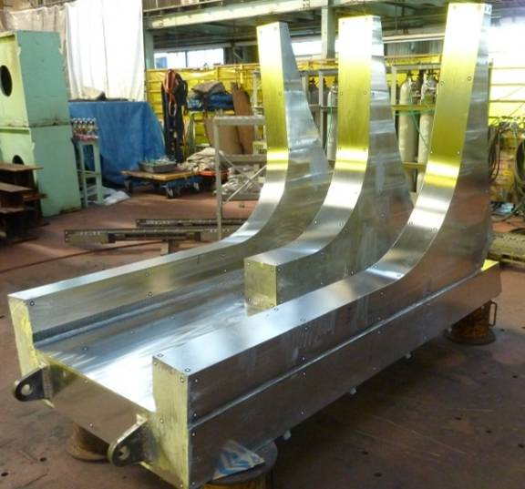
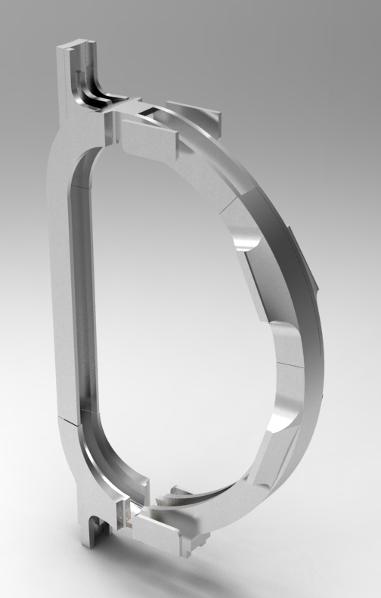

TF Coil Structures Progress – JADA
A1 Segment
Pre-compression Ring Flange
B3 Segment
Manufacturability study of large TF coil components by Toshiba and its sub-contractor KHI
Inter-coil Structure - Forging
Pictures courtesy JAEA & Contractors Toshiba & KHI
Notes:
40

Slide 41



TF Coils Progress (KHI-JA)
Welding Trials for attachment of
Pre-compression Ring Flange
to TF Coil Case
~ 900 mm
TF Coil Case Straight Leg

Slide 42


ITER Central Solenoid
Single CS module
Peak Field 12.5 T
CS Conductor

Slide 43



Poloidal Field Coils
Facts
• So big (23 m) must be manufactured on site!
• Building is 250 m long x 45 m wide and will be the first on site!
Terminals
Support clamps
Conductor
Winding
He inlets

Slide 44


ITER Magnets Feeders
CS Coil

Slide 45
Vacuum Vessel & In Vessel Components

Slide 46
Design inputs for VV and PFCs
Electromagnetic loads. During a plasma instabilities eddy currents are induced in the PFCs. These currents interact with the toroidal magnetic field thus resulting in extremely high forces applied to the PFCs. These forces (several MN) can generate mechanical stresses up to a few hundreds of MPa with a consequent strong impact in the design of the supporting structures.
Toroidal field
Poloidal field
Eddy currents
In PFCs
Plasma current

Slide 47


Vertical Displacement Events (VDE)
can cause large currents to flow through the blanket, divertor and VV
cause large vertical forces on the BL, Div, VV >150 MN
Plasma current in MA
Plasma radial position in m
Plasma vertical
position in m

Slide 48



VV Status
Facts
- First safety barrier for ITER
- SS 316 LN-IG
- ~5300 tons (VV, ports, shielding only)
- 19.4 m (63 ft) torus outer diameter
- 11.3 m (37 ft) torus height
ELM & VS Coils
(VV interfaces implemented)
Status
• VV sector and port PA’s signed (EU, KO, IN, & RF)
• KO - VV & port contract awarded to Hyundai Heavy Industries
• EU - VV contract awarded
• Manufacturing schedule is on critical path!!!
Technical Challenges
• Large Size
• Tight tolerances
• High quality components
• Part of safety boundary

Slide 49



Vacuum Vessel Prototypes
VV Mock-up of Electron Beam welding on the inner shell (EU Domestic Agency)
Mock-up of E-beam Welding for Key and
Blanket Manifold Support
(KO Domestic Agency & HHI)
Full Size Prototype of the ITER Vacuum Vessel (2001) (JA Domestic Agency)
Notes:
49

Slide 50


VV Assembly Scheme, In Wall Shielding, VV-Support
- The space between the double walls of the VV is filled with in-wall shielding (IWS), which is mainly made of an austenitic stainless steel containing 1-2% weight boron to improve the neutron shielding efficiency.
Triplet #1
Reference
Triplet
VV-Support
Triplet #2

Slide 51

Principal in-vessel components
First wall/blanket → heat exhaust, impurity management, nuclear shielding
Be
Carbon fibre composite (CFC) and W
Divertor → particle
and heat exhaust

Slide 52


In Vessel System Integration

Slide 53




In Vessel System Integration
Electrical Straps
Integrate ELM/VS Coils and Blanket Manifolds
Flexible attachments

Slide 54

ITER Thermal Load Specifications: resumé
Steady state:
q|| ~ 8 MWm⁻², λ_{q||} > 4.0 cm
q|| ~ 24 MWm⁻², λ_{q||} > 2.5 cm (ELMs)
Disruptions
q|| ~ 45-120 MJm⁻², λ_{q||} > 20 cm
t = 3.0-6.0 ms
VDE (up):
q|| ~ 70-270 MJm⁻², λ_{q||} > 3.0 cm
t = 1.5-3.0 ms
Radiation:
SS: 0.5 MWm⁻²
(photon+CX)
Disruptions
TQ: ~0.5 MJm⁻²
t ~ 1 ms (mitigated)
CQ: ~0.9 MJm⁻²
t ~ 10 ms
Start-up:
q|| ~ 25 MWm⁻², λ_{q||} ~ 5.0 cm
Several seconds
Confinement transients
q|| ~ 250 MWm⁻², ~2-3 secs
Start-up and rampdown:
q|| ~ 40 MWm⁻², λ_{q||} > 1.2 cm
Several seconds
VDE (down):
q|| ~ 90-300 MJm⁻², λ_{q||} > 3.0 cm

Slide 55





A generic shaping solution
Inboard
BM #1-6
Central column
HFS start-up
Toroidal & poloidal shaping
Top
BM #7-10
Secondary divertor region
Toroidal & poloidal shaping
Outboard
BM #11-18
Outboard
LFS start-up/ramp-down
Toroidal shaping

Slide 56





First wall: blanket modules (BM)
Two main components
Neutron shielding:
Semi-permanent massive Shield Block (SB): ~3.5±0.5 tonnes
0.5 m
1.4 m
1.0 m
Plasma-facing surfaces: separable shaped First Wall (FW) Panel
Armoured with Be tiles
Total number of BMs: 440
Total mass: ~1800 tonnes
All water cooled

Slide 57


The first ITER divertor – now in procurement phase
54 divertor assemblies (~8.7 tonnes each)
4320 water cooled heat flux elements
Bakeable to 350°C
Cost > €100 million
Must sustain steady heat fluxes of ~10 MWm²
Guarantee sufficient He exhaust and retention of impurities

Slide 58




Vertical target monoblocks
Inner target
59184 CFC monoblocks
193,428 W monoblocks
No front surface shaping on first divertor.
27-32 mm
W
8
12 mm
Toroidal gaps:
CFC: 1.0 mm (max)
W: 1.3 mm (max)
28-30 mm
CFC
20 mm
15
Poloidal gaps:
CFC: 0.7 mm (max)
W: 1.0 mm (max)

Slide 59





Divertor Qualification Prototypes
CFC Armoured Areas
  1000 cycles at 10 MW/m²
  1000 cycles at 20 MW/m²
W Armoured Areas
  1000 cycles at 3 MW/m²
  1000 cycles at 5 MW/m²
All the 3 Domestic Agencies have qualified

Slide 60
Plasma transients – biggest threat to ITER
Disruptions & VDEs
ELMs
Worst case full energy disruptions → peak energy densities on the divertor of 5.0-20 MJm⁻² on timescales of 1.5-3 ms (thermal quench)
“Natural” ELMs expected to expel ~6% of W_{plasma} at 1-2 Hz → peak energy densities on ITER divertor of 2-10 MJm⁻² on timescales of 250-500 μs
Current quench: runaway electron currents up to 12 MA with 10-20 MeV in localised areas on timescales of a few 10’s of ms
No material can tolerate these energy densities → reliable ELM and disruption avoidance and mitigation mandatory

Slide 61


Divertor Target Behaviour under ELM Loads
Thermal exposure at QSPA facility (RF)
Pre-heating of samples at 500 °C
60 degree inclination
Plasma pulse duration: 500 μs
Peak absorbed energy density: from 0.5 to 1.5 MJ/m²
Total number of simulated ELMs: 100 cycles
CFC erosion starts at > 0.6 MJ/m² (~1µm/pulse at 1 MJ/m²)
Tungsten cracking occurs at > 0.2 MJ/m²; melting of tile edges at > 0.4 MJ/m2

Slide 62
Remote Maintenance & Hot Cell, Assembly

Slide 63



ITER Remote Handling / Hot Cell
PBS 23-5
NB RH
PBS 23-6
Hot Cell RH
Hot Cell
building
Tokamak
building
PBS 23-3
Transfer cask

Slide 64


Cask & Plug Handling System – Cask transfer

Slide 65

Blanket RH System
Rail Support Equipment and Module Transporter
Rail Support Equipment
Vehicle Manipulator
Cable Handling
Equipment
Transfer frame for Cable Handling Equipment
Tractor
Module / Tool transporter
Rail
Payload: 7ton - (max. 10 ton at limited location)
Reach: 1.3 – 3.8m from the rail center - Rail location: R6.2m from machine center

Slide 66



Blanket Handling – Transfer Casks
IVT Cask
BM transport
Intermediate Cask
Rail
Rail connecting
equipment
Vehicle manipulator
Vehicle fixing arm
Sliding beam
Rail positioning arm
Tractor
IVT deployment
Rail storage table
Cask base Plate

Slide 67


Full scale 180° rail deployment test (1998)
RH system for blanket has shown its ability to perform the job
Some issues remain
2 decades of development to provide demonstration of feasibility and reliability
In-port rail connection
2008-2009

Slide 68



Divertor Handling – Divertor RH System
Toroidal Subsystem
Radial Subsystem

Slide 69

Hot Cell Facility layout level L1
The import / export facility,
The docking station of transfer casks to the red zone,
The reception/cleaning workstations,
The refurbishment workstations (port plugs, TBM, other vacuum vessel components),
The testing workstations (port plugs, TBM, other vacuum vessel components),
The buffer storage for port plugs,
The HCF remote handling preparation, decontamination and repair area;
Link to Neutral Beam cell.

Slide 70


Hot Cell RH System – Building Overview – B2/B1
Hot Remote Handling Test Facility
Rad waste RH
Equipment
Cask park
(partial)
IVT TESTING
Scope of Hot Cell RH System
Procurement Package
Cask
maintenance

Slide 71



Machine Assembly
TF Coil / Sector Assembly
~1400 ton
Status
• Detailed assemble plans developed
• Assembly tool PA signed with Korea
Tokamak and Assembly Building

Slide 72
Summary of Lecture 3 (14th April 2011)
ITER is a political as well as a high tech Project
  Makes the execution more difficult and more expensive
A Tokamak Reactor is a highly integrated machine
  Everything is linked – Physics and Technology
  Difficult to separate into different systems
  Even more difficult to procure systems in different countries
ITERs technology has been developed during last 2 decades
  Every part is underpinned by R&D and qualification prototypes
Manufacturing has started for Major Tokamak Systems
In Lecture 4 peripheral Systems and DEMO Technology will be presented

