Slide 1
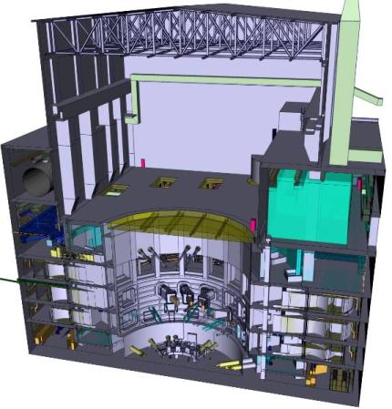
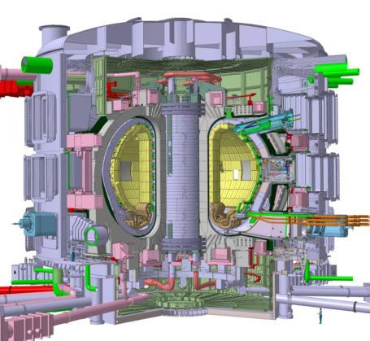
Fusion Technology Part 2
Status of the ITER Project
Further Development towards DEMO
(ITER at CERN Lecture 4)
Scientific Lectures
CERN
15. April 2011
Guenter Janeschitz
ITER Organization, Route de Vinon, CS 90 046 13067 St Paul Lez Durance Cedex, France
Notes:
1

Slide 2
Outline Lecture 4 (15th April 2011)
Fusion Technology, Challenges, ITER Design continue
  Cryostat and Thermal Shield
  The D-T Fuel Cycle
  Plasma Heating Systems and Plasma Diagnostic Systems
  The Cryo system
Status of the ITER Project
Which Technologies are needed for a DEMO Reactor
  The T- Breeding Blanket & a He Cooled Divertor
  Structural and Functional Materials for the In Vessel Components
  Improvements in H&CD, in RH, and possibly in Magnets
What if Mankind needs Fusion Faster ?
  The Apollo like program – the Ultra Fast Track to Fusion Energy
Summary

Slide 3
Cryostat and Thermal Shield

Slide 4
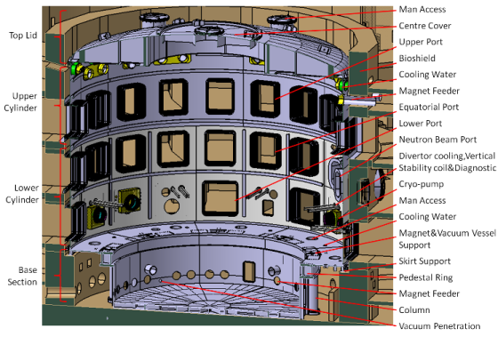
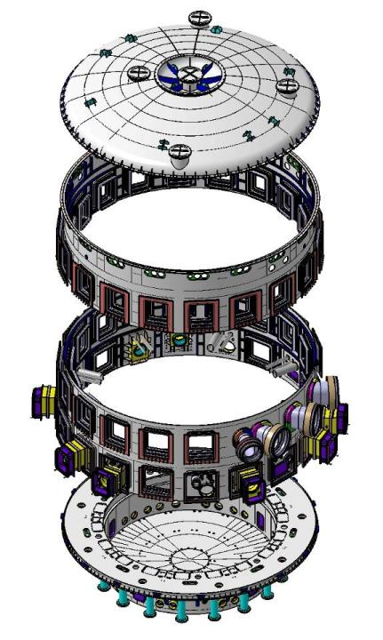
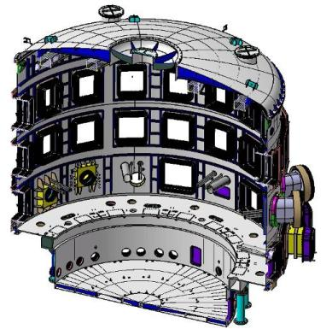
The ITER Cryostat Design
ITER Cryostat forms a vacuum tight container, surrounding the entire Tokamak Basic Machine.
It provides the vacuum insulation environment for the operation of the superconducting magnet systems and thermal shield system
Diameter | 29.2 meters
Height | ~29 meters
Weight | ~3300 tons
Operation Pressure | < 10⁻⁴ Pa
Structure Material | Type 304 & 304L
Accident Pressure | 0.2 MPa
Cryostat within Bio-shield
3D View of ITER Cryostat
Cryostat sub-assembly
Cryostat (Section view)

Slide 5
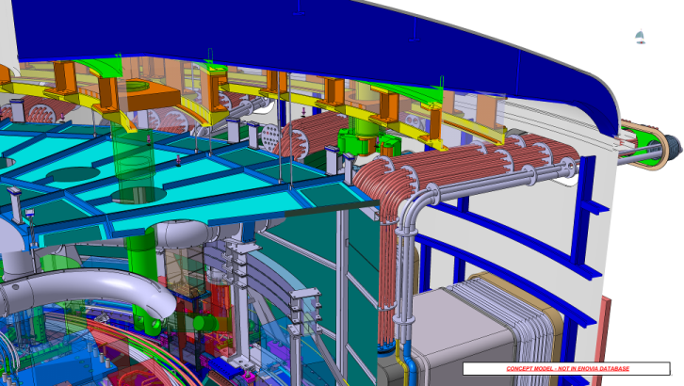
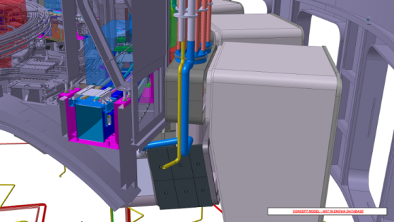
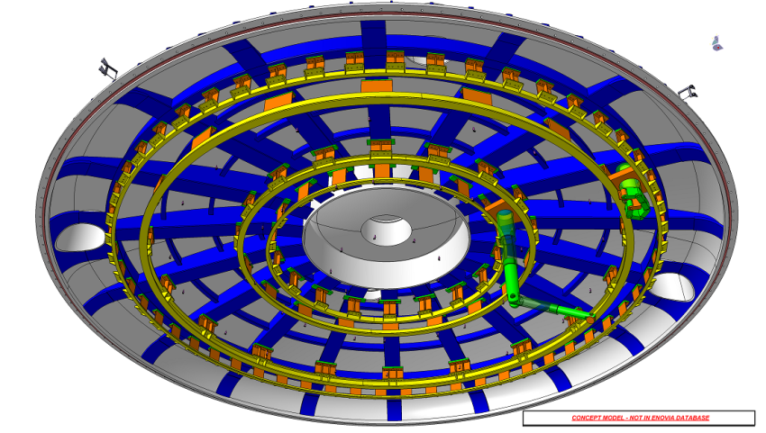
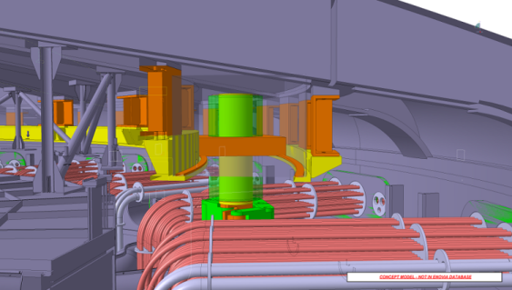
Integration and Maintenance inside the Cryostat Top part
Hands-on maintenance operations to be performed from Cryostat top lid via access points (semi-remote tools needed to handle the components on top and at side walls) as well as on the bottom through openings in the cryostat lower section, tools supported on thermal shield base

Slide 6
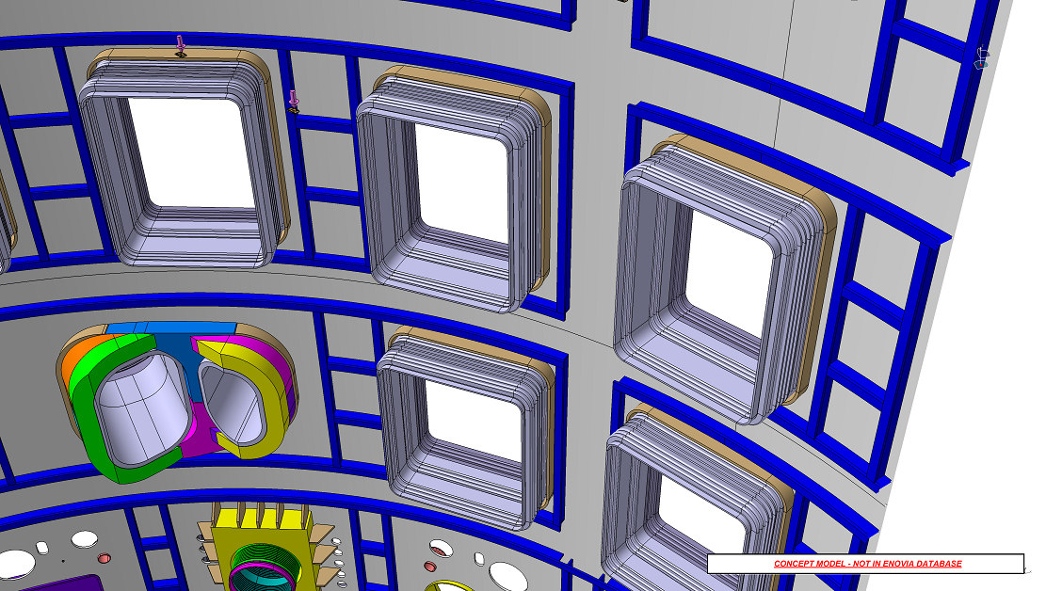
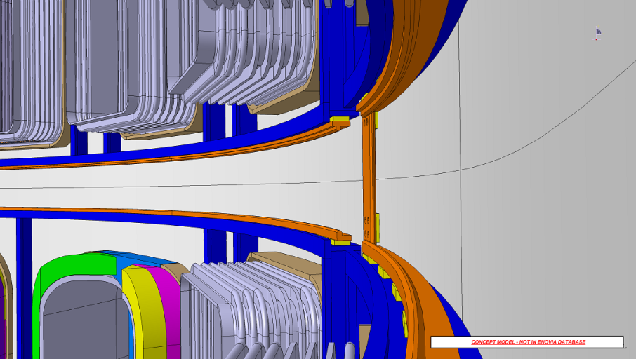
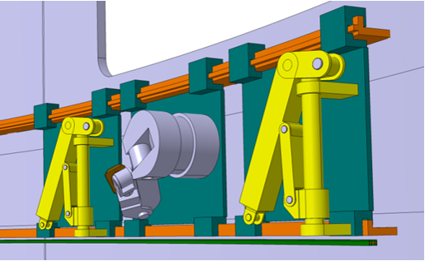
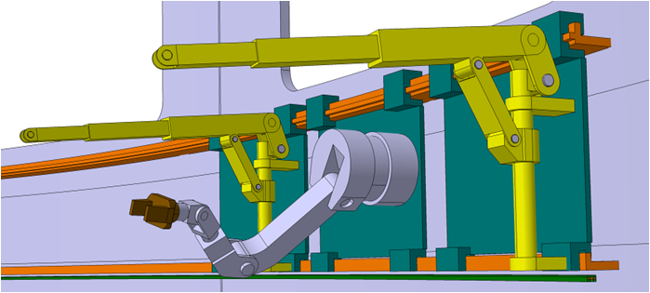
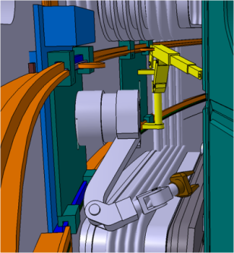
Maintenance concepts Equatorial Cryostat

Slide 7
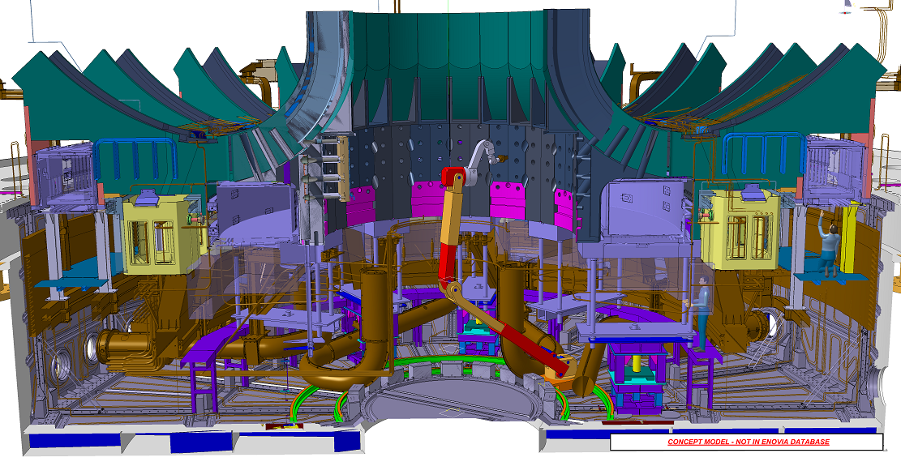
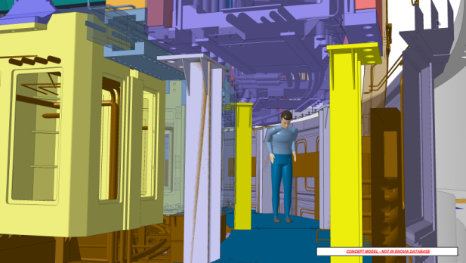
Maintenance concepts Lower Cryostat

Slide 8
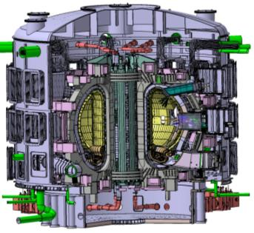
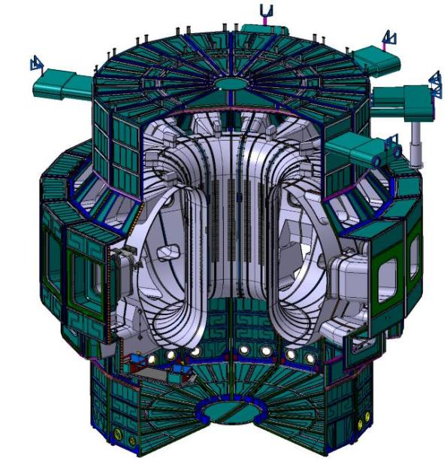
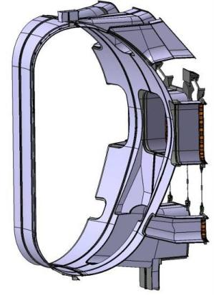
Thermal Shield Status
Facts
- Operation at 80 K (He cooled)
- SS 316 LN-IG
- ~880 tons
- 28 m outer diameter
- 23 m tall
Status
• PA signed with Korea in May 2010
• Drawings for VV TS issued August 2010
• Drawings for cryostat TS to be issued in 2011

Slide 9
The D-T Fuel Cycle

Slide 10
The Inner and Outer Fuel Cycle of Fusion Reactors
Technically most suitable fusion reaction
is the one between deuterium and tritium
  D + T→ ⁴He (3.5 MeV) + n (14.1 MeV)
  Deuterium from natural water (0.016%)
  Tritium must be imported (limited)
  or bred internally from lithium
    Breeding reactions in a fusion reactor
      n + ⁶Li → T + ⁴He or n + ⁷Li → T + ⁴He + n
  56 kg tritium is required per GW year
  of fusion power
  About 100 g tritium is produced per
  year in a standard CANDU fission unit
  For ITER tritium will be imported
      20 to 25 kg tritium will be available worldwide for operation of ITER

Slide 11
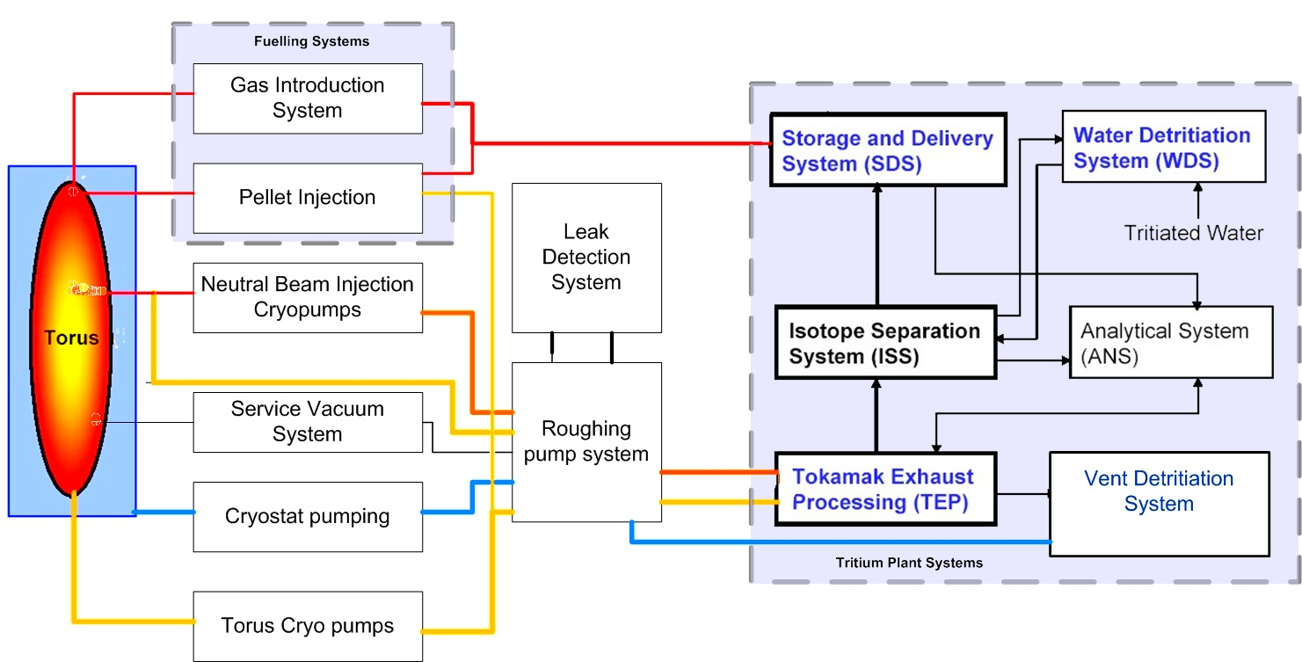
The ITER Closed Tritium Deuterium Loop
T recycling 100 kg / a; 20000$ / g; 1 billion / a
Apart from the cryogenic guard vacuum – exhausts are centralized and controlled

Slide 12
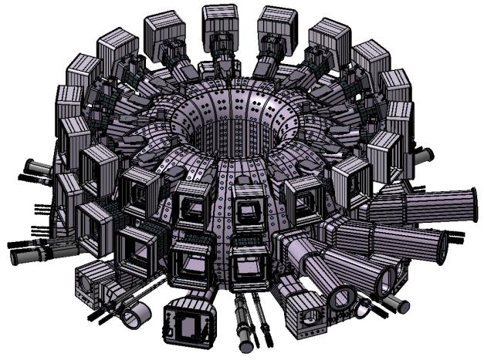
Fuelling Systems and their Toroidal Distribution
Fusion Power Shutdown System (FPSS) for neon injection at 2 upper ports
ITER Vacuum Vessel
with 44 Ports
4 upper ports and 3 divertor ports for Gas Injection (GI)
3 divertor ports for Pellet Injectors (PI, total of 6 casks)

Slide 13
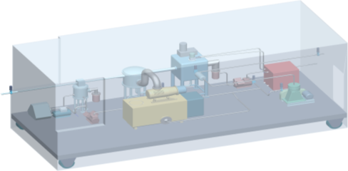

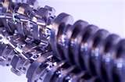
Outline Flow Diagram of the Pellet Injection System
Guard vacuum
Liquid D₂/T₂ enters twin extruder at triple point temperature (~20K) on top & cooled to ~14K at the nozzle end to produce D₂ and T₂ ice
P
V_{extr} = 25 cm³
1-3 bar
P
Microwave
cavity
P
Selector
30 bar
250mbar-L/s
30 mbar-L/s
2nd stage
ballast tank
P ~ 0.1 mbar
30 bar
CP
500L/s
300mbar-L/s
P
Fuel
P
V2
3L/s
P
D₂/T₂
0.9 bar
Compressor
P
V1
CP
1000 L/s
15 m³/h
D₂
0.9 bar
Compressor
6000 m³/h
250 m³/h
3 L/s
Propellant
P
500 mbar-L/s at ~1bar
DT Supply
Microwave
Cavity
Pellet Injector
ITER Vacuum
Vacuum
Cryocooler
Compressor
Roots and
Screw Blower
Propellant
Compressor

Slide 14
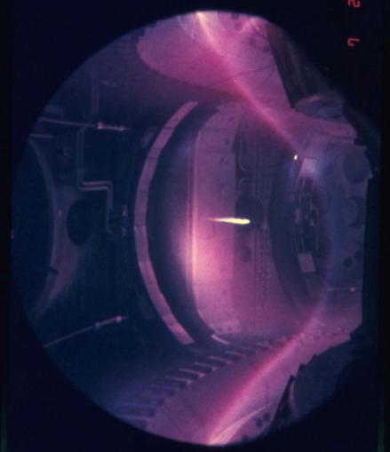
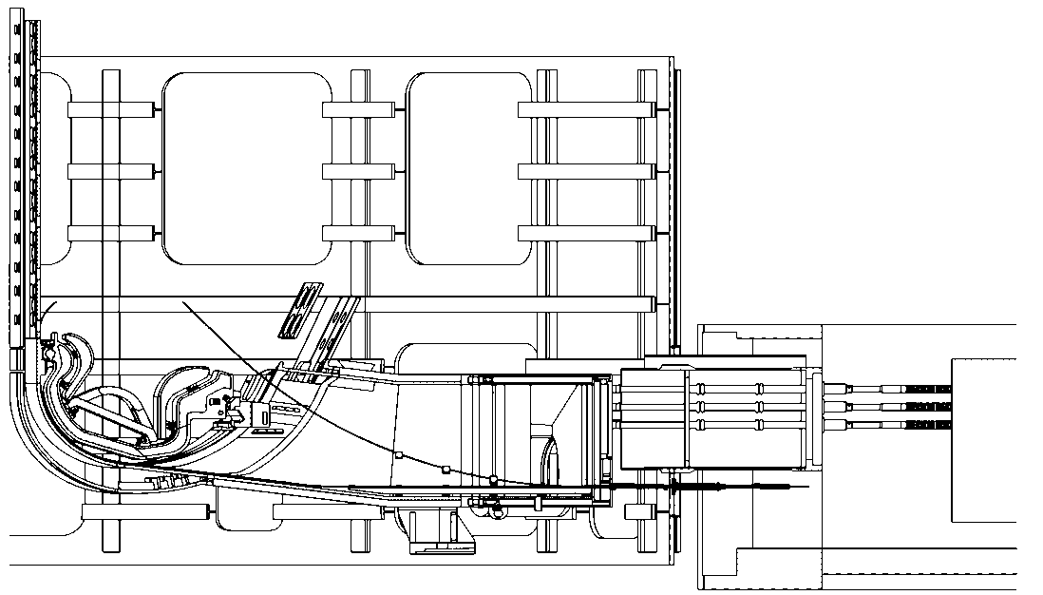
Pellet Injection Flight Tube Layout
HFS flight tube (mainly for plasma density control through core fuelling)
LFS flight tube/trajectory (mainly for ELM pacing)
Pellet in ASDEX

Slide 15
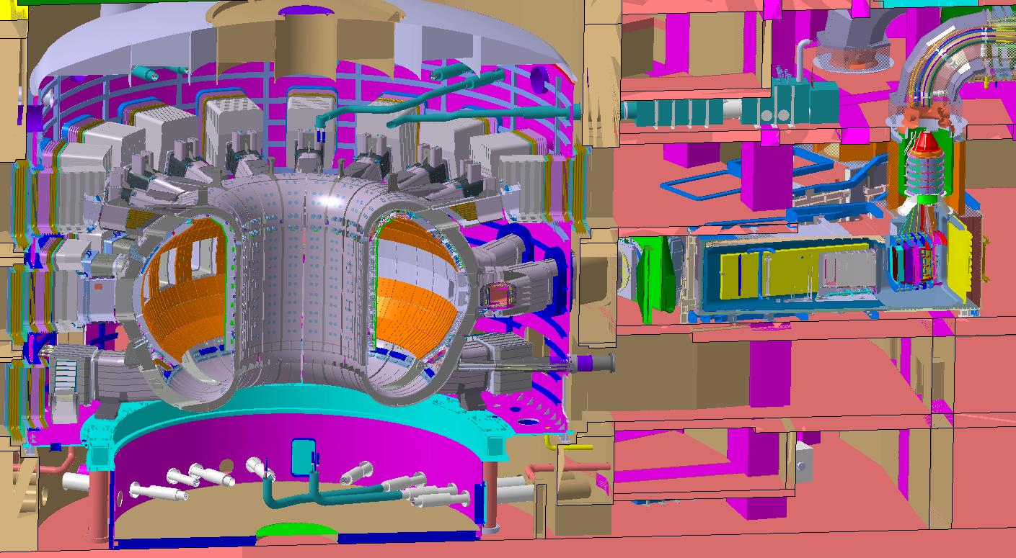
ITER Vacuums
  Cryostat vacuum( <10⁻⁴ Pa) 8500 m³
  Torus vacuum(~10⁻⁶ Pa) 1330 m³
  Neutral Beam vacuums(~10⁻⁷ Pa) 860 m³ ( for 4)
  Cryogenic Guard Vacuum
  Service Vacuum System (Inc diagnostics)
  ICRH and ECRH Vacuums

Slide 16
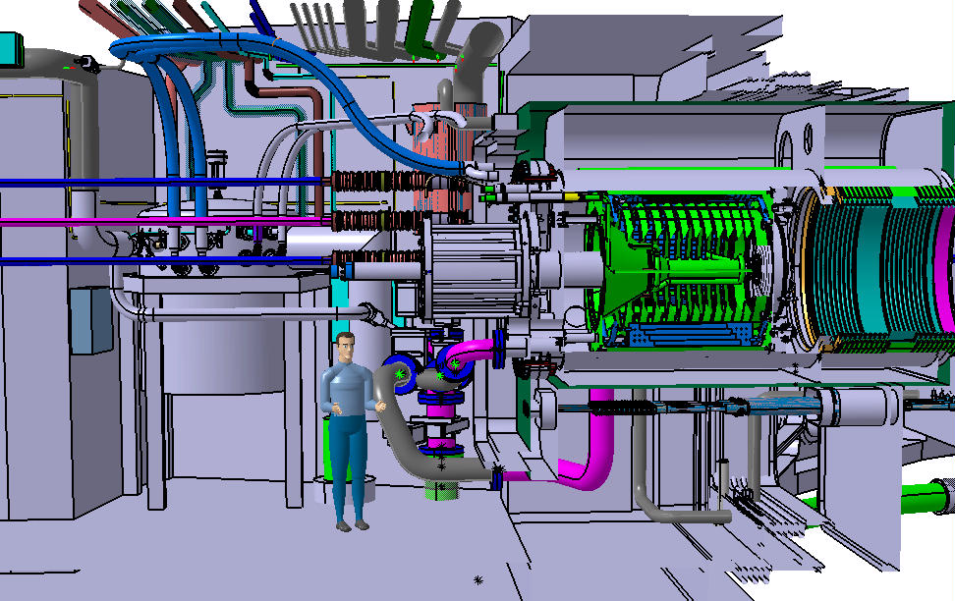
Torus and Cryostat Cryopumps Integration in Port Cell

Slide 17
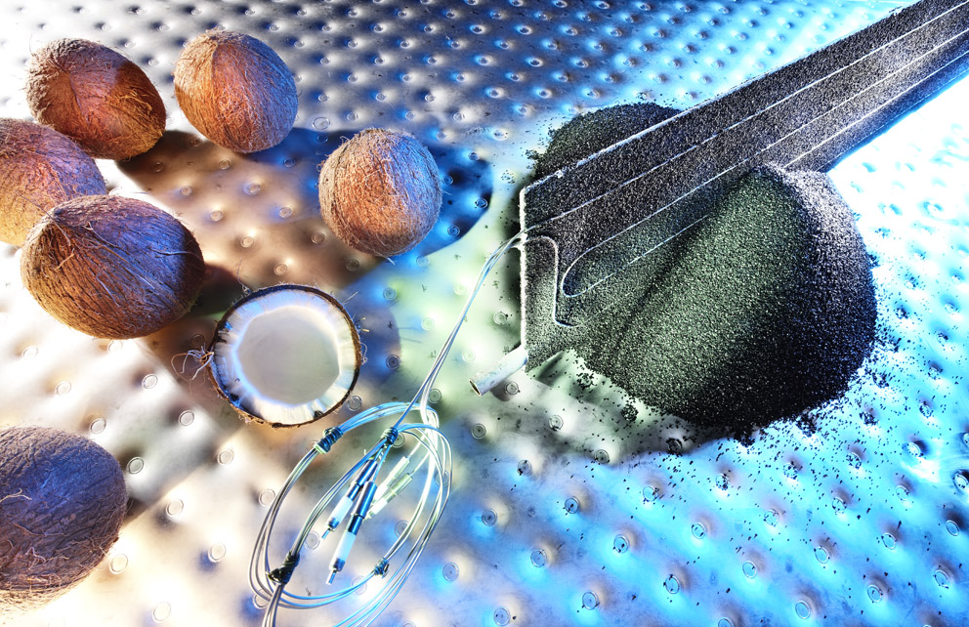
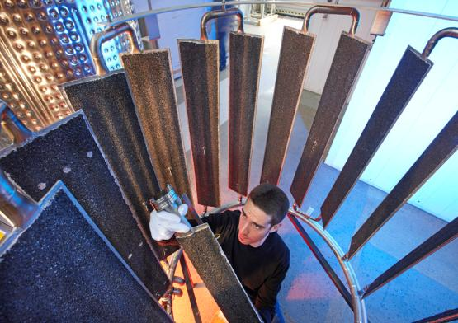
Cryopumps Utilise Activated Charcoal for Helium Pumping

Slide 18
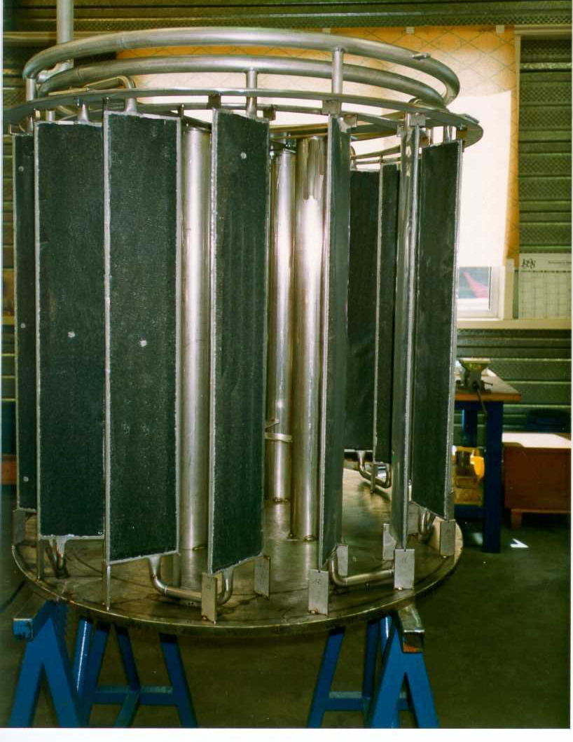
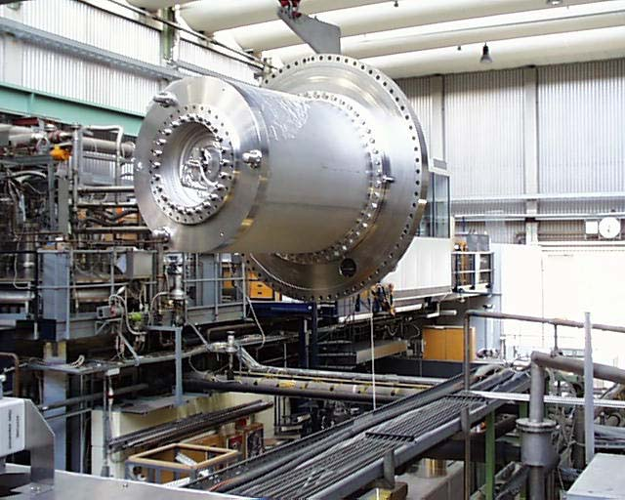
ITER Torus Cryopump
Prototype tested in FZK
4.5 K Panels

Slide 19
Torus Cryopumps Fast Cyclic Operation during Operation
Pump No | Dwell |  |  |  | 3000 second pulse time intervals of 150 seconds |  |  |  |  |  |  |  |  |  |  |  |  |  |  |  |  |  |  |  | Dwell
 | 77 | 78 | 79 | 80 | 1 | 2 | 3 | 4 | 5 | 6 | 7 | 8 | 9 | 10 | 11 | 12 | 13 | 14 | 15 | 16 | 17 | 18 | 19 | 20 | 21 | 22 | 23 | 24 | 25 | 26 | 27 | 28 | 29 | 30 | 31 | 32 | 33 to 76 | 76
18d | HR | W | E | CD | P | P | P | P | HR | W | E | CD | P | P | P | P | HR | W | E | CD | P | P | P | P | HR | W | E | CD | DP | DP | DP | DP | DP | DP | DP | DP | DP | DP
5b | DP | HR | W | E | CD | P | P | P | P | HR | W | E | CD | P | P | P | P | HR | W | E | CD | P | P | P | DP | HR | W | E | CD | DP | DP | DP | DP | DP | DP | DP | DP | DP
6d | DP | DP | HR | W | E | CD | P | P | P | P | HR | W | E | CD | P | P | P | P | HR | W | E | CD | P | P | DP | DP | HR | W | E | CD | DP | DP | DP | DP | DP | DP | DP | DP
13b | DP | DP | DP | HR | W | E | CD | P | P | P | P | HR | W | E | CD | P | P | P | P | HR | W | E | CD | P | DP | DP | DP | HR | W | E | CD | DP | DP | DP | DP | DP | DP | DP
1b | DP | DP | DP | DP | HR | W | E | CD | P | P | P | P | HR | W | E | CD | P | P | P | P | HR | W | E | CD | DP | DP | DP | DP | HR | W | E | CD | DP | DP | DP | DP | DP | DP
4d | DP | DP | DP | DP | P | HR | W | E | CD | P | P | P | P | HR | W | E | CD | P | P | P | P | HR | W | E | CD | DP | DP | DP | DP | HR | W | E | CD | DP | DP | DP | DP | DP
7b | DP | DP | DP | DP | P | P | HR | W | E | CD | P | P | P | P | HR | W | E | CD | P | P | P | P | HR | W | E | CD | DP | DP | DP | DP | HR | W | E | CD | DP | DP | DP | DP
12d | DP | DP | DP | DP | P | P | P | HR | W | E | CD | P | P | P | P | HR | W | E | CD | P | P | P | P | HR | W | E | CD | DP | DP | DP | DP | HR | W | E | CD | DP | DP | DP
P Pumping, SB Stand by, DP Dwell pumping, HR Helium recovery, W Warm up, E Evacuation, CD Cool down
Maximum fueling rate of 200Pa/m³/s for 400 second pulse

Slide 20
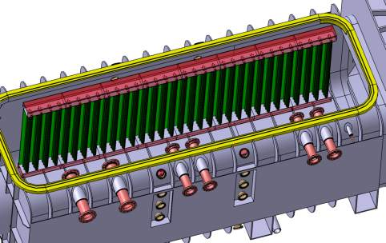
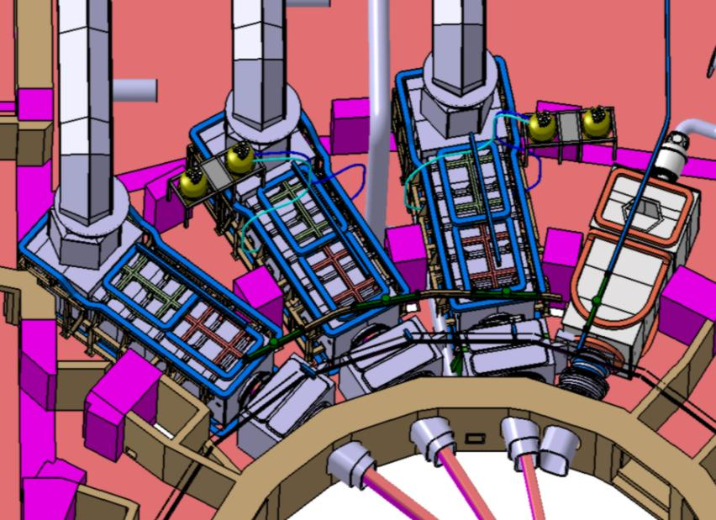
Heating and Diagnostic Beam Cryo-Sorption Pumping
HNB Pumping Speed:-
H₂ - 4650 m³/s
D₂ - 3700 m³/s
HNB Gas Flow:-
H₂ operation (870KeV) 48 Pam³/S
D₂ Operation (1MeV) 23 Pam³/S

Slide 21
Cryopumps distribution
for the 4.5 K circuit
From/to
cryoplant
LP1
Supply
Torus/Cryostat cryolines
NB cryoline
LP2
to cryoplant
or 470K heater.
Supply ≈5 bar / ≈4.7-4.8 K to :
- Cryopumps Cool down
- Possibility of PIS normal operation
By-pass
JT
Cold helium Recovery only for Torus and Cryostat cryopumps
ACB
Cryopump
Bath
Cold
Compressor
NB
CRY
TOR
PIS
Circulating
Pump
Corrugated pipe vacuum isolated outside the cryolines
- Warm up / Cool down line for Torus / Cryostat / NB cryopumps
PIS normal operation
6 – 100 K
100 – 6 K
* No cold helium recovery for the NB (T exhaust = 6.5 K)

Slide 22
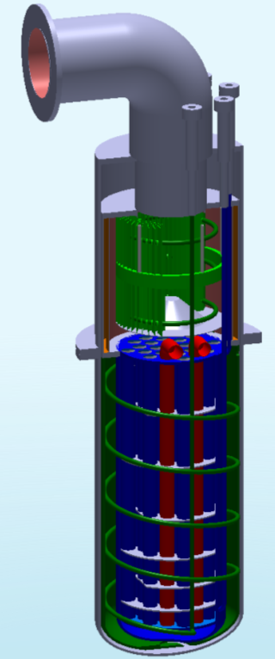
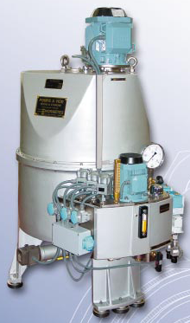
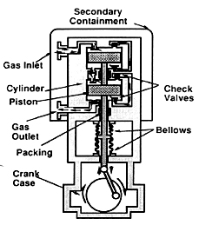
Vacuum Systems Roughing Pumps
Pump Inlet
Height ~2 m
Diameter ~0.5m
Volume ~ 0.17 m³
Toyo (Mikuni)
Piston Pump
He separated from plasma exhaust
Condensation pumping stage
Normetex
Scroll Pump
Cryogenic Viscous Compressor (CVC) utilizing
cryo-condensation of deuterium and tritium
  Helium is compressed to a roughing pump
  Deuterium and tritium is released at
  pressures up to atmospheric during
  regenerations to a roughing pump

Slide 23
Block Diagram of the ITER DT Fuel Cycle

Slide 24
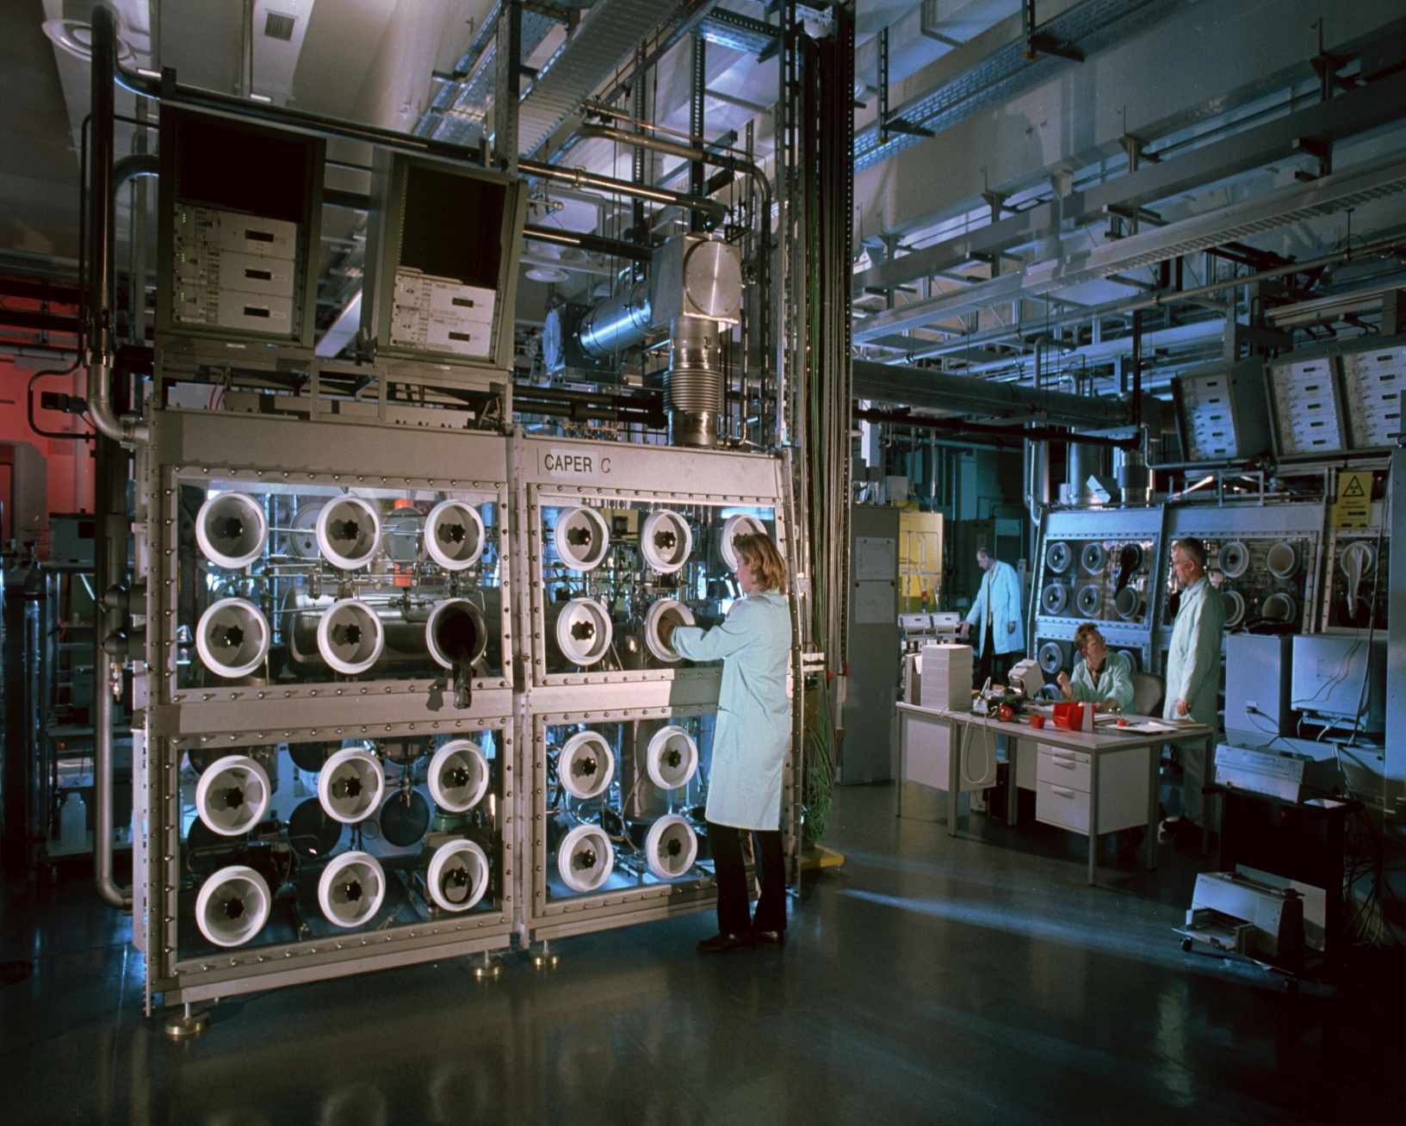
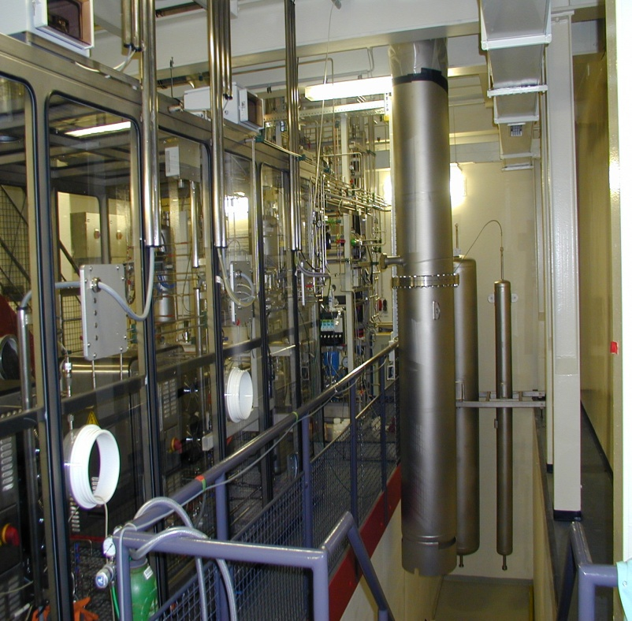
Typical T-plant glove Box – gas cleaning

Slide 25
Tritium Plant Building Systems Layout
7 Floors
  2 below
  grade
L = 80 m
W = 25 m
H = 35 m
Release
point elevation:
60 m
  Tokamak building height: 57 m

Slide 26
Plasma Heating Systems
Plasma Diagnostic Systems

Slide 27
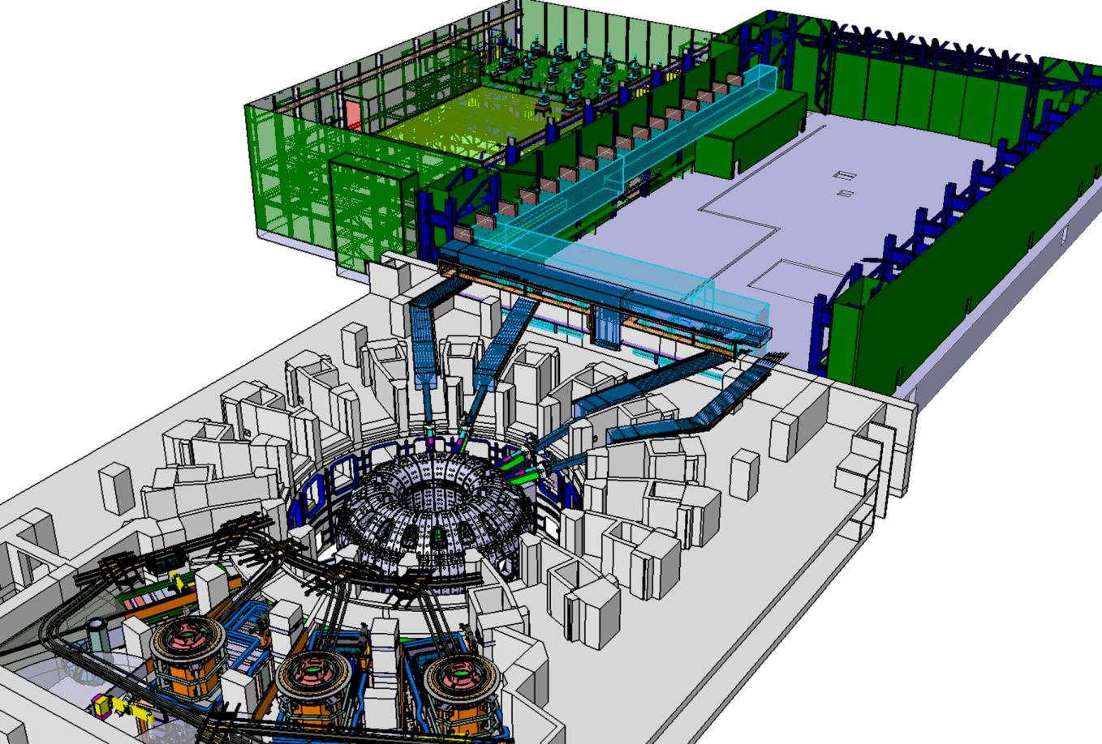
Overview of the 70 MW ITER heating systems
IC & EC power supplies & sources
IC & EC waveguides
20 MW each
Neutral beam injectors in NB cell (32 MW)

Slide 28
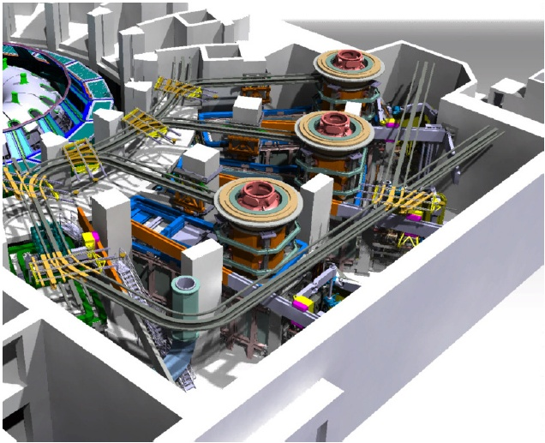
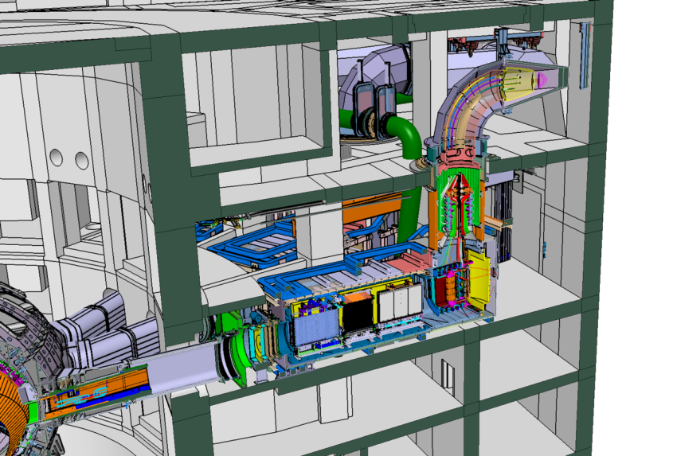
ITER – N-Neutral Beam Injection systems
First of its kind; hence a Neutral Beam Test Facility in Padua:
100kV ion source test bed (beg. 2014)
full size HNB injector test bed
(end 2016)
2 N-NBIs
P_{beam} = 16.5 MW
I = 40 A
V = 1 MV
T_{pulse} = 3600 s
60 GJ to be delivered to the plasma
by each beam
1MeV neutrals implies negative ions for efficient neutralisation (60%)
Notes:
28

Slide 29
Neutral Beam Injector
The Injector can be separated in
beam components (Ion Source, Accelerator, Neutralizer, Residual Ion Dump and Calorimeter)
other components (cryo-pump, vessels, fast shutter, duct, magnetic shielding, and residual magnetic field compensating coils)
9m
HNB Injector
~1000t
15m
5m

Slide 30
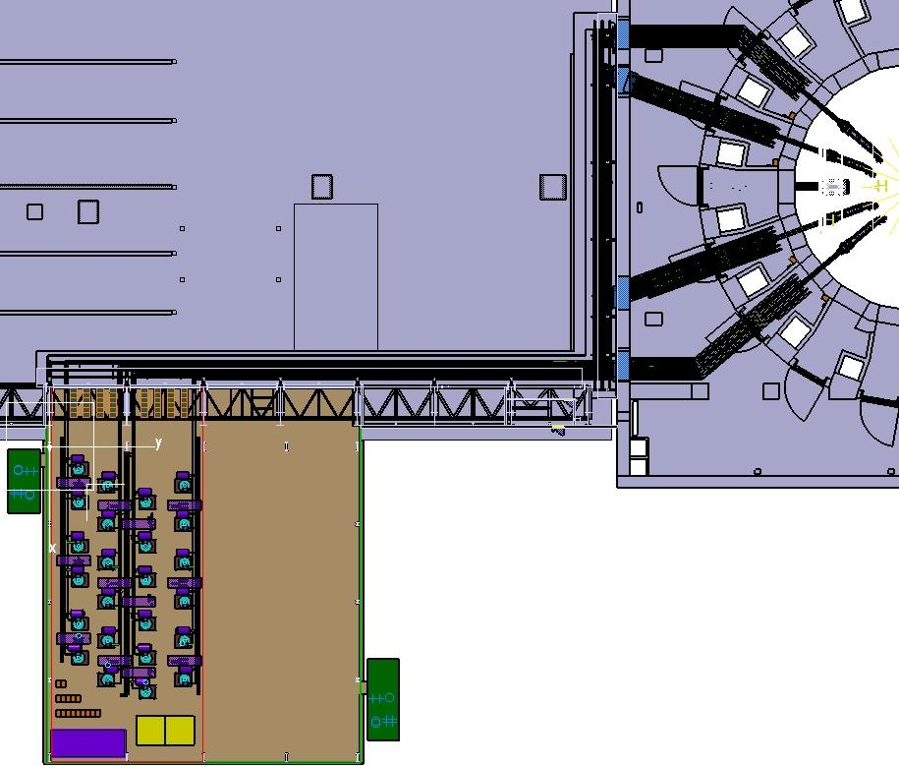
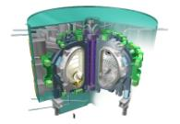

Electron Cyclotron H & CD System
Main Functionalities:
Provide auxiliary heating (20MW) to assist in accessing H mode and achieve Q=10.
Provide steady state on-axis and off-axis current drive in the range of 0<ρ_{T}<0.5.
Control MHD instabilities by localized current drive.
Assist initial breakdown and heat during current ramp-up.
Assembly Hall
Tokamak
Building
Launchers
Transmission Lines
Gyrotrons
Upper Launcher
Switch
to upper port
Switch
Polarizer
MB
Diamond window
RF
Building
Isolation valve
DC break
to equatorial
port
DC break
& Taper
BPS
(APS)
MHVPS
Frequency: 170 GHz
Power Supplies
Equatorial Launcher

Slide 31
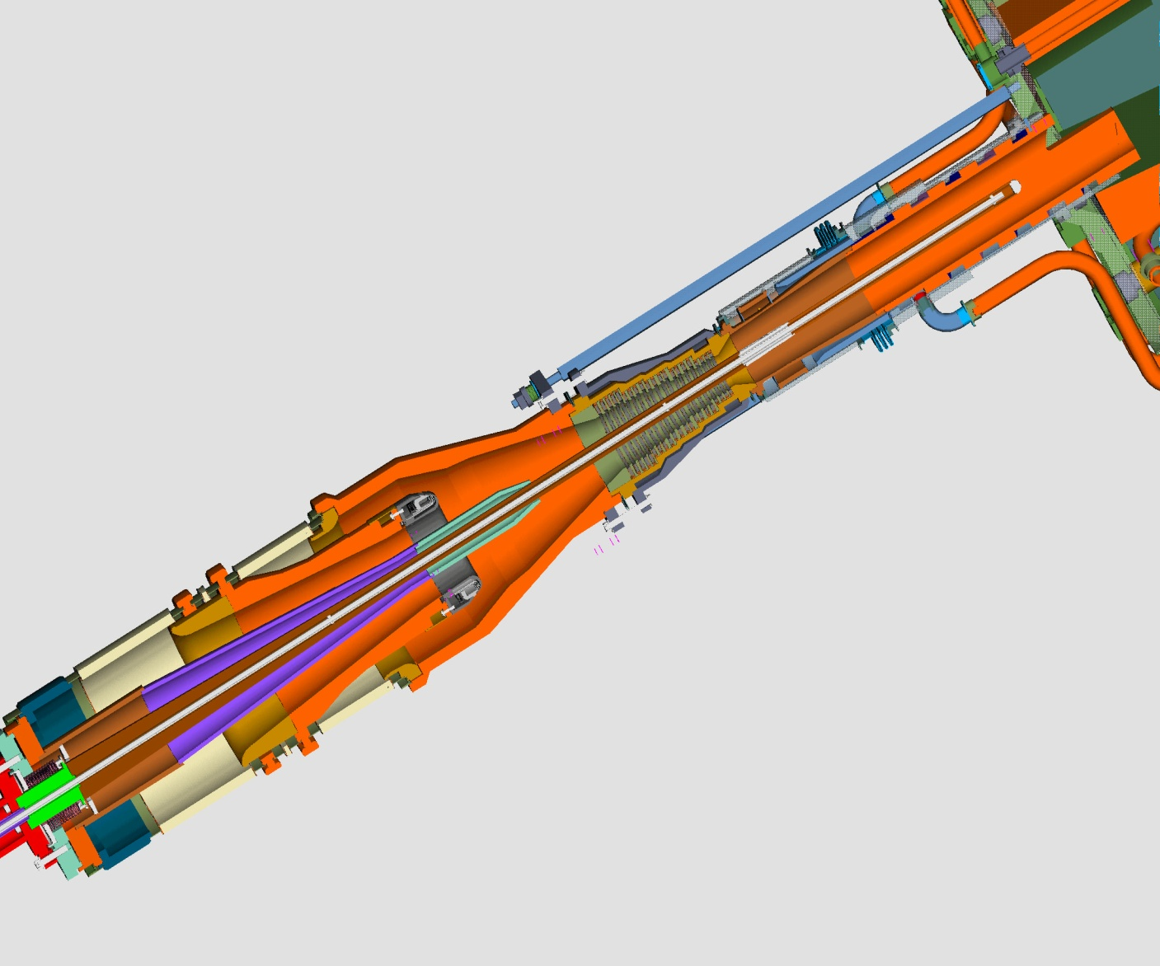
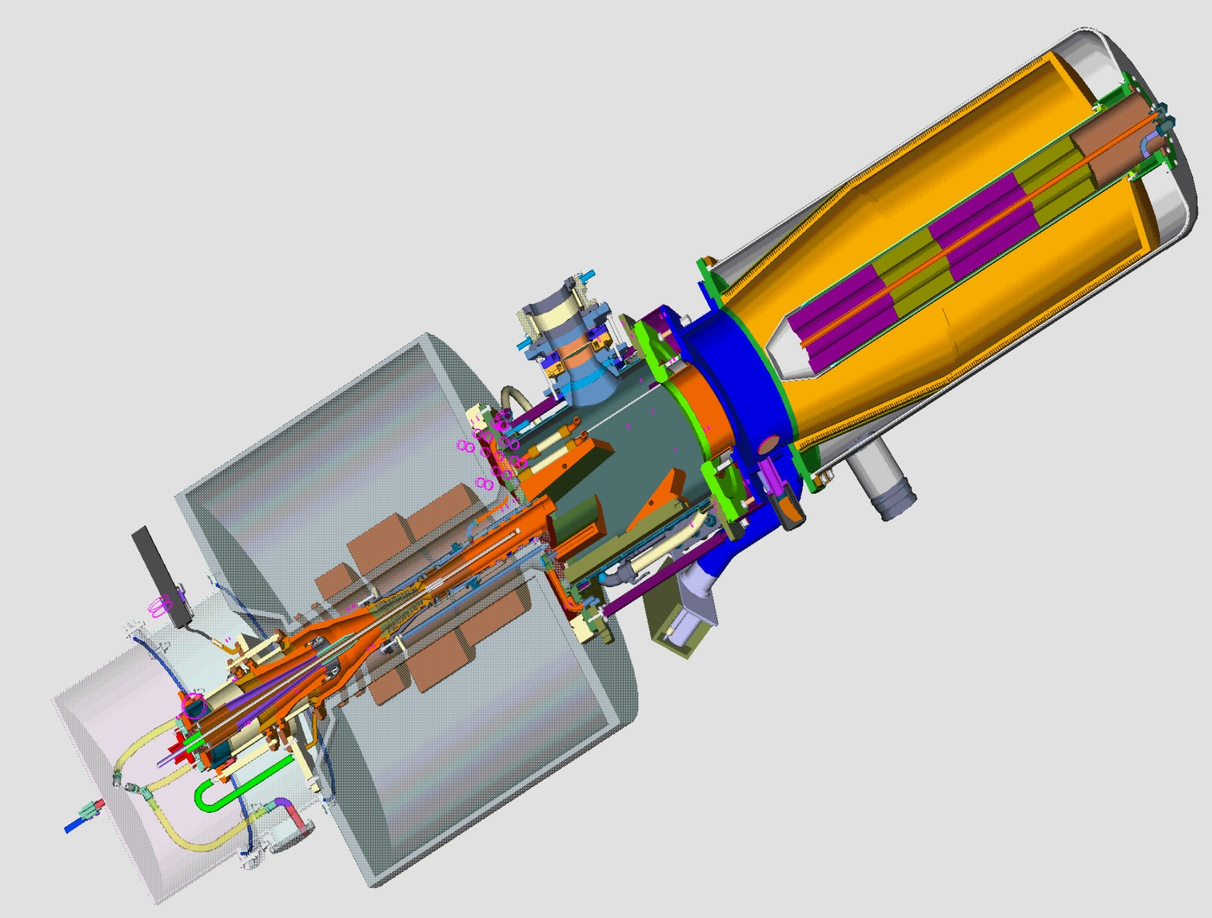
ECRH: 170 GHz 2 MW Gyrotron Development
Gyrotron with superconducting
magnet

Slide 32
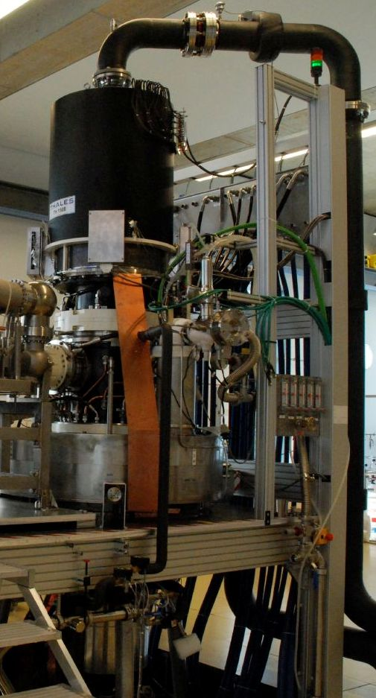
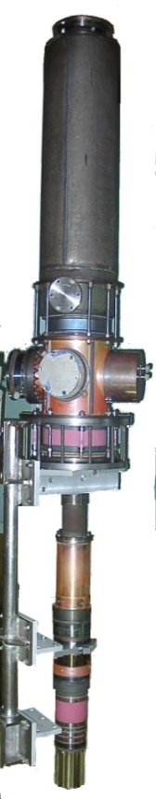
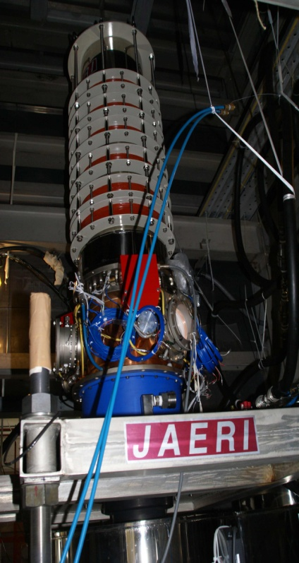


ECRH - Progress on Gyrotrons
2 MW gyrotrons from EU, 1 MW from JA and RF.
Diode type gun gyrotrons from EU and RF, triode type from JA (requiring an additional PS for the anode).
Challenge is the development of the sources – good progress
And the development of the lounchers – very good progress
Short pulse prototype
2MW short pulses
1MW
~300s
1MW
800s

Slide 33
Development of the ITER ECRH Top Port Plugs (I)
A detailed design was developed composed of detachable blanket shield module (BSM) of the main structure setting the frame.

Slide 34
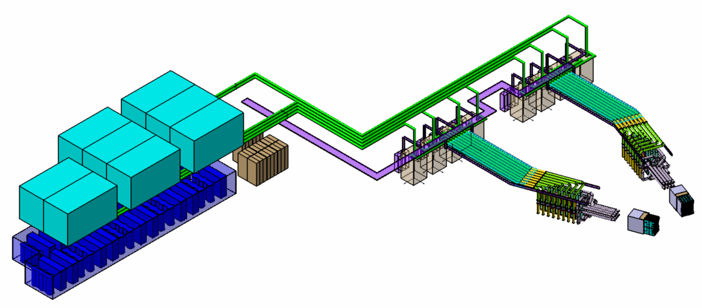
IC H&CD system
Matching units (2)
Transmission lines (8)
RF sources (8+1)
Challenge is antenna design and coupling to the plasma - TBD
Antennas (2)
HVPS (8+1)
->Improved and optimized IC system with 2 antennas allows to secure the coupling of 20 MW in all envisaged scenarios (large scrape off, short decay length, 40 to 55 MHz, dipole phasing) with 40 kV max in the circuits
->Efficient resilient matching limit ELM effect: reflected power is kept below 1% of forward power

Slide 35
Diagnostics: Overview
About 45 different diagnostic systems installed around ITER tokamak
for machine protection or basic control,
for advanced performance control, and
evaluating the plasma performance and understanding important physical phenomena

Slide 36
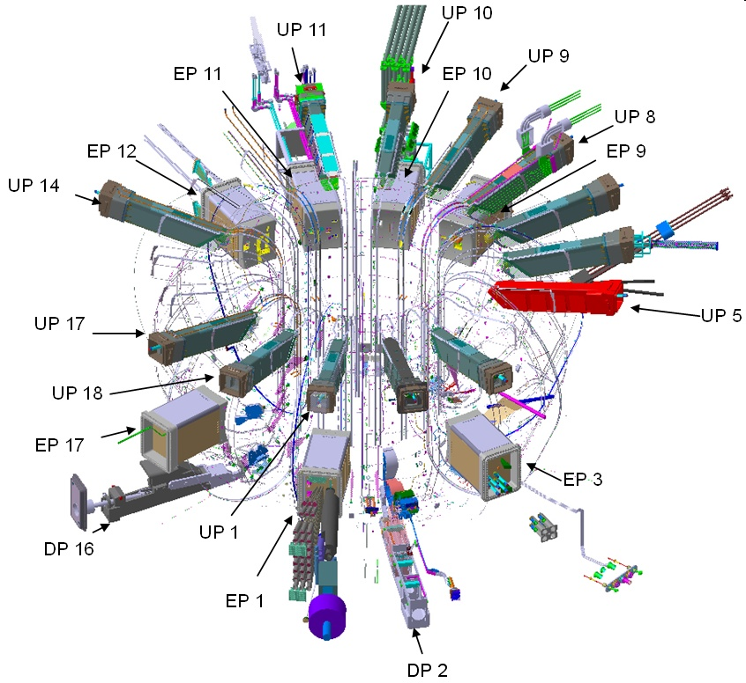
Vessel & Port-based Diagnostic subsystems
Machine Assembly Phase
MA-I
All in-ex vessel
Magnetics
Bolometry
Waveguides
Eq ports 11 & 12
MA-II
All lower ports
Most Eq and Up ports
MA-III
- Remaining ports
UP 7
MA-I
MA-III

Slide 37

Ports contain several diagnostics
ITER_D_3Z6EAB v1.2
Common features:
High fluxes onto plasma-facing mirrors
- Nuclear radiation - 0.5 MW / m²
⁻ Heat, peaking in x-rays
- Escaping neutrals and ions
Mirror/waveguide labyrinths for shielding
- Require extensive neutronics analysis
- Performance compromised
- No fibres, lenses or windows in port
Some systems cannot use labyrinths
- X-ray camera, spectroscopy
- Neutron and gamma cameras
Some systems require vacuum extensions
- VUV spectroscopy
- Neutral particle analyser
High electromagnetic loads
- Plasma current of 15MA can disrupt in 40ms

Slide 38
The Cryo System

Slide 39
ITER Plant operation states
ITER will be operated 365 days/year 24 h/day.
2 consecutive weeks plasma operation followed by 2 to 3 days break
ITER operations will be performed in 3*8 h shifts
Cps 470 K Regeneration mode
Toroidal field
68
Mag & Cps in Nominal mode
00
TF Coil current (kA)
3*8 h plasma shifts
STM
Plasma operation
Short Term Maintenance
11 consecutive days
2 days up to 3 days
Plasma campaign 16 months
WU
Major Shutdown 8 months
CD
Magnet 4.3 K
Cryopumps 4.3 K
Magnet [80 K] 300 K
Cryopumps [4.3 K] 300 K

Slide 40
Cryogenic System
Cryoplant
Facts
LHe cryoplant: 65 kW equivalent @ 4.5 K
  Cooling of the superconducting magnet system, HTS current leads
  Unprecedented large dynamic loads
  Cooling of cryo-pumps with high regeneration frequency and small users
  Helium inventory: 24 t
LN2 cryoplant: 1300 kW @ 80 K
  Thermal shielding, LHe cryoplant pre-cooling
Status
Conceptual design in progress
Preparation for industrial procurements
Cryo distribution boxes and cryolines
Notes:
Talk
40

Slide 41

Coping with large pulsed heat loads
Without active control of the cooling loop
CC
With active control of the cooling loop
SHe Pump
To/from Structures
~ 6000 t of Structures used as thermal damper

Slide 42
Layout of cryo distribution boxes and cryolines inside Tokamak building

Slide 43
Layout of cryoplant building

Slide 44
Status of ITER Construction

Slide 45









New ITER Baseline
New baseline agreed at the IC meeting in July 28, 2010
First plasma – November 2019
First DT – March 2027
Costs - New baseline of 4585 kIUA (~7100 M €)
Additional Reserve of 115 kIUA => total = 4700 kIUA
Plus contributions of local area – 467 M €
Operation Cost 188 kIUA/year – sharing will be different
Deactivation Cost 281 MEuro
Decommissioning Cost 530 MEuro
1

Slide 46

ITER New Organization Structure
As of end September 2010, the IO has a total of 463 staff members with 296 professional and 167 technical support staff members
and > 200 Contractors

Slide 47
Schedule for Construction Phase (2019 First Plasma)
First Plasma
ITER Construction
2010
2011
2012
2013
2014
2015
2016
2017
2018
2019
2020
2021
2022
2023
TF Coils (EU)
Case Winding Mockups Complete TF10 TF15
CS Coil
CS Final Design Approved CS3L CS3U CS Ready for Machine Assembly
Vacuum Vessel (EU)
New Project Baseline
Approved by IC in July 2010
First Plasma Date – Nov 2019
DT operation to begin – March 2027
VV Fabrication Contract Award VV 05 VV09 VV07
Buildings & Site
Construction Contract Award Tokamak Bldg 11 RFE
Tokamak Assembly
Start Machine Assembly
Tokamak Basic Machine Assembly
Start Install CS Start Cryostat Closure
Ex Vessel Assembly
In Vessel Assembly
Assembly Phase 2
Assembly Phase 3
ITER Operations
Pump Down & Integrated Commissioning
Plasma Operations

Slide 48
Schedule – Initial Operation Phase
First Plasma
Nominal Plasma
Start Tritium
ITER Construction
2019
2020
2021
2022
2023
2024
2025
2026
2027
2028
2029
2030
2031
2032
Hydrogen-Helium Complete
Q=10 Long Pulse Achieved
Assembly Phases II and III
Assembly Phase 2
Assembly Phase 3
ITER Operations
Integrated Commissioning
Start Torus Pump Down
Pump Down & Integrated Commissioning
Magnet Commissioning
Hydrogen-Helium Operations Campaign
Commission, Cool & Vacuum
Plasma Development & H&CD Commissioning
Full H&CD, TBM & Diagnostics Commissioning
Pre-Nuclear Shutdown & Divertor Change
Deuterium Operations Campaign
Deuterium Operations
Q=10 Short Pulse
Start DT
Planned Shutdown
Deuterium-Tritium Operations Campaign
Deuterium-Tritium Operations
Q=10 Long Pulse Achieved

Slide 49

Main Buildings on the ITER Site
PF Coils winding
Tokamak
Cryoplant
Tritium
Magnet power convertor
Cooling towers
Hot cell
Will cover an area of about 60 ha
Large buildings up to 250m long
Large number of systems
Control
Main Office
Notes:
The Major Technical Systems:
A ~50kW Cryogenics Plant.
~1 GVA electrical installation power in + out.
A tritium plant to fuel the plasma and recover the tritium. ~3kg.
A Neutral Beam (H⁻) system for ~40 MW.
2-3 RF systems ~50MHz, 130-170 GHZ, and 3.5 GHz providing 20-40MW each.
Full remote handling capability for the Tokamak including the “hot cell”.
Waste stream management plan.

Slide 50




Present Construction on ITER Site
The concrete foundation for the Poloidal Field Coil Winding Facility is being put in place
Excavation of the Tokamak Building
Construction of the Annex Office
Building

Slide 51

^{Construction work:} ^{39 buildings and} ^{technical installations}
Copyright video: AIF, F4E 2010
The ITER Headquarters
AIF / as part of France’s commitments to ITER and on behalf of Europe
Dimensions : 200 metre-long, 5 storeys, 460 staff
^{Planning : 2010-2012}
Architects : Rudy Ricciotti, Laurent Bonhomme
Tokamak Seismic Pit excavation
^{Contracting Owner F4E}
Dimensions : 120 m x 80 m x 22 m
^{Planning : 2010-2011}
Quantités : extraction of nearly 300,000 m3
^{of rock and soil}
^{Support structure} ^{construction}
^{50,000} ^{m3 of concrete}
Construction of the Poloidal Field Coil Winding facility
^{Contracting Owner F4E}
Dimensions : 253 m x 45 m x 20 m
^{Planning : 2010-2011}

Slide 52
Technologies needed for DEMO

Slide 53

Schematic View of a future Fusion Power Reactor
Hot Gas – i.e. Plasma (> 100 M°C)
Neutrons transport 4/5 of the energy

Slide 54



Main Technology Developments needed for DEMO
Low Activation Structural Material for the “In Vessel” Components which can withstand the large neutron fluence (150 dpa end of life)
Allows 5 year lifetime for blanket
Erosion will determine lifetime for Divertor = 2 years
Improved RH Systems which can act faster than presently foreseen in ITER have to be developed - availability
Pebble
Bed Blanket
400-550°C
Vertical
Manifold ~320°C
He cooled Breeding Blanket and T-extraction
Strong
Ring
Shield ~320°C
Heating Systems extended to Steady state (ITER -> 3000 sec) and high availability – a challenge today !!
Vacuum
Vessel ~100°C
He cooled Divertor
DEMO = Demonstration Fusion Reactor Plant

Slide 55




High temperature SC coils – an opportunity to improve the efficiency of DEMO and for spin offs
Strand Samples | No. of punched tapes | Thickness (mm) | I_{c}(A) DC,s.f. 77 K
Roebel (14x1) | 14 | 1 | 465
Roebel (13x3) | 39 | 2.7 | 1120
Roebel (10x5) | 50 | 3.8 | 1320
14 tapes
39 tapes
50 tapes
50 tapes
First approach for such a Rutherford cable (KIT):
20 strands x 1320 A (77K, self field)
→ Expected current for cable: ~ 16.5 kA (T = 50 K and B = 10 T)
Facilities: Industry + ITER, KIT, CEA, CRPP, etc – existing capability for testing model coils – not full size
G. Janeschitz
Notes:
In Roebel strands, the twist length limits the number of single tapes that can be assembled. By using stacks of tapes for assembling, the current carrying capability of a Roebel strand can be enhanced without changing the twist length or width of the Roebel strand.
The enhancement of Ic is demonstrated by three different Roebel strands that have been assembled.
The first was assembled with 14 single tapes. Ic= 465 A
The second was assembled with 13 stacks of 3 tapes each. Ic=1120 A
The third cable was assembled with 10 stacks of 5 tapes each. Ic=1320 A
The estimation for the current carrying capability of a Rutherford cable was made on the assumption that 20 strands with 50 tapes each (=1000 tapes)) can be assembled, each with the highest of the above mentioned current carrying capability of 1320 A (77K, self field).
The critical current of each tape is 55 A at 77K, self field.
At 50 K, 10 T the current carrying capability is approximately 30% of Ic(77K, s.f.). → 1000 x 0.3x 55 A = 16.5 kA
Prof. Dr. Max Mustermann |
Name of Faculty
55

Slide 56
Fuel cycle for DEMO / Challenges
Parameter | ITER | DEMO | GAP
Tritium production | 25 mg/day (module) | ~ 500 g/day (machine) | 2 x 10⁴
He flow rate in TES | ~ 40 m³/h | ~ 10 000 m³/h | ~10³
He flow rate in CPS | ~ 10 m³/h | ~ 50 000 m³/h | ~5 x10³
Tritium permeation | ~ 10 mg/d | ~ 10 g/d | ~10³
  Note: Tritium production in Breeder Blanket is fixed, other values are moving
  targets greatly depending on blanket design & efficiency of tritium processing
Test Blanket Modules in ITER will not demonstrate DEMO tritium technology
Parallel R&D program needed for DEMO
Facilities: KIT-TLK, ITER, JET – however, enhancement of e.g. KIT-TLK needed to test DEMO relevant Fuel cycle
Notes:
The inner-fuel cycle of DEMO should be very close to the ITER’s one
(higher burn-up will more or less compensate higher fuelling rate)
But challenging is the tritium processes in the outer-fuel cycle (breeder blanket):
huge He throughputs containing tritium as traces in different chemical forms (molecular Q₂ and oxidised Q₂O)
Prof. Dr. Max Mustermann | Musterfakultät
56

Slide 57
Heating System Developemnt for DEMO
All systems need to get more reliable > 95% and should operate continuously up to 2 years before maintenance is required
ECRH:
  Improve reliability of Gyrotrons, possibly develop 4 MW sources
  Launchers are a challenge (mirror steering), step Tunable gyrotrons would help
  Transmission lines are already at the limit in ITER (2MW)
NBI:
  Due to large openings a challenge in DEMO
  Neutraliser efficiency must improve – optical neutralisers – mirror quality
  Cs source must be improved: lower pressure, ions produced on surface, etc
  Accelerator should be improved - ESQ
ICRH:
  Coupling problems have to be overcome – to be demonstrated at ITER
LH:
  Coupling problems, wave penetration and source development needed

Slide 58


Solid breeder concept
⁹Be (n,2n)
threshold 2.5 MeV
n
14.08
MeV
Purge Gas
P L A S M A
Lithium-Ceramics
⁶Li (n,α)
Cooling plates
⁷Li (n,n,α)
2.8 MeV
FIRST WALL

Slide 59






First Wall
A typical modular design for a DEMO blanket
Verification of manufacturing route of ITER Test blanket module (TBM)
Breeder Unit
HIP
bending
FW scale 1:4
Spark Erosion
Main ideas (also for DEMO):
Modular fabrication
Automated welding (low distortion)
Compatibility to RH –measures
+ Matching standards for nuclear facilities
FW bending
Fusion Industry Innovation Forum, 6th July 2010, Brussels, P. Fritz
Notes:
Testblanket module for ITER developed within a EU consortium is matured and the current
Focus is directed towards the verification of the fabrication route, its qualification and finally the licensability to a nuclear ambience.
As seen on the graph the Blanket is modular built up consisting of
Canister of the first wall (produced by hot isostatic pressing HIP-process)
Subsequent bending and finally
Welding to an integral structure
Within the canister the breeder units are inserted containing the
. Neutron multiplier (Beryllium)
. Breeder medium itself (in the HCPB concept shown here Lithiumorthosilcate Li4SiO4) and
. Additional Helium coolant channels
All steps must be validated (here industry input is strongly required – currently conducted in the context of a national measure in Germany)
Matching the constraints mentioned on the right bottom in the context of a future licensing as a nuclear component.

Slide 60






T-breeding Blanket modules (Pebble Bed as well as liquid metal) will be tested in ITER together with their infrastructure
Tritium Extraction
System (TES)
Tritium building
Helium Cooling
System (HCS)
TCWS-Vault
Data Acquisition
System (DAS)
Tokamak-building
HELIUM at 8 MPa
300 to 500 °C
Port Cell
Equipment
HCPB
TBM

Slide 61




Blanket design and Remote maintenance for DEMO
an example
Poloidal ~12 m
Toroidal ~ 3 m
Radial ~ 3 ÷ 4.5 m
DEMO KIT
Dimensions
Shield
MMS
100°C
Dynamic Electromagnetic Moments
Flexible Bars holding shield or MMS
Remote Handling
Radial ~ 29 MNm
Toroidal ~ 5 MNm
Poloidal ~ 1.2 MNm
MMS
440°C
320°C
Thermal Mismatch
in supporting structure
Weight
Inboard MMS ~ 75 tons
Outboard MMS ~35 tons
Bars before the shield ΔT ~ 340 °C
Bars behind the shield ΔT ~ 220 °C
Change all In Vessel Components within 2 to 3 month
Notes:
All large written paragraphs denote extreme ranges for which currently no solution exist:
Enormous Dimensions and
Weight
Dynamic electromagnetic Moments (torque, bending, twisting)
of highly irradiated materials not only once during life-time of a reactor
Additionally the multi-modular segments (MMS) attached to the support structure experience large
Thermal gradients during operation to be compensated.

Slide 62


A Helium cooled Divertor for DEMO
Main work areas:
- Design & thermo-hydraulic layout
- Development of material and manufacturing technology
- Experiments
Divertor target plates with modular thermal shield (W alloy)
inboard
Dome & structure (ODS RAFM)
He-cooled modular divertor with multiple-jet cooling (HEMJ)
10 MW/m²
outboard
Divertor cartridge (ODS RAFM steel)
700°C
He 600°C, 10 MPa
divertor cassette
9 finger module
1 finger module

Slide 63




HHF performance tests in a combined He loop & Tsefey EB facility (60 kW, 27 keV) at EFREMOV - KIT
EB
EFREMOV under KIT contract
He loop
EB
He loop
2010: Mockup survived > 1000 cycles at 10 MW/m²
30s/30s sharp ramp
Notes:
63
63

Slide 64




Development of He cooling Technology for Blanket and Divertor – KIT: liquid Metal loop in ENEA
HELOKA Stage 1 – for Blanket – starts operation in 2010
550 C at 8 MPa Pressure
1.3 kg/sec throughput
He leak tightness 10⁻⁶ Pa.m³/s
Can test full size TBM
HELOKA Stage 2 for He cooled Divertor
Extension of the HELOKA loop
1 kg/s: test a fraction of an
outboard target
Temperature: 750°C or higher (900°C)
64

Slide 65

Materials Development for DEMO In Vessel Components
Power: 1.30 GW_{e}
Plant Efficiency: 37-45%
DEMOnstration
Reactor Concept
Blanket: ≤30 dpa/yr, 2.5MW/m²
Plasma Facing Materials
Reduced Activation Structural Materials
  RAFM-steels (EUROFER) 250-550°C
Functional Materials (Be, Li₄SiO₄,…)
Divertor: ≤10 dpa/yr, 10-15 MW/m²
Refractory alloys (e.g. W-ODS)
Nano-scaled RAF(M)-ODS Steels
5 m
850-1200 °C
~600 - 1300 °C
300-650 °C
~250 - 750 °C
Notes:
65
High performance structural materials for blankets and divertors are the basis of commercial fusion power plants, and include.
- reduced activation ferritic/martensitic steels, nano-composited oxide dispersion strengthened ferritic steels,
- V alloys,
- SiCf/SiC composites and
- W based refractory materials.
The present and future challenge is to enlarge the temperature window, specifically to increase the for higher temperature limitation. The strategy therefore is oxide dispersion strengthening (ODS) of the steel or tungsten alloy, that is, to distribute homogeneously nanoscaled ODS particles (diameter 3-12 nm) in the matrix.
In adition, besides Plasma facing materials, functional materials are needed:
All process control parameters temperatures are simultanously present on fast time scales and in may cases far beyond classical nuclear engineering, which poses the material qualification and development as the key towards DEMO. Without such a measure a Deamo reactor is even not thinkable.

Slide 66

Low activation Structuiral Material Development
Behaviour of the γ-Dosisrate over time after neutron irradiation of up to 12.5 MWa/m²
R
ecovery of irradiation induced embrittlement
Unirradiated
EUROFER97
Irradiated and
annealed
Irradiated
70 dpa/ 335°C

Slide 67



International Fusion Materials Irradiation Facility IFMIF – needed for Material development and Qualification
PIE Facilities
Access cell
He gas
0
20
40m
Test Cell
Irradiation of DEMO-relevant structural materials by 14 MeV neutrons – neutron flux twice of DEMO
KIT design

Slide 68
What if Fusion is needed earlier
  An Apollo like Program
  The Ultra Fast Track

Slide 69
Road Map to the Fusion Reactor (can we accelerate this?)
My personal opinion
Ultra Fast Track
Electrical Power Production
Comercial Fusion Power
Plasmaphysics – Tokamak, Stellarator
Ultra Fast Track
Ultra Fast Track
JET
ITER
DEMO
Commercial power delivery starts
Transtion from demostration to commercial power
14-MeV-Neutronsource IFMIF
Fusion Technology
Ultra Fast Track – Start of DEMO / PROTO Construction
2005 2010 2015 2020 2025 2030 2035 2040 2045 2050

Slide 70
Can we accelerate fusion development further ? my personal opinion !!
The answer is yes by approximately 10 to 20 years => “Ultra Fast Track”
if the construction of a combined DEMO – PROTO starts in 2016 and the built-up of a team, the design and the R&D in 2011 !!
  Development and construction cost ~ 25 billion € spread over 16 years (includes IFMIF and ITER upgrade)
  An increased economical risk (availability, cost of electricity) versus the Fast Track has to be accepted
    Risk and approach similar to Man on the Moon project of the 60s
Even in this “Ultra Fast Track” scenario ITER and the Broader Approach are essential elements which also would have to be accelerated (ITER operation)
  Increase of ITER costs ~ 10%, i.e. ~ 1.0 billion € spread over 10 years
  IFMIF needs to be constructed earlier (start 2010), cost ~ 2 billion €

Slide 71
What is the Role of ITER and IFMIF in this scenario
ITER and JT60SA need to develop the operation scenario for DEMO
  Considering the timeline ITER must develop two or maximum three reactor plasma scenarios within ~ 7 to 8 years of gross operation time and ~ 4 to 5 years of DT operation (aggressive but possible)
  Needs accelerated operation program and e.g. more heating power installed on day on => explains higher cost in slide above
  JT60SA, (KSTAR, EAST, JET) will support the development of these plasma scenarios
IFMIF needs to qualify the structural material (EUROFER) for the “in vessel” components
  At least one campaign must be completed before integrated commissioning starts in DEMO, i.e. ~ 2024 => operation license
All of the above can be performed in parallel to the construction of DEMO

Slide 72
What are the Challenges and the Risks ?
The first challenge is to get this program agreed at the political level
  The money (~ 25 billion €) and a decision to built until 2011 The next big challenge is people, we have not only to attract people but we have to educate them and this takes time => ramp up of team during 3 years
  1000 professionals needed directly inside the team
The technical challenges are
  The He cooling systems, the in vessel components and materials
  The H&CD systems with the reliability needed – to be developed during ITER construction and further during ITER operation
What are the Risks ?
  The main risk is economic, namely how much electric power will be produced and what is the availability after the first 5 years of operation
  The risk that such a machine will not work is extremely small

Slide 73




Fusion Energy Development
Energy Conversion
Technology
H₂ Production ?
Operation 2018
IFMIF
Materials
EU DEMO operation
start ~ 2025 to 2030
DT > 2030
Technology
TBM, TDM
now
Physics &
Technology
ITER Start Operation
in 2019; DT 2026

